Slide 1
Midterm 1 Pedibus Team #22
Team Members:
Kyle Anderson
Stephen Avery
Alejandro San Segundo
Brett Willenbacher
Sponsor:
Ron Goldstein
Advisor:
Keith Larson
Professors:
Dr. Shih
Dr. Helzer
Dr. Gupta
Team No.22
Slide 1 of 14
Kyle Anderson
Midterm 1

Slide 2
Overview
Currently in Design Phase
Frame Design
Steering Design
Component Sourcing
Price vs. Performance
Availability
Lead Times
Team No.22
Slide 2 of 14
Stephen Avery
Midterm 1

Slide 3
Design Requirements
10 -14 person Seating Arrangements
Bench Seating and Captain’s Chair
Rolling Chassis must be < 1499 lbs
Towing Legalities
Must be Transportable
“Off the Shelf”
Team No.22
Slide 6 of 14
Stephen Avery
Midterm 1
Notes:
Point 1: 10 Peddlers, 1 driver, 1 “bartender”, and 2 non-peddlers
Point 2: Because of Tallahassee’s hills a crawl gear and cruise gears are recomended

Slide 4
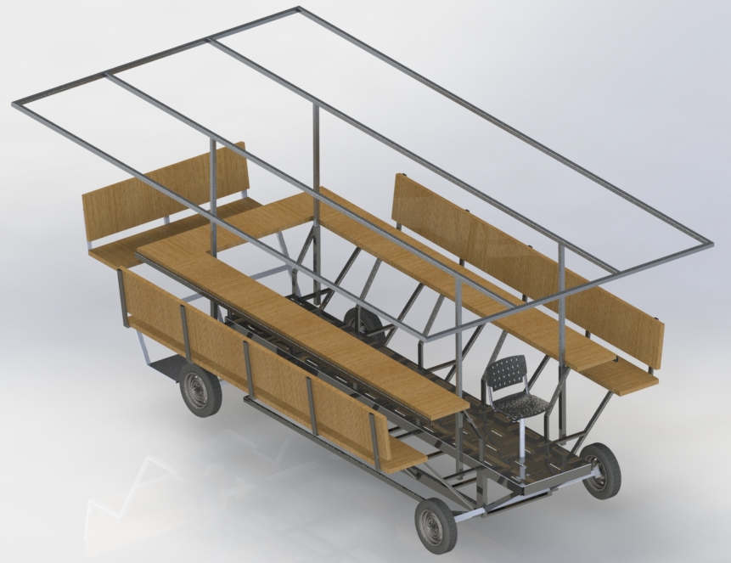
Current Design
Bench Seating
Increased Seating Capacity
All Steel Construction
Multi-Speed F-N-R Transaxle
Towing Accommodations
Team No.22
Slide 5 of 14
Kyle Anderson
Midterm 1

Slide 5
Chassis Construction
A500 Structural Box Steel Construction
Main Frame Rails 48” Apart
Ladder Style Frame
 | Weight: | Price: | Rigidity: | Machinability: | Total:
Decision Weight: | 5 | 3 | 2 | 7 | 17
A500 Steel | 5 | 9 | 9 | 7 | 119
6061 Aluminum | 8 | 6 | 4 | 4 | 94
Team No.22
Slide 7 of 14
Stephen Avery
Midterm 1

Slide 6
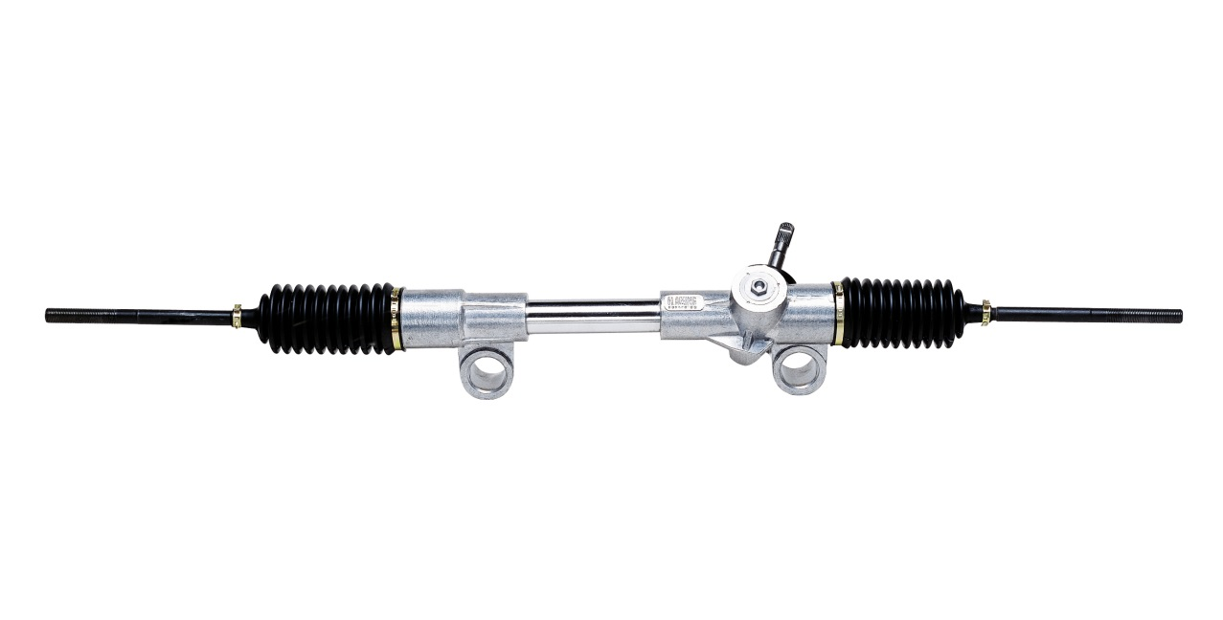
Steering Requirements
Tow Ready Steering
Fully Lockable
Tow Rated Components
Curb to Curb < 45 ft
Reasonable U-Turn Diameter
Rack and Pinion
Easy to Source and Implement
Team No.22
Slide 8 of 14
Kyle Anderson
Midterm 1

Slide 7
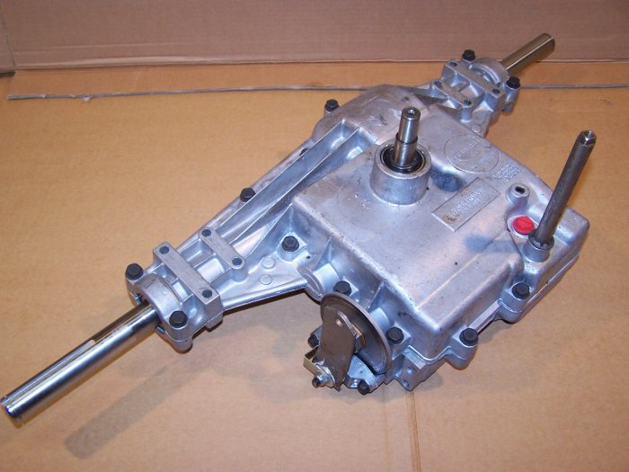
Drivetrain
Peerless 820-040
Clutch System
“Shift-on-the-Fly”
Belt Friction Clutch
 | Durability | Cost | Modularity | User Fatigue | Maintenance | Complexity | Total:
Weight: | 8 | 4 | 2 | 6 | 6 | 2 | 28
Hydrostatic Transaxle: | 2 | 8 | 6 | 6 | 4 | 2 | 124
Manual Transaxle: | 7 | 4 | 8 | 8 | 8 | 3 | 190
Vehicle Axle: | 10 | 6 | 2 | 2 | 7 | 8 | 178
Team No.22
Slide 9 of 14
Stephen Avery
Midterm 1

Slide 8
Wheels and Brakes
Front 13” Disc Brakes
16” Wheel
Brake Accommodations
5 on 4.5” Bolt Pattern
175/50/R16 – 185/60/R16 size tire
Emergency Brake
Team No.22
Slide 10 of 14
Stephen Avery
Midterm 1

Slide 9
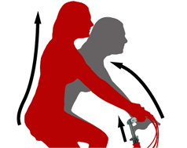
Ergonomics
Driver’s Chair
Swiveling for Easy Access
Seat Back for Reduced Fatigue
Bench Seating
Narrow Seat for Easy Pedaling
Seat Back Isolates Passengers
Free Wheeled Driveshaft
Allows Individual Pace
Does not Allow Back Driving
Team No.22
Slide 10 of 14
Stephen Avery
Midterm 1

Slide 10
Safety and Testing
Large Vehicle Footprint
Increased Stability
Floorboards
Pre-Fabrication Analysis
SolidWorks FEA
Matlab Force Calculations
Post-Fabrication Testing
Road Testing Prior to Release
Team No.22
Slide 10 of 14
Stephen Avery
Midterm 1

Slide 11
Future Considerations
Roof or Awning
Hitch Mounted Modular Accessories
Grill, Cooler, or Additional Seating
Re-evaluation of Electronics
Digital Advertisement
LED Lighting
Sound System
Team No.22
Slide 4 of 14
Kyle Anderson
Midterm 1

Slide 12
Timeline
Add Gannt chart
Team No.22
Slide 12 of 14
Kyle Anderson
Midterm 1

Slide 13
Summary
Significant Progress
Initial Designs
Component Selection and Sourcing
Remain on Schedule
Finish Designs
Start Fabrication
Team No.22
Slide 13 of 14
Stephen Avery
Midterm 1

Slide 14
Questions
Team No.22
Slide 14 of 14
Stephen Avery
Midterm 1

