Slide 1




Pedibus
Team 22
Team Members:
Kyle Anderson
Stephen Avery
Alejandro San Segundo
Brett Willenbacher
Sponsor:
Ron Goldstein
Advisor:
Keith Larson
Professors:
Dr. Shih
Dr. Gupta
Team No.22
Slide 1 of 15
Kyle Anderson
Midterm I

Slide 2

Status Update
All main structural components have been fabricated
Drivetrain and steering subsystems fully designed, sourced and prepped for fabrication
Currently working on fabrication of other minor subsystems
Team No.22
Slide 2 of 15
Kyle Anderson
Midterm I

Slide 3

Design Requirements
Pedibus Requirement | Status
10 pedaling passengers | ✓
Room for extra (non-pedaling) passengers | ✓
Rolling Chassis must be < 1499 lbs (FL law) | ✓
Off the Shelf parts | ✓
Torque output to climb 8° hill grade | ✓
Able to hold 3000 lbs payload | ✓
Free weight transportable | ✓
Reverse gear capability | ✓
Movable on single rider input | ✓
Team No.22
Slide 3 of 15
Stephen Avery
Midterm I
Notes:
Point 1: 10 Peddlers, 1 driver, 1 “bartender”, and 2 non-peddlers
Point 2: Because of Tallahassee’s hills a crawl gear and cruise gears are recomended

Slide 4
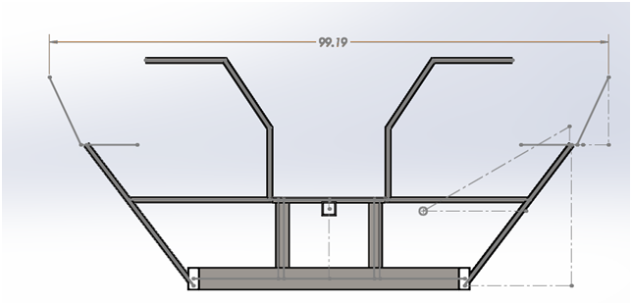
Final Chassis Changes
Narrowed Chassis over 25”
      Determined Proper Cross Bracing
Added Bracing for Drivetrain
Removed Unnecessary Vertical Bracing
Front view of Pedibus frame design.
Team No.22
Slide 4 of 15
Stephen Avery
Midterm I

Slide 5
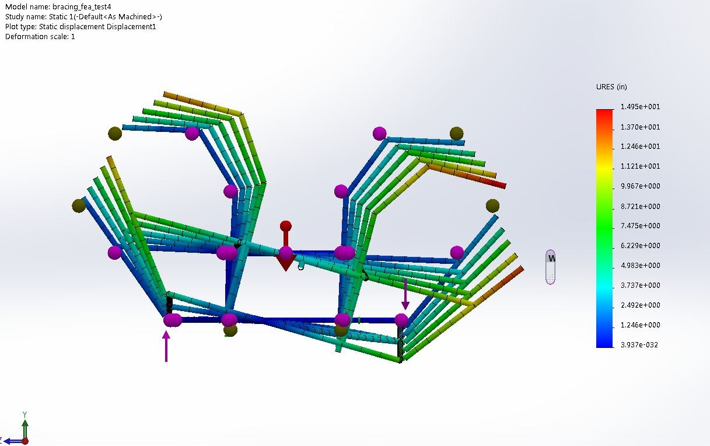
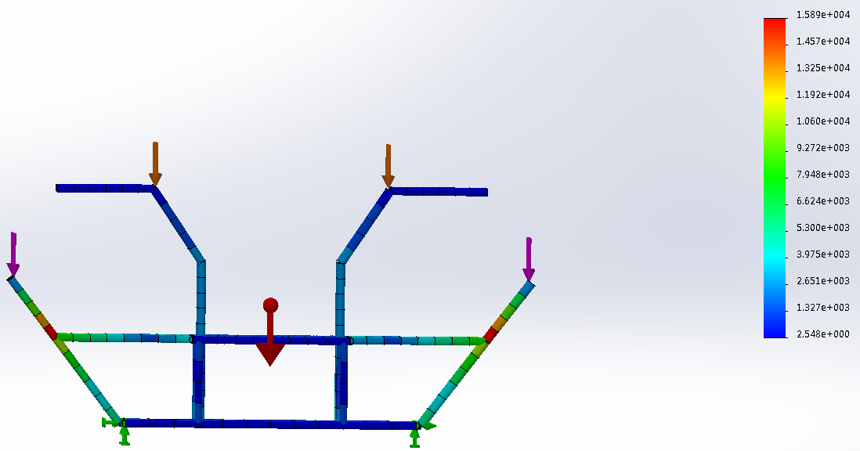
Frame FEA Testing
10000 lb Torsional Force
Lightest Bracing Configuration
Least Deformation of 4 configurations
Discussed in Final 1 Report
4500 lb Force on Seat Posts
500 lb Force on Bar Post
1.3 Factor of Safety
Max Deformation of 0.13 in
Team No.22
Slide 5 of 15
Stephen Avery
Midterm I

Slide 7
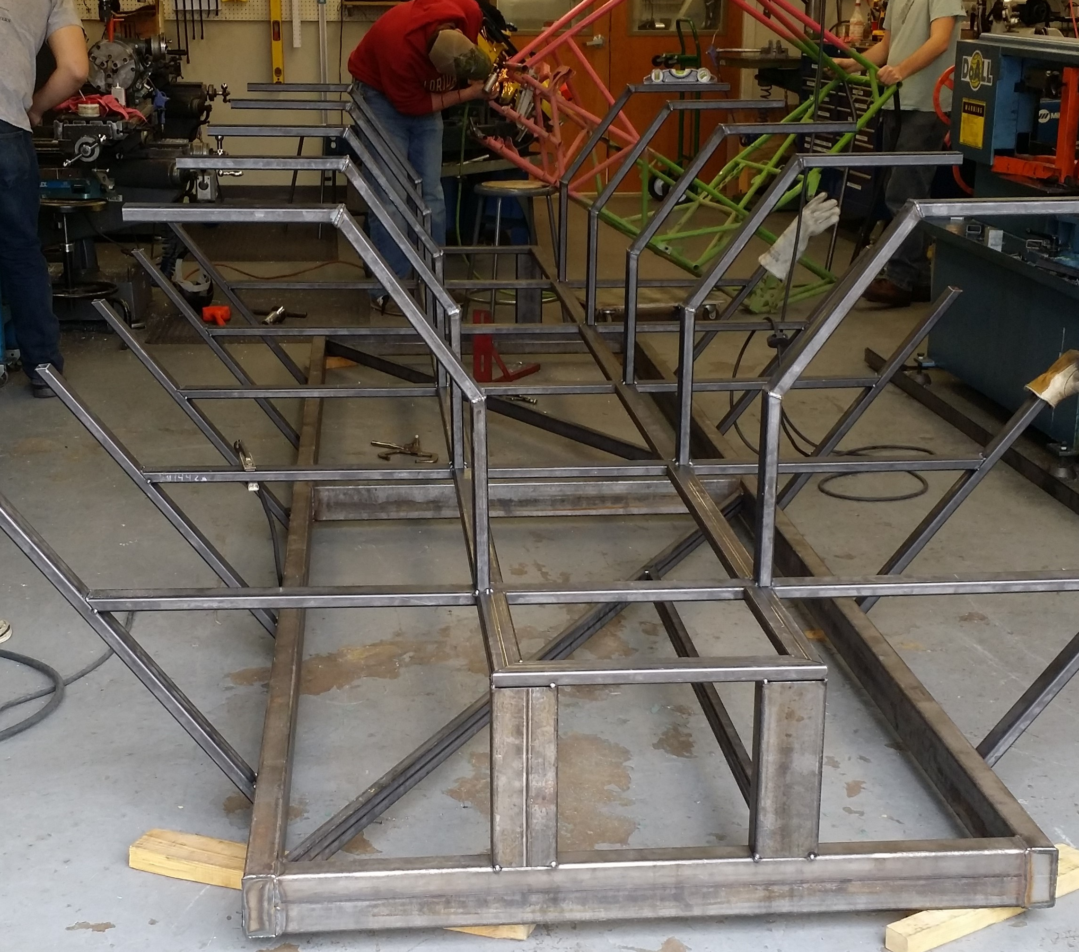
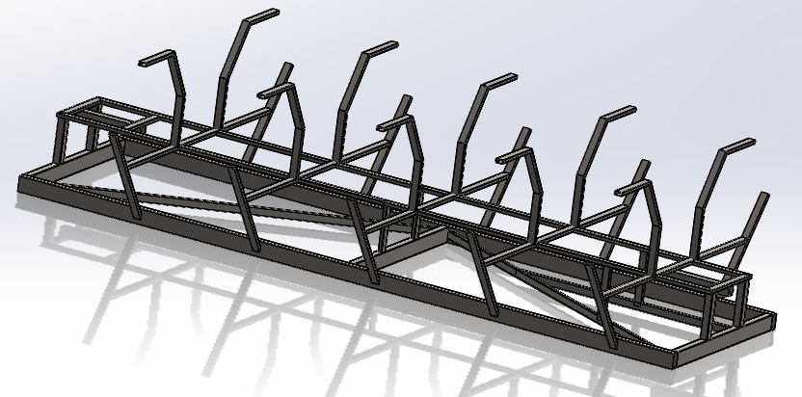
Final Frame
Final Ladder Frame Design
w/o Integrated Suspension
Team No.22
Slide 6 of 15
Kyle Anderson
Midterm I

Slide 8
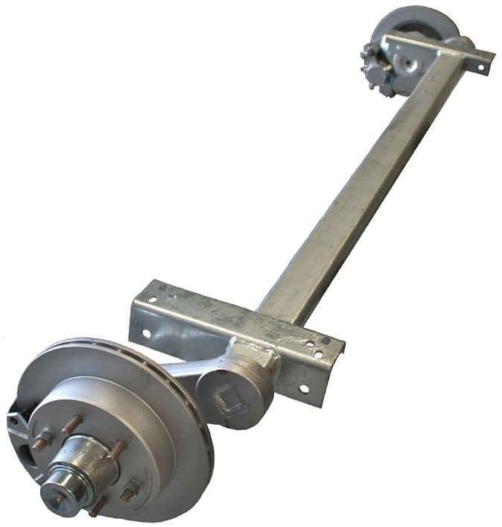
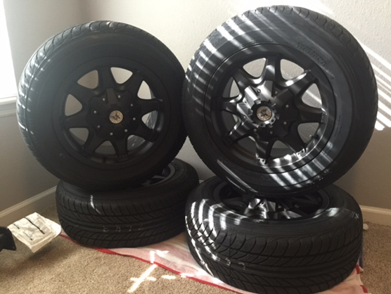
Wheels & Brake System
Axle | Brakes | Wheels | Tires | Bolt Patterns
Rolling Front | 10” Hydraulic Disc | 16” | Same | 5 on 4.5”
Rolling Rear | 8” Hydraulic Disc
Towing | 10” Electric Drum
Team No.22
Slide 7 of 15
Kyle Anderson
Midterm I

Slide 9
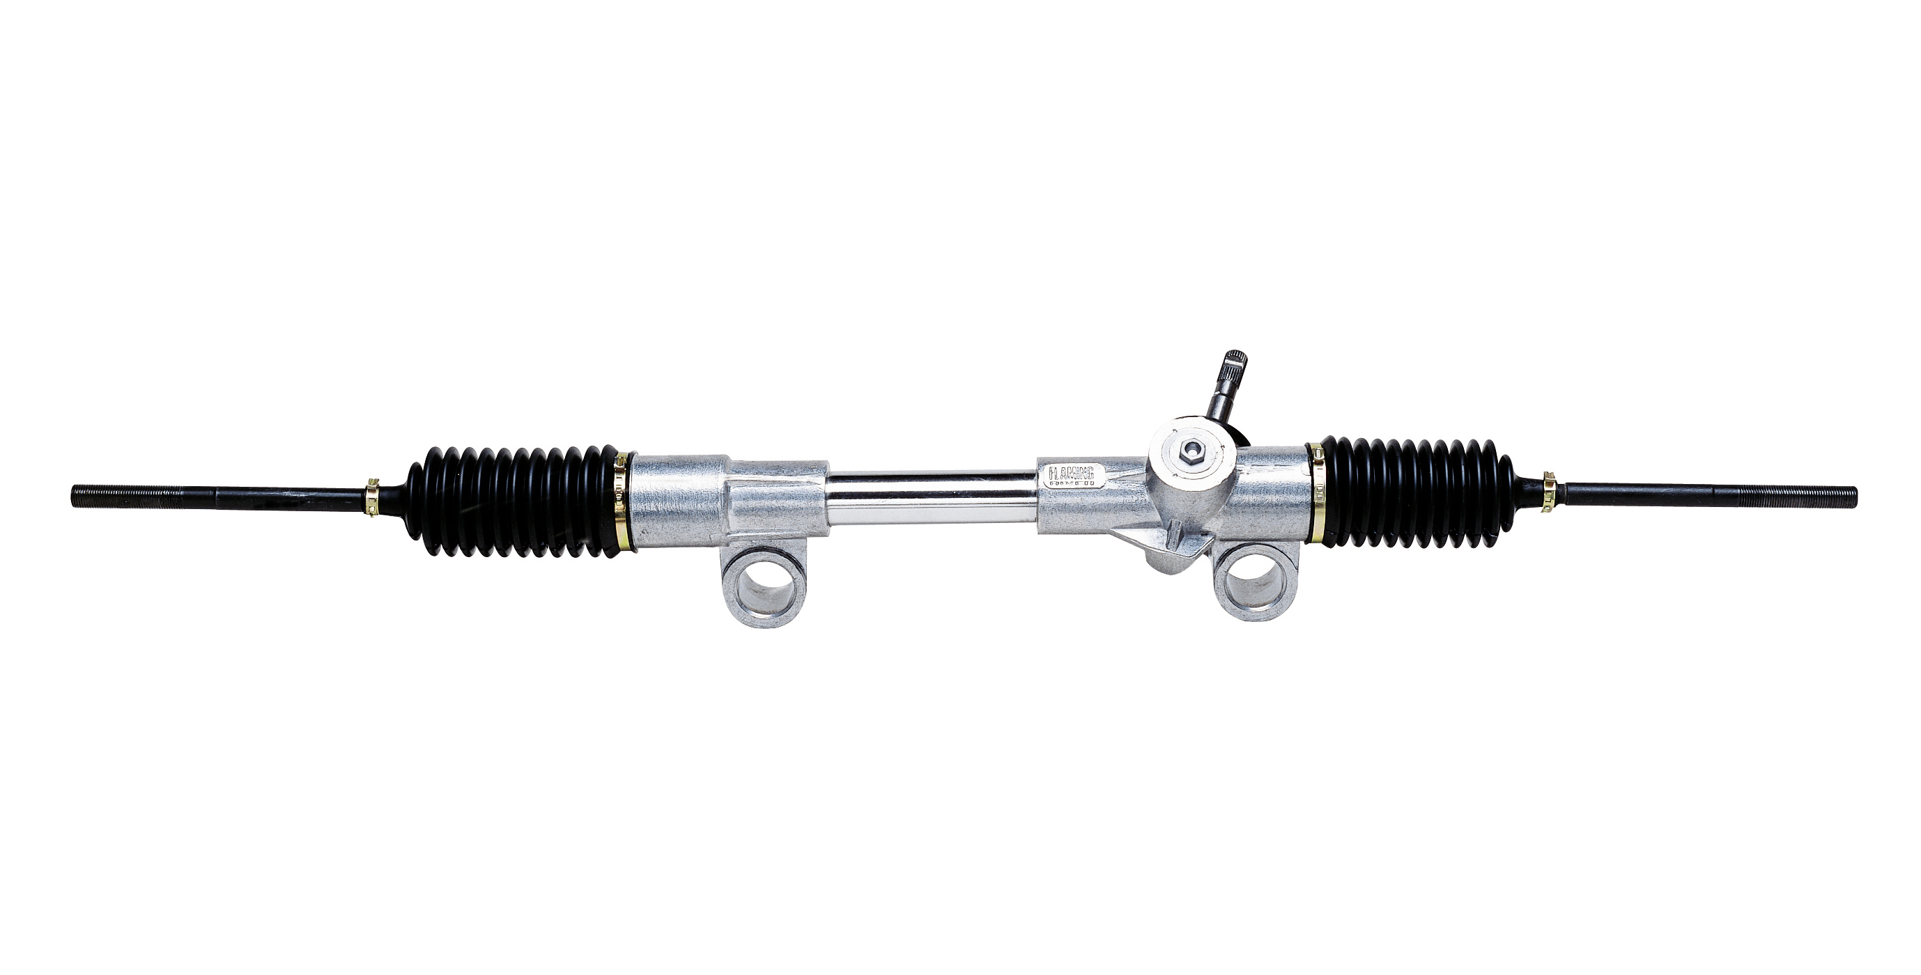
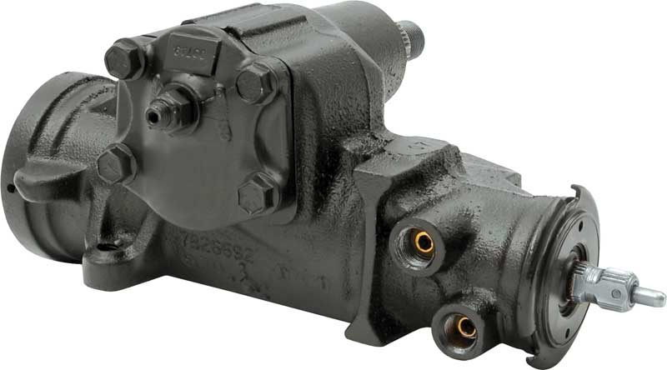
Steering
Curb to Curb < 45 ft
  Reasonable U-Turn Diameter
Option A: Manual Rack and Pinion
  Easy to Source and Implement
  Mustang II Manual Rack and Pinion
Option B: Manual Steering Gear Box
  Easy to Source and Implement
  First Generation Camaro
Team No.22
Slide 8 of 15
Kyle Anderson
Midterm I

Slide 10
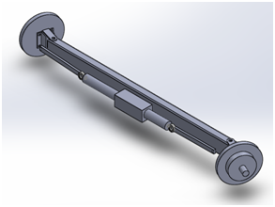
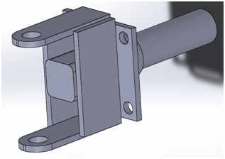
Current Steering Design
Straight Axle Set Up
Cut and Weld Upright Design
Currently trying to use a Manual Rack and Pinion
Team No.22
Slide 9 of 15
Kyle Anderson
Midterm I

Slide 11
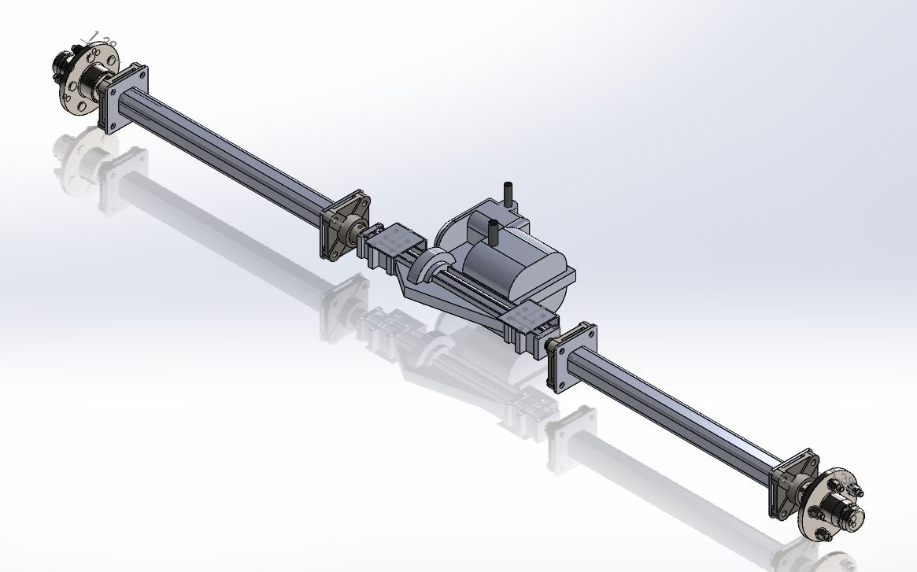
Drivetrain
Independently Supported Axle Shafts
Belt Friction Clutch
Freewheeled Driveshafts
Peerless 820-040
  Manual 6 speed Transaxle
Team No.22
Slide 10 of 15
Stephen Avery
Midterm I

Slide 12
Sourcing and Ordering
Team No.22
Slide 11 of 15
Stephen Avery
Midterm I

Slide 13
Sourcing and Ordering Continued…
Team No.22
Slide 12 of 15
Stephen Avery
Midterm I

Slide 14
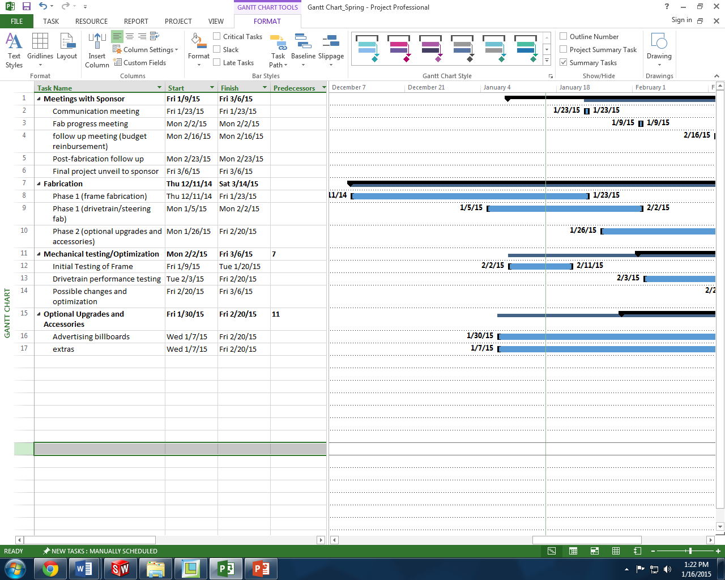
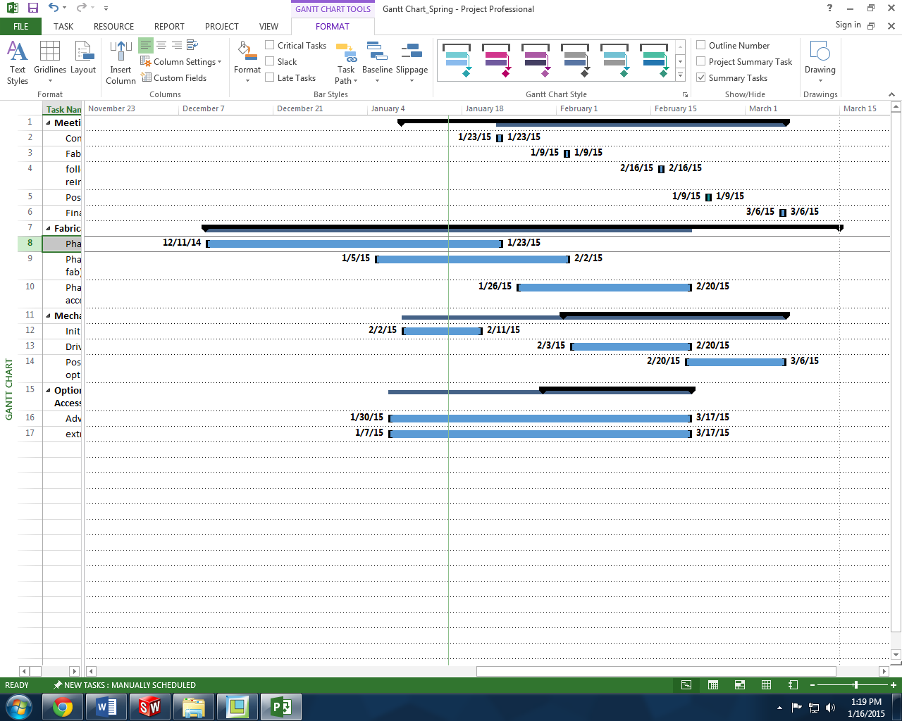
Timeline
Team No.22
Slide 13 of 15
Kyle Anderson
Midterm I

Slide 15

Summary
Frame Built
Slight Delay Due to Frame Adjustments
Most Components Acquired
Installing Subsystem Assemblies
Team No.22
Slide 14 of 15
Stephen Avery
Midterm I

Slide 16

Questions?
Team No.22
Slide 15 of 15
Kyle Anderson
Midterm I

