Slide 1
System Block Diagrams
By: Joshua Cushion

Slide 2
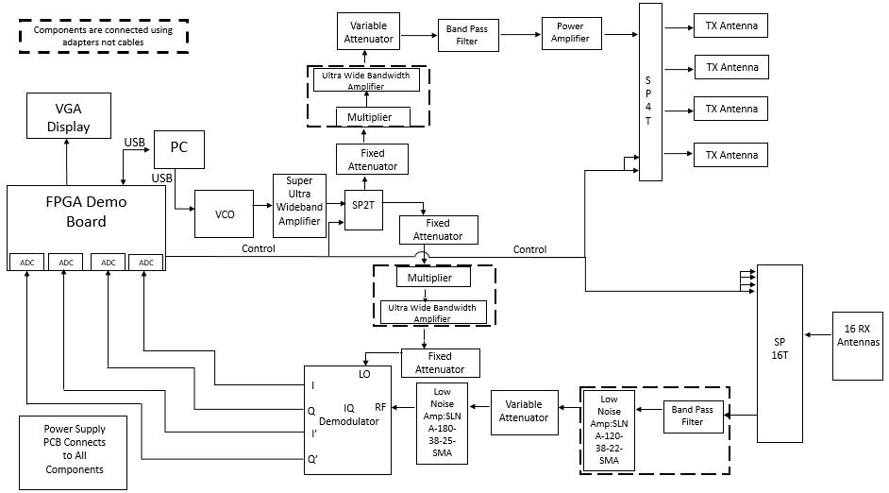
Electrical System Overview

Slide 3
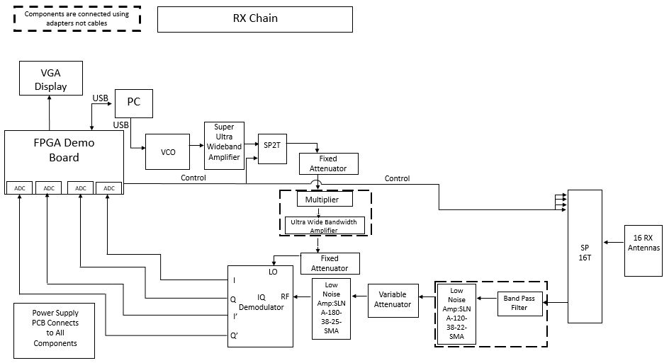
Receive Signal Chain

Slide 4
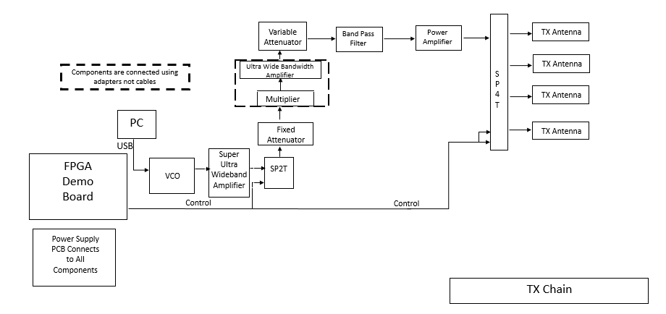
Transmit Signal Chain

Slide 5
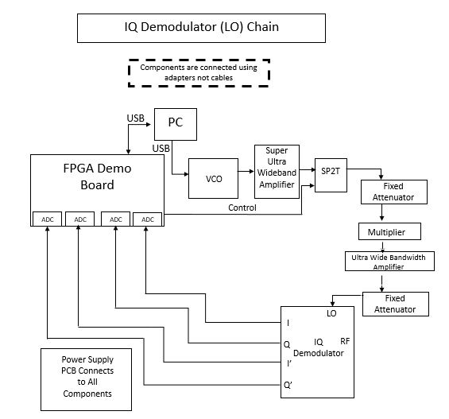
IQ Demodulator LO Chain

Slide 6
Analysis

