Slide 1
Team 29: IEEE Southeastcon Hardware Competition 2015

Slide 2
Objective
To build a robot to win the 2015 Southeastcon Hardware Competition.

Slide 3
Southeastcon Hardware Competition
The Southeastcon Hardware Competition is:
IEEE sponsored
autonomous robot competition
held annually
Open to students throughout IEEE Region 3 (most of the Southeast and Jamaica.)
School has done well historically.
This years competition:
Ft. Lauderdale, last Saturday

Slide 4
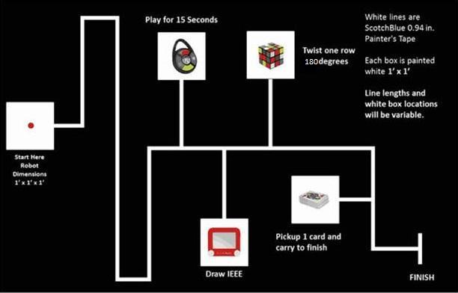
Southeastcon Rules
Road trip theme.
Four different challenges:
Turning one row of a Rubik’s Cube 180 degrees.
Playing 15 seconds of Simon.
Drawing IEEE on an Etch-A-Sketch.
Picking up a playing card.
Points also awarded for:
Time.
Following white line to each game.

Slide 5
System Overview
Presenter: Ryan – David Reyes

Slide 6
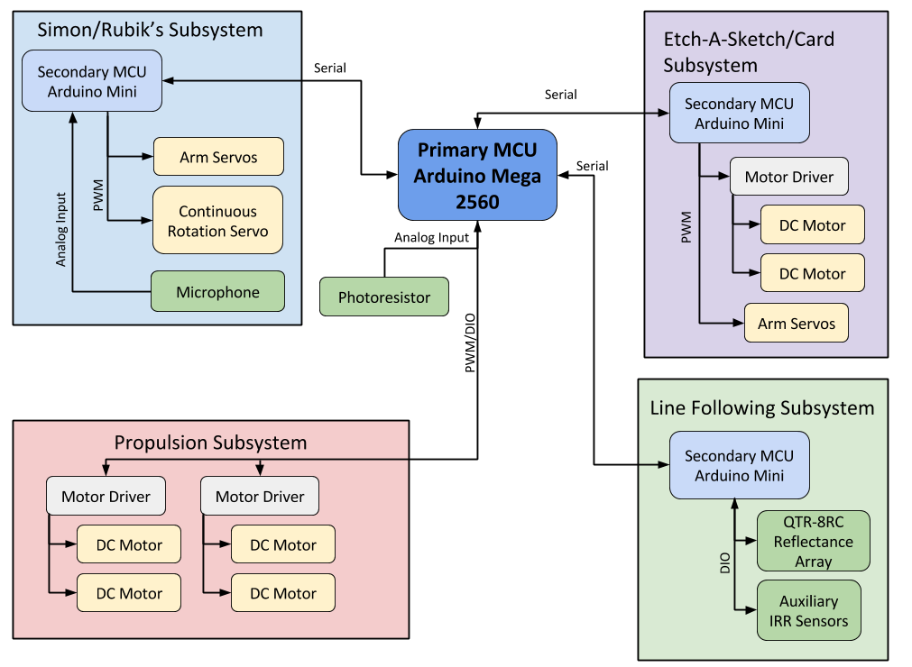
System Overview
Primary Microcontroller:
Atmega 2560
54 DIO, 16 AIO
4 Serial IO, one for each Secondary MCU
Secondary Microcontrollers:
AtMega 328p
14 DIO, 8 AIO
1 Serial IO

Slide 7
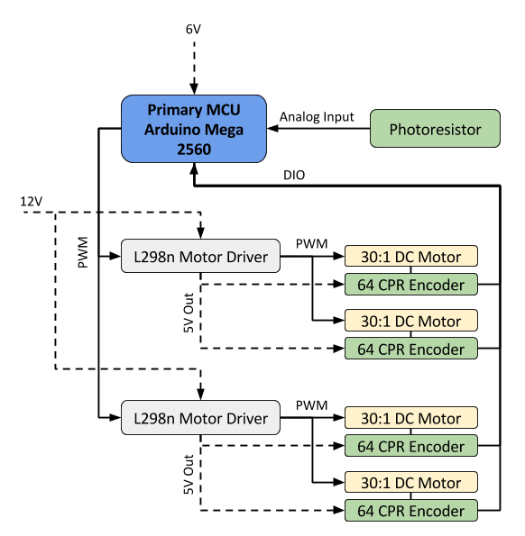
Propulsion Subsystem
Mecanum Wheels:
Omnidirectional Movement
2 in. radius
Good response due to weight
MCU Implementation:
Timer Interrupt based Velocity PID
Forward Kinematics for vector-based navigation
External Interrupt lines for reading encoders

Slide 8
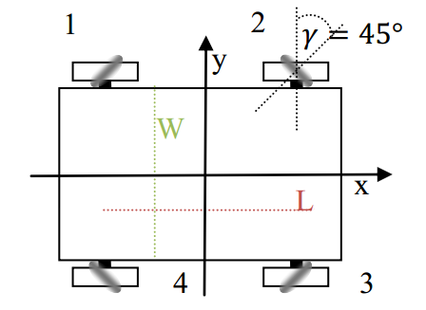
Kinematic Equation
The system is governed by the following equation[1]:
$$\left[\begin{matrix}ω_{1} \\ \begin{matrix}ω_{2} \\ \begin{matrix}ω_{3} \\ ω_{4}\end{matrix}\end{matrix}\end{matrix}\right]=\left[\begin{matrix}1 & 1 & −\frac{L+W}{2} \\ 1 & −1 & −\frac{L+W}{2} \\ \begin{matrix}1 \\ 1\end{matrix} & \begin{matrix}1 \\ −1\end{matrix} & \begin{matrix}\frac{L+W}{2} \\ \frac{L+W}{2}\end{matrix}\end{matrix}\right]\left[\begin{matrix}v_{x} \\ v_{y} \\ ω\end{matrix}\right]$$
[1] Viktor Kalman, "On modeling and control of omnidirectional wheels,” Budapest University of Technology and Economics: 2013, .

Slide 9
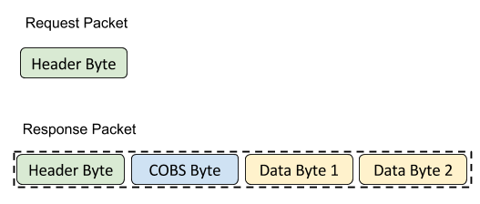
Inter System Serial Communication
Data encoded in Consistent Overhead Byte Stuffing: COBS
Request-Response design pattern:
Primary MCU requests data when required
Secondary MCU replies with fixed size data packet
Primary MCU processes data and re-requests on header mismatch
Repeat

Slide 10
Line Following
Presenter: Nils Bjeren

Slide 11
Line Following System
Requirements
Follow white line
Navigate corners
Navigate curves
Navigate T-junctions
Branch-and-return
Design Alternatives
Camera
IRR Sensors
3x3 sensor grid
Integrated row of sensors

Slide 12
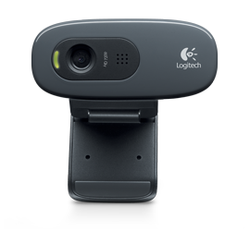
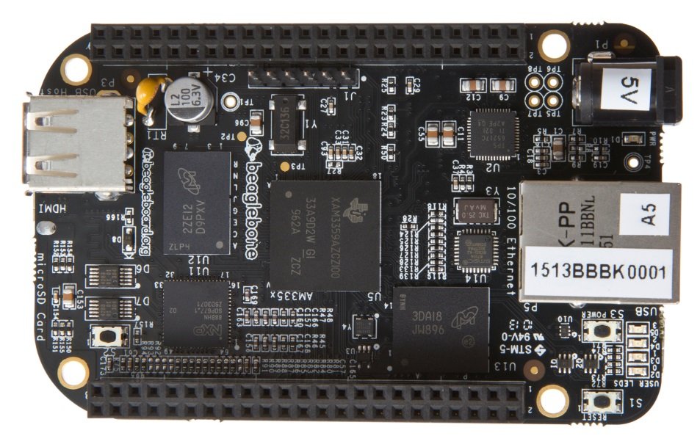
Camera
Advantages:
Flexibility
Power
Disadvantages:
Complexity (image processing)
Decided against at an early stage because of complexity

Slide 13
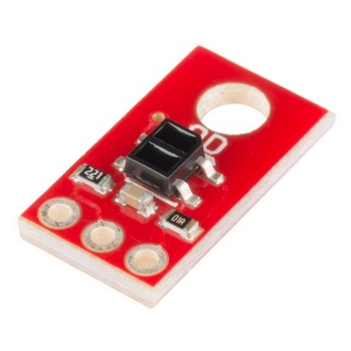
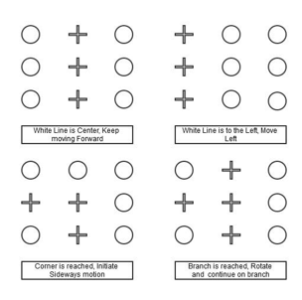
3x3 IRR sensor grid
Advantages:
Simpler than camera
Can make use of Mecanum wheels
Disadvantages:
Still essentially pattern recognition
Not proven solution
Was originally implemented, but scrapped after extensive testing.

Slide 14
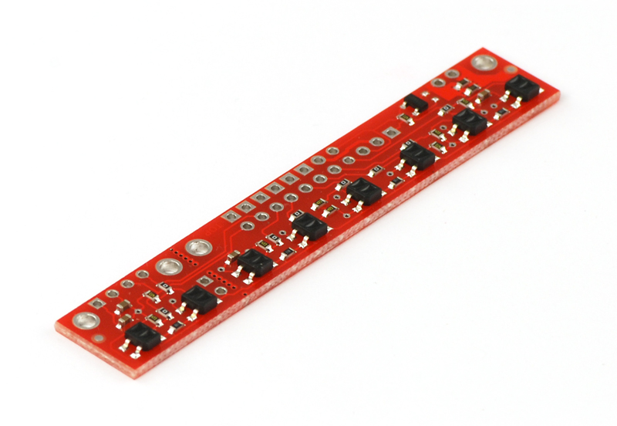
Traditional IRR sensor rows
One sensor row on each end, as well as a single IRR sensor on each side for branch detection.
Advantages:
Solved problem
Provides greater resolution than 3x3 grid
Disadvantages:
Makes taking advantage of Mecanum wheels more difficult
This is the implemented solution

Slide 15
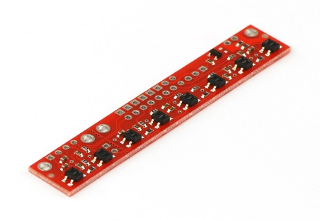
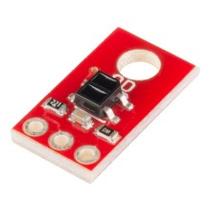
Traditional IRR sensor rows
18 sensors in total:
2 rows of 8
2 single sensors
Implementation:
Robot only ever uses one row of sensors + the two single sensors
When a branch is found, robot turns onto branch facing the appropriate direction
Robot returns to main line without needing to turn around

Slide 16
Simon Says: Detection
Presenter: Nils Bjeren

Slide 17
Simon Says Detection System
Requirements
Detect which color Simon Says button the robot needs to push
Should not “cover” the game
Design Alternatives
Light Sensor
Sound Detection

Slide 18
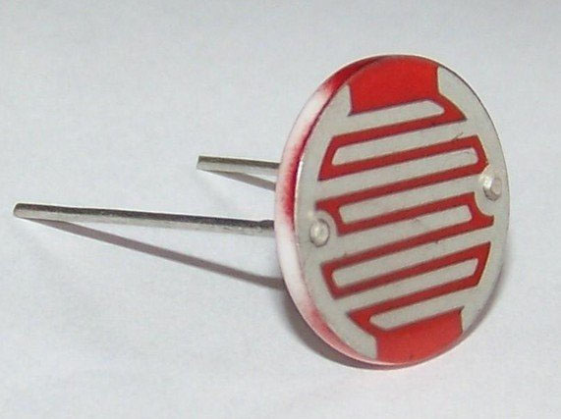
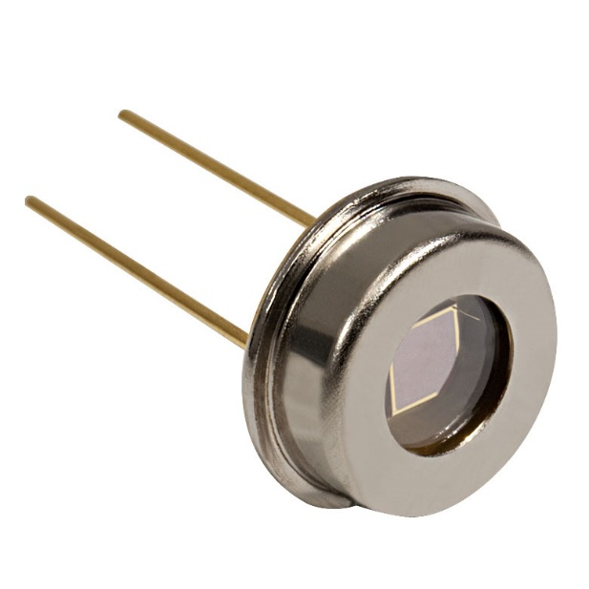
Light sensor
Would be implemented using photoresistors, photodiodes, or similar.
Advantages:
Less programming-intensive than other options
Reliable as long as environmental conditions are stable
Disadvantages:
Extreme reliance on ambient lighting remaining constant
Was decided against early on, due to rules against “covering” the Simon Says.

Slide 19
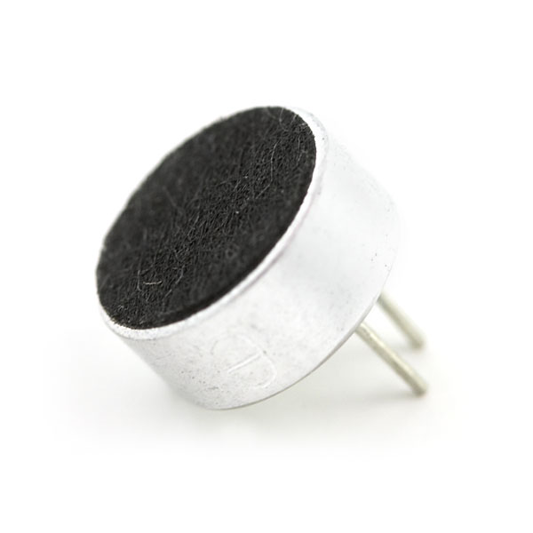
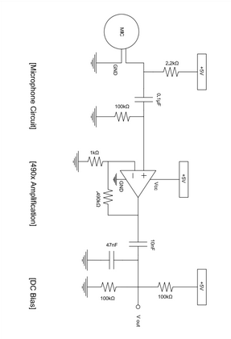
Sound detection
This approach uses sound sampling and filtering in order to extract frequency information
Advantages:
Handles ambient noise better than other options
Does not require covering the Simon Says game
Disadvantages:
Very programming-intensive
Assumes certain acoustic conditions
Timing issues
This was the implemented solution.

Slide 20
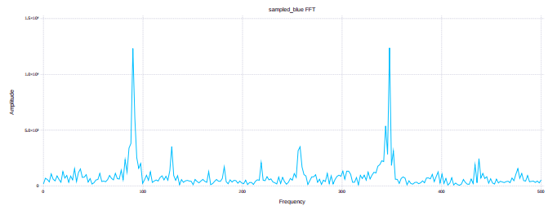
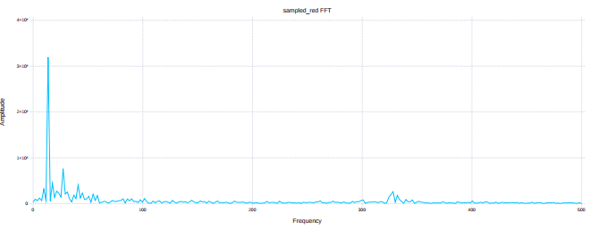
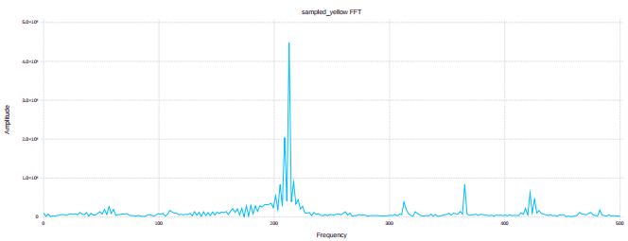
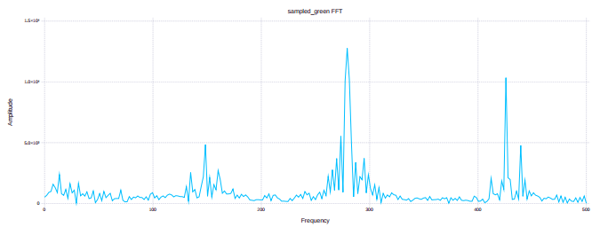
Sound detection
Implementation:
Sound is sampled at 1 kHz
Sampled signal is passed through 4 IRR band-pass filters, each centered around a color’s sound frequency
MCU picks a color based on the energy content coming out of the band-pass filter bank

Slide 21
Arm and End Effector Design
Presenter: James Pace

Slide 22
General Overview
One arm would be too general, four arms uneconomical.
Two arms, one on each side of robot
Draw IEEE on the Etch-A-Sketch and pickup playing card
Play Simon and turn Rubik’s Cube
Use synergies and parallelism between the games.

Slide 23
Vertical Motion
Both sides use a power screw for vertical motion.
Power screw is easy to drive, hides well on the inside of the chassis, not back drivable.
Con: Really slow.

Slide 24
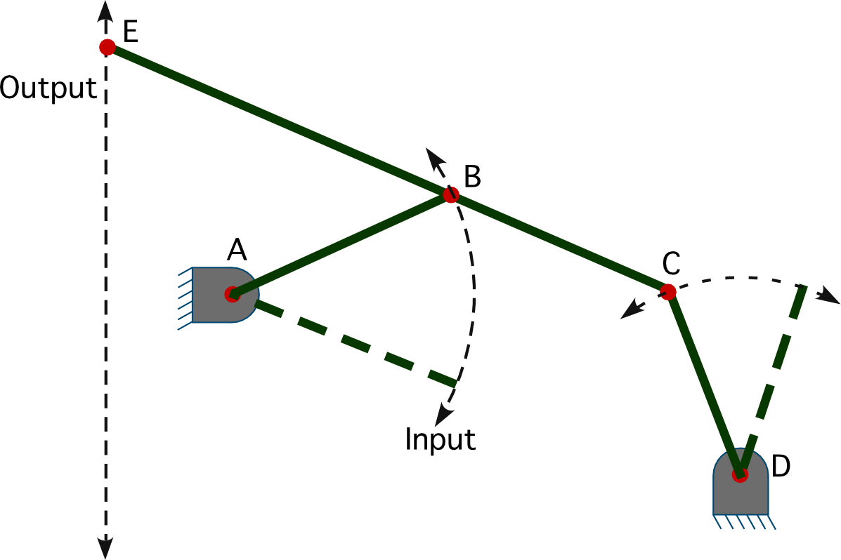
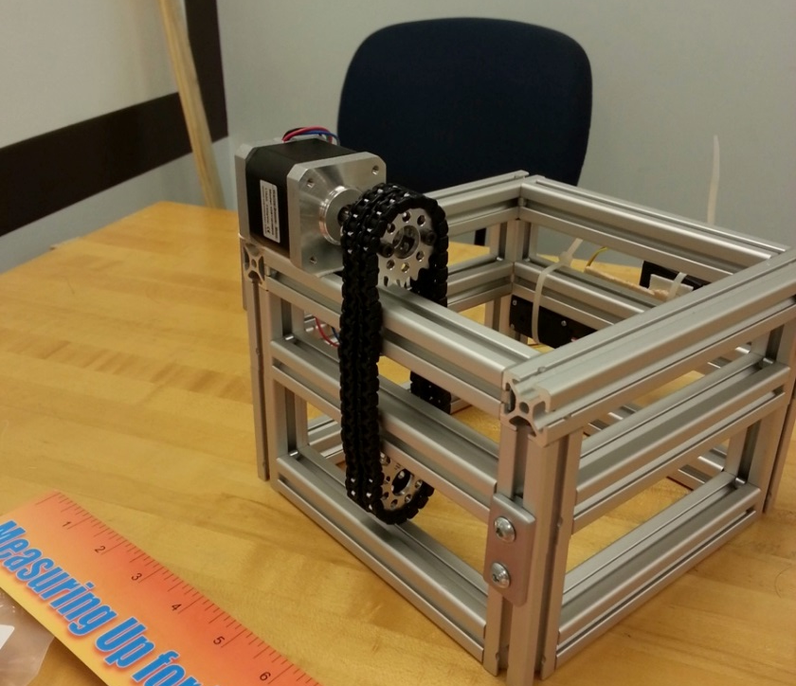
Alternatives
Four Bar Linkage.
Too much space.
Complexity.
Chain drive.
Simon Arm, could go over chassis
Need slack
Need guiderails

Slide 25
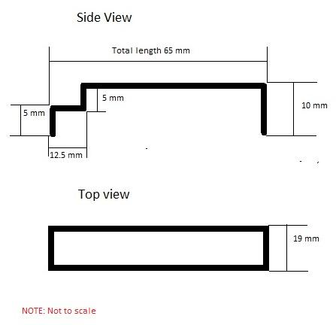
Simon/Rubik End Effector
Single piece that can rotate and is sized to play each game.
Driven by Continuous Rotation Servo
Small switches placed between the end effector and platform to provide feedback.

Slide 26
Simon/Rubik Alignment
“Dorito”
Use size similarities to align both games.

Slide 27
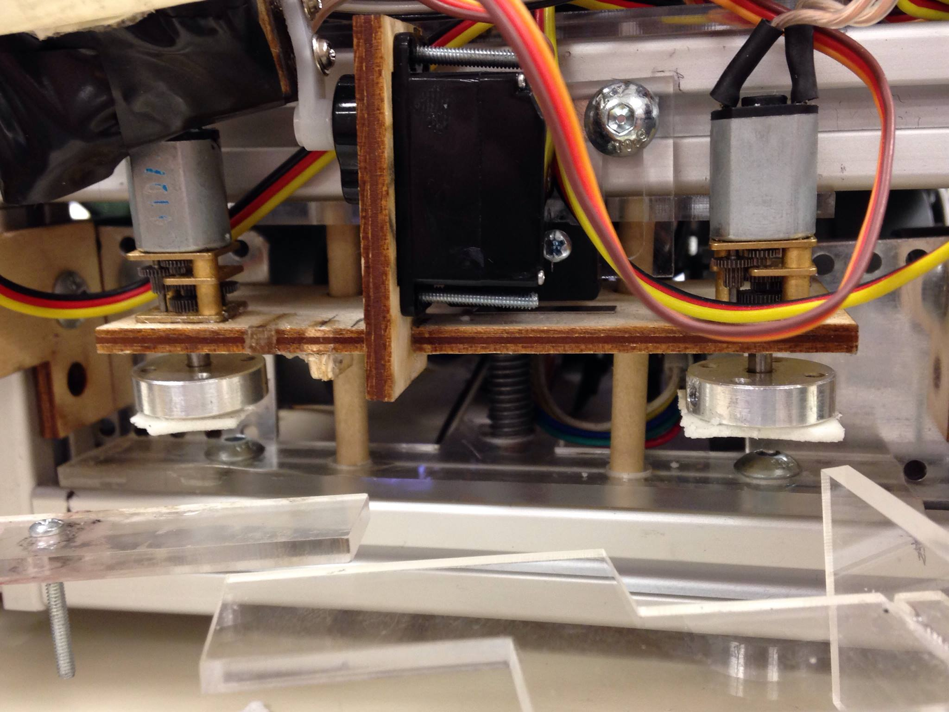
Etch-A-Sketch End Effector
Double Sided Tape on two DC motors.

Slide 28
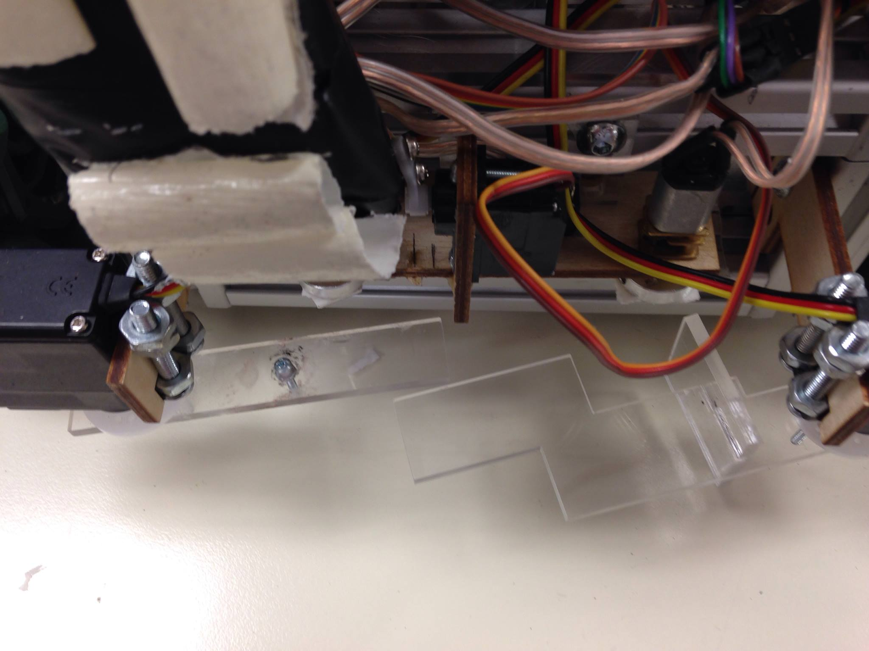
Etch-A-Sketch Alignment
Hands have holes just the right size to wrap around knobs, game fits perfectly.

Slide 29
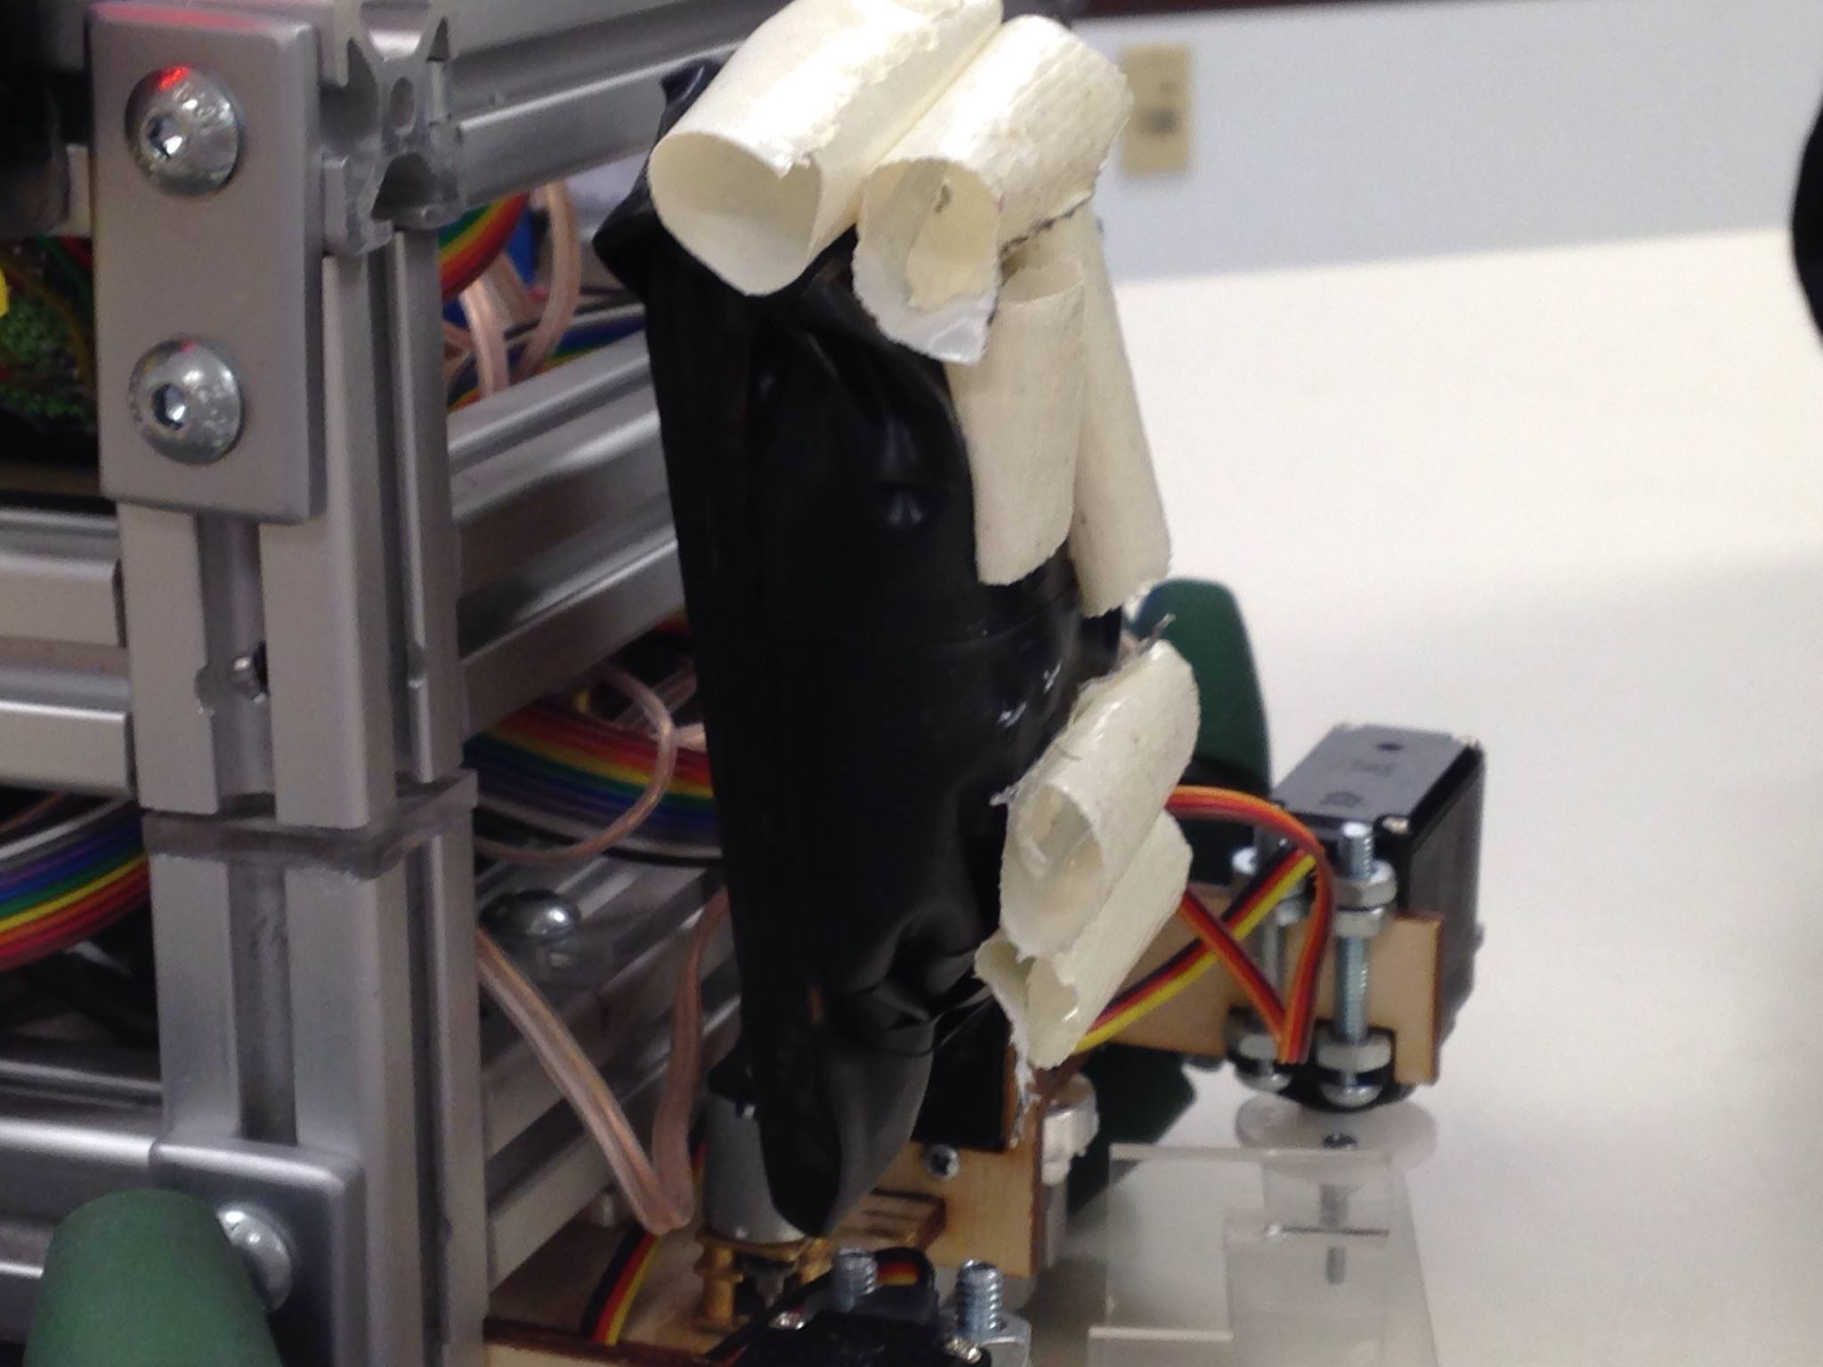
Card Arm
Compliance
avoid point contact
Give flexibility in where you align

Slide 30
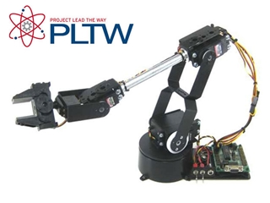
Arm Alternatives

Slide 31
Project Management and results
Presenter: James Pace

Slide 32
Results
Project Goal:
Win Southeastcon Hardware Competition.
In Ft. Lauderdale
7th of 39 schools competing
2nd in State of Florida

Slide 33
Project Management
7 members:
Parallelize tasks where possible
Split into 2-3 member sub teams for most tasks
Twice a week meeting as whole
Group texts for organization

Slide 34
Lessons Learned
More preplanning, integrated design, less ad-hoc
Use smaller wheels = easier to control, would have freed chassis and therefore arm design.

Slide 35
Questions?

