Slide 1
SoutheastCon Team 1A
Milestone 2 Report: Project Proposal and Statement of Work

Slide 2
IEEE SoutheastCon Hardware Competition
Team 1A:
Nils Bjeren
Donovan Carey
Christopher Lewis
Kurt Marsman
James Pace
Ryan-David Reyes
Julian Velasquez
Faculty Advisors:
Dr. Mike Frank
Dr. Bruce Harvey
Dr. Carl Moore
Dr. Linda DeBrunner
EEL4911C: Senior Design 1
Fall 2014
September 24th

Slide 3
Requirements
Sense a red LED (start condition)
Navigate according to the white line
Detect the sequence on a Simon Says game
Actuate the correct button sequence on a Simon Says game
Twist both knobs on an Etch-a-Sketch
Twist exactly one row of a Rubik’s Cube
Pick up and carry a single playing card

Slide 4
Limitations
Robot must be fully autonomous
Robot must fit inside a 1’ by ‘1 by 1’ box at the beginning and end of a run
Robot cannot split into multiple pieces
Robot must contain no flammable liquids, explosives, high pressures, or otherwise dangerous elements
The course must be completed in less than 5 minutes

Slide 5
Preliminary design
Arduino Mega 2560 is the main controller
Wheels are omnidirectional Mecanum
DC motors with encoders are used for propulsion
Line following subsystem:
9 IRR Sensors with dedicated Arduino Mini Pro
2 “challenge” subsystems with dedicated microcontrollers:
Rubik/Simon subsystem
Etch-a-Sketch/Playing card subsystem

Slide 6
Project Management
Team Manager: Nils Bjeren
Coordinates the project as a whole
Serves as interface between team and ECE faculty
Is responsible for continued progress being made
Head Programmer/Control Engineer: Ryan-David Reyes
Oversees and maintains stable versions of all code
Implements omnidirectional motor control
Implements communication between subsystems
Head Mechanical Engineer: James Pace
Has the final say on all mechanical/structural decisions
Serves as interface between team and ME faculty
Assures the structural integrity of the chassis

Slide 7
Project Management
Financial Advisor/Power Engineer: Julian Velasquez
Maintains budget and purchase record for the team
Calculates power requirements
Chooses battery units to satisfy power requirements
Secretary/Systems Engineer: Kurt Marsman
Creates and maintains meeting minutes and other required documents
Creates and maintains the system that ensures reliable start
Assists in development of Rubik/Simon Says subsystem
Systems Engineer: Donovan Carey
Creates the system-level design of the Etch-a-Sketch/Playing Card subsystem
Submits software requirements to the Control Engineers
Performs mechanical testing of the subsystem

Slide 8
Project Management
Control Engineer: Christopher Lewis
Works with Etch-a-Sketch/Playing Card systems engineer to establish software requirements
Writes software for the subsystem
Mentor and assist other team members with programming

Slide 9
Concept Generation and Selection
Christopher Lewis
Donovan Carey

Slide 10
Movement / Line Following Design
Differential Steering vs. Omnidirectional Steering
Infrared Reflective Sensors vs. Camera
Movement Design | Control (0.4) | Flexibility (0.6) | Total
Differential Steering | 4 | 1 | 2.2
Omnidirectional Steering | 3 | 5 | 4.2

Slide 11
Chassis Design
U-Shaped Chassis
Hole in the Center Chassis
Square Shaped Chassis
Chassis Design | Support of Manipulation (0.4) | Structural Integrity (0.5) | Ease of Manufacture (0.1) | Total
U-Shaped | 4 | 2 | 2 | 2.8
Hole in the Center* | 4 | 3 | 3 | 3.4
Square Shaped | 3 | 5 | 5 | 4.2

Slide 12
Communication
NO outside communication with the robot.
Communication Protocols
I2C
Lower Complexity in wiring
More difficult to implement
Communication errors affect entire system
RS232 (serial)
Requires Wiring from Mega to each subsystem
Improved Reliability due to errors only affecting the local subsystem.

Slide 13
Manipulator Arms
Pros:
Provides a simple means of interface between the autonomous robot and the different challenge
Can minimize the number of manipulators if similarities are found between the challenge games
Cons:
Robot must be perfectly aligned with the toys

Slide 14
Simon Says/ Rubik’s Cube
The design for playing the Simon Says game and the Rubik’s cube challenge both require the same circular motion.
Simon Says Implementation
Rubik’s Cube Implementation
Lower arm over the Simon game
Detect the game sequence using sound detection from a microphone
Analyze the sequence given by the game
Use the servo on the arm move the penetrator to the desired button
Lower the entire arm to press the desired buttons in the sequence given
Hold the Rubik’s in place using some type of gripping tool
Lower the arm onto the Rubik’s cube
Use the servo on the arm to turn the top row of the Rubik’s cube an entire 180 degrees

Slide 15
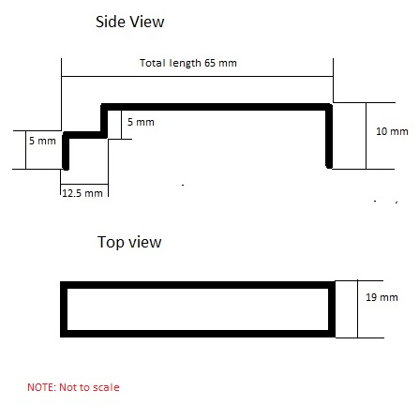
Figure 1: Custom Simon Says/Rubik’s Cube interface

Slide 16
Etch a Sketch/ Playing Card
The design for the etch and sketch arm requires movement in the z-direction which can be used to pick up the playing card using adhesive.
Etch a Sketch Implementation
Playing Card Implementation
Use a servo to lower the arm onto the game
Align the motors perfectly with the knobs using an adhesive
Use the frictional contact of the adhesive to work with the motors for movement of the knobs
Use the knobs to sketch IEEE into the toy in a timely fashion
Lower the arm onto the stack of cards
Use adhesive on arm to lift the playing card from the stack
Use the arm to then lift the card
Carry the playing card across the finish line

Slide 17
Power Systems
We are looking at using two Lithium Polymer(LiPo) for the power distribution to the robot. One of the batteries is intended for the propulsion system while the other will be used to power the manipulator subsystems.
Propulsion Devices
Manipulator Devices
DC motors with Encoders (x4)
Arduino Mega 2560 microcontroller
Line Following Sensors (x9)
DC motors (x3)
Servos (x2)
Arduino Redboard (x2)
Arduino Mini

Slide 18
Alternative Solutions
Power System
Lithium Polymer (LiPo)
Nickel-metal hydride (NiMH)
Simon Says Sequence Detection
Light Detection
Sound Detection (frequency counter vs FFT)
Color Sensor
Simon Says Interface
Four-bar-linkage (single piston)
Four pistons
Etch-a-Sketch Manipulation
Claws
Adhesive between the mounted motors
and knobs
Frictional Contact on the side of the
knob
Rubik’s Cube Rotation
Use motor and adhesive
Servo attached to a manufactured piece
to rotate the row from the outside
Claw rotating around horizontal plane

Slide 19
Preliminary System-Level Design
Ryan-David Reyes
James Pace

Slide 20
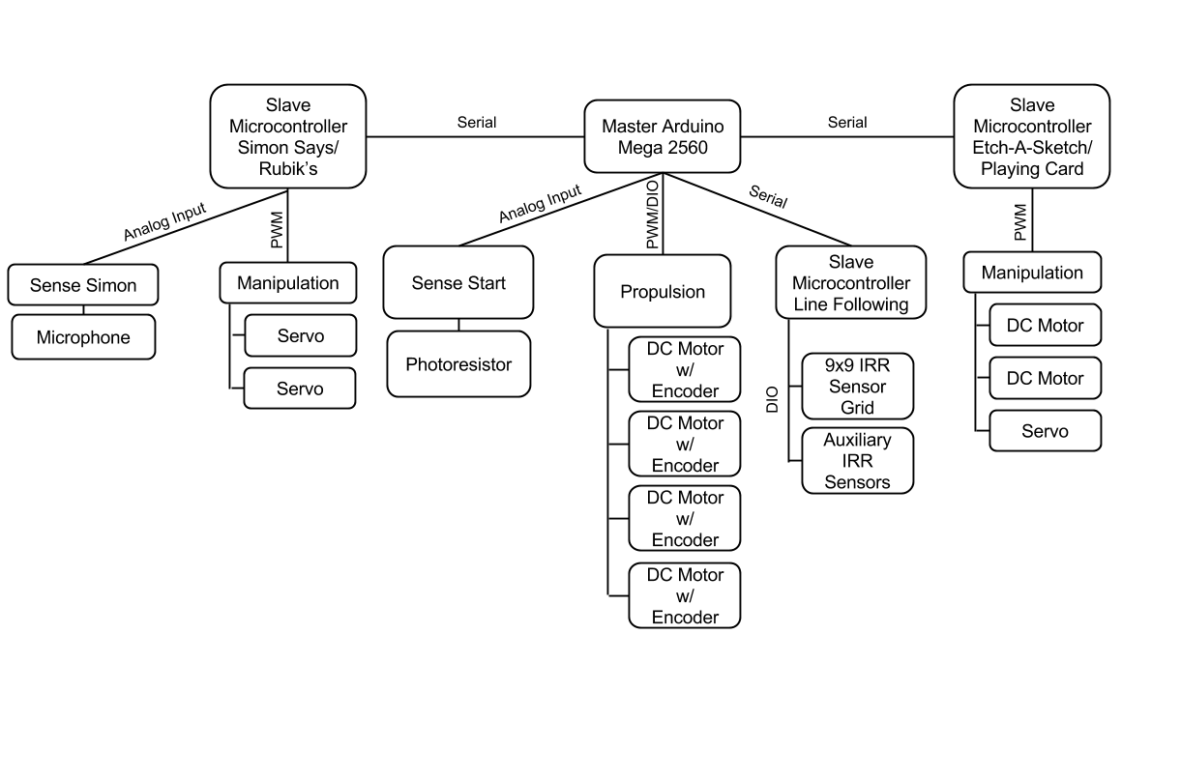
Block Diagram

Slide 21
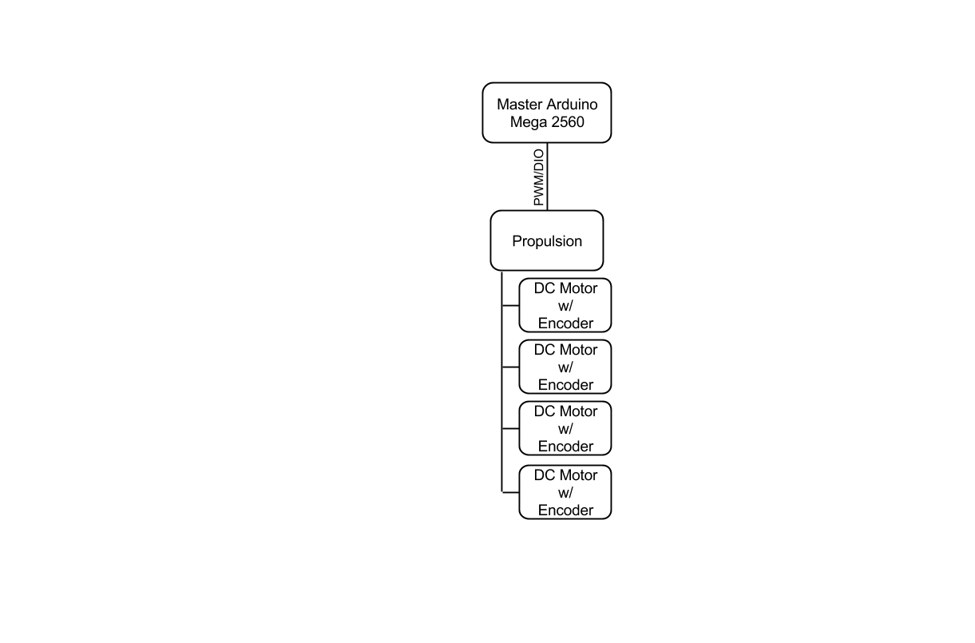
Specifications
Chassis Size:
Width: 7 in.
Length: 7 in.
Height: ½ in. from ground
Propulsion Motors:
110 oz-in. stall torque
Encoder: 1920 CPR
350 RPM
300 mA free run current
Mecanum Wheels:
2 in. radius
Master Microcontroller Specs:
Atmega 2560
54 DIO, 16 AIO
4 Serial IO
Batteries:
2x LiPo 2.3 Ah

Slide 22
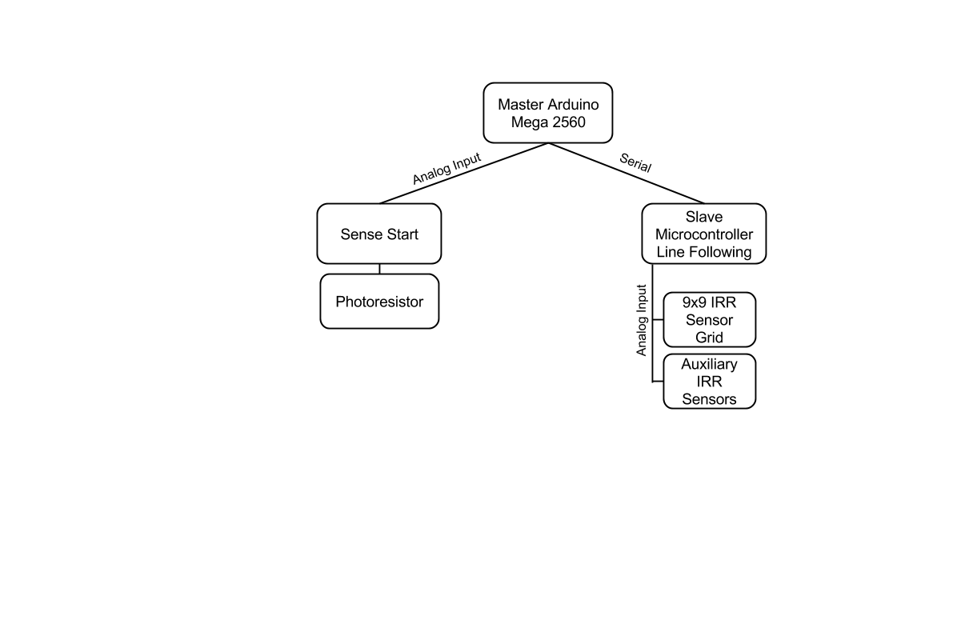
Specifications
Photoresistor (Sense Start)
5k-100k Ohm variable resistance
Line Following Sensors: IR Reflectivity
Phototransistor output
½ in. effective range
Slave Microcontroller
Atmega328p
14 DIO

Slide 23
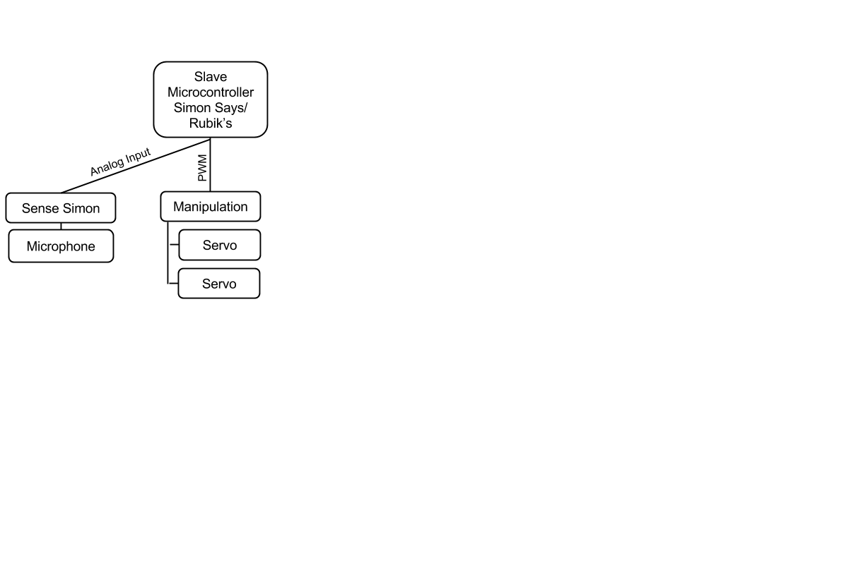
Specifications
Rubik’s Cube Arm
Servo 1
12 oz-in stall torque
180 degrees of rotation
Servo 2
93 oz-in stall torque
360 degrees of rotation
Microphone
5V Supply
Requires 500x Output Amplification
Slave Microcontroller
Atmega328p
14 DIO

Slide 24
Specifications
Etch-A-Sketch Arm
DC Motors
20 oz-in stall torque
120 RPM
Servo
12 oz-in stall torque
180 degrees of rotation
Slave Microcontroller
Atmega328p
14 DIO

Slide 25
Overall Constraints
1 ft. by 1 ft. by 1 ft. size constraint at beginning and end.
Must be able to complete track in 5 minutes.
Robot must not split completely apart.

Slide 26
Preliminary Overall Design

Slide 27
Lower Level

Slide 28
Electronics Level

Slide 29
Arms

Slide 30
Budget
Julian Velasquez

Slide 31
Budget
Budget estimate for milestone 1
Category | Cost
Wheels | $80.00
Motors | $300.00
Batteries/Chargers | $150.00
Microcontrollers | $300.00
Electronics | $200.00
Misc. Mechanical Parts | $170.00
Total: | $1,200.00

Slide 32
Budget
Budget as of 10/17/14
Purpose | Items | Cost
Simon Frequency Analysis | Miscellaneous Electronics | $11.47
Propulsion | Motor Drivers | $47.95
Battery Charger for Propulsion/Manipulators Batteries | Battery Charger | $40.08
Batteries for Manipulators | Battery | $27.75
Simon/Rubik’s Manipulator | Servo Motor | $19.40
Propulsion | Miscellaneous Equipment | $51.89
Propulsion | Motors for Propulsion | $177.25
Etch-a-sketch manipulator | Gearmounts | $20.35
Etch-a-sketch manipulator | Miscellaneous equipment | $20.11
Mecanum Wheels | Propulsion | $71.76
 | Total: | $508.01

Slide 33
Budget
Personnel Cost
Personnel | Total Hours per Semester | Total Hours Worked Both Semesters | Total Base Salary ($30 per hour) | Total Salary + Fringe Rate of (29%)
1 Group Member | 192 | 384 | $11,520 | $14,861
Whole Team (7 Members) | 1,344 | 2,688 | $80,640 | $104,026
Direct and Overhead Costs
Direct Cost | Direct Cost + Fringe Rate + Overhead rate (45%) | Direct Cost + Overhead Rate (45%)
$81,148 | $151,574 | $117,665
Overhead costs refers to an ongoing expense of operating a business. I.e. rent, gas, electricity, and labor burden.

Slide 34
Budget
Total Project cost
Category | Expense ($)
Supplies and Small Items (Current) | $508.01
Additional Supplies and Small Items (Projected) | $691.99
Direct Cost + Fringe Rate + Overhead rate (45%) | $151,573.74
Total Project Cost: | $152,773.74
Fringe rate is the cost of an employee’s benefits divided by the wages paid to an employee for the hours worked.

Slide 35
Schedule
Julian Velasquez

Slide 36
Schedule
Event | Date | Individuals Responsible
Simon Arm Prototype Complete | 11/6/2014 | Julian, Nils
Etch-A-Sketch Prototype Complete | 12/16/14 | Donovan, Chris, James
Line Following Complete | 11/4/14 | Nils, Ryan
Final Chassis Built | 2/4/15 | James
Local Competition | Late February | Whole Team

Slide 37
Risk Assessment
Kurt Marsman

Slide 38
Budgetary Risks
Design Requirements Not Met
Buying wrong parts
Proper planning
Scheduling
Overall bottom line
Gantt chart

Slide 39
Hardware
Voltage and Current Associated with Design
Motor Drivers
Motors on Robot Breaking
Double check specs
Solarbotics L298 Compact Motor Driver

Slide 40
Software
Errors in Code
Version control
GIT
No Walls on Track
Refine code early on
Have people ready to catch the bot

Slide 41
Performance Risks
Precision
Positioning
Motor Encoder Decoder
Arm Alignment
Axis of rotation
Grabber Design
Sideways Movement
Line following
Forward motion with turn in place

