Slide 1
SoutheastCon Team a
Milestone 4: Detailed Design Review and Test Plan
ECE Team 1A/ME Team 29:
Christopher Lewis Computer Engineering
Donovan Carey Electrical Engineering
James Pace Mechanical Engineering
Julian Velasquez Electrical Engineering
Kurt Marsman Electrical Engineering
Ryan-David Reyes Electrical and Computer Engineering
Nils Bjeren Electrical Engineering and Economics

Slide 2
Introduction

Slide 3
Design highlights
Two challenge subsystems:
Etch-a-Sketch/Playing Card
Rubik’s Cube/Simon Says
Primary/Secondary Architecture
1 Primary MCU (ATmega 2560)
3 Secondary MCUs (ATmega 328)
Serial communication

Slide 4
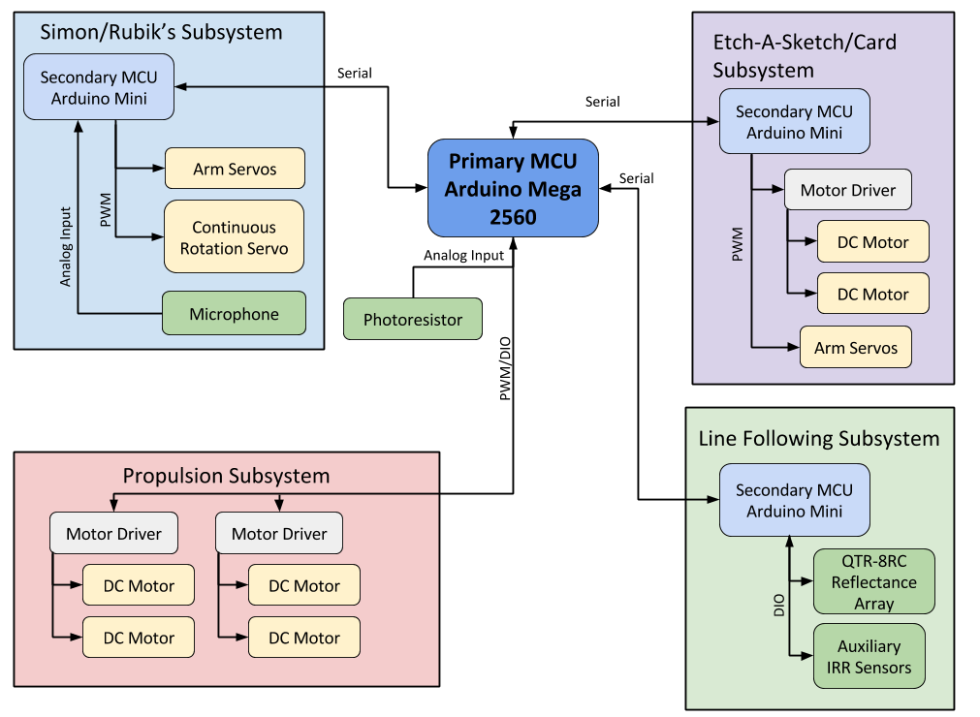
System Overview
Primary Microcontroller:
Atmega 2560
54 DIO, 16 AIO
4 Serial IO, one for each Secondary MCU
Secondary Microcontrollers:
Atmega 328p
14 DIO, 8 AIO
1 Serial IO

Slide 5
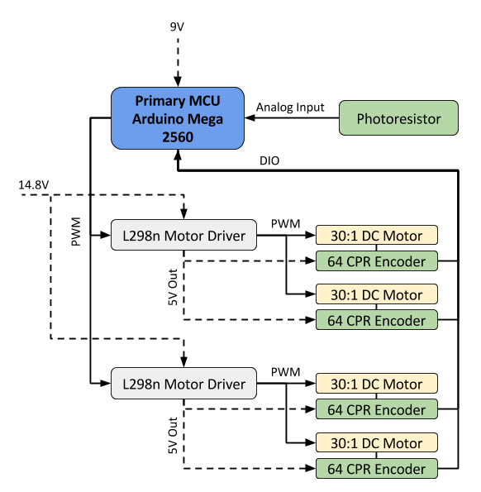
Propulsion Subsystem
Mecanum Wheels:
2 in. radius
Better response due to weight
MCU Implementation:
External Interrupt lines for reading encoders
Timer Interrupt based Velocity PID
Increased PID Constants due to higher weight
Forward Kinematics for vector-based navigation

Slide 6
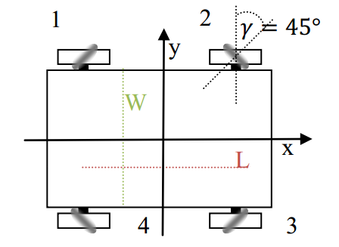
Kinematic Equation
The system is governed by the following equation[1]:
$$\left[\begin{matrix}ω_{1} \\ \begin{matrix}ω_{2} \\ \begin{matrix}ω_{3} \\ ω_{4}\end{matrix}\end{matrix}\end{matrix}\right]=\left[\begin{matrix}1 & 1 & −\frac{L+W}{2} \\ 1 & −1 & −\frac{L+W}{2} \\ \begin{matrix}1 \\ 1\end{matrix} & \begin{matrix}1 \\ −1\end{matrix} & \begin{matrix}\frac{L+W}{2} \\ \frac{L+W}{2}\end{matrix}\end{matrix}\right]\left[\begin{matrix}v_{x} \\ v_{y} \\ ω\end{matrix}\right]$$
W is width of robot.
L is distance from axle to axle.
[1]
[1] Viktor Kalman, "On modeling and control of omnidirectional wheels,” Budapest University of Technology and Economics: 2013, .

Slide 7
Inter-System Serial Communication
Request-Response design pattern:
Primary MCU requests data when required
Secondary MCU replies with fixed size data packet
Primary MCU processes data and re-requests on header mismatch
Repeat

Slide 8
Communication EXAMPLE: Line Following
Primary MCU requests heading data (send unique byte)
Line following secondary MCU sends data packet (right)
Data Packet (4+ bytes)
Header (0xFF)
Forwards/Backwards Velocity
Left/Right Velocity
Angular Correction
Debug
RS232
Primary MCU
Secondary Line Following MCU
RS232

Slide 9
Line Following
Nils Bjeren

Slide 10
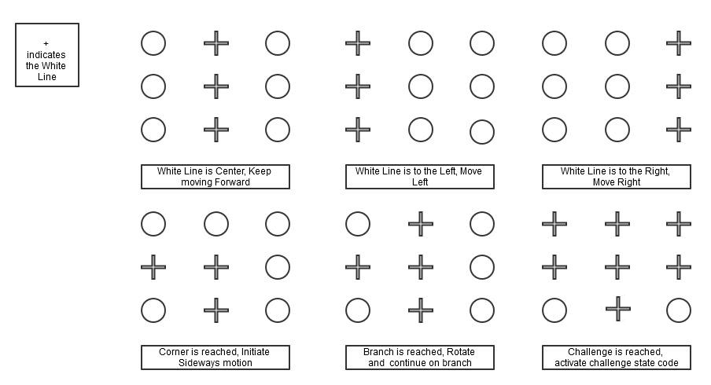
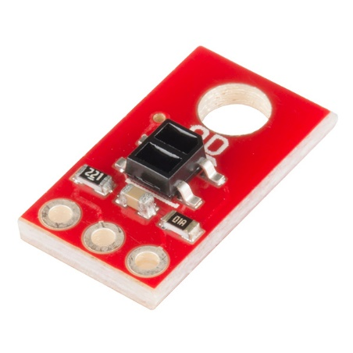
Line Following: where we were

Slide 11
Line Following: What went wrong
Reasons for failure:
Too ambitious
Not enough resolution
Lessons learned:
Test early and often
“Don’t be afraid to start over”
KISS
Remedies:
Use already proven solution
Brainstorming

Slide 12
Line Following: where we are now
Basic Sensing:
Row of sensors for main line following
Auxiliary sensors for branch sensing and to help with “game box” detection
Error correction:
Robust algorithm, realizes the robot has made a wrong turn

Slide 13
Line Following Testing
Completed:
Sensors able to differentiate “white” from “black”
Robot able to navigate online
Robot able to recover from an error
To go:
Reliable branch navigation
Full run with gameplay

Slide 14
Simon Says/Rubik’s Cube Subsystem
Nils Bjeren, Julian Velasquez, Kurt Marsman

Slide 15
Simon Says Logic
Logic is initiated by master MCU on arrival at Simon Says game
Finish will occur at 15 seconds after start, independent of success
Primary MCU
Secondary Rubik/Simon MCU

Slide 16
Pitch Detection Software
Highest pitch: < 500 Hz
Sample rate: 38.5 kHz
Every time the waveform crosses “0” with rising slope, the slope is recorded.
The period is the time between two rising edges with the same slope.

Slide 17
Sequence Construction
The sequence detection only cares about the last “color” in the sequence
This gets added to the end of the already established sequence
Begin recording
Sample frequencies until “quiet”
Add last discernable frequency to sequence

Slide 18
Simon Says Software Testing
Completed:
Full detection and reconstruction
To go:
System integration testing

Slide 19
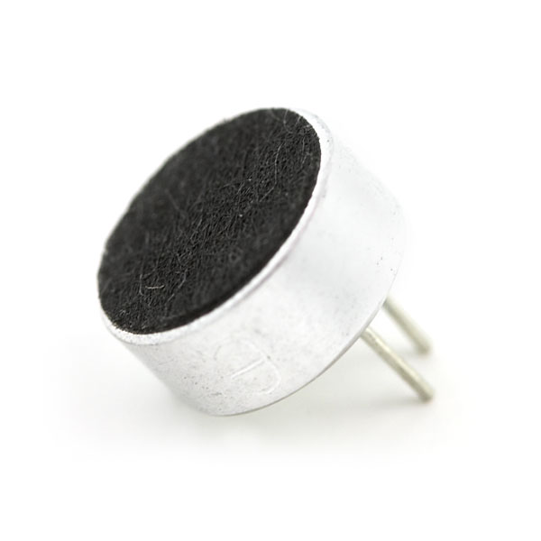
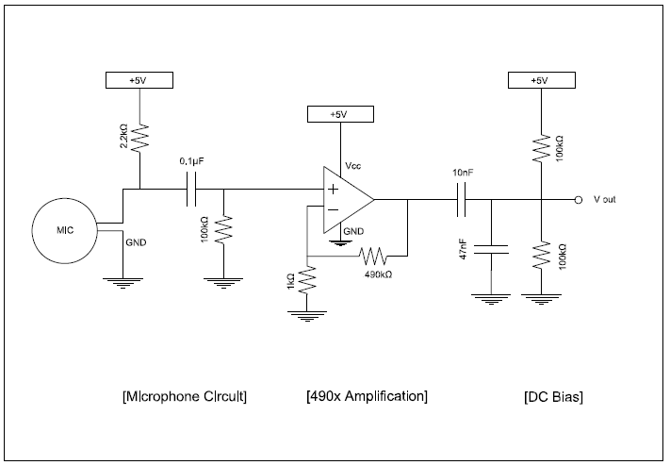
Simon Says: Pitch Detection Hardware

Slide 20
Simon/Rubik: Encoder
360 degrees of freedom needed to play both games
Continuous rotation servo doesn’t have feedback
Feedback provided by white spots positioned at 90 degree intervals
White spots are “seen” by an IRR sensor

Slide 21
Simon/Rubik: Motor
AR-3606HB continuous rotation servo rated for 93oz-in of torque at 6 V
The torque is over-specified for the design but this is because there is no weight or price difference with lower torque motors

Slide 22
Simon/Rubik: Manipulator Prototype
This system allows the inner notch to touch the buttons of the Simon Says game, whereas the outer ends are far enough apart to grab onto and twist the top row of the Rubik’s Cube
Vertical motion (in order to push the Simon buttons or touch the Cube) will be provided by lowering and raising the arm with which the servo is attached to the body of the robot.

Slide 23
Simon/Rubik: Grabber Prototype
This system allows some room for error when it comes to alignment and positioning of the robot
The two servos are strong enough to hold the Rubik’s cube as it spins and will move out of the way to allow the Simon Says buttons to be pressed

Slide 24
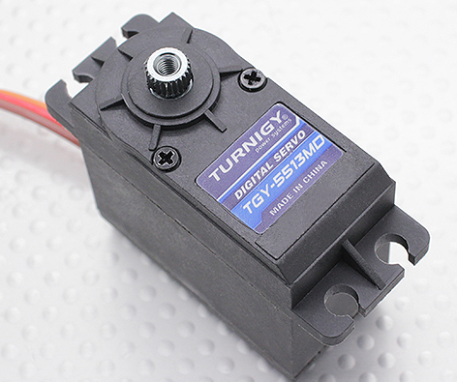
Simon/Rubik: Grabber Prototype
Turnigy TGY-5513MD Metal Gear Digital Servo 12kg / 0.18sec / 54.5g
Stall torque (6.0V): 12.25kg.cm (170.15 oz/in)
Servos had to be stronger than the continuous rotation servo in order to properly hold the Rubik’s cube while it spins

Slide 25
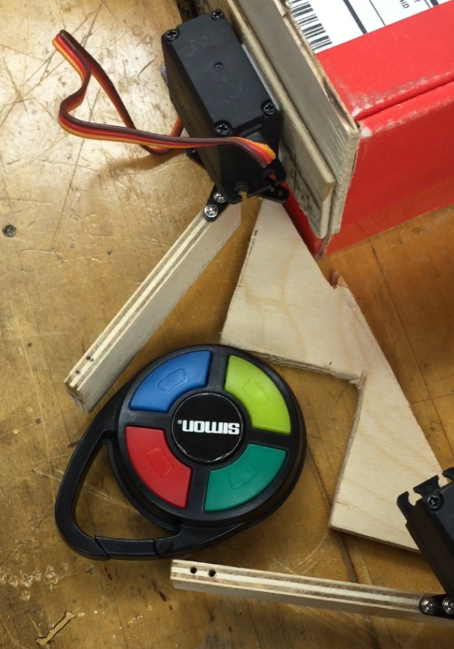
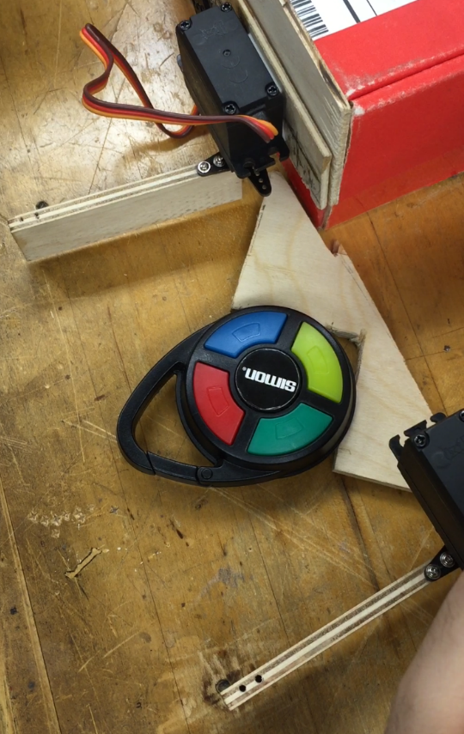
Simon/Rubik: Grabber (Simon Sequence)

Slide 26
Simon/Rubik: Grabber (Rubik’s Sequence)

Slide 27
Battery
The LiPo chosen is a Rhino 2150 mAH 20C LiPo Pack
The battery is composed of 4 cells each of 3.7 V, for a total voltage of 14.8 V
The constant discharge of the battery is 20C with a burst rate of 30C for 15 seconds
The dimensions of the battery are 113x35x27 mm, the weight is 215 g

Slide 28
Power Analysis

Slide 29
Current Budget
Purpose | Cost
Simon/Rubik’s Manipulator | $114.97
Etch-a-sketch manipulator | $13.21
Power System | $76.41
Propulsion | $414.76
Chassis | $222.78
Total: | $842.13

Slide 30
Chain Drive
Designed to solve alignment issue
High torque stepper motor
Delrin chain
End Effector
Notes:
With most of the focus on the EAS implementation, the simon/rubik’s subsystem was a simple retrofit to the other side of the robot
The first idea was a chain drive
This was driven by a high torque stepper motor with gears
A delrin chain moved when the motor turned
The end effector was attached by means of tying or epoxy

Slide 32
Prototype Testing
Stepper worked reliably
Mounting issues
Chain stability
Notes:
The stepper motor worked reliably and turned the chain with little issues
The main problem encountered was with mounting the end effector to the chain
Both tying the chain and epoxying the end effector the servo seemed unreliable
Another issue that arose was with chain stability while the end effector was manipulating the game

Slide 33
New Arm
Simpler design to implement
Alignment figured out by pincer
2 servos to control height of end effector
1 for extension
1 for angling
The arm design accounts for the height of both games
Notes:
With the design of the new pincer alignment mechanism for the EAS and the simon, alignment to the games becomes much less of an issue
The next design that was prototyped involved an arm that is much simpler to implement
The design consists of 2 servos: 1 for extending the arm when at the game and the other for angling the end effector when the arm is lowered onto the game
The 2 servo design of the arm allows for the same arm to be used for both games since there servo controlling the height of the arm and the alignment pincer works for both games

Slide 35
Arm testing
Operational with proper alignment to game
Whole subsystem integration
Notes:
in isolated prototype testing, the mechanism worked as intended and successfully lowered the end effector onto the cube and pressed the buttons of the simon.
The next step is to integrate the pincer and the arm to test for successful function.

Slide 36
Etch-a-Sketch/Playing Card Subsystem
Donovan Carey, Christopher Lewis

Slide 37
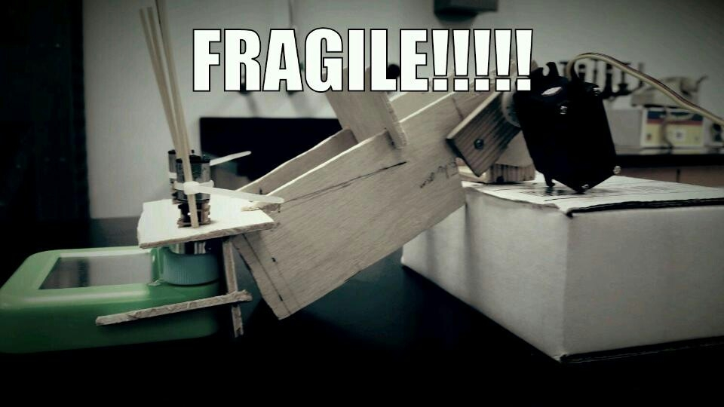
Where We Were

Slide 38
New Interfacing System
Worm Gear System
Motor and Bolt
Guide Rails
End effector
Back Plate
Benefits
Alignment between
knobs and motors
Challenges
Horrible alignment between end effector and toy

Slide 39
Gripper
Starts in the inward position against backplate
Opens 180 degrees before approaching etch-a-sketch toy
Closes gripping the knobs of the toy
Aligns the etch-a-sketch toy in the same longitude and latitude position every round
Holds the etch-a-sketch still for precise movement of the micro-motors on the knobs

Slide 40
Etch-a-Sketch
3. Completing the Challenge
Approach the toy
Use gripper to align the toy with the end effector
Use the worm gear subsystem to interface the motors and the knobs of the toy
Write “IEEE” on the toy
Lift manipulator quickly to remove the adhesive from the toy

Slide 41
Playing Card
Completing the Course
Drive up to the stack of cards
Lower the manipulator so the adhesive sits at the top of the stack
Lift the manipulator slowly to make sure that the card remains on the adhesive
Drive the card across the finish line

Slide 42
Software Design Overview
Code will all be programmed on the local Arduino Mini, which will connect to the Primary Controller
2 Separate Functions
Playing Card Function
Etch-a-Sketch Function
Control Signal will be sent from the Main Controller to activate the different challenge functions

Slide 43
Alignment – Servo Arms
There are 2 servos that are used to “grab” and align the Etch-a-Sketch.
The Arduino Servo Library <Servo.h> is used to control the servos.
The Servos are connected directly to the Arduino Mini.
Servo myservo; // Servo object is declared
myservo.attach(14); // Servo is attached to a pin
myservo.write(0-180); // Servo moves to degree position between 0-180 degrees
// if Servo is continuous rotation then this function sets // the speed with 0 being max clockwise rotation and 180 // being max cclockwise rotation
delay(2000); // used to control the time the servos hold position (in ms)

Slide 44
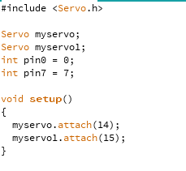
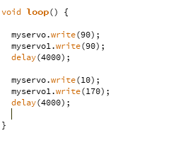
Sample COde

Slide 45
Worm Gear System - Micromotors
There are 3 DC micromotors that are used, one to drive the worm gear and two to turn the knobs of the Etch-a-Sketch.
The DC micromotors will be connected to motor controllers (L298N) which will be connected to the Arduino Mini.
With this, we are able to control the rotational direction as well as control the speed of all 3 DC micromotors.
To make the letters “IEEE” on the Etch-a-Sketch, we will rotate clockwise and cclockwise for a certain duration using the delay(#); function

Slide 46
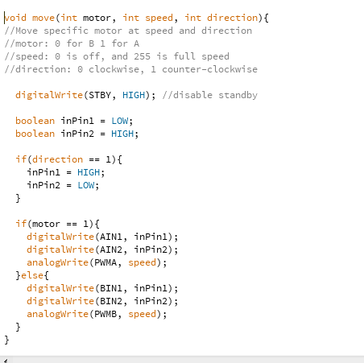
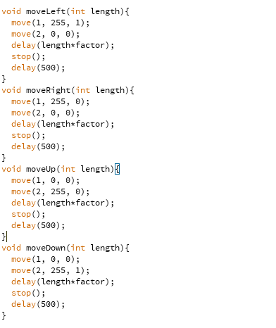
Sample Code

Slide 47
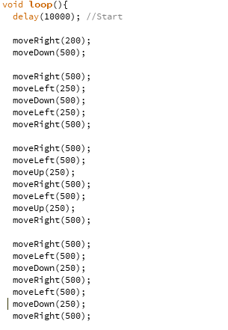
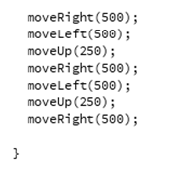
Sample Code

Slide 48
Testing Plan – Etch-a-Sketch/Playing Card
Test 1: Run Micromotors Result: Success
Test 2: Adhesive Test Result: Success
Test 3: Control Micromotors Result: Success
Test 4: Etch-a-Sketching Test Result: Success
Test 5: Run Arm Servo, test torque Result: Success
Test 6: Prototype Arm Design Result: Failure
*Test 7: Servo Alignment test Result: Success
Test 8: Worm Gear Platform Test Result: Success
Test 9: Prototype Gear Platform Test Result: In Progress

Slide 49
Structure
James Pace

Slide 50
Last Time…
Extruded Aluminum
3 Modular Sections
Major Goals:
Provide structure for everything else to attach to
1 ft by 1 ft by 1 ft attachment

Slide 51
Since Then…
Built Chassis
Finished week or two into semester
Moved electronics onto it 1-2 weeks ago

Slide 52
Next …
Manipulator design drastically changed.
Need Fourth Layer to be able to fit everything.
Materials delivered Monday
Currently at Machine Shop

Slide 53
Size Testing
~0.1in bigger than 12in wide wheel tip to wheel tip
(ProE predicted <11.85in width…)
Fix:
Washers between motors and brackets should push motors/wheels back a little

Slide 54
Vibration
As wheels turn:
Forces both tangential to and perpendicular to wheel
What this means in practice:
Wheels experience excess vibrations during normal operation, pulling of the axle.
Fix:
Loctite set screws down before competition.
Safety wire down the end caps.

