Slide 1
SoutheastCon Team 1A: Final Presentation
Donovan Carey (EE)
Christopher Lewis (CpE)
Kurt Marsman (EE)
James Pace (ME)
Ryan-David Reyes (ECE)
Julian Velasquez (EE)
Nils Bjeren (EE)

Slide 2
The Problem
Autonomous Robot
Follow Line
Play “Simon Says”
Write IEEE on Etch-a-Sketch
Twist one row of a Rubik’s Cube
Pick up one playing card

Slide 3
System Overview: Low Level Control Inter System Communication
Ryan – David Reyes

Slide 4
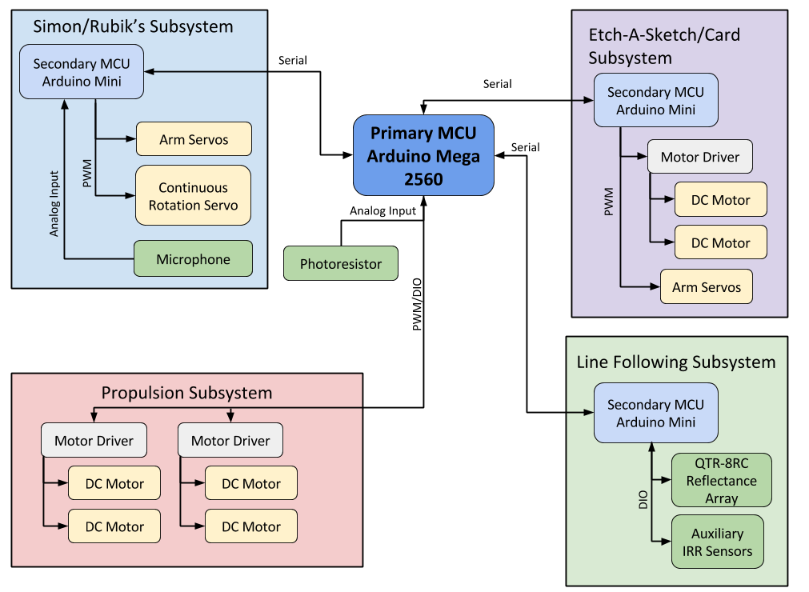
System Overview
Primary Microcontroller:
Atmega 2560
54 DIO, 16 AIO
4 Serial IO, one for each Secondary MCU
Secondary Microcontrollers:
AtMega 328p
14 DIO, 8 AIO
1 Serial IO

Slide 5
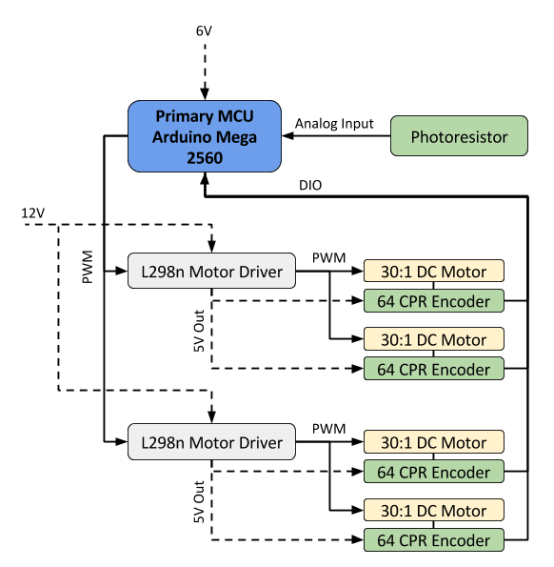
Propulsion Subsystem
Mecanum Wheels:
Omnidirectional Movement
2 in. radius
Good response due to weight
MCU Implementation:
Timer Interrupt based Velocity PID
Forward Kinematics for vector-based navigation
External Interrupt lines for reading encoders

Slide 6
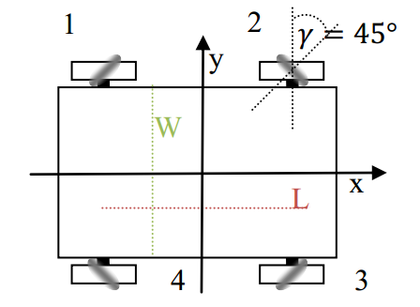
Kinematic Equation
The system is governed by the following equation[1]:
$$\left[\begin{matrix}ω_{1} \\ \begin{matrix}ω_{2} \\ \begin{matrix}ω_{3} \\ ω_{4}\end{matrix}\end{matrix}\end{matrix}\right]=\left[\begin{matrix}1 & 1 & −\frac{L+W}{2} \\ 1 & −1 & −\frac{L+W}{2} \\ \begin{matrix}1 \\ 1\end{matrix} & \begin{matrix}1 \\ −1\end{matrix} & \begin{matrix}\frac{L+W}{2} \\ \frac{L+W}{2}\end{matrix}\end{matrix}\right]\left[\begin{matrix}v_{x} \\ v_{y} \\ ω\end{matrix}\right]$$
[1] Viktor Kalman, "On modeling and control of omnidirectional wheels,” Budapest University of Technology and Economics: 2013, .

Slide 7
Inter System Serial Communication
Request-Response design pattern:
Primary MCU requests data when required
Secondary MCU replies with fixed size data packet
Primary MCU processes data and re-requests on header mismatch
Repeat
Data encoded in Consistent Overhead Byte Stuffing: COBS

Slide 8
Consistent Overhead Byte Stuffing (COBS)
Provides efficient, reliable, unambiguous packet framing
COBS ensures a unique header byte – 0x00
An overhead of only one byte in 254
Simple to implement, low MCU overhead

Slide 9
Chassis
James Pace

Slide 10
Chassis
Requirements
Goals
Provide structure for everything else to mount to.
Fit in 1ft by 1ft by 1ft size constraint.
Doesn’t fall apart.
Allow for easy maintenance.
Modularity
Flexibility & Ease in mounting components.

Slide 11
Alternatives Considered
U-Shaped Chassis
Hole in Center of Chassis
Simple Cube Design

Slide 12
Chosen Design
Simple box shape
Extruded Aluminum
Layered
Layers remove easily, allowing access to electronics

Slide 13
Easy Attachment
Extrusion Provides easy mounting holes for everything.
Particularly:
Skirt
Dorito

Slide 14
Arm Flexibility
(Chassis built before arms finalized.)
Simple cube design allowed for flexibility when finalizing arms.
Lots of possibilities stayed open, even with the chassis being designed so quickly.

Slide 15
Line Following
Nils Bjeren

Slide 16
Line Following System
Requirements
Follow white line
Navigate corners
Navigate curves
Navigate T-junctions
Branch-and-return
Design Alternatives
Camera
IRR Sensors
3x3 sensor grid
Integrated row of sensors

Slide 17
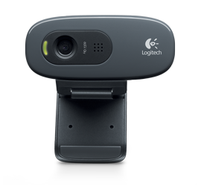
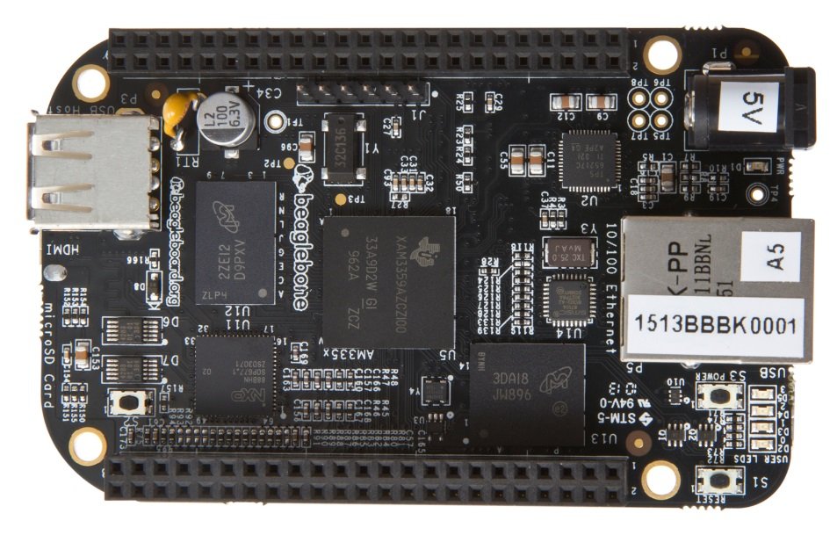
Camera
Advantages:
Flexibility
Power
Disadvantages:
Complexity (image processing)
Decided against at an early stage because of complexity

Slide 18
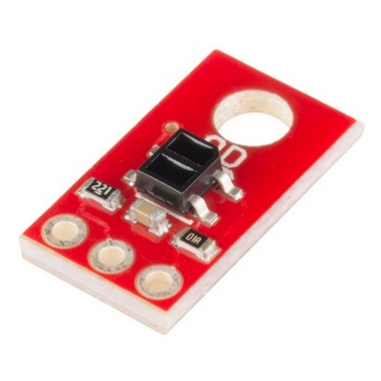
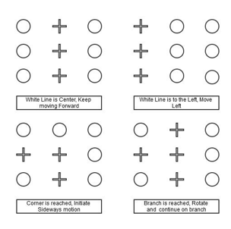
3x3 IRR sensor grid
Advantages:
Simpler than camera
Can make use of Mecanum wheels
Disadvantages:
Still essentially pattern recognition
Not proven solution
Was originally implemented, but scrapped after extensive testing.

Slide 19
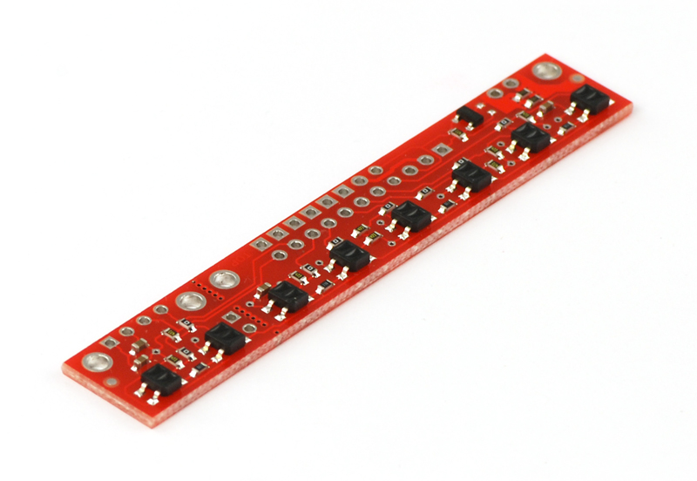
Traditional IRR sensor rows
One sensor row on each end, as well as a single IRR sensor on each side for branch detection.
Advantages:
Solved problem
Provides greater resolution than 3x3 grid
Disadvantages:
Makes taking advantage of Mecanum wheels more difficult
This is the implemented solution

Slide 20
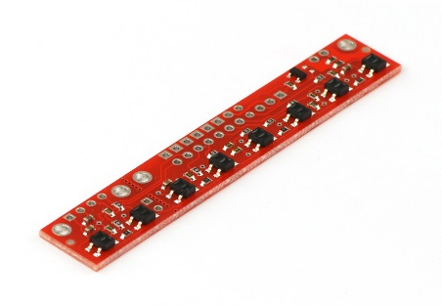
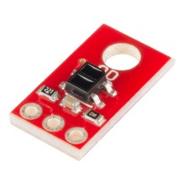
Traditional IRR sensor rows
18 sensors in total:
2 rows of 8
2 single sensors
Implementation:
Robot only ever uses one row of sensors + the two single sensors
When a branch is found, robot turns onto branch facing the appropriate direction
Robot returns to main line without needing to turn around

Slide 21
Alignment and Power Screw Design:
Christopher Lewis

Slide 22
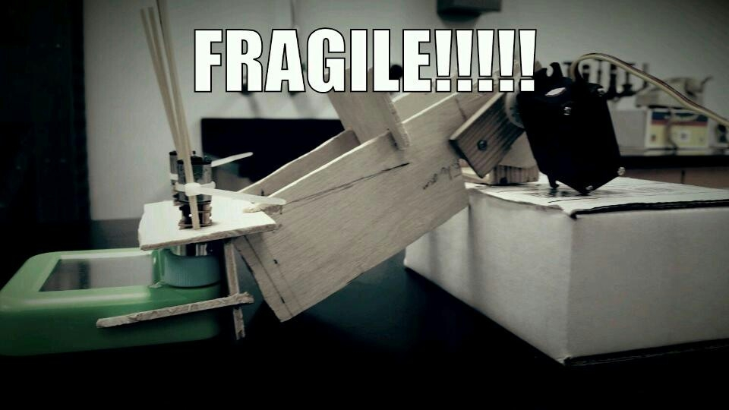
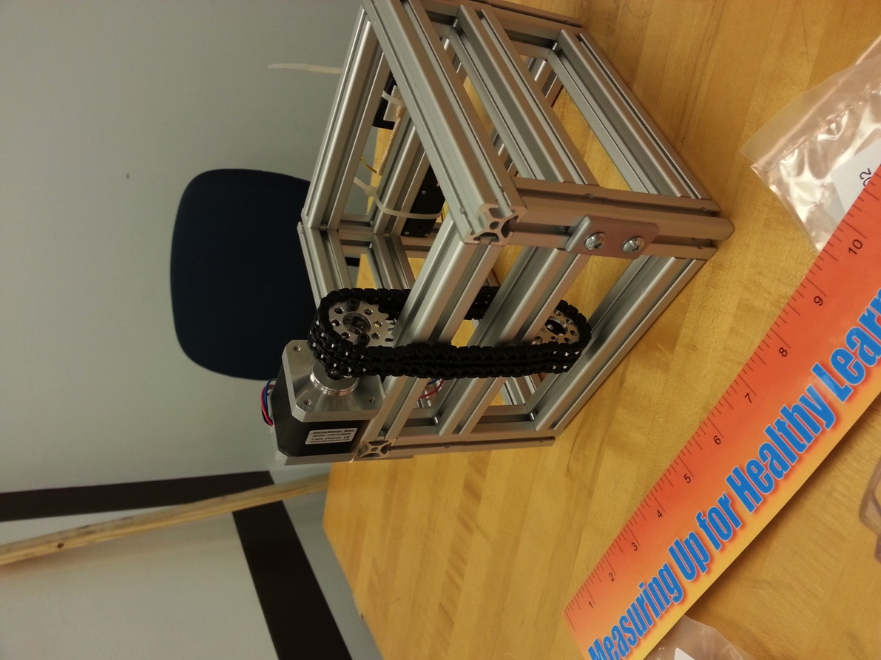
Previous Designs
1st Design: Arm (Etch-a-Sketch)
Lower Arm onto Etch-A-Sketch and Playing Card
Was not able to align or to produce enough force onto the Etch-A-Sketch knobs
2nd Design: Chain Drive
Delrin Chain driven by a Stepper Motor
End-Effector would start on top of robot and flip onto game
Was not able to make a stable attachment onto the chain.

Slide 23
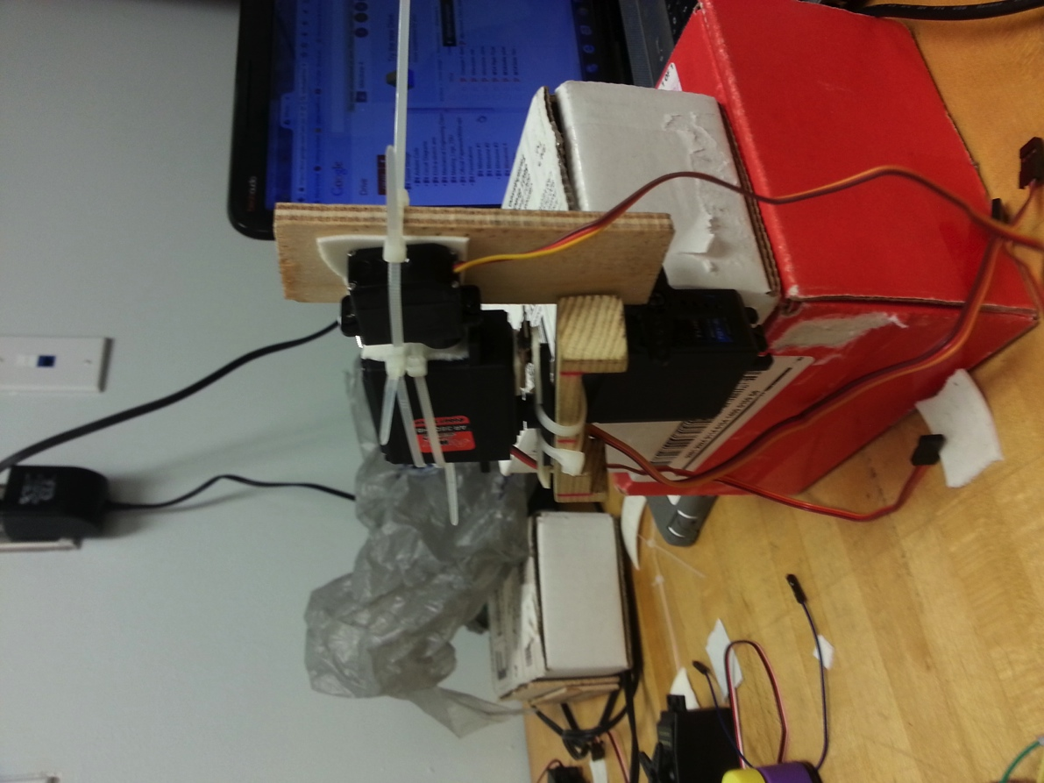
Designs: continued
3rd Design: Servo Arm
Similar to 1st Arm Design, with addition of an “Orientation Servo”
Orientation Servo would be coded to always have the End-Effector angled the correct way.
Took up too much space
Was not stable enough

Slide 24
Final Design (Both Sides):
4th Design: Power Screw
Provides only a Vertical Motion
Great for alignment purposes
More Robust than the Arm and Chain Designs
What was used for both sides of the robot
Used to play all 4 of the games

Slide 25
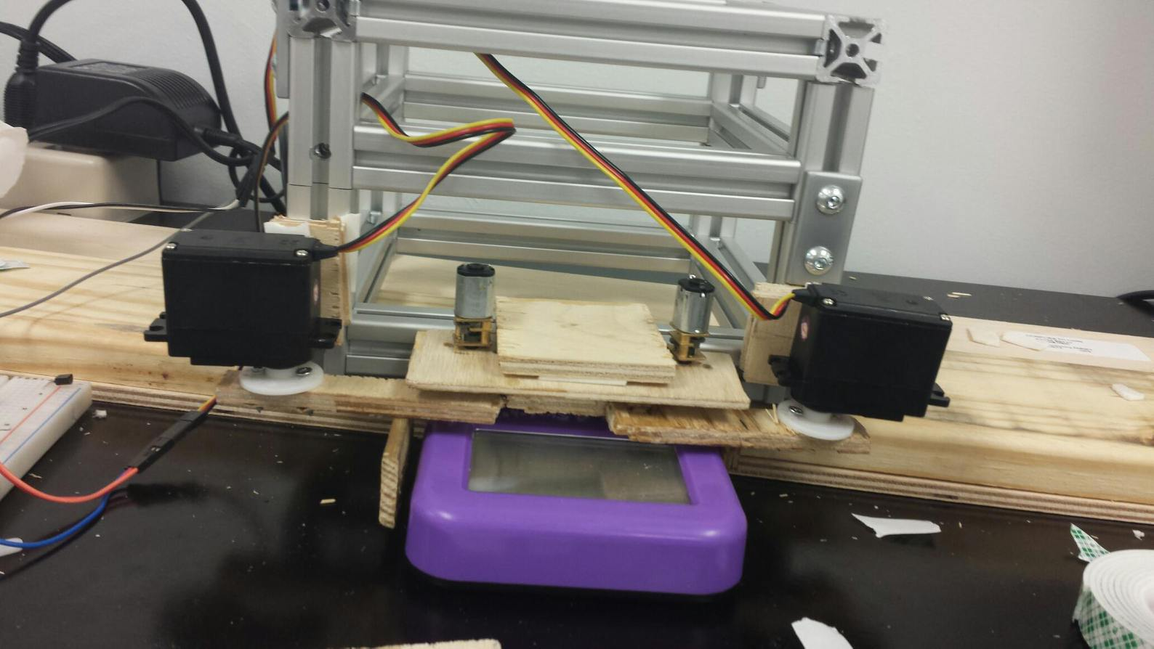
Alignment: Etch-a-Sketch
2 Servo Arms
“Grabs” the knobs of the Etch-a-Sketch
Aligns and holds Etch-a-Sketch in place
Robust, large margin of error for “catching the Etch-a-Sketch

Slide 26
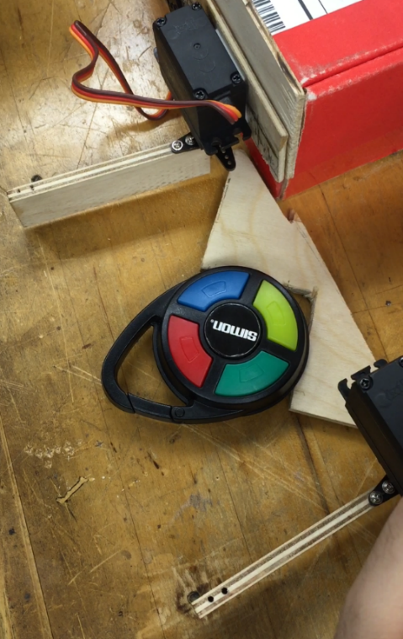
Alignment: Rubik’s Cube/Simon Says
Triangular Frame
Designed to align both the Rubik’s and Simon into the same spot
2 Servo Arms then close, aligning the Simon and holding the Rubix Cube

Slide 27
Card Arm, Photoresistor, Simon Detection
Kurt Marsman

Slide 28
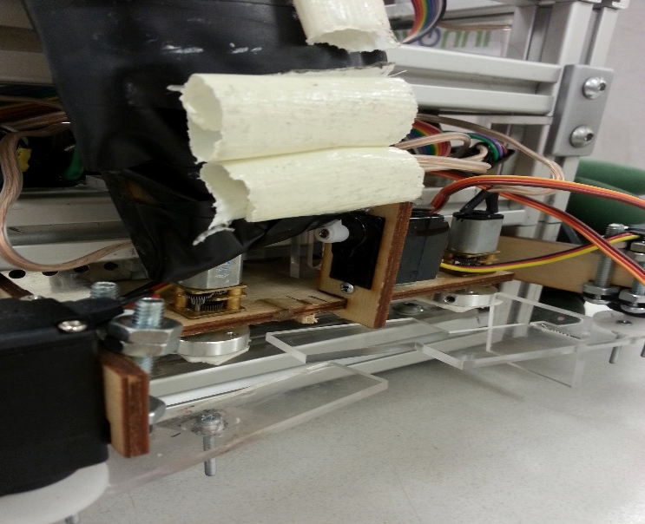
Card Arm
Version 1.0
“Air Bag”
Tape Selection
Operating motion

Slide 29
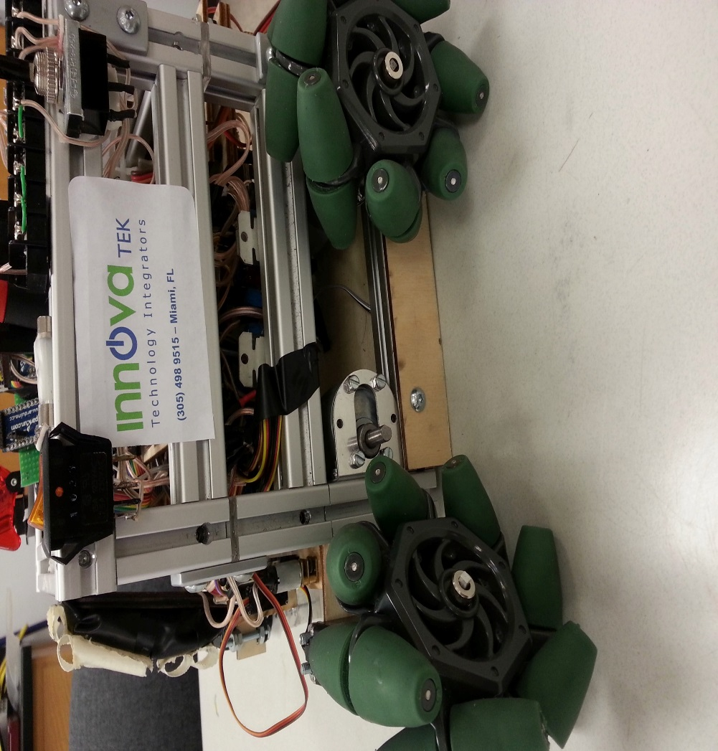
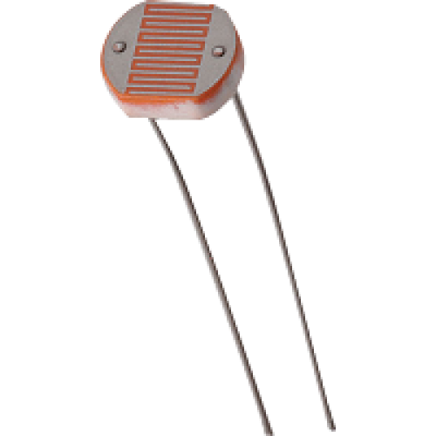
Photoresistor
Initial testing
50k in series with PR
Mounting & Calibration
Side skirts

Slide 30
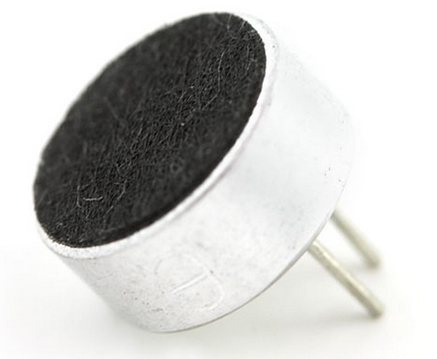
Simon Microphone Circuit
Electret Microphone
A/D Converter

Slide 31
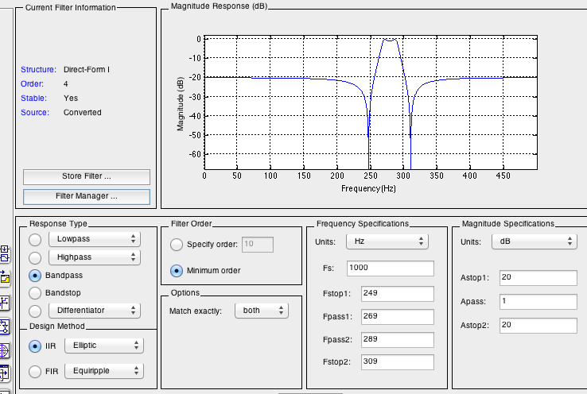
Simon Detection
Bandpass Filters
FDA Tool

Slide 32
Simon Detection continued
Fs = 1kHz
Reliability issues

Slide 33
Etch-a-Sketch and Circuit Board
Donovan Carey

Slide 34
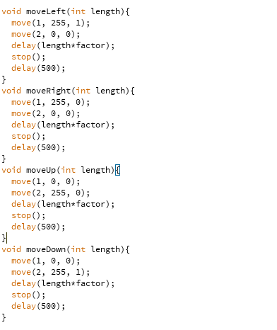
Playing Etch-a-Sketch

Slide 35
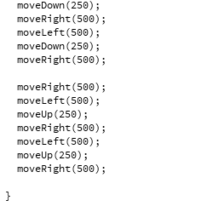
Writing “IEEE”

Slide 36
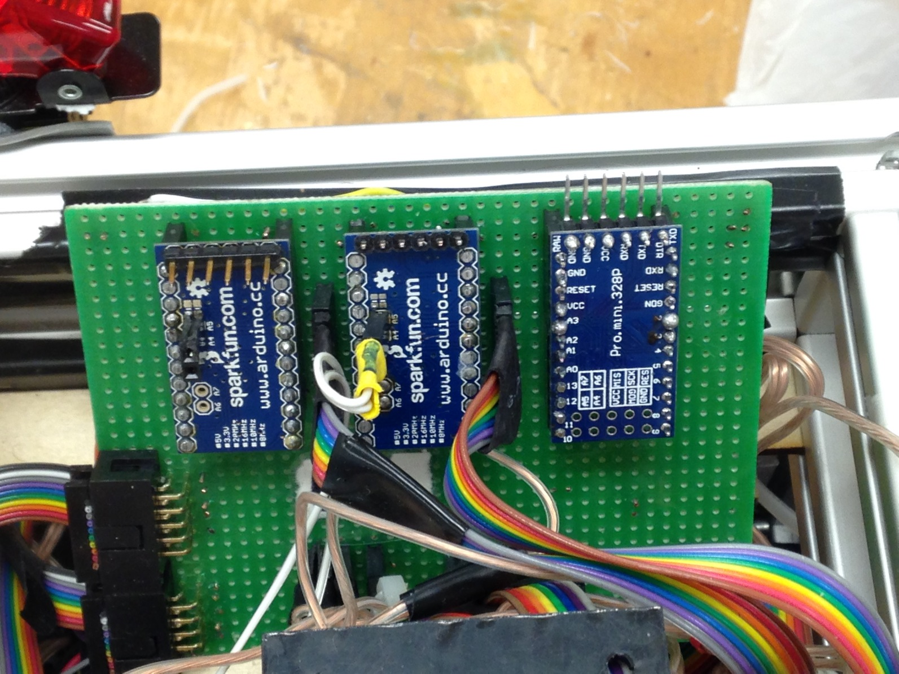
The Circuit Board

Slide 37
Inside the Circuit Board
Why The Circuit Board
Circuit Board Setup
Creates modularity between layers of the chassis
Cleaner wiring mitigates the risk of shorting and faulty wires
Simplifies troubleshooting and debugging of the system
M1: Simon/Rubiks Mini
M2: Line Following Mini
M3: EAS/Card Mini
Ribbon Cable 1: M1 and M3 system components
Ribbon Cable 2: Serial Lines and the 5V and 6V power lines
Ribbon Cables 3 and 4: Line Following Sensors
Ribbon Cable 5: Motor Drivers

Slide 38
Pin Assignments

Slide 39
Rubik’s Cube, Simon Says, and Power
Julian Velasquez

Slide 40
Arm 2: Encoder
With the same necessities as before
IRR sensors were not precise, the servo wouldn’t stop exactly where we wanted
A configuration of 3 bump sensors allowed us to turn the Rubik’s Cube to 180 degrees while also being able to accurately hit any Simon Says button
The reason two bump sensors are placed back to back is because it defines the home position for the manipulator, when both bump sensors change state we know that we are in the home position

Slide 41
Arm 2: Motor
AR-3606HB continuous rotation servo rated for 93oz-in of torque at 6 V
The torque is over-specified for the design but this is because there is no weight or price difference with lower torque motors

Slide 42
Arm 2: Manipulator Prototype
This system allows the inner notch to touch the buttons of the Simon Says game, whereas the outer ends are far enough apart to grab onto and twist the top row of the Rubik’s Cube
Vertical motion (in order to push the Simon buttons or touch the Cube) will be provided by lowering and raising the arm with which the servo is attached to the body of the robot.

Slide 43
Arm 2: Grabber
This system allows some room for error when it comes to alignment and positioning of the robot
The two servos are strong enough to hold the Rubik’s cube as it spins and will move out of the way to allow the Simon Says buttons to be pressed

Slide 44
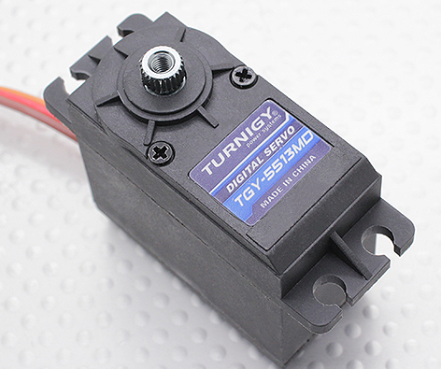
Arm 2: Grabber
Turnigy TGY-5513MD Metal Gear Digital Servo 12kg / 0.18sec / 54.5g
Stall torque (6.0V): 12.25kg.cm (170.15 oz/in)
Servos had to be stronger than the continuous rotation servo in order to properly hold the Rubik’s cube while it spins

Slide 45
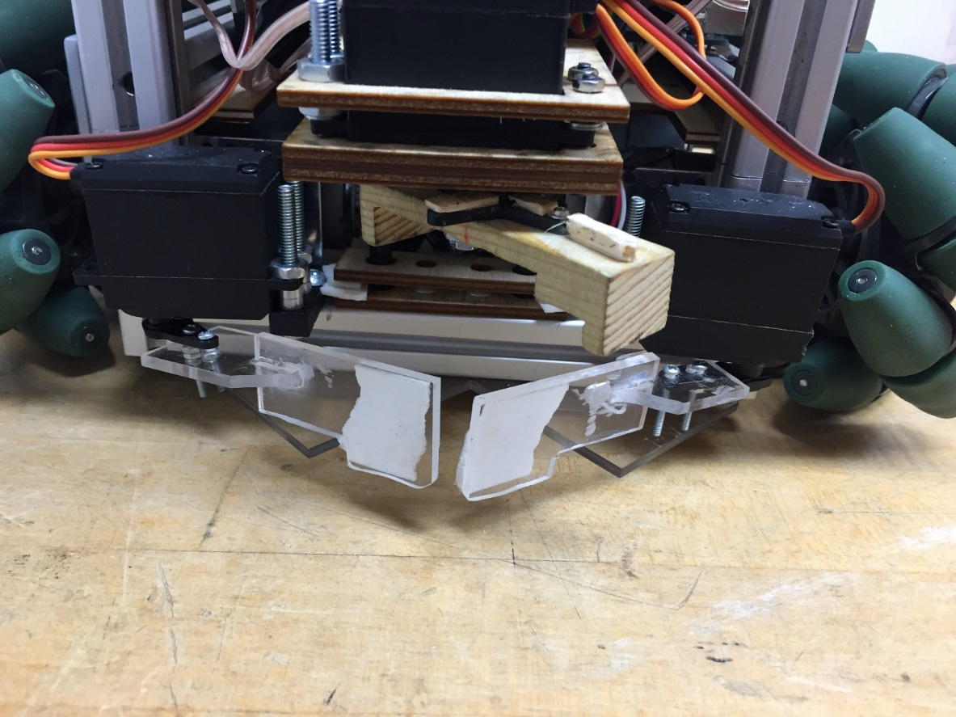
Arm 2: Grabber (Simon Sequence)
Video

Slide 46
Arm 2: Grabber (Rubik’s Sequence)
Video

Slide 47
Battery
The LiPo chosen is a Rhino 2200 mAH 25C LiPo Pack
The battery is composed of 3 cells each of 3.7 V, for a total voltage of 11.1 V
The constant discharge of the battery is 25C with a burst rate of 35C for 15 seconds
The dimensions of the battery are 107x21x34 mm, the weight is 163 g

Slide 48
Power System
Black switch on top of the screen only controls the drive/propulsion of the robot
This was beneficial when debugging and testing, the robot wouldn’t drive erratically
Orange switch on right of picture controlled all the MCUs
This helped us reset the Arduinos between every run
The blue switch at the bottom left of the picture controlled start LED system
When the switch changed states it began to look for a change in the red LED, otherwise the LED could go on and off and the robot will not start

Slide 49
Conclusion
Nils Bjeren

Slide 50
Conclusion
Project was a success
Placed 7th out of 39 teams
Team pioneered certain practices:
A well-organized team should be allowed to start SoutheastCon early
Having a Mechanical Engineering student on the team proved invaluable
The Mechanical Engineering department will, in the future, be willing to contribute more students and money to the project

