Slide 1

Design & Manufacture of Rotorcraft
IME Team#8/ME Team#31
Chabely Amo
Louisny Dufresne
Robert Johnson
Mohammed Nabulsi
Taniwa Ndebele
Victoria Rogers
Kimberlee Steinman
Mitchell Stratton

Slide 2
Team Organization

Slide 3
Milestones for Spring Semester
Analyze Phase:
    Perform ergonomic simulation using Siemens Jack software
    Analyze component characteristics using the eCalc tool
    Perform stress analysis on the whole design
    Perform simulation to make sure the rotorcraft fits the backpack
    Perform power analysis
Design Phase:
    Protocol for the operation of the rotorcraft
    Build the rotorcraft and provide assembly instructions
Verify Phase:
    Compare actual apparatus performance with simulations performed in previous phases
Business Plan:
    Finalize the project and establish a business case.

Slide 4
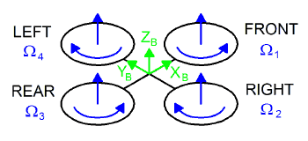
Background
A rotorcraft is a flying machine that uses lift generated by wings called rotor blades that revolve around a mast
Rotary unmanned aerial vehicles often
  fall into one of two classifications:
  High payload capacity but low
    portability
  High portability but a reduced
    payload capacity.
Figure 1. Example of a Quad-rotor [1]

Slide 5
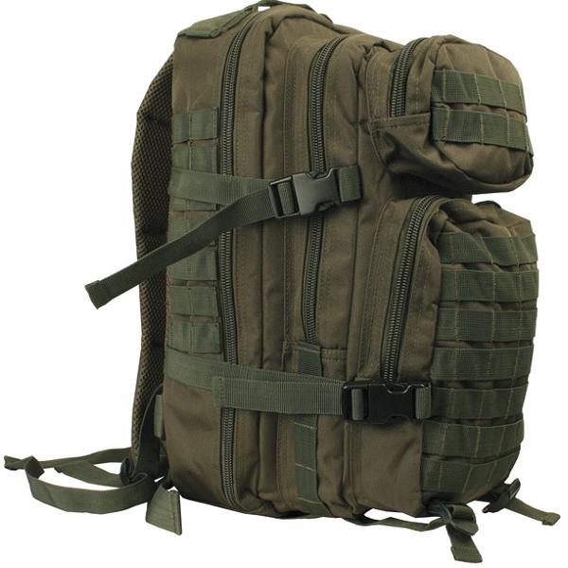
Goal Statement and Objective
Design a rotorcraft that can:
  Fit in a military backpack (23”x14.5”x15”)
  Carry a payload of at least 50 pounds
  Be made with commercial off the shelf (COTS) components
  Travel up to approximately 1 mile
  Be easily maintained and used in the field
Design the manufacturing processes to be used in creating the rotorcraft
Build a prototype of the rotorcraft
State the protocols for the operation and assembly of the rotorcraft.
30 pounds
Figure 2. Military Backpack [2]

Slide 6
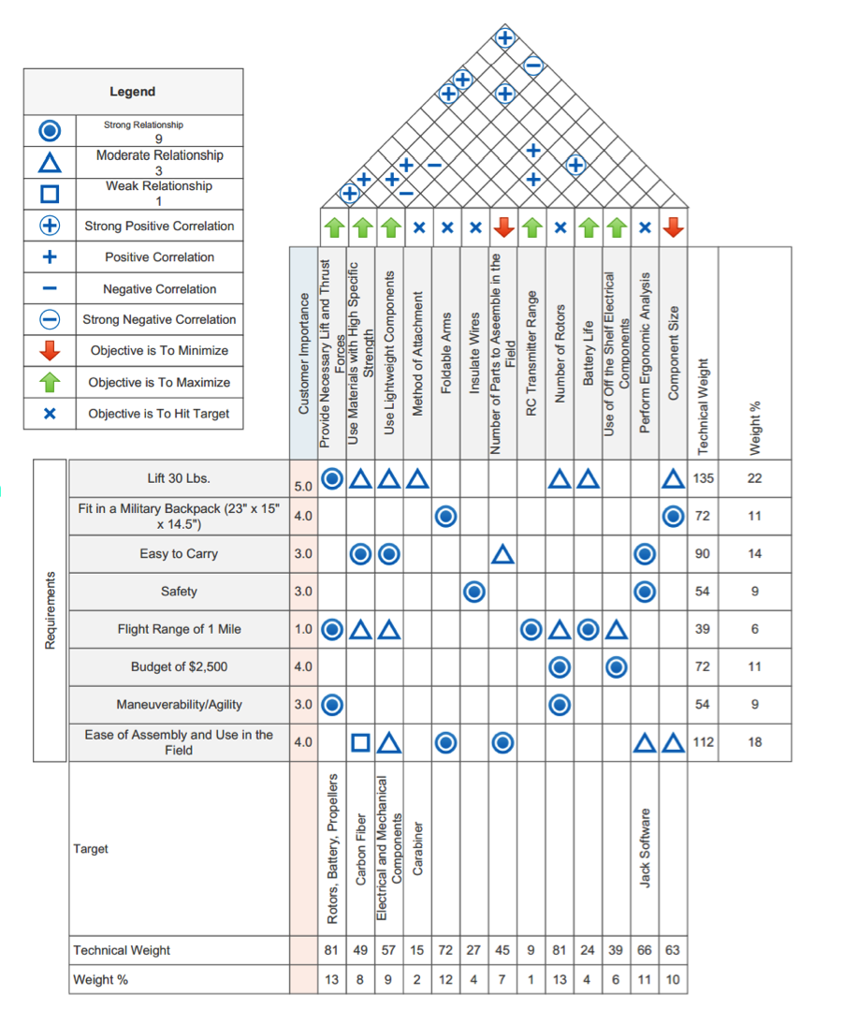
House Of Quality

Slide 7
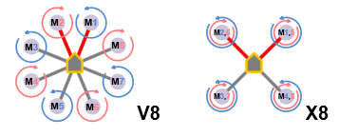
Multi-copter Configuration
Two types:
Coaxial Setup (X8)
  Two engines mounted co-axially on the ends of each boom
  Excellent Lifting Power
  Easier Portability
Radial Setup (V8)
  One engine mounted on the
    end of each boom
Figure 3. Multi-copter Configurations [3]

Slide 8
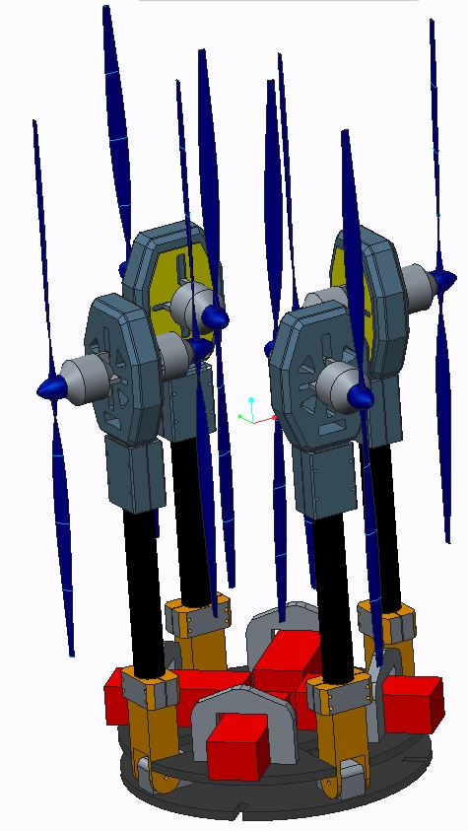
General Design
Motor
Propeller
Motor Mounts
Hinges
Carbon Fiber Arms
Battery
Battery Clamps
Base Plates

Slide 9
Analyze Phase Tool: eCalc Analysis
Provides web-based quality services to calculate evaluate and design electric motor driven systems for remote controlled models
Provides Rotorcraft outcome based on:
  Battery
  Speed Controller
  Motor
  Propeller
Guarantees error margin no greater than ±10%

Slide 10
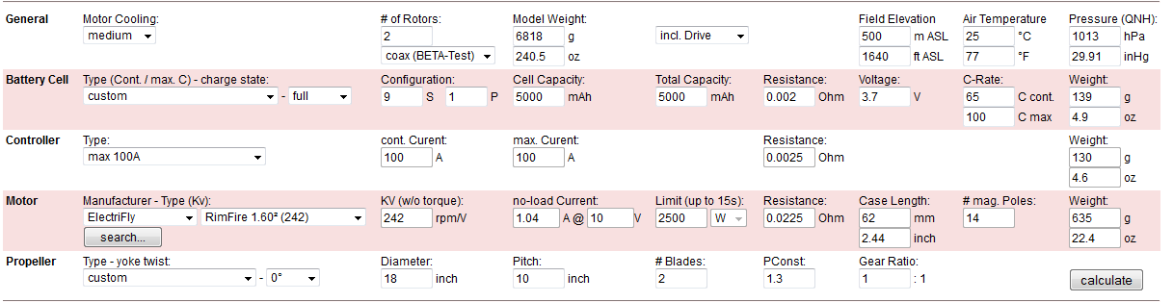
eCalc Multi-Copter Calculator
Table 2. Components in eCalc

Slide 11
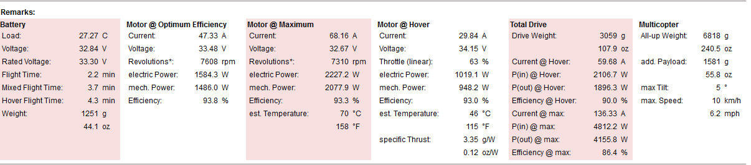
eCalc Multi-Copter Calculator
Table 3. Results in eCalc

Slide 12
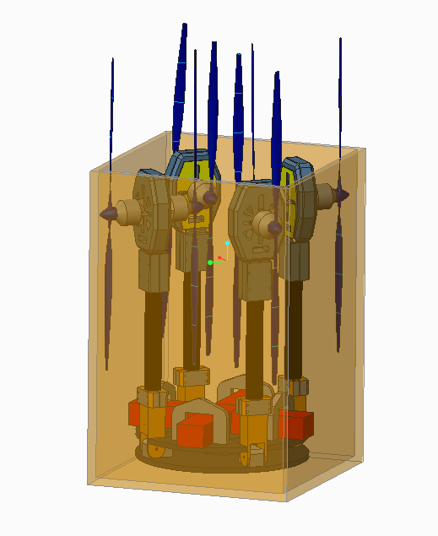
Does it Fit in the Backpack?
6.0”
9.0”
23”
20”
Figure 5. Rotorcraft in backpack

Slide 13
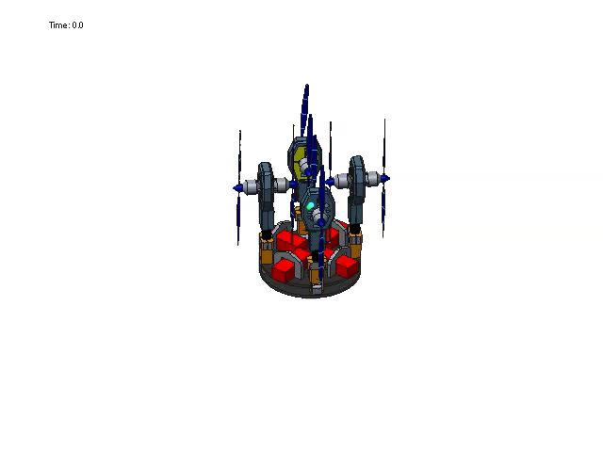
Rotorcraft Simulation

Slide 14
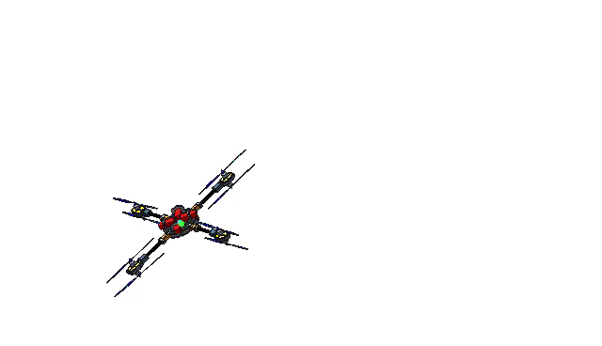
Rotorcraft Simulation

Slide 15
Stress Analysis
Assume arms and base plate will be carbon fiber
Attach 50 pound load to rotorcraft
Team’s analysis shows amount of deformation under load in mm

Slide 16
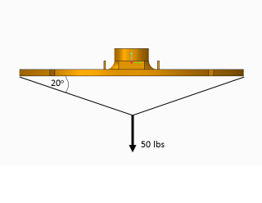
New Attachment Method
Figure 6. New attachment method

Slide 17
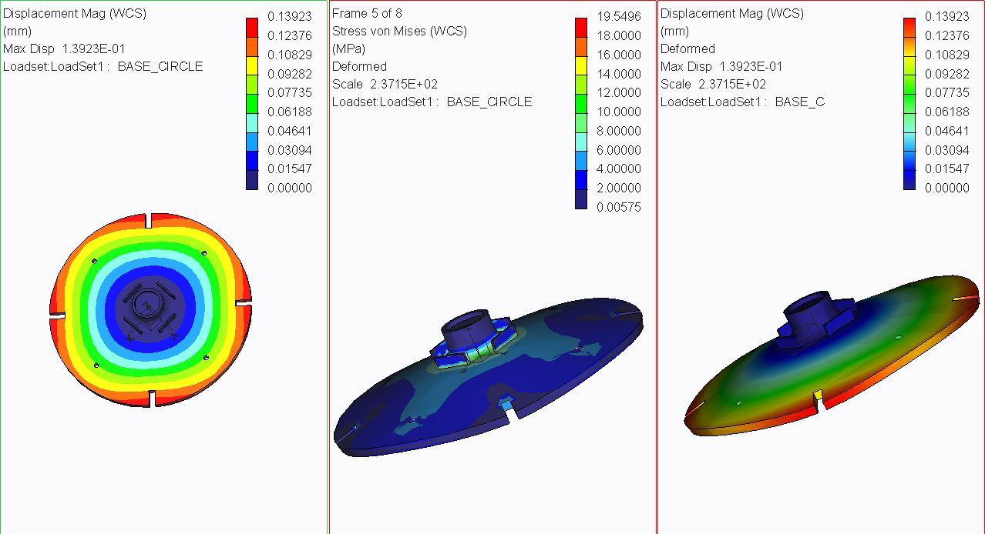
Base Plate Stress Analysis
Figure 7. Base plate stress analysis

Slide 18
Ergonomic Analysis with Jack
Uses pre-built objects and humans called Jack and Jill to simulate a work task and analyze those tasks
Analysis used in this project:
  Timing Report
  Static Strength Prediction (SSP)
  Lower Back Analysis (LBA)

Slide 19
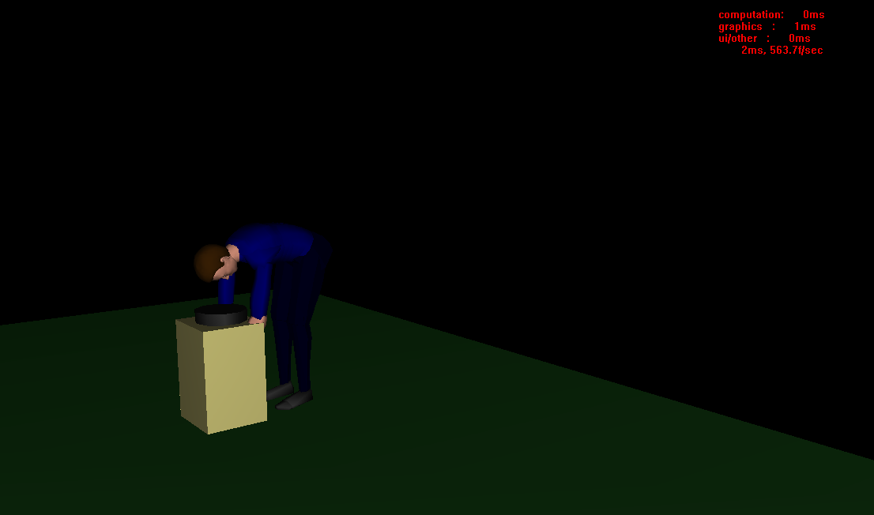
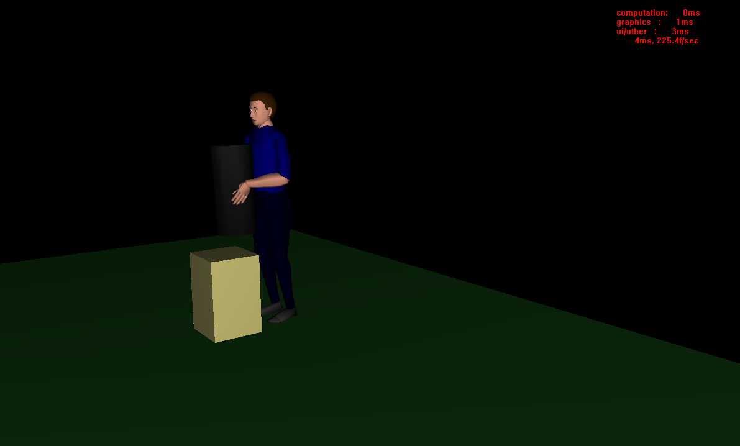
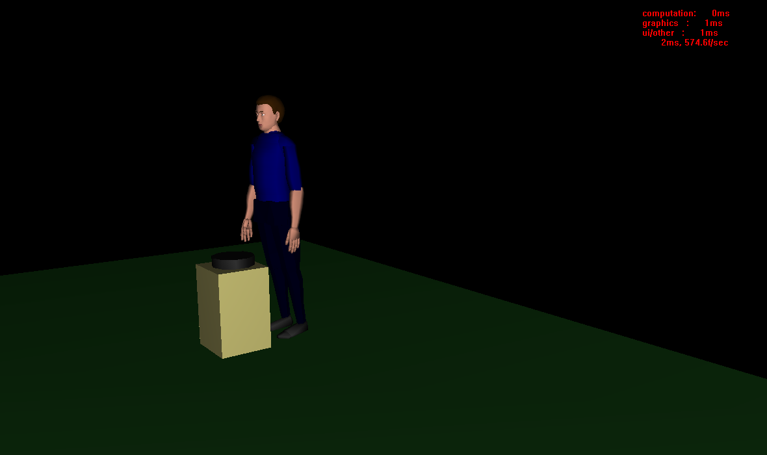
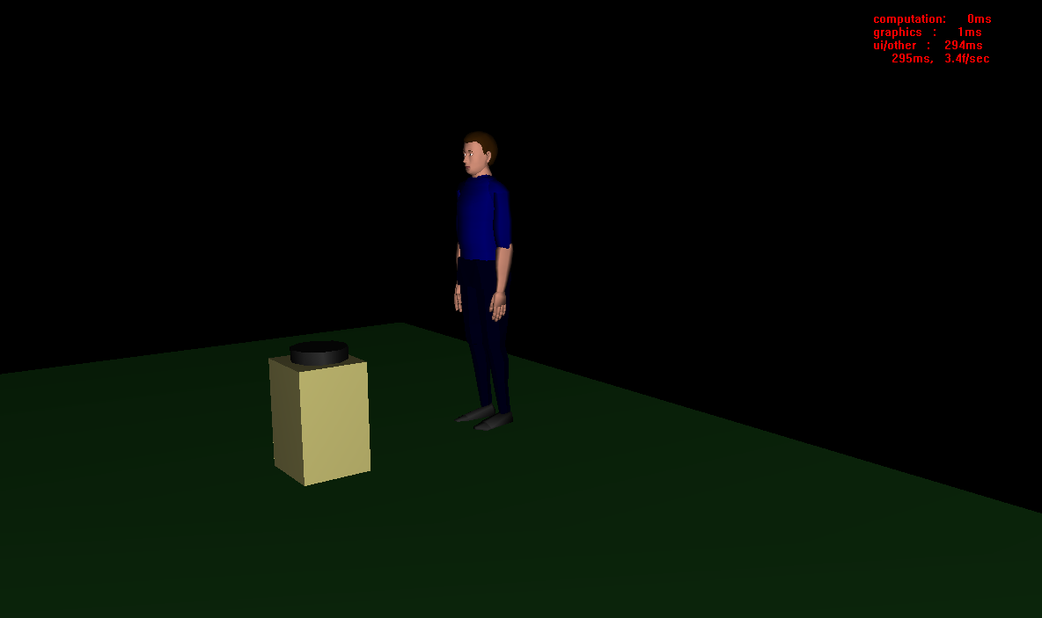
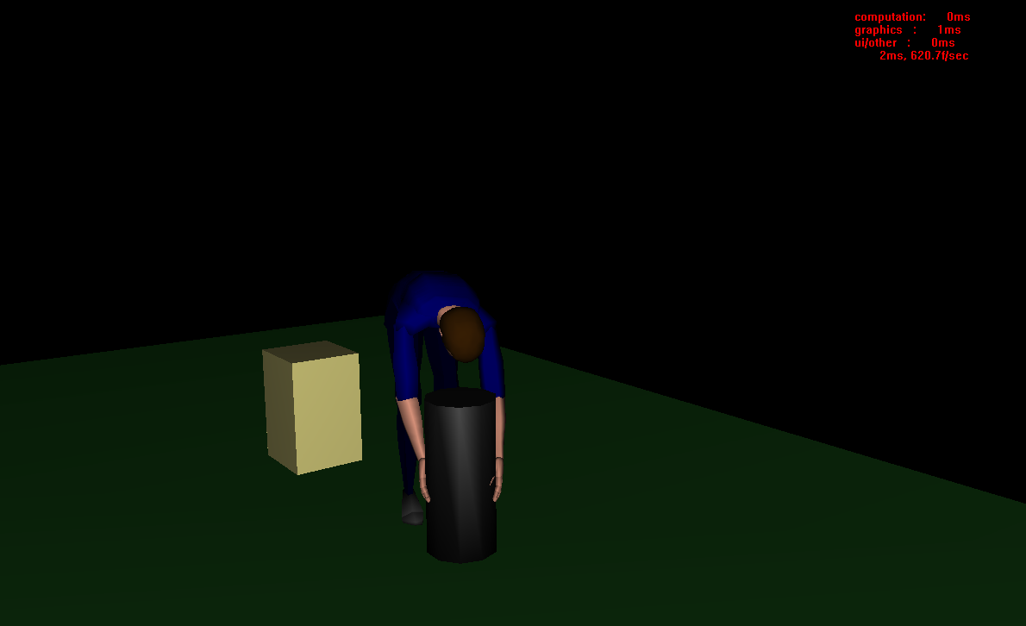
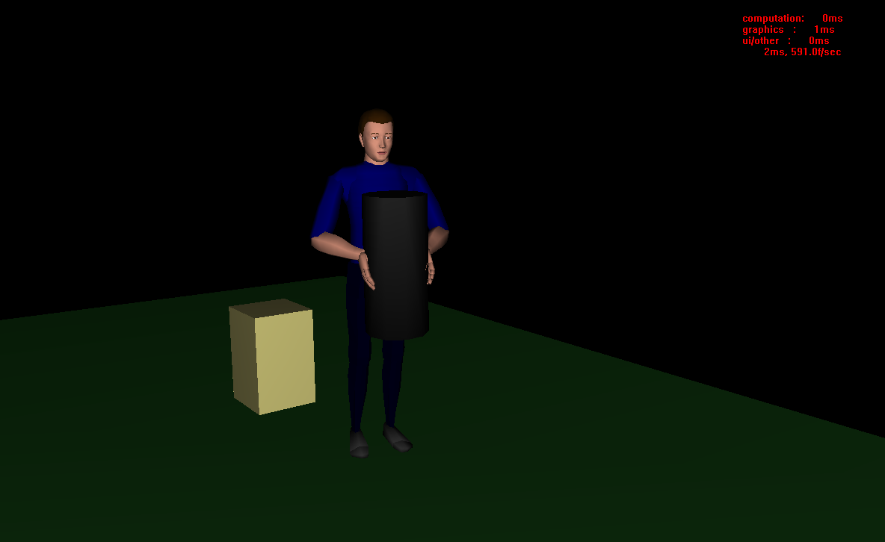
Task Simulation

Slide 20
Timing Report
Maximum: 8.07 seconds
  Grabbing the rotorcraft: 3.15 seconds
  Lifting the rotorcraft out of the backpack and placing it on the ground: 4.92 seconds
Minimum: 3.22 seconds
  Achieved by eliminating or minimizing the Arise From Bend, Walk, and Bend And Reach actions in put_hermes task (4.85 seconds total)

Slide 21
Static Strength Prediction
Analyzes pose requirements individually
Determines which percent of the general population should be capable of posing a certain body part a certain way
Lowest Percent Capable score is 82.72%
Table 3. Percent Capable risk criteria
 | Percent Capable
Low | > 75%
Medium | Between 25% and 75%
High | < 25%

Slide 22
Lower Back Analysis
Analyzes compression and shear forces on lower back
Largest compression force: 2,335 N (time: 3.4 seconds)
Largest shear force: 762 N (time: 3.2 seconds)
Table 4. Compression and AP Shear risk criteria
 | Compression Forces | AP Shear Forces
Low | < 3400 N | < 750 N
Medium | Between 3400 and 6400 N | Between 750 and 1000 N
High | > 6400 N | > 1000 N

Slide 23
Electrical Analysis
Avoid components to be overpowered or underpowered
Currents need to be strong enough for operation
Assure both motors are getting the same amount of power
Implement Multisim software to assist in analysis

Slide 24
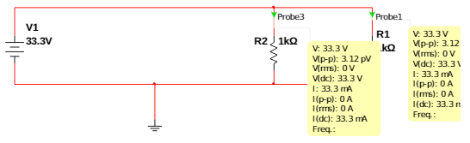
Battery to Motor Power
Maximum voltage of the batteries is 33.3 V
Operating voltage for motors is 33.3 V - 44.4 V
One battery has to power two motors
Resistor values can be swapped out to change the amount of current supplied to the motors
Figure 8. Battery to motor circuit diagram

Slide 25
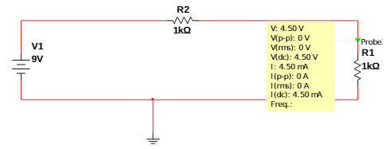
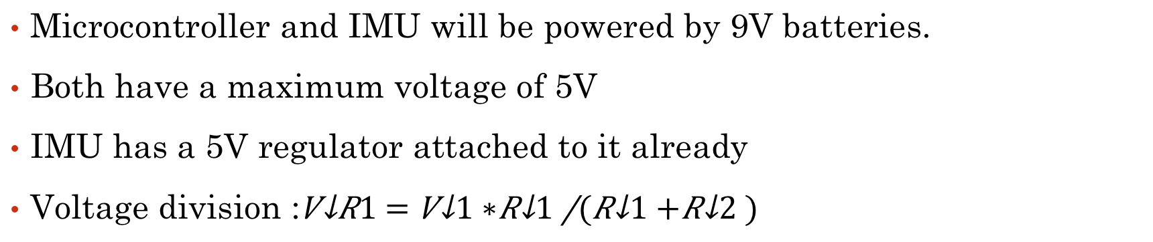
Microcontroller/IMU Sensor Power
Microcontroller and IMU will be powered by 9V batteries.
Both have a maximum voltage of 5V
IMU has a 5V regulator attached to it already
Voltage division :
Figure 9. Electrical components circuit diagram

Slide 26
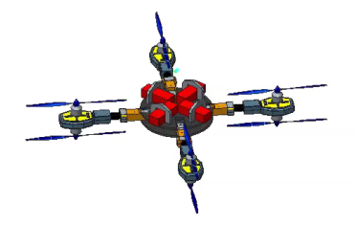
Spatial Analysis
Batteries will be attached to the baseplate
Wires and connections from the batteries to the motors will run along the arms of the craft
Must make sure there is enough slack for when it folds
Microcontroller and IMU will be inside base of the craft
Figure 10. Rotorcraft with arms unfolded

Slide 27
Ordering and Receiving Parts
Parts Ordered | Expected
RimFire 1.60 | ✓
With 2:1 Ratio Slow Epoxy Hardener (32 oz.) | ✓
High-Strength Carbon Fiber Tube | ✓
PVA Release Film (1 Gal) | 1 Weeks
85A Brushless Programmable ESC | 2-4 Weeks
18x10 APC Electric Prop | 2-4 Weeks
Arduino Leonardo with headers | 2-4 Weeks
MOTOR MOUNT 33mm BOOM HEAVY LIFT COAX | 2-4 Weeks
5000mAh 9-Cell/9S 33.3V G8 Performance Pro 45C LiPo | 4 Weeks

Slide 28
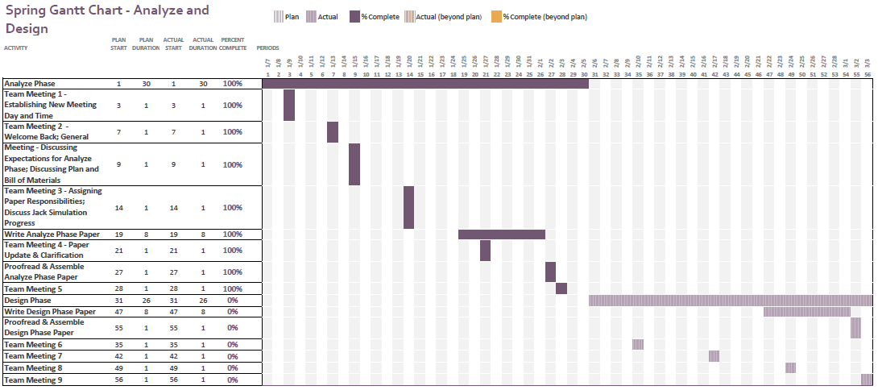
Schedule: Gantt Chart
Table 5. Partial Gantt Chart

Slide 29
Conclusion
Objective:
  Design and Manufacture a Rotorcraft that can:
    Fit in a military backpack (23x14.5x15)
    Can carry a payload of at least 30 pounds
    Made with COTS components (off the shelf)
    Has a range of approximately 1 mile
    Easy to maintain and use in the field
What’s Next:
    Design Phase

Slide 30
References
[1] "FlightGear Forum • View Topic - Four Rotor Helicopter." FlightGear Forum • View Topic - Four Rotor Helicopter. PhpBB Group, n.d. Web. 02 Dec. 2014.
[2] "SMALL MOLLE ASSAULT BACKPACK MILITARY RUCKSACK ARMY NEW." eBay. N.p., n.d. Web. 22 Oct. 2014. <http://www.ebay.com/itm/SMALL-MOLLE-ASSAULT-BACKPACK-MILITARY-RUCKSACK-ARMY-NEW-/170555911038>.
[3] "Multi-Rotor Frame Configurations - CopterCraft.com." CopterCraftcom RSS2. Web. 30 Nov. 2014. <http://www.coptercraft.com/multirotor-frame-configurations/#!prettyPhoto>.
[4] "Power 110 Brushless Outrunner Motor, 295Kv." (EFLM4110A): E-flite. Web. 30 Nov. 2014. <http://www.e-fliterc.com/Products/Default.aspx?ProdID=EFLM4110A>.
[5] "Power 360 Brushless Outrunner Motor, 180Kv." (EFLM4360A): E-flite. Web. 30 Nov. 2014. <http://www.e-fliterc.com/Products/Default.aspx?ProdID=EFLM4360A>.
[6] "Power 52 Brushless Outrunner Motor, 590Kv." (EFLM4052A): E-flite. Web. 30 Nov. 2014. <http://www.e-fliterc.com/Products/Default.aspx?ProdID=EFLM4052A>.
[7] "Lithium Polymer Battery." Wikipedia. Wikimedia Foundation, 29 Nov. 2014. Web. 30 Nov. 2014. <http://en.wikipedia.org/wiki/Lithium_polymer_battery>.
[8] "Pulse Battery." Pulse Battery. Web. 30 Nov. 2014. <http://pulsebattery.com/products_new.php?page=4>.
[9] "Thunder Power RC G8 Pro Force 70C 5000mAh 9-Cell/9S 33.3V LiPo Battery FREE SHIPPING SKU: TP5000-9SPF70." RCToyscom New Products. Web. 30 Nov. 2014. <http://www.rctoys.com/rc-toys-and-parts/TP5000-9SPF70/RC-PARTS-THUNDER-POWER-9-CELL-LITHIUM-BATTERIES.html>.
[10] "APC APCE-18X10, APCE 18X10, Accessories." APC APCE-18X10. Web. 30 Nov. 2014. <https://www.aero-model.com/1_3_69/Accessories_APC-18x10-E-Prop/APCE-18X10.html>.
[11] "APC APCE-24X12, APCE 18X10, Accessories." APC APCE-18X10. Web. 30 Nov. 2014. <https://www.aero-model.com/1_3_69/Accessories_APC-18x10-E-Prop/APCE-18X10.html>.
[12] "USA DEALS." 2Pcs 16.5 X 10 Black Plastic Folding Propeller Blade for RC Helicopter. Web. 30 Nov. 2014. <http://findusadeals.com/deals/B00KHUVK20.html>.
[13] "How To Build A Quadcopter." THE WORLD FROM MY POINT OF VIEW. N.p., n.d. Web. 22 Oct. 2014. <http://akashstevekhanna.wordpress.com/2014/03/01/2899/>.

Slide 31


