Slide 1


Design & Manufacture of a Rotorcraft
FAMU-FSU College of Engineering
Chabely Amo, Louisny Dufresne, Robert Johnson, Mohammed Nabulsi, Taniwa Ndebele, Victoria Rogers, Kimberlee Steinman, Mitchell Stratton
IME #8/ME #31 Louisny Dufresne

Slide 2
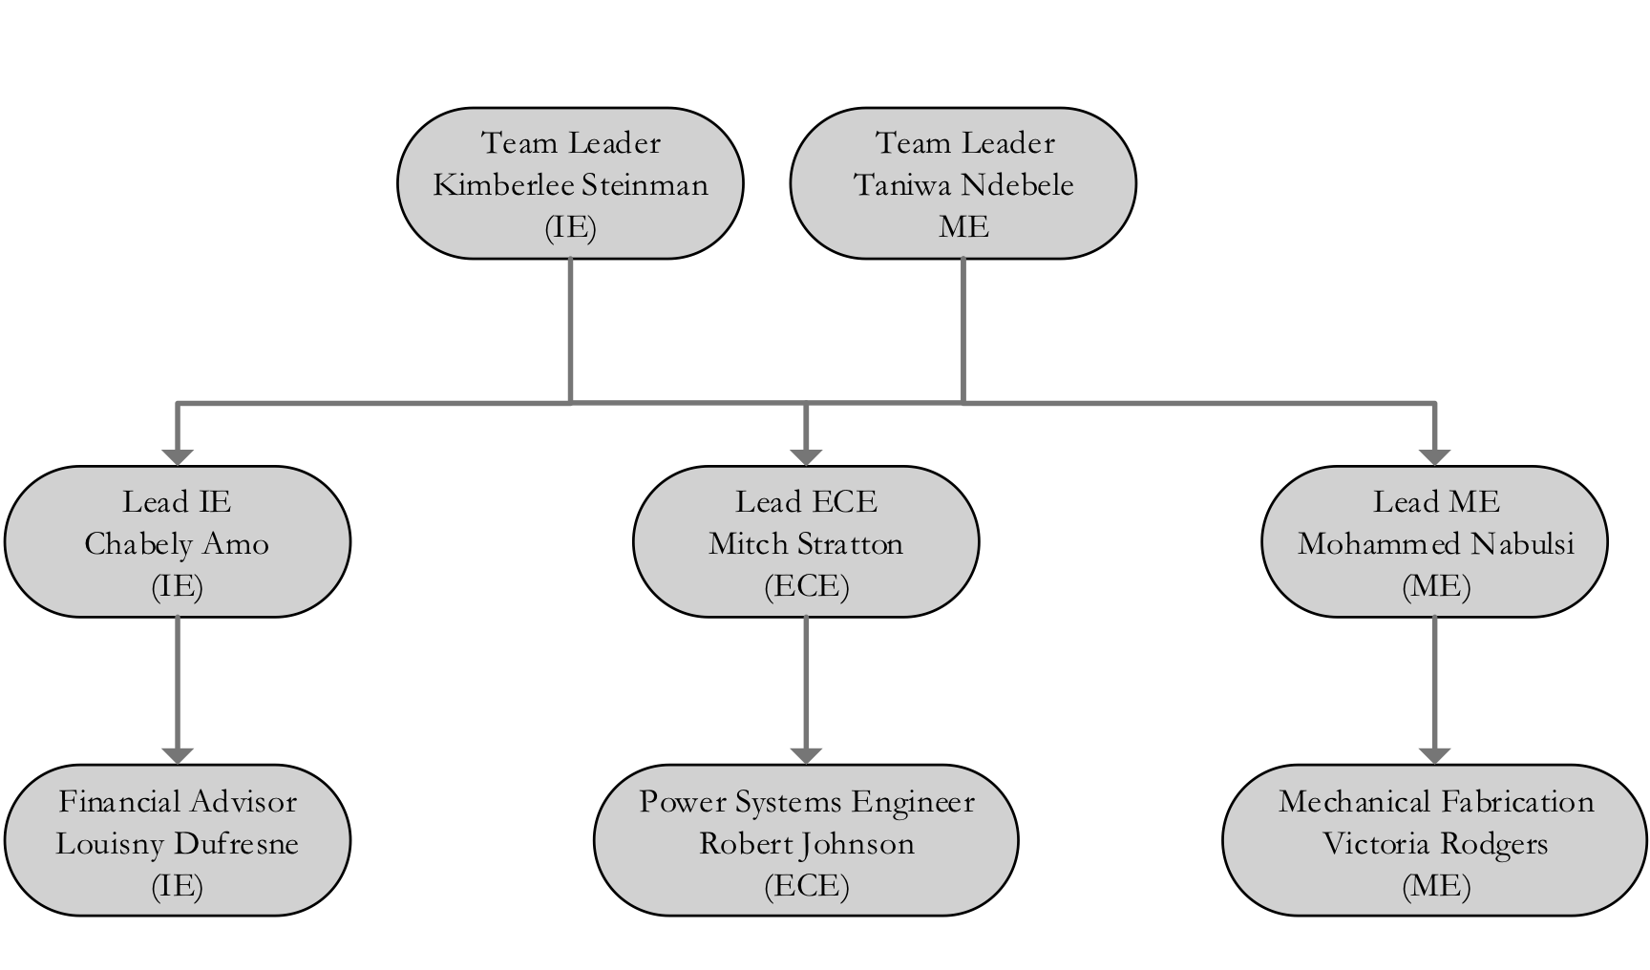
Team Organization
IME #8/ME #31 Louisny Dufresne

Slide 3

Presentation Outline
Introduction
Background
Goal Statement and Objectives
Rotorcraft Design
Rotorcraft Components
Ergonomic Analysis with Jack
Rotorcraft Assembly
Rotorcraft Business Analysis
Future Outlook
Conclusion
Acknowledgments
References
IME #8/ME #31 Louisny Dufresne

Slide 4
Introduction
The sponsor of this project is the U.S. Air Force
Why is a rotorcraft useful in military applications?
  Can go into high risk environments, granting some safety to human soldiers
  Replacing a rotorcraft is less expensive and less tragic than replacing a soldier
Most useful for Air Force: a rotorcraft with both high portability and high payload capacity
The team followed the DMADV (Define, Measure, Analyze, Design, Verify) Six-Sigma process to complete the project
IME #8/ME #31 Taniwa Ndebele

Slide 5
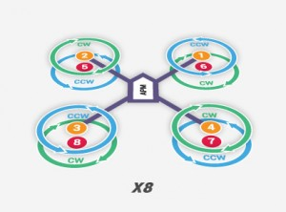
Background
A rotorcraft is a flying machine that uses lift generated by wings called rotor
blades that revolve around a mast
Rotary unmanned aerial vehicles often
  fall into one of two classifications:
  High payload capacity but low
  portability
  High portability but a reduced
    payload capacity.
Figure 1. Example of a Rotorcraft [1]
IME #8/ME #31 Taniwa Ndebele

Slide 6
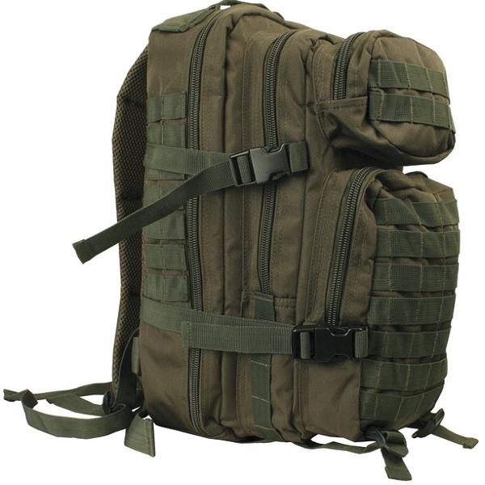
Goal Statement and Objective
The project is sponsored by the US Air force, the requirements are as follows:
  Design a rotorcraft that can:
    Fit in a military backpack (23”x14.5”x15”)
    Carry a payload of at least 30 pounds
    Be made with commercial off the shelf (COTS) components
    Travel up to approximately 1 mile
    Be easily maintained and used in the field
  Design the manufacturing processes to be used in creating the rotorcraft
  Build a prototype of the rotorcraft
  State the protocols for the operation and assembly of the rotorcraft
Figure 2. Military Backpack [2]
IME #8/ME #31 Taniwa Ndebele

Slide 7
Rotorcraft Design
IME #8/ME #31 Chabely Amo

Slide 8
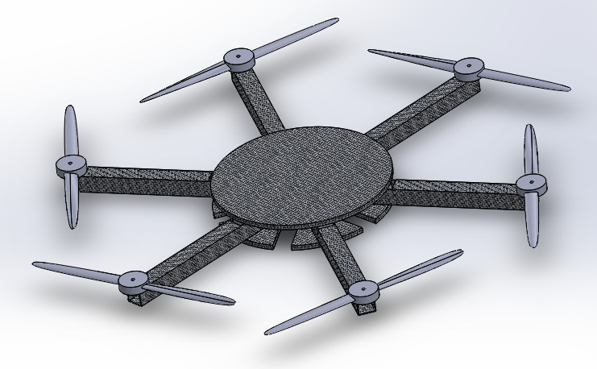
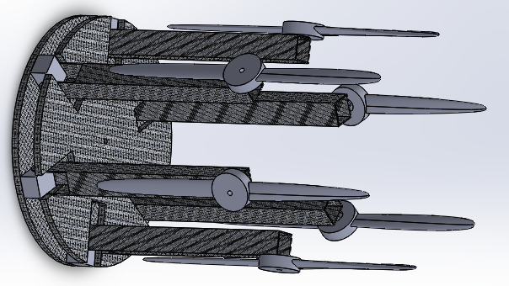
Previous Work
Design proposed by: Intern Cameron Alexander
Hexacopter configuration.
Figure 3. Deployed View of Cameron’s Design
Figure 4. Collapsed View of Cameron’s Design
IME #8/ME #31 Chabely Amo

Slide 9
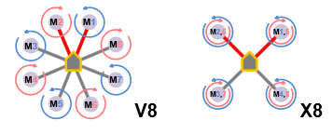
Rotorcraft Configurations
Two types:
Coaxial Setup (X8)
  Two engines mounted co-axially on the ends of each boom
  Excellent Lifting Power
  Easier Portability
Radial Setup (V8)
  One engine mounted on the
    end of each boom
Figure 5. Multi-copter Configurations [3]
IME #8/ME #31 Chabely Amo

Slide 10
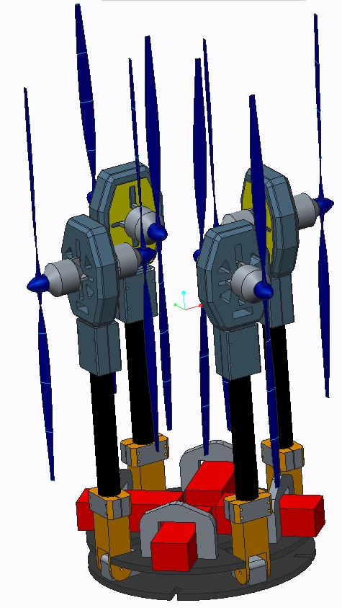
Team General Design
Motor
Propeller
Motor Mounts
Hinges
Carbon Fiber Arms
Battery
Battery Clamps
Base Plates
IME #8/ME #31 Chabely Amo

Slide 11
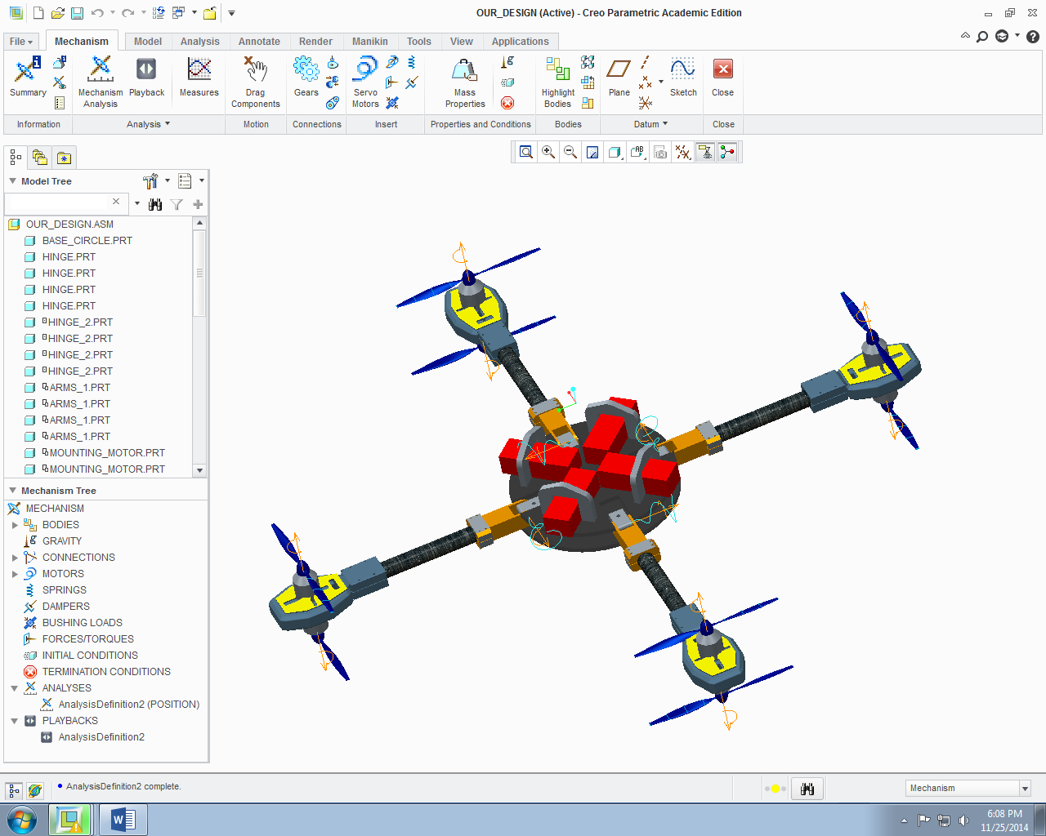
Team General Design – Deployed View
Thrust
Thrust
Generates 15 lbs. of Thrust per Arm
Rotors Spin at 7181 RPM per Arm
Thrust
Thrust
IME #8/ME #31 Chabely Amo

Slide 12
Rotorcraft Components
IME #8/ME #31 Mohammed Nabulsi

Slide 13
Analysis Tool eCalc
Provides web-based quality services to calculate evaluate and design electric motor driven systems for remote controlled models
Provides Rotorcraft outcome based on:
  Battery
  Speed Controller
  Motor
  Propeller
Guarantees error margin no greater than ±10%
IME #8/ME #31 Mohammed Nabulsi

Slide 14
Essential Components Chosen:
Thunder Power Lithium Polymer Battery
Electronic Speed Controller
Electrifly Rimfire 1.60 Motor
Zinger Wood Propeller 18”x 10”
IME #8/ME #31 Mohammed Nabulsi

Slide 15
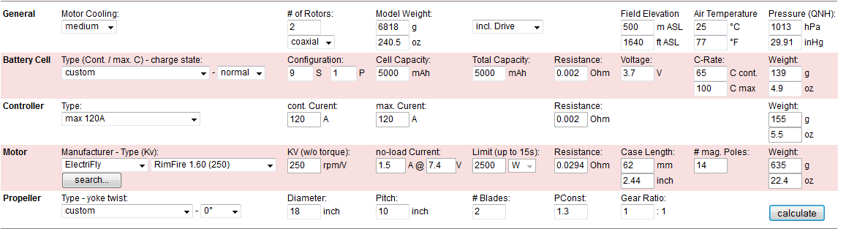
eCalc Rotorcraft Calculator Input:
IME #8/ME #31 Mohammed Nabulsi

Slide 16
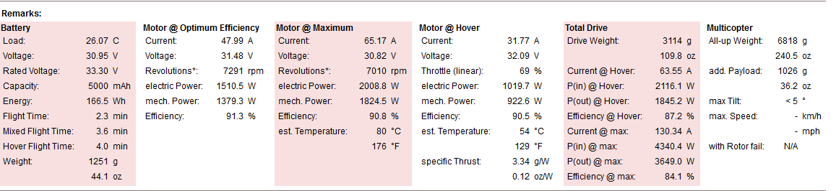
eCalc Rotorcraft Calculator Output:
IME #8/ME #31 Mohammed Nabulsi

Slide 17
Essential Components Chosen
Spektrum ar610 Receiver
Spektrum DX5e Controller
cc3d Flight Controller
IME #8/ME #31 Mitchell Stratton

Slide 18
Manufacture of Top Plate and Base Plate
Carbon Fiber, Vinyl Ester Resin, and Balsa Wood Composite
Final Base Plate
IME #8/ME #31 Kimberlee Steinman

Slide 19
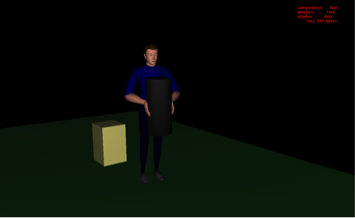
Ergonomic Analysis with Jack
Uses pre-built objects and humans called Jack and Jill to simulate a work task and analyze those tasks
Analysis used in this project:
  Timing Report
    Task should take between 3s - 8s to complete
  Static Strength Prediction (SSP)
    82.72% of population can complete task
  Lower Back Analysis (LBA)
    Task is categorized as a low risk for back injury
IME #8/ME #31 Kimberlee Steinman

Slide 20
Rotorcraft Assembly
IME #8/ME #31 Taniwa Ndebele

Slide 21
Rotorcraft Frame Assembly
Tighten Down Corner Braces
Insert Pins
Insert Safety Mechanism for Pins
IME #8/ME #31 Taniwa Ndebele

Slide 22
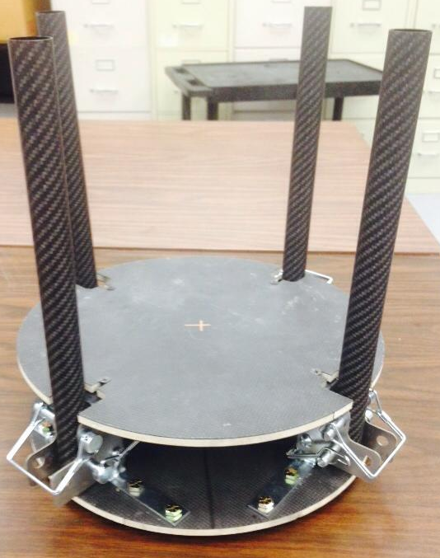
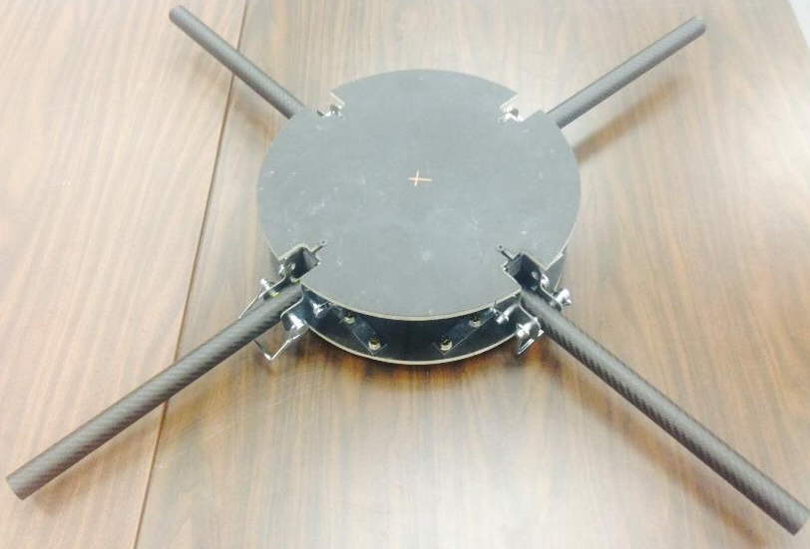
Rotorcraft Prototype
Figure 6. Collapsed View of Team’s Prototype
Figure 7. Deployed View of Team’s Prototype
IME #8/ME #31 Taniwa Ndebele
Notes:
Could go after mechanical assembly also

Slide 23
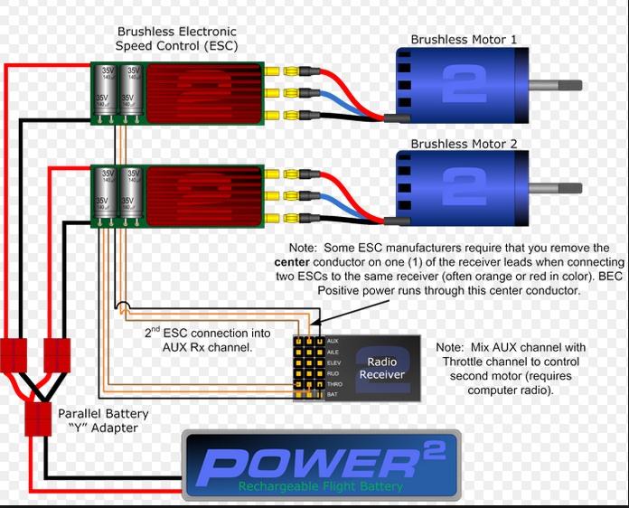
Electrical Assembly
IME #8/ME #31 Robert Johnson

Slide 24
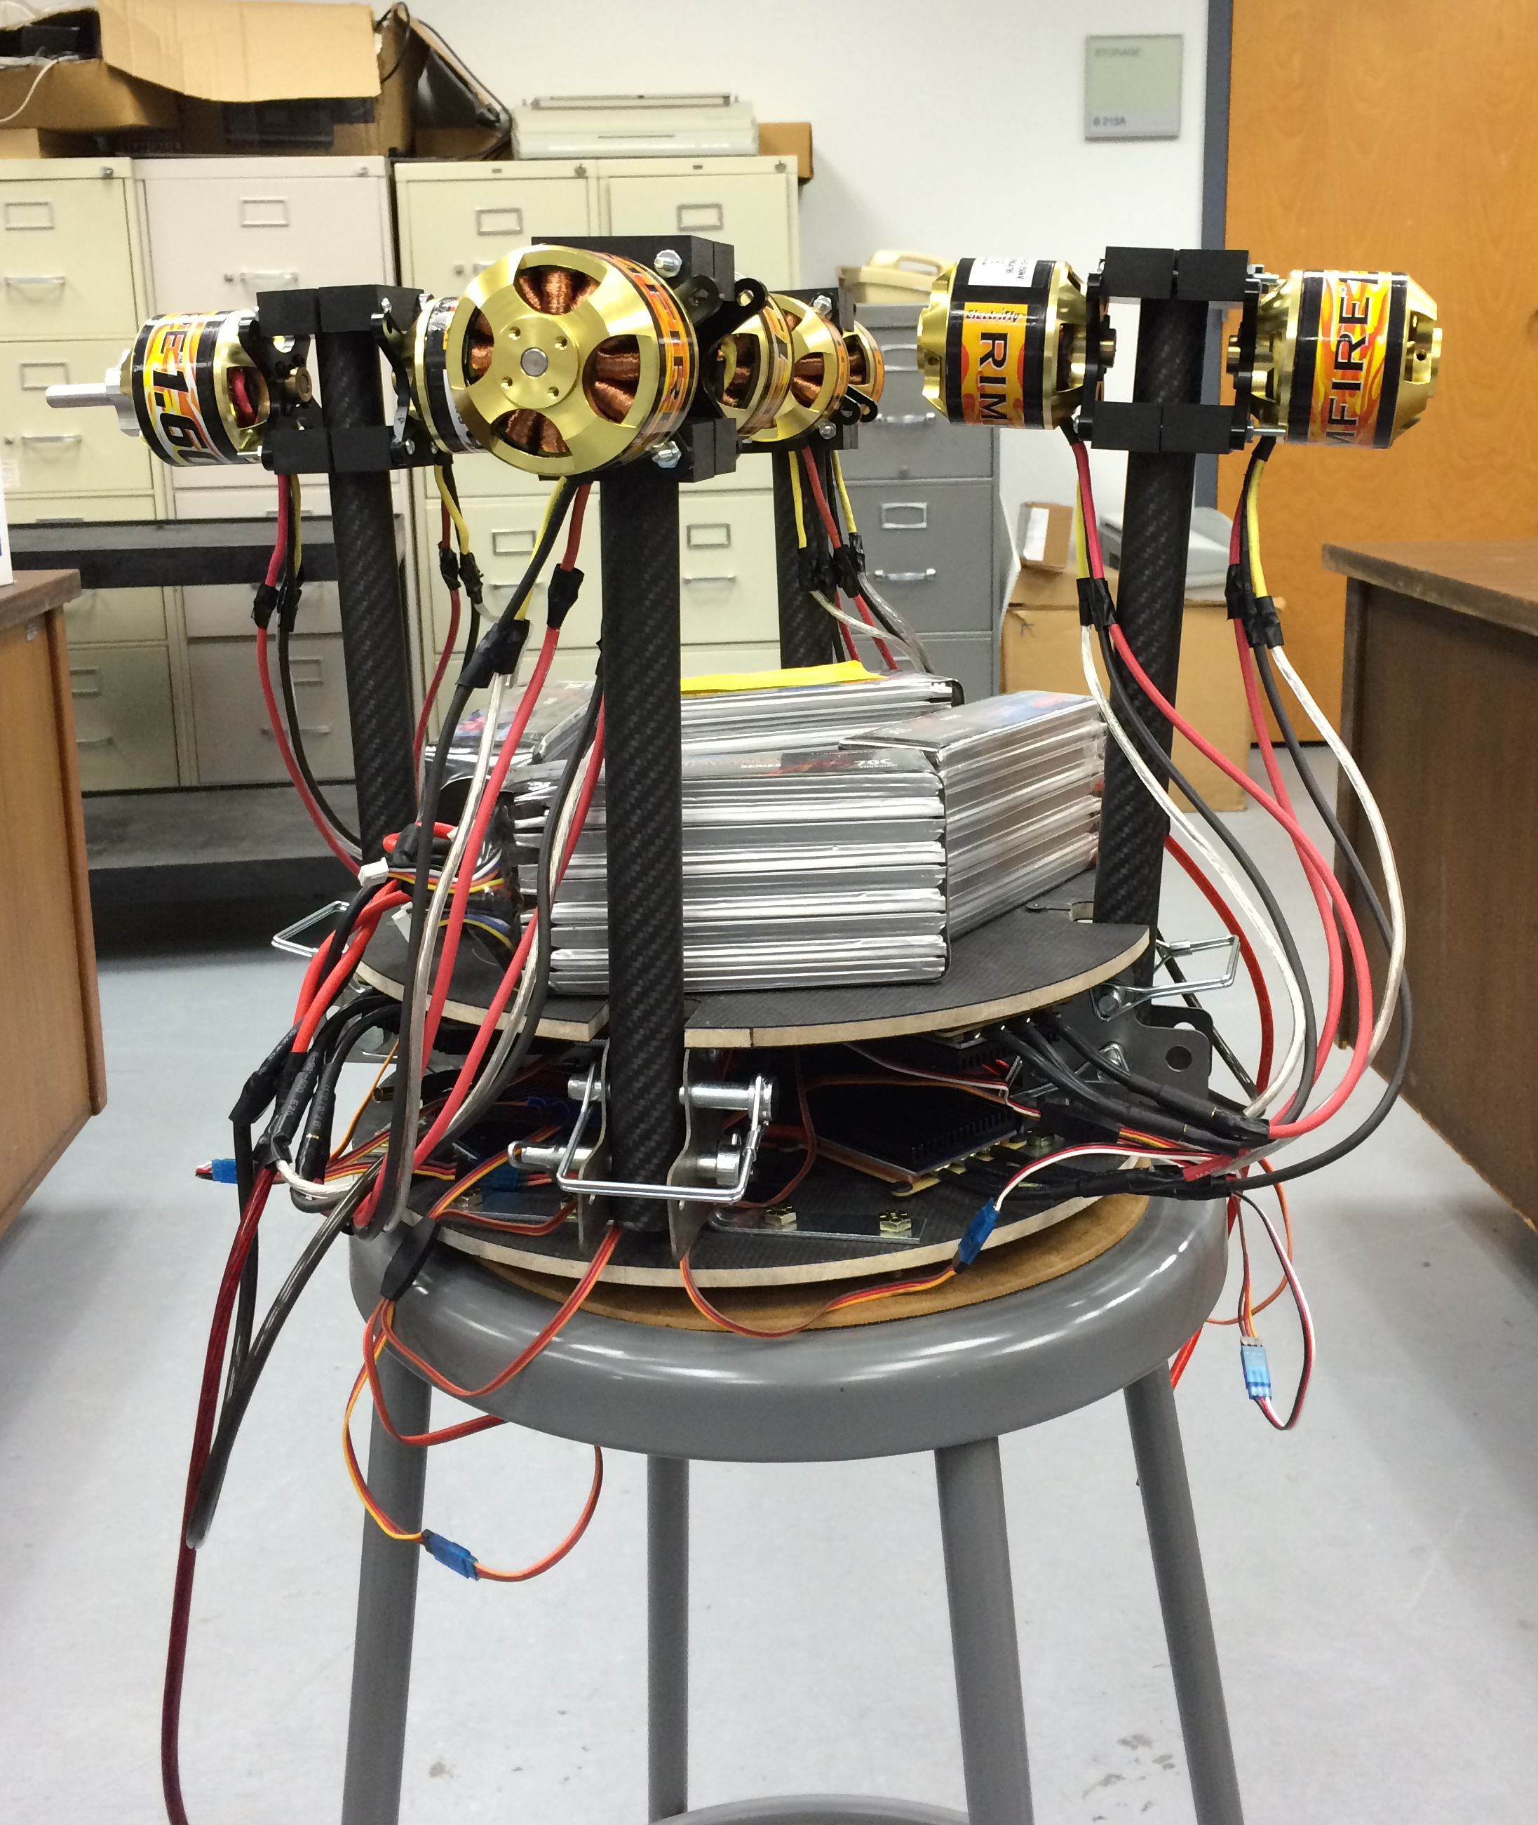
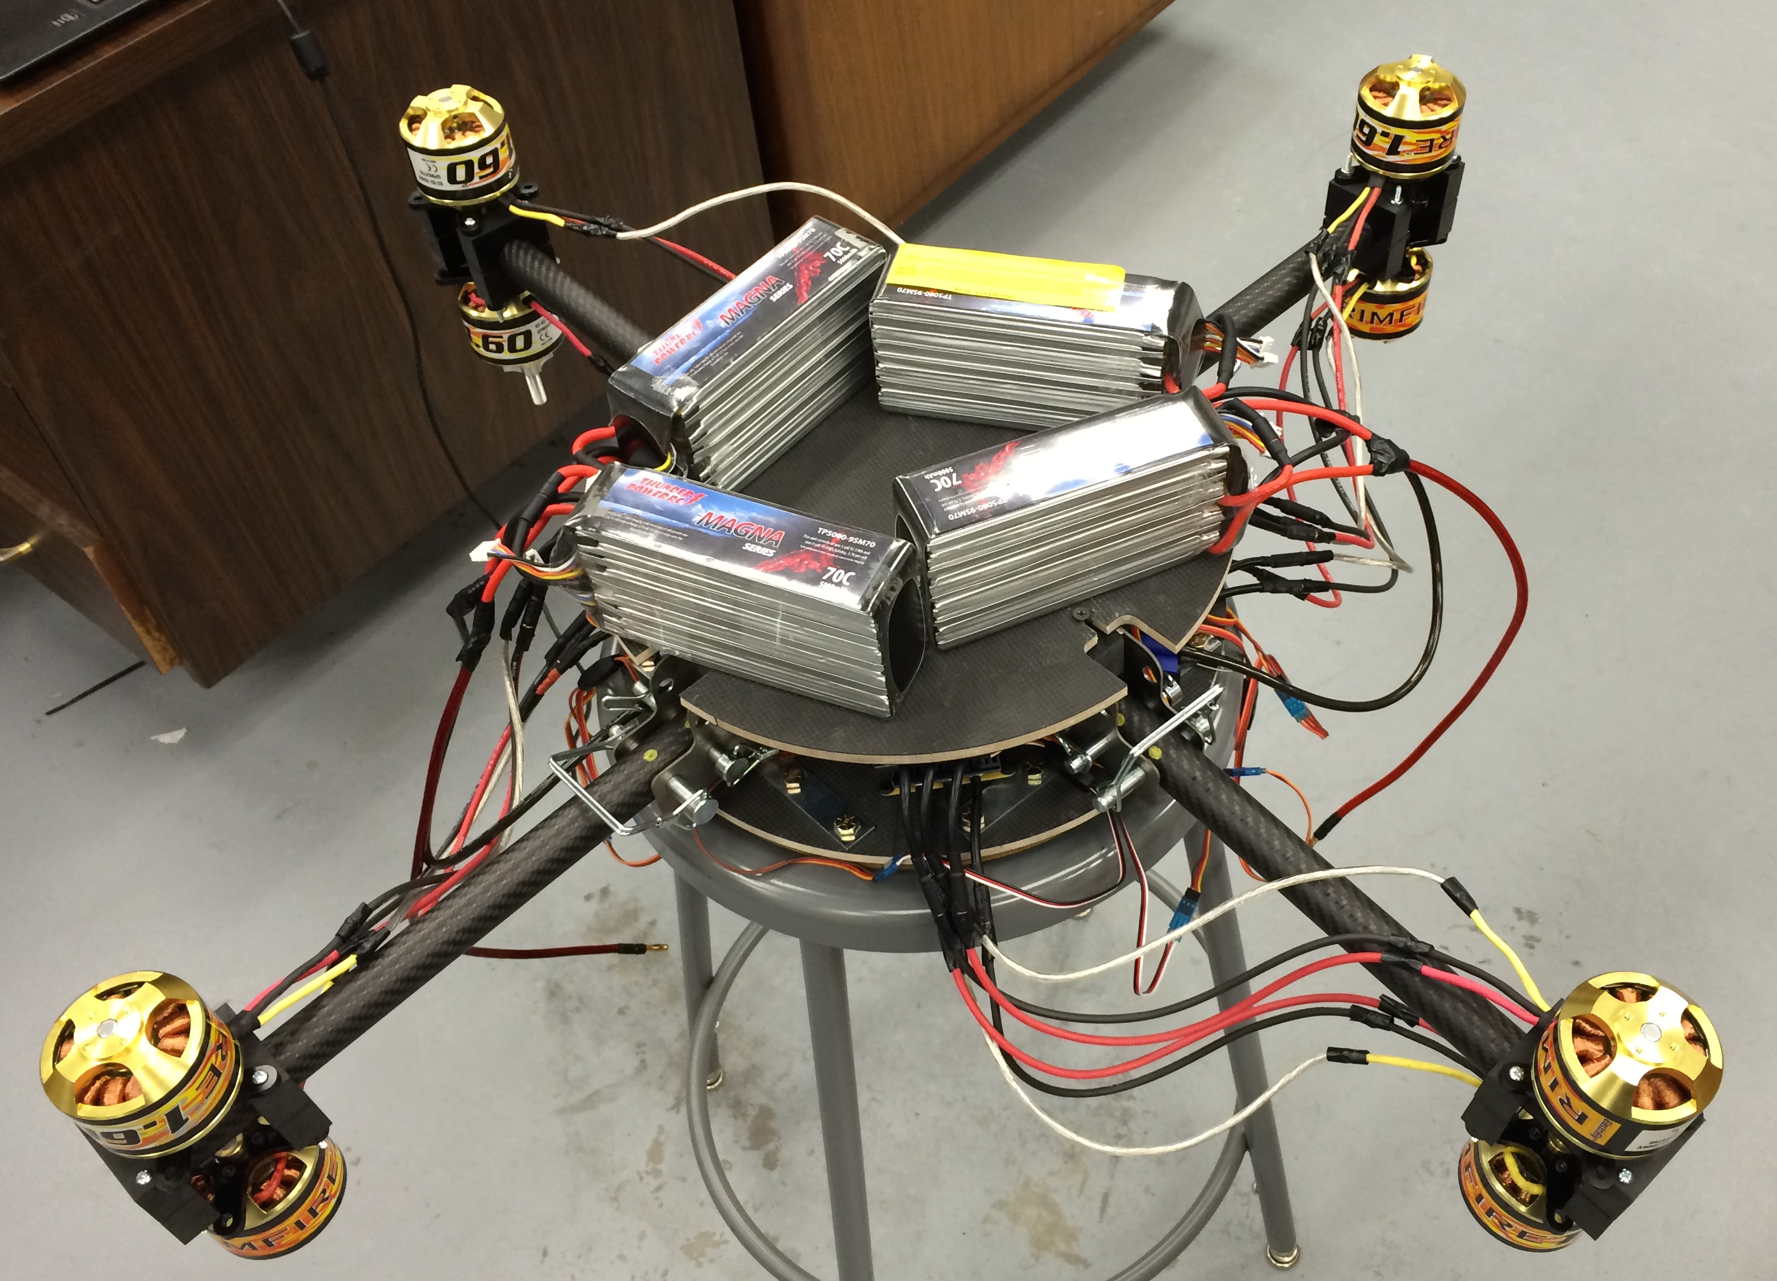
Rotorcraft Final Prototype
Figure 8. Collapsed View of Team’s Prototype
Figure 9. Deployed View of Team’s Prototype
IME #8/ME #31 Robert Johnson

Slide 25
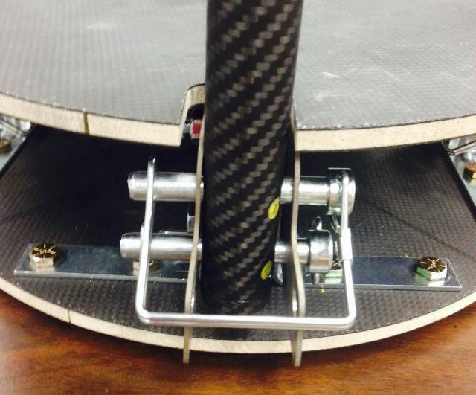
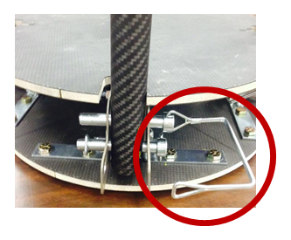
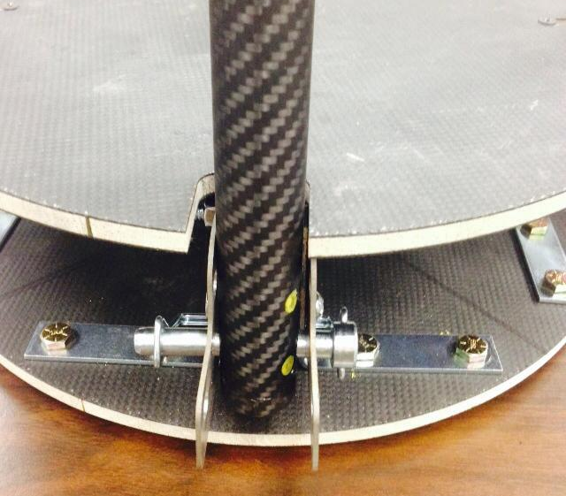
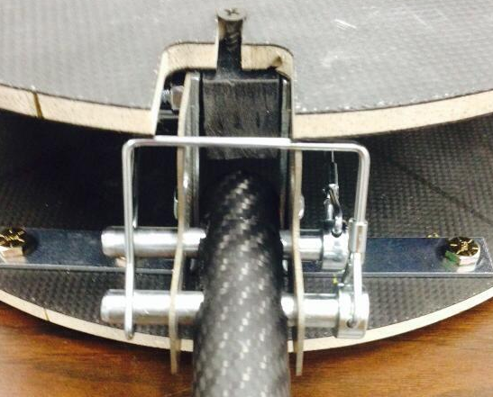
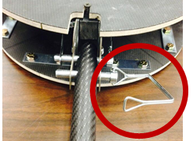
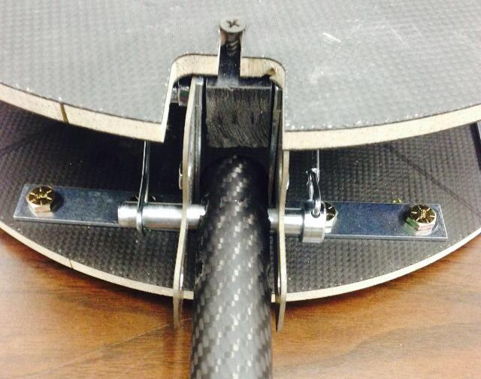
Protocol for Operation
IME #8/ME #31 Victoria Rogers

Slide 26
Rotorcraft Business Analysis
IME #8/ME #31 Mitchell Stratton

Slide 27
Health and Safety
Flight Safety:
  Do not fly over unprotected people, vessels, vehicles, or structures
  Successful radio equipment ground-range check in accordance with manufacturer’s recommendations is to be completed before first flight of a new/repaired rotorcraft
  Establish a safety line at all flying sites, locations, and testing areas that only personnel associated with flight are allowed to cross
Manufacturing Safety:
  Proper lab safety during manufacture of base plates (lab coats, gloves, safety goggles)
  Water jet cutting is performed by somebody well versed and thoroughly trained in the use of the machine
  Dust mask is necessary when cutting the carbon fiber tubes for the arms
IME #8/ME #31 Mitchell Stratton

Slide 28

Health and Safety
Rotor Safety:
  Rotors operate at 7,000 RPM (revolutions per minute), which is capable of causing serious injury even at low speeds
  Do not attempt to touch rotors during operation and wait for rotors to stop spinning before approaching the rotorcraft
  Wear safety goggles during operation
Battery Safety
  Do not operate at less than -20°C or more than 60°C
  Store batteries at room temperature (19°C to 25°C)
  Avoid serious impact with batteries
  Practice proper charging procedures
  Dispose of damaged batteries properly
Figure 10. Safety First Guy
IME #8/ME #31 Mitchell Stratton

Slide 29

Sustainability
The design is concerned with minimizing the weight of the rotorcraft
Reducing and eliminating weight and waste where possible
  Minimizing consumption, reusing materials when feasible, using renewable resources
Figure 11. Sustainability
IME #8/ME #31 Louisny Dufresne

Slide 30
Economic Analysis
Today’s engineers must design and create new technology that improves on previous designs while reducing cost
Potential non-military usage of this rotorcraft: hobbyists, older children, and general market sales during gift-giving holidays such as Christmas
Societal impact of this rotorcraft depends on the end use of the craft.
  Combat usage: Surveillance, distraction, delivery missions, combat missions
  Non-combat: Healthcare, navigation, exploring areas that are dangerous for humans
Economic benefit depends on the societal impact and end use
IME #8/ME #31 Robert Johnson

Slide 31
Operating Environment
Hobbyist and Stateside Use:
  More people with remote controlled flight vehicles → greater potential for problems
    Rotorcraft are sophisticated vehicles, not toys, and should be used with great caution
  Should not be flown inside
  Should not be flown within 30 feet of any building or structure
Military Use:
  Less concern for buildings and structures in combat
  Should still be trained in flying rotorcraft and take caution with controlling and operating the rotorcraft
IME #8/ME #31 Kimberlee Steinman

Slide 32
Ethical Considerations
The ethical considerations of war and the military in general are beyond the scope of this project
Ethical considerations specific to this rotorcraft and its usage:
  Usage of this rotorcraft is likely to be in combat or in other dangerous situations
  It is less costly and less tragic to lose a rotorcraft than it is to lose a human life
  This rotorcraft is ethical because it reduces the harm to society in the form of reducing the risk of harm to soldiers in combat
IME #8/ME #31 Kimberlee Steinman

Slide 33
Social and Political Considerations
Political (military):
  Unmanned aerial vehicles (drones) are becoming a more commonly utilized form of military defense and antiterrorism operations
  Rotorcraft keeps soldiers away from heavy combat zones, reducing the likelihood of injury
  There is very little oversight of United States military drone use and the United States government is fearful of other countries developing drone technology
Social (civilian):
  Amazon delivery rotorcraft – limit of five pound payloads
  Strict FAA guidelines for usage of unmanned aerial vehicles
IME #8/ME #31 Victoria Rodgers

Slide 34

Future Outlook
Optimize method of attachment of payload
Add foldable legs at the bottom of the base plate
Test payload capacity
Figure 11. Future Outlook Guy
IME #8/ME #31 Victoria Rodgers

Slide 35
Conclusion
Successfully designed and developed a Rotorcraft with coaxial configuration.
Successfully completed the (VARTM) process for manufacturing of two baseplates.
Successfully completed a Rotorcraft that weights 30 lbs. and can be carried by a soldier
Ordered & received all components that are all compatible with each other necessary to fly the Rotorcraft.
Due to FAA restrictions the team will only be allowed to hover the Rotorcraft
Table 1: Verifying Objectives
Verifying Objectives: | Status
Be made with commercial off the shelf (COTS) components | Yes
Be easily maintained and used in the field | Yes
Fit in a military backpack (23”x14.5”x15”) | Conditionally
Carry a payload of at least 30 pounds | Unknown
Travel up to approximately 1 mile | Unknown
IME #8/ME #31 Victoria Rodgers
Notes:
Also need to incorporate what we learned into this slide, what was concluded from project, what was the IMPACT of the project, might need 2 slides a what we learned and a conclusion slide

Slide 36
Acknowledgments
The team would like to thank:
    Dr. Dickens
    Dr. Chuy
    Dr. Gupta
    Dr. Collins
    Dr. Faruque
    Dr. Okoli
    Dr. Frank
    Mr. Gerald Horne
    Ms. Emily Hammel
    Ms. Margaret Scheiner
IME #8/ME #31 Victoria Rodgers

Slide 37
References
[1] "FlightGear Forum • View Topic - Four Rotor Helicopter." FlightGear Forum • View Topic - Four Rotor Helicopter. PhpBB Group, n.d. Web. 02 Dec. 2014.
[2] "SMALL MOLLE ASSAULT BACKPACK MILITARY RUCKSACK ARMY NEW." eBay. N.p., n.d. Web. 22 Oct. 2014. <http://www.ebay.com/itm/SMALL-MOLLE-ASSAULT-BACKPACK-MILITARY-RUCKSACK-ARMY-NEW-/170555911038>.
[3] "Multi-Rotor Frame Configurations - CopterCraft.com." CopterCraftcom RSS2. Web. 30 Nov. 2014. <http://www.coptercraft.com/multirotor-frame-configurations/#!prettyPhoto>.
[4] "Thunder Power RC G8 Pro Force 70C 5000mAh 9-Cell/9S 33.3V LiPo Battery FREE SHIPPING SKU: TP5000-9SPF70." RCToyscom New Products. Web. 30 Nov. 2014. <http://www.rctoys.com/rc-toys-and-parts/TP5000-9SPF70/RC-PARTS-THUNDER-POWER-9-CELL-LITHIUM-BATTERIES.html>.
[5] “120 Amp Speed Controls: Brushless Speed Controllers, ESCs from Hobby Express." 120 Amp Speed Controls: Brushless Speed Controllers, ESCs from Hobby Express. 1 Apr. 2015. Web. 2 Apr. 2015.
[6] "The Brushless Advantage for Outrunner Design Motors!" ElectriFly. Web. 2 Apr. 2015.
[7] "APC APCE-18X10, APCE 18X10, Accessories." APC APCE-18X10. Web. 30 Nov. 2014. <https://www.aero-model.com/1_3_69/Accessories_APC-18x10-E-Prop/APCE-18X10.html>.
[8] "ECalc - the Most Relaibale RC Calculator on the Web." ECalc - the Most Relaibale RC Calculator on the Web. Web. 2 Apr. 2015.
[9] http://2bfly.com/knowledgebase/electronic-speed-controls/multi-engine-esc-wiring/
IME #8/ME #31 Victoria Rogers

Slide 38

Questions

