Slide 1

Design & Manufacture of Rotorcraft
Group 31
Mohammed Nabulsi
Victoria Rogers
Kimberlee Steinman
Louisny Dufresne
Taniwa Ndebele
Robert Johnson
Chabely Amo Fernandez
Group #31
Slide 1 of 26
Taniwa Ndebele
Design & Manufacture of Rotorcraft

Slide 2
Team organization:
Group #31
Slide 2 of 26
Taniwa Ndebele
Design & Manufacture of Rotorcraft

Slide 3
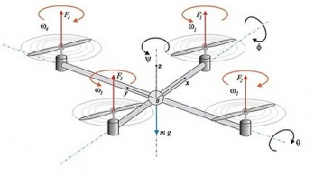
Background:
A rotorcraft is a flying machine that uses lift generated by wings called rotor blades that revolve around a mast [1].
Rotary unmanned aerial vehicles often fall into one of two classifications:
  high payload capacity but low portability
  high portability but a reduced payload capacity.
Figure 1. Example of a Quad-rotor [1]
Group #31
Slide 3 of 26
Taniwa Ndebele
Design & Manufacture of Rotorcraft

Slide 4
Need statement
While there exist rotary unmanned aerial vehicles that carry high pay loads, they lack the portability for practical applications.
Increase in military applications since 1990s
Thus attempting to create is a necessity for improvement
Group #31
Slide 4 of 26
Taniwa Ndebele
Design & Manufacture of Rotorcraft

Slide 5
SWOT Analysis Quadrants
Strengths
  Interdisciplinary group
  Open communication
  Sponsor and Resources
Weaknesses
  Large group
  One electrical engineer (managed by addition of Mitchell)
Opportunities
  Amazon “drones”, FAA guideline changes, military
Threats
  Current FAA guidelines are restrictive of commercial aircraft, limiting commercial applications of this rotorcraft
Group #31
Slide 5 of 26
Kimberlee Steinman
Design & Manufacture of Rotorcraft
Notes:
Delete

Slide 6
SIPOC Analysis Chart
Suppliers | Input | Process | Output | Customers
HPMI, Online retailers, College of Engineering departments. | Group member's knowledge and training in design and manufacturing | Design a rotorcraft that meets the customer's requirements and the manufacturing processes required to create the rotorcraft | Rotorcraft matching our projects goal statement | The Department of Industrial and Manufacturing Engineering and Dr.Okoli
Group #31
Slide 6 of 26
Kimberlee Steinman
Design & Manufacture of Rotorcraft
Notes:
Delete

Slide 7
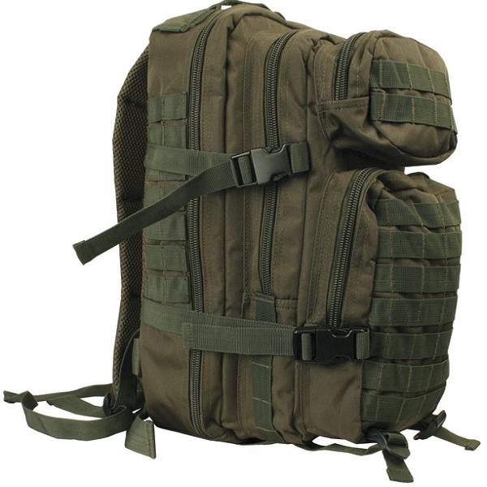
Goal Statement & objective
Design a rotorcraft that can:
  Fit in a military backpack (23x14.5x15)
  Can carry a payload of at least 50 pounds
  Made with COTS components (off the shelf)
  Has a range of approximately 1 mile
  Easy to maintain and use in the field
Design the manufacturing processes for this rotorcraft
Build a prototype of this rotorcraft
Figure 2. Military Backpack [2]
Group #31
Slide 7 of 26
Kimberlee Steinman
Design & Manufacture of Rotorcraft
Notes:
combine

Slide 8
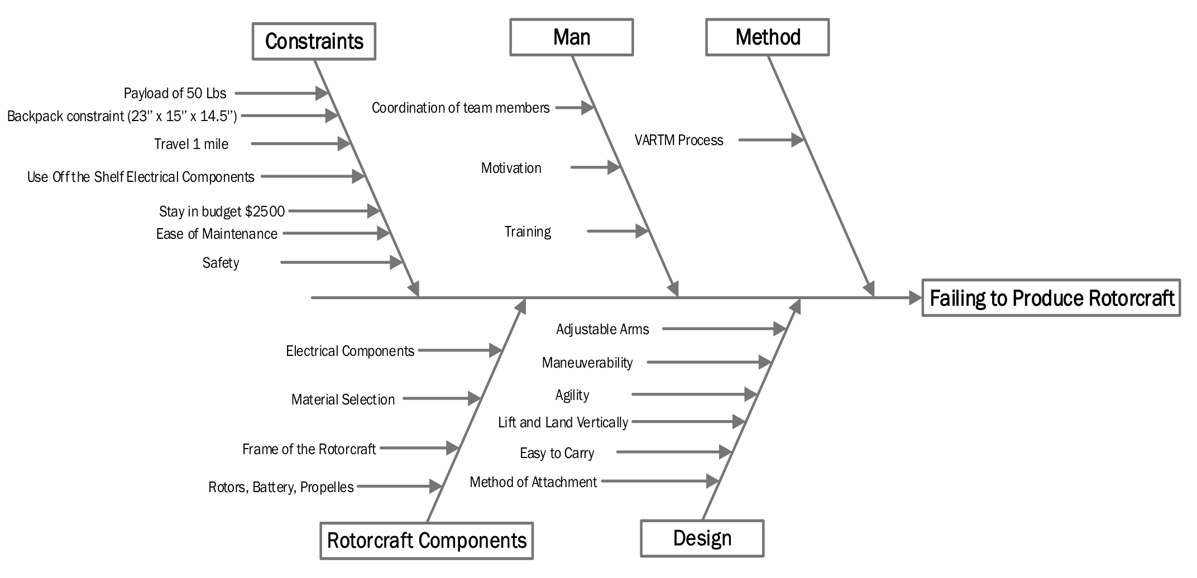
Analysis of Customer Requirements
Group #31
Slide 8 of 26
Chabely Amo Fernandez
Design & Manufacture of Rotorcraft

Slide 9
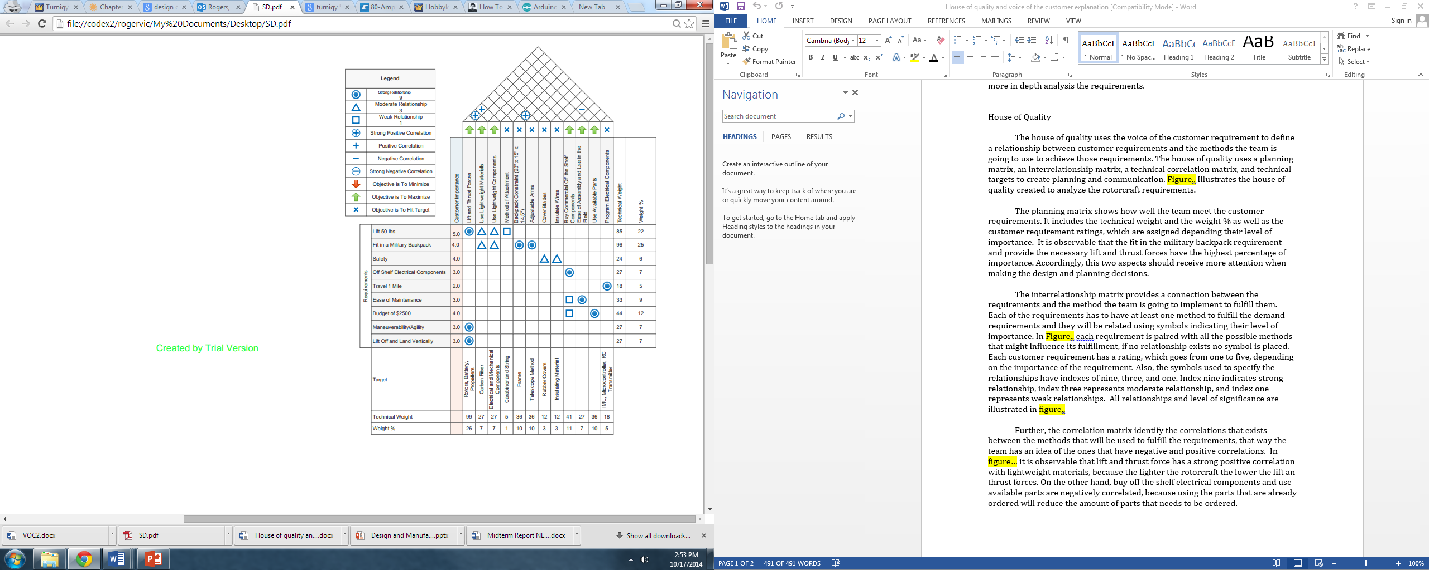
House of Quality

Slide 10
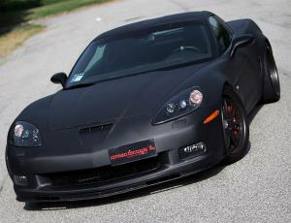
Material Selection
Rotorcraft has to tolerate stresses:
  Low to high frequency vibrations
  Heat
  Centrifugal forces
  Hard landings
Material has to be STRONG and STIFF
Figure 3. Carbon Fiber Chevrolet Z06 Corvette [3]
Group #31
Slide 10 of 26
Victoria Rogers
Design & Manufacture of Rotorcraft

Slide 11
Material Selection
Table 1. Carbon Fiber vs. Glass Fiber [ 4, 5,6 ]
Material | Tensile Strength (Mpa) | Young Modulus (Gpa) | Density (g/cm³) | Strength-to-weight ratio | Elongation (%) | CTE | Price/Yard ($)
Carbon Fiber | 4127 | 125 – 181 | 1.58 | 1013 | 1.05 | < 2 | 30 - 40
Glass Fiber | 3450 | 30 – 40 | 2.66 | 564 | 2.5 | 7 - 8 | 3 - 6
Group #31
Slide 11 of 26
Victoria Rogers
Design & Manufacture of Rotorcraft

Slide 12
Material Selection: Epoxy Resin
Thermosetting network polymer = epoxide resin + polyamine hardener
    Strong
    Hard
    Rigid
Adhesive with strong resistance coatings and finishes
Used as the matrix in fiber reinforced plastics
Table 2. Epoxy Resin [7]
Material | Young Modulus (Gpa) | Density (g/cm³) | Strength-to-weight ratio | Elongation (%) | T_{g} (°C) | Price/half gallon ($)
Epoxy Resin | 3 | 1 – 1.15 | 28 | 4 | 75 | 30 - 40
Group #31
Slide 12 of 26
Victoria Rogers
Design & Manufacture of Rotorcraft

Slide 13

Design & Analysis: Thrust
        $\frac{total weight to be lifted}{number of rotor}=required thrust per rotor$
        $\frac{150 lbs.}{4 rotors}≈37.5 lbs. thust per rotor$
        $\frac{150 lbs.}{6 rotors}≈ 25 lbs. thust per rotor$
        $\frac{150 lbs.}{8 rotors}≈ 18 lbs. thust per rotor$
        $\frac{150 lbs.}{12 rotors}≈12 lbs. thust per rotor$
Group #31
Slide 13 of 26
Mohammed Nabulsi
Design & Manufacture of Rotorcraft

Slide 14
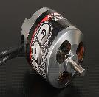
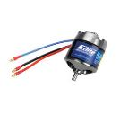
Design & Analysis: Rotor
Table 3. Rotor Specification's [8]
Rotor | Image | Kv (rpm/v) | Weight (lbs.) | Max Current (A) | Max Voltage (V) | Power (W) | Shaft (mm) | Cost ($)
Turnigy G60 Brushless Outrunner |  | 500 | 0.79 | 65 | 25 | 1500 | 6 | 54
E-Flite Power 52 Brushless Outrunner |  | 590 | 0.76 | 65 | 22 | 1600 | 6 | 109
Figure 4. G60 Rotor
Figure 5. E-Flite Rotor
Group #31
Slide 14 of 26
Mohammed Nabulsi
Design & Manufacture of Rotorcraft

Slide 15
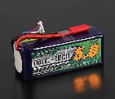
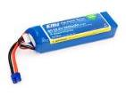
Design & Analysis: Battery
Table 4. Battery Specifications [9]
Battery | Image | Capacity (mAh) | Voltage (V) | Config (s) | Discharge (©) | Weight (Pounds) | Cost ($)
Turnigy Nano-Tech 5000mah 6S Lipo Pack |  | 5000 | 22.2 | 6 | 65 | 1.86 | 116
E-Flite 3200mah 6S Lipo Pack |  | 3200 | 22.2 | 6 | 30 | 1.49 | 100
Figure 6. Nano-Tech
Figure 7. E-Flite
Group #31
Slide 15 of 26
Mohammed Nabulsi
Design & Manufacture of Rotorcraft

Slide 16
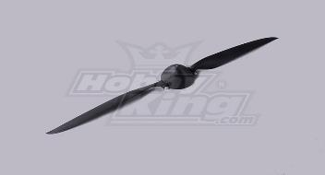

Design & Analysis: Propeller
The purpose of a propeller is to convert power (delivered by a rotating shaft) into thrust.
        $Propeller Efficiency= \frac{k×Thrust×Speed}{Power}=4.1$
        $( where k is a constant to account for units)$
Larger diameter and pitch generates more thrust.
16.5x10 plastic propeller only cost $6.75!
Figure 8. Plastic Propeller Assembly [10]
Group #31
Slide 16 of 26
Mohammed Nabulsi
Design & Manufacture of Rotorcraft

Slide 17
Comparison of Specifications:
Table 5. Comparison of Designs
Designs | Motor | Battery | Propeller | Thrust Generated | Thrust Required | Cost ($)
Presented Design | Turnigy G60 Brushless Outrunner | Turnigy Nano-Tech 5000mah 6S Lipo Pack | 16.5x10 plastic propeller | 25.7 lb. | Hex-copter = 25 lb. Octo-copter = 18 lb. | 921
FAMU/FSU Design | E-Flite Power 52 Brushless Outrunner | E-Flite 3200mah 6S Lipo Pack | 16.5x5 plastic propeller | 29.8 lb. |  | 1278
Group #31
Slide 17 of 26
Mohammed Nabulsi
Design & Manufacture of Rotorcraft

Slide 18
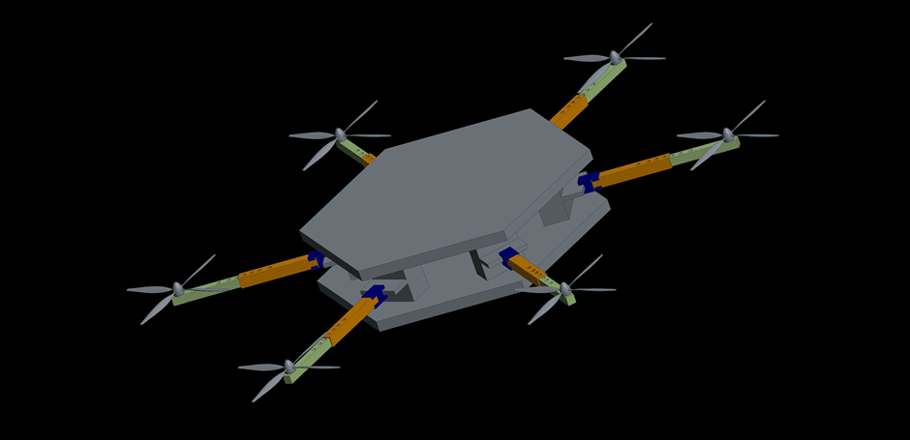
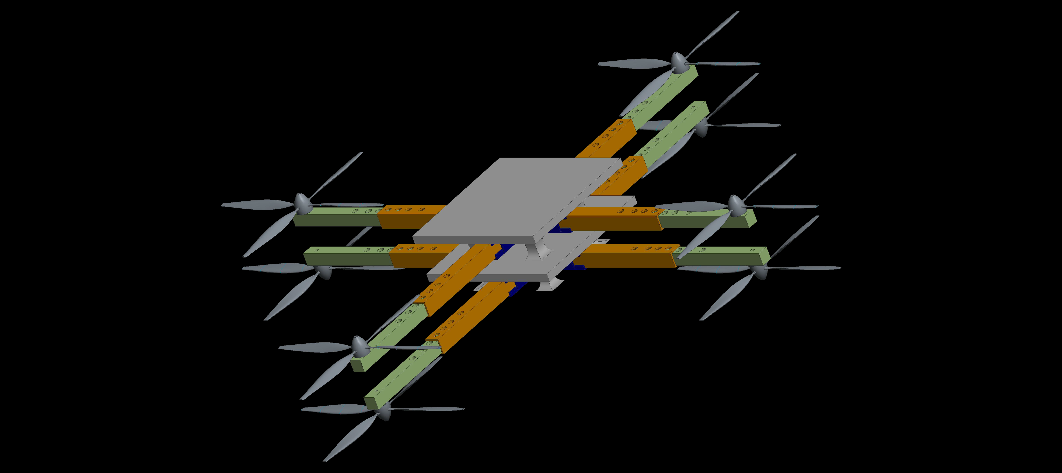
Design & Analysis: Frame
Figure 9. Hexacopter Design in Creo-Parametric 2.0
Figure 10. Octocopter Design in Creo-Parametric 2.0
Group #31
Slide 18 of 26
Mohammed Nabulsi
Design & Manufacture of Rotorcraft

Slide 19
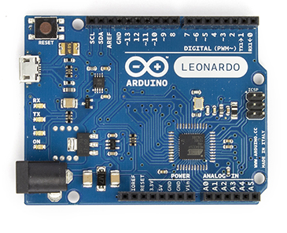
Design & Analysis: Microcontroller
Brain of the rotorcraft
Can be programmed on a computer and saved on the chip
Low voltage requirement for operation (3.3-5V)
Arduino Leonardo
Analog and Digital pins
Figure 11. Microcontroller [11]
Group #31
Slide 19 of 26
Robert Johnson
Design & Manufacture of Rotorcraft

Slide 20
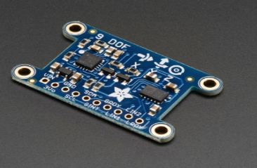
Design & Analysis: Imu
Measure and record the velocity, orientation, and gravitational forces acting on the rotorcraft
Controls pitch, roll, and yaw (X,Y,Z)
Either six or nine degrees of freedom measured
Used to maneuver the craft
Figure 12. IMU sensor [11]
Group #31
Slide 20 of 26
Robert Johnson
Design & Manufacture of Rotorcraft

Slide 21
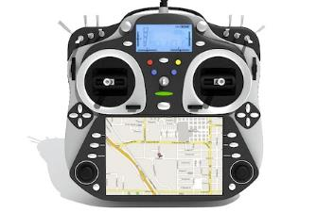
Design & Analysis: Rc Transmitter
Uses frequencies to transmit radio waves between antennas
Only certain frequencies are allowed for consumer use
Allows control the rotorcraft with a remote control
Connected to the microcontroller/imu sensor
Figure 13. RC Transmitter [11]
Group #31
Slide 20 of 26
Robert Johnson
Design & Manufacture of Rotorcraft

Slide 22
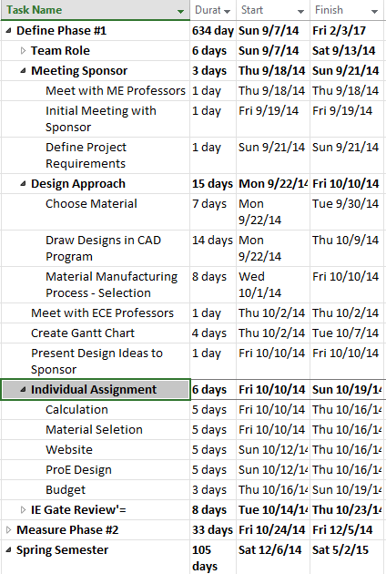
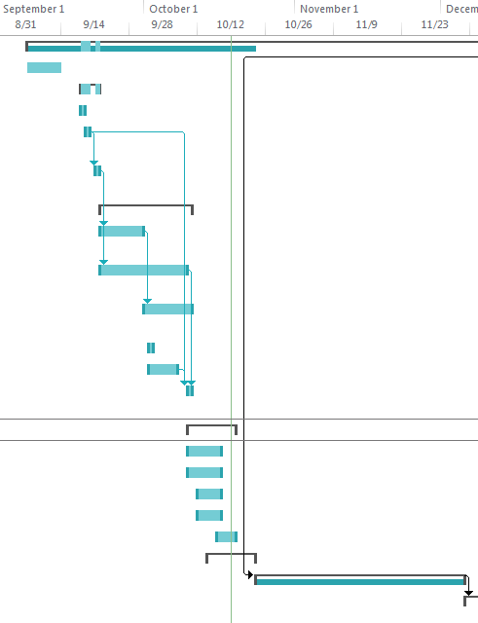
Schedule: Gantt Chart
Group #31
Slide 21 of 26
Louisny Dufresne
Design & Manufacture of Rotorcraft

Slide 23
Bill Of Materials
Part Name | Qty | Unit | Unit Cost | Cost
Turnigy G60 Brushless Rotor | 8 | 1 | $ 54.43 | $ 435.44
Turnigy Nano-Tech 5000mah 6S Lipo Pack | 4 | 1 | $ 116.70 | $ 466.80
Plastic Propeller Assembly | 8 | 1 | $ 6.75 | $ 54.00
Arduino Leonardo with Headers | 1 | 1 | $ 24.95 | $ 24.95
Adafruit 9-DOF IMU Breakout - L3GD20 + LSM303 | 1 | 1 | $ 19.95 | $ 19.95
HobbyKing SS Series 90-100A | 1 | 1 | $ 24.85 | $ 24.85
Carbon Fiber |  |  | $ 35.00 | $ -
Epoxy Resin |  |  | $ 41.95 | $ -
Total Amount |  |  |  | $ 1025.95
Budget: $2,500
Group #31
Slide 23 of 26
Louisny Dufresne
Design & Manufacture of Rotorcraft

Slide 24
Conclusion
Objective: Design and Manufacture of Rotorcraft
  Fit in a military backpack (23x14.5x15)
  Can carry a payload of at least 50 pounds
  Made with COTS components (off the shelf)
  Has a range of approximately 1 mile
  Easy to maintain and use in the field.
Next Steps
Measure Phase
Meet with Our Sponsor figure out which design to go with.
Create Detail Drawing
Order Materials
Group #31
Slide 24 of 26
Louisny Dufresne
Design & Manufacture of Rotorcraft

Slide 25
References
[1] "[RC Sailplanes, Gliders and Electrics]." [icare-icarus]. N.p., n.d. Web. 19 Oct. 2014. <http://www.icare-icarus.com/CAM-Folding-Prop-16-x-10_p_413.html>.
[2] "SMALL MOLLE ASSAULT BACKPACK MILITARY RUCKSACK ARMY NEW." eBay. N.p., n.d. Web. 22 Oct. 2014. <http://www.ebay.com/itm/SMALL-MOLLE-ASSAULT-BACKPACK-MILITARY-RUCKSACK-ARMY-NEW-/170555911038>.
[3] "Romeo Ferraris presents the 667 hp carbon fiber Corvette." . 16997 car pictures at high resolution. N.p., n.d. Web. 22 Oct. 2014. <http://www.auto-power-girl.com/images-info/romeo_ferraris_presents_the_667_hp_carbon_fiber_corvette-5026-16997>.
[4] "CARBON FIBER - GRAPHITE - KEVLAR." CARBON FIBER - GRAPHITE - KEVLAR. US Composites, n.d. Web. 16 Oct. 2014.
[5] DeMerchant, Cristine. "Comparison of Carbon Fiber, Kevlar (Aramid) and E Glass Used in Composites for Boatbuilding." Comparing the Characteristics of Glass, Kevlar (Aramid) and Carbon Fiber. N.p., n.d. Web. 16 Oct. 2014
[6] "High Strength Fiberglass." - Fiberglass E Glass Woven Cloth, Fiberglass Cloth for Grinding Wheel Disc and Fiberglass S Glass Woven Cloth Manufacturer & Supplier from Mumbai, India. N.p., n.d. Web. 16 Oct. 2014.
[7] "Epoxy : Epoxy Resins and Hardeners." Epoxy : Epoxy Resins and Hardeners. US Composites, n.d. Web. 16 Oct. 2014.
[8] "Turnigy G60 Brushless Outrunner 500kv (.60 Glow)." HobbyKing Store. N.p., n.d. Web. 19 Oct.2014.<https://www.hobbyking.com/hobbyking/store/__19029__Turnigy_G60_Brushless_Outrun
[9] "Turnigy nano-tech 5000mah 6S 65~130C Lipo Pack." HobbyKing Store. N.p., n.d. Web. 19 Oct.2014.<http://www.hobbyking.com/hobbyking/store/__19156__Turnigy_nano_tech_5000mah_6S
[10] "- Propeller Performance Factors -." Propeller Performance: An introduction, by EPI Inc.. N.p.,n.d.Web.16Oct.2014.<http://www.epieng.com/propeller_technology/selecting_a_propeller.htm>.
[11] "How To Build A Quadcopter." THE WORLD FROM MY POINT OF VIEW. N.p., n.d. Web. 22 Oct. 2014. <http://akashstevekhanna.wordpress.com/2014/03/01/2899/>.
Group #31
Slide 25 of 26
Louisny Dufresne
Design & Manufacture of Rotorcraft

Slide 26
Questions?
Group #31
Slide 26 of 26
Louisny Dufresne
Design & Manufacture of Rotorcraft

