Slide 1

Design & Manufacture of a Rotorcraft
FAMU-FSU College of Engineering
Chabely Amo, Louisny Dufresne, Robert Johnson, Mohammed Nabulsi, Taniwa Ndebele, Victoria Rogers, Kimberlee Steinman, Mitchell Stratton
IME #8/ME #31 Mitchell Stratton

Slide 2
Team Organization
IME #8/ME #31 Mitchell Stratton

Slide 3
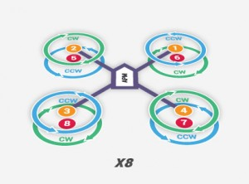
Background
A rotorcraft is a flying machine that uses lift generated by wings called rotor blades that revolve around a mast
Rotary unmanned aerial vehicles often
  fall into one of two classifications:
  High payload capacity but low
    portability
  High portability but a reduced
  payload capacity.
Figure 1. Example of a Rotorcraft [1]
IME #8/ME #31 Mitchell Stratton

Slide 4
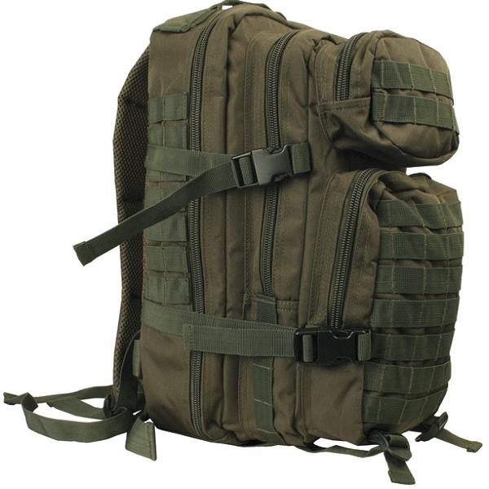
Goal Statement and Objective
The project is sponsored by the US Air Force, the requirements are as follows:
Design a rotorcraft that can:
  Fit in a military backpack (23”x14.5”x15”)
  Carry a payload of at least 30 pounds
  Be made with commercial off the shelf (COTS) components
  Travel up to approximately 1 mile
  Be easily maintained and used in the field
Design the manufacturing processes to be used in creating the rotorcraft
Build a prototype of the rotorcraft
State the protocols for the operation and assembly of the rotorcraft
Figure 2. Military Backpack [2]
IME #8/ME #31 Louisny Dufresne

Slide 5
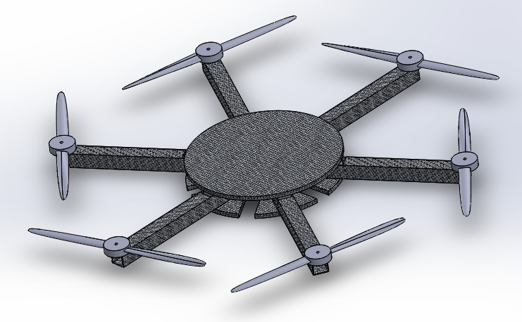
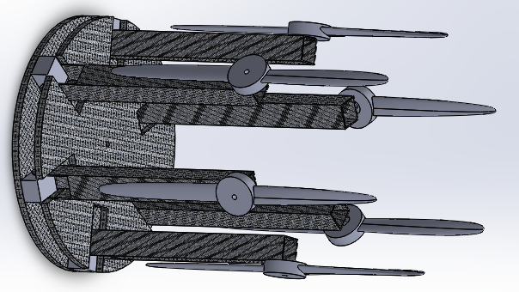
Previous Work
Design proposed by: Intern Cameron Alexander
Hexacopter configuration.
Figure 3. Deployed View of Cameron’s Design
Figure 4. Collapsed View of Cameron’s Design
IME #8/ME #31 Kimberlee Steinmann

Slide 6
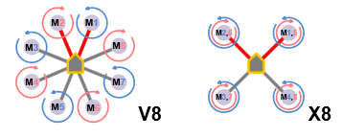
Rotorcraft Configurations
Two types:
Coaxial Setup (X8)
  Two engines mounted co-axially on the ends of each boom
  Excellent Lifting Power
  Easier Portability
Radial Setup (V8)
  One engine mounted on the
    end of each boom
Figure 5. Multi-copter Configurations [3]
IME #8/ME #31 Kimberlee Steinmann

Slide 7
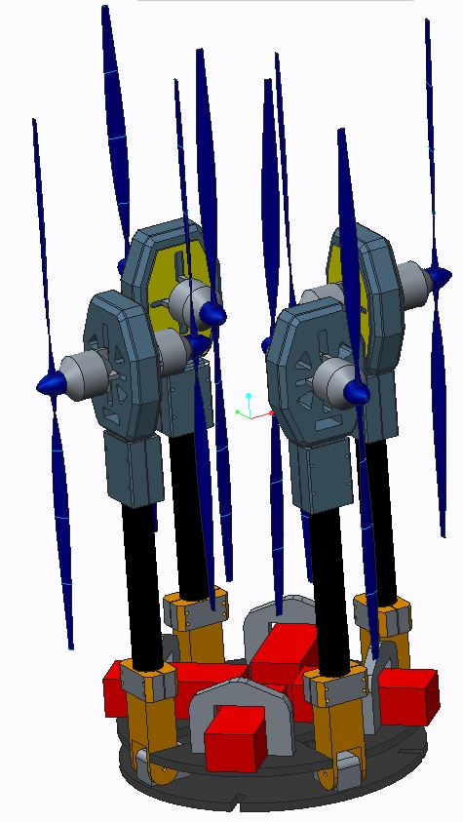
Team General Design
Motor
Propeller
Motor Mounts
Hinges
Carbon Fiber Arms
Battery
Battery Clamps
Base Plates
IME #8/ME #31 Kimberlee Steinmann

Slide 8
Analysis Tool eCalc
Provides web-based quality services to calculate evaluate and design electric motor driven systems for remote controlled models
Provides Rotorcraft outcome based on:
  Battery
  Speed Controller
  Motor
  Propeller
Guarantees error margin no greater than ±10%
IME #8/ME #31 Mohammed Nabulsi

Slide 9
Essential Components Chosen:
Thunder Power Lithium Polymer Battery
Electronic Speed Controller
Electrifly Rimfire 1.60 Motor
Zinger Wood Propeller 18”x 10”
IME #8/ME #31 Mohammed Nabulsi

Slide 10
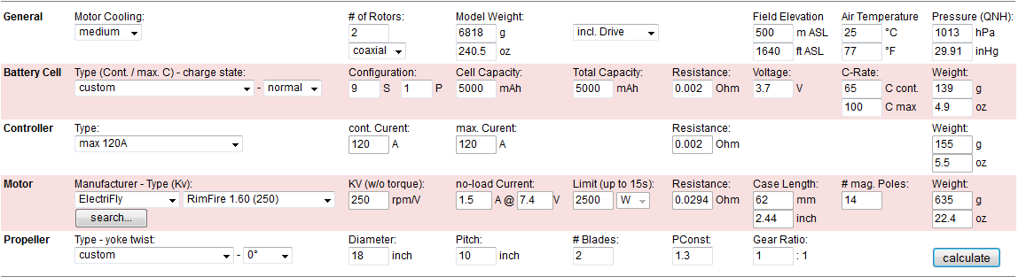
eCalc Rotorcraft Calculator Input:
IME #8/ME #31 Mohammed Nabulsi

Slide 11
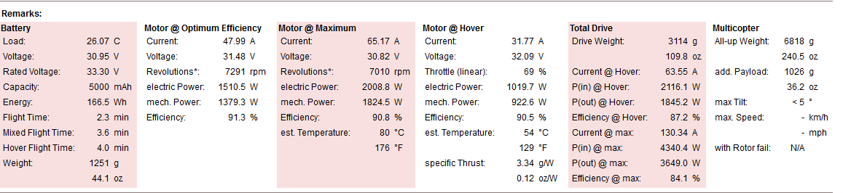
eCalc Rotorcraft Calculator Output:
IME #8/ME #31 Mohammed Nabulsi

Slide 12
Rotorcraft Frame Assembly
Tighten Down Corner Braces
Insert Pins
Insert Safety Mechanism for Pins
IME #8/ME #31 Taniwa Ndebele

Slide 13
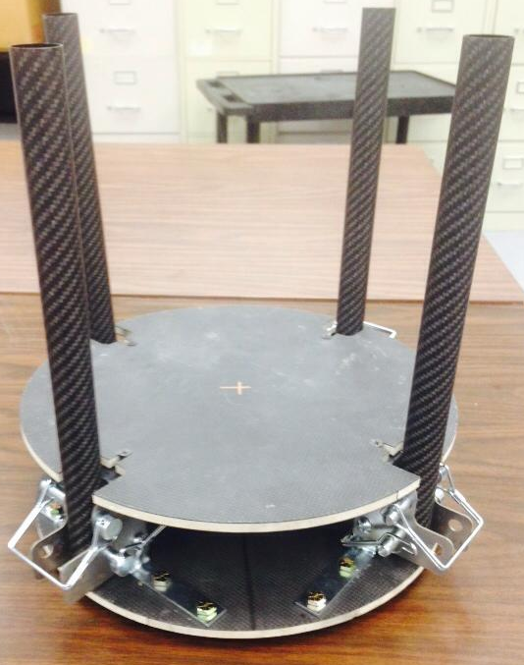
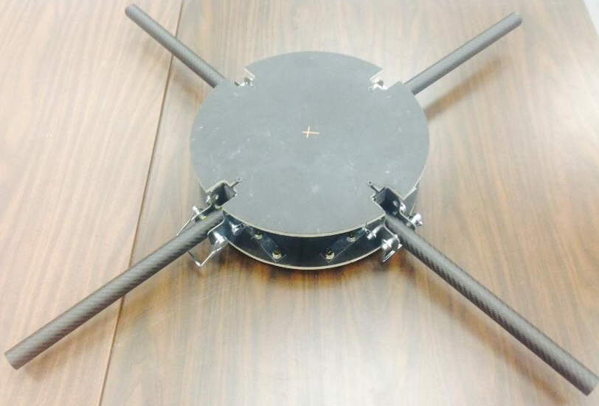
Rotorcraft Prototype
Figure 6. Collapsed View of Team’s Prototype
Figure 7. Deployed View of Team’s Prototype
IME #8/ME #31 Taniwa Ndebele
Notes:
Could go after mechanical assembly also

Slide 14
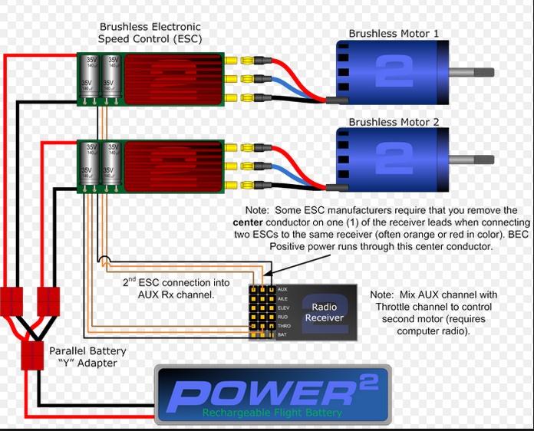
Electrical Assembly
IME #8/ME #31 Robert Johnson

Slide 15
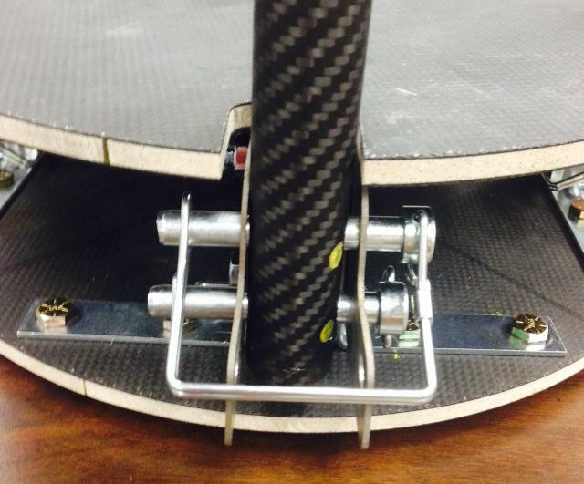
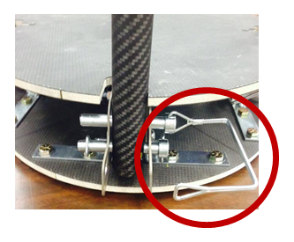
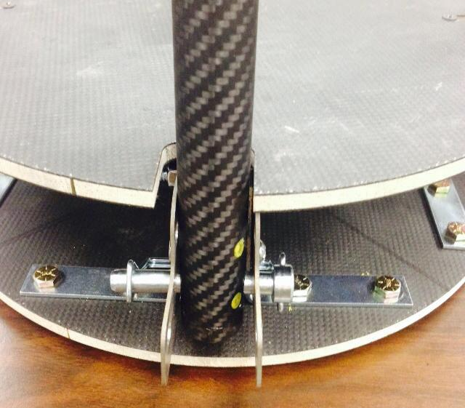
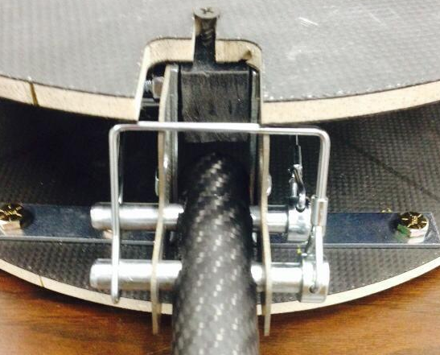
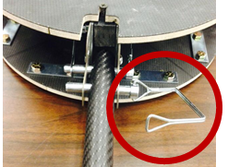
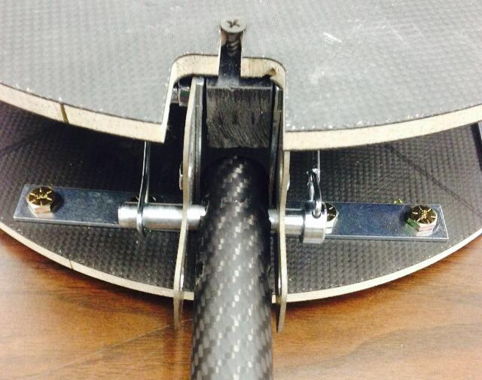
Protocol for Operation
IME #8/ME #31 Victoria Rogers

Slide 16
Future Work and Design Validation
Complete electrical assembly
Safety Consideration
Simulate in field procedure of completed rotorcraft
Optimize method of attachment of payload
Testing Payload Capacity
Analyzing and Comparing to eCalc Results and Ergonomic analysis
Table 1. Ergonomic Analysis
Timing Report | Task should take between 3s - 8s to complete
Static Strength Prediction (SSP) | 82.72% of population can complete task
Lower Back Analysis (LBA) | Task is categorized as a low risk for back injury
IME #8/ME #31 Chabely Amo

Slide 17
Bill of Materials
Part Name | Description | Quantity | Unit Cost | Cost | Purchaser
Top and Base Plates | Carbon Fiber Vinyl Ester Resin Composite | 2 | ** | *** | HPMI
Carbon Fiber Layers | 3K Plain Carbon Fiber | 3 | ** | ***
Vinyl ester Resin | Ivex c410 | * | ** | ***
Carbon Fiber Arms | High-Strength Carbon Fiber Tube, 1.000" | 2 | $152 | $305 | Sponsor
Motor Mounts | MOTOR MOUNT 25mm BOOM HEAVY LIFT COAX (PAIR) | 4 | $57 | $228
Speed Controller | 120A HV Brushless Programmable ESC | 8 | $140 | $1,119
Motors | RimFire 1.60 | 8 | $179 | $1,440
Battery | 5000mAh 9-Cell/ 33.3V/ 45C/ LiPo | 4 | $385 | $1,540 | ME & ECE
Balsa Wood | 1/8 X 6 X 36 in Balsa Wood Sheet | 3 | $5 | $16 | TEAM
 | 1/8 X 4 X 36 in Balsa Wood Sheet | 4 | $3 | $12
Propeller | Zinger Wood Propeller 18x10 in | 8 | $25 | $200.00
IME #8/ME #31 Chabely Amo
Notes:
Need a bom in general, can’t find a previous one in my email

Slide 18
Bill of Materials
Part Name | Description | Quantity | Unit Cost | Cost | Purchaser
Flight Controller | Flight Controller | 1 | $50 | $50 | TEAM
RC Controller | Spektrum DX5e 5-Channel Transmitter with AR610 Receiver | 1 | $96 | $96
Pins | 3/8 in Aluminum Pins | 8 | $4 | $36
Battery Charger | 9s Lipo Charger | 1 | $50 | $50
AGW Wires | American Gage Wire | 2 ft. | $7 | $14
Carbon Fiber Arms Holder | Cut from aluminum sheet | 8 | $1 | $10
Corner Brace | 3 in. Zinc Plated Corner Braces | 8 | $3 | $30
IMU Sensor | Adafruit 10-DOF IMU Breakout - L3GD20H + LSM303 + BMP180 | 1 | $30 | $30
Velcro Pack | 12' x 3/4" Roll - Black | 1 | $8 | $8
Screws | ¼ in diameter and 5/8 in long screws | 16 | $1 | $13
 | ¼ in diameter and 2 ½ in long screws | 8 | $1 | $7
Total cost: $5,207
IME #8/ME #31 Chabely Amo

Slide 19
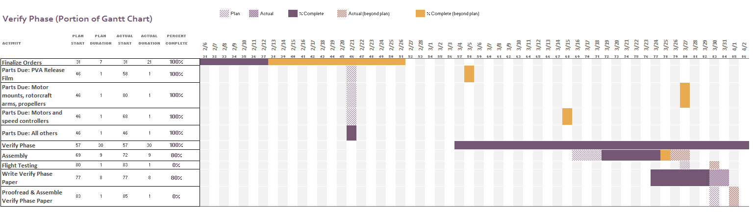
Schedule – Gantt Chart
IME #8/ME #31 Louisny Dufresne
Notes:
Get from Lou

Slide 20

Lessons Learned
Order parts on time
Check the specifications for each individual component
Call manufacturers to confirm components can be delivered on time
Take into consideration minor details
Better team, sponsor, and advisor communication
Hold each individual accountable for their role
Take into consideration machine shop time
Implement better organization
Figure 8. Lessons Learned Guy
IME #8/ME #31 Victoria Rogers

Slide 21
Conclusion
Successfully designed and developed a Rotorcraft with coaxial configuration.
Successfully completed the VARTM process for manufacturing of two baseplates.
Successfully minimized the weight of the Rotorcraft to be under 30 pounds.
Ordered & received all components necessary to fly the Rotorcraft.
Due to FAA restrictions the team will only be allowed to hover the Rotorcraft
Table 2. Objective Status
Verifying Objectives: | Status
Be made with commercial off the shelf (COTS) components | Yes
Be easily maintained and used in the field | Yes
Fit in a military backpack (23”x14.5”x15”) | Unknown
Carry a payload of at least 30 pounds | Unknown
Travel up to approximately 1 mile | Unknown
IME #8/ME #31 Victoria Rogers
Notes:
Also need to incorporate what we learned into this slide, what was concluded from project, what was the IMPACT of the project, might need 2 slides a what we learned and a conclusion slide

Slide 22
References
[1] "FlightGear Forum • View Topic - Four Rotor Helicopter." FlightGear Forum • View Topic - Four Rotor Helicopter. PhpBB Group, n.d. Web. 02 Dec. 2014.
[2] "SMALL MOLLE ASSAULT BACKPACK MILITARY RUCKSACK ARMY NEW." eBay. N.p., n.d. Web. 22 Oct. 2014. <http://www.ebay.com/itm/SMALL-MOLLE-ASSAULT-BACKPACK-MILITARY-RUCKSACK-ARMY-NEW-/170555911038>.
[3] "Multi-Rotor Frame Configurations - CopterCraft.com." CopterCraftcom RSS2. Web. 30 Nov. 2014. <http://www.coptercraft.com/multirotor-frame-configurations/#!prettyPhoto>.
[4] "Thunder Power RC G8 Pro Force 70C 5000mAh 9-Cell/9S 33.3V LiPo Battery FREE SHIPPING SKU: TP5000-9SPF70." RCToyscom New Products. Web. 30 Nov. 2014. <http://www.rctoys.com/rc-toys-and-parts/TP5000-9SPF70/RC-PARTS-THUNDER-POWER-9-CELL-LITHIUM-BATTERIES.html>.
[5] “120 Amp Speed Controls: Brushless Speed Controllers, ESCs from Hobby Express." 120 Amp Speed Controls: Brushless Speed Controllers, ESCs from Hobby Express. 1 Apr. 2015. Web. 2 Apr. 2015.
[6] "The Brushless Advantage for Outrunner Design Motors!" ElectriFly. Web. 2 Apr. 2015.
[7] "APC APCE-18X10, APCE 18X10, Accessories." APC APCE-18X10. Web. 30 Nov. 2014. <https://www.aero-model.com/1_3_69/Accessories_APC-18x10-E-Prop/APCE-18X10.html>.
[8] "ECalc - the Most Relaibale RC Calculator on the Web." ECalc - the Most Relaibale RC Calculator on the Web. Web. 2 Apr. 2015.
[9] http://2bfly.com/knowledgebase/electronic-speed-controls/multi-engine-esc-wiring/
IME #8/ME #31 Victoria Rogers

Slide 23

Questions

