Slide 1
Mass Flow Sensor Integration
Team 5:
Beau Rodgers
Luis Mendez
Brian Roberts
Keenan Cheeks
Sponsored by: Danfoss Turbocor
Advised by: Dr. Shih
Notes:
We are working together with our sponsor Danfoss Turbocor, and our faculty advisor Dr. shih.

Slide 2
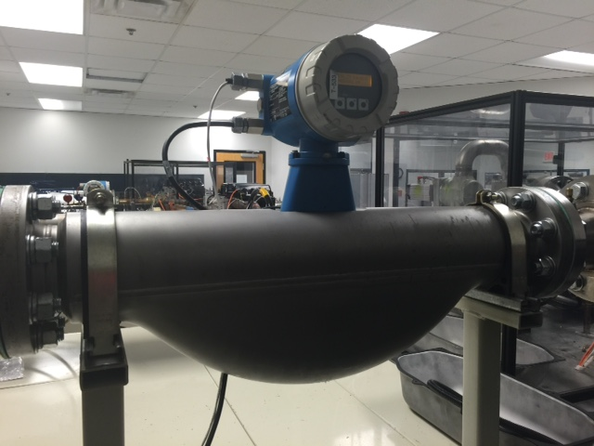
Danfoss Turbocor
Danfoss Turbocor is the world leader in oil-free centrifugal compressors.
Danfoss Turbocor is currently only able to measure compressor efficiency on site.
Mass Flow of the refrigerant is necessary to calculate efficiency.
Figure 1: Endress-Hauser flow meter
Presenter : Luis Mendez
Notes:
To begin I want to give a little background on Turbocor and what they do. Danfoss Turbocor has designed maglev technology that uses magnetic bearings to levitate the compressor shaft eliminating the need for oil.
Currently Turbocor can only measure the efficiency of these compressors at their testing facility using a very bulky in-line mass flow sensors.

Slide 3
Customer Needs
Need Statement: Turbocor seeks to add value to their existing product in order to compete with emerging technologies by determining real time efficiency at application sites.
Goal Statement: Integrate external mass flow sensor to aid in measuring real time efficiency of Turbocor compressors.
Presenter : Luis Mendez
Notes:
Currently, more companies are starting to develop oil free compressors making the field more competitive. To stand out on top, Turbocor wants to develop a failure modes prediction system to provide to their customers. As of now Turbocor does not have a way of acquiring real time data or monitoring real time efficiency of their compressors.
Our goal here is to concentrate on providing a means by which Turbocor can measure real-time efficiency on existing Turbocor platforms that can easily be used with their current compressor monitoring system. This is a stepping stone in developing a failure modes prediction system.

Slide 4
Project Scope
Using an externally mounted mass flow sensor, develop a package to determine real time compressor efficiency
Collected data will eventually be used to help determine future failure modes.
Presenter : Luis Mendez
Notes:
Our first major task was to determine what our sponsor Turbocor wanted from us that would be helpful to them in the future but also comply with the requirements of this class. We jumped from designing algorithms to determine failure modes to mass storage device integration and finally to what we are working on today with developing an externally mounted mass flow sensor package to determine compressor efficiency.

Slide 5
Our Needs
Determine relevant thermodynamic properties and required parameters.
Research relations/equations to calculate desired values.
Use Turbocor supplied software and data to test equations.
Analyze sensor output to determine compatibility.
Test system and determine errors and possible remedies.
Presenter : Luis Mendez

Slide 6
Design Concept
Use existing ultrasonic sensors with corresponding modules to determine mass flow rate and focus on integrating sensor outputs into existing Turbocor platforms.
Presenter : Luis Mendez
Notes:
After choosing a direction and examining the properties of the system we had two basic approaches we came up with. We could use existing ultrasonic transducers and compute our own algorithms for analyzing the output. This would also entail designing the assembly with to mount the system on the chiller. Our other idea was to find a complete sensor set that we could interface with the existing compressor hardware. This would allow us to focus on integration and the mounting mechanism itself.

Slide 7
Potential Challenges
Maintaining budget (~$2000)
Flow measurement accuracy (<1% error)
Clamp versatility
Compatibility of systems
      Sensors must have output that can be integrated into Turbocor’s existing platform.
Calibration of System
Presenter : Luis Mendez
Notes:
The direction we chose has its own perils. First, these sensors tend to be expensive. Research showed systems can range from hundreds to thousands of dollars. Another concern is accuracy. Our sponsors want less than 1% error in our measurement. Another potential problem is compatibility. There are only a small number of unused inputs and our system must be able to interface with what is available. In addition it would be beneficial if the system needed as little calibration as possible for field setup. Part of the entire concept of automated data analytics is reducing the need for onsite visits from technicians. If the system is too difficult to setup it would be counter to this ideal.

Slide 8
Current Progress
Researched relevant thermodynamic principles
Developed equation model using simplified system diagram
Ordered ultrasonic sensor
Acquired NI myRIO for data testing and acquisition
Acquired temperature sensors
Contacted Danfoss about scheduling times at their test facility
Presenter: Brian Roberts

Slide 9

Necessary Parameters
Available Parameters
  $T_{in,compressor}$
  $T_{out,compressor}$
  $P_{in,compressor}$
  $P_{out,compressor}$
Required Parameters
  $T_{water,in}$
  $T_{water,out}$
  ${\dot{m}}_{water}$
  $h_{R,in_chiller}$
Figure 2 : Thermodynamic Cycle
Presenter : Brian Roberts
Notes:
From all of these correlations we currently have access to: available parameters
We will then need to measure: required parameters
And finally we can find work out and efficiency.

Slide 10
Thermal-Fluid Correlations
${\dot{Q}}_{w}={\dot{m}}_{w}c_{p,w}\left(T_{w,in}−T_{w,out}\right)$
${\dot{Q}}_{R}={\dot{m}}_{R}\left(h_{R,in}−h_{R,out}\right)$
${\dot{W}}_{out,comp}=\left(P_{in,R}−P_{out,R}\right){\dot{V}}_{R}$
$η_{comp}=\frac{{\dot{W}}_{out,comp}}{{\dot{W}}_{in,comp}}$
Where:
${\dot{m} }_{w}=$ mass flow rate of water
${\dot{m}}_{R} =$ mass flow rate of refrigerant
$T_{w,in}$ = Inlet water temperature
$T_{w,out}=$ exit water temperature $h_{R,in}$ = inlet enthalpy of refrigerant
$h_{R,out}$ = exit enthalpy of refrigerant
$P_{in,R}$ = inlet pressure of refrigerant
$P_{out,R}$ = exit pressure of refrigerant
${\dot{V}}_{R}$ = volume flow rate of refrigerant
Presenter : Brian Roberts
Notes:
Here we have the heat transfer concepts that are involved with the evaporator
The first two equations are basic expressions for the rate of heat transfer experienced by a fluid. As seen in the previous figure the rate of heat transfer experienced by the water theoretically is the same heat transfer experienced by the refrigerant. This assumption allows us to find the rate of heat transfer of the refrigerant and ultimately the mass flow rate of the refrigerant without having to cut any pipes to insert an in-line mass flow sensor in the compressor cycle.
After we determine the mass flow rate of the refrigerant the next step is to calculate the power that the compressor is out putting by cooling the water using the third correlation.
Finally, the power output can be used to calculate the efficiency of the compressor.
The issue here is that we have made a major assumption that the evaporator transfers 100% of the heat or that it is 100% effective when we know that this isn’t true.

Slide 11
Sensor Selection Matrix
Characteristics Weighted 1-5 | Accuracy | Cost | Pipe ᴓ (m) | Fluid Temp(°C) | Fluid Velocity(m/s) | Calculate Q̇ ? | Output (Analog or Digital) | Total
 | 5 | 3 | 4 | 4 | 4 | 3 | 2
 | Actual Values rated from 0-3
Sierra InnovaSonic 210i | ±0.5% 3 | $3,170 1 | 0.15 to 6 3 | -40 to 80 2 | 0.05 to 12 1 | No 0 | A 2 | 46
Dalian Hipeak TDS-100 | > ±1% 2 | $500-700 3 | 0.15 to 7 3 | 0 to 90 2 | -30 to 30 3 | Yes 3 | A/D 3 | 66
GE Panametrics PT878 | ±1% 1 | $10,035 0 | .13 to 7.6 3 | -10 to 50 1 | -40 to 40 3 | No 0 | A/D 3 | 39
Greyline TTFM 1.0 | ±1% 1 | $2,600 2 | 0.12 to 1.2 2 | -40 to 150 3 | 0.02 to 12 2 | No 0 | A 2 | 43
Table 1 : Selection Matrix
Presenter : Brian Roberts
Notes:
Several models of sensors were researched and analyzed. The best four out of the packages found are presented here in a selection matrix. The customer requirements were weighted from 1 to 5 and each model was assigned a value from 0 to 3 corresponding to how well it meets the design criteria. From this analysis it was determined that the Dalian Hipeak TDS-100 would best suit our needs.

Slide 12
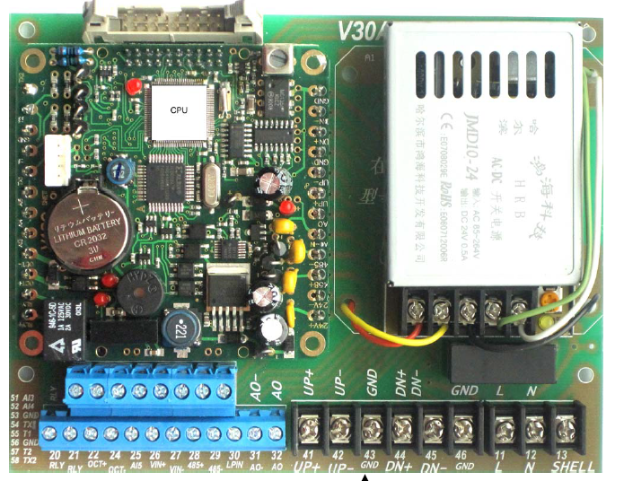
TDS-100
Large range of pipe diameters
  15 cm to 7 m
Appropriate range of fluid temperatures
  0-90°C
Adjusts for current fluid temperature
Mounting points included
Versatile Output
  RS-485
  Analog 4-24mA
Figure 3 : TDS-100 Control Board
Presenter : Brian Roberts
Notes:
The TDS-100 is a versatile machine. Depending upon the configuration, it can measure velocities on pipes from 15cm to 18m. With added temperature sensors it can also adjust for the changing properties of the fluid due to differences in temperature in its operating range. Another benefit for our purpose is the included mounting points which can be used to integrate the TDS-100 into our mounting apparatus. In addition there are multiple types of output including the standard RS-485 communication protocol or an analog signal that ranges from 4-24mA. Both of these options would work for the existing system.

Slide 13
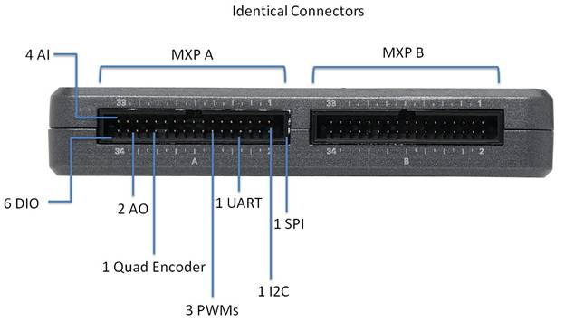
NI myRIO
A versatile system with multiple inputs and outputs
An interface with the computer via LabVIEW
Allows logging of data into excel files
Figure 4 : NI myRIO input/output
Presenter : Brian Roberts
Notes:
While researching the best way to calculate the mass flow rate without being intrusive to the current customer platforms we came across many different principles that can provide the necessary information. The only one that we found that was externally mounted was the ultrasonic mass flow sensor which was found to also be very accurate and robust.

Slide 14
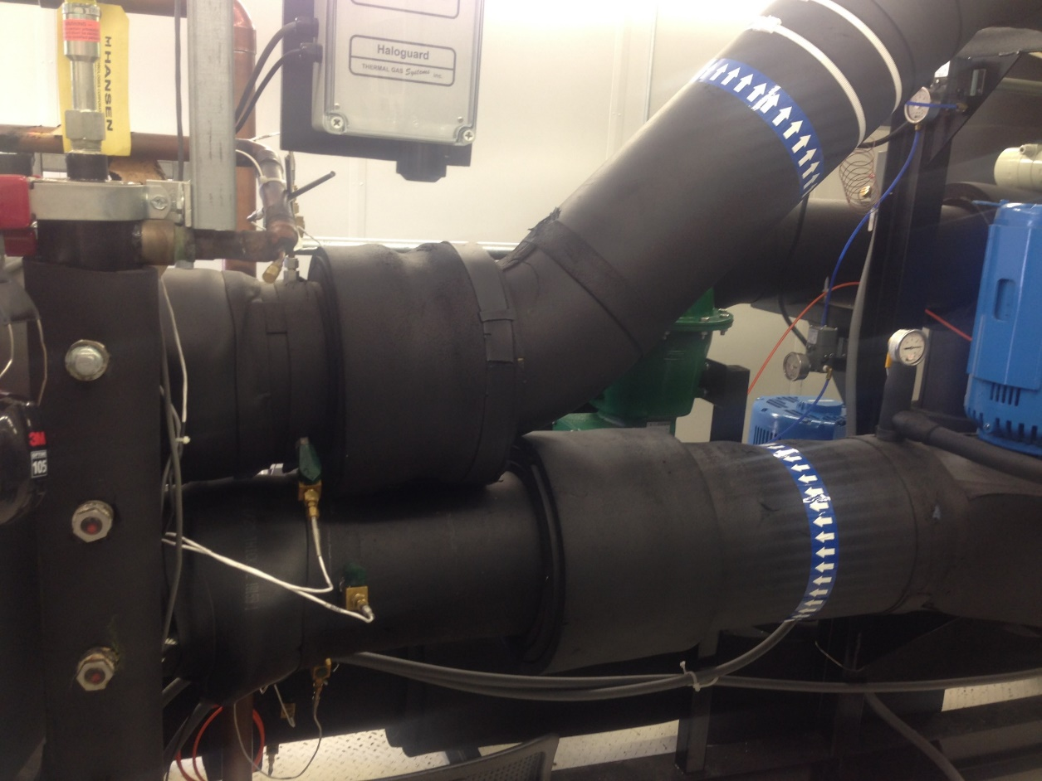
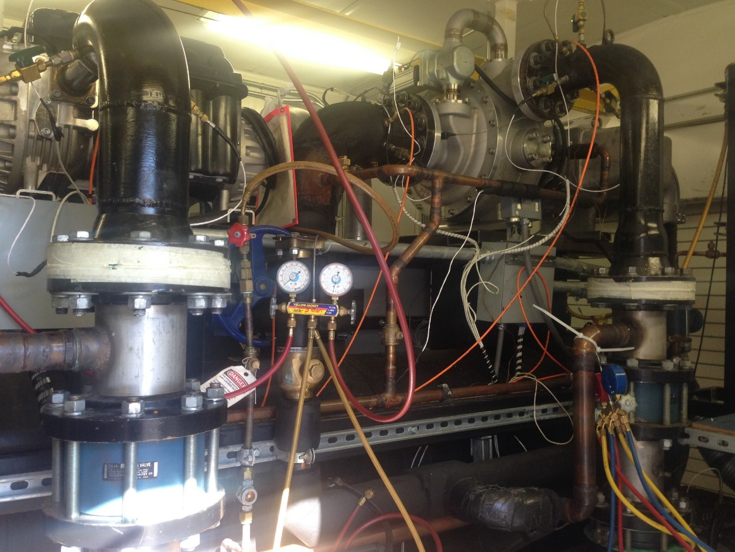
Test Facility “Chiller 3”
Full access to all operating parameters on either TT or VTT model
  Compressor Input power [kW]
  Necessary Temperature and Pressure
Minor System modifications allowed
Figure 5 : Danfoss Turbocor Chiller 3 Test Rig
Figure 6 : Inlet/Outlet of Evaporator
Presenter: Beau Rodgers

Slide 15
Future Plans
Use test data to validate our thermodynamic model.
Use hardware dimensions to begin CAD design of mounting clamp.
Work with our Turbocor advisor (system programmer) to develop pseudocode necessary to be adopted into the Turbocor platform.
Presenter : Beau Rodgers
Notes:
Moving forward we need to begin acquiring the physical parts of our system and designing the mounting bracket. After we assemble the system we can start running tests to analyze our thermodynamic model. The next step will be to integrate the system and determine overall efficiency for the compressor.

Slide 16
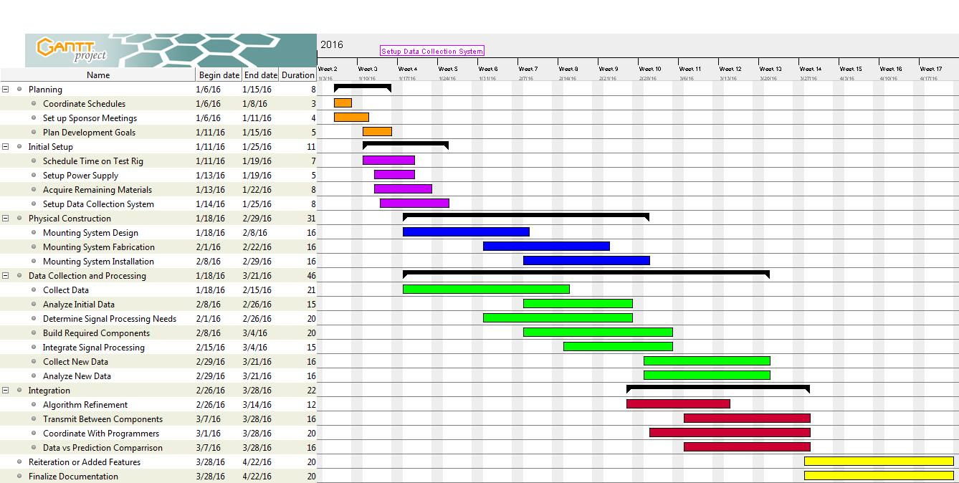
Project Plan
Figure 14 : Gantt Chart
Presenter: Beau Rodgers
Notes:
Here is the Gantt chart we are currently using to guide our progress. Currently we are finalizing our needed parts and working on designing the bracket itself. We would like to get to prototyping early in the spring semester so that we can quickly move on to running experiments on the system.

Slide 17
Conclusion
As new technologies begin to challenge Turbocor’s dominance, they desire added value for their products to maintain market share.
One way to achieve this goal is to add the ability to analyze data both instantly and over an extended period.
To aid in the goal of advanced data analytics we are designing a sensor module that can determine compressor efficiency to integrate into their platform.
Measuring efficiency is a necessary stepping stone towards advanced failure modes analysis.
Presenter : Beau Rodgers
Notes:
As any new technology become more common place, competition becomes ever fiercer for the originator of the technology. Turbocor is looking forward and trying to maintain their place at the top of the frictionless compressor market. One approach they are taking is to add features to their existing product, specifically data analytics. This allows for failure prediction before they occur and prevent unnecessary damage to equipment. To achieve their goals several different metrics need to be monitored. Compressor efficiency is one important aspect that can reveal system health. To help them in their goal we are working to determine the mass flow rate of the refrigerant which they are not currently able to monitor.

Slide 18
Questions?

Slide 19
References
https://www.gemeasurement.com/flow-measurement/ultrasonic-liquid/transport-pt878-portable-ultrasonic-liquid-flow-meter
      Ge Panametrics PT878
http://www.sierrainstruments.com/products/210Prod.html
      Sierra InnovaSonic 210i
http://www.ecefast.com.au/media/blfa_files/TDS-100Fmanual_ece.pdf
      Dalian Hipeak TDS-100F
http://www.greyline.com/ttfm10.htm
      Greyline TTFM 1.0
http://www.us.endress.com/en
      General Massflow Sensor information
http://www.cdiweb.com/Manufacturers/sensata/FP/Pressure_Transducer-Transmitter/?type=94&manf=512&cate=512:10&NavType=2#null
      TI 112CP3-4

