Slide 1
Mass Flow Sensor Integration
Team 5:
Beau Rodgers
Luis Mendez
Brian Roberts
Keenan Cheeks
Sponsored by: Danfoss Turbocor
Advised by: Dr. Shih
Notes:
We are working together with our sponsor Danfoss Turbocor, and our faculty advisor Dr. shih.

Slide 2
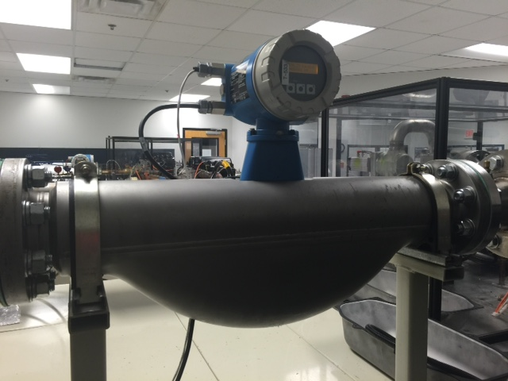
Danfoss Turbocor
Danfoss Turbocor is the world leader in oil-free centrifugal compressors.
Danfoss Turbocor is currently only able to measure compressor efficiency on site.
Mass Flow of the refrigerant is necessary to calculate efficiency.
Figure 1: Endress-Hauser flow meter
Presenter : Keenan Cheeks
Notes:
To begin I want to give a little background on Turbocor and what they do. Danfoss Turbocor has designed maglev technology that uses magnetic bearings to levitate the compressor shaft eliminating the need for oil.
Currently Turbocor can only measure the efficiency of these compressors at their testing facility using very bulky in-line mass flow sensors.

Slide 3
Problem Definition
Need Statement: Turbocor seeks to add value to their existing product in order to compete with emerging technologies by determining real time efficiency at existing application sites.
Goal Statement: Integrate externally mounted mass flow sensor to aid in measuring real time efficiency (COP) of Turbocor compressors.
Presenter : Keenan Cheeks
Notes:
Currently, more companies are starting to develop oil free compressors making the field more competitive. To stand out on top, Turbocor wants to develop a failure modes prediction system to provide to their customers. As of now Turbocor does not have a way of acquiring real time data or monitoring real time efficiency of their compressors.
Our goal here is to concentrate on providing a means by which Turbocor can measure real-time efficiency on existing Turbocor platforms that can easily be used with their current compressor monitoring system. This is a stepping stone in developing a failure modes prediction system.

Slide 4
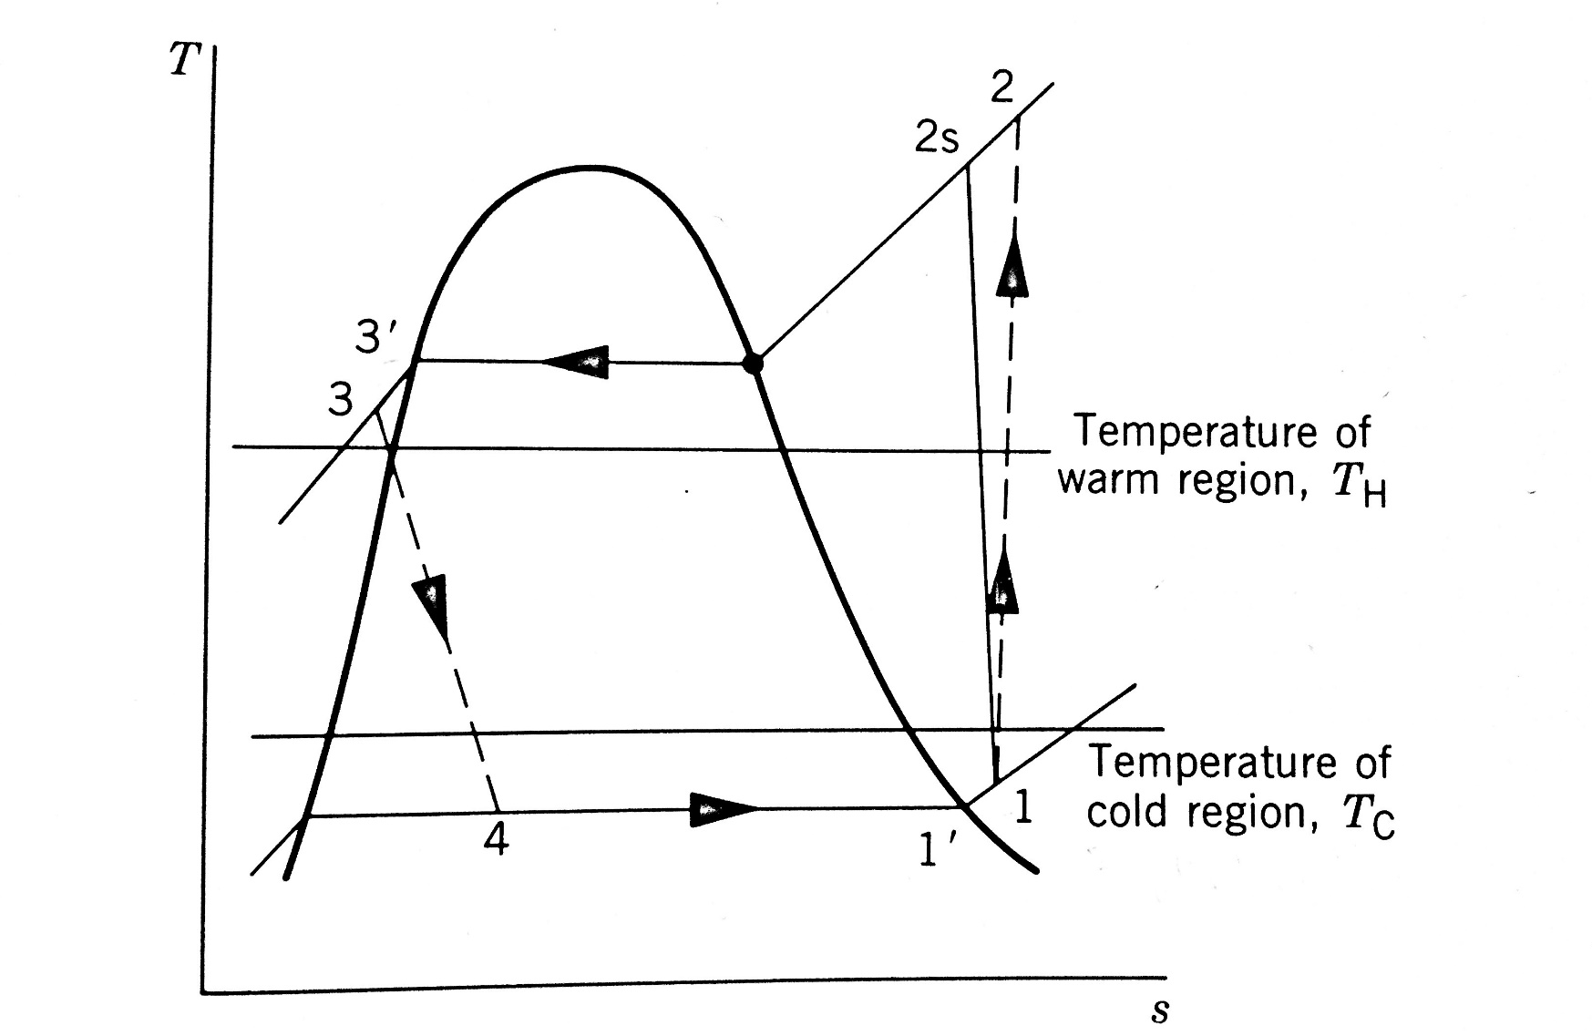
Thermodynamic Principles
Figure 3: Cycle T-s Diagram
Figure 2: System Diagram
Presenter : Keenan Cheeks
Notes:
To provide this to Turbocor we must first understand the thermodynamics behind the water cooled HVAC systems that Turbocor compressors are used in. Here is a simplified diagram of the refrigerant cycle of system with relevant temperatures and pressures. The process starts on the suction side of the compressor and continues through the condenser to the throttling process and finally to the evaporator where heat is removed from the water that is providing AC to the environment.
Looking at a Temperature-entropy diagram for a compressor we can extract the information that is needed to define the efficiency and the coefficient of performance of the evaporator as well as the compressor itself which is our goal. After meeting with Dr. Kumar and engineers at Turbocor we have recently discovered errors in our thought process and found new ways to obtain these efficiencies.

Slide 5


Thermodynamic Principles
$COP=\frac{P_{in,comp}}{{\dot{m}}_{w}{∗c}_{p}∗(T_{w,in −}T_{w,out })}$
${\dot{W}}_{out,comp}=\left(P_{in,R}−P_{out,R}\right){\dot{V}}_{R}$
${\dot{Q}}_{R}= {\dot{m}}_{evap}∗∆h_{isentropic}$
$η_{comp}=\frac{{\dot{m}}_{evap}∗(∆h_{isentropic}\text{) }}{P_{in,comp}}$
Where:
${\dot{m} }_{w}=$ mass flow rate of water
$\text{COP}\text{ = }\text{coefficient} \text{of} \text{performance}$
$c_{p}\text{ = }\text{Specific} \text{Heat} \text{Capacity}$
$P_{in,comp}\text{ = }\text{Power} \text{drawn} \text{by} \text{compressor}$
$T_{w,in}$ = Inlet water temperature
$T_{w,out}=$ exit water temperature
$P_{in,R}$ = inlet pressure of refrigerant
$P_{out,R}$ = exit pressure of refrigerant
${\dot{V}}_{R}$ = volume flow rate of refrigerant
$h_{2s}$ = Isentropic enthalpy at discharge
$h_{4}$ = Enthalpy at evaporator entrance
${\dot{m}}_{evap} =$ mass flow rate in evaporator $∆h_{isentropic}$ = $h_{2s}$ - $h_{4}$
Presenter : Keenan Cheeks
Notes:
First, we found that in industry the COP is used to express how well the system is running and is given by this first equation. With the mass flow rate sensor that we purchased we will be able to find each parameter to give the COP in the KW/TON of cooling capacity standard.
Then, we discovered that our definition of the compressor power output was incorrect because we did not take into account that some of the mass flow rate of the refrigerant through the compressor, which is used to find the volume flow rate, is actually sent to cool the motor and perform other task. This means that we would be artificially overinflating the efficiency of the machine by using this equation here.
To overcome this adversity we will instead be using this equation which gives the work done by the compressor with the correct amount of refrigerant flow rate. Logically that mass flow rate will be the mass flow rate of the refrigerant going to the heat exchanger providing the cooling capacity.
The cooling or refrigeration capacity is defined as the rate of heat transfer of refrigerant through a control volume enclosing the refrigerant side of the evaporator. We will be assuming that the heat transfer between the refrigerant and water are equal which means that the ${\dot{Q}}_{R}$ is the same as ${\dot{Q}}_{w}$. Thus, by using refrigerant tables the mass flow sensor and temperature sensors we will know the mass flow rate through the evaporator.
Finally, we will be able to find the efficiency of the compressor itself using the final correlation here.
The reason we must use isentropic enthalpy difference in these two equations is because it gives the ideal power output with the given evaporator refrigerant flow rate.

Slide 6
Mass Flow Sensor Requirements
Externally mounted with no cutting required
Accuracy within ±1%
Able to interface with existing hardware
System cost <$1000
Presenter : Brian Roberts

Slide 7
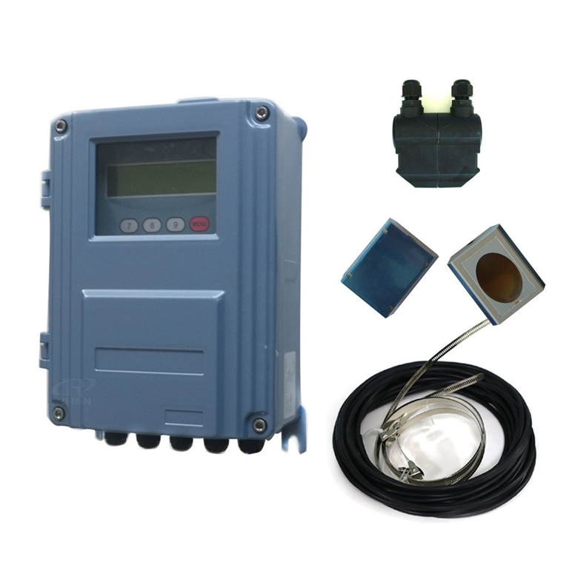
Mass Flow Sensor Choice
    TDS 100-F
Large range of pipe diameters
      15 cm to 7 m
Appropriate range of fluid temperatures
      0-90°C
Adjusts output for current fluid temperature
Versatile Output
      RS-485
      Analog 4-24mA
Figure 4 : TDS 100-F Mass Flow Sensor
Presenter : Brian Roberts

Slide 8
Hardware Integration
Quick release mounting system being designed for sensor package
National Instruments myRIO will be used to collect sensor data
After sensor calibration, device will be wired directly to compressor control board
Presenter : Brian Roberts

Slide 9
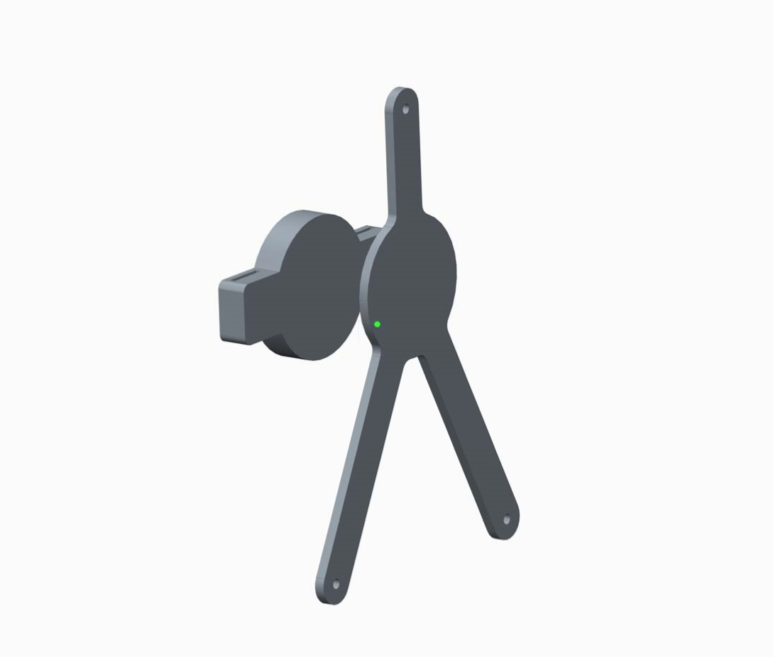
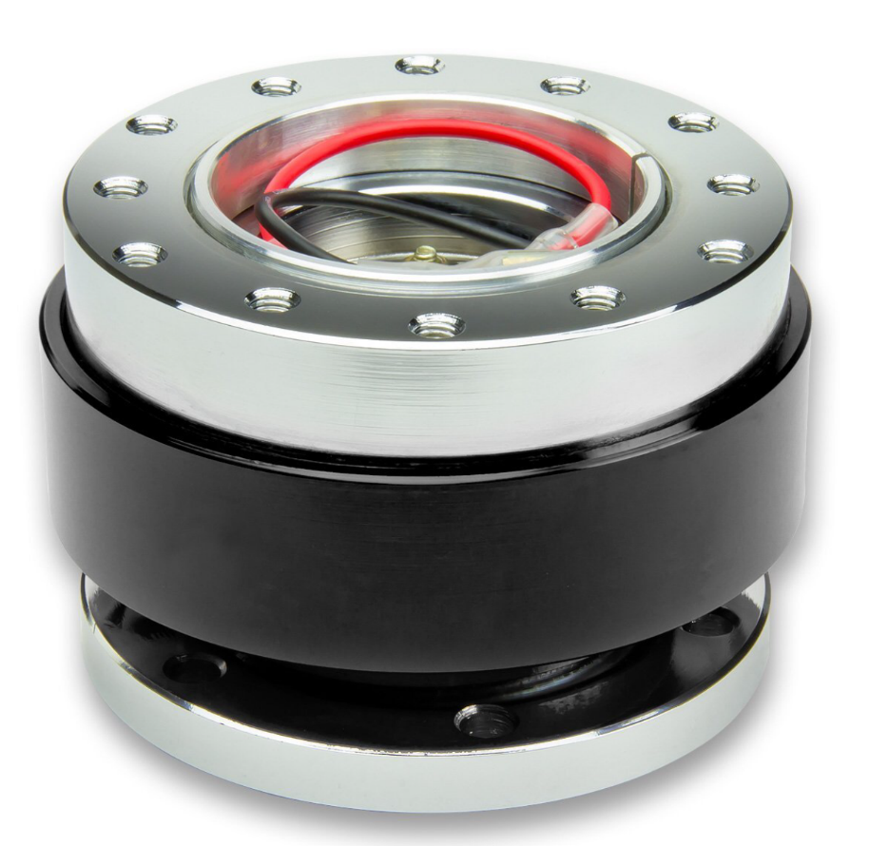
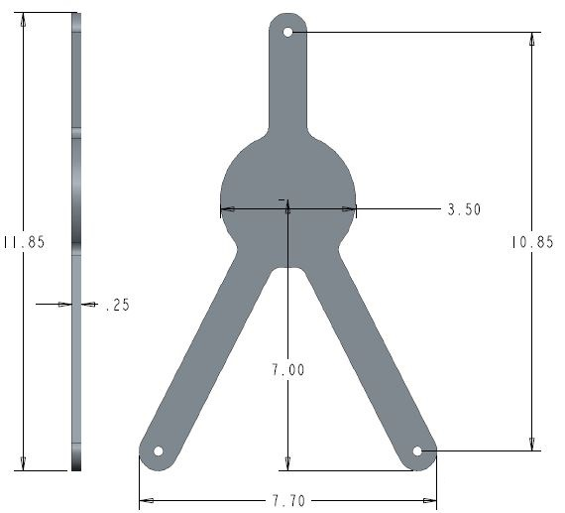
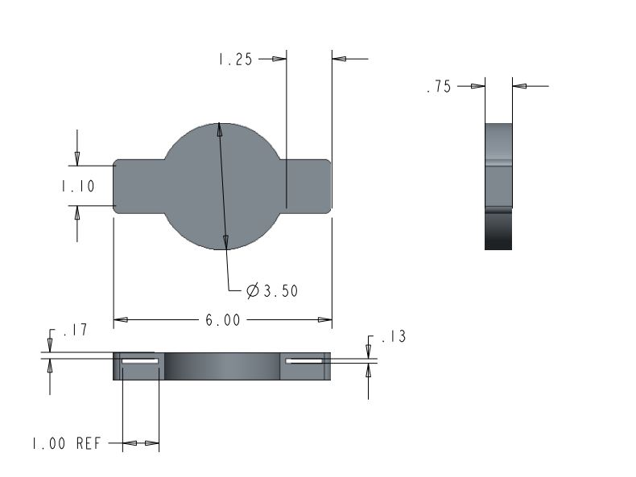
Mounting Bracket
Figure 7 : Mounting Bracket Assembly
Figure 5 : Mounting Bracket - Pipe
Figure 8 : Quick Release Mechanism
Figure 6 : Mounting Bracket - Sensor
Presenter : Brian Roberts

Slide 10
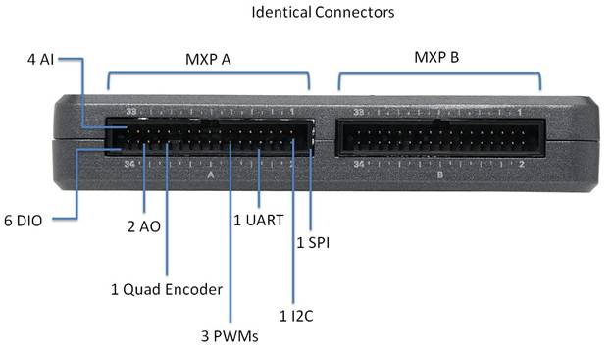
myRIO
Versatile I/O
  10 analog inputs
  6 analog outputs
  40 digital I/O lines
256 MB Internal Memory
USB 2.0 Port
Xilinx FPGA and dual-core ARM Cortex-A9 processor
  667 MHz
Programmable with LabVIEW or C
Figure 9 : myRIO
Presenter : Brian Roberts

Slide 11
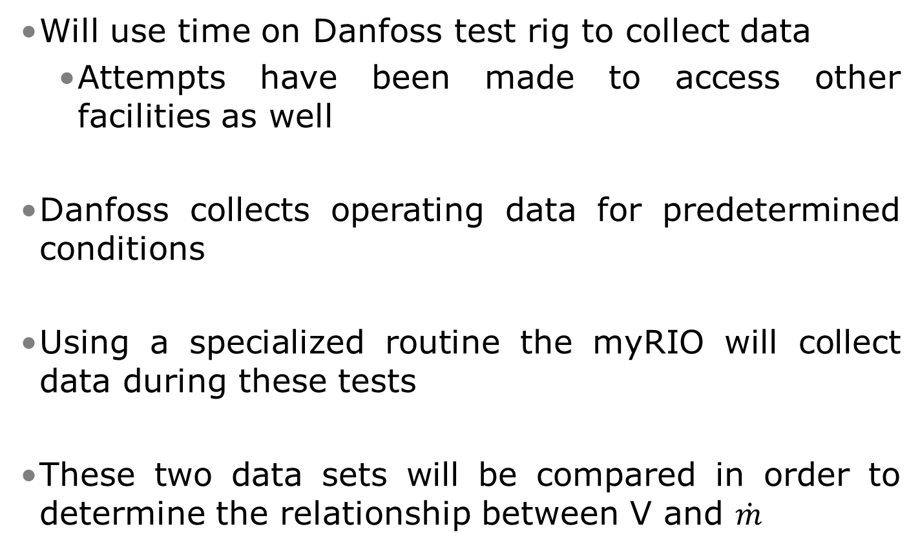
Sensor Calibration
Will use time on Danfoss test rig to collect data
    Attempts have been made to access other facilities as well
Danfoss collects operating data for predetermined conditions
Using a specialized routine the myRIO will collect data during these tests
These two data sets will be compared in order to determine the relationship between V and $\dot{m}$
Presenter : Brian Roberts

Slide 12
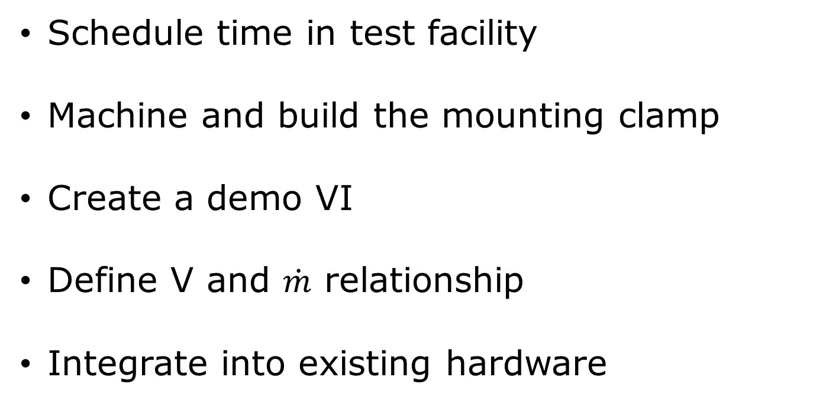
Future Plans
Schedule time in test facility
Machine and build the mounting clamp
Create a demo VI
Define V and $\dot{m}$ relationship
Integrate into existing hardware
Presenter : Keenan Cheeks

Slide 13
Conclusion
Danfoss desires the ability to determine real-time efficiency
In order to fulfill this request a mass flow sensor needs to be added to the system
An Ultrasonic mass flow sensor meets the requirements
Data analysis process has been initiated.
Presenter : Keenan Cheeks

Slide 14
Questions?

Slide 15
References
https://www.gemeasurement.com/flow-measurement/ultrasonic-liquid/transport-pt878-portable-ultrasonic-liquid-flow-meter
      Ge Panametrics PT878
http://www.sierrainstruments.com/products/210Prod.html
      Sierra InnovaSonic 210i
http://www.ecefast.com.au/media/blfa_files/TDS-100Fmanual_ece.pdf
      Dalian Hipeak TDS-100F
http://www.greyline.com/ttfm10.htm
      Greyline TTFM 1.0
http://www.us.endress.com/en
      General Massflow Sensor information
http://www.cdiweb.com/Manufacturers/sensata/FP/Pressure_Transducer-Transmitter/?type=94&manf=512&cate=512:10&NavType=2#null
      TI 112CP3-4

