Slide 1
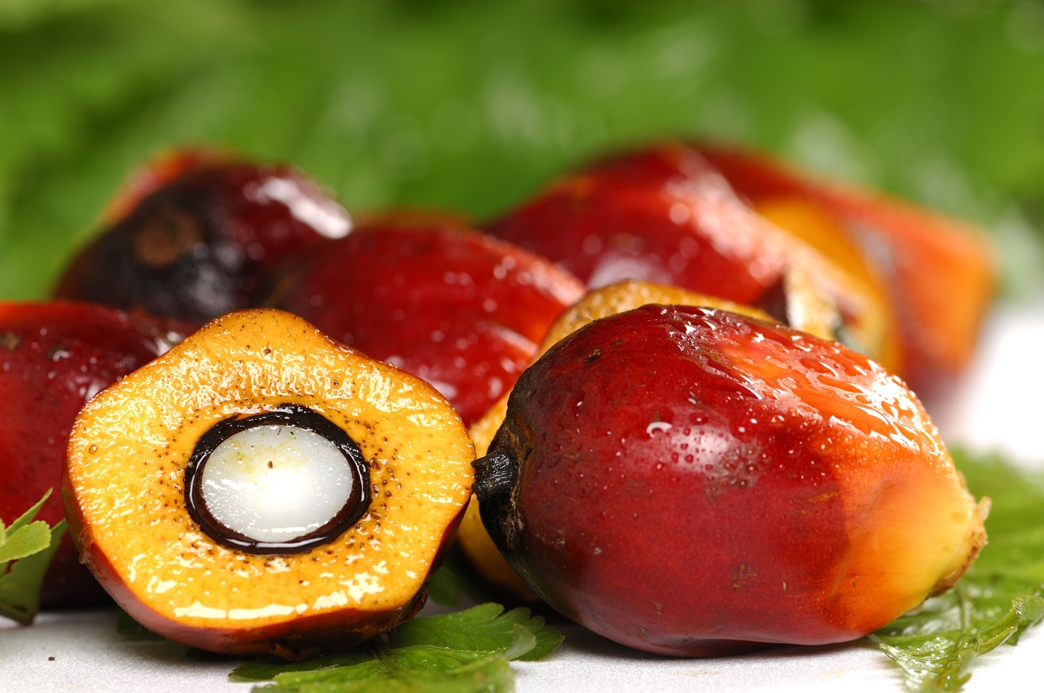
Group 10
Semi-Autonomous
Oil Palm Fruit Harvesting
Analyze Phase
Maria Vetencourt
Matthew Gerstenblitt
Patrick Howard
Gabriel Diez
Alberto Machado
Derek Morin
Enrique Gonzalez
Notes:
Introduce yourself

Slide 2
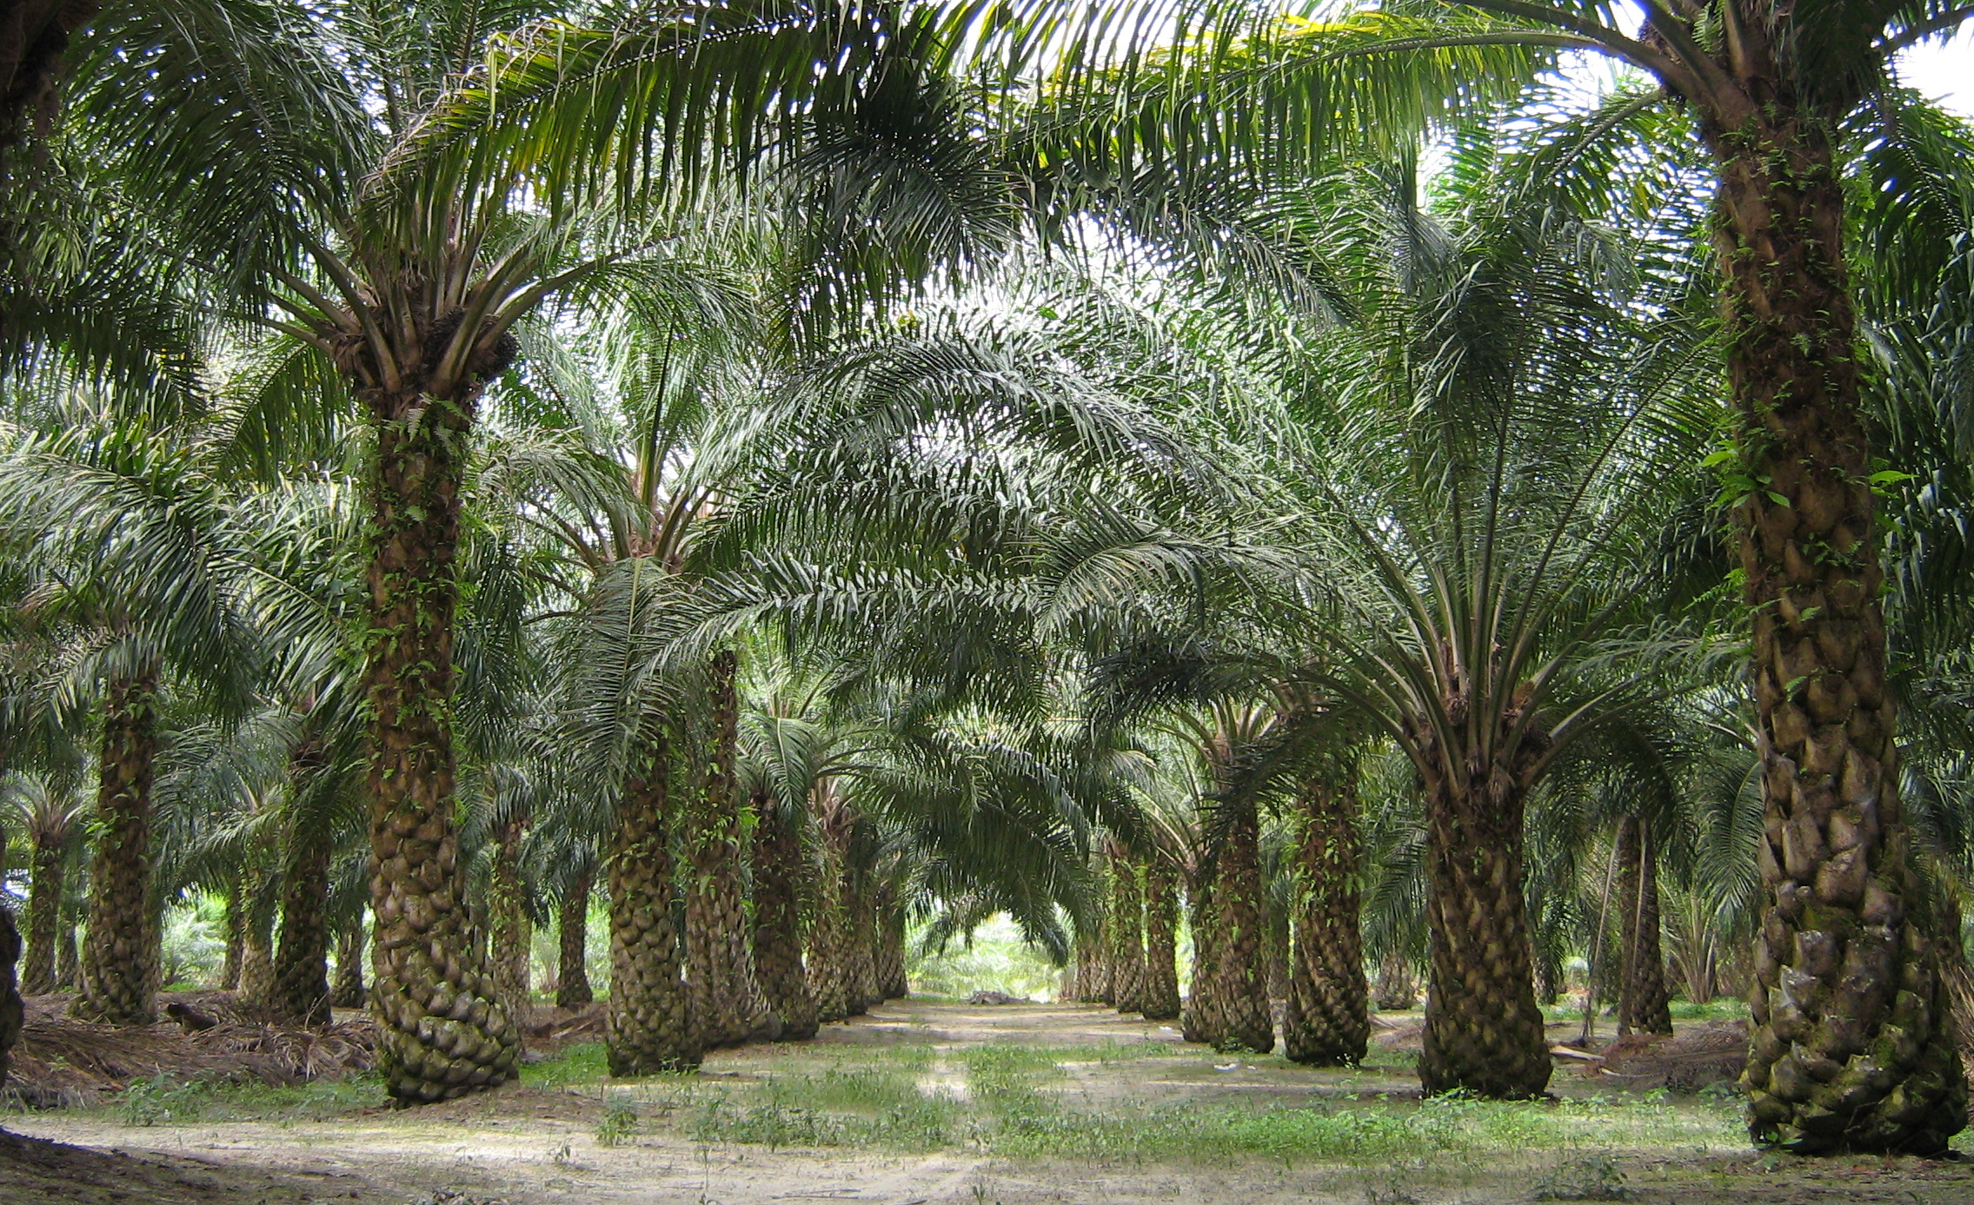
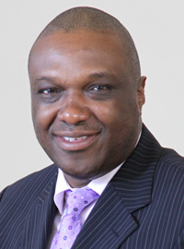
Sponsor
Dr. Okenwa Okoli
Maria Vetencourt
Notes:
Introduce sponsor

Slide 3

Stakeholders
Dr. Okenwa Okoli
Maria Vetencourt
Maria Vetencourt
3
Notes:
Stakeholders include…
Dr. Okoli, our sponsor

Slide 4
Stakeholders
Dr. Okenwa Okoli
Dr. Nikhil Gupta
Maria Vetencourt
Maria Vetencourt
3

Slide 5
Stakeholders
Dr. Okenwa Okoli
Dr. Nikhil Gupta
Dr. Jerris Hooker
Maria Vetencourt
Maria Vetencourt
3

Slide 6
Stakeholders
Dr. Okenwa Okoli
Dr. Nikhil Gupta
Dr. Jerris Hooker
Ms. Margaret Scheiner
Maria Vetencourt
Maria Vetencourt
3

Slide 7
Stakeholders
Dr. Okenwa Okoli
Dr. Nikhil Gupta
Dr. Jerris Hooker
Ms. Margaret Scheiner
Mr. Ryan Adams
Maria Vetencourt
3

Slide 8
Stakeholders
Dr. Okenwa Okoli
Dr. Nikhil Gupta
Dr. Jerris Hooker
Ms. Margaret Scheiner
Mr. Ryan Adams
FAMU-FSU College of Engineering
Maria Vetencourt
Maria Vetencourt
3

Slide 9
Stakeholders
Dr. Okenwa Okoli
Dr. Nikhil Gupta
Dr. Jerris Hooker
Ms. Margaret Scheiner
Mr. Ryan Adams
FAMU-FSU College of Engineering
Department of Industrial and Manufacturing Engineering
Maria Vetencourt
Maria Vetencourt
3

Slide 10
Stakeholders
Dr. Okenwa Okoli
Dr. Nikhil Gupta
Dr. Jerris Hooker
Ms. Margaret Scheiner
Mr. Ryan Adams
FAMU-FSU College of Engineering
Department of Industrial and Manufacturing Engineering
Department of Mechanical Engineering
Maria Vetencourt
Maria Vetencourt
3

Slide 11
Stakeholders
Dr. Okenwa Okoli
Dr. Nikhil Gupta
Dr. Jerris Hooker
Ms. Margaret Scheiner
Mr. Ryan Adams
FAMU-FSU College of Engineering
Department of Industrial and Manufacturing Engineering
Department of Mechanical Engineering
Department of Electrical and Computer Engineering
Maria Vetencourt
Maria Vetencourt
3

Slide 12
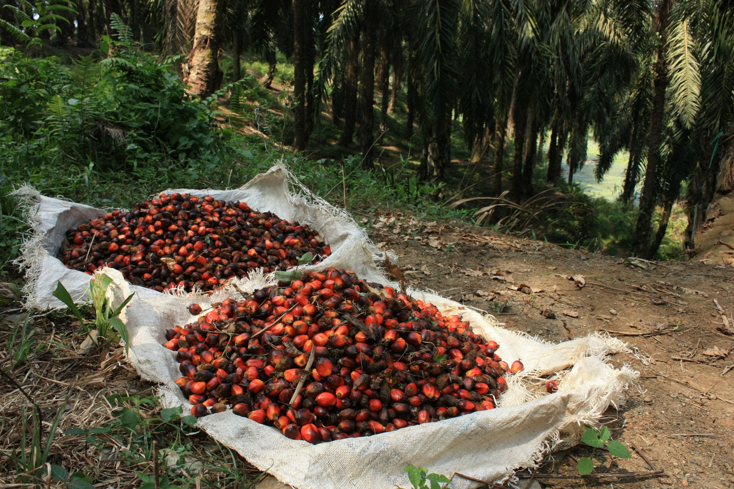
Project
Develop a device to harvest oil palm fruit
Maria Vetencourt

Slide 13

Background
Height of the trees
Fibrous consistency
Budget
Safety
Maria Vetencourt

Slide 14
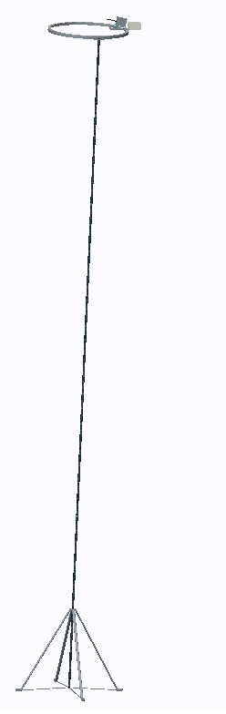
Measure Phase Design
Ring
Pole
Stand
Matthew Gerstenblitt
6
Notes:
In the previous phase, we came up with this design. We devised a ring with a cutting mechanism that traverses around the ring. It is connected by a pole to a stand. The operator would insert 5-foot sections of the pole from the ground to push the mechanism upward toward the tree.

Slide 15
Measure Phase Design
Conducted finite element analysis
  Pole could not withstand load
Required design change
Matthew Gerstenblitt
7

Slide 16
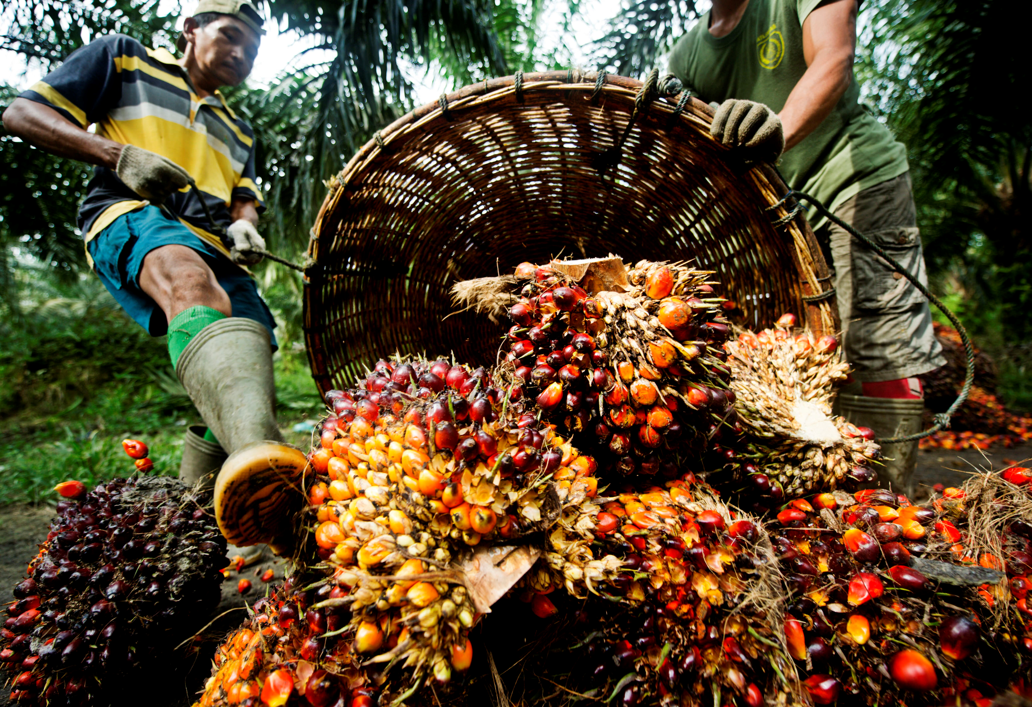
New Design
Adopted last year’s telescoping pole
Improved cutter
Matthew Gerstenblitt
Notes:
In the previous phase report we proposed three design concepts. In this selected design we borrowed ideas from two of them: the pole pruner and the tree climber.

Slide 17
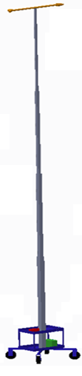
Class of 2015’s Design
Electric Pole Saw
Telescoping Poles
Utility Cart
Matthew Gerstenblitt
9
Notes:
Cite 2015 report
Telescoping pole, wheels, cart, saw
Talk about it.
The cheapest initial approach would be to improve the previous year’s design
Utilized a telescoping aluminum poll with an electric saw at the end

Slide 18
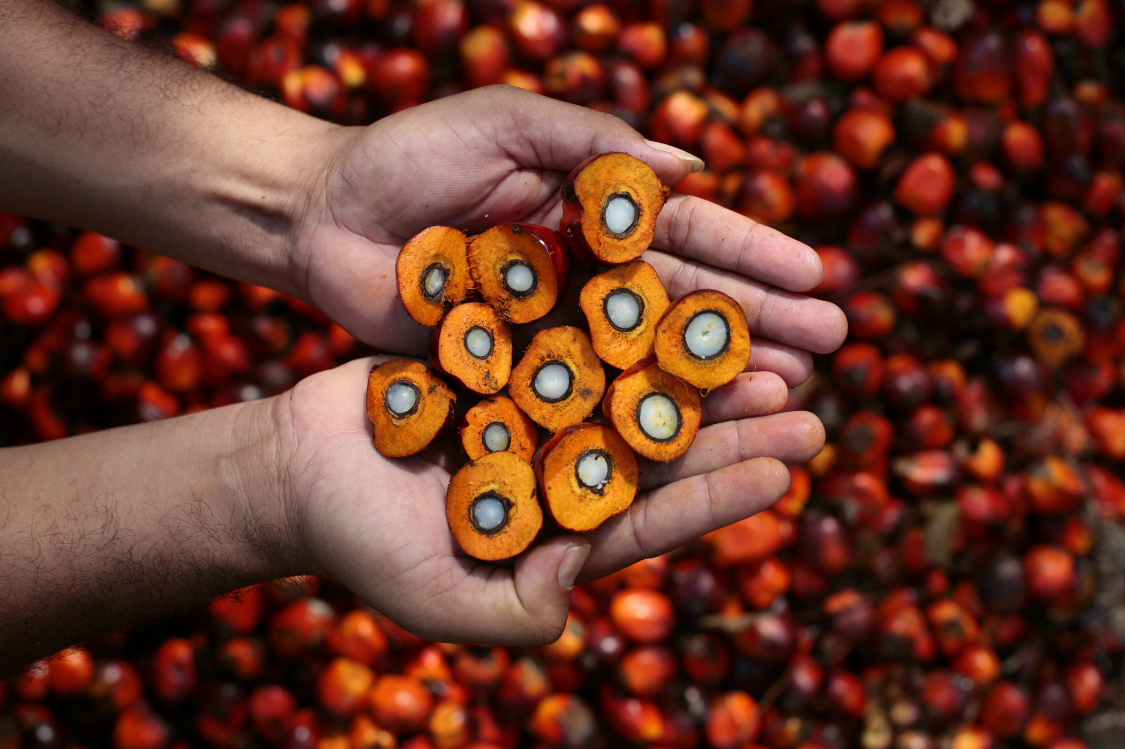
Our Design
Conducted new finite element analysis
Portability
Cutter mobility
Ring
Patrick Howard
Notes:
As you may recall, the pole pruner was a modification to an existing landscaping tool. It utilized light weight material for its pole to be able to be hand held and reach 40-feet. It also was equipped with a wireless camera so that the operator may have a better view of the fruit they are cutting.

Slide 19
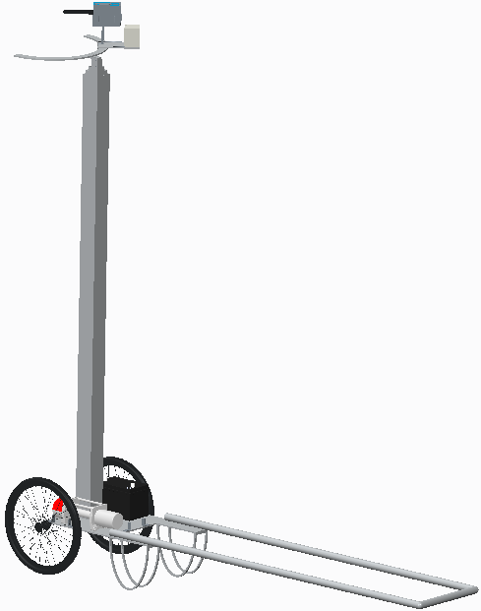
New Design
Ring
Telescoping Pole
Cart
Patrick Howard
Notes:
This is just a visual representation of the extended pole pruner, as you can see it is gas operated, it has a telescoping pole to extend to the fruit and a chainsaw equipped with a camera that can be viewed by the operator on the ground

Slide 20
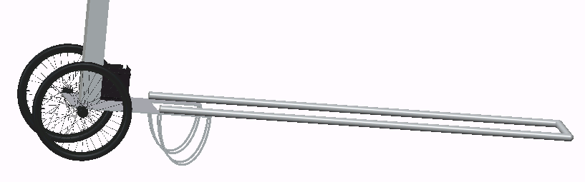
Cart
Gabriel Diez
12

Slide 21
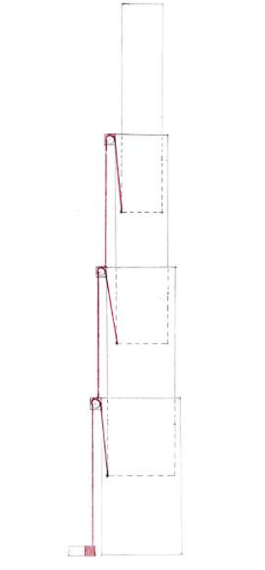
Pulley System
Gabriel Diez
13

Slide 22
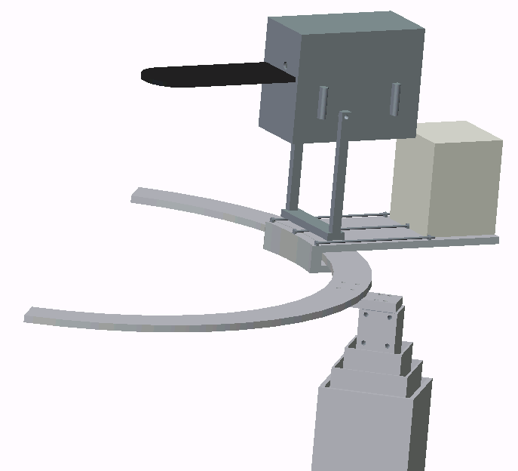
Pole and Ring
Gabriel Diez
14

Slide 23
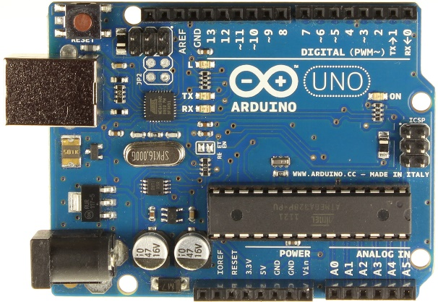
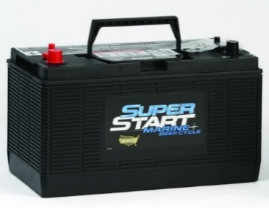
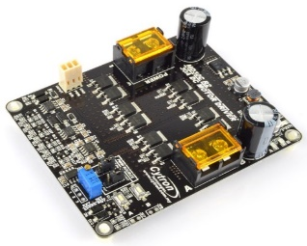
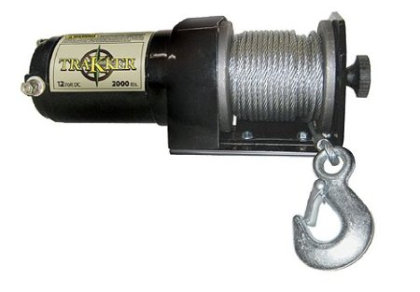
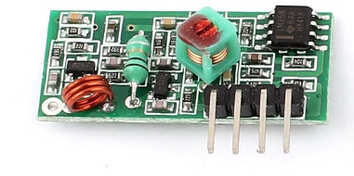
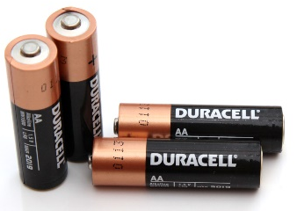
Electronic Components - Cart
Key
12V
5V
Digital/PWM
Ground
Derek Morin
15

Slide 24
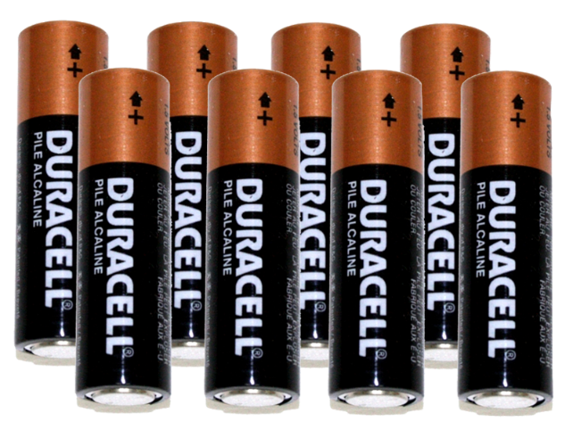

Electronic Components - Controller
Key
12V
Digital/PWM
Ground
Derek Morin
16

Slide 25


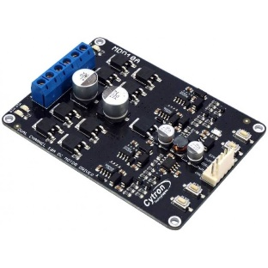
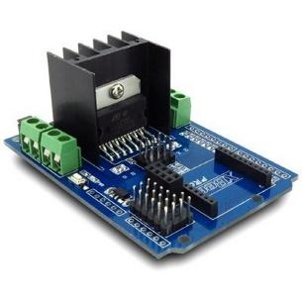
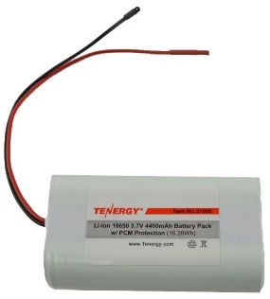
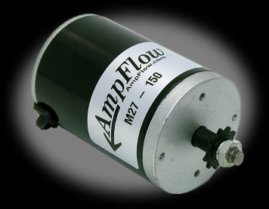
Electronic Components – Cutting Mechanism
Key
24V
5V
Digital/PWM
Digital/PWM
Bus
Ground
6 batteries
To Electronics Box 2
Derek Morin
17

Slide 26
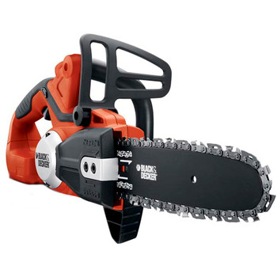
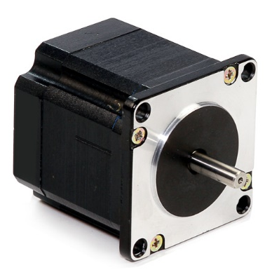
Electronic Components – Cutting Mechanism
From Electronics Box 1
Key
24V
Digital/PWM
Bus
Ground
Derek Morin
18

Slide 27

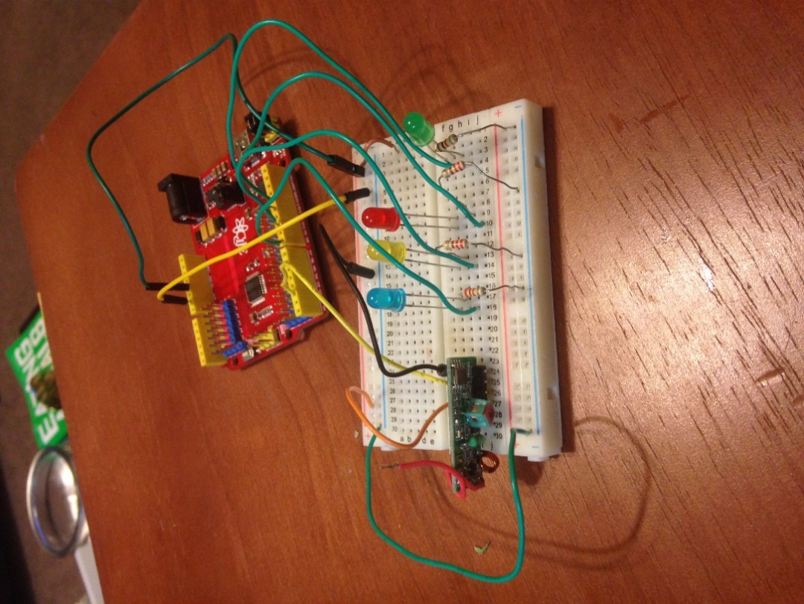
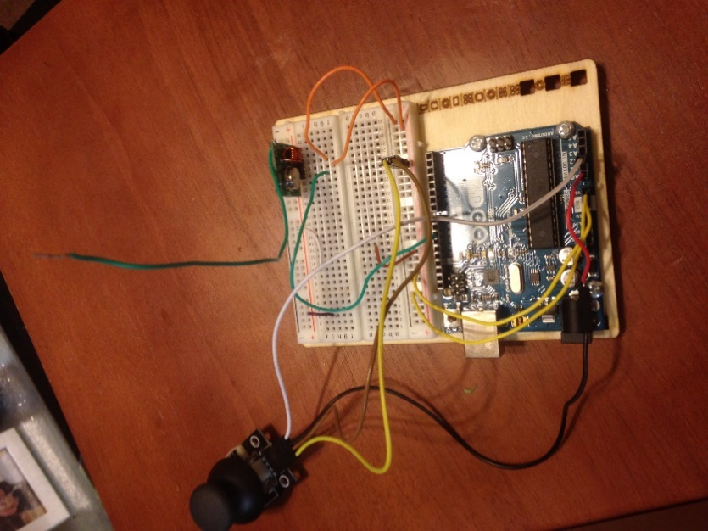
Testing
Wireless
Alberto Machado
18

Slide 28
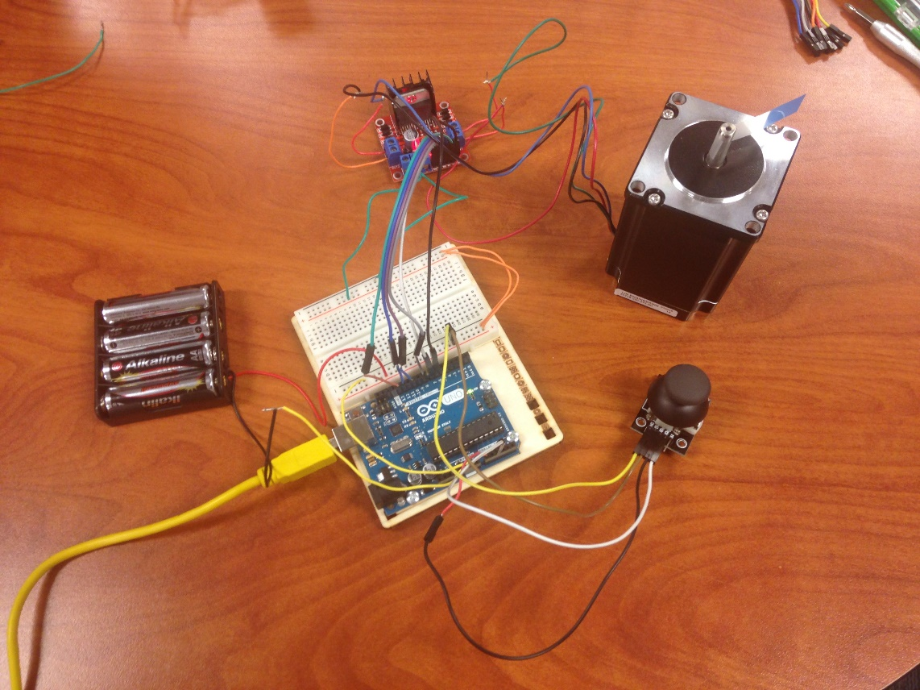
Testing
Stepper Motor
Alberto Machado
19

Slide 29
Testing
Controller
DC Motors
Winch
Saw
Whole System
Alberto Machado
20

Slide 30
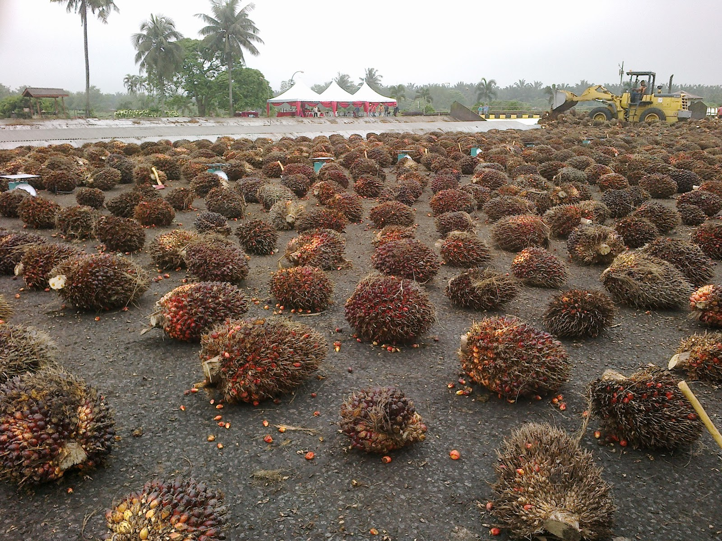
Budget
Part | Cost ($)
Ring | 1,050
3D Printing Material | 100
DC Motors | 150
DC Motors | 150
Stepper Motor | 130
Lead Screw Rod | 27
Lead Screw Nut | 12
Electrical Components | 115
Linear Bearings | 30
Shaft | 38
Shaft Housing | 20
Robot Mount | 30
Battery | 150
Total | 2,002
Enrique Gonzalez
Notes:
We decided to approach this project from the top down since the ring is not only the most complex, it’s also the most important. After designing the ring and cutter and looking for different parts we found that in order to get it to work properly and meet all design requirements it would make up the majority of our budget. Therefore, in order to leave some room in our budget for unexpected failures we have decided to concentrate the majority of the prototype assembly on the cutting and traversing mechanism, but still design the pole and base for following years to build off of.

Slide 31

Safety
Pole is well balanced and stable
Worker will be operating the device far from the tree
The chainsaw being used comes with a cover for the blade
Enrique Gonzalez

Slide 32
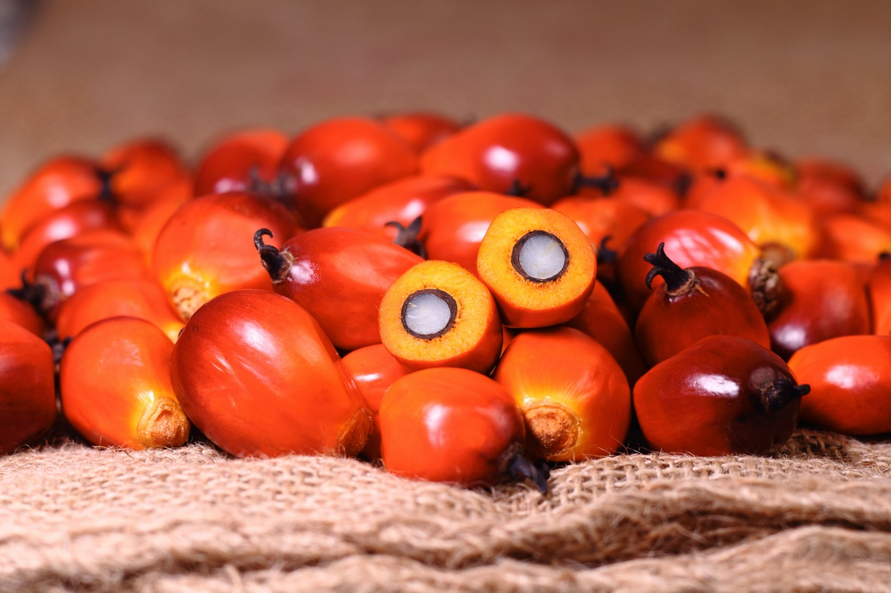
References
[1] G. Diez, P. Howard, M. Gerstenblitt, M. Vetencourt, E. Gonzalez, A. Machado and D. Morin, "Development of a Semi-Autonomous Oil Palm Fruit Harvesting Device - Define Phase," FAMU-FSU College of Engineering, Tallahassee, 2015.
[2] B. Carpenter, C. X. Smith, J. A. Rojas, W. Craig, O. Abakporo and S. Trayner, "Define Phase Report for IE Senior Design Class," FAMU-FSU College of Engineering, Tallahassee, 2011.
[3] A. Castle, "Know Your Arduino: A Practical Guide to The Most Common Boards," 12 June 2013. [Online]. Available: http://www.tested.com/tech/robots/456466-know-your-arduino-guide-most-common-boards/. [Accessed 24 November 2015].

Slide 33
References
[4] AmpFlow, "Small High Performance Motors," 2015. [Online]. Available: http://www.ampflow.com/small_high_performance_motors.htm. [Accessed 29 November 2015].
[5] Lin Engineering, "NEMA SIZE 23 | Step Size 1.8°," 2015. [Online]. Available: http://www.linengineering.com/stepper-motors/E5718.aspx. [Accessed 29 November 2015].
[6] L. George, "L293D – Quadruple Half H DC Motor Driver," 2015. [Online]. Available: https://electrosome.com/l293d-quadruple-half-h-dc-motor-driver/. [Accessed 24 November 2015].

Slide 34
References
[7] Terapeak, "433mhz - Wireless Uhf Receiver - Arduino & Raspberry," 2015. [Online]. Available: http://www.terapeak.com/worth/433mhz-wireless-uhf-receiver-arduino-raspberry/281207346165/. [Accessed 24 November 2015].
[8] StackExchange, "Can I use a 6 pin Bluetooth module in a 4 pin socket?," 30 July 2015. [Online]. Available: http://arduino.stackexchange.com/questions/13818/can-i-use-a-6-pin-bluetooth-module-in-a-4-pin-socket. [Accessed 24 November 2015].
[9] Seculife, "Wireless Home Security System Baby Monitor 2.4GHz 7" LCD One 4CH DVR & One 380TVL Weatherproof Camera WRC890+WCM7061B - AU Plug," 2015. [Online]. Available: http://www.seculife.com/details/Wireless-Home-Security-System-Baby-Monitor-2-4GHz-7-LCD-One-4CH-DVR-One-380TVL-Weatherproof-Camera-WRC890-WCM7061B-AU-Plug-84000327D/?utm_source=google&utm_medium=pla&utm_campaign=cse&gclid=CjwKEAiA7MWyBRDpi5TFqqmm6hMSJAD6G. [Accessed 2015 November 2015].

Slide 35

Questions?

