Slide 1
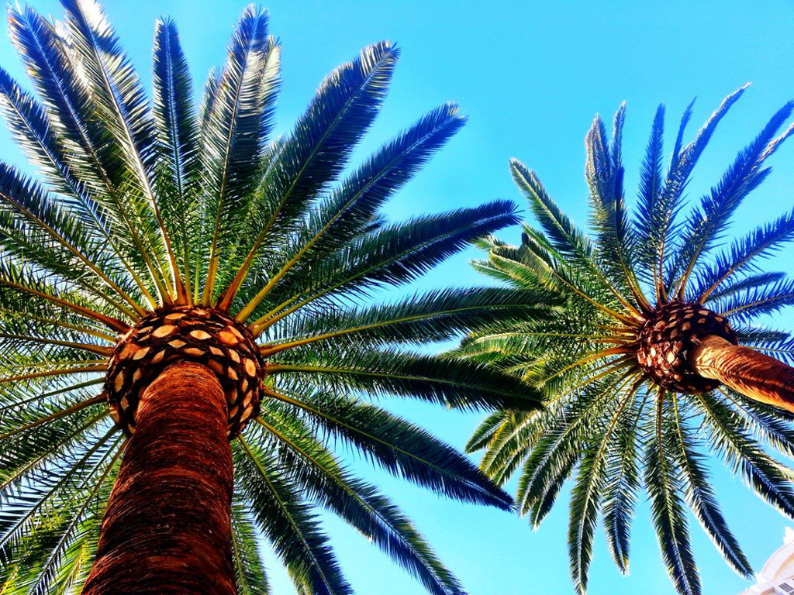


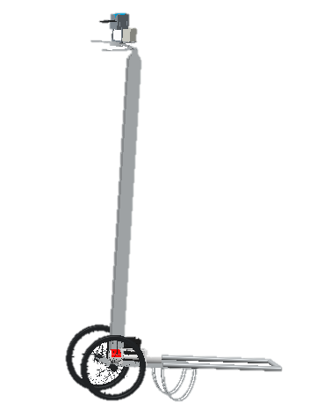
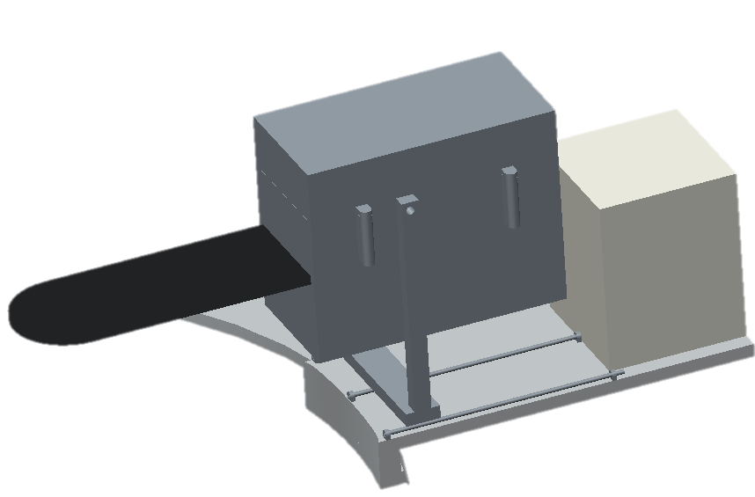
Semi-Autonomous Oil Palm Fruit Harvesting
Team No: 10
Gabriel Diez, Matthew Gerstenblitt, Enrique Gonzalez, Patrick Howard,
Alberto Machado, Derek Morin, Maria Vetencourt
Aim: To develop an electromechanical device that can safely and easily harvest ripe oil palm fruit.
Introduction/Background
Analyses/Safety
Palm Oil Harvesting:
Produces 3.7 metric tons per hectare annually
36% of oil produced globally
  5% of all oil crop farm land
Fruit bunches suspended 12 meters above the ground
Workers ascend trees and manually cut fruit bunches
Dangerous working conditions
Analyses:
Finite element analysis
  Proved that poles were stable
Tested electromechanical components
  Proved concept was feasible
Safety:
Electronic winch assists in raising and lowering poles
Remote control allows user to work from a safe distance
Ring
Telescoping Pole
Cart
Technical Approach
Conclusions
Met with sponsor to determine requirements
Created house of quality to quantify requirements
Examined existing processes and tools
Started developing design concepts
Devised cart design inspired by wheelbarrows and rickshas
Cutter Box
Inexpensive cart design
Robot improves harvesting safety
Wheels and handles allow easy mobility
Future Recommendations
Use lightweight materials throughout entire design
Decrease pole length
  Increase portability
Add retractable stabilizers to cart
Electronics box
Notes:
Gabriel Diez, Matthew Gerstenblitt, Enrique Gonzalez, Patrick Howard, Alberto Machado, Derek Morin, Maria Vetencourt
Include sponsor logo in top right corner. Use only College of Engineering logo on the top left corner (neither FSU nor FAMU logo).
Team can follow any arrangement and/or add more section as long as the poster is easy to read and provide enough information.
Set page size to 8.5”X11” and leave 0.5” margin on the both sides for binding purpose.
Try to be creative and make poster look attractive. Do not over-fill the page.
Page size should be 8.5”X11”. Leave 0.5” margin on the both sides for binding purpose.
Minimum section heading text size: 16, bold
Minimum body text size: 14
Figures -- use them!
Any figure used must have size greater than 300 dpi (300X300).
Provide enough technical background
Provide proper labeling
Text should be clear (axis title etc.)

