Slide 1
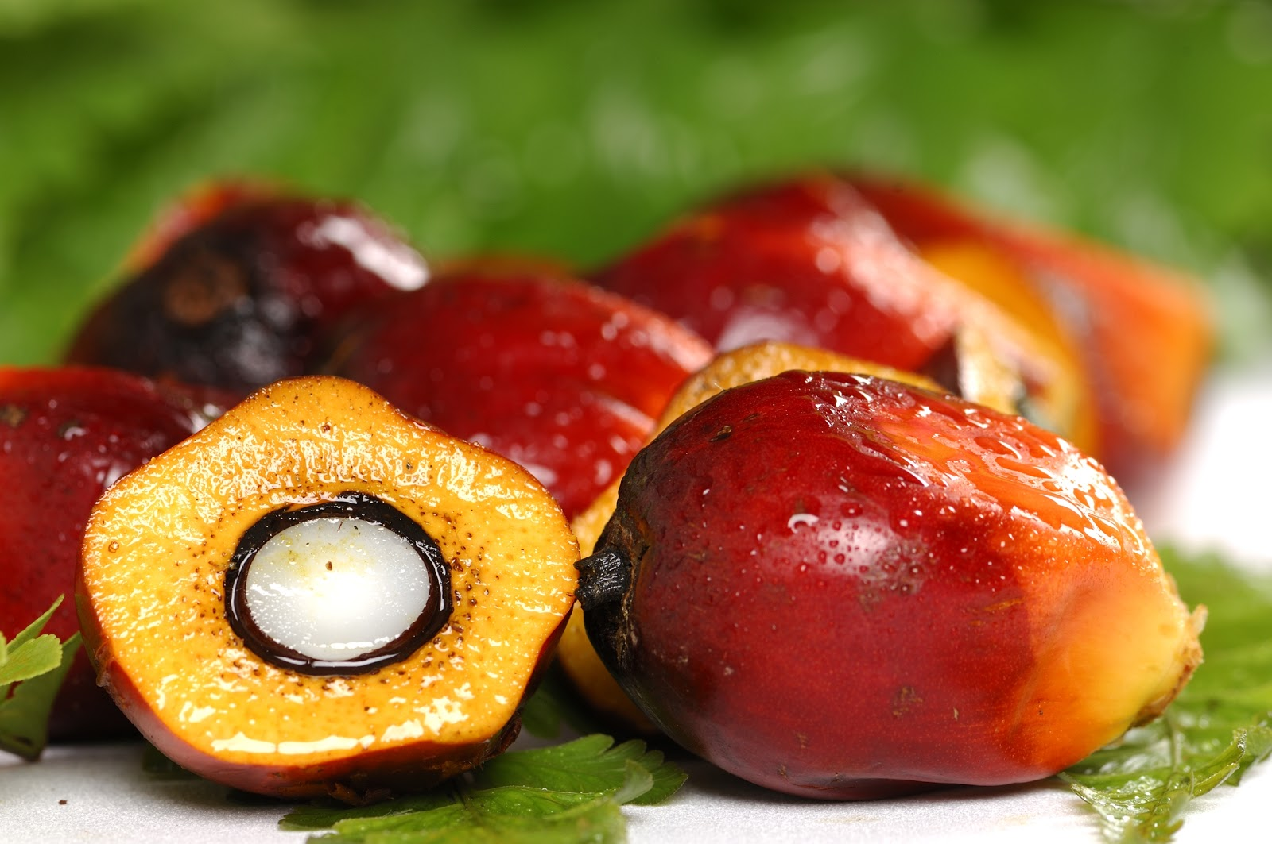
Maria Vetencourt
Enrique Gonzalez
Matthew Gerstenblitt
Alberto Machado
Gabriel Diez
Patrick Howard
Derek Morin

Slide 2
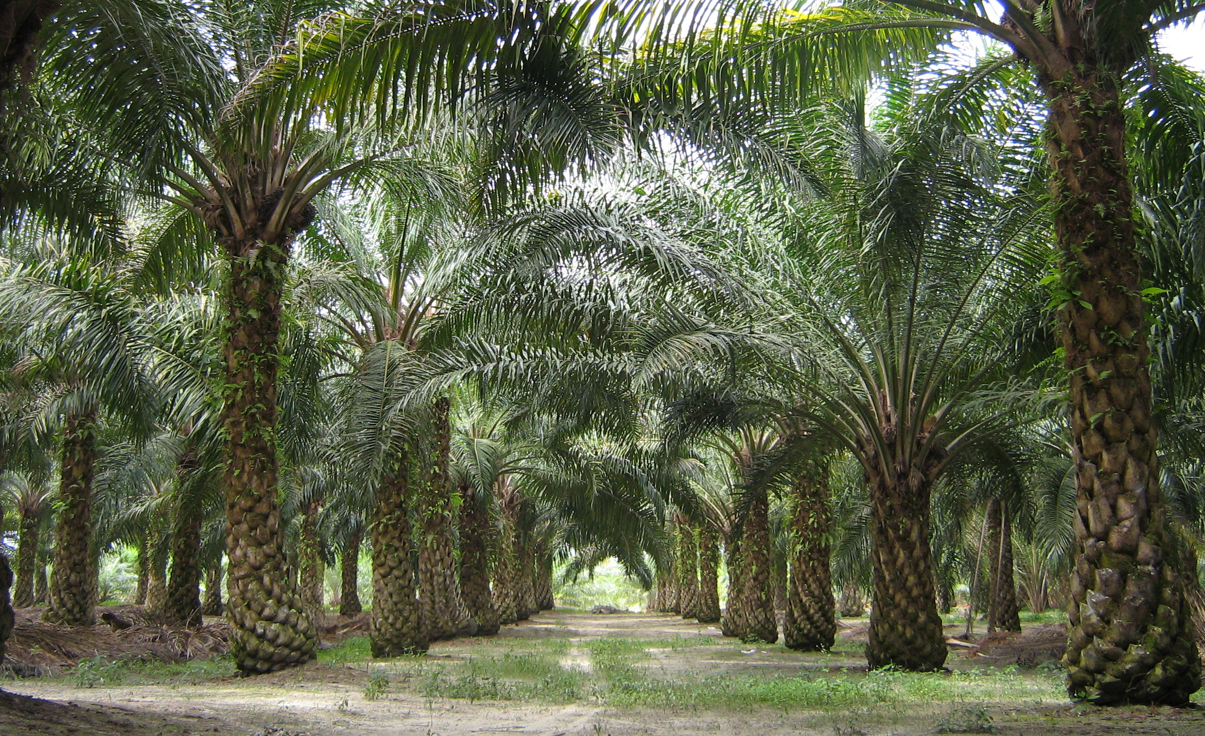
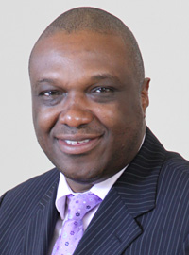
Sponsor
Dr. Okenwa Okoli

Slide 3
Stakeholders
Dr. Okenwa Okoli
Notes:
Stakeholders include…
Dr. Okoli, our sponsor

Slide 4
Stakeholders
Dr. Okenwa Okoli
Dr. Nikhil Gupta

Slide 5
Stakeholders
Dr. Okenwa Okoli
Dr. Nikhil Gupta
Dr. Jerris Hooker

Slide 6
Stakeholders
Dr. Okenwa Okoli
Dr. Nikhil Gupta
Dr. Jerris Hooker
Ms. Margaret Scheiner

Slide 7
Stakeholders
Dr. Okenwa Okoli
Dr. Nikhil Gupta
Dr. Jerris Hooker
Ms. Margaret Scheiner
Mr. Ryan Adams

Slide 8
Stakeholders
Dr. Okenwa Okoli
Dr. Nikhil Gupta
Dr. Jerris Hooker
Ms. Margaret Scheiner
Mr. Ryan Adams
FAMU-FSU College of Engineering

Slide 9
Stakeholders
Dr. Okenwa Okoli
Dr. Nikhil Gupta
Dr. Jerris Hooker
Ms. Margaret Scheiner
Mr. Ryan Adams
FAMU-FSU College of Engineering
Department of Industrial and Manufacturing Engineering

Slide 10
Stakeholders
Dr. Okenwa Okoli
Dr. Nikhil Gupta
Dr. Jerris Hooker
Ms. Margaret Scheiner
Mr. Ryan Adams
FAMU-FSU College of Engineering
Department of Industrial and Manufacturing Engineering
Department of Mechanical Engineering

Slide 11
Stakeholders
Dr. Okenwa Okoli
Dr. Nikhil Gupta
Dr. Jerris Hooker
Ms. Margaret Scheiner
Mr. Ryan Adams
FAMU-FSU College of Engineering
Department of Industrial and Manufacturing Engineering
Department of Mechanical Engineering
Department of Electrical and Computer Engineering

Slide 12
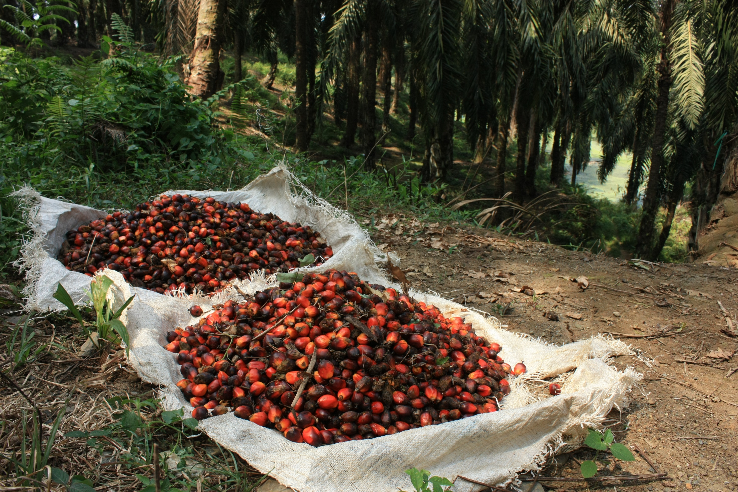
Scope
Develop a device to harvest oil palm fruit

Slide 13
Important Constants
Height of the trees
Fibrous consistency
Budget
Safety

Slide 14
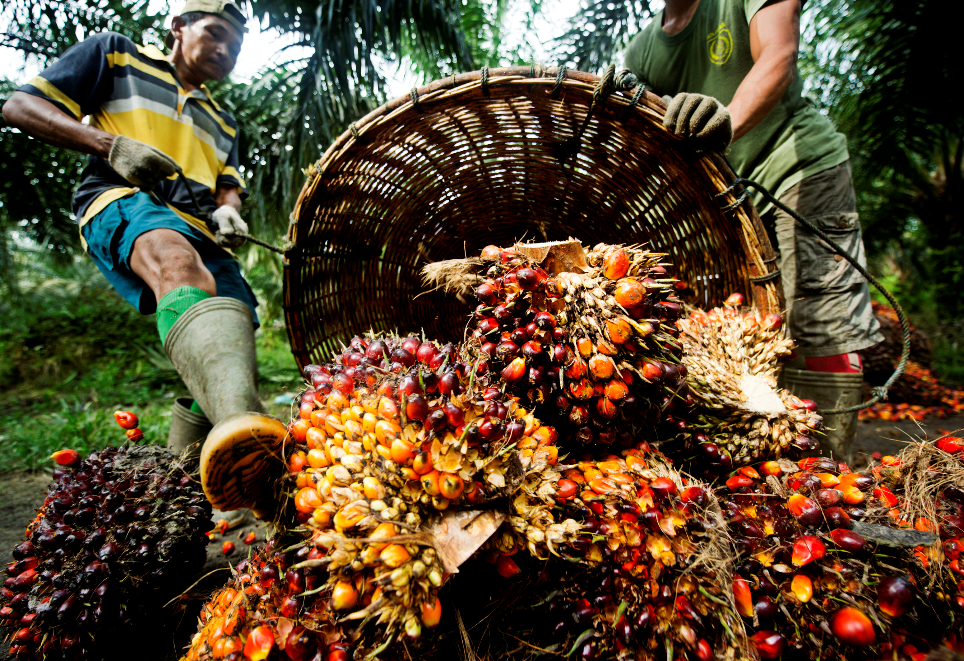
Design Considerations
Our current selected design borrows from two previous design concepts
Pole Pruner
Tree Climber
Notes:
In the previous phase report we proposed three design concepts. In this selected design we borrowed ideas from two of them: the pole pruner and the tree climber.

Slide 15
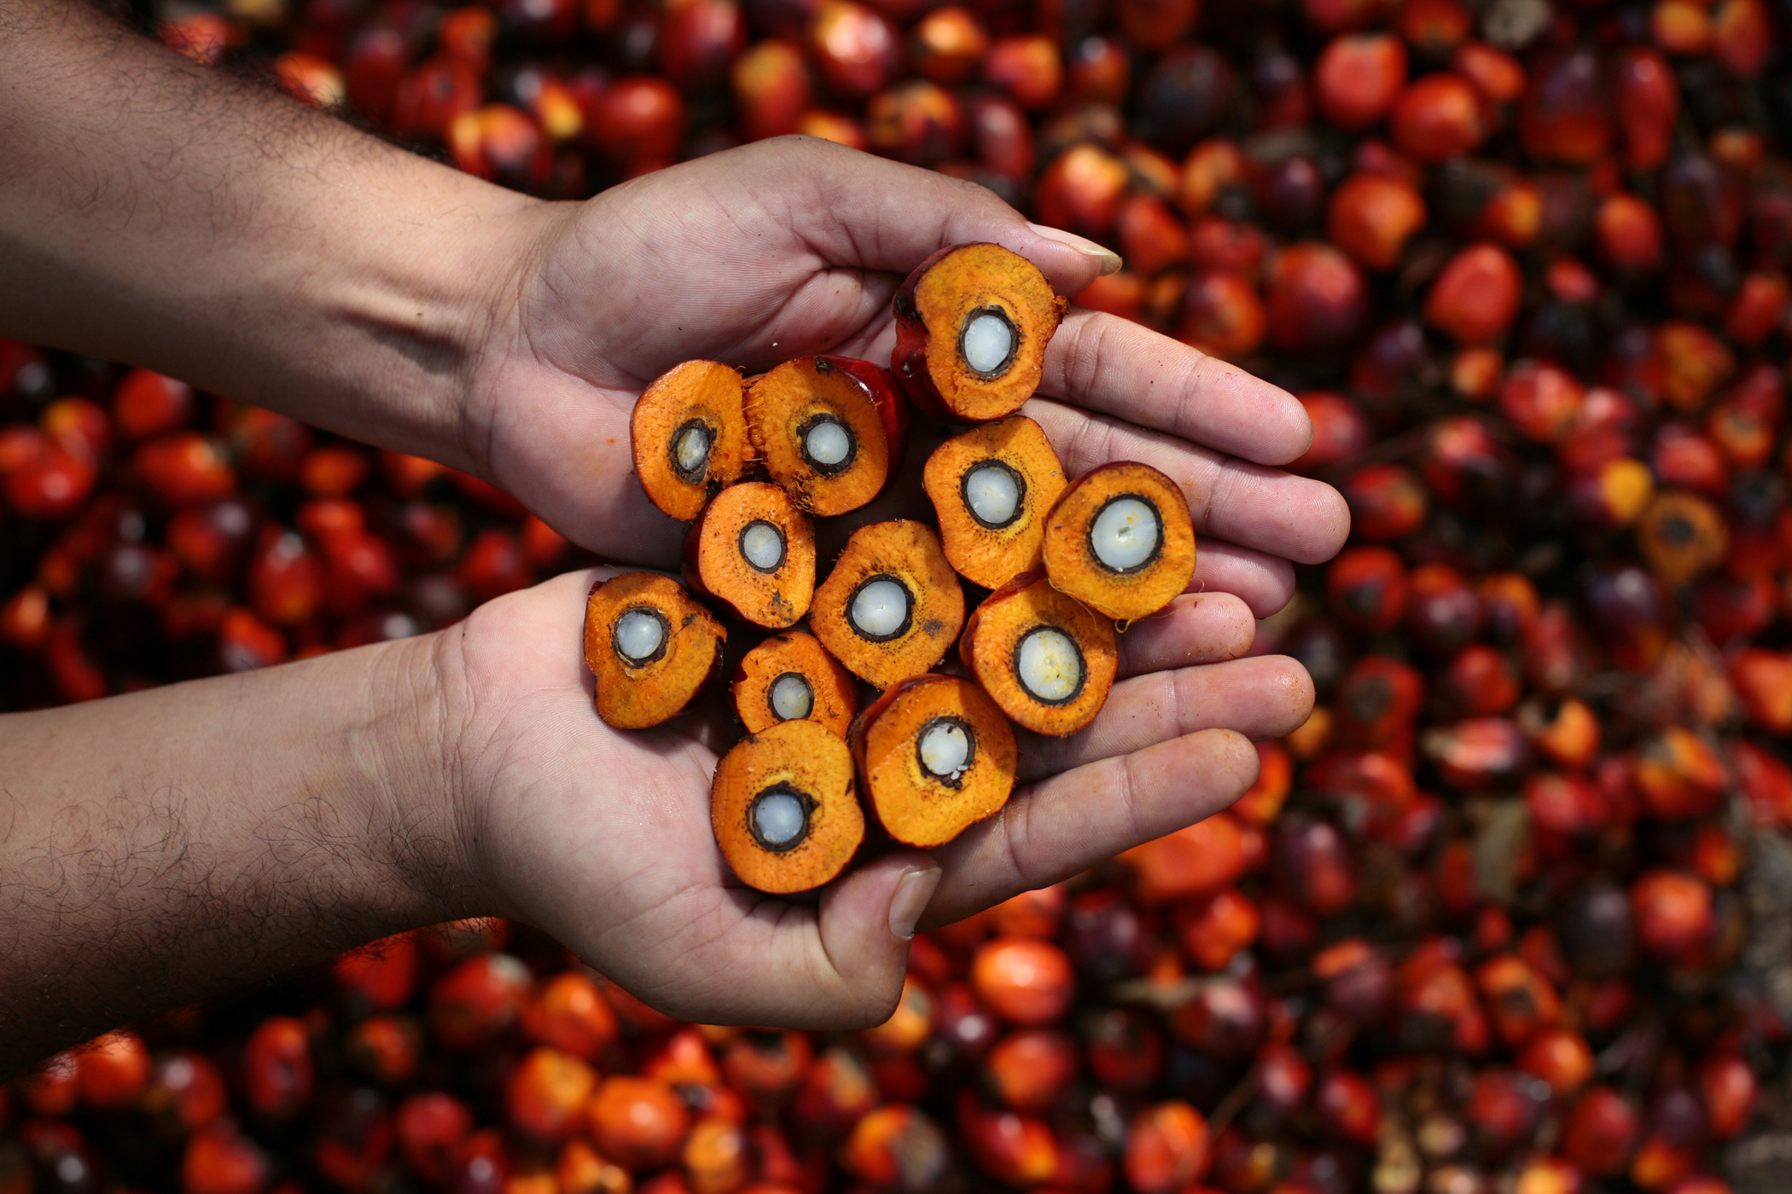
Modified Pole Pruner
Allow vertical extension up to 40 feet
Mount wireless camera
Notes:
As you may recall, the pole pruner was a modification to an existing landscaping tool. It utilized light weight material for its pole to be able to be hand held and reach 40-feet. It also was equipped with a wireless camera so that the operator may have a better view of the fruit they are cutting.

Slide 16
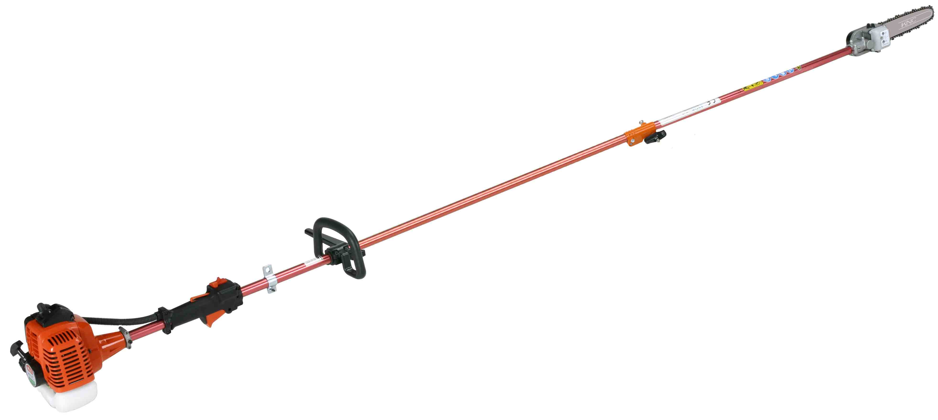
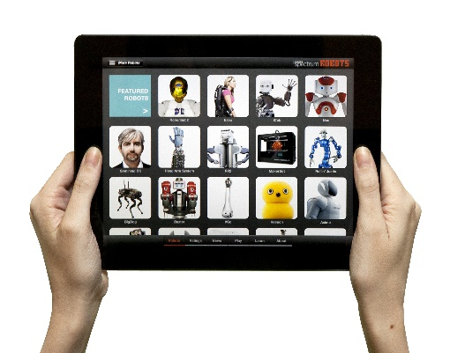
Extended Pole Pruner
Telescoping Pole
Gas Motor
User Interface
Notes:
This is just a visual representation of the extended pole pruner, as you can see it is gas operated, it has a telescoping pole to extend to the fruit and a chainsaw equipped with a camera that can be viewed by the operator on the ground

Slide 17
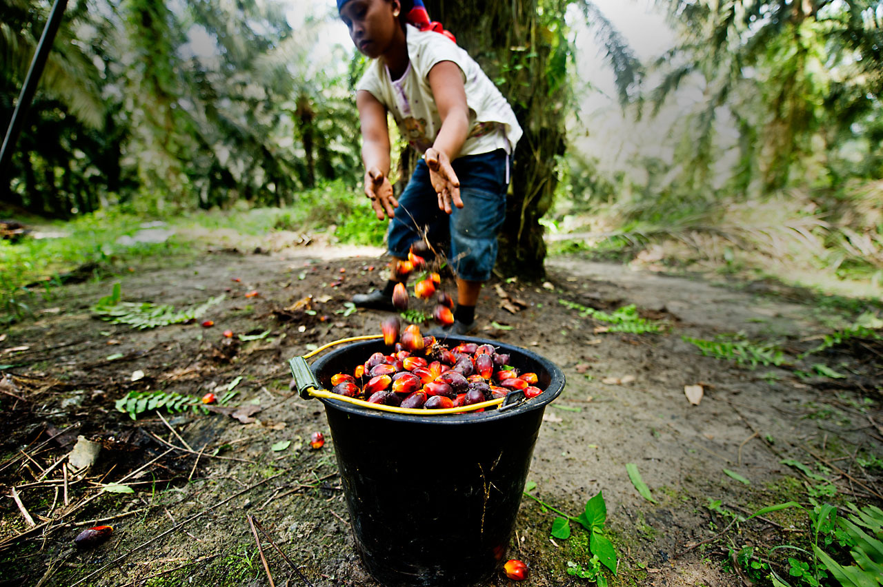
Problems
Weight of saw mechanism caused too much deflection given the angle of use
Tripping hazard
Notes:
Some problems with this design were that because of the weight of the chainsaw the 40-foot pole would likely have deflected too much to be usable. Additionally, since it is essentially a chainsaw attached 40-feet away from the operator, if they were to trip it would endanger the lives of people up to 40-feet away from them.

Slide 18
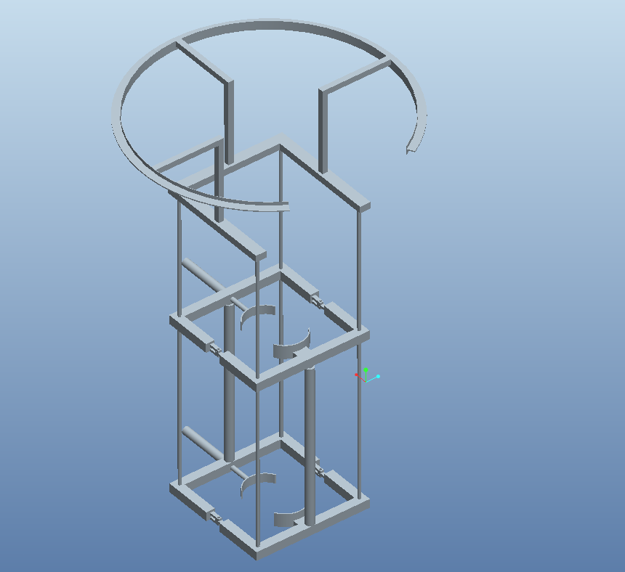
2012’s tree climbing robot
How it climb tree tho
Saw moves around tho
Notes:
The tree climber was based on 2012’s “King Climber” design. This would climb by gripping the tree, holding the grip, pivoting upward, gripping again and repeating the process. Once it was at the top it had a circular ring that the cutter would traverse around and cut the palm fruit down from.

Slide 19
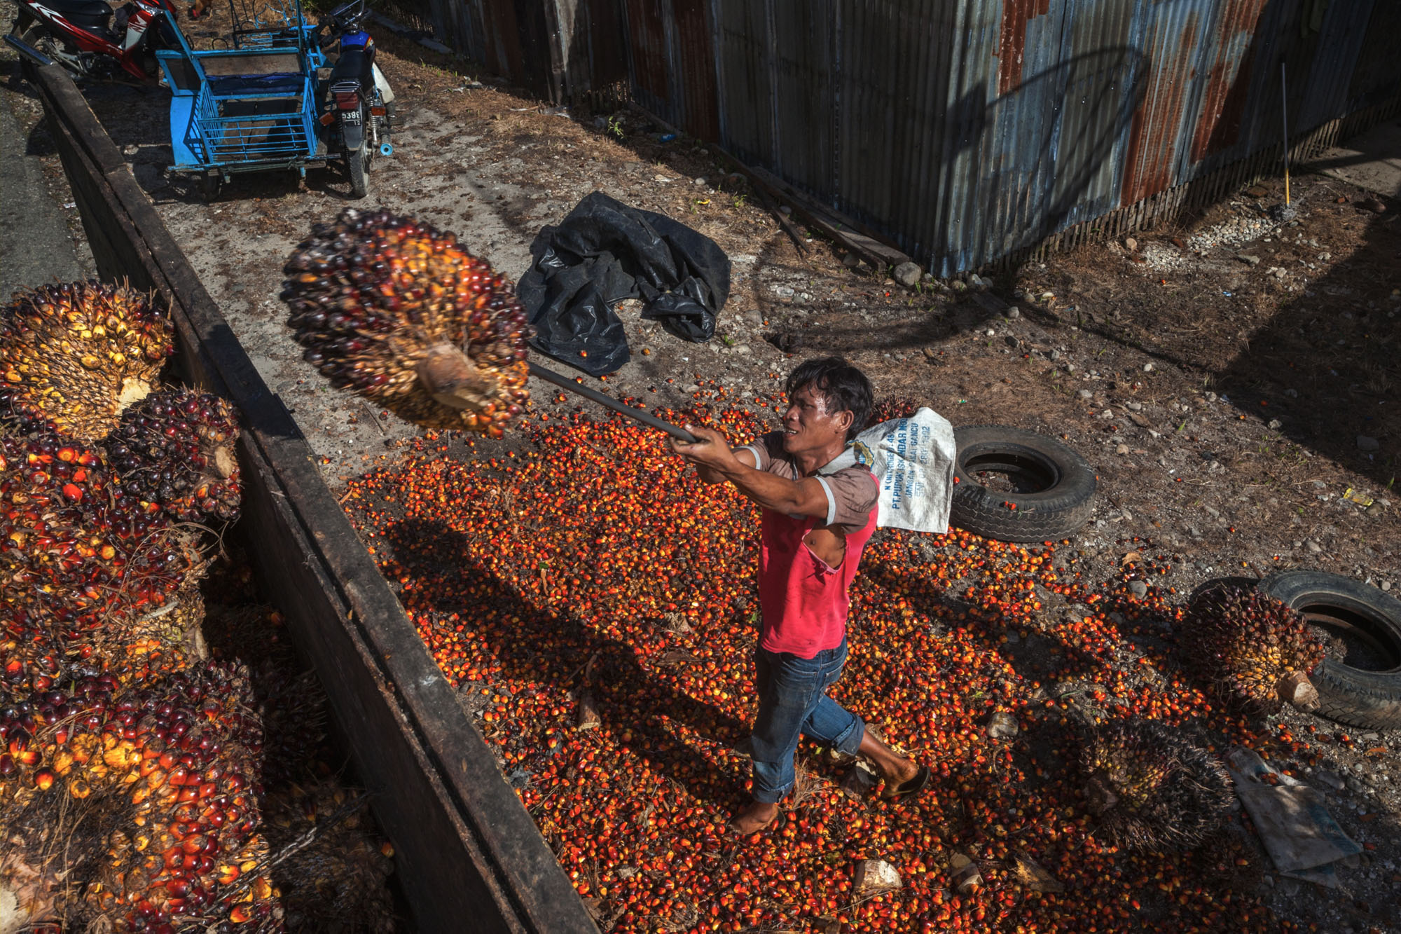
Problems with Tree Climber
Too complex
Dangerous
No 360 degree axis
Notes:
So there were a few problems with this design. To begin with, getting a device that is actually capable of climbing a tree is a very ambitious undertaking and the team was not actually able to achieve their goal. Here at the STRIDE lab, Dr. Gupta and his colleagues have been working on designing a tree climber of their own and have yet to be successful, and they aren’t even trying to attach a heavy cutting mechanism to it. Because of this, even if it was able to climb all the way to the top, it lacked the sophistication to ensure that it will not fall down, making it an extreme hazard both to itself and the people operating it. Additionally as you can see, the ring did not have a 360 degree axis to the palm fruit, which really makes it an incomplete design.

Slide 20
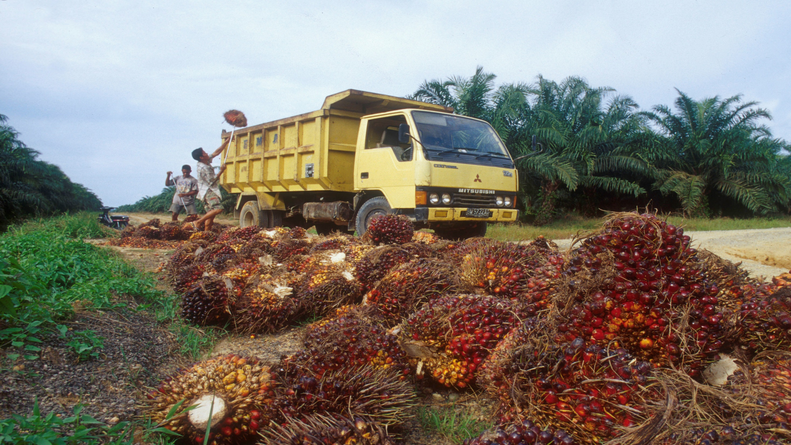
Current Design
Decided to use the stability of the tree to send a cutter upward similar to 2012
Also used light weight pole material to make raising and lowering easier
Notes:
So in our current design we decided to use the natural stability of the tree to assist in having the cutter go all the way up but without the complexity of an actual tree climbing robot. Additionally we borrowed from our own pole pruner idea by using a strong, lightweight pole to elevate the cutter in order to make it portable for the user.

Slide 21
RING
POLE
BASE

Slide 22
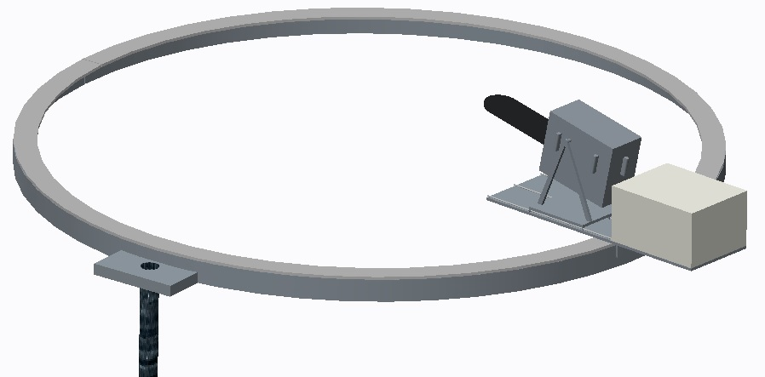
Ring

Slide 23
Cutting Mechanism
Notes:
The cutting mechanism will consist of a saw on a platform that traverses around the circumference of the ring. The raw sits on a second platform that is then connected to a lead screw and two guide shafts which control its forward and backward translation, allowing it to cut fruit off of trees of varying diameter. On top of the second platform there is a box that houses the DC motor that controls the chainsaw in addition to the stepper motor that controls the pitch of the saw. In other words there are four motors that control three degrees of freedom: forward/backward, pitch, and side to side.

Slide 24
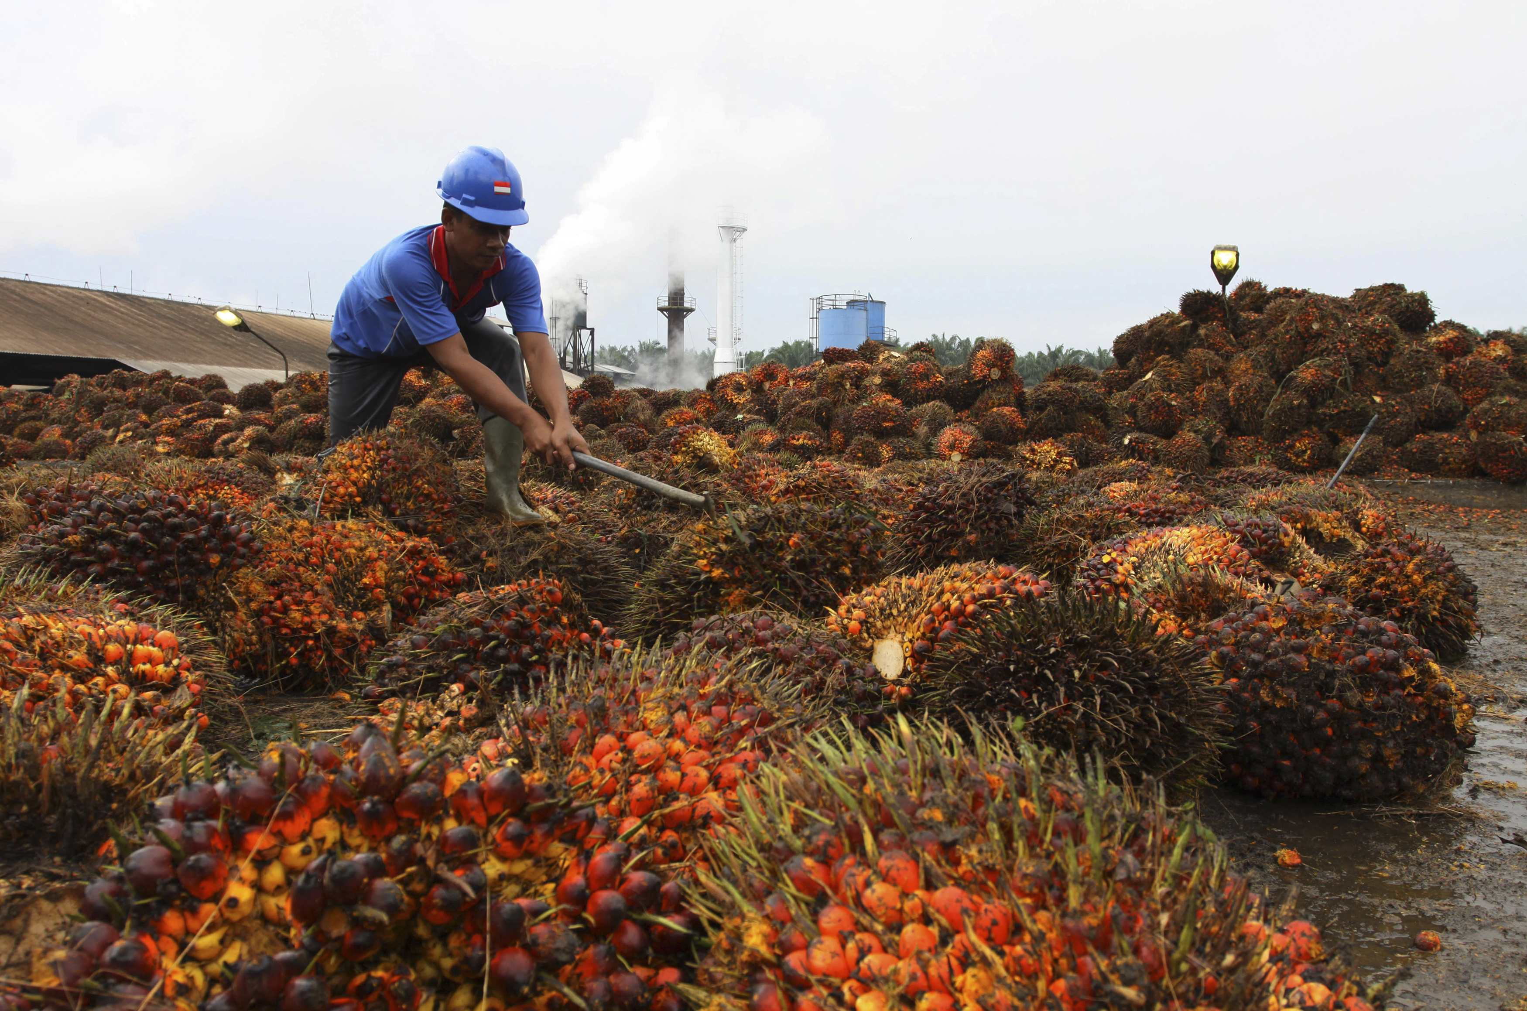
Cutter
Tico and Derek?
Notes:
All the electronics of the cutter are housed in this box behind it which also behaves as a counterweight, preventing the roller from applying an excessive torsional load on the ring. The electronics that are used to control the cutter are blah blah blah and this this this and that that that.

Slide 25
Pole

Slide 26
Base

Slide 27
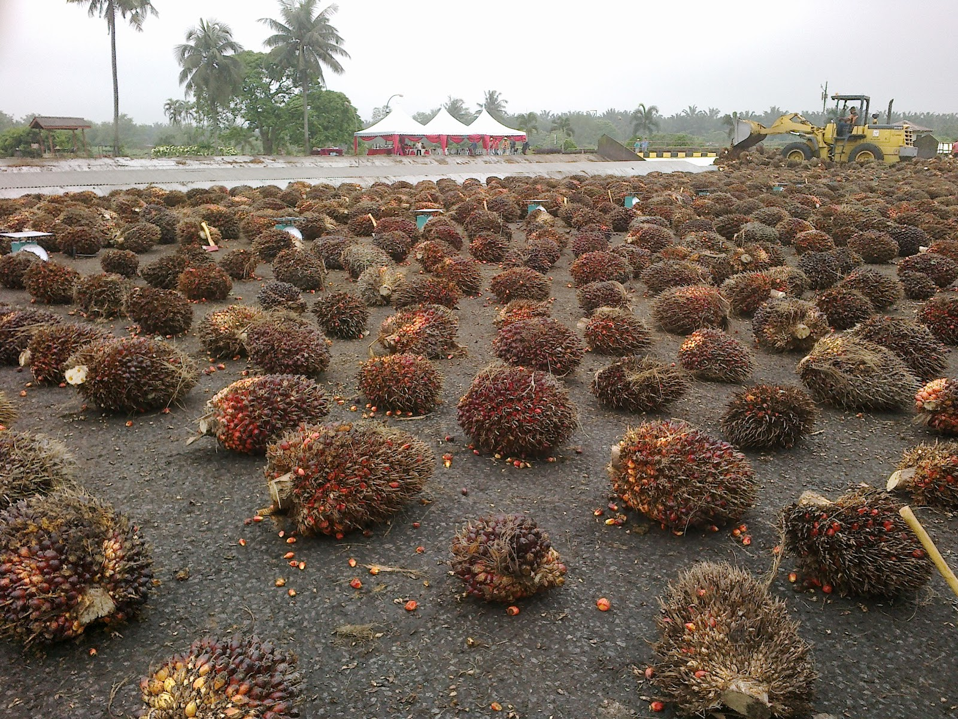
Budget
Ring | 1050 | Online Metals
3D Printing Material | 100
DC Motors | 150 | Estimate
DC Motors | 150 | Estimate
Stepper Motor | 130
lead screw rod | 27 | http://www.mcmaster.com/#93410a111/=zx7m3i
lead screw nut | 12 | http://www.mcmaster.com/#general-purpose-acme-rods/=zx7kbl
Electrical Components | 100 | Estimate
Linear Bearings | 30 | http://www.adafruit.com/products/1179?gclid=CLHz-aK8pMkCFVGQHwodJwUG9A
Shaft | 38 | http://www.mcmaster.com/#precision-shafts/=zx7snq
Shaft Housing | 20 | http://www.adafruit.com/products/1182
Robot Mount | 30 | Online Metals
Battery | 150 | Estimate
Total | 1987
Notes:
We decided to approach this project from the top down since the ring is not only the most complex, it’s also the most important. After designing the ring and cutter and looking for different parts we found that in order to get it to work properly and meet all design requirements it would make up the majority of our budget. Therefore, in order to leave some room in our budget for unexpected failures we have decided to concentrate the majority of the prototype assembly on the cutting and traversing mechanism, but still design the pole and base for following years to build off of.

Slide 28
Safety
Pole is attached to tree which prevents it from falling over
Ring also encompasses the tree which eliminates the possibility of the cutter falling down
The chainsaw being used comes with a cover for the blade.
Notes:
Explain how the ropes are tied. None of the components touches the tree. The stand is only placed on the ground without harming the environment. Since the electronic components use a battery as the source, it does not emit any hazardous elements. The only component that has contact with the tree is the blade which is covered for safety.

Slide 29
Questions?

Slide 30
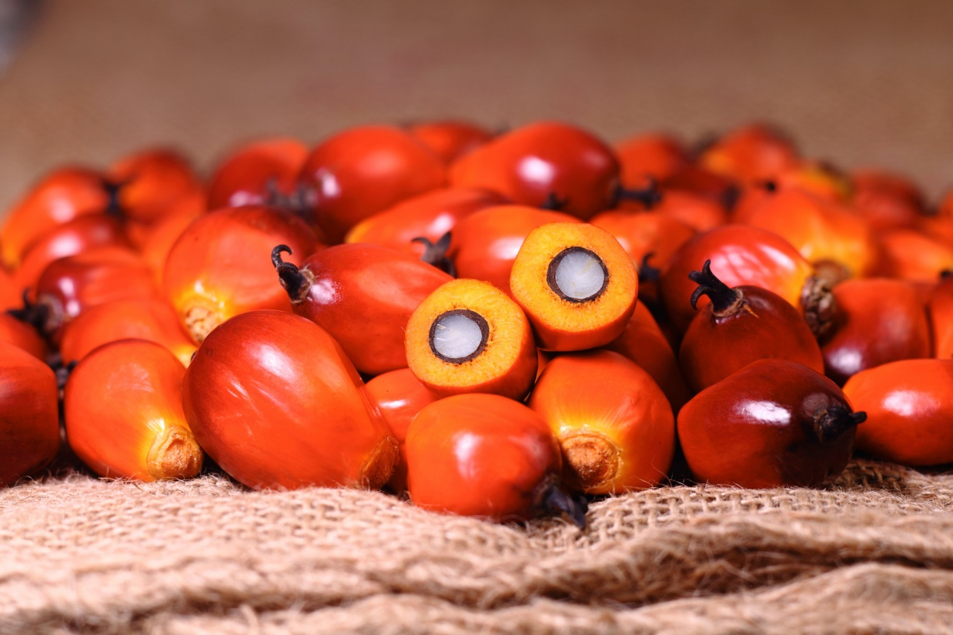
References

