Slide 1
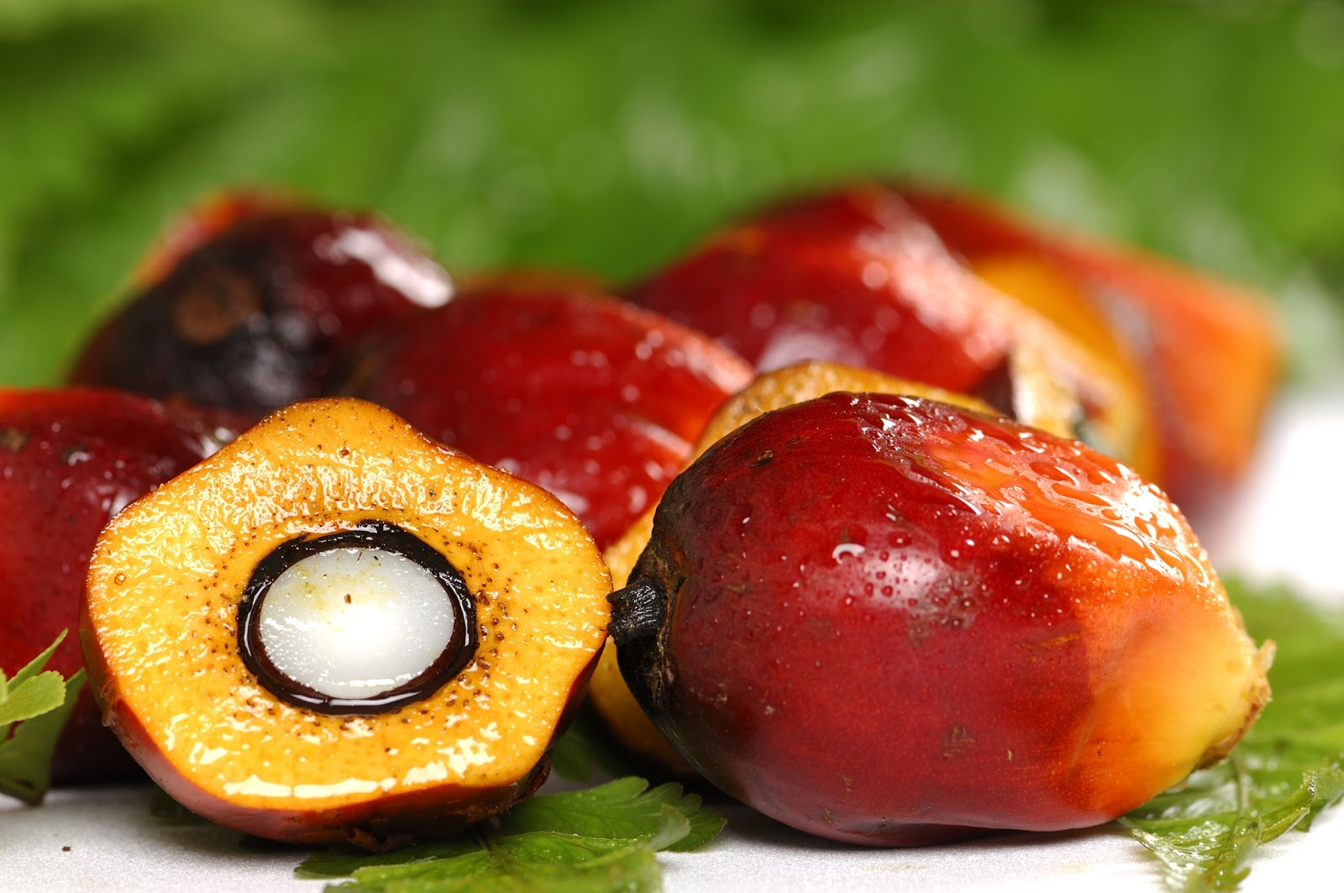
Group 10
Semi-Autonomous
Oil Palm Fruit Harvesting
Improve Phase
Maria Vetencourt
Matthew Gerstenblitt
Gabriel Diez
Patrick Howard
Alberto Machado
Derek Morin
Enrique Gonzalez
Notes:
Introduce yourself

Slide 2
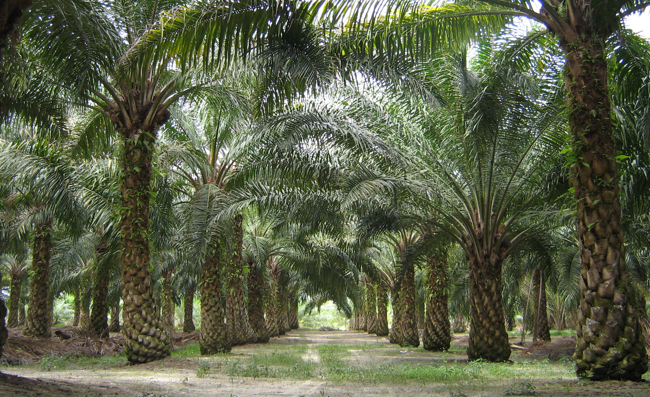

Sponsor
Dr. Okenwa Okoli
Maria Vetencourt

Slide 3

Stakeholders
Dr. Okenwa Okoli
Maria Vetencourt
3
3
Notes:
Stakeholders include…
Dr. Okoli, our sponsor

Slide 4
Stakeholders
Dr. Okenwa Okoli
Dr. Nikhil Gupta
Maria Vetencourt
3
3

Slide 5
Stakeholders
Dr. Okenwa Okoli
Dr. Nikhil Gupta
Dr. Jerris Hooker
Maria Vetencourt
3
3

Slide 6
Stakeholders
Dr. Okenwa Okoli
Dr. Nikhil Gupta
Dr. Jerris Hooker
Ms. Margaret Scheiner
Maria Vetencourt
3
3

Slide 7
Stakeholders
Dr. Okenwa Okoli
Dr. Nikhil Gupta
Dr. Jerris Hooker
Ms. Margaret Scheiner
Mr. Ryan Adams
Maria Vetencourt
3
3

Slide 8
Stakeholders
Dr. Okenwa Okoli
Dr. Nikhil Gupta
Dr. Jerris Hooker
Ms. Margaret Scheiner
Mr. Ryan Adams
FAMU-FSU College of Engineering
Maria Vetencourt
3
3

Slide 9
Stakeholders
Dr. Okenwa Okoli
Dr. Nikhil Gupta
Dr. Jerris Hooker
Ms. Margaret Scheiner
Mr. Ryan Adams
FAMU-FSU College of Engineering
Department of Industrial and Manufacturing Engineering
Maria Vetencourt
3
3

Slide 10
Stakeholders
Dr. Okenwa Okoli
Dr. Nikhil Gupta
Dr. Jerris Hooker
Ms. Margaret Scheiner
Mr. Ryan Adams
FAMU-FSU College of Engineering
Department of Industrial and Manufacturing Engineering
Department of Mechanical Engineering
Maria Vetencourt
3

Slide 11
Stakeholders
Dr. Okenwa Okoli
Dr. Nikhil Gupta
Dr. Jerris Hooker
Ms. Margaret Scheiner
Mr. Ryan Adams
FAMU-FSU College of Engineering
Department of Industrial and Manufacturing Engineering
Department of Mechanical Engineering
Department of Electrical and Computer Engineering
Maria Vetencourt
3

Slide 12
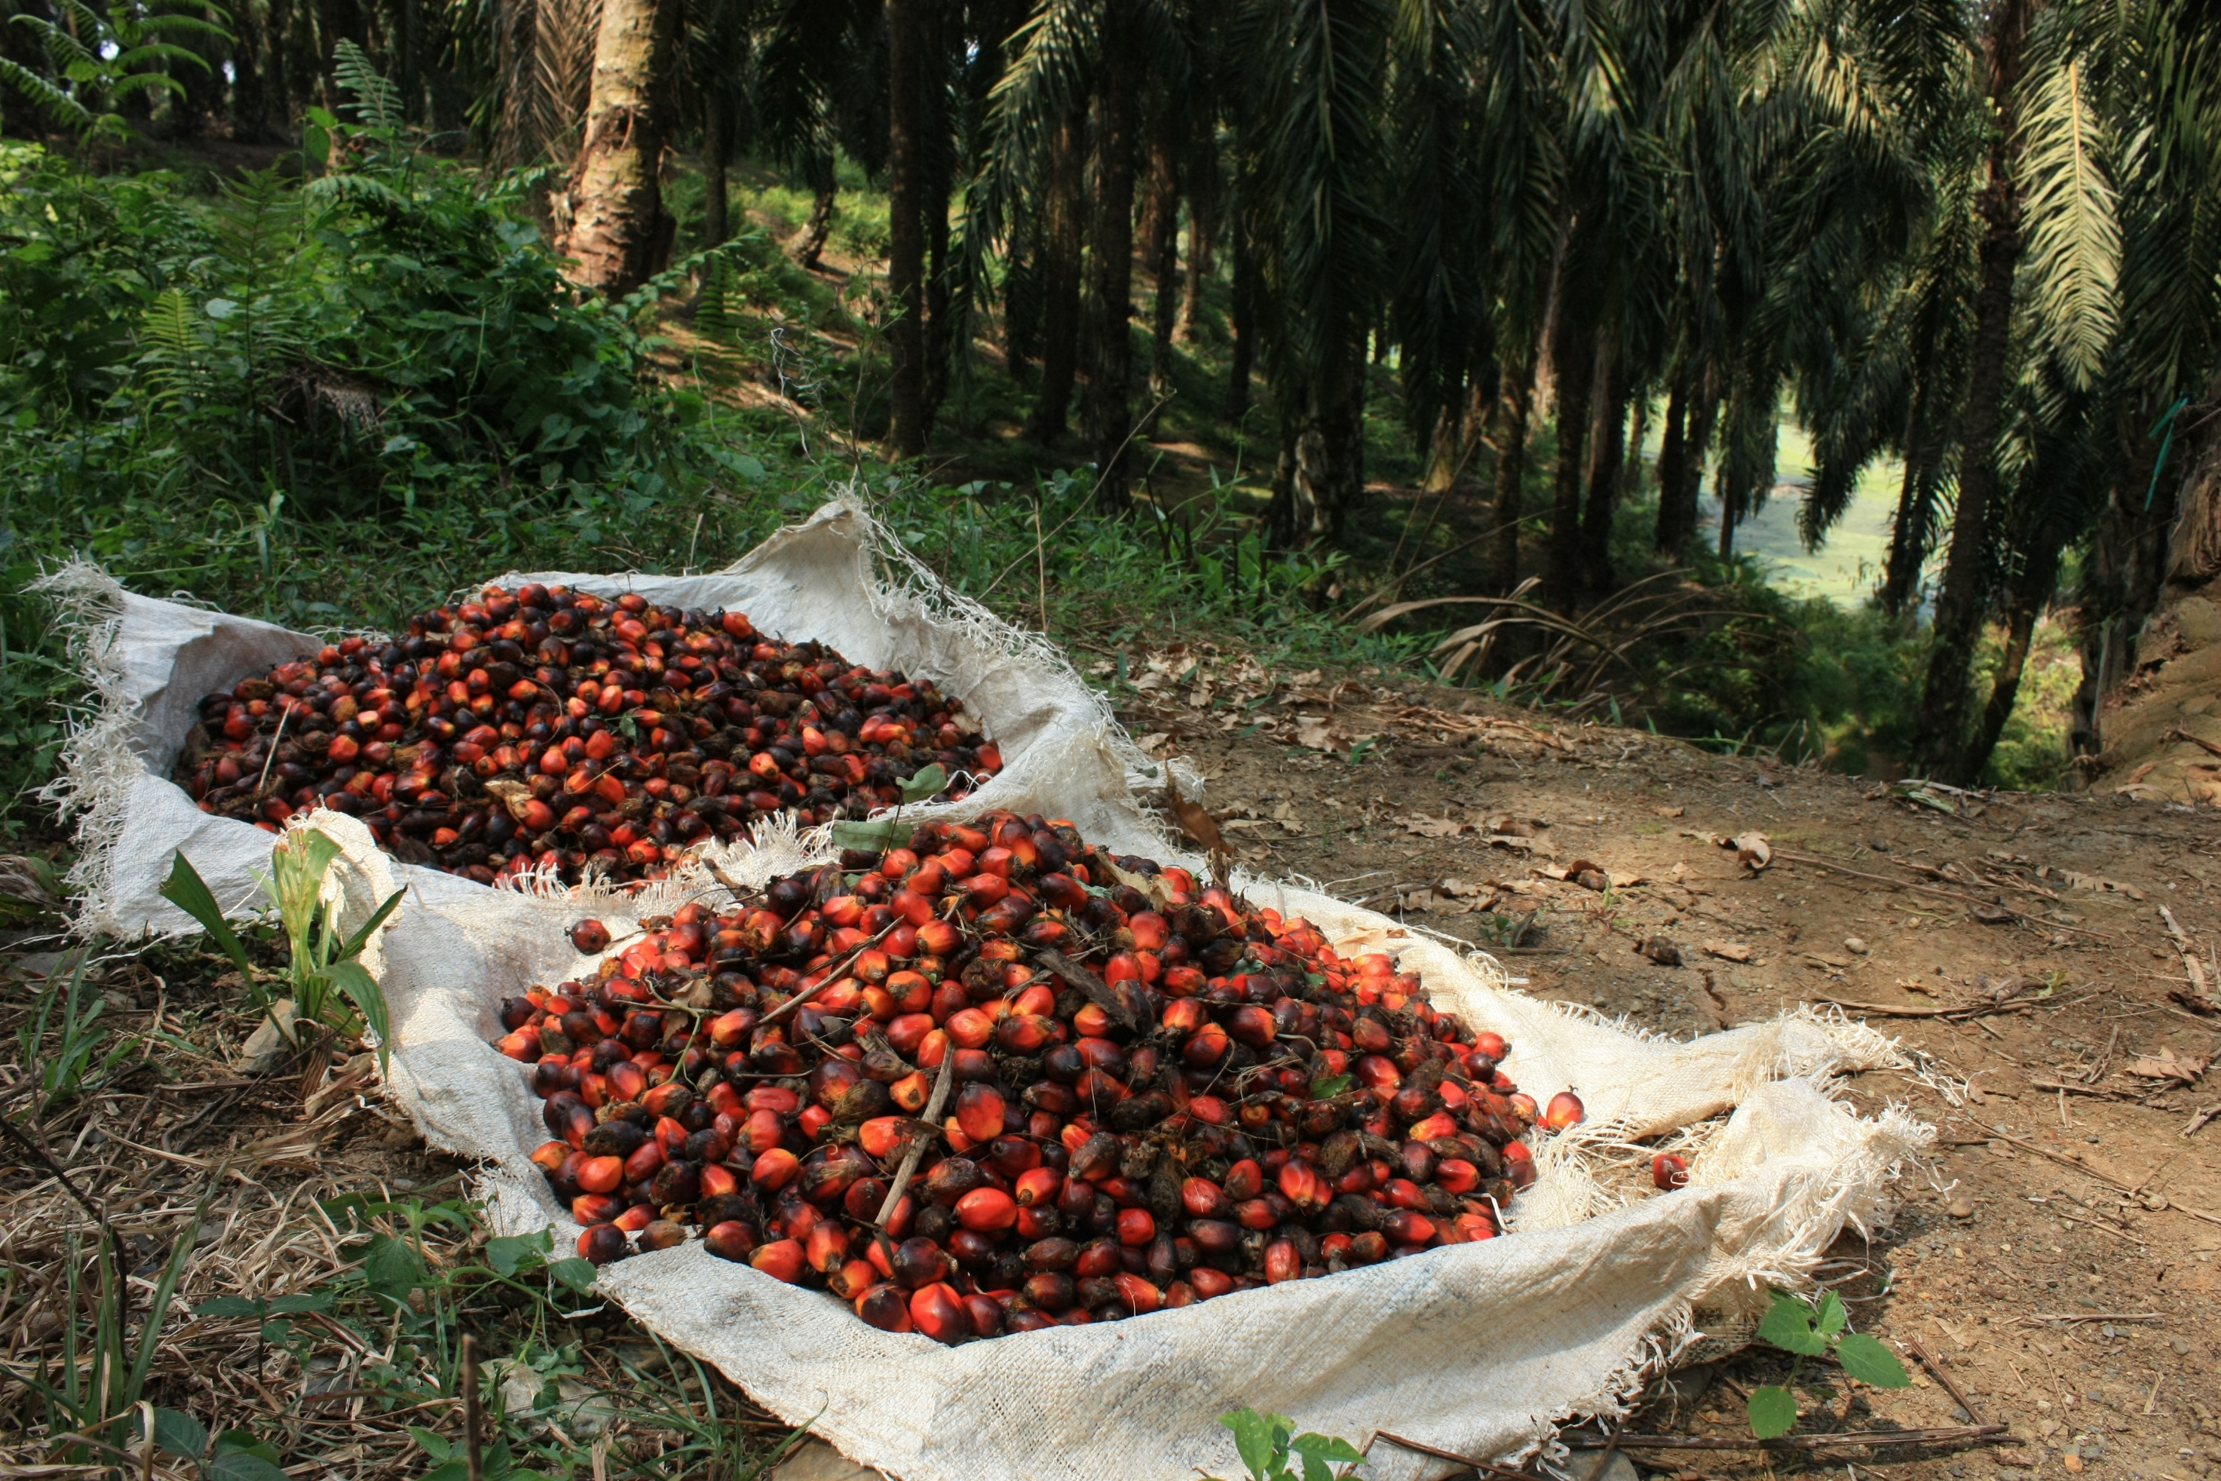
Project
Develop a device to harvest oil palm fruit
Maria Vetencourt

Slide 13
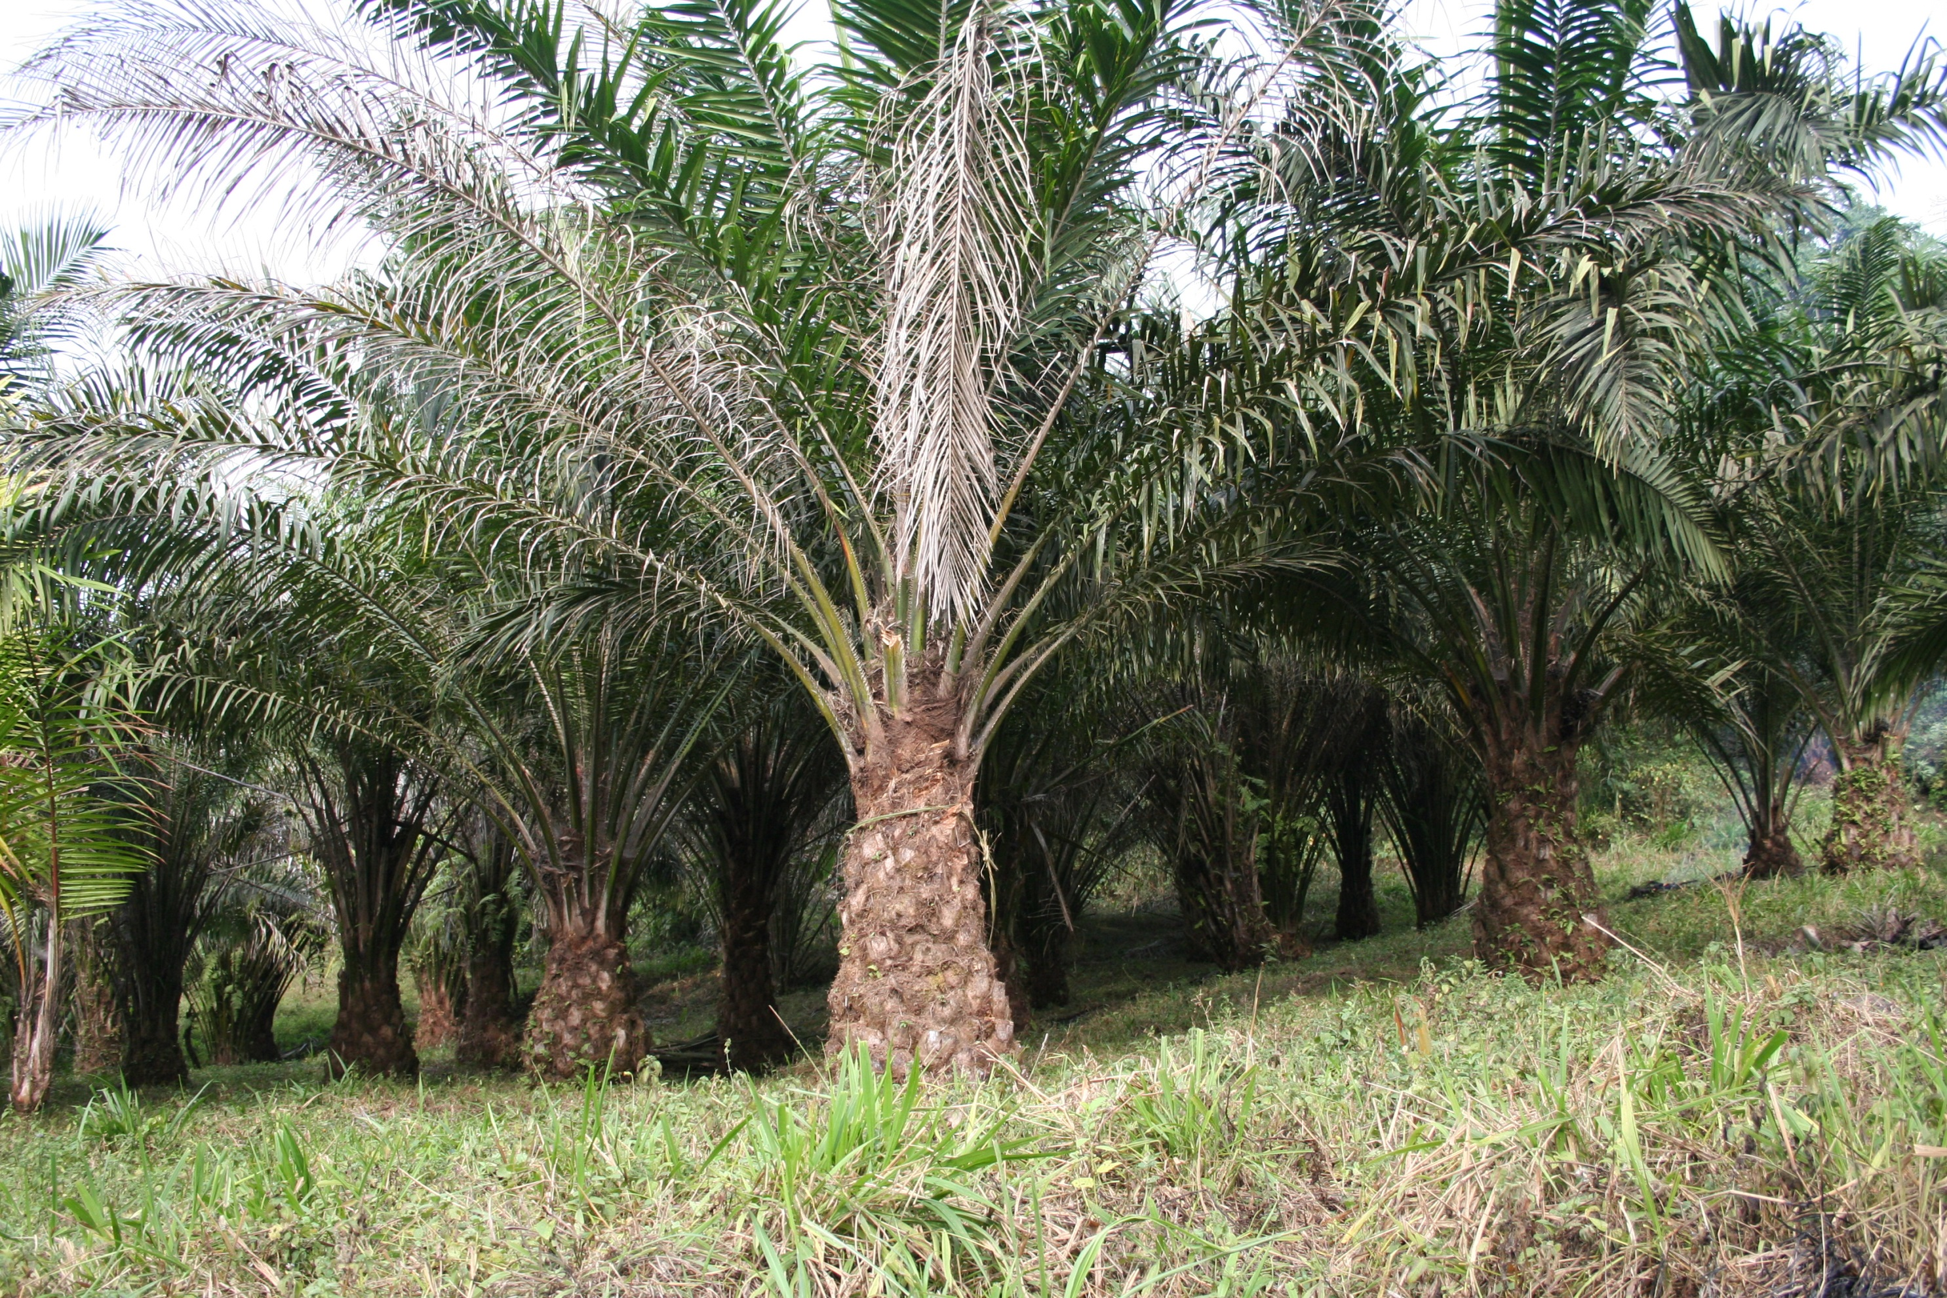
Oil Palm Trees
40 feet tall
Fibrous
Oil Palm Fruit:
  1000–4000 pieces per tree
  Bunches weigh 40–60 pounds
    22% oil by volume
Maria Vetencourt
Notes:
2015 rpt

Slide 14
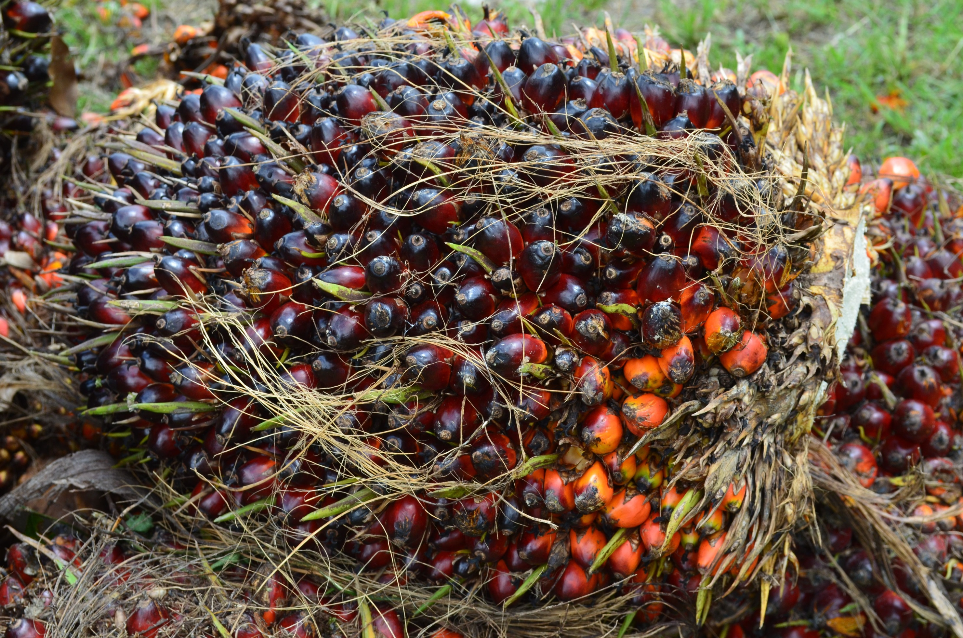
Current Harvesting Techniques
Humans climb trees that are 40 feet tall
Long pole pruners
Maria Vetencourt
Notes:
2015 rpt
As a result of these trees being located in developing countries, the current methods used are not ideal.
Look at this photo of a tall palm tree.
The current technique involves a person climbing up this tree.
Our sponsor also told us some countries have even experimented with training monkeys to climb the up the trees with knives and cut down the fruit.

Slide 15

Dangers
Falling from tree
Poor working conditions
Humanitarian concerns
Maria Vetencourt
Notes:
cite 2015 rpt

Slide 16
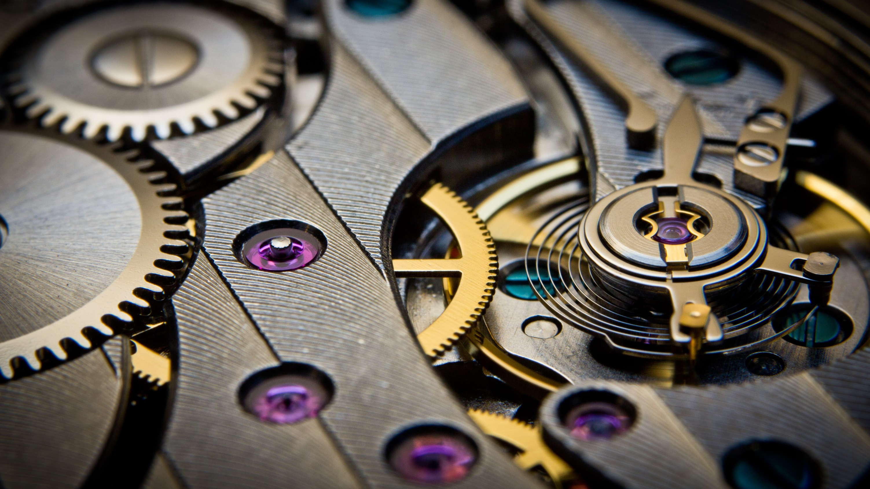
Benefits of a Mechanical Replacement
Lower palm oil production cost
  High initial cost
  Low long-run cost
  Increase worker productivity
  Decrease worker fatigue
Increase worker safety
  Remove human operator
Maria Vetencourt
Notes:
cite 2015 rpt

Slide 17
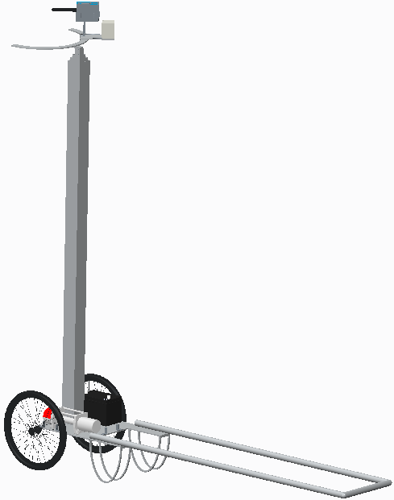
Analyze Phase Design
Ring
Telescoping Pole
Cart
Matthew Gerstenblitt
Notes:
So, this is the design we developed in the previous phase. It consists of the ring cutting mechanism, telescoping poling in the middle, and a cart design that was inspired by wheelbarrows and rickshas.

Slide 18
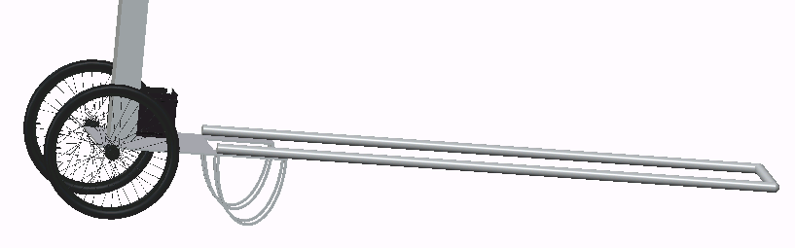
Analyze Phase Cart
11 feet
Matthew Gerstenblitt
10
Notes:
Looking more closely at the cart, we initially designed the length to be 11 feet, to allow the user to have a mechanical advantage when maneuvering it

Slide 19
OSHA Analysis
OSHA does not have explicit lifting guidelines
  National Institute for Occupational Safety and Health (NIOSH)
Yields a recommended weight limit (RWL)
RWL = LC x HM x VM x DM x AM x FM x CM
Uses many distinct factors
  Distance from grip to ground
  Distance traveled
  Average load
Matthew Gerstenblitt
Notes:
So, OSHA does not actually have lifting guidelines, but instead refers to NIOSH (say out loud) equation that yields a RWL. Here is the equation. It uses many distinct factors. For example, the distance from the user’s grip to the ground, the distance traveled, and the average load that needs to be lifted.

Slide 20

NIOSH Equation
Used NIOSH equation to determine recommended weight limit
  Used a load lifted of 28 pounds
Obtained recommended weight limit
  32.62 pounds
    1 lift/5 minutes
    8 hours per day
Allowed the cart length to be shortened
Matthew Gerstenblitt
Notes:
We used the NIOSH equation to determine the RWL for our design. For these calculations, the user needs to lift a 28-pound load. After running these calculations, we determined that the RWL is 32.62 pounds if the user performs the lift once every 5 minutes, for 8 hours/day. This told us that our original cart length was essentially overdesigned and allowed us to shorten the cart length used.

Slide 21
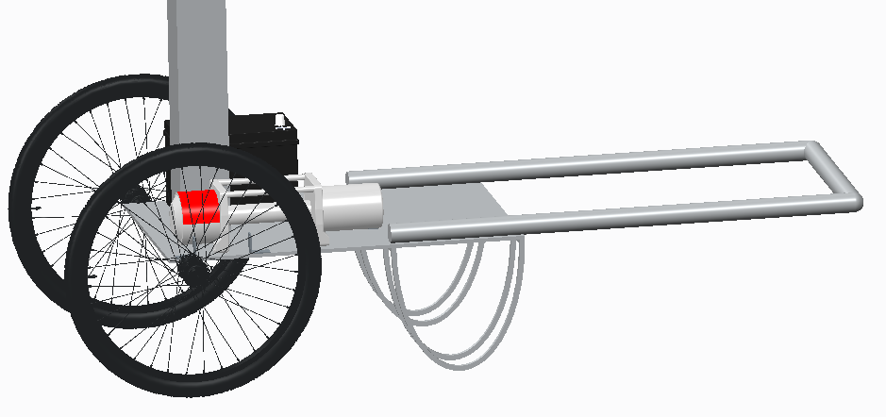
New Optimized Cart
4 feet
Matthew Gerstenblitt
13
Notes:
This is the shortened cart. It is 4 feet long. This means that our previous length of 11 feet was essentially an overdesign. This new shortened cart should give the user the same mechanical advantage of the longer cart, with increased maneuverability, due to its shortened length.

Slide 22
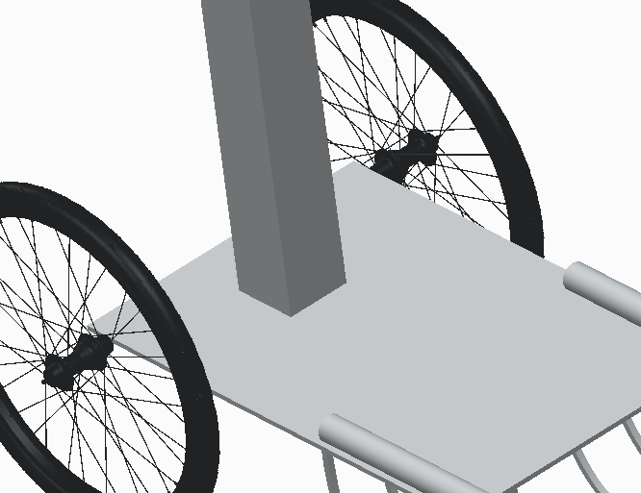
Welding
Pole
Cart
Gabriel Diez
14

Slide 23
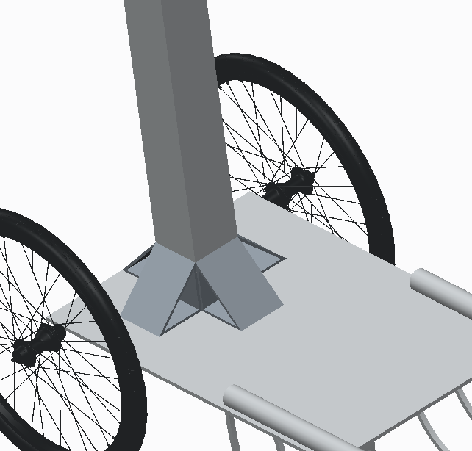
Welding
Gussets
Gabriel Diez
15

Slide 24
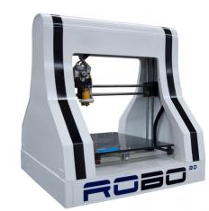
3D Printing Overview
Robo3D R1
  8” x 9” x 10” print volume
  100 micron resolution
  PLA print filament
    Polylactic acid thermoplastic
  Heated bed
  Fused Filament Fabrication (FFF)
Patrick Howard
16

Slide 25
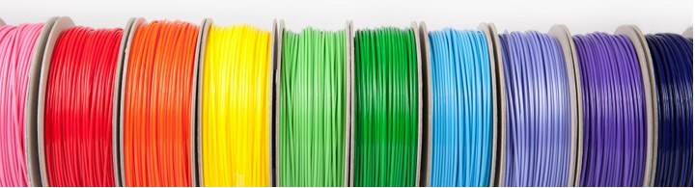
3D Printing Overview
PLA
  Easiest to print
  Most consistent results
  High melting temperature
  Young’s modulus
    3.5 GPa
  Compressive strength
    46.54 MPa
Patrick Howard
17

Slide 26
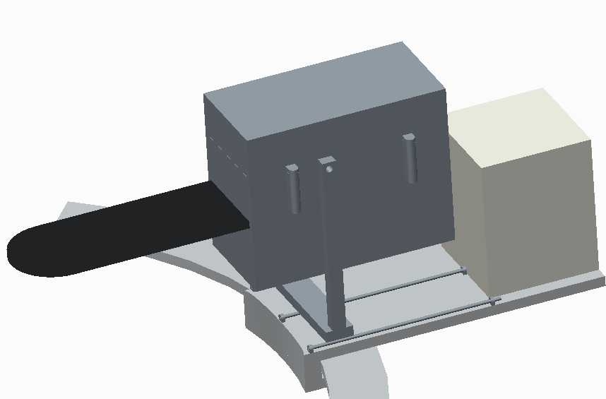
Utilizing FFF (Fused Filament Fabrication)
Electronics box
  6” x 6” x 6”
Cutter housing
  7.3” x 3.7” x 5.8”
Cost effective
Time efficient
Complications
  Readily accessible
  Failed prints
Patrick Howard
18

Slide 27
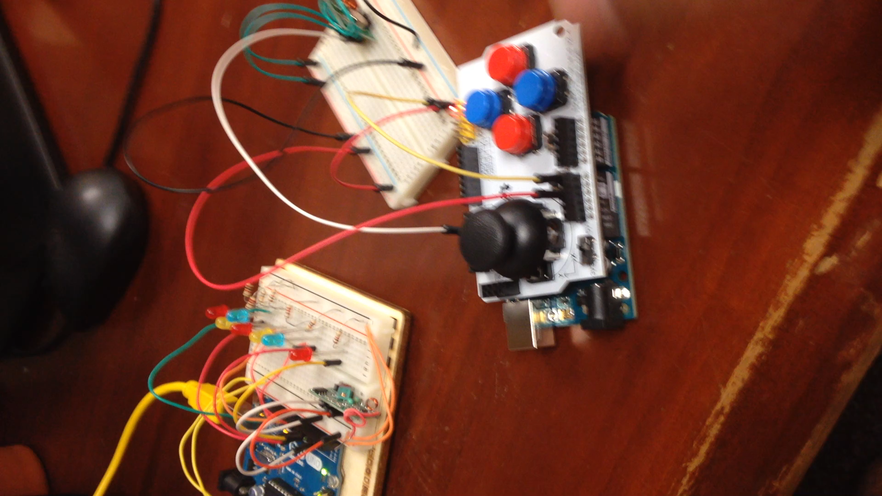
Testing Joystick Shield & Wireless Components
Simulates Stepper Motor
Simulates In & Out Motor
Transmitter
Simulates Saw
Joystick Shield
Receiver
Alberto Machado
19

Slide 28
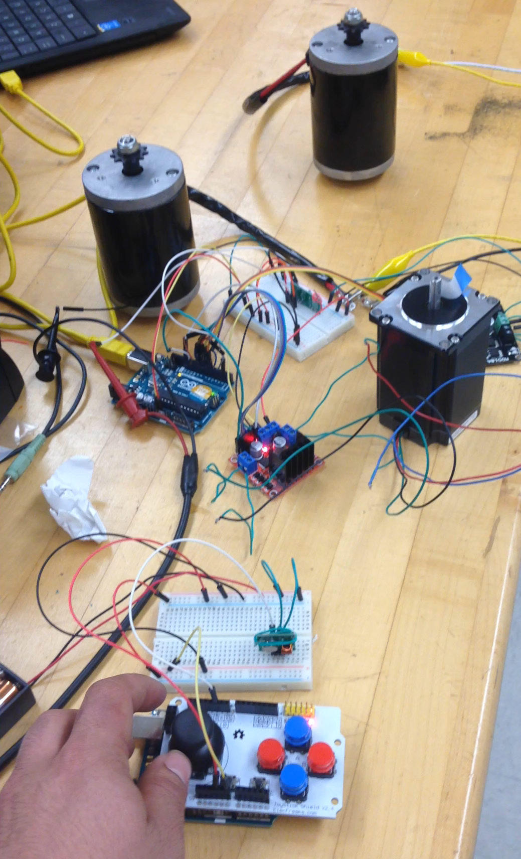
Testing Stepper Motor and DC Motors
DC Motor
(Simulates saw motor)
DC Motor (In and out)
Stepper Motor (Pitch)
Alberto Machado
20

Slide 29
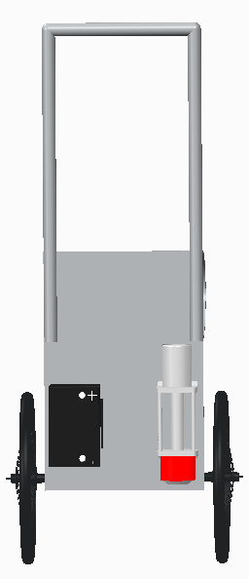
Next Steps - Base
Awaiting wheelbarrow and winch from Lowe’s
  Ordered 2/8
  Should be in next week
Waterjet aluminum sheet
  Completed: 2/24
  Attach base plate to bottom pole
Assemble pole
Attach battery and winch
Test system
Winch
Base Plate
Wheelbarrow
Battery
Derek Morin
21

Slide 30
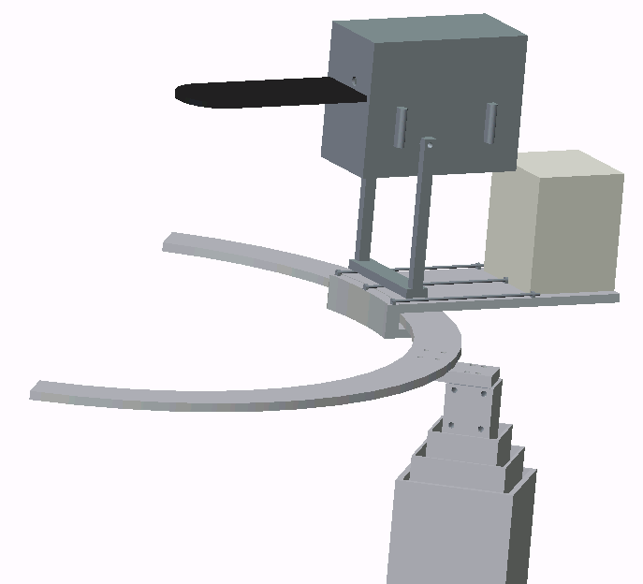
Next Steps – Cutting Mechanism
Attach cutter ring to pole
Assemble complete cutting mechanism
  Test for functionality
Optimize Rover Design
  Save Space
  More efficient pivoting
  Increase modularity
Cutter Box
Cutter Ring
Electronics Box
Aluminum Attachment Block
Derek Morin
23

Slide 31

Safety
Improve:
Handle bar length shortened after redesign
Weld calculations ensure the model is stable and balanced
Lifting Index < 1.0, mechanism is safe to lift
Enrique Gonzalez

Slide 32
Safety
Improve:
There exist few risk factors for pushing the prototype
Mechanism reduces the risk of musculoskeletal disorder or back injuries
Worker will be operating the device far from the tree
The chainsaw being used comes with a cover for the blade
Enrique Gonzalez

