Slide 1
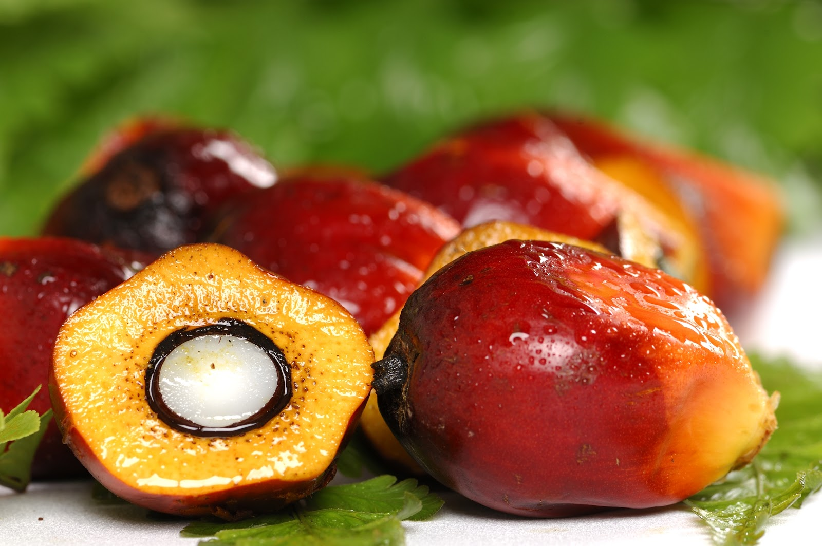
Maria Vetencourt
Matthew Gerstenblitt
Patrick Howard
Gabriel Diez
Alberto Machado
Derek Morin
Enrique Gonzalez

Slide 2
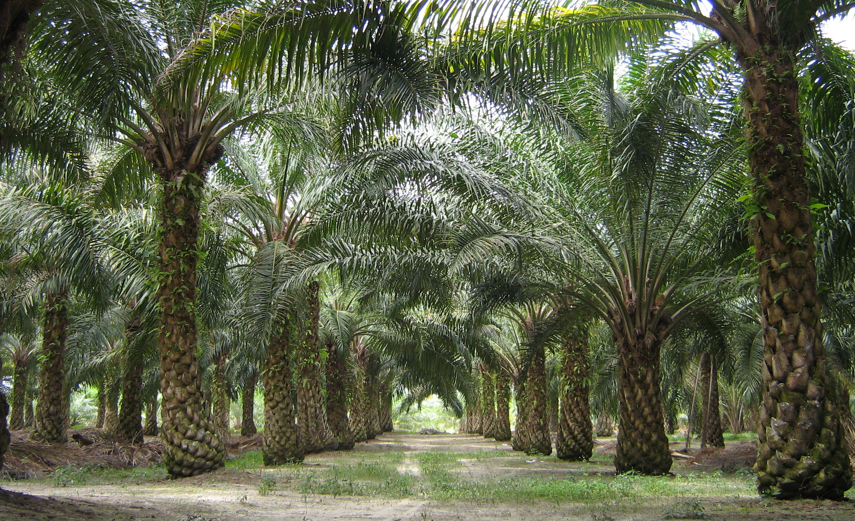
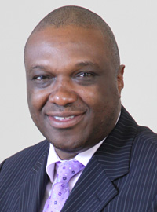
Sponsor
Dr. Okenwa Okoli
Maria Vetencourt

Slide 3
Stakeholders
Dr. Okenwa Okoli
Maria Vetencourt
3
Notes:
Stakeholders include…
Dr. Okoli, our sponsor

Slide 4
Stakeholders
Dr. Okenwa Okoli
Dr. Nikhil Gupta
Maria Vetencourt
3

Slide 5
Stakeholders
Dr. Okenwa Okoli
Dr. Nikhil Gupta
Dr. Jerris Hooker
Maria Vetencourt
3

Slide 6
Stakeholders
Dr. Okenwa Okoli
Dr. Nikhil Gupta
Dr. Jerris Hooker
Ms. Margaret Scheiner
Maria Vetencourt
3

Slide 7
Stakeholders
Dr. Okenwa Okoli
Dr. Nikhil Gupta
Dr. Jerris Hooker
Ms. Margaret Scheiner
Mr. Ryan Adams
Maria Vetencourt
3

Slide 8
Stakeholders
Dr. Okenwa Okoli
Dr. Nikhil Gupta
Dr. Jerris Hooker
Ms. Margaret Scheiner
Mr. Ryan Adams
FAMU-FSU College of Engineering
Maria Vetencourt
3

Slide 9
Stakeholders
Dr. Okenwa Okoli
Dr. Nikhil Gupta
Dr. Jerris Hooker
Ms. Margaret Scheiner
Mr. Ryan Adams
FAMU-FSU College of Engineering
Department of Industrial and Manufacturing Engineering
Maria Vetencourt
3

Slide 10
Stakeholders
Dr. Okenwa Okoli
Dr. Nikhil Gupta
Dr. Jerris Hooker
Ms. Margaret Scheiner
Mr. Ryan Adams
FAMU-FSU College of Engineering
Department of Industrial and Manufacturing Engineering
Department of Mechanical Engineering
Maria Vetencourt
3

Slide 11
Stakeholders
Dr. Okenwa Okoli
Dr. Nikhil Gupta
Dr. Jerris Hooker
Ms. Margaret Scheiner
Mr. Ryan Adams
FAMU-FSU College of Engineering
Department of Industrial and Manufacturing Engineering
Department of Mechanical Engineering
Department of Electrical and Computer Engineering
Maria Vetencourt
3

Slide 12
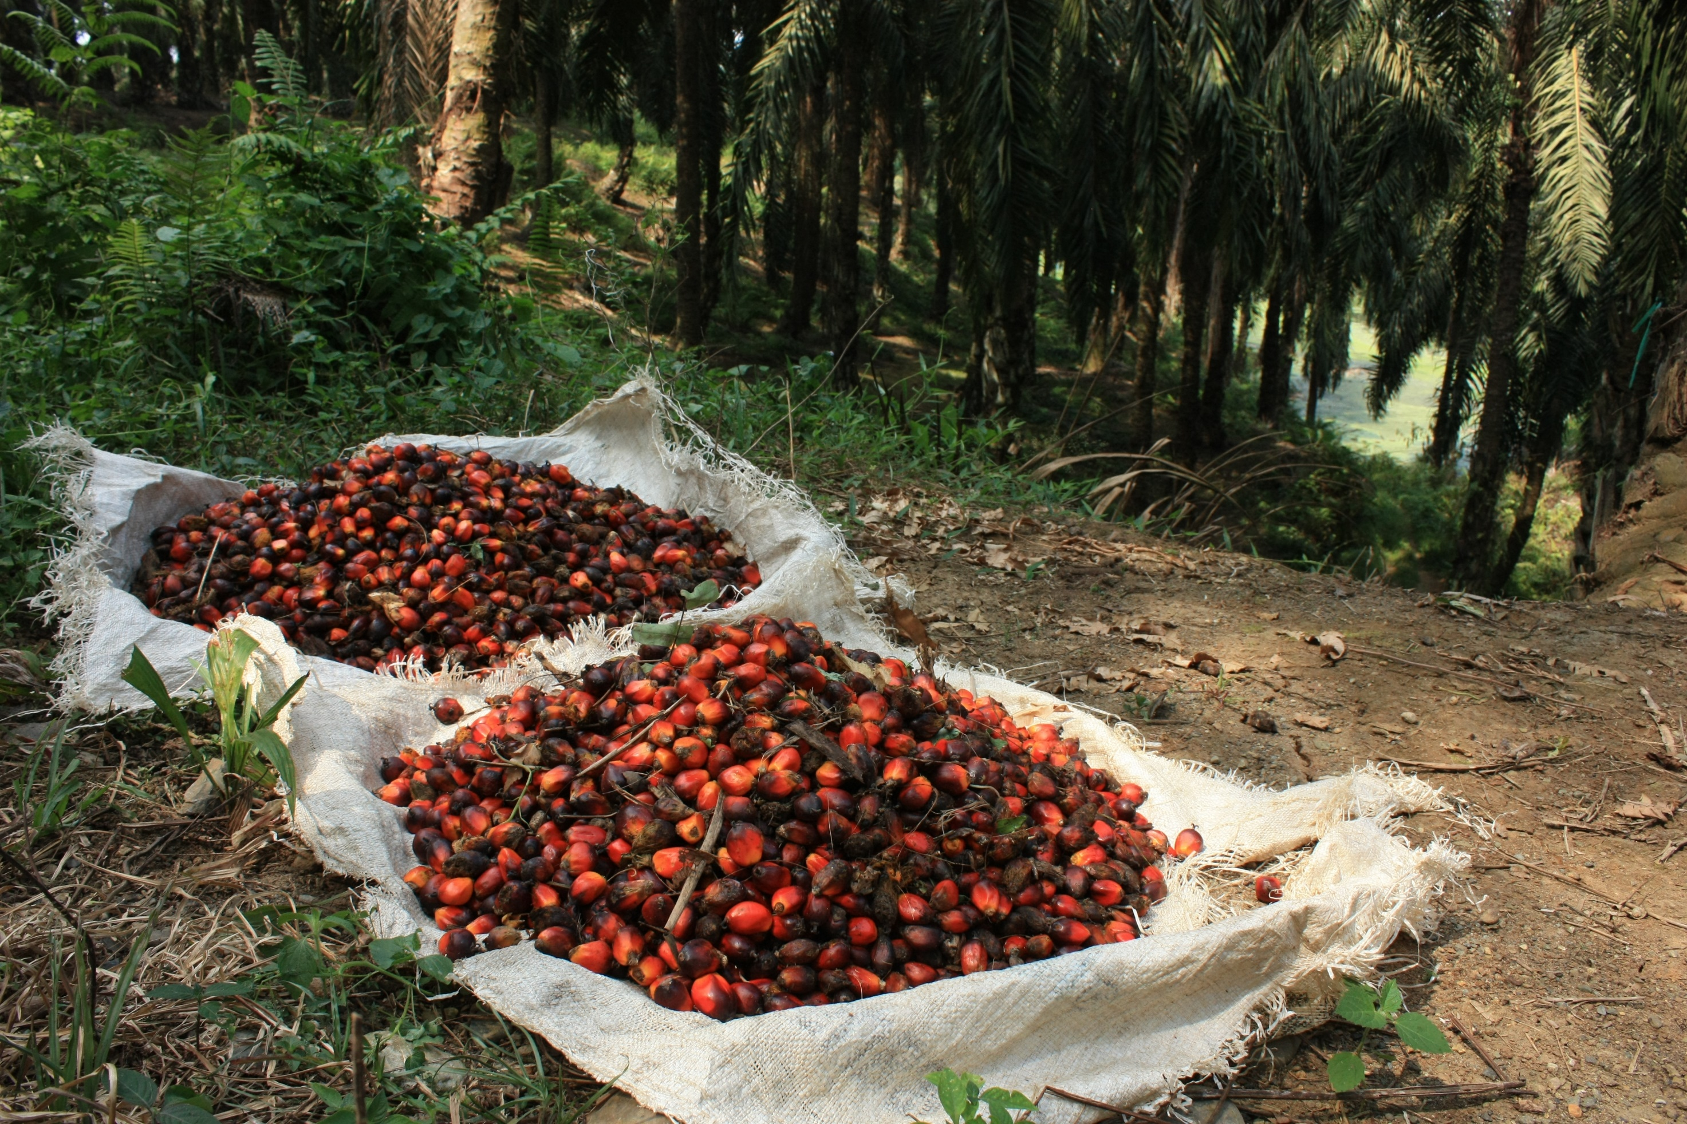
Project
Develop a device to harvest oil palm fruit
Maria Vetencourt

Slide 13
Important Factors [1]
Height of the trees
Fibrous consistency
Budget
Safety
Maria Vetencourt

Slide 14
Design Considerations
Current selected design borrows from two previous design concepts
Pole Pruner
Tree Climber
Matthew Gerstenblitt
Notes:
In the previous phase report we proposed three design concepts. In this selected design we borrowed ideas from two of them: the pole pruner and the tree climber.

Slide 15
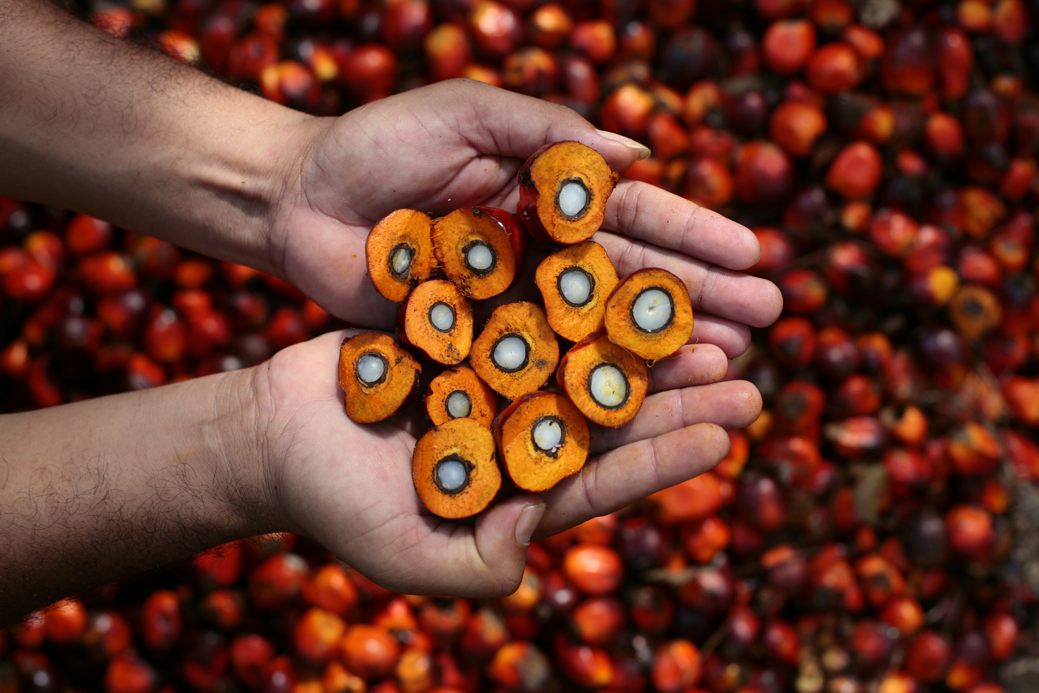
Modified Pole Pruner
Allow vertical extension up to 40 feet
Mount wireless camera
Matthew Gerstenblitt
7
Notes:
As you may recall, the pole pruner was a modification to an existing landscaping tool. It utilized light weight material for its pole to be able to be hand held and reach 40-feet. It also was equipped with a wireless camera so that the operator may have a better view of the fruit they are cutting.

Slide 16
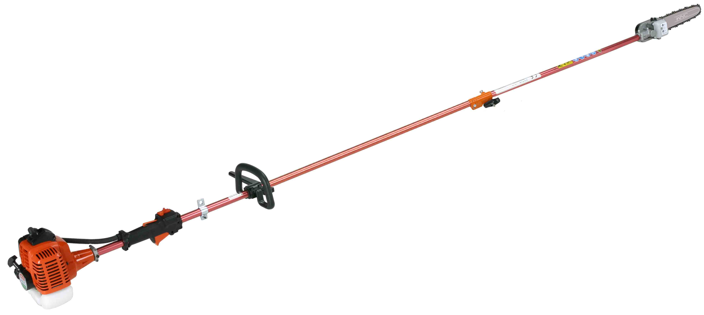
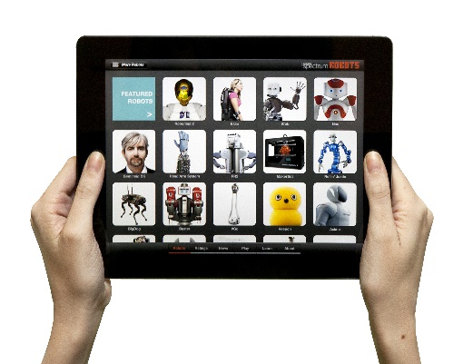
Extended Pole Pruner
Telescoping Pole
Gas Motor
User Interface
Matthew Gerstenblitt
Notes:
This is just a visual representation of the extended pole pruner, as you can see it is gas operated, it has a telescoping pole to extend to the fruit and a chainsaw equipped with a camera that can be viewed by the operator on the ground

Slide 17
Problems
Weight of saw mechanism caused too much deflection, given the angle of use
Tripping hazard
Matthew Gerstenblitt
Notes:
Some problems with this design were that because of the weight of the chainsaw the 40-foot pole would likely have deflected too much to be usable. Additionally, since it is essentially a chainsaw attached 40-feet away from the operator, if they were to trip it would endanger the lives of people up to 40-feet away from them.

Slide 18
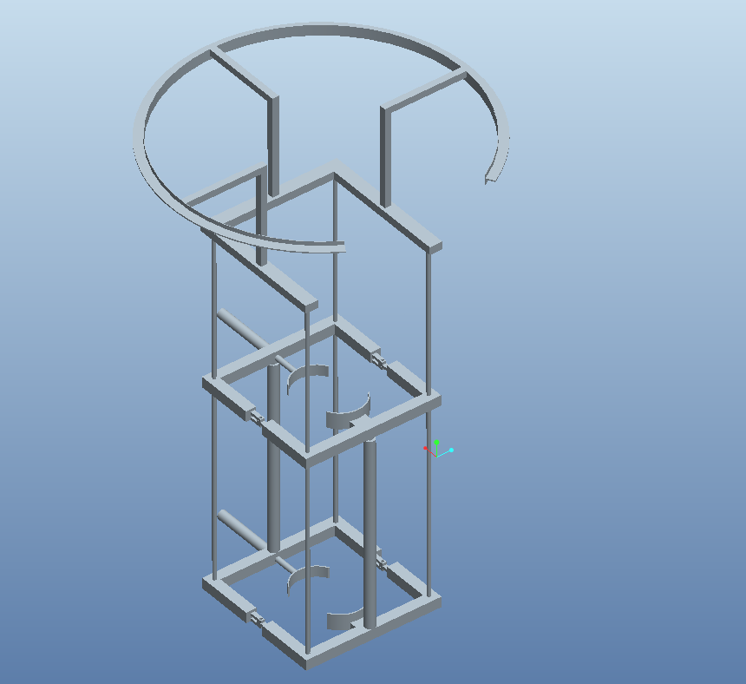
2012’s Tree Climbing Robot [2]
Matthew Gerstenblitt
Notes:
The tree climber was based on 2012’s “King Climber” design. This would climb by gripping the tree, holding the grip, pivoting upward, gripping again and repeating the process. Once it was at the top it had a circular ring that the cutter would traverse around and cut the palm fruit down from.

Slide 19
Problems with Tree Climber
Too complex
Dangerous
No 360° axis
Matthew Gerstenblitt
Notes:
So there were a few problems with this design. To begin with, getting a device that is actually capable of climbing a tree is a very ambitious undertaking and the team was not actually able to achieve their goal. Here at the STRIDE lab, Dr. Gupta and his colleagues have been working on designing a tree climber of their own and have yet to be successful, and they aren’t even trying to attach a heavy cutting mechanism to it. Because of this, even if it was able to climb all the way to the top, it lacked the sophistication to ensure that it will not fall down, making it an extreme hazard both to itself and the people operating it. Additionally as you can see, the ring did not have a 360 degree axis to the palm fruit, which really makes it an incomplete design.

Slide 20
Current Design
Decided to use the stability of the tree to send a cutter upward similar to 2012
Also used light weight pole material to make raising and lowering easier
Patrick Howard
Notes:
So in our current design we decided to use the natural stability of the tree to assist in having the cutter go all the way up but without the complexity of an actual tree climbing robot. Additionally we borrowed from our own pole pruner idea by using a strong, lightweight pole to elevate the cutter in order to make it portable for the user.

Slide 21
Ring
Pole
Stand
Patrick Howard
13

Slide 22
Base
Patrick Howard

Slide 23
Pole
Patrick Howard

Slide 24
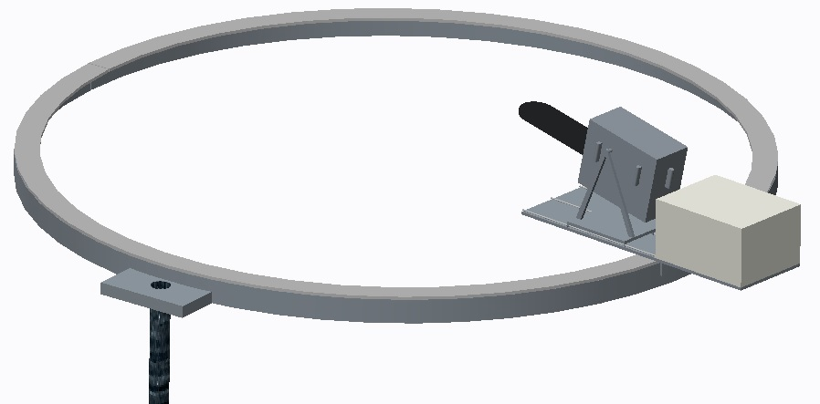
Ring
Gabriel Diez
16

Slide 25
Cutter
Gabriel Diez
17
Notes:
The cutting mechanism will consist of a saw on a platform that traverses around the circumference of the ring. The raw sits on a second platform that is then connected to a lead screw and two guide shafts which control its forward and backward translation, allowing it to cut fruit off of trees of varying diameter. On top of the second platform there is a box that houses the DC motor that controls the chainsaw in addition to the stepper motor that controls the pitch of the saw. In other words there are four motors that control three degrees of freedom: forward/backward, pitch, and side to side.

Slide 26
Arduino Uno [3]
Alberto Machado
18
Notes:
Has 14 I/O pins, 6 Analog Pins, 32KB Flash, 5V operating voltage. Low-power requirements

Slide 27
Stepper Motor [4]
Operating voltage of 12 V
37.5 inch-pounds
4 phase
1 ampere per phase
Alberto Machado
Notes:
1 amp/phase 12V operating. 1.8 degree step
http://www.linengineering.com/stepper-motors/E5718.aspx

Slide 28
DC Motor [5]
Operating voltage of 24 V
2,600 no load rpm
1/8 horsepower
Alberto Machado
Notes:
12V-24V operating voltage. 1/8 hp 2600 no load rpm at 24V will need to be geared down for desired torque, needs Guptas approval
http://www.ampflow.com/small_high_performance_motors.htm

Slide 29
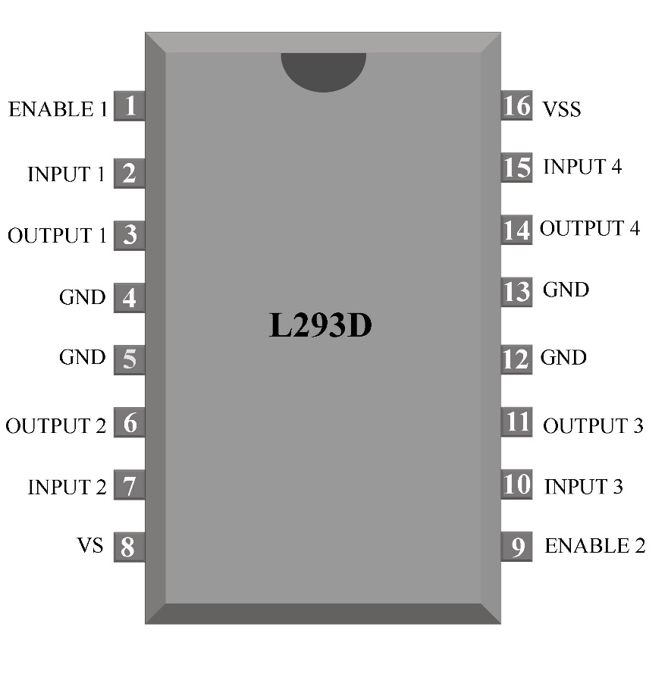
L293D H-Bridge Motor Driver [6]
Alberto Machado
Notes:
L293D H-Bridge Motor Driver, we will need 3. Explain how it works.

Slide 30
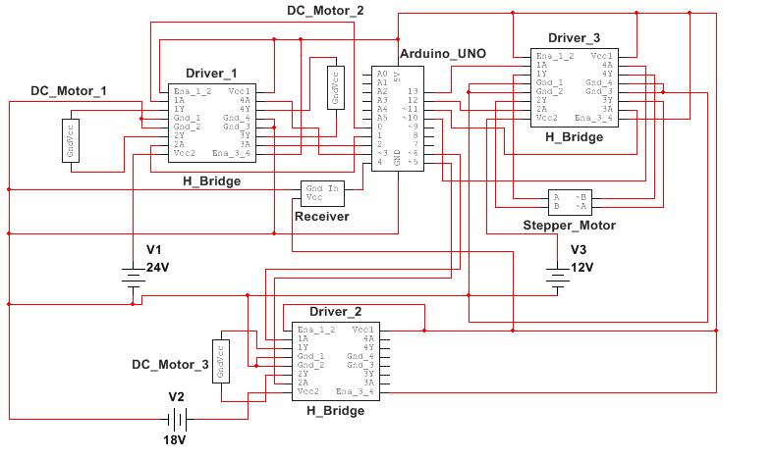
Cutting Mechanism Electronics
Alberto Machado
22
Notes:
This is all of the components inside of the cutter. Talk about each component.

Slide 31
Cutting Mechanism Batteries
16 rechargeable D batteries – 3.5 hours of use minimum
10,000 mAh
Derek Morin
Notes:
2- 8 D cell battery holders Dimension for both together: 5.25” L x 2.75”W x 4.5”H
http://www.vetco.net/catalog/product_info.php?products_id=956&gclid=CLS3nI3Zs8kCFQuPHwodz_oIuA
8 D batteries will last the DC motors 1-1.5hrs of total time use, 16 D batteries will last 3.5-4hrs of use. Going to get approval from sponsor before making final.
http://www.batteryjunction.com/4dni10reba.html?gclid=CIrRg4zds8kCFcYRHwodosQL9g

Slide 32
Transmitter and Receiver [7]
Operation voltage: 12 V
Antenna Length: 6.8”
Communication distance: 100 ft
Derek Morin
Notes:
Talk about Transmitter and Receiver. How much Voltage and how long antenna is needed for communication
Extremely cheap. We have an Arduino Library made for this particular device. Online resources have told us that when powered at 12V and with an antenna of atleast 6”, it will be more than enough range to reach the cutting mechanism from the ground. I have ordered one that should get in at any moment and they will be tested over winterbreak.

Slide 33
Joystick and Buttons [8]
Derek Morin
Notes:
The controller will also use an Arduino UNO and will use a joystick shield for user input. Fits perfectly.

Slide 34
Joystick and Buttons [8]
Joystick Left and Right – traverse the track
Joystick Up and Down – Saw in and out
Button D: Turn on Saw
Button A: Turn off Saw
Button B: Pitch Saw Up
Button C: Pitch saw down
Derek Morin
Notes:
Schematic of joystick shield when attached. Receiver will be connected to a pin that is free (Such as D10).
Joystick:
Left/Right → move around track
Up/Down → Saw moves in and out
Button D: Turn on Saw
Button A: Turn off Saw
Button B: Pitch Saw Up
Button C: Pitch saw down

Slide 35
Controller Batteries
Derek Morin
Notes:
Controller will be powered by 8 AA batteries.
Holder dimension: 2.5” L x 2.25” W x 1” H
Holder:
http://www.parts-express.com/8-aa-cell-battery-holder--140-978?utm_source=google&utm_medium=cpc&utm_campaign=pla
Non-Rechargeable since they will last long in the controller (low power requirements) and the batteries are cheap
Batteries:
http://www.bhphotovideo.com/bnh/controller/home?O=&sku=1074544&gclid=COGUyoros8kCFYT1Hwod1Y0EnQ&is=REG&ap=y&m=Y&A=details&Q=

Slide 36
Screen and Camera [9]
Derek Morin
28

Slide 37
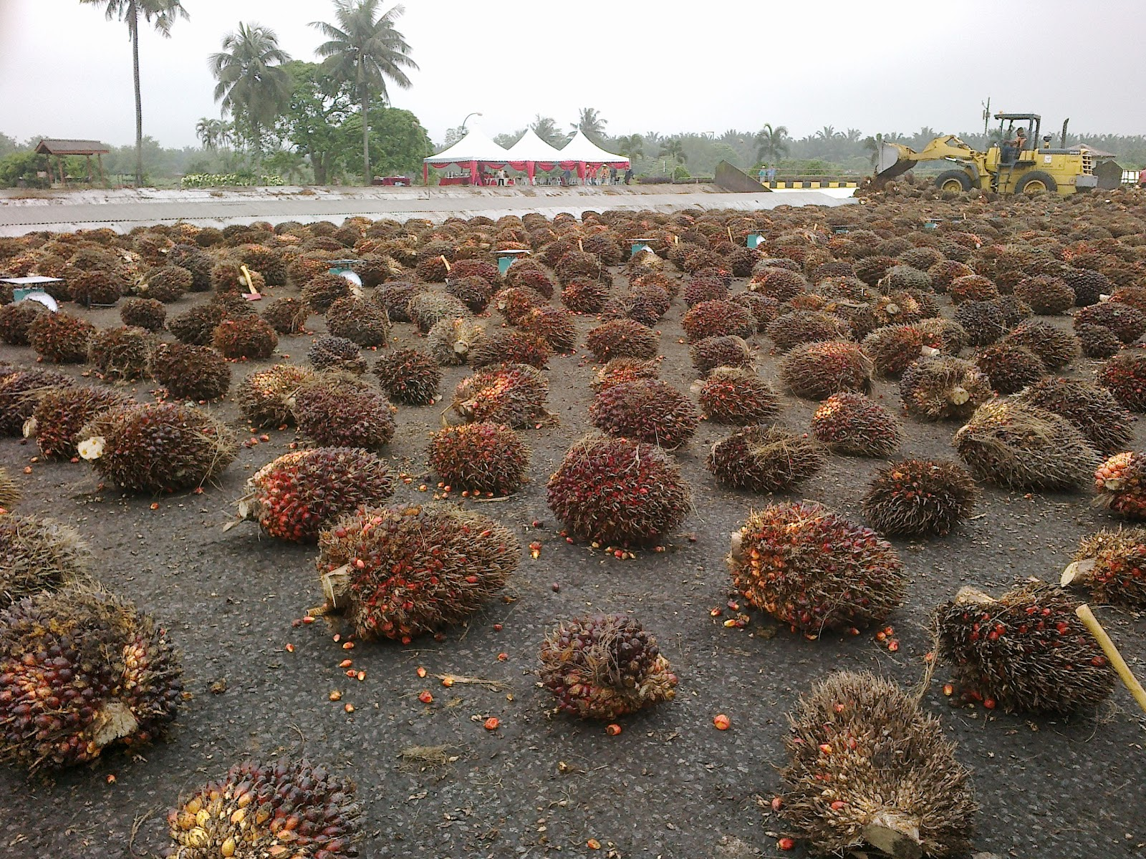
Budget
Part | Cost ($)
Ring | 1,050
3D Printing Material | 100
DC Motors | 150
DC Motors | 150
Stepper Motor | 130
Lead Screw Rod | 27
Lead Screw Nut | 12
Electrical Components | 115
Linear Bearings | 30
Shaft | 38
Shaft Housing | 20
Robot Mount | 30
Battery | 150
Total | 2,002
Enrique Gonzalez
Notes:
We decided to approach this project from the top down since the ring is not only the most complex, it’s also the most important. After designing the ring and cutter and looking for different parts we found that in order to get it to work properly and meet all design requirements it would make up the majority of our budget. Therefore, in order to leave some room in our budget for unexpected failures we have decided to concentrate the majority of the prototype assembly on the cutting and traversing mechanism, but still design the pole and base for following years to build off of.

Slide 38
Safety
Pole is attached to tree which prevents it from falling over
Ring also encompasses the tree which eliminates the possibility of the cutter falling down
The chainsaw being used comes with a cover for the blade.
Enrique Gonzalez

Slide 39
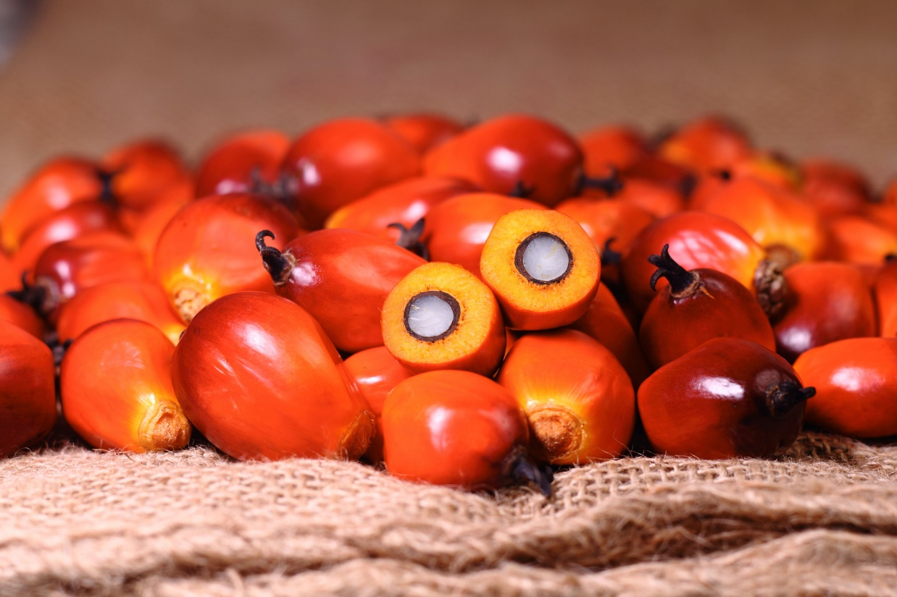
References
[1] G. Diez, P. Howard, M. Gerstenblitt, M. Vetencourt, E. Gonzalez, A. Machado and D. Morin, "Development of a Semi-Autonomous Oil Palm Fruit Harvesting Device - Define Phase," FAMU-FSU College of Engineering, Tallahassee, 2015.
[2] B. Carpenter, C. X. Smith, J. A. Rojas, W. Craig, O. Abakporo and S. Trayner, "Define Phase Report for IE Senior Design Class," FAMU-FSU College of Engineering, Tallahassee, 2011.
[3] A. Castle, "Know Your Arduino: A Practical Guide to The Most Common Boards," 12 June 2013. [Online]. Available: http://www.tested.com/tech/robots/456466-know-your-arduino-guide-most-common-boards/. [Accessed 24 November 2015].
Enrique Gonzalez

Slide 40
References
[4] AmpFlow, "Small High Performance Motors," 2015. [Online]. Available: http://www.ampflow.com/small_high_performance_motors.htm. [Accessed 29 November 2015].
[5] Lin Engineering, "NEMA SIZE 23 | Step Size 1.8°," 2015. [Online]. Available: http://www.linengineering.com/stepper-motors/E5718.aspx. [Accessed 29 November 2015].
[6] L. George, "L293D – Quadruple Half H DC Motor Driver," 2015. [Online]. Available: https://electrosome.com/l293d-quadruple-half-h-dc-motor-driver/. [Accessed 24 November 2015].
Enrique Gonzalez

Slide 41
References
[7] Terapeak, "433mhz - Wireless Uhf Receiver - Arduino & Raspberry," 2015. [Online]. Available: http://www.terapeak.com/worth/433mhz-wireless-uhf-receiver-arduino-raspberry/281207346165/. [Accessed 24 November 2015].
[8] StackExchange, "Can I use a 6 pin Bluetooth module in a 4 pin socket?," 30 July 2015. [Online]. Available: http://arduino.stackexchange.com/questions/13818/can-i-use-a-6-pin-bluetooth-module-in-a-4-pin-socket. [Accessed 24 November 2015].
[9] Seculife, "Wireless Home Security System Baby Monitor 2.4GHz 7" LCD One 4CH DVR & One 380TVL Weatherproof Camera WRC890+WCM7061B - AU Plug," 2015. [Online]. Available: http://www.seculife.com/details/Wireless-Home-Security-System-Baby-Monitor-2-4GHz-7-LCD-One-4CH-DVR-One-380TVL-Weatherproof-Camera-WRC890-WCM7061B-AU-Plug-84000327D/?utm_source=google&utm_medium=pla&utm_campaign=cse&gclid=CjwKEAiA7MWyBRDpi5TFqqmm6hMSJAD6G. [Accessed 2015 November 2015].
Enrique Gonzalez

Slide 42
Questions?
Enrique Gonzalez

