Slide 1

2nd Stage Development of an Autonomous Search and Rescue UAV
Team 12: Matthias Clarke, Devin Justice, Trent Loboda, Cody Rochford, Marcus Yarber, Qinggele ‘Gale’ Yu
Presenters: Matthias Clarke, Marcus Yarber, Qinggele ‘Gale’ Yu
Advisor: Dr. Alvi
1

Slide 2
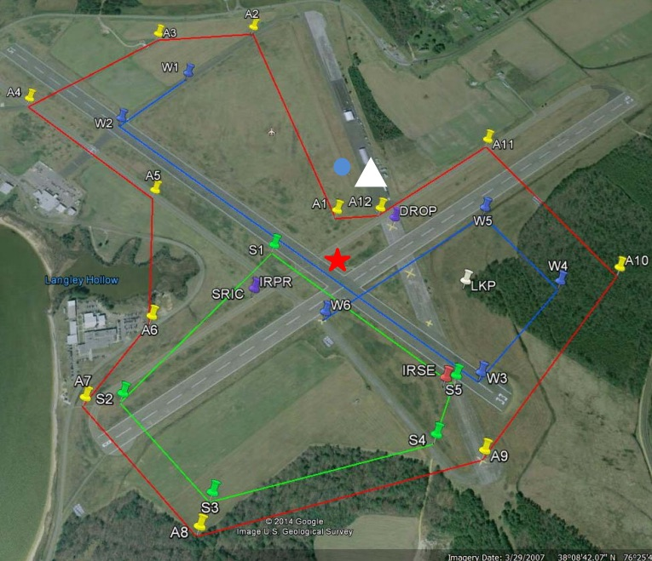
Project Introduction
Student Unmanned Aerial Systems (SUAS) 2017 Competition
Simulated search and rescue of a hiker
Tasks:
  Autonomous flight
    Waypoint capturing, navigation, take off, and landing
  Payload delivery
  Target detection
  Object avoidance
Figure 1. Mission map for the SUAS 2017 Competition.
Matthias Clarke
Project Introduction Previous Work Current work conclusion
2

Slide 3
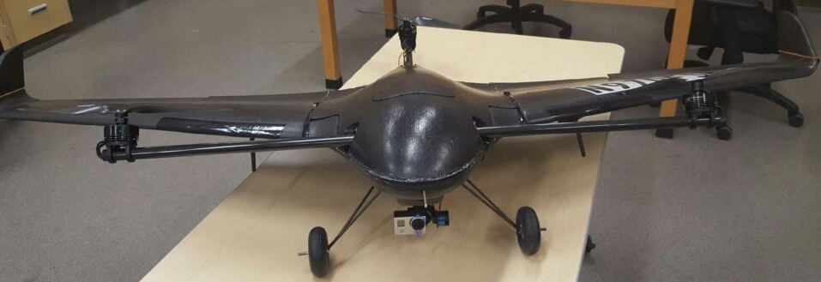
Development Stages
1st stage development:
  Design, build, test UAV system
2nd stage development:
  Upgrade electronics package
  Implement:
    Target color detection
    Target shape detection
    Target alphanumeric detection
    Dynamic target detection
    Payload delivery
    Object avoidance
6’-7”
Figure 2. Current UAV developed by team 8 in 2016.
Matthias Clarke
Project Introduction Previous Work Current work conclusion
3

Slide 4
Objectives
Objectives:
  Select and develop electronics payload.
  Design, build, and integrate payload delivery mechanism.
  Select and integrate lightweight landing gear configuration.
  Create programs to detect and classify stationary targets.
  Create programs to detect and classify emerging targets.
  Develop control system to autonomously avoid objects.
3
Figure 3. Stationary target example.
Matthias Clarke
Project Introduction Previous Work Current work conclusion
4

Slide 5
Constraints
Constraints:
  Maximum takeoff weight must be less than 55 lbs.
  Maximum speed must be less than 70 Knots Indicated Air Speed (KIAS).
  Must be capable of operation with 15 knots winds with gusts up to 20 knots.
  Must be capable of operation in 110°F and average over 100°F for over 12 hours.
Solutions:
  Wind load calculations have been conducted.
  Finite element analysis to be done on heat transfer to electronics from environment.
Matthias Clarke
Project Introduction Previous Work Current work conclusion
5

Slide 6
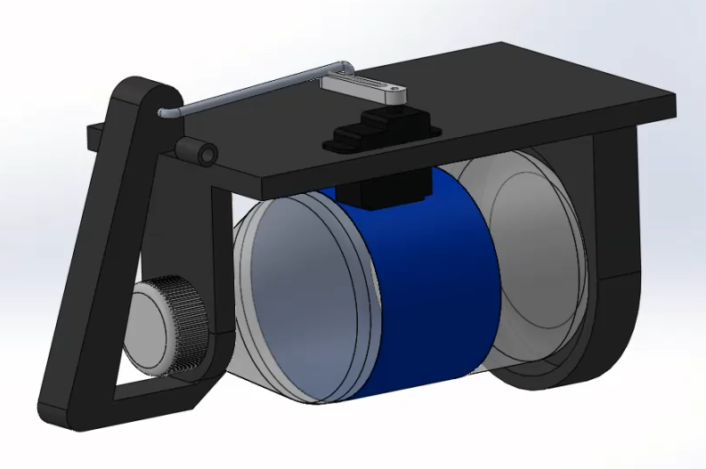
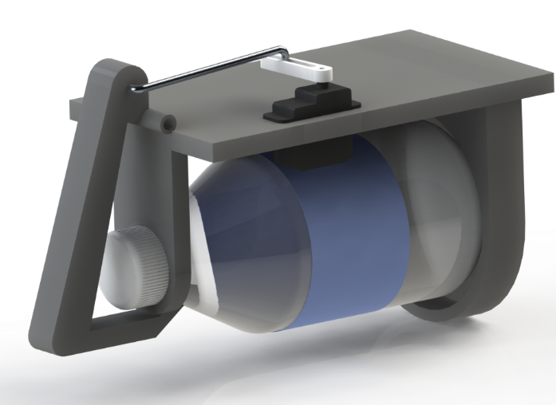
Payload Delivery Mechanism
Figure 4. 3D Model Rendering of Latch-Servo Design.
Figure 5. 3D Animation of Latch-Servo Design.
Marcus Yarber
Project Introduction Previous Work Current work conclusion
6

Slide 7
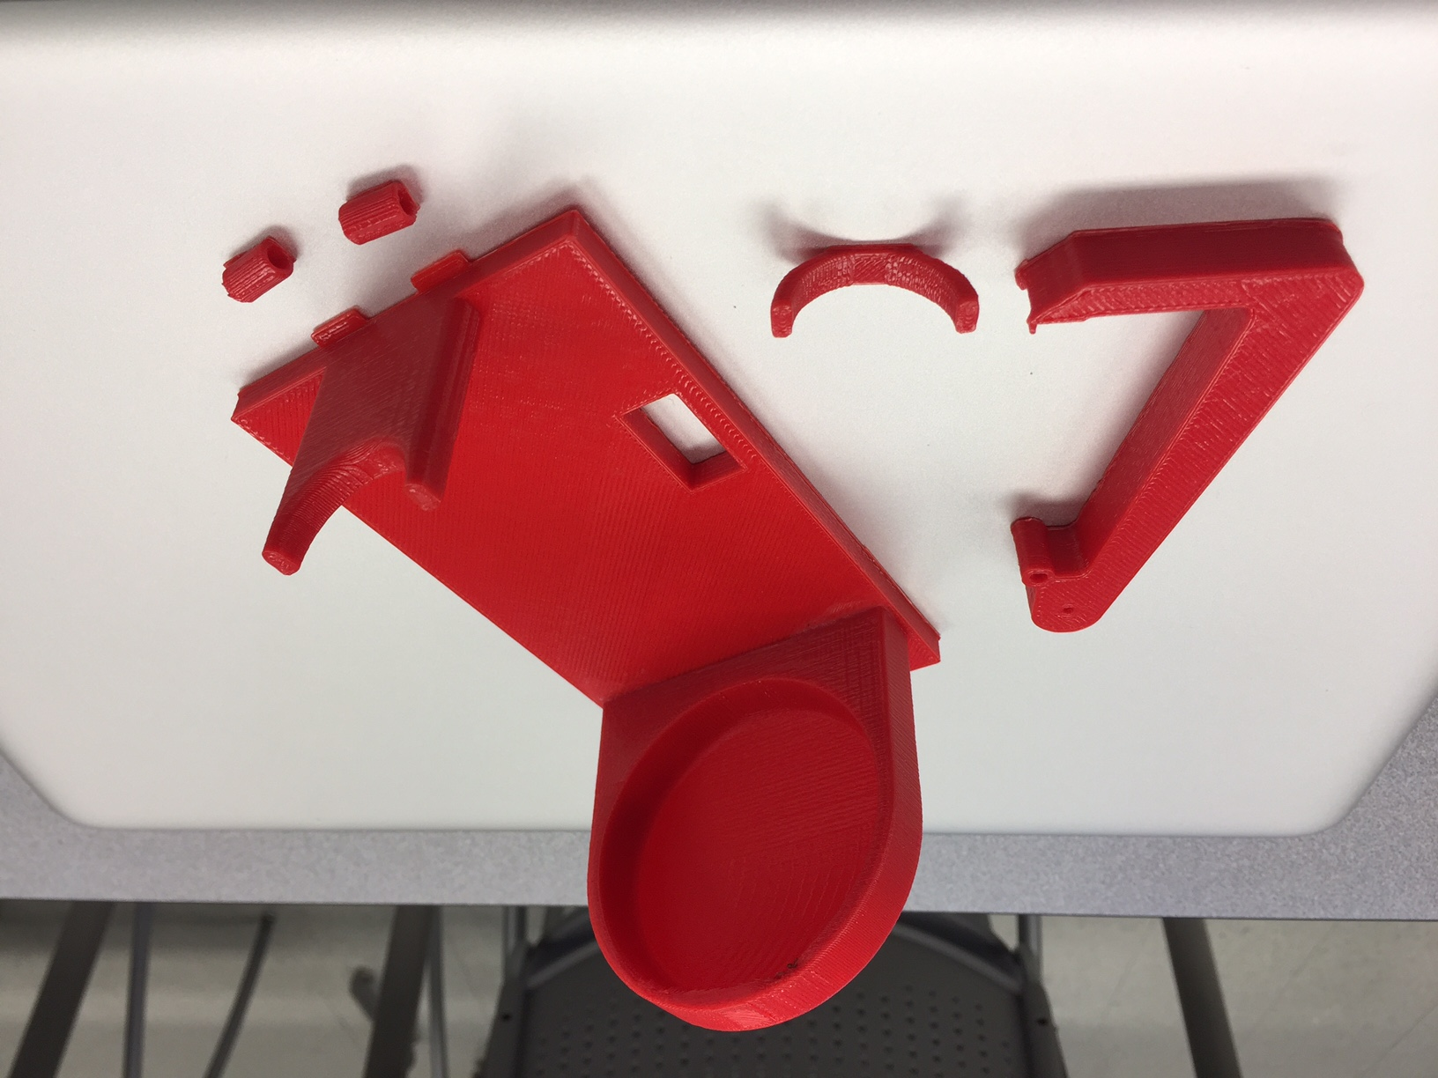
Payload Delivery Mechanism
Figure 6. First Iteration Prototype.
Marcus Yarber
Project Introduction Previous Work Current work conclusion
7

Slide 8

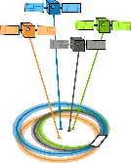



Electrical Systems Design
System Requirement Solution
Autonomy Autopilot component
Navigation GNSS/IMU
Target detection Camera
Communication Multiple antennas
Image Processing CPU
Marcus Yarber
Project Introduction Previous Work Current work conclusion
8

Slide 9
Ordered Electronics
Table 1. Ordered electronics and cost.
Electrical Component | Cost (Dollars)
Odroid C2 Motherboard | 40
Zubax Global Navigation Satellite System (GNSS) | 129
Sony Camera | 90
Wi-Fi Antennas | 26
Total: | 285
Marcus Yarber
Project Introduction Previous Work Current work conclusion
9

Slide 10
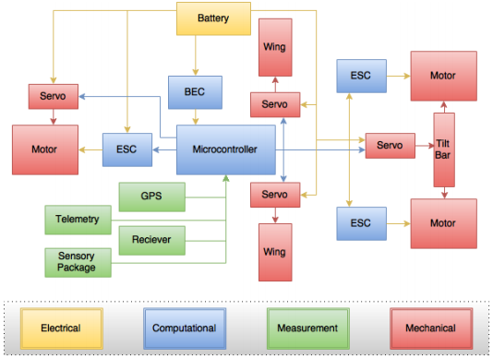
Electronics Update
Figure 7. Original top-level electronics design.
Marcus Yarber
Project Introduction Previous Work Current work conclusion
10

Slide 11
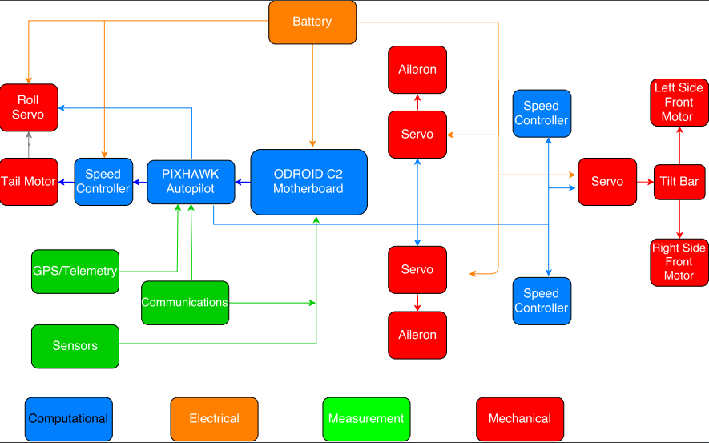
Electronics Update
Figure 8. Proposed top-level electronics design.
Marcus Yarber
Project Introduction Previous Work Current work conclusion
11

Slide 12
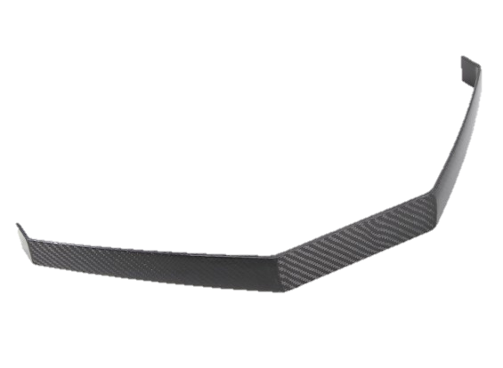
Landing Gear Selection
Problem:
  Current landing gear risks damaging rotors upon landing.
Solution:
  New landing gear under development, allows clearance for rotors.
  New landing gear will have a rear castor wheel which will increase stability during takeoff and landing.
Figure 9. Forward strut example of new landing gear.
Marcus Yarber
Project Introduction Previous Work Current work conclusion
12

Slide 13



Design of Experiments: Target Detection
Taguchi method 2 level fractional factorial design used to design experiments for color detection and alphanumeric symbol detection.
Variables:
  Brightness High/Low
  Target size Large/Small
  Contrast High/Low
  Distance Far/Close
  Motion Dynamic/Static
$$n=2^{k}$$
$$n≜number of experiments$$
$$k ≜number of parameters$$
Preliminary testing: 32 trials
Further testing of color, shapes, and symbols will make use of Taguchi orthogonal arrays.
Gale Yu
Project Introduction Previous Work Current work conclusion
13

Slide 14
Design of Experiments: Flight
Order of testing:
  Motors
  Pixhawk
  GPS
  Sensors
  Waypoint capture
  Path following
  Take-off/Landing
  Object avoidance
Fall Semester
Spring Semester
Gale Yu
Project Introduction Previous Work Current work conclusion
14

Slide 15
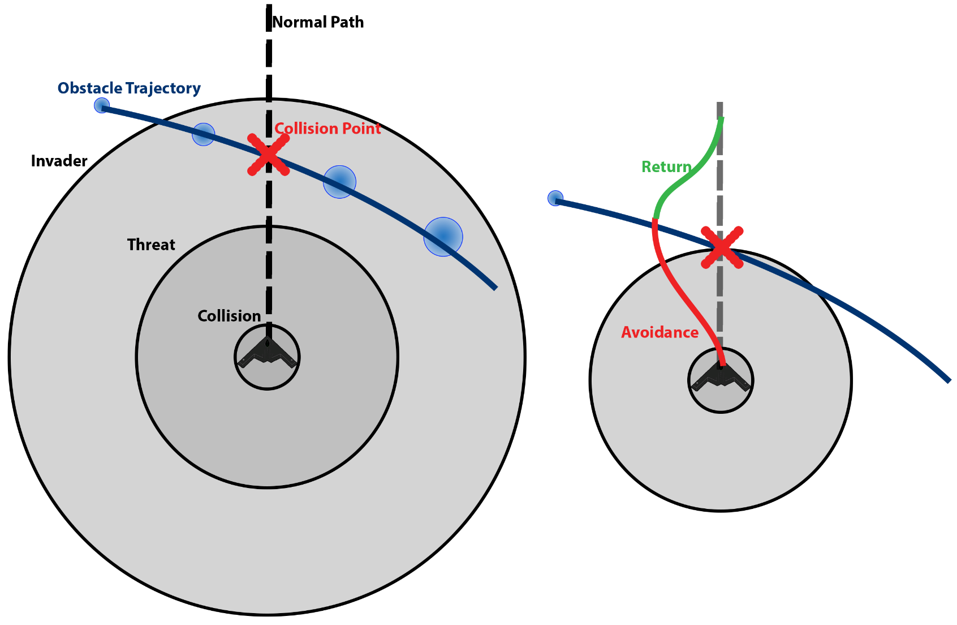
Object Avoidance: Preliminary Approach
Paths:
  Normal (Waypoints, etc.)
  Avoidance (Avoid Obstacle)
  Return (Return To Normal)
Ranges:
  Collision (Closest Range)
  Threat (Immediate Action)
  Invader (Detectable/In UAV Flying Area)
Figure 10. Object avoidance working principle.
Gale Yu
Project Introduction Previous Work Current work conclusion
15
Notes:
PDF: Moving Obstacle Avoidance for Unmanned Aerial Vehicles by Yucong Lin
Focuses Mainly on Obstacle Avoidance (Not The Return Path,etc.)
Attractive Forces Include: Normal Path/ Target or Goal
Repulsive Forces Include: Geo-fence, The Obstacle, Ground/Max Alt
Avoidance Path Computation:
Min/Max Climb Angles (Pitch)
Min/Max Steering Angles (Yaw)
Min/Max Speed & Acceleration
Attractive & Repulsive Forces

Slide 16
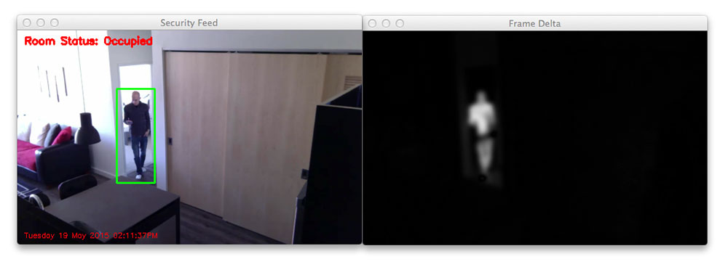
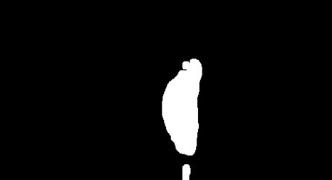
Dynamic Target Detection: Approach
Compare current image with previous; use differences to detect changes.
Challenge: constantly changing environment.
Proposed solution: if large changes are found, set image as new background.
Figure 11. Motion detection progression.
Gale Yu
Project Introduction Previous Work Current work conclusion
16

Slide 17

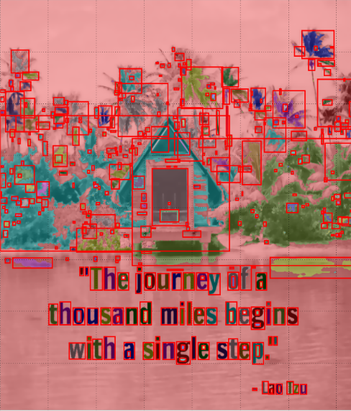
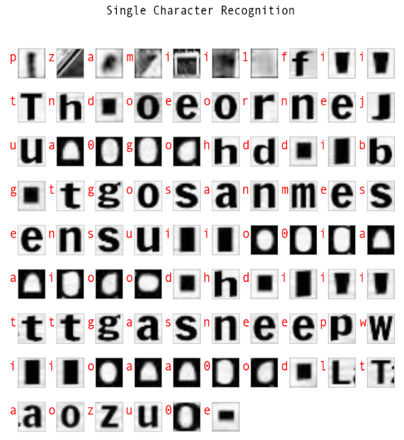
Future Work
Test code for color and alphanumeric detection.
Test electronics upon delivery and test flight capabilities.
Integrate payload delivery mechanism.
Continue work on first iteration of object avoidance code.
Continue work on first iteration of dynamic target detection
Figure 12. Letter recognition processing.
Gale Yu
Project Introduction Previous Work Current work conclusion
17

Slide 18
Challenges
Target detection:
  Recognize alphanumeric symbols and shapes, reliant on camera capability and distance.
  Emergent target detection in a constantly changing environment is less prevalent in open source code.
  Recognize objects while flying with the propellers in the horizontal position.
  Development of transitional propeller control system.
Object avoidance:
  Develop evasive maneuvering within the limited flight envelope for flying wing design.
  Write a robust program capable implementation with hardware for realistic application.
Gale Yu
Project Introduction Previous Work Current work conclusion
18

Slide 19
Conclusion
Electronics have been ordered.
Payload delivery mechanism has been 3D printed.
Testing of color detection and alphanumeric detection has been outlined.
Test flight tasks have been determined.
Object avoidance and dynamic target detection approaches have been outlined.
Gale Yu
Project Introduction Previous Work Current work conclusion
19

Slide 20
References
Competition Rules SUAS 2017. (2017).
K. Aley, J. Denman, D. Fitzpatrick, C. Mard, P. McGlynn, and K. Ijagbemi, "Needs Assessment" Sep. 25, 2015.
K. Aley, J. Denman, D. Fitzpatrick, C. Mard, P. McGlynn, and K. Ijagbemi, "Project Plan & Product Specifications" Oct. 22, 2015.
"Hardkernel," in ODROID. [Online]. Available: http://www.hardkernel.com/main/products/. Accessed: Oct. 6, 2016.
Rosebrock, Adrian. "Determining Object Color with OpenCV - PyImageSearch." PyImageSearch. 14 Apr. 2016. Web. 9 Nov. 2016.
Cross, Nigel. "Engineering Design Methods: Strategies for Product Design, 4th Edition." Engineering Design Methods: Strategies for Product Design, 4th Edition. Wiley, n.d. Web. 7 Nov. 2016.
K, Abid Rahman. "Simple Digit Recognition OCR in OpenCV-Python." OpenCV-Python. N.p., 01 Jan. 1970. Web. 8 Nov. 2016.
Hoblit, Frederick. "Gust Response Equations of Motion: Formulation and Solution." Gust Loads on Aircraft: Concepts and Applications (1988): 8 Nov. 2016.
Lin, Yucong (Author), and Srikanth (Advisor) Saripalli. "Moving Obstacle Avoidance for Unmanned Aerial Vehicles." ASU Digital Repository. Arizona State University, 01 Jan. 1970. Web. 8 Nov. 2016.
Rosebrock, Adrian. "Basic Motion Detection and Tracking with Python and OpenCV - PyImageSearch." PyImageSearch. 07 June 2015. Web. 9 Nov. 2016.
Project Introduction Previous Work Current work conclusion
20

Slide 21
Questions
Are there any questions?
Project Introduction Previous Work Current work conclusion
21

Slide 22
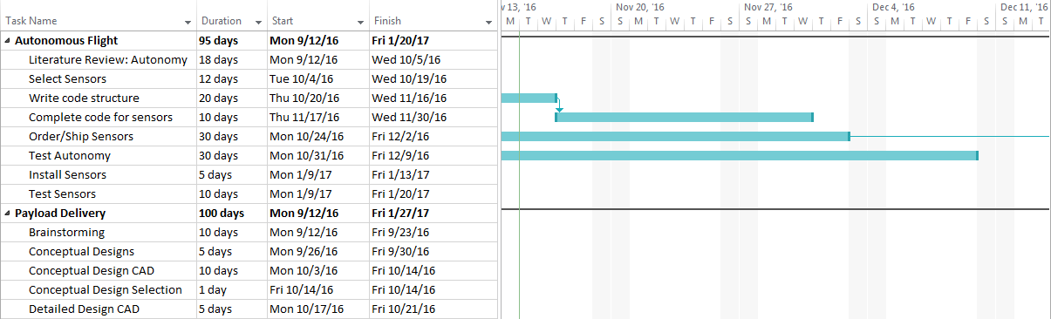
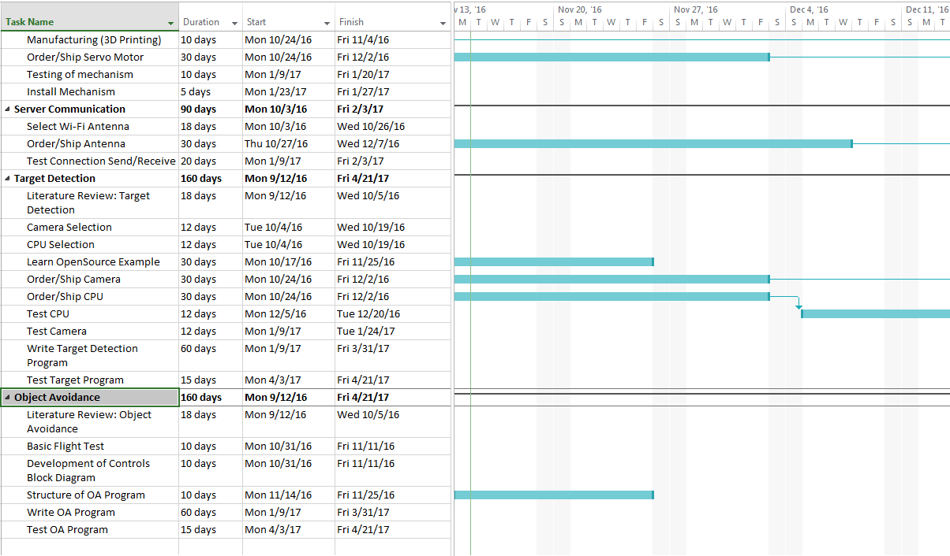
Gantt Chart 1
22

Slide 23
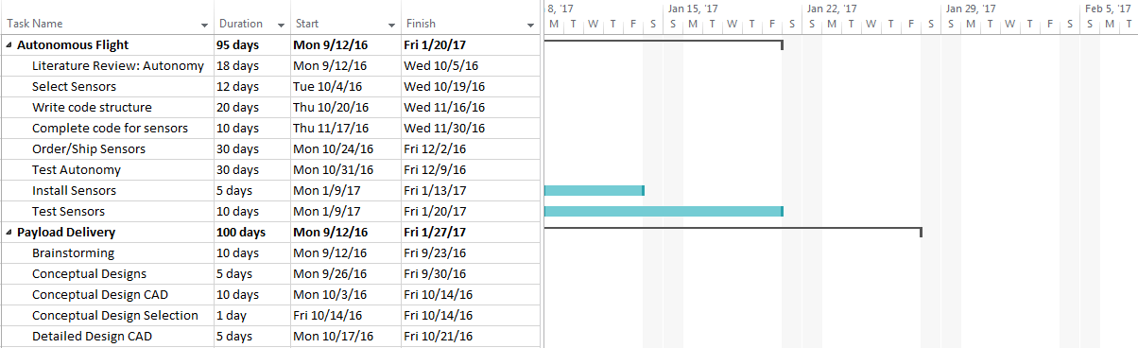
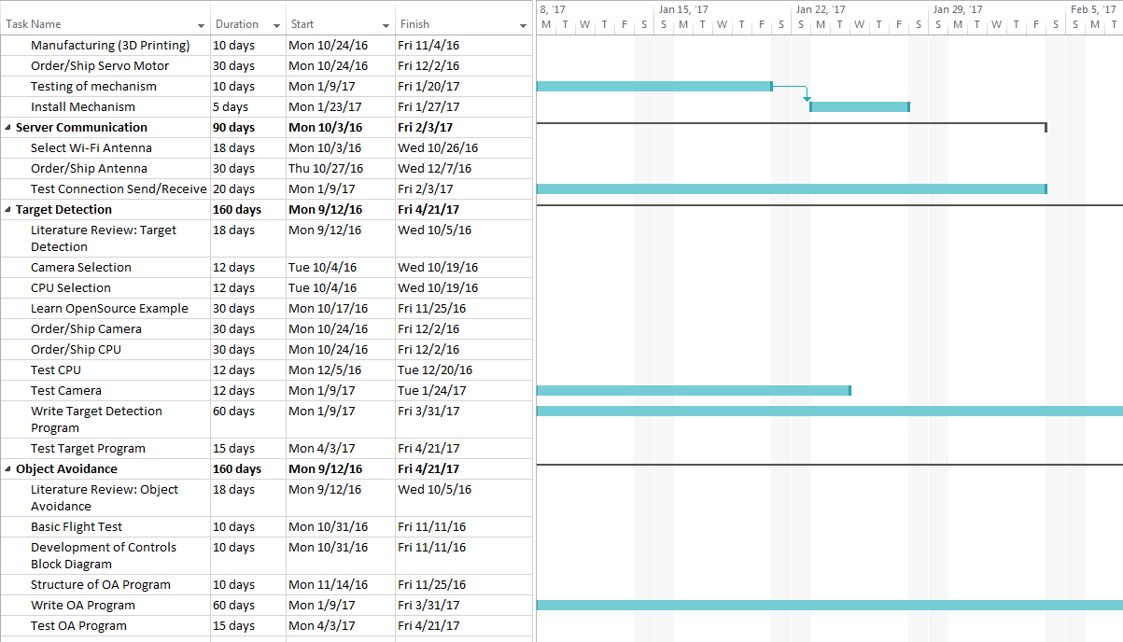
Gantt Chart 2
23

Slide 24
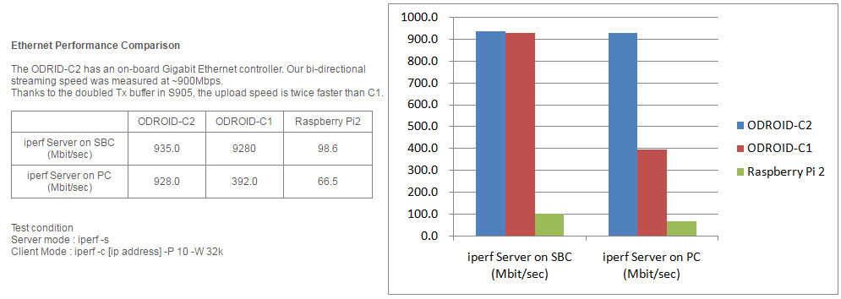
CPU Ethernet Performance
Figure 13. ODROID Comparison (Mbit/sec).
24

Slide 25
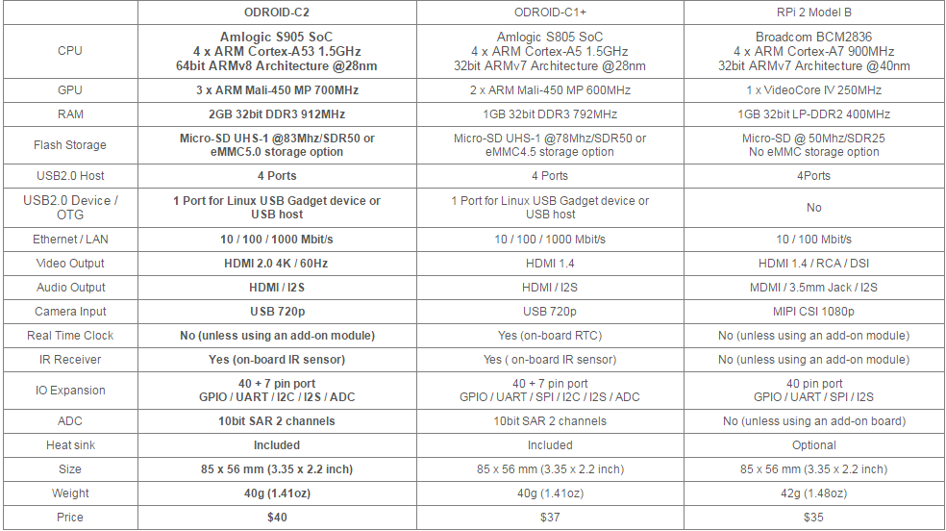
Component Justification
Table 6. ODROID Board Specification Comparisons.
25

