Slide 1

SOAAR UAV: Small Object Avoidance Autonomous Rescue Unmanned Aerial Vehicle
Team 12: Matthias Clarke, Devin justice, Trent Loboda, Cody Rochford, Marcus Yarber, Qinggele ‘Gale’ Yu
Presenters: Devin Justice, Trent Loboda, Cody Rochford
Advisor: Dr. Alvi
Conceptual design
1

Slide 2
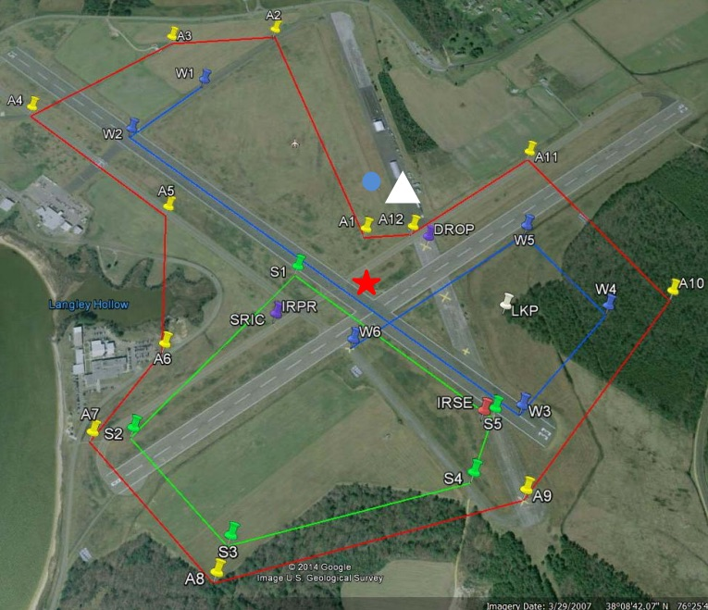
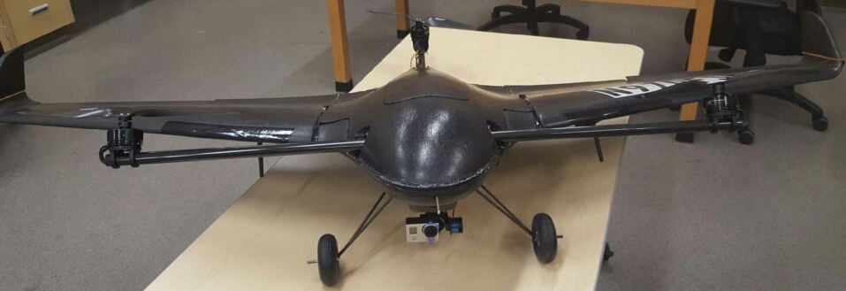
Project Introduction
Association for Unmanned Vehicle Systems International (AUVSI) Student Unmanned Aerial Systems (SUAS) 2017 Competition
“The competition requires students to design, integrate, report on, and demonstrate a UAS capable of autonomous flight and navigation, remote sensing via onboard payload sensors, and execution of a specific set of tasks.”
Figure 1. Current UAV developed by team 8 in 2016.
Figure 2. Mission map for the SUAS 2017 Competition.
Devin justice
Conceptual design
2

Slide 3
Goal Statement
Develop an autonomous UAV featuring autonomous takeoff and landing, autonomous flight and navigation, target detection and classification, stationary and dynamic object avoidance, and payload delivery.
Objectives:
  Select and develop electronics payload.
  Design, build, and integrate payload delivery mechanism.
  Select and integrate lightweight landing gear configuration.
  Create programs to detect and classify stationary targets.
  Create programs to detect and classify emerging targets.
  Develop control system to autonomously avoid objects.
Devin justice
Conceptual design
3

Slide 4
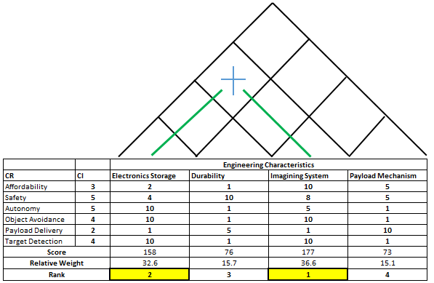
Feasibility of Previous UAV
Figure 3. House of Quality to determine feasibility of previous build.
Devin justice
Conceptual design
4

Slide 5

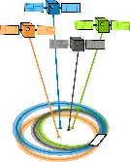



Electrical Systems Design
System Requirement Solution
Autonomy Autopilot component
Navigation GPS
Object detection/avoidance Camera
Communication Multiple antennas
Control system CPU
Trent Loboda
Conceptual design
5

Slide 6
Current Systems and New Designs
Remaining Components New Components
PIXHAWK autopilot/flight controller PIXHAWK meets requirements
Integrated 3DR telemetry unit Zubax gnss GPS module
Pixy CMUcam5 camera Sony DCS-W710/B 16MP camera
Spectrum DX8 transmitter and AR8000 receiver Transmitter & receiver meet
  the requirements
No existing CPU ODROID C2 CPU
Trent Loboda
Conceptual design
6

Slide 7
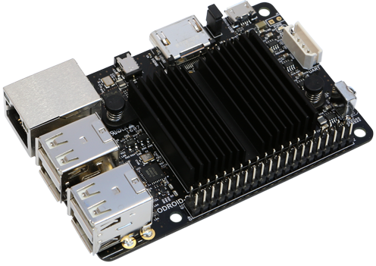
Component Justification
Companion Computer Selection
After thorough research, the student selected the ODROID C2
board for its robust processing power, low cost, and small size.
Table 1. CPU Comparison between Odroid C2 and Competitors.
 | Odroid C2 | Odroid C1+ | Rpi 2 Model B
GPU | 3x ARM 700Mhz | 2x ARM 600MHz | 1x VideoCore 250MHz
Weight | 40g | 40g | 42g
Price | $40 | $37 | $35
Figure 4. ODROID C2 Board for Onboard CPU.
Trent Loboda
Conceptual design
7

Slide 8
Component Justification: Camera Selection
Pairwise Comparison matrix
                Needs by importance: Weight
                1. Resolution 0.55
                2. Size 0.27
                3. Power Consumption 0.18
Competition constraint requires object recognition at up to 300ft
Prior camera Pixycam CMUcam5 not powerful enough to accurately recognize distant objects
Table 2. Pairwise Comparison Matrix for Camera Selection.
Trent Loboda
Conceptual design
8

Slide 9

Component Justification
System Telemetry
Current Configuration Planned replacement
3DR Ublox GPS and compass Zubax gnss GPS
Pro: Team has this component and Pro: Refresh rate meets
it functions competition constraint
Con: The refresh rate does not Con: Team will have to purchase
meet the competition constraint the component
Trent Loboda
Conceptual design
9

Slide 10
Payload Delivery
Payload
  8oz sealed water bottle
  Total payload must not exceed 16oz
GPS coordinates for drop
  Must retain 80% of the water
  Points awarded: max(0, (150ft − distance) / 150ft)
Cody rochford
Conceptual design
10

Slide 11
Concept Generation: Morphological Chart
Table 3. Morphological Chart for Payload Delivery Mechanism.
Sub-Functions | Possible Solutions
Payload Accuracy | Timed Release | Adaptive Control Surface | Ballast Weight
Integrate with Aerodynamic Design | Geometry | Shaved Foam Attachment
Payload Safety | Parachute | Padding | Spring | Strong Case
Release Mechanism | Key Design/Geometry | Direct Servo Interaction | Lock/Pin Mechanism
Sub-Functions | Possible Solutions
Payload Accuracy | Timed Release | Adaptive Control Surface | Ballast Weight
Integrate with Aerodynamic Design | Geometry | Shaved Foam Attachment
Payload Safety | Padding | Parachute | Spring | Strong Case
Release Mechanism | Key Design/Geometry | Lock/Pin Mechanism | Direct Servo Interaction
Concept 1
Concept 2
Concept 3
Cody rochford
Conceptual design
11

Slide 12
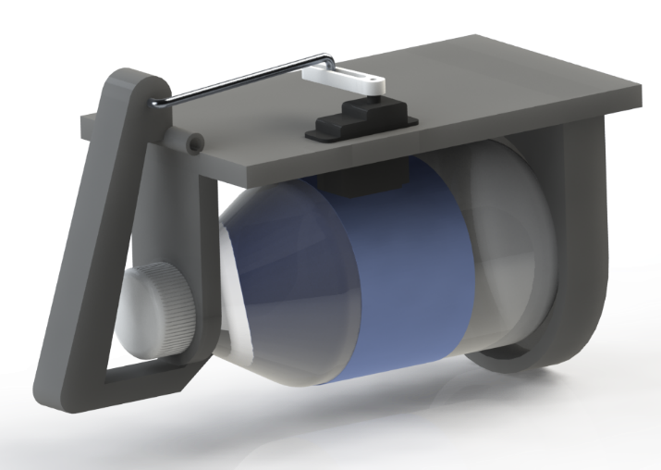
Concept 1
Advantages:
  Simplistic Design
  Lightweight
Disadvantages:
  Open-Air Design
  Less aerodynamics
  High torqued servo arm
  Bottle Entrapment
Figure 5. 3D Model Rendering of Latch-Servo Design.
Cody rochford
Conceptual design
12

Slide 13
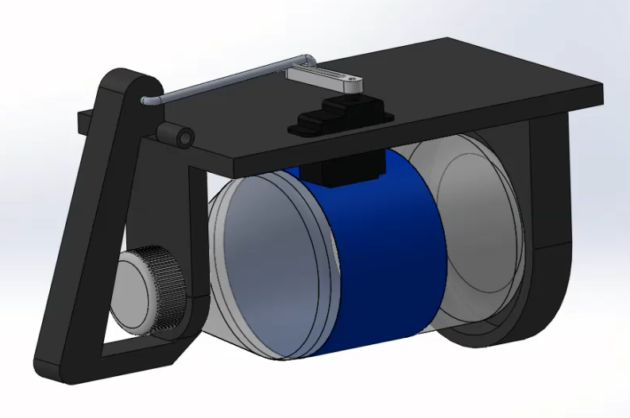
Concept 1 Continued
Figure 6. 3D Model of Latch-Servo Design.
Cody rochford
Conceptual design
13

Slide 14
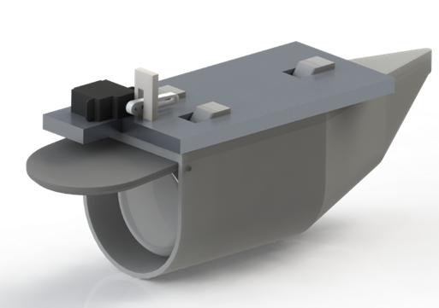
Concept 2
Advantages:
  Payload incorporated housing
  Less force on servo arm
  Aerodynamic geometry
  Full enclosure of water bottle
Disadvantages:
  Complex design
  Failure to disengage
  Door failure
Figure 7. 3D Model Rendering of Geometry Release Design.
Cody rochford
Conceptual design
14

Slide 15
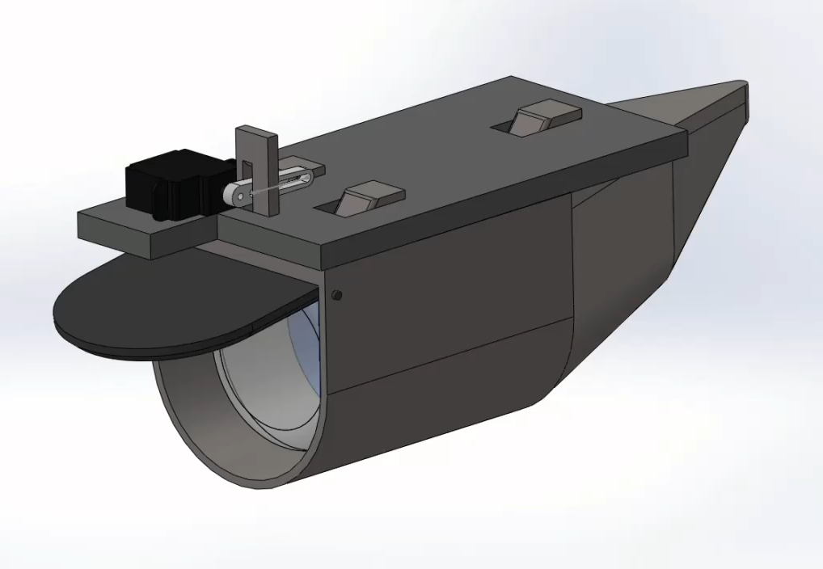
Concept 2 Continued
Figure 8. 3D Model of Geometry Release Design.
Cody rochford
Conceptual design
15

Slide 16
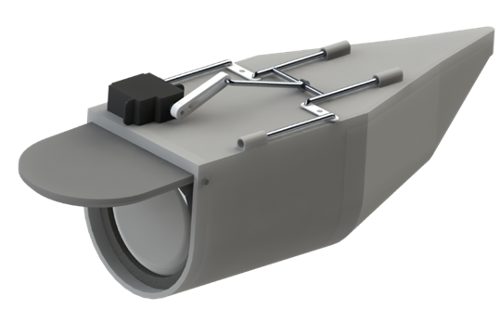
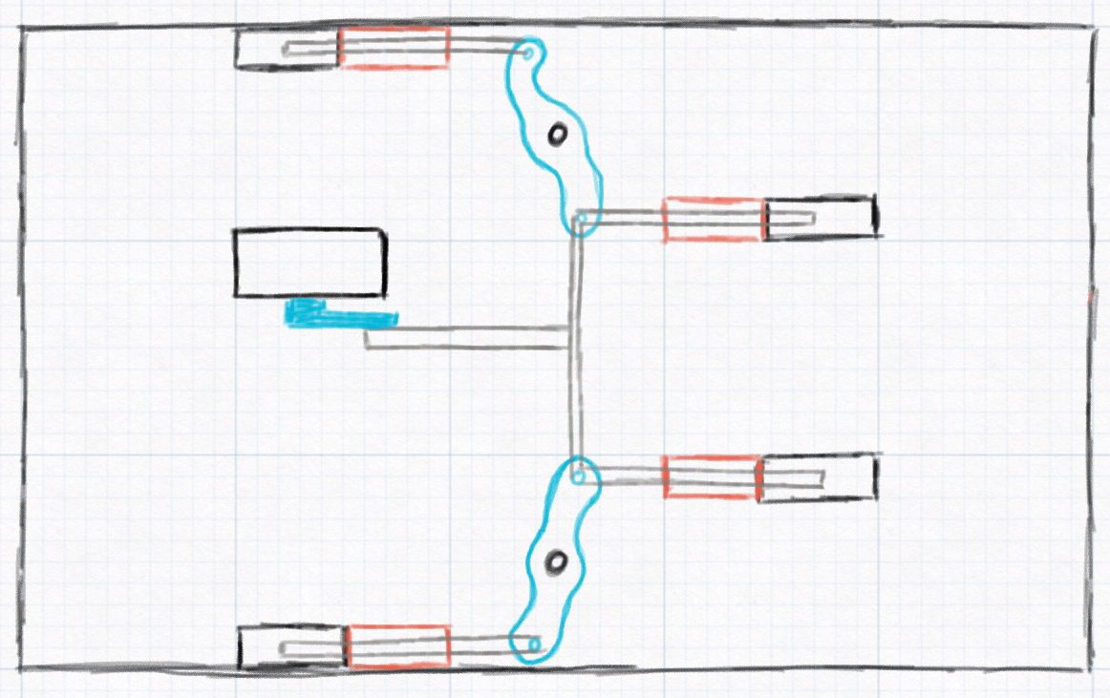
Concept 3
Advantages:
  Payload incorporated housing
  Accurate release
  Aerodynamic geometry
  Full enclosure of water bottle
Disadvantages:
  Complex design
  Moving mechanism
  Pin disengagement failure
  Lack of parachute
Figure 9. 2D Schematic of Servo Mechanism.
Figure 10. 3D Model Rendering of Concept 3 Pin/Hole Design.
Cody rochford
Conceptual design
16

Slide 17
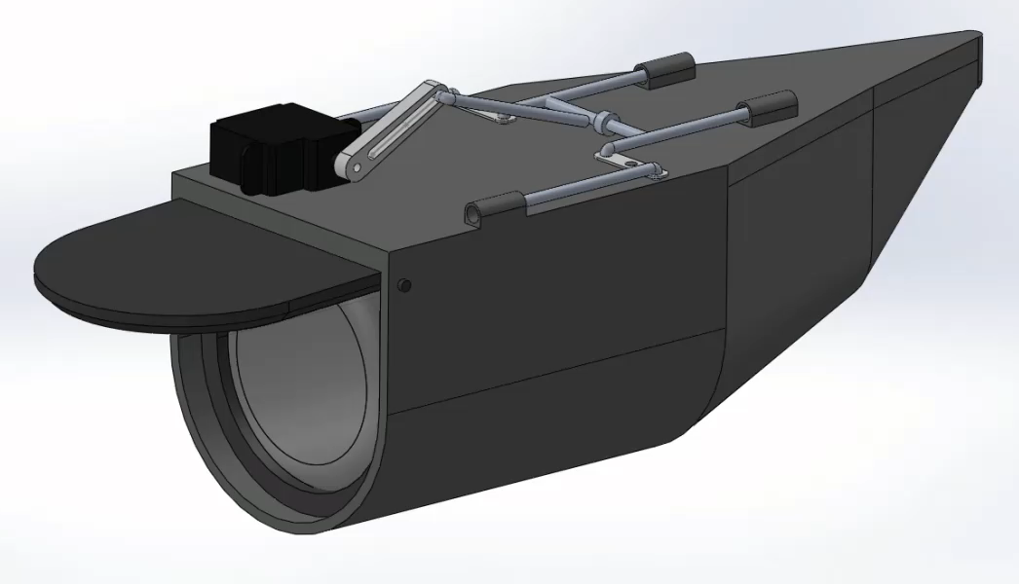
Concept 3 Continued
Figure 11. 3D Model of Concept 3 Pin/Hole Design.
Cody rochford
Conceptual design
17

Slide 18
Payload Delivery Concept Selection
Table 4. Pugh Matrix to select for Payload Delivery Mechanism.
Selection Criteria | Baseline | Concept Design 1 | Concept Design 2 | Concept Design 3
Aerodynamic | 0 | 0 | +1 | +1
Simplicity | 0 | +1 | -1 | -1
Weight | 0 | +1 | -1 | -1
Size | 0 | 0 | 0 | 0
Accuracy | 0 | -1 | -1 | +1
Score | 0 | +1 | -2 | 0
Devin justice
Conceptual design
18

Slide 19
Future Work
Order and test electronics.
Build and integrate payload delivery mechanism.
Begin writing program for stationary and emerging target detection.
  Upon completion “teach” targets.
Begin object avoidance program.
  Write program to develop trajectory based on object location and size.
Interface with “Interoperablility” system to ensure compatibility.
Test system in varying environments.
Devin justice
Conceptual design
19

Slide 20
Challenges
Target detection:
  Recognize alphanumeric symbols and shapes, reliant on camera capability and distance.
  Emergent target detection is less prevalent in open source code.
  Recognize objects while flying with the propellers in the horizontal position.
  Development of transitional propeller control system.
Object avoidance:
  Develop evasive maneuvering within the limited flight envelope for flying wing design.
  Write a robust program capable implementation with hardware for realistic application.
Devin justice
Conceptual design
20

Slide 21
Conclusion
Previous UAV structure, propulsion system, and flight controller have been deemed feasible.
Electronic hardware has been selected.
3-dimensional modeling has been developed for the payload delivery mechanism.
Future work has been outlined and scheduled for the fall and spring semesters.
Devin justice
Conceptual design
21

Slide 22
References
Competition Rules SUAS 2017. (2017).
K. Aley, J. Denman, D. Fitzpatrick, C. Mard, P. McGlynn, and K. Ijagbemi, "Needs Assessment" Sep. 25, 2015.
K. Aley, J. Denman, D. Fitzpatrick, C. Mard, P. McGlynn, and K. Ijagbemi, "Project Plan & Product Specifications" Oct. 22, 2015.
"Hardkernel," in ODROID. [Online]. Available: http://www.hardkernel.com/main/products/. Accessed: Oct. 6, 2016.
Devin justice
Conceptual design
22

Slide 23
Questions
Are there any questions?
Devin justice
Conceptual design
23

Slide 24
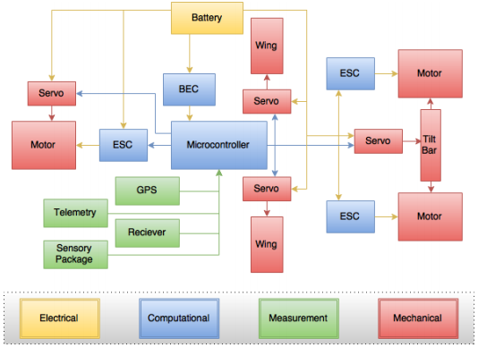
Q&A Electrical Systems
Top-Level Design
Figure 12. Top-Level Design of Electronics System.
Conceptual design
24

Slide 25
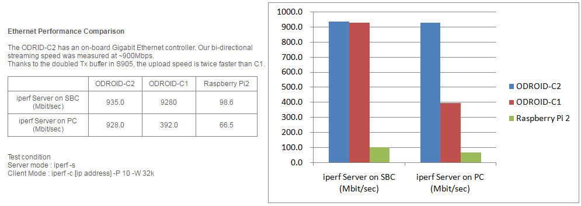
CPU Ethernet Performance
Figure 13. ODROID Comparison (Mbit/sec).
Conceptual design
25

Slide 26
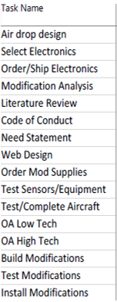
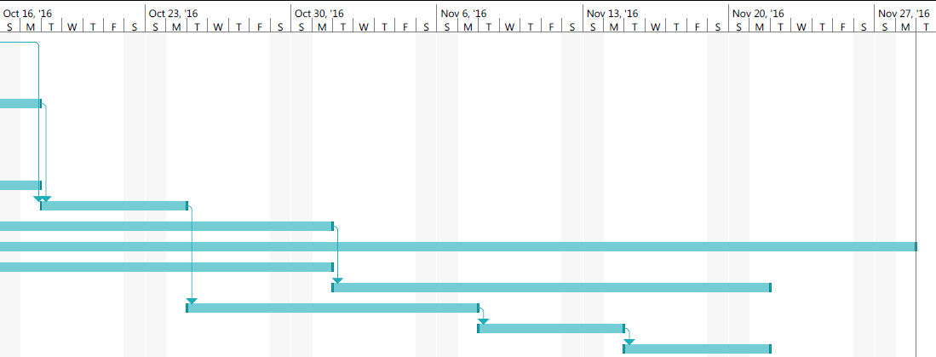
Gantt Chart 2
Table 5. Gantt Chart current date through end of semester.
Conceptual design
26

Slide 27
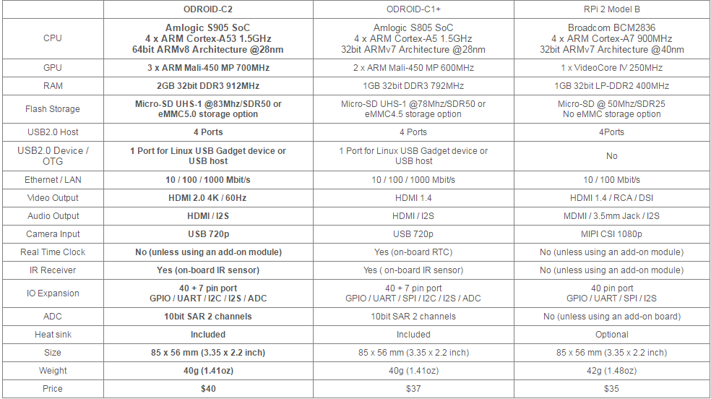
Component Justification
Table 6. ODROID Board Specification Comparisons.
Conceptual design
27

