Slide 1
LiDAR Cave Mapper
FAMU-FSU College of Engineering
ME & ECE Senior Design

Slide 2
Our Team
Project Manager
Lead ECE
Lead ME
Financial Advisor
Webmaster
Power Engineer
Alisha Hunt
James Oliveros
Spencer Day
Cesar Rivas
Hunter Hayden
Jake Ogburn

Slide 3
The Problem
Alisha Hunt
Cave mapping can be a very expensive undertaking. We need to create a portable cave mapper device for freelance cavers. Current LiDAR devices are expensive and cave mapping is often done using notepads and measuring tape. This project is intended to make LiDAR devices more accessible to cavers by both making it affordable and simple DIY style with open source code.
Cheaper scanner (6m range)
Notes:
Alisha Hunt

Slide 4
Design Overview
Alisha Hunt
Updates
Must be able to map fully around circle and at least 270 degrees in phi direction.
Needs to fit in sponsor-provided casing ~12x6x8
Map at least every .5m from 40m away
May use alternative mapping styles to save memory
Convert data into importable 3D image
Weighs no more than 5lbs
User friendly (easy to use in dark caves)

Slide 5
Data Flow Hierarchy
Alisha Hunt
Sends point cloud data
controller dictates motor speed and direction
Controller specifies pulse train to LiDAR
Inertial Measurement Unit accounts for position of LiDAR sensor and adjusts data
Processor sends final data to external memory chip
Top motor
LiDAR Lite
Base motor
IMU (Inertial Measurement Unit)
Specifies pulse train and timing
specifies motor speed and direction
Returns calibrated point data
Microcontroller
Final data formatting for AutoCAD/MATLAB
I2C and PWM encodings
External memory
SD card

Slide 6
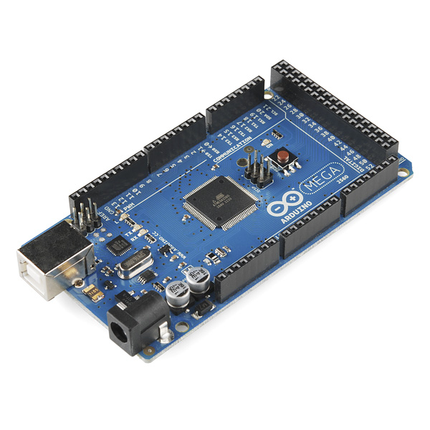
Micro-controller Selection
Alisha Hunt
Huge open source Arduino libraries
Code is very similar to C and easy for beginners
While an Uno has a slower clock than a Raspberry Pie (16MHz vs 900MHz), it is better for executing simple processing tasks
Less likely to encounter software errors if rebooting after power completely dies

Slide 7
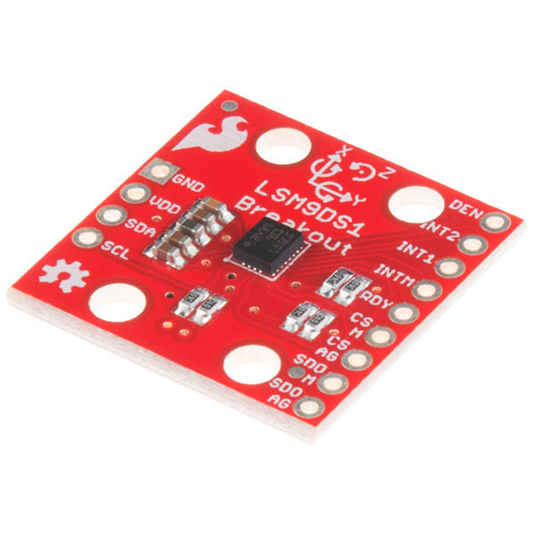
Inertial Measurement Unit
Alisha Hunt
Has 9 degrees of freedom: x, y, & z for angular rotation, acceleration and magnetic force
Gives geolocation from magnetic fields
Will track movement of motors
Will help cancel out potential ringing of motors

Slide 8
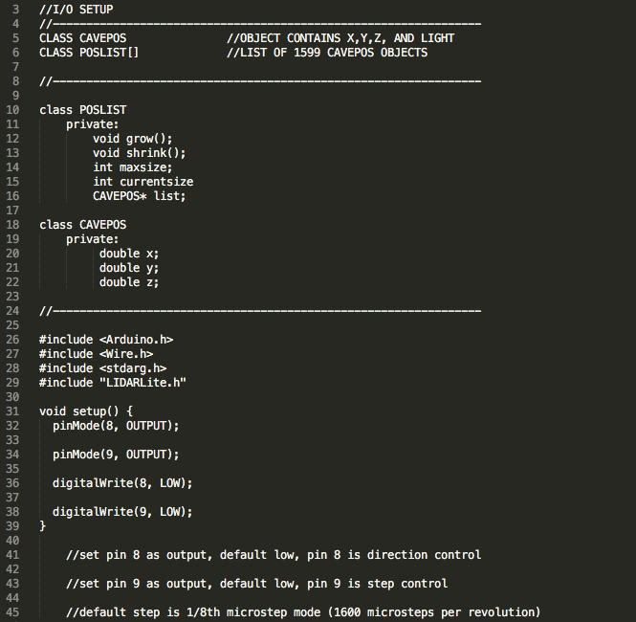
James Oliveros
Pseudocode: I/O Setup

Slide 9
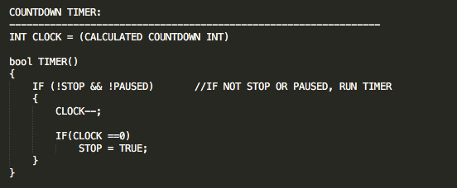
James Oliveros
Pseudocode: Initial Countdown Timer

Slide 10
James Oliveros
Pseudocode: Error Detection Setup

Slide 11
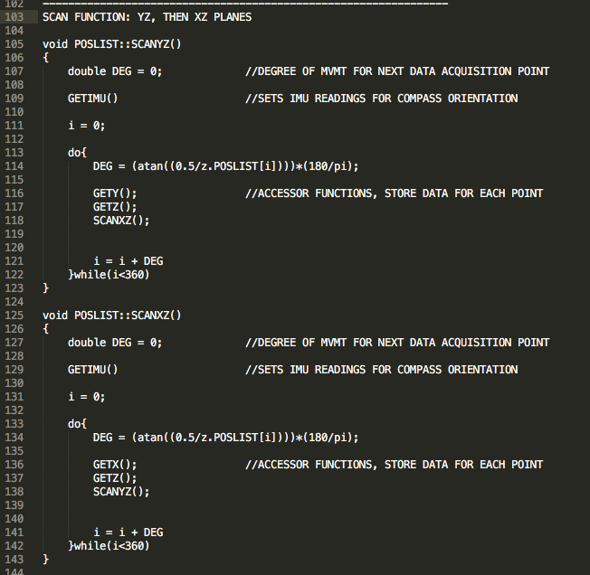
Pseudocode: Scanning x/z Plane
James Oliveros
Worst-case-scenario: .7162 degrees
(.5 m accuracy @ 40 m distance)

Slide 12
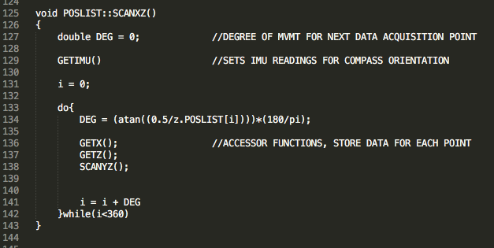
James Oliveros
Pseudocode: Scanning y/z Plane

Slide 13
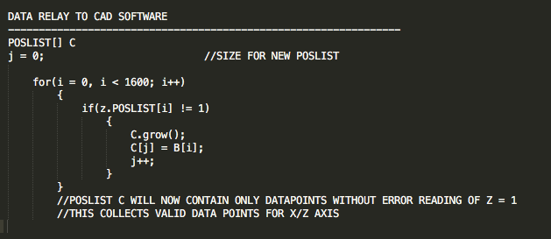
James Oliveros
Pseudocode: Data Relay

Slide 14
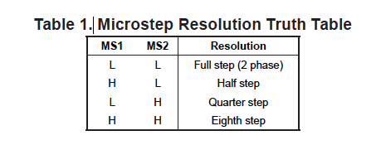
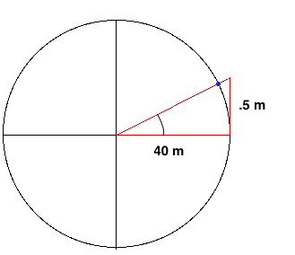
James Oliveros
Microstepping
1/8th Microstep revolution should be sufficient for our purposes
(200 steps) x (8 microsteps) = 1600 microsteps per revolution
(360 degrees) / 1600 microsteps = .225 degrees per microstep
3x.225 = .675 degrees (closest to worst case scenario degree movement)
360 / .675 = 533 measurements per plane
EasyDriver A3967 Motor Driver Specifications
Worst-case-scenario: .7162 degrees
(.5 m accuracy @ 40 m distance)

Slide 15
James Oliveros
Arduino Memory Capabilities
(360 / .675) Degrees = 533.3333 Data points
= 533 Data points on one plane
533^2 (for two planes) = 253009 Data points
= 253009 Bytes of Data (1 bytes per data point)
= 253.009 kB
Arduino local flash memory capacity is 256 kB, therefore, some kind of external (SD) memory is required for multiple point of data acquisition
503 x 503 x 20 Milliseconds per data point = 1.405 Hours

Slide 16
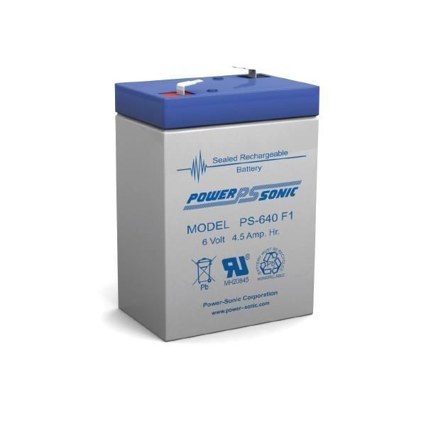
Power System: Electronics
Jake Ogburn
 | Current (mA) | Voltage (V)
Arduino Mega | 100 | 9
LIDAR Lite 3 | 135 | 5
Inertial Measurement Unit | 0.6 | 3.3
Power Consumption: | 235 mAh
Power Consumption for One Target Area: | 940 mAh
Battery | Power Sonic PS-640-F1
Voltage | 6 V
Power | 4.5 Ah
Target Areas | 4.79
Figure 1: Power Sonic PS-640-F1 Battery

Slide 17
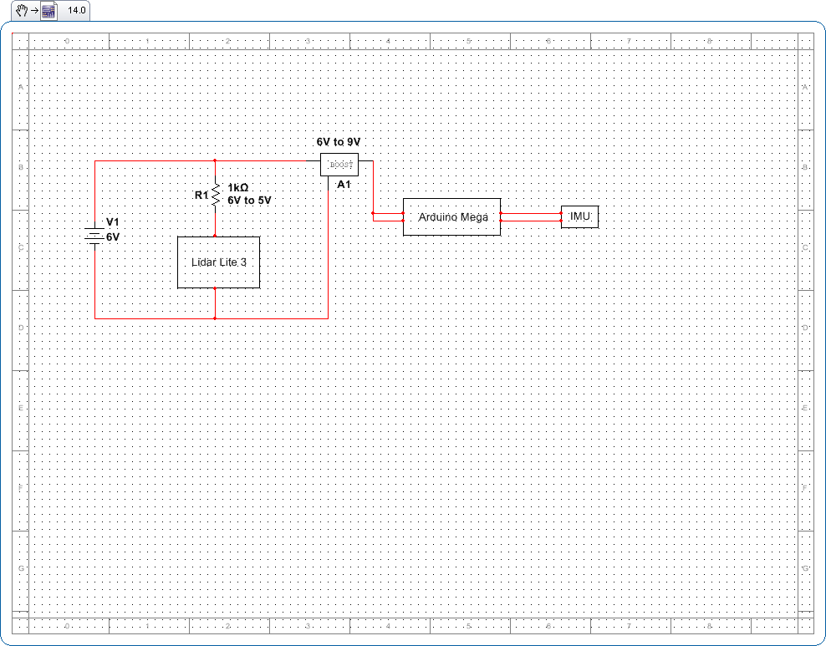
Electronics Power Supply Diagram
Jake Ogburn
Figure 2: Wire diagram for electronics power supply

Slide 18
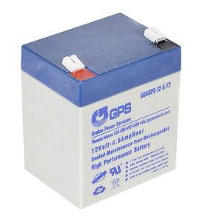
Power System: Motors
Jake Ogburn
 | Current (A) | Voltage (V)
NEMA 8 Stepper Motor | 0.6 | 4.8
EZ Drive Motor Driver | 0.30 | 9.0
Sanyo Pancake Stepper Motor | 1.1 | 4.5
EZ Drive Motor Driver | 0.55 | 9.0
Power Consumption: | 0.85 Ah
Power Consumption for One Target Area: | 3.4 Ah
Battery | GPS 58AGPS-12-5-F2
Voltage | 12 V
Power | 4.6 Ah * 2 = 9.2 Ah
Target Areas | 2.7
Figure 3: Gruber Power Supply 58AGPS-12-5-F2

Slide 19
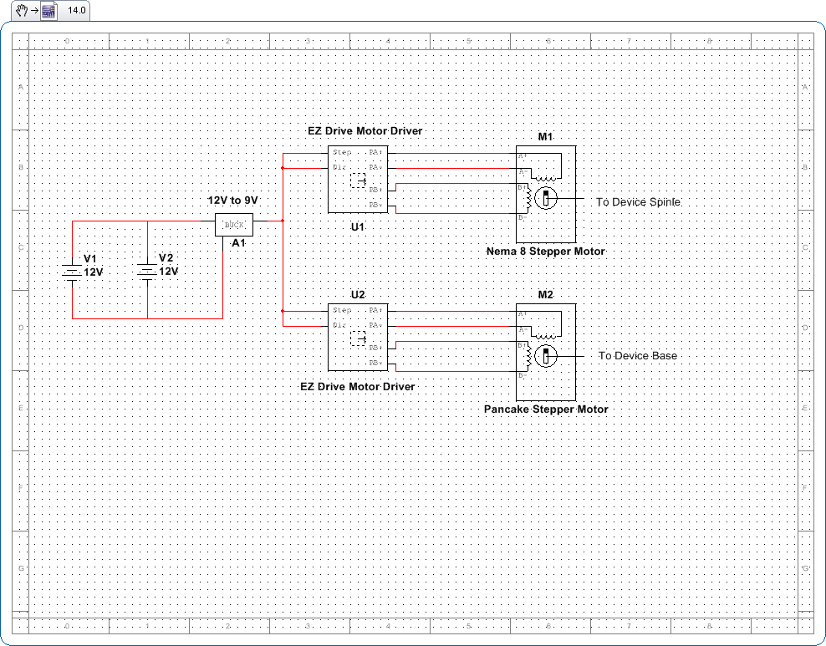
Motor Power Supply Diagram
Jake Ogburn
Figure 4: Wire diagram for motor power supply

Slide 20
Mechanical Design
Spencer Day
Concept 1 was determined to be the design that best accomplished our set goals
Limits complicated maneuvers that will tangle wires
Design makes manufacturing straight forward
90 degree decrease of field of view is negligible
Figure 5: CAD Model of Concept 1

Slide 21
Animated Rendering
Spencer Day

Slide 22
Material and Manufacturing Processes
Spencer Day
Material: ABS thermoplastic
Durable, printable, very inexpensive
Great for prototyping and trial and error
Limitations: Intricate designs and parts smaller than 1 millimeter
Manufacturing
3D printing
Increasingly common and accessible
Opportunity for multiple attempts
Fastening: Non-metallic nuts and bolts, 4mm diameter

Slide 23
Hardware
Spencer Day
Sanyo 200 steps per revolution pancake stepper motor
5 mm output shaft
55 X 11 mm base can support the frame
5 mm bushing
NEMA 8 200 step per revolution stepper motor
4 mm output shaft
4 mm shaft coupler
4 mm bushing
All wires from the LIDAR will be run through a slip ring to reduce tangling

Slide 24
Construction
Hunter Hayden
Almost all parts used will be 3D printed
Cuts down on cost, weight, and avoids interference with IMU.
Non-metallic nuts and bolts will connect pancake motor to the bottom of the main base
LIDAR will be bolted to its own base on an aluminum shaft
NEMA 8 motor will be supported on the outside of the frame
A 5-way bubble level will be secured to the top of the main base to ensure the tripod is level before the system runs

Slide 25
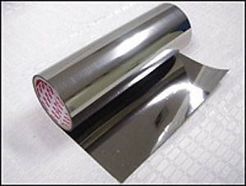
Magnetic Interference
Hunter Hayden
Need to prevent any ferrous parts and our motors from interfering with the magnetometer.
Mu Metal: Nickel-Iron soft metallic alloy which is very permeable and is used to block static or low frequency magnetic fields in order to protect electronic components.
Mu metal sheets will be either wrapped or cut and pasted onto motors and any ferrous metals in our assembly.
Figure 6: Mu Metal Roll

Slide 26
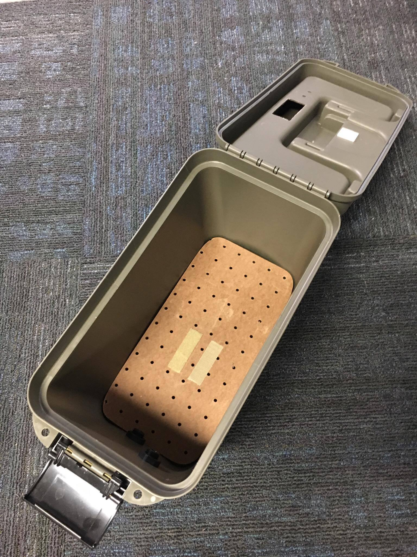
Storage and Setup
Hunter Hayden
Design requirement: All of the mechanical and electrical components of the LiDAR system must fit into a 12”x6”x8” hard plastic case.
We plan to cut foam pieces to fit the different parts of.
More organized storage
Little chance of being damaged while inside the case
Figure 7: Storage Case

Slide 27
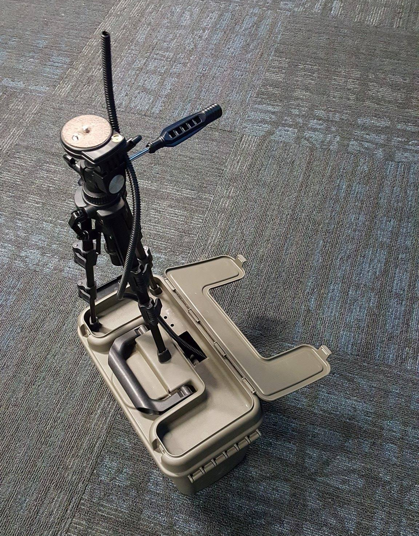
Storage and Setup
Hunter Hayden
While running the scans, the storage case will be used as a base for the LiDAR system.
The LiDAR and its base will be mounted on a tripod which will be set up on top of the plastic casing.
Allows us to run wiring from LiDAR directly down into the case which will house the batteries and electrical components.
Maintains ease of use in low-light conditions.
Figure 8: Experimental Setup

Slide 28
Schedule
Hunter Hayden

Slide 29
Budget
Cesar Rivas
Item | Quanity | Unit Cost | Total Cost
Lidar Lite 3 Range Finder | 1 | $149.99 | $149.99
Arduino Mega 2560 R3 | 1 | $45.95 | $45.95
9 Degrees of Freedom IMU SM9DS1 | 1 | $24.95 | $24.95
Sanyo 200 Step Pancake Stepper Motor | 1 | $49.95 | $49.95
NEMA 8 Stepper Motor 1.8° | 1 | $16.00 | $16.00
Data Logging Shield for Arduino | 1 | $18.95 | $18.95
Proto Screw Shield Assembled | 1 | $15.95 | $15.95
Sandisk 4GB SD card | 1 | $7.00 | $7.00

Slide 30
Budget (continued)
Cesar Rivas
Item | Quanity | Unit Cost | Total Cost
Split Loom Tubing (1/4 ") - 10 ft | 1 | $1.20 | $1.20
Slip Ring - 12 wire | 1 | $19.95 | $19.95
22 Gauge wires | 1 | $10.00 | $10.00
Powersonic 6V 4.5 Ah Battery (Electronics) | 1 | $4.99 | $4.99
GPS 12V 4.6 Ah Batter (Stepper Motors) | 1 | $20.00 | $20.00
UPG D1724 6V or 12V/500 mA Battery Charger | 1 | $9.65 | $9.65
Dry Storage Box | 1 | $9.98 | $9.98
Plastic Submersible Cord Grip | 2 | $2.48 | $4.96
Kapro 1-5/8" Bulls Eye Surface Level | 1 | $2.95 | $2.95

Slide 31
Budget (continued)
Cesar Rivas
Item | Quanity | Unit Cost | Total Cost
Dry Running Sleeve Bearings (4 mm) | 1 | $1.82 | $1.82
Polulo Universal Aluminum Mounting Hub | 1 | $7.49 | $7.49
Strut Gears for Stepper MOtorPinion | 1 | $8.00 | $8.00
Light Duty Turntable (4'25 OD) | 1 | $7.16 | $7.16
Flex Shaft Couplers (4mm) | 1 | $7.49 | $7.49
Flex Shaft Couplers (5mm) | 1 | $7.49 | $7.49
Aluminum Rod (4 mm) (1 ft) | 1 | $7.21 | $7.21
Aluminum Rod (5 mm) (1 ft) | 1 | $7.99 | $7.99
Tripod | 1 | $10.00 | $10.00
M2.5 Screws, Nuts, and Washers | 1 | $3.00 | $3.00

Slide 32
Budget: Total
Cesar Rivas
TOTAL $482.02
$17.98 allocated to unexpected costs.

Slide 33
Risk Assessment: Schedule Risks
Cesar Rivas
Conflicting schedules could lead to inability to finish project on time.
Team will aim to finish project as early as possible to prevent this.
3D-printed parts may not completed on time.
Our group will make sure to submit requests much earlier than needed.
Due to us having most of our required components, we will not have to worry about not receiving any shipped components on time.

Slide 34
Risk Assessment: Safety Risks
Cesar Rivas
Pinch points (i.e: rotating part)
Contact with pinch points can cause injury
Electrical components
Potential electrical shock from exposed wires
Shorted circuit can cause fire
Risks in environment
Potential risk of getting trapped inside cave
Slipping on cave floor can lead to injury

Slide 35
Risk Assessment: Equipment Damage
Cesar Rivas
Physical damage
Dropping system components can lead to loss of functionality
Moisture
Contact with water will damage electrical components
Electrical overload
Providing too much power to components will cause a short in the system and cause permanent damage.

Slide 36
Risk Assessment: Experimental Risks
Cesar Rivas
Insufficient battery life
Not likely
Batteries used will allow for multiple scans
Insufficient memory
4GB SD card is more than enough to hold mapping data

Slide 37
References
"About - ILMF." ILMF. N.p., n.d. Web. 11 Oct. 2016.
"Caving Projects." Southern Arizona Grotto. N.p., n.d. Web. 10 Oct. 2016.
"LIDAR-Lite V3." - SEN-14032. N.p., n.d. Web. 4 Oct. 2016.
"Slamtec's RPLIDAR A2 Has a Range of 6 Meters And Can Take Up To 4000 Samples of Laser Ranging per Second ($480)." Into Robotics. N.p., n.d. Web. 4 Oct. 2016.
"Underwater Cave (low Poly)." 3D Model :. N.p., n.d. Web. 10 Oct. 2016.
"Vermont Center ForGeographic Information." VCGI LiDAR Program. N.p., n.d. Web. 11 Oct. 2016.
"What Is LIDAR." US Department of Commerce, National Oceanic and Atmospheric Administration. N.p., n.d. Web. 6 Oct. 2016.
England, Emily. "The Effigy Mounds and Mallam | Anthropology | Luther College." The Effigy Mounds and Mallam | Anthropology | Luther College. N.p., n.d. Web. 13 Oct. 2016.
Nguyen, Quyen. "Running a Raspberry Pi from 6 AA Batteries." Tutorial Raspberry Pi :. N.p., 1970. Web. 12 Oct. 2016.
S. Kish and B. Broedel, "Introduction to Cave Mapping Design Project," 2016.
S. Kish, "Mapping of the Wakulla Springs Conduit-Cave System Using LIDAR and Inertial Navigation Sensor System– Prototype Modeling,”.
"Arduino vs. Raspberry Pi: Mortal Enemies, or Best Friends?" Digital Trends. Digital Trends, 2015. Web. 17 Nov. 2016.
Notes:
"What Is LIDAR." US Department of Commerce, National Oceanic and Atmospheric Administration. N.p., n.d. Web. 6 Oct. 2016.
"About - ILMF." ILMF. N.p., n.d. Web. 14 Oct. 2016.
"LIDAR-Lite V3." - SEN-14032. N.p., n.d. Web. 14 Oct. 2016.
Nguyen, Quyen. "Running a Raspberry Pi from 6 AA Batteries." Tutorial Raspberry Pi :. N.p., 1970. Web. 14 Oct. 2016.
"Underwater Cave (low Poly)." 3D Model :. N.p., n.d. Web. 14 Oct. 2016.
"Vermont Center ForGeographic Information." VCGI LiDAR Program. N.p., n.d. Web. 14 Oct. 2016.
"Caving Projects." Southern Arizona Grotto. N.p., n.d. Web. 14 Oct. 2016.
England, Emily. "The Effigy Mounds and Mallam | Anthropology | Luther College." The Effigy Mounds and Mallam | Anthropology | Luther College. N.p., n.d. Web. 14 Oct. 2016.
"Slamtec's RPLIDAR A2 Has a Range of 6 Meters And Can Take Up To 4000 Samples of Laser Ranging per Second ($480)." Into Robotics. N.p., n.d. Web. 14 Oct. 2016.
S. Kish and B. Broedel, "Introduction to Cave Mapping Design Project," 2016.
S. Kish, "Mapping of the Wakulla Springs Conduit-Cave System Using LIDAR and Inertial Navigation Sensor System– Prototype Modeling,".
_____________________
Photo 1
http://projectraspi.blogspot.com/2014/05/running-raspberry-pi-from-6-aa-batteries.html
Photo 2
http://www.3drivers.com/catalog/333/672/
Emergency Robot
http://asblab.mie.utoronto.ca/sites/clover/files/batbot1.jpg
http://vcgi.vermont.gov/LiDAR
http://sagrotto.caves.org/?page_id=122
http://www.luther.edu/anthropology/lab-collections/exhibits/lab/mounds/
http://www.robotshop.com/en/rplidar-a2-360-laser-scanner.html
http://i.ebayimg.com/images/i/400531548570-0-1/s-l1000.jpg
http://i.ebayimg.com/images/a/(KGrHqJ,!hQE5om2EVYMBObmC2TlVg~~/s-l300.jpg
S. Kish and B. Broedel, "Introduction to Cave Mapping Design Project," 2016.
S. Kish, "Mapping of the Wakulla Springs Conduit-Cave System Using LIDAR and Inertial Navigation Sensor System– Prototype Modeling,".
http://oceanservice.noaa.gov/facts/lidar.html
http://www.lidarmap.org/about/
https://www.sparkfun.com/products/14032

Slide 38
Questions?

