Slide 1
LiDAR Cave Mapper
FAMU-FSU College of Engineering
ME & ECE Senior Design

Slide 2
Our Team
Project Manager
Lead ECE
Lead ME
Financial Advisor
Webmaster
Power Engineer
Alisha Hunt
James Oliveros
Spencer Day
Cesar Rivas
Hunter Hayden
Jake Ogburn

Slide 3
Table of Contents
Problem Description
Project Requirements
Background
Justification
Engineering Problems
Design

Slide 4
The Problem
Cave mapping can be a very expensive undertaking. We need to create a portable cave mapper device for freelance cavers. Current LiDAR devices are expensive and cave mapping is often done using notepads and measuring tape. This project is intended to make LiDAR devices more accessible to cavers by both making it affordable and simple DIY style with open source code.
Alisha Hunt
Cheaper scanner (6m range)
Notes:
Alisha Hunt

Slide 5
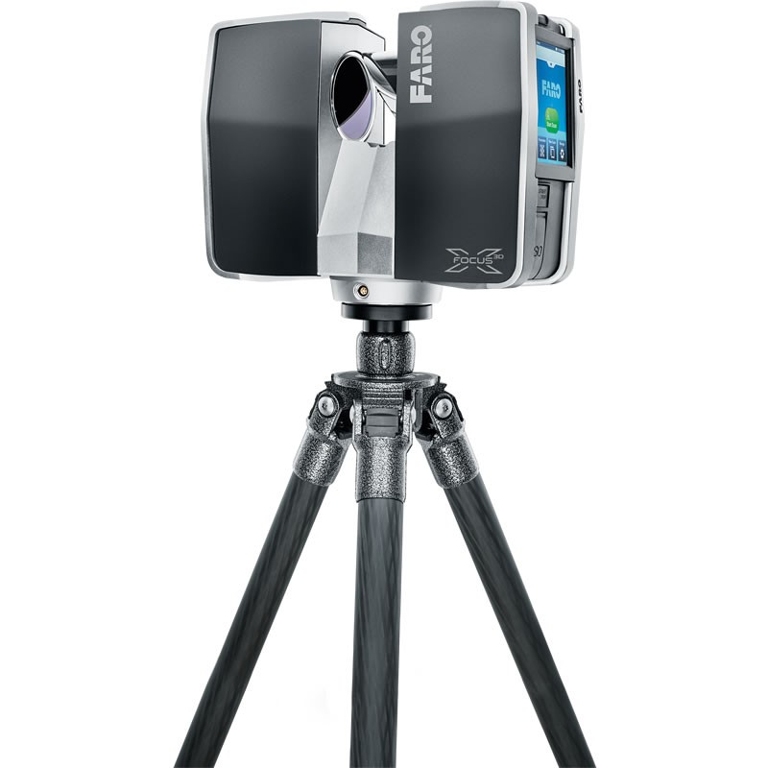
Sample Scanners
Cheaper Scanner: RP LiDAR
Only 6m range.
4,000 samples/sec.
About $500
Professional: FARO Focus 3D
Up to 180m range
4.5 hour battery life
Can cost $20,000
Figure 2: FARO Focus 3D LiDAR Scanner
Figure 1: RP LiDAR Trigonometric Scanner
Alisha Hunt
Notes:
Alisha Hunt

Slide 6
Design Requirements
Must be fully rotational in x, y, and z.
Map up to 5cm accuracy
Convert data into a 3D image
No more than 1.5ft tall
Total cost within $500
Weighs no more than 5lbs
User friendly (easy to use in dark caves)
Must be made entirely of nonmagnetic materials
Alisha Hunt

Slide 7
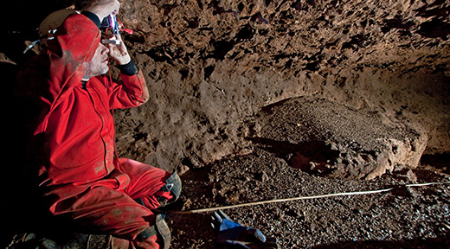
Background: Cave Mapping
Traditional approach usually requires a team of people and is time intensive
LIDAR technologies have facilitated quicker and more accurate cave mapping techniques
Very costly ($50,000+)
Figure 3: A scientist attempts to map a cave using a traditional method.
James Oliveros
Notes:
Cave mapping has traditionally consisted of choosing a centerline in a cave and taking a series of measurements from that centerline to the walls of the cave. The data would then be entered into a computer, which could produce a 2D/3D representation depending on the extent to which the researchers collected measurements
This approach usually requires a team of at least four people, and can take hours, days, or even weeks.
In recent years, technology has allowed for quicker, more accurate mapping of caves using LIDAR, but the apparatuses can cost upwards of $50,000.

Slide 8
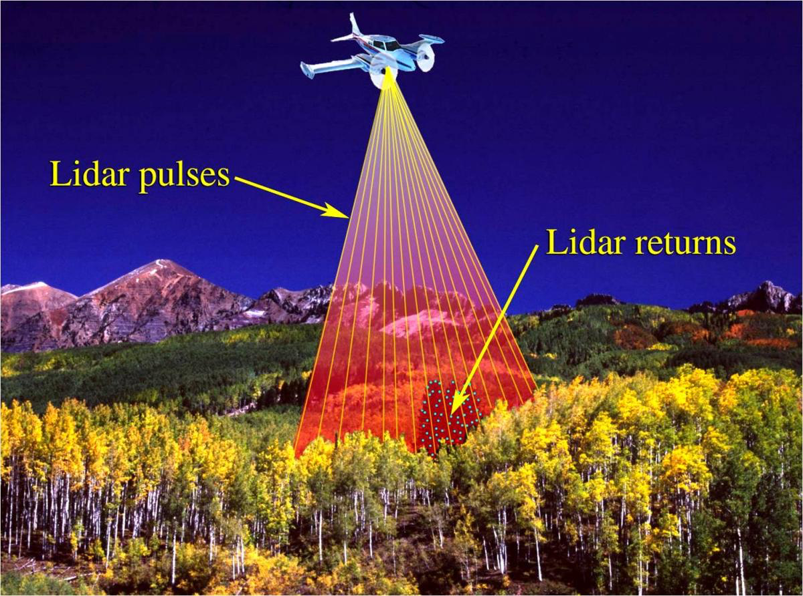
Background: LIDAR
Remote Sensing Technology
LIDAR (Light Imaging, Detection, And Ranging
Utilizes ultraviolet, visible, near infrared light, GPS
Figure 4: Schematic showing what LiDAR “sees”
James Oliveros
Notes:
remote sensing technology often used for geographical mapping and surveying
The word LIDAR is an abbreviation for Light Imaging, Detection, And Ranging.
LIDAR technology typically utilizes ultraviolet, visible, and near inferred light imaging in conjunction with GPS

Slide 9
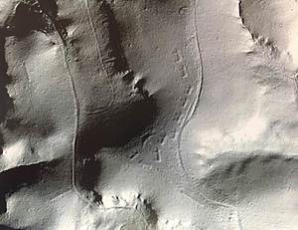
Background: LIDAR
LIDAR has applications in many fields (geology, atmospheric research, geodesy etc.)
LIDAR has a wide range of materials with high resolution
(30 cm resolution or better)
Figure 5: 2007 High-Resolution LIDAR image of Marching Bear Mound Group
(Iowa Department of natural Resources)
James Oliveros
Notes:
LIDAR is widely used in the fields of geodesy, meteorology, geology, atmospheric research, geography, and more.
It is often used to create high-resolution maps because of its ability to target a very wide range of materials with very high resolution (typically around 30 cm resolution or better).

Slide 10
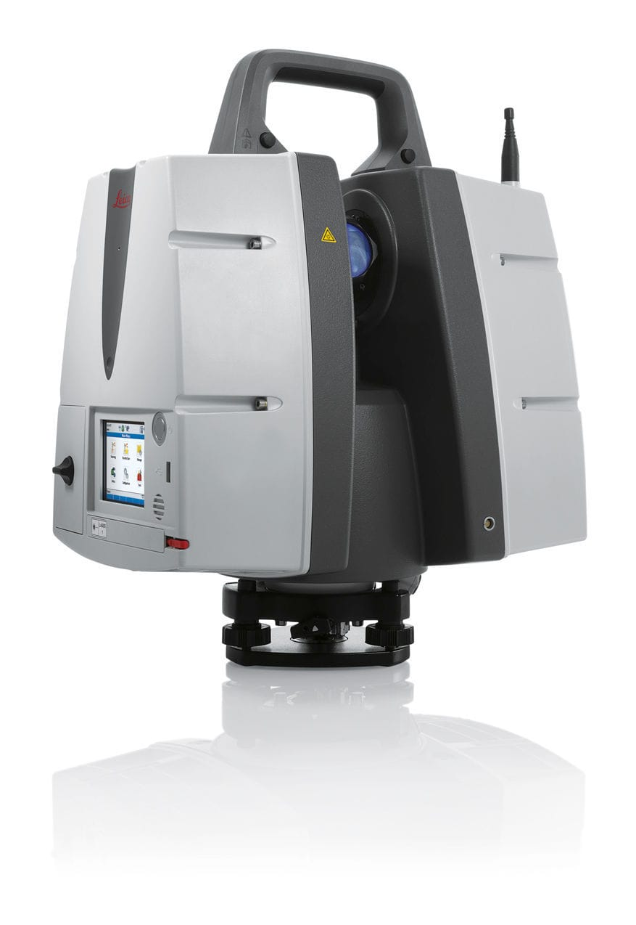
Justification
Most explorers and researchers do not have access to sufficient funding to obtain one of the state of the art LIDAR mapping systems.
Most cost tens or even hundreds of thousands of dollars.
An affordable, accurate mapping system would allow many more teams of researchers to work together to compile data.
Earth’s cave system would be mapped at a drastically more rapid pace than it currently is.
Figure 6: Leica ScanStation P40 3D Laser Scanner which costs nearly $125,000
Hunter Hayden

Slide 11
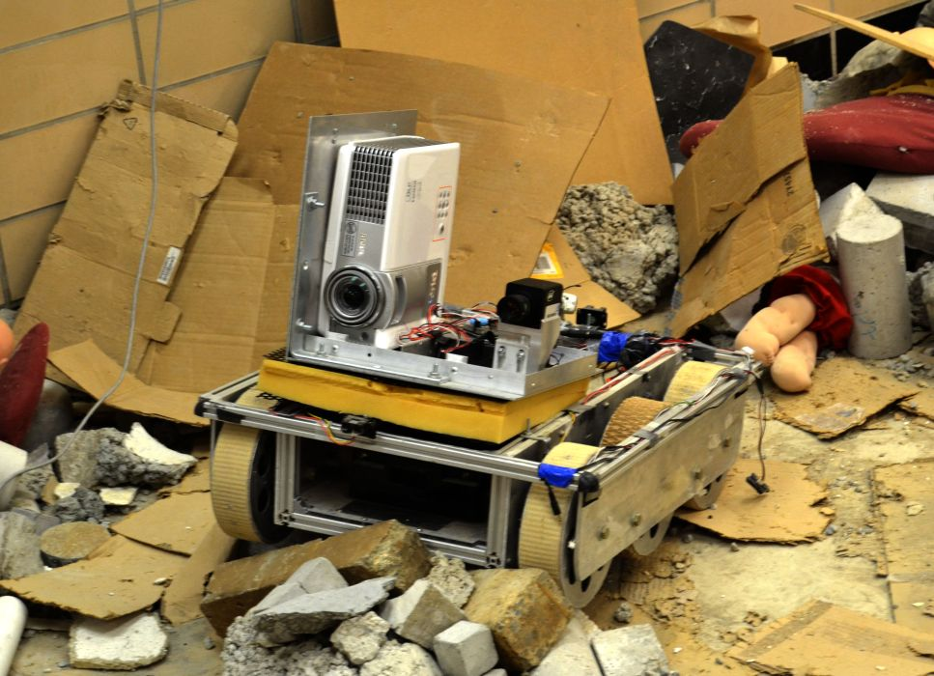
Justification
Our design could be used in emergency situations
i.e. after natural disasters, terror attacks
Future iterations of our project could be used in the event of catastrophic events to map damaged buildings or piles of rubble which may have lives trapped inside.
It would eventually become a common piece of equipment that researchers, explorers, or rescue operators could use in advance of actual human exploration.
Figure 7: Example of a robot being tested for an emergency situation.
Hunter Hayden

Slide 12
Hunter Hayden

Slide 13
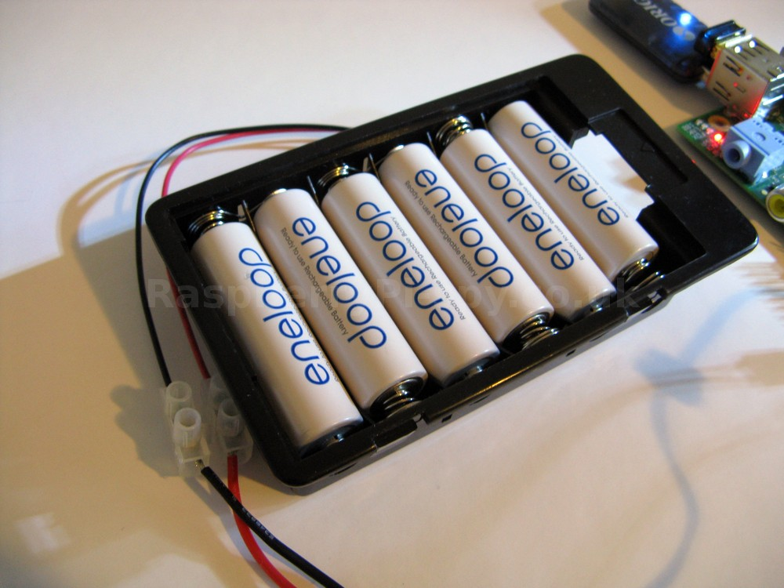
Engineering problems
Power Consumption
Two power sources: Motors and Electronics
Calculations to supply ample power to both systems
Batteries must be small enough to be portable
Figure 8: Example Battery pack
Jake Ogburn

Slide 14
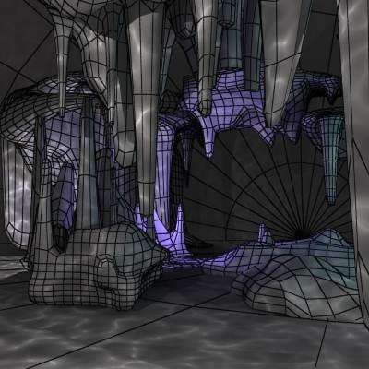
Engineering problems
Coding
Full rotational movement in the x, y, and z plane
Reading in data and storing to memory
Exporting data to AutoCAD to create a 3d image of cavern
Figure 9: Sample 3D CAD rendering of a cave.
Jake Ogburn

Slide 15
Engineering problems
The LiDAR systems needs to be able to rotate with 3 degrees of freedom to collect data from every point in space in the cave.
Need to minimize the amount of surface area in the cave that data cannot be collected for due to mounting of the device.
i.e. if LiDAR is mounted on a platform, it will not be able to collect data at any angle which drops below the platform.
Spencer Day

Slide 16
Concept Frame 1
Specifications
Field of view: 270 degrees
Stepper motors required: 2
Limitations
No view of cave floor
Function
System as a whole rotates on the X-Z plane
Lidar System is mounted to a base that rotates on the Y-Z plane
Figure 10: Design Concept 1
Spencer Day

Slide 17
Concept Frame 2
Specifications
Field of view: 90 degrees
Stepper motors required: 2
Function
System rotates in X-Y plane
Mirror rotates in Y-Z plane while Lidar signal is reflected toward the cave walls
Limitations
Can’t see the cave ceiling or the cave floor
Mirror is fragile and will need extra care and maintenance
Gathering date through a reflection will lead to error due to vibration and imperfect reflectivity
Figure 11: Design Concept 2
Spencer Day

Slide 18
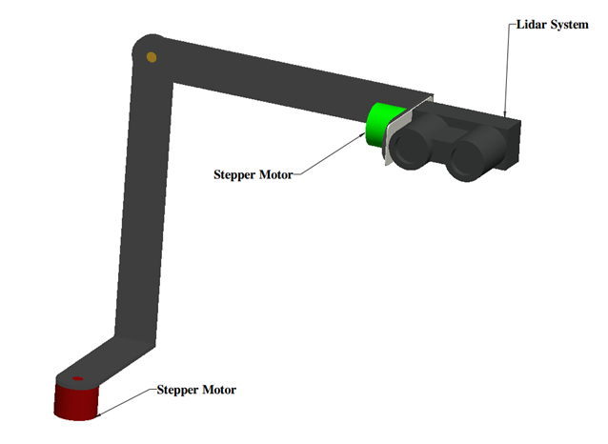
Concept Frame 3
Specifications
Field of view: 360 degrees
Number of stepper motors: 2
Function
Base rotates in the X-Z plane
Lidar is mounted to a bearing that rotates 360 degrees in Y-Z plane
Limitations
Lidar is vulnerable to environmental elements
Blind spot directly below the first stepper motor
Figure 12: Design Concept 3
Spencer Day

Slide 19
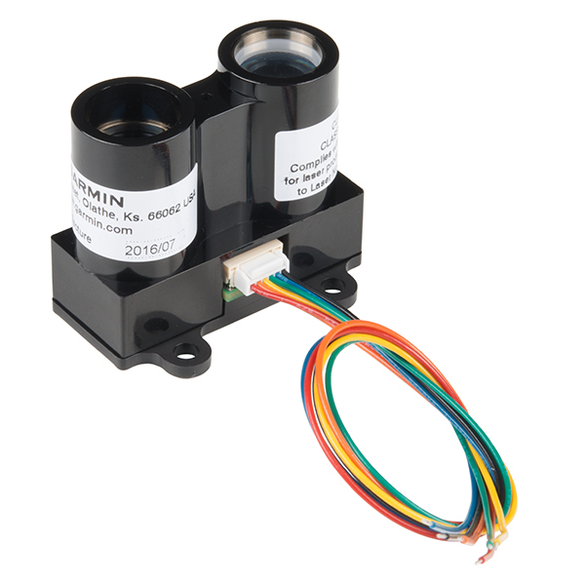
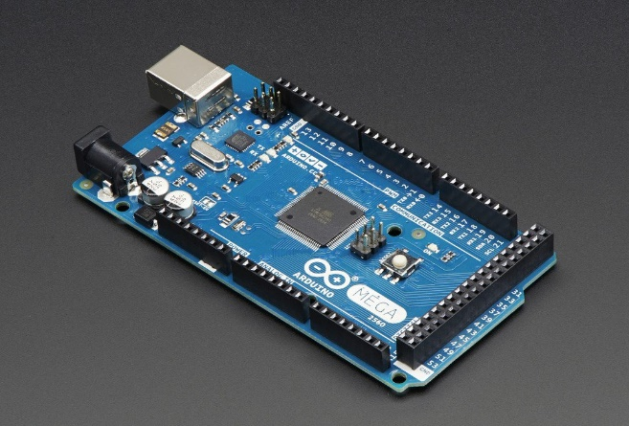
Electrical Components
LIDAR LITE 3
Microcontroller (ARDUINO MEGA 2560)
2 x Stepper Motors (vertical and horizontal directions)
2 x Stepper Drivers
Inertial Measurement Unit (Accelerometer, Magnetometer, Gyroscope)
Batteries
External Memory for Data storage
Status LED’s
Figure 13: Garmin LiDAR Lite v3
Figure 14: Arduino
Cesar Rivas

Slide 20
Software Components
Start timer
Device will wait short duration before starting scan, giving user plenty of time to exit cave.
Stepper motor controls
Program will rotate device 0.9° horizontally and 1.8° vertically.
Device will rotate 360° vertically for every 0.9° horizontal step, recording the distance at each point.
Each point will produce a 3-element vector.
Vectors will be saved as array for easy export of data.
Error Detection
In the event of a stall during scanning, an LED will be turned on to alert the user.
Cesar Rivas
Notes:
Changed 3min wait time to “short duration.” This is something we will want to time out. ~ Alisha

Slide 21
Other Components
Tripod
Tripod mount for device
Battery case
Protective and portable case for complete device
*Materials chosen must be non-magnetic and light-weight.
Cesar Rivas

Slide 22
References
"About - ILMF." ILMF. N.p., n.d. Web. 11 Oct. 2016.
"Caving Projects." Southern Arizona Grotto. N.p., n.d. Web. 10 Oct. 2016.
"LIDAR-Lite V3." - SEN-14032. N.p., n.d. Web. 4 Oct. 2016.
"Slamtec's RPLIDAR A2 Has a Range of 6 Meters And Can Take Up To 4000 Samples of Laser Ranging per Second ($480)." Into Robotics. N.p., n.d. Web. 4 Oct. 2016.
"Underwater Cave (low Poly)." 3D Model :. N.p., n.d. Web. 10 Oct. 2016.
"Vermont Center ForGeographic Information." VCGI LiDAR Program. N.p., n.d. Web. 11 Oct. 2016.
"What Is LIDAR." US Department of Commerce, National Oceanic and Atmospheric Administration. N.p., n.d. Web. 6 Oct. 2016.
England, Emily. "The Effigy Mounds and Mallam | Anthropology | Luther College." The Effigy Mounds and Mallam | Anthropology | Luther College. N.p., n.d. Web. 13 Oct. 2016.
Nguyen, Quyen. "Running a Raspberry Pi from 6 AA Batteries." Tutorial Raspberry Pi :. N.p., 1970. Web. 12 Oct. 2016.
S. Kish and B. Broedel, "Introduction to Cave Mapping Design Project," 2016.
S. Kish, "Mapping of the Wakulla Springs Conduit-Cave System Using LIDAR and Inertial Navigation Sensor System– Prototype Modeling,”.
Notes:
"What Is LIDAR." US Department of Commerce, National Oceanic and Atmospheric Administration. N.p., n.d. Web. 6 Oct. 2016.
"About - ILMF." ILMF. N.p., n.d. Web. 14 Oct. 2016.
"LIDAR-Lite V3." - SEN-14032. N.p., n.d. Web. 14 Oct. 2016.
Nguyen, Quyen. "Running a Raspberry Pi from 6 AA Batteries." Tutorial Raspberry Pi :. N.p., 1970. Web. 14 Oct. 2016.
"Underwater Cave (low Poly)." 3D Model :. N.p., n.d. Web. 14 Oct. 2016.
"Vermont Center ForGeographic Information." VCGI LiDAR Program. N.p., n.d. Web. 14 Oct. 2016.
"Caving Projects." Southern Arizona Grotto. N.p., n.d. Web. 14 Oct. 2016.
England, Emily. "The Effigy Mounds and Mallam | Anthropology | Luther College." The Effigy Mounds and Mallam | Anthropology | Luther College. N.p., n.d. Web. 14 Oct. 2016.
"Slamtec's RPLIDAR A2 Has a Range of 6 Meters And Can Take Up To 4000 Samples of Laser Ranging per Second ($480)." Into Robotics. N.p., n.d. Web. 14 Oct. 2016.
S. Kish and B. Broedel, "Introduction to Cave Mapping Design Project," 2016.
S. Kish, "Mapping of the Wakulla Springs Conduit-Cave System Using LIDAR and Inertial Navigation Sensor System– Prototype Modeling,".
_____________________
Photo 1
http://projectraspi.blogspot.com/2014/05/running-raspberry-pi-from-6-aa-batteries.html
Photo 2
http://www.3drivers.com/catalog/333/672/
Emergency Robot
http://asblab.mie.utoronto.ca/sites/clover/files/batbot1.jpg
http://vcgi.vermont.gov/LiDAR
http://sagrotto.caves.org/?page_id=122
http://www.luther.edu/anthropology/lab-collections/exhibits/lab/mounds/
http://www.robotshop.com/en/rplidar-a2-360-laser-scanner.html
S. Kish and B. Broedel, "Introduction to Cave Mapping Design Project," 2016.
S. Kish, "Mapping of the Wakulla Springs Conduit-Cave System Using LIDAR and Inertial Navigation Sensor System– Prototype Modeling,".
http://oceanservice.noaa.gov/facts/lidar.html
http://www.lidarmap.org/about/
https://www.sparkfun.com/products/14032

