Slide 1
FAMU-FSU
BOOSTERS
Ryan Dwyer, Kjell Gordon, Cedryc Midy

Slide 2
Introduction
Ryan Dwyer
Kjell Gordon
Chris Bredberg
James Beattie
Cedryc Midy

Slide 3
Introduction
NASA Hybrid Motor Rocket Competition
Sponsored by the NASA Florida Space Grant Consortium (FSGC) and the North East Florida Association of Rocketry (NEFAR)
Develop a hybrid rocket capable of reaching an altitude of two thousand feet from launch.
Supporting Faculty: Dr. Chiang Shih and Dr. Kourosh Shoele

Slide 4
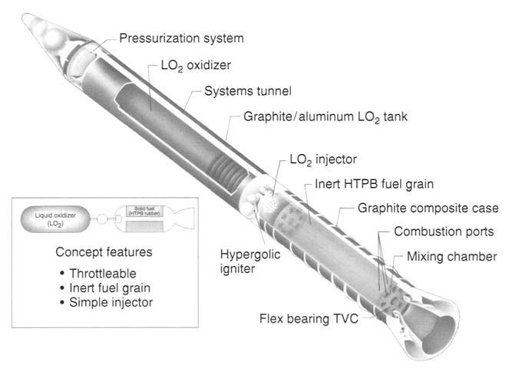
Background
Types of Fuels
A hybrid rocket is one that provides lift from a motor of two different types of fuels, solid and liquid or gaseous
The reaction between the solid grain fuel and the liquid oxidizer is what produces a reaction to come out of a nozzle to produce thrust, as seen in Figure 1.
Figure 1- Example of a Hybrid Rocket Booster

Slide 5
Background
Fuel Examples
Liquid/gaseous Fuel Types
Liquid oxygen (LOX), Nitrous Oxide(N2O), Dinitrogen Tetroxide(N2O4)
Solid Grain Fuel Types
HTPB(hydroxyl-terminated polybutadiene), Hydrocarbon composed of Plexiglass and Magnesium

Slide 6
Background
Motor
Rocket Motors are designated by class, determined by the amount of impulse a motor can deliver
The Hybrid Rocket Competition requires a G-class or lower motor which is equivalent to an impulse of 0-160 N*s
Anything above a G-class motor is no longer considered a model rocket by the National Rocket Association, but is known as a high powered rocket motor

Slide 7
Background
Motor
Most motors are designated with a Letter classification followed by two numbers (e.g. C5-0)
The letter classification is based on the total impulse limit

Slide 8
Background
Motor
The first number a classification based on average thrust
A high number, 10, would be a higher average thrust over a smaller time whereas a 1 would be the weakest average thrust over a larger time period
The second classification number, precursed by a hyphen is related to the time delay from when the motor burns out and a recovery system is deployed
The delay time is related to the weight of the rocket
The average time delay can generally range anywhere from 0-10 seconds depending on the weight of the rocket

Slide 9
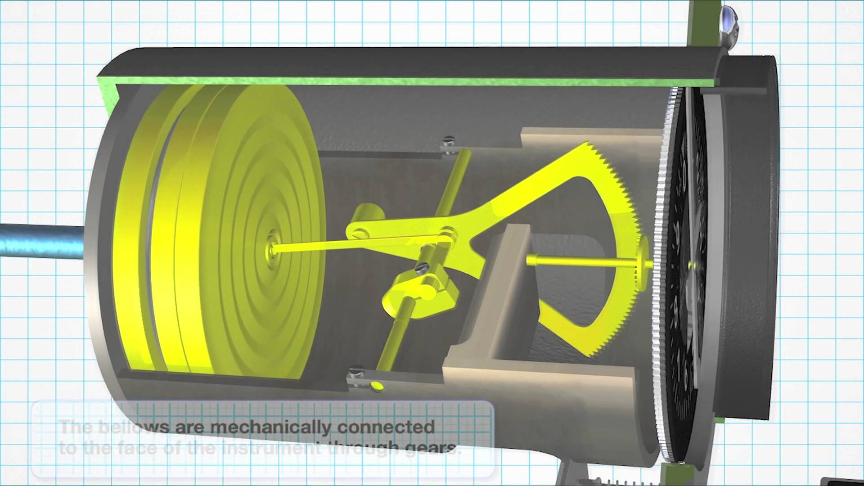
Background
Sensors
Altitude of rocket is determined with an altimeter
Altimeter measures pressure versus reference pressure
Traditionally, atmospheric pressure compresses wafers and is translated to rotation

Slide 10
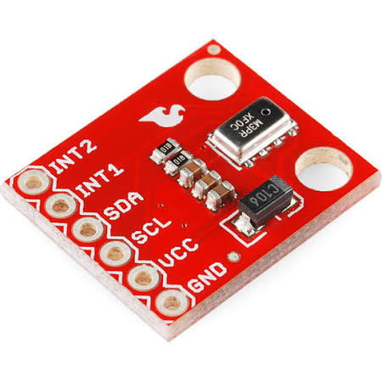
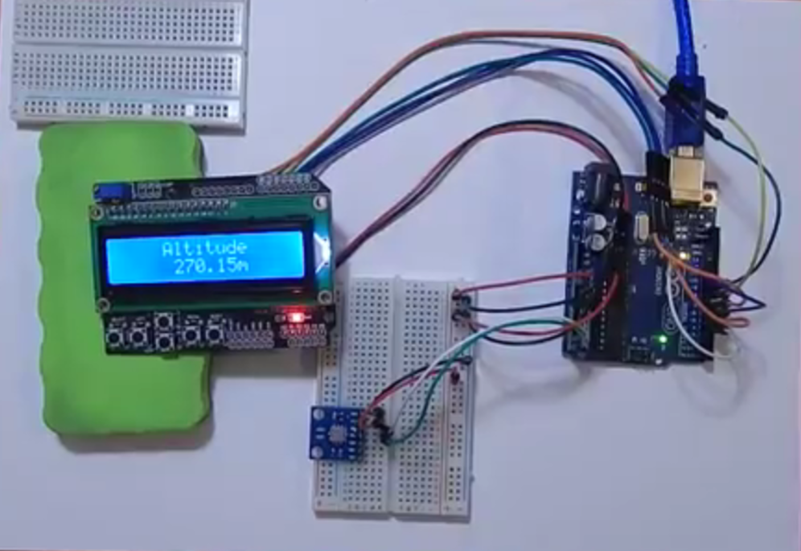
Background
Sensors
Electronic altimeter data will be logged
Electronic altimeter
Board - Arduino, BeagleBone, Dragonboard
Power source - 9 Volt

Slide 11
Background
Rocket Body Components and Uses
Body
Aerodynamics, storage and structure
Payload
- Electronics
Nose Cone
Aerodynamics and storage
Recovery System
- Parachute
Fins
Stability
Propulsion System
Propellant storage and combustion
Nozzle
Provides thrust
Diverging and converging geometry

Slide 12
Background
Aerodynamic forces
Weight
Thrust
Drag
Lift
Center of Gravity (COG)
-Point where forces due to gravity are assumed to act
Center of Pressure (COP)
- Point where sum of forces due to pressure are assumed to

Slide 13
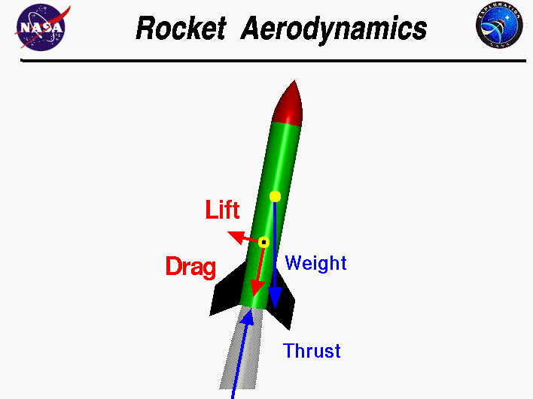
Background
Aerodynamic forces
Lift
Generated from velocity difference of the rocket and the surrounding fluid
Acts perpendicular to the drag force towards the vertical axis
Weight
Due to gravitational acceleration
Acts downward to the Earth
Drag
Caused by friction between the rocket’s body and the surrounding fluid
Acts in the opposite direction of the motion
Thrust
Provides force to accelerate and launch rocket
Opposes weight of the rocket

Slide 14
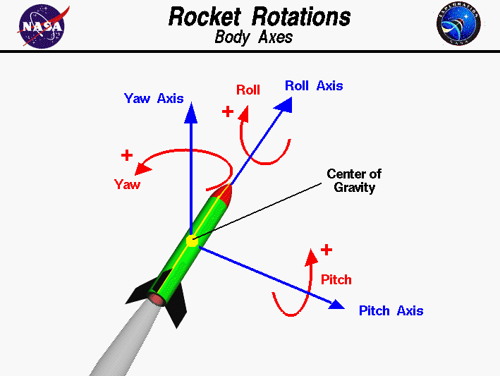
Background
Performance
A high performance rocket is stable
Yaw and pitch motions results in an unstable rocket due to wind

Slide 15
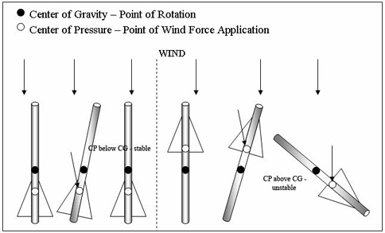
Background
To Ensure Stability
COP located below the COG for stability
Rocket aligns with the direction vector drawn from COP to COG
Increase distance from COP to COG
Increasing the number or size of fins
Raise COG toward the nose cone by adding weight to the top of the rocket
Induce a rolled spin on the rocket
Reduces the effects of wind attempting to create instability

Slide 16
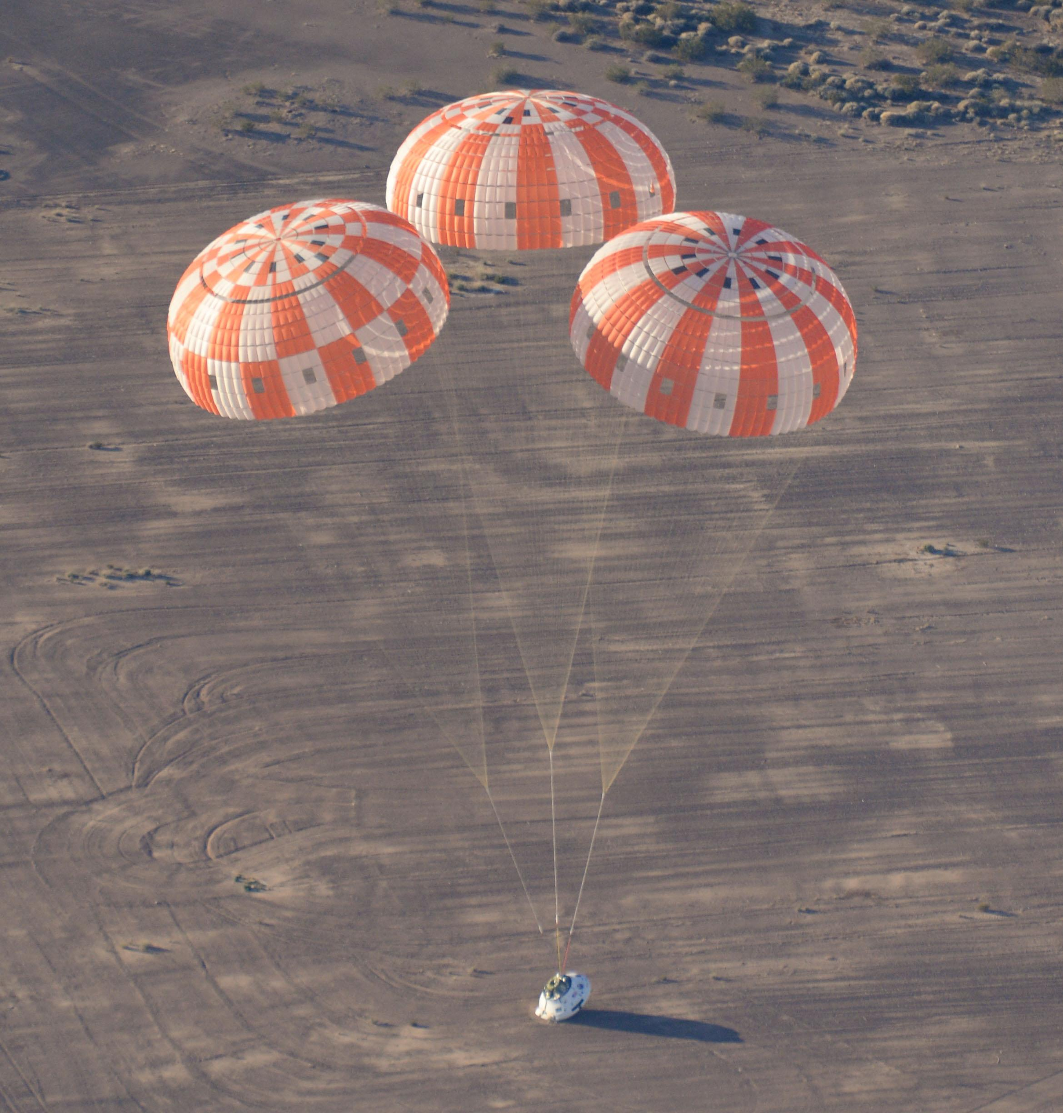
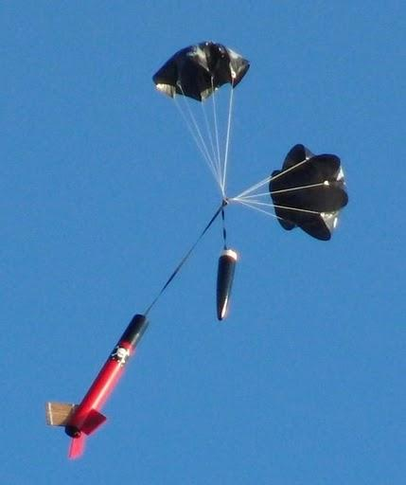
Background
Recovery system & Safety
Safety is a top priority
Safety of people
Safety of rocket – reusability
Materials:
Lightweight - easy recovery
Temperature resistant - withstands high temperatures
Strong - Endure aerodynamic forces during launch, flight and landing

Slide 17
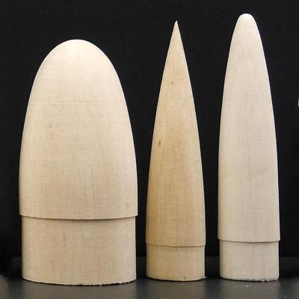
Background
Recovery system & Safety
Material Examples:
Paper
Wood
Plastics
Fiberglass

Slide 18
Project Scope
Key Goals
Build and test a prototype of rocket.
Finalize design for competition.
Achieve altitude of as close to two thousand feet as possible.
Win the NASA Hybrid Rocket Competition.
Lay the groundwork for future aerospace competitions for the FAMU-FSU COE.

Slide 19
Project Scope
Assumptions
Fuel sources/motor are able to be housed by FAMU-FSU COE.
FMEA and Hazard Analysis meets FSGC standards to gain access to competition.
Engineering Notebook for the competition is accepted to by FSGC to be allowed to compete.

Slide 20
Project Scope
Primary Markets
Aerospace Industry Corporations such as NASA, SpaceX, Lockheed Martin, Boeing, Northrup Grumman, etc.
Secondary Markets
Rocket related educational and hobby groups such as AIAA, high schools and other universities participating in rocketry projects.

Slide 21
Project Scope
Stakeholders
 | Investors | Decision Makers | Advisers | Receivers
NASA | Yes | Yes | No | Yes
Florida Space Grant Consortium (FSGC) | Yes | Yes | No | Yes
North East Florida Association of Rocketry (NEFAR) | No | No | No | Yes
Dr. Chiang Shih | No | Yes | Yes | Yes
Dr. Kourosh Shoele | No | Yes | Yes | Yes
Dr. Shayne McConomy | No | Yes | Yes | Yes
FAMU-FSU College of Engineering | Yes | Yes | Yes | Yes
FAMU-FSU AIAA. | No | No | No | Yes

Slide 22
Customer Needs
Project Needs
The specifications provided for the hybrid motor rocket competition are very concise and make up the following guidelines for this project:
Rocket purposed to reach apex of 2,000 feet
Will utilize a hybrid motor rated “G” or from a lower class
Rocket will be fired from a distance of 300 feet from launch rails/pad
A recording barometric altimeter will record altitude data for the competition.

Slide 23
Customer Needs
Deliverable Needs
While these are not strictly needs pertaining to the functionality of the product, they are still required by the sponsor.
A Failure Modes & Effects Analysis (FMEA) report will be submitted by November 17, 2017

Slide 24
Customer Needs
Deliverable Needs
Three to four page report will be submitted every two weeks detailing the progress of the team detailing the progress and achievements of the team
Engineering analysis book to be submitted two weeks prior to competition
Includes engineering data, calculations, drawings and sketches, test results, notes, ideas, meeting notes, etc

Slide 25
Functional Decomposition
Body
Protect other Subsystems from harm
Store other Subsystems
Ensure stability during flight
Motor
Provide thrust to allow rocket to gain altitude
Use solid fuel grain with liquid or gas oxidizer as fuel sources (Hybrid motor)

Slide 26
Functional Decomposition
Launch System
Rail system to point the rocket within 30 degrees of straight up
Have a backup safety switch to prevent accidental ignition
Capable of being launched from 300 ft away

Slide 27
Functional Decomposition
Electronics
Read from Altimeter
Store Data
Activate Recovery System
Recovery System
Decelerate the body/motor to a safe speed before landing

Slide 28
Conclusion – Up Next…
Targets
Concept Generation
Design
Budget

Slide 29
References
http://www.kr4.us/MPL3115A2-Altitude-Pressure-Sensor-Breakout.html?gclid=CjwKCAjwjozPBRAqEiwA6xTOYKScBHpKJ5QYVaHAxWud2lBCFVYp_IELqOV3GwwB1-r0n9QZra2-rBoC8DUQAvD_BwE
http://www.explainthatstuff.com/how-altimeters-work.html
https://www.youtube.com/watch?v=ftyAAH35tzQ
https://www.youtube.com/watch?v=OiVCX04YJMY
http://www.rocketryforum.com/link.php?u=http://www.teachengineering.org/view_lesson.php?url=collection/cub_/lessons/cub_rockets/cub_rockets_lesson03.xml&thread=64407&postid=691700
https://www.nasa.gov/multimedia/imagegallery/image_feature_2333.html
http://modelrocketbuilding.blogspot.com/2010/11/parachute-attachment-tip_28.html
http://www.asp-rocketry.com/ecommerce/Model-Rocket-Parts-Building-Materials.cfm?cat_id=7
http://www.ewp.rpi.edu/hartford/~ernesto/S2013/EP/MaterialsforStudents/Lee/Sutton-Biblarz-Rocket_Propulsion_Elements.pdf

