Slide 1
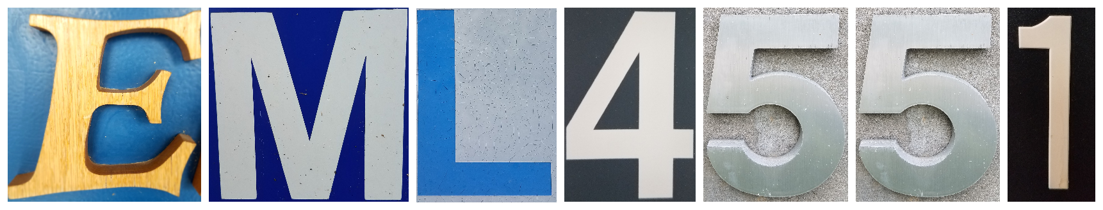
FAMU-FSU
BOOSTERS
Design Review 4
Chris Bredberg, Ryan Dwyer, Kjell Gordon
Gordon

Slide 2
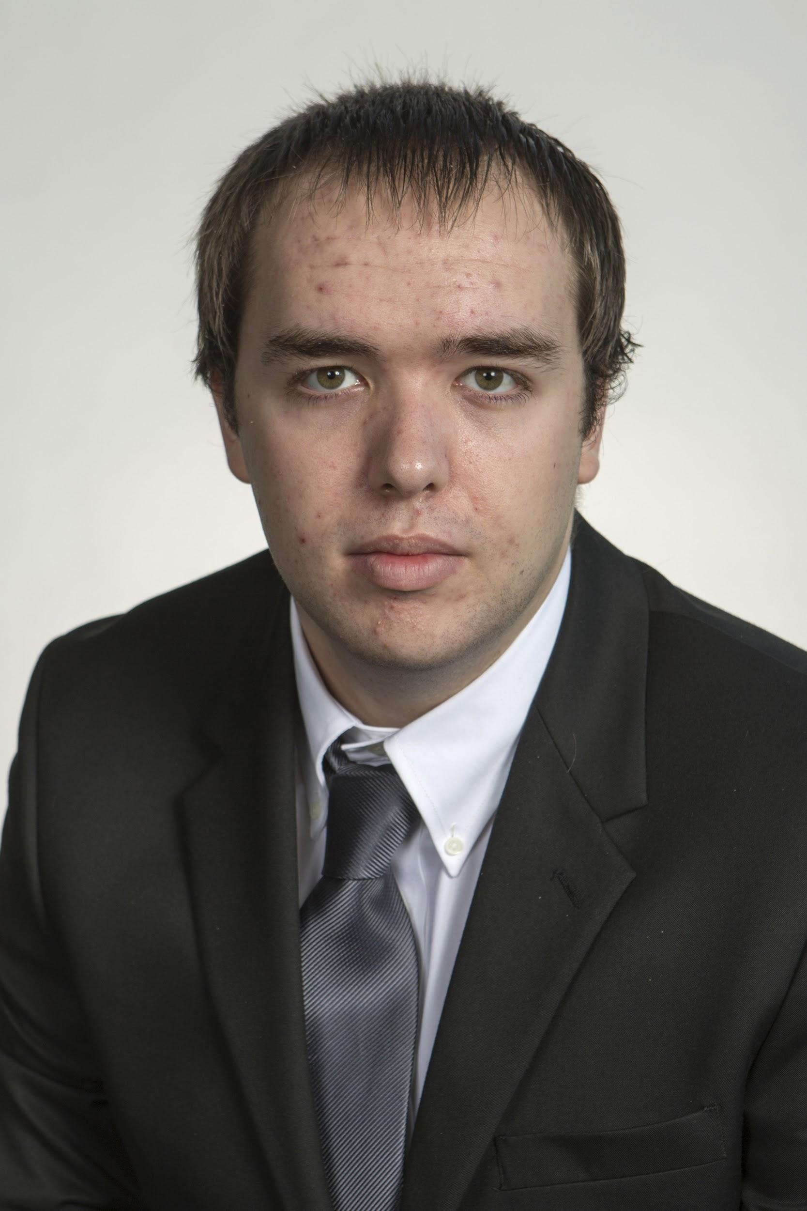

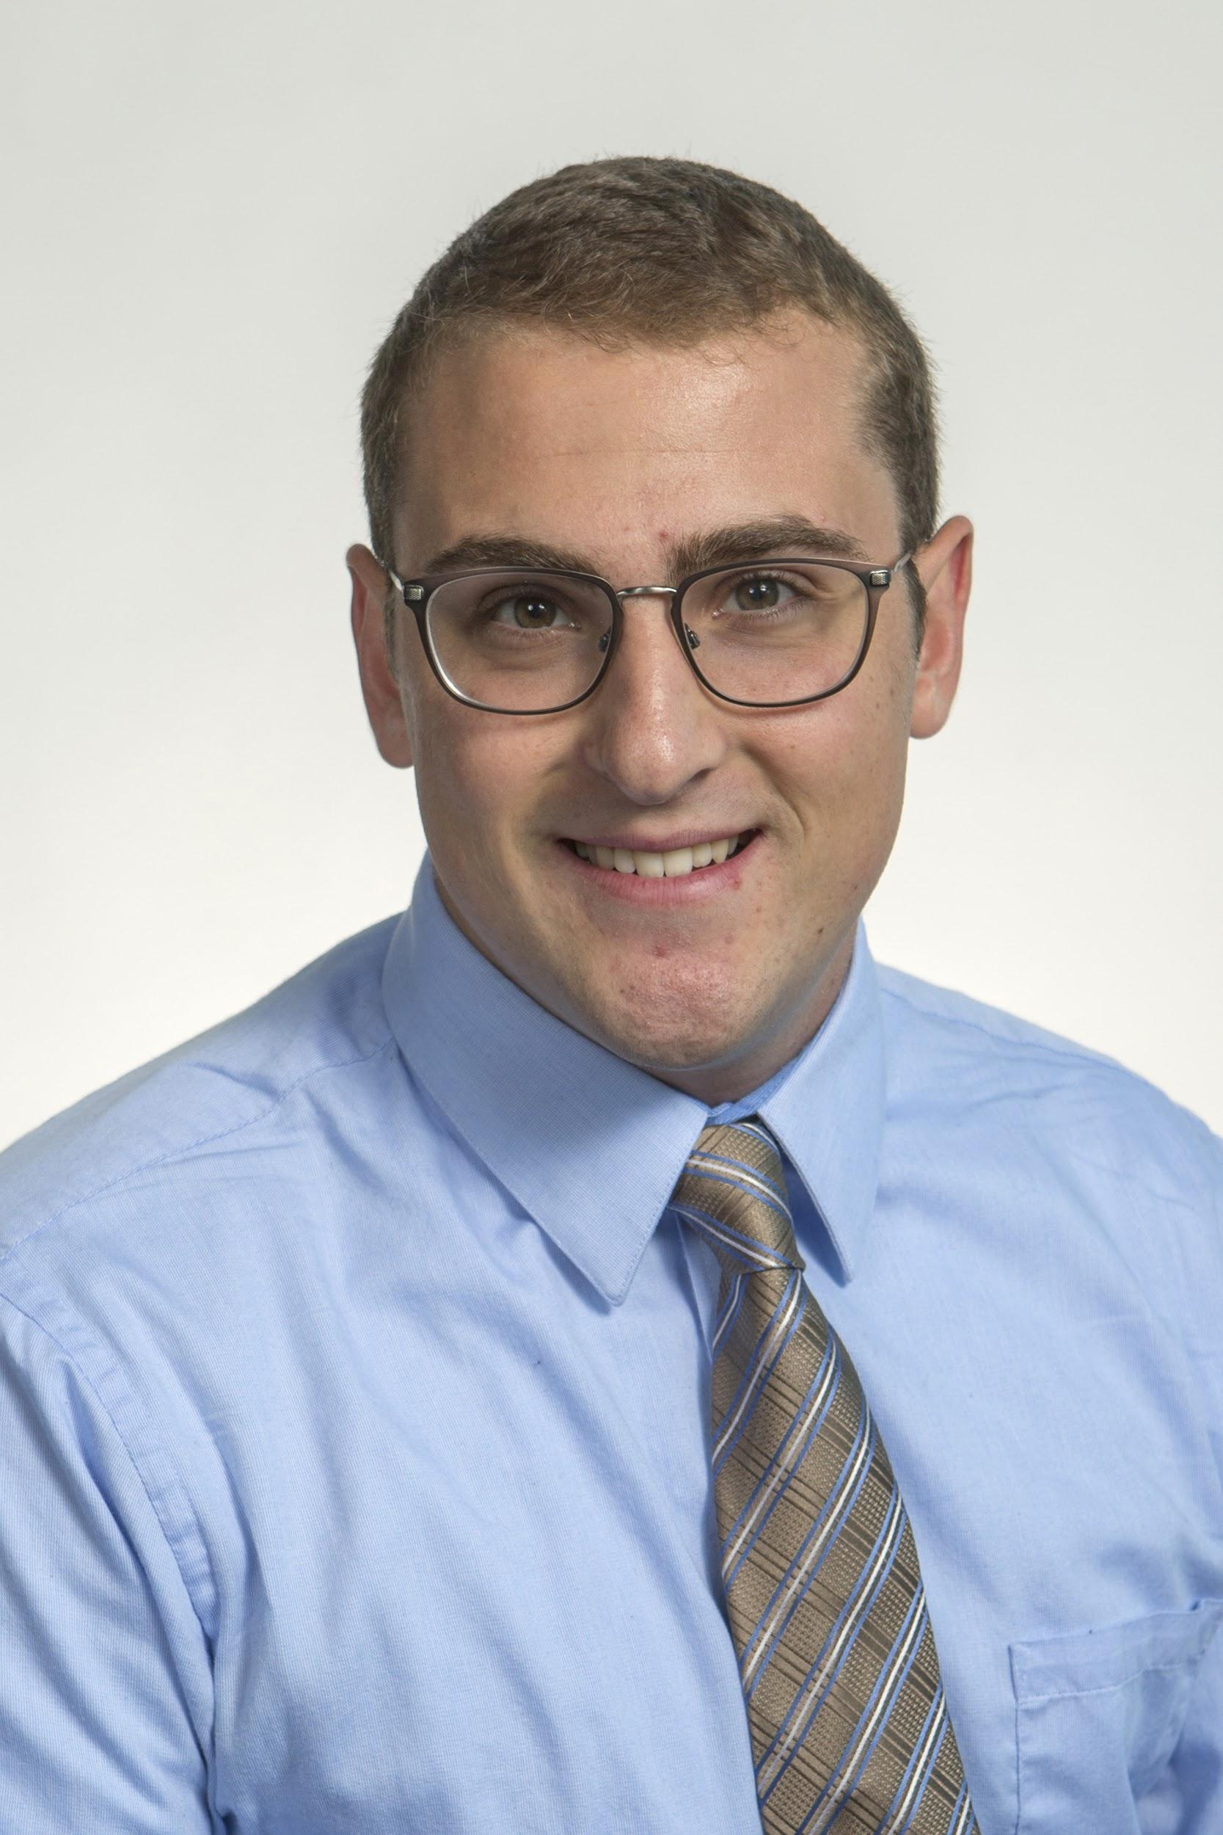


Introduction
Ryan Dwyer
Kjell Gordon
Chris Bredberg
James Beattie
Cedryc Midy
Gordon

Slide 3
Agenda
Previous Work
  Purpose
  Previous Accomplishments
Recent Work
  Completed work
    Simulation - Rocksim
    CAD design
    Purchase orders
  Current Work
    Assembly of prototype
    Logistics - launch sites, required launch materials
    Final purchase orders
Issues and Solutions
  Electronics
  Fin attachment
  Parachute sizing
Future Work
  Launch Pad
  Parachute Deployment
  Build, Test, Redesign and Optimize
Gordon
Notes:
A lower impulse rated motor can be utilized if deemed necessary

Slide 4
Previous Work
Kjell Gordon
Gordon

Slide 5
Purpose: Competition
Hybrid Motor Rocket Competition
  Goal is to reach 2,000 feet
  Use hybrid motor of a G-class or less (up to 160 Ns of impulse)
Competition requirements
  Bi-weekly updates
  FMEA
  Engineering notebook
Gordon

Slide 6
Previous VDR Accomplishments
Established important parameters of project
  Project Scope, Customer Needs, Functional Decomposition, etc.
Research of rocketry
  Background research
  Manufacturing/creation of a rocket
Concept generation - per section of the rocket
  Multiple concepts and options for each section
Concept Selection
  House of Quality
  Pugh Matrix
Gordon

Slide 7
Recent Work – Completed
Kjell Gordon
Gordon

Slide 8
Simulation
Simulation software: Rocksim
Parameters
  Resolution: Flight resolution = 800 samples/s, Descent resolution = 1 sample/s.
  Launch Conditions: Sea level liftoff (0 ft.), 30 in. of pressure, 50% humidity, 59° F, calm wind.
Gordon

Slide 9
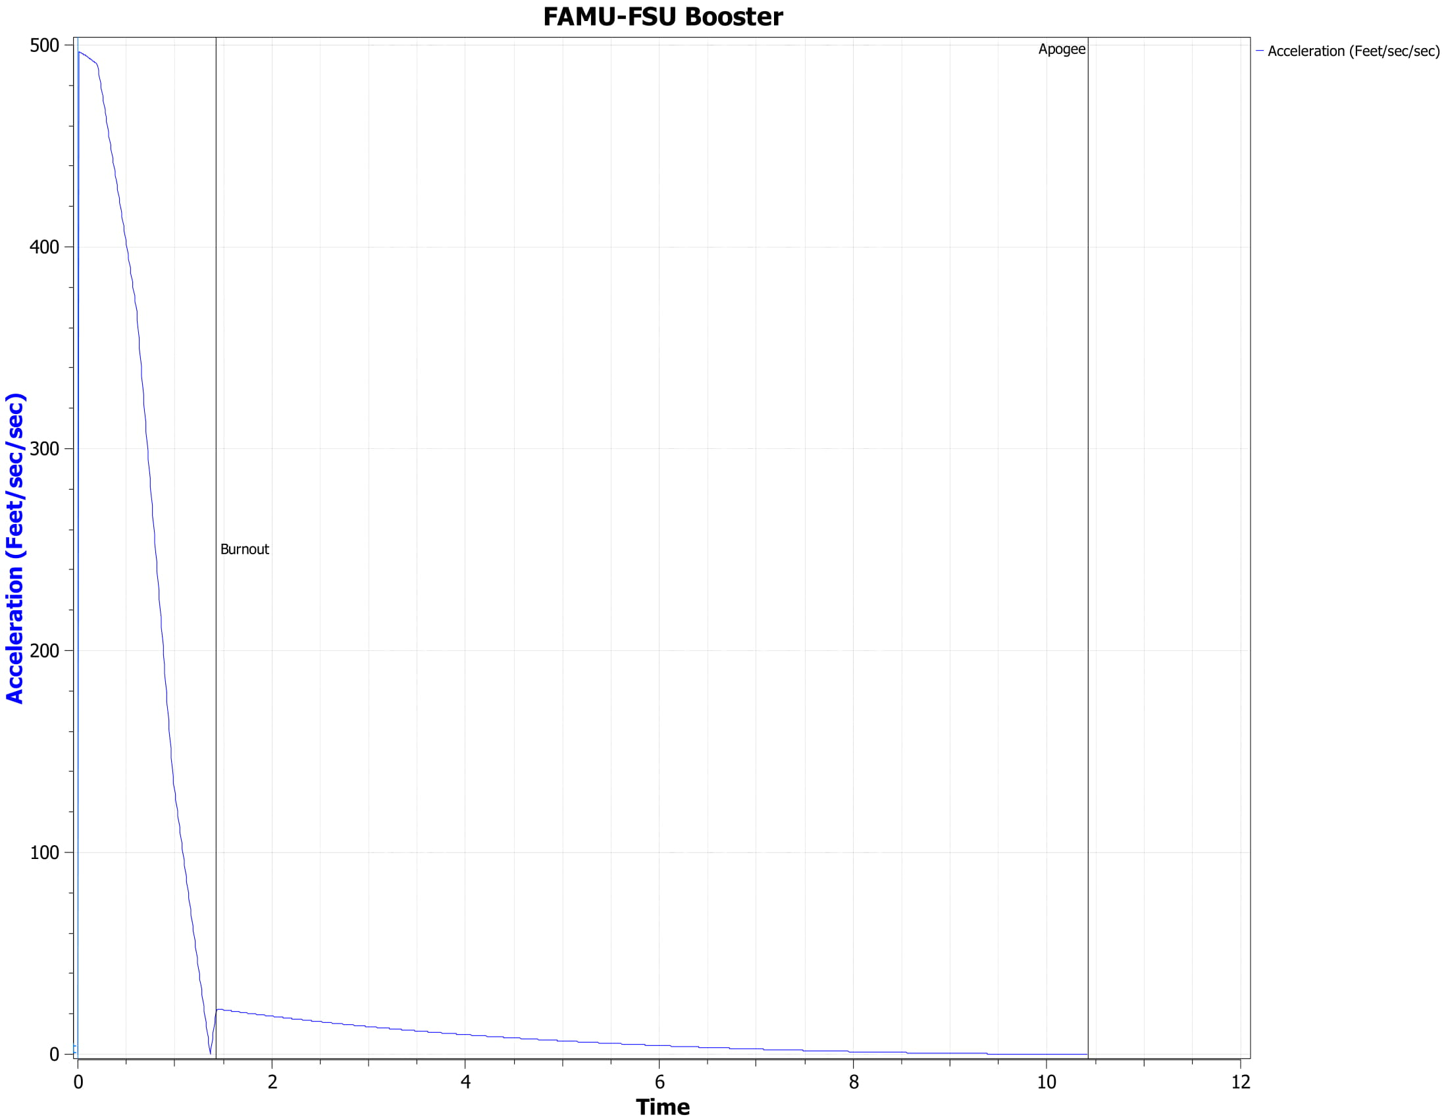
Maximum acceleration of 465 ft/s/s (14.5 G’s)
Gordon
9

Slide 10
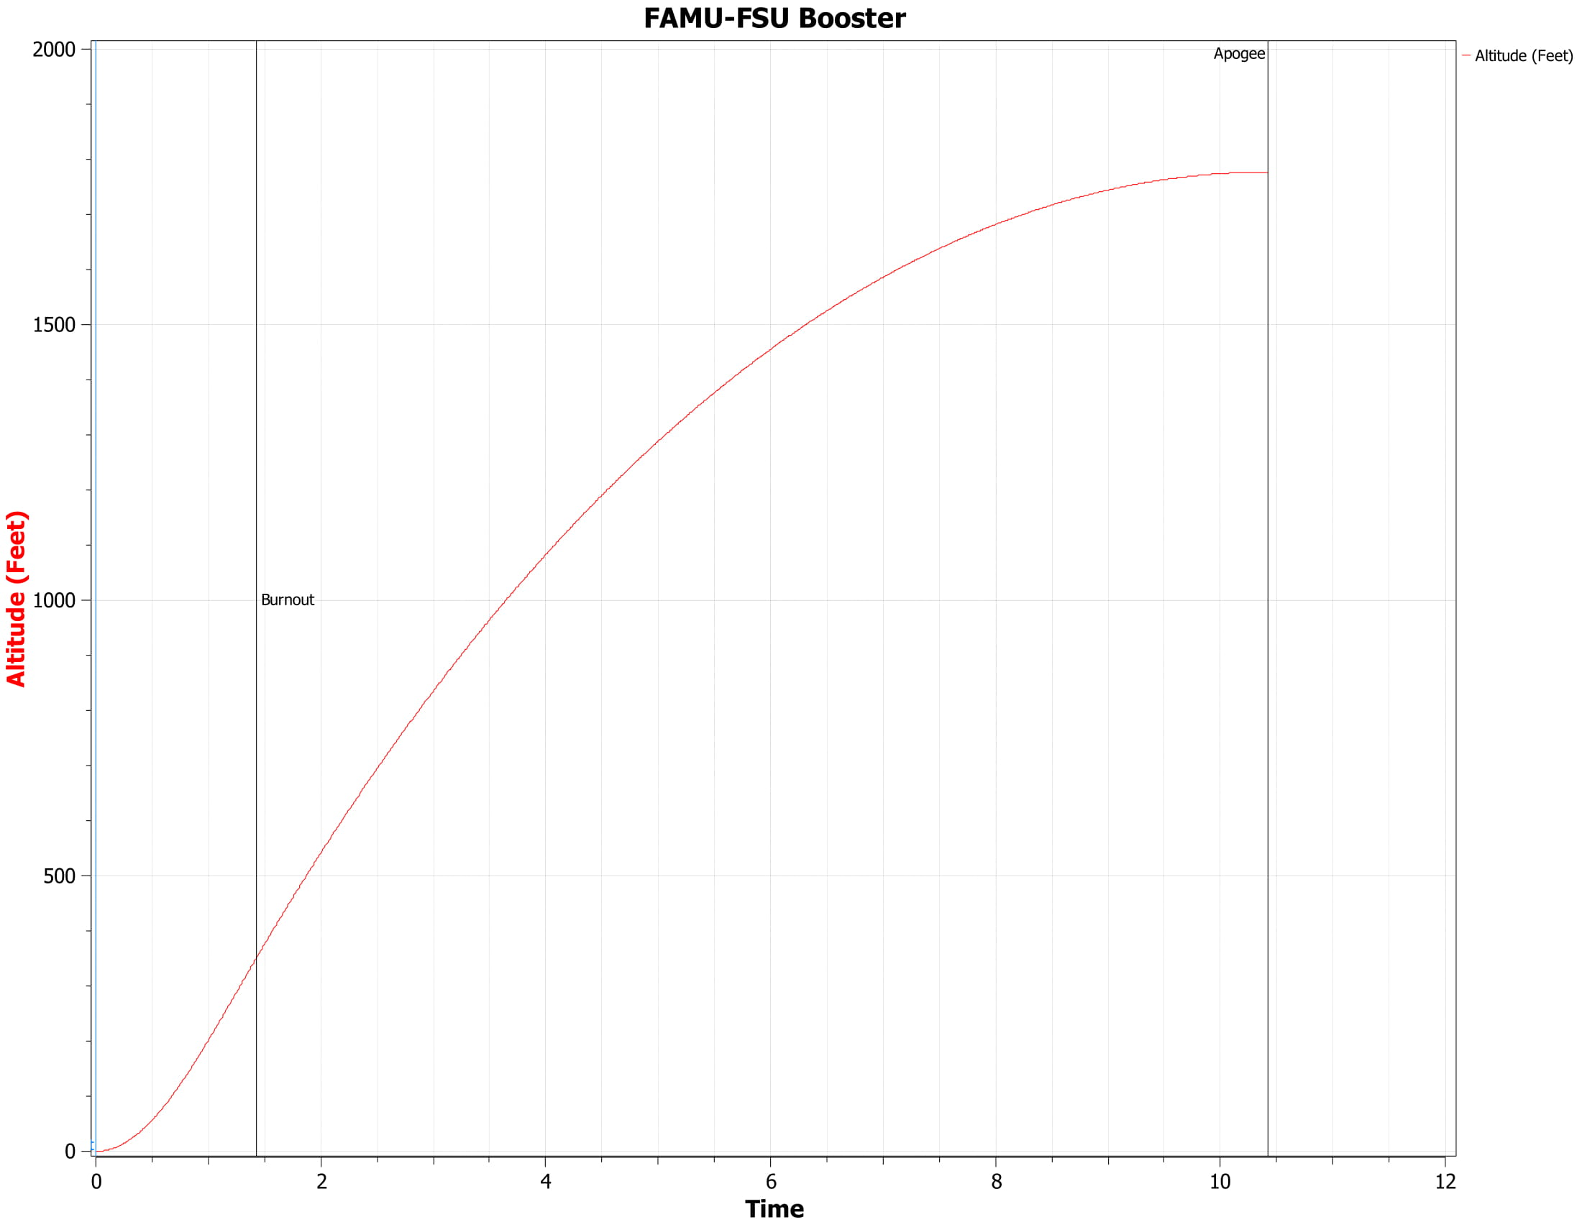
Maximum altitude of 1777 feet
Gordon
10

Slide 11
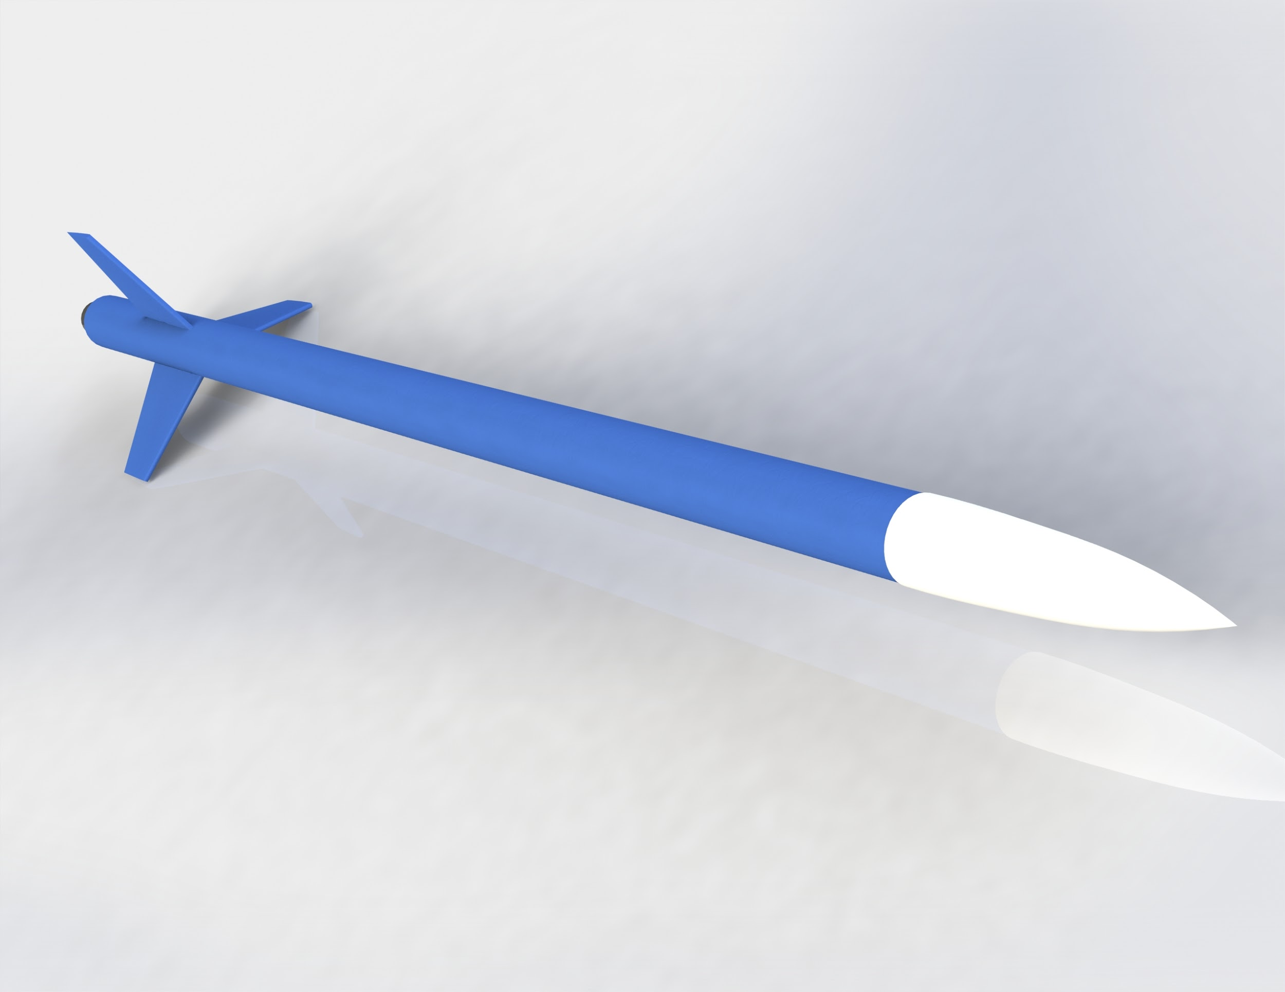
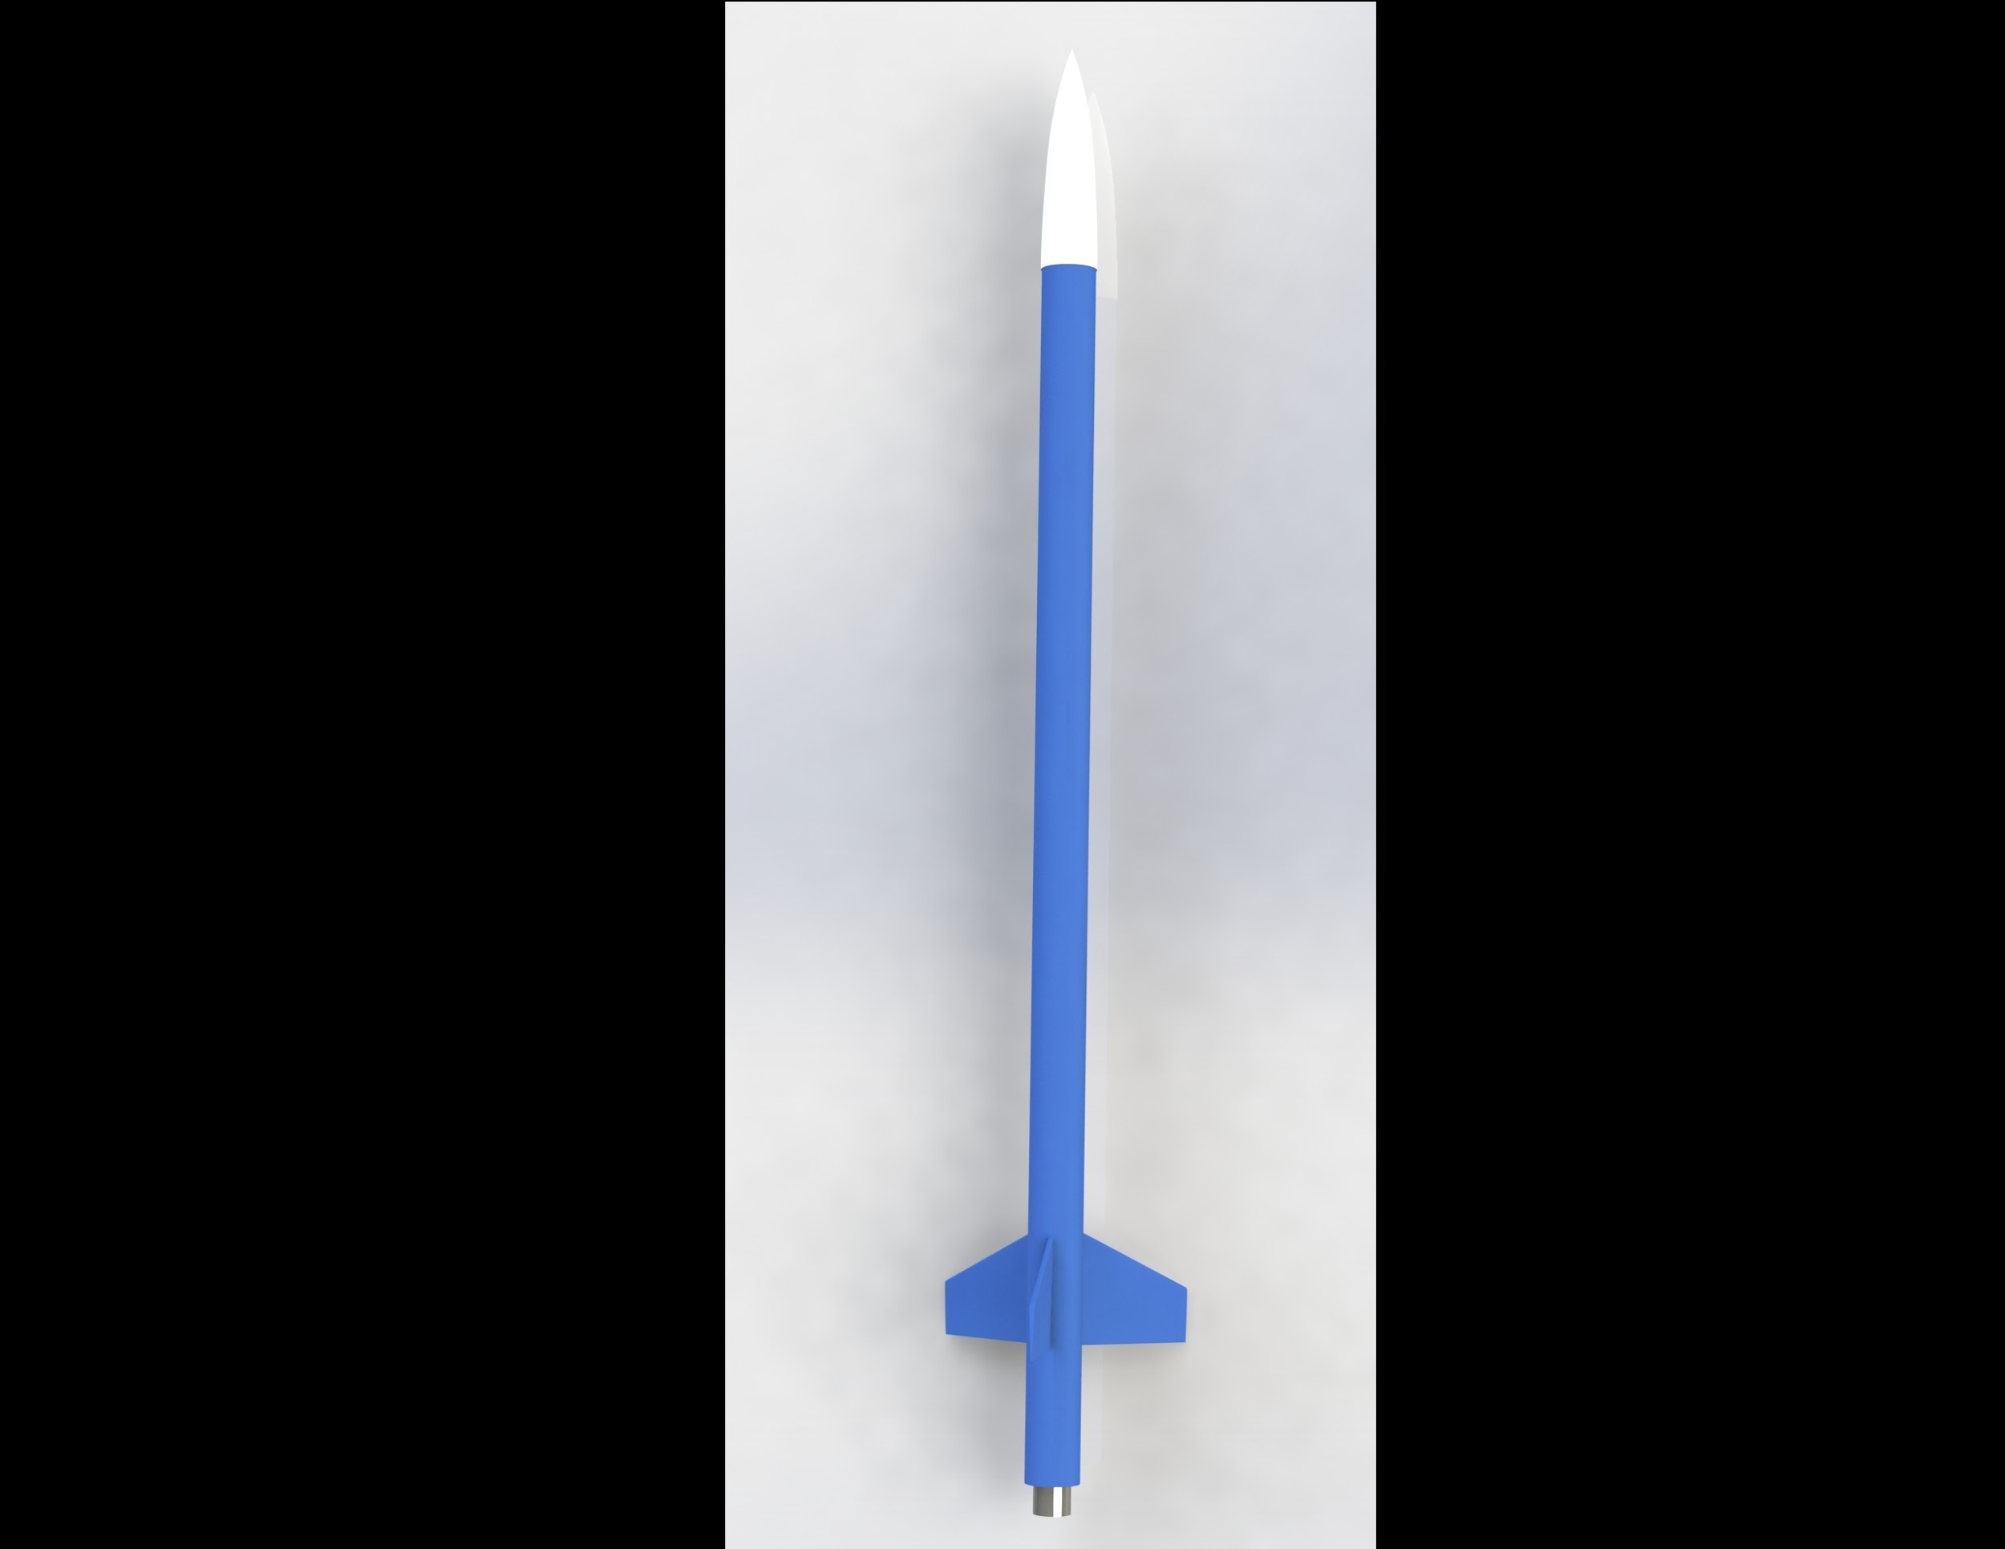
CAD Design
Gordon

Slide 12
Purchase Orders
Electronic components ordered and picked up
Motor and reloads ordered and picked up, awaiting assembly
Body material ordered, awaiting delivery
Gordon

Slide 13
Recent Work – Current
Ryan Dwyer
Gordon

Slide 14
Assembly of Prototype
Motor being assembled
Electronics being programmed and soldered
Body material awaiting delivery
Fins and nose cone awaiting 3-D printing
Dwyer

Slide 15
Logistics
Contacted Tallahassee Parks and Recreation for information on launch sites or scheduling a launch in a local area
  They requested safety information about the rocket and all relevant details
  A detailed email concerning all relevant material on safety is currently being drafting to be sent to the representative
Working on the capabilities of moving the fuel of the rocket (Nitrous Oxide) for tests
  Communicate with FAMU-FSU COE Facilities Coordinator (Donald Hollett)
Dwyer

Slide 16
Final Purchase Orders
Working on filling out order forms for parachutes and ejector caps
Need 3-D printer filament for fins
Accelerometer
Dwyer

Slide 17
Issues and Solutions
Chris Bredberg
Dwyer

Slide 18
Electronics
Microcontroller is needed to access and save data such as altitude
  Data acquisition and usage
Initially, Arduino Uno was chosen as it would perform as required
  Very close fit
  After closer examination, width of the board enclosed in a circular tube would not fit
Finally chose the Arduino Nano
  Has just enough pins to connect to all electronics
    SD card port for storing altimeter data was changed to decrease the amount of pins used
  Significantly smaller than the Uno
Bredberg
Notes:
The initial Arduino Uno was too big for premade bodies given the material we decided to use so we decided to use a smaller arduino board, the Arduino Nano, that has enough pins to connect to the different electronic accessories needed. We also had to choose a different sd card reader board accessory to accommodate the amount of pins on the new board.

Slide 19
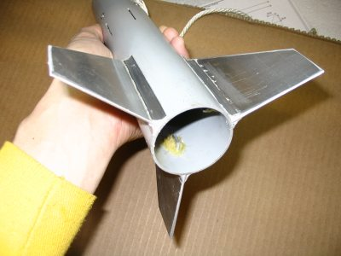
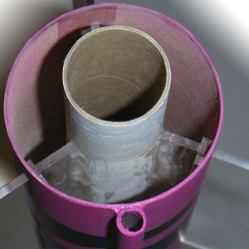
Fin Attachment
Initial plan was to attach fins to outside of airframe
Motor classes above D usually require “through the wall” mounting
  Fins subject to larger forces during flight and landing
Fins were redesigned to mount to both the engine mount tube and airframe
Fins were also thinned to reduce weight
Bredberg

Slide 20
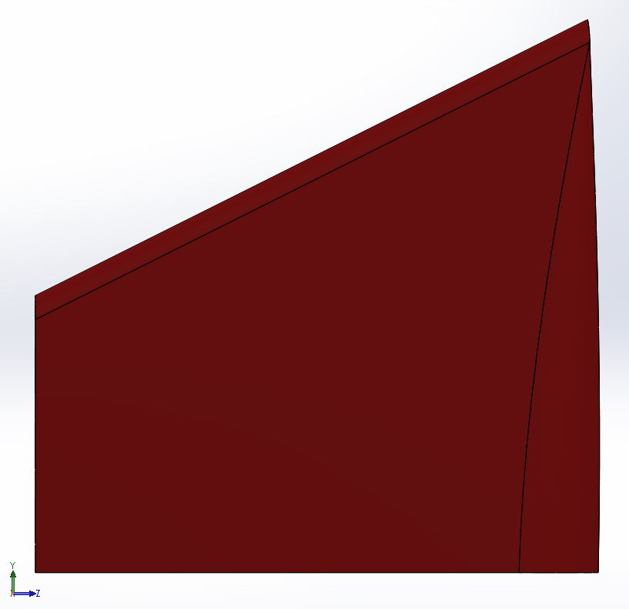
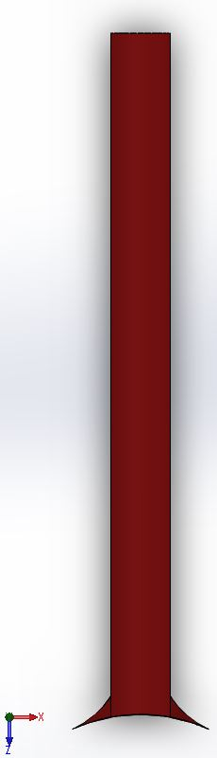
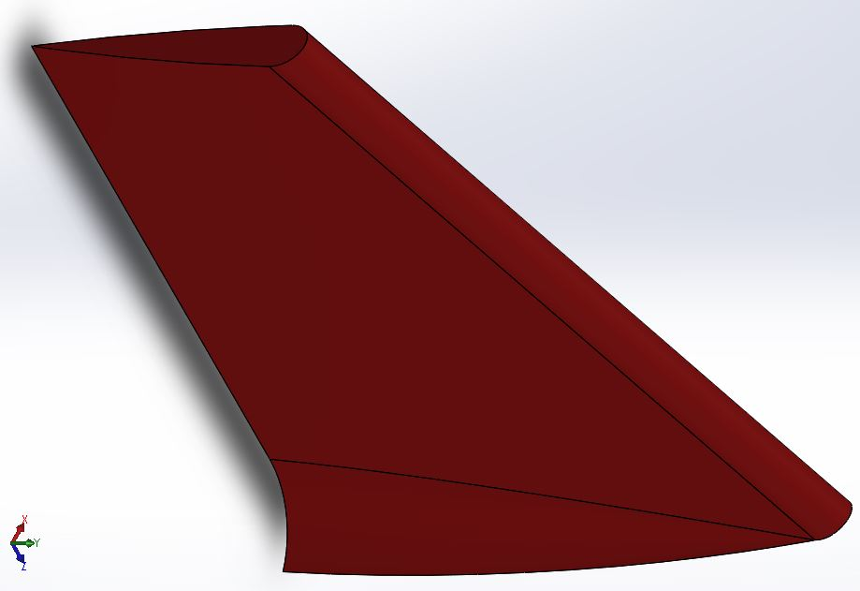
Initial Fin Design
Side
Front
Isometric
Bredberg
20

Slide 21
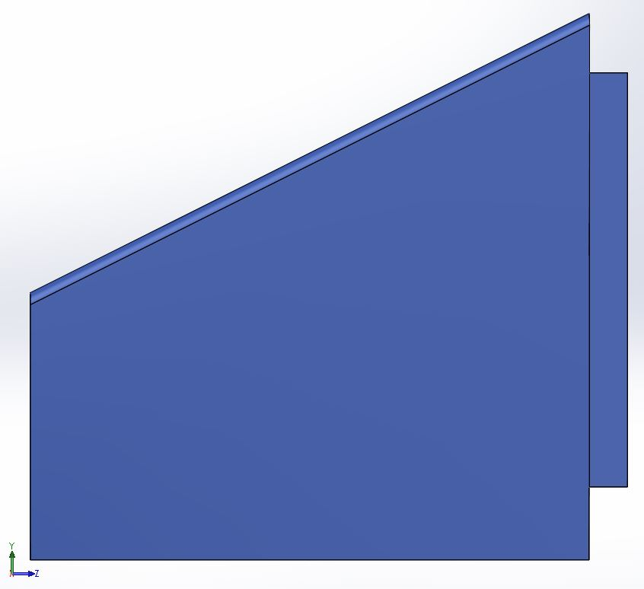
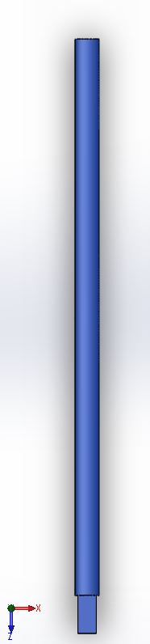
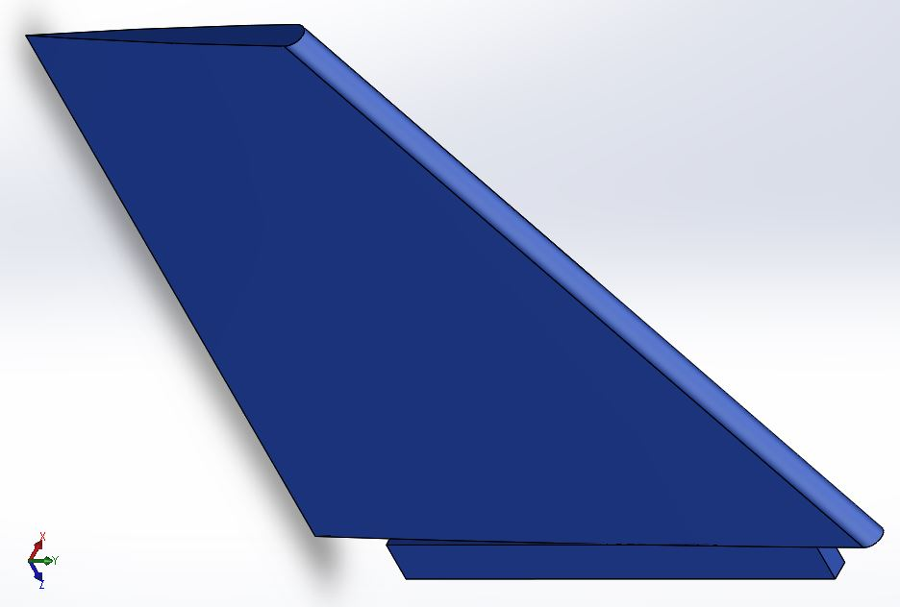
Final Fin Design
Side
Front
Isometric
Bredberg
21

Slide 22
Parachute Sizing
Factors in sizing:
Fall rate/final velocity
  Do not design specifically for this
    No competition regulations
    Rocket materials are quite sturdy
Mass of object
  We require a parachute between 1 to 5 square feet
    Parachutes between these areas don’t vary in cost much so it may be beneficial to select a larger mass parachute i.e. 5 feet
Bredberg
Notes:
Parachutes are largely based on mass and fall rate/ velocity since fall rate and velocity are inconsequential i.e. our body material is sturdy enough to handle an impact within the velocity range and time is not a factor in the competition the only thing we have to choose for a parachute is mass. The mass of our rocket can vary in prototyping because of stability purposes so we have to choose a bigger parachute with a wider range of mass.

Slide 23
Future Work
Ryan Dwyer
Bredberg

Slide 24
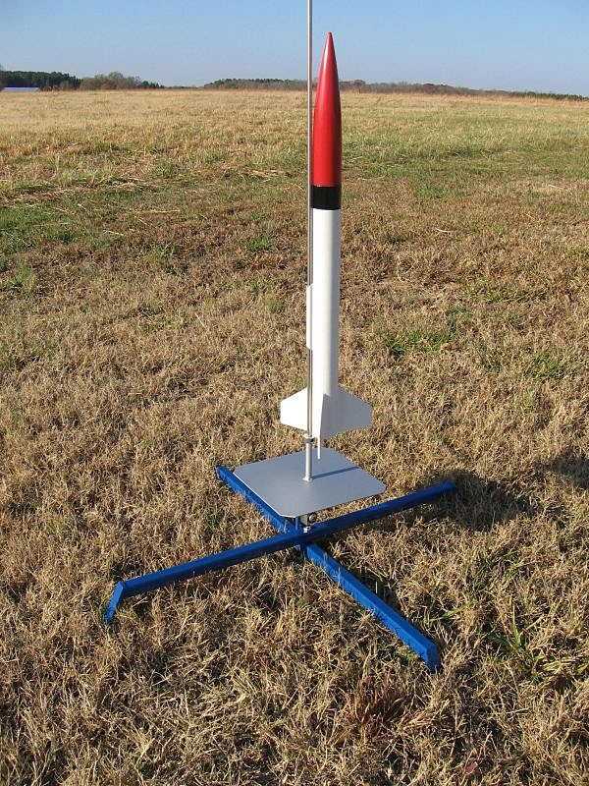
Launch Pad
Research
  Required components
  Purchasing and manufacturing options
  Where to buy launch pad or equipment
Competition requirement: must be able to launch rocket from a distance of 300 feet
Dwyer

Slide 25
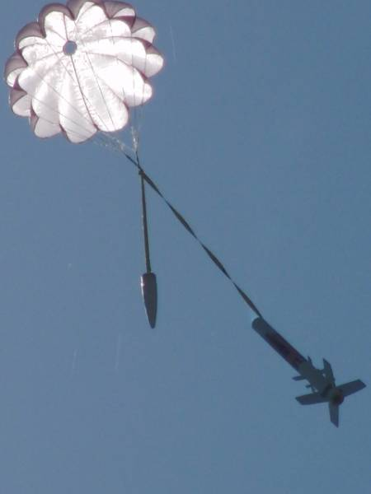
Parachute Deployment
Research
  Different methods of ejecting parachute
  Integration with electronics
  Parachute packing methods
Dwyer

Slide 26
Build, Test, Redesign and Optimize
Assemble prototype
Test prototype
Verify and improve design
Optimize design to reach desired goal of 2,000 feet
Finalize rocket design for competition
Dwyer

Slide 27
Resources
http://www.nakka-rocketry.net/skydart1.html
http://www.jcrocket.com/crayons.shtml
http://homeinabox.us/Home-built-model-rocket-launch-pad.html
Dwyer

