Slide 1
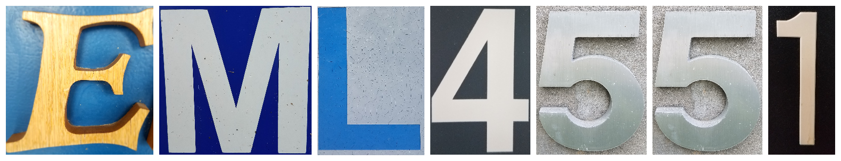

Design Review 5
James Beattie, Cedryc Midy
Midy

Slide 2
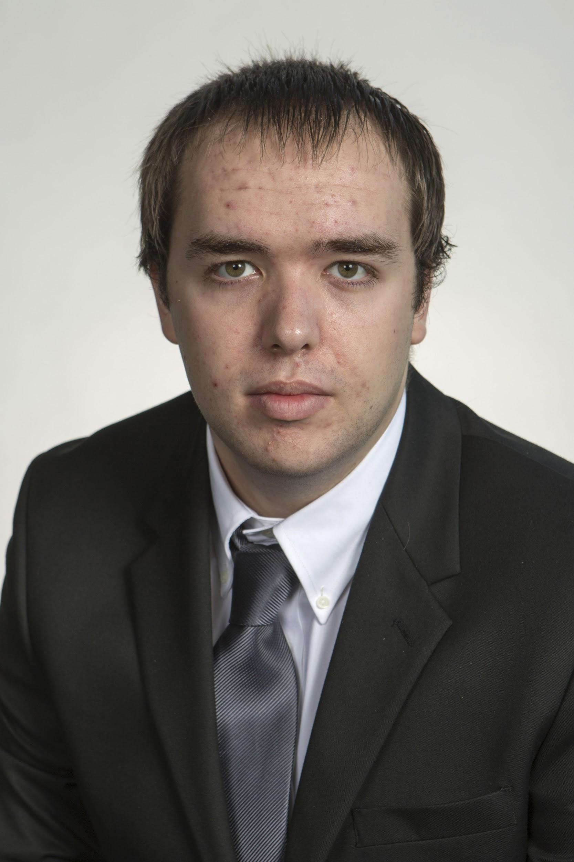

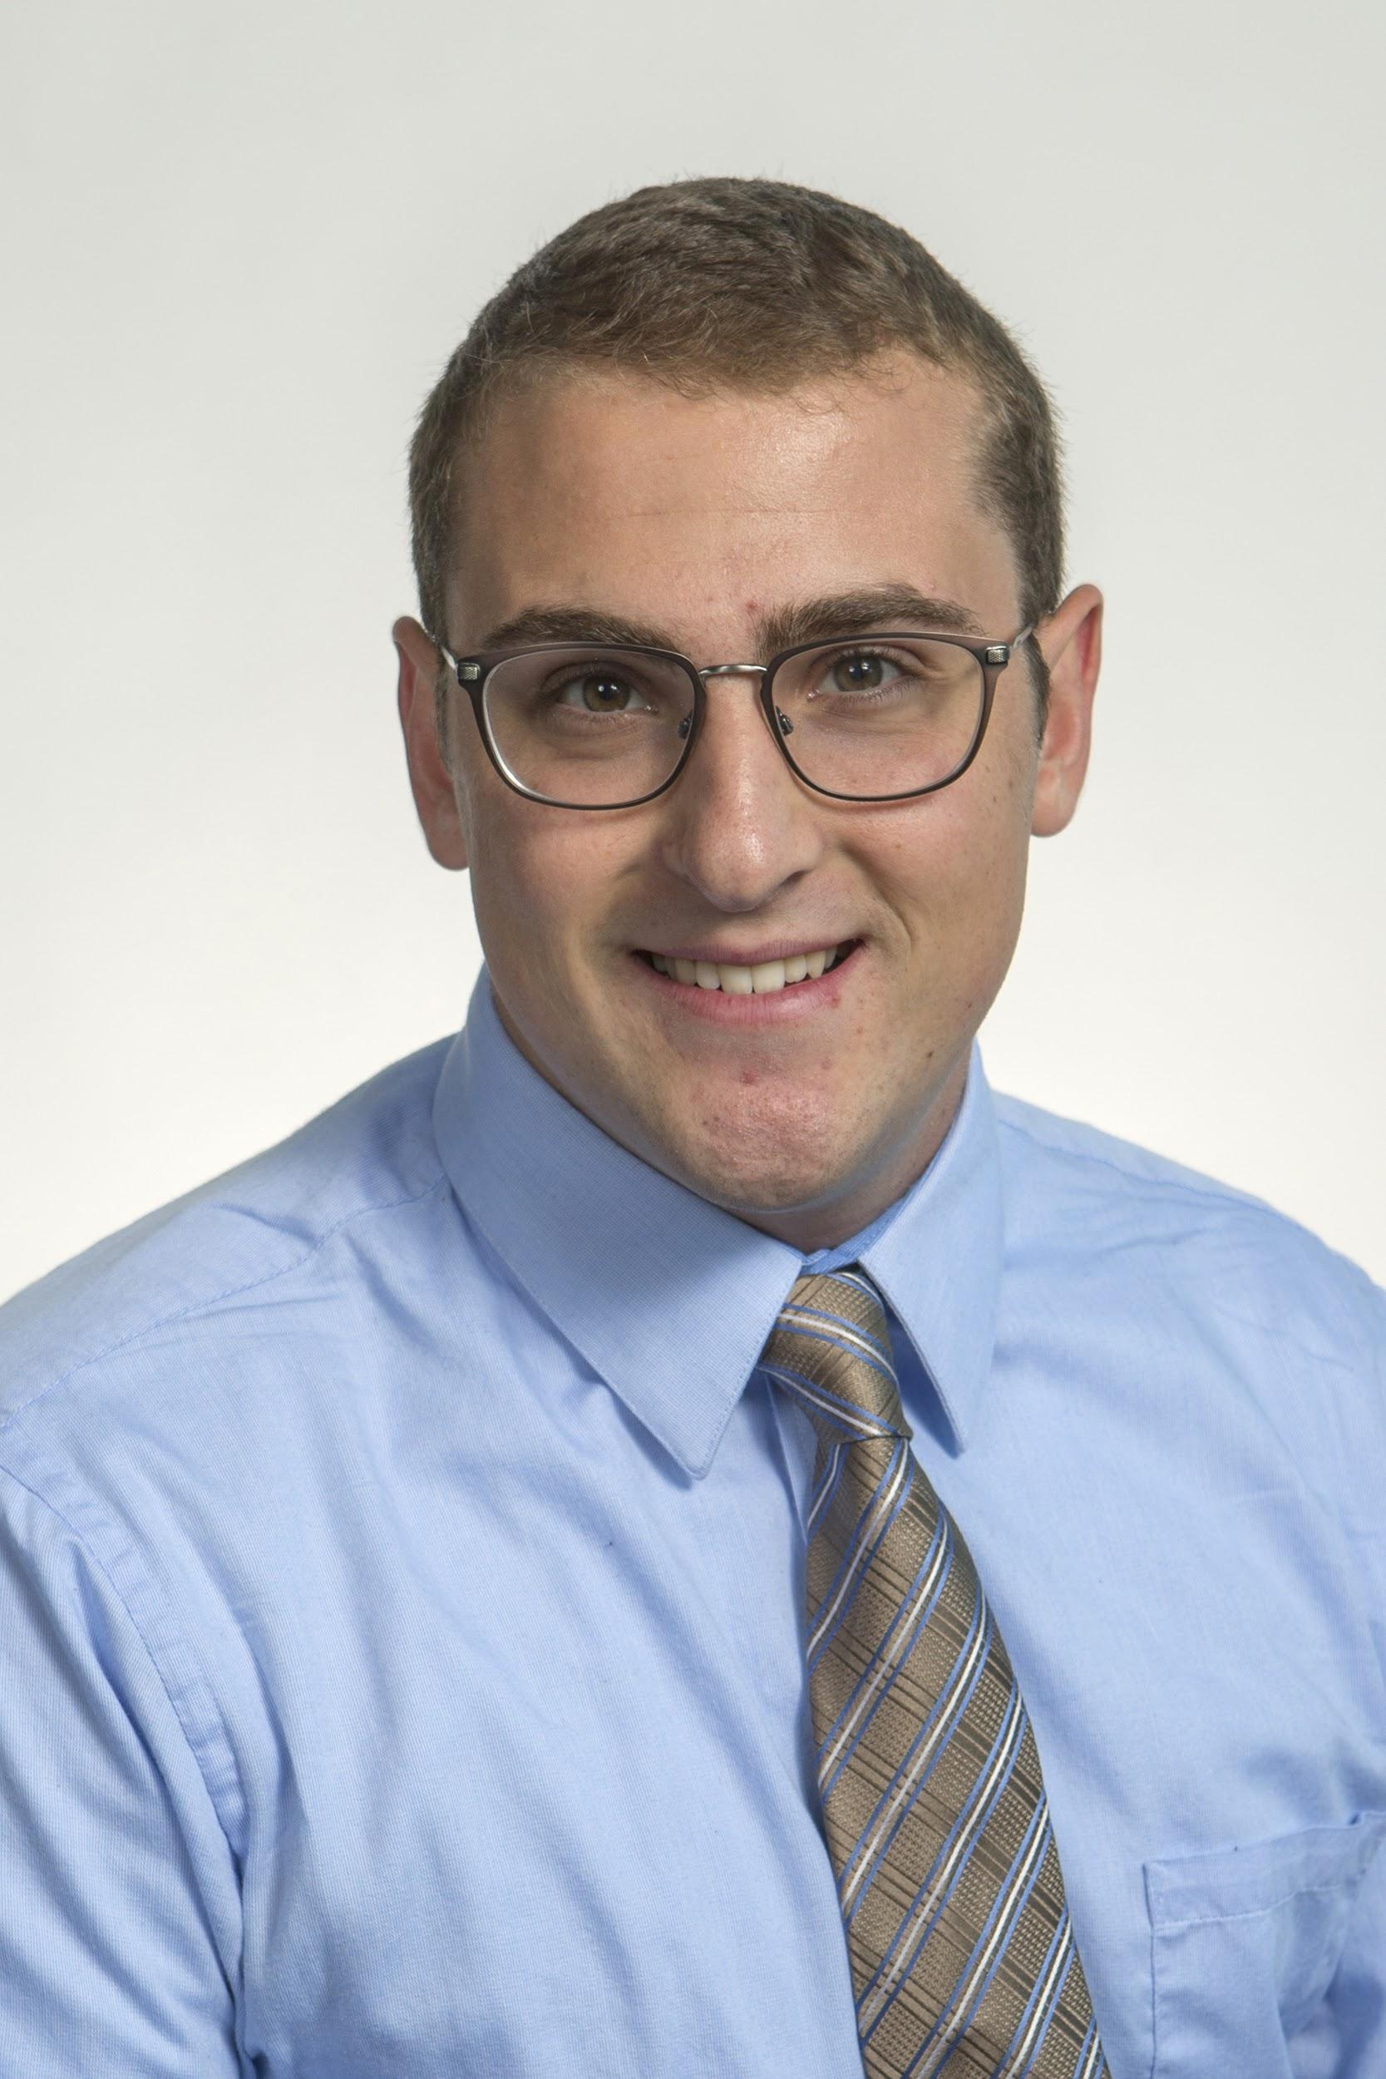


Introduction
Ryan Dwyer
Kjell Gordon
Chris Bredberg
James Beattie
Cedryc Midy
Midy

Slide 3
Agenda
Introduction
  Purpose
  Project Scope
  Customer Needs
Design
  Targets
  Concept Generation
  CAD Render
Issues and Solutions
  Electronics
  Fin attachment
  Parachute sizing
  Simulations
Final Product
  Design
  Testing
Conclusion
  Passing the torch
Midy
Notes:
A lower impulse rated motor can be utilized if deemed necessary

Slide 4
Introduction
Cedryc Midy
Midy

Slide 5


Purpose: Competition
NASA Hybrid Motor Rocket Competition
  Sponsored by the NASA Florida Space Grant Consortium (FSGC) and the North East Florida Association of Rocketry (NEFAR)
Develop a hybrid rocket capable of reaching an altitude of two thousand feet from launch.
Supporting Faculty: Dr. Chiang Shih, Dr. Kourosh Shoele and Dr. Mcconomy
Midy

Slide 6
Project Scope
Key Goals
Build and test a prototype of rocket.
Finalize design for competition.
Achieve altitude of as close to two thousand feet as possible.
Win the NASA Hybrid Rocket Competition.
Lay the groundwork for future aerospace competitions for the FAMU-FSU COE.
Midy

Slide 7
Project Scope
Primary Markets
Aerospace Industry Corporations such as NASA, SpaceX, Lockheed Martin, Boeing, Northrop Grumman, etc.
Secondary Markets
Rocket related educational and hobby groups such as AIAA, high schools and other universities participating in rocketry projects.
Midy

Slide 8
Customer Needs
Project Needs
The specifications provided for the hybrid motor rocket competition are very concise and make up the following guidelines for this project:
Rocket purposed to reach apex of 2,000 feet
Will utilize a hybrid motor rated “G” or from a lower class
Rocket will be fired from a distance of 300 feet from launch rails/pad
A recording barometric altimeter will record altitude data for the competition.
Midy

Slide 9
Customer Needs
Deliverable Needs
  While these are not strictly needs pertaining to the functionality of the product, they are still required by the sponsor.
A Failure Modes & Effects Analysis (FMEA) report will be submitted by November 17, 2017
Three to four page report will be submitted every two weeks detailing the progress of the team detailing the progress and achievements of the team
Engineering analysis book to be submitted two weeks prior to competition
  Includes engineering data, calculations, drawings and sketches, test results, notes, ideas, meeting notes, etc
Midy

Slide 10
Design
James Beattie
Beattie

Slide 11
Target Summary
 | Metric | Target | Target Unit
Body | Impact Failure Force | - | N
 | Drag | - | N
 | Distance of Center of Pressure | - | m
Motor | Impulse | 160 | N*s
 | Time of Thrust | 5 | s
Electronics | Altimeter Measurement | 79.495 | kPa
 | Source Current to Deploy Recovery System | 2 | Amps
 | Data Storage Capacity | 10 | mb
 | Sampling Rate | 1 | kHz
Launch System | Launch Cable Length | 91.44 | m
Recovery System | Parachute Deployment Delay | 5 | ms
 | Descent Speed | 4.5 - 6.1 | m/s
Whole System | Apogee | 609.6 | m
 | Maximum Error in Altitude | ±15.24 | m
Beattie
Notes:
Better format saved to pptx file in the VDR 2 folder when making the final presentation slides

Slide 12
Concept Generation
1 Body
2 Nose Cone
3 Fins
4 Electronics
5 Recovery System
6 Motor
Beattie

Slide 13
Body
Beattie

Slide 14
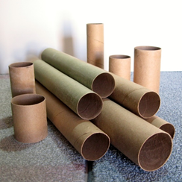
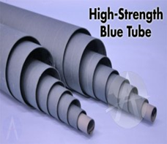
1.1 Body Material
1.1.1 Thin Cardboard
Light, cheap and easy to handle, weak
1.1.2 Thick Cardboard
Cheap, stronger than thin cardboard
1.1.3 Blue Tube
Strongest, and light, but expensive and heavy
1.1.4 Fiberglass
Strong, light, but expensive
Beattie

Slide 15
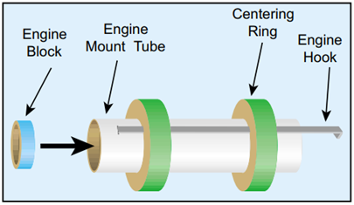
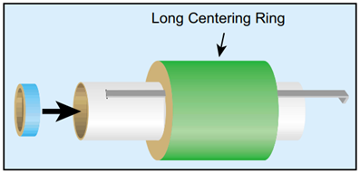
1.2 Engine Mount
1.2.1 Two Centering Rings
Light and most popular
1.2.2 One Long Centering Ring
Simple, but heavy
1.2.3 Two Disc-Type Centering Rings
Lightest, but less reliable
Beattie

Slide 16
Nose Cone
Beattie

Slide 17
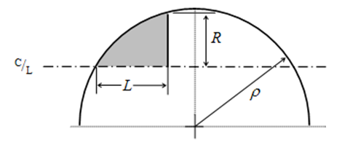
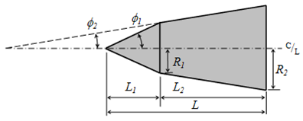
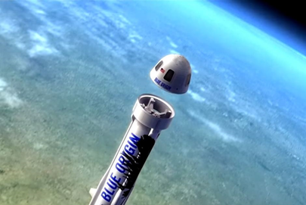
2.1 Shape
2.1.1 Conical - Simple
2.1.2 Spherically Blunted Cone - Aerodynamic
2.1.3 Bi-Cone - Simple
2.1.4 Hemispherical - Storage
2.1.5 Parabolic - Aerodynamic
2.1.6 Ogive - Storage
Beattie

Slide 18
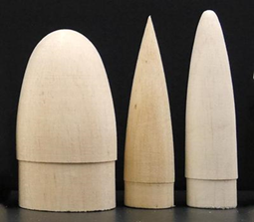
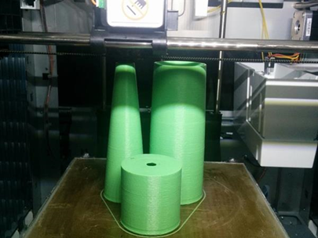
2.2 Materials
2.2.1 Balsa Wood
Very light, cheap, but not hollow
2.2.2 Plastic
Strong, many forms
2.2.3 3D Printed
Strong, made to our specification
Beattie

Slide 19
Fins
Beattie

Slide 20
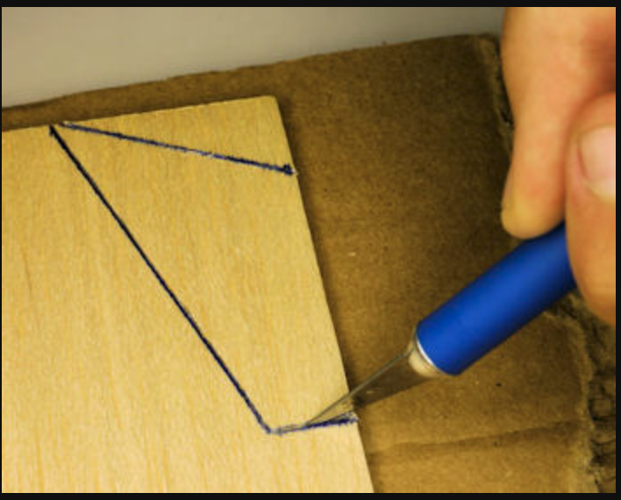
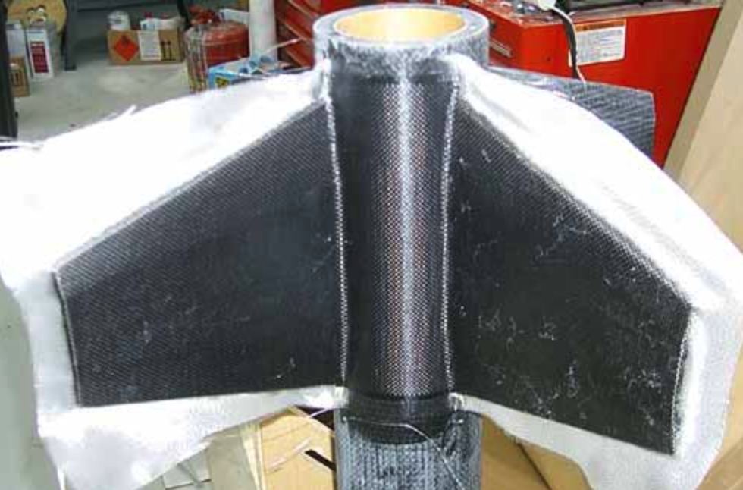
3.1 Fin Material
3.1.1 Balsa Wood
Cheap, Lightweight, Workable yet not particularly strong
3.1.2 Plastic
Cheap, Lightweight, Formable to a mold, fairly good strength
3.1.3 Fiberglass
Fairly expensive, yet very lightweight and very strong, able to be formed into a mold
Beattie

Slide 21
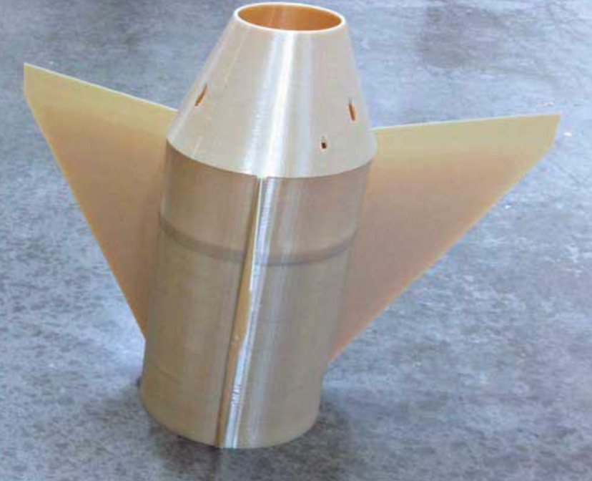
3.1 Fin Material
3.1.4 Basswood
Similar to Balsa wood yet less compressible and stronger
3.1.5 Plywood
Cheap, Lightweight, less workable and rougher than Balsa wood or Basswood
3.1.6 3D Printed Material
Most versatile material in terms of shape, stronger and stiffer than wood
Beattie
Notes:
https://www.makeitfrom.com/compare/Acrylonitrile-Butadiene-Styrene-ABS/Balsa

Slide 22
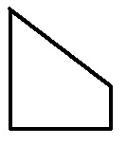
3.2 Fin Geometry
3.3.1 Elliptical
Most aerodynamically efficient
3.3.2 Trapezoidal
Similar to elliptical but with corners
3.3.3 Square
Easiest to manufacture yet least aerodynamically efficient
3.3.4 Clipped Delta
In between being easy to manufacture and aerodynamically efficient
Beattie
Notes:
pictures

Slide 23
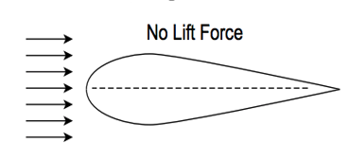
3.3 Airfoil Shape
3.5.1 Teardrop
Most efficient airfoil in terms of aerodynamics
3.5.2 Squared
Most basic airfoil, easiest to manufacture
3.5.3 Tapered
Less drag at the tip due to thinning
Beattie
Notes:
pictures

Slide 24
Electronics
Beattie

Slide 25
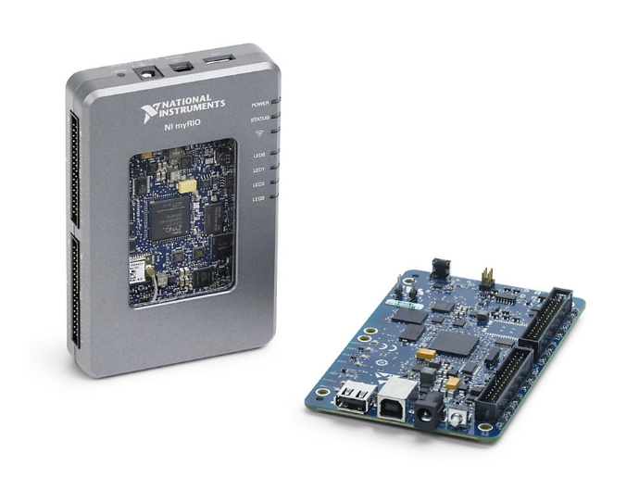
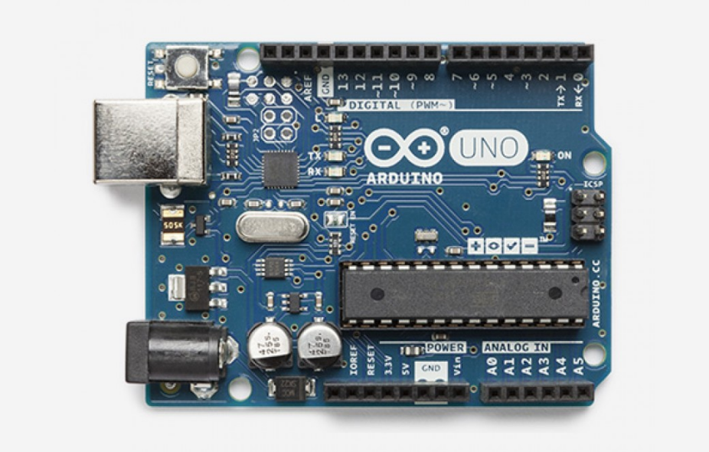
4.1 Boards
4.1.1 myRio
Heaviest board, but widely used and compatible
4.1.2 BeagleBone Blue
Not widely compatible but good processing power
4.1.3 Arduino Uno RV3
Cheap, reliable and adaptable
Beattie

Slide 26
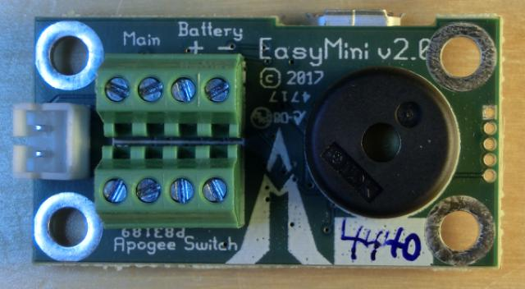
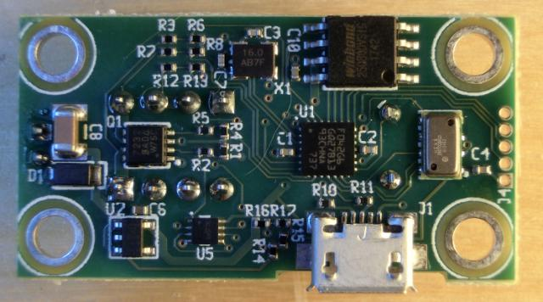
4.2 Altimeter
4.2.1 EasyMini
EasyMini Dual Deployment Altimeter
Beattie

Slide 27
Recovery System
Beattie

Slide 28
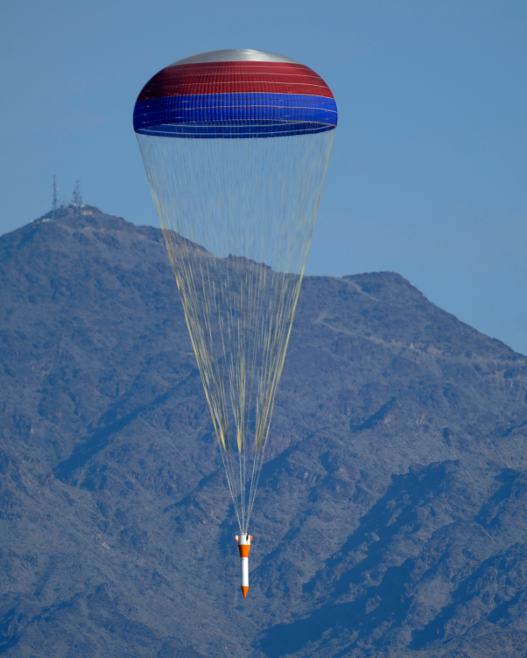
5.1 - Rocket Recovery
5.1.1 – Drogue Chute
Deployed at apogee to decrease velocity of the falling rocket before main parachute deployment
5.1.2 – Main Parachute
Deployed at around 600 feet to reach a lower final velocity
Beattie

Slide 29
Motor
Beattie

Slide 30
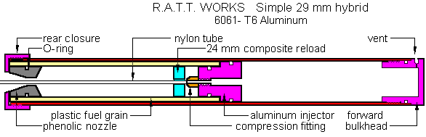
6.1 G Class
6.1.1 G-100
6.1.2 G-130
6.1.3 G-300
6.1.4 G-123
6.1.5 G-234
Beattie

Slide 31
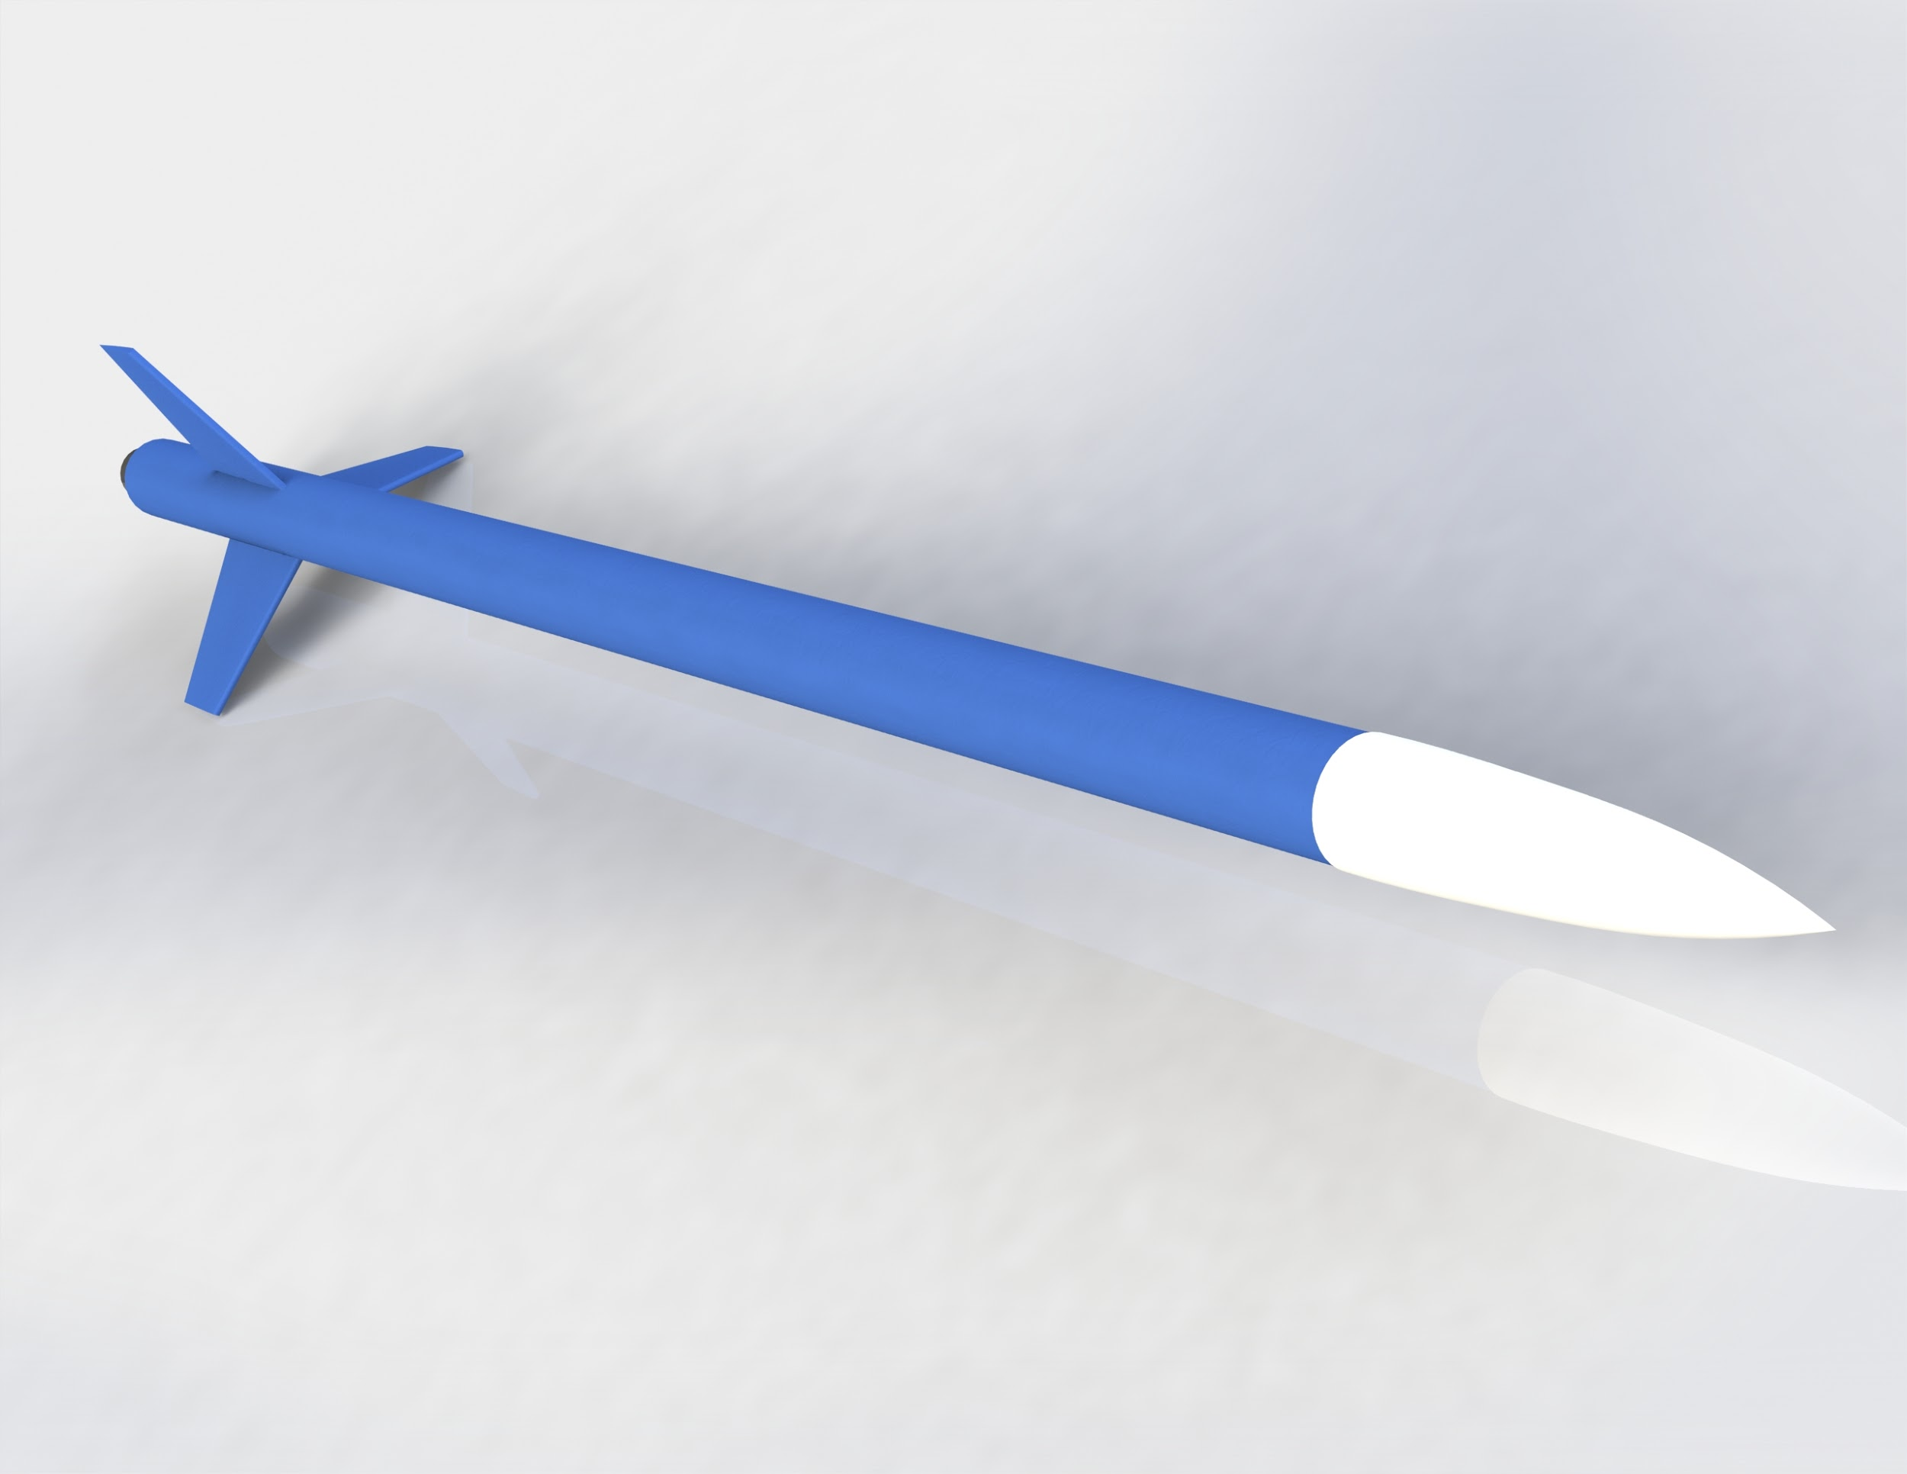
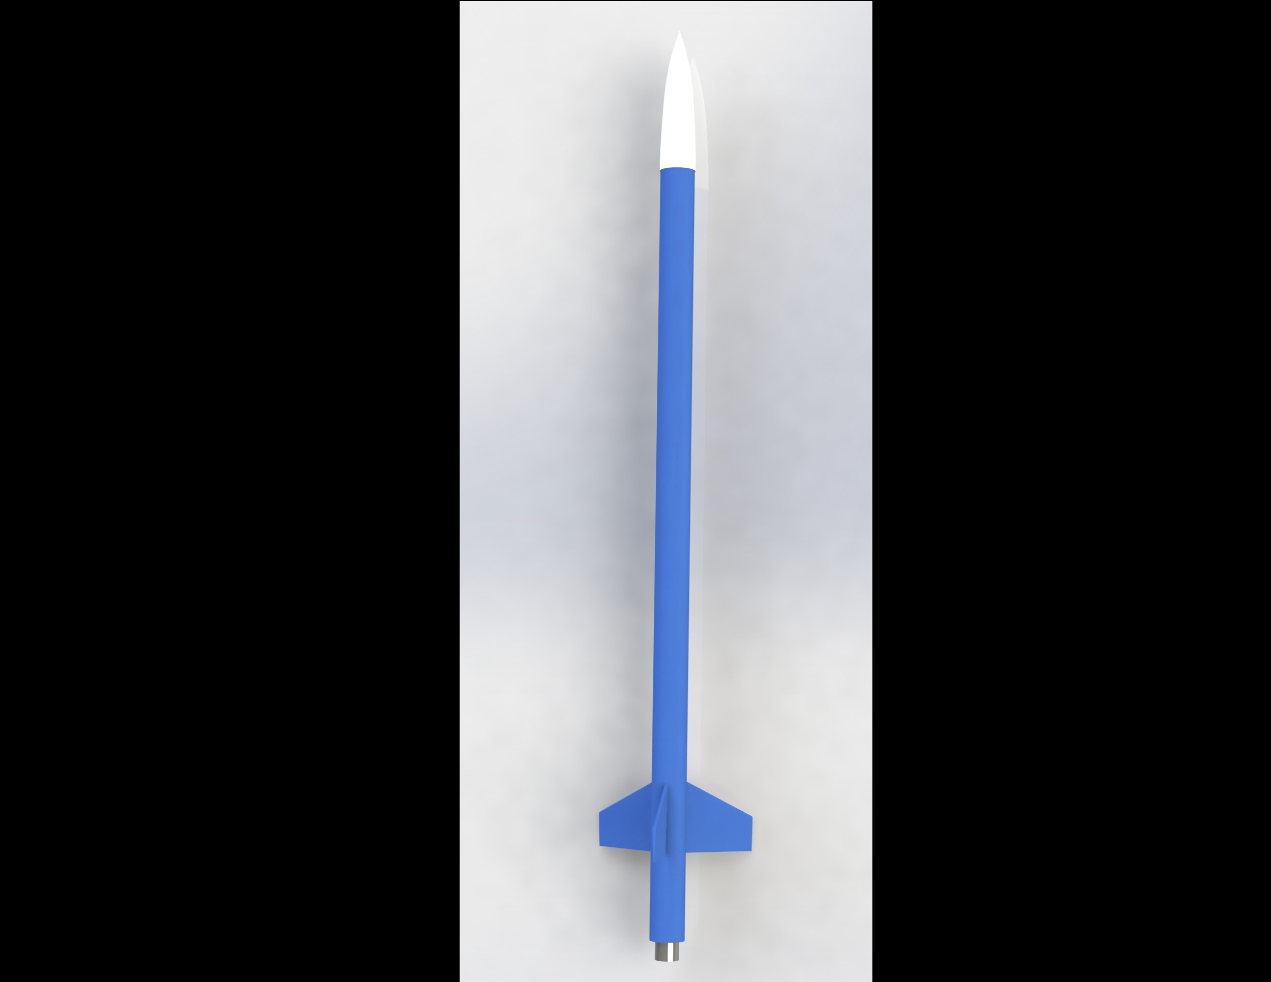
CAD Design
Beattie

Slide 32
Issues and Solutions
Cedryc Midy
Midy

Slide 33
Electronics
Microcontroller is needed to access and save data such as altitude
Initially, Arduino Uno was chosen as it would perform as required
  After closer examination, width of the board enclosed in a circular tube would not fit
Arduino Nano
  Same capabilities as the Uno yet significantly smaller
EasyMini Altimeter With Dual Deployment System
  Same small form factor as the Arduino Nano
  Capable of recording data and has ease of access through micro USB
  Dual Deployment system replaces all additional electronics
Midy
Notes:
The initial Arduino Uno was too big for premade bodies given the material we decided to use so we decided to use a smaller arduino board, the Arduino Nano, that has enough pins to connect to the different electronic accessories needed. We also had to choose a different sd card reader board accessory to accommodate the amount of pins on the new board.

Slide 34
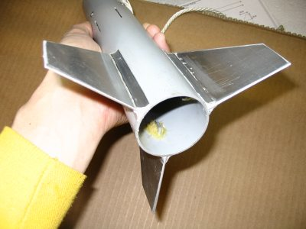
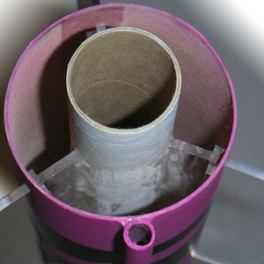
Fin Attachment
Initial plan was to attach fins to outside of airframe
Motor classes above D usually require “through the wall” mounting
  Fins subject to larger forces during flight and landing
Fins were redesigned to mount to both the engine mount tube and airframe
Fins were also thinned to reduce weight
Midy

Slide 35
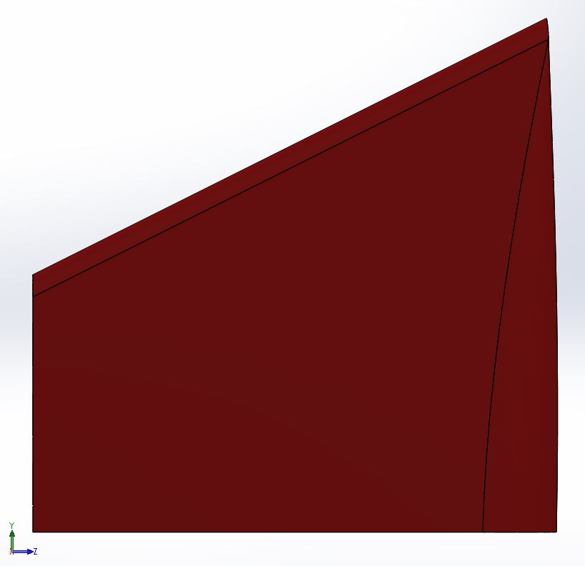
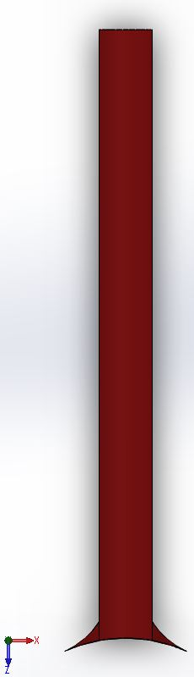
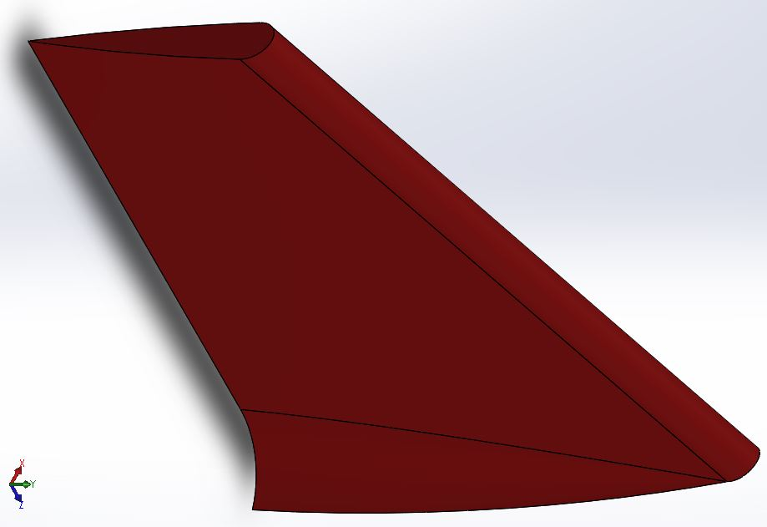
Initial Fin Design
Side
Front
Isometric
35
Midy

Slide 36
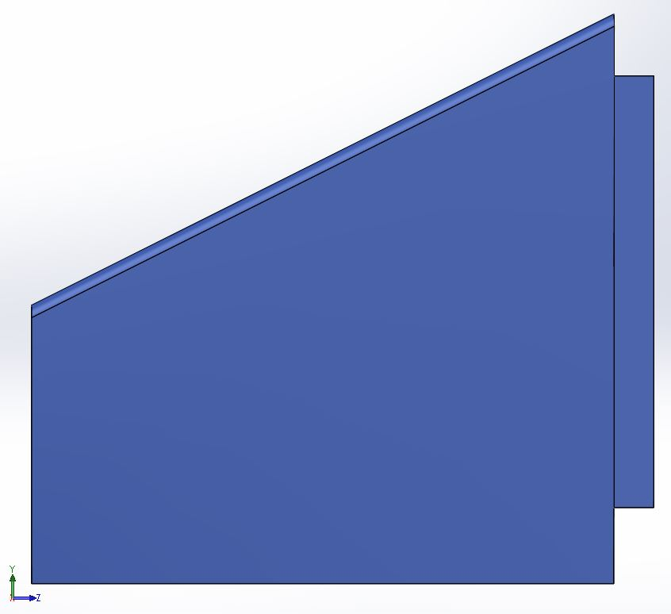
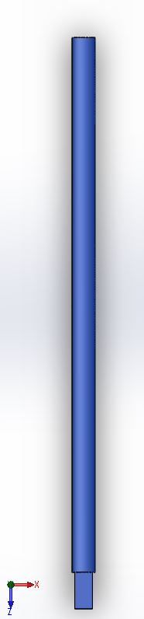
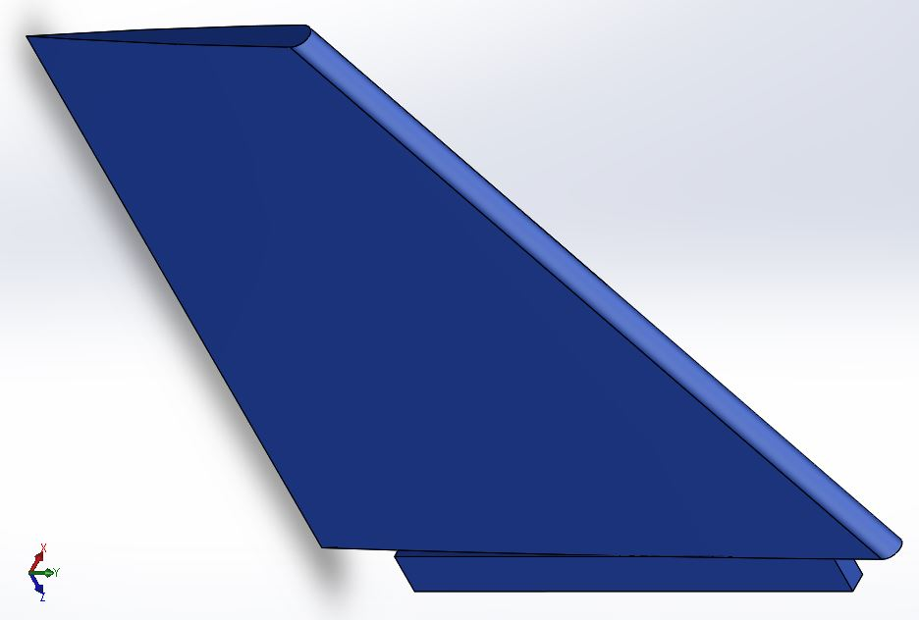
Final Fin Design
Side
Front
Isometric
36
Midy

Slide 37
Parachute Sizing
Single parachute not feasible for recovery
  Deploying at apogee would result in extremely long travel time
  Retrieval of rocket would be troublesome without honing system
Implementation of drogue parachute at apogee
  Smaller area allows the rocket to descend at a lower velocity
  Deployment of the main chute can then occur at a lower altitude
  Radius of retrieval is significantly reduced
Two stage parachute required additional components
  Coupler was added to house payload
  Allowed the body to separate into two separate housings
Midy
Notes:
Parachutes are largely based on mass and fall rate/ velocity since fall rate and velocity are inconsequential i.e. our body material is sturdy enough to handle an impact within the velocity range and time is not a factor in the competition the only thing we have to choose for a parachute is mass. The mass of our rocket can vary in prototyping because of stability purposes so we have to choose a bigger parachute with a wider range of mass.

Slide 38
Initial Simulation
Simulation software: Rocksim – Apogee of 1776 ft reached
Parameters
  Launch Conditions:
  Sea level liftoff (0 ft.)
  1 atm of pressure
  50% humidity
  75° F
  Calm wind
Midy

Slide 39
Revised Simulation
Simulation software: Open Rocket – Apogee of 1896 ft reached
Parameters
  Launch Conditions:
  Sea level liftoff (0 ft.)
  1 atm of pressure
  50% humidity
  75° F
  Calm wind
Revisions:
  Mass removed by reducing body length of rocket (48 in to 25 in)
  All components were added to final model
Midy

Slide 40
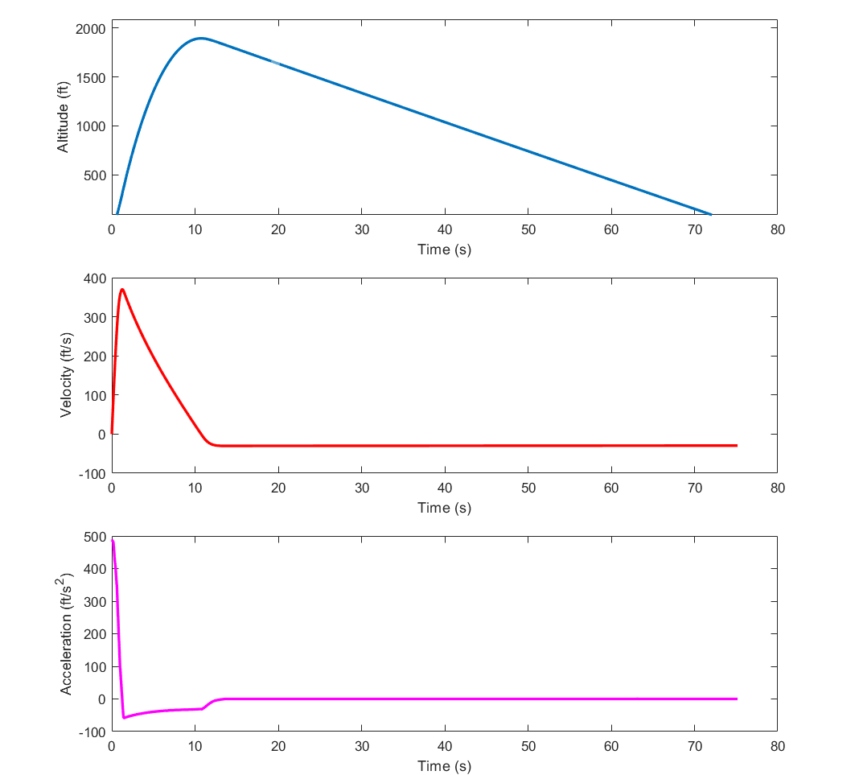
Revised Simulation
Midy

Slide 41
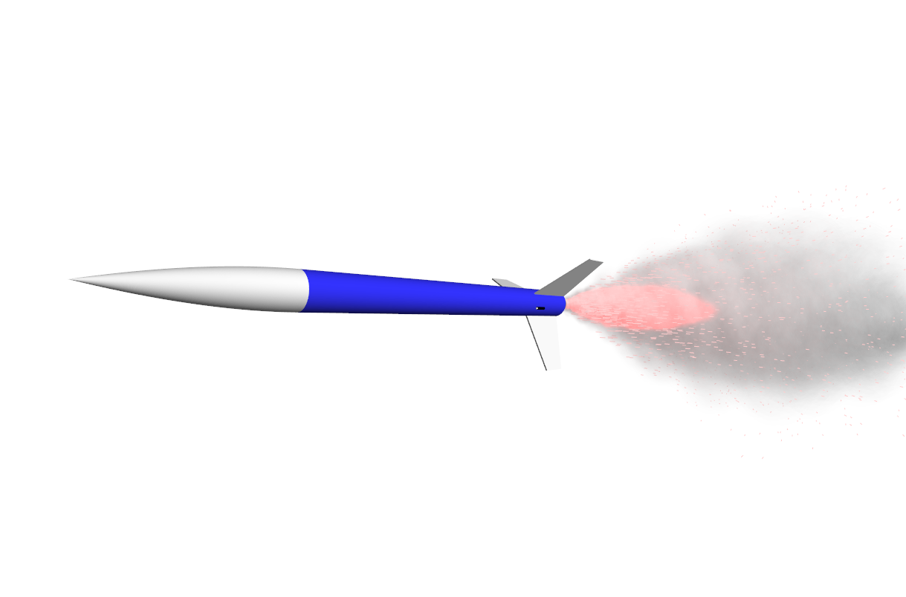
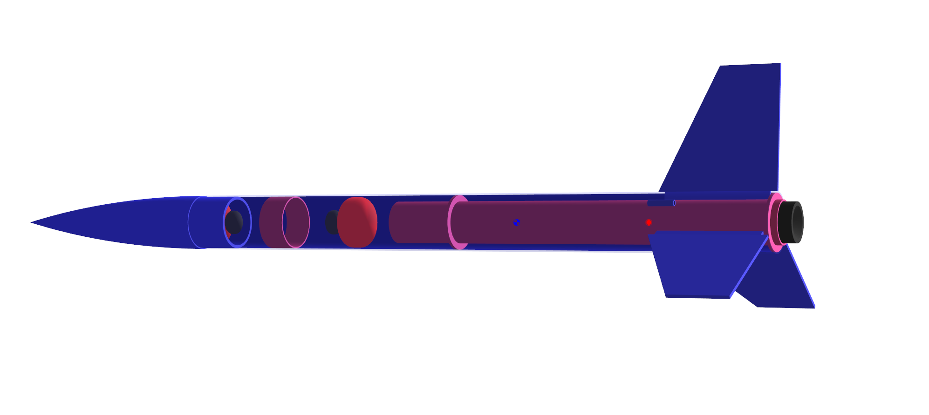
Revised CAD Design
Midy

Slide 42
Final Product
James Beattie
Beattie

Slide 43
Final Design
Rocket Body Components and Uses
Body
Blue Tube
Dual Deployment Altimeter
Main Parachute
Nose Cone
Aerodynamic Ogive Shape
Houses Drogue Parachute
Propulsion System
G-100 Hybrid Motor
Fins
Airfoil 3D-Printed Fins
  “Finished” ABS
Nozzle
Choked Nozzle
Beattie

Slide 44
Final Design
Testing
  Parachute deployment
    Multiple tests of the parachute deployment system
  Test launch
    Tested at the Miccosukee Canopy Road Greenway
    Reached a final altitude of 1898 ft
Beattie
Notes:
Parachutes are largely based on mass and fall rate/ velocity since fall rate and velocity are inconsequential i.e. our body material is sturdy enough to handle an impact within the velocity range and time is not a factor in the competition the only thing we have to choose for a parachute is mass. The mass of our rocket can vary in prototyping because of stability purposes so we have to choose a bigger parachute with a wider range of mass.

Slide 45
Conclusion
Cedryc Midy
Midy

Slide 46
Conclusion
Continuing with future FAMU-FSU senior design teams
Include FAMU-FSU AIAA club in the competition
  Invite club to NASA FSGC Hybrid Motor Competition
  Provide AIAA with collected deliverables and documentation for future competitions
Midy
Notes:
Parachutes are largely based on mass and fall rate/ velocity since fall rate and velocity are inconsequential i.e. our body material is sturdy enough to handle an impact within the velocity range and time is not a factor in the competition the only thing we have to choose for a parachute is mass. The mass of our rocket can vary in prototyping because of stability purposes so we have to choose a bigger parachute with a wider range of mass.

Slide 47
Acknowledgments
Thank you to Dr. Shoele and Dr. Shih for their guidance throughout the design process
Thank you to the NASA Florida Space Grant Consortium for their sponsorship of this project
Midy

