Slide 1
The Examination of Occupant and Vehicle Responses to Low Speed Rear-End Crashes Team 504
Presenters: Michael Small & Robert “Todd” Montuoro

Slide 2
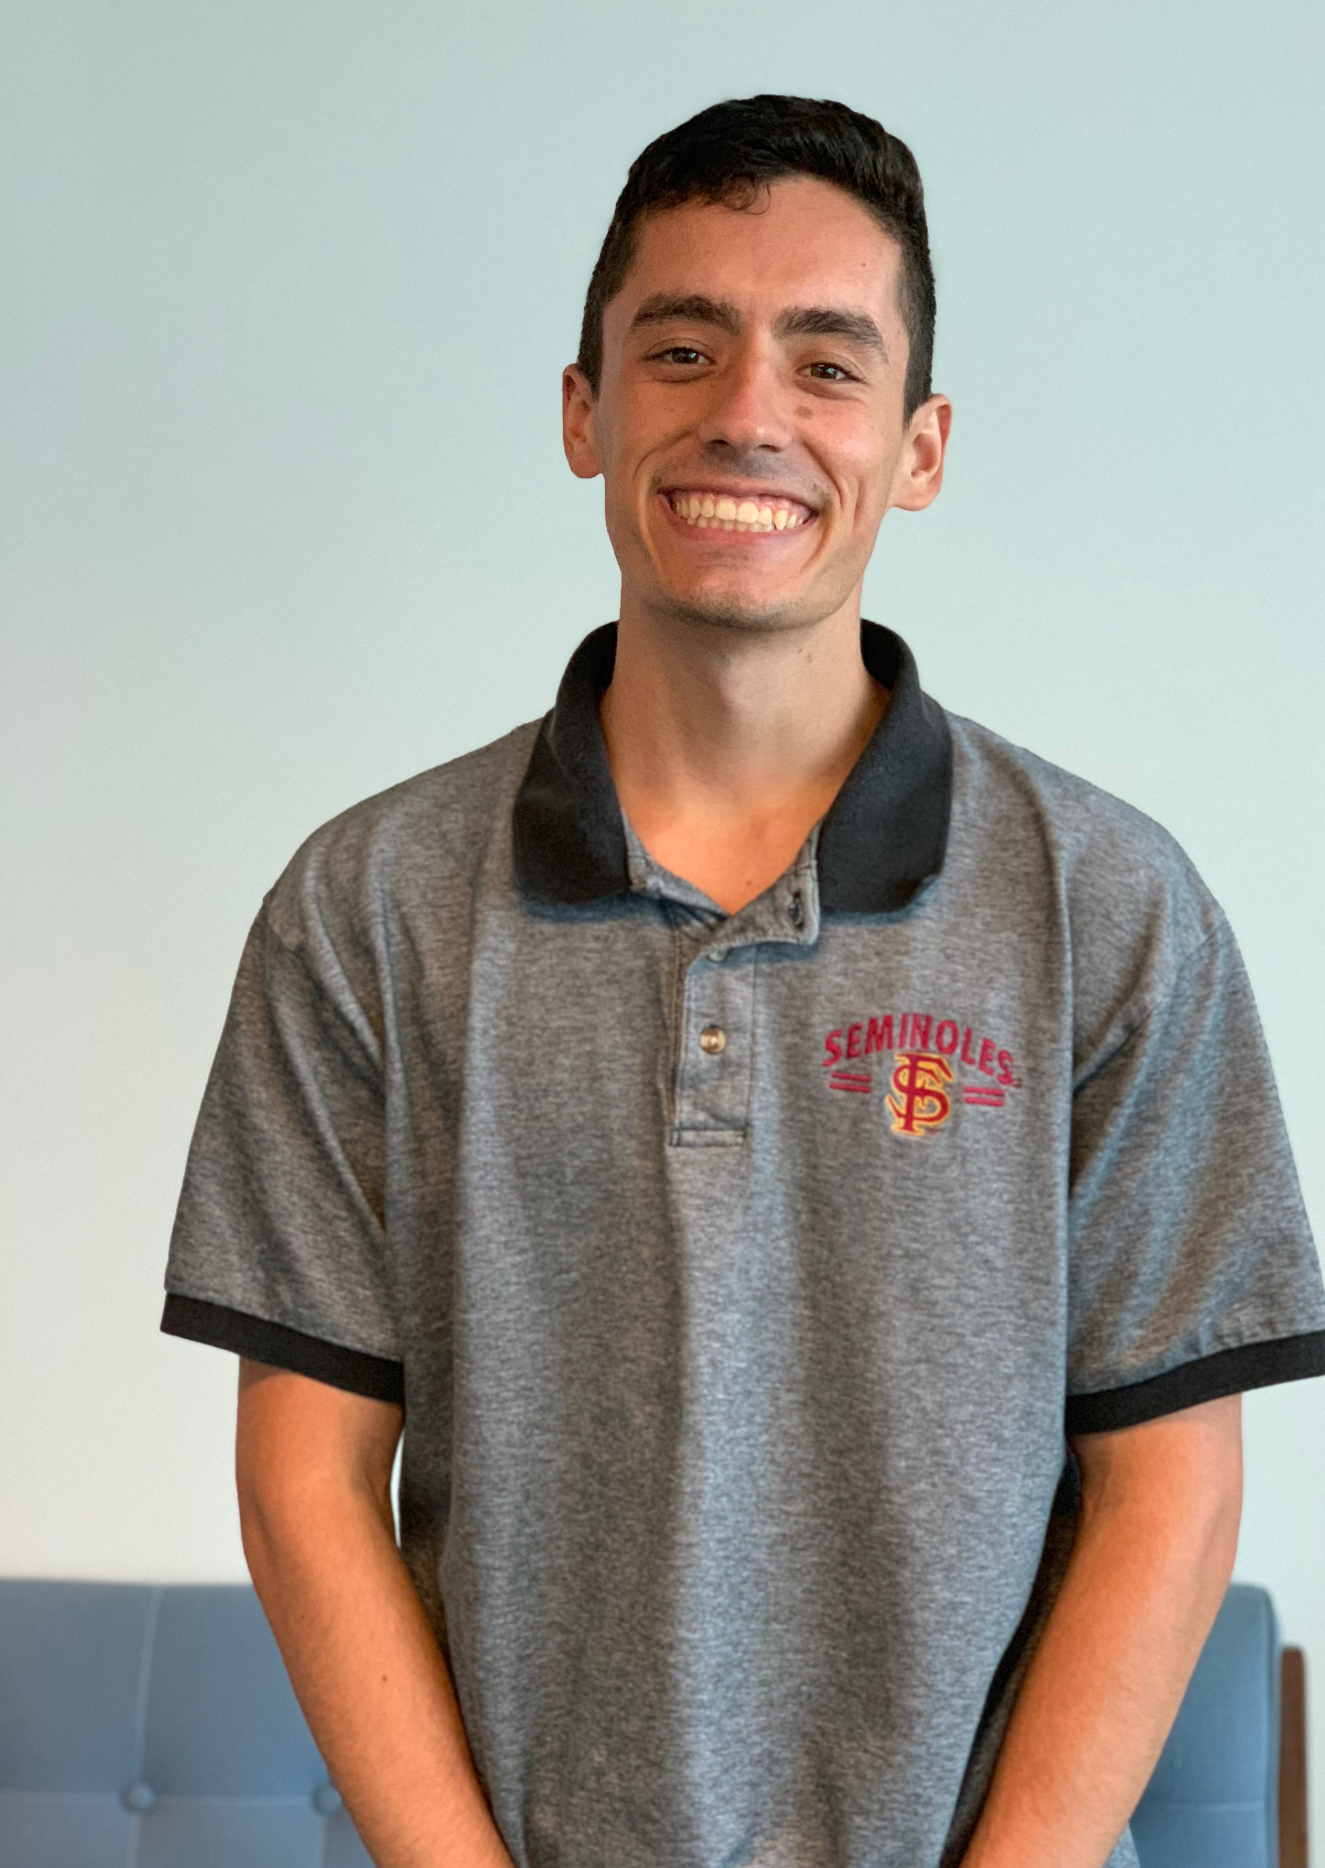
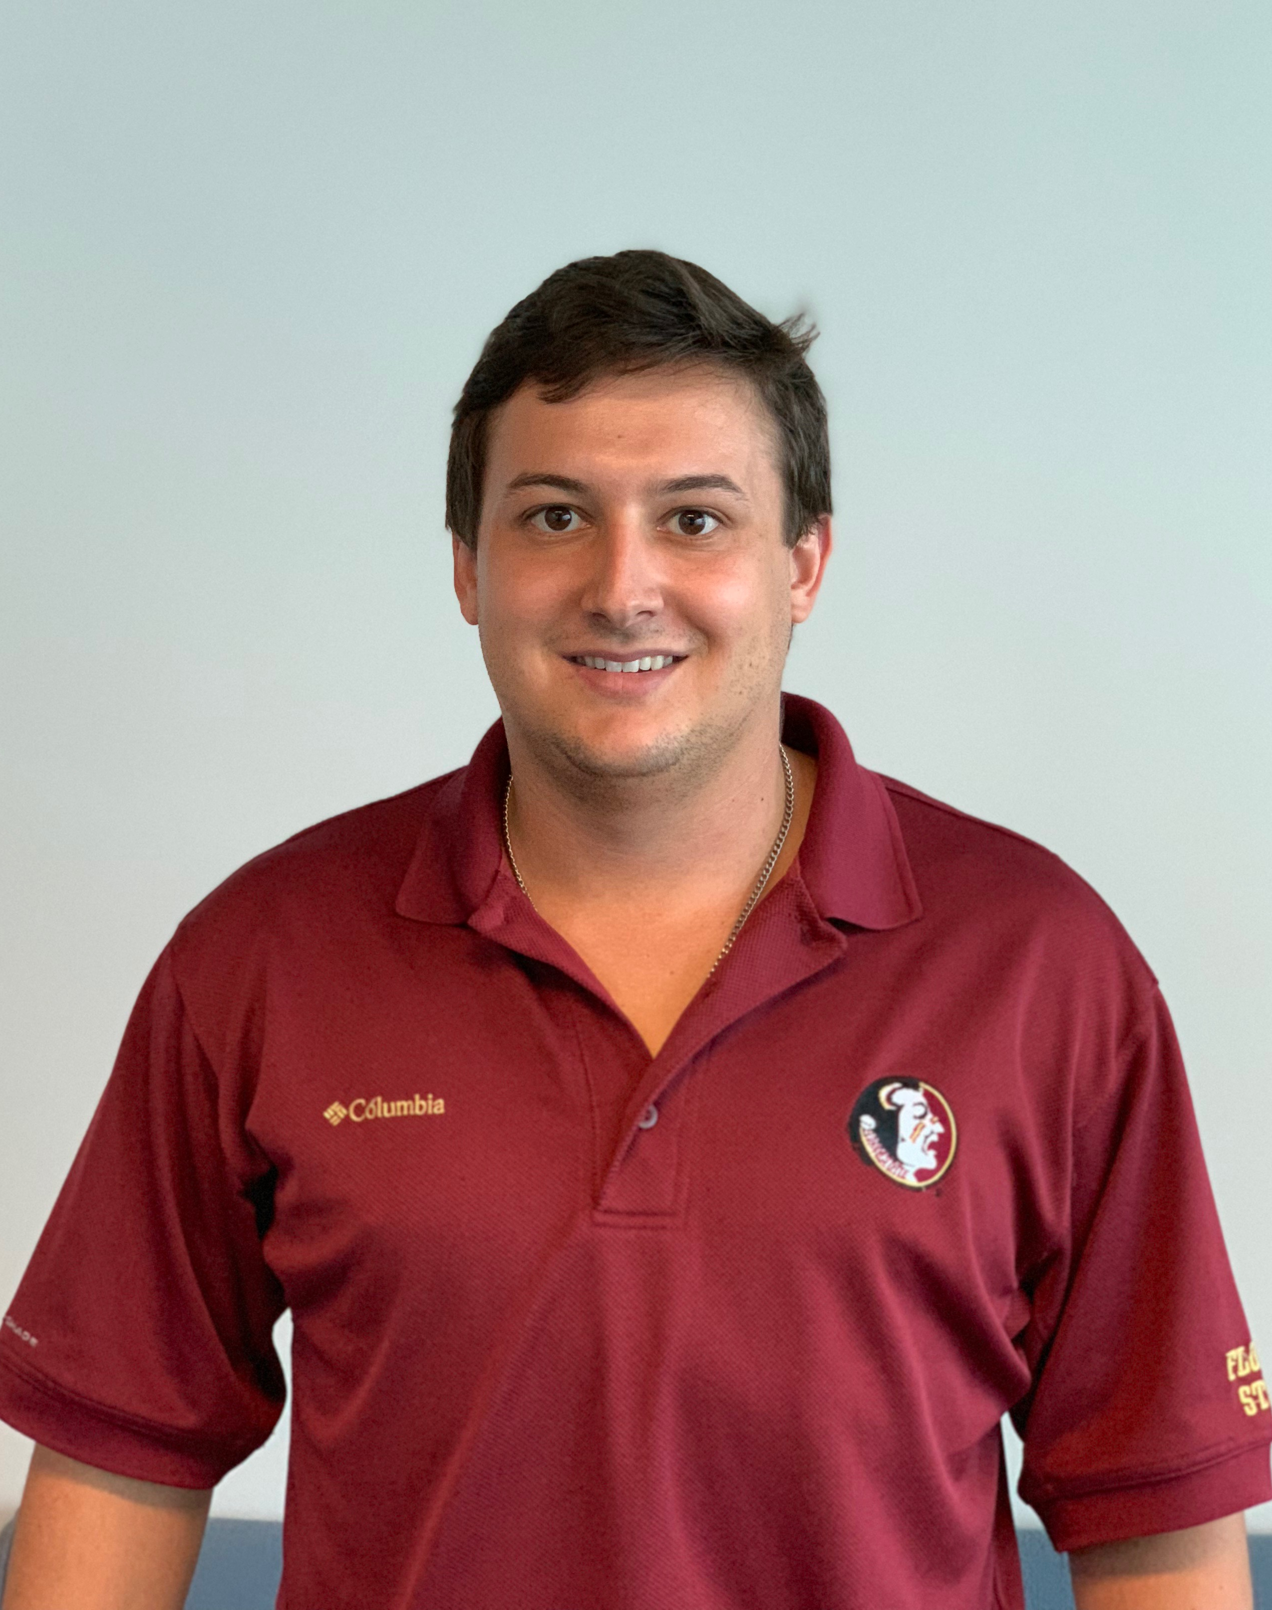
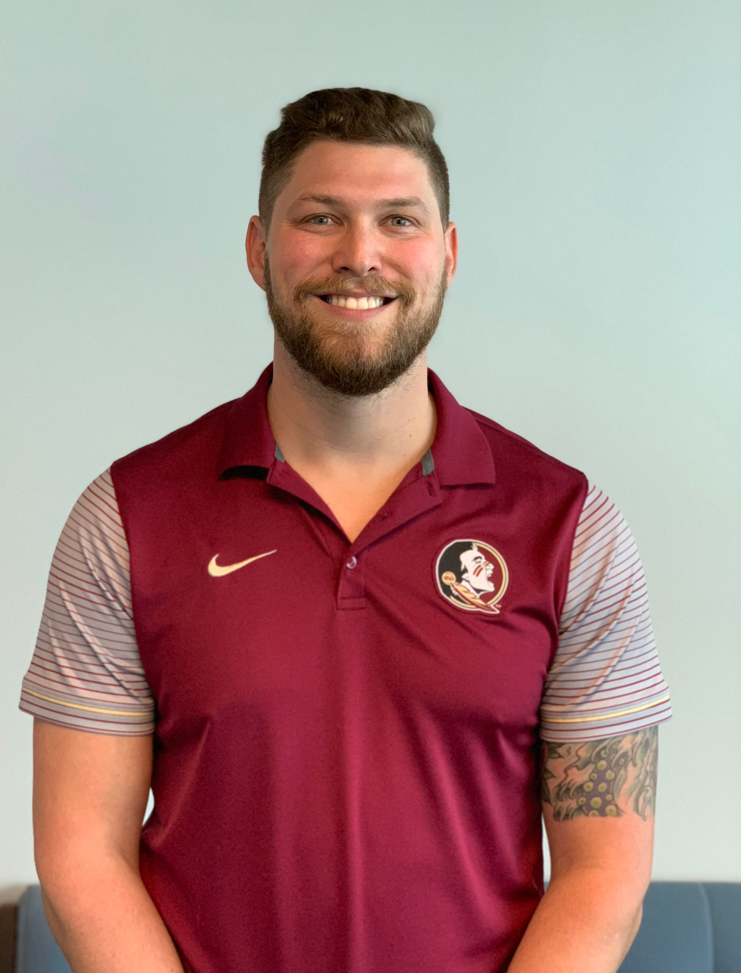
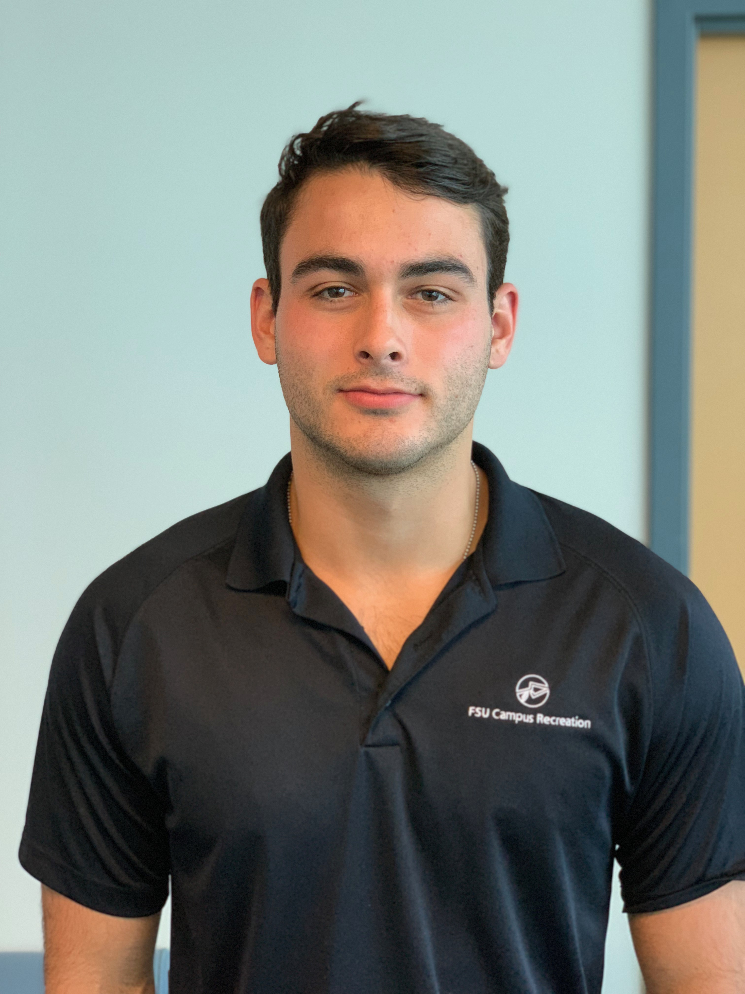
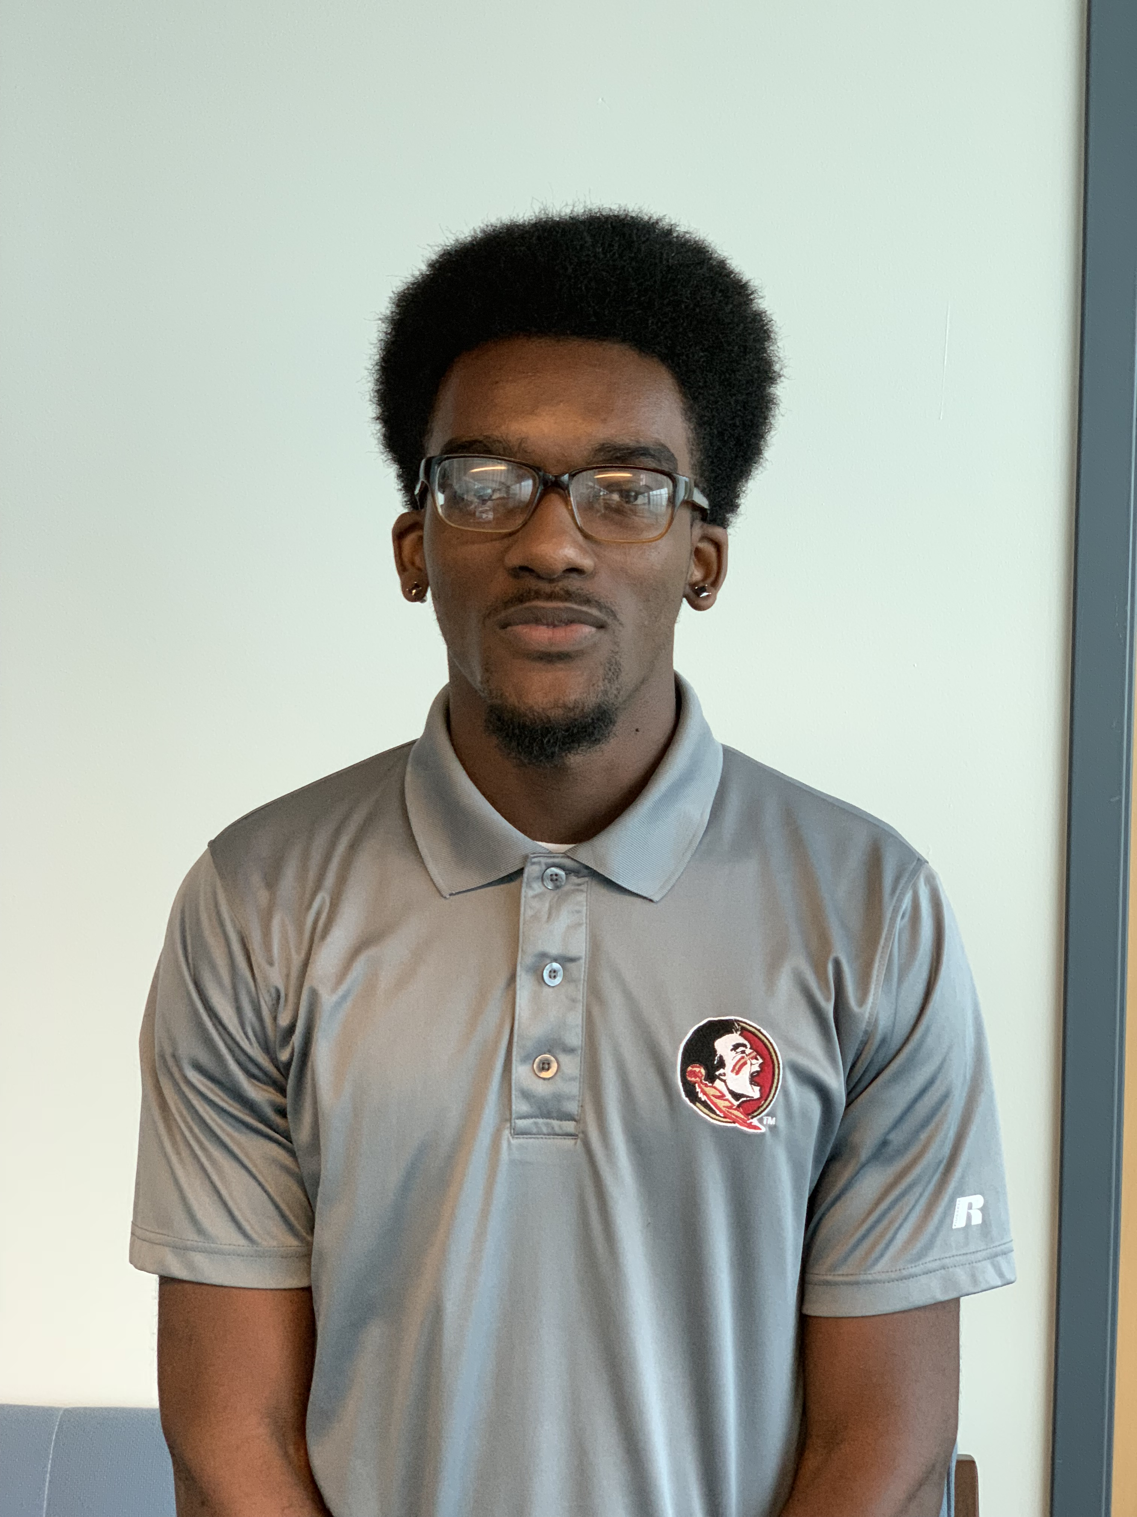
Team Introductions
Vincent Grimes
Project Manager
Michael Small
Timeline Lead
Robert Montuoro
Design Engineer
Joseph Godio
Model Manager
William Abraira
Financial Overseer
Michael Small

Slide 3
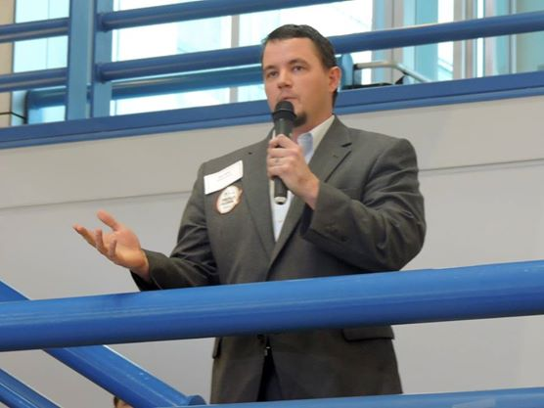
Sponsor
Cummings Scientific, LLC.
Forensic Engineering Consulting Firm
Specializing in accident reconstruction analysis, biomechanics, and biomedical engineering
Nation-wide leader in expert witness consulting
Branches located in Tallahassee, Florida and Atlanta, Georgia
Representative: Beau Biller
Forensic Scientist/Engineering Manager
Michael Small

Slide 4
Objectives
Create a general empirical model for low speed collisions
Determine a relationship between occupant and vehicle responses
Further the current knowledge on low speed collisions
Michael Small

Slide 5
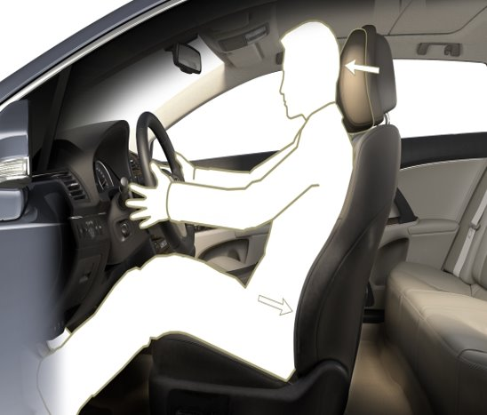
Project Description
Cummings asked to develop a method to analyze low speed* collisions
Wants to implement last year's deliverable
*low speed: a change in velocity (∆v) of less than or equal to 7
Michael Small

Slide 6
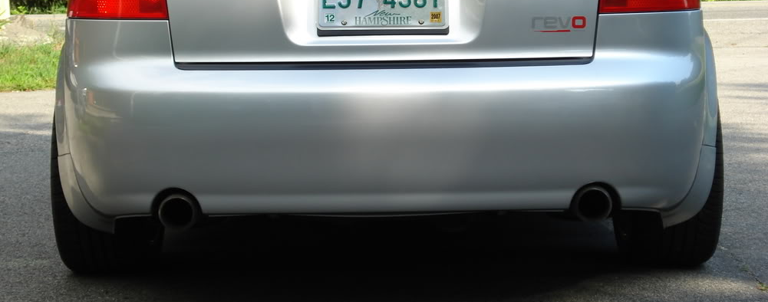
Project Description (cont.)
Data will be from a result of live crash tests
Bumper mount will be used to set parameters for collisions
Can improve mount if needed
Analysis of data will be performed using modeling software
Michael Small

Slide 7
Project Scope
Primary Market
Cummings Scientific, LLC.
Secondary Market
Forensic engineering firms
Accident reconstruction
Insurance agencies
Automotive industry
Codes and passenger safety
Michael Small

Slide 8
Project Background
Robert Montuoro
Robert Montuoro

Slide 9
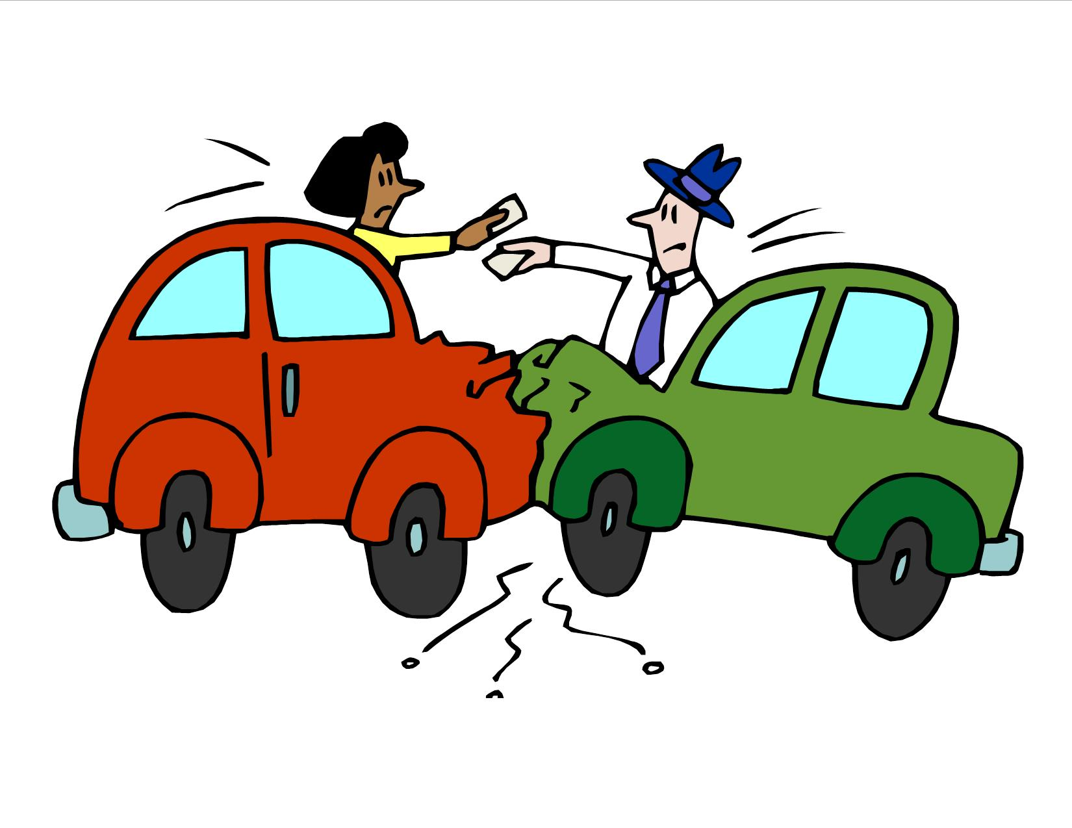
Background
Low speed collisions account for more long-term injury than any other crash mode
Annual cost of whiplash type injuries is north of a billion dollars
Determining the speed of the cars in these cases is necessary to determine claims
Our research will help establish a basis for low-speed related cases
Robert Montuoro

Slide 10
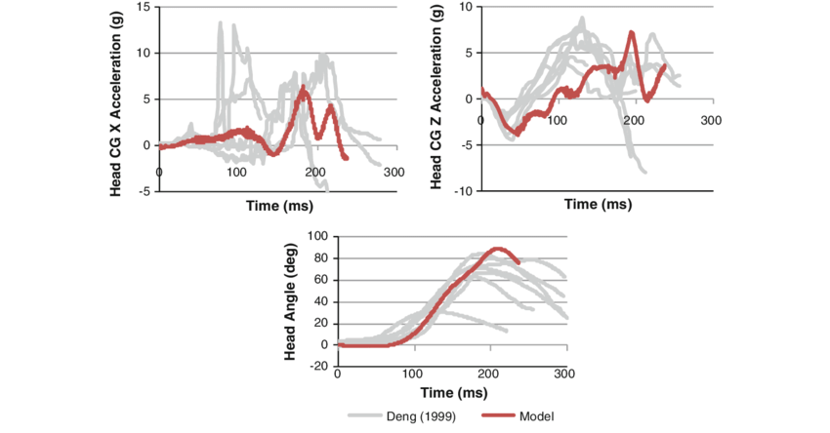
Customer Needs
Can attach the test rig easily
Able to calculate force generated on the occupant based on speed of impact
Easy to use test sensors
Robert Montuoro

Slide 11
Customer Needs
Easily Repeatable test
Durable and robust testing rig
Combine results to create a simulation of crashes
Compare current methods with our test results
Robert Montuoro

Slide 12
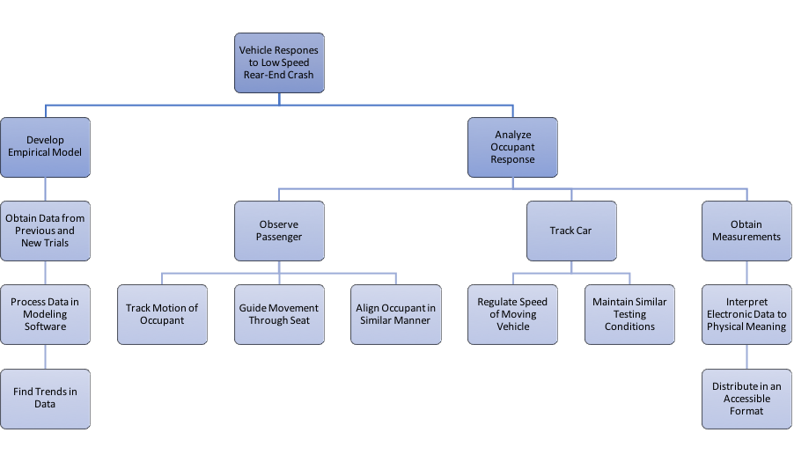
Functional Decomposition
Robert Montuoro

Slide 13
Four Most Important Points from this Lecture
We were tasked by Cummins Scientific, LLC to develop a test to find a general empirical model for car and crashes at low speeds.
Possible additional tasks include examining the occupant during said collisions and improving upon last year's interchangeable bumper mount.
Combine results to create a main function to calculate the forces on the vehicle (and occupant) based only on the initial speed of impact.
Our data will be compared with known data to find common trends and confirm or oppose their conclusions.
Robert Montuoro

Slide 14
References
http://cummingssci.com/associates-bb.php
https://www.sciencedirect.com/science/article/pii/S0001457515000354
https://www.iihs.org/iihs/sr/statusreport/article/39/9/1
https://www.researchgate.net/figure/Global-kinematic-response-of-the-model-during-a-7g-rear-impact-Muscle-activation-not_fig5_51089862
Robert Montuoro
Notes:
Not this slide will advance on default after 2 seconds. If you would like to change this then go to the transition tab and under timing change the advance slide settings.

Slide 15
Questions

