Slide 1
The Examination of Occupant and Vehicle Responses to Low Speed Rear-End Crashes Team 504
Presenters: Joseph Godio, Vincent Grimes, & William Abraira

Slide 2
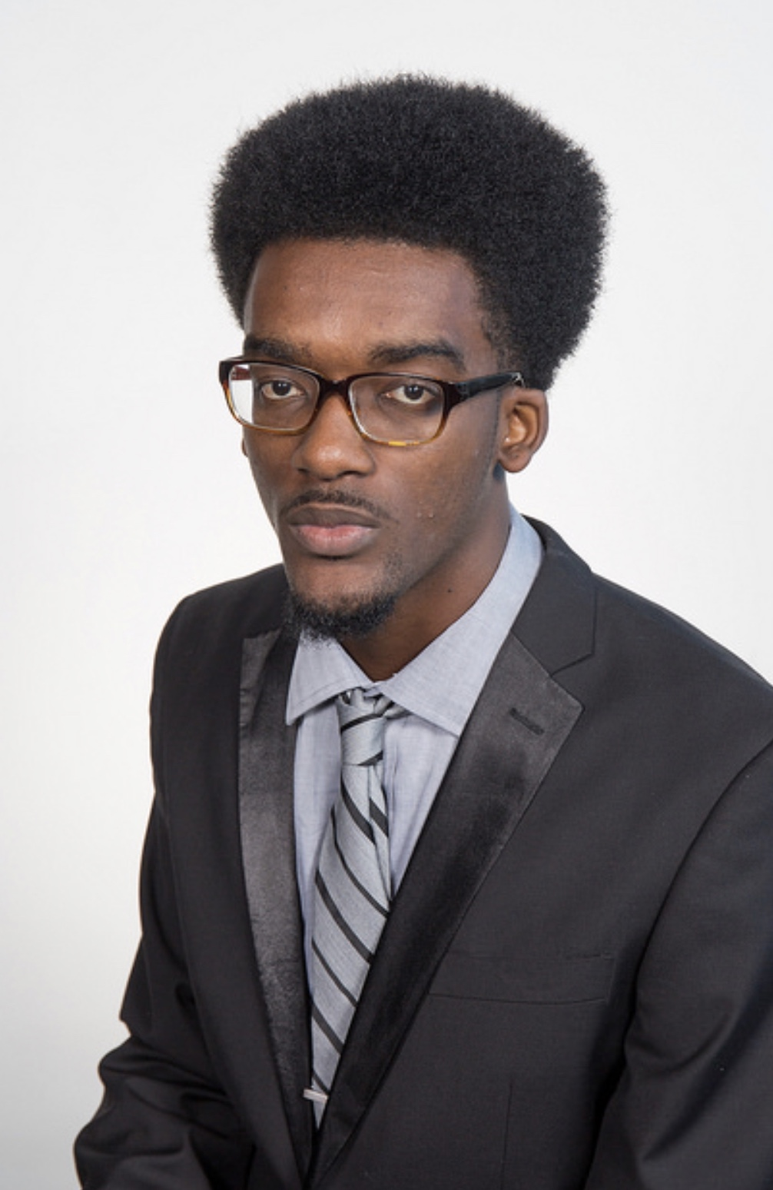
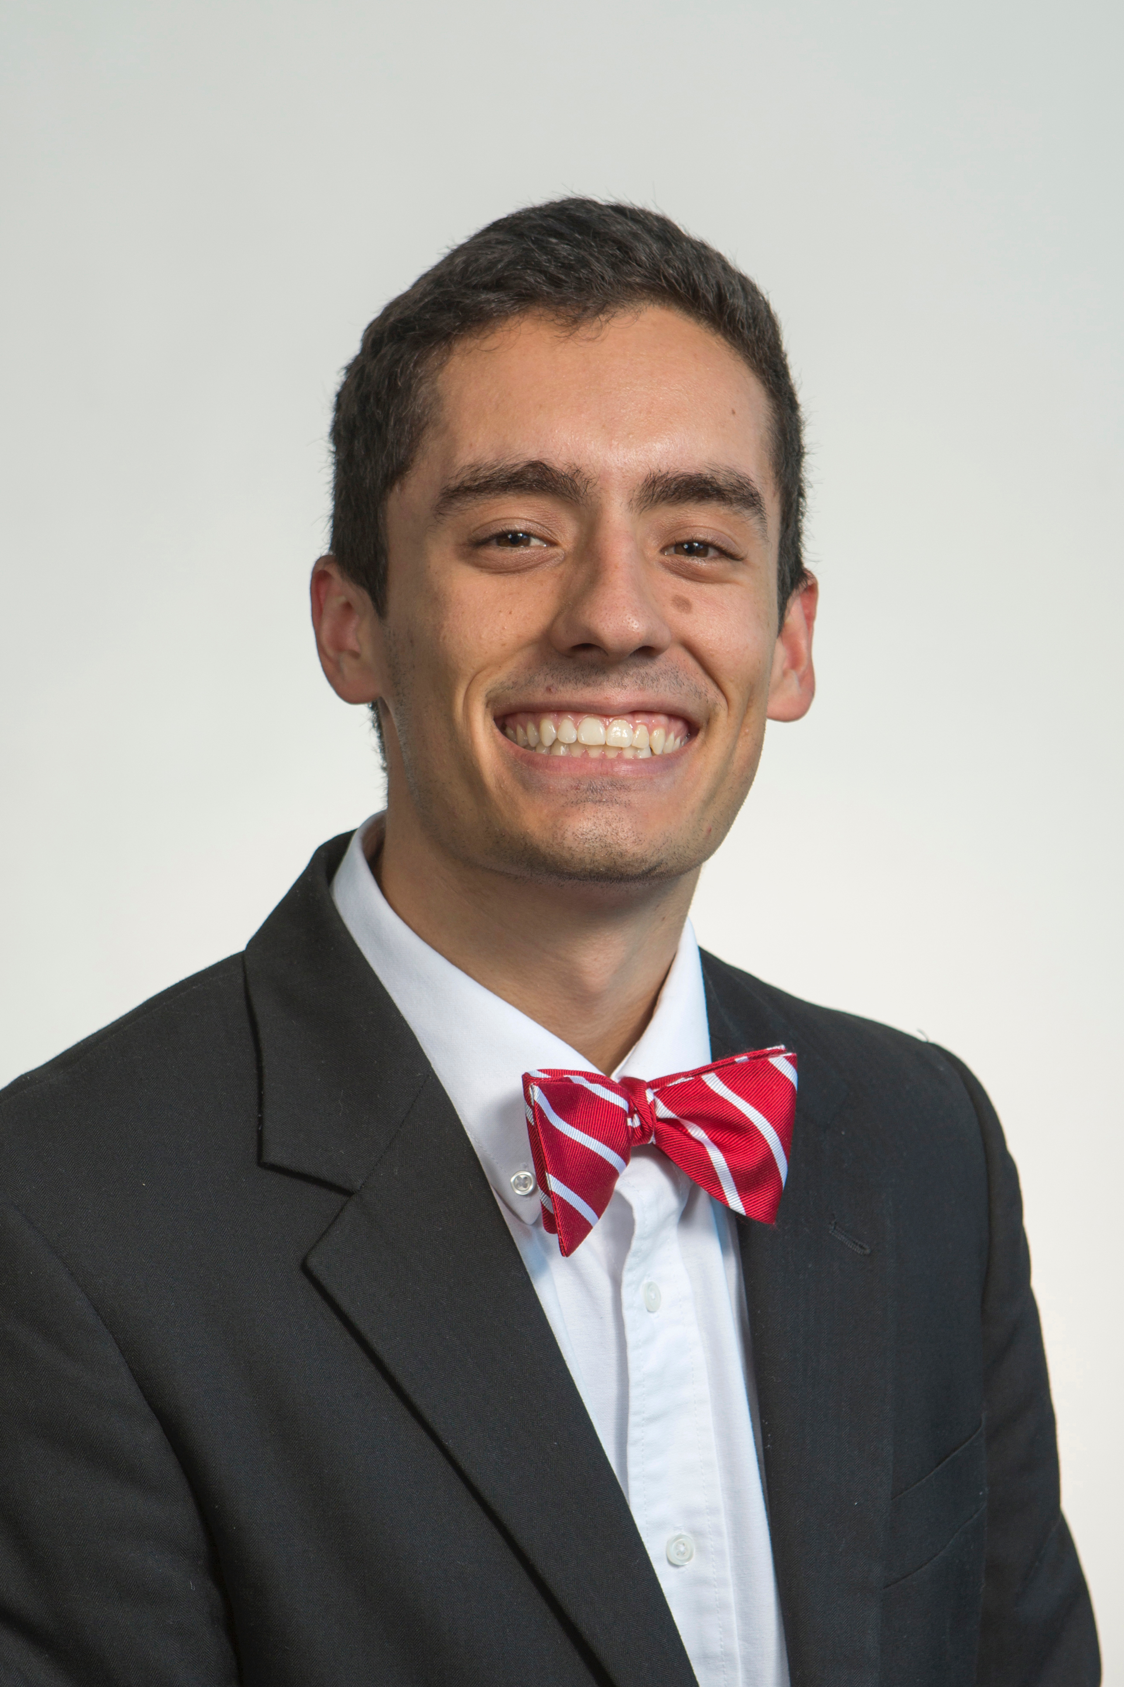
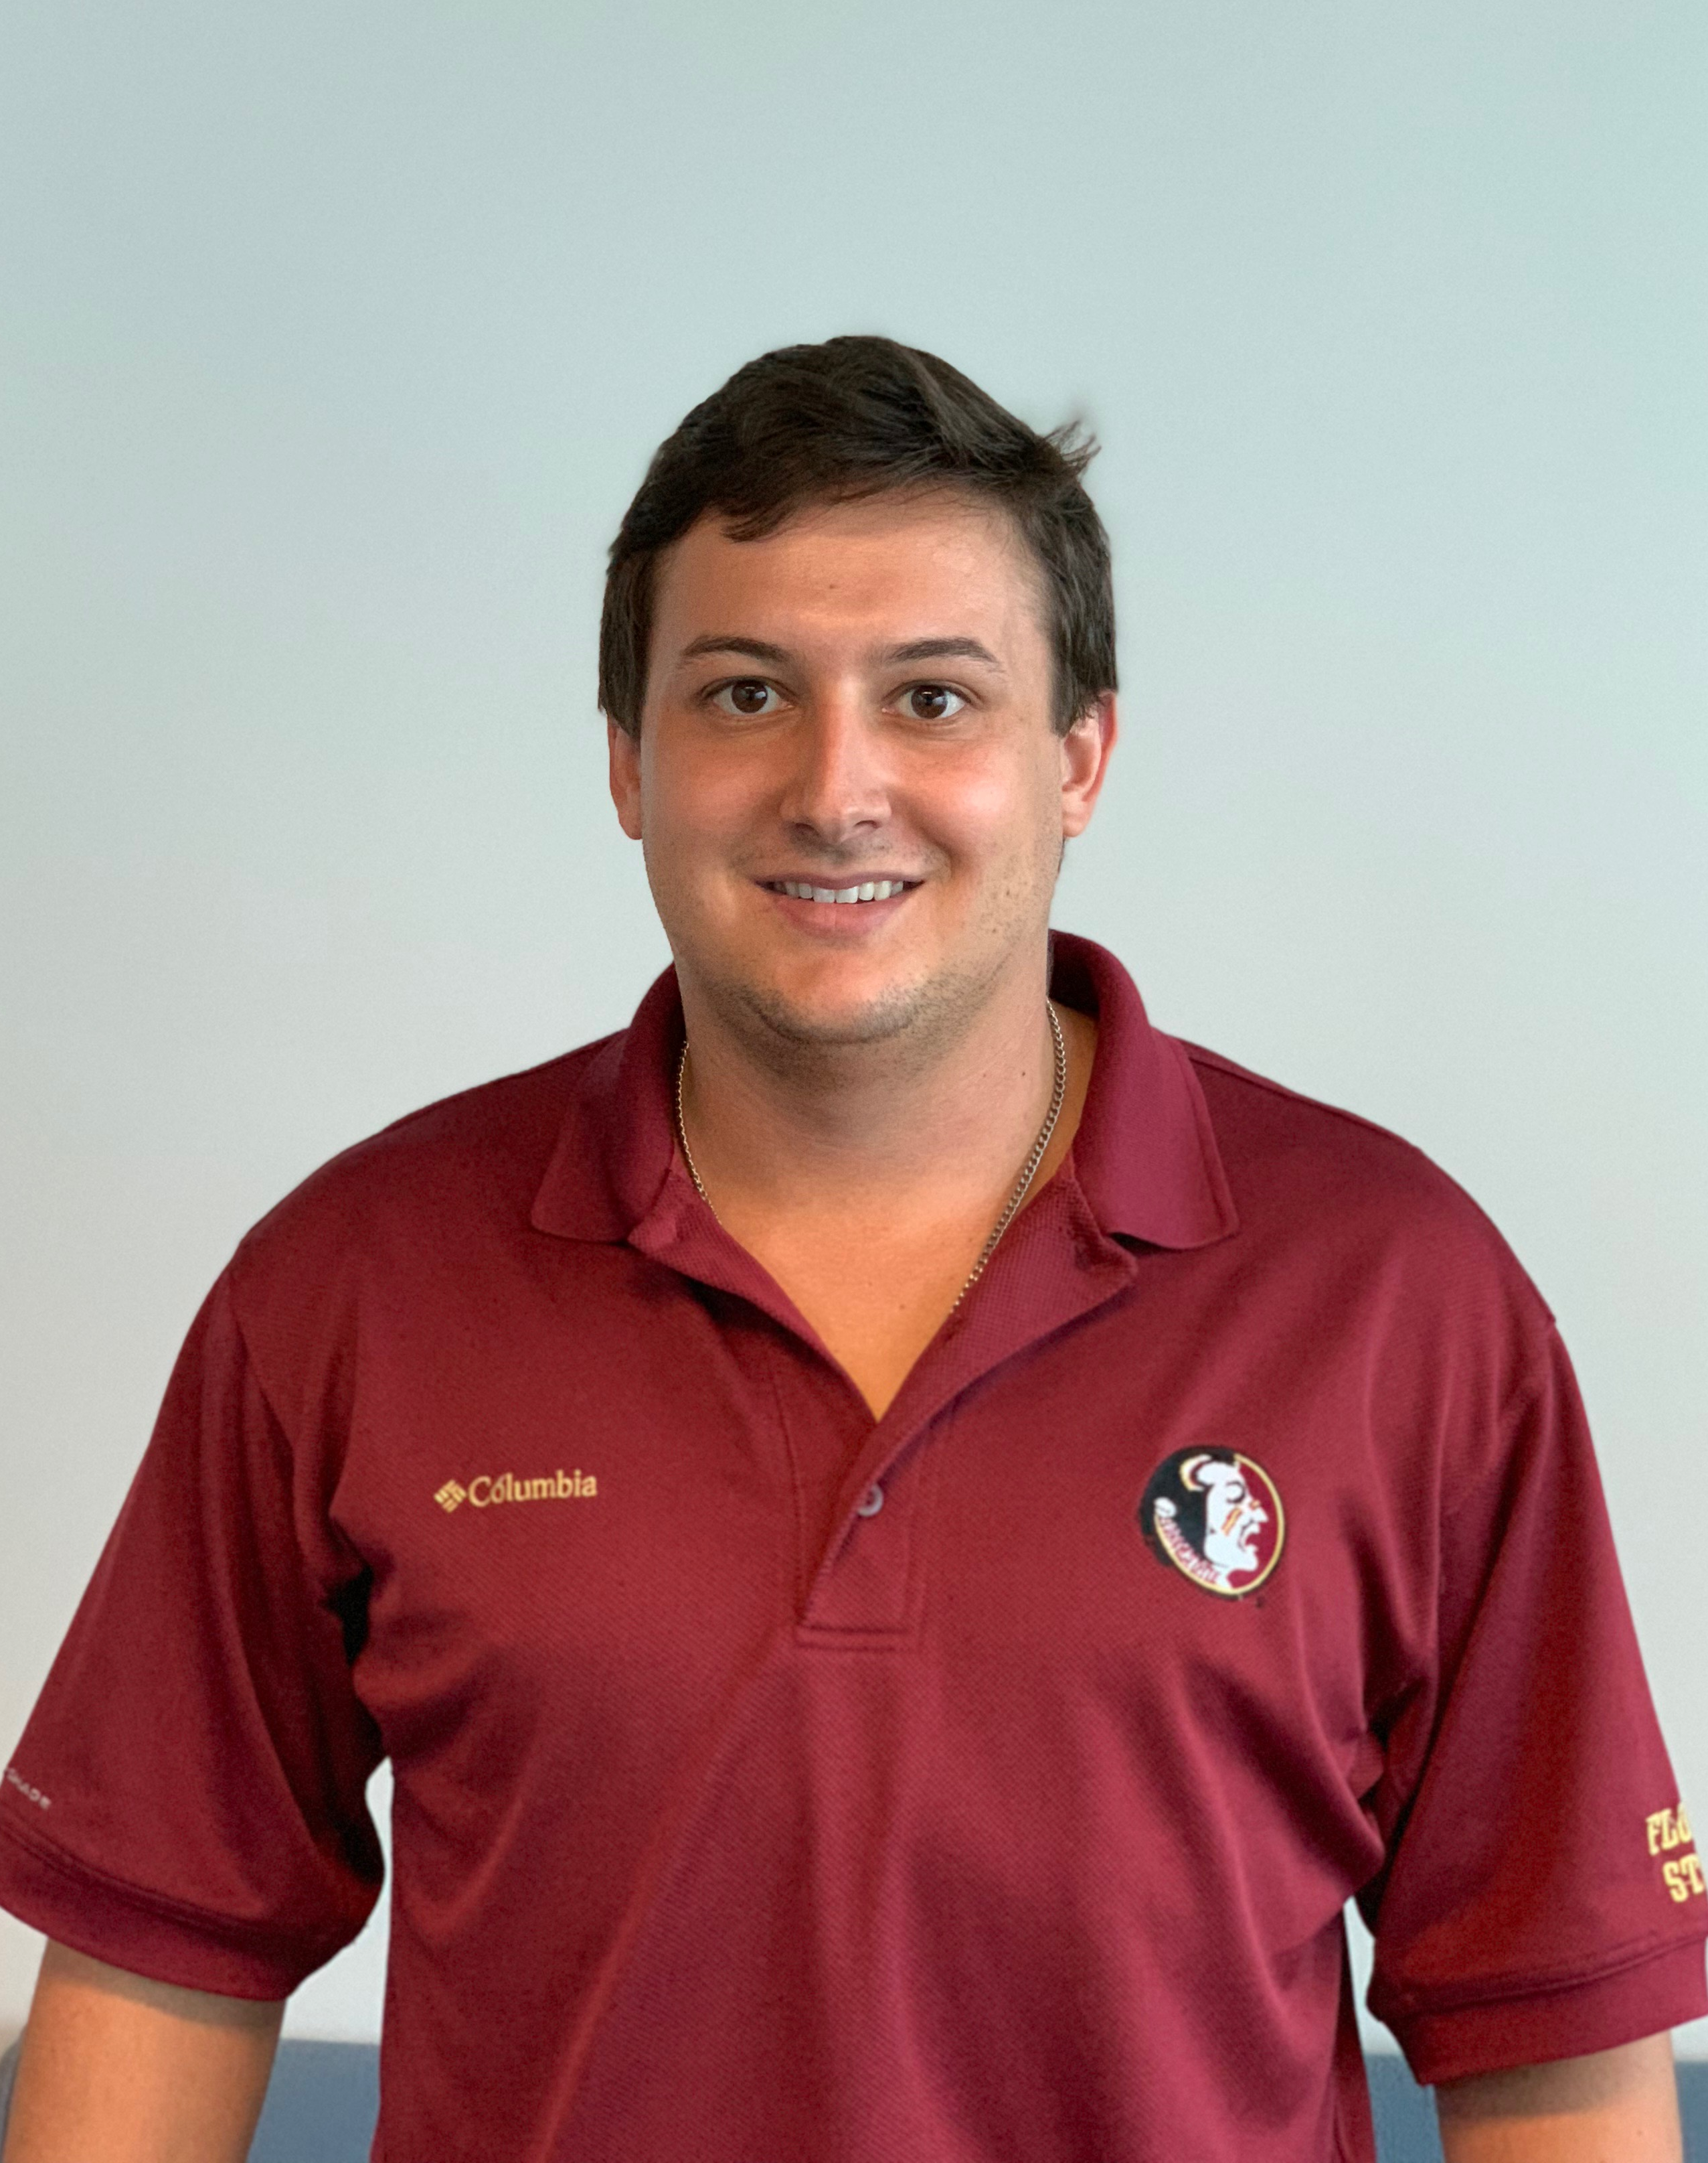
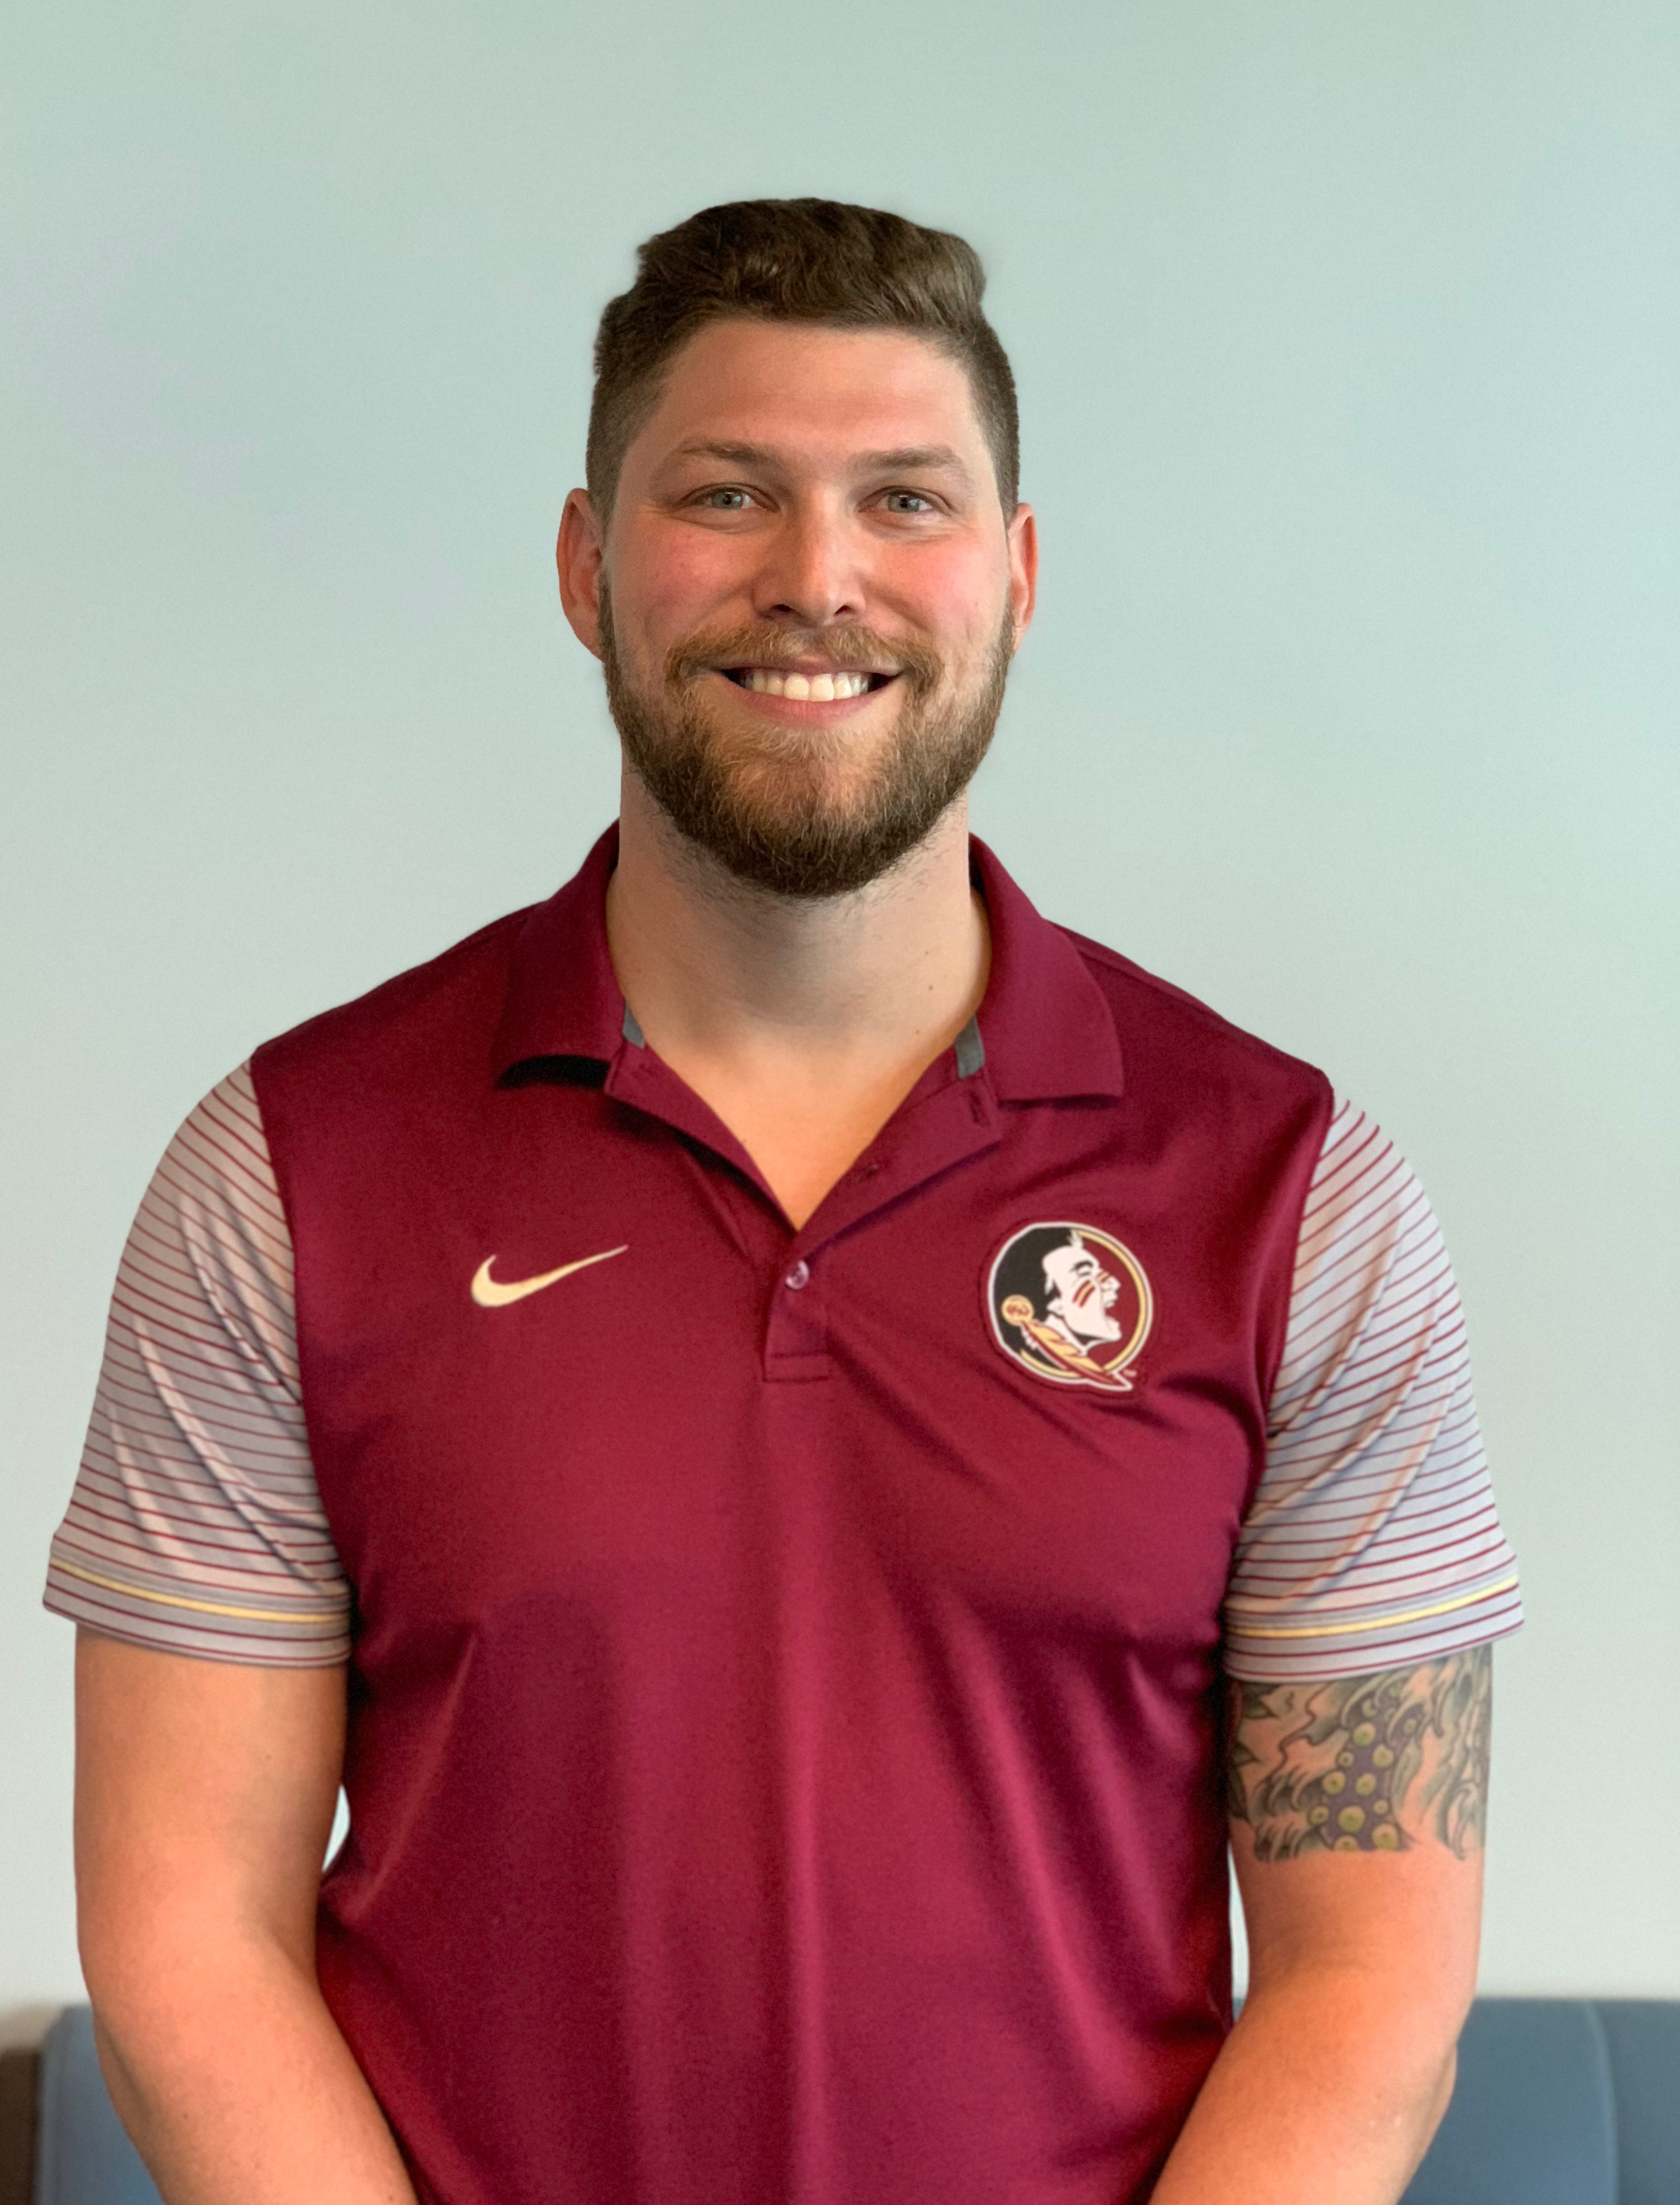
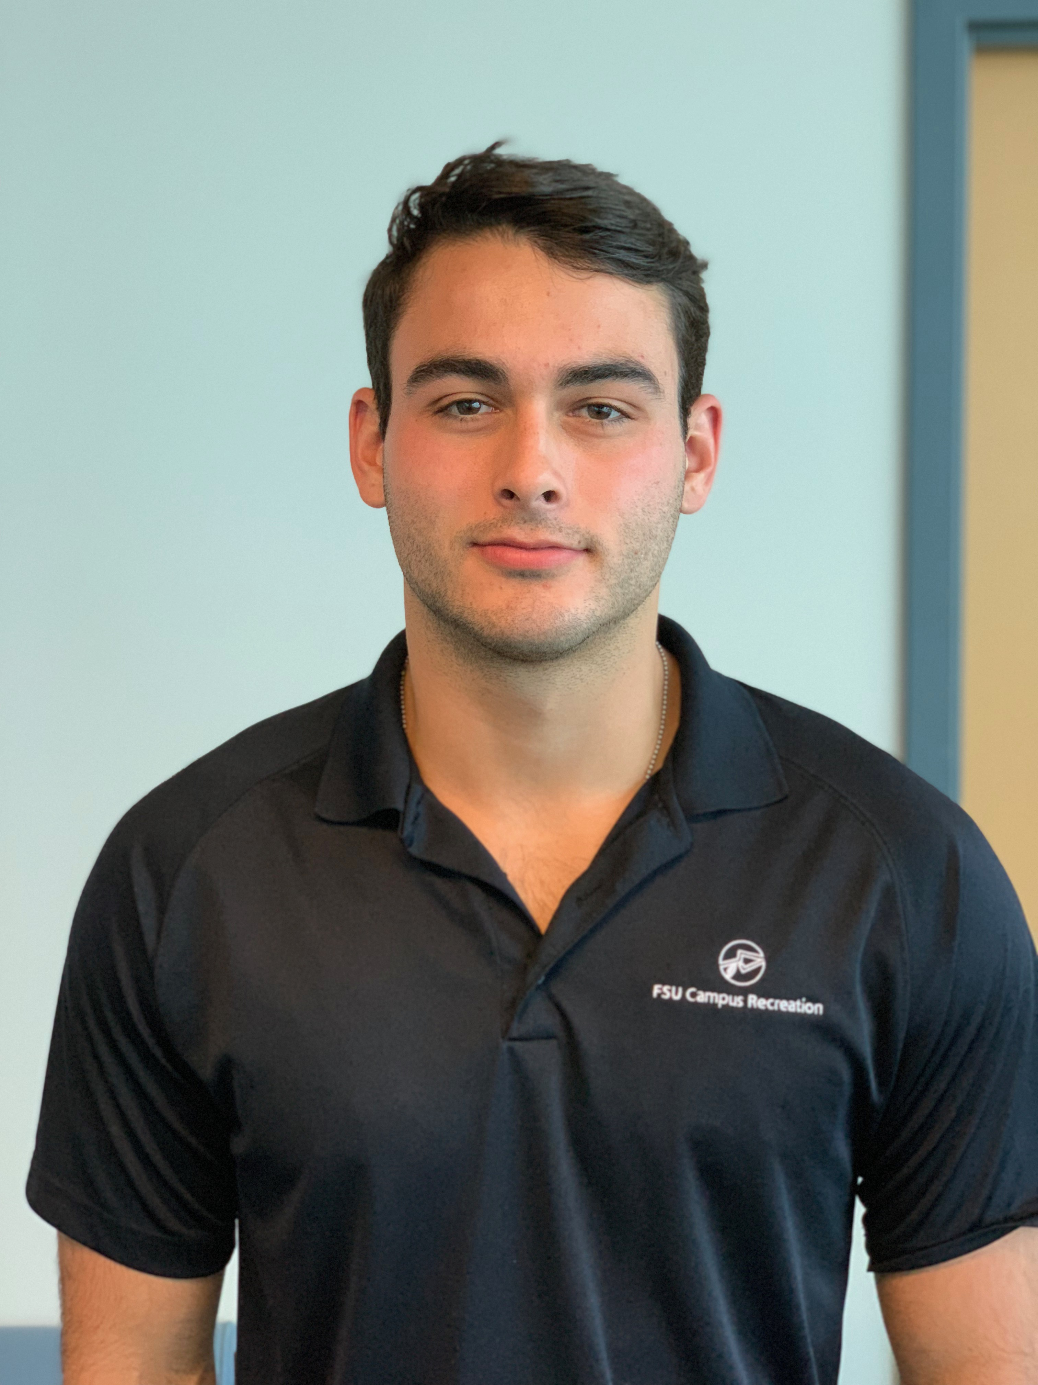
Team Introductions
Vincent Grimes
Project Manager
Michael Small
Timeline Lead
Robert Montuoro
Design Engineer
Joseph Godio
Model Manager
William Abraira
Financial Overseer

Slide 3
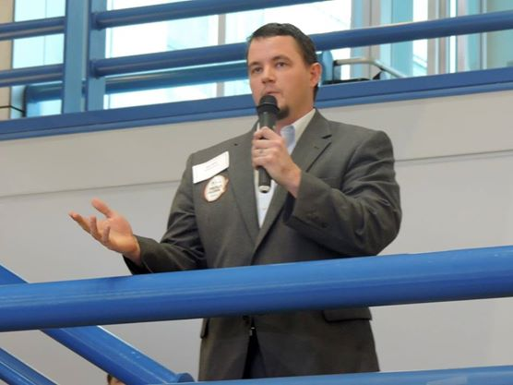
Sponsor
Cummings Scientific, LLC.
Forensic Engineering Consulting Firm
Specializing in accident reconstruction analysis, biomechanics, and biomedical engineering
Nation-wide leader in expert witness consulting
Representative: Beau Biller
Forensic Scientist/Engineering Manager
Joseph Godio

Slide 4
Objectives
Create a general empirical model for low speed collisions at or below 7mph using last year’s deliverable
This will be done using live crash tests
Determine a relationship between occupant and vehicle responses
Will be used to validate expert witness claims in court
Further the current knowledge on low speed collisions
Joseph Godio

Slide 5
Previous Work
Spoke with Mr. Biller to establish needs as a customer
Able to measure force responses on occupant
Have an easily repeatable test
Be able to compare to current methods
Broke down project into individual components so the parts could be analyzed
The two major components were to develop an empirical model and analyze occupant response
Joseph Godio

Slide 6
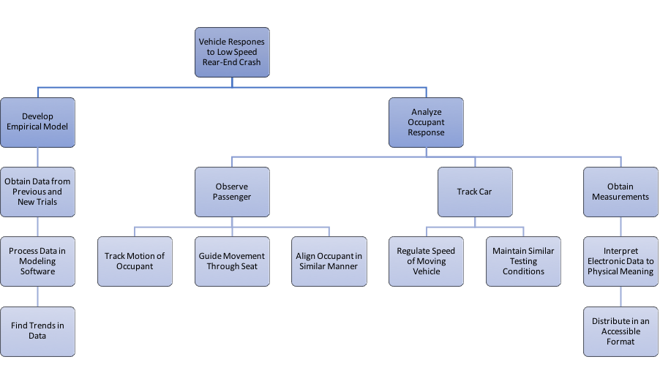
Previous Work (cont.)
Joseph Godio

Slide 7
Targets
Joseph Godio

Slide 8
Target Summary
Project is primarily experimental, with no physical deliverable, thus we plan to validate using targets more than metrics
Metrics are ways to validate a function
Targets are specific values used to design around
Many of our decisions were made based on the previous team's testing and results, and what this phase of the project requires
Joseph Godio

Slide 9
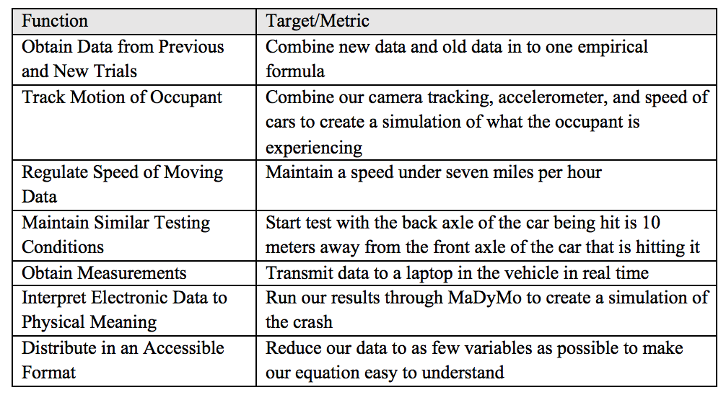
Target Table
Joseph Godio

Slide 10
Target Table
Joseph Godio

Slide 11
Target Table
Joseph Godio

Slide 12
Concept Generation
Vincent Grimes

Slide 13
Concept Generation
Our project is primarily experimentation driven
We aren’t producing a final product
We decided to generate concepts for five different components of our project
How to properly place the sensors on the occupant
How to test if the bumper mount affects the dynamics of the car
What materials/how to create the camera mount
Ways to improve the bumper mount
How to maintain similar testing conditions
Vincent Grimes

Slide 14
Concept 1. Sensor Testing
Important concepts for tracking occupant's response to impact:
Monitors center of occupant's body
Monitors occupant's head motion
Vincent Grimes

Slide 15
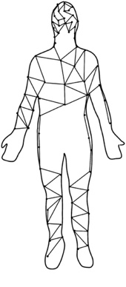
Concept 1. Sensor Testing
Important concepts for tracking occupant's response to impact:
Monitors the occupant's head and neck
Monitors the occupant's entire body
Vincent Grimes

Slide 16
Concept 2. Car Dynamics Testing
Run two tests with and without the bumper mount
Comparing these test with each other will tell us if we have any difference and if it is consistent
Use the chart below to compare with known data
 | With Bumper Mount | Without Bumper Mount
Low Speed | Results of experimentation | Can find results online
High Speed | Can test (very costly) | Can find results online
Vincent Grimes

Slide 17
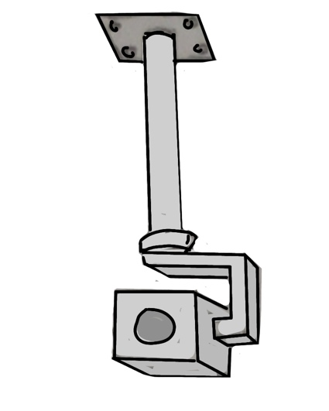
Concept 3. Camera Mount
Records footage of the occupant:
Monitors the occupant's response with higher accuracy due to stability features
Vincent Grimes

Slide 18
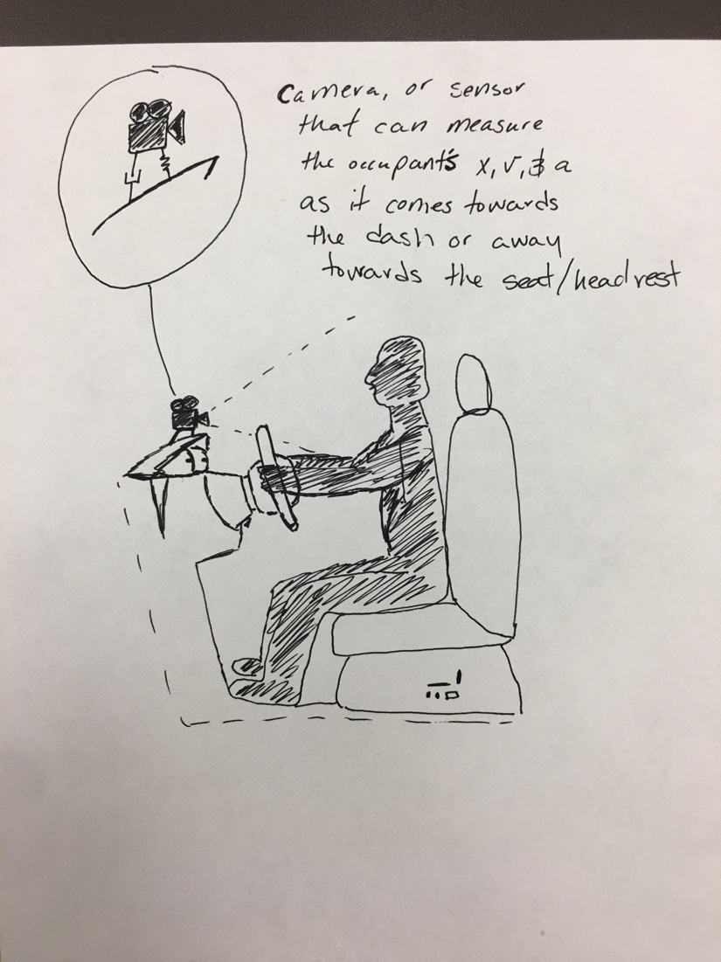
Concept 3. Camera Mount
Records footage of the occupant:
This idea has ample vibration which disturbs camera imaging
Vincent Grimes

Slide 19
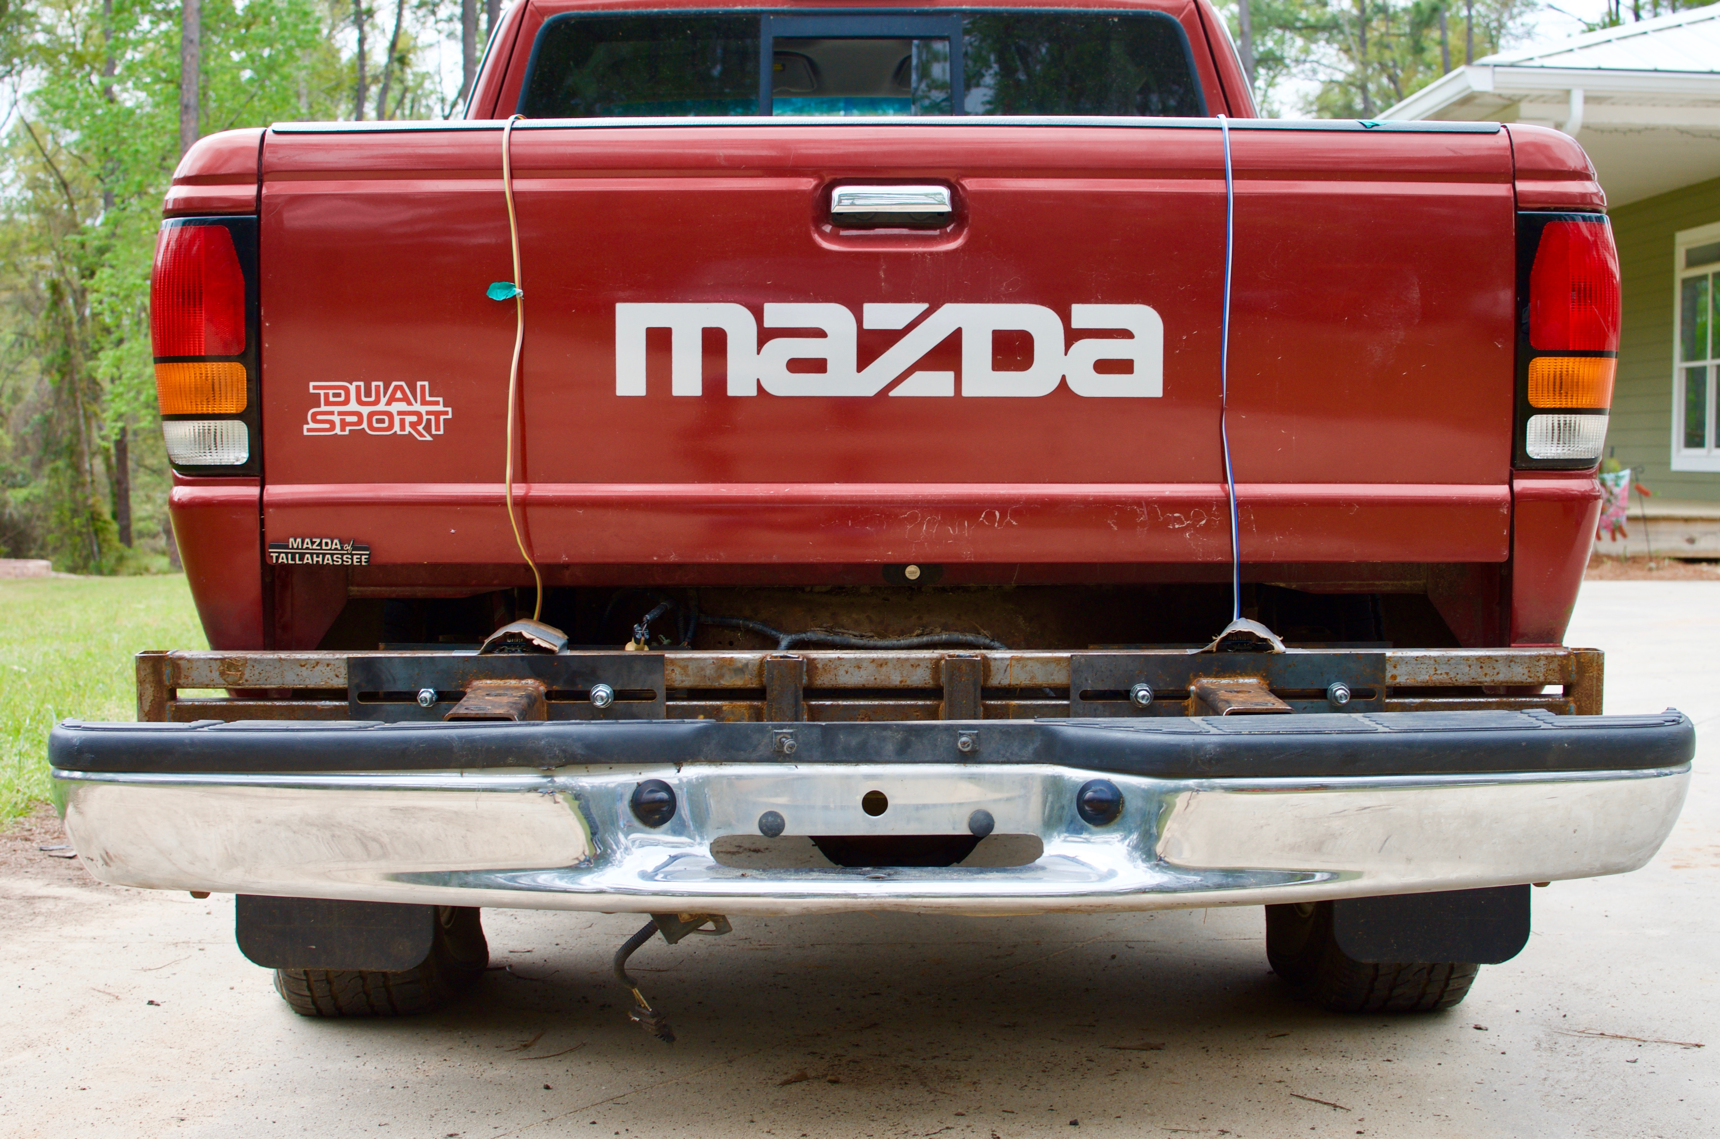
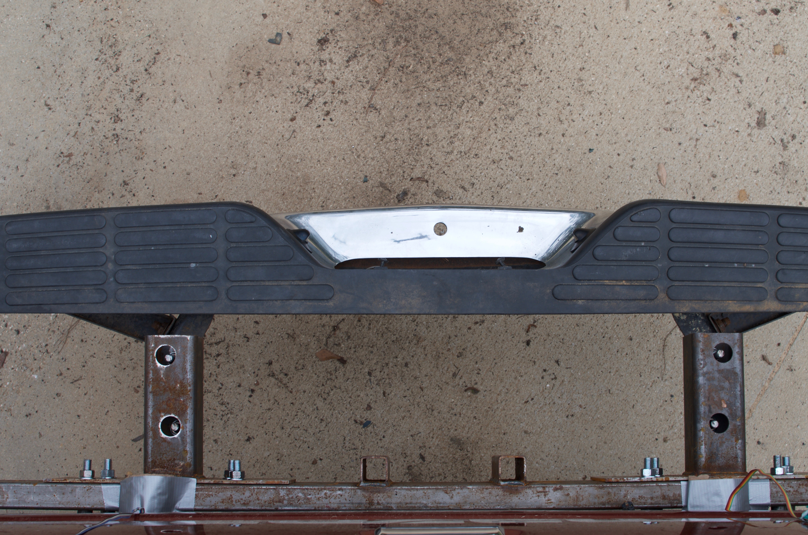
Concept 4. Improving Bumper Mount
Once testing begins our results will determine the need to make any changes
Can possibly use lighter materials or make bumper mount protrude less
Vincent Grimes

Slide 20
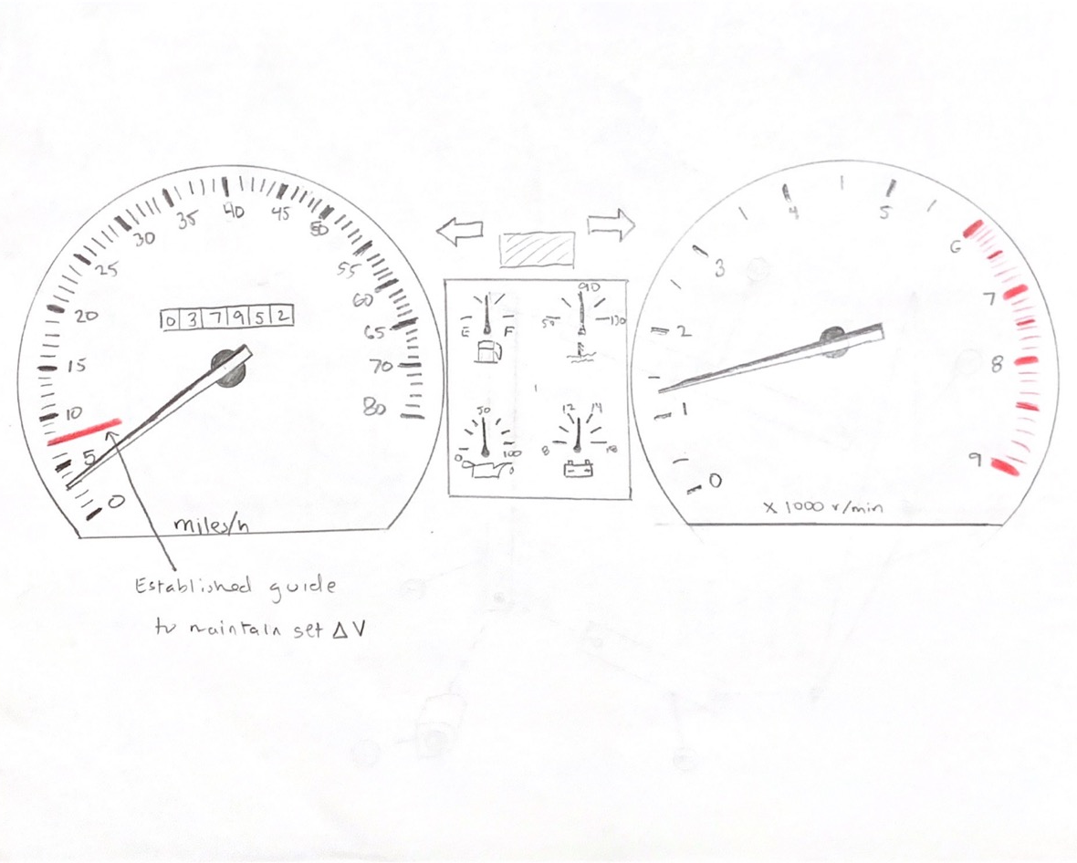
Concept 5. Maintain Testing Conditions
Creates an establish guide to ensure the speed is within the desired range
Vincent Grimes

Slide 21
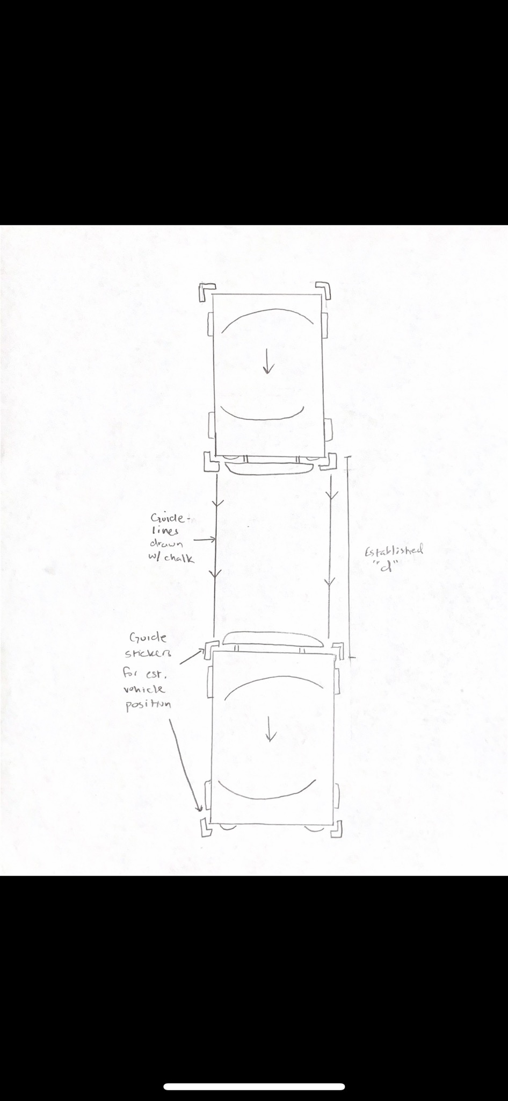
Concept 5. Maintain Testing Conditions
Utilizes tape or chalk as guidelines for starting positions of each vehicle before each test run
Vincent Grimes

Slide 22
Concept Selection
William Abraira

Slide 23
Concept Selection
We then took the previous concepts noted above and chose the best and did some stuff and wanted to analytically calculate which is the best option
Because most of the concepts are again not producing a physical deliverable, we did the primary concept selection on the camera mount
William Abraira

Slide 24
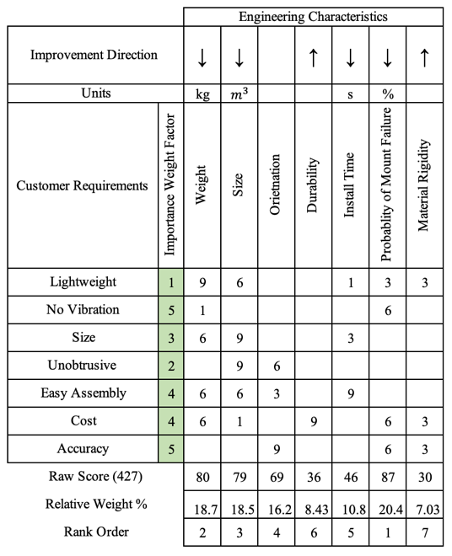
House of Quality
We made a House of Quality to compare the engineering characteristics to the customer requirements
William Abraira

Slide 25
House of Quality
We made a House of Quality to compare the engineering characteristics to the customer requirements
William Abraira

Slide 26
House of Quality
We made a House of Quality to compare the engineering characteristics to the customer requirements
William Abraira

Slide 27
House of Quality
We made a House of Quality to compare the engineering characteristics to the customer requirements
William Abraira

Slide 28
House of Quality
We made a House of Quality to compare the engineering characteristics to the customer requirements
William Abraira

Slide 29
Pugh Chart
We then used a Pugh Chart to compare our generated concepts using the selection criteria found in the house of quality
Concept 1 – roof mounted gimbal
Concept 2 – fixed three arm mount
Concept 3 – sensor attached to dash cam
Concept 4 – headband camera mount
Concept 5 – suction cup windshield mount (datum)
William Abraira

Slide 30
Initial Pugh Chart
Compared to datum
+ for better than – for weaker than
William Abraira

Slide 31
Secondary Pugh Chart
A secondary test was run with the roof mounted gimbal as the datum and the sensor attached to the dash/suction cup camera as the other concepts
These were the top three concepts from last Pugh Chart
William Abraira

Slide 32
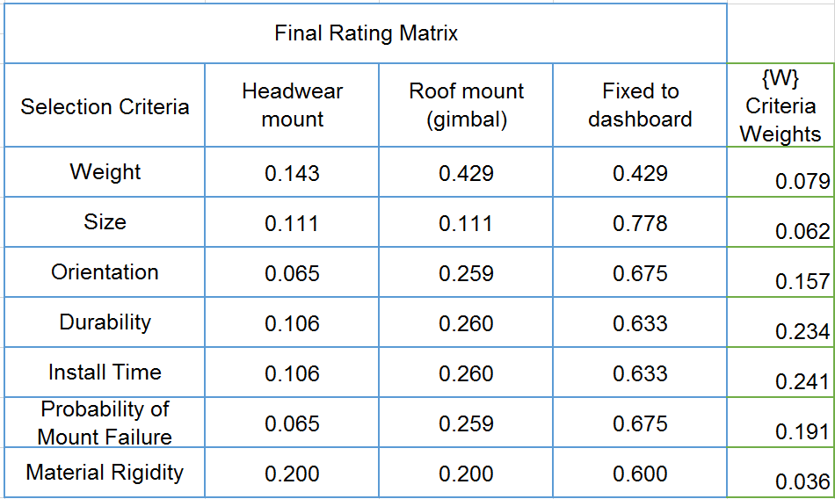
Analytical Hierarchy Process (AHP)
Analytical decision-making method that works alongside logic
A series of pairwise comparisons resulted in the weights and the ratings of our top 3 selection criteria
William Abraira

Slide 33
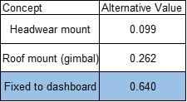
Analytical Hierarchy Process
Fixed to dashboard won
But we are hesitant to believe because there will be excess vibrational affects
Roof mounted gimbal logically seems best
William Abraira

Slide 34
Concept 1. Sensors on Occupant
We will design a headwear monitoring system because we care more about the head position and resultant whiplash rather than the overall body movement
The final design will have a similar model to the proposed idea
William Abraira

Slide 35
Concept 2. Car Dynamics Testing
We have limited time and money
But we will follow the table and compare results
 | With Bumper Mount | Without Bumper Mount
Low Speed | Results of experimentation | Can find results online
High Speed | Can test (very costly) | Can find results online
William Abraira

Slide 36
Concept 4. Improving Bumper Mount
We currently have no real desire to change
Once testing begins we will reevaluate based on our results and redesign if needed
William Abraira

Slide 37
Concept 5. Maintain Testing Conditions
We will implement a start zone and crash zone using tape, spray paint, or sidewalk chalk
We will establish the guide discussed previously to ensure impact speed is consistent
We will inspect the driver and the monitoring equipment after each test run
We will use the same testing location
William Abraira

Slide 38
Four Most Important Points from this Lecture
We were tasked with designing and improving low speed crash test data knowledge by Cummings Scientific
The testing variables are going to be the same (speed, car model, occupant number, etc) except the bumper will be changed
We are going to use a camera to collect more data and the mounting of said camera was chosen to be a roof mounted gimbal
The test results will create a simulation of a low speed rear impact crash and our data will be used to help validate/oppose claims
William Abraira

Slide 39
References
http://cummingssci.com/associates-bb.php
https://www.sciencedirect.com/science/article/pii/S0001457515000354
https://www.iihs.org/iihs/sr/statusreport/article/39/9/1
https://www.researchgate.net/figure/Global-kinematic-response-of-the-model-during-a-7g-rear-impact-Muscle-activation-not_fig5_51089862
https://ww2.eng.famu.fsu.edu/me/senior_design/2018/team02/sponsor.html
William Abraira
Notes:
Not this slide will advance on default after 2 seconds. If you would like to change this then go to the transition tab and under timing change the advance slide settings.

Slide 40
Questions

