Slide 1
The Examination of Occupant and Vehicle Responses to Low Speed Rear-End Crashes Team 504
24-Jan-19

Slide 2
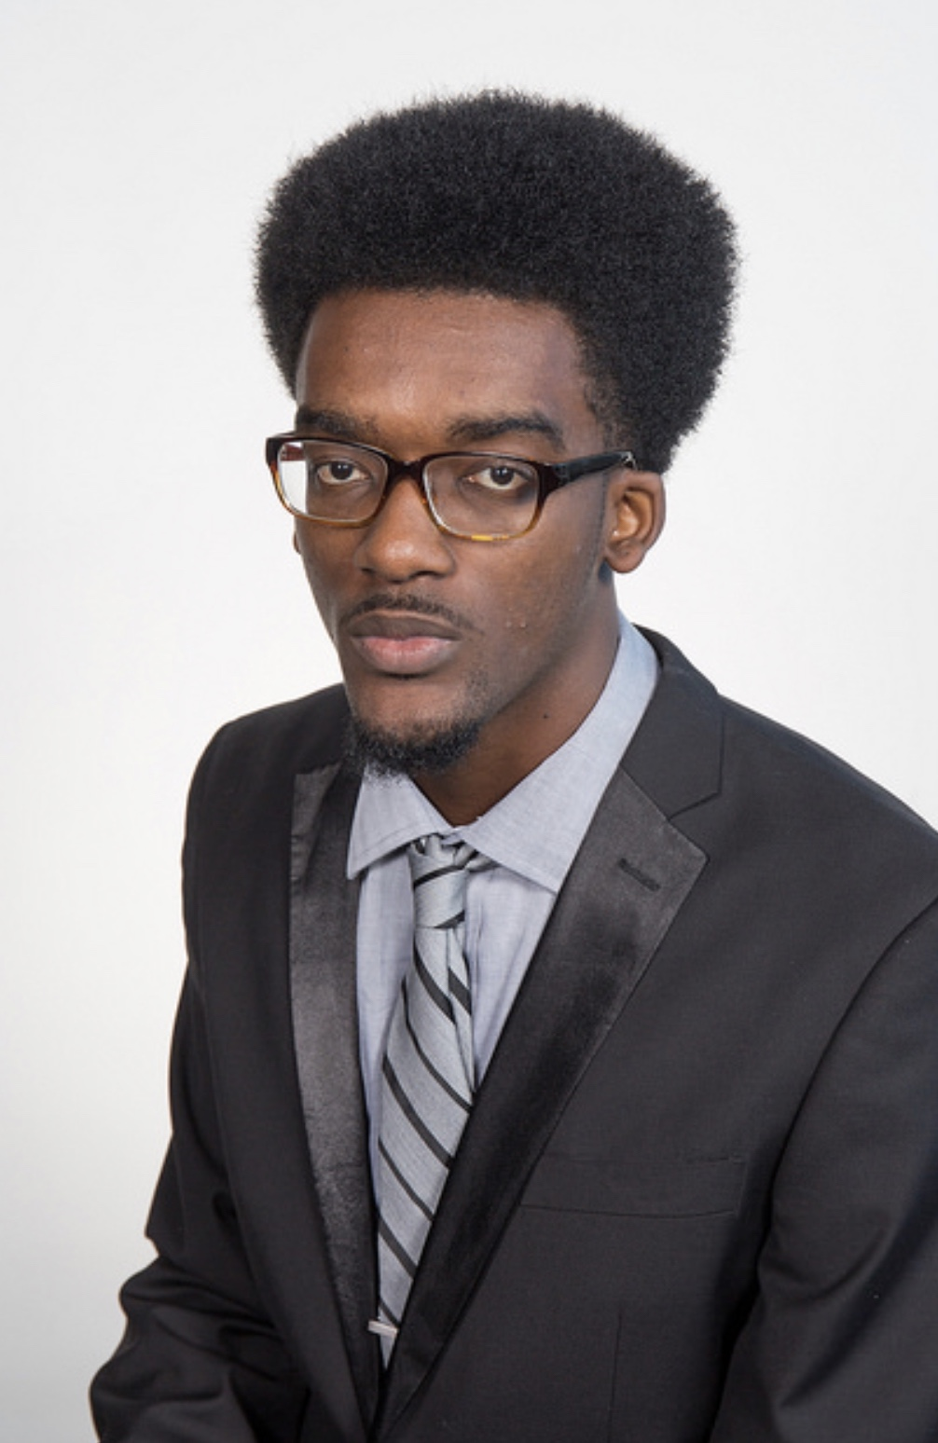
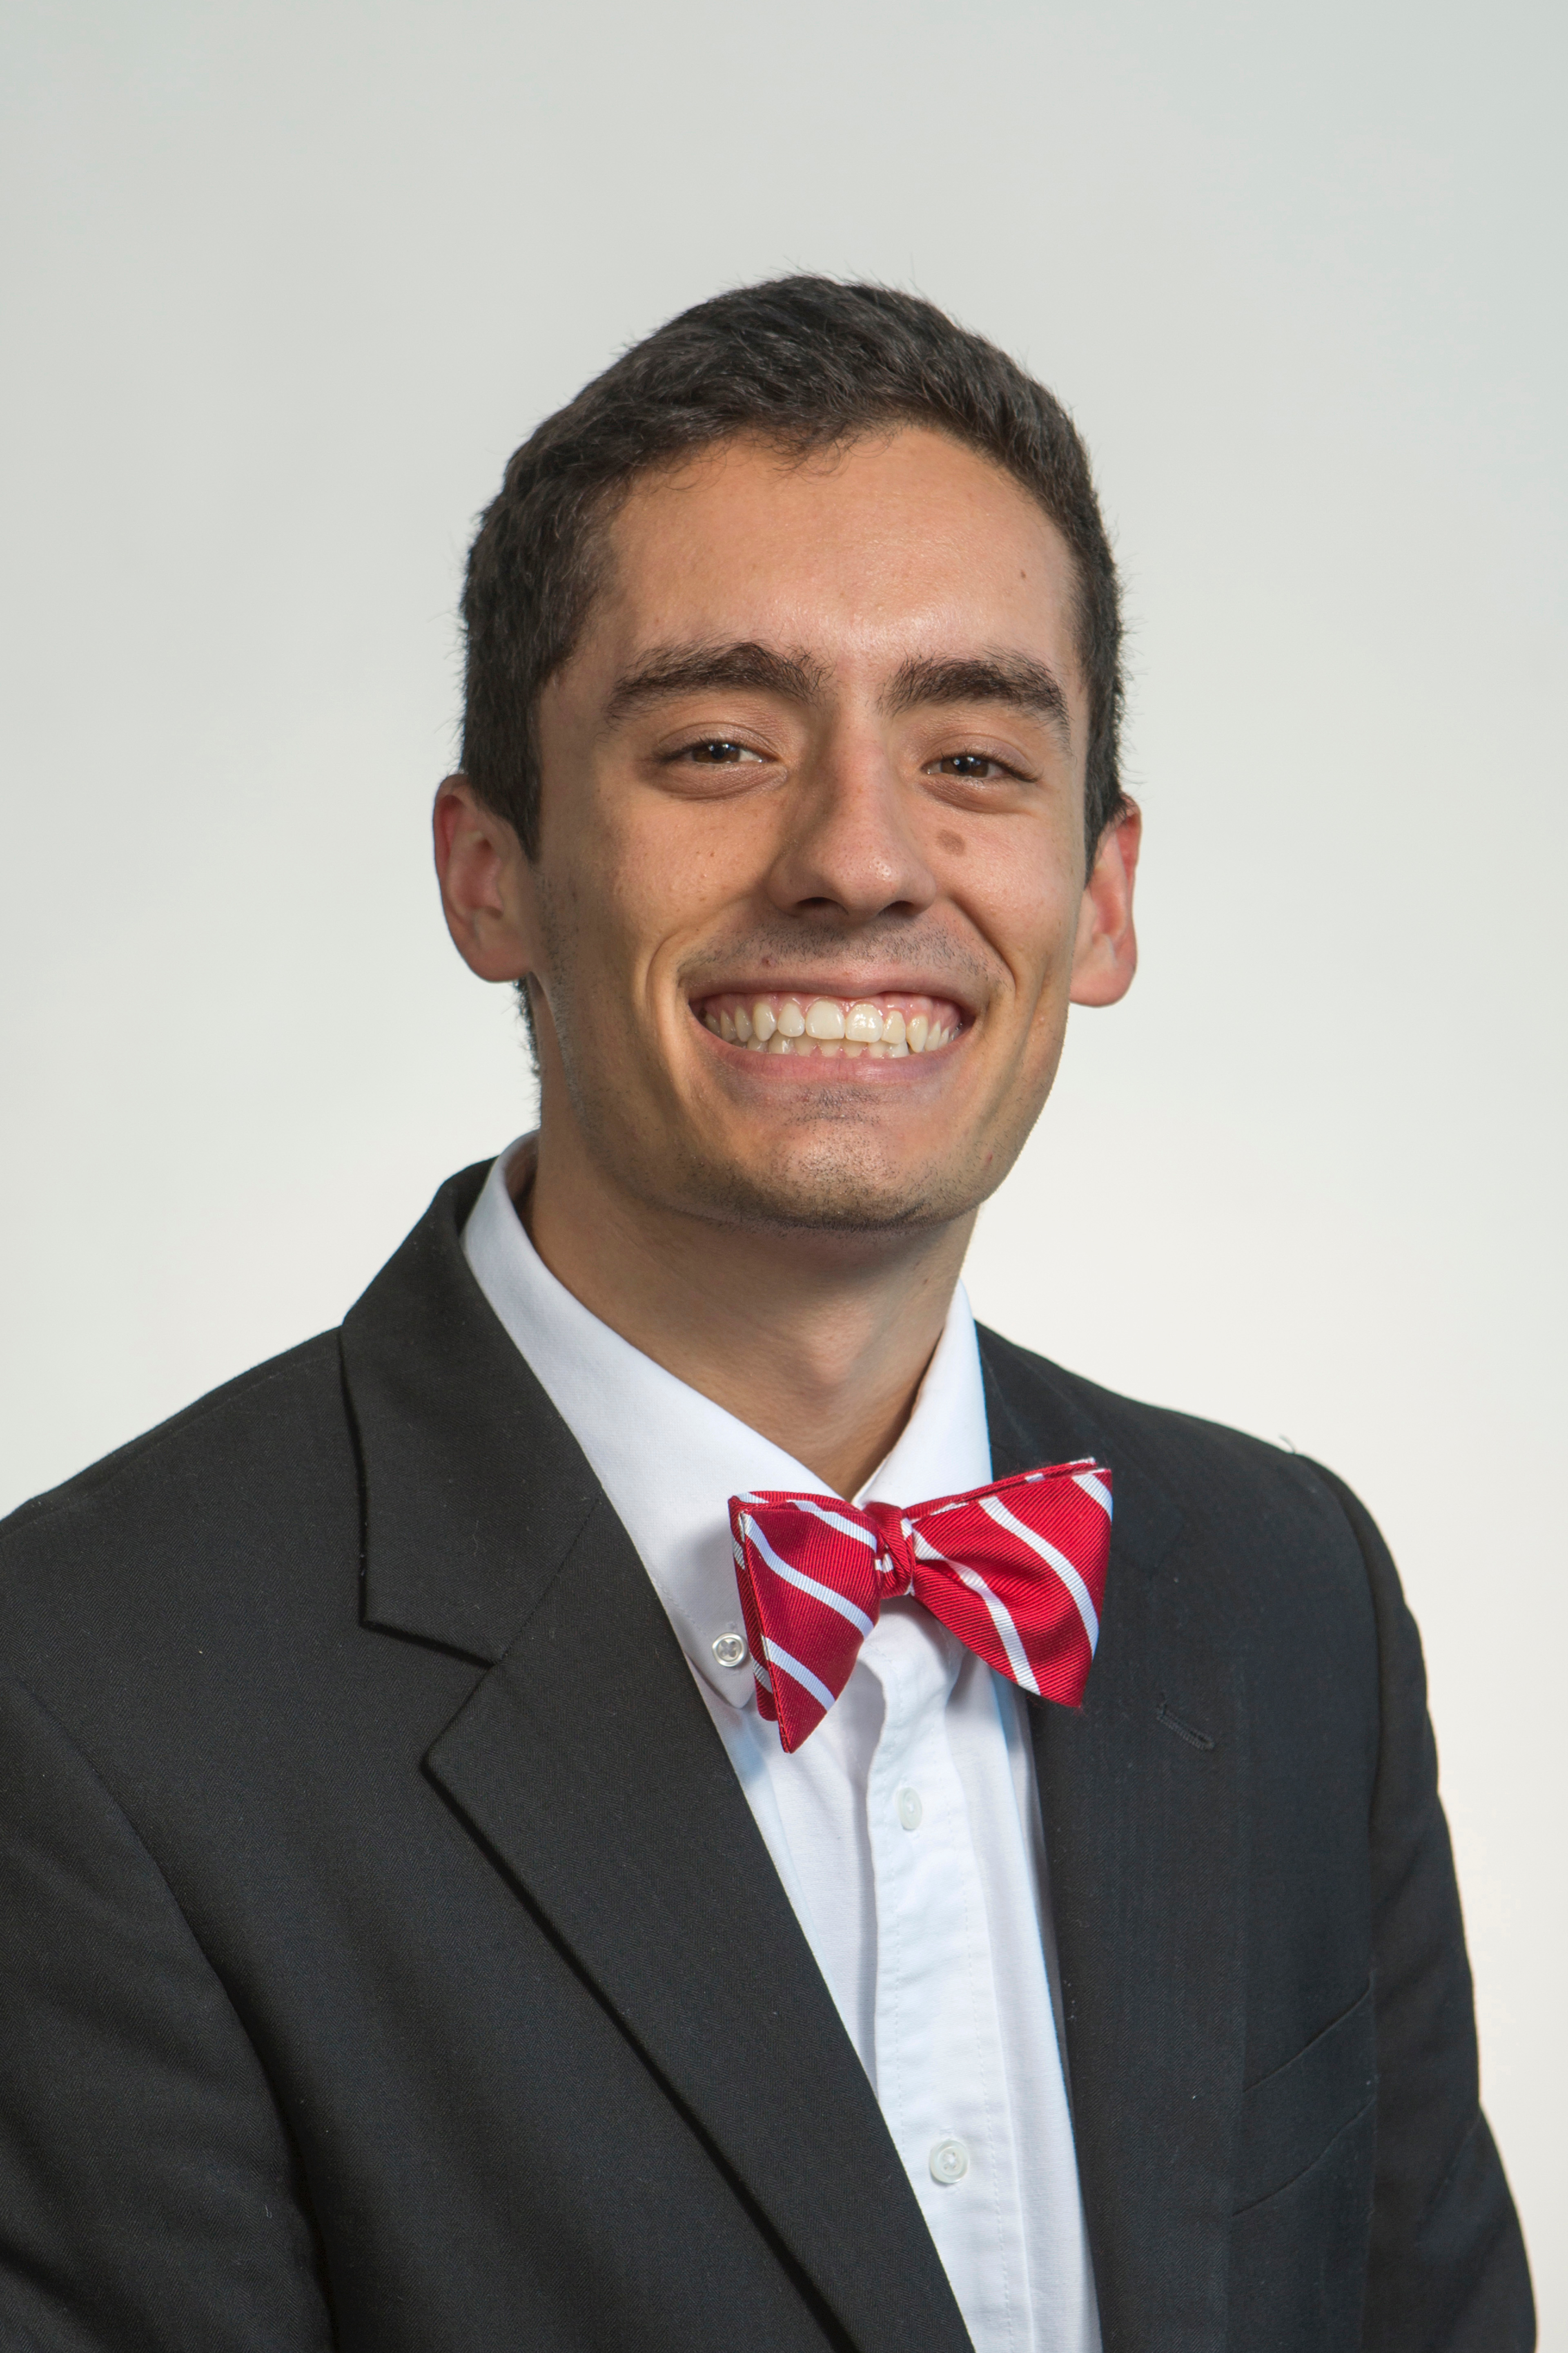
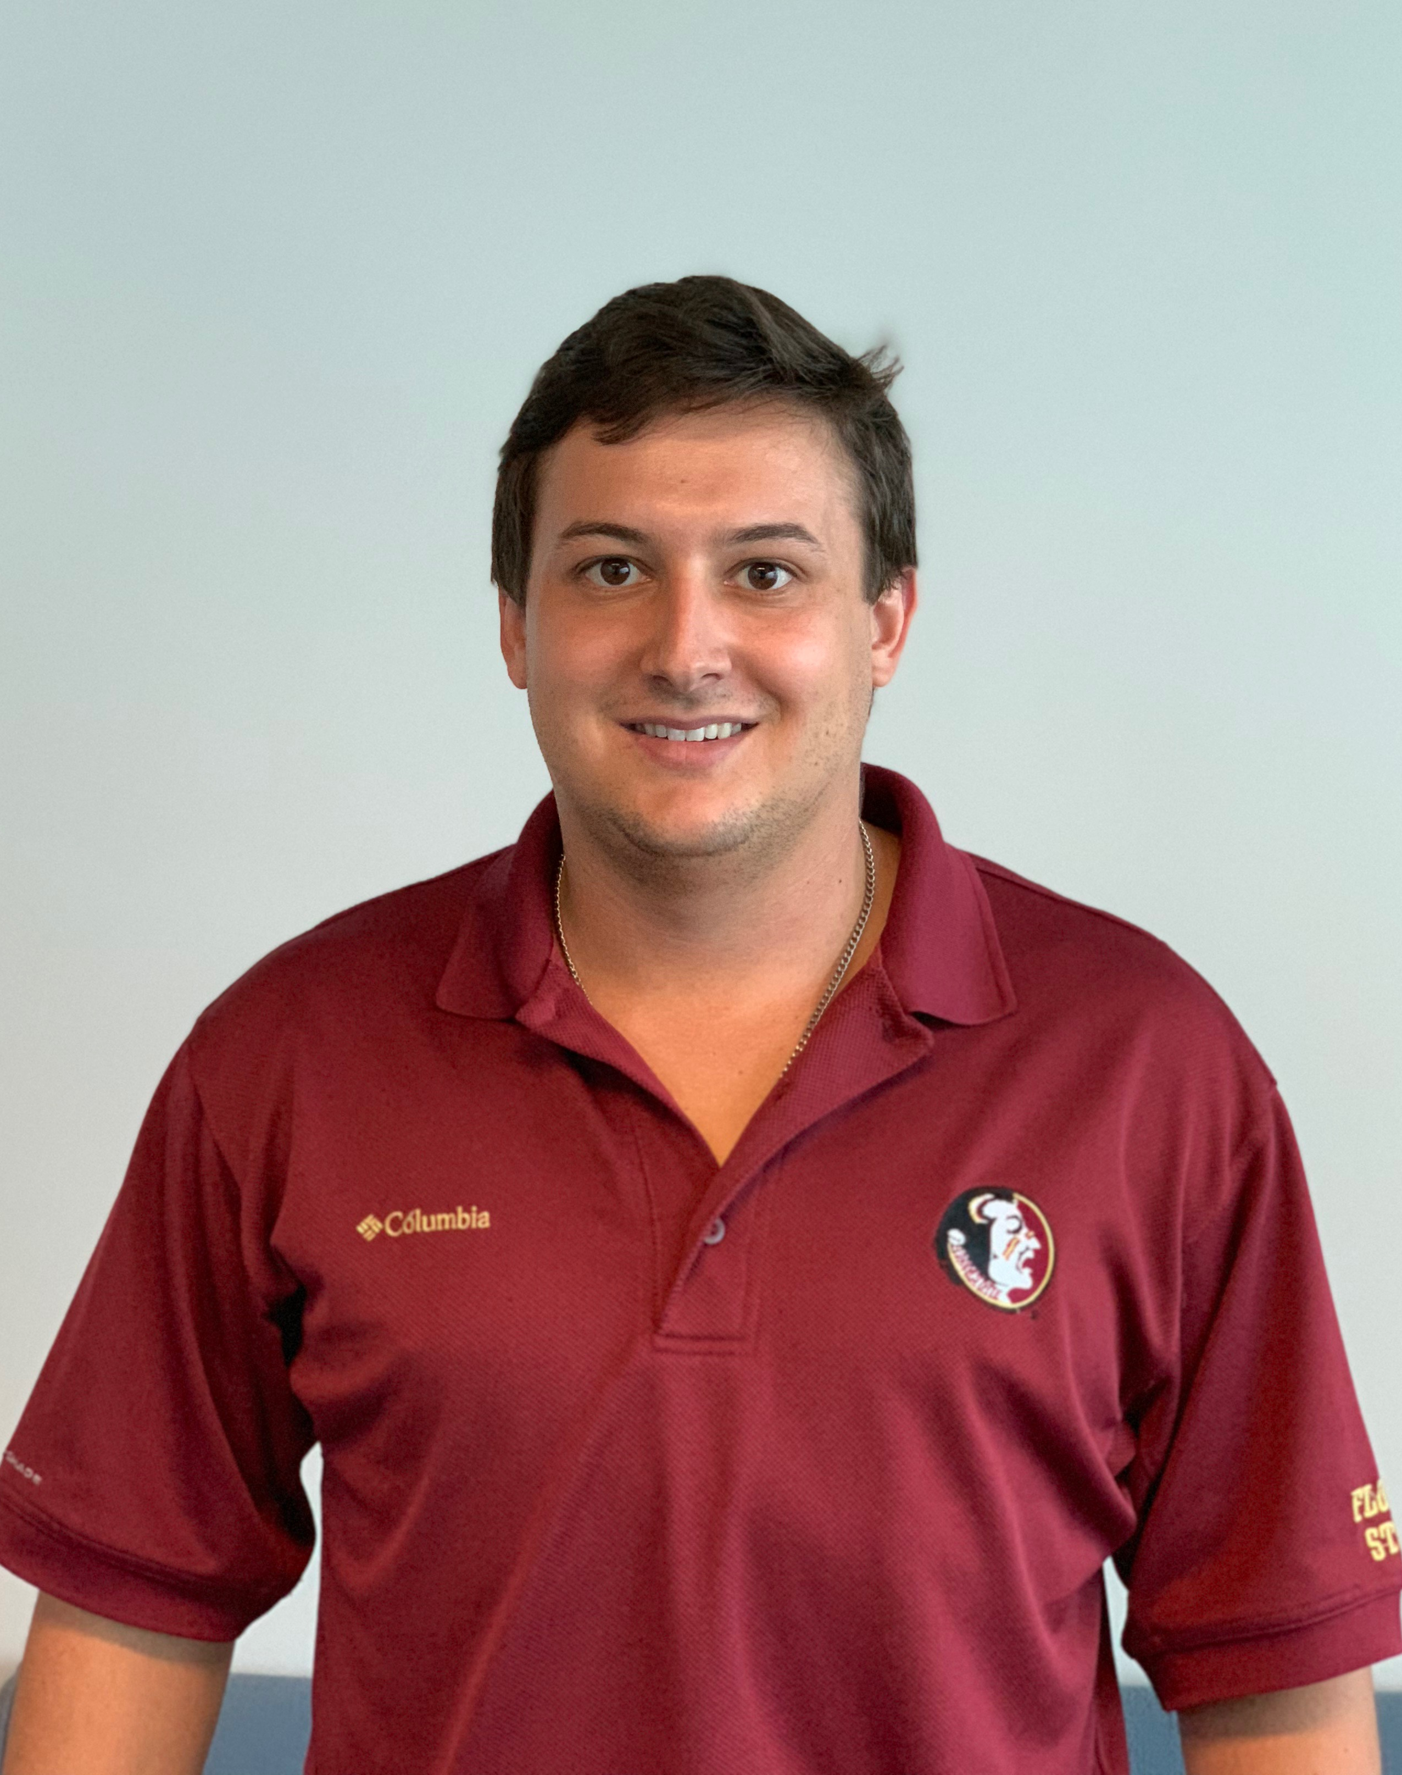
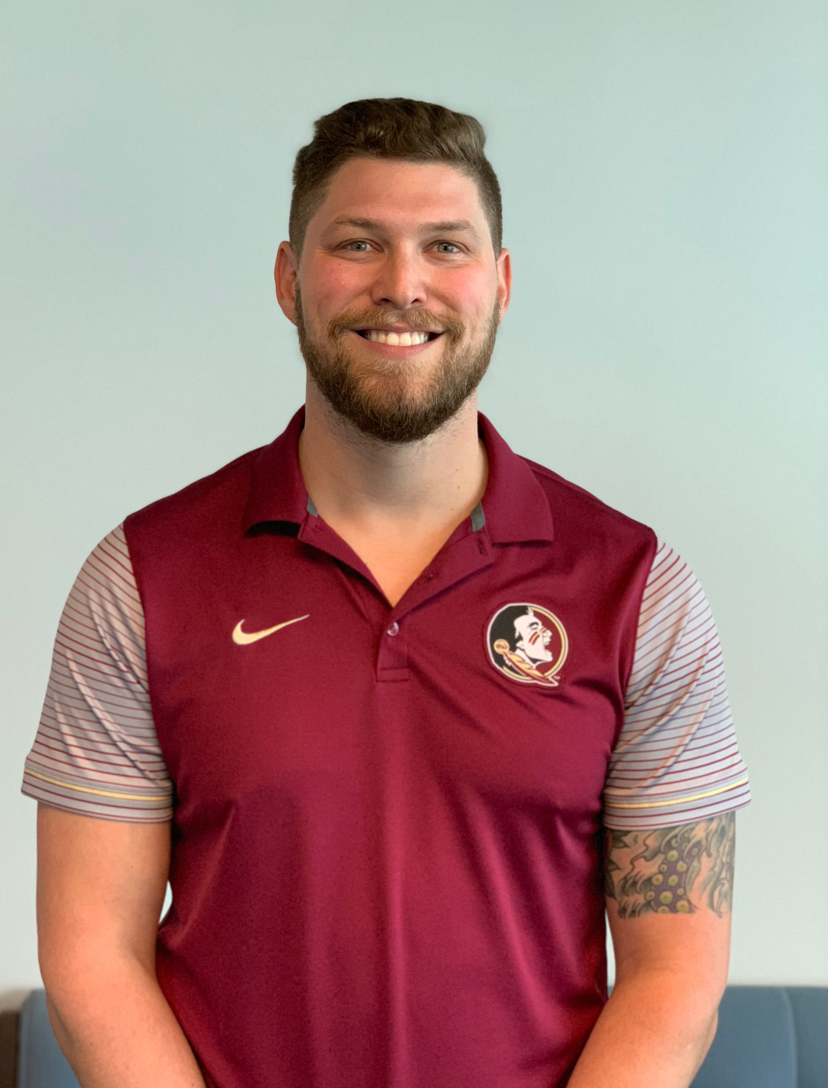
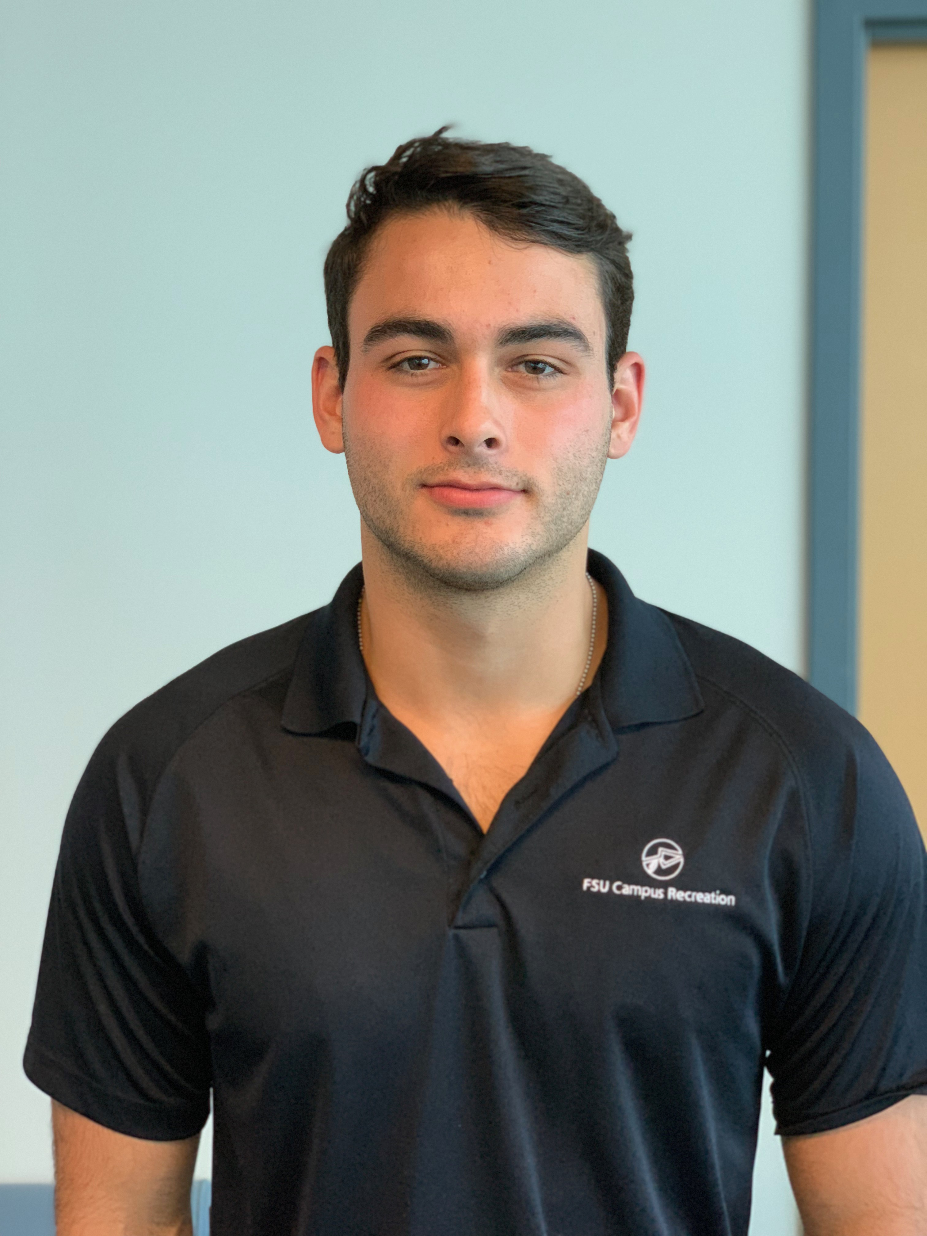
Team Introductions
Vincent Grimes
Project Manager
Michael Small
Analytics Engineer
Robert Montuoro
Design Engineer
Joseph Godio
Model Manager
William Abraira
Fiscal Engineer

Slide 3
Objectives
Create a general empirical model for low speed collisions at or below 7mph
This will be done using live crash tests
Determine a relationship between occupant and vehicle responses
Will be used to validate expert witness claims in court
Further the current knowledge on low speed collisions
Michael Small

Slide 4
Project Background
Michael Small

Slide 5
Background About Cars
Most known information on crashes are high speed
+40 mph
Under 7 mph, American bumpers are designed not to break, transferring more force through the vehicle
These impacts can cause “whiplash”
1 billion dollars in insurance claims a year
Michael Small

Slide 6
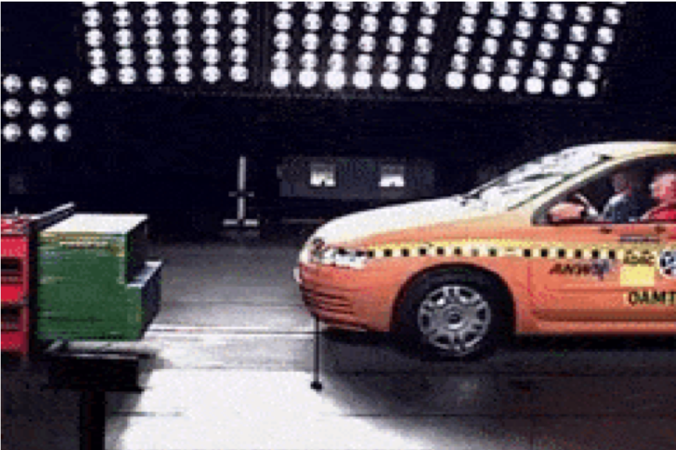
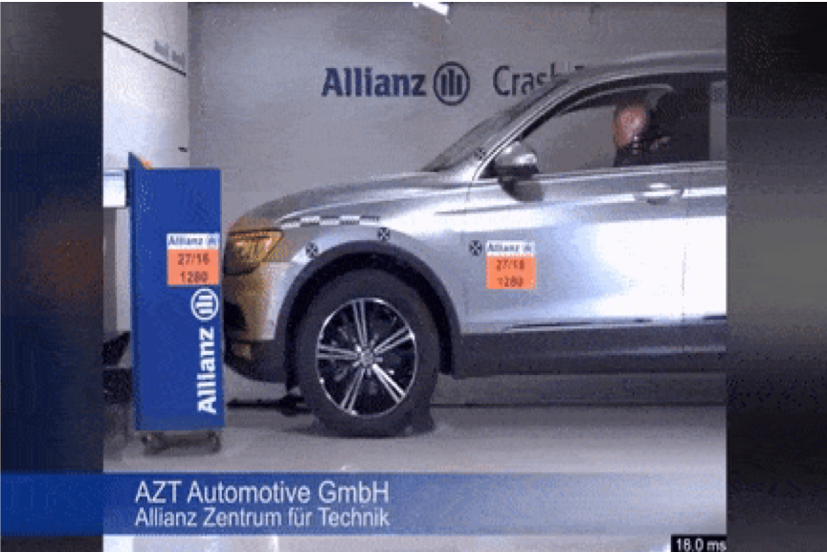
Crash Test High Speed vs. Low Speed
Michael Small

Slide 7
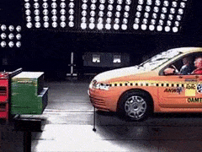
Crash Test High Speed vs. Low Speed
Michael Small

Slide 8
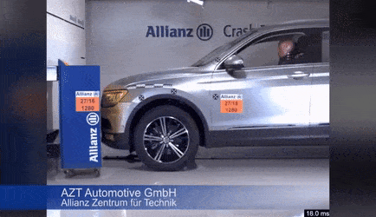
Crash Test High Speed vs. Low Speed
Michael Small

Slide 9
Background About Whiplash
Michael Small

Slide 10
Background About Whiplash
Michael Small

Slide 11
Background About Whiplash
Use a supported rope analogy******
Michael Small

Slide 12
Project Scope
William Abraira

Slide 13
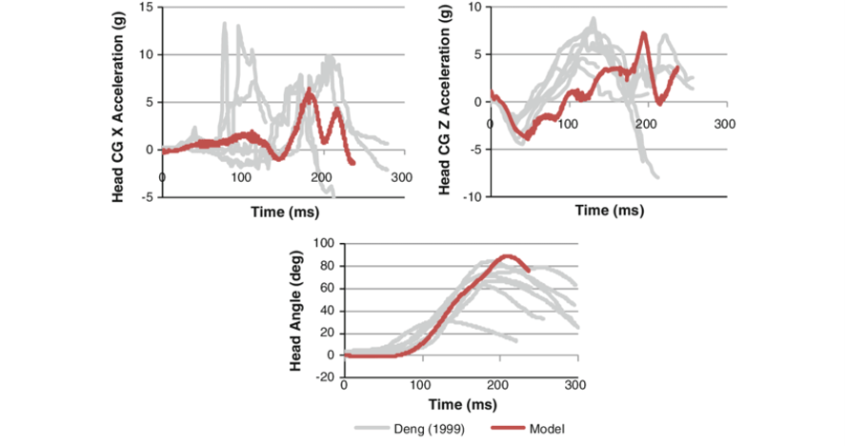
Project Scope
Live crash testing is done using accelerometers monitoring movement of occupant and vehicle
Results will be analyzed using Mathematical Dynamic Modeling (MADYMO)
Modeling software that will interpret accelerometer data
William Abraira

Slide 14
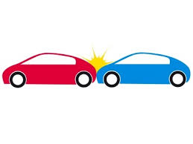
Experimental Setup
Interchangeable bumper mount
Designed to connect the stock bumper to the stationary car
Consistent testing parameters
Centered collision location
Travel path
Data acquisition
William Abraira

Slide 15
Experimental Setup
Stationary car fixed with bumper mount
The stationary car will be hit from behind by another car traveling ≤ 7mph
Accelerometers will be placed on the front car and front car occupant
Repeated trials and data will be analyzed to find experimental trends
Occupant response will be analyzed
Car response will be analyzed
William Abraira

Slide 16
Customer Needs
Michael Small

Slide 17
Customer Needs
Easy assembly of test site and equipment
Able to determine force generated on the occupant based on speed of impact
Test sensors that are simple to use but are accurate
We are using Arduino connected accelerometers
Michael Small

Slide 18
Customer Needs
Durable and robust testing rig
Combine results to create a simulation of crashes
Compare current methods with our test results
Increase in number of live crash tests
Michael Small

Slide 19
Functional Decomposition
Michael Small

Slide 20
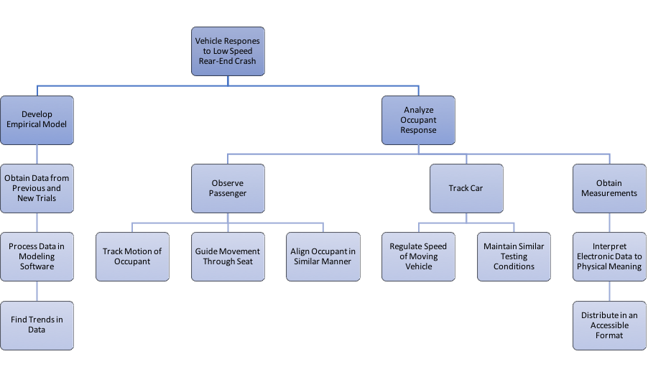
Functional Decomposition
Michael Small

Slide 21
Functional Decomposition
Michael Small

Slide 22
Functional Decomposition
Michael Small

Slide 23
Develop An Empirical Model
Obtain data from previous trials
Legacy project
Process data in modeling software
MADYMO
Find trends in data
Michael Small

Slide 24
Functional Decomposition
Michael Small

Slide 25
Functional Decomposition
Michael Small

Slide 26
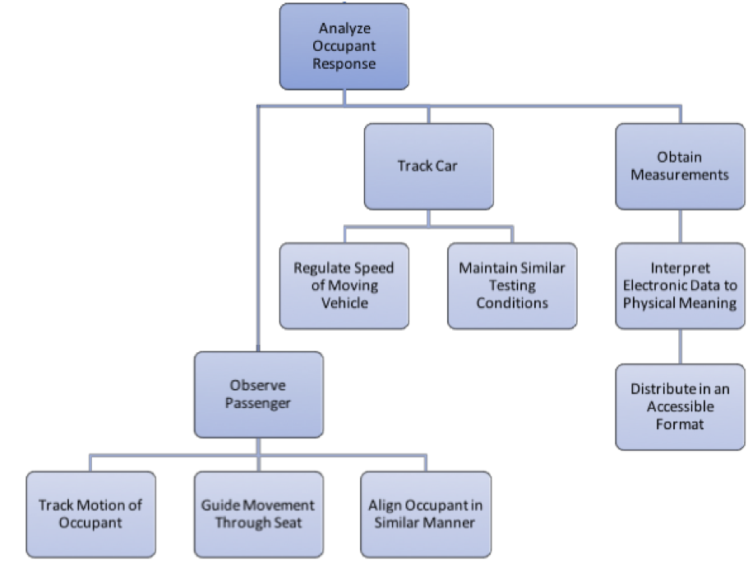
Analyze Occupant Response
Observe passengers
Roof mounted gimbal
Accelerometers to track movement
Track car
Allow the car to coast for a repeatable speed
Obtain Measurements
Accelerometers, MADYMO
Michael Small

Slide 27
Targets
William Abraira

Slide 28
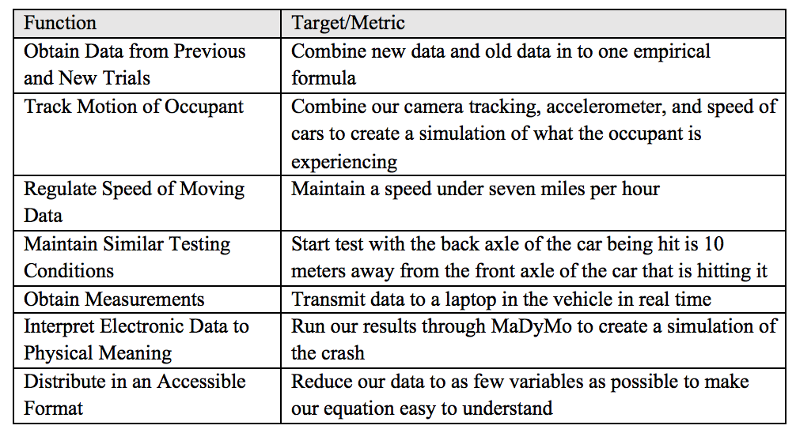
Target Table
William Abraira

Slide 29
Target Table
William Abraira

Slide 30
Target Table
William Abraira

Slide 31
Concept Generation and Selection
William Abraira

Slide 32
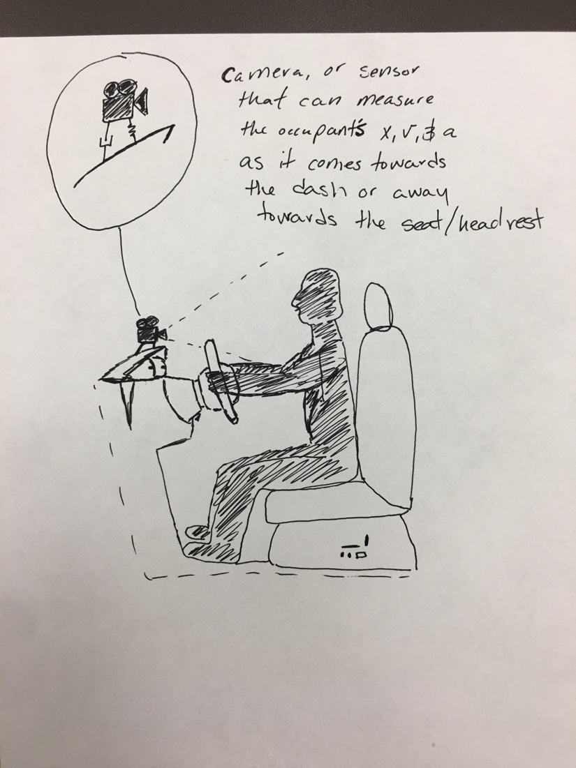
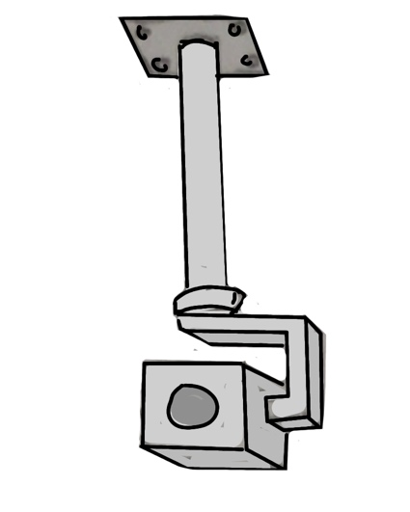
Concept Generation
We were tasked to develop a way to visually track the occupant
Potential ideas
Roof mounted gimbal
Dashboard mount
Headwear mount
William Abraira

Slide 33
Concept Selection
Final selection was the roof mounted gimbal
Stable if mounted to the car
Did not interfere with testing
Provided clear recording
William Abraira

Slide 34
Budget Report
William Abraira

Slide 35
Budget Report
Total budget was never set
We are told to plan for $1000
Total purchases were $825.85
$755.70 online purchases
$70.15 reimbursement total
Bumpers
Each part of the budget was given a weight factor to show importance
William Abraira

Slide 36
Future Work
Michael Small

Slide 37
Future Work
Four major components:
Mounting the gimbal
Solder wires and mount the Arduino
Develop a method to obtain the data from the testing
Develop a clear testing rig for easy repeatability
Michael Small

Slide 38
Mounting the Gimbal
In order to have the tracking camera, the gimbal must be mounted
Will be positioned upside down
Must drill into the the roof to mount
Michael Small

Slide 39
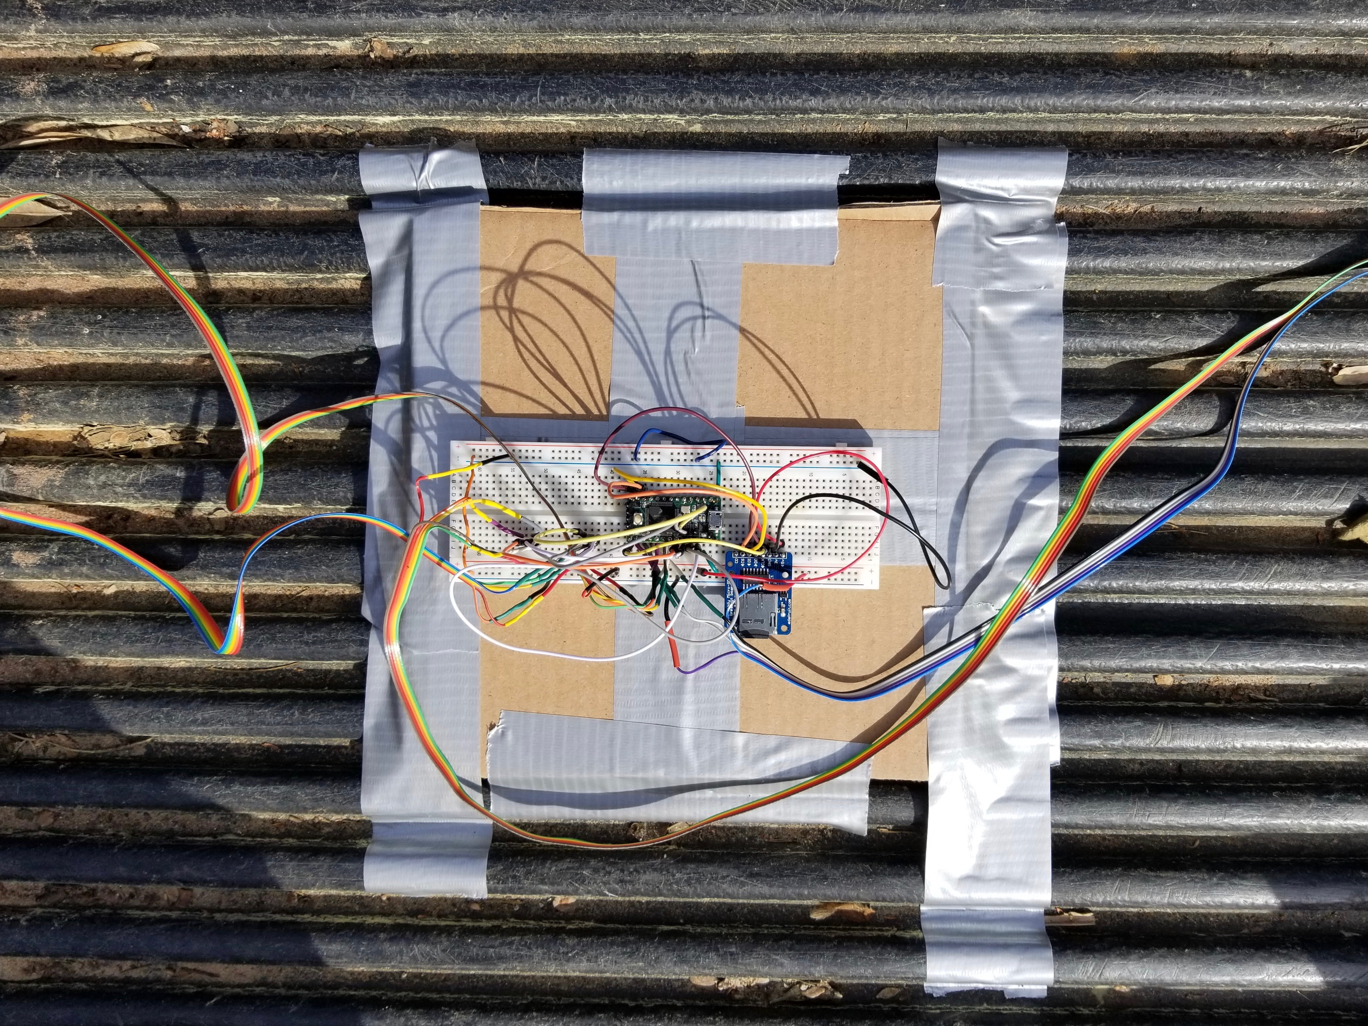
Arduino Wiring
The wiring needs to be updated to decrease room for error
Previous wiring was mounted and glued to a cardboard box
A custom mount will be used to ensure accuracy
Michael Small

Slide 40
Acquiring and Processing Data
We need to become knowledge in MADYMO
Biggest roadblock in the foreseeable future
No convenient access to the program
Moderately difficult learning curve
Limited online tutorial videos
Michael Small

Slide 41
Develop a Clear Testing Rig
Need to define starting/stopping positions of the cars
Will be marked with bright traffic cones
Chalk and additional tape can be used as guidance
Must regulate the car speed
Must be going less than 7 mph
Michael Small

Slide 42
Four Most Important Points from this Lecture
We were tasked with designing and improving low speed crash test data knowledge by Cummings Scientific
The testing variables are going to be the same (speed, car model, occupant number, etc) except the bumper will be changed
We are going to use a camera to collect more data and the mounting of said camera was chosen to be a roof mounted gimbal
The test results will create a simulation of a low speed rear impact crash and our data will be used to help validate/oppose claims
William Abraira

Slide 43
References
http://cummingssci.com/associates-bb.php
https://www.sciencedirect.com/science/article/pii/S0001457515000354
https://www.iihs.org/iihs/sr/statusreport/article/39/9/1
https://www.researchgate.net/figure/Global-kinematic-response-of-the-model-during-a-7g-rear-impact-Muscle-activation-not_fig5_51089862
https://ww2.eng.famu.fsu.edu/me/senior_design/2018/team02/sponsor.html
William Abraira
Notes:
Not this slide will advance on default after 2 seconds. If you would like to change this then go to the transition tab and under timing change the advance slide settings.

Slide 44
Questions

Slide 45
Backup Sildes
Supporting Slides to the content above.

Slide 46
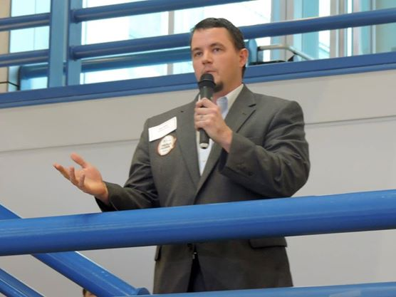
Sponsor
Cummings Scientific, LLC.
Forensic Engineering Consulting Firm
Specializing in accident reconstruction analysis, biomechanics, and biomedical engineering
Nation-wide leader in expert witness consulting
Representative: Beau Biller
Forensic Scientist/Engineering Manager
Joseph Godio

Slide 47
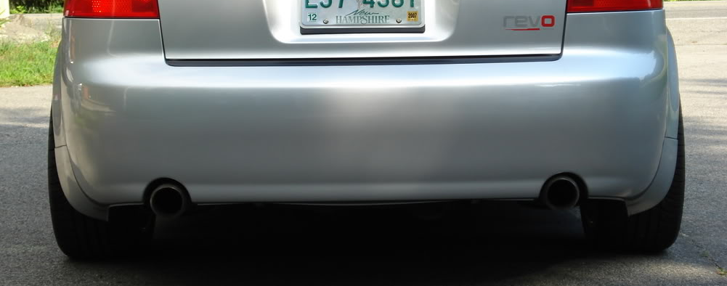
Project Summary
Data will be from a result of live crash tests
Bumper mount will be used to set parameters for collisions
Can improve mount if needed
Analysis of data will be performed using modeling software
Michael Small

Slide 48
Project Summary
Data will be from a result of live crash tests
Bumper mount will be used to set parameters for collisions
Can improve mount if needed
Analysis of data will be performed using modeling software
Michael Small

Slide 49
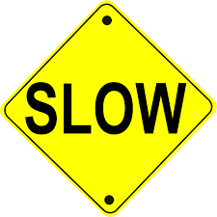
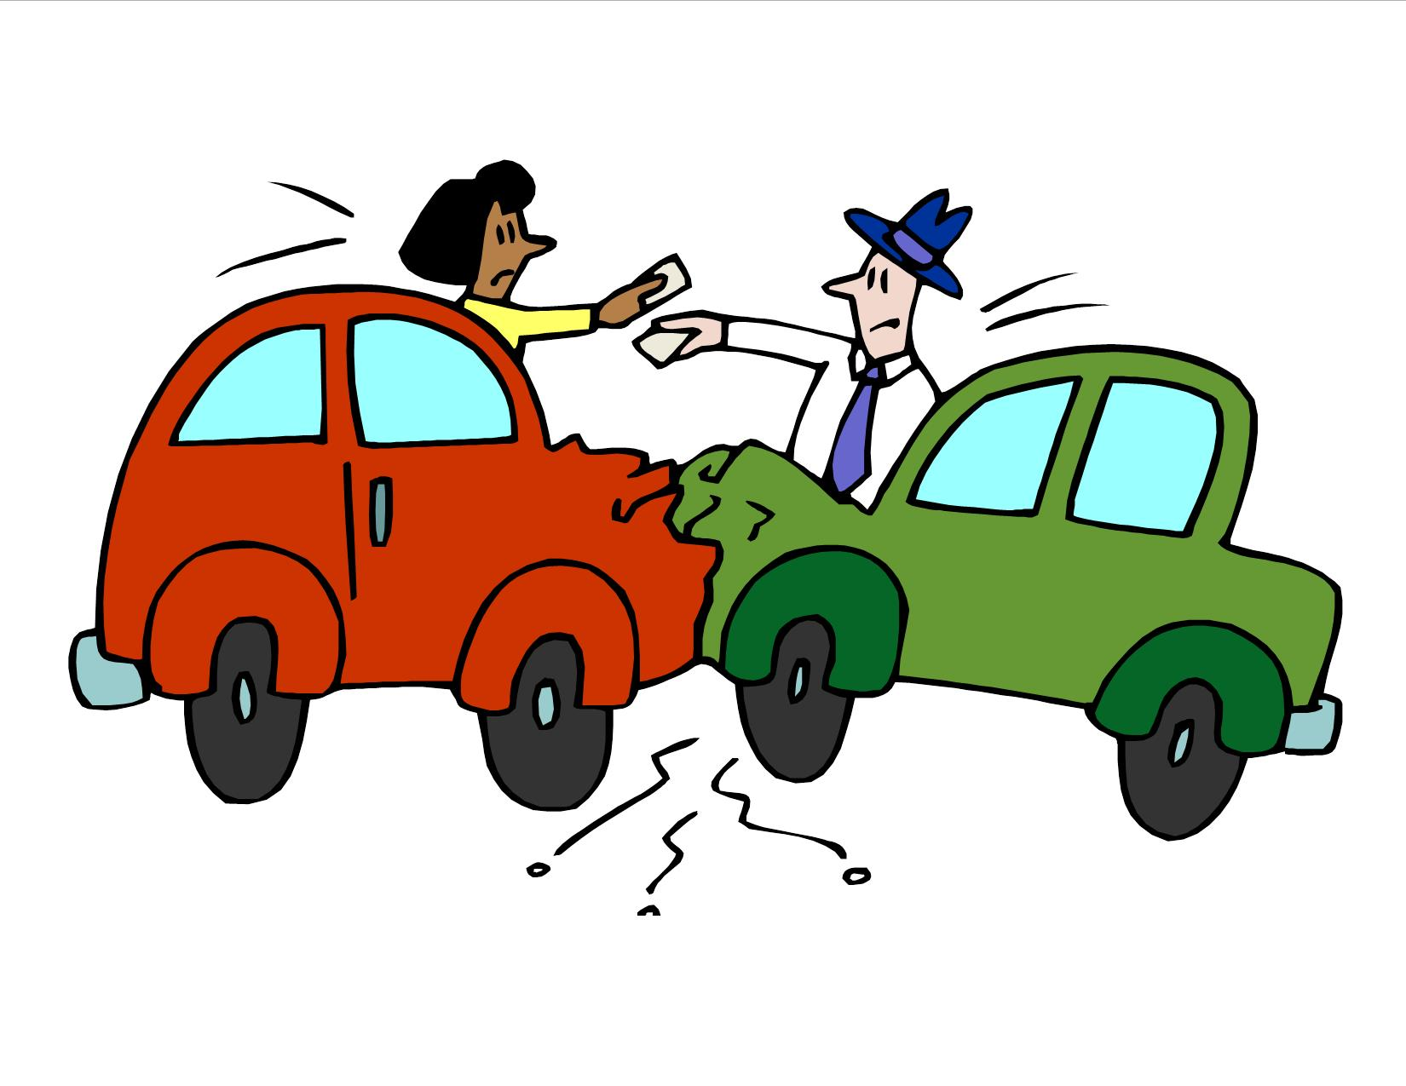
Background About Injury
Low speed collisions account for more long-term injury than any other crash mode
Annual cost of whiplash type injuries is north of a billion dollars
Determining the speed of the cars in these cases is necessary to determine claims
Our research will help establish a basis for low-speed related cases
Robert Montuoro

Slide 50
Target Summary
Project is primarily experimental, with no physical deliverable, thus we plan to validate using targets more than metrics
Metrics are ways to validate a function
Targets are specific values used to design around
Many of our decisions were made based on the previous team's testing and results, and what this phase of the project requires
Joseph Godio

Slide 51
Concept Selection
William Abraira

Slide 52
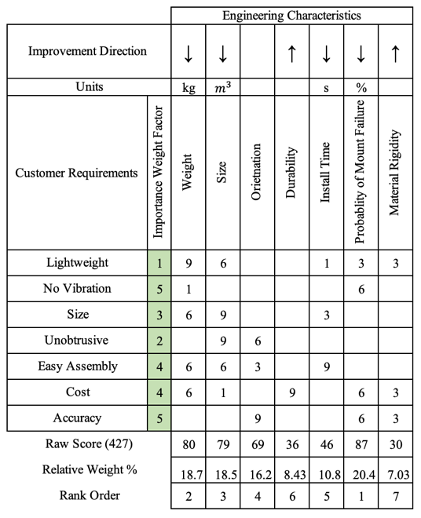
House of Quality
We made a House of Quality to compare the engineering characteristics to the customer requirements
William Abraira

Slide 53
House of Quality
We made a House of Quality to compare the engineering characteristics to the customer requirements
William Abraira
Notes:
Customer requirements that we were told and also interpreted based off the customer needs.

Slide 54
House of Quality
We made a House of Quality to compare the engineering characteristics to the customer requirements
William Abraira
Notes:
Engineering characteristics we determined that would be worth cross checking with the customer requirements.

Slide 55
House of Quality
We made a House of Quality to compare the engineering characteristics to the customer requirements
William Abraira
Notes:
Raw score was determined by adding a weight factor to each customer requirement and then weight (1,3,6,9) to the customer needs and engineering characteristics.

Slide 56
House of Quality
We made a House of Quality to compare the engineering characteristics to the customer requirements
William Abraira
Notes:
After analysis this was the ranking of what we believed to be most important to the design of our concepts.
Here the top 3 were:
Probability of mount failure
Weight
Size

Slide 57
Initial Pugh Chart
Compared to datum
+ for better than – for weaker than
William Abraira
Notes:
Here we used the suction mount as the datum and compared all the other concepts and designs to it.

Slide 58
Secondary Pugh Chart
A secondary test was run with the roof mounted gimbal as the datum and the sensor attached to the dash/suction cup camera as the other concepts
These were the top three concepts from last Pugh Chart
William Abraira

Slide 59
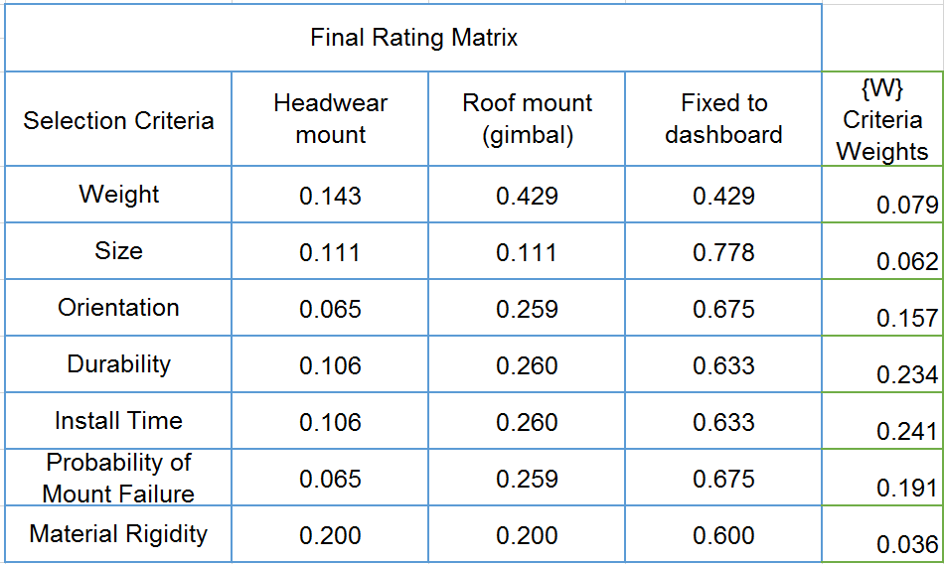
Analytical Hierarchy Process (AHP)
Analytical decision-making method that works alongside logic
A series of pairwise comparisons resulted in the weights and the ratings of our top 3 selection criteria
William Abraira

Slide 60
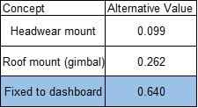
Analytical Hierarchy Process
Fixed to dashboard won
But we are hesitant to believe because there will be excess vibrational affects
Our sponsor recommended the gimbal would be the easiest and best for future testing circumstances
William Abraira

Slide 62
Budget Report
William Abraira

Slide 63
Budget Report
William Abraira

Slide 64
Budget Report
William Abraira

Slide 65
Standard Shapes
Summary Box
Text box 1
Outlined Text Box

Slide 66
Approved Logos

Slide 67
Color Palette

Slide 68
APA Tables
Category 1 | Category 2 | Category 3 | Category 4 | Category 5
Item 1
Item 2
Item 3
Item 4
 | Category 2 |  |  | Category 3
Category 1 | subcategory 1 | subcategory 2 |  | subcategory 1 | subcategory 2
Item 1
Item 2
Item 3
Item 4

