Slide 1
The Examination of Occupant and Vehicle Responses to Low Speed Rear-End Crashes
Team 504

Slide 2
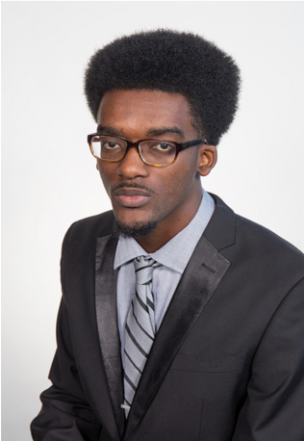
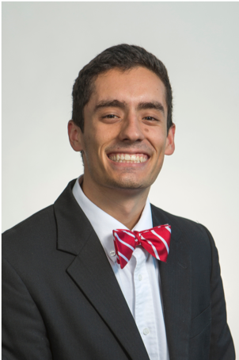
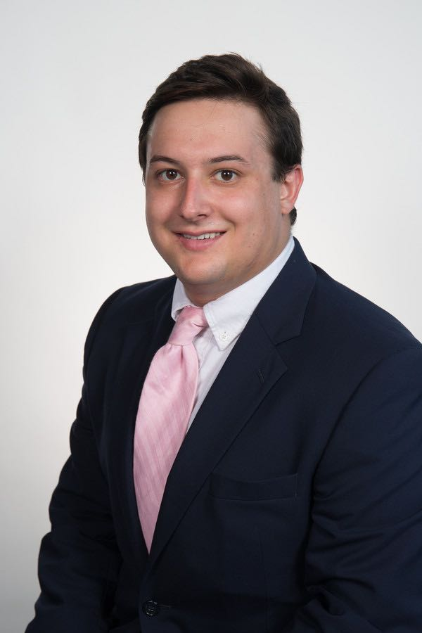
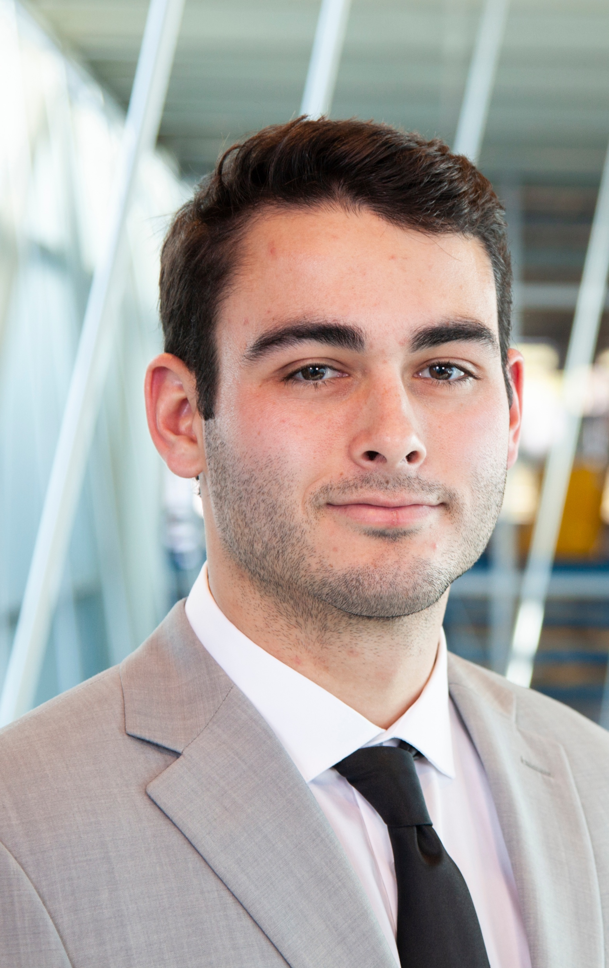
Team Introductions
Joseph Godio
Model Manager
Vincent Grimes
Project Manager
Michael Small
Analytics Engineer
Robert Montuoro
Design Engineer
William Abraira
Fiscal Engineer

Slide 3
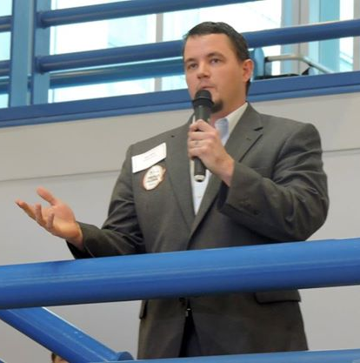
Sponsor and Advisor
Cummings Scientific Representative
Mr. Beau Biller
Forensic Scientist/Engineering Manager
Academic Advisor
Shayne McConomy, Ph.D.
Teaching Faculty/Professor

Slide 4
Objectives
Create a general empirical model for low speed collisions at or below 7mph
This will be done using live crash tests
Determine the relationship between occupant and vehicle responses
This will be used to validate expert witness claims in court
Further the current knowledge of low speed collisions
Todd Montuoro

Slide 5
Project Background
Todd Montuoro

Slide 6
Background About Cars
Most known information on crashes are at high speeds
Over 40 mph
Under 7mph, American bumpers are designed not to break, transferring more force through the vehicle
These impacts can cause “whiplash”
1 billion dollars in insurance claims a year
Todd Montuoro

Slide 7
Background About Whiplash
Whiplash is a neck injury caused by a rapid back-and-forth movement of the neck
Although the term is used frequently, whiplash is not a real physiologic injury
It can be used to describe a feeling or injury sustained, but one cannot be diagnosed with whiplash
Todd Montuoro

Slide 8
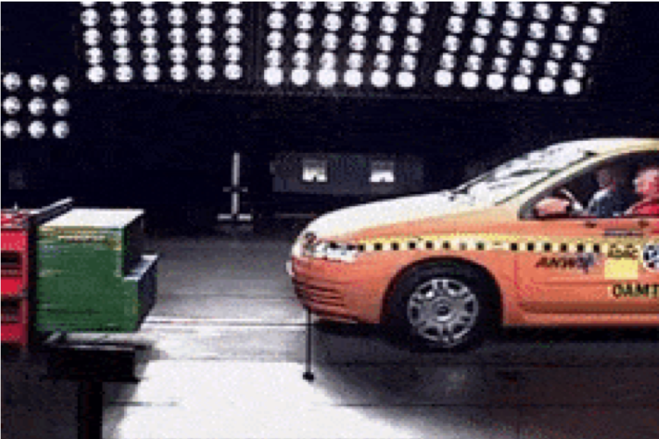
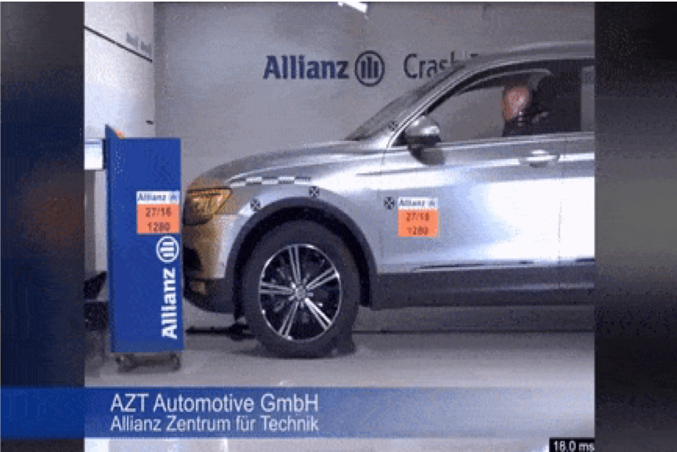
High Speed vs. Low Speed
Todd Montuoro

Slide 9
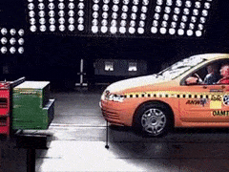
High Speed vs. Low Speed
Todd Montuoro

Slide 10
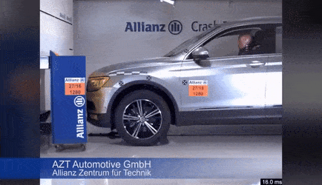
High Speed vs. Low Speed
Todd Montuoro

Slide 11
Project Scope
Todd Montuoro

Slide 12
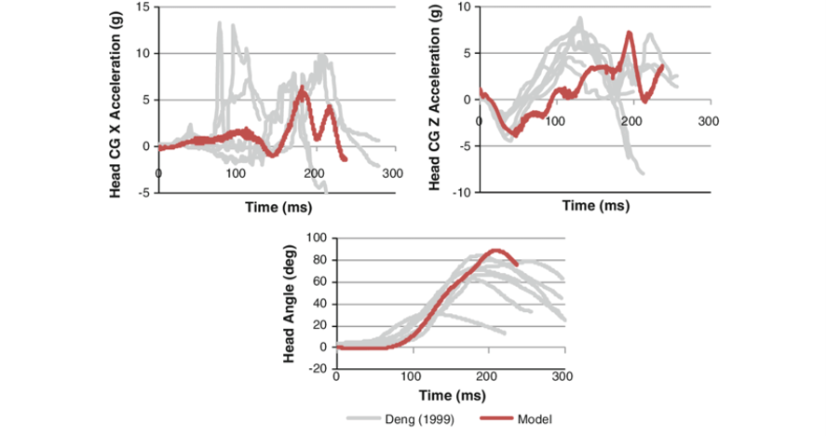
Testing and Modeling
Live crash testing is done using accelerometers monitoring movement of occupant and vehicle
Results will be analyzed using Mathematical Dynamic Modeling (MADYMO)
Modeling software that will interpret accelerometer data
Todd Montuoro

Slide 13
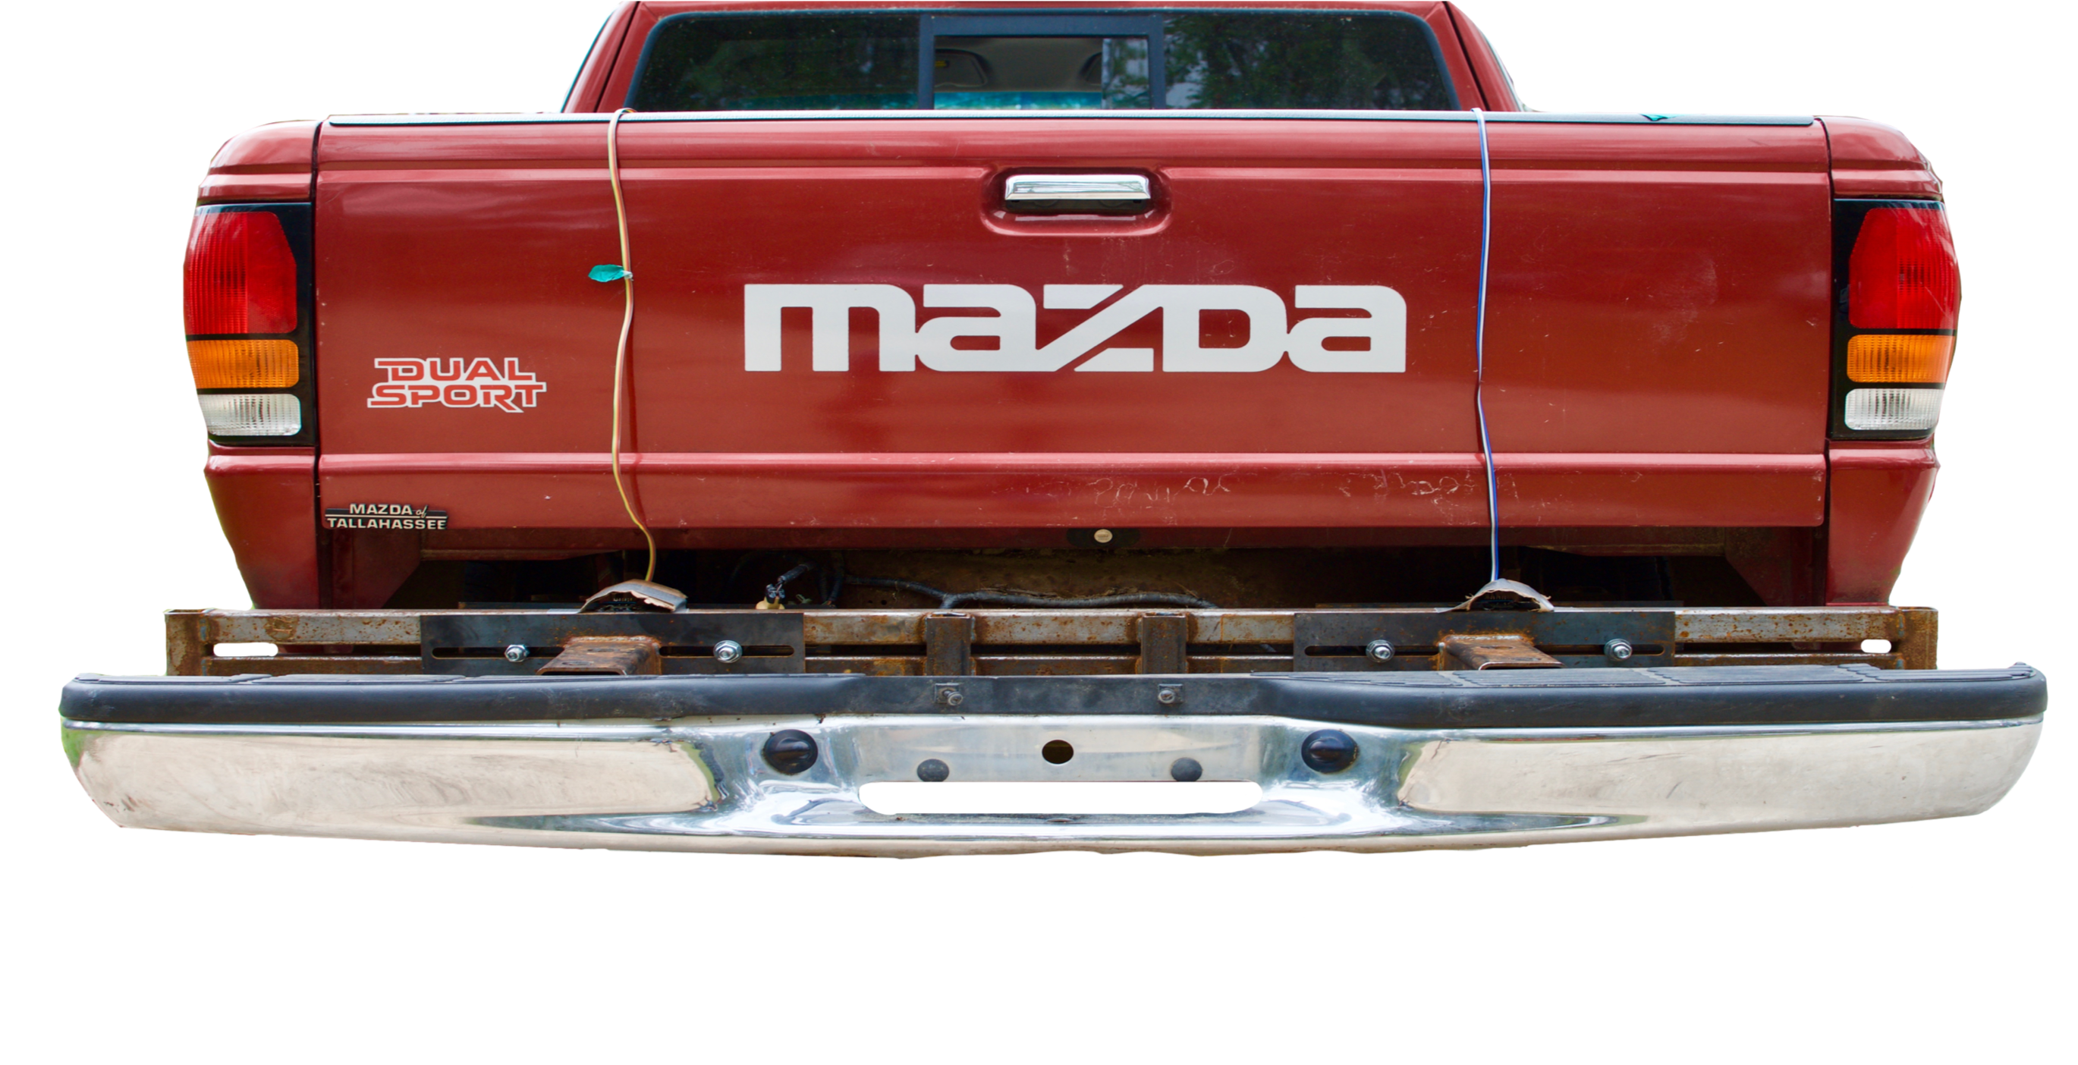
Experimental Setup
Interchangeable bumper mount used for easily repeatable testing
Designed to connect the stock bumper to the stationary car
Consistent testing parameters
Centered collision location
Travel path mapped by cones
Data acquisition
Todd Montuoro

Slide 14
Experimental Setup
Stationary car fixed with bumper mount will be hit from behind by another car traveling at ≤ 7mph
Accelerometers will be placed on the front car and front car occupant
Cummings representative Beau Biller will be the driver
Occupant and car responses will be analyzed
Repeated trials for an abundance of data
Todd Montuoro

Slide 15
Customer Needs
Todd Montuoro

Slide 16
Customer Needs
Easy assembly of test site and equipment
Able to determine force generated on the occupant based on speed of impact
Test sensors that are simple to use but are accurate
We are using Arduino connected accelerometers
Todd Montuoro

Slide 17
Customer Needs
Durable and robust testing rig
Combine results to create a simulation of crashes
Compare current methods with our test results
Increase in number of live crash tests
Todd Montuoro

Slide 18
Functional Decomposition
Vincent Grimes

Slide 19
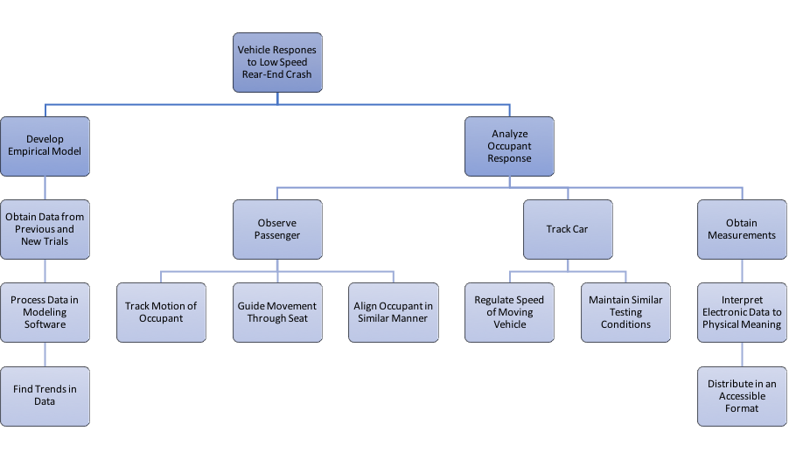
Functional Decomposition
Vincent Grimes

Slide 20
Functional Decomposition
Vincent Grimes

Slide 21
Develop An Empirical Model
Obtain data from previous trials
Already have 7-8 trials
Want to increase the number to approximately 35-40
Process data in modeling software
MADYMO
Find trends in data
Vincent Grimes

Slide 22
Functional Decomposition
Vincent Grimes

Slide 23
Analyze Occupant Response
Observe passengers
Roof mounted gimbal
Accelerometers to track movement
Track car
Allow the car to coast for a repeatable speed
Accelerometers on the car will analyze its change in speed
Obtain Measurements
Accelerometers, MADYMO
Vincent Grimes

Slide 24
Targets
Vincent Grimes

Slide 25
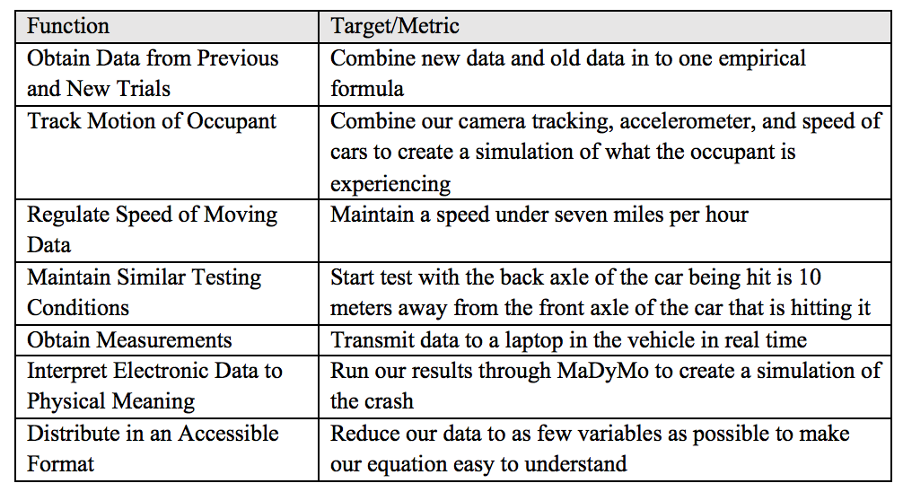
Target Table
Vincent Grimes

Slide 26
Target Table
Vincent Grimes

Slide 27
Target Table
Vincent Grimes

Slide 28
Concept Generation and Selection
Vincent Grimes

Slide 29
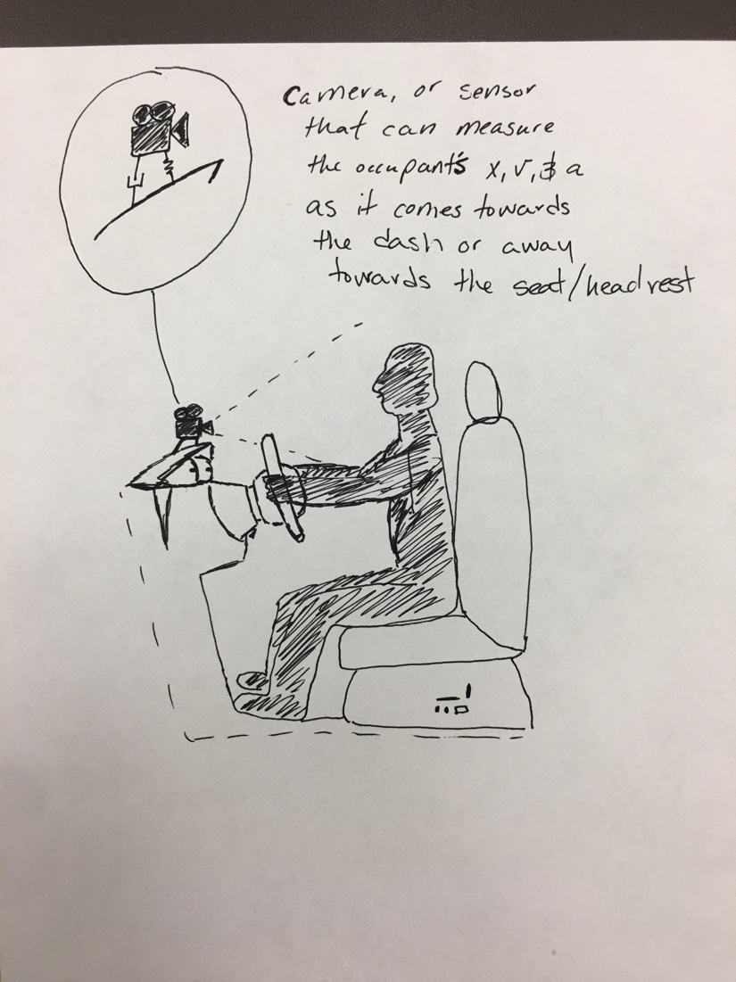
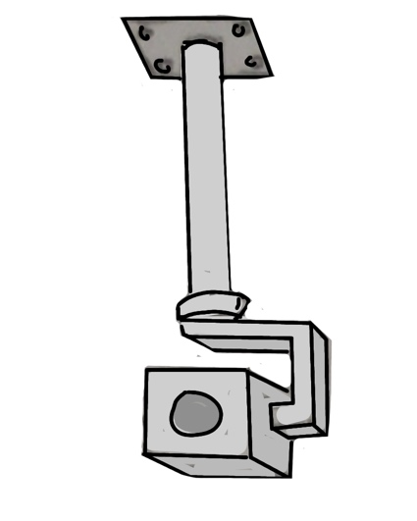
Concept Generation
We were tasked to develop a way to visually track the occupant
Potential ideas
Roof mounted gimbal
Dashboard mount
Headwear mount
Vincent Grimes

Slide 30
Concept Selection
Final selection was the roof mounted gimbal
Stable if mounted to the car
Did not interfere with testing
Provide clear recording
Our sponsor requested a roof mounted gimbal as it is easy to use and has limited room for error
Vincent Grimes

Slide 31
Manufacturing
Joseph Godio

Slide 32
Budget Report
Total budget was never set
We are told to plan for $1000
Total purchases were $825.85
$755.70 online purchases
$70.15 reimbursement total
Bumpers
Joseph Godio

Slide 33
Manufacturing Needs
Should we put anything here?

Slide 34
Testing
Joseph Godio

Slide 35
Testing Conditions
Our plans to produce repeatable tests and reliable results:
Consistent start zone and crash zone for the testing vehicles
Distance of 20 ft between each vehicle
Create guidelines for a consistent track
Speed of the vehicle is ≤ 7 mph
Driver and equipment monitored after each test
Joseph Godio

Slide 36
Possible Testing Problems
Plan to simulate all live-crash testing in one weekend. Although, potential testing problems exist:
Installation of the gimbal
Wiring set-up for the Arduino
Damages to equipment
Data acquisition
Accurate readings from accelerometers
Photography from camera
Scheduling with our sponsor
Joseph Godio

Slide 37
Future Work
Joseph Godio

Slide 38
Future Work
Three major components:
Mounting the gimbal
Solder wires and mount the Arduino
Develop a method to obtain the data from the testing
Joseph Godio

Slide 39
Mounting the Gimbal
In order to have the tracking camera, the gimbal must be mounted
Will be positioned upside down
Must drill into the the roof to mount
Joseph Godio

Slide 40
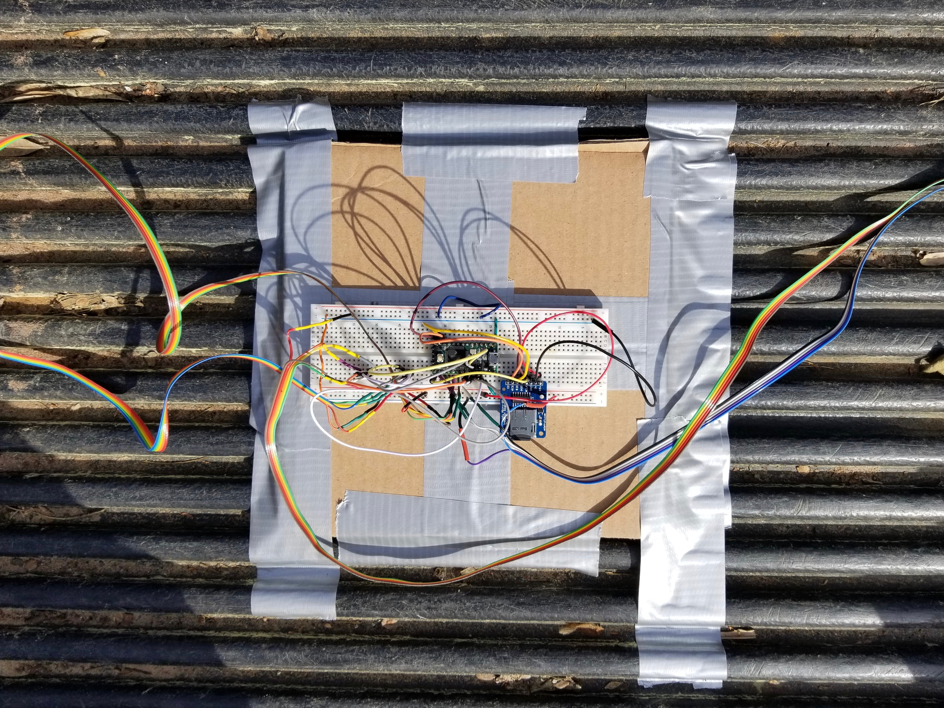
Arduino Wiring
The wiring needs to be updated to decrease room for error
A custom mount will be used to ensure accuracy
Joseph Godio

Slide 41
Acquiring and Processing Data
We need to gain more knowledge in MADYMO
Biggest roadblock in the foreseeable future
No convenient access to the program
Moderately difficult learning curve
Limited online tutorial videos
Joseph Godio

Slide 42
Four Most Important Points from this Lecture
We were tasked with designing and improving low speed crash test data knowledge by Cummings Scientific
The testing variables are going to be the same (speed, car model, occupant number, etc) except the bumper will be changed
We are going to use a camera to collect more data and the mounting of said camera was chosen to be a roof mounted gimbal
The test results will create a simulation of a low speed rear impact crash and our data will be used to help validate/oppose claims
Joseph Godio

Slide 43
References
http://cummingssci.com/associates-bb.php
https://www.sciencedirect.com/science/article/pii/S0001457515000354
https://www.iihs.org/iihs/sr/statusreport/article/39/9/1
https://www.researchgate.net/figure/Global-kinematic-response-of-the-model-during-a-7g-rear-impact-Muscle-activation-not_fig5_51089862
https://ww2.eng.famu.fsu.edu/me/senior_design/2018/team02/sponsor.html
Notes:
Not this slide will advance on default after 2 seconds. If you would like to change this then go to the transition tab and under timing change the advance slide settings.

Slide 44
Questions

Slide 45
Backup Slides

Slide 46
Lessons Learned

Slide 47
Functional Decomp Backup

Slide 50
Concept Selection Backup

Slide 53
Detailed Math Backup

Slide 56
Standard Shapes
Summary Box
Text box 1
Outlined Text Box

Slide 57
Approved Logos

Slide 58
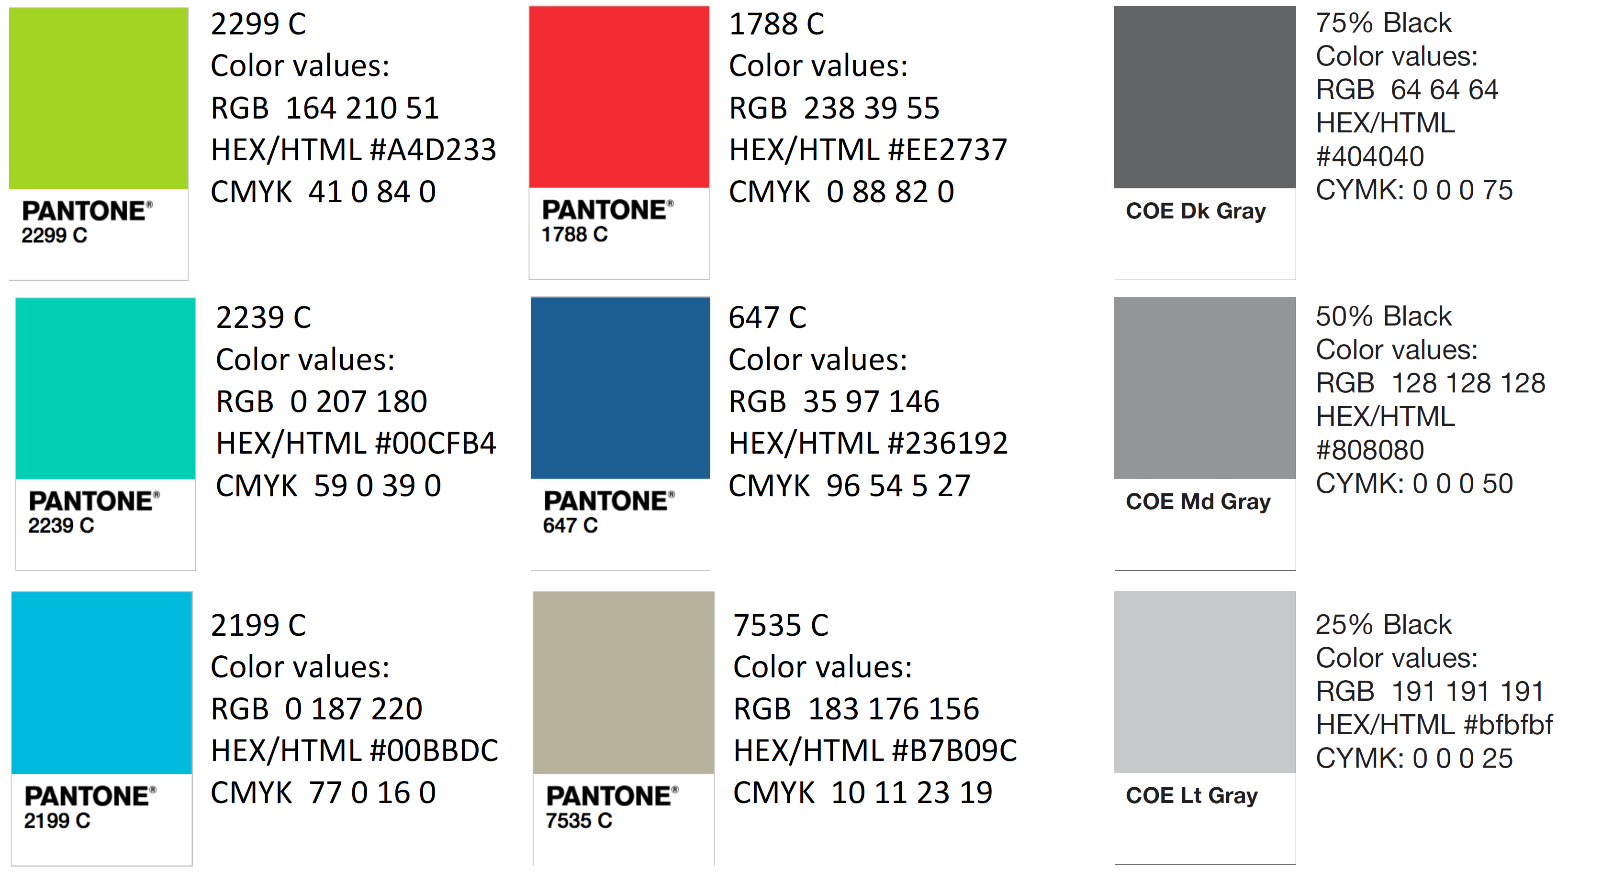
Color Palette

Slide 59
APA Tables
Category 1 | Category 2 | Category 3 | Category 4 | Category 5
Item 1
Item 2
Item 3
Item 4
 | Category 2 |  |  | Category 3
Category 1 | subcategory 1 | subcategory 2 |  | subcategory 1 | subcategory 2
Item 1
Item 2
Item 3
Item 4

