Slide 1
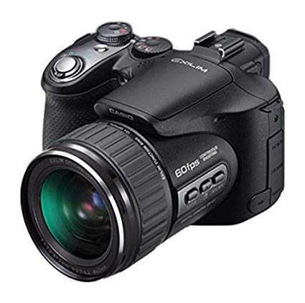
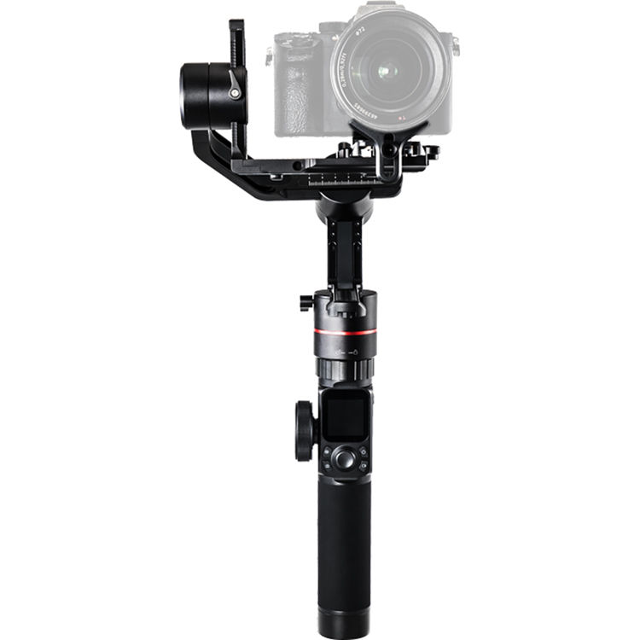
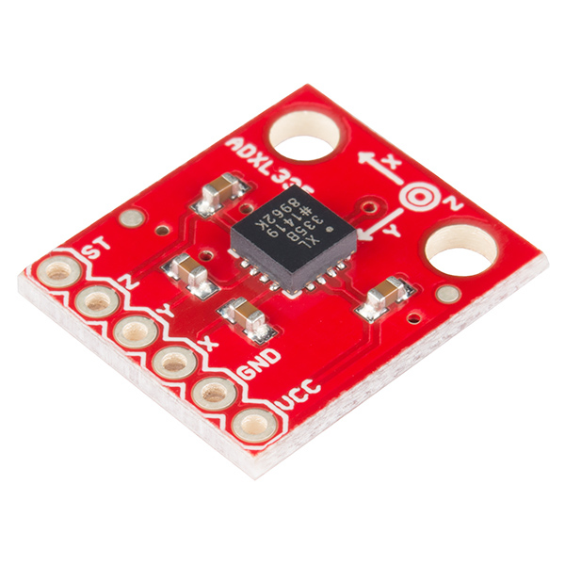
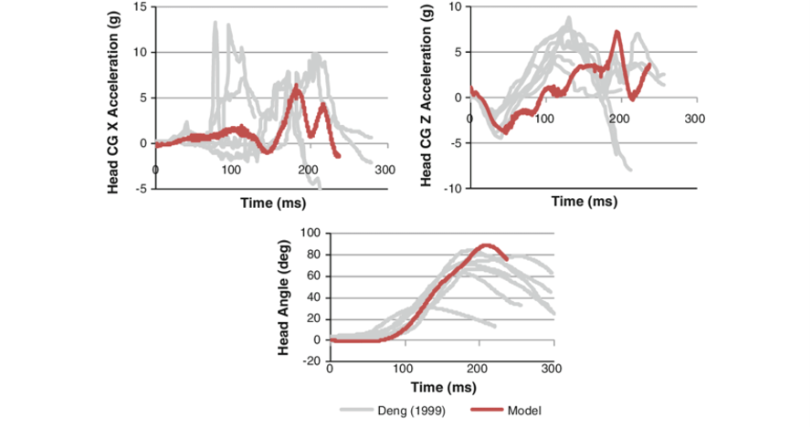
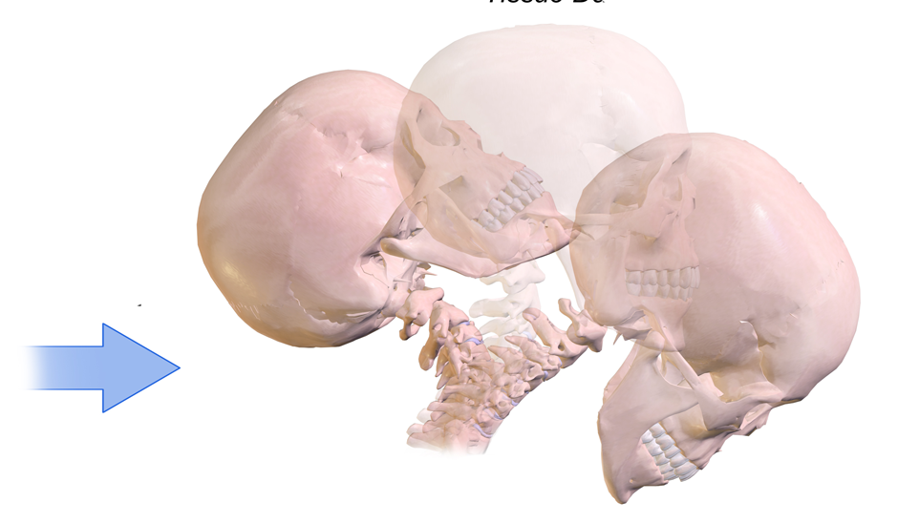
Team 504: The Examination of Occupant and Vehicle Responses to Low Speed Rear-End Collisions
Objectives
Data Acquisition
Determine a relationship between the occupant and vehicle responses to low speed collisions
Analyze the effects of ‘whiplash’
Create a model based off data
Further the knowledge on low speed collisions
Visual
Analytical
Whiplash Background
Under 7mph, the bumpers are not made to deform, so more forces are transferred through the vehicle to the occupant
The feeling of whiplash is used most frequently in these cases
Whiplash is caused by a back-and-forth movement of the neck
Used to describe a feeling than being a diagnosis
Our results will show, in this particular scenario, the forces felt by the occupant
Testing
Procedure
Future Work
Live low-speed crash testing
Easy-setup testing rig for repeatable purposes
30 – 40 trials (plus previous 8)
Collecting two types of data:
Visual - video tracking
Roof mounted gimbal
Analytical – motion tracking
Car and occupant accelerometers
Cars will be aligned directly in front/behind
Test car will be hit from behind moving at a speed of 7mph (coasting speed)
Once struck, accelerometers read movement of person and truck
Numerical data is exported to readable format
Process will be repeated for definite conclusion
Interpret our data in MADYMO
Draw conclusions based on overall data
Display our data/findings in an appropriate and understandable manner
Acknowledgements
Team 504 would like to thank Cummings Scientific and their representative, Beau Biller, for bringing this project to fruition. We would also like to thank Dr. McConomy and Dr. Clark for their continuous aid in the design and analytical processes. Finally, we would like to again thank Dr. McConomy for keeping the team on track and stimulating our minds.
Team Members: William Abraira, Joseph Godio, Vincent Grimes, Robert Montuoro, and Michael Small
Sponsor: Beau Biller | Faculty Assistance: Jonathan Clark, Shayne McConomy| Adviser: Shayne McConomy

