Slide 1
DR 4 The Detector Baby
Team 511
Karli Cash, Matthew Zawiski, Shadi Bilal, David Miller
29-Jan-19

Slide 2
Team Introductions
Karli Cash
Team Manager
Shadi Bilal
Test Engineer
Matthew Zawiski
Software Engineer
David Miller
Design Engineer/ Financial Manager, Webmaster

Slide 3
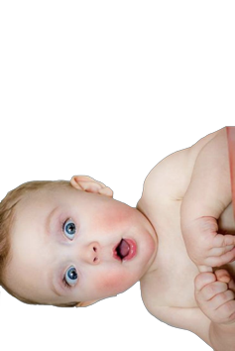
Project Brief
High infant fatalities rates due to being left behind in cars.
According to the Safety Organization of Kids and Cars, an average of 37 kids die each year in hot cars (Willingham, 2018).
Our sponsor Lisa Allen has recruited our team to create a device to prevent the death of infants left behind in cars.
Our device will alert parents/caregivers when a child remains in a car and also measure the temperature in the surrounding environment.
Karli Cash

Slide 4
Project Expectations
Design a functional device that will accurately detect an infant left behind in a vehicle and effectively alert user.
Design a device with minimal error outcome.
Construct a durable device that has the ability to operate in critical temperature conditions.
Design a device that will effectively lower yearly infant fatality rates.
Design a marketable device that will be sold to parents/legal guardians.
Karli Cash

Slide 5
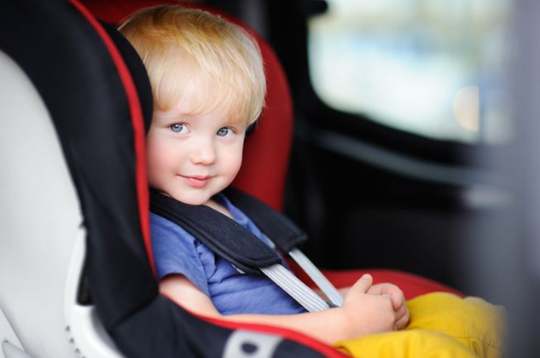
System Breakdown
Alert parents when child remains in stationary vehicle.
Measure inside car temperature and inform parent when temperature becomes unsuitable.
Measure rate of change of interior temperature.
Alert emergency personnel if no action is taken in a certain time period.
Karli Cash

Slide 6
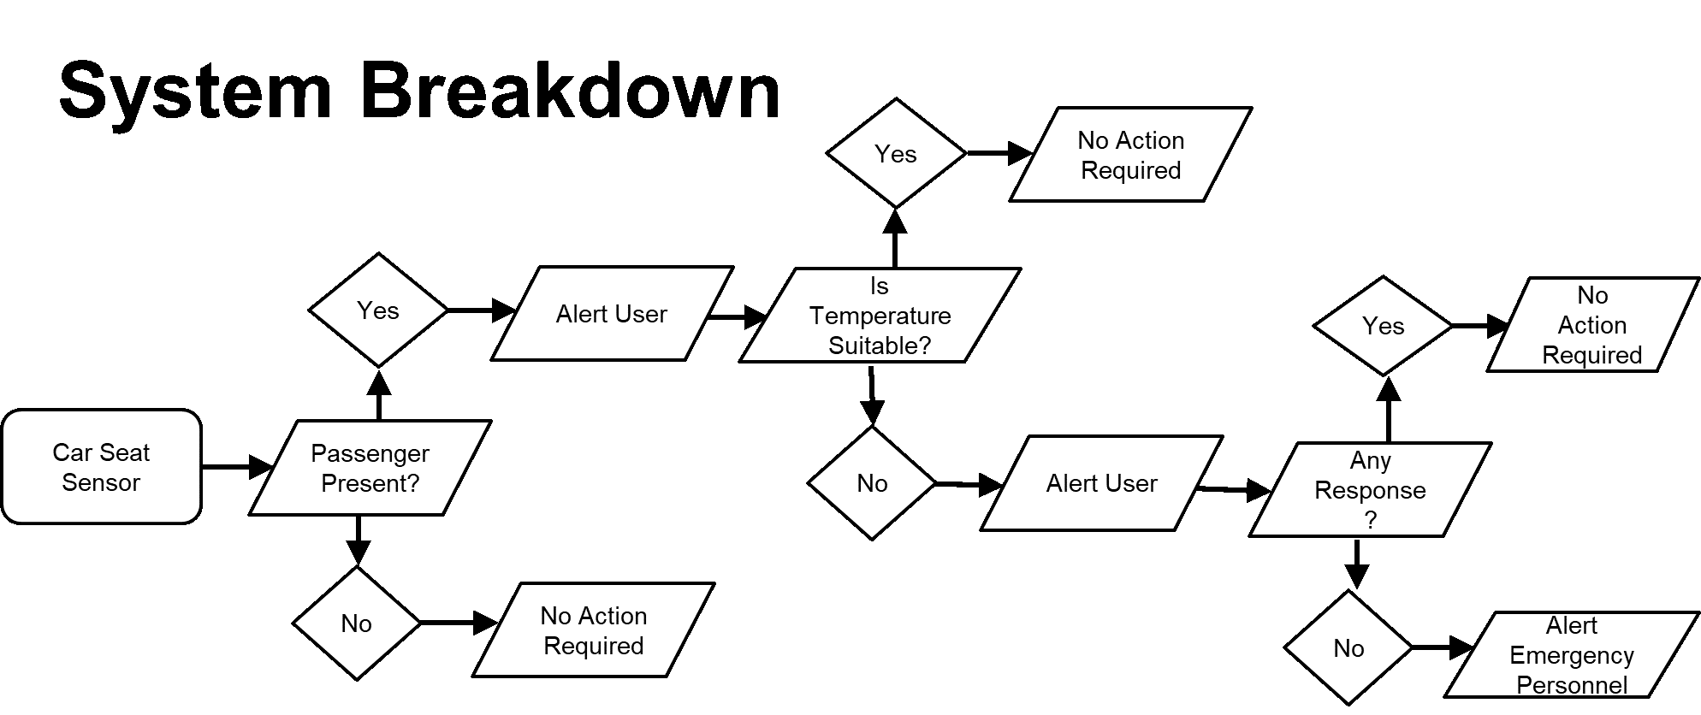
Karli Cash

Slide 7
Customer Needs
Innovative Logistics wants to market a device that will decrease fatalities resulting from children being left behind in cars.
Uses two components:
One located in the car evaluating the environment.
Another carried by the user to alert of passenger detection and life-threatening conditions.
Alert 911 emergency personnel providing GPS location and conditions in the vehicle if child is neglected.
Design around the provided budget ($500-2500)
Shadi Bilal

Slide 8
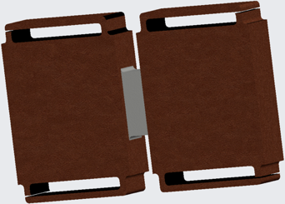
Final Design Specifications
Preliminary Buckle Design
The final design is a combination of:
- A baby monitor attached to the car seat buckles
- A positive/ negative temperature coefficient thermistor
- Rate of temperature increase
- A key fob
Device should be compatible with all car seats.
Detect if baby is in car seat.
Display temperature ranges
Alert users and emergency personnel.
Device should not be in power or measuring temperatures when passenger is not present.
Shadi Bilal

Slide 9
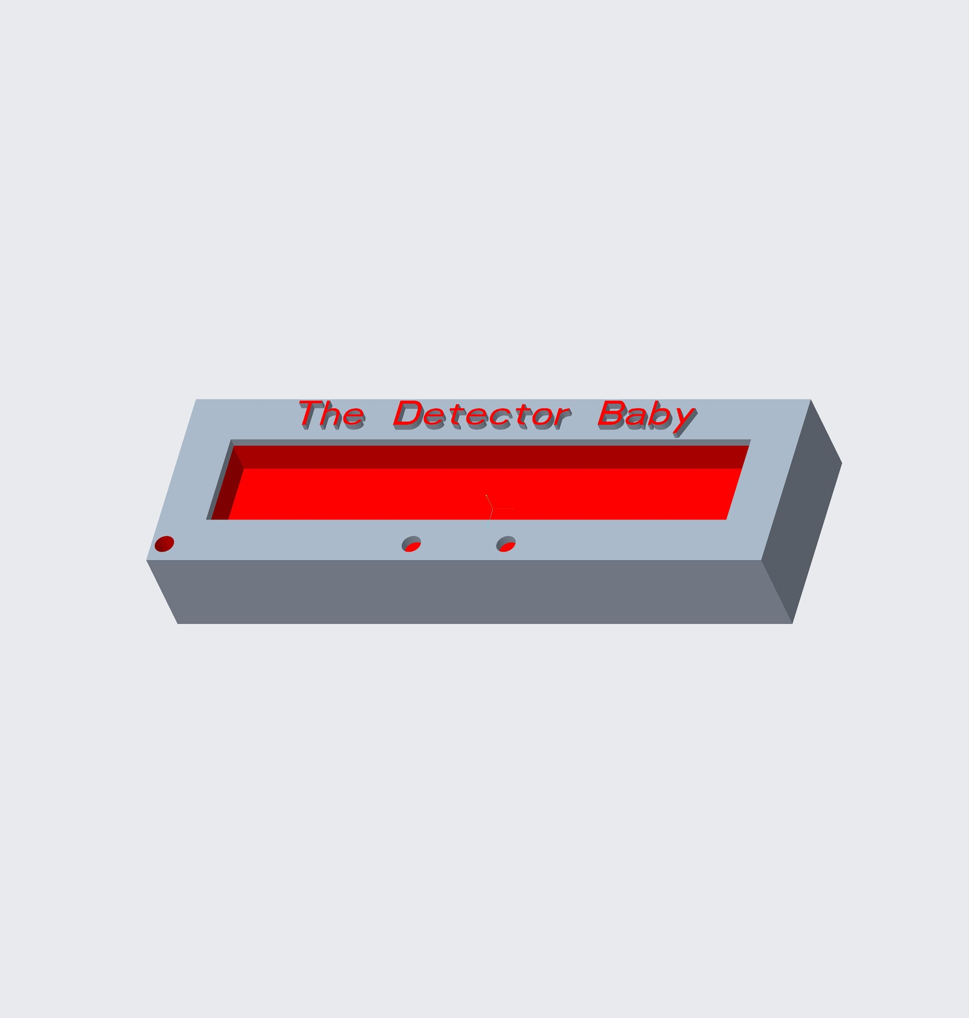
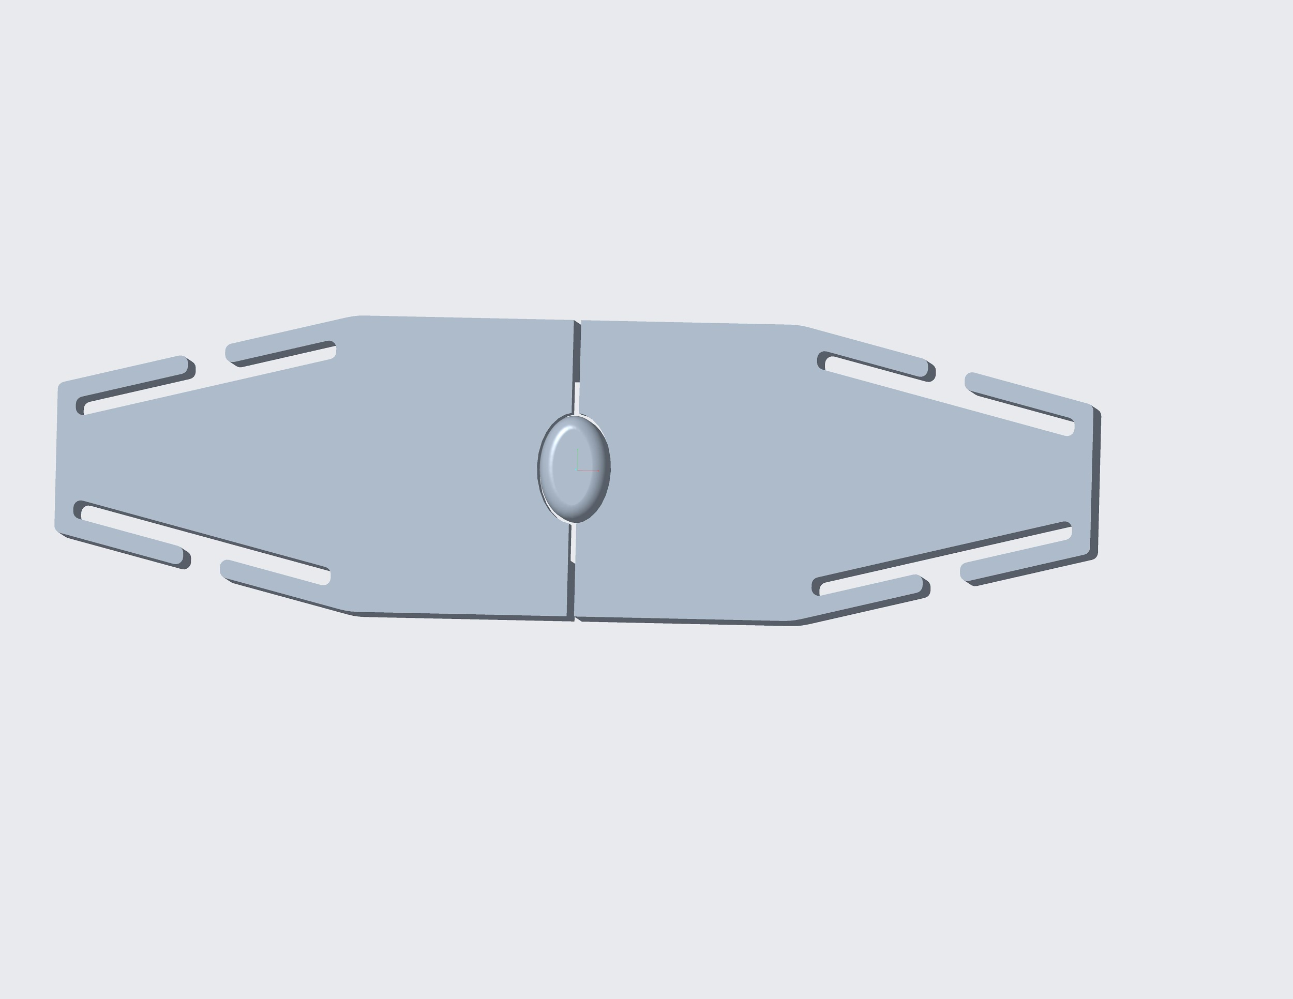
Chosen Prototype Design
Key Fob Prototype
Seat Belt Buckle Prototype
Shadi Bilal

Slide 10
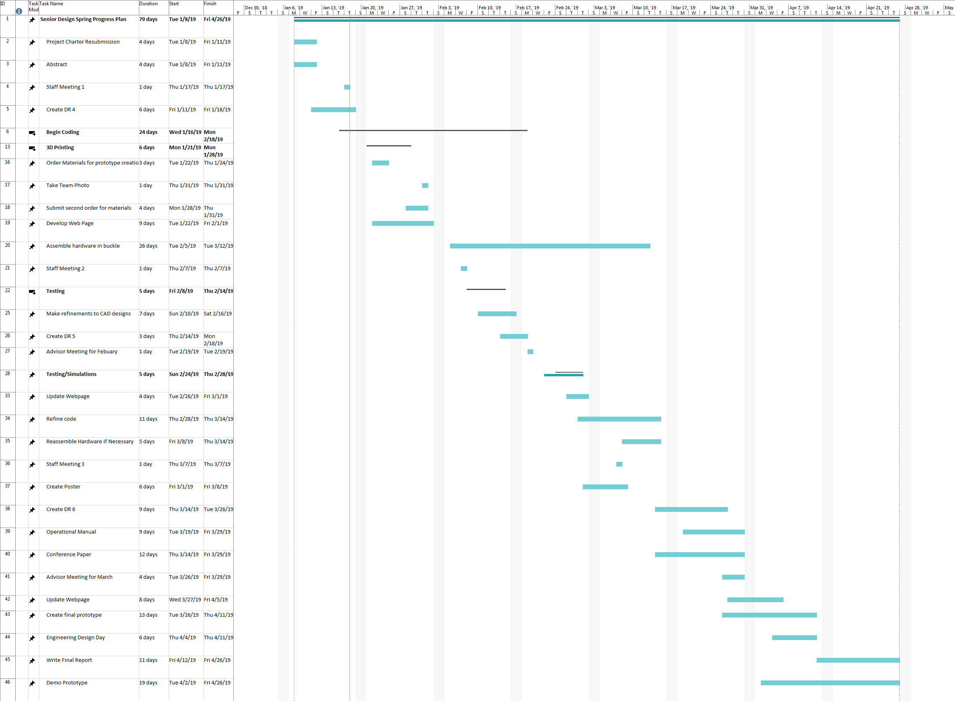
Shadi Bilal

Slide 11
Completed Work in January
Written abstract
Revised project charter
Initial seat belt buckle coding
Displays alert on LCD screen when seat belt is buckled (i.e. when button is pushed)
Dismiss message when standby button is pushed
Measures the temperature of the room
Displays alert on LCD screen when temperature rises above set parameter
Shadi Bilal

Slide 12
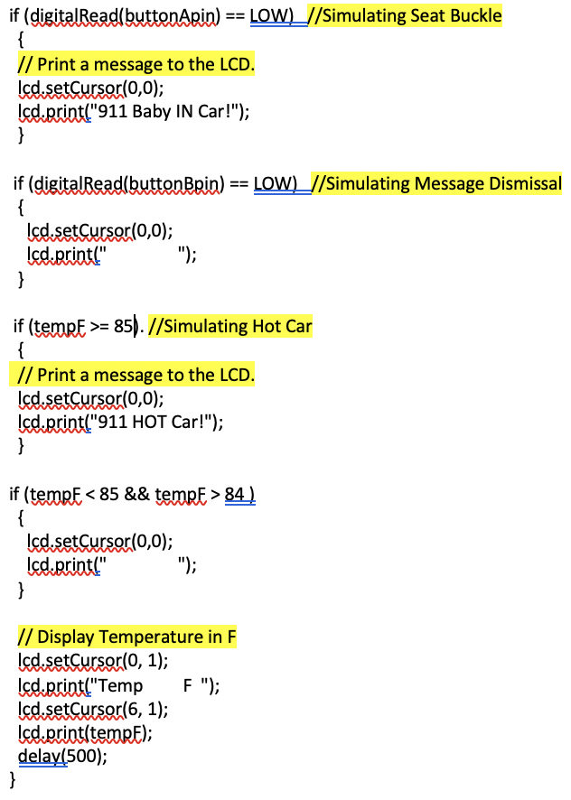
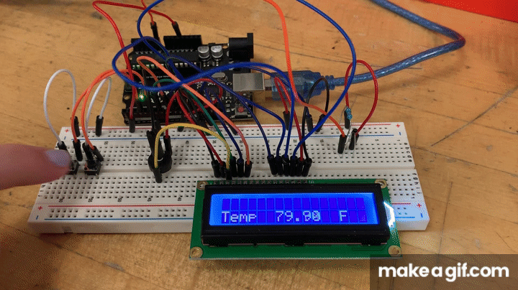
Progress
Karli Cash

Slide 13
Upcoming Hardware Components
Magnetic Reed Switch
Magnetically activated switch located in buckle used to detect presence of a child and activate code.
Accelerometer
Used as a fail safe when initially entering car to detect movement of the vehicle and prevent alarming when initially placing child in hot car.
Wifi or Bluetooth Signal
After alarm is ignored for a certain period, a signal will be wirelessly transmitted to activate blue and red LED’s, simulating a contact with the authorities.
Speakers, Buzzers and Vibration Sensors
Placed within the key fob to alert the parents when necessary.
Transmitter and Receiver
Hardware to connect the key fob and buckle and transmit information, such as temperature, movement and presence of child.
Karli Cash

Slide 14
Testing Parameters
The accuracy of temperature detection will be tested using a standard thermometer and comparing readings.
Response range will be tested by measuring the distance the two devices can operate until feedback is no longer received.
To insure devices can operate properly in high temperatures it will be placed in an environment simulating that of a hot car.
Test to ensure device can detect when a passenger is in the car seat.
Test to make sure the key fob is able to snooze/dismiss alerts from afar.
Test to make sure all devices can operate wirelessly.
Shadi Bilal
Notes:
This test would be repeated multiple times at and above the critical temperature to insure its accuracy.
(continuing on last bullet point)

Slide 15
Future Work
Have 3D printed parts done at the Innovation hub
Have initial coding completed and ready for initial tests
Refine CAD as needed
Develop web page
Order materials
Assemble hardware in devices
Shadi Bilal

Slide 16
References
Willingham AJ. (2018) More than 36 kids die in hot cars every year and July is usually the deadliest month. CNN. Retrived from https://www.cnn.com/2018/07/03/health/hot-car-deaths-child-charts-graphs-trnd/index.html.
.
Notes:
Not this slide will advance on default after 2 seconds. If you would like to change this then go to the transition tab and under timing change the advance slide settings.

Slide 17
Questions?

