Slide 1

Simulated Assembly Line and Process Workstation
Team 520
Sponsor: Tallahassee Community College
Sponsor Representatives: Bobette Stubble and Dylan Sutton
Academic Advisor: Dr. Dorr Campbell
Instructor: Dr. Shayne McConomy

Slide 2





Group Introduction
Cheyenne R. Laurel
Project Manager
David C. DiMaggio
Design Engineer
Boluwatife Olabiran
Program Engineer
Nataajah Taylor
Software Engineer
Joell Williams
Test Engineer

Slide 3
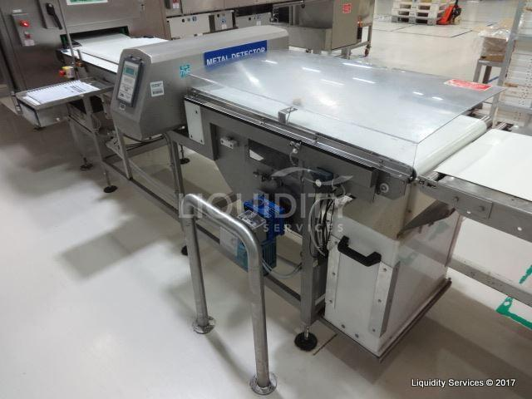
Project Overview
TCC needs an automated assembly station for teaching and certifying their students in a mechatronic program. The team is required to build a conveyor belt system with categorizing and sorting capabilities using materials provided.
Example of Material Detection Manufacturing Machine
Nataajah Taylor​

Slide 4
Project Scope
This machine will teach the integration of electrical and mechanical components in a factory-style setting.
Based on products Tallahassee Community College (TCC) has already purchased, materials of different sizes will be detected and sorted according to required conditions using the technologies previously described.
The major stakeholders in this project include Tallahassee Community College (TCC), and the students of TCC that will use the machine as learning or other project piece.
Nataajah Taylor

Slide 5
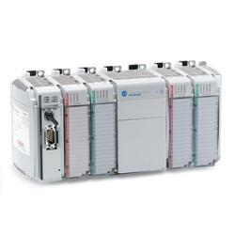
Manufacturing Background
Assembly lines date back to early 19th century in the meatpacking industry with overhead trolleys, automotive industry optimized assembly line.¹
Current manufacturing relies on programmable logic controllers (PLCs) to automate manufacturing processes ⁴
  A PLC is an industrial digital computer that controls manufacturing processes with high reliability control and ease of programming and process fault diagnosing.
  Allen-Bradley PLCs and Rockwell Automation
Allen Bradley Compact Logix PLC
Cheyenne Laurel

Slide 6
Customer Needs
Automatic assembly line capable of moving products through manufacturing processes
Manufacturing processes must include:
  Detection of object
  Differentiation of object characteristics (size, material, etc.)
  Physical redirection of product based on characterization
Modular system integration to allow for instructing problem diagnoses and resolution
Mechatronic program manipulation
  Program must be able to be manipulated to use as educational tool for a mechatronic certification process
Nataajah Taylor

Slide 7
Requirements
Conveyer Belt
Sensors
Guiding Device
Item Placeholders
Easy programmable methods
Nataajah Taylor

Slide 8
Manufacturing Technology
Proximity Sensor
Solenoids
Photoelectric Sensor
Nataajah Taylor

Slide 9
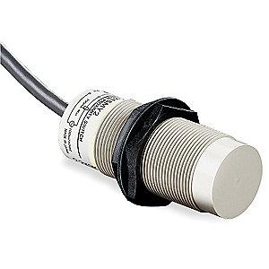
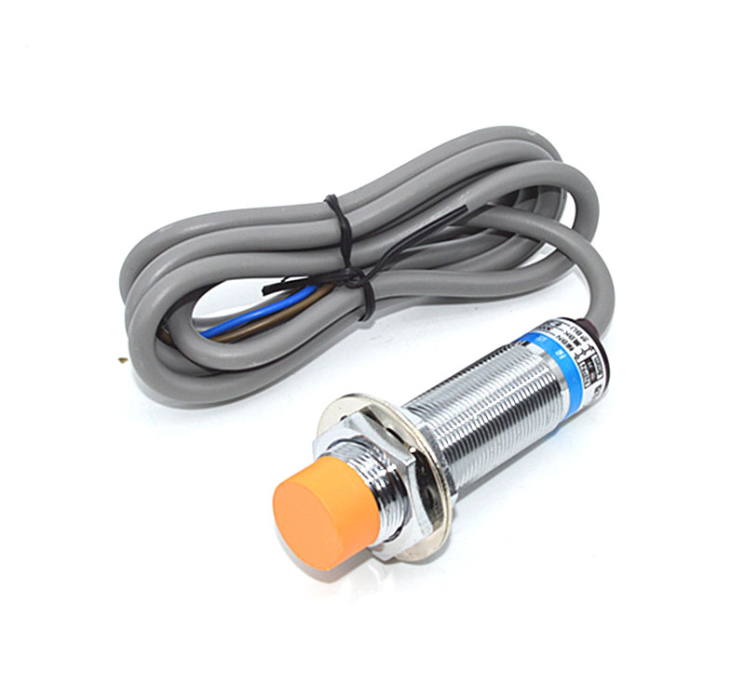
Proximity Sensor
  Proximity Sensor
    Detects the presence of nearby objects without any physical contact
    Requires object to be within a few millimeters of sensor
Proximity Sensor
Capacitive (Used in Project)
Proximity Sensor
Inductive
Cheyenne Laurel

Slide 10
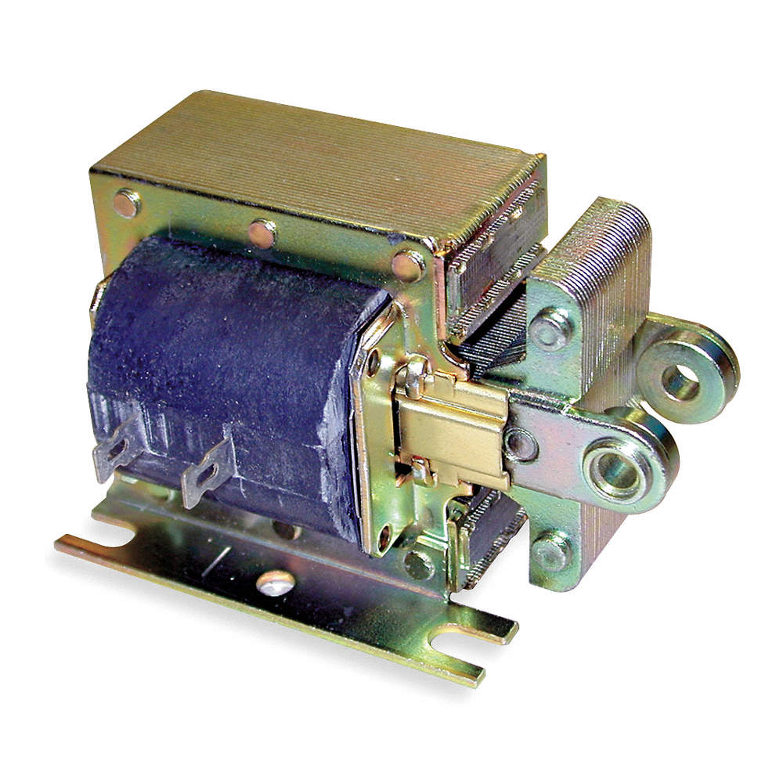
Solenoids
Solenoids
  Use electric currents to create an electromagnetic field in the stacked sheets of metal to create a mechanical motion.⁶
  Many different types for different applications
  Will be using AC Laminated Linear Solenoid
Dormeyer 120VAC Continuous Solenoid
Cheyenne Laurel

Slide 11
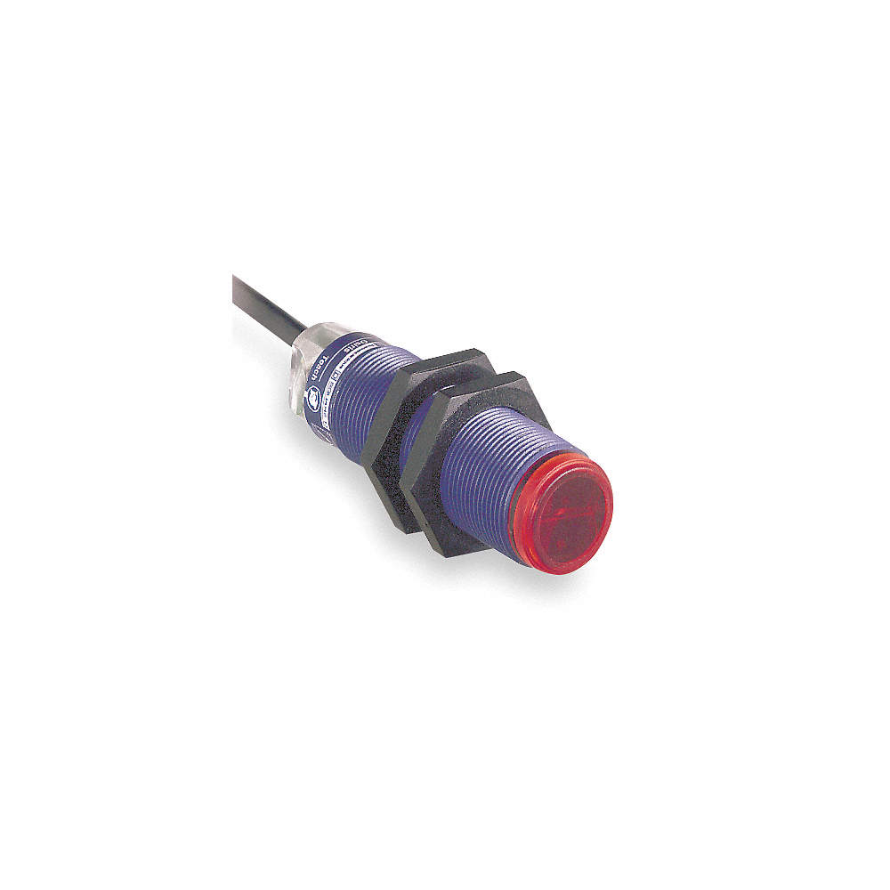
Photoelectric Sensor
Photoelectric /Retroreflective Sensor
  The light emitter and receiver are in the same unit, so a reflector is needed for the sensor to be able to detect if the light beam is being blocked or reflected to determine size, opaqueness, material, etc.⁵
TELEMECANIQUE Photoelectric Sensor
Cheyenne Laurel

Slide 12
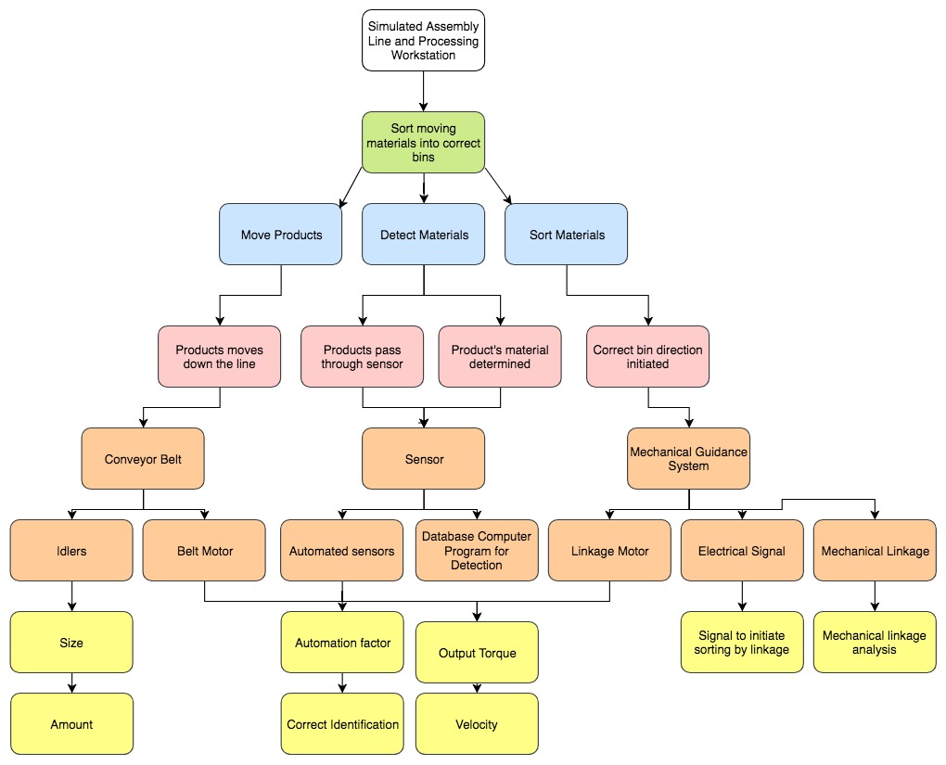
Functional Decomposition
Cheyenne Laurel

Slide 13
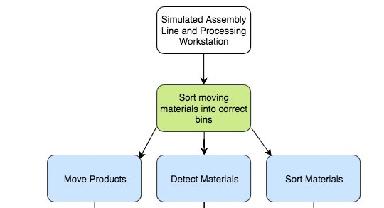
Cheyenne Laurel

Slide 14
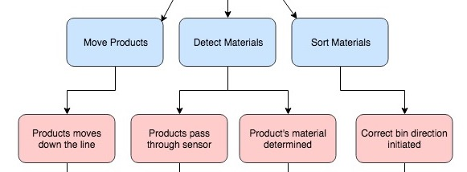
Cheyenne Laurel

Slide 15
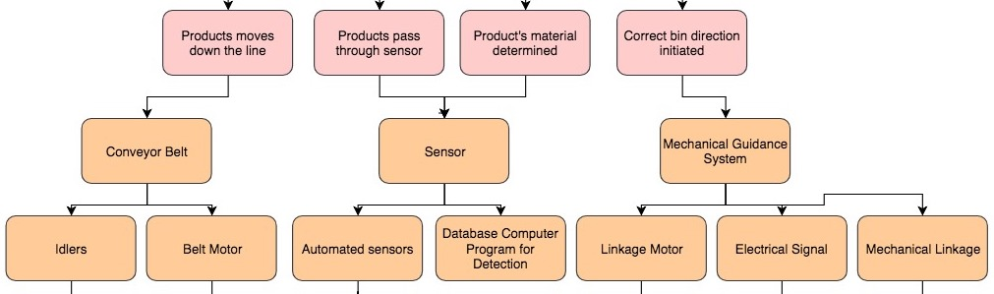
Cheyenne Laurel

Slide 16
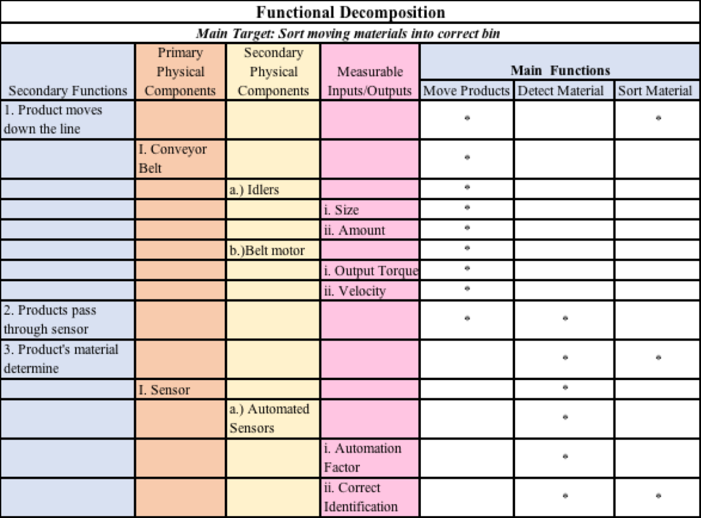
            Bullets represent areas where the secondary functions, and corresponding physical components are required in order to complete the three main functions of the machine.
            More bullets next to the secondary functions and components indicate a more important part of the system
Cheyenne Laurel

Slide 17
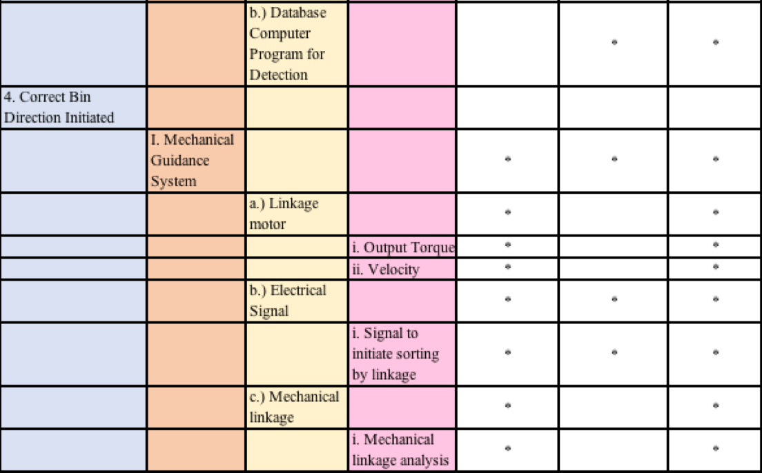
            Based on the table, the mechanical guidance system that will be used to redirect the objects to their designated line, and the electrical signal that initiates sorting, are key to making all three functions happen.
Cheyenne Laurel

Slide 18
References
1. Kranzberg, M., & Hannan, M. T. (2017, June 02). History of the organization of work. Retrieved from https://www.britannica.com/topic/history-of-work-organization-648000/The-assembly-line#ref539120
2. CEIA , THS, Metal Detector, 2011, Serial number 20800450034, aperture 550 x 75mm, belt 2750 x 500mm .This items will be. (n.d.). Retrieved from https://www.go-dove.com/en/auction/view?id=13216983
3. Free flowchart maker and diagrams online. (n.d.). Retrieved from https://www.draw.io/.
4. Flexible & Easy to Configure. (n.d.). Retrieved from https://ab.rockwellautomation.com/
5. 48mm Retroreflective Cylindrical Photoelectric Sensor; Max. Sensing Distance: 3.0m. (n.d.). Retrieved from https://www.grainger.com/product/TELEMECANIQUE-SENSORS-48mm-Retroreflective-Cylindrical-32J327?searchBar=true&searchQuery=32J327
6. T. (2018, January 31). Solenoid, 120VAC Coil Volts, Stroke Range: 1/8" to 1", Duty Cycle: Continuous. Retrieved from https://www.grainger.com/product/DORMEYER-Solenoid-4X241?searchBar=true&searchQuery=4X241
Notes:
Not this slide will advance on default after 2 seconds. If you would like to change this then go to the transition tab and under timing change the advance slide settings.

Slide 19
Questions?

