Slide 1

Simulated Assembly Line and Process Workstation
Team 520
Sponsor: Tallahassee Community College
Sponsor Representatives: Bobette Stubble and Dylan Sutton
Academic Advisor: Dr. Dorr Campbell

Slide 2

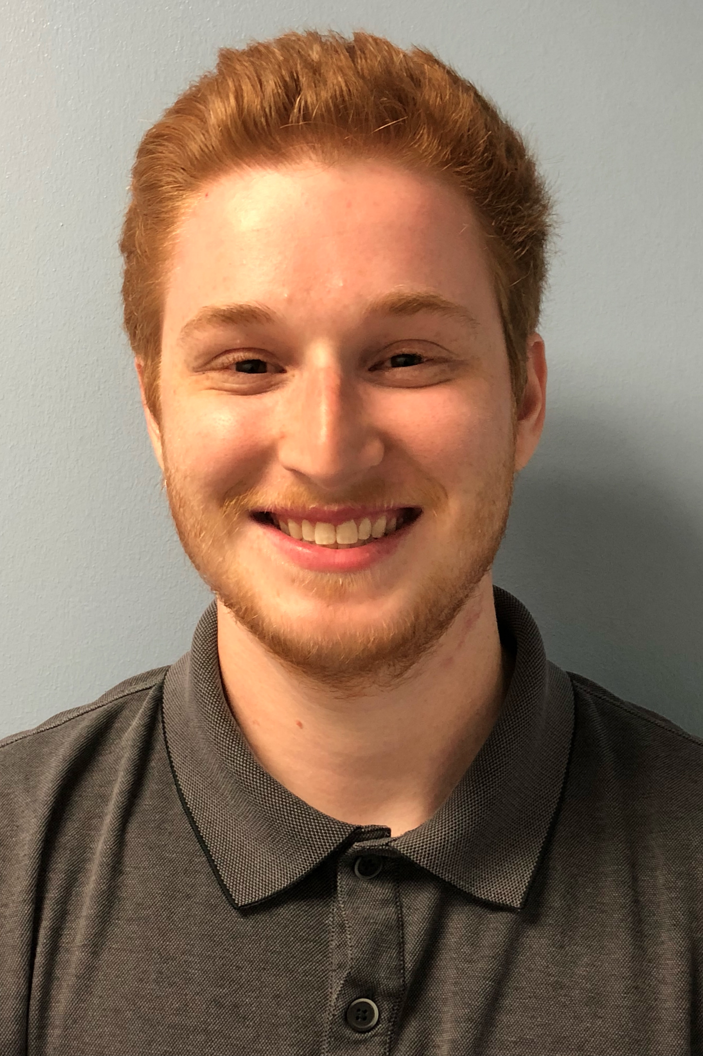
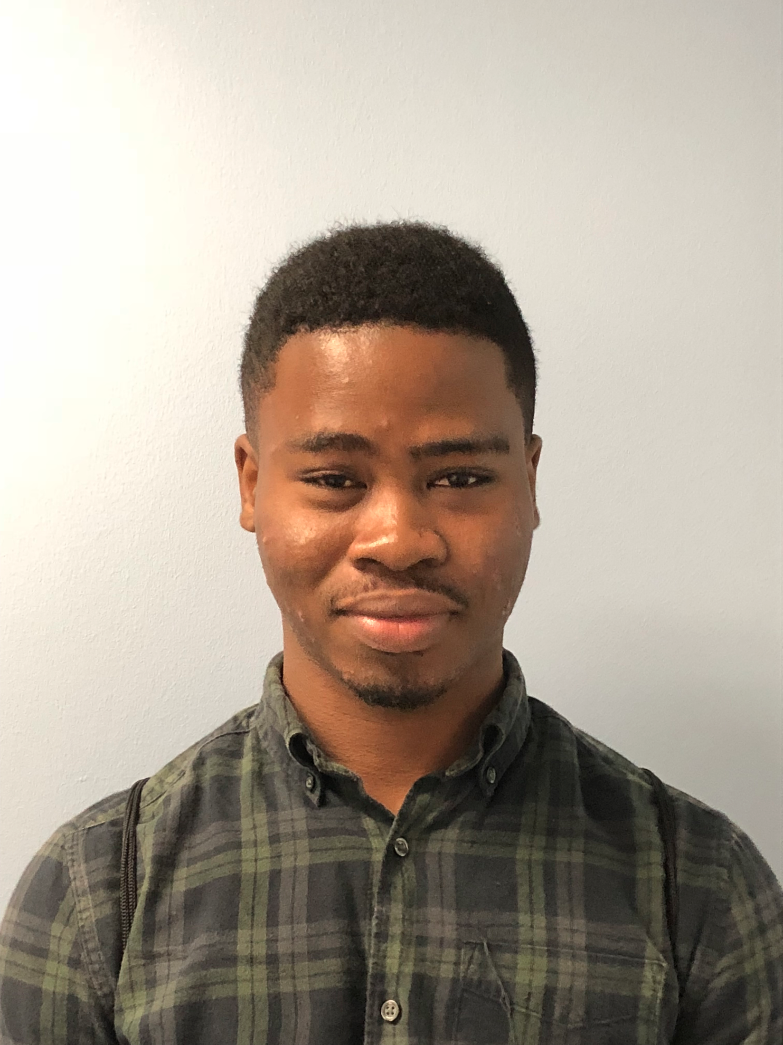
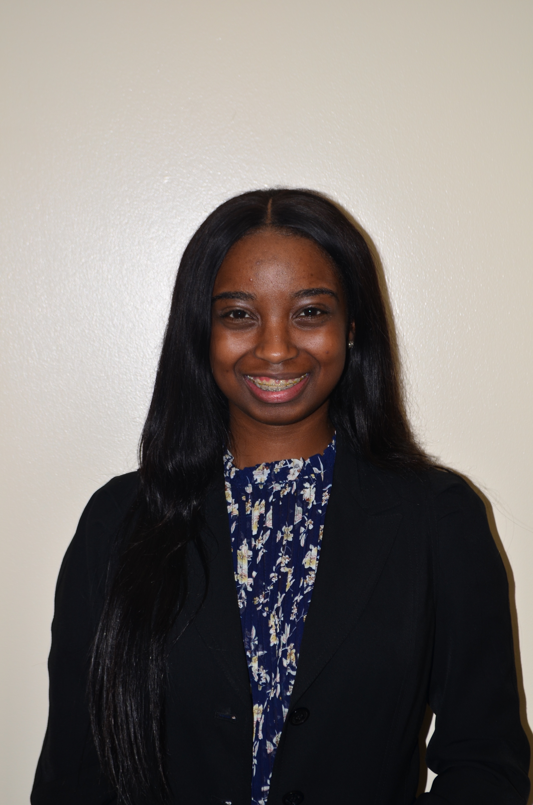
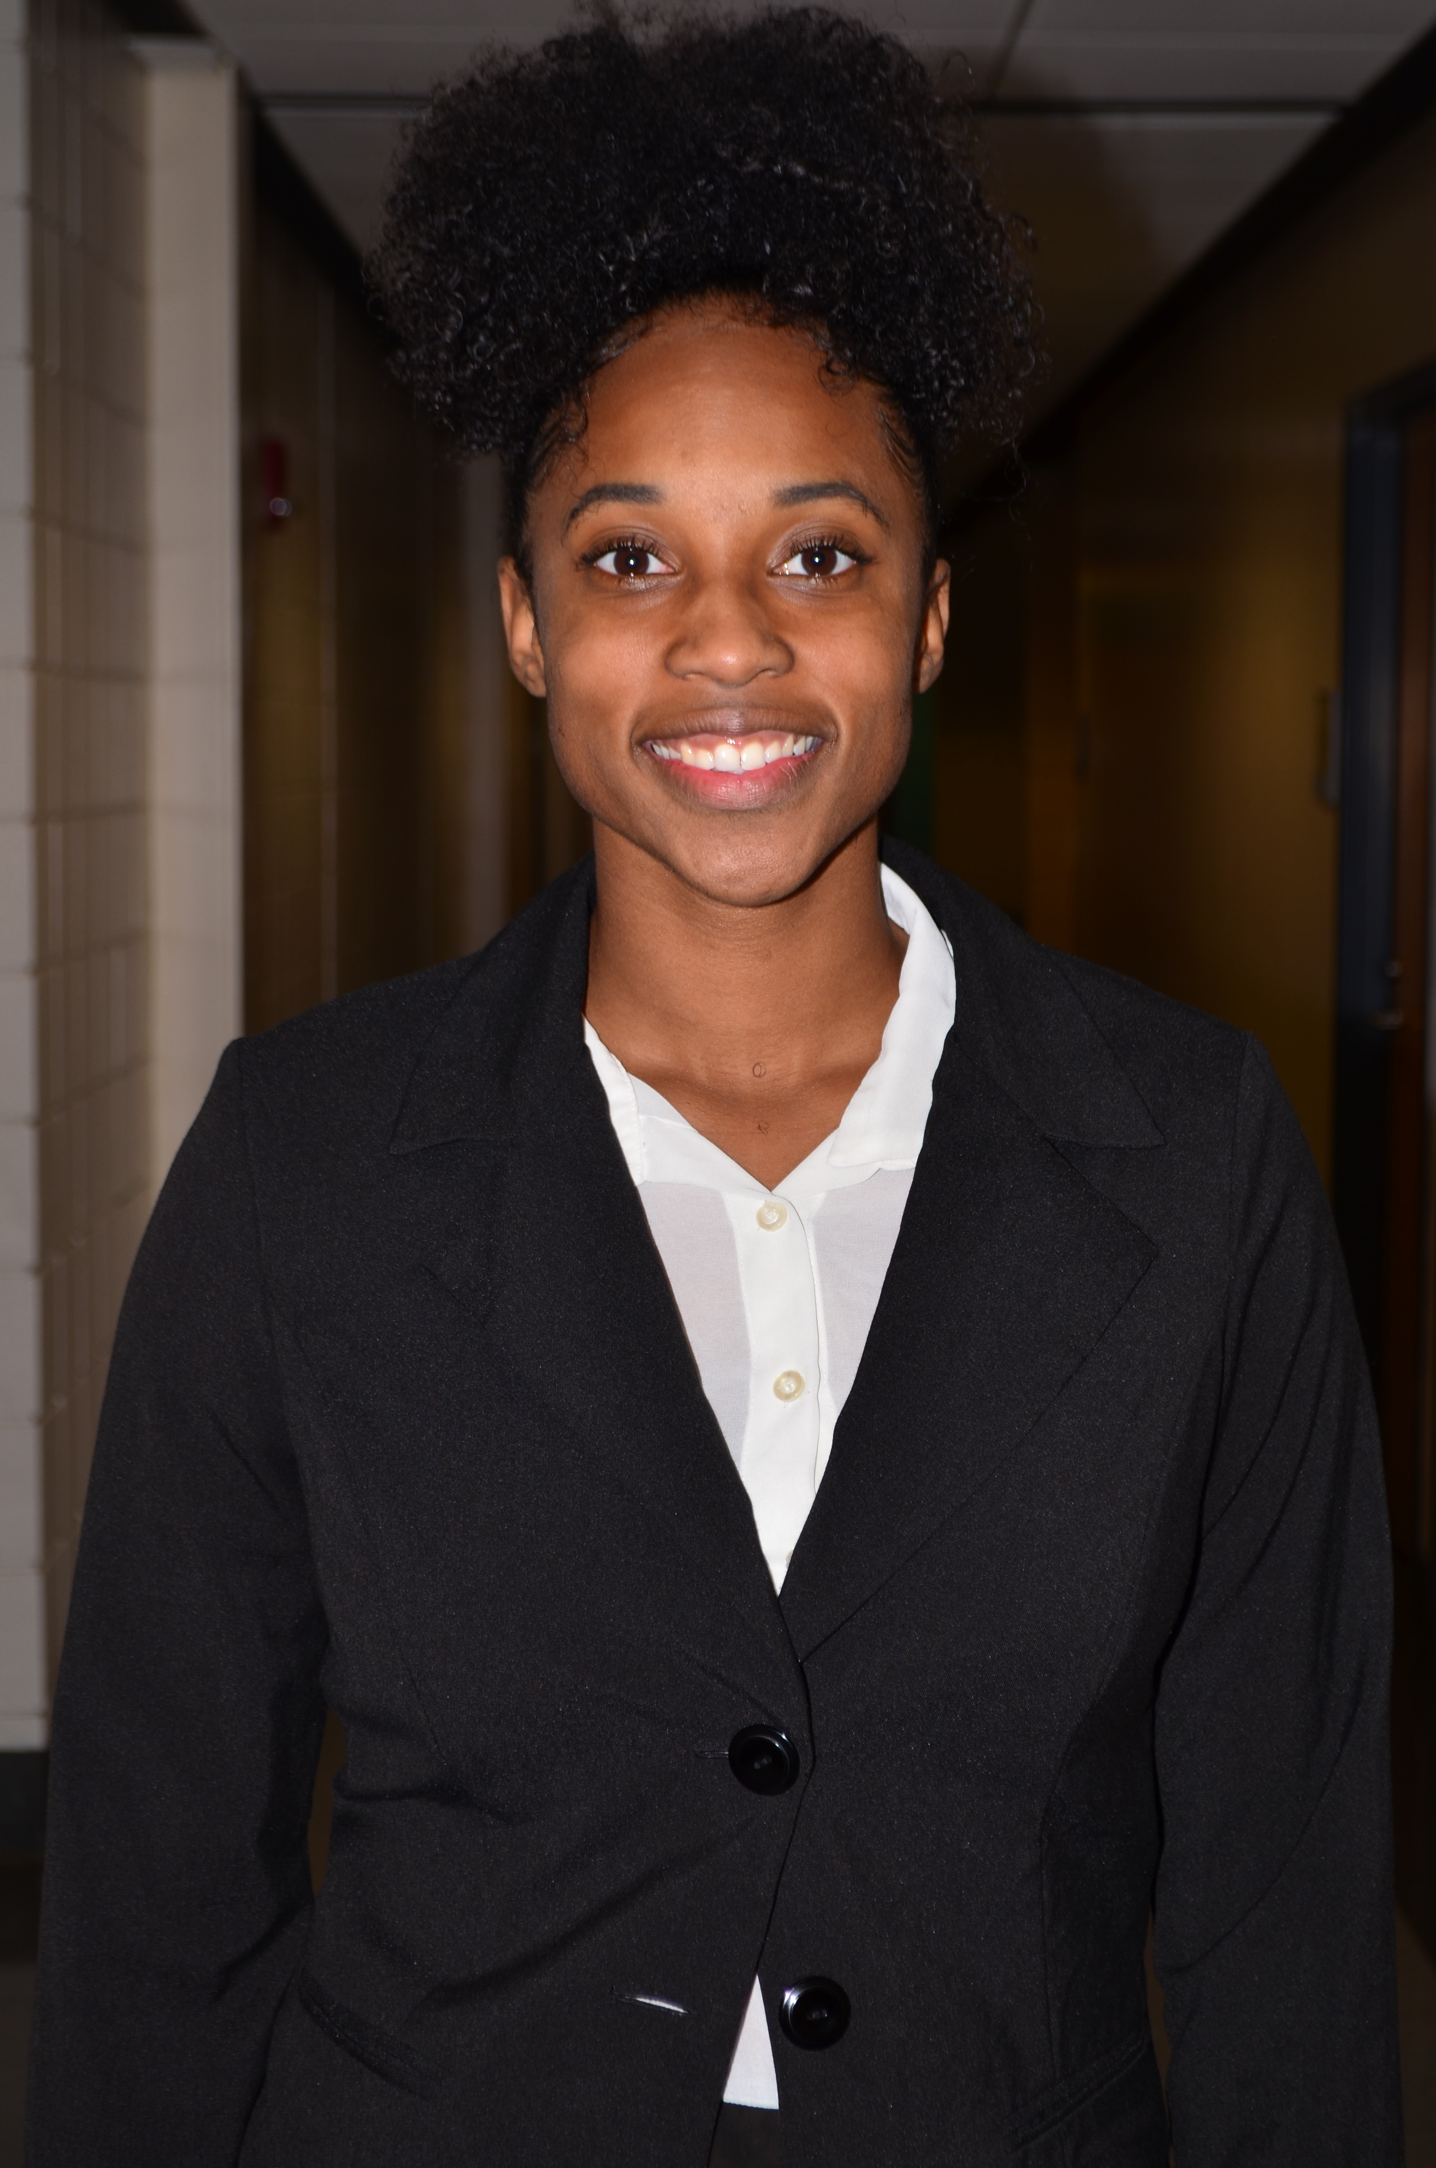
Team Introduction
Cheyenne R. Laurel
Project Manager
David C. DiMaggio
Design Engineer
Boluwatife Olabiran
Software Engineer
Nataajah Taylor
Hardware Engineer
JoEll Williams
Test Engineer
1

Slide 3
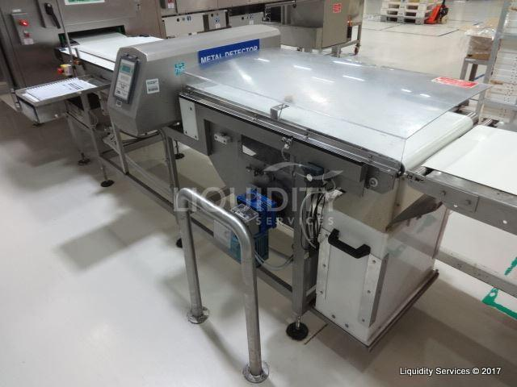
Project Overview
TCC needs an automated assembly station for teaching and certifying their students in a mechatronics program
The team is required to build a conveyor belt system with categorizing and sorting capabilities using materials provided.
Figure 1: Example of Material Detection Manufacturing Machine
David DiMaggio
2

Slide 4
Manufacturing Technology
Photoelectric Sensor
Capacitive Proximity Sensor
Inductive Proximity Sensor
David DiMaggio
3

Slide 5
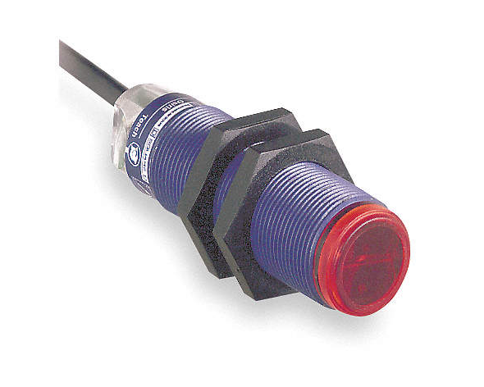
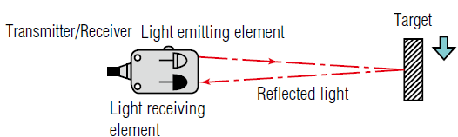
Photoelectric Sensor
Used to discover the distance, absence, or presence of an object
Using a light transmitter and a photoelectric receiver
Figure 2: Photoelectric sensor
Figure 3: Photoelectric sensing process
David DiMaggio
4

Slide 6
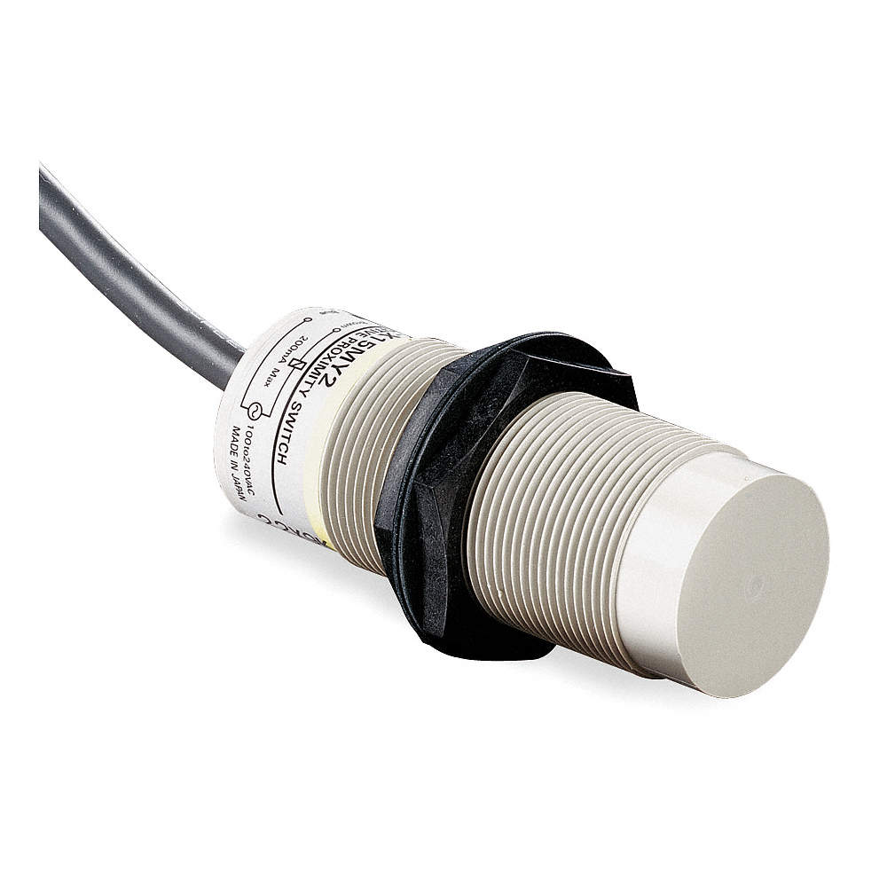
Capacitive Proximity Sensor
Detects the capacitance of nearby objects without physical contact to determine material
Limited by detection range, typically around 4mm – 40mm
Figure 4: Capacitive Sensor
David DiMaggio
5

Slide 7
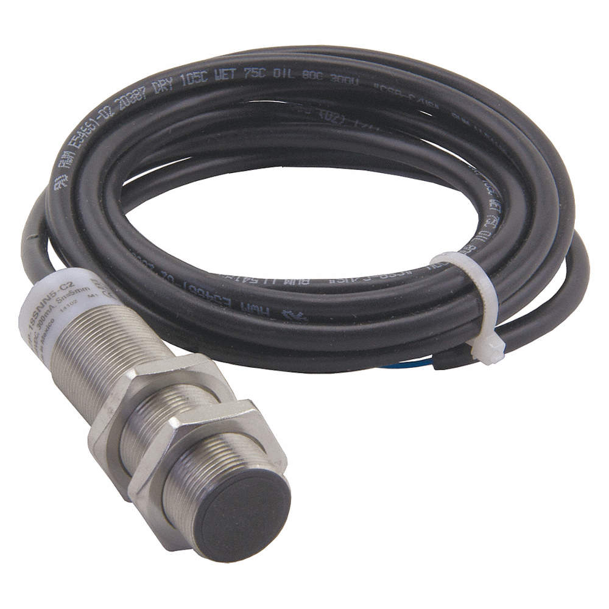
Inductive Proximity Sensor
Uses a magnetic field to detect whether an object is metal or not
Does not require physical contact, but limited by detection range, typically around 4mm- 40mm
Figure 5: Inductive Sensor
David DiMaggio
6

Slide 8
Concept Generation
Boluwatife Olabiran
7

Slide 9
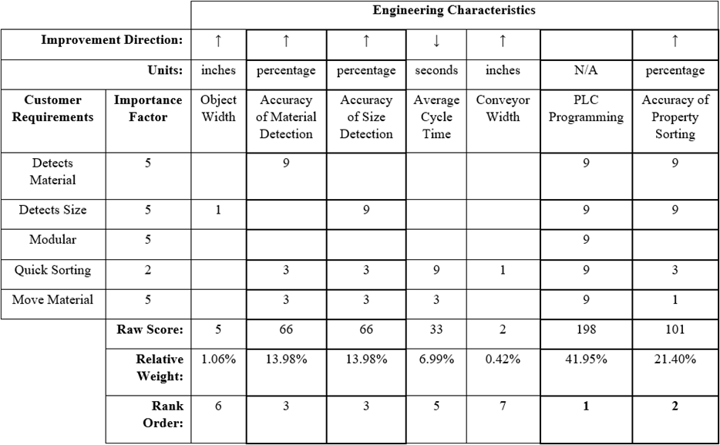
House of Quality
Allows the group to focus on the most important engineering characteristics in concept generation without bias
Most Important Engineering Characteristics:
  Accuracy of Material Detection
  Accuracy of Size Detection
  PLC Programming
  Accuracy of Property Sorting
Boluwatife Olabiran
8

Slide 10
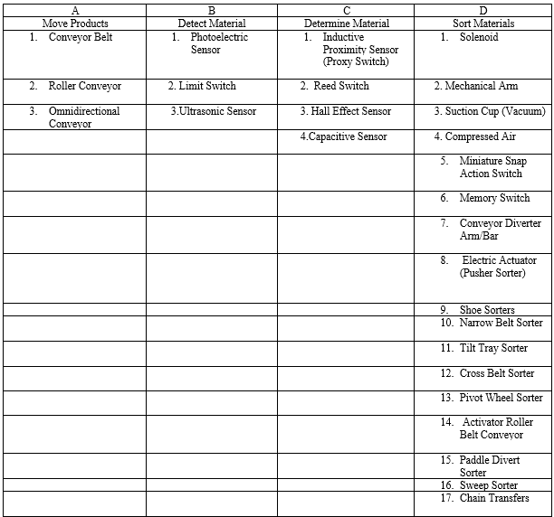
Concepts Generated for
Each Major
Function
Boluwatife Olabiran
9
9

Slide 11
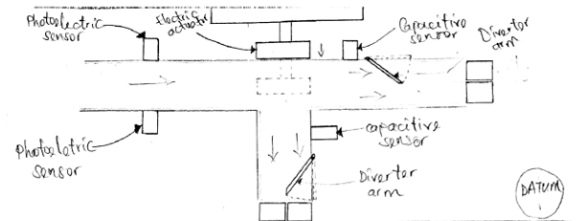
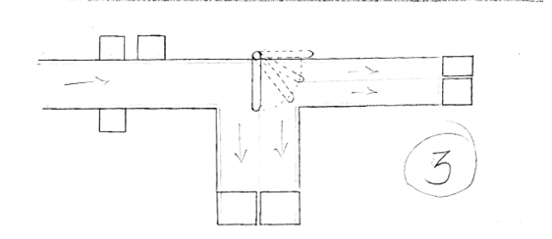
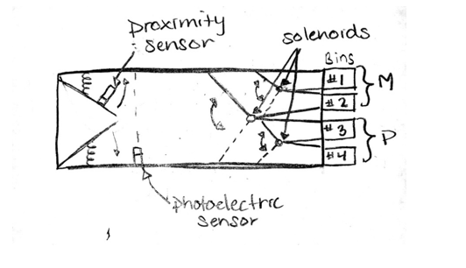
Top 3 Concepts
Boluwatife Olabiran
10

Slide 12
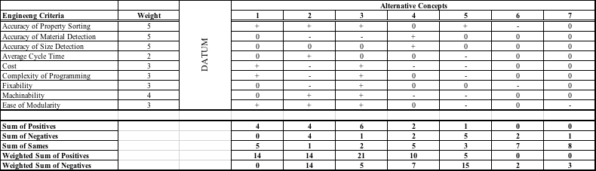
Pugh Chart
Boluwatife Olabiran
11

Slide 13
Final Ratings
Selection Criteria | Accuracy of Property Sorting | Accuracy of Material Detection | Accuracy of Size Detection | Average Cycle Time | Cost | Complexity of Programming | Fixability | Machinability | Ease of Modularity
Concept 1 | 0.30 | 0.19 | 0.28 | 0.19 | 0.08 | 0.10 | 0.25 | 0.25 | 0.33
Concept 3 | 0.37 | 0.08 | 0.64 | 0.75 | 0.72 | 0.69 | 0.66 | 0.66 | 0.33
Concept 4 | 0.33 | 0.72 | 0.07 | 0.75 | 0.19 | 0.21 | 0.09 | 0.09 | 0.33
Figure 5: Final Rating Matrix
Concept # | Value
1 | 0.23
3 | 0.46
4 | 0.31
Figure 6: Final Selection Values
JoEll Williams
12

Slide 14
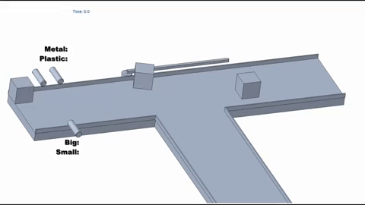
Winning concept
Shows a box as it travels through system at different points
Design includes:
  2 Photoelectric sensors
  1 Capacitive sensor
  Rotating arm
  Two conveyor belts
  Collecting bins
JoEll Williams
13

Slide 15
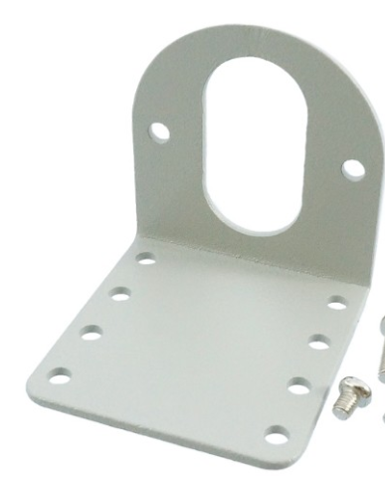
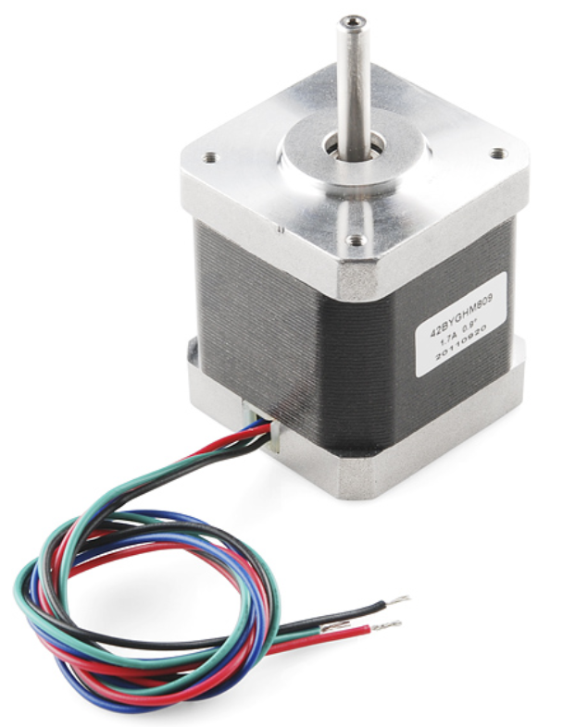
Moving Forward
Designing of Sensor Mounts
Size of sorting bins
Stepper motor
Programmable logic controller (PLC)
JoEll Williams
14

Slide 16
References
CEIA , THS, Metal Detector, 2011, Serial number 20800450034, aperture 550 x 75mm, belt 2750 x 500mm .This items will be. (n.d.). Retrieved from https://www.go-dove.com/en/auction/view?id=13216983
“48mm Retroreflective Cylindrical Photoelectric Sensor; Max. Sensing Distance: 3.0m.” Grainger - For the Ones Who Get It Done., www.grainger.com/product/TELEMECANIQUE-SENSORS-48mm-Retroreflective-Cylindrical-32J327?searchBar=true&searchQuery=32J327.
“Detection Based on ‘Light‘What Is a Photoelectric Sensor?” Main Types of Microscopes: Types & Principle｜KEYENCE Biological Fluorescence Microscopes, www.keyence.com/ss/products/sensor/sensorbasics/photoelectric/info/.
“100 Hz Capacitive Cylindrical Proximity Sensor with Max. Detecting Distance 8.0mm.” Grainger - For the Ones Who Get It Done., www.grainger.com/product/OMRON-100-Hz-Capacitive-Cylindrical-2AKD8?searchBar=true&searchQuery=2AKD8.
“1200 Hz Inductive Cylindrical Proximity Sensor with Max. Detecting Distance 8.0mm.” Grainger - For the Ones Who Get It Done., www.grainger.com/product/EATON-1200-Hz-Inductive-Cylindrical-40HT96?searchBar=true&searchQuery=40HT96.
15

Slide 17
Questions?
16

