Slide 1


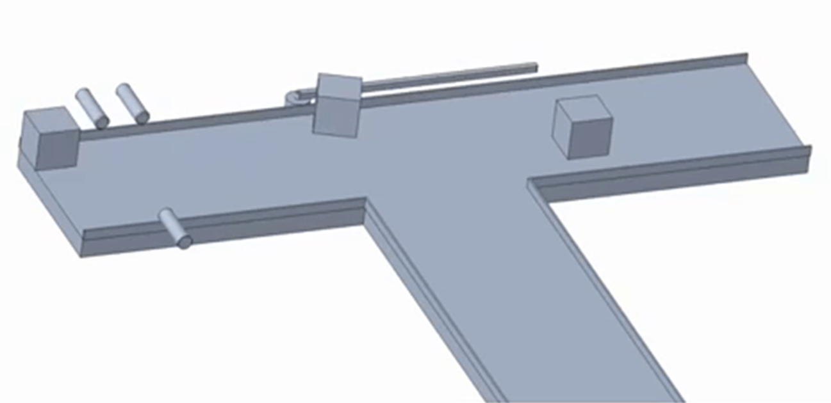
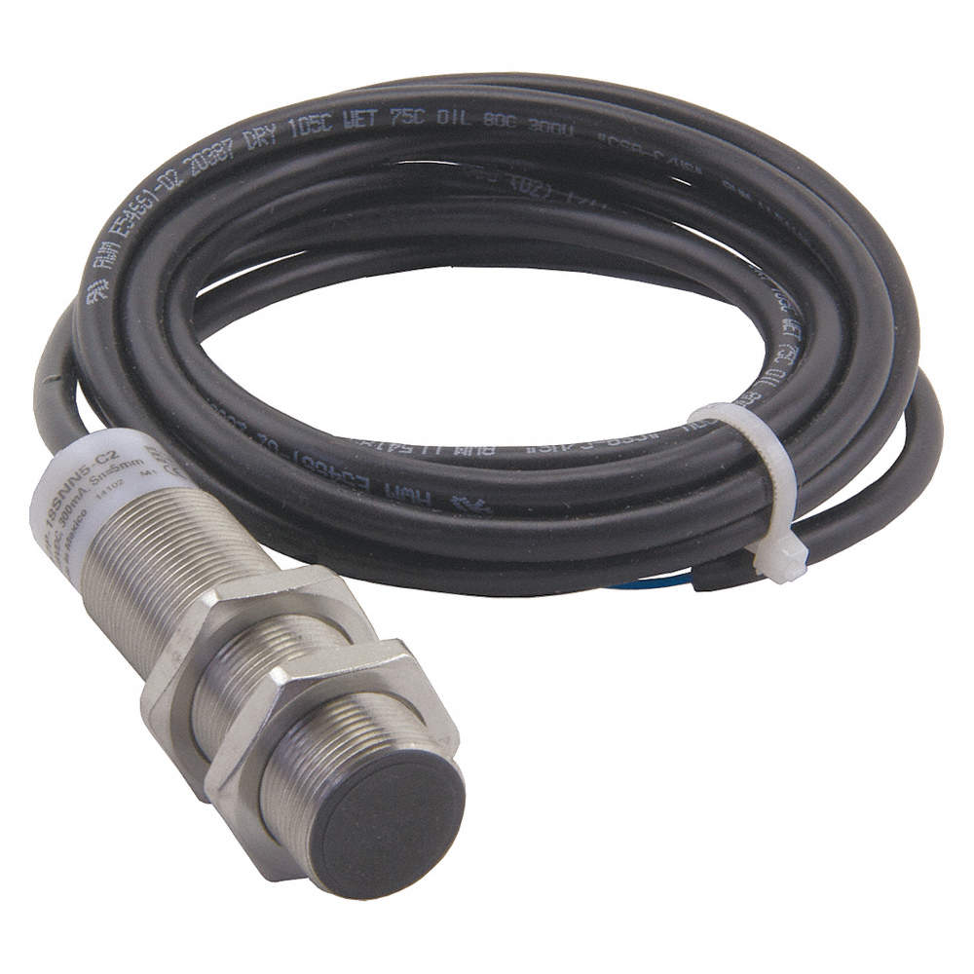
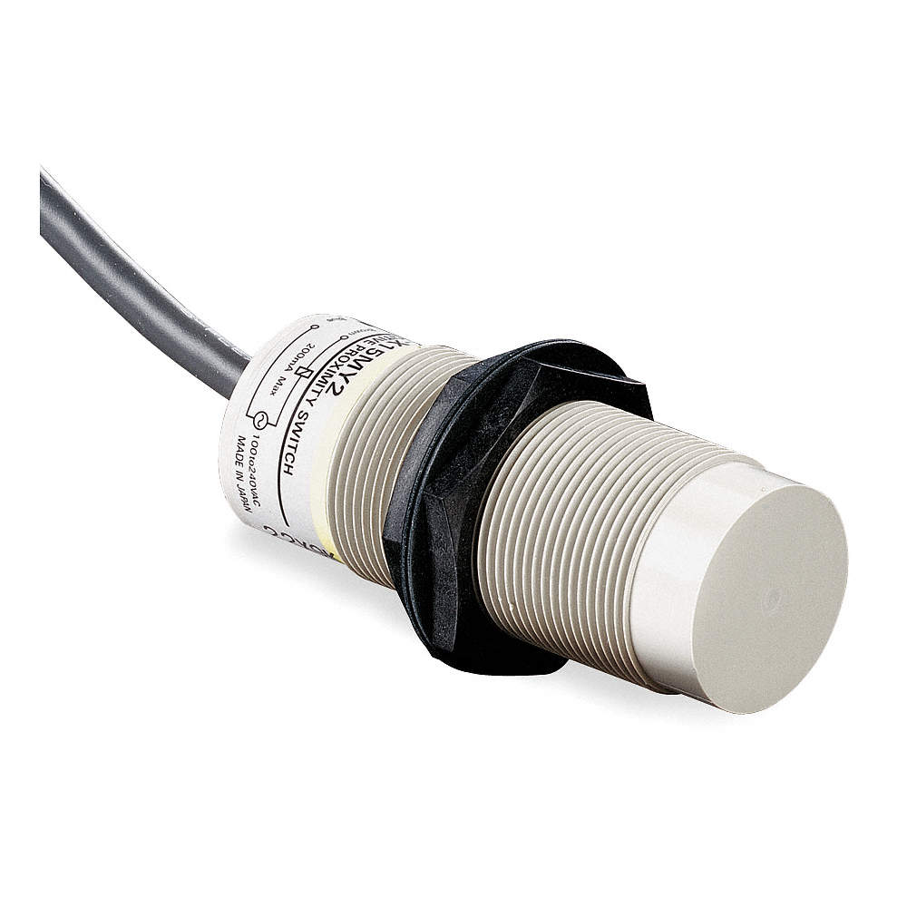
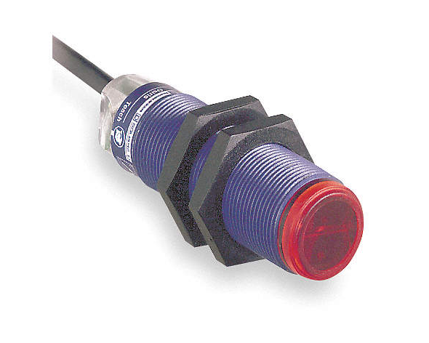
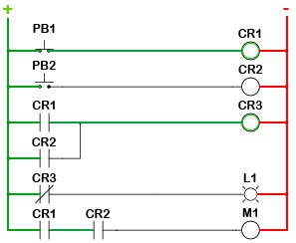
Simulated Assembly Line and Processing Workstation
Advisor: Dr. Dorr Campbell Instructor: Dr. Shayne McConomy
Motivation
Tallahassee Community College is in need of a manufacturing machine that will be used for teaching their Advanced Manufacturing students the integration of mechanical and electrical components in a factory style setting.
Moving Forward
Creation of supports to hold up the sensors, motor, PLC, and collection bins
Determine the number of collection bins to be used
Determine what type of motor to go with and the specifications needed
Program the PLC to control the sensors and the motor.
Physical construction of all components
Diverter Arm attached to Stepper Motor
Design
Capacitive Sensor
Inductive Sensor
Project Scope
Team 520’s project will consist of building a manufacturing machine that will be able to detect materials, then sort them accordingly into their proper bins from the processing line. During the construction of the machine, the group is also expected to understand the deconstruction of the machine as a way of understanding manufacturing flexibility. It must consist of modular integration capable of being altered to represent real problems that occur in manufacturing machines, and then proceed to solve the system’s issues.
Acknowledgements
Team 520 would like to show special thanks to Bobette Stubblefield and Dylan Sutton, our TCC representatives as well as TCC Advanced Manufacturing and Training Center for their generous contribution of all supplies.
The group would also like to thank the technical support of Dr. Dorr Campbell and Dr. Jerris Hooker towards the advancement of our project.
Metal and Plastic materials are diverted onto separate belts, where they are sorted by size
Photoelectric Sensor
Manufacturing Technology
Programming Logic Controller (PLC)
  An industrial digital computer idealized for manufacturing processes and assembly lines
  Uses Ladder Logic programming
    Ladder logic was originally a written method to document the design and construction of relay racks as used in manufacturing and process control. Each device in the relay rack would be represented by a symbol on the ladder diagram with connections between those devices shown.
Inductive Proximity Sensor
  Uses magnetic field to detect if an object is metal
  Very small sensing distance (~ 8 mm)
Capacitive Proximity Sensor
  Detects capacitance to differentiate between material
  Very small sensing distance (~ 8 mm)
Photoelectric Sensor
  Sensor head contains transmitter and receiver, while reflector is used on other side of the conveyor belt
  Used to measure distance
Stepper Motor
  DC motor that moves in discrete steps, allowing precise positioning and speed control
  Will be used to control the mechanical arm that does the physical sorting
Figure 1: CompactLogix PLC
Figure 2: Inductive Proximity Sensor
Figure 3 Capacitive Proximity Sensor
Figure 4: Photoelectric Sensor
Figure 5: Stepper Motor
Figure 6: Example of Ladder Logic
Team 520: David DiMaggio, Cheyenne Laurel, Boluwatife Olabiran, Nataajah Taylor, JoEll Williams

