Slide 1


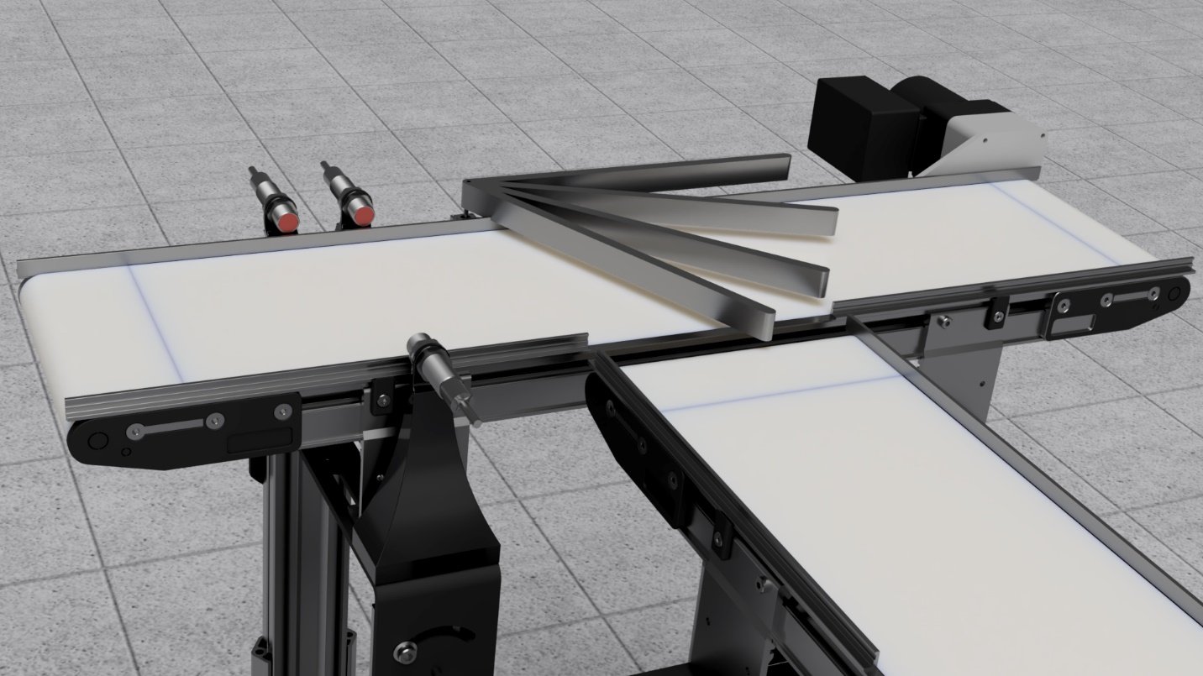

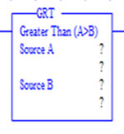



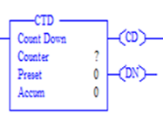

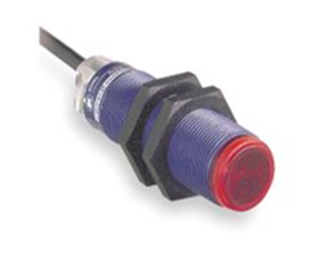
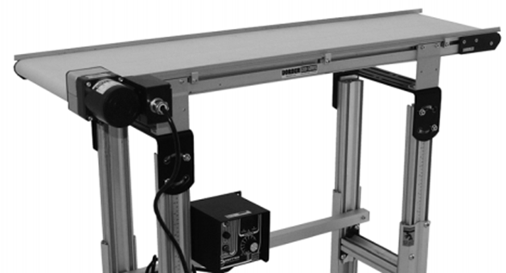
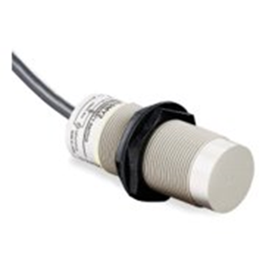
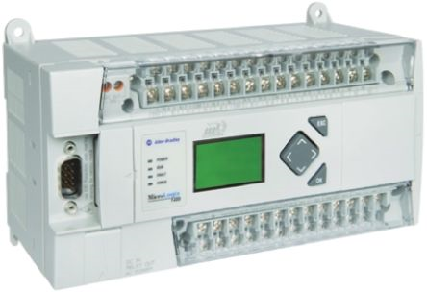
Simulated Assembly Line and Processing Workstation
Team 520
Project Objective
Tallahassee Community College requires an educational tool for their Mechatronics Certification program at the Advanced Manufacturing and Training Center. The team will accomplish this by creating a manufacturing system capable of sensing size and material, and then having objects sorted accordingly. Pre-programmed faults and defects in the system will be available to allow students to diagnose and correct the issues in the system.
Project Design
Diverter Arm Positions:
① 0° ③ 47 °
② 23 ° ④ 65 °
Ladder Logic Programming
CURRENTLY PROCEEDING WITH PROGRAMMING
Greater than function:Used to compare the capacitance values
Failure Modes and Effects Analysis
Failure Modes and Effects Analysis is a tool that identifies the most vulnerable points in a system. After rating each individual part's possible failures on their severity, occurrence, and detection, a Risk Priority Number (RPN) is calculated. The part with the highest RPN is the part that is most likely to cause failure in the system. Below is the project's highest RPN numbers.
TABLE
Count down:
Timer that will consistently time the arm to ensure accuracy of sorting
Manufacturing Technology
Output Latch: Maintains the output, keeping the are stationary
Photoelectric Sensor: Uses a light transmitter and receiver to test if an object is in the sensing area, while also detecting size
Dorner 220 Conveyor Belt: 8–inch wide belt that will move the materials through the sys
Acknowledgements
Team 520 would like to show special thanks to Bobette Stubblefield and Dylan Sutton, our TCC representatives as well as TCC Advanced Manufacturing and Training Center for their generous contribution of all supplies.
The group would also like to thank the technical support of Dr. Dorr Campbell and Dr. Jerris Hooker towards the advancement of our project.
Capacitive Proximity Sensor: Detects the capacitance of nearby objects without physical contact to determine material
Programmable Logic Device: Industrialized computer ruggedized for
David DiMaggio, Cheyenne Laurel, Boluwatife Olabiran, Nataajah Taylor, JoEll Williams

