Slide 1
Mini - iTX Computer Case
18-Oct-18
Presenters: Fabrizio Alvarado & William Pineda

Slide 2
Team Introductions
Paul Hromadka
Team Leader
Patrick Huffman
Thermal Design Engineer
Fabrizio Alvarado
Entrepreneurial Advisor
William Pineda
Design Engineer

Slide 3
Sponsors
Dr. Michael Devine
Entrepreneur in Residence & Professor, Ph.D
Yourri Dessureault Project Proposer
Fabrizio Alvarado

Slide 4
Summary of Project Brief
Goal: Design a Mini-iTX computer case with an integrated cooling system
Avoid high end CPUs and GPUs from thermal throttling
Remain completely enclosed
Appeal to growing market, such as hobbyists and professionals
Fabrizio Alvarado
Notes:
Talk briefly about what Mini-iTX is, the size, but no specs

Slide 5
Project Scope
Description:
Create a Mini-iTX case considering its layout and cooling
Develop a viable thermal system for heat transfer
Primary Markets:
PC Gamers
Bitcoin Miners
Researchers
Secondary Markets:
Commercial Applications
Integrated Systems
Fabrizio Alvarado

Slide 6
Relevant Information
What is the Mini-iTX form factor? Mini-iTX refers to a specific set of dimensions for a computer’s motherboard. Mini-iTX motherboards are set as 17cm x 17cm.
Why is an integrated cooling system needed? Thermal throttling occurs when a CPU and GPU begin taking on a workload that is too intense for their specifications. Creating a computer case that also acts as the cooling system reduces complications with computer construction and will allow for a smaller and more portable case.
Notes:
Performance decreases manifest as a loss in processing power, lower frame rates, and other stuff

Slide 7
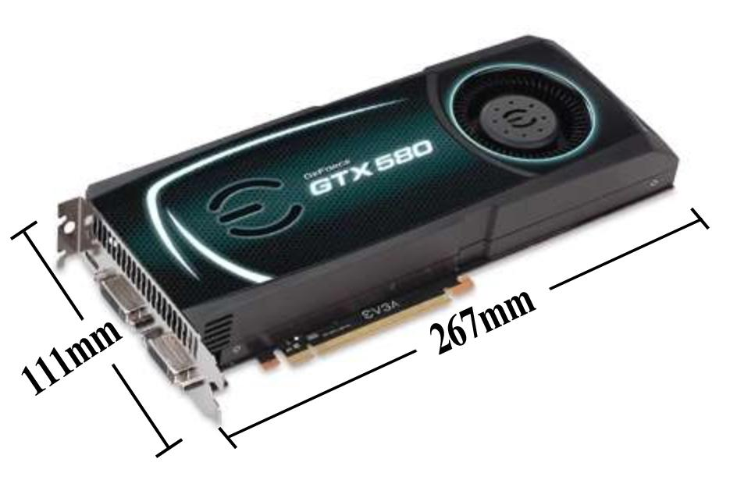
Customer Needs
Keep the GPU below 70℃ and the CPU below 50℃
Have no external powersource
Fully support a reference size GPU while maintaining a competitive internal volume (≤7.5L)
Preferably room for multiple SSD expansion slots
Simple installation and integration of components with internal cooling system
GTX 580 Reference Size GPU
William Pineda
Notes:
Customer Needs came primarily from Yourri Des. as he originally proposed the project and is extremely knowledgeable in the custom computer building world.

Slide 8
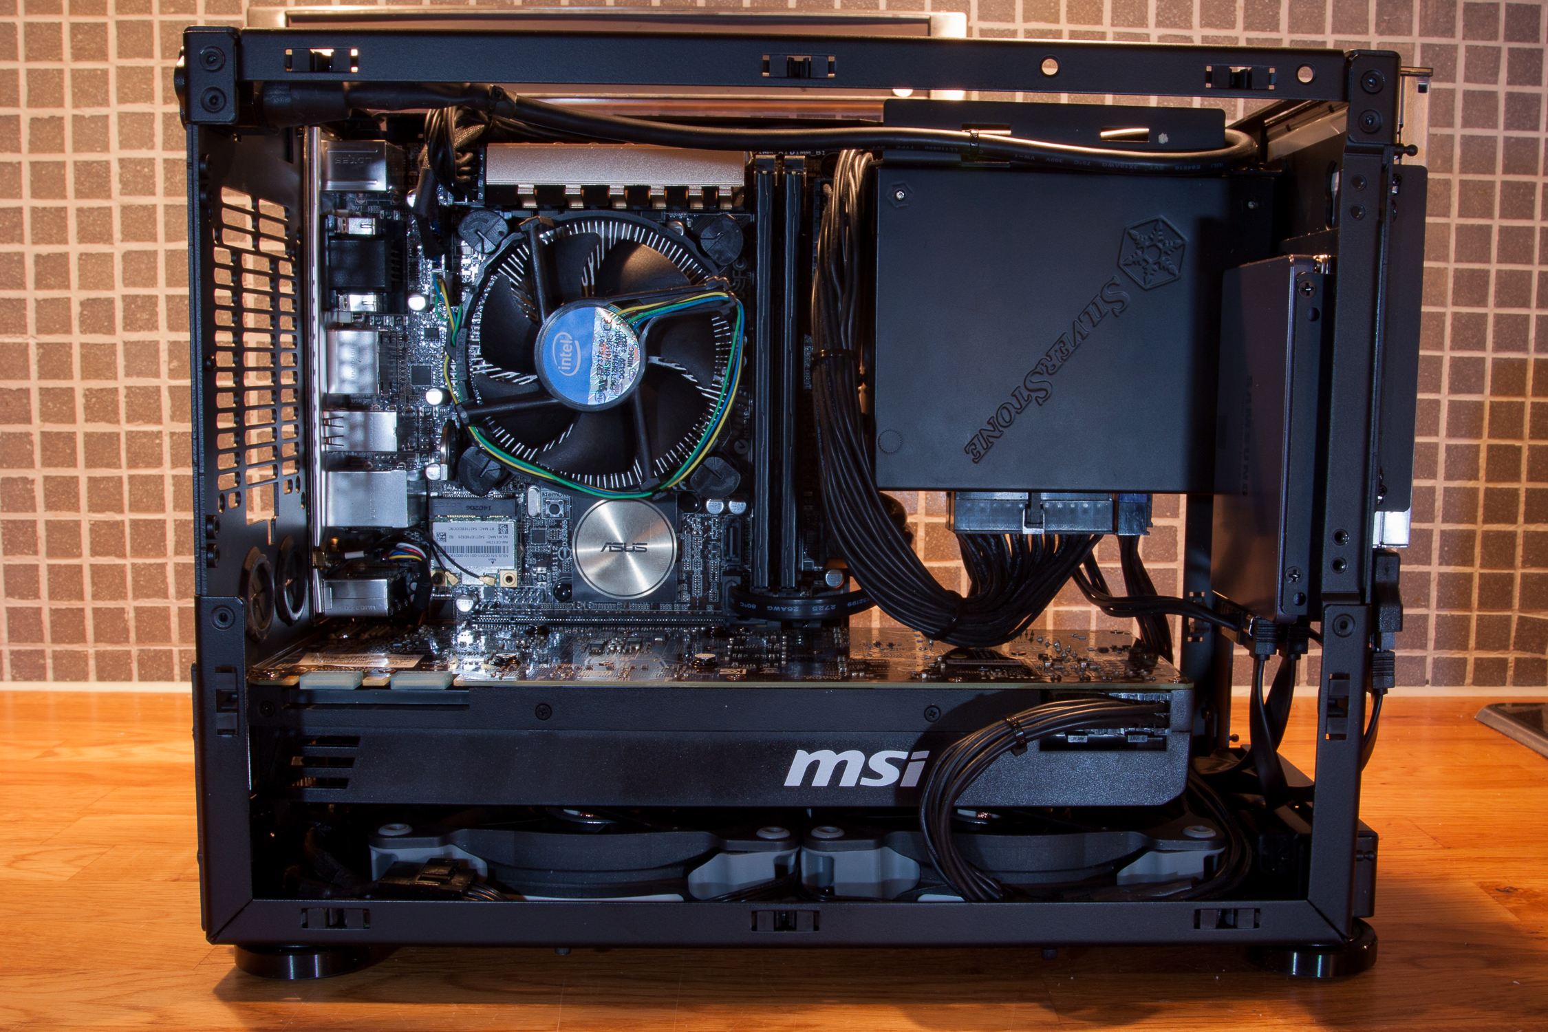
Customer Needs
Mini-iTX Motherboard
2.5” SSD
Graphics Card
William Pineda
Notes:
https://www.howtogeek.com/wp-content/uploads/2017/11/build-pc.gif
Must be able to accommodate the following components
Full sized reference graphics processing unit (i.e. Nvidia GTX 1070)
Any socket motherboard of mini-itx form factor
At least 1x 2.5 in solid state drive

Slide 9
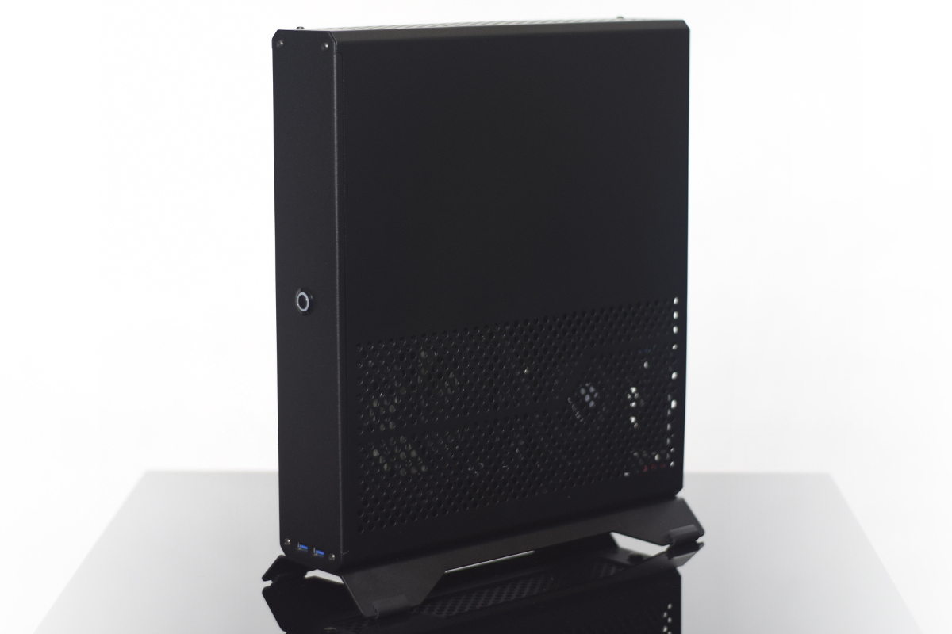
Competitor Analysis
Dr. Zaber Sentry 2.0 is also a >7.5L volume Mini-ITX case that can support a reference size GPU. Dr. Zaber offers their “console computer” with a variety of customization options available at purchase. These systems are from major manufacturers.
Dr. Zaber Sentry 2.0 “Console Case”
William Pineda
Notes:
Dr. Zaber Sentry 2.0 can’t fit a 120mm water cooling system. Limited to air cooling
https://hardforum.com/data/attachment-files/2018/04/116297_r68Tqxl.gif
Performance decreases manifest as a loss in processing power, lower frame rates.

Slide 10
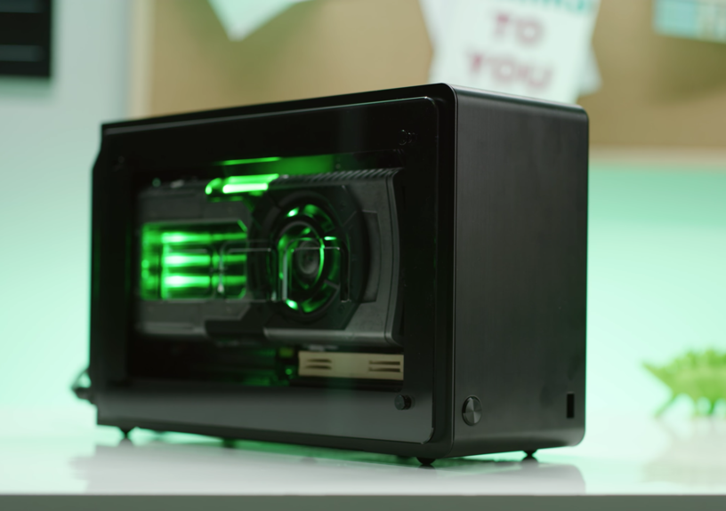
Competitor Analysis
DAN A4-SFX v.3 is a 7.2L volume Mini-ITX case that can support a reference size GPU. While the power supply is internal, the case calls for the purchase and installation of the customer’s choice of cooling systems.
Dan A4-SFX “Console Case”
William Pineda
Notes:
Performance decreases manifest as a loss in processing power, lower frame rates.
Discuss that these cases require consumers to select, purchase, and install their own cooling systems from other manufacturers

Slide 11
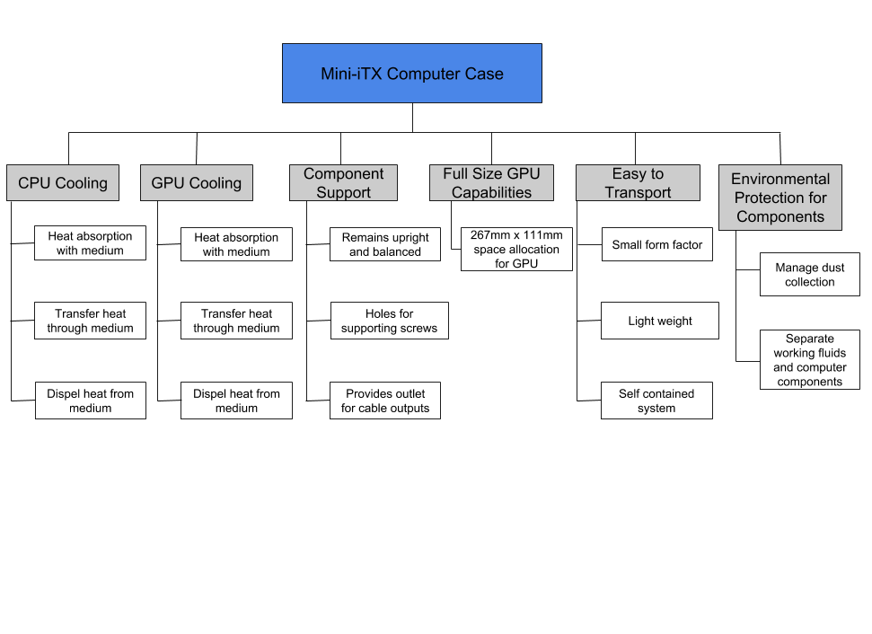
Functional Decomposition
William Pineda

Slide 12
Functional Decomposition
CPU & GPU Cooling
Determine proper medium for cooling components
Implement system for medium transport
Create cooling medium loop
Reference GPU Capabilities
Allocate effective area for reference sized GPU placement
Ensure compatibility with cooling system and the small form factor of a Mini-iTX computer case
William Pineda

Slide 13
Entrepreneurial Senior Design and InNOLEvation Project
As an ESD project, it is required that we compete in the InNOLEvation Project through the Jim Moran School of Entrepreneurship.
InNOLEvation is a business model competition, aimed at challenging students business and entrepreneurial skills in order to create and market an idea.
William Pineda

Slide 14
Key Points
The primary objective is cooling of the CPU and GPU in a computer case ≤ 7.5L
The customer’s needs translates to key functions that will be implemented in the design of the computer case
A functional business model will need to be created for InNOLEvation and FAMU-FSU College of Engineering Shark Tank competitions
William Pineda

Slide 15
Questions?

Slide 16
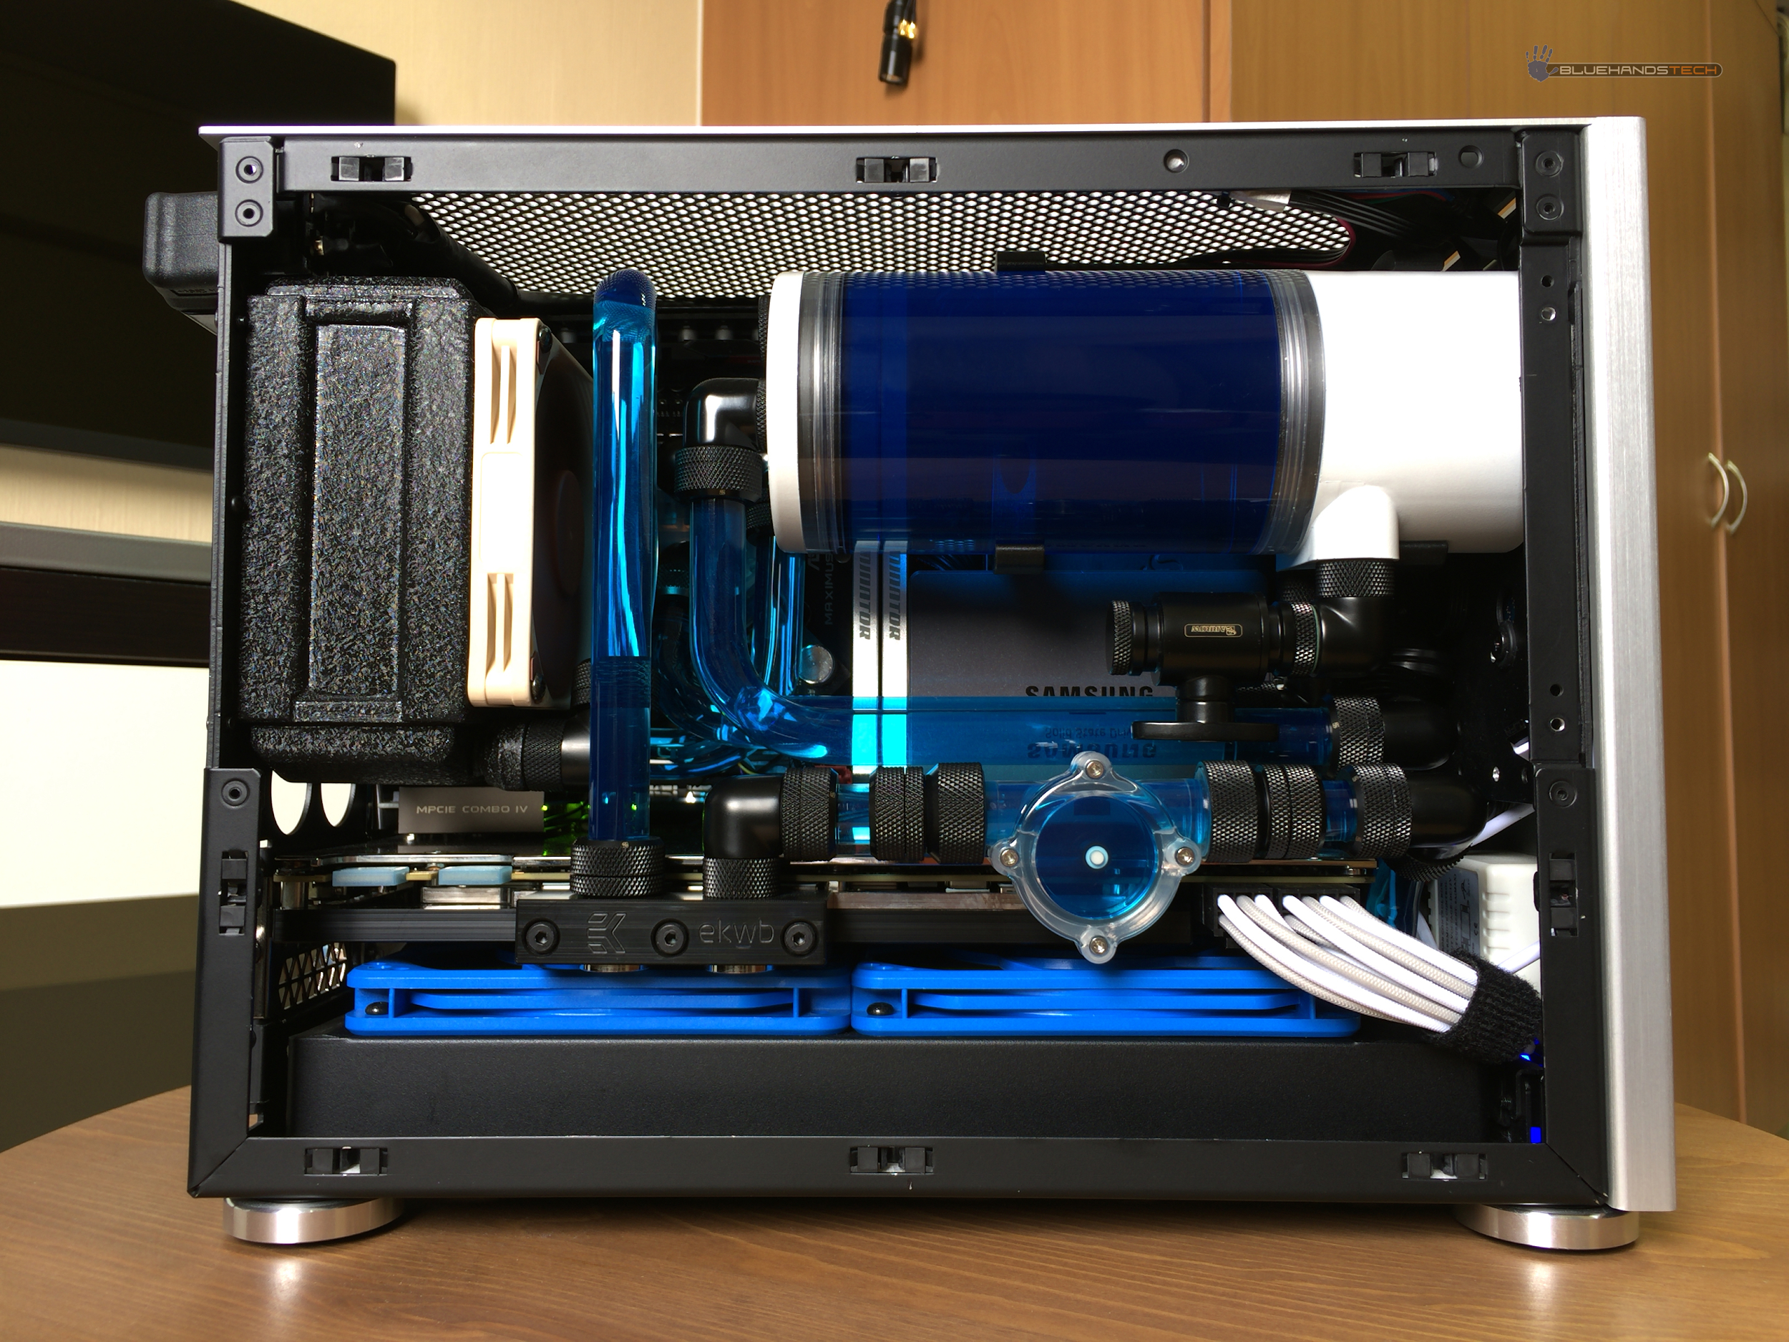
Example of water cooling system

Slide 17
