Slide 1
FPL Lineman Robot
Team 310
Denis Dineen, Jacob Hutto, Hunter Kramer, Doran McFalls, Nicolas Palmeiro

Slide 2
Team Introduction
Denis Dineen
Project Lead Engineer
Doran McFalls
Mechatronics Design Engineer
Jacob Hutto
Electrical Design Engineer
Hunter Kramer
Lead Mechanical Engineer
Nicolas Palmeiro
Lead Electrical Engineer

Slide 3
Stakeholders
Giovanni Herazo Smart Grid and Innovation Manager Florida Power and Light
FAMU-FSU College of Engineering
Dr. Rodney Roberts Academic Advisor
FAMU-FSU College of Engineering

Slide 4
Project Background
Florida Power & Light (FPL) is the largest energy company in the United States with upwards of 5 million customer accounts across the state.
Linemen experience many risks in order to do their jobs. Approximately 17 to 23 deaths occur per thousand workers over a 45 year period [OHSA].
FPL values their line workers and wishes to increase their safety as much as possible.

Slide 5
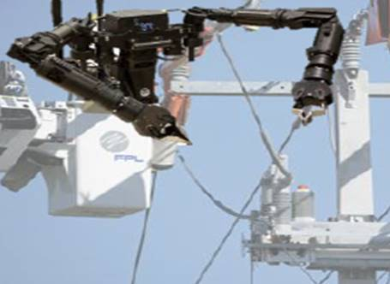
Our Mission
Our team is determined to develop a solution for Florida Power & Light that aids in the performance of routine installation and repair on distribution power lines while increasing operator safety.
Mock Design of Project (provided by FPL)

Slide 6
Key Goals
Improve line worker safety while performing field work.
1
Increase overall efficiency of common line work (installation, maintenance, etc).
2
Incorporate user friendly controls based off proper training procedures.
3
Improve technical sophistication through a tailored training software.
4

Slide 7
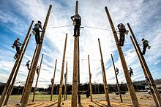
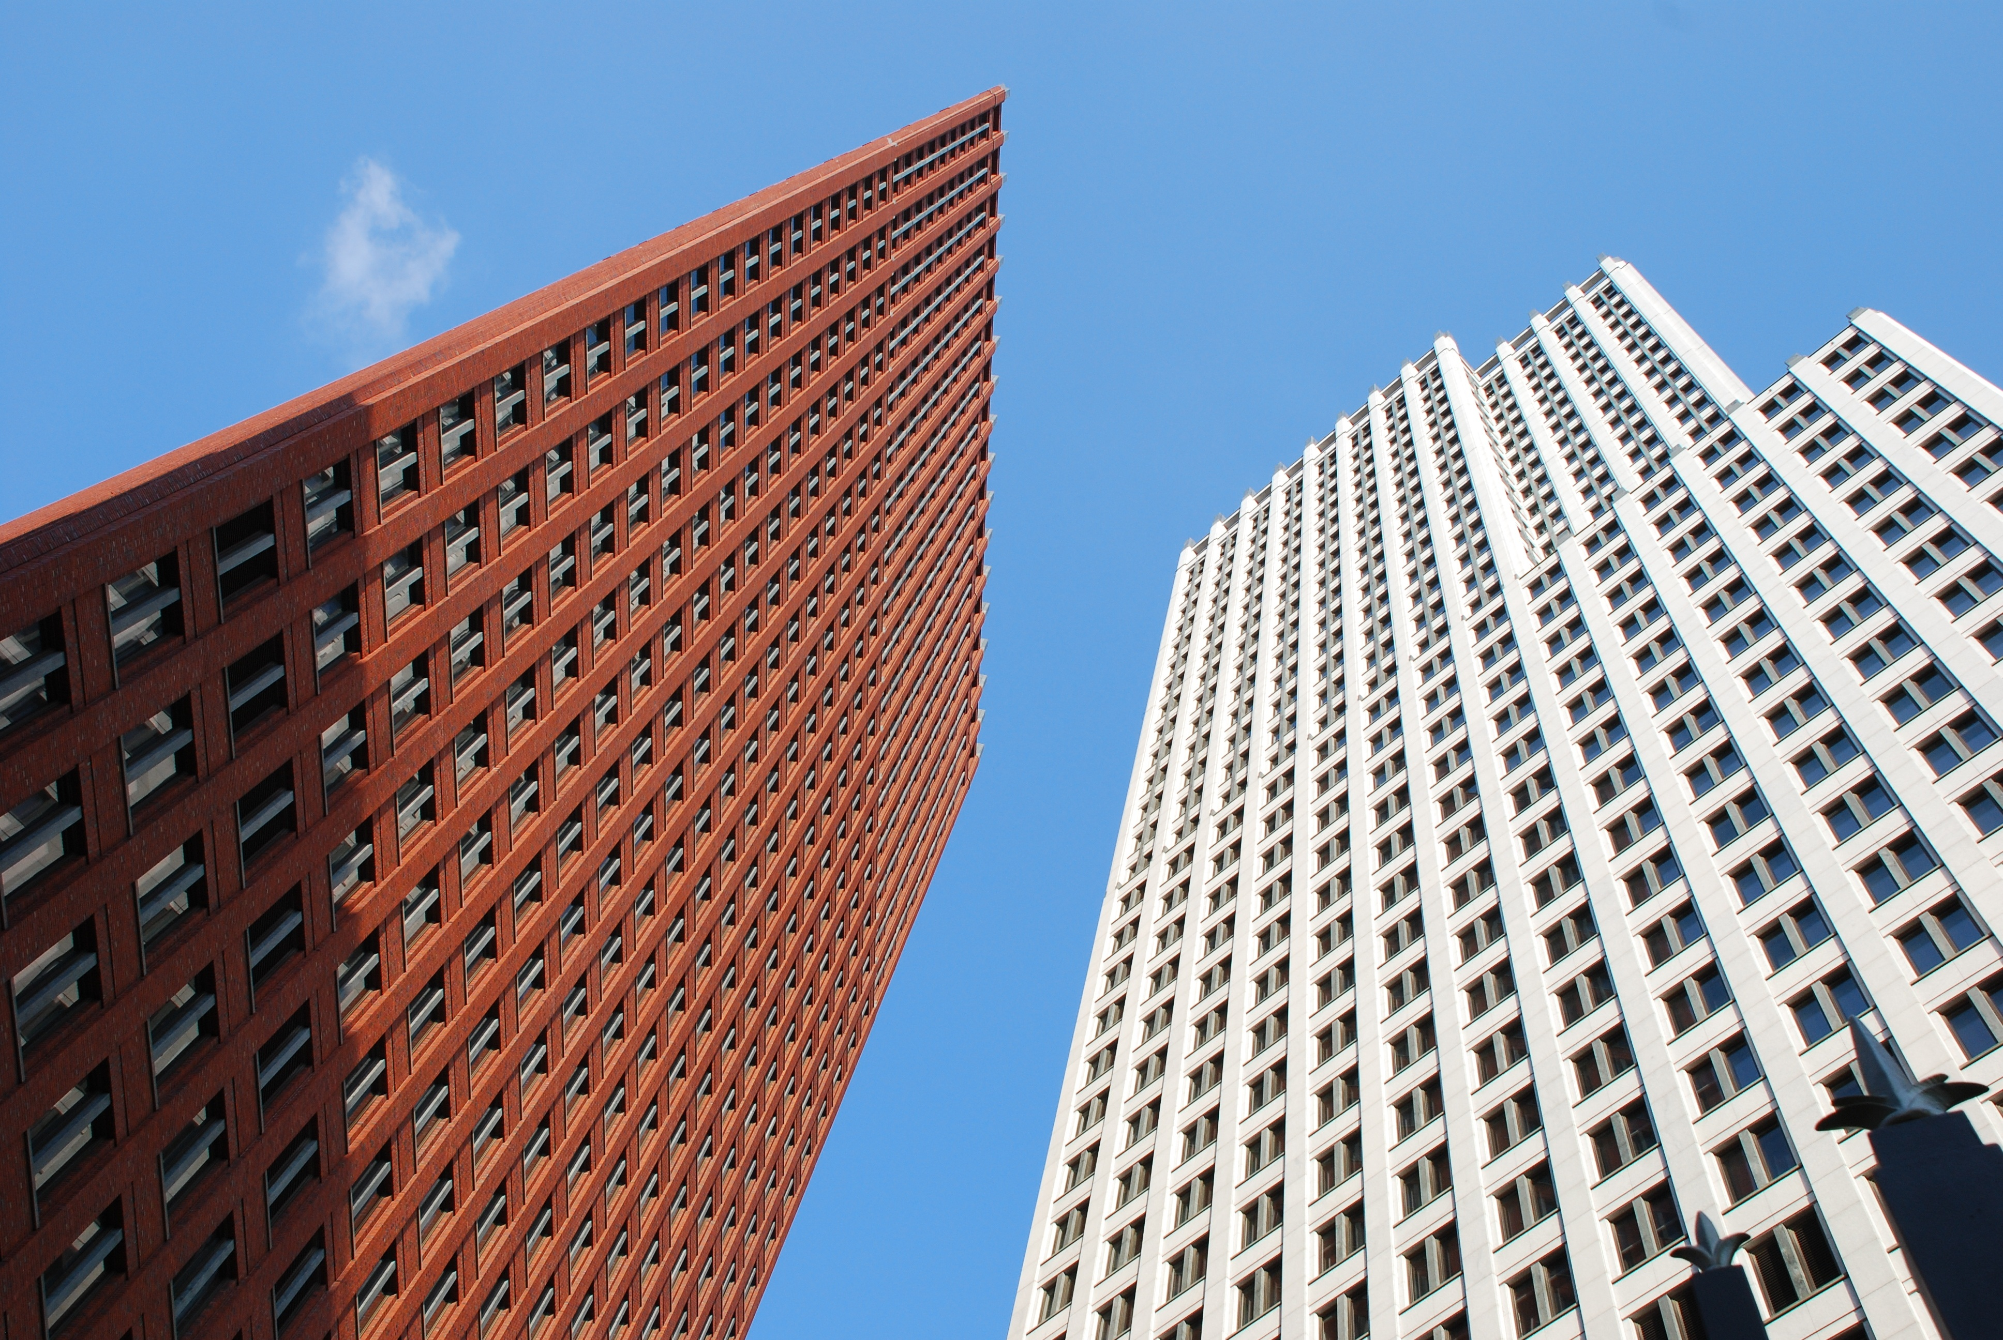
Primary Markets:
Line worker technical institutions
Secondary Markets:
Construction contractors
Emergency response organizations
Utility companies
Municipality emergency operations
Intended Markets

Slide 8
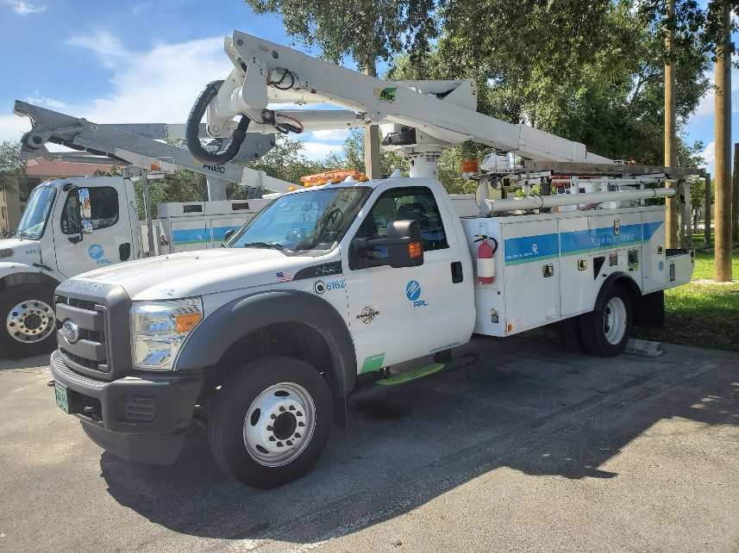
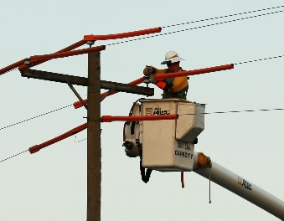
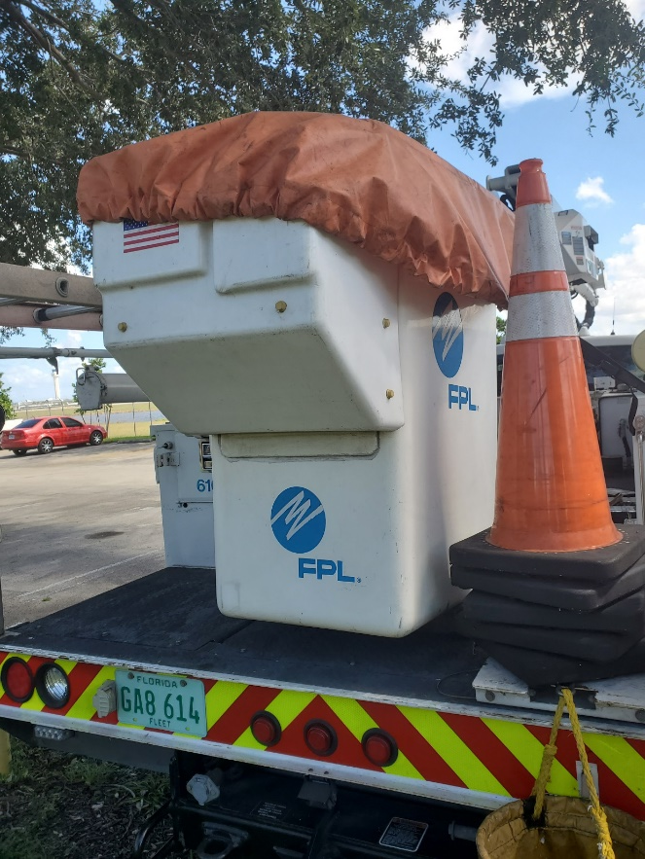
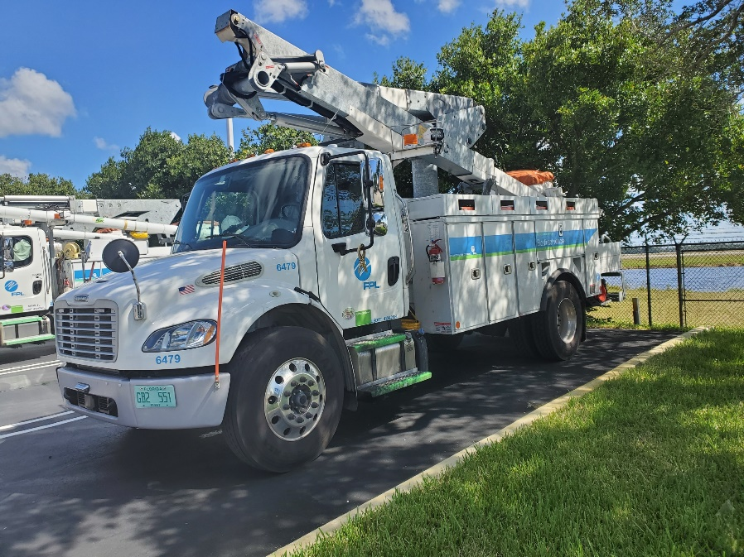
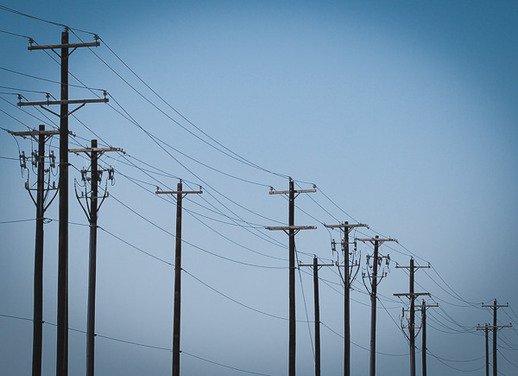
Assumptions
Line worker will be present when operating the device.
Operator will have completed proper training requirements prior to use.
Line wires will be energized when device is in operation.
Device will be used under standard line repair weather conditions.
Truck buckets will be uniform in size.
Standard repair equipment will also be located within truck bucket.

Slide 9
Assumptions
Line worker will be present when operating the device.
Operator will have completed proper training requirements prior to use.
Line wires will be energized when device is in operation.
Device will be used under standard line repair weather conditions.
Truck buckets will be uniform in size.
Standard repair equipment will also be located within truck bucket.

Slide 10
Assumptions
Line worker will be present when operating the device.
Operator will have completed proper training requirements prior to use.
Line wires will be energized when device is in operation.
Device will be used under standard line repair weather conditions.
Truck buckets will be uniform in size.
Standard repair equipment will also be located within truck bucket.

Slide 11
Assumptions
Line worker will be present when operating the device.
Operator will have completed proper training requirements prior to use.
Line wires will be energized when device is in operation.
Device will be used under standard line repair weather conditions.
Truck buckets will be uniform in size.
Standard repair equipment will also be located within truck bucket.

Slide 12
Assumptions
Line worker will be present when operating the device.
Operator will have completed proper training requirements prior to use.
Line wires will be energized when device is in operation.
Device will be used under standard line repair weather conditions.
Truck buckets will be uniform in size.
Standard repair equipment will also be located within truck bucket.

Slide 13
Assumptions
Line worker will be present when operating the device.
Operator will have completed proper training requirements prior to use.
Line wires will be energized when device is in operation.
Device will be used under standard line repair weather conditions.
Truck buckets will be uniform in size.
Standard repair equipment will also be located within truck bucket.

Slide 14
Customer Needs
Question/Prompt
What PPE (Personal Protection Equipment) is required by FPL for linemen?
Customer Response
FPL linemen are required to wear a hard hat, FR (fire rated) shirt, safety glasses, 17KV gloves, leather gloves and steel toe shoes.
Interpreted Need
Device can operate with a high voltage.

Slide 15
Customer Needs
Device increases distance between line worker and energized line.
Device can manipulate objects of various size, weight, and shape.
Device adheres to all company standards.
Device can operate with a high voltage.

Slide 16
Customer Needs
Device increases distance between line worker and energized line.
Device can manipulate objects of various size, weight, and shape.
Device adheres to all company standards.
Device can operate with a high voltage.

Slide 17
Customer Needs
Device increases distance between line worker and energized line.
Device can manipulate objects of various size, weight, and shape.
Device adheres to all company standards.
Device can operate with a high voltage.

Slide 18
Customer Needs
Device increases distance between line worker and energized line.
Device can manipulate objects of various size, weight, and shape.
Device adheres to all company standards.
Device can operate with a high voltage.

Slide 19
Targets and Metrics
Function Number | Function | Target Value | Unit of Measurement
1 | Resist High Voltage | 45 | kV
5 | Separate Worker from Danger | 60 | Feet
8 | Manipulate Wires in Complex Ways | 6 | Degrees of Freedom
16 | Adheres to Company Standards | 0 | Infractions

Slide 20
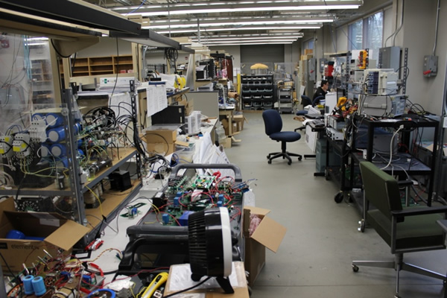
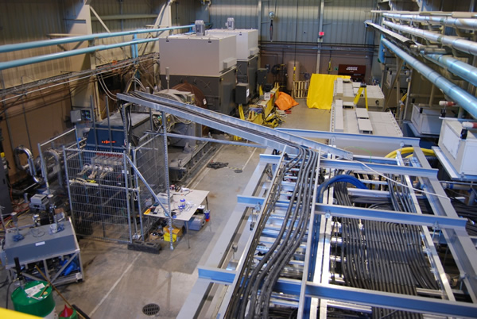
Additional Resources
Power Electronics Lab
5-Megawatt Prototype Facility

Slide 21
Future Work
Concept Generation
Concept Selection
Risk Assessment
Spring Project Plan

Slide 22
References
Occupational Safety and Health Administration. (n.d.). Power Transmission & Distribution in Construction.
Retrieved October 4, 2019, from https://www.osha.gov/archive/oshinfo/priorities/power.html.

Slide 23
FPL Lineman Robot
Team 310
Denis Dineen, Jacob Hutto, Hunter Kramer, Doran McFalls, Nicolas Palmeiro

Slide 24
Functional Decomposition
Line Worker Robot
Safety
Operation
Efficiency
Integration

Slide 25
Safety
Resists Damage From the Elements
Separates Worker from Danger
Resists High Voltages
Resists Wind
Resists Water
Resists Heat

Slide 26
Operation
Performs Basic Maintenance
Lifts Heavy Objects
Removes Protective Materials
Operates Under Multiple Conditions
Uses Different Power Sources
Manipulates Physical Components
Manipulates Wires in Complex Ways
Uses Lights
Operates for Long Periods of Time

Slide 27
Efficiency
Requires Minimal Setup
Allows for single or Multiple User Operation
Implements a Good User Interface

Slide 28
Integration
Simulates Work Environment for Training
Records Operation
Records/Stores Video
Adheres to Company Standards
Records/Stores Audio

Slide 29
Question/Prompt | Customer Response | Interpreted Need
What is your vision for this project? | Our goal is to develop a telerobotic Line Worker system to perform installations and maintenance on power lines. | Device can perform basic power line repairs.
Will the device operate on transmission and/or distribution power lines? | The initial concept will be to deploy on distribution lines, but if we can make it work for both applications would be great as well. | Device can reach height of power lines.
How long will the device be in operation on a daily basis? | I would expect the robot to operate 6-8 hours of continuous use. In the future I expect the telerobotic system to be integrated with the onboard electronics of the boom truck to reduce weight and additional maintenance of battery systems. | Device relies on power source capable of extended use.
What are the biggest hazards/risks in a lineman’s job? | The biggest hazard for a lineman is working next to energized power lines. | Device increases distance between line worker and energized line.
 | Working in extreme heat can cause dehydration and overheating. | Device operates normally within severe heat conditions.

Slide 30
Question/Prompt | Customer Response | Interpreted Need
What PPE (Personal Protection Equipment) is required by FPL for linemen? | FPL linemen are required to wear a hard hat, FR (fire rated) shirt, safety glasses, 17KV gloves, leather gloves and steel toe shoes. | Device can operate with a high voltage.
How do you ensure that linemen will follow safety protocols? | We have an LJASC committee...full review is done in the event of [safety] violation. | Device records action while in operation. Recordings can be accessed at a later point in time.
Would you want the device to operate during inclement weather? | We typically limit our crews to not work when winds are over 35mph. In the future if we have a fully autonomous robot than can operate in any weather conditions would be great! | Device can withstand high wind speeds.
What components are routinely replaced? What is the frequency of these replacements? | Hardware that is typically replaced during maintenance are Lightning Arrestors, Insulators, Splices, etc. | Device can manipulate objects of various size, weight, and shape.

Slide 31
Question/Prompt | Customer Response | Interpreted Need
What is your vision for this project? | Our goal is to develop a telerobotic Line Worker system to perform installations and maintenance on power lines. | Device can perform basic power line repairs.
Will the device operate on transmission and/or distribution power lines? | The initial concept will be to deploy on distribution lines, but if we can make it work for both applications would be great as well. | Device can reach height of power lines.
How long will the device be in operation on a daily basis? | I would expect the robot to operate 6-8 hours of continuous use. In the future I expect the telerobotic system to be integrated with the onboard electronics of the boom truck to reduce weight and additional maintenance of battery systems. | Device relies on power source capable of extended use.
What are the biggest hazards/risks in a lineman’s job? | The biggest hazard for a lineman is working next to energized power lines. | Device increases distance between line worker and energized line.
 | Working in extreme heat can cause dehydration and overheating. | Device operates normally within severe heat conditions.

Slide 32
Question/Prompt | Customer Response | Interpreted Need
What PPE (Personal Protection Equipment) is required by FPL for linemen? | FPL linemen are required to wear a hard hat, FR (fire rated) shirt, safety glasses, 17KV gloves, leather gloves and steel toe shoes. | Device can operate with a high voltage.
How do you ensure that linemen will follow safety protocols? | We have an LJASC committee...full review is done in the event of [safety] violation. | Device records action while in operation. Recordings can be accessed at a later point in time.
Would you want the device to operate during inclement weather? | We typically limit our crews to not work when winds are over 35mph. In the future if we have a fully autonomous robot than can operate in any weather conditions would be great! | Device can withstand high wind speeds.
What components are routinely replaced? What is the frequency of these replacements? | Hardware that is typically replaced during maintenance are Lightning Arrestors, Insulators, Splices, etc. | Device can manipulate objects of various size, weight, and shape.

Slide 33
Function Number | Function | Target Value | Unit of Measurement
1 | Resist High Voltage | 45 | kV
2 | Resist Wind | 35 | Mph
3 | Resist Water | IPX4 | IEC Standards
4 | Resist Heat | 322 | K
5 | Separate Worker from Danger | 60 | Feet
6 | Lift Heavy Objects | 50 | Lbs.
7 | Remove Protection Material |  | Inches
8 | Manipulate Wires in Complex Ways | 6 | Degrees of Freedom
9 | Uses Different Power Sources | 3 | Modes of Power
10 | Uses Light | 600 | Lumens
11 | Operates for Long Periods of Time | 8 | Hours
12 | Records Video | 1920 x 1080 | Display Resolution
13 | Stores Video | 8 | Hours
14 | Records Audio | 44.1 | kHz Sample Rate
15 | Stores Audio | 8 | Hours
16 | Adheres to Company Standards | 0 | Infractions
17* | Prevent Excess Strain on Truck Bucket from Project Weight | 300 | Lbs.
18* | Resist Arc Flash Events | 120 | Volts
19* | Adhere to Federal/State Electrical Standards | 0 | Infractions in Standards

