Slide 1
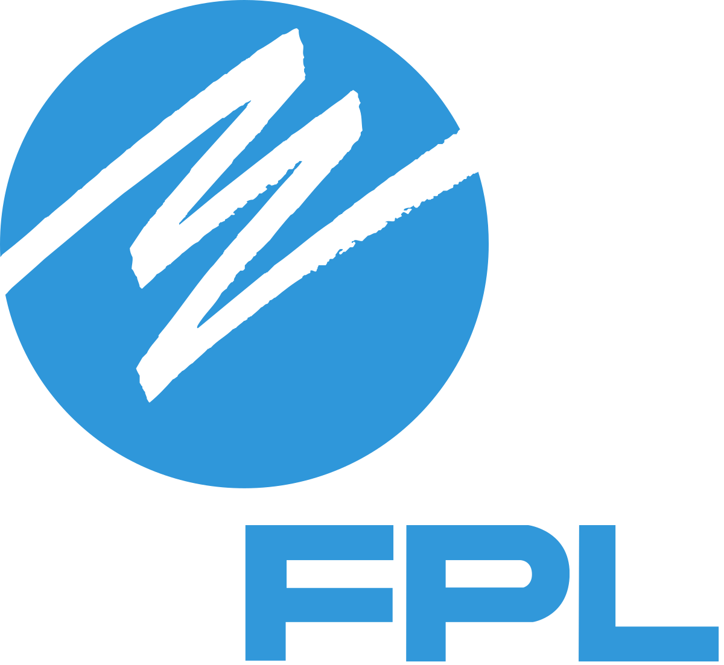
FPL Line Worker Robot
Team 310
Denis Dineen, Jacob Hutto, Hunter Kramer, Doran McFalls, Nicolas Palmeiro

Slide 2
Team Introduction
Denis Dineen
Project Manager
Doran McFalls
Mechatronics Design Engineer
Jacob Hutto
Electrical Design Engineer
Hunter Kramer
Mechanical Design Engineer
Nicolas Palmeiro
Power Engineer
Nicolas Palmeiro

Slide 3
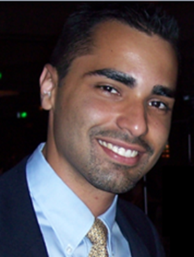
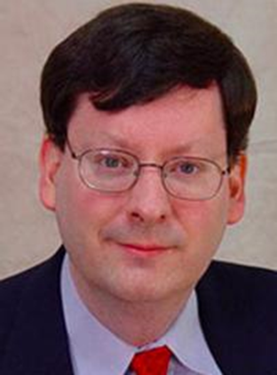

Stakeholders
Giovanni Herazo
Smart Grid & Innovation Manager
Florida Power & Light
Rodney Roberts
Academic Adviser
FAMU-FSU College of Engineering
FAMU-FSU
College of Engineering
Nicolas Palmeiro

Slide 4
Project Background
Florida Power & Light (FPL) is the largest energy company in the United States with upwards of 5 million customer accounts across the state.
FPL restored power to approximately 163,000 customers the first two days after hurricane Dorian. [4]
FPL values their line workers and wishes to increase their safety as much as possible.
Nicolas Palmeiro

Slide 5
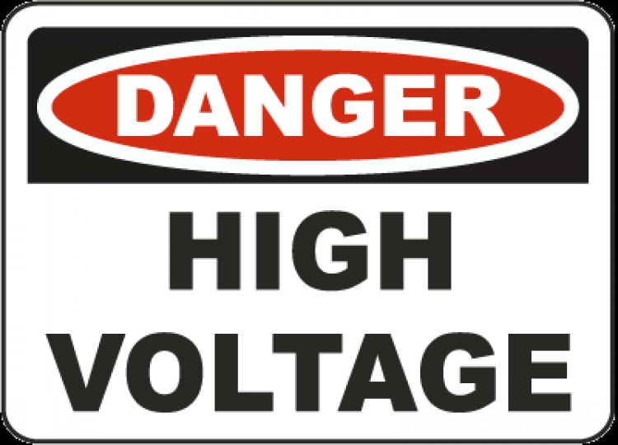
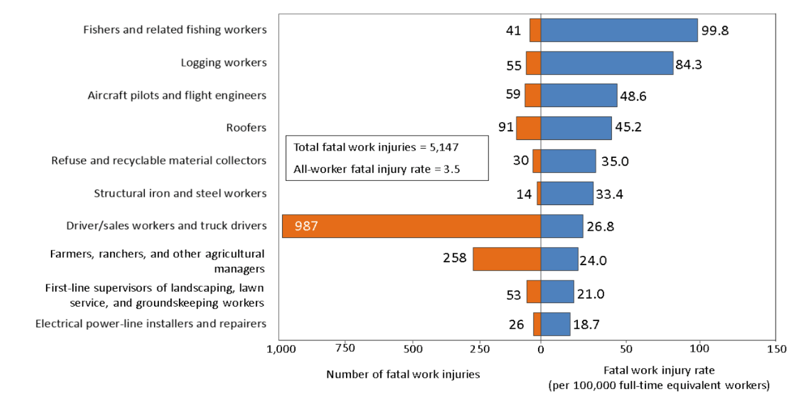
Project Background
The Bureau of Labor Statistics reports a steady increase of line worker injuries related to overexertion. From 1,930 in 2011 to 2,960 in 2015 alone. Increase of 53%*.
Reducing the amount physical exertion required line workers could help reduce the number of injuries on job. [5]
The BLS lists electrical power-line installers among the Top 10 most dangerous jobs in terms of fatal injuries each year.
Nicolas Palmeiro
*These number do not represent FPL operation rather national averages

Slide 6
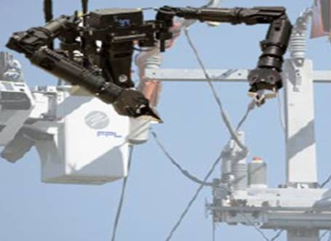
Our Mission
Our team is determined to develop a solution for Florida Power & Light that aids in the performance of routine installation and repair on distribution power lines while increasing operator safety.
Mock Design of Lineman Robot (provided by FPL)
Nicolas Palmeiro

Slide 7
Project Recap
Our last review outlined our problem as stated by our customer and how we planned to execute strategies to solve it.
We converted customer needs into product functions and requirements.
We assigned targets to each function to assess project completion.
Nicolas Palmeiro

Slide 8
Feedback and Improvements
Narrow down the scope!
Removed unreasonable targets
Focused on one function
Move Fast!
Prototyping
Moving ahead of schedule
Quality over quantity
Testing
Nicolas Palmeiro
Notes:
The team was encouraged to narrow our scope.
After talking with our sponsor, the team decided to focus on a single task to accomplish.
Some of our targets were unreasonable
Through conversation with our sponsor and advisors the team adjusted the targets to better fit the scope of our project.

Slide 9
Critical Targets and Metrics
Function Number | Function | Target Value | Unit of Measurement
1 | Withstands High Voltage | 17 | kV
5 | Separate Worker from Danger | 60 | Feet
8 | Manipulate Wires in Complex Ways | 4 | Degrees of Freedom
16 | Adheres to Company Standards | 0 | Infractions
Nicolas Palmeiro

Slide 10
Concept Generation
Biomimicry
Brainstorming Sessions
Morphological Chart
Doran McFalls
100 Concepts
Notes:
In order to make sure the team didn't overlook any possible solutions to our problem we developed as many concepts as we could
This helped us to evaluate the problem from a lot of different perspectives
The methods we used to produce the majority of our concepts were biomimicry, brainstorming, and a morphological chart.

Slide 11
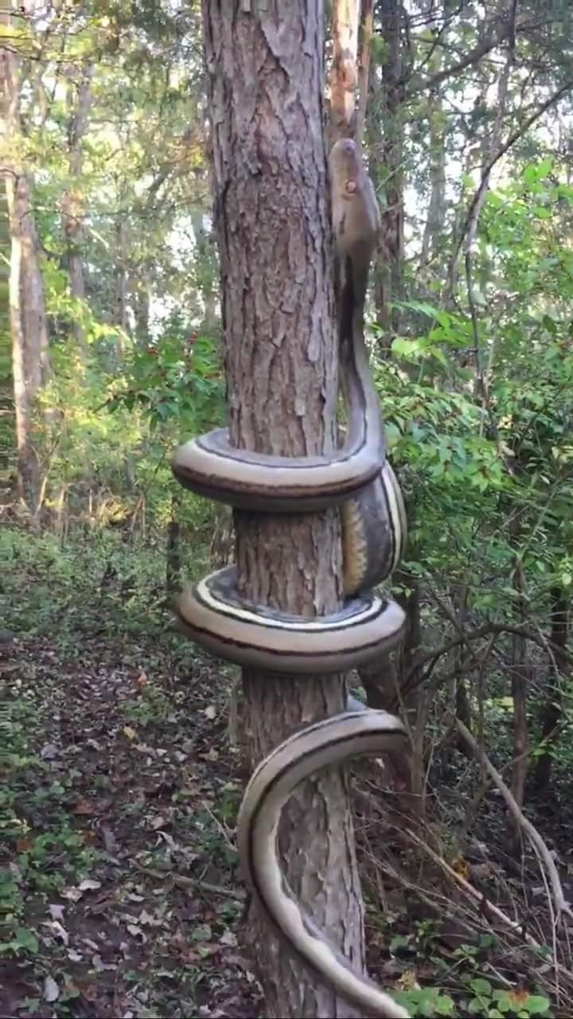
Biomimicry
Design of systems modeled on biological entities
Doran McFalls
Notes:
Biomimicry is a useful tool in concept generation because the things we see that work in nature are tried and true. Brought about by natural selection and are proven to work efficiently. For example we may look at a snake climbing a tree by wrapping itself around it and try to make a robot that climbs a power pole in a similar fashion.

Slide 12
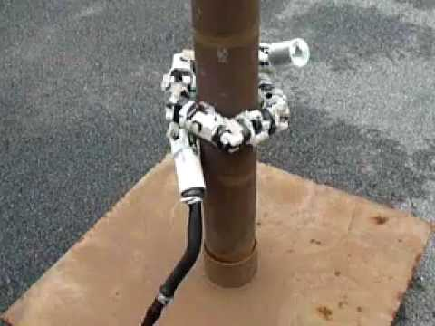
Biomimicry
Design of systems modeled on biological entities
Doran McFalls

Slide 13

Brainstorming Sessions
Pomodoro Method
  Brainstorm without interruption
  Regular breaks throughout session
Doran McFalls

Slide 14
Morphological Chart
Material | Training software | Communication to device | Power Sources | Light Sources | AV Recording
PVC | Unity VR | Bluetooth | Battery | LED headlights | Camera mount
Plexiglass | Unreal VR | Wi-Fi | Truck Power | flashlights | Built in camera
Wood | AR simulations | Wired | Solar | Headlamps | Attached GoPro™
Aluminum w/ insulation | Training course | Mechanical Linkage | Purely Mechanical | Infrared camera | External camera on truck
Fiberglass | Online training | IR remote | Hydraulic | Truck's headlights | Camcorder
Doran McFalls
Notes:
Using a morphological chart is the best way to fully flesh out every possible design concept. Each component of the solution may have 3 to 5 possible ways to be implemented into a design. The morphological chart sorts them and makes it easy to pick one option from each component to form a concept. In doing this the team is able to come up with over 15000 possible concepts.

Slide 15
Morphological Chart
Material | Training software | Communication to device | Power Sources | Light Sources | AV Recording
PVC | Unity VR | Bluetooth | Battery | LED headlights | Camera mount
Plexiglass | Unreal VR | Wi-Fi | Truck Power | flashlights | Built in camera
Wood | AR simulations | Wired | Solar | Headlamps | Attached GoPro™
Aluminum w/ insulation | Training course | Mechanical Linkage | Purely Mechanical | Infrared camera | External camera on truck
Fiberglass | Online training | IR remote | Hydraulic | Truck's headlights | Camcorder
Concept 1
Doran McFalls

Slide 16
Morphological Chart
Material | Training software | Communication to device | Power Sources | Light Sources | AV Recording
PVC | Unity VR | Bluetooth | Battery | LED headlights | Camera mount
Plexiglass | Unreal VR | Wi-Fi | Truck Power | flashlights | Built in camera
Wood | AR simulations | Wired | Solar | Headlamps | Attached GoPro™
Aluminum w/ insulation | Training course | Mechanical Linkage | Purely Mechanical | Infrared camera | External camera on truck
Fiberglass | Online training | IR remote | Hydraulic | Truck's headlights | Camcorder
Concept 1
Concept 2
Doran McFalls

Slide 17
Concept Generation
Biomimicry
Brainstorming Sessions
Morphological Chart
Doran McFalls
100 Concepts
Notes:
In order to make sure the team didn't overlook any possible solutions to our problem we developed as many concepts as we could
This helped us to evaluate the problem from a lot of different perspectives
The methods we used to produce the majority of our concepts were biomimicry, brainstorming, and a morphological chart.

Slide 18
Concept Generation
Biomimicry
Morphological Chart
Brainstorming Sessions
100 Concepts
Doran McFalls

Slide 19
Concept Generation
100 Low Fidelity
5 Medium Fidelity
3 High Fidelity
Jacob Hutto

Slide 20
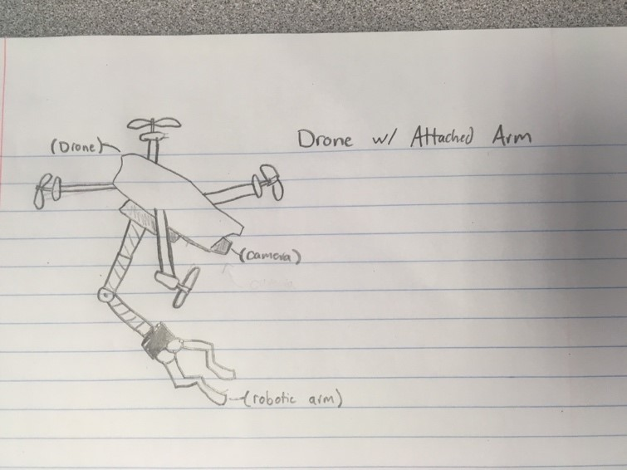
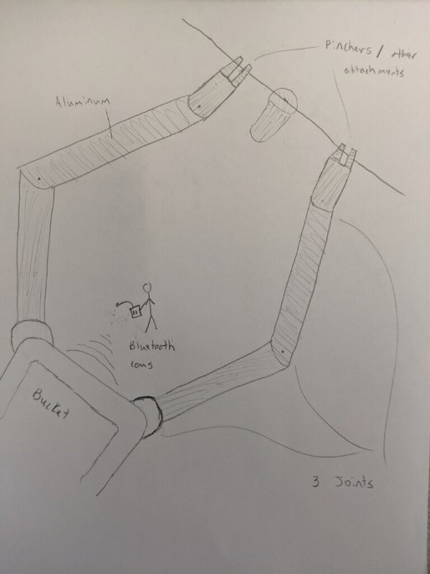
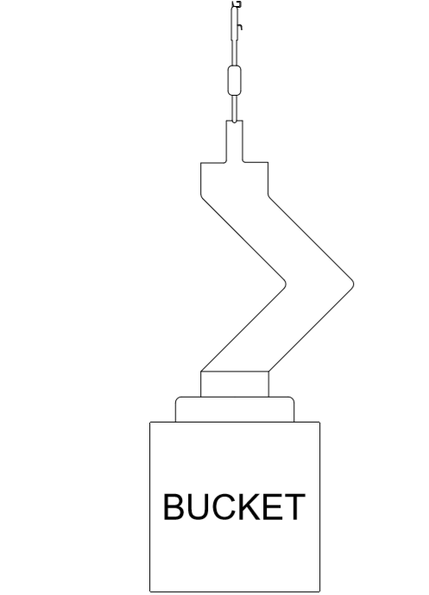
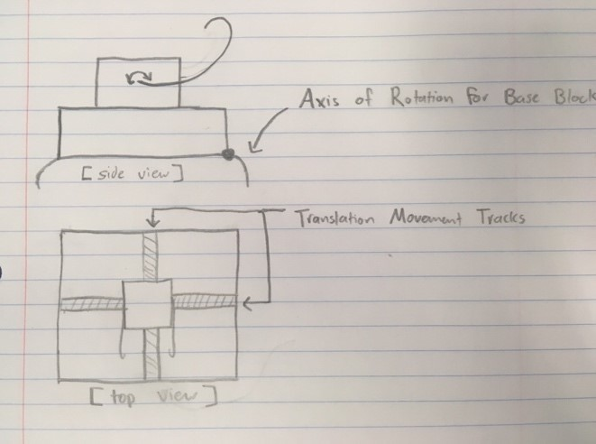
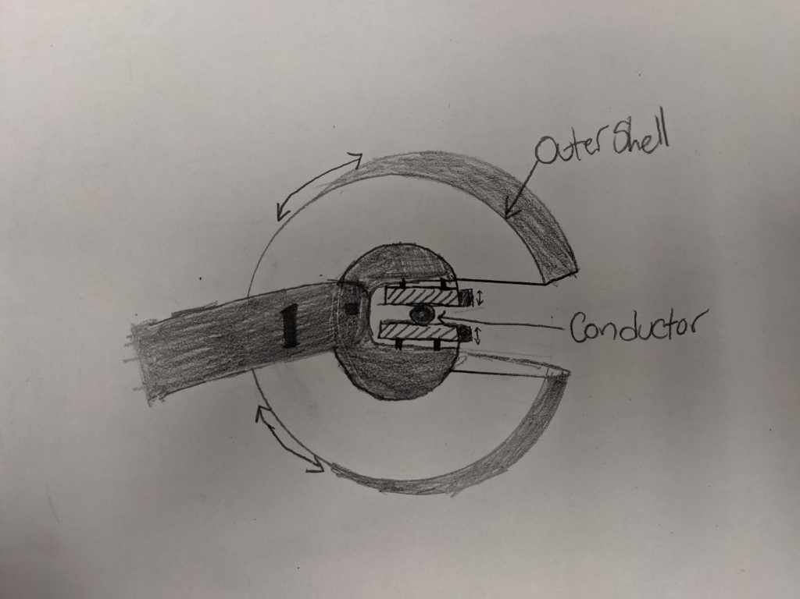
Medium Fidelity Concepts
Drone w/ Attached Arms
Double Sided Hook Robot
Rotating Claw Within Frame
Double Robotic Arms
Bucket Mounted Robot w/ Shotgun Stick
Jacob Hutto

Slide 21
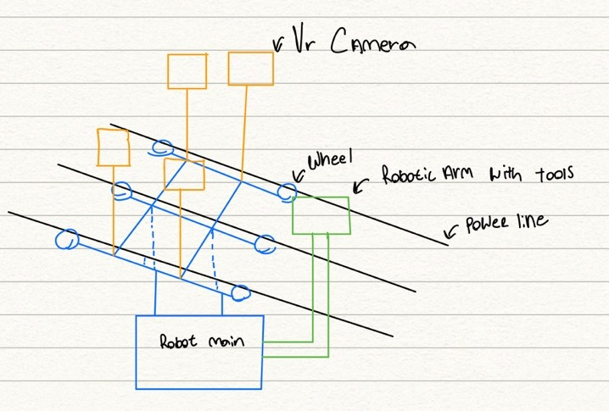
High Fidelity Concepts
Line Suspended Robot
Pros
Separates the operator from the energized line completely
Allows the device to get very close to the line for work
Cons
Is weight limited so it doesn’t put excess strain on the line
Limited as to what tools it can use since the strength of the device is limited due to weight restrictions
Must be battery powered
Jacob Hutto

Slide 22
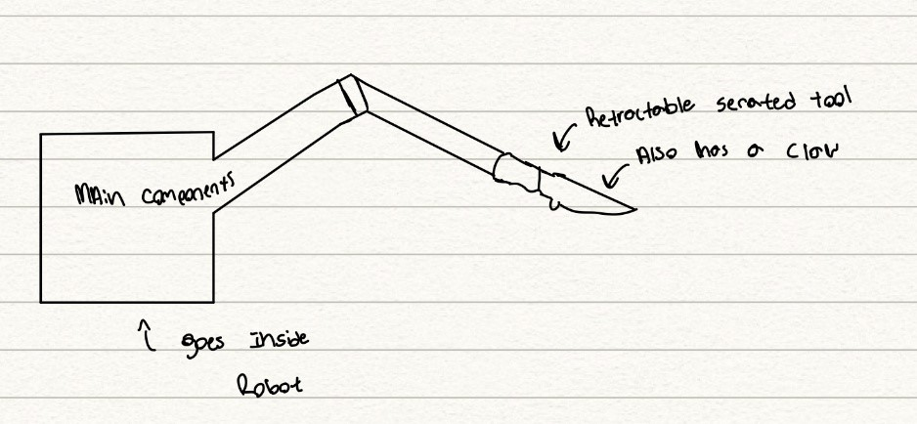
High Fidelity Concepts
Serrated Edge/ Claw Arm
Pros
Allows the device to complete one job easily and effectively
Is a very simple and straightforward design
Cons
The device is limited since it can only cut wire and grab it
The device must be very precise, so it doesn’t cut the main conductor
Bucket
Jacob Hutto

Slide 23
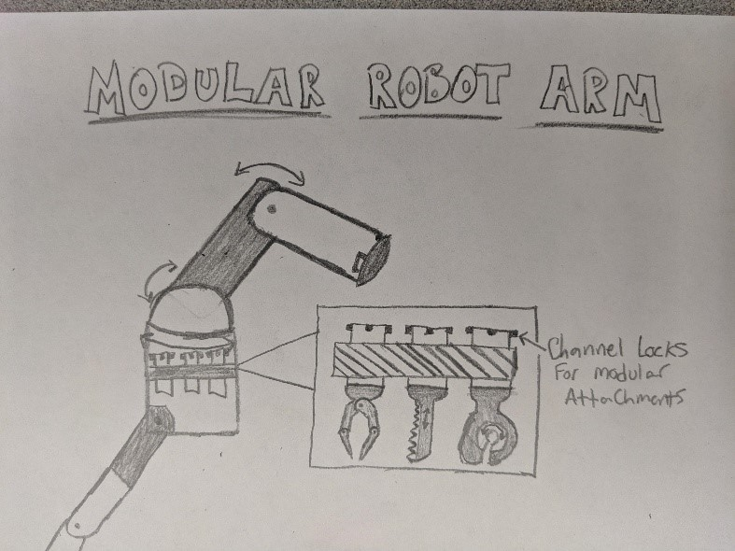
High Fidelity Concepts
Modular Arm w/ Attachments
Pros
Allows the device to use multiple tools
The device can complete multiple overhead jobs
Separates the operator from the energized line
Cons
Takes more time to complete jobs since the attachments must be changed for each job
Jacob Hutto

Slide 24
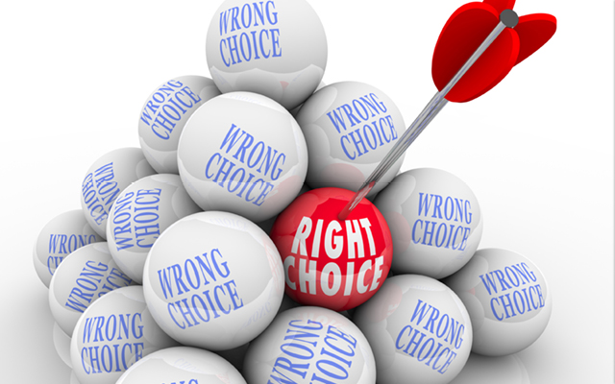
Concept Selection
Selection Tools Used
  Pairwise Comparison
  House of Quality
  Pugh Chart
  Analytical Hierarchy Process
Hunter Kramer

Slide 25
Pairwise Comparison
Hunter Kramer
Notes:
Customer requirements compared to each other

Slide 26
House of Quality
Hunter Kramer
Notes:
Compared customer requirements to the engineering characteristics of the solution and shows how they are correlated
Most important characteristics:
Distance between worker and Energized Line
Adhering to Company Standards
Lifting Heavy Objects

Slide 27
Pugh Chart
Hunter Kramer
Notes:
Compared engineering characteristics to the concepts using a datum

Slide 28
Pugh Chart
Hunter Kramer

Slide 29
Pugh Chart
Hunter Kramer
Notes:
New datum, same process

Slide 30
Pugh Chart
Hunter Kramer

Slide 31
Analytical Hierarchy Process (AHP)
Hunter Kramer
Notes:
Selection criteria are compared to each other to show which is most important

Slide 32
Analytical Hierarchy Process (AHP)
Hunter Kramer
Notes:
Compared each concept to each other on the basis of the selection criteria

Slide 33
Analytical Hierarchy Process (AHP)
Hunter Kramer
Notes:
Weights found by multiplying each score from previous step by the criteria wieght and adding all the resultant products together

Slide 34
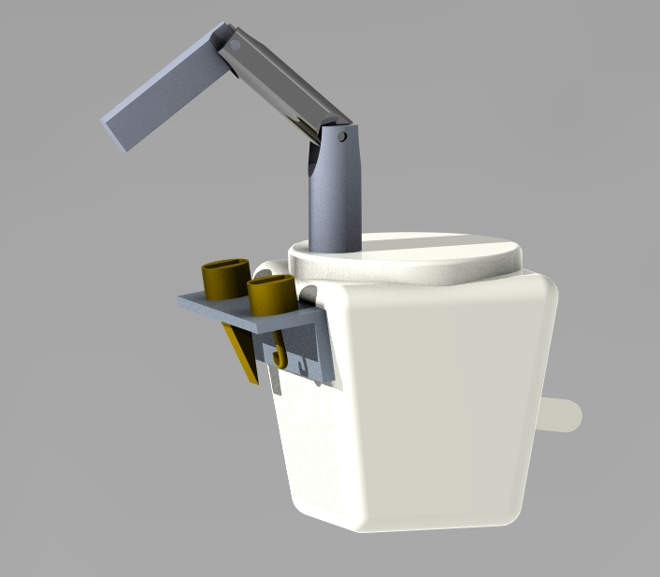
Final Concept Selected
Modular Hydraulic Powered Arm
Hunter Kramer

Slide 35

Future Work
Bill of Materials
Begin Prototype Stage
Risk Assessment
Spring Project Plan
Hunter Kramer

Slide 36
References
  [1] Kraus, M. (2018, March). 36.7 Million Affected by Power Outages in 2017, Per Eaton Study. Retrieved October 5, 2019, from
  https://www.ecmag.com/section/systems/367-million-affected-power-outages-2017eaton-study#targetText=While the number of outages,2017 lasted approximately 81 minutes.
  [2]Burlew, J., & Schweers, J. (2018, October 10). Update: Power out for more than 80,000 and climbing in Leon County. Retrieved October 5, 2019, from https://www.tallahassee.com/story/news/2018/10/10/power-out-more-than-3-000-and-climbing-tallahassee/1588990002/.
[3]Occupational Safety and Health Administration. (n.d.). Power Transmission & Distribution in Construction. Retrieved October 4, 2019, from https://www.osha.gov/archive/oshinfo/priorities/power.html.
[4] FPL After Hurricane Dorian -https://cbs12.com/news/local/fpl-says-all-dorian-power-outages-resolved
[5] National Census of Fatal Occupational Injuries in 2017- https://www.bls.gov/news.release/pdf/cfoi.pdf
Images:
UPDATE: Power restored to over 5,000 NYSEG customers in Broome County. (2016, June 6). Retrieved October 5, 2019, from https://www.binghamtonhomepage.com/news/update-power-restored-to-over-5000-
nyseg-customers-in-broome-county/.
wallpaper skyscraper, mga gusali, kalangitan hd: widescreen: high definition: fullscreen. (2017, March 2). Retrieved October 5, 2019, from https://1freewallpapers.com/skyscrapers-buildings-
sky/tl.
Southeast Lineman Training Center. (2019, September 28). Retrieved October 5, 2019, from https://en.wikipedia.org/wiki/Southeast_Lineman_Training_Center.
Teaching emergency preparedness. (2018, August 16). Retrieved October 5, 2019, from https://publicdomainvectors.org/en/free-clipart/Teaching-emergency-preparedness/76611.html.
Center for Advanced Power Systems. (n.d.). Retrieved October 5, 2019, from https://www.caps.fsu.edu/about-caps/tour-the-caps-facilities/.
Cuthbertson, T. (2017, January 23). Small Step Forward for ELD Mandate. Retrieved October 5, 2019, from https://www.eldfacts.com/small-step-forward-eld-mandate/.
https://steemitimages.com/p/2bP4pJr4wVimqCWjYimXJe2cnCgnKpTf2JcRr2VdiQn?format=match&mode=fit
Snake climbing robot- https://i.ytimg.com/vi/0HEn-fWKcqc/hqdefault.jpg

Slide 37
FPL Line Worker Robot
Team 310
Denis Dineen, Jacob Hutto, Hunter Kramer, Doran McFalls, Nicolas Palmeiro

Slide 38
Project Recap (Will change it)
Our Mission
Intended Markets
Customer Needs
Functional Decomposition
Targets and Metrics
Nicolas Palmeiro

Slide 39

Feedback and Improvements
The team was encouraged to narrow our scope.
  After talking with our sponsor, the team decided to focus on a single task to accomplish.
Some of our targets were unreasonable
  Through conversation with our sponsor and advisors the team adjusted the targets to better fit the scope of our project.
Nicolas Palmeiro

Slide 40
Key Goals
Improve line worker safety while performing field work.
1
Increase overall efficiency of common line work (installation, maintenance, etc).
2
Incorporate user friendly controls based off proper training procedures.
3
Improve technical sophistication through a tailored training software.
4
Doran McFalls
40
7

Slide 41

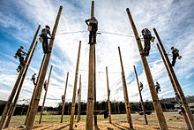

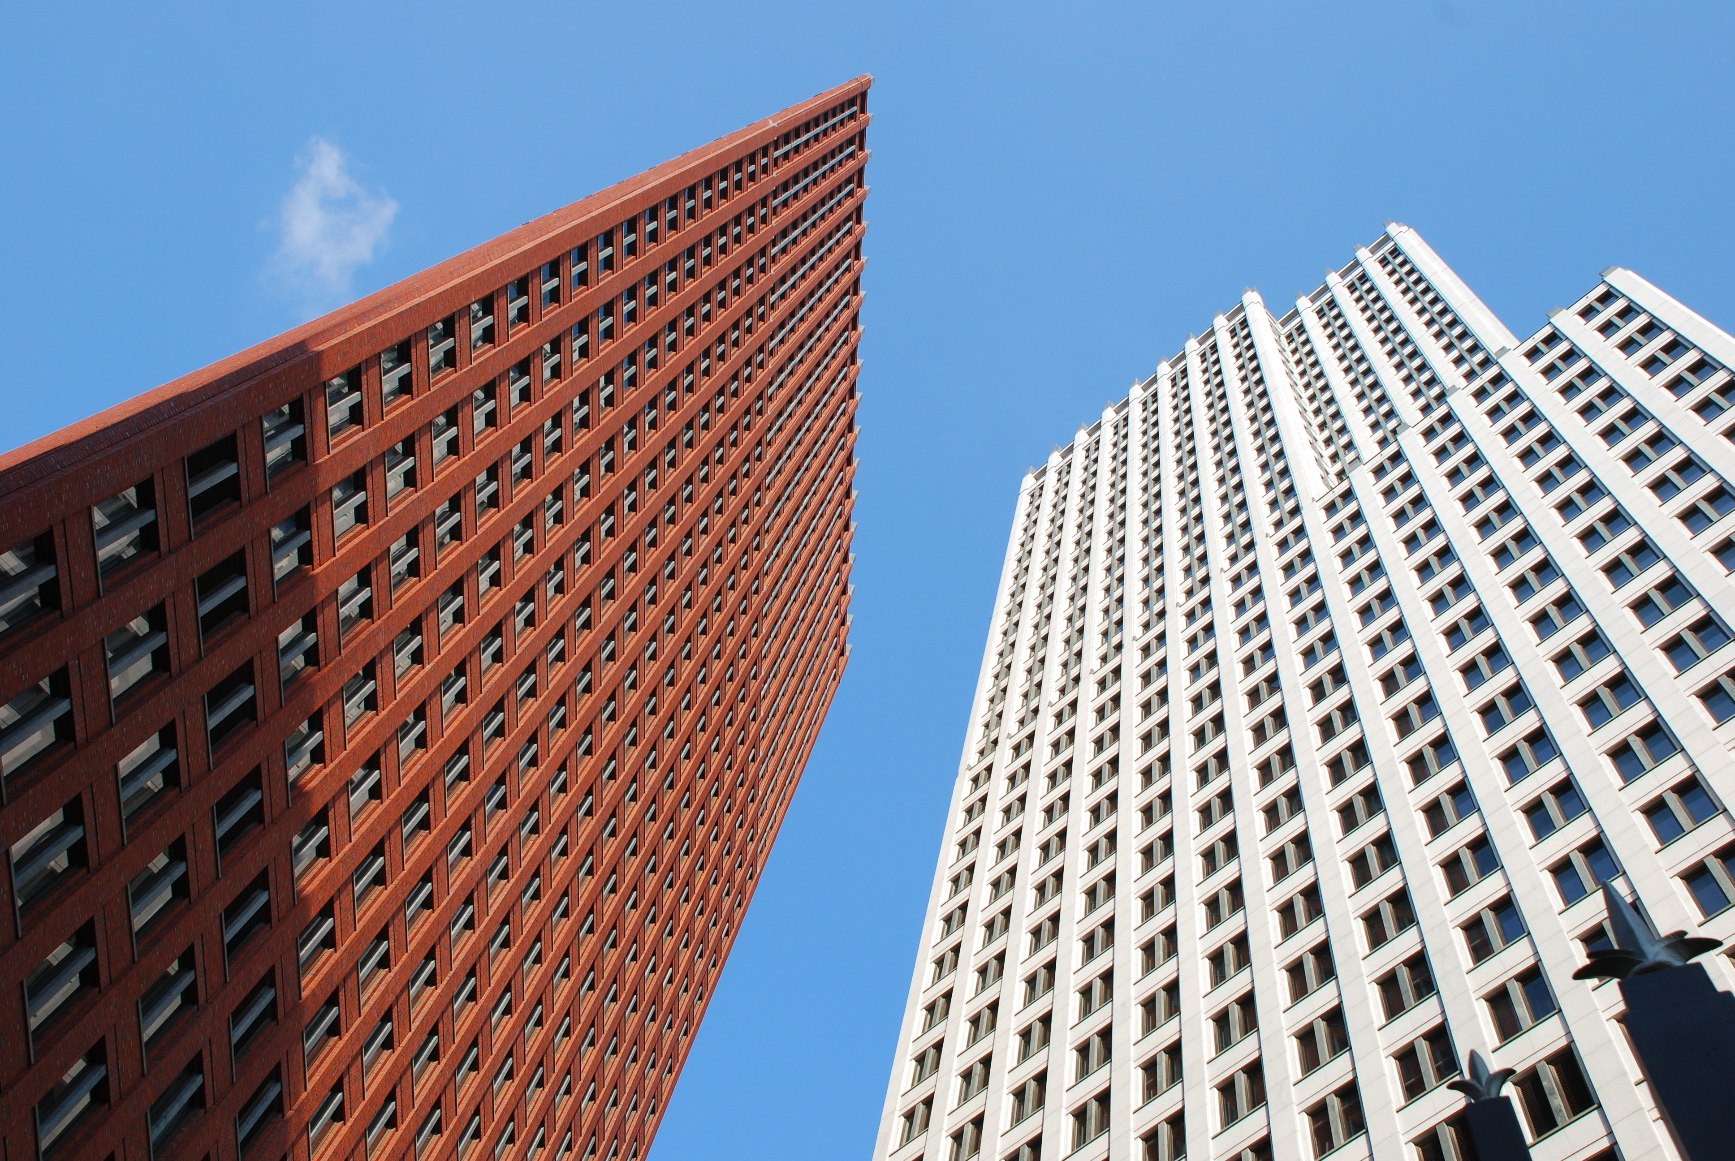
Intended Markets
Primary Markets:
Line worker technical institutions
Secondary Markets:
Construction contractors
Emergency response organizations
Utility companies
Municipality emergency operations
Doran McFalls
41
8

Slide 42
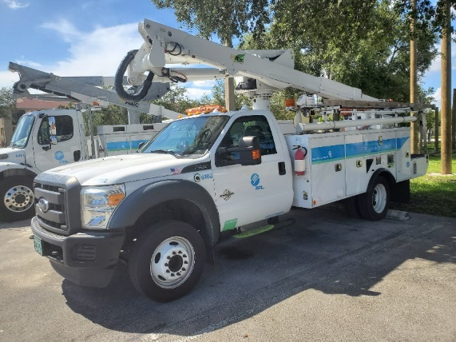
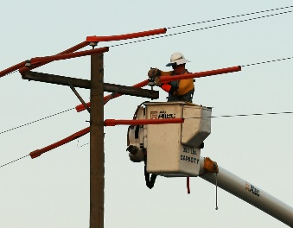
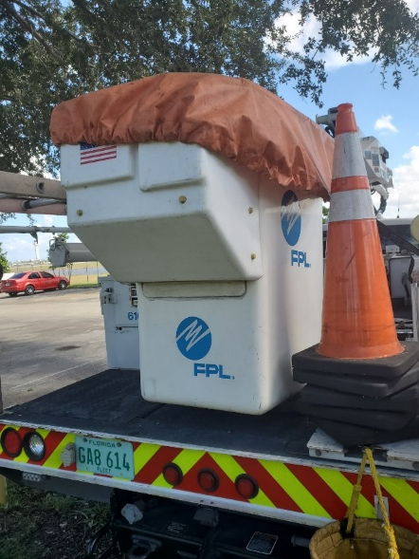
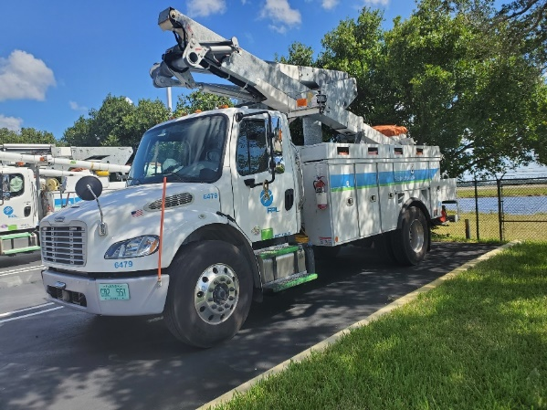
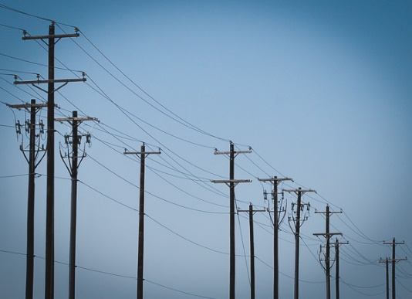
Assumptions
Line worker will be present when operating the device.
Operator will have completed proper training requirements prior to use.
Line wires will be energized when device is in operation.
Device will be used under standard line repair weather conditions.
Truck buckets will be uniform in size.
Standard repair equipment will also be located within truck bucket.
Jacob Hutto
42
9

Slide 43
Customer Needs
Question/Prompt
What PPE (Personal Protection Equipment) is required by FPL for line workers?
Customer Response
FPL line worker are required to wear a hard hat, FR (fire rated) shirt, safety glasses, 17KV gloves, leather gloves and steel toe shoes.
Interpreted Need
Device can operate with a high voltage.
Device can operate with high heat
Hunter Kramer
43
15

Slide 44
Customer Needs
Device increases distance between line worker and energized line.
Device can manipulate objects of various size, weight, and shape.
Device adheres to all company standards.
Device can operate with a high voltage.
Hunter Kramer
44
16

Slide 45
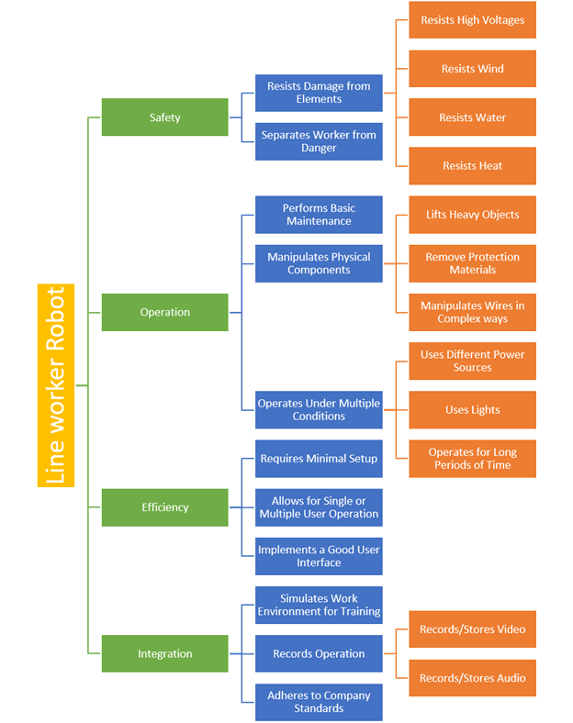
Functional Decomposition
Nicolas Palmeiro
20

Slide 46
Functional Decomposition
Interpreted Need
Device can operate with a high voltage.
Major Function
Safety
Minor Function
Resist High Voltage
Nicolas Palmeiro
46
21

Slide 47

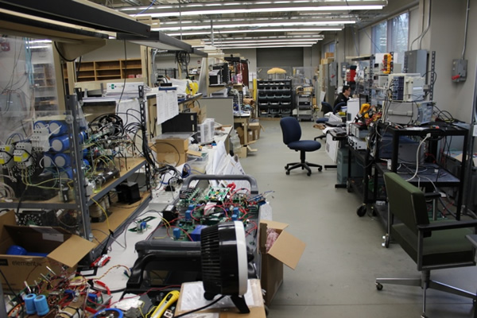
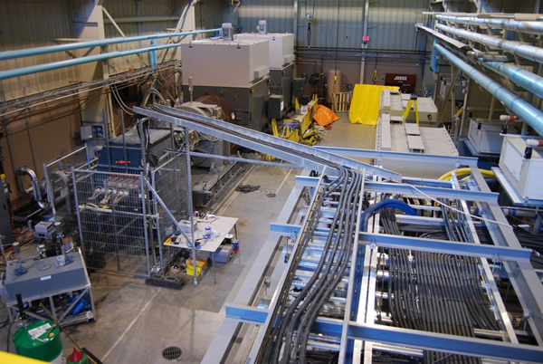
Additional Resources
Power Electronics Lab
5-Megawatt Prototype Facility
Nicolas Palmeiro
47
23

