Slide 1
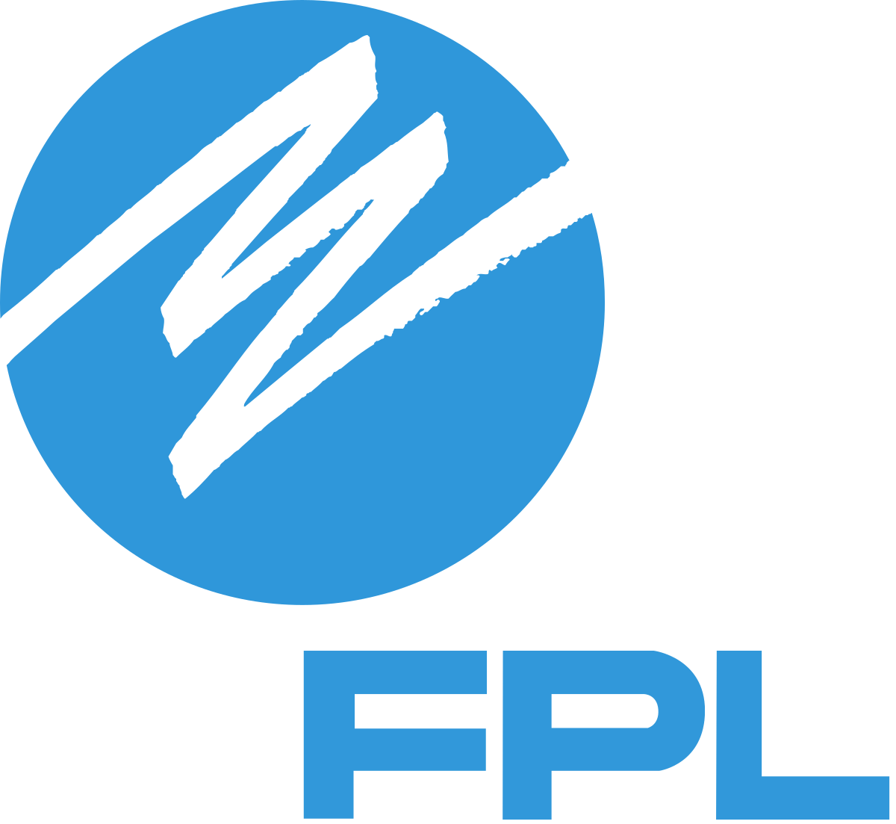
FPL Telerobotic Lineman Worker
Team 310
Denis Dineen, Jacob Hutto, Hunter Kramer, Doran McFalls, Nicolas Palmeiro

Slide 2
Team Introduction
Denis Dineen
Project Manager
Doran McFalls
Mechatronics Design Engineer
Jacob Hutto
Electrical Design Engineer
Hunter Kramer
Mechanical Design Engineer
Nicolas Palmeiro
Power Engineer

Slide 3
Stakeholders
Genese Augustin
Lead Project Manager
Florida Power & Light
Rodney Roberts
Academic Adviser
FAMU-FSU College of Engineering
FAMU-FSU
College of Engineering
Nicolas Palmeiro

Slide 4
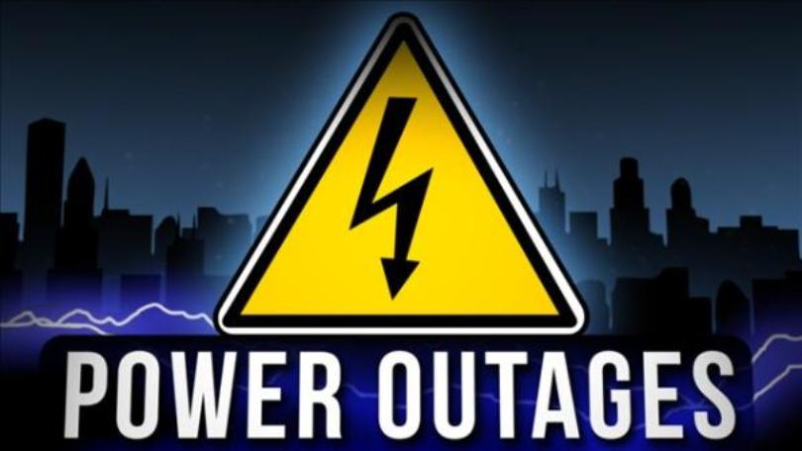
Project Background
Close to 36.7 million people were affected by 3,526 reported outages for average of 81 minutes in 2017.^{[1]}
State of Florida has been hit by numerous natural disasters over the past four years.
Nearly 50,000 Tallahassee electric utility customers lost power as a result of Hurricane Michael in 2018.^{[2]}
Nicolas Palmeiro

Slide 5
Project Background
Florida Power & Light (FPL) is the largest energy company in the United States with upwards of 5 million customer accounts across the state.
Line workers experience many risks in order to do their jobs. Approximately 17 to 23 deaths occur per thousand workers over a 45-year period.[3] **National statistics, not FPL specific**
FPL values their line workers and wishes to increase their safety as much as possible.
Nicolas Palmeiro

Slide 6
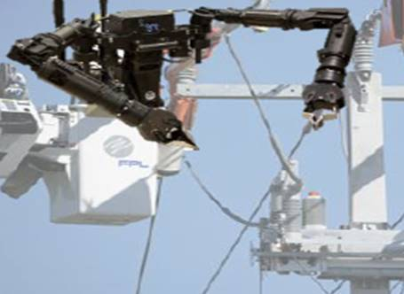
Our Mission
Our team is determined to develop a solution for Florida Power & Light that aids in the performance of routine installation and repair on distribution power lines while increasing operator safety.
Mock Design of Project (provided by FPL)
Nicolas Palmeiro

Slide 7
Redefined Scope
Lineman have a wide variety of responsibilities
Our design will focus on insulator replacements
Decision based on input from several members of FPL
Future developments could accommodate to other lineman tasks
Nicolas Palmeiro

Slide 8
Concept Generation
Morphological Chart
Biomimicry
Brainstorming Sessions
100 Concepts
Jacob Hutto

Slide 9
Concept Generation
100 Low Fidelity
5 Medium Fidelity
3 High Fidelity
Jacob Hutto

Slide 10
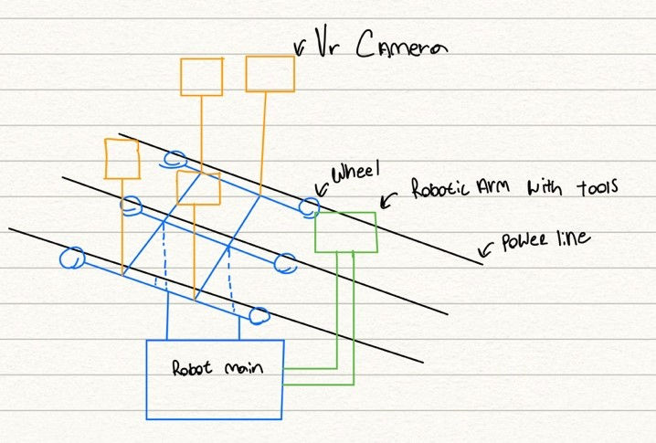
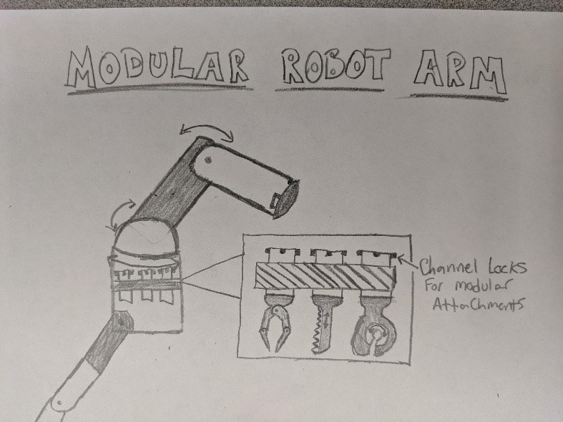
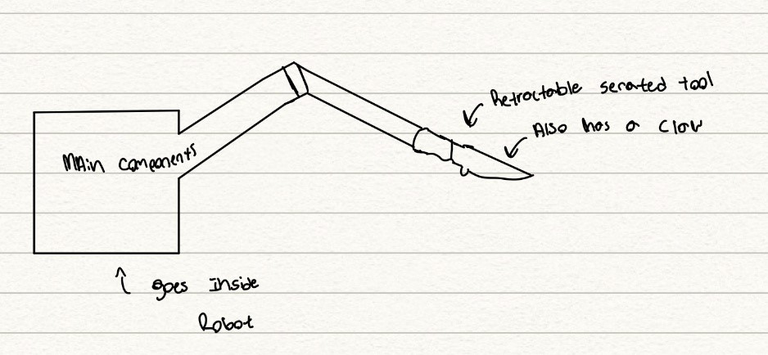
High Fidelity Concepts
Line Suspended Robot
Modular Arm w/ Attachments
Serrated Edge/
Claw Arm
Jacob Hutto

Slide 11
Concept Selection
Selection Tools Used
Pairwise Comparison
House of Quality
Pugh Chart
Analytical Hierarchy Process
Jacob Hutto

Slide 12
Final Concept Selected
Modular Arm w/ Attachments
Doran McFalls

Slide 13
Design Refinement
Doran McFalls

Slide 14
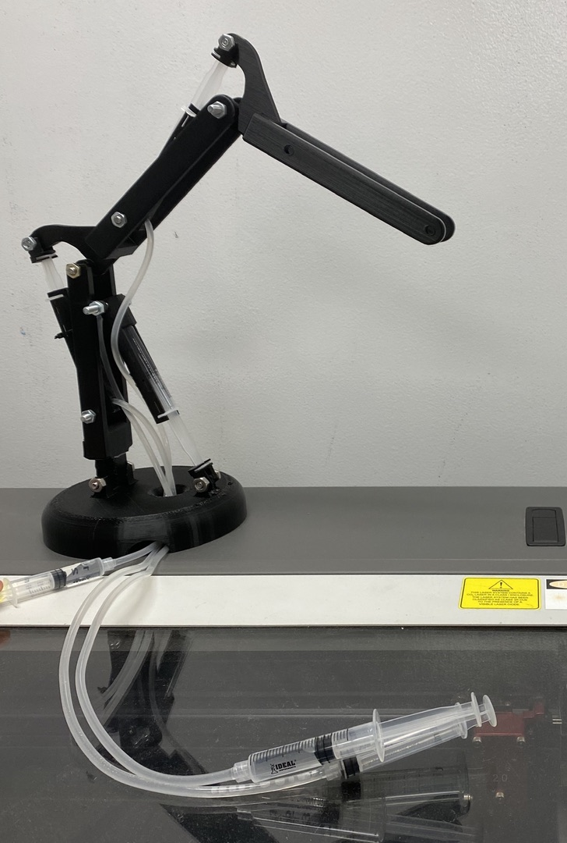
Design Refinement
Doran McFalls

Slide 15
Design Refinement
All links were 3D printed at 30% scale.
Plastic syringes used as small-scale hydraulic cylinders to actuate arm.
At full scale, pumps and electronics will be housed in lower body bucket shown in CAD model.
30% scale model
Doran McFalls

Slide 16
Material Selection
Desired Characteristics:
Non-conductive
Strong enough to remove wire
Lightweight
Durable
Weather Resistant
Proposed Materials:
Arm Links – Fiberglass
Linear Actuators – Hydraulic Cylinders
Fasteners – Ceramic Screws and Nuts
Insulated lower body to house electronics.
Insulative coating for tools
Denis Dineen

Slide 17
Material Selection
Challenges of Incorporating Desired Materials:
Fiberglass requires a mold and time to cure
Hydraulics are loud, heavy, and present safety hazard
Ceramic nuts and bolts are expensive
Denis Dineen

Slide 18
Material Selection
Final Prototype Materials:
Welded Aluminum 6063 for links
Aluminum Alloy Pneumatic Air Cylinders
Polyethene tubing
12-V Pneumatic solenoid valve
Denis Dineen

Slide 19
Pneumatics vs Hydraulics
Pneumatics | Hydraulics
Cheaper | Less Compressible
Lighter | More Precise
Easier Implementation | Higher Force Output
Safer Operation | Less Maintenance Required
Quiet Operation | Greater Temperature Stability
Denis Dineen

Slide 20
Further Look Into Design
Arm movement controlled through use of hydraulic/pneumatic cylinders
Arm will utilize CNC collet to switch between necessary attachments
Planetary gear in the base allows rotation of the arm.
Hunter Kramer

Slide 21
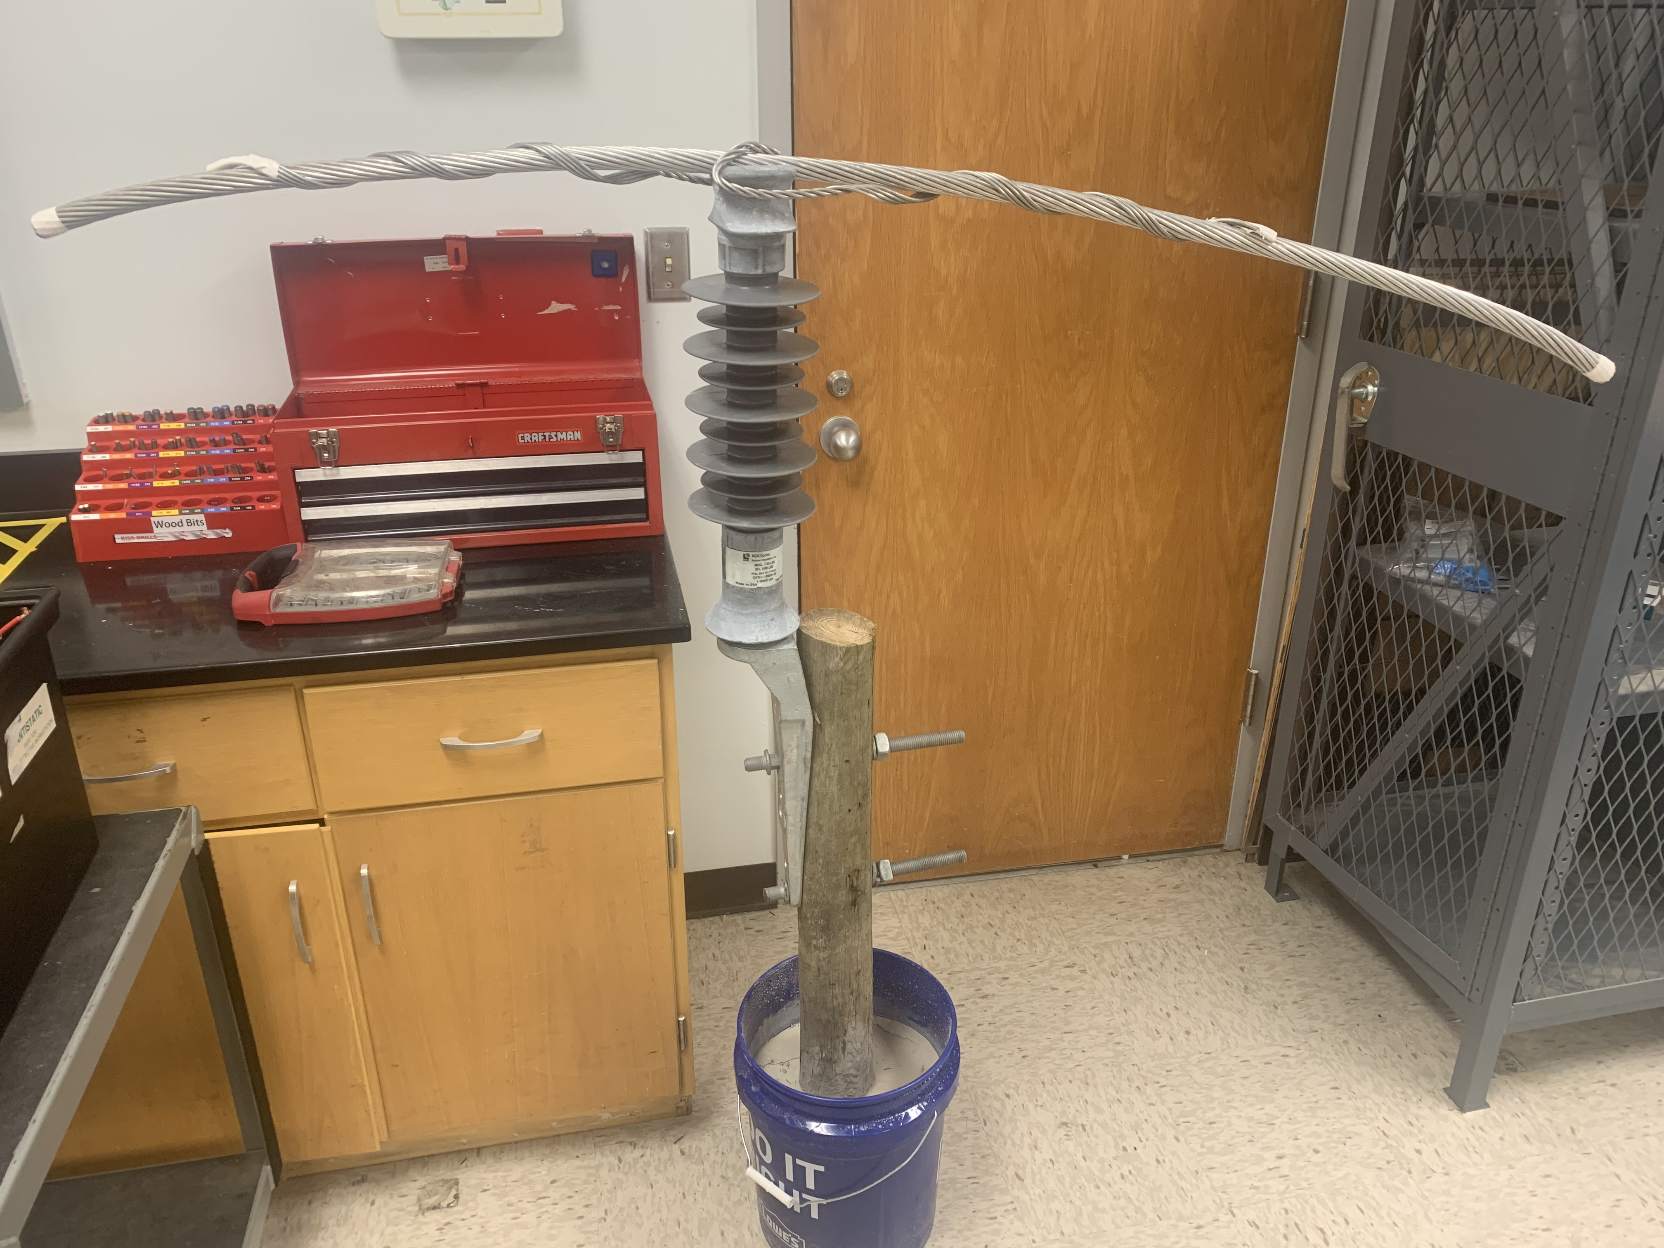
Testing Environment
Obtained wooden pole, insulator, and preformed wires from FPL
Configuration which simulates a stand-alone power line
Hunter Kramer

Slide 22
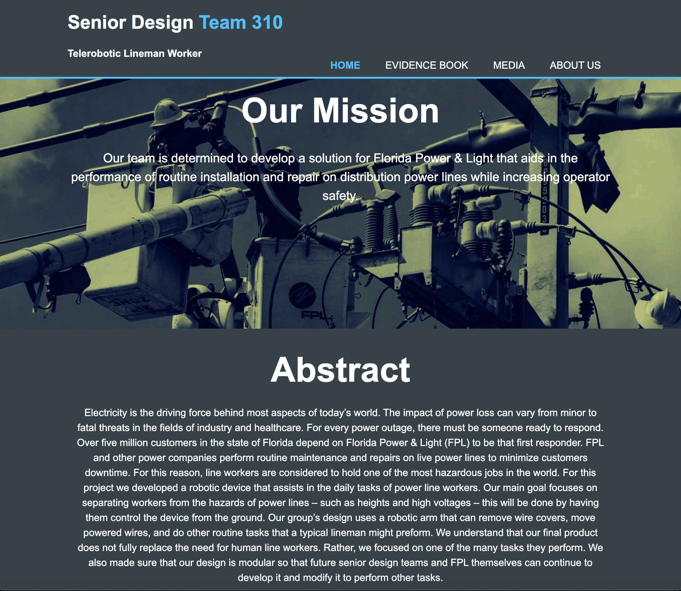
Website Progress
Hunter Kramer
https://ww2.eng.famu.fsu.edu/me/senior_design/2020/team310/

Slide 23
Future Work
Hydraulic Calculations (Torque and Power Requirements)
Derivation of Inverse Kinematics for End Effector Control Scheme
Possible Tool Attachments
Robustness and Control Testing
Hunter Kramer

Slide 24
References
[1] Kraus, M. (2018, March). 36.7 Million Affected by Power Outages in 2017, Per Eaton Study. Retrieved October 5, 2019, from
https://www.ecmag.com/section/systems/367-million-affected-power-outages-2017eaton-study#targetText=While the number of outages,2017 lasted approximately 81 minutes.
[2]Burlew, J., & Schweers, J. (2018, October 10). Update: Power out for more than 80,000 and climbing in Leon County. Retrieved October 5, 2019, from https://www.tallahassee.com/story/news/2018/10/10/power-out-more-than-3-000-and-climbing-tallahassee/1588990002/.
[3]Occupational Safety and Health Administration. (n.d.). Power Transmission & Distribution in Construction. Retrieved October 4, 2019, from https://www.osha.gov/archive/oshinfo/priorities/power.html.
Images:
UPDATE: Power restored to over 5,000 NYSEG customers in Broome County. (2016, June 6). Retrieved October 5, 2019, from https://www.binghamtonhomepage.com/news/update-power-restored-to-over-5000-
nyseg-customers-in-broome-county/.
wallpaper skyscraper, mga gusali, kalangitan hd: widescreen: high definition: fullscreen. (2017, March 2). Retrieved October 5, 2019, from https://1freewallpapers.com/skyscrapers-buildings-
sky/tl.
Southeast Lineman Training Center. (2019, September 28). Retrieved October 5, 2019, from https://en.wikipedia.org/wiki/Southeast_Lineman_Training_Center.
Teaching emergency preparedness. (2018, August 16). Retrieved October 5, 2019, from https://publicdomainvectors.org/en/free-clipart/Teaching-emergency-preparedness/76611.html.
Center for Advanced Power Systems. (n.d.). Retrieved October 5, 2019, from https://www.caps.fsu.edu/about-caps/tour-the-caps-facilities/.
Cuthbertson, T. (2017, January 23). Small Step Forward for ELD Mandate. Retrieved October 5, 2019, from https://www.eldfacts.com/small-step-forward-eld-mandate/.
https://steemitimages.com/p/2bP4pJr4wVimqCWjYimXJe2cnCgnKpTf2JcRr2VdiQn?format=match&mode=fit
Snake climbing robot- https://i.ytimg.com/vi/0HEn-fWKcqc/hqdefault.jpg
25

Slide 25
FPL Telerobotic Lineman Worker
Team 310
Denis Dineen, Jacob Hutto, Hunter Kramer, Doran McFalls, Nicolas Palmeiro

