Slide 1

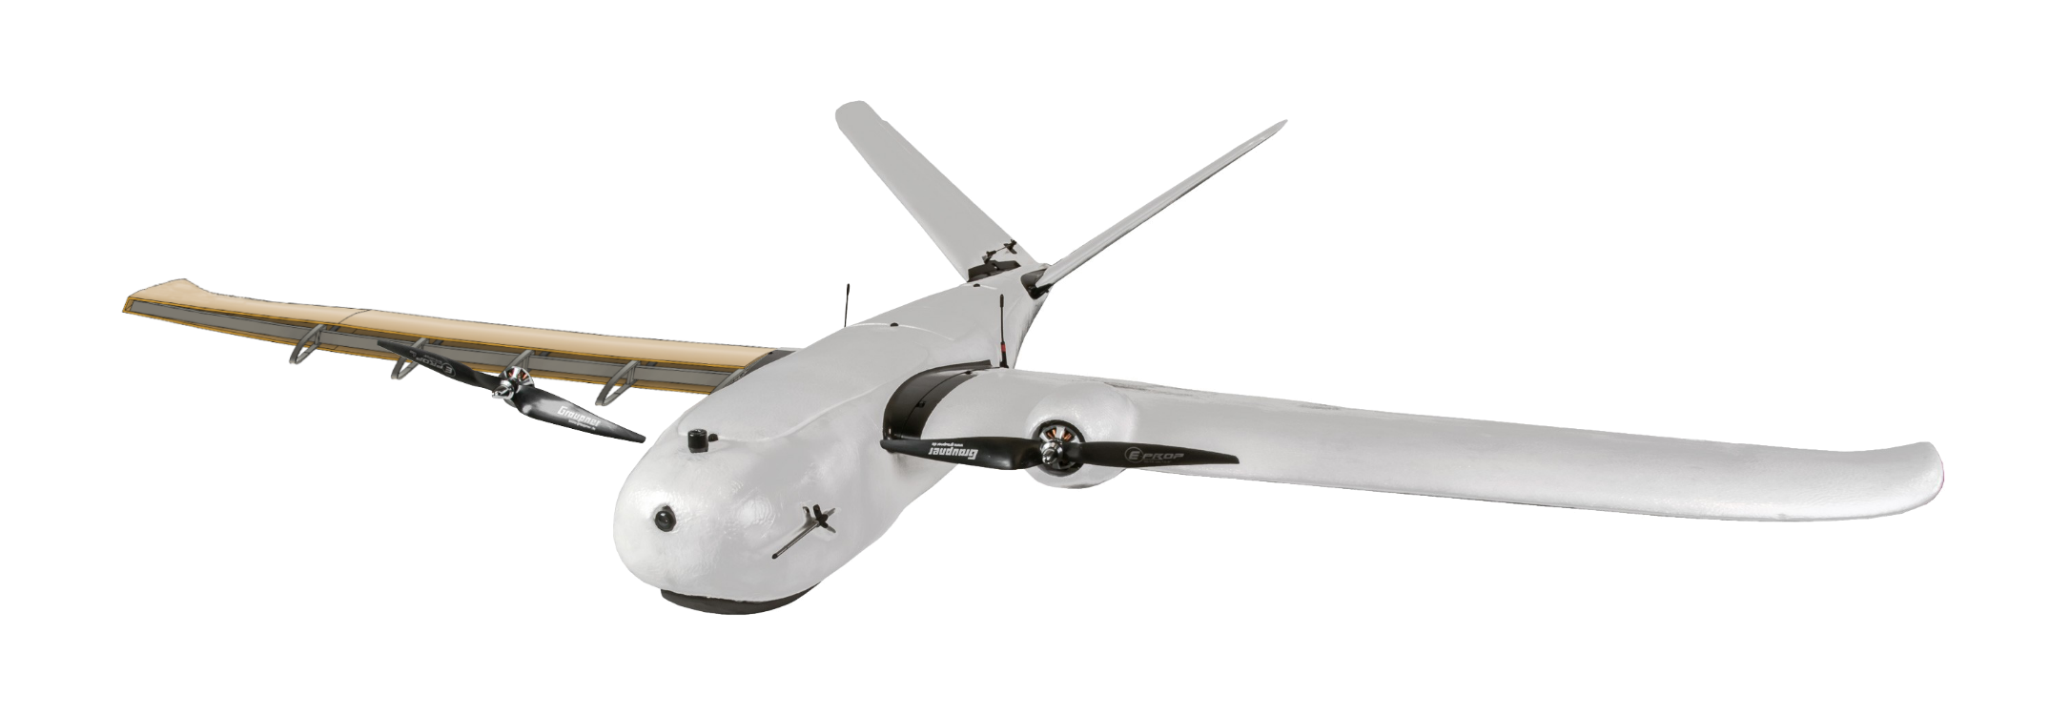
Lightweight UAV
Team 518
Clayton Cooley, Taylor Jacobs, Zachary Noay, Brenden Richman, Brian Thervil

Slide 2





Team Introduction
Zachary Noay
Embedded Systems Engineer
Electrical Engineering
Clayton Cooley
Test Engineer
Mechanical Engineering
Taylor Jacobs
Flight Dynamics Engineer
Mechanical Engineering
Brenden Richman
CAD/Materials Engineer
Mechanical Engineering
Brian Thervil
Software/System Integration Engineer
Electrical Engineering

Slide 3


Sponsor and Advisor
A global security company that provides innovative solutions worldwide.
Dr. Rajan Kumar
Jennifer Tecson
Research in Aerodynamics, Experimental Fluid Mechanics, and Flow Diagnostics
Taylor Jacobs

Slide 4
Project Objective
The objective of this project is to reduce the weight of a commercially available UAV through light-weighting processes.
Taylor Jacobs

Slide 5
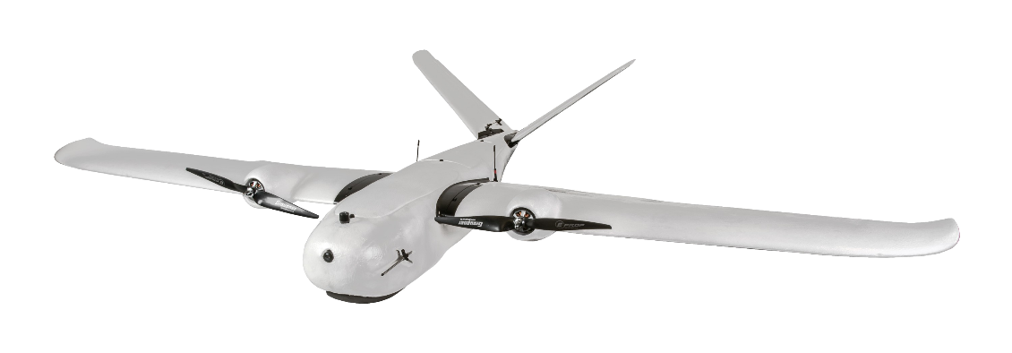
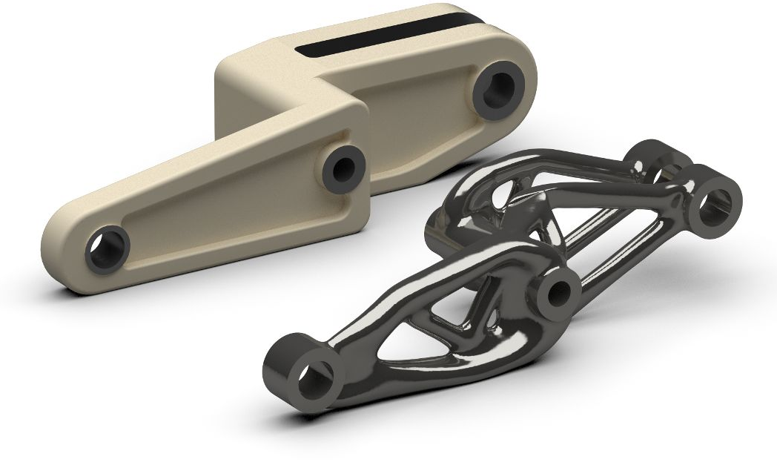
Project Summary
Narrowed down the project scope
  Lighten and optimize a commercial fixed wing UAV
  Match or improve original UAV parameters
Select a commercial drone
  Believer 1960mm
Determine methods of light-weighting
  Generative Design
  Multi-use Components
Begin designing and planning
Believer 1960mm
Taylor Jacobs

Slide 6
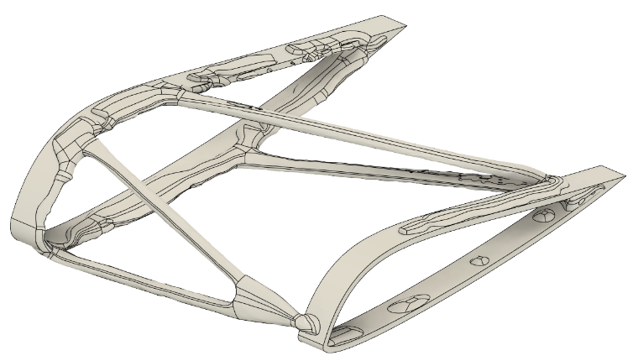
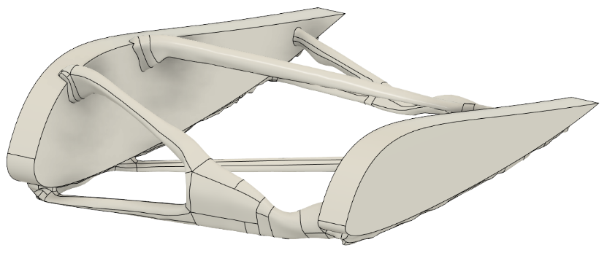
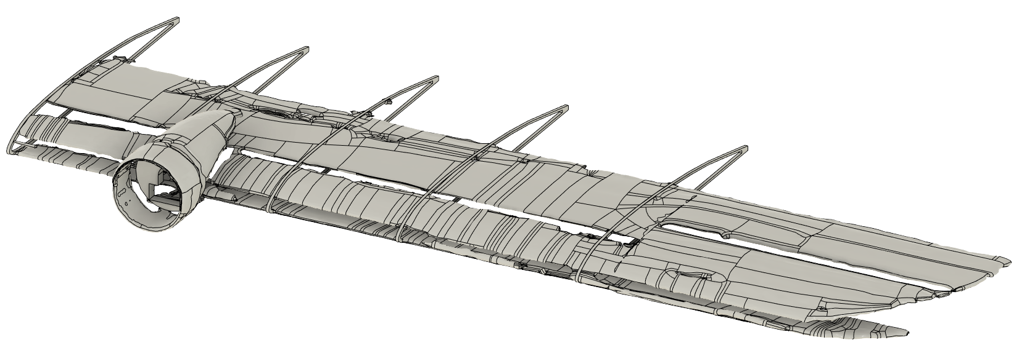
Generative Design
Wing support for small sections
Problematic for following shapes
Use for supports and mounts in fuselage
Taylor Jacobs

Slide 7
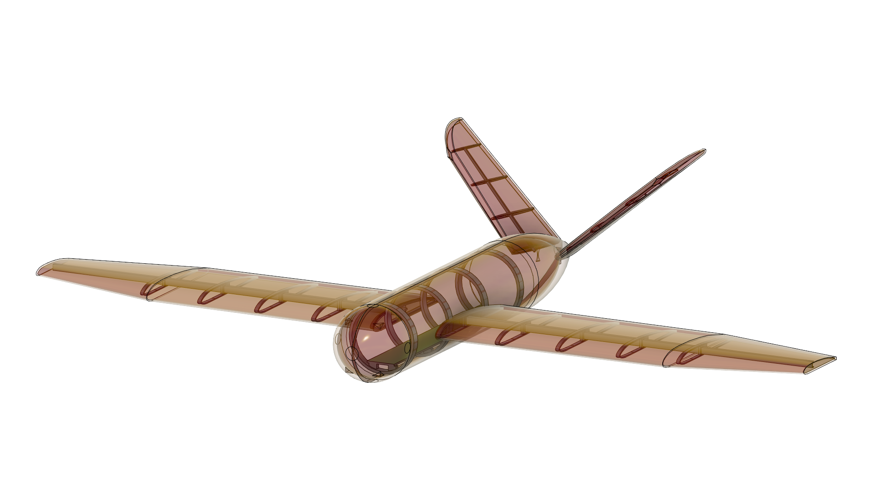
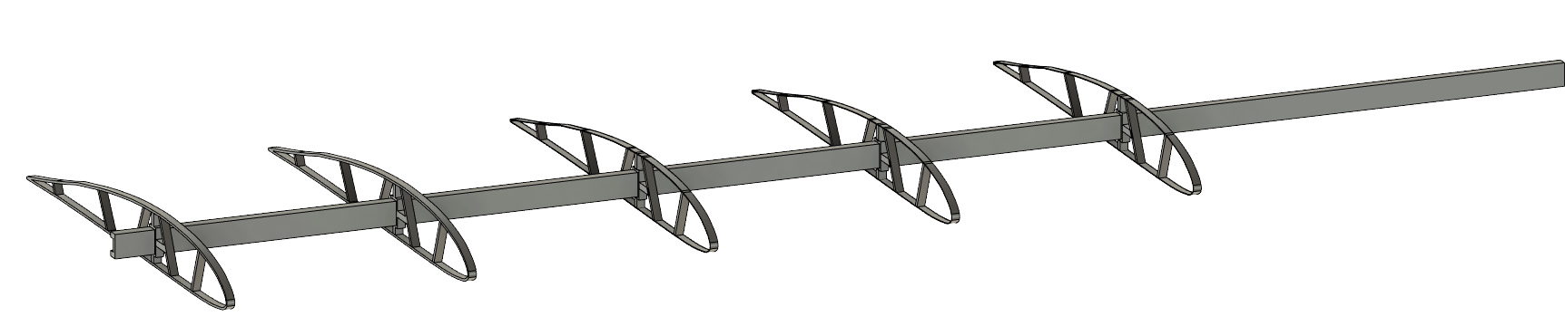
CAD Designs
All body components created
Ribbed support structure
Weight estimations calculated
Taylor Jacobs

Slide 8
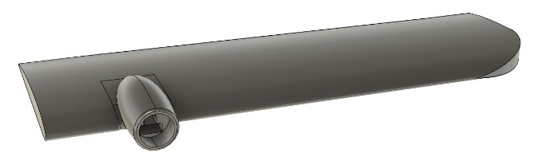
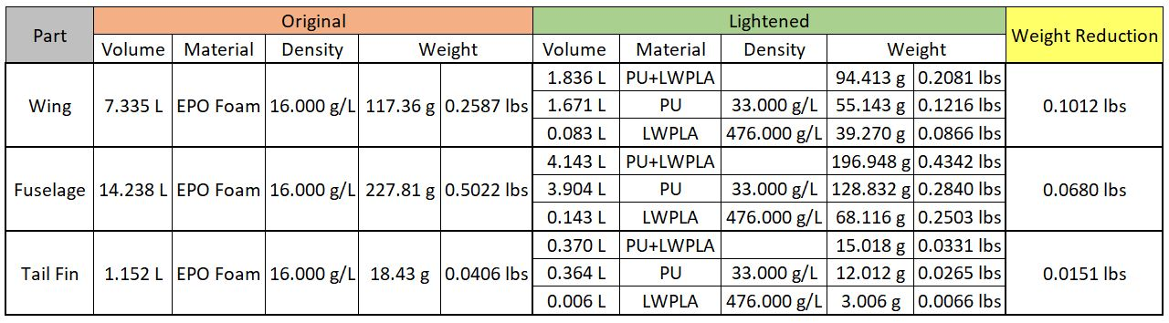
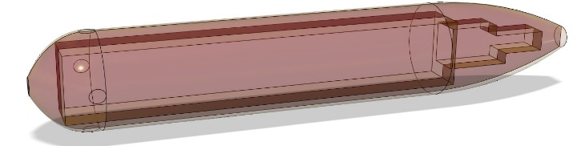
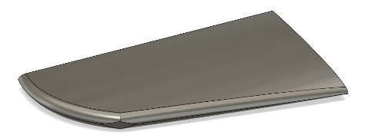
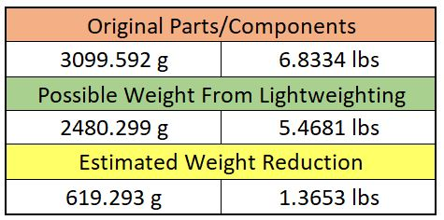
Weight Savings
Taylor Jacobs

Slide 9
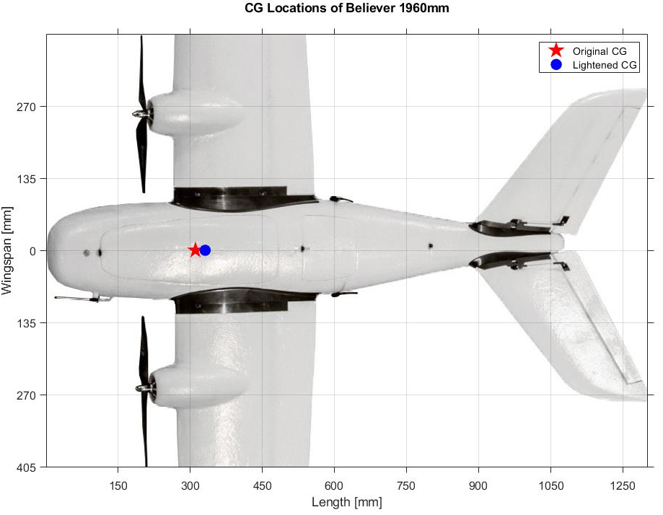
Effects on Flight
Changes stability of flight
Lift and drag changes
Can be fixed with component placement
Taylor Jacobs

Slide 10
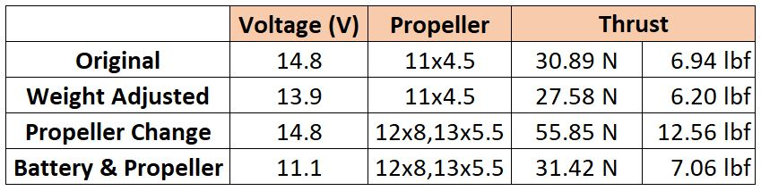
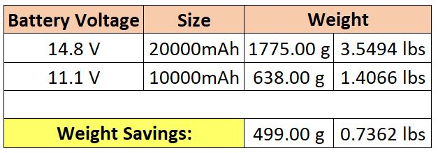
Thrust Changes
Thrust calculations at full throttle
Weight reduction changes max thrust requirement
Battery adjustment achieves required thrust
Taylor Jacobs

Slide 11
Prototyping
Taylor Jacobs

Slide 12
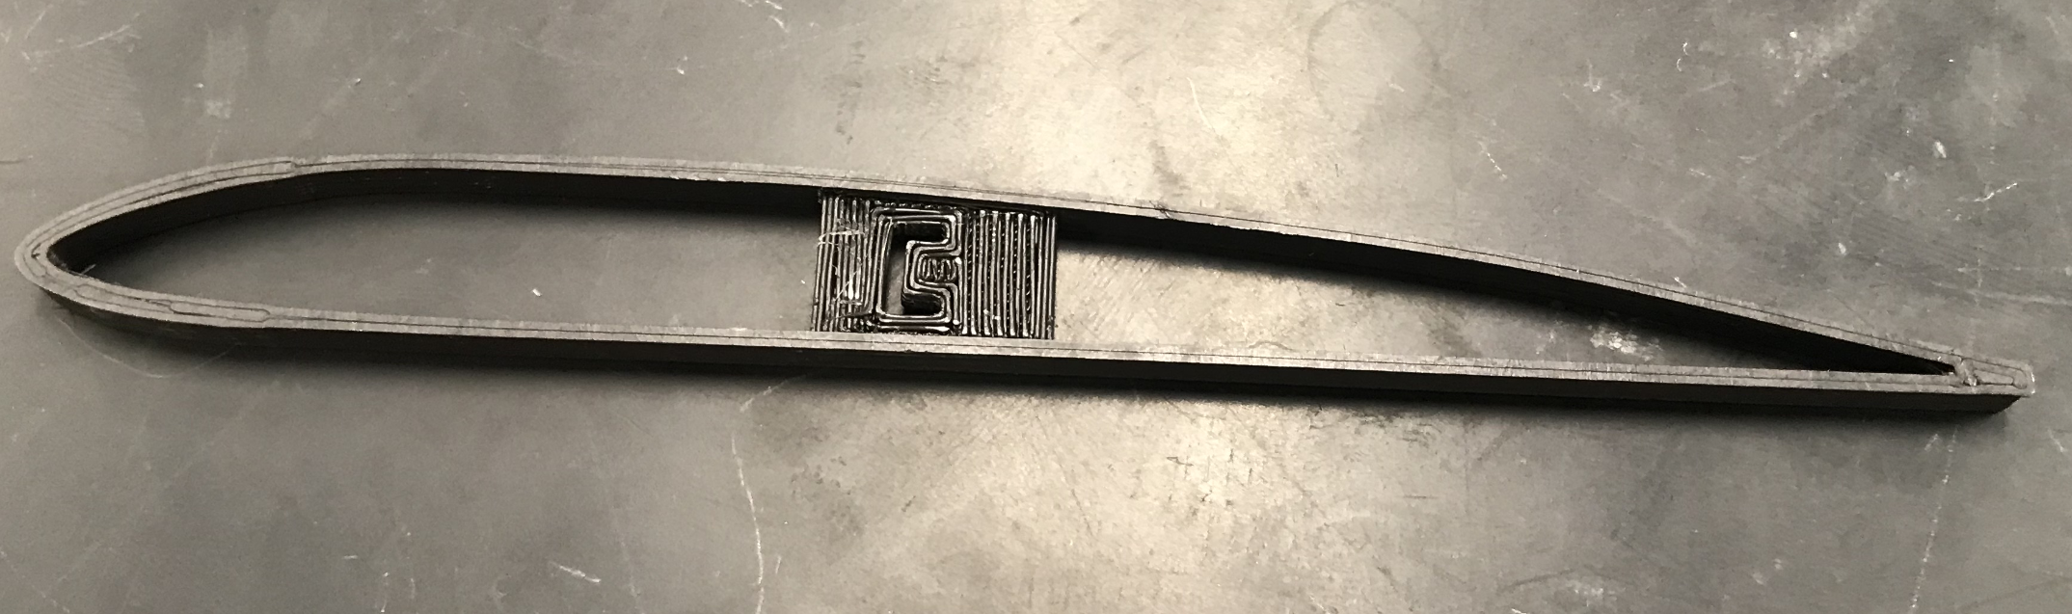
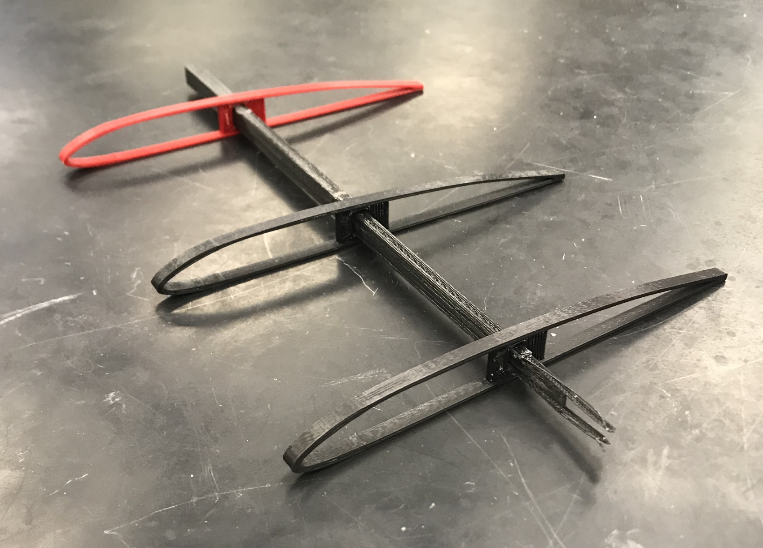
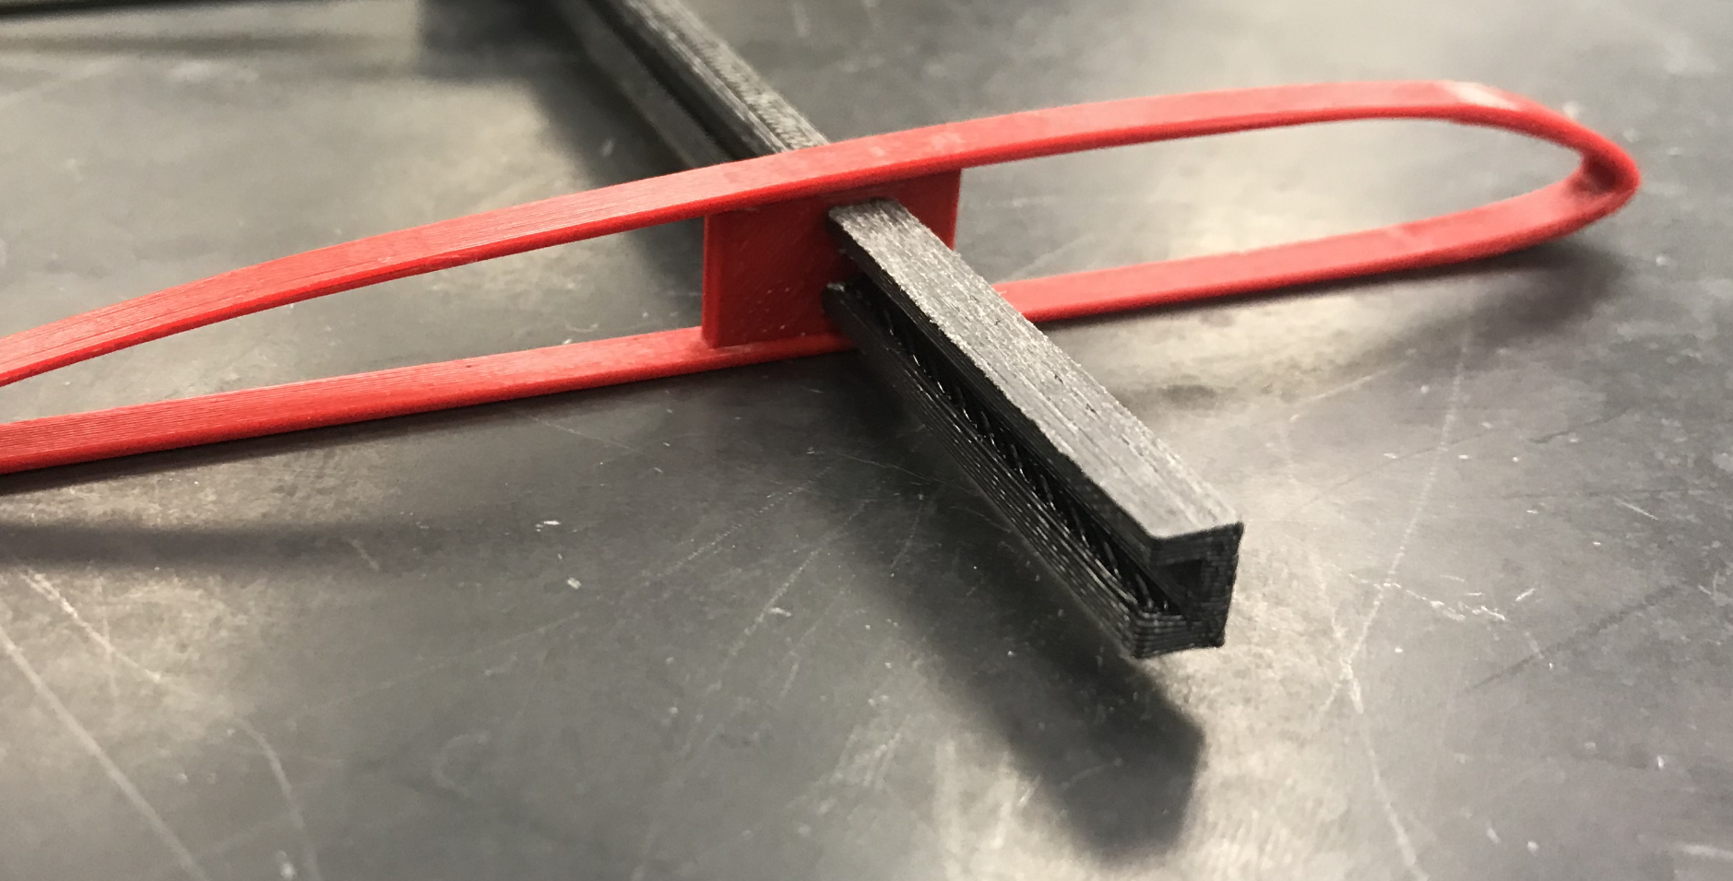
3D Skeletons
Printed PLA wing skeletons (Scaled down to 50%)
  Individual ribbed sections
  Connected with C-channel
  Low structural integrity
Brenden Richman

Slide 13
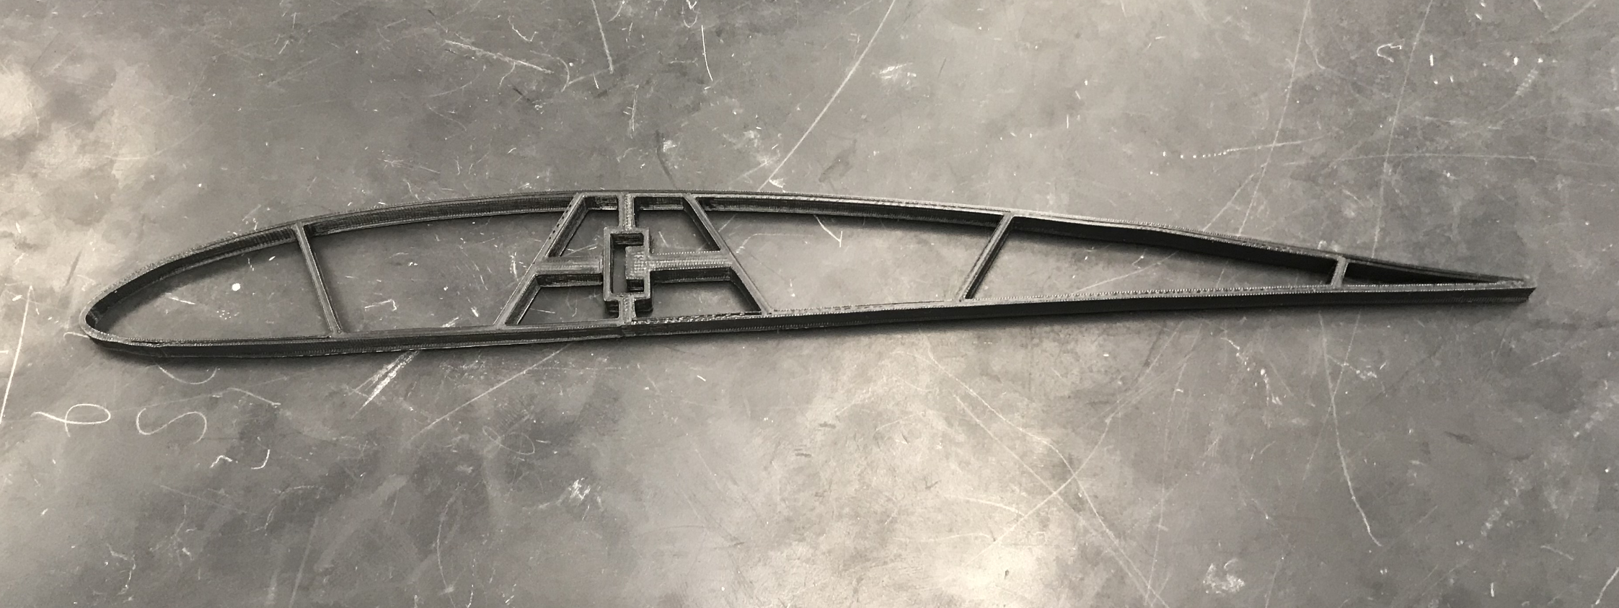
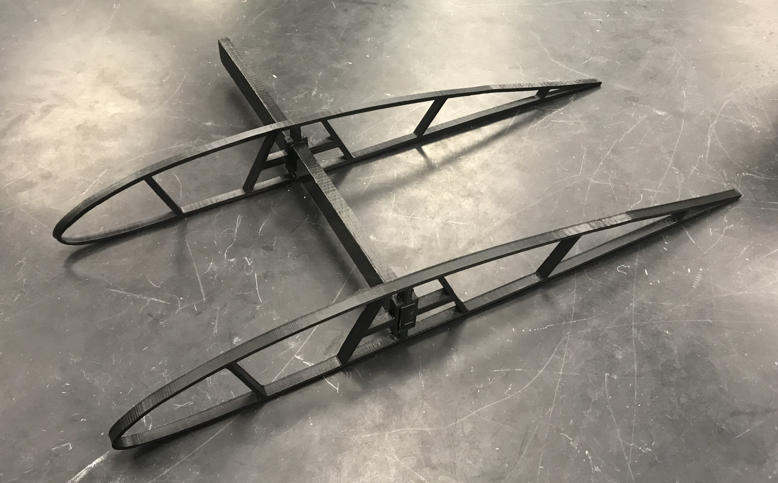
3D Skeletons
Eventually printed in Light-weight PLA
  Modeled to scale
  Structural supports added
  When implemented, covered with foam
Brenden Richman

Slide 14
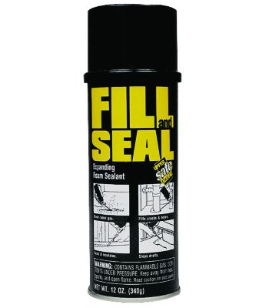
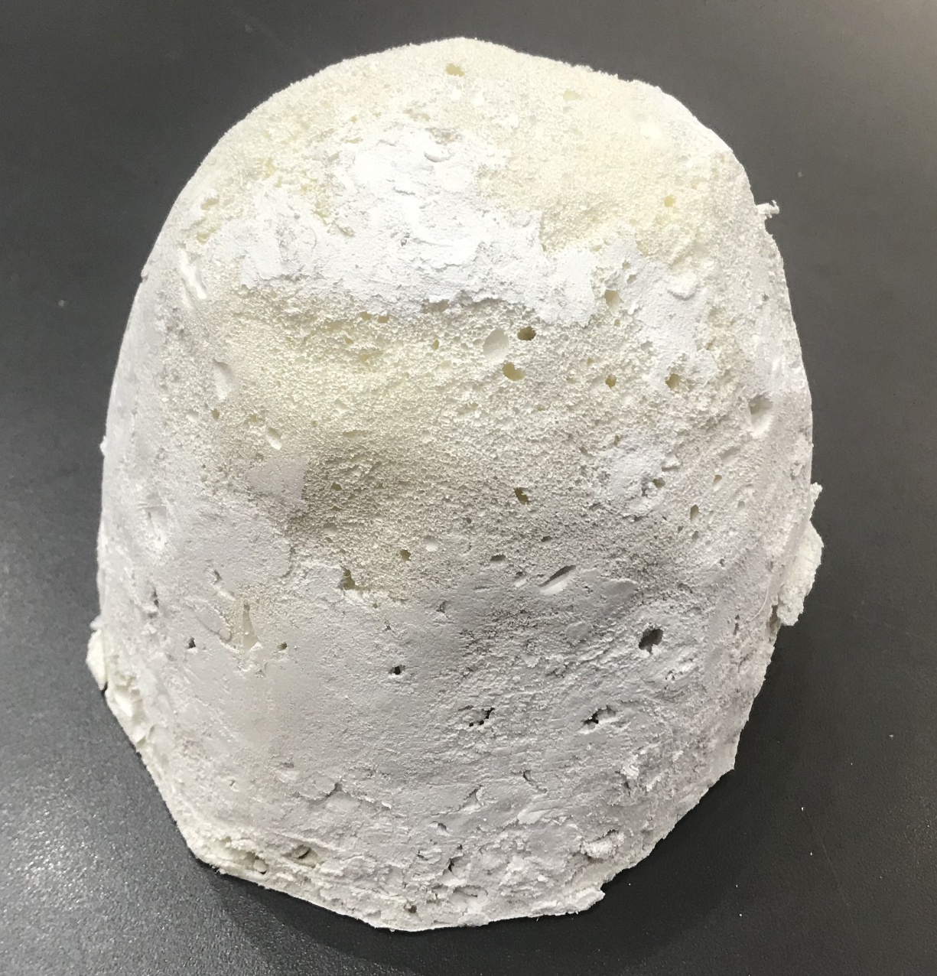
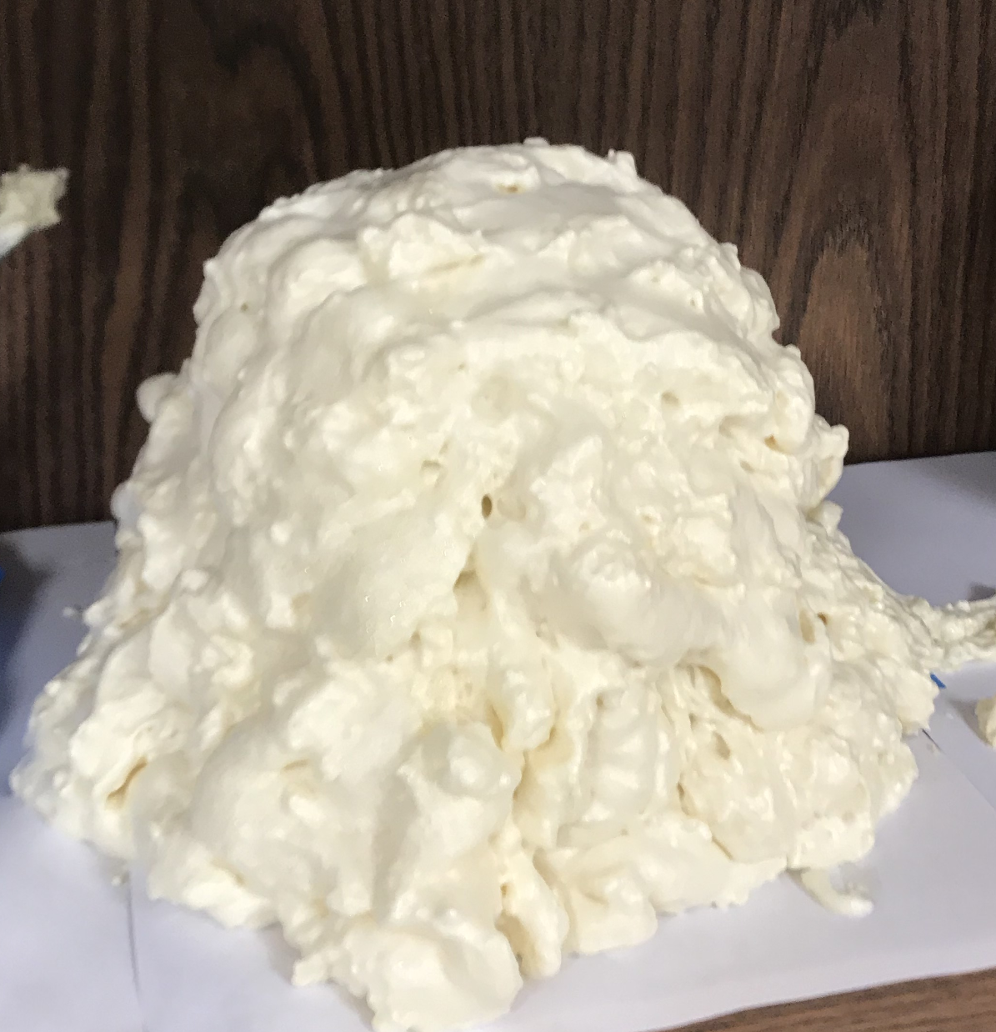
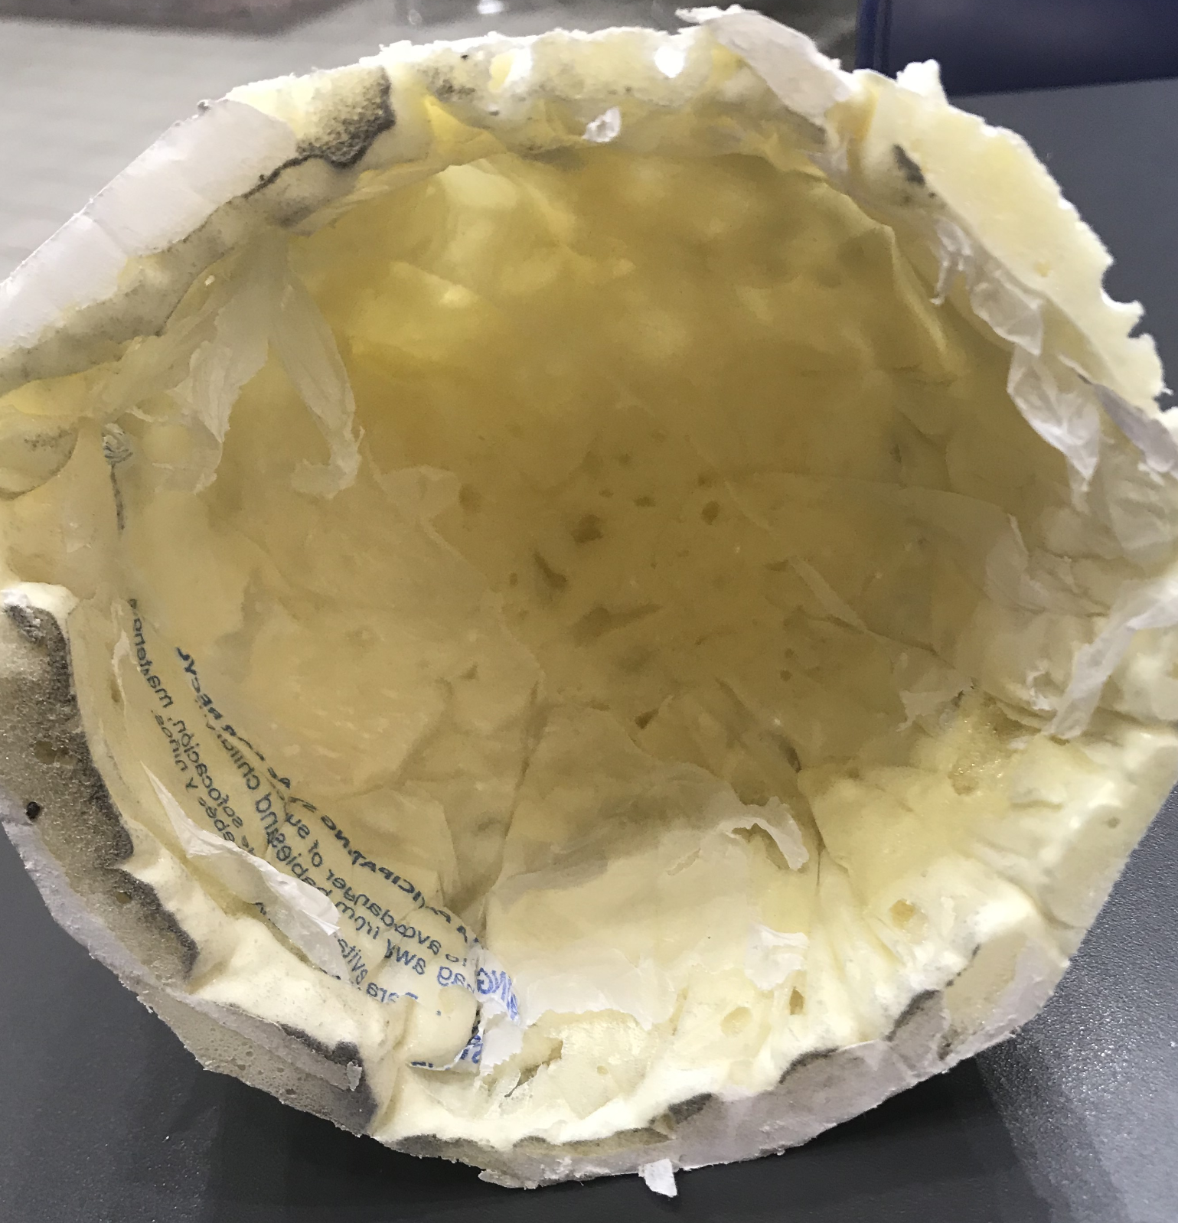
Expanding Foam
Initial Tests done with Fill and Seal foam (up to 3x expansion)
  Foam tends to stick to mold
Brenden Richman

Slide 15
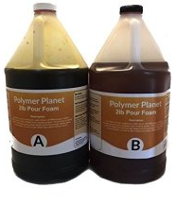
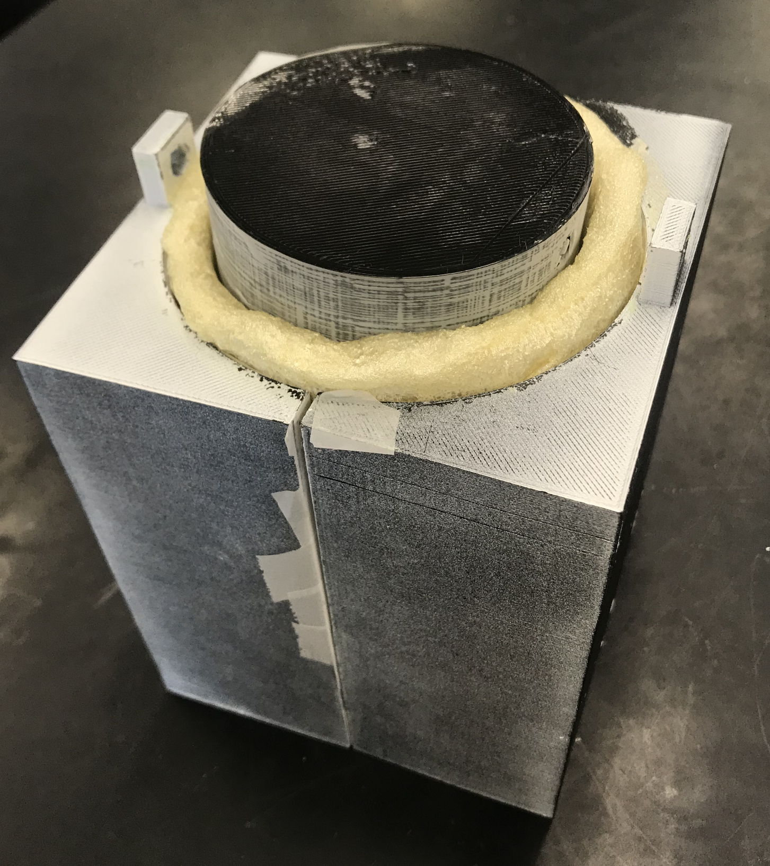
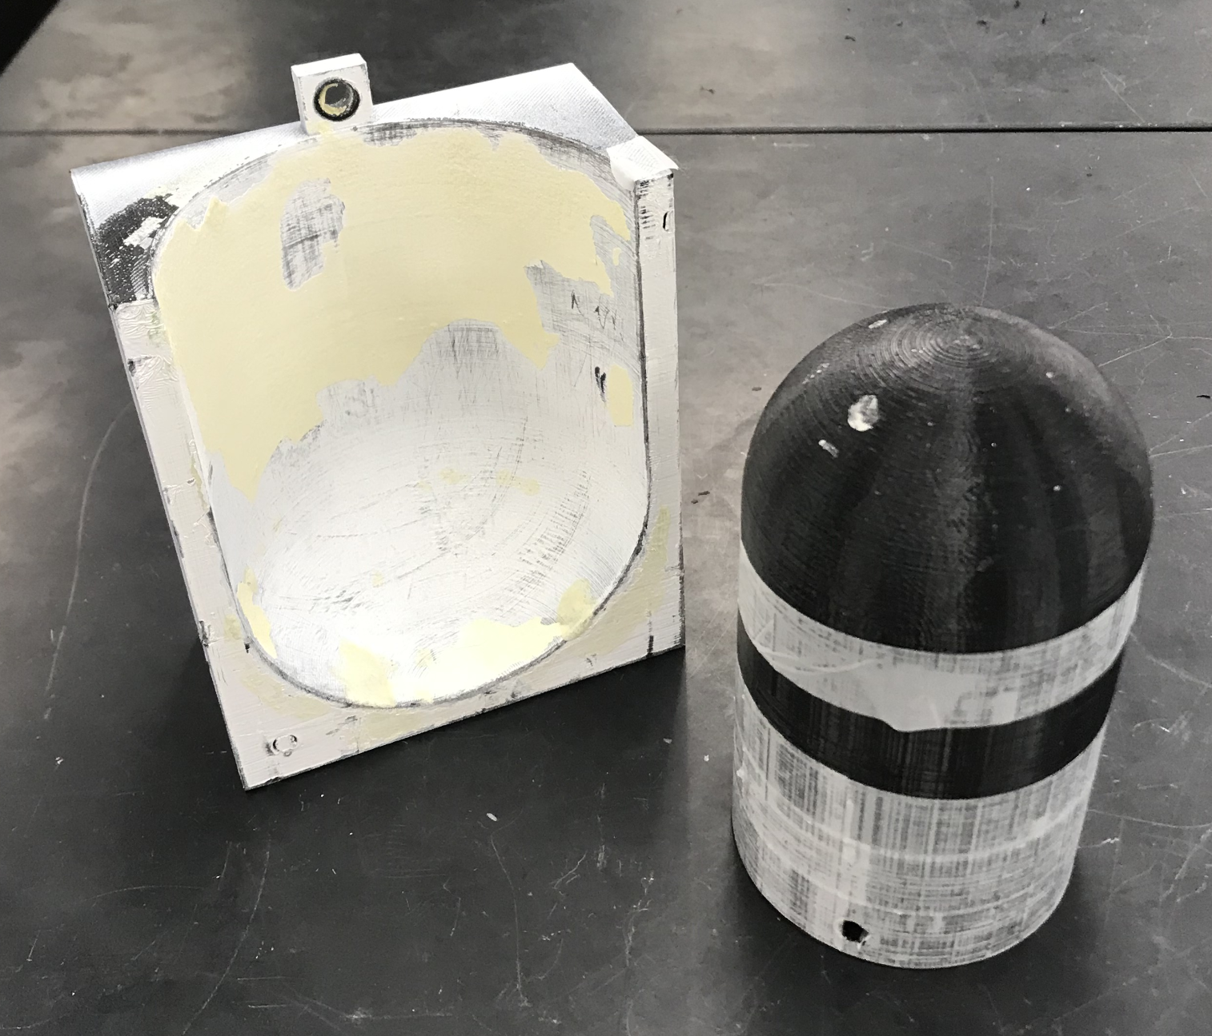
Polyurethane Foam
2-Part Solution
  Up to 25x expansion
Molded using a pour over, casting method
  Inner and Outer shell
  Scaled down mold (60% actual size)
Brenden Richman

Slide 16
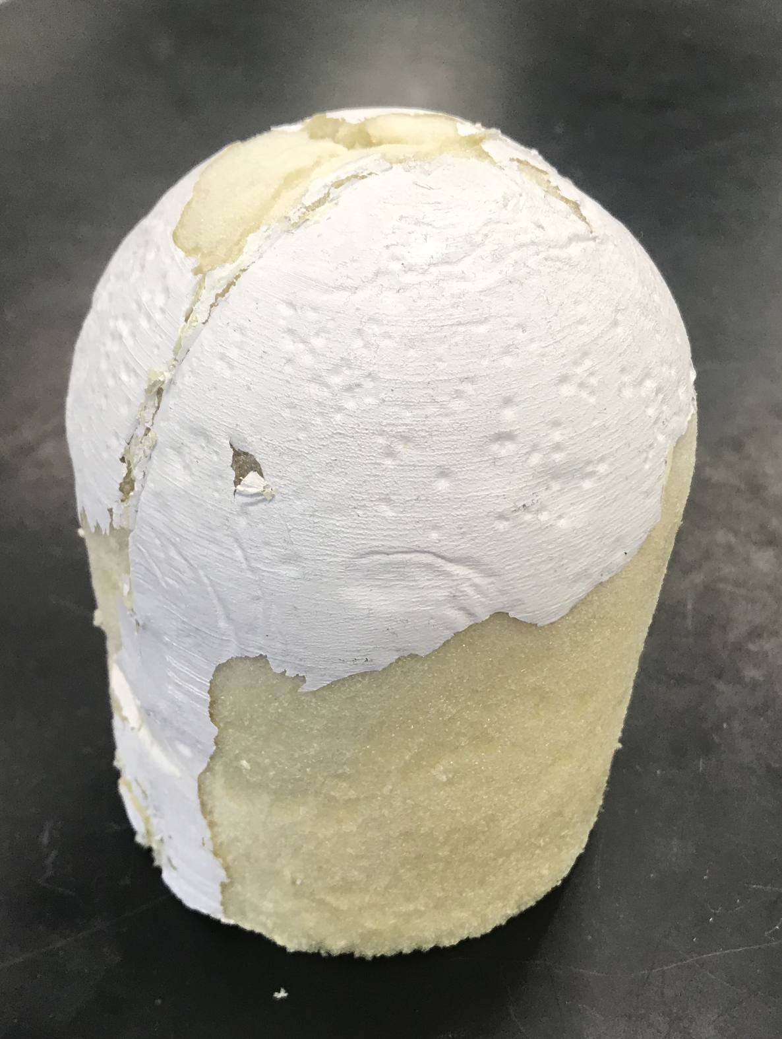
Polyurethane Foam
Epoxy-paint + Wax (Outside)
  Paint sticks due to reaction heat
  Wax has little effect
  Poor surface finish (open cell)
  Can be sanded and painted
    Adds weight
Saran Wrap (Inside)
  Very wrinkly surface
  Sticks to foam
Brenden Richman

Slide 17
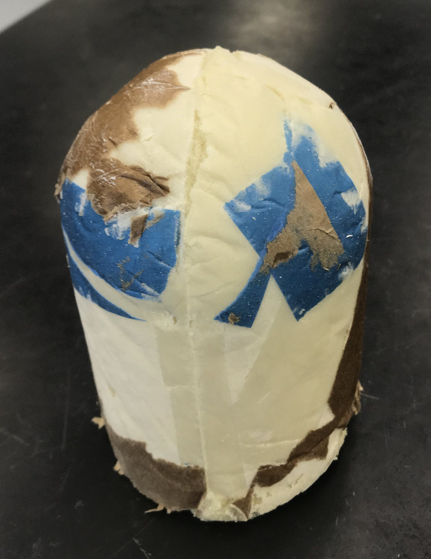
Polyurethane Foam
Packing Paper (Outside)
  Easy release from mold
  Paper and masking tape sticks
  Improved surface finish
Wax Paper (Inside)
  Easy release from mold
  Completely sticks to foam
  Wrinkly finish
Brenden Richman

Slide 18
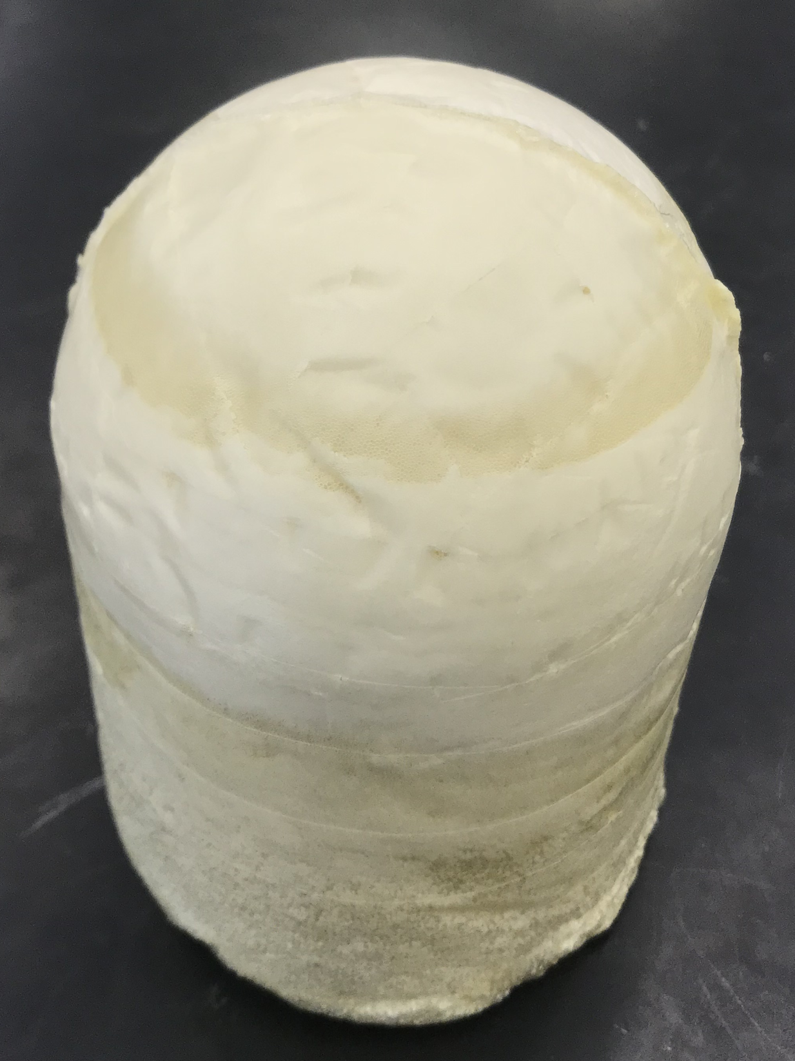
Polyurethane Foam
Scotch Tape (Outside + Inside)
  Foam doesn’t stick to polypropylene
  Easy release from mold
  Small wrinkles
  Best surface finish (closed cell)
  Could be improved with packing tape
Brenden Richman

Slide 19

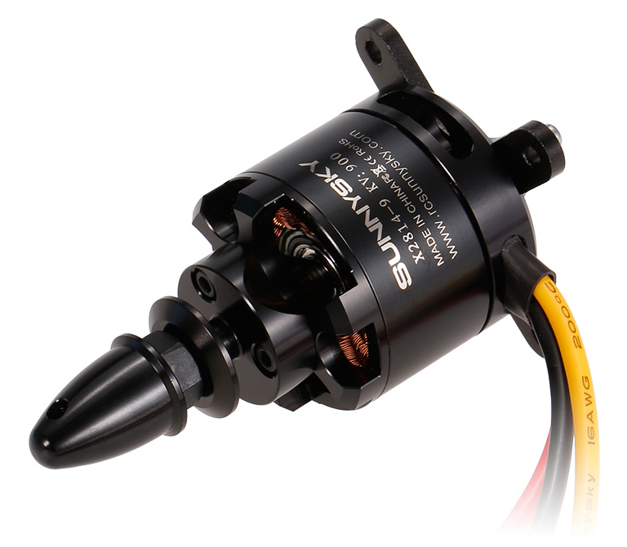
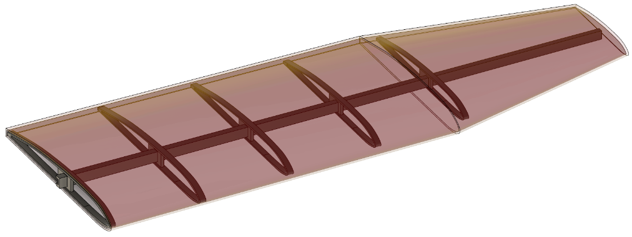
Future Work
Complete prototype body
Test electrical systems
  Servos, controller, remote, etc...
Finish weighing and dimensioning body pieces
  Improve calculation accuracy
Begin LW-PLA printing of skeleton
Foam molding of wing exterior
Brenden Richman

Slide 20
References
Staples, G. (2013, July 16). Propeller Static & Dynamic Thrust Calculation. Retrieved from https://www.electricrcaircraftguy.com/2013/09/propeller-static-dynamic-thrust-equation.html
T, G. (2005, March 04). What Doesn't Expanding Foam Stick To? Retrieved from RC Groups: https://www.rcgroups.com/forums/showthread.php?341842-What-DOESN-T-expanding-foam- stick-to/page2

Slide 21
Questions
Team 518
Clayton Cooley, Taylor Jacobs, Zachary Noay, Brenden Richman, Brian Thervil

Slide 22
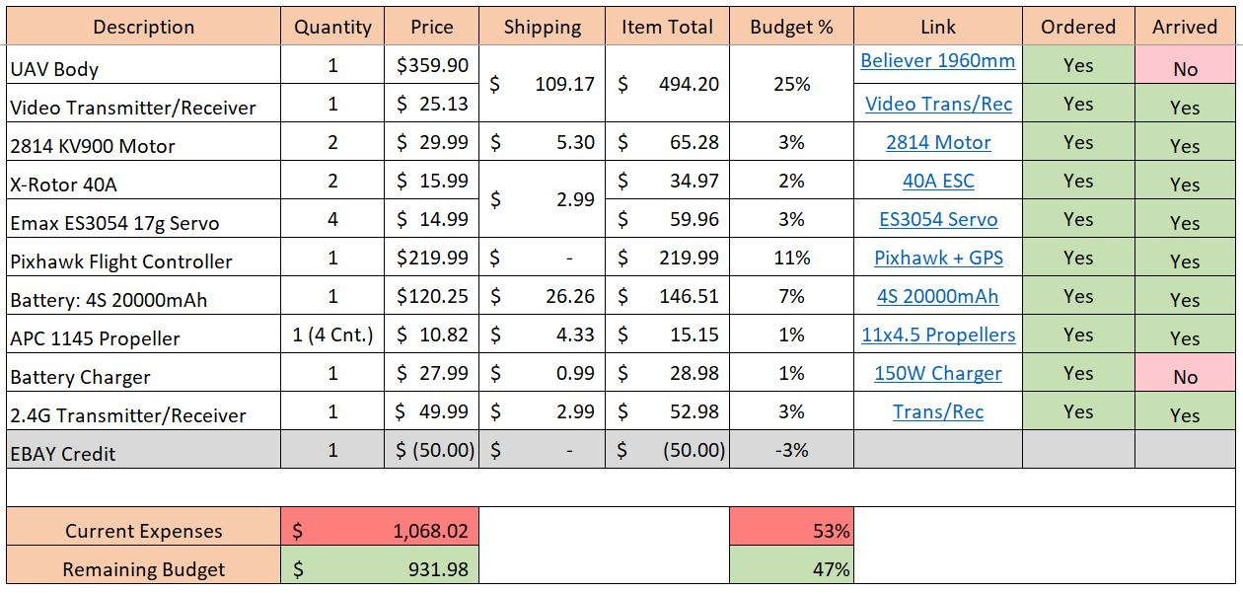
Budget

Slide 23
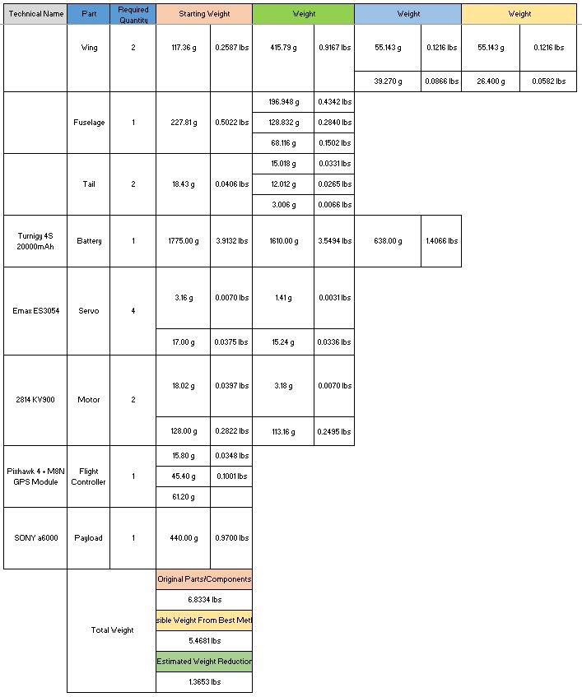
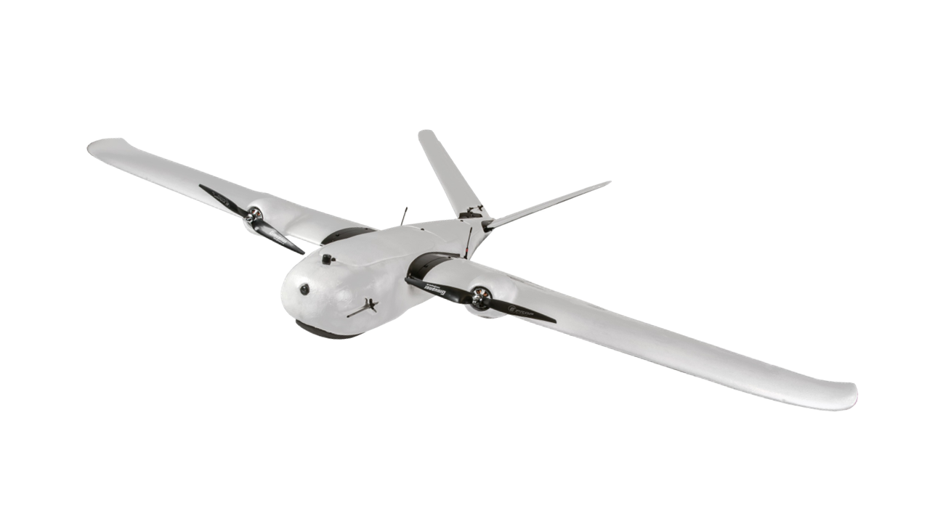
Full Weight Savings

Slide 24
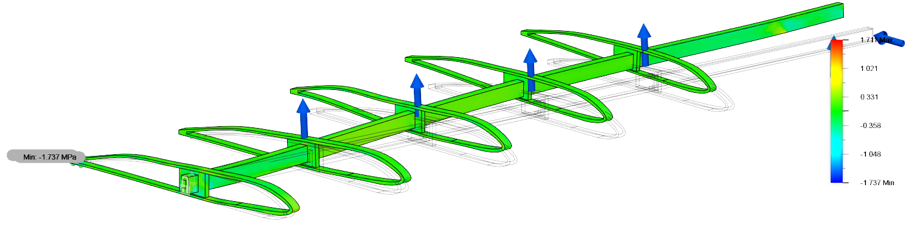
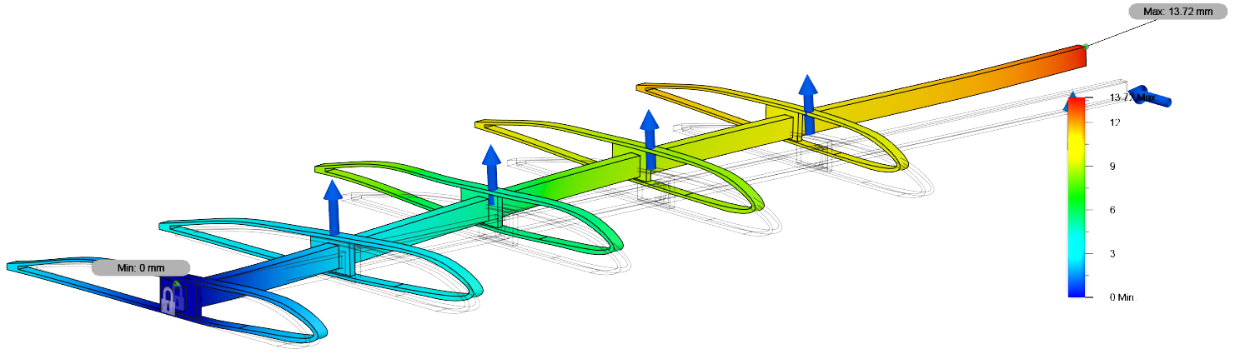
Force Analysis
Stress
Displacement

Slide 25
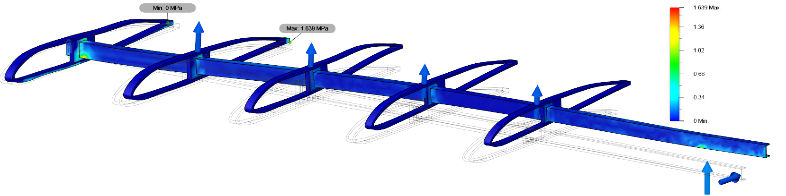
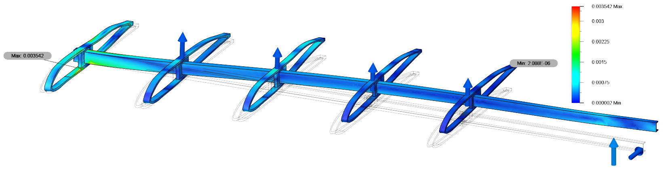
Contact Pressure
Strain

