Slide 1
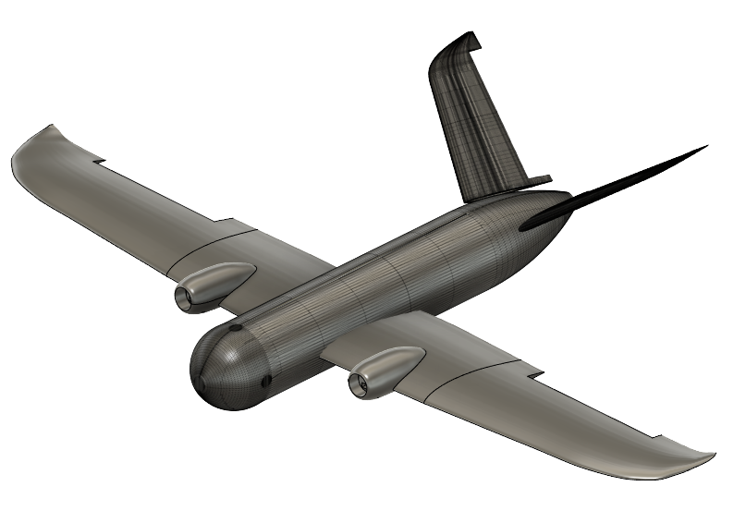

Lightweight UAV
Team 518
Clayton Cooley, Taylor Jacobs, Brenden Richman, Brian Thervil, Zachary Noay

Slide 2

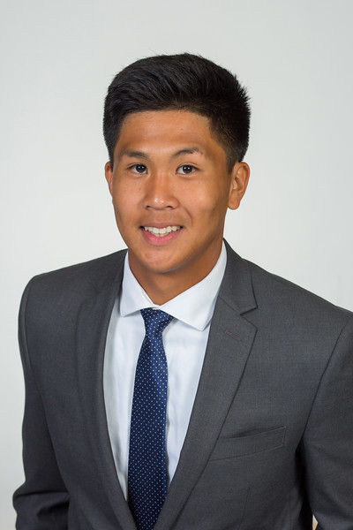


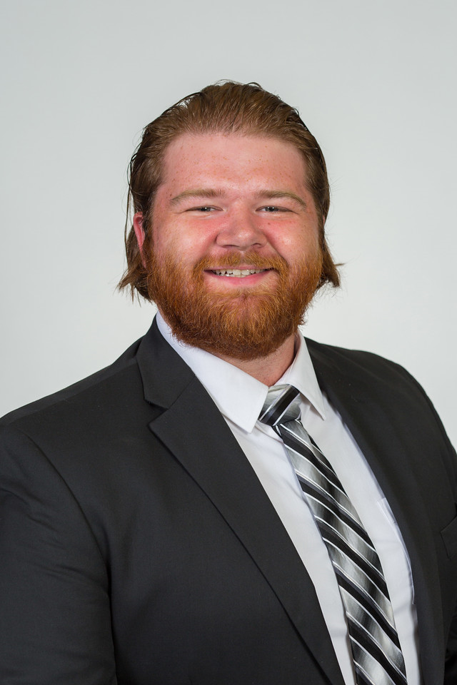
Team Introduction
Taylor Jacobs
Flight Dynamics Engineer
Mechanical Engineering
Zachary Noay
Embedded Systems Engineer
Electrical Engineering
Clayton Cooley
Test Engineer
Mechanical Engineering
Brian Thervil
Software/System Integration Engineer
Electrical Engineering
Brenden Richman
CAD/Materials Engineer
Mechanical Engineering

Slide 3


Sponsor and Advisor
A global security company that provides innovative solutions worldwide.
Dr. Rajan Kumar
Jennifer Tecson
Research in Aerodynamics, Experimental Fluid Mechanics, and Flow Diagnostics
Clayton Cooley

Slide 4
Project Objective
The objective of this project is to reduce the weight of a commercially available UAV through light-weighting processes.
Clayton Cooley

Slide 5
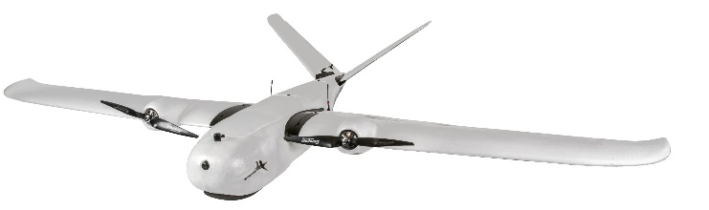
Project Summary
Narrowed down the project scope
  Lighten and optimize a commercial fixed wing UAV
  Match or improve original UAV parameters
Select a commercial drone
  Believer 1960mm
Light-weighting goals
  Reduce weight of UAV by 10% ~1lb
Generative Design
  Interior mounting brackets
Clayton Cooley

Slide 6
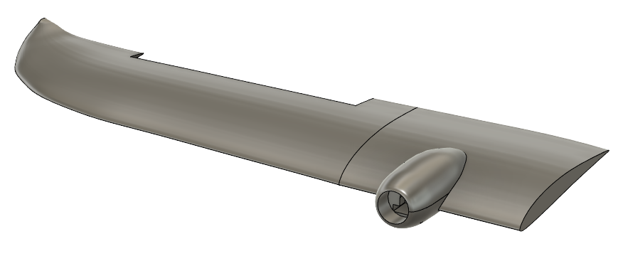
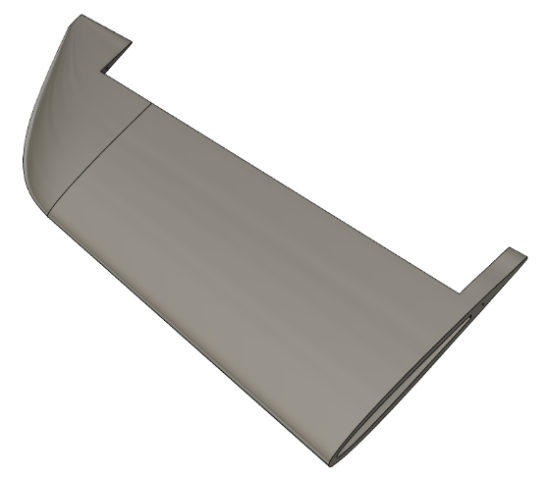
Project Summary
CAD designs
  Complete body modeled
  Ribbed structures for interior support
Rough weight estimations
  Estimated 1.7lb reduction
Clayton Cooley

Slide 7
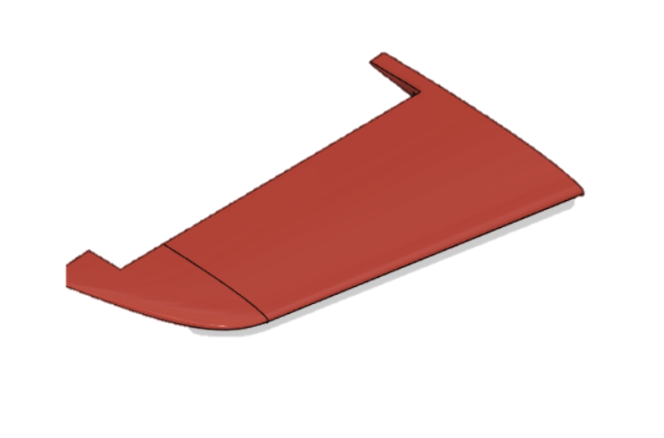
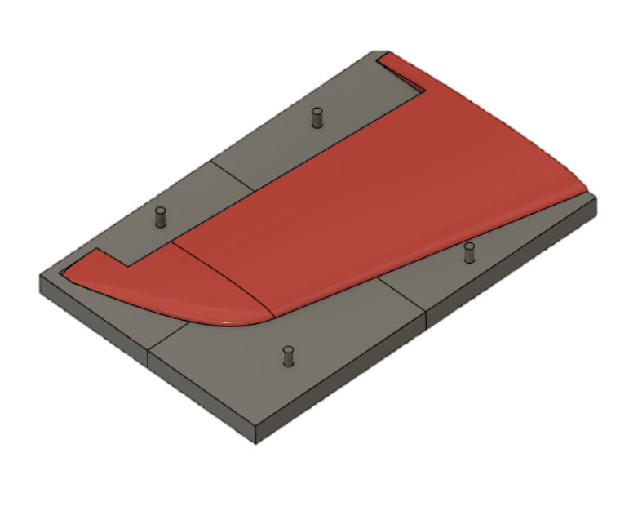
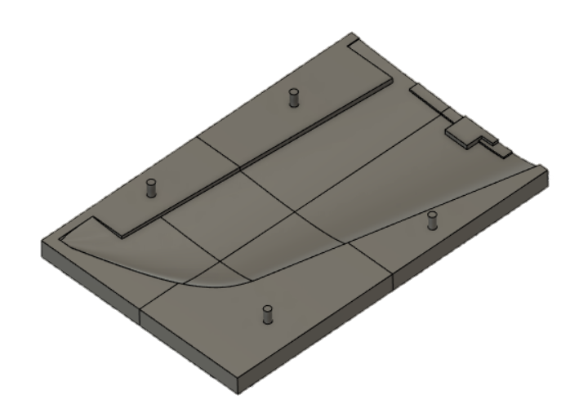
Foam Prototyping
Begins with modeling part in CAD
Mold created around part and broke into 3-D printable pieces
Clayton Cooley

Slide 8
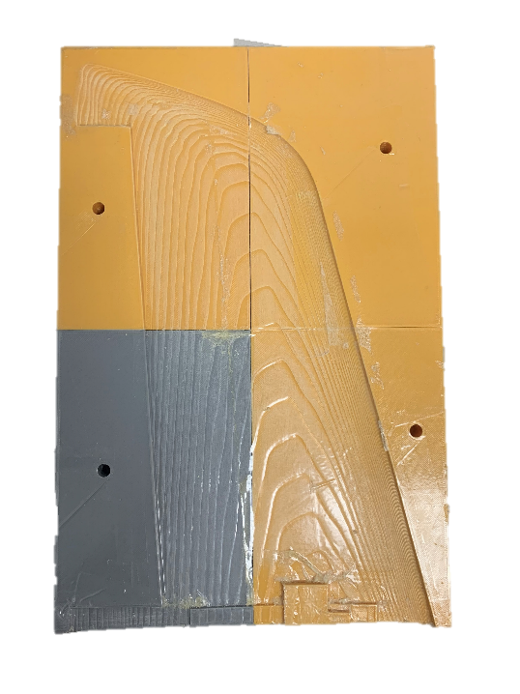

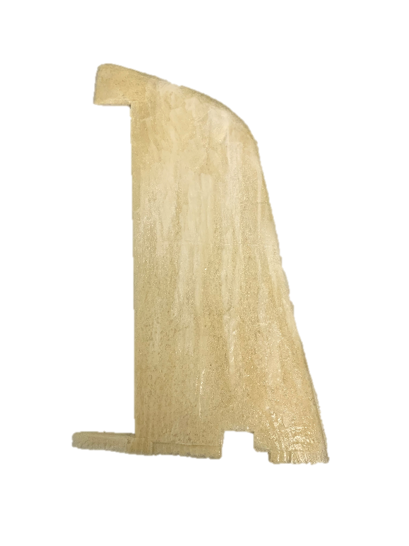
Foam Prototyping
Mold printed and sanded down to smooth surface
Mold wrapped in scotch tape and sprayed with mold release
2-part polyurethane foam mixed and poured into mold
Clayton Cooley

Slide 9
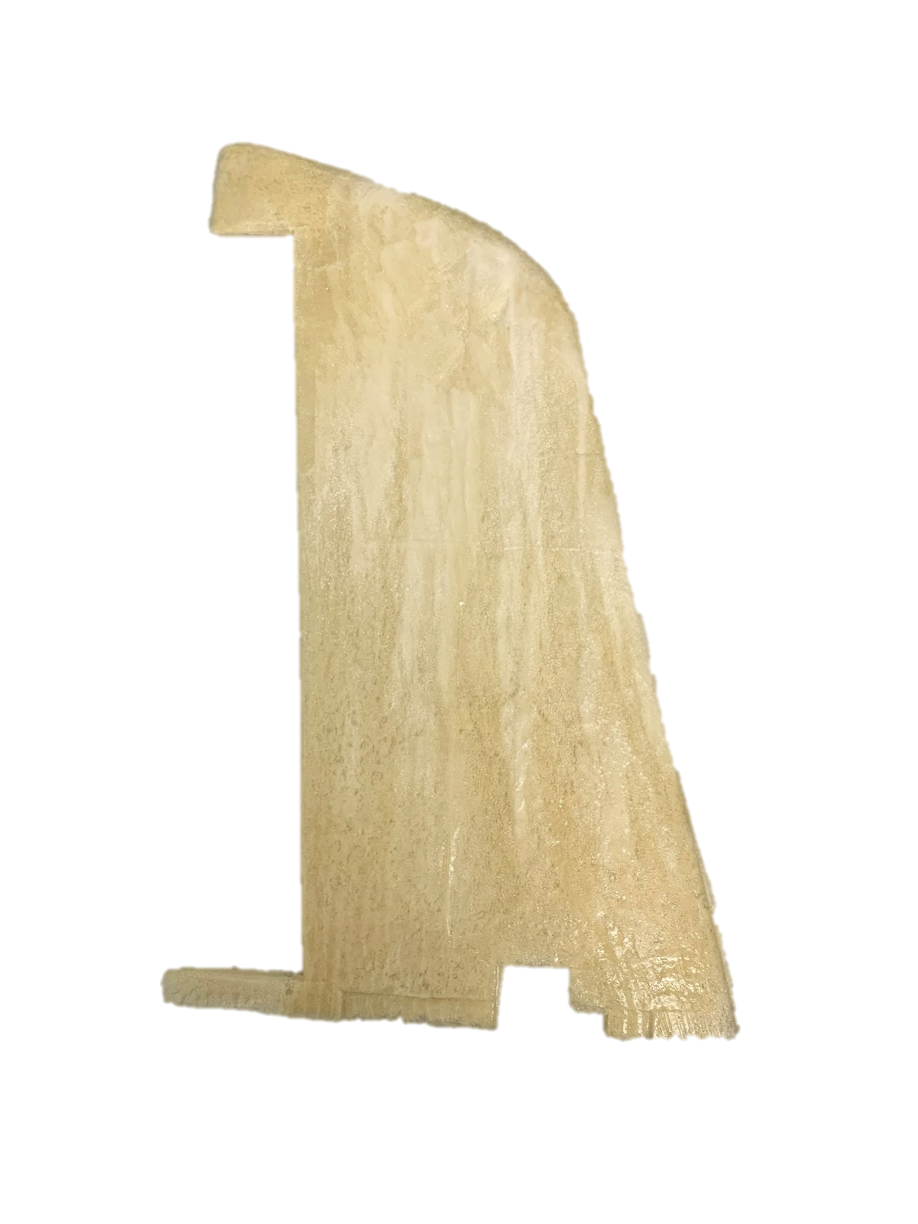
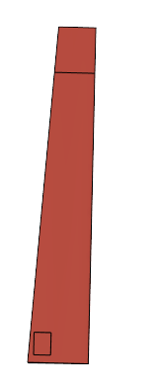
Foam Prototyping Challenges
Difficult to produce smaller parts
Tough to produce a desirable surface finish
Hard to create inner mold that can be removed
Clayton Cooley

Slide 10
Electrical Configuration
Program Configuration
Wire Configuration
System Configuration
Trial & Error
Configured
Clayton Cooley
Department of Mechanical and Electrical & Computer Engineering
10

Slide 11
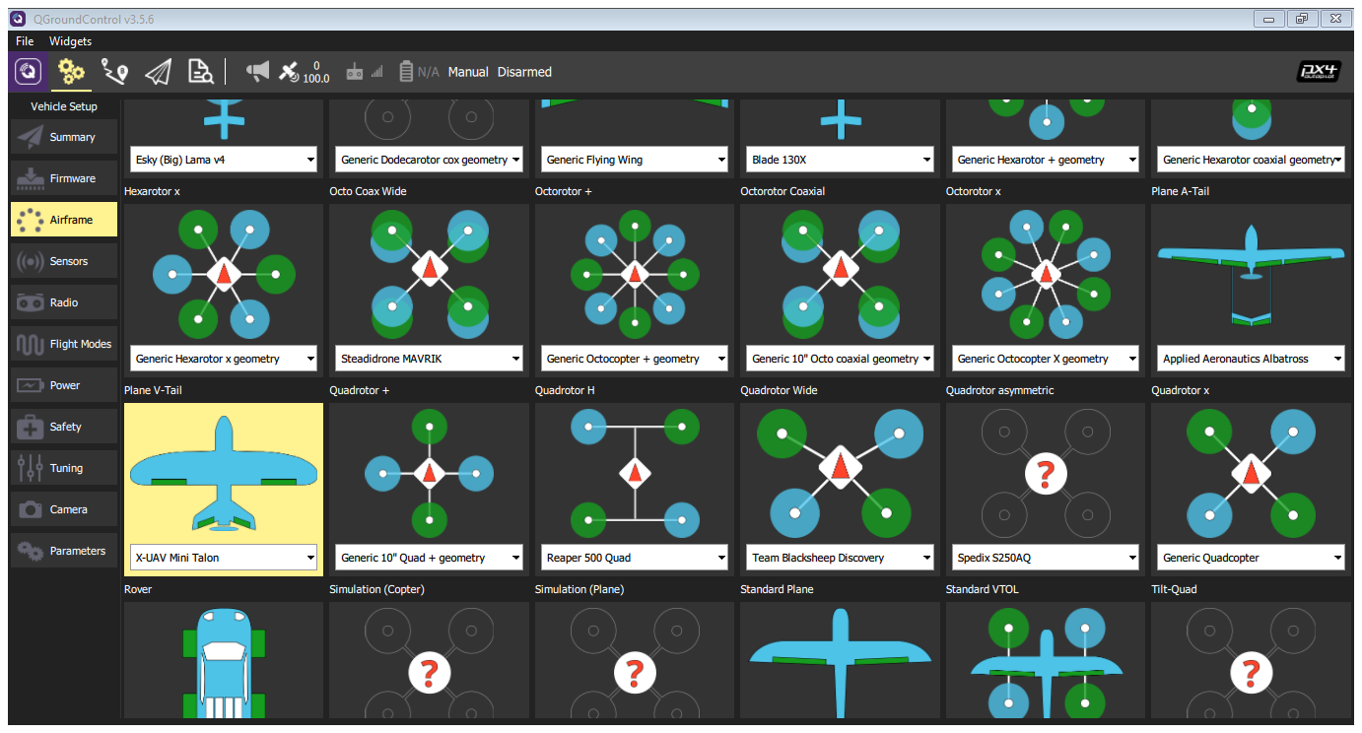
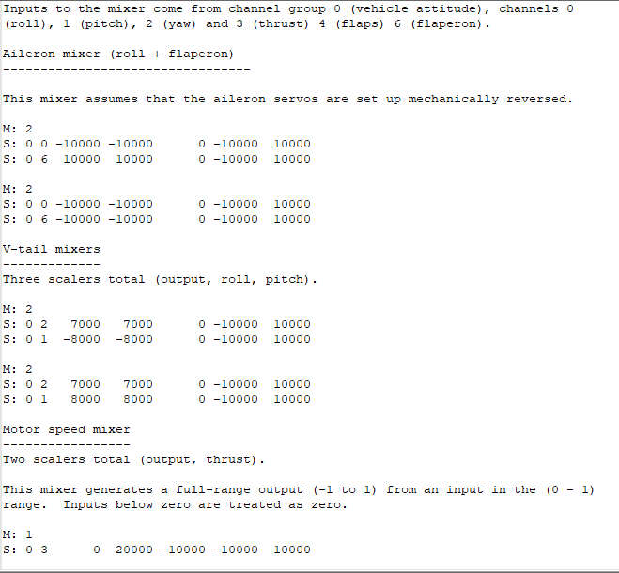
Electrical Systems – Program Configuration
Airframe Selection – Plane V-Tail
Airframe Code
Block Diagram of Code
Set Outputs
Set Aileron
Set V-Tail
Set Motors
Program Configuration
Zachary Noay

Slide 12
Electrical Systems – Program Configuration
Airframe Selection – Plane V-Tail
Airframe Code
Block Diagram of Code
Set Outputs
Set Aileron
Set V-Tail
Set Motors
Program Configuration
Zachary Noay

Slide 13
Electrical Systems – Program Configuration
Airframe Selection – Plane V-Tail
Airframe Code
Block Diagram of Code
Set Outputs
Set Aileron
Set V-Tail
Set Motors
Program Configuration
Zachary Noay

Slide 14
Electrical Systems – Program Configuration
Airframe Selection – Plane V-Tail
Airframe Code
Block Diagram of Code
Set Outputs
Set Aileron
Set V-Tail
Set Motors
Program Configuration
Zachary Noay

Slide 15
Electrical Systems – Program Configuration
Airframe Selection – Plane V-Tail
Airframe Code
Block Diagram of Code
Set Outputs
Set Aileron
Set V-Tail
Set Motors
Program Configuration
Zachary Noay

Slide 16
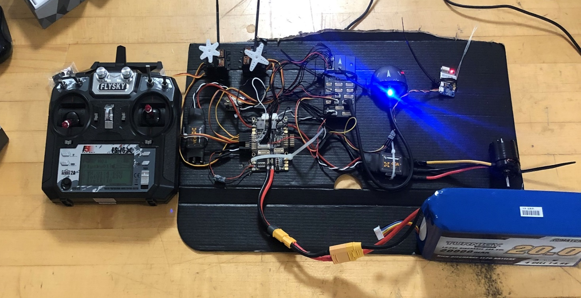
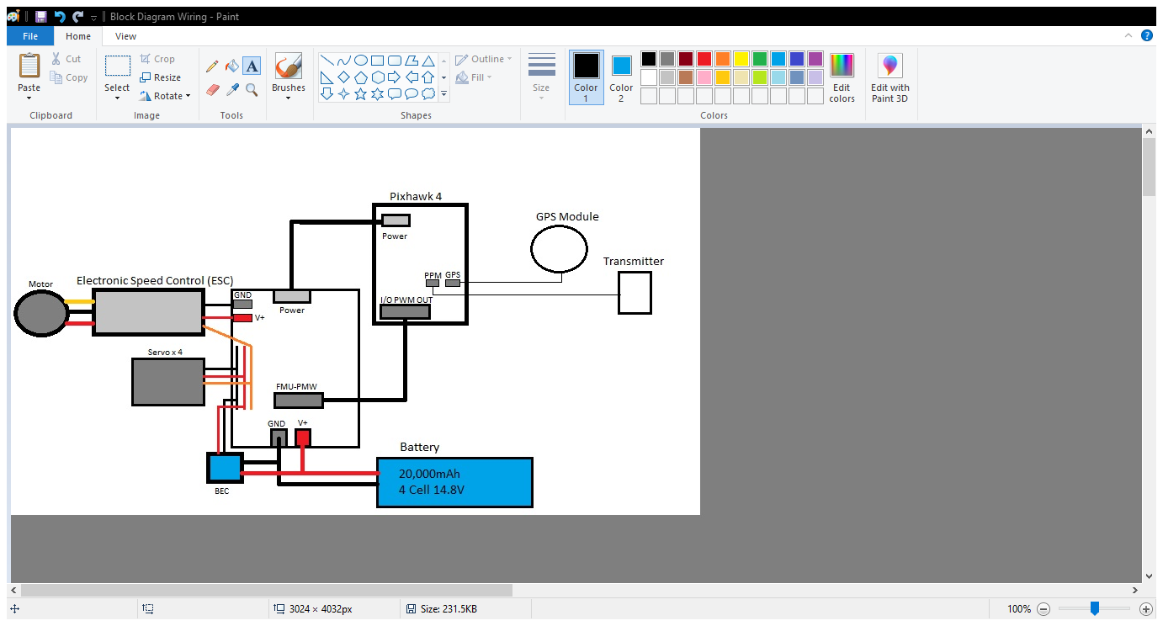
Electrical Systems – Wire Configuration
Wire Configuration Diagram
Wire Configuration
Program Configuration
Wire Configuration
Zachary Noay

Slide 17
Electrical Systems – Wire Configuration
Wire Configuration Diagram
Wire Configuration
Program Configuration
Wire Configuration
Zachary Noay

Slide 18
Electrical Systems – Wire Configuration
Wire Configuration Diagram
Wire Configuration
Program Configuration
Wire Configuration
Zachary Noay

Slide 19
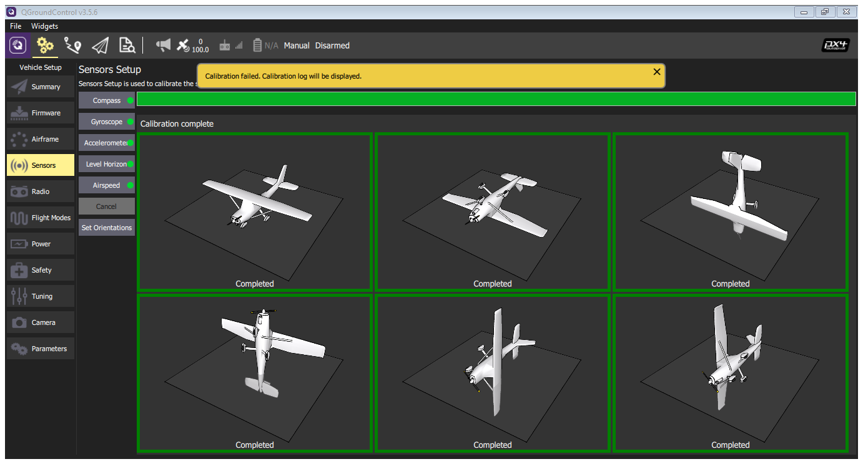
Electrical Systems – System Configuration
Compass Calibration
Sensor Setup
  Calibration of the X,Y,Z axis
  Airspeed of the aircraft
Program Configuration
Wire Configuration
System Configuration
Zachary Noay

Slide 20
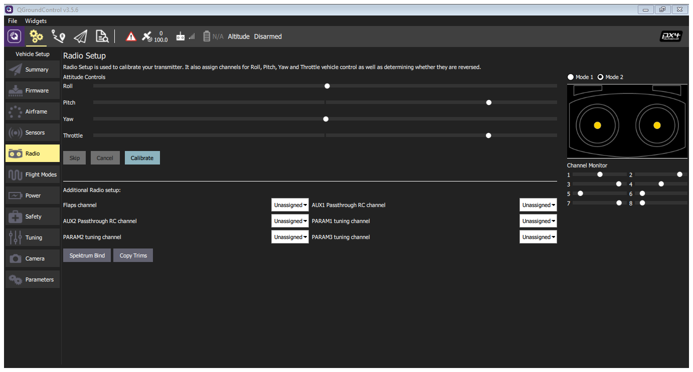
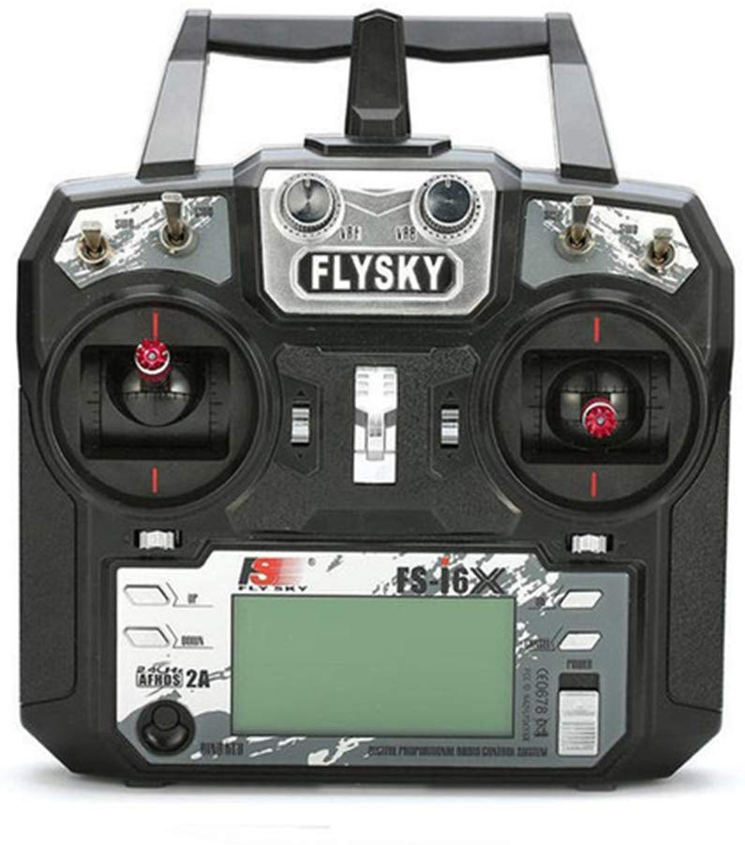
Electrical Systems – System Configuration
Radio Calibration
Program Configuration
Wire Configuration
System Configuration
Zachary Noay

Slide 21
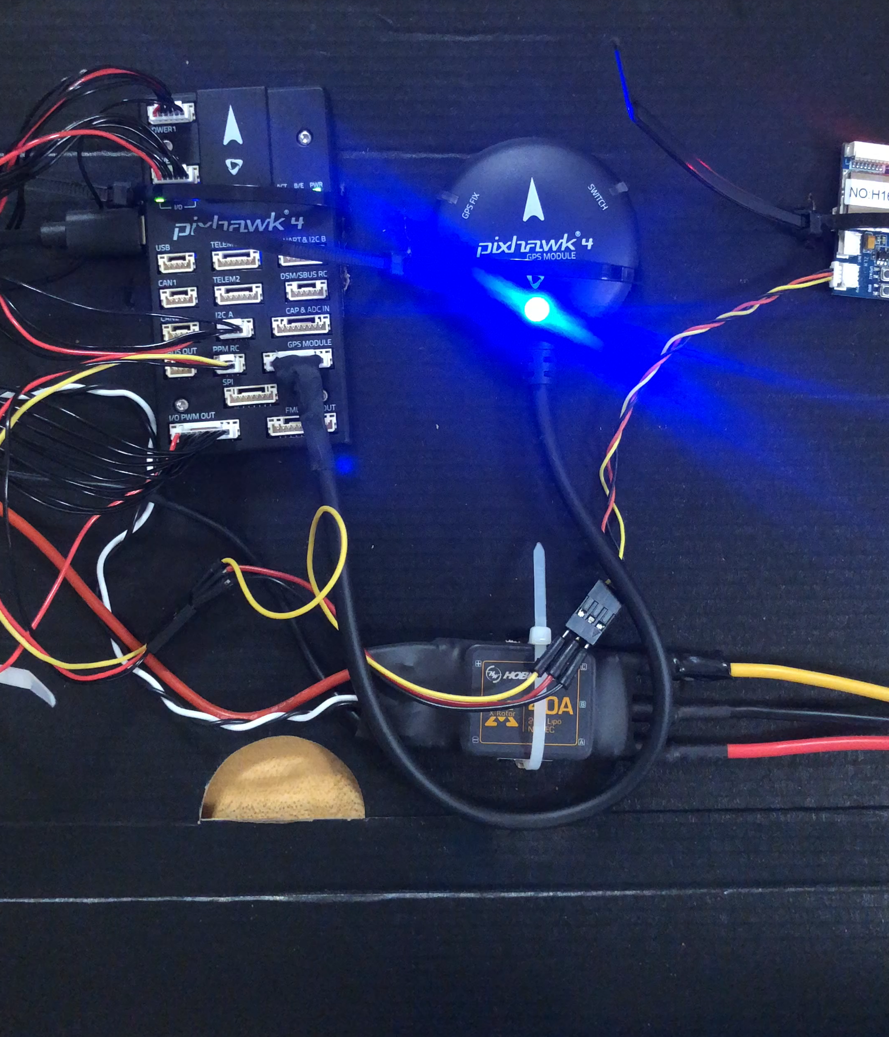
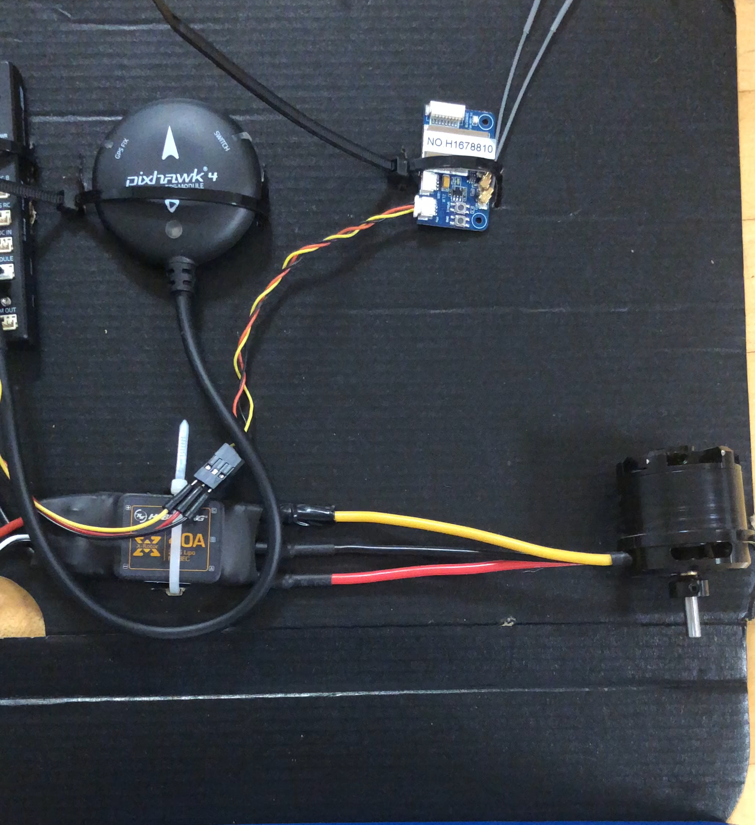
Electrical Systems – Trial Error
Not Arming
No Signal to ESC
Program Configuration
Wire Configuration
System Configuration
Trial Error
Zachary Noay

Slide 22
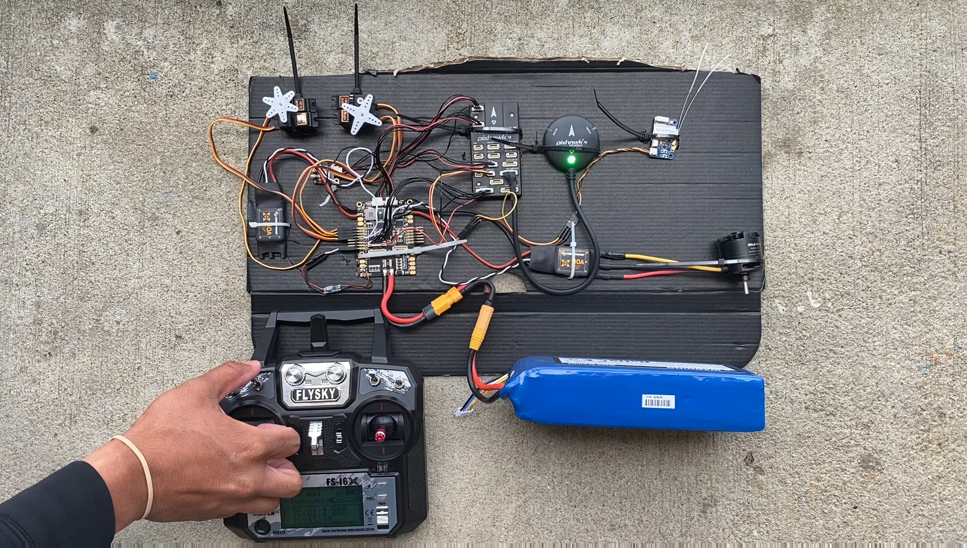
Electrical Systems - Configured
Motor & Servos
Program Configuration
Wire Configuration
System Configuration
Trial Error
Configured
Zachary Noay

Slide 23
Current/Future Work
Lightweight Battery
Lightweight Motors
Status/Plans
Updated Weight Savings
Budget Update
Zachary Noay
Department of Mechanical and Electrical & Computer Engineering
23

Slide 24

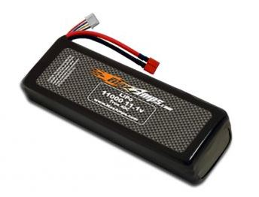
Electrical System
Light weighting process
  Replace current battery with two smaller batteries in parallel connection
1x
3.5lb
2x
2.8lb
Lightweight Battery
Brian Thervil

Slide 25
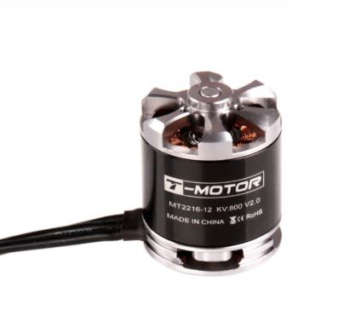
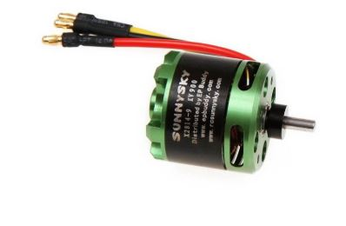
Electrical System
Light weighting process
  Replace current motors with lighter motors
2x
0.48lb
2x
0.33lb
Lightweight Battery
Lightweight Motor
Brian Thervil

Slide 26
Electrical System
Current Electrical Work
  Servos are operational
  Motors are operational
  Radio Communication is operational
Future Electrical Work
  Incorporate new Battery
  Find lighter motors
  Update code
  Combine electrical system with UAV body
Lightweight Battery
Status/Plans
Lightweight Motor
Brian Thervil

Slide 27
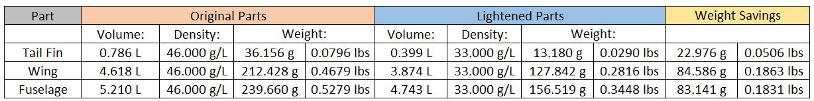

Updated Weight Savings
Lightweight Battery
Lightweight Motor
Status/Plans
Updated Weight Savings
Brian Thervil

Slide 28
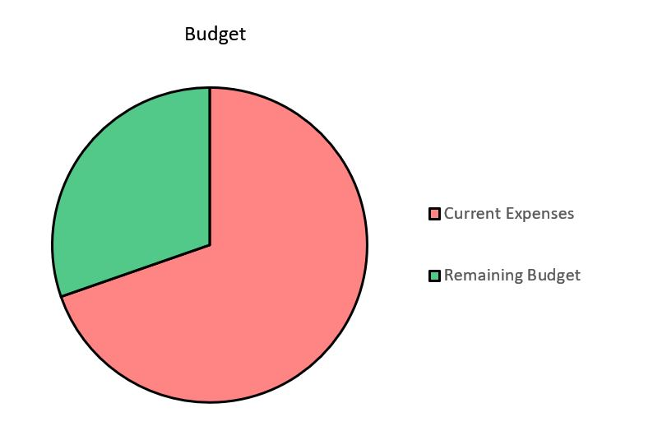
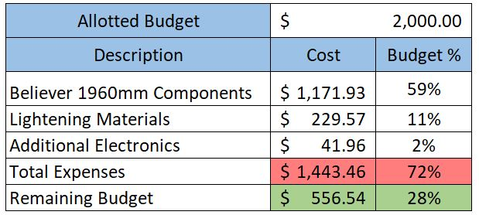
Budget Update
28%
($556.54)
72%
($1,443.46)
Lightweight Battery
Lightweight Motor
Status/Plans
Updated Weight Savings
Budget Update
Brian Thervil

Slide 29
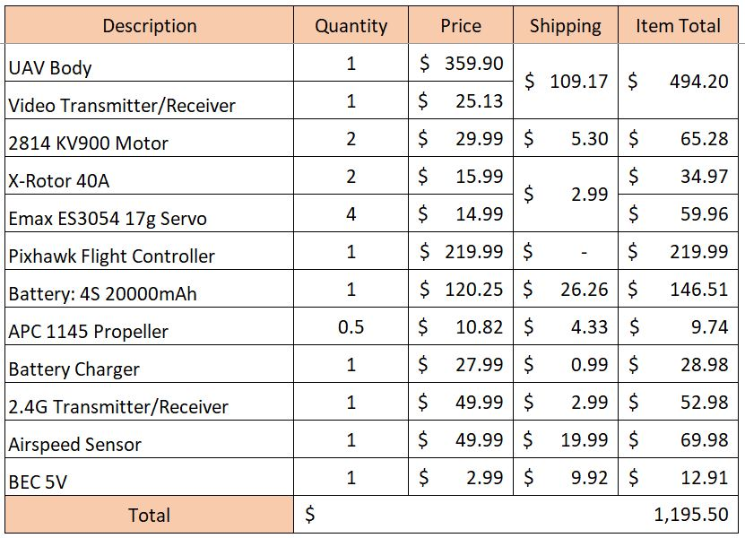
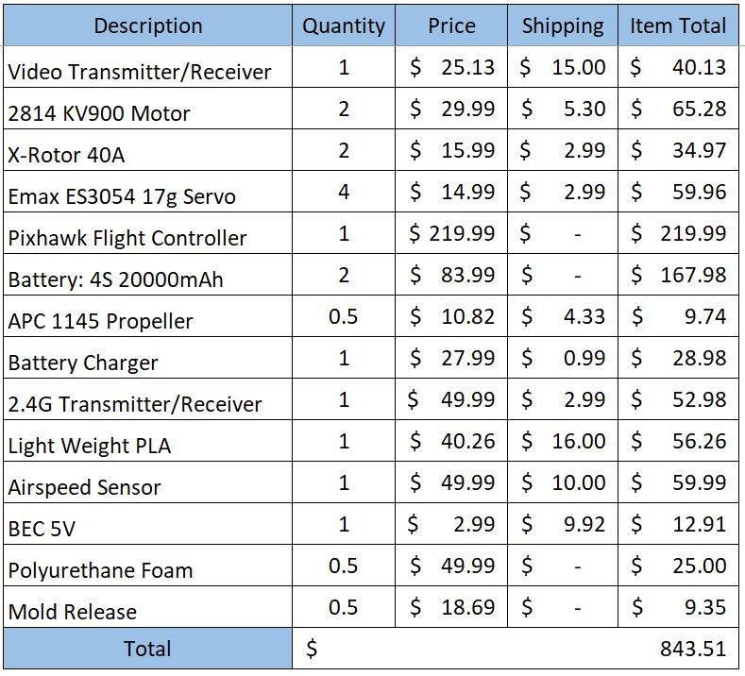
Budget Update
Believer 1960mm Cost
Lightened UAV Cost
Lightweight Battery
Lightweight Motor
Status/Plans
Updated Weight Savings
Budget Update
Brian Thervil

Slide 30
References
Dronecode (2016, September). Pixhawk 4 Wiring Quick Start. Retrieved from https://docs.px4.io/v1.9.0/en/assembly/quick_start_pixhawk4.html
Mixer code (2018, October). Firmware/ROMFS/px4fmu_common/mixers. Retrieved from https://github.com/PX4/Firmware/blob/master/ROMFS/px4fmu_common/mixers/AAVVTWFF_vtail.main.mix

Slide 31
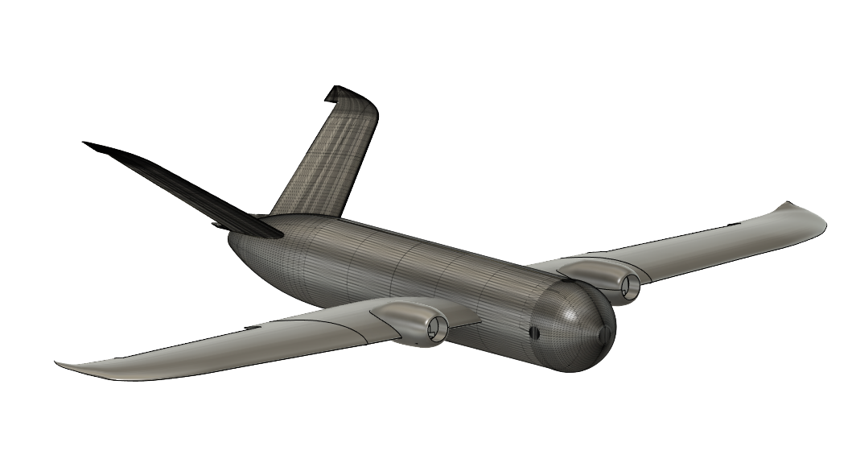
Questions
Team 518
Clayton Cooley: cc15e@my.fsu.edu
Taylor Jacobs: tjj14@my.fsu.edu
Brenden Richman: br16@my.fsu.edu
Brian Thervil:bjt15@my.fsu.edu
Zachary Noay:zvn16@my.fsu.edu

Slide 32
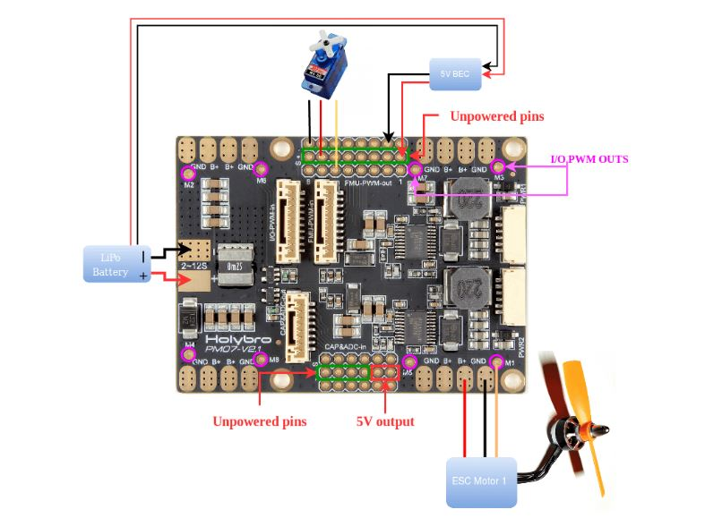
Electrical System
Power Management Board
  Responsible for power distribution
  Data collection
  Powered by battery
Brian Thervil

Slide 33
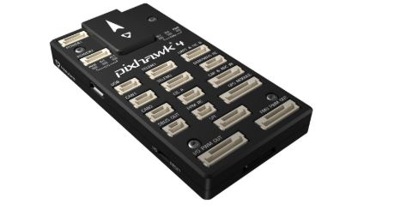
Electrical System
Pixhawk 4
  Flight Controller
  Responsible for control over motors and servos
  Connects most important peripherals
  Code is flashed to the Pixhawk 4
Brian Thervil

Slide 34
Electrical Systems – Wire Configuration
Wire Configuration Diagram
Wire Configuration
Program Configuration
Wire Configuration
Zachary Noay

