Slide 1
Assembly Line Trainer
Team 520:
Damira Solms, Justin Law, Nick Salerno, Robert Smith, and Ryan Dodson

Slide 2





Team 520 Introduction
Damira Solms
Sorting Mechanism Engineer
Justin Law
Design/ Mechanical Engineer
Nick Salerno
Process Engineer
Robert Smith
Programming/Electrical Engineer
Ryan Dodson
Hardware Engineer

Slide 3
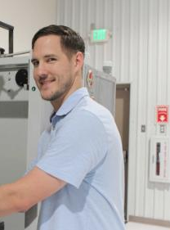

Sponsor and Adviser
Dylan Sutton
TCC AMTC Representative
Dr. Carl Moore
Design Team Adviser
Justin

Slide 4
Project Scope
Produce a system that detects material type and size of an object and sort accordingly. The system will operate using a traditional industry recognized automation system.
Justin

Slide 5

Project Brief Summary
The TCC Advanced Manufacturing Training Center, AMTC, needs a course aid for a future PLC/Manufacturing maintenance course
The teaching aid will be a conveyor controlled via a PLC to sort objects based on size and material type
Instructors will be able to create malfunctions in the system for students to debug
Justin
Notes:
The TCC Advanced Manufacturing Training Center, AMTC, needs a course aid for a future PLC/Manufacturing maintenance course
The teaching aid will be a conveyor controlled via a PLC to sort objects based on size and material type
Instructors will be able to create malfunctions in the system for students to debug

Slide 6
Project Brief Summary
The TCC Advanced Manufacturing Training Center, AMTC, needs a course aid for a future PLC/Manufacturing maintenance course
The teaching aid will be a conveyor controlled via a PLC to sort objects based on size and material type
Instructors will be able to create malfunctions in the system for students to debug
Justin
Notes:
The TCC Advanced Manufacturing Training Center, AMTC, needs a course aid for a future PLC/Manufacturing maintenance course
The teaching aid will be a conveyor controlled via a PLC to sort objects based on size and material type
Instructors will be able to create malfunctions in the system for students to debug

Slide 7
Project Brief Summary
The TCC Advanced Manufacturing Training Center, AMTC, needs a course aid for a future PLC/Manufacturing maintenance course
The teaching aid will be a conveyor controlled via a PLC to sort objects based on size and material type
Instructors will be able to create malfunctions in the system for students to debug
Justin
Notes:
The TCC Advanced Manufacturing Training Center, AMTC, needs a course aid for a future PLC/Manufacturing maintenance course
The teaching aid will be a conveyor controlled via a PLC to sort objects based on size and material type
Instructors will be able to create malfunctions in the system for students to debug

Slide 8
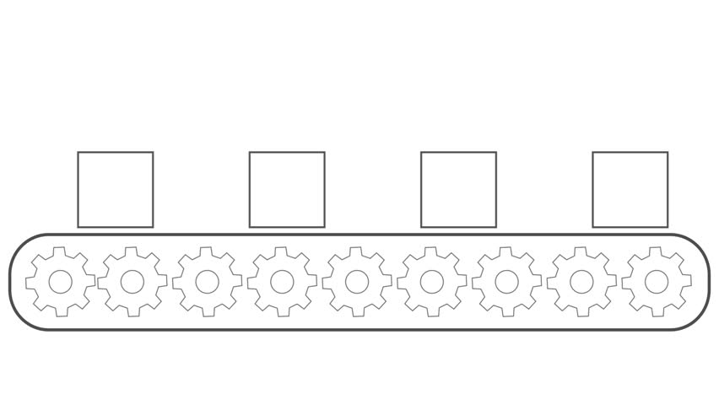
Background
Assembly line trainer is a continuation from SD ‘19
A programmable logic controller (PLC) is a type of computer used in industrial control applications
SD ‘20 will attempt to utilize a PLC controller and sensors for sorting between material and size
The trainer will be able to sort between two material types
Justin

Slide 9
Background
Assembly line trainer is a continuation from SD ‘19
A programmable logic controller (PLC) is a type of computer used in industrial control applications
SD ‘20 will attempt to utilize a PLC controller and sensors for sorting between material and size
The trainer will be able to sort between two material types
Justin

Slide 10
Background
Assembly line trainer is a continuation from SD ‘19
A programmable logic controller (PLC) is a type of computer used in industrial control applications
SD ‘20 will attempt to utilize a PLC controller and sensors for sorting between material and size
The trainer will be able to sort between two material types
Justin

Slide 11
Background
Assembly line trainer is a continuation from SD ‘19
A programmable logic controller (PLC) is a type of computer used in industrial control applications
SD ‘20 will attempt to utilize a PLC controller and sensors for sorting between material and size
The trainer will be able to sort between two material types
Justin

Slide 12
Customer Needs
Use common hardware problems like loose wiring and improperly aimed sensors.
Determine several options for cubes with various sizes in a range of 1 inch to 4 inch.
The device needs to be easy to assemble and disassemble.
Nick

Slide 13
Customer Needs
Use common hardware problems like loose wiring and improperly aimed sensors.
Determine several options for cubes with various sizes in a range of 1 inch to 4 inch.
The device needs to be easy to assemble and disassemble.
Nick

Slide 14
Customer Needs
Use common hardware problems like loose wiring and improperly aimed sensors.
Determine several options for cubes with various sizes in a range of 1 inch to 4 inch.
The device needs to be easy to assemble and disassemble.
Nick

Slide 15
Targets
Distinguish between metallic and non-metallic objects.
Distinguish between Small (1-2 in.) and Large (3-4 in.) objects.
Distinguish accurately at a rate of 98% or more.
Have a minimum of 5 hardware errors and 5 software errors.
Sort with an accuracy rate no lower than 95%.
Sort into 4 different bins.
Meet or exceed all Customer needs and project targets.
Nick
Notes:
Need new design of arm to calculate moment of inertia

Slide 16
Functional Decomposition
Assembly Line Trainer
Transports
Distinguish
Train
Support Load
Detect
Size
Detect
Material
Apply
PLC
Accepts
Inputs
Separates Size
Separate Material
Deliver
Calibrates
Defect
Perform
Nick

Slide 17
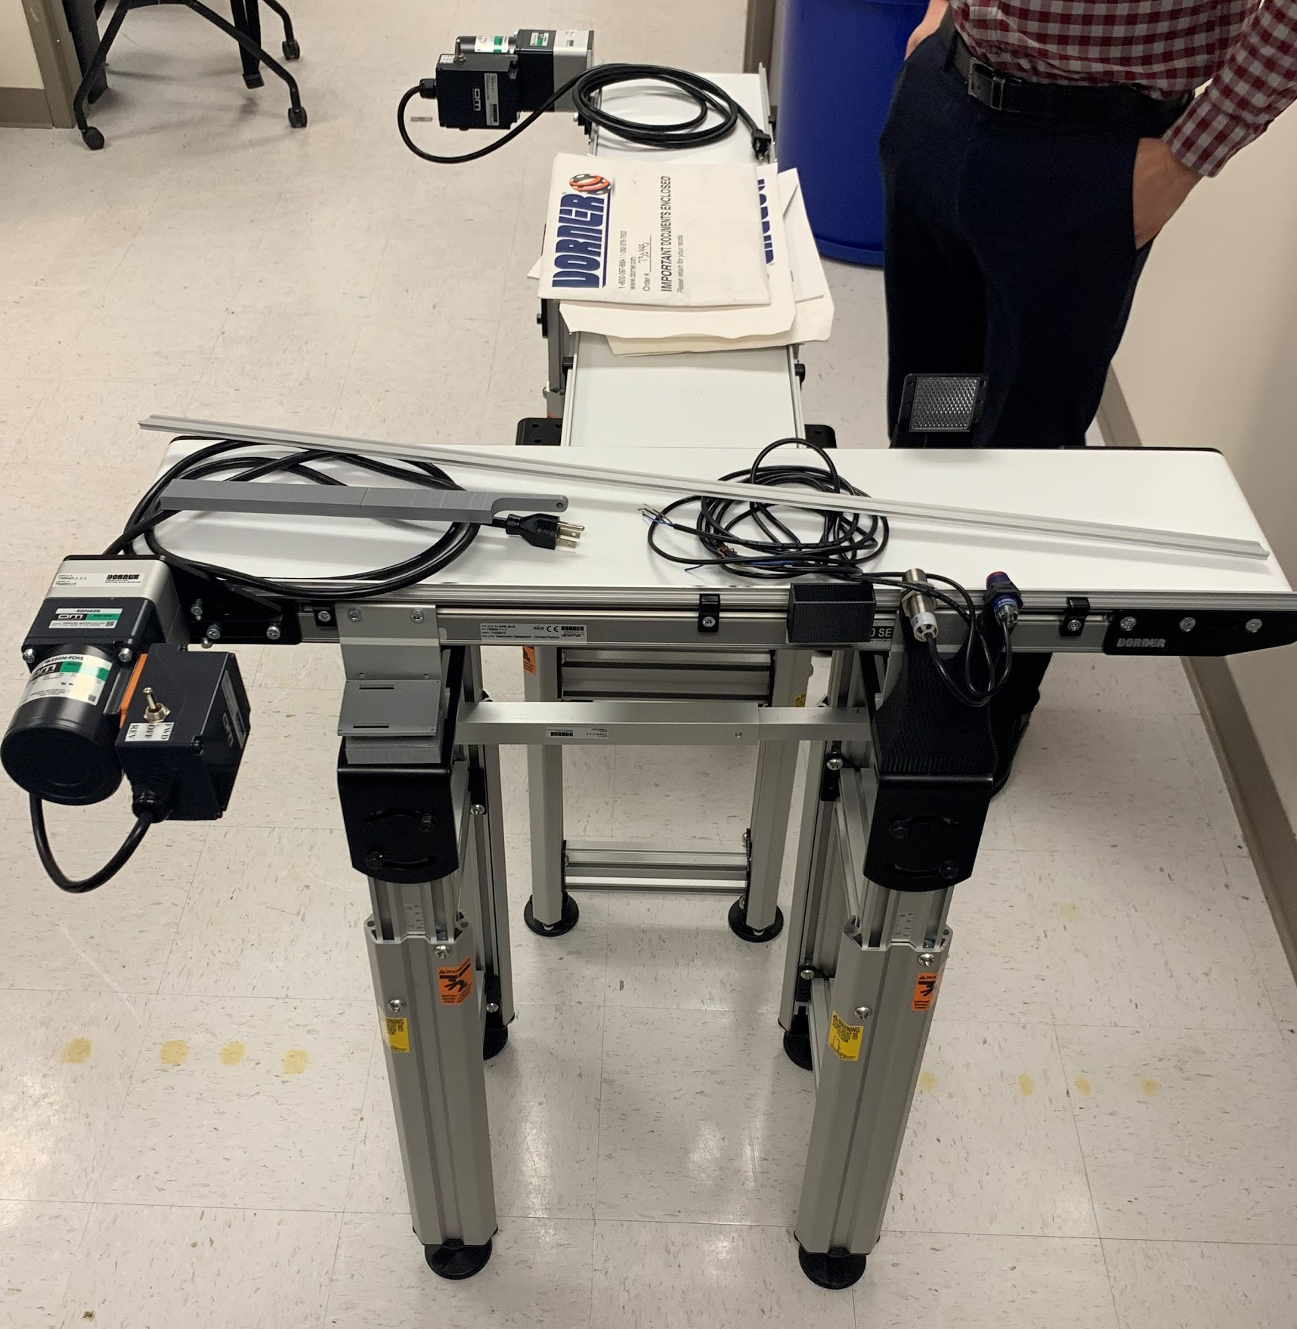
Flat Belt Conveyor
The purchased conveyors are Dorner 2200 flat belt conveyors
Nick

Slide 18
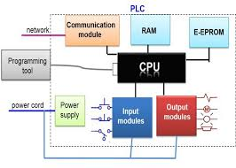
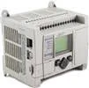
Programmable Logic Controller (PLC)
The PLC we will utilize is produced by Rockwell Automation
Justin

Slide 19
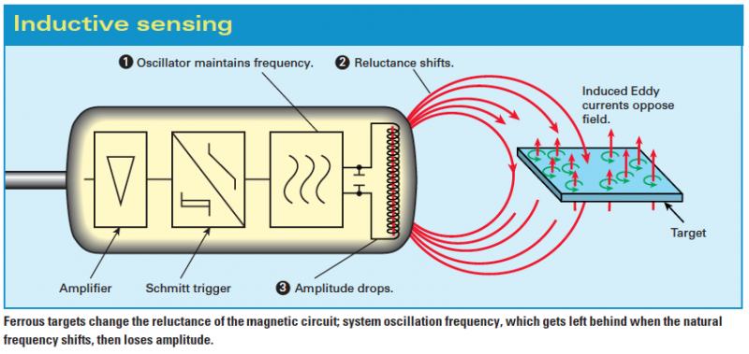
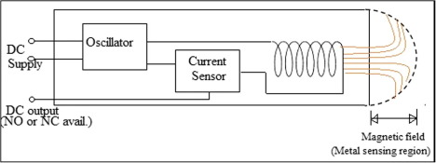
Inductive Sensor
Justin

Slide 20
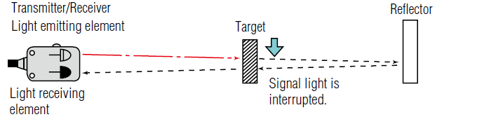
Proximity Sensor
Placed at varying heights to determine size (small or large)
Justin

Slide 21
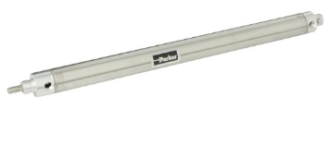
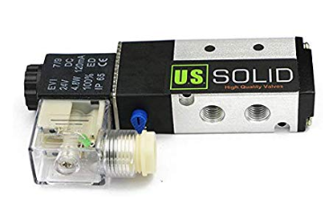
Pneumatic Linear Actuator
μ=0.3
Fstatic=μN
F=𝝈airA
Fstatic = 16.34 N
Fstatic
Max Pressure (psi) | 250
Stroke (in) | 12
Force at 30 psi (lbf) | 22.5
Justin
Notes:
F=PA A=area of bore diameter A=0.75 in^2 50 psi(37.5 lbf)

Slide 22
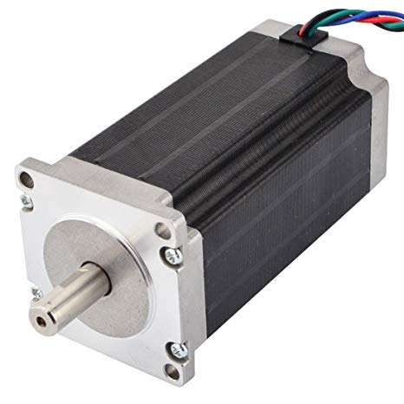
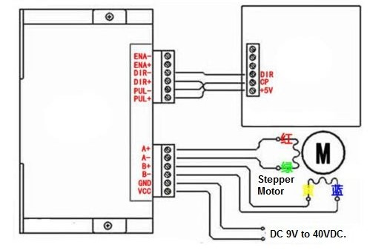
Stepper Controlled Arm
Stepper motor chosen over DC because it will retain position when powered off.
Minimum holding torque of 10 N*m.
Nick
Notes:
DC Motor
Simplest to control: no timing or protocol needed, faster response time, continuous displacement and can be controlled accurately and positioned exactly
Vary the speeds by controlling the current going through (change voltage)
To change direction, just reverse polarity of power source
Stepper Motor
Moderate coding to control: full rotation is broken into segments, need to control 4 different nodal voltages to rotate
Vary speeds by utilizing delays before next voltage orientation
To change direction, reverse order of nodal voltages

Slide 23
Concept Selection
Concept 1
Concept 7
PLC controlled
Two forms of actuation
Both conveyors used
Complex Design
Pneumatic Actuation
One Conveyor
Simple Design
Concept 6
Rotational Actuator
Previous Group’s Design
Damira

Slide 24
Conceptual Design
Pneumatic Actuator
Reflector
Rotational Arm
Large
Metal
Small
Metal
Reflector
Inductive Sensor
Proximity Sensor
Proximity Sensor
Small Non-Metal
Pneumatic Actuator
Large
Non-Metal
Nick

Slide 25
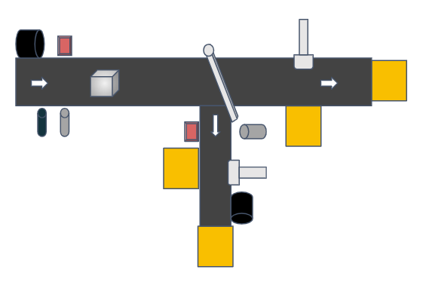
Conceptual Design
If (I == nonmetal)
{
// Rotate motor clockwise a certain degree
// Wait for object to get on second belt
// Return motor to resting position
If (P1 == small)
{
// delay until object is in front of An
// Activate An
// Reset An to normal position
}
}
Else
{
If (P1 == small)
{
// delay until object is in front of Am
// Activate Am
// Reset Am to normal position
}
}
Motor
Am
P2
I
P1
An
Nick

Slide 26
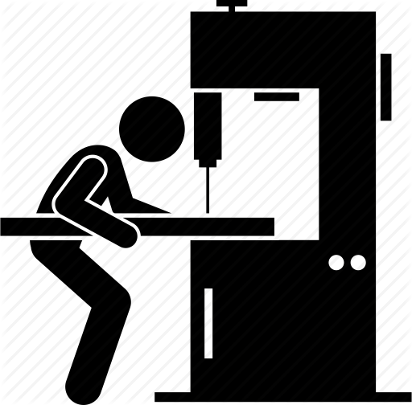
End of Fall Semester Tasks
Finalize CAD designs for rotational arm
  3D print for testing
Select stepper motor
Finalize CAD designs for stepper motor mount
  Submit to Machine Shop
First wave of purchases
Start first version of logic code
Justin

Slide 27
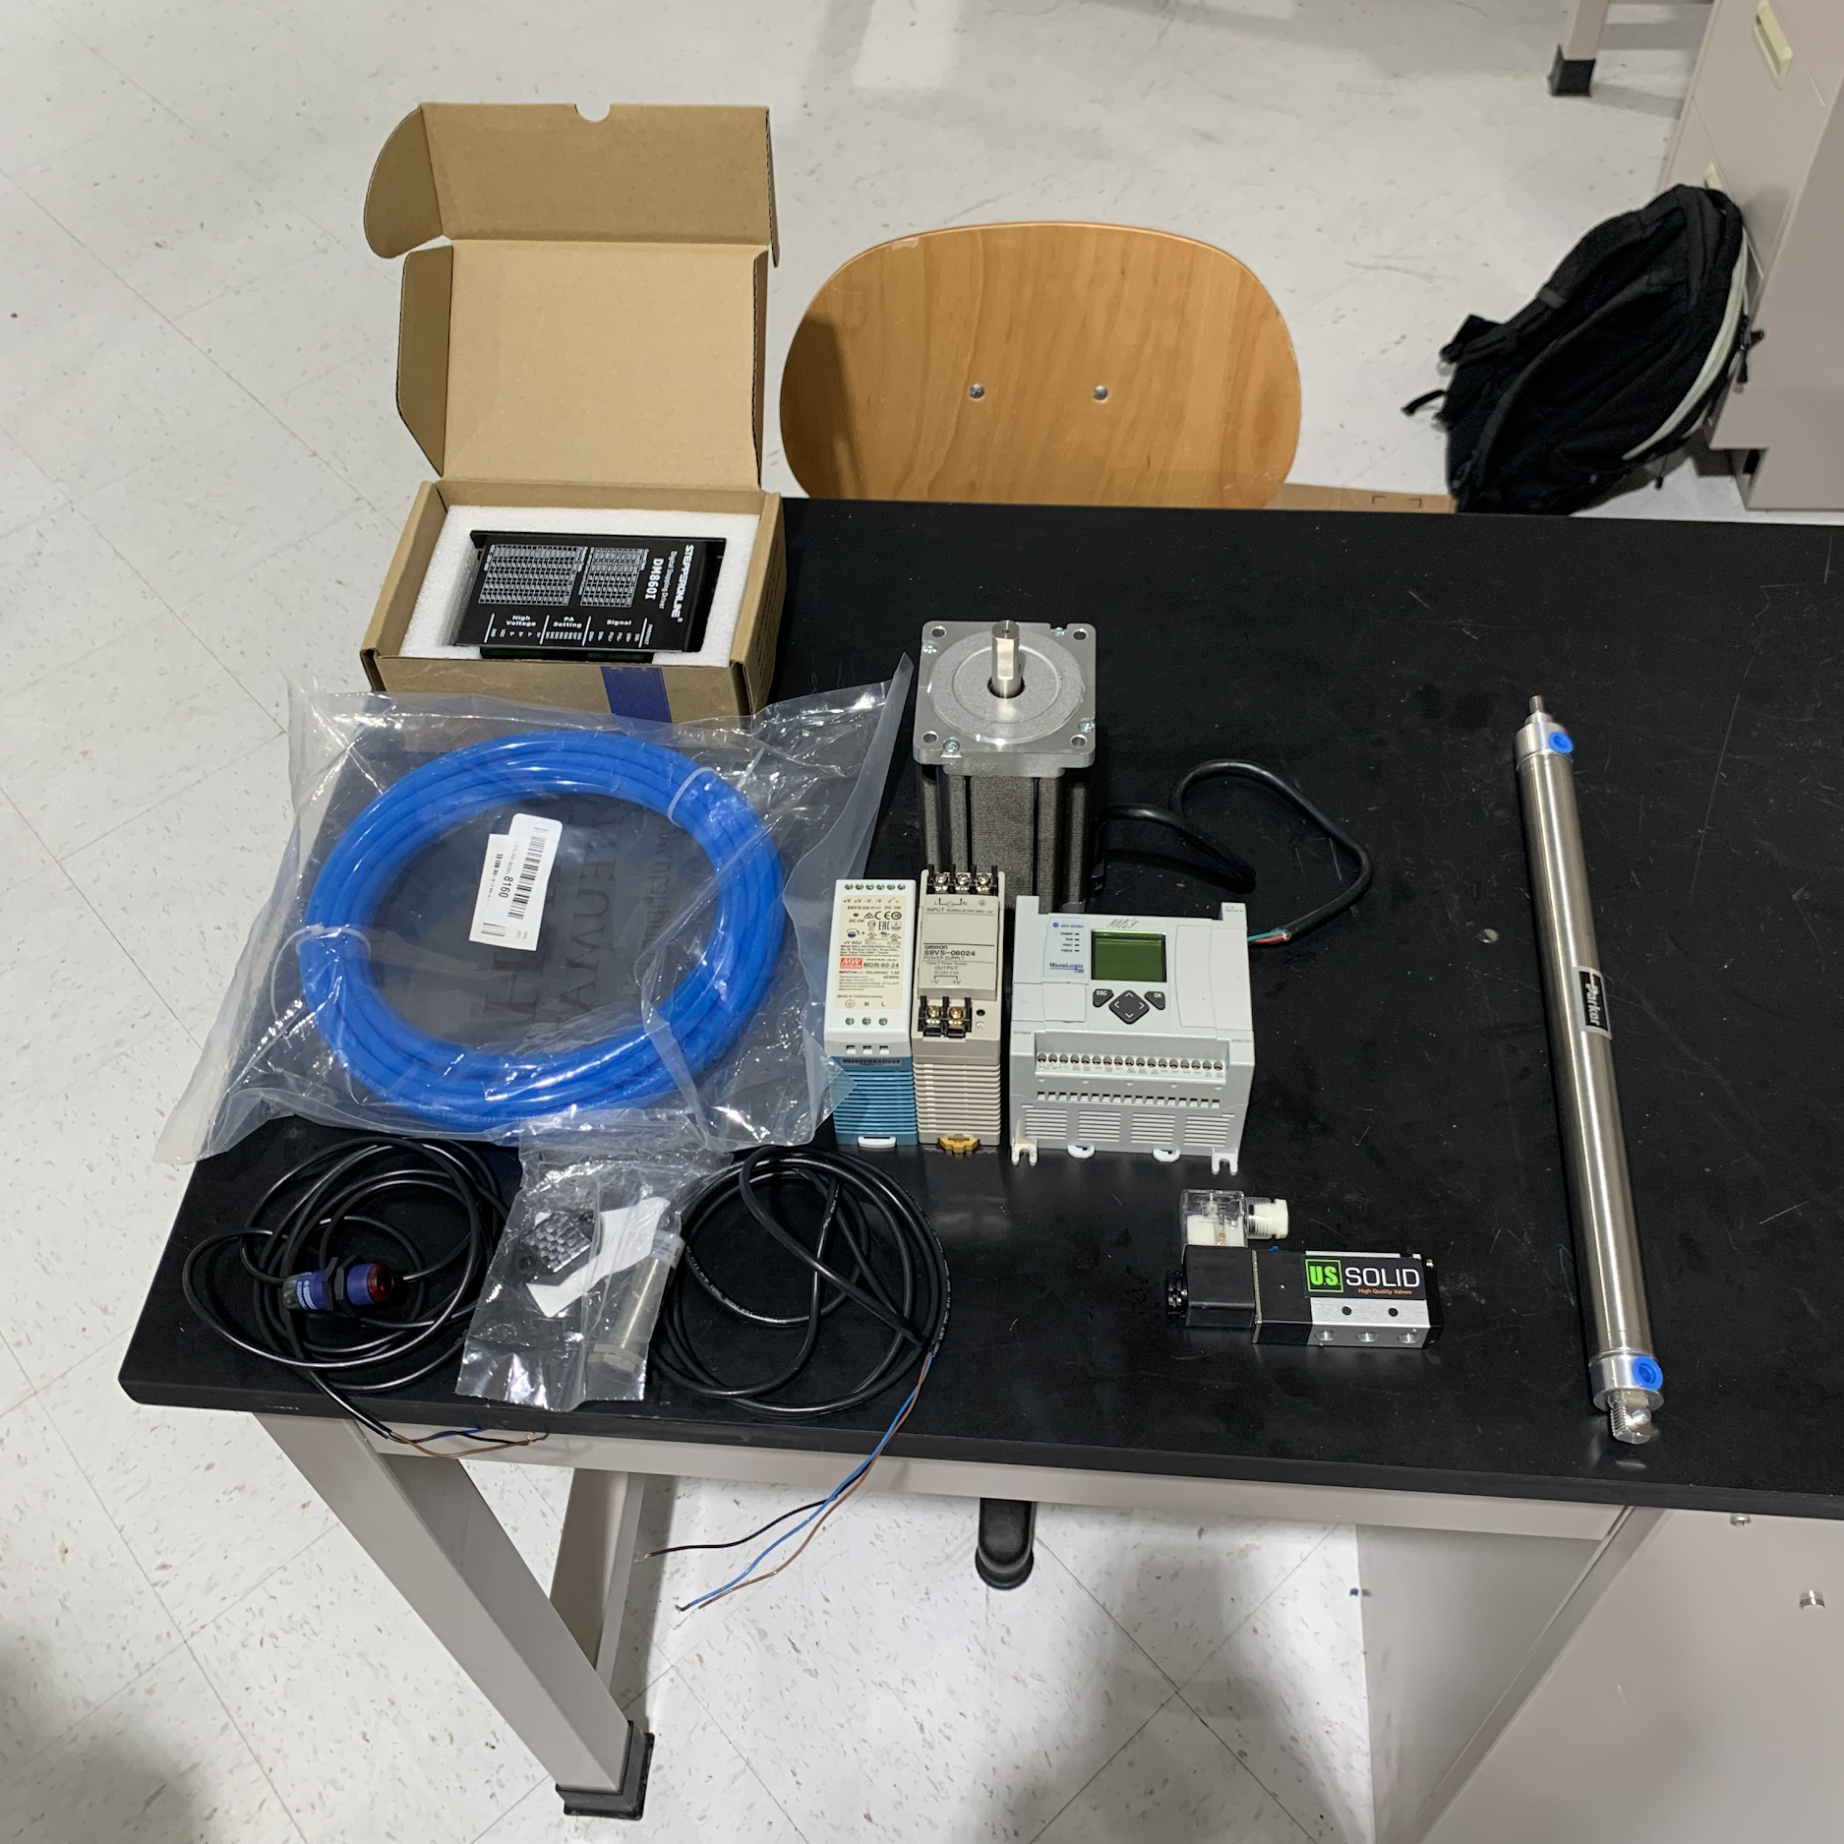
Received Purchase Items
Power Supplies
  2 x 120 VAC to 24 VDC Converters
Actuators
  NEMA 34 Stepper Motor and Driver
  Linear Pneumatic and Solenoid
Fittings for air supply and actuators
Second Wave of Purchases:
  Linear Pneumatic and Solenoid
  Proximity Sensor
Picture of materials here
Justin

Slide 28
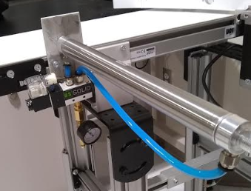
Linear Actuator
Solenoid has a maximum pressure of 113 Psi
Double acting actuator using compressed air to close instead of spring
Justin

Slide 29
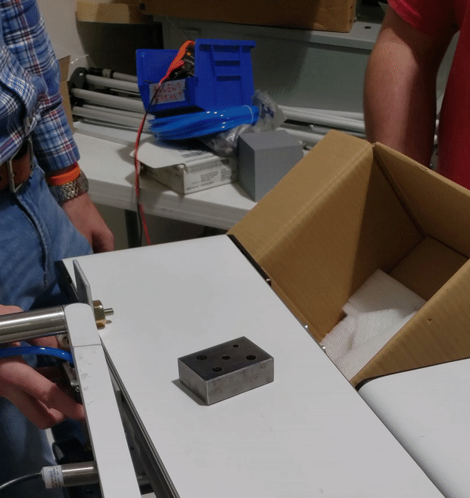
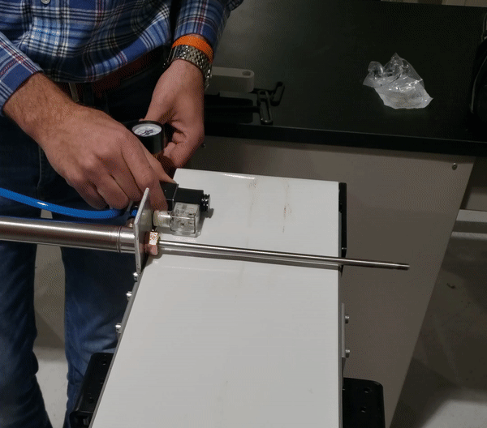
Linear Actuator
Verified functionality
Has 4 configurations for speed
Attach an adapter that will catch object
Justin

Slide 30
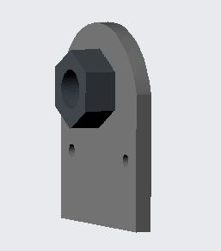
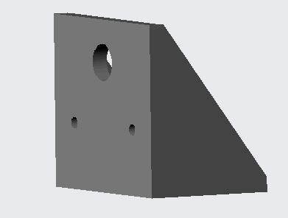
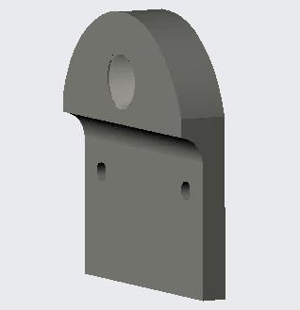

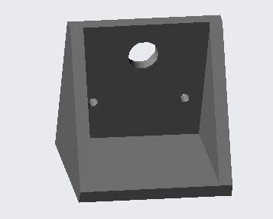
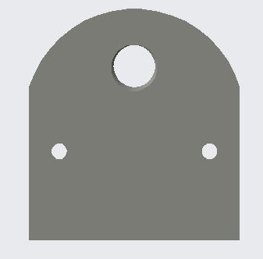
Linear Actuator Mounts
Test Mount
Reinforced Mount
Final Design
Nick

Slide 31
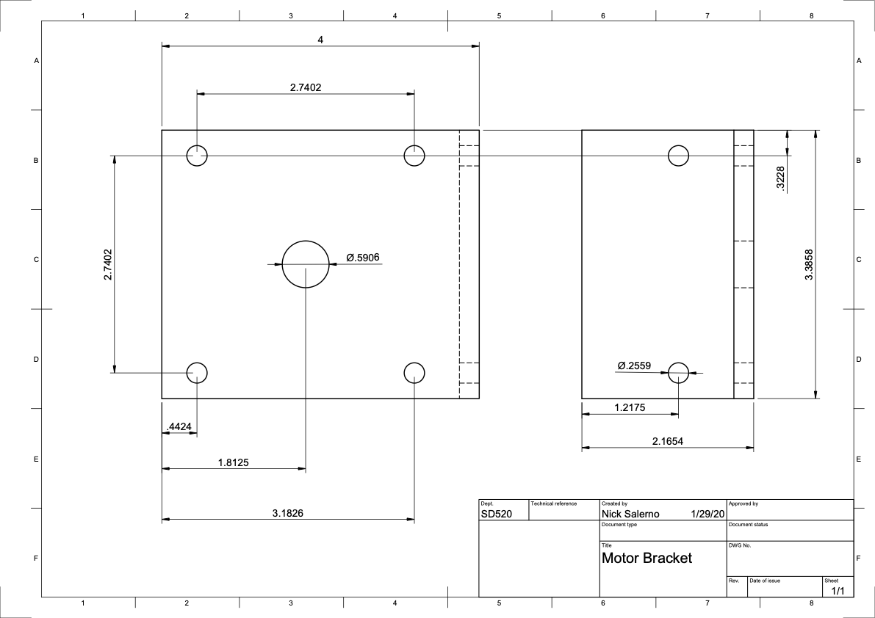
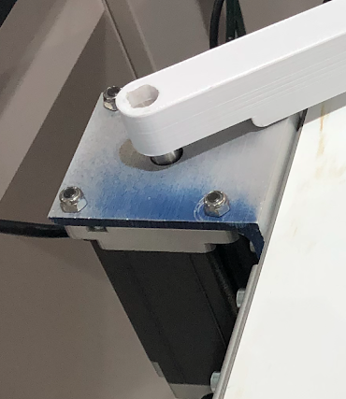
Stepper Motor Mount
Nick

Slide 32
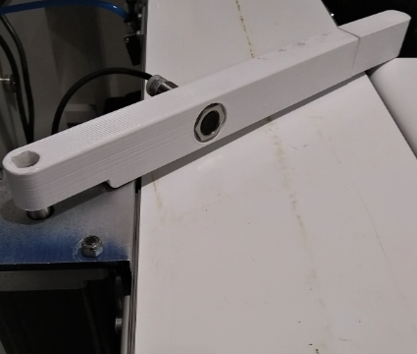
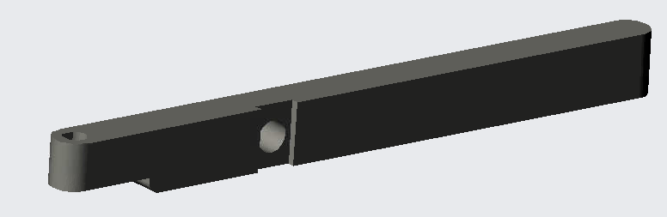
Inductive Sensor Placement
Inductive sensor has a sensing range of 8 mm
Embedded sensor into rotational arm
Nick

Slide 33

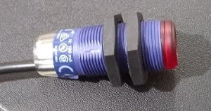
Proximity Sensor Mount
Sensor mounts to conveyor
Slides horizontally and vertically and can miss 1” cube
This will be used as a timing and hardware error
Nick

Slide 34
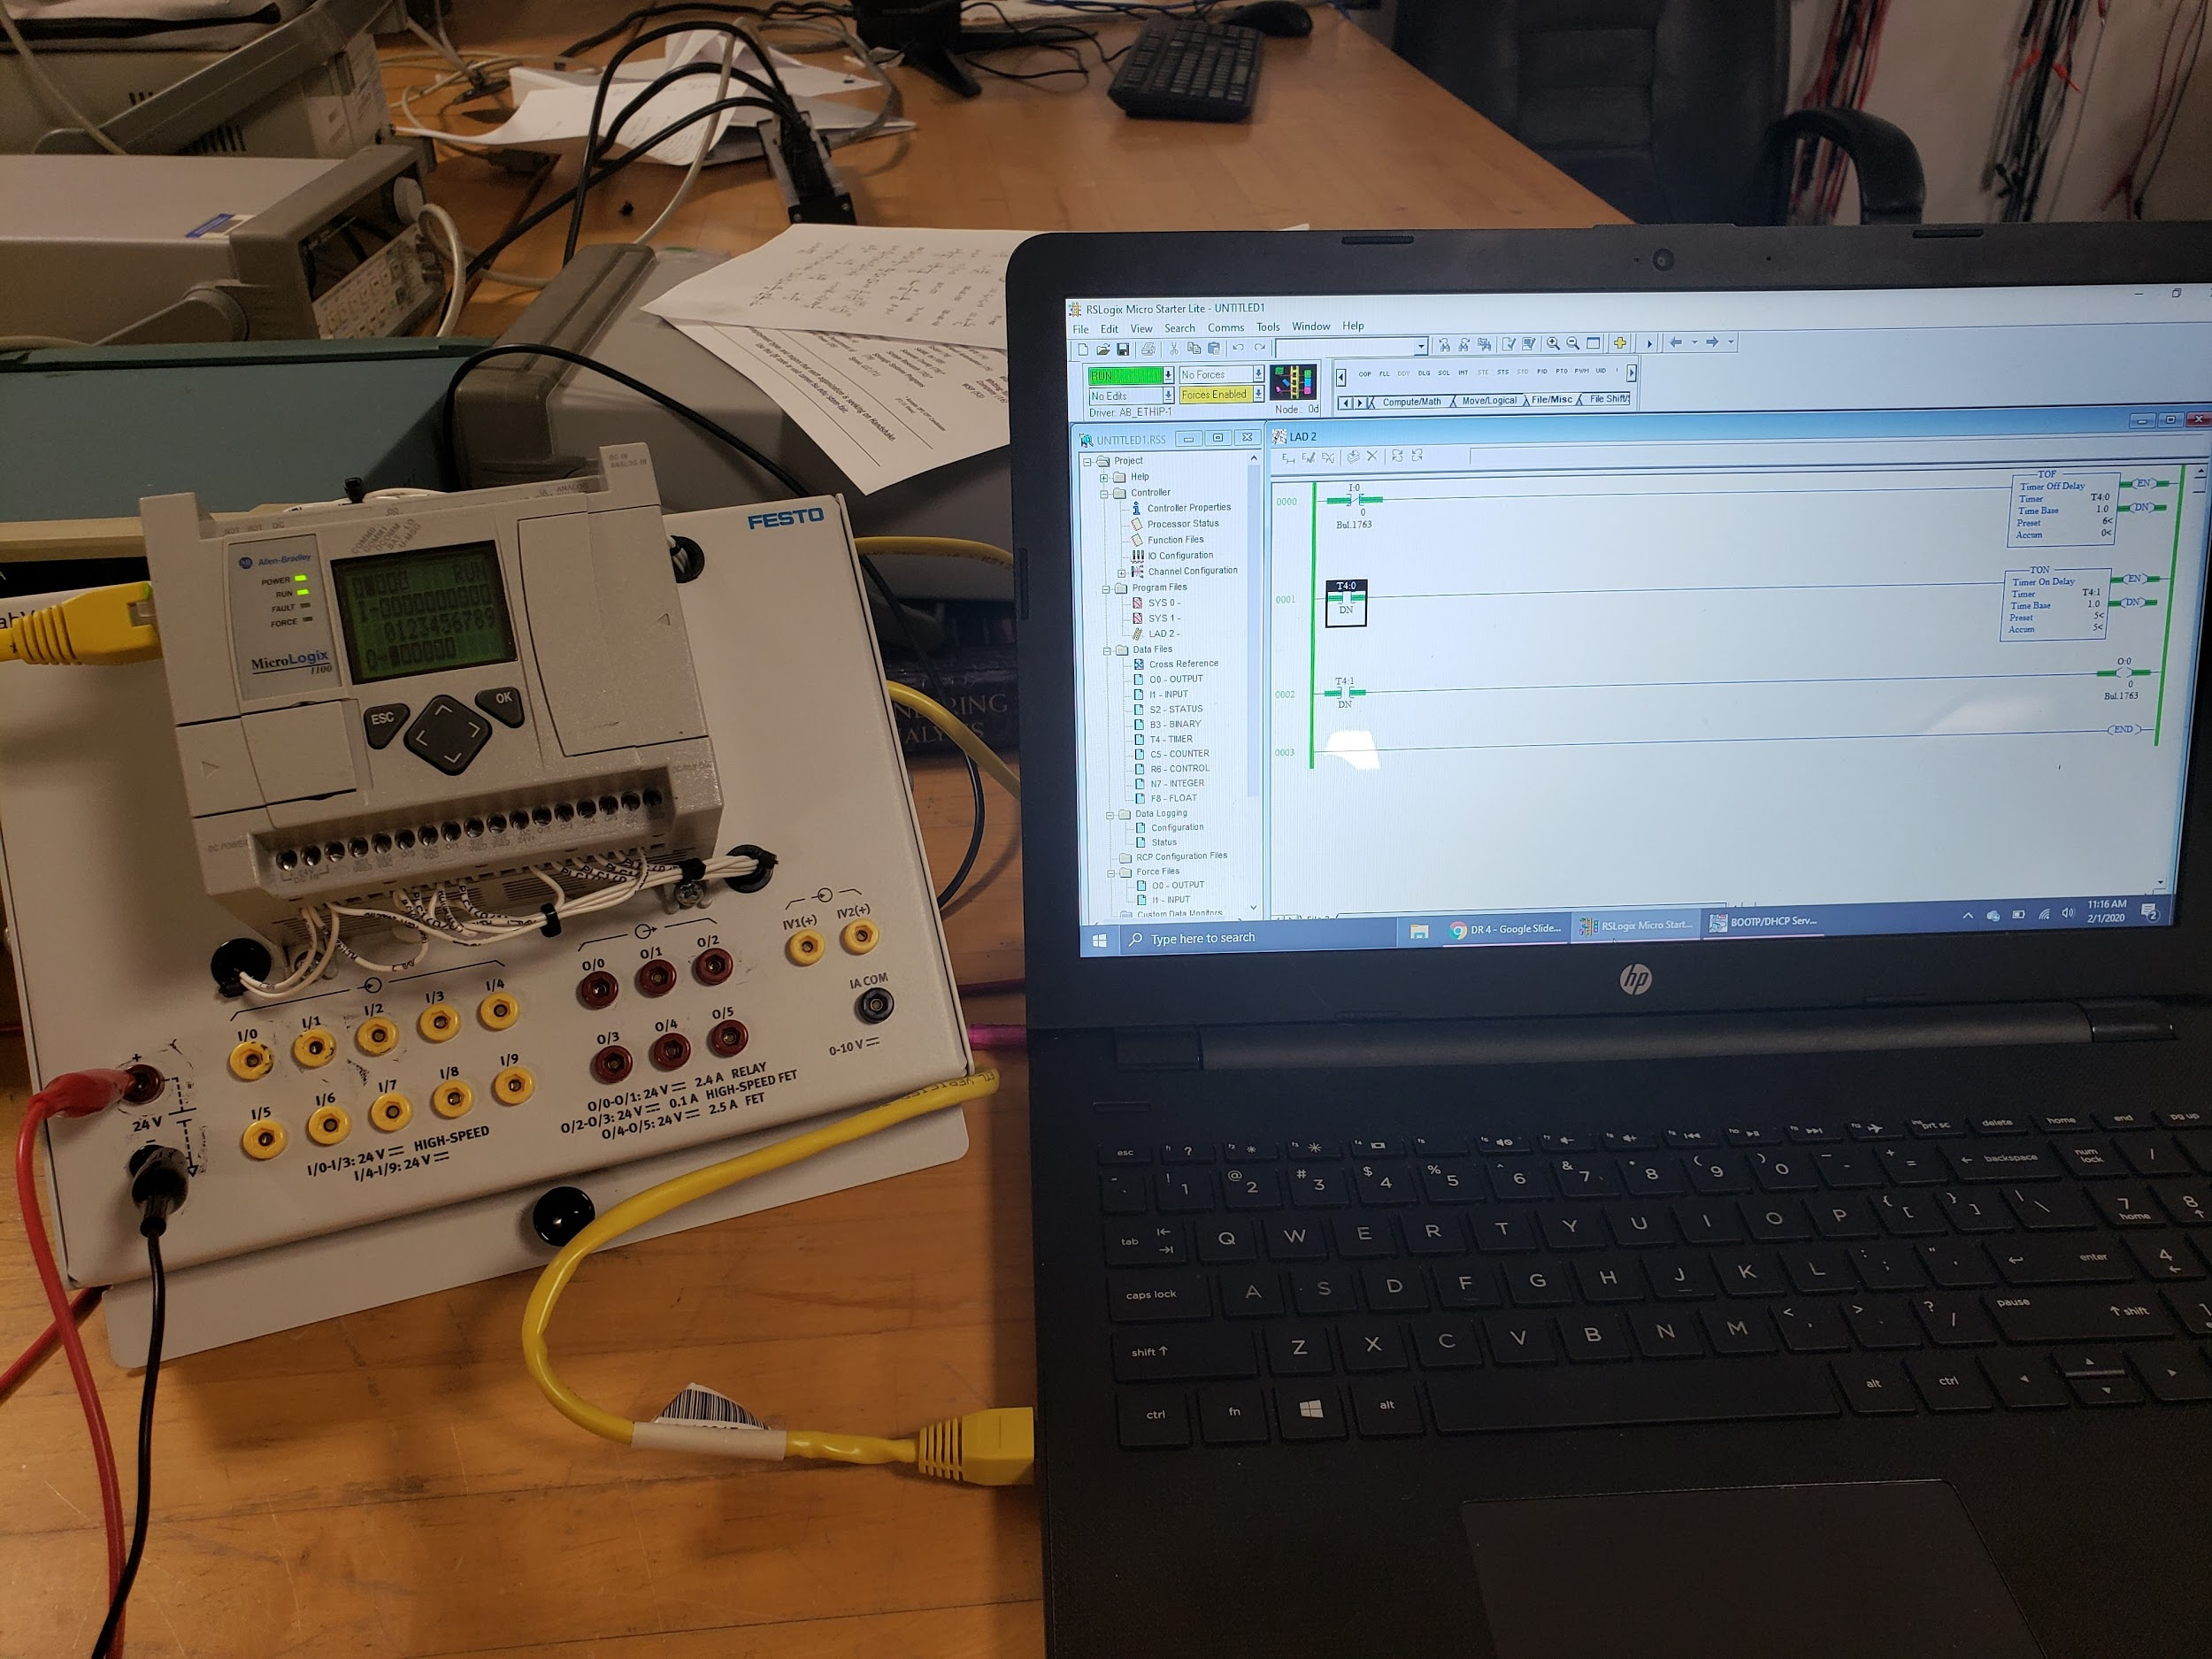
PLC Implementation
Configured communication ports
Verified input and output functionality through simple programs
Started implementing sorting algorithm
Nick

Slide 35
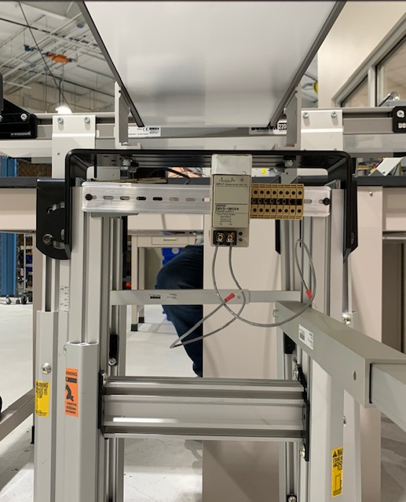
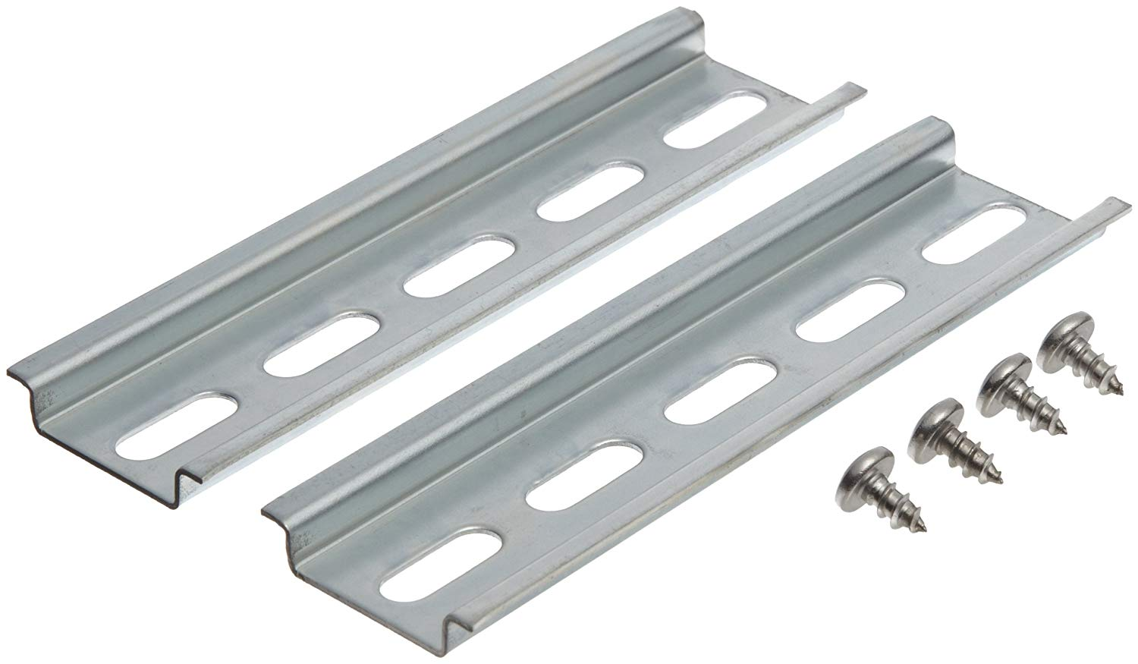
Mounting for PLC and Power Supply
DIN Rail for PLC and Power Supply mounting
Placed under conveyor, connected to legs
Justin

Slide 36
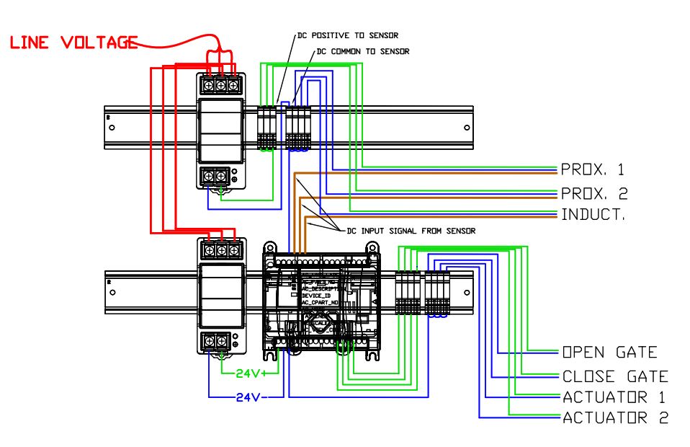
Wiring Diagram
Inputs:
  2 x Proximity Sensors
  1 x Inductive Sensor
Outputs:
  2 x Linear Actuators
  2 x Stepper Motor
Routing:
  Through conduit under conveyor
  Power strip cord is only wire outside of conveyor
Justin

Slide 37
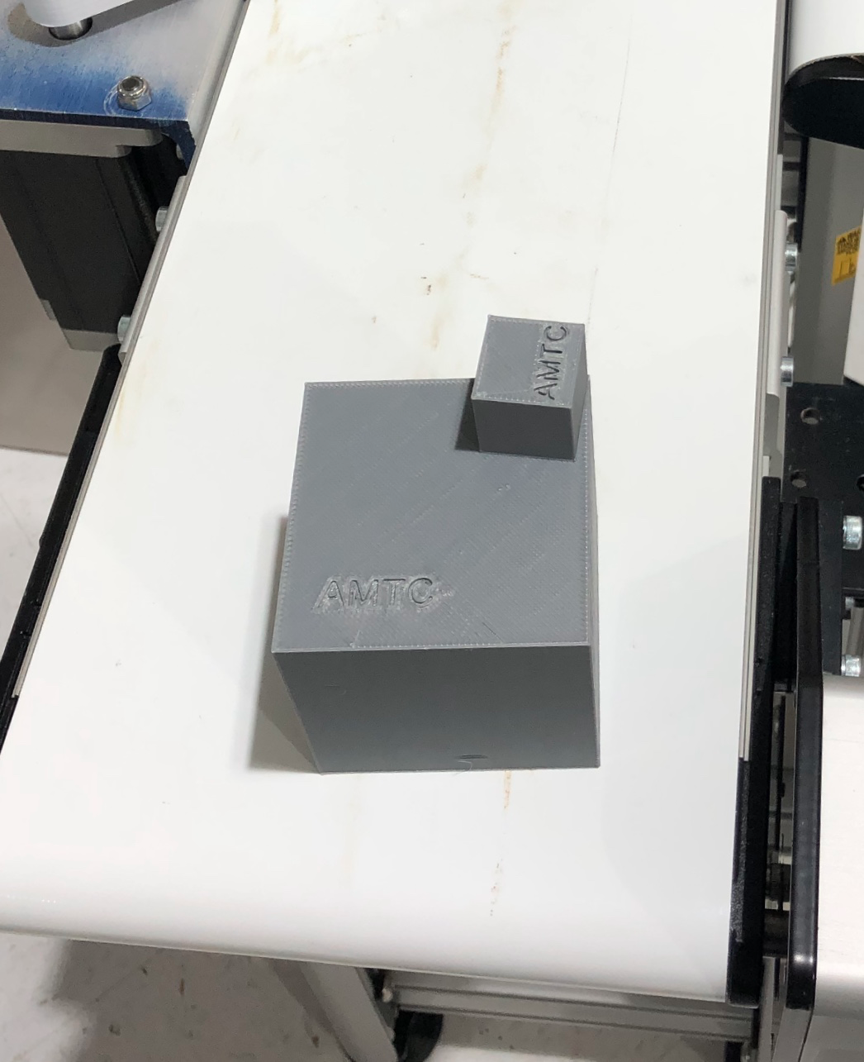
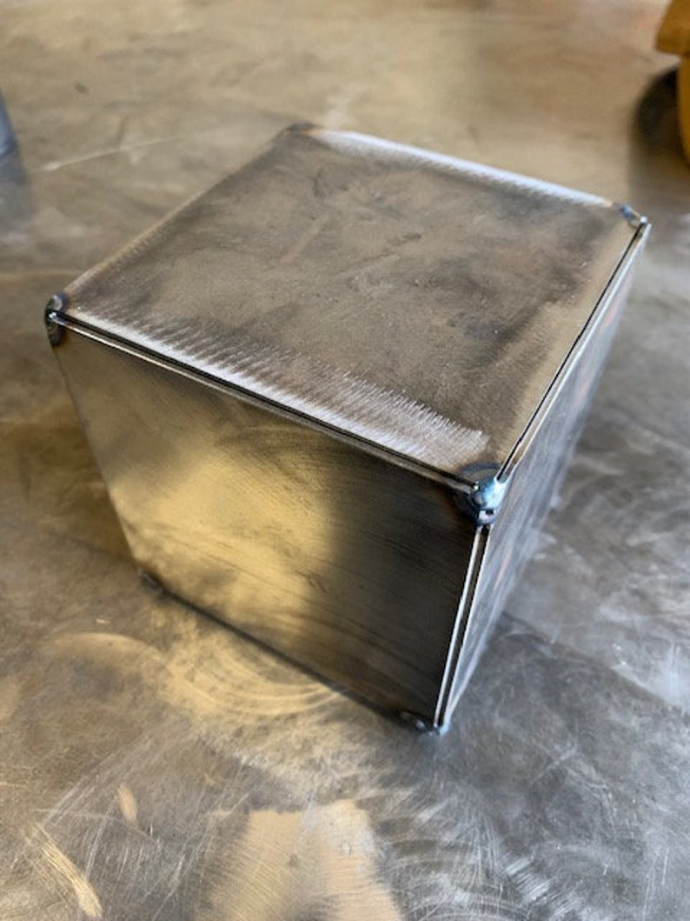
Test Cubes
Nonmetal cubes
PLA
Innovation Hub
1’’, 2’’, 3’’, 4’’
Metal Cubes
Aluminum
McMaster Carr Sheet metal
Welding by machine shop
Justin

Slide 38
Hardware Failures
Failure/Error | Consequence of Failure/Error | Solution
Actuator Placement | Won’t push object into box | Adjust actuator
Sensor Placement | Logic errors | Adjust sensors
Stepper Motor Driver Settings | Arm will not rotate enough or too much | Reconfigure driver
Faulty Wiring/Tubing | Sensors/Actuators will not function | Replace wiring/tubing
Blown Fuse | Sensors/Actuators will not function | Replace fuse
Justin

Slide 39
Software Failures
Failure/Error | Consequence of Failure/Error | Solution
Timer/Delays | Size may be wrong, actuators activate wrong time | Reconfigure delay/timers in logic
Sorting Algorithm | Objects sorted into wrong bin | Debug algorithm
Stepper Motor Direction | Arm will not rotate enough or too much, or in wrong direction | Reconfigure driver or output addresses
Incorrect Actuator Assignment | Wrong actuator will be activated | Reconfigure output addresses
All Code in Single Rung | System will only operate properly once | Break code up into segments
Justin

Slide 40
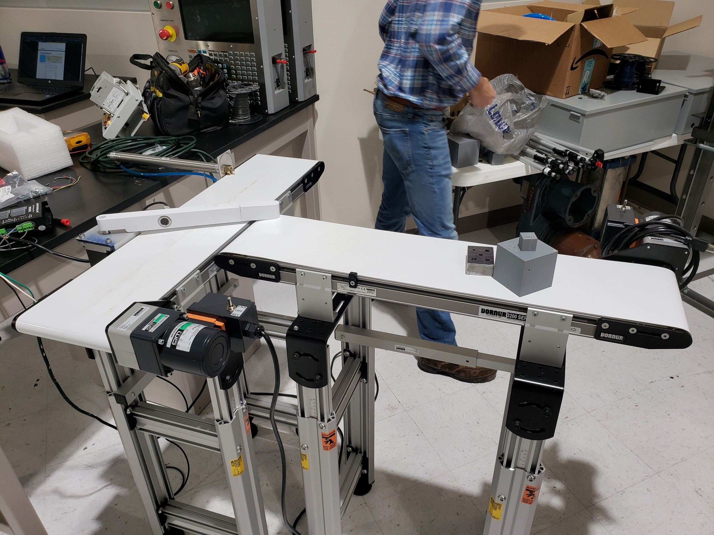
Future Work
Receive second wave of materials
Calibrate timers/delays
Start designing lesson plans
  Create manuals for various lessons
Finish creating/assembling mounts
Finish implementing working assembly line
Nick

Slide 41
Timeline for Spring Semester
February:
Have remaining materials delivered
Design and machine remaining mounts
Finish assembling conveyor
Have correct sorting algorithm completed
Start implementing failures/errors
March:
Start/continue implementing errors
Start creating curriculum
Finish implementing failures/errors
Create User Manual
Finish creating curriculum
April:
Update website with finished user manual, curriculum, and evidence book
Prepare for Engineering Design Day
Deliver final product and documentation to Sponsor
Nick

Slide 42
Questions? Contact us!
Ryan Dodson:
ryan1.dodson
@famu.edu
Justin Law:
jml17d@my.fsu.edu
Nick Salerno:
nms15f@my.fsu.edu
Vestibulum congue
Vestibulum congue
Vestibulum congue
Robert Smith:
rds16e@my.fsu.edu
Vestibulum congue
Vestibulum congue
Vestibulum congue
Vestibulum congue
Vestibulum congue
Vestibulum congue
Damira Solms:
ds15d@my.fsu.edu
Vestibulum congue
Vestibulum congue
Vestibulum congue
Nick

