Slide 1
T311- Material Handler Robot
EEL4911C
VDR5
12-March-21

Slide 2
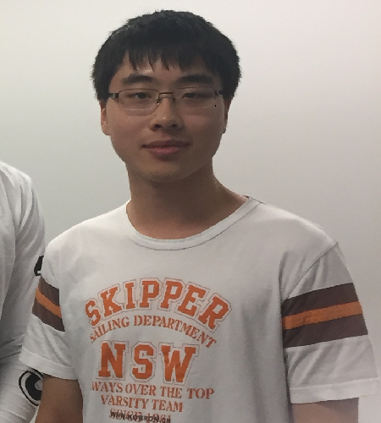
Team Introductions
WALTER CALDWELL
Project Technical Manager
TIFFANY
MILLER
Hardware Co-lead Engineer
SEBASTIAN MURIEL
Hardware Co-Lead Engineer
ALEX JEN
Software Co-Lead Engineer
TONY ZHENG
Software Co-Lead Engineer

Slide 3
ME Senior Design Team 506
NICHOLAS NORWOOD
Controls Engineer
PETER WATSON
Materials Engineer
DIANDRA REYES
Additive Manufacturing Engineer
ALEXANDER WOZNY
Systems Engineer
TAYLOR HARVEY
Mechanical Design Engineer

Slide 4
Outline
Project Recap
Updates
&
Results
Future Work
Questions
Objective
Key Goals
Current Progress
Video Progress
Challenges
Future Plans
GANTT Chart

Slide 5
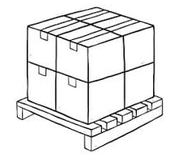
Objective
The objective of this project is to create a partially autonomous material handling robot that works in a dark warehouse with conditions unfavorable to human workers.

Slide 6
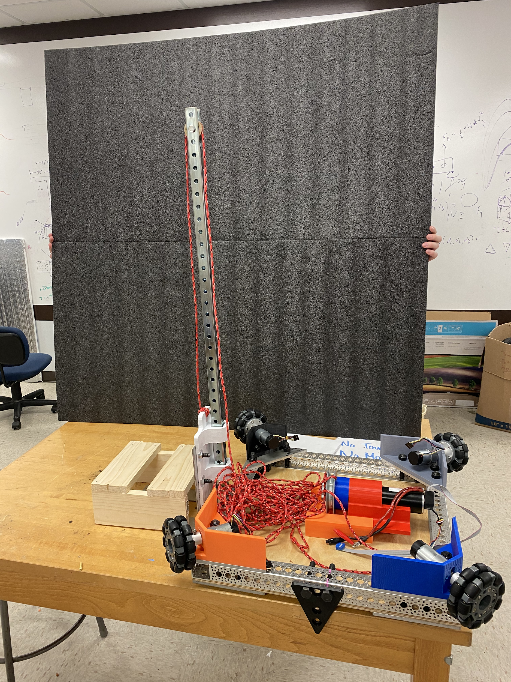
Key Goals
Autonomous navigation of the modified warehouse.
Pick up and move boxes up to 25 lbs.
Identify packages using QR codes.
Track inventory using QR codes.
Be able to perform the key tasks in a
modified warehouse with low lighting.
Notes:
Explicitly state that these are the minimum requirements for the robot to be considered a success.

Slide 7
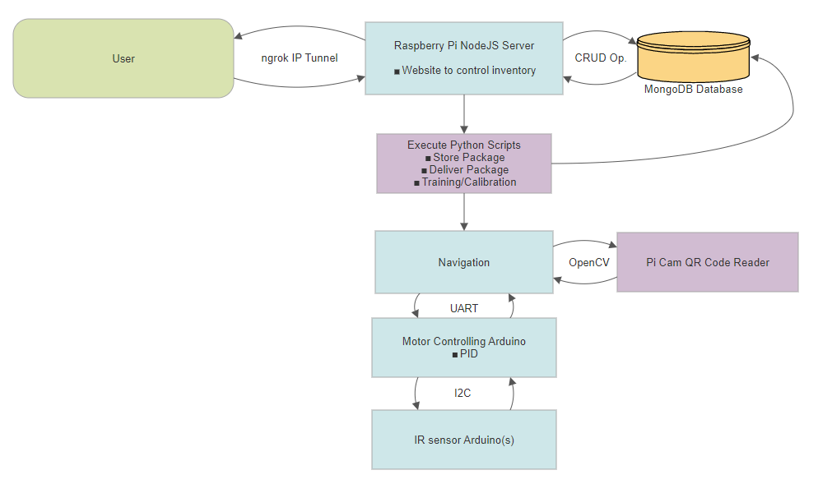
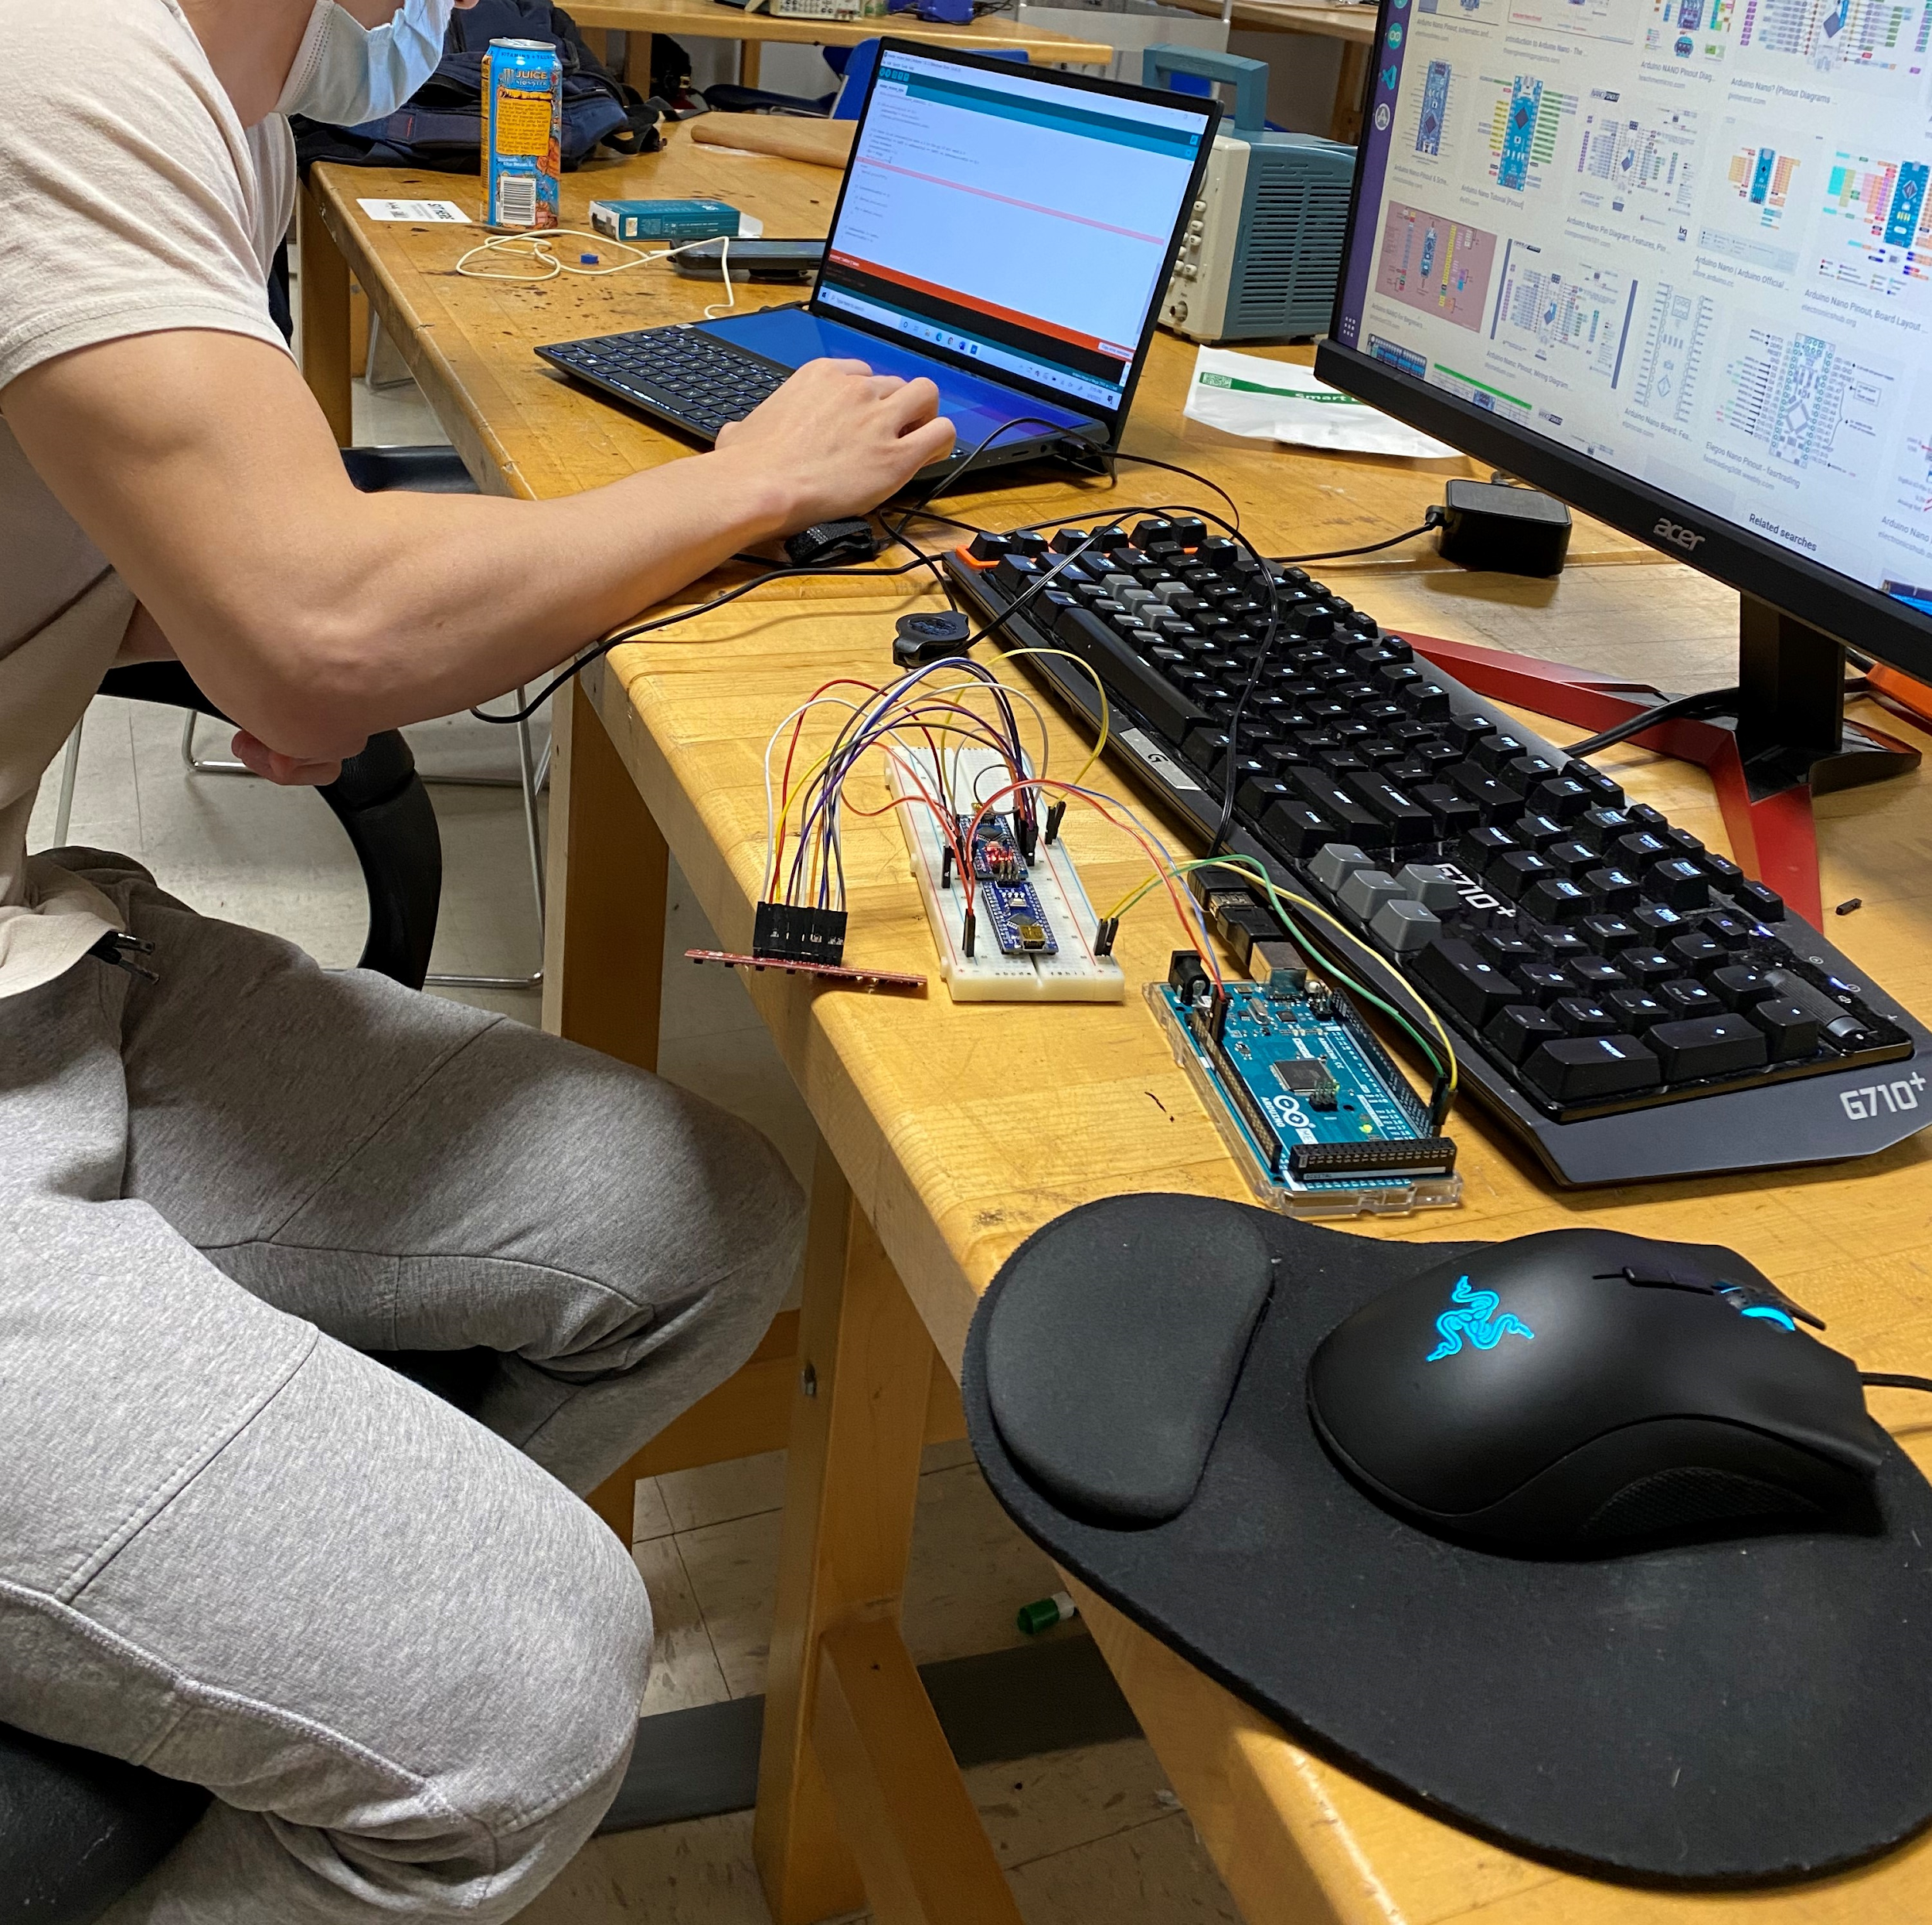
Current Progress
Completed Systems
UART
I2C
User/machine Interface
User connection
CRUD operations
Pi Cam QR Reader
WIP Systems
Store Package
Training/Calibration
Deliver Package
PID Controls
Notes:
Explicitly state that these are the minimum requirements for the robot to be considered a success.

Slide 8
Video Progress
Notes:
Explicitly state that these are the minimum requirements for the robot to be considered a success.

Slide 9
Challenges
Wheels have not been thoroughly tested.
Certain brands of arduinos not behaving properly with the Pi.
Power source might be insufficient.
Need more motors, two of the gearbox’s have broken.
Notes:
Explicitly state that these are the minimum requirements for the robot to be considered a success.

Slide 10
Future Plans
Testing movement and navigation
Continue to develop PID system
Set up mock warehouse.
Integrate all the components together.
Test accuracy with forklift
Test Training/Calibration
Store Package
Test Deliver packages
Notes:
Explicitly state that these are the minimum requirements for the robot to be considered a success.

Slide 11
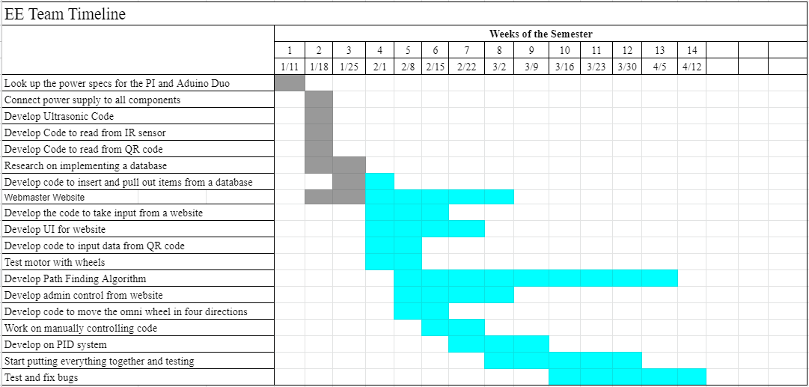
Previous GANTT Chart
Notes:
Explicitly state that these are the minimum requirements for the robot to be considered a success.

Slide 12
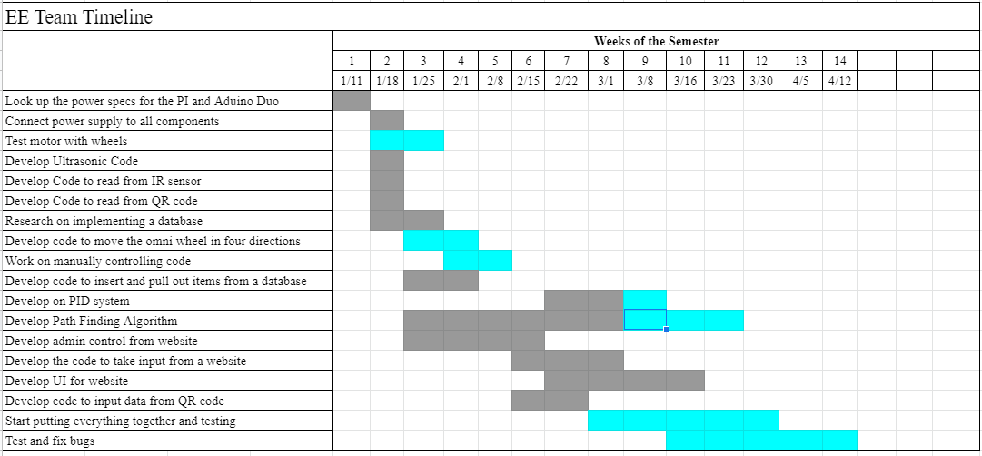
Updated GANTT Chart
Notes:
Explicitly state that these are the minimum requirements for the robot to be considered a success.

Slide 13
Questions

