Slide 1
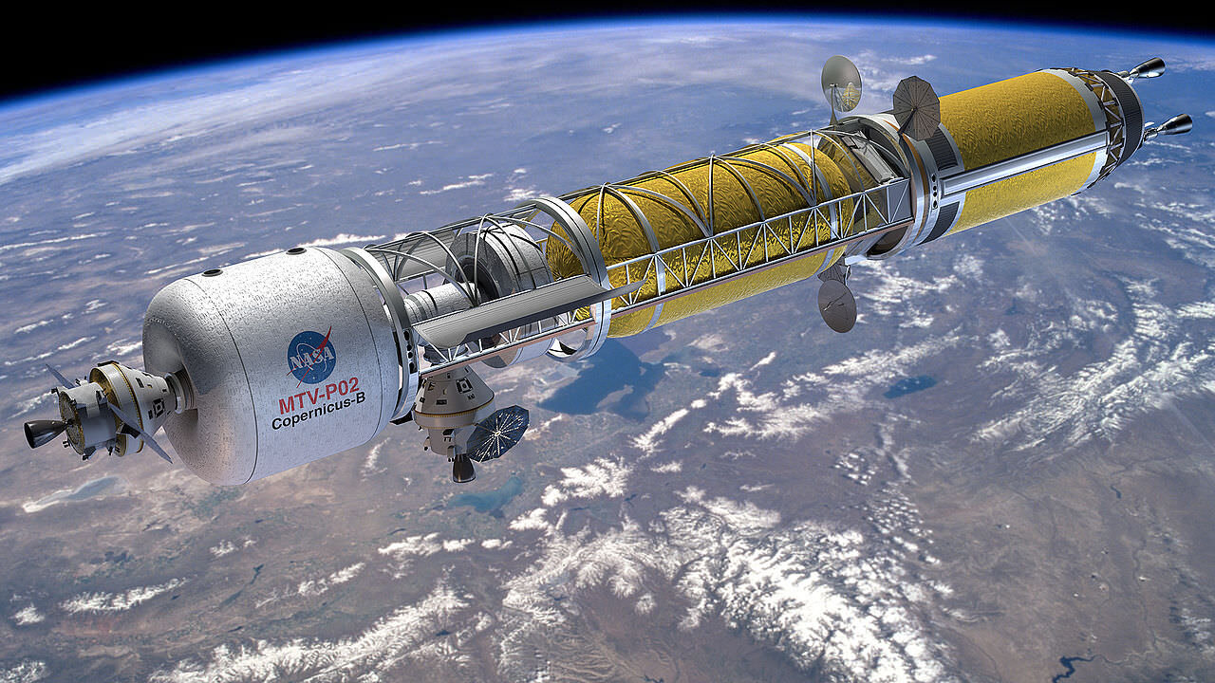
Team 514: Hydrogen Pre-Heater in the Nuclear Thermal Rocket Simulation
Michael Corak
Kevin Hartzog
Fisher Hillburn
Jordan Weid
Notes:
https://www.asme.org/topics-resources/content/the-future-of-nuclear-rockets-for-space-travel

Slide 2
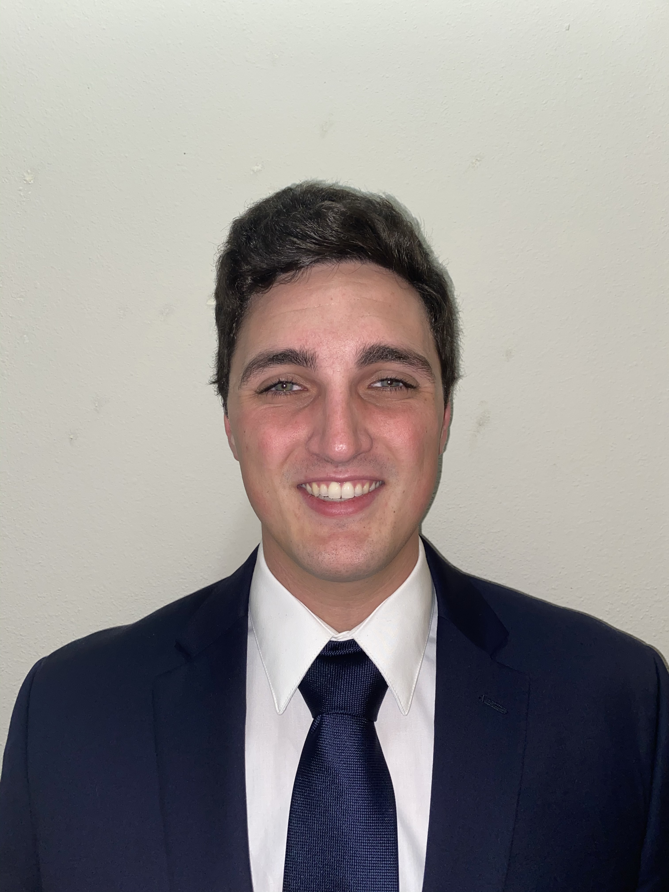
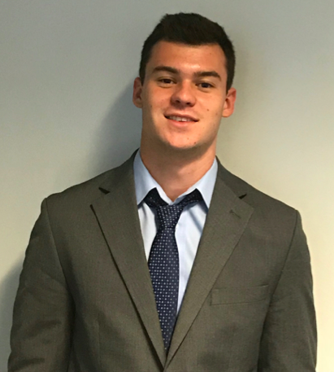


Team Introductions
Michael Corak
Project & Aero-Thermal
Engineer
Kevin Hartzog
Project Manager &
Aero-Thermal analysis
Fisher Hillburn
Mechanical Design &
Systems Engineer
Jordan Weid
Simulation/Structural
Design Engineer
Jordan Weid

Slide 3
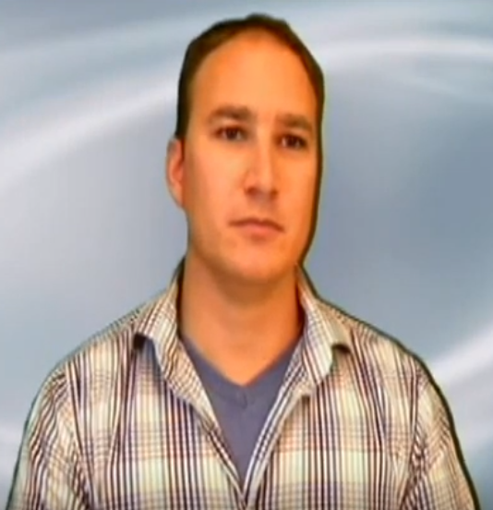
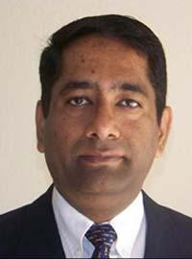
Sponsor and Advisor
Engineering Mentor
Michael Schoenfeld
Nuclear Systems Team Lead
Academic Advisor
Rajan Kumar, Ph.D.
Associate Professor
Jordan Weid

Slide 4
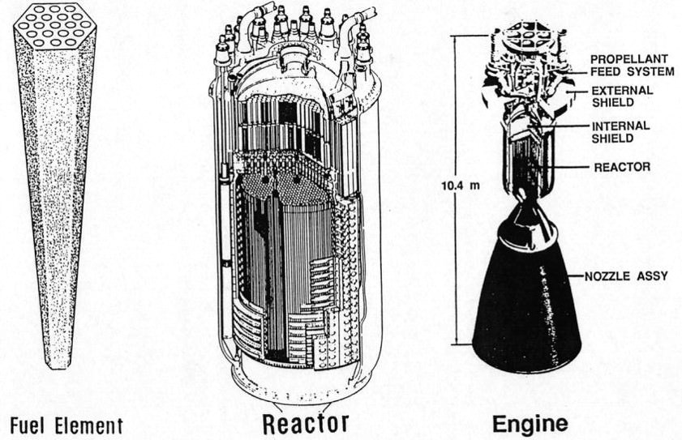
Project Background
Theory behind Nuclear Thermal Propulsion(NTP)
Jordan Weid
Notes:
http://toughsf.blogspot.com/2019/09/nter-nuclear-thermal-electric-rocket.html

Slide 5
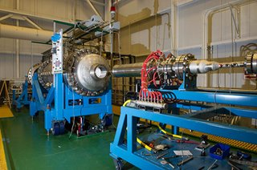
Project Background
Nuclear Thermal Rocket Element Environment Simulator (NTREES) at NASA's Marshall Space Flight Center (MSFC)
Jordan Weid
Notes:
https://www.nasa.gov/centers/marshall/news/news/releases/2014/ntrees.html

Slide 6


Project Background
Existing test article design
Simulate nuclear heating - volumetric phenomenon
Induction Coils
Hydrogen Flow
Jordan Weid

Slide 7
Project Background
T4
T3
Temperature (K)
Motivation
  Simulate the conditions found at any length of test article
T2
T1
Distance (in)
50 inches
Standard Uranium core size
20 inches
NTREES test article size
Jordan Weid

Slide 8
Objective
Provide independent control and feedback of hydrogen inlet temperature
Integrate with existing system with minimal negative effects
Jordan Weid

Slide 9
Targets/Metrics
Critical Functions
Power output target of 15 kW
Steps of 5% of the max power for temperature adjustments
Measure temperatures up to 2500 K
Display feedback
Operate at 85% efficiency
12-bit A/D conversion
Fisher Hilburn
Notes:
Be sure to talk about the split between critical and non-critial targets. Critical targets/metrics are absoutely required to make the project work

Slide 10
Concept Generation
Our team ideated 100 concepts that would accomplish our necessary functions
Several methods were used in this process:
  Battle of Perspectives
  Biomimicry
  Rapid Brainstorming
  Morphological Chart
From these, the most promising ideas were chosen to be high fidelity
Fisher Hilburn

Slide 11
Concept Generation
Battle of Perspectives Chart
Induction heating vs resistive heating
Conduction vs convection
Digital feedback vs analog feedback
Electrical hardware control vs software control
Established methods vs novel methods
This chart was used in comparing the dualities of the engineering areas that the design encompasses
Some of the stronger ideas that came from this method was the method of control and the comparison between established and novel method
Fisher Hilburn

Slide 12
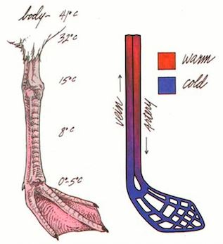
Concept Generation
Biomimicry :
  Crane's use of counter-flow heat transfer in their legs to keep body temperature high
  Termites regulating the heat of their mound using different geometries
  Fluid flows in cave and river erosion systems
Figure: Heat Transfer in the Leg of a Crane
Source (https://www.birdwatchingdaily.com/news/science/eldon-greij-explains-clever-way-birds-keep-legs-feet-warm/)
Fisher Hilburn

Slide 13
High Fidelity Concepts
Concept 1:
  Control – Potentiometer
  Mounting – Composite Plate w/ thru hole
  Heat Exchanger – Cylindrical
Concept 2:
  Control – Voltage
  Mounting – Stinger Plate
  Heat Exchanger – Helical
Concept 3:
  Control – Microcontroller
  Mounting – Cradle
  Heat Exchanger – U-Tube
Fisher Hilburn

Slide 14
Concept Selection
Our team used multiple systematic and analytical methods to weed out our final concept, such as:
  Binary Pairwise Comparison Matrix
  House of Quality
  Pugh Chart
  AHP
Fisher Hilburn

Slide 15
Concept Selection
After we completed this process of charts and rankings, we ended up with selecting concept 1 as our final design because:
  Component 1. The Potentiometer: has the least modes of failure
  Component 2. The Mounting: Easiest to electro-thermally isolate
  Component 3. The Heat Exchanger: Highest efficiencies
Fisher Hilburn

Slide 16
References
Fisher Hilburn

Slide 17
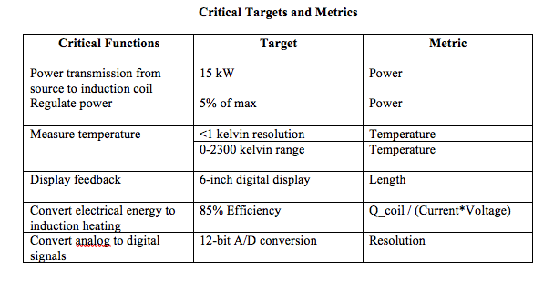
Appendix A: Critical Targets/Metrics

Slide 18
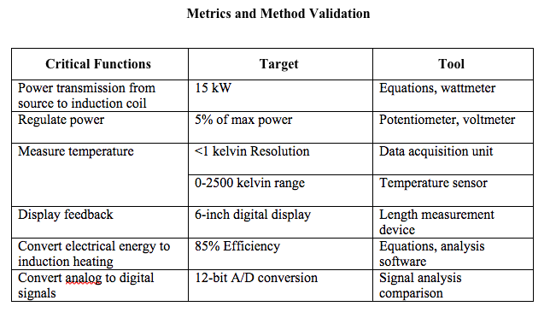
Appendix A: Critical Targets/Metrics - Validation Methods

Slide 19
Appendix B : Concept Generation and Selection
Morphological Chart
Transfers heat | Gives feedback | Allows control | Allows efficient fluid flow | Mounts easily | Efficient coil shape | Measure Temperature
Counterflow heat exchanger | Digital screen | Potentiometer | Twisting shape | Clamping mechanism | Spiral | Thermocouple
Fin | Dial | Radio frequency control | Straight piping | Picatinny rail | Helical | Pyrometer
Brazed plate | LED lights | Mechanical control | Radial piping | Suspension | Pancake style | Infared Scanner
Envelope style heat exchanger | Program | Software control |  | Minimal material | Helical sweep with growth rate
 | Physical Buttons |  |  |  | Cylindrical
 |  |  |  |  | Hexagonal cross section

Slide 20
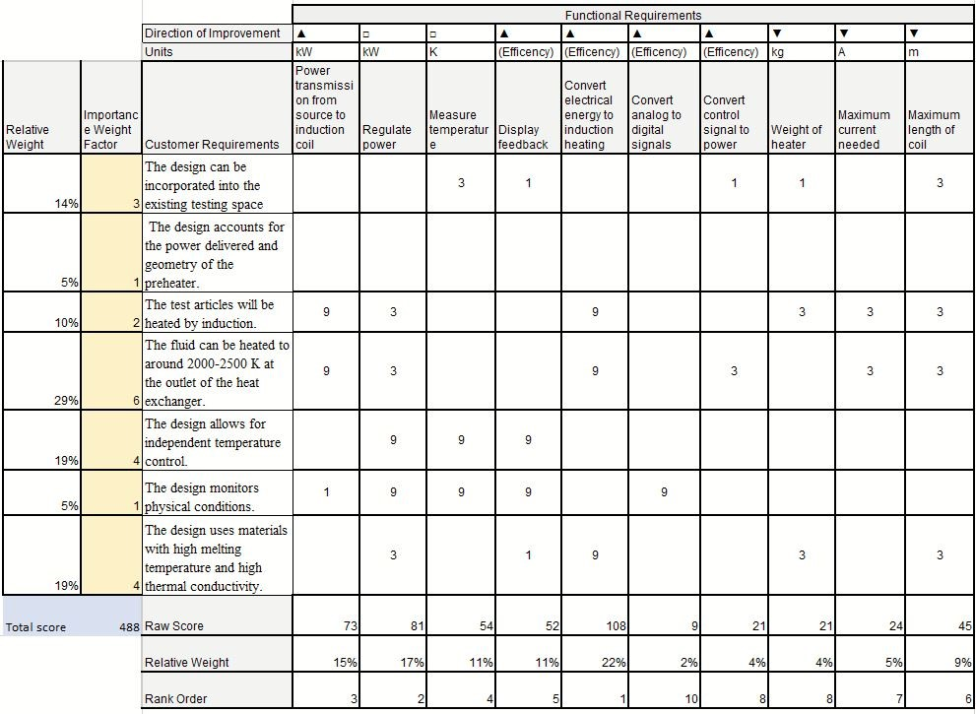
Appendix B : Concept Generation and Selection
House of Quality

Slide 21
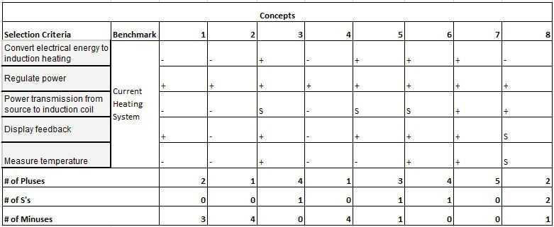
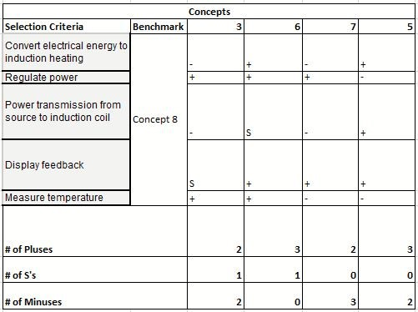
Appendix B : Concept Generation and Selection
Pugh Chart

Slide 22
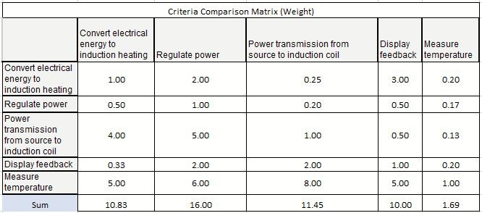
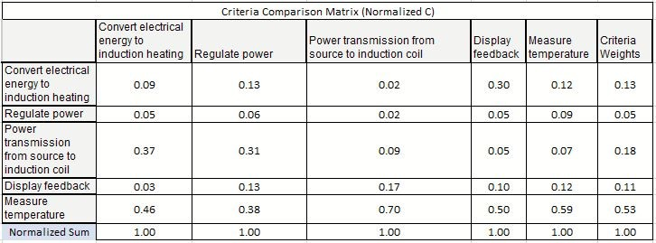
Appendix B : Concept Generation and Selection
AHP

Slide 23
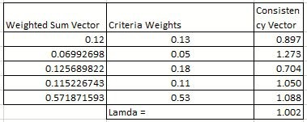

Appendix B : Concept Generation and Selection
AHP

