Slide 1
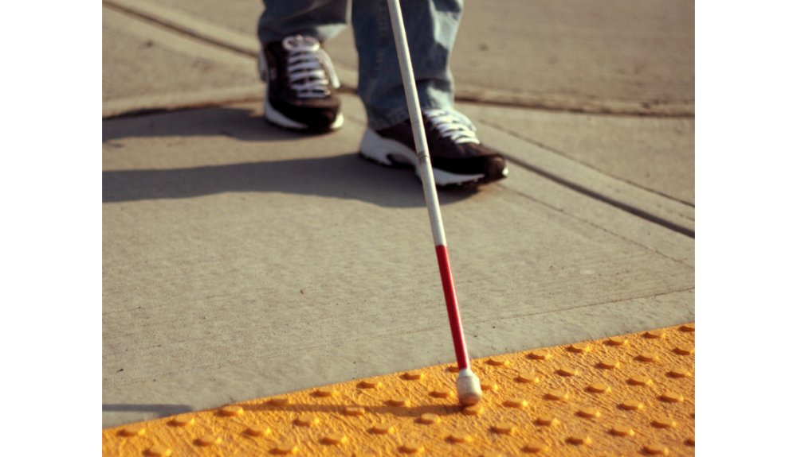
ESD- Vision Impaired Technology
Team 522

Slide 2
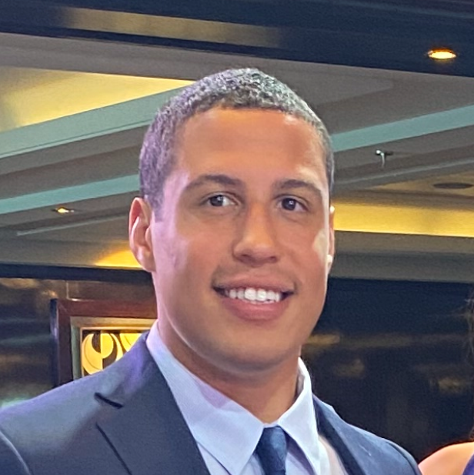
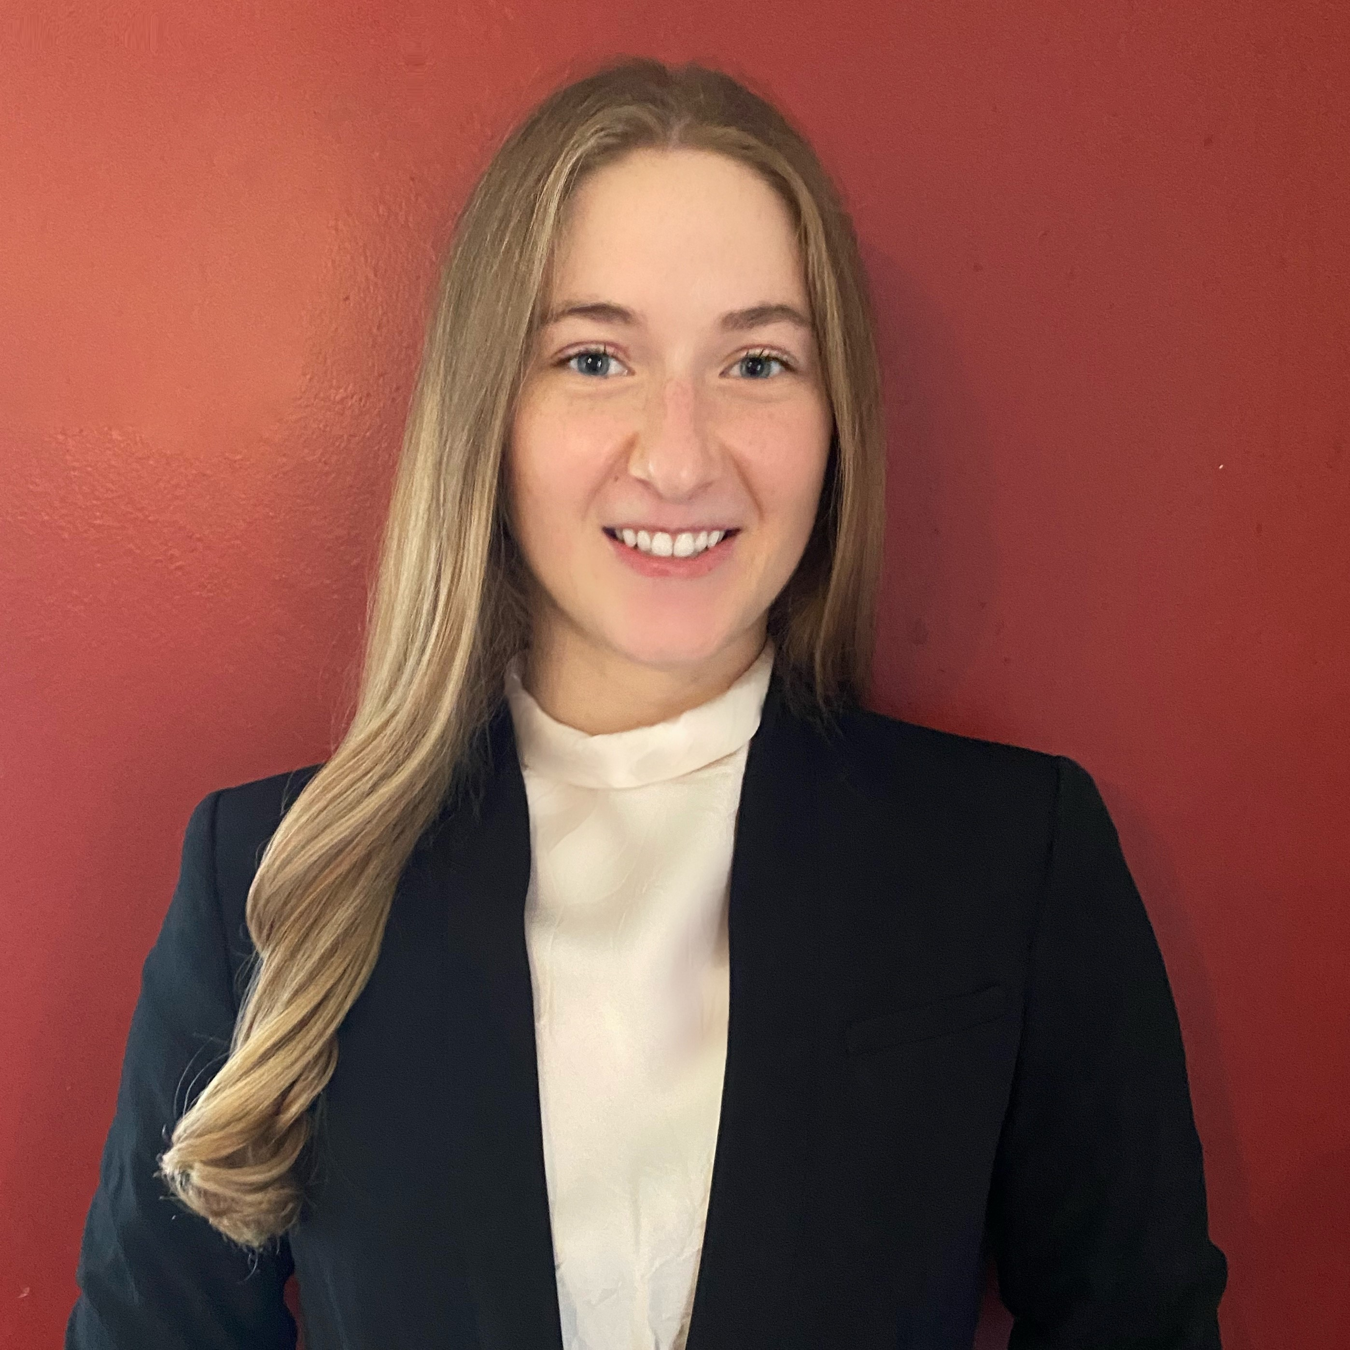


Team Introductions
David Alicea
Field/Test Engineer and Quality Control
Madison Jaffe​
Project Manager and Manufacturing/Controls Engineer
Nicolas Garcia
Webmaster, Design Engineer and Resource Manager
Ethan Saffer
Systems/Design
Engineer
David Alicea

Slide 3



Advisors
Shayne McConomy
FAMU-FSU College of Engineering
Department of Mechanical Engineering
Michael Devine
Florida State University
Jim Moran College of Entrepreneurship
Jerris Hooker
FAMU-FSU College of Engineering
Department of Electrical Engineering
David Alicea

Slide 4
Synopsis: Senior Design 1
Key Goals:
  Aids the visually impaired in daily activities.
  Assist people who are visually impaired to become more active.
  Keep the visually impaired safe while executing relatively complex tasks.
Assumptions:
  Users are unaware of objects in new surroundings.
  Users have undergone Orientation and Mobility training/rehabilitation.
  The visually impaired are not fully comfortable in our current society.
David Alicea

Slide 5


Synopsis: Senior Design 1
Markets:
  Primary market: People with severe visual impairment, rehabilitation and treatment centers.
  Secondary market: Autonomous Systems and State-Local Departments of
  Transportation.
David Alicea

Slide 6
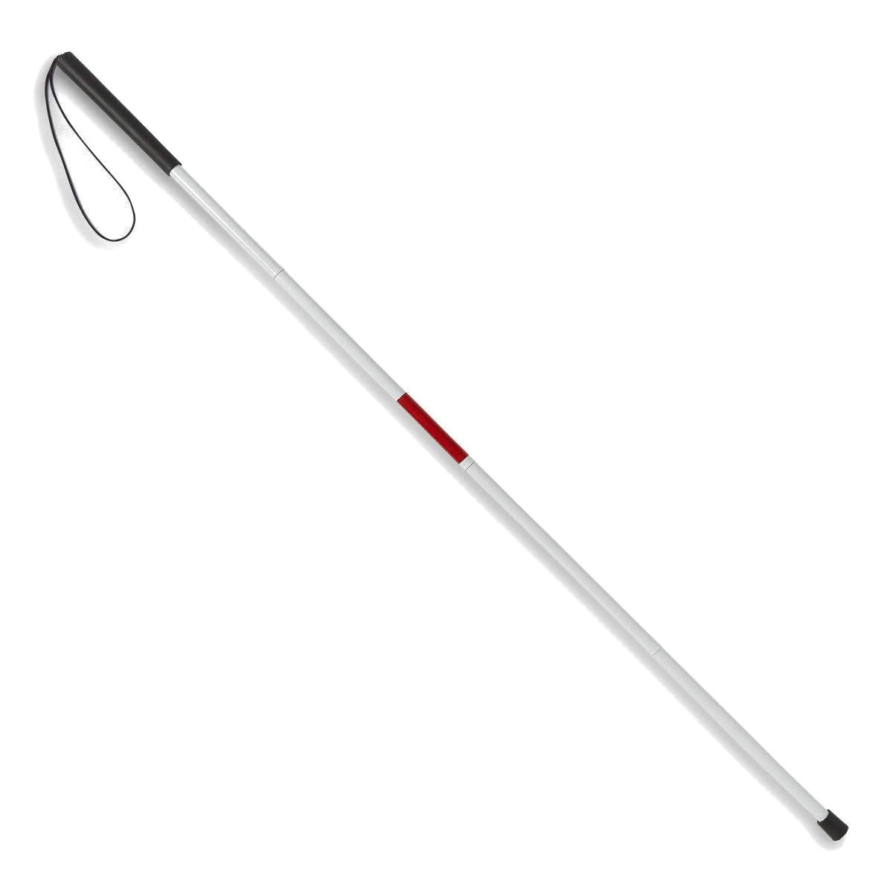
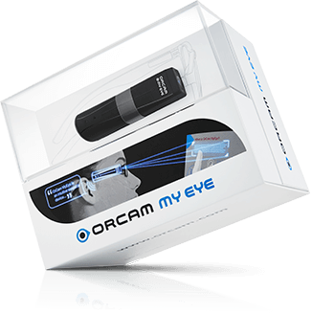
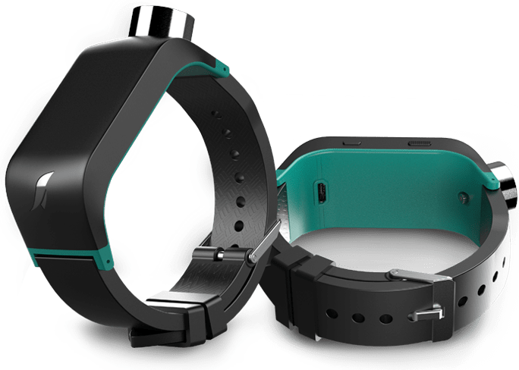
Synopsis: Senior Design 1
White Cane
Sunu Band
OrCam MyEye 2
https://athome.medline.com/en/medline-white-cane-for-blind-vision-impaired-1ct-mdswhtcane
https://www.sunu.com/es/index
https://www.orcam.com/en/orcam-faq/
David Alicea

Slide 7
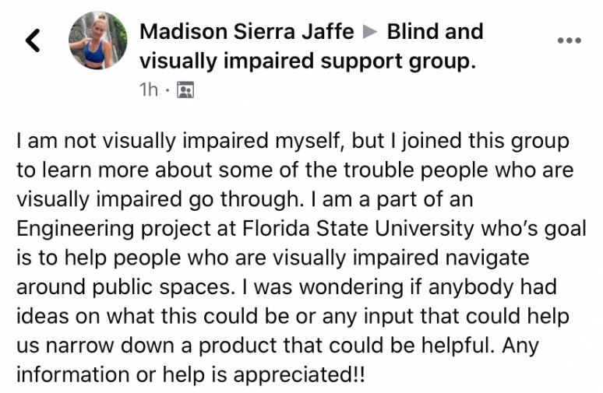
Synopsis: Senior Design 1
Interpreted Customer Needs:
1. Helps Avoid Ground Irregularities
2. Allows for Location Awareness
3. Recognizes Surrounding Objects
4. Notify Emergency Contacts
5. Intuitive with O & M Training
6. Identifies and Reads Text
7. Priced for Low-Income Households
David Alicea

Slide 8





Critical Functions
Alert of Elevation
Determine Location
Alert of Physical Object
Identify Possible Threats
Interpret Sensory Information
David Alicea

Slide 9

Concept Generation & Selection
Over 100 ideas were generated through multiple concept generation techniques.
Medium and high-fidelity concepts were chosen to meet our critical function targets.
A House of Quality chart, Pugh Charts, and the Analytical Hierarchy Process were the selection methods used to select a design.
David Alicea

Slide 10
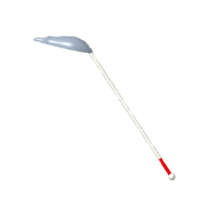
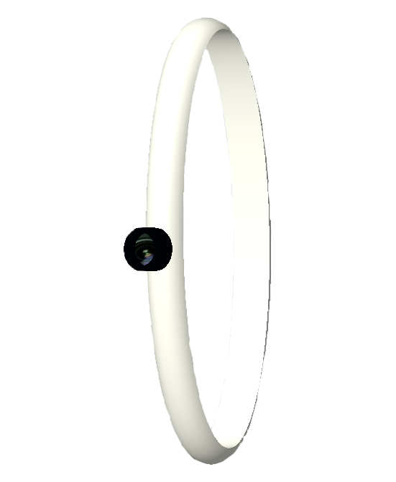
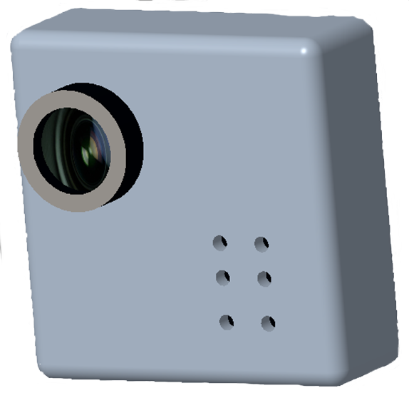


Final Selection
Our final potential designs were ranked:
  Haptic Smart Cane
  Sensor Pin Chip
  Sensor Watch
#1
Haptic Smart Cane
#2
Sensor Pin Chip
#3
Sensor Watch
David Alicea

Slide 11

Functions
Madison Jaffe

Slide 12


Functions
Sense
The ultrasonic sensor will sense an object up to 3 meters away.
Madison Jaffe

Slide 13


Functions
Sense
Determine
The ultrasonic sensor will sense an object up to 3 meters away.
The Raspberry Pi will interpret the sensed information to calculate the proximity to an object.
Madison Jaffe

Slide 14


Functions
Sense
Determine
Alert
The ultrasonic sensor will sense an object up to 3 meters away.
The Raspberry Pi will interpret the sensed information to calculate the proximity to an object.
Haptic feedback will alert the user with multiple motors with intensity based on distance.
Madison Jaffe

Slide 15


Functions
Sense
Determine
Alert
The ultrasonic sensor will sense an object up to 3 meters away.
The Raspberry Pi will interpret the sensed information to calculate the proximity to an object.
Haptic feedback will alert the user with multiple motors with intensity based on distance.
Scan
The camera can be activated to scan the desired products.
Madison Jaffe

Slide 16


Functions
Sense
Determine
Alert
The ultrasonic sensor will sense an object up to 3 meters away.
The Raspberry Pi will interpret the sensed information to calculate the proximity to an object.
Haptic feedback will alert the user with multiple motors with intensity based on distance.
Scan
Identify
The camera can be activated to scan the desired products.
Up to 500 stored products will be in the memory of the Raspberry Pi to identify the product.
Madison Jaffe

Slide 17


Functions
Sense
Determine
Alert
The ultrasonic sensor will sense an object up to 3 meters away.
The Raspberry Pi will interpret the sensed information to calculate the proximity to an object.
Haptic feedback will alert the user with multiple motors with intensity based on distance.
Scan
Identify
Notify
The camera can be activated to scan the desired products.
Up to 500 stored products will be in the memory of the Raspberry Pi to identify the product.
Haptic feedback will
notify the user when the product has been identified and a speaker will relay the product name.
Madison Jaffe

Slide 18
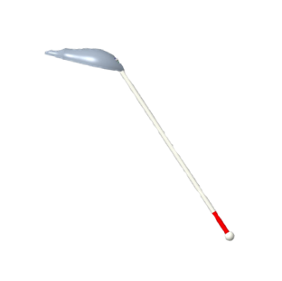
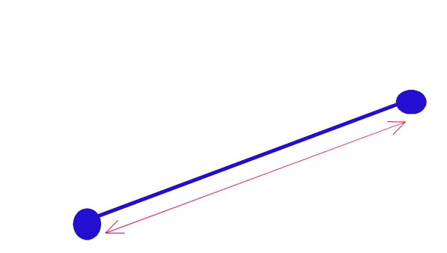
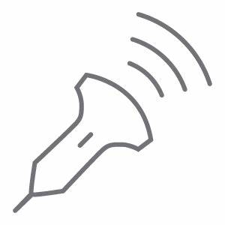

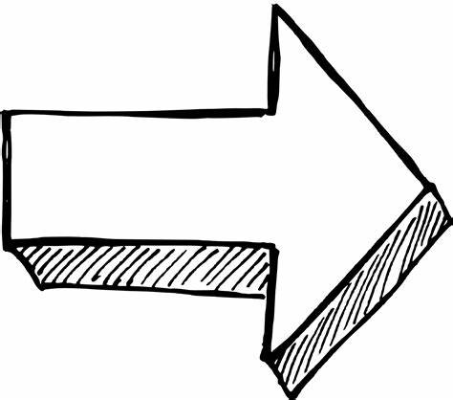

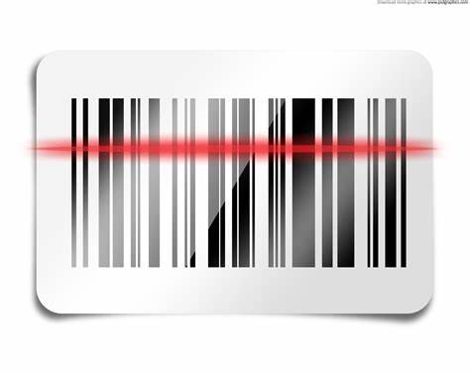


Our Product - HapTac
Our product attaches to the standard white cane.
Device is perpendicular to retain standard use while also aiming towards components correctly.
Madison Jaffe
Sense
Determine
Alert
Sense
Determine
Alert
Sense
Sense
The ultrasonic sensor will sense an object up to 3 meters away.
The Raspberry Pi will interpret the sensed information to calculate the proximity to an object.
Haptic feedback will alert the user with multiple motors with intensity based on distance.
The ultrasonic sensor will sense an object up to 3 meters away.
The Raspberry Pi will interpret the sensed information to calculate the proximity to an object.
Haptic feedback will alert the user with multiple motors with intensity based on distance.
Scan
Identify
Notify
Scan
Identify
Notify
The camera can be activated to scan the desired products.
The camera can be activated to scan the desired products.

Slide 19
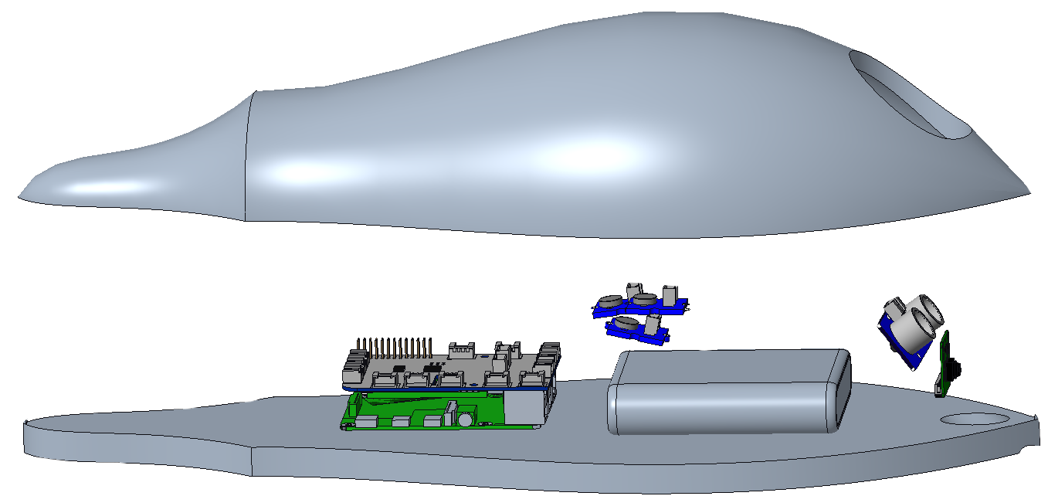
Our Product - HapTac
Madison Jaffe
Sense
Determine
Alert
Sense
Determine
Alert
Sense
Sense
The ultrasonic sensor will sense an object up to 3 meters away.
The Raspberry Pi will interpret the sensed information to calculate the proximity to an object.
Haptic feedback will alert the user with multiple motors with intensity based on distance.
The ultrasonic sensor will sense an object up to 3 meters away.
The Raspberry Pi will interpret the sensed information to calculate the proximity to an object.
Haptic feedback will alert the user with multiple motors with intensity based on distance.
Scan
Identify
Notify
Scan
Identify
Notify
The camera can be activated to scan the desired products.
The camera can be activated to scan the desired products.

Slide 20
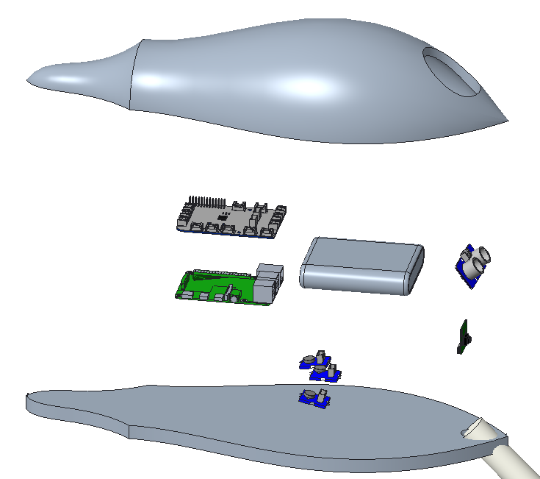
Our Product - HapTac
GrovePi+
Battery Pack
Ultrasonic Sensor
Housing
Camera
Raspberry Pi 4
Vibration Motors (3)
Madison Jaffe

Slide 21
Device Operational Time
Ultrasonic Sensor
8 mA
Camera
Up to 800 mA
Vibration Motor
58 mA average
100 mA max
Raspberry Pi
3,000 mA
Power Supply
20,000 mAh
Theoretical (Maximum Current Draw) Operation Time: 4.87 Hours
4 hours, 52 minutes and 12 seconds
Madison Jaffe

Slide 22
Prototype Preparation
Ordering the parts listed in the Bill of Materials
Manufacturing our minimum viable prototype
  Iterating 3D printed housing for the product.
  Overall coding of system.
    Integrating AlexNet
Testing and Validation
  Validate battery usage/ battery life.
  Verify accuracy of various sensors and motors.
Madison Jaffe

Slide 23

InNOLEvation Challenge
We are one of fifteen projects to advance to the semi-final round of the competition.
Moving forward, we will develop a business pitch and finalize our business model canvas.
Madison Jaffe

Slide 24
Reference
[1] McConomy, S. (2020, November 11). Engineering Characteristics, Functions, Targets, and Metric. FAMU-FSU College of Engineering.
[2] Queen, K. (2016, June). 7 Ways to Make Communities More Livable for People With Vision or Hearing Impairments. AARP.
Madison Jaffe

Slide 25
Team 522: Vision Impaired Technology
David Alicea
Field/Test Engineer and Quality Control
Daa16@my.fsu.edu
Madison Jaffe​
Project Manager and Manufacturing/Controls Engineer
Msj16d@my.fsu.edu
Nicolas Garcia
Webmaster, Design Engineer and Resource Manager
Ng16m@my.fsu.edu
Ethan Saffer
Systems and Design
Engineer
Ers16c@my.fsu.edu
Madison Jaffe

Slide 28
APPENDIX

Slide 29
8 + 800 + 300 + 3000 = 4108 mA
mAh is mA * (hours operating) = mAh
20000mAh / 5016mA = 4.86855 hours
https://elinux.org/Rpi_Camera_Module
https://static6.arrow.com/aropdfconversion/7ce3c19d47af65a2e4096b327057dad3e30632e1/pgurl_grove-vibration-motor-p-839l.pdf
Sensor 8 mA
Pi: 3A (based on power source)
Camera: up to 800mA
Motor: 58 mA standard, 100 mA at max
Power Supply= 20000 mAh
Therefore: 4.87 Hours of operation at max use

Slide 30
Function ​ | Target ​ | Metric ​
Alert of Elevation* ​ | 0.25 to 12 inches ​ | Distance ​
Determine Location* ​ | Margin of error of at most 16 feet ​ | Distance ​
Alert of Physical Object* ​ | 65 inches ​ | Distance ​
Identify Possible Threats* ​ | Up to 60 miles per hour ​ | Velocity ​
Access Emergency Contact ​ | 15 seconds ​ | Time ​
Interpret Sensory Information* ​ | 7 seconds ​ | Time ​
Store Frequent Tasks ​ | 1 GB ​ | Memory Allocation ​
Interface with Pre-Existing Skills ​ | 70% ​ | User Satisfaction ​
Compete within Market ​ | 20% ​ | Price Range USD ($) ​
Remain Lightweight ​ | <5 lb ​ | Weight ​
Remain Discrete ​ | 70% ​ | User Approval ​

Slide 31
Synopsis: Semester 1
Markets:
  Primary market: People with severe visual impairment, rehabilitation and treatment centers.
  Secondary market: Autonomous Systems and State-Local Departments of Transportation.
David Alicea

Slide 32
Synopsis: Semester 1
Markets:
  Primary market: People with severe visual impairment, rehabilitation and treatment centers.
  Secondary market: Autonomous Systems and State-Local Departments of Transportation.
Interpreted Customer Needs:
1. Helps Avoid Ground Irregularities
2. Allows for Location Awareness
3. Recognizes Surrounding Objects
4. Notify Emergency Contacts
5. Intuitive with O & M Training
6. Identifies and Reads Text
7. Priced for Low-Income Households
David Alicea

Slide 33
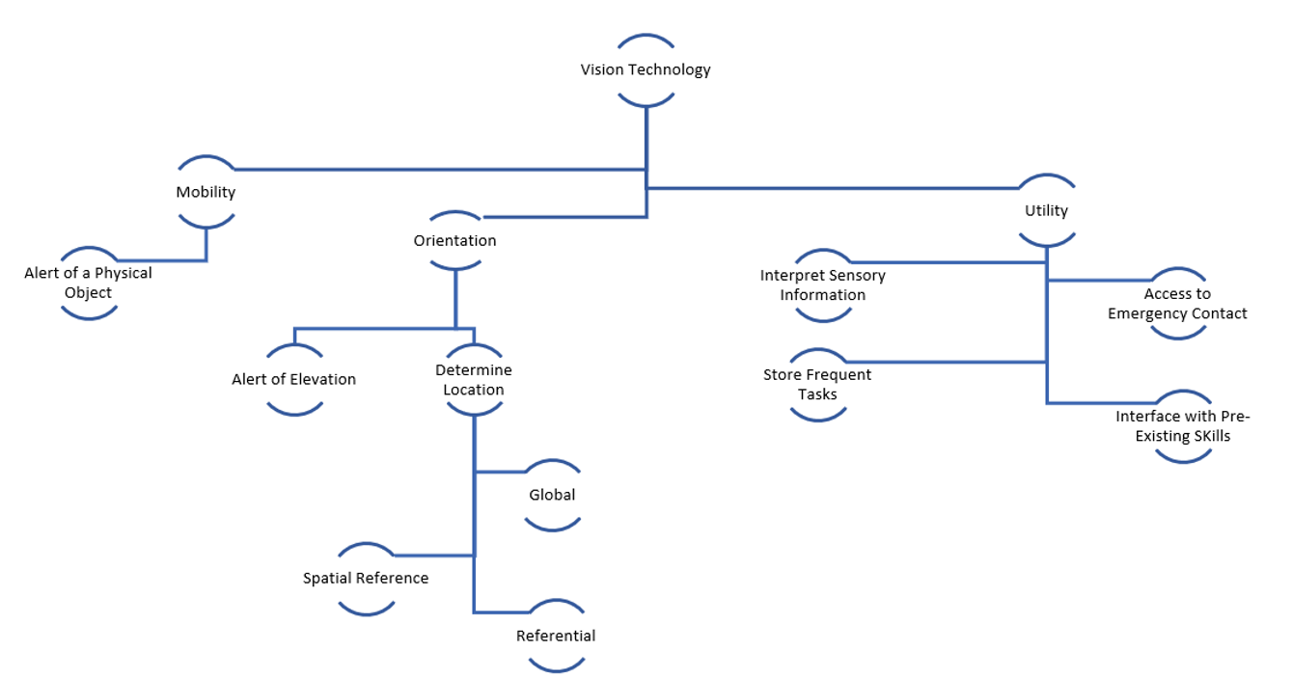
Functional Decomposition
David Alicea

Slide 34
Targets and Metrics
Function | Target | Metric
Alert of Elevation* | 0.25 to 12 inches | Distance
Determine Location* | ~ 16 feet | Distance
Alert of Physical Object* | 65 inches | Distance
Identify Possible Threats* | Up to 60 miles per hour | Velocity
Access Emergency Contact | 15 seconds | Time
Interpret Sensory Information* | 7 seconds | Time
Store Frequent Tasks | 1 GB | Memory Allocation
Interface with Pre-Existing Skills | 70% | User Satisfaction
Compete within Market | 20% | Price Range USD ($)
Remain Lightweight | < 5.1 lb | Weight
Remain Discrete | 70% | User Approval
David Alicea

Slide 35
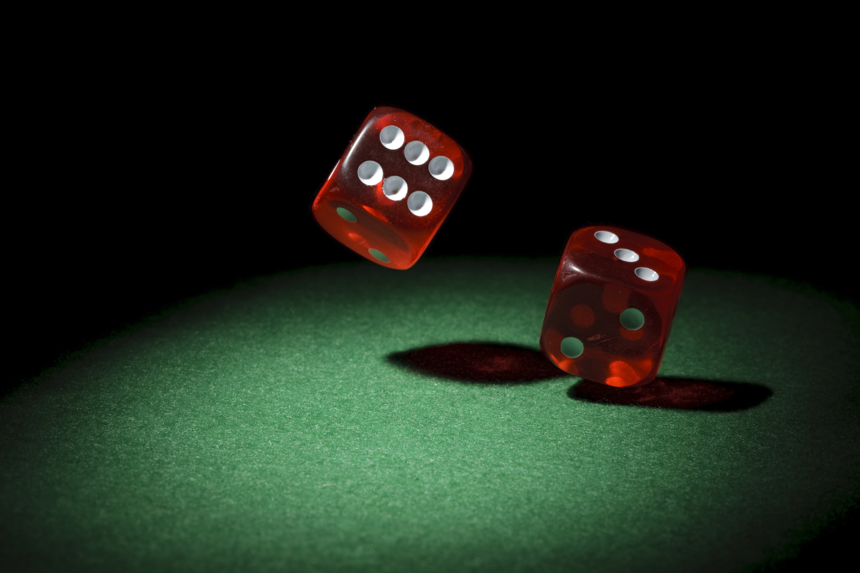
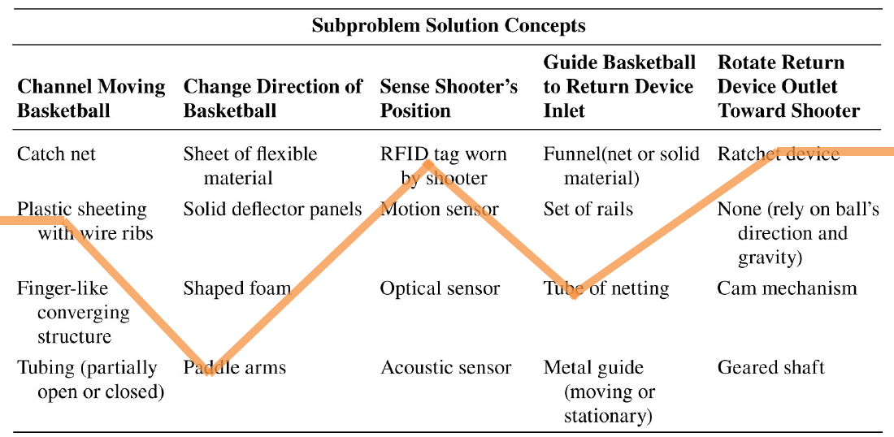
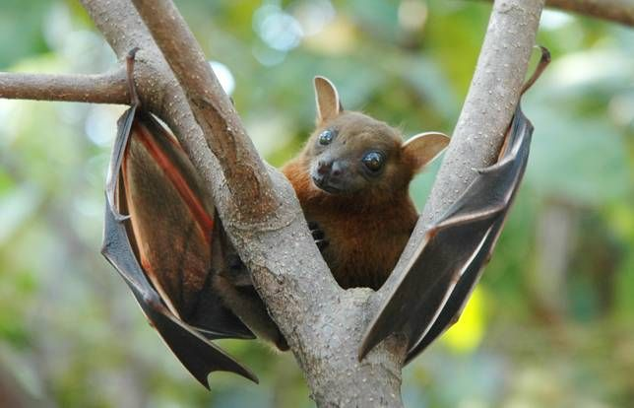
Concept Generation Tools
Crap Shoot
Morphological Chart
Biomimicry
McConomy, S. (2020, November 11). Engineering Characteristics, Functions, Targets, and Metric. FAMU-FSU College of Engineering.
David Alicea

Slide 36
Morphological Chart
Alert of Elevation | Determine Location | Alert of Physical Object | Inform of Possible Threats | Interpret Sensory Information
Sensor | GPS Through Wi-Fi/Internet Signal | Distance Sensor | Heat | Camera
Cane/Stick | GPS w/ Maps Downloaded | Velocity Sensor | Vibrate | Text Conversion
 | Camera to Read Street Signs and Other Landmarks | Lidar | Noise | Live Imaging Scanned to a PDF Document
 | Memory Storage of Previous Paths |  | Poke | Text to Braille
David Alicea

Slide 37
Medium Fidelity Concepts
GPS Watch:
- GPS indicate where the user is
- haptic feedback provided through vibration on wrist
Haptic Feedback cane:
- haptic feedback voice-activated
- phone compatible
Smart Glasses:
- sensor and GPS for user location
- Audio feedback through glass-mounted earpiece
Audio Feedback cane:
- audio feedback
- Tactile or voice activation
- Phone compatible
- camera to interpret the environment
GPS app:
- Lidar
- user information through haptics
- computer and GPS track and locate user
David Alicea

Slide 38
Concept Selection
David Alicea

Slide 39






Importance Weight Factor
Interpreted Customer Needs
Recognizes Surrounding Objects
Intuitive with O&M Training
Notify Emergency Contact
Importance Weight Factor
Priced for Low-Income Households
Helps Avoid Ground Irregularities
Identifies and Reads Text
Allows for Location Detection
Nicolas Garcia

Slide 40
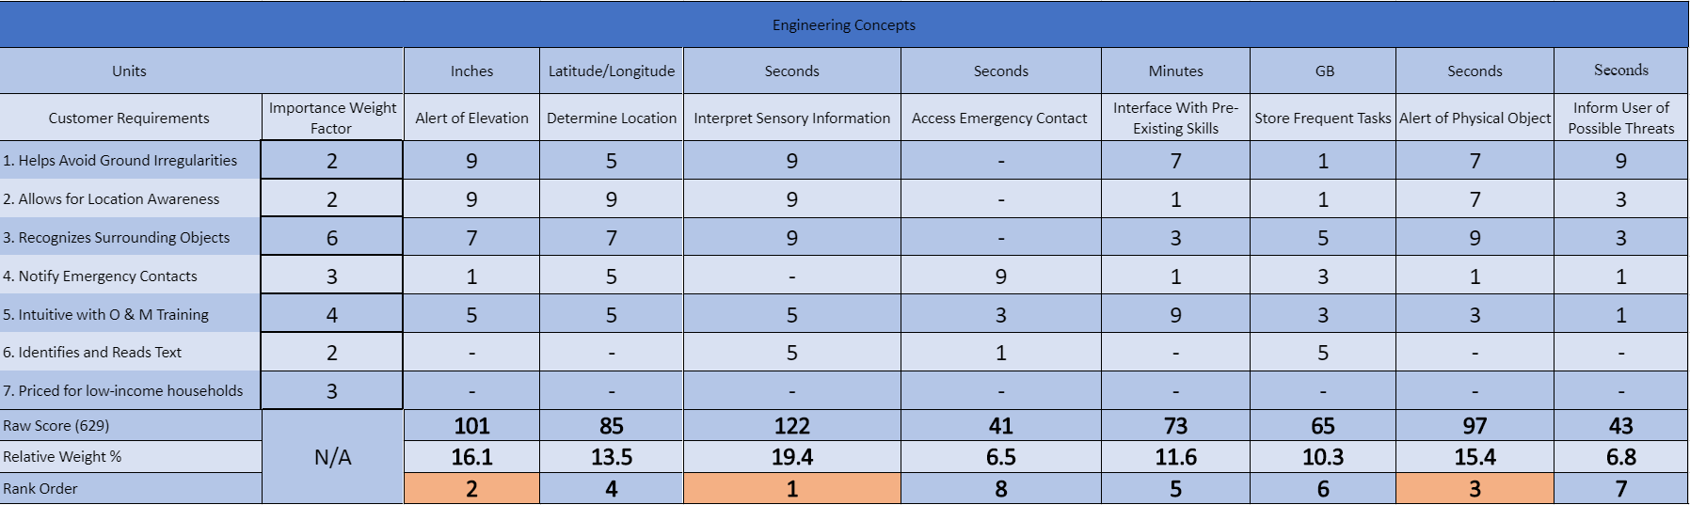
House of Quality
Nicolas Garcia

Slide 41
House of Quality
Interpret Sensory Information
Alert of Elevation
Alert of Physical Objects
Determine Location
Interface with Pre-Existing Skills
Store Frequent Tasks
Inform User of Potential Threats
Access Emergency Contacts
Nicolas Garcia

Slide 42
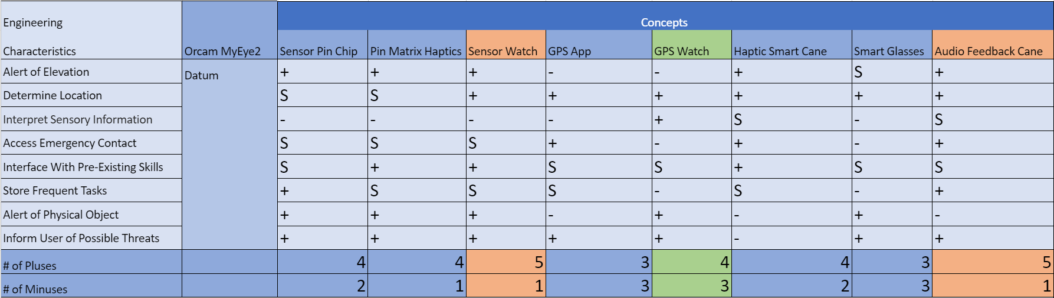
Pugh Chart
Nicolas Garcia

Slide 43
Pugh Chart
Nicolas Garcia

Slide 44
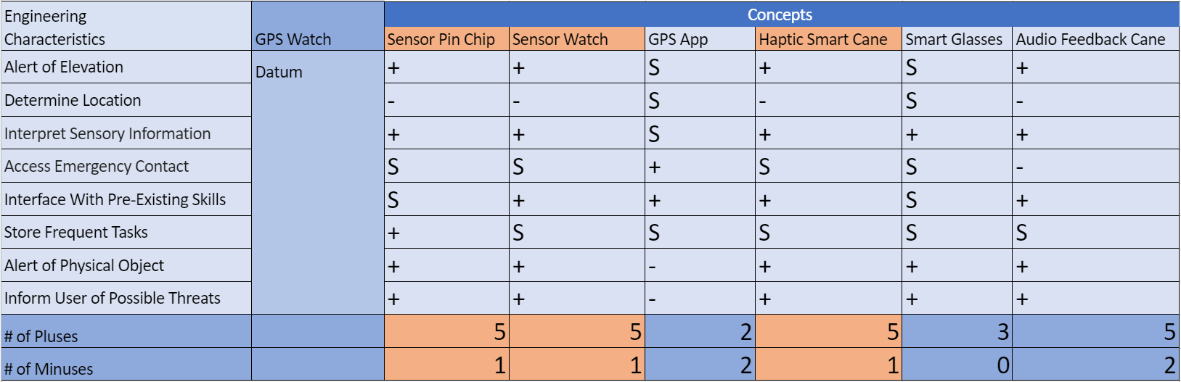
Second Pugh Chart
Nicolas Garcia

Slide 45
Second Pugh Chart
Nicolas Garcia

Slide 46
Analytical Hierarchy Process
Criteria Comparison Matrix [C]
Functions | Criteria Weights{W}
Alert of Elevation | 0.11
Determine Location | 0.13
Interpret Sensory Information | 0.24
Access Emergency Contact | 0.03
Interface With Pre-Existing Skills | 0.11
Store Frequent Tasks | 0.04
Alert of Physical Object | 0.19
Inform User of Possible Threats | 0.15
Sum | 1.00
Nicolas Garcia

Slide 47
Analytical Hierarchy Process
 | Sensor Pin Chip | Sensor Watch | Haptic Smart Cane
Alert of Elevation | 0.11 | 0.11 | 0.78
Determine Location | 0.16 | 0.19 | 0.66
Interpret Sensory Information | 0.45 | 0.45 | 0.09
Access Emergency Contact | 0.20 | 0.20 | 0.60
Interface with Pre-existing Skills | 0.14 | 0.14 | 0.71
Store Frequent Tasks | 0.33 | 0.33 | 0.33
Alert of a Physical Object | 0.43 | 0.14 | 0.43
Inform User of Possible Threats | 0.33 | 0.33 | 0.33
Nicolas Garcia

Slide 48
Analytical Hierarchy Process
 | Sensor Pin Chip | Sensor Watch | Haptic Smart Cane
Alert of Elevation | 0.11 | 0.11 | 0.78
Determine Location | 0.16 | 0.19 | 0.66
Interpret Sensory Information | 0.45 | 0.45 | 0.09
Access Emergency Contact | 0.20 | 0.20 | 0.60
Interface with Pre-existing Skills | 0.14 | 0.14 | 0.71
Store Frequent Tasks | 0.33 | 0.33 | 0.33
Alert of a Physical Object | 0.43 | 0.14 | 0.43
Inform User of Possible Threats | 0.33 | 0.33 | 0.33
Nicolas Garcia

Slide 49
Analytical Hierarchy Process
 | Sensor Pin Chip | Sensor Watch | Haptic Smart Cane
Alert of Elevation | 0.11 | 0.11 | 0.78
Determine Location | 0.16 | 0.19 | 0.66
Interpret Sensory Information | 0.45 | 0.45 | 0.09
Access Emergency Contact | 0.20 | 0.20 | 0.60
Interface with Pre-existing Skills | 0.14 | 0.14 | 0.71
Store Frequent Tasks | 0.33 | 0.33 | 0.33
Alert of a Physical Object | 0.43 | 0.14 | 0.43
Inform User of Possible Threats | 0.33 | 0.33 | 0.33
Nicolas Garcia

Slide 50
Binary Comparison Chart
Interprted Customer Needs | 1 | 2 | 3 | 4 | 5 | 6 | 7 | Total 1
1. Helps Avoid Ground Irregularities | - | 1 | 0 | 0 | 0 | 0 | 1 | 2
2. Allows for Location Awareness | 0 | - | 0 | 1 | 0 | 1 | 0 | 2
3. Recognizes Surrounding Objects | 1 | 1 | - | 1 | 1 | 1 | 1 | 6
4. Notify Emergency Contacts | 1 | 0 | 0 | - | 1 | 0 | 1 | 3
5. Intuitive with O & M Training | 1 | 1 | 0 | 0 | - | 1 | 1 | 4
6. Identifies and Reads Text | 1 | 0 | 0 | 1 | 0 | - | 0 | 2
7. Priced for low-income households | 0 | 1 | 0 | 1 | 0 | 1 | - | 3
Total: | 4 | 4 | 0 | 4 | 2 | 4 | 4 | 6

Slide 51
Functional Decomposition
 | Orientation | Mobility | Utility
Alert of Elevation | X | X
Determine Location | X | X
Alert of Physical Object | X | X
Inform User of Possible Threats |  | X | X
Access to Emergency Contact |  |  | X
Interpret Sensory information |  |  | X
Store Frequent Tasks | X |  | X
Interface With Pre-Existing Skills |  |  | X
David Alicea

Slide 52
Engineering |  | Concepts
Characteristics | Oram MyEye2 | Sensor Pin Chip | Pin Matrix Haptics | Sensor Watch | GPS App | GPS Watch | Haptic Smart Cane | Smart Glasses | Audio Feedback Cane
Alert of Elevation | Datum | + | + | + | - | - | + | S | +
Determine Location |  | S | S | + | + | + | + | + | +
Interpret Sensory Information |  | - | - | - | - | + | S | - | S
Access Emergency Contact |  | S | S | S | + | - | + | - | +
Interface With Pre-Existing Skills |  | S | + | + | S | S | + | S | S
Store Frequent Tasks |  | + | S | S | S | - | S | - | +
Alert of Physical Object |  | + | + | + | - | + | - | + | -
Inform User of Possible Threats |  | + | + | + | + | + | - | + | +
# of Pluses |  | 4 | 4 | 5 | 3 | 4 | 4 | 3 | 5
# of Minuses |  | 2 | 1 | 1 | 3 | 3 | 2 | 3 | 1

Slide 53
Engineering |  | Concepts
Characteristics | GPS Watch | Sensor Pin Chip | Sensor Watch | GPS App | Haptic Smart Cane | Smart Glasses | Audio Feedback Cane
Alert of Elevation | Datum | + | + | S | + | S | +
Determine Location |  | - | - | S | - | S | -
Interpret Sensory Information |  | + | + | S | + | + | +
Access Emergency Contact |  | S | S | + | S | S | -
Interface With Pre-Existing Skills |  | S | + | + | + | S | +
Store Frequent Tasks |  | + | S | S | S | S | S
Alert of Physical Object |  | + | + | - | + | + | +
Inform User of Possible Threats |  | + | + | - | + | + | +
# of Pluses |  | 5 | 5 | 2 | 5 | 3 | 5
# of Minuses |  | 1 | 1 | 2 | 1 | 0 | 2

Slide 54
Engineering Concepts
Units |  | Inches | Latitude/Longitude | Seconds | Seconds | Minutes | GB | Seconds | Seconds
Customer Requirements | Importance Weight Factor | Alert of Elevation | Determine Location | Interpret Sensory Information | Access Emergency Contact | Interface With Pre-Existing Skills | Store Frequent Tasks | Alert of Physical Object | Inform User of Possible Threats
1. Helps Avoid Ground Irregularities | 2 | 9 | 5 | 9 | - | 7 | 1 | 7 | 9
2. Allows for Location Awareness | 2 | 9 | 9 | 9 | - | 1 | 1 | 7 | 3
3. Recognizes Surrounding Objects | 6 | 7 | 7 | 9 | - | 3 | 5 | 9 | 3
4. Notify Emergency Contacts | 3 | 1 | 5 | - | 9 | 1 | 3 | 1 | 1
5. Intuitive with O & M Training | 4 | 5 | 5 | 5 | 3 | 9 | 3 | 3 | 1
6. Identifies and Reads Text | 2 | - | - | 5 | 1 | - | 5 | - | -
7. Priced for low-income households | 3 | - | - | - | - | - | - | - | -
Raw Score (629) | N/A | 101 | 85 | 122 | 41 | 73 | 65 | 97 | 43
Relative Weight % |  | 16.1 | 13.5 | 19.4 | 6.5 | 11.6 | 10.3 | 15.4 | 6.8
Rank Order |  | 2 | 4 | 1 | 8 | 5 | 6 | 3 | 7

Slide 55
Development of Candidate Set of Criteria Weights {W}
Criteria Comparison Matrix [C]
 | Alert of Elevation | Determine Location | Interpret Sensory Information | Access Emergency Contact | Interface With Pre-Existing Skills | Store Frequent tasks | Alert of Physical Objects | Inform User of Possible Threats
Alert of Elevation | 1.00 | 1.00 | 0.33 | 5.00 | 1.00 | 3.00 | 0.33 | 1.00
Determine Location | 1.00 | 1.00 | 0.33 | 5.00 | 1.00 | 3.00 | 1.00 | 1.00
Interpret Sensory Information | 3.00 | 3.00 | 1.00 | 5.00 | 3.00 | 5.00 | 1.00 | 1.00
Access Emergency Contact | 0.20 | 0.20 | 0.20 | 1.00 | 0.20 | 1.00 | 0.33 | 0.20
Interface With Pre-Existing Skills | 1.00 | 1.00 | 0.33 | 5.00 | 1.00 | 3.00 | 0.33 | 1.00
Store Frequent Tasks | 0.33 | 0.33 | 0.20 | 1.00 | 0.33 | 1.00 | 0.33 | 0.33
Alert of Physical Object | 3.00 | 1.00 | 1.00 | 3.00 | 3.00 | 3.00 | 1.00 | 1.00
Inform User of Possible Threats | 1.00 | 1.00 | 1.00 | 5.00 | 1.00 | 3.00 | 1.00 | 1.00
Sum | 10.53 | 8.53 | 4.40 | 30.00 | 10.53 | 22.00 | 5.33 | 6.53

Slide 56
Development of Candidate Set of Criteria Weights {W}
Criteria Comparison Matrix [C]
 | Alert of Elevation | Determine Location | Interpret Sensory Information | Acccess Emergency Contact | Interface With Pre-Existing Skills | Store Fequent tasks | Alert of Physical Objects | Inform User of Possible Threats | Criteria Weights{W}
Alert of Elevation | 0.09 | 0.12 | 0.08 | 0.17 | 0.09 | 0.14 | 0.06 | 0.15 | 0.11
Determine Location | 0.09 | 0.12 | 0.08 | 0.17 | 0.09 | 0.14 | 0.19 | 0.15 | 0.13
Interpret Sensory Information | 0.28 | 0.35 | 0.23 | 0.17 | 0.28 | 0.23 | 0.19 | 0.15 | 0.24
Access Emergency Contact | 0.02 | 0.02 | 0.05 | 0.03 | 0.02 | 0.05 | 0.06 | 0.03 | 0.03
Interface With Pre-Existing Skills | 0.09 | 0.12 | 0.08 | 0.17 | 0.09 | 0.14 | 0.06 | 0.15 | 0.11
Store Frequent Tasks | 0.03 | 0.04 | 0.05 | 0.03 | 0.03 | 0.05 | 0.06 | 0.05 | 0.04
Alert of Physical Object | 0.28 | 0.12 | 0.23 | 0.10 | 0.28 | 0.14 | 0.19 | 0.15 | 0.19
Inform User of Possible Threats | 0.09 | 0.12 | 0.23 | 0.17 | 0.09 | 0.14 | 0.19 | 0.15 | 0.15
Sum | 1.00 | 1.00 | 1.00 | 1.00 | 1.00 | 1.00 | 1.00 | 1.00 | 1.00

Slide 57
Weighted Sum Vector | Criteria Weights{W} | Consistency vector
0.94 | 0.11 | 8.37
1.07 | 0.13 | 8.32
2.02 | 0.24 | 8.57
0.29 | 0.03 | 8.23
0.94 | 0.11 | 8.37
0.35 | 0.04 | 8.32
1.61 | 0.19 | 8.61
1.22 | 0.15 | 8.32
# of criteria | RI value | Average Consistency | Consistency Index | Consistency Ratio
8.00 | 1.40 | 8.39 | 0.06 | 0.04

Slide 58
Development of Candidate Set of Criteria Weights {W} ALERT OF ELEVATION | Alert of Elevation
Criteria Comparison Matrix [C]
 | Sensor Pin Chip | Sensor Watch | Haptic Smart Cane
Sensor Pin Chip | 1.00 | 1.00 | 0.14
Sensor Watch | 1.00 | 1.00 | 0.14
Haptic Smart Cane | 7.00 | 7.00 | 1.00
Sum | 9.00 | 9.00 | 1.29

Slide 59
Analytical Hierarchy Process
Criteria Comparison Matrix [C]
 | Alert of Elevation | Determine Location | Interpret Sensory Information | Access Emergency Information | Interface with pre-existing skills | Store Frequent Tasks | Alert of Physical Objects | Inform User of Possible Threats
Alert of Elevation | 1.00 | 1.00 | 0.33 | 5.00 | 1.00 | 3.00 | 0.33 | 1.00
Determine Location | 1.00 | 1.00 | 0.33 | 5.00 | 1.00 | 3.00 | 1.00 | 1.00
Interpret Sensory Information | 3.00 | 3.00 | 1.00 | 5.00 | 3.00 | 5.00 | 1.00 | 1.00
Access Emergency Information | 0.20 | 0.20 | 0.20 | 1.00 | 0.20 | 1.00 | 0.33 | 0.20
Interface with Pre-existing Skills | 1.00 | 1.00 | 0.33 | 5.00 | 1.00 | 3.00 | 0.33 | 1.00
Store Frequent Tasks | 0.33 | 0.33 | 0.20 | 1.00 | 0.33 | 1.00 | 0.33 | 0.33
Alert of Physical Objects | 3.00 | 1.00 | 1.00 | 3.00 | 3.00 | 3.00 | 1.00 | 1.00
Inform User of Possible Threats | 1.00 | 1.00 | 1.00 | 5.00 | 1.00 | 3.00 | 1.00 | 1.00
Sum | 10.53 | 8.53 | 4.40 | 30.00 | 10.53 | 22.00 | 5.33 | 6.53
Nicolas Garcia

Slide 60
Development of Candidate Set of Criteria Weights {W}
Criteria Comparison Matrix [C]
 | Sensor Pin Chip | Sensor Watch | Haptic Smart Cane | Design Alternative Priorities {Pi}
Sensor Pin Chip | 0.11 | 0.11 | 0.11 | 0.11
Sensor Watch | 0.11 | 0.11 | 0.11 | 0.11
Haptic Smart Cane | 0.78 | 0.78 | 0.78 | 0.78
Sum | 1.00 | 1.00 | 1.00 | 1.00

Slide 61
Weighted Sum Vector | Design Alternative Priorities | Consistency vector
0.33 | 0.11 | 3.00
0.33 | 0.11 | 3.00
2.33 | 0.78 | 3.00
# of criteria | RI value | Average Consistency | Consistency Index | Consistency Ratio
3.00 | 0.52 | 3.00 | 0.00 | 0.00

Slide 62
Development of Candidate Set of Criteria Weights {W} | Determine Location
Criteria Comparison Matrix [C]
 | Sensor Pin Chip | Sensor Watch | Haptic Smart Cane
Sensor Pin Chip | 1.00 | 1.00 | 0.20
Sensor Watch | 1.00 | 1.00 | 0.33
Haptic Smart Cane | 5.00 | 3.00 | 1.00
Sum | 7.00 | 5.00 | 1.53

Slide 63
Development of Candidate Set of Criteria Weights {W}
Criteria Comparison Matrix [C]
 | Sensor Pin Chip | Sensor Watch | Haptic Smart Cane | Design Alternative Priorities {Pi}
Sensor Pin Chip | 0.14 | 0.20 | 0.13 | 0.16
Sensor Watch | 0.14 | 0.20 | 0.22 | 0.19
Haptic Smart Cane | 0.71 | 0.60 | 0.65 | 0.66
Sum | 1.00 | 1.00 | 1.00 | 1.00

Slide 64
Weighted Sum Vector | Design Alternative Priorities | Consistency vector
0.48 | 0.16 | 3.01
0.56 | 0.19 | 3.01
2.00 | 0.66 | 3.06
# of criteria | RI value | Average Consistency | Consistency Index | Consistency Ratio
3.00 | 0.52 | 3.00 | 0.00 | 0.00

Slide 65
Development of Candidate Set of Criteria Weights {W} | Interpret Sensory Information
Criteria Comparison Matrix [C]
 | Sensor Pin Chip | Sensor Watch | Haptic Smart Cane
Sensor Pin Chip | 1.00 | 1.00 | 5.00
Sensor Watch | 1.00 | 1.00 | 5.00
Haptic Smart Cane | 0.20 | 0.20 | 1.00
Sum | 2.20 | 2.20 | 11.00

Slide 66
Development of Candidate Set of Criteria Weights {W}
Criteria Comparison Matrix [C]
 | Sensor Pin Chip | Sensor Watch | Haptic Smart Cane | Design Alternative Priorities {Pi}
Sensor Pin Chip | 0.45 | 0.45 | 0.45 | 0.45
Sensor Watch | 0.45 | 0.45 | 0.45 | 0.45
Haptic Smart Cane | 0.09 | 0.09 | 0.09 | 0.09
Sum | 1.00 | 1.00 | 1.00 | 1.00

Slide 67
Weighted Sum Vector | Design Alternative Priorities | Consistency vector
1.36 | 0.45 | 3.00
1.36 | 0.45 | 3.00
0.27 | 0.09 | 3.00
# of criteria | RI value | Average Consistency | Consistency Index | Consistency Ratio
3.00 | 0.52 | 3.00 | 0.00 | 0.00

Slide 68
Development of Candidate Set of Criteria Weights {W} | Access Emergency Contact
Criteria Comparison Matrix [C]
 | Sensor Pin Chip | Sensor Watch | Haptic Smart Cane
Sensor Pin Chip | 1.00 | 1.00 | 0.33
Sensor Watch | 1.00 | 1.00 | 0.33
Haptic Smart Cane | 3.00 | 3.00 | 1.00
Sum | 5.00 | 5.00 | 1.67

Slide 69
Development of Candidate Set of Criteria Weights {W}
Criteria Comparison Matrix [C]
 | Sensor Pin Chip | Sensor Watch | Haptic Smart Cane | Design Alternative Priorities {Pi}
Sensor Pin Chip | 0.20 | 0.20 | 0.20 | 0.20
Sensor Watch | 0.20 | 0.20 | 0.20 | 0.20
Haptic Smart Cane | 0.60 | 0.60 | 0.60 | 0.60
Sum | 1.00 | 1.00 | 1.00 | 1.00

Slide 70
Weighted Sum Vector | Design Alternative Priorities | Consistency vector
0.60 | 0.20 | 3.00
0.60 | 0.20 | 3.00
1.80 | 0.60 | 3.00
# of criteria | RI value | Average Consistency | Consistency Index | Consistency Ratio
3.00 | 0.52 | 3.00 | 0.00 | 0.00

Slide 71
Development of Candidate Set of Criteria Weights {W} | Interface With Pre-Existing Skills
Criteria Comparison Matrix [C]
 | Sensor Pin Chip | Sensor Watch | Haptic Smart Cane
Sensor Pin Chip | 1.00 | 1.00 | 0.20
Sensor Watch | 1.00 | 1.00 | 0.20
Haptic Smart Cane | 5.00 | 5.00 | 1.00
Sum | 7.00 | 7.00 | 1.40

Slide 72
Development of Candidate Set of Criteria Weights {W}
Criteria Comparison Matrix [C]
 | Sensor Pin Chip | Sensor Watch | Haptic Smart Cane | Design Alternative Priorities {Pi}
Sensor Pin Chip | 0.14 | 0.14 | 0.14 | 0.14
Sensor Watch | 0.14 | 0.14 | 0.14 | 0.14
Haptic Smart Cane | 0.71 | 0.71 | 0.71 | 0.71
Sum | 1.00 | 1.00 | 1.00 | 1.00

Slide 73
Weighted Sum Vector | Design Alternative Priorities | Consistency vector
0.43 | 0.14 | 3.00
0.43 | 0.14 | 3.00
2.14 | 0.71 | 3.00
# of criteria | RI value | Average Consistency | Consistency Index | Consistency Ratio
3.00 | 0.52 | 3.00 | 0.00 | 0.00

Slide 74
Development of Candidate Set of Criteria Weights {W} | Store Frequent Tasks
Criteria Comparison Matrix [C]
 | Sensor Pin Chip | Sensor Watch | Haptic Smart Cane
Sensor Pin Chip | 1.00 | 1.00 | 1.00
Sensor Watch | 1.00 | 1.00 | 1.00
Haptic Smart Cane | 1.00 | 1.00 | 1.00
Sum | 3.00 | 3.00 | 3.00

Slide 75
Development of Candidate Set of Criteria Weights {W}
Criteria Comparison Matrix [C]
 | Sensor Pin Chip | Sensor Watch | Haptic Smart Cane | Design Alternative Priorities {Pi}
Sensor Pin Chip | 0.33 | 0.33 | 0.33 | 0.33
Sensor Watch | 0.33 | 0.33 | 0.33 | 0.33
Haptic Smart Cane | 0.33 | 0.33 | 0.33 | 0.33
Sum | 1.00 | 1.00 | 1.00 | 1.00

Slide 76
# of criteria | RI value | Average Consistency | Consistency Index | Consistency Ratio
3.00 | 0.52 | 3.00 | 0.00 | 0.00
Weighted Sum Vector | Design Alternative Priorities | Consistency vector
1.00 | 0.33 | 3.00
1.00 | 0.33 | 3.00
1.00 | 0.33 | 3.00

Slide 77
Development of Candidate Set of Criteria Weights {W} | Alert of Physical Object
Criteria Comparison Matrix [C]
 | Sensor Pin Chip | Sensor Watch | Haptic Smart Cane
Sensor Pin Chip | 1.00 | 3.00 | 1.00
Sensor Watch | 0.33 | 1.00 | 0.33
Haptic Smart Cane | 1.00 | 3.00 | 1.00
Sum | 2.33 | 7.00 | 2.33

Slide 78
Development of Candidate Set of Criteria Weights {W}
Criteria Comparison Matrix [C]
 | Sensor Pin Chip | Sensor Watch | Haptic Smart Cane | Design Alternative Priorities {Pi}
Sensor Pin Chip | 0.43 | 0.43 | 0.43 | 0.43
Sensor Watch | 0.14 | 0.14 | 0.14 | 0.14
Haptic Smart Cane | 0.43 | 0.43 | 0.43 | 0.43
Sum | 1.00 | 1.00 | 1.00 | 1.00

Slide 79
Weighted Sum Vector | Design Alternative Priorities | Consistency vector
1.29 | 0.43 | 3.00
0.43 | 0.14 | 3.00
1.29 | 0.43 | 3.00
# of criteria | RI value | Average Consistency | Consistency Index | Consistency Ratio
3.00 | 0.52 | 3.00 | 0.00 | 0.00

Slide 80
Development of Candidate Set of Criteria Weights {W} | Inform User of Possible Threats
Criteria Comparison Matrix [C]
 | Sensor Pin Chip | Sensor Watch | Haptic Smart Cane
Sensor Pin Chip | 1.00 | 1.00 | 1.00
Sensor Watch | 1.00 | 1.00 | 1.00
Haptic Smart Cane | 1.00 | 1.00 | 1.00
Sum | 3.00 | 3.00 | 3.00

Slide 81
Development of Candidate Set of Criteria Weights {W}
Criteria Comparison Matrix [C]
 | Sensor Pin Chip | Sensor Watch | Haptic Smart Cane | Design Alternative Priorities {Pi}
Sensor Pin Chip | 0.33 | 0.33 | 0.33 | 0.33
Sensor Watch | 0.33 | 0.33 | 0.33 | 0.33
Haptic Smart Cane | 0.33 | 0.33 | 0.33 | 0.33
Sum | 1.00 | 1.00 | 1.00 | 1.00

Slide 82
# of criteria | RI value | Average Consistency | Consistency Index | Consistency Ratio
3.00 | 0.52 | 3.00 | 0.00 | 0.00
Weighted Sum Vector | Design Alternative Priorities | Consistency vector
1.00 | 0.33 | 3.00
1.00 | 0.33 | 3.00
1.00 | 0.33 | 3.00

Slide 83
 | Sensor Pin Chip | Sensor Watch | Haptic Smart Cane
Alert of Elevation | 0.11 | 0.11 | 0.78
Determine Location | 0.16 | 0.19 | 0.66
Interpret Sensory Information | 0.45 | 0.45 | 0.09
Access Emergency Contact | 0.20 | 0.20 | 0.60
Interface With Pre-Existing Skills | 0.14 | 0.14 | 0.71
Store Frequent Tasks | 0.33 | 0.33 | 0.33
Alert of Physical Object | 0.43 | 0.14 | 0.43
Inform User of Possible Threats | 0.33 | 0.33 | 0.33
Concept | Alternative Value
Sensor Pin Chip | 0.27
Sensor Watch | 0.24
Haptic Smart Cane | 0.49

Slide 84
Standard Shapes
Summary Box
Text box 1
Outlined Text Box

Slide 85




Approved Logos

Slide 86
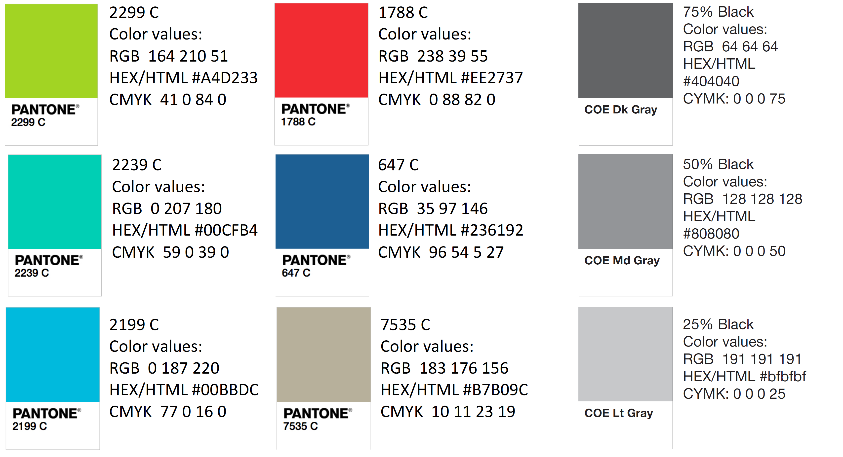
Color Palette

Slide 87
Slides to keep:
Intro, Synopsis of VDR1 (Rename), Customer Needs, minimize Concept Gen. & Selection, Final Selection?, What's Next, Last team member slide, Ref.
Slides to add:
Specs of design
BOM/Ordering parts
Our progress in the InNOLEvation challenge?

Slide 88
APA Tables
Category 1 | Category 2 | Category 3 | Category 4 | Category 5
Item 1
Item 2
Item 3
Item 4
 | Category 2 |  |  | Category 3
Category 1 | subcategory 1 | subcategory 2 |  | subcategory 1 | subcategory 2
Item 1
Item 2
Item 3
Item 4

