Slide 1
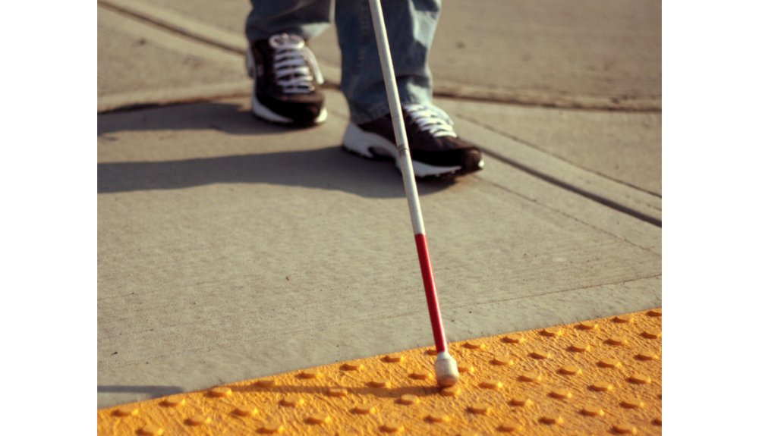
ESD- Vision Impaired Technology
Team 522

Slide 2

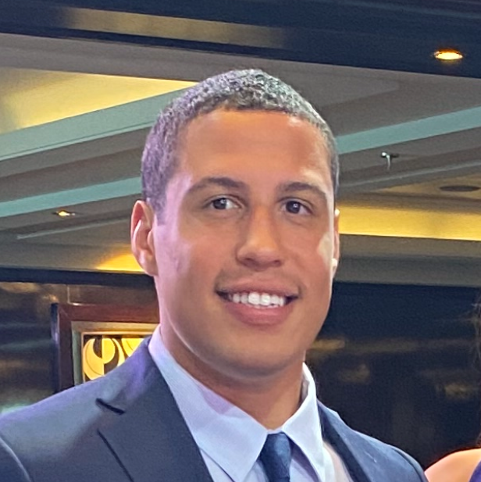
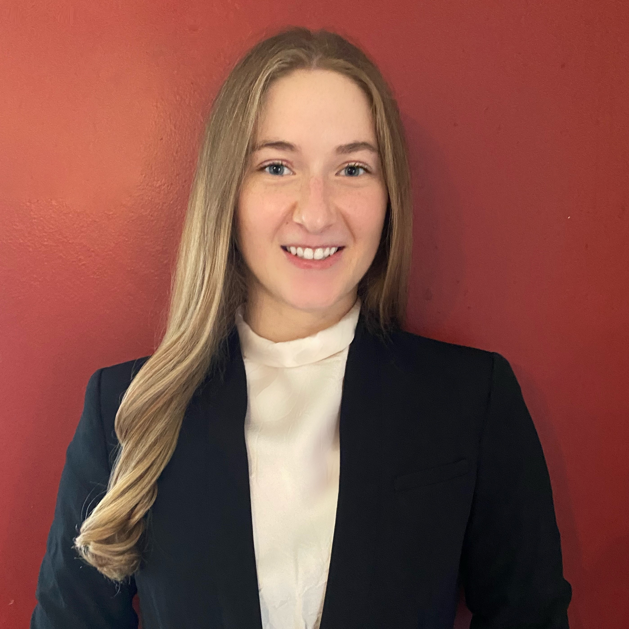

Team Introductions
Ethan Saffer
Systems/Design
Engineer
David Alicea
Field/Test Engineer and Quality Control
Madison Jaffe​
Project Manager and Manufacturing/Controls Engineer
Nicolas Garcia
Webmaster, Design Engineer and Resource Manager
Ethan Saffer

Slide 3



Advisors
Shayne McConomy
FAMU-FSU College of Engineering
Department of Mechanical Engineering
Michael Devine
Florida State University
Jim Moran College of Entrepreneurship
Jerris Hooker
FAMU-FSU College of Engineering
Department of Electrical Engineering
Ethan Saffer

Slide 4
Key Goals and Assumptions
Key Goals:
  Aids the visually impaired in daily activities.
  Assist people who are visually impaired to become more active.
  Keep the visually impaired safe while executing relatively complex tasks.
Assumptions:
  Users are unaware of objects in new surroundings.
  Users have undergone Orientation and Mobility training/rehabilitation.
  The visually impaired are not fully comfortable in our current society.
Ethan Saffer

Slide 5


Markets
  Primary market: People with severe visual impairment, rehabilitation and treatment centers.
  Secondary market: Autonomous Systems and State-Local Departments of Transportation.
Ethan Saffer

Slide 6
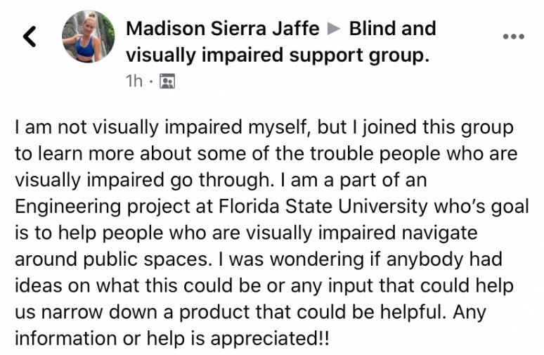
Interpreted Customer Needs
1. Helps Avoid Ground Irregularities
2. Allows for Location Awareness
3. Recognizes Surrounding Objects
4. Notify Emergency Contacts
5. Intuitive with O & M Training
6. Identifies and Reads Text
7. Priced for Low-Income Households
Ethan Saffer

Slide 7





Critical Functions
Alert of Elevation
Determine Location
Alert of Physical Object
Identify Possible Threats
Interpret Sensory Information
Ethan Saffer

Slide 8
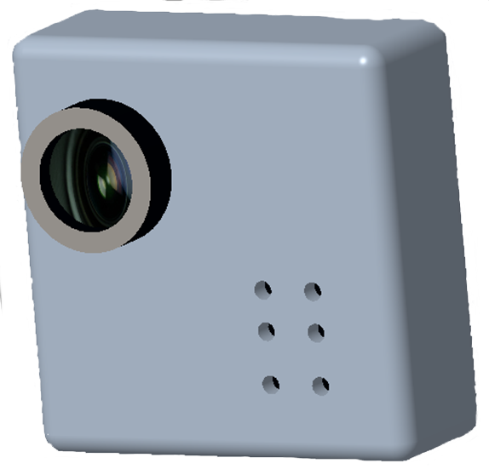
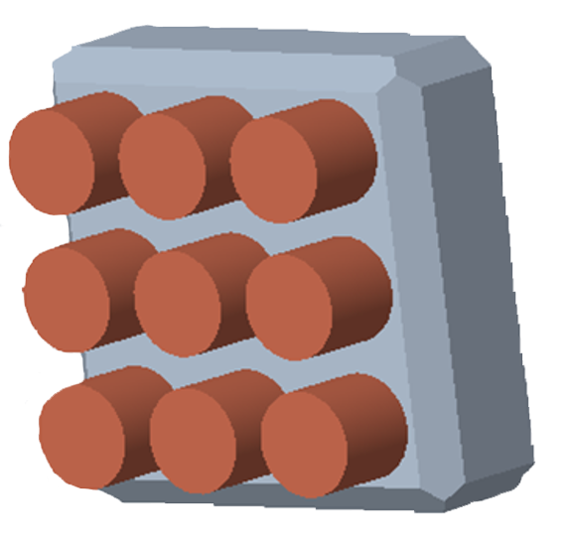
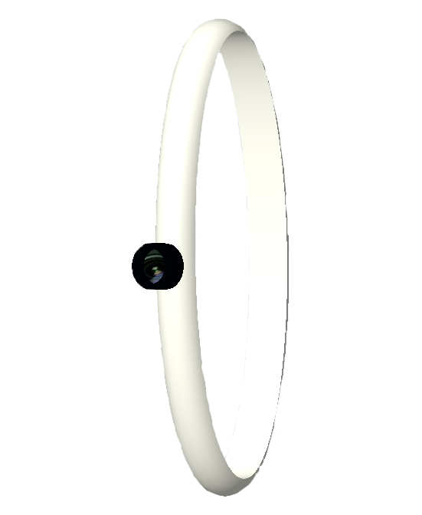
Medium-High Fidelity Concepts
GPS Watch:
Haptic Feedback cane:
Smart Glasses:
Audio Feedback cane:
GPS app:
Pin Matrix Haptics:
Sensor Watch:
Sensor Pin Chip:
Ethan Saffer

Slide 9
Concept Generation & Selection
 | Sensor Pin Chip | Sensor Watch | Haptic Smart Cane
Alert of Elevation | 0.11 | 0.11 | 0.78
Determine Location | 0.16 | 0.19 | 0.66
Interpret Sensory Information | 0.45 | 0.45 | 0.09
Access Emergency Contact | 0.20 | 0.20 | 0.60
Interface with Pre-existing Skills | 0.14 | 0.14 | 0.71
Store Frequent Tasks | 0.33 | 0.33 | 0.33
Alert of a Physical Object | 0.43 | 0.14 | 0.43
Inform User of Possible Threats | 0.33 | 0.33 | 0.33
 | Sensor Pin Chip | Sensor Watch | Haptic Smart Cane with Camera
Alert of Elevation | 0.11 | 0.11 | 0.78
Determine Location | 0.16 | 0.19 | 0.66
Interpret Sensory Information | 0.20 | 0.20 | 0.60
Access Emergency Contact | 0.20 | 0.20 | 0.60
Interface with Pre-existing Skills | 0.14 | 0.14 | 0.71
Store Frequent Tasks | 0.33 | 0.33 | 0.33
Alert of a Physical Object | 0.43 | 0.14 | 0.43
Inform User of Possible Threats | 0.33 | 0.33 | 0.33
Ethan Saffer

Slide 10
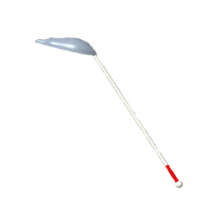


Final Selection
Our final potential designs were ranked:
  Haptic Smart Cane
  Sensor Pin Chip
  Sensor Watch
#1
Haptic Smart Cane
#2
Sensor Pin Chip
#3
Sensor Watch
Ethan Saffer

Slide 11
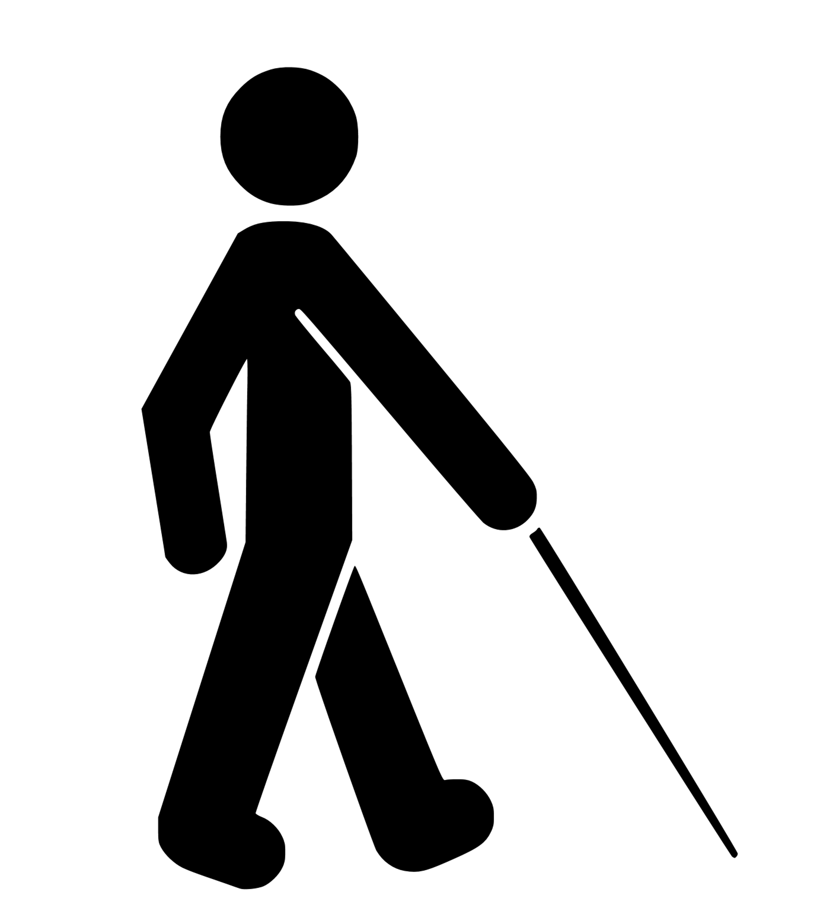
Functions
Ethan Saffer

Slide 12


Functions
Sense
The ultrasonic sensor will sense an object up to 3 meters away.
Ethan Saffer

Slide 13


Functions
Sense
Determine
The ultrasonic sensor will sense an object up to 3 meters away.
The Raspberry Pi will interpret the sensed information to calculate the proximity to an object.
Ethan Saffer

Slide 14


Functions
Sense
Determine
Alert
The ultrasonic sensor will sense an object up to 3 meters away.
The Raspberry Pi will interpret the sensed information to calculate the proximity to an object.
Haptic feedback will alert the user with multiple motors with intensity based on distance.
Ethan Saffer

Slide 15


Functions
Sense
Determine
Alert
The ultrasonic sensor will sense an object up to 3 meters away.
The Raspberry Pi will interpret the sensed information to calculate the proximity to an object.
Haptic feedback will alert the user with multiple motors with intensity based on distance.
Scan
The camera can be activated to scan the desired products.
Ethan Saffer

Slide 16


Functions
Sense
Determine
Alert
The ultrasonic sensor will sense an object up to 3 meters away.
The Raspberry Pi will interpret the sensed information to calculate the proximity to an object.
Haptic feedback will alert the user with multiple motors with intensity based on distance.
Scan
Identify
The camera can be activated to scan the desired products.
Up to 500 stored products will be in the memory of the Raspberry Pi to identify the product.
Ethan Saffer

Slide 17


Functions
Sense
Determine
Alert
The ultrasonic sensor will sense an object up to 3 meters away.
The Raspberry Pi will interpret the sensed information to calculate the proximity to an object.
Haptic feedback will alert the user with multiple motors with intensity based on distance.
Scan
Identify
Notify
The camera can be activated to scan the desired products.
Up to 500 stored products will be in the memory of the Raspberry Pi to identify the product.
Haptic feedback will
notify the user when the product has been identified and a speaker will relay the product name.
Ethan Saffer

Slide 18
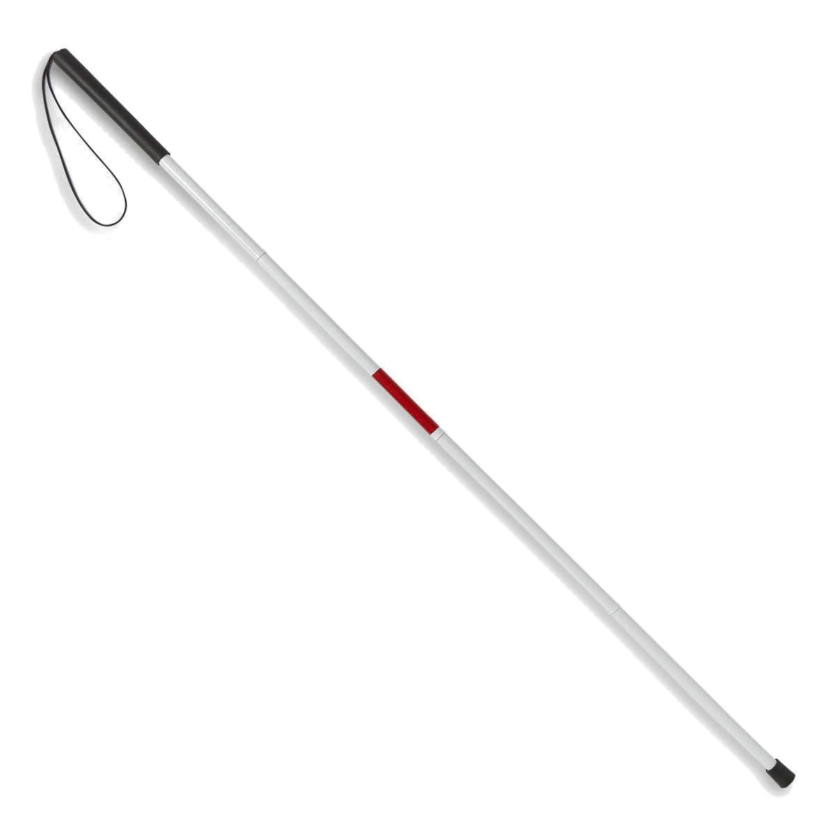
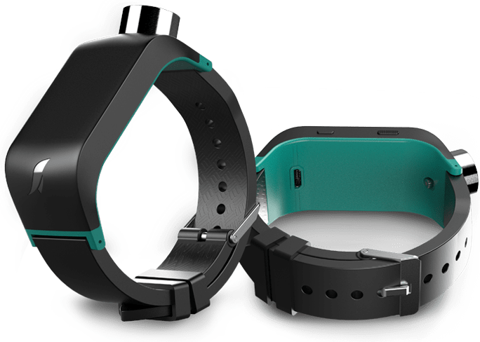
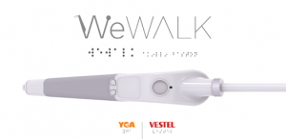
Competitors
White Cane
Sunu Band
WeWalk
https://athome.medline.com/en/medline-white-cane-for-blind-vision-impaired-1ct-mdswhtcane
https://www.sunu.com/es/index
https://webrazzi.com/en/2020/05/01/wewalk-investment-750k/
Ethan Saffer

Slide 19
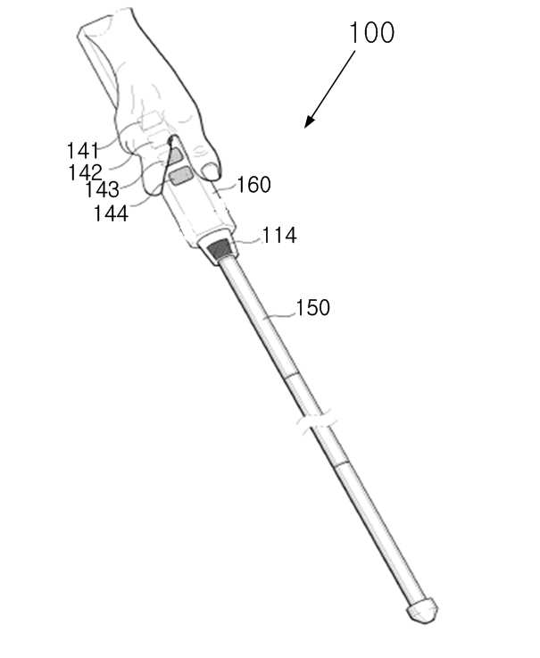
WeWalk
Similar product that incorporates ultrasonic sensors in the format of a smart-cane.
Uses infrared sensors to detect ground irregularities.
Overload of information.
Ethan Saffer

Slide 20
Competitor Comparison
White Cane | Sunu Band | WeWalk | Our Solution
Senses irregularities below the waist Standard aid for visually impaired | Senses objects nearby Set position on wrist, can discomfort user to "aim" | Infrared Sensor for floor irregularities Ultrasonic sensor for object detection | Senses ground irregularties Notifies user

Slide 21
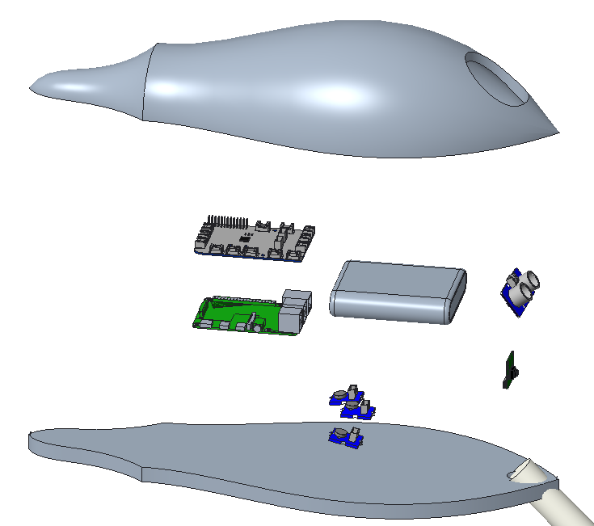
Previous Housing & Assembly
GrovePi+
Battery Pack
Ultrasonic Sensor
Housing
Camera
Raspberry Pi 4
Vibration Motors (3)
Nicolas Garcia

Slide 22
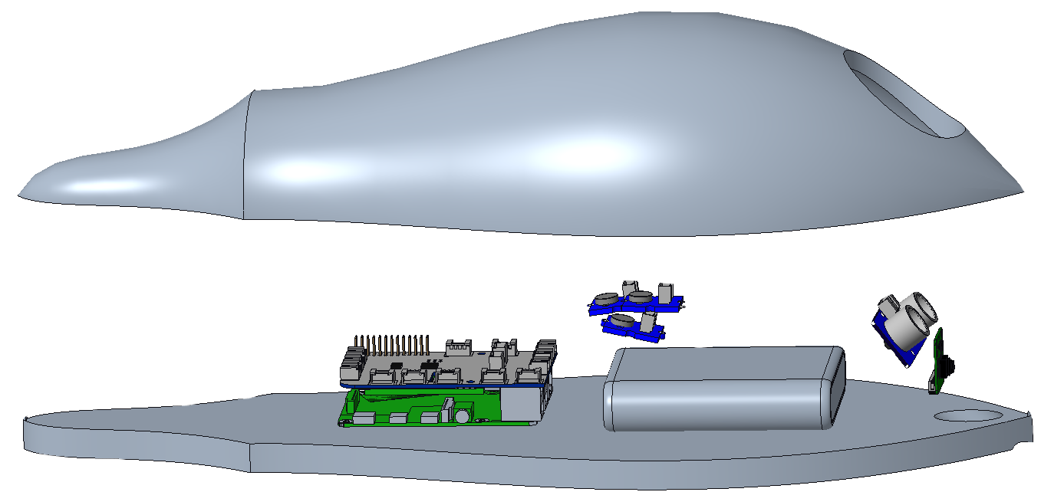

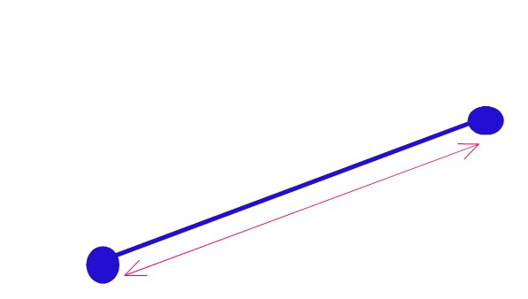
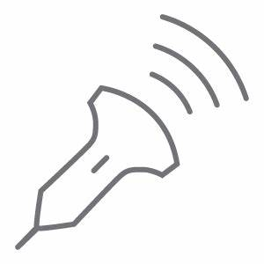

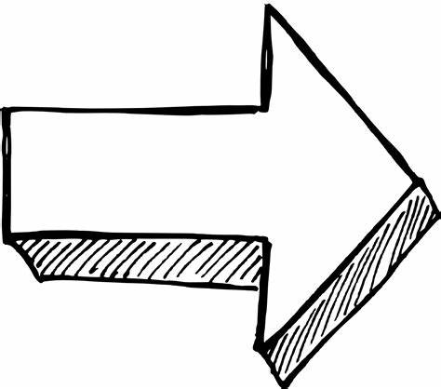

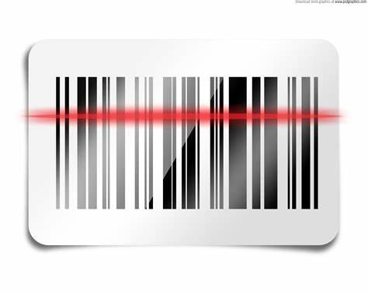


Previous Housing & Assembly
Nicolas Garcia
Sense
Determine
Alert
Sense
Determine
Alert
Sense
Sense
The ultrasonic sensor will sense an object up to 3 meters away.
The Raspberry Pi will interpret the sensed information to calculate the proximity to an object.
Haptic feedback will alert the user with multiple motors with intensity based on distance.
The ultrasonic sensor will sense an object up to 3 meters away.
The Raspberry Pi will interpret the sensed information to calculate the proximity to an object.
Haptic feedback will alert the user with multiple motors with intensity based on distance.
Scan
Identify
Notify
Scan
Identify
Notify
The camera can be activated to scan the desired products.
The camera can be activated to scan the desired products.

Slide 23
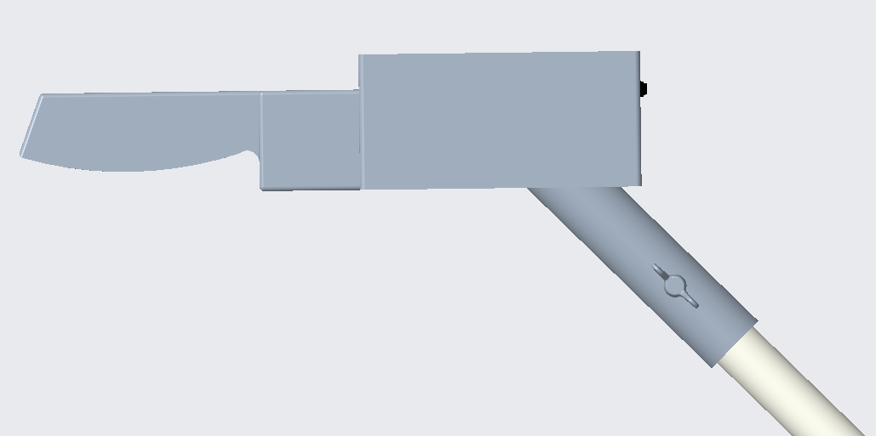
Housing Issues Addressed
Our previous housing design was failing at the cane attachment.
The new design is more capable of handling the stresses that will act on the housing.
Nicolas Garcia

Slide 24
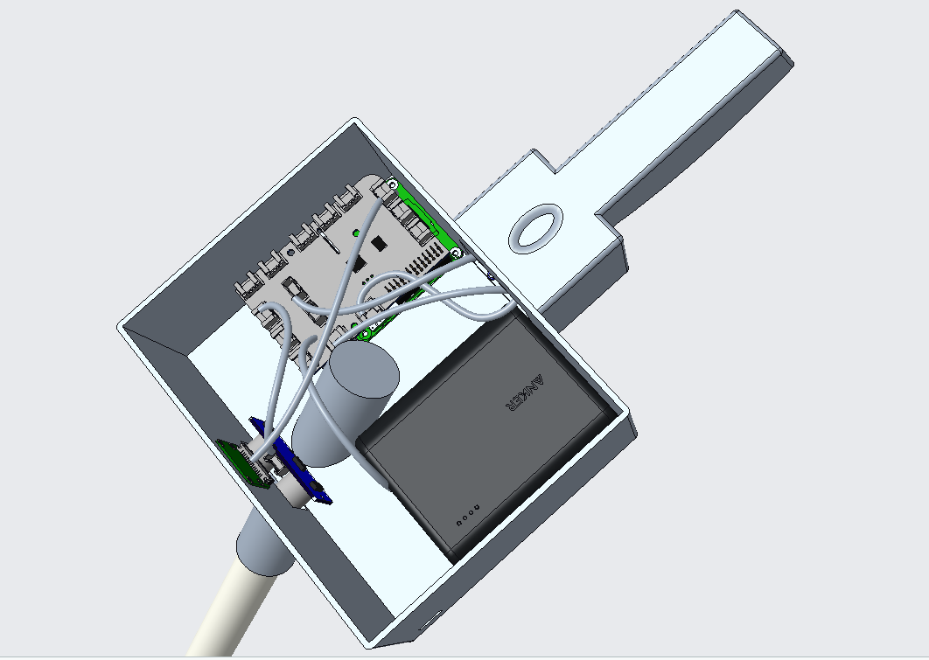
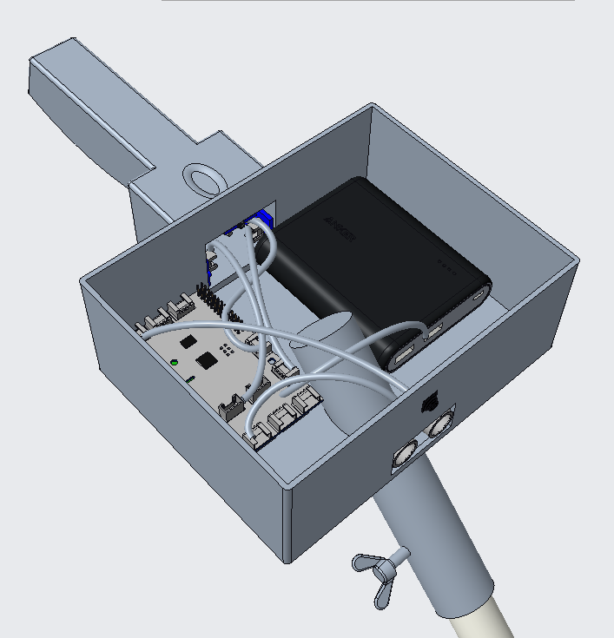
Updated HapTac Assembly
Nicolas Garcia

Slide 25
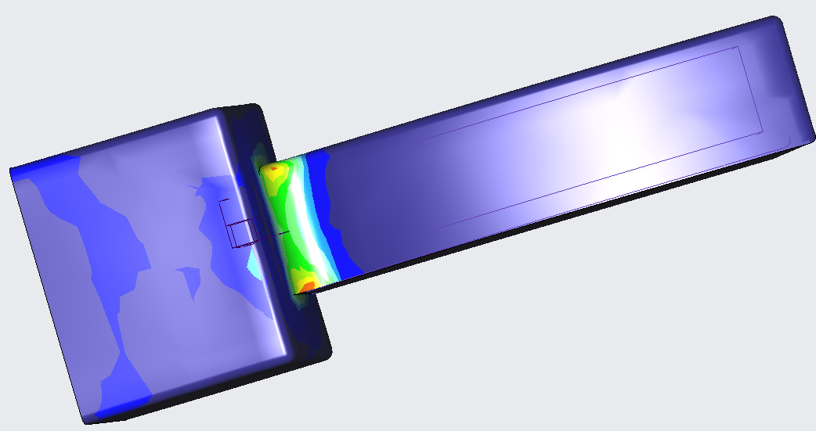

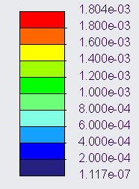
FEA Analysis on Handle
Megapascals (MPa)
The orange on the diagram shows where the stress concentration is highest.
Nicolas Garcia

Slide 26
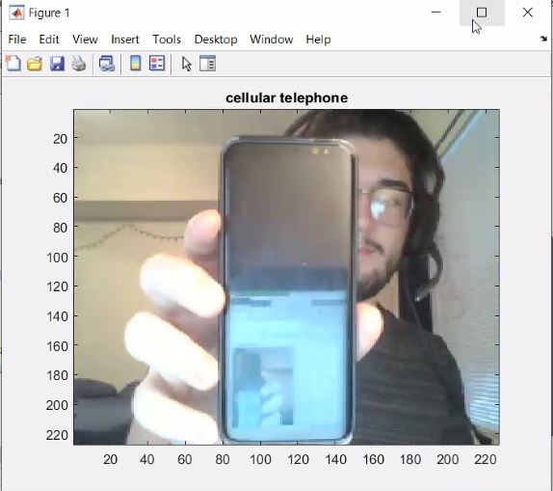
Camera Identification - AlexNet
8-layer identification software.
Capable of adding new items to its memory.
Low power drawn enables running on Raspberry Pi.
Nicolas Garcia

Slide 27
Purchasing Parts
Orders for parts have been placed.
Only one was not successfully ordered by the Mechanical Engineering Department.
An alternate vendor for power source was found.
Nicolas Garcia

Slide 28
Moving Forwards
Continue iterating 3D printed housing for the product.
Overall coding of system.
Testing and Validation
  Battery
  Sensor
  Camera
  Motors
  Housing
Nicolas Garcia

Slide 29
Timeline
Retrieve Parts
InNOLEvation Challenge: Finals
Code Software
Testing and Validation
Reiterate Design
Final Product
Order Parts
Print Handle & Housing
Nicolas Garcia

Slide 30

InNOLEvation Challenge
Selected as one of the eight finalists.
  Executive summary
  Finalize our business model canvas.
Nicolas Garcia

Slide 31
Reference
[1] Ebben, J. M., PhD. (n.d.). Wrists at risk: Awkward postures to avoid. Retrieved February 18, 2021, from https://www.iacindustries.com/get-started/ergonomics/wrists-at-risk.asp
[2] González, A., Salgado, D., García Moruno, L., & Sánchez Ríos, A. (2018). An Ergonomic Customized-Tool Handle Design for Precision Tools using Additive Manufacturing: A Case Study. Applied Sciences, 8(7), 1200. doi:10.3390/app8071200
[3] McConomy, S. (2020, November 11). Engineering Characteristics, Functions, Targets, and Metric. FAMU-FSU College of Engineering.
[4] National Federation of The Blind. https://www.nfb.org/resources/blindness-statistics
[5] Queen, K. (2016, June). 7 Ways to Make Communities More Livable for People With Vision or Hearing Impairments. AARP.
[6] Wang, C., & Cai, D. (2020). Hand tool handle size and shape determination based on hand measurements using a contour gauge. Human Factors and Ergonomics in Manufacturing &amp; Service Industries, 30(5), 349-364. doi:10.1002/hfm.20846
Nicolas Garcia

Slide 32
Team 522: Vision Impaired Technology
David Alicea
Field/Test Engineer and Quality Control
Daa16@my.fsu.edu
Madison Jaffe​
Project Manager and Manufacturing/Controls Engineer
Msj16d@my.fsu.edu
Nicolas Garcia
Webmaster, Design Engineer and Resource Manager
Ng16m@my.fsu.edu
Ethan Saffer
Systems and Design
Engineer
Ers16c@my.fsu.edu
Nicolas Garcia

Slide 35
APPENDIX

Slide 36
Device Operational Time
Ultrasonic Sensor
8 mA
Camera
Up to 800 mA
Vibration Motor
58 mA average
100 mA max
Raspberry Pi
3,000 mA
Power Supply
20,000 mAh
Theoretical (Maximum Current Draw) Operation Time: 4.87 Hours
4 hours, 52 minutes and 12 seconds
Madison Jaffe

Slide 37
8 + 800 + 300 + 3000 = 4108 mA
mAh is mA * (hours operating) = mAh
20000mAh / 5016mA = 4.86855 hours
https://elinux.org/Rpi_Camera_Module
https://static6.arrow.com/aropdfconversion/7ce3c19d47af65a2e4096b327057dad3e30632e1/pgurl_grove-vibration-motor-p-839l.pdf
Sensor 8 mA
Pi: 3A (based on power source)
Camera: up to 800mA
Motor: 58 mA standard, 100 mA at max
Power Supply= 20000 mAh
Therefore: 4.87 Hours of operation at max use

Slide 38
Function ​ | Target ​ | Metric ​
Alert of Elevation* ​ | 0.25 to 12 inches ​ | Distance ​
Determine Location* ​ | Margin of error of at most 16 feet ​ | Distance ​
Alert of Physical Object* ​ | 65 inches ​ | Distance ​
Identify Possible Threats* ​ | Up to 60 miles per hour ​ | Velocity ​
Access Emergency Contact ​ | 15 seconds ​ | Time ​
Interpret Sensory Information* ​ | 7 seconds ​ | Time ​
Store Frequent Tasks ​ | 1 GB ​ | Memory Allocation ​
Interface with Pre-Existing Skills ​ | 70% ​ | User Satisfaction ​
Compete within Market ​ | 20% ​ | Price Range USD ($) ​
Remain Lightweight ​ | <5 lb ​ | Weight ​
Remain Discrete ​ | 70% ​ | User Approval ​

Slide 39
Synopsis: Semester 1
Markets:
  Primary market: People with severe visual impairment, rehabilitation and treatment centers.
  Secondary market: Autonomous Systems and State-Local Departments of Transportation.
David Alicea

Slide 40
Synopsis: Semester 1
Markets:
  Primary market: People with severe visual impairment, rehabilitation and treatment centers.
  Secondary market: Autonomous Systems and State-Local Departments of Transportation.
Interpreted Customer Needs:
1. Helps Avoid Ground Irregularities
2. Allows for Location Awareness
3. Recognizes Surrounding Objects
4. Notify Emergency Contacts
5. Intuitive with O & M Training
6. Identifies and Reads Text
7. Priced for Low-Income Households
David Alicea

Slide 41
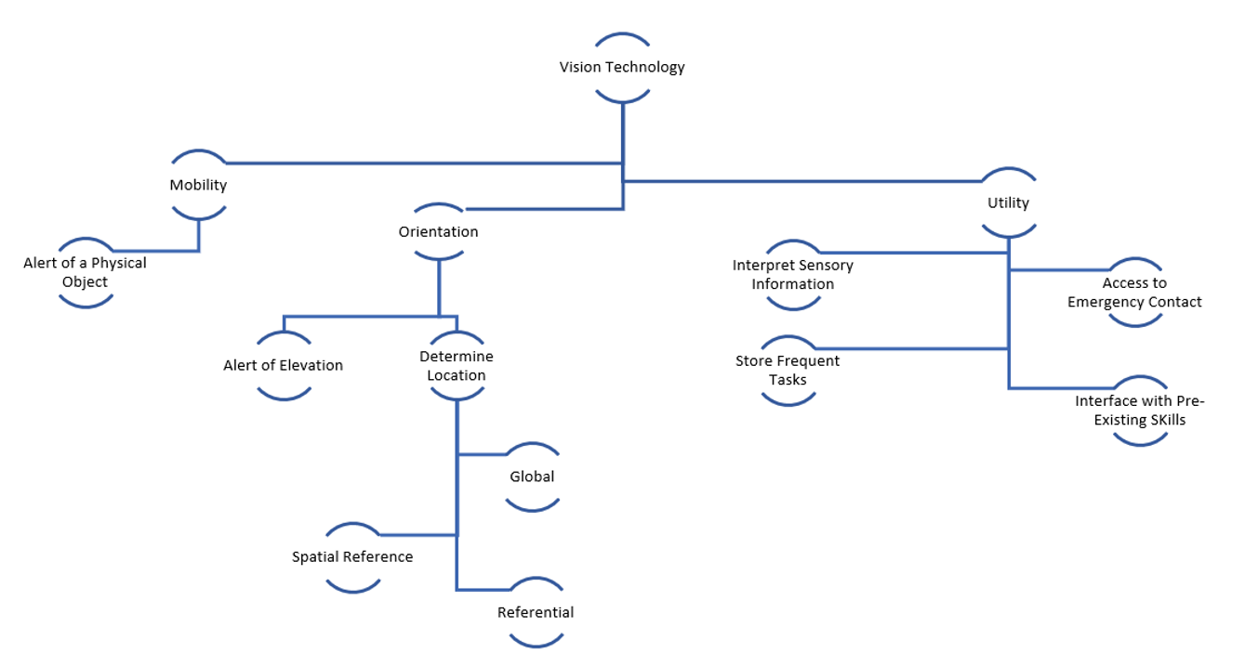
Functional Decomposition
David Alicea

Slide 42
Targets and Metrics
Function | Target | Metric
Alert of Elevation* | 0.25 to 12 inches | Distance
Determine Location* | ~ 16 feet | Distance
Alert of Physical Object* | 65 inches | Distance
Identify Possible Threats* | Up to 60 miles per hour | Velocity
Access Emergency Contact | 15 seconds | Time
Interpret Sensory Information* | 7 seconds | Time
Store Frequent Tasks | 1 GB | Memory Allocation
Interface with Pre-Existing Skills | 70% | User Satisfaction
Compete within Market | 20% | Price Range USD ($)
Remain Lightweight | < 5.1 lb | Weight
Remain Discrete | 70% | User Approval
David Alicea

Slide 43
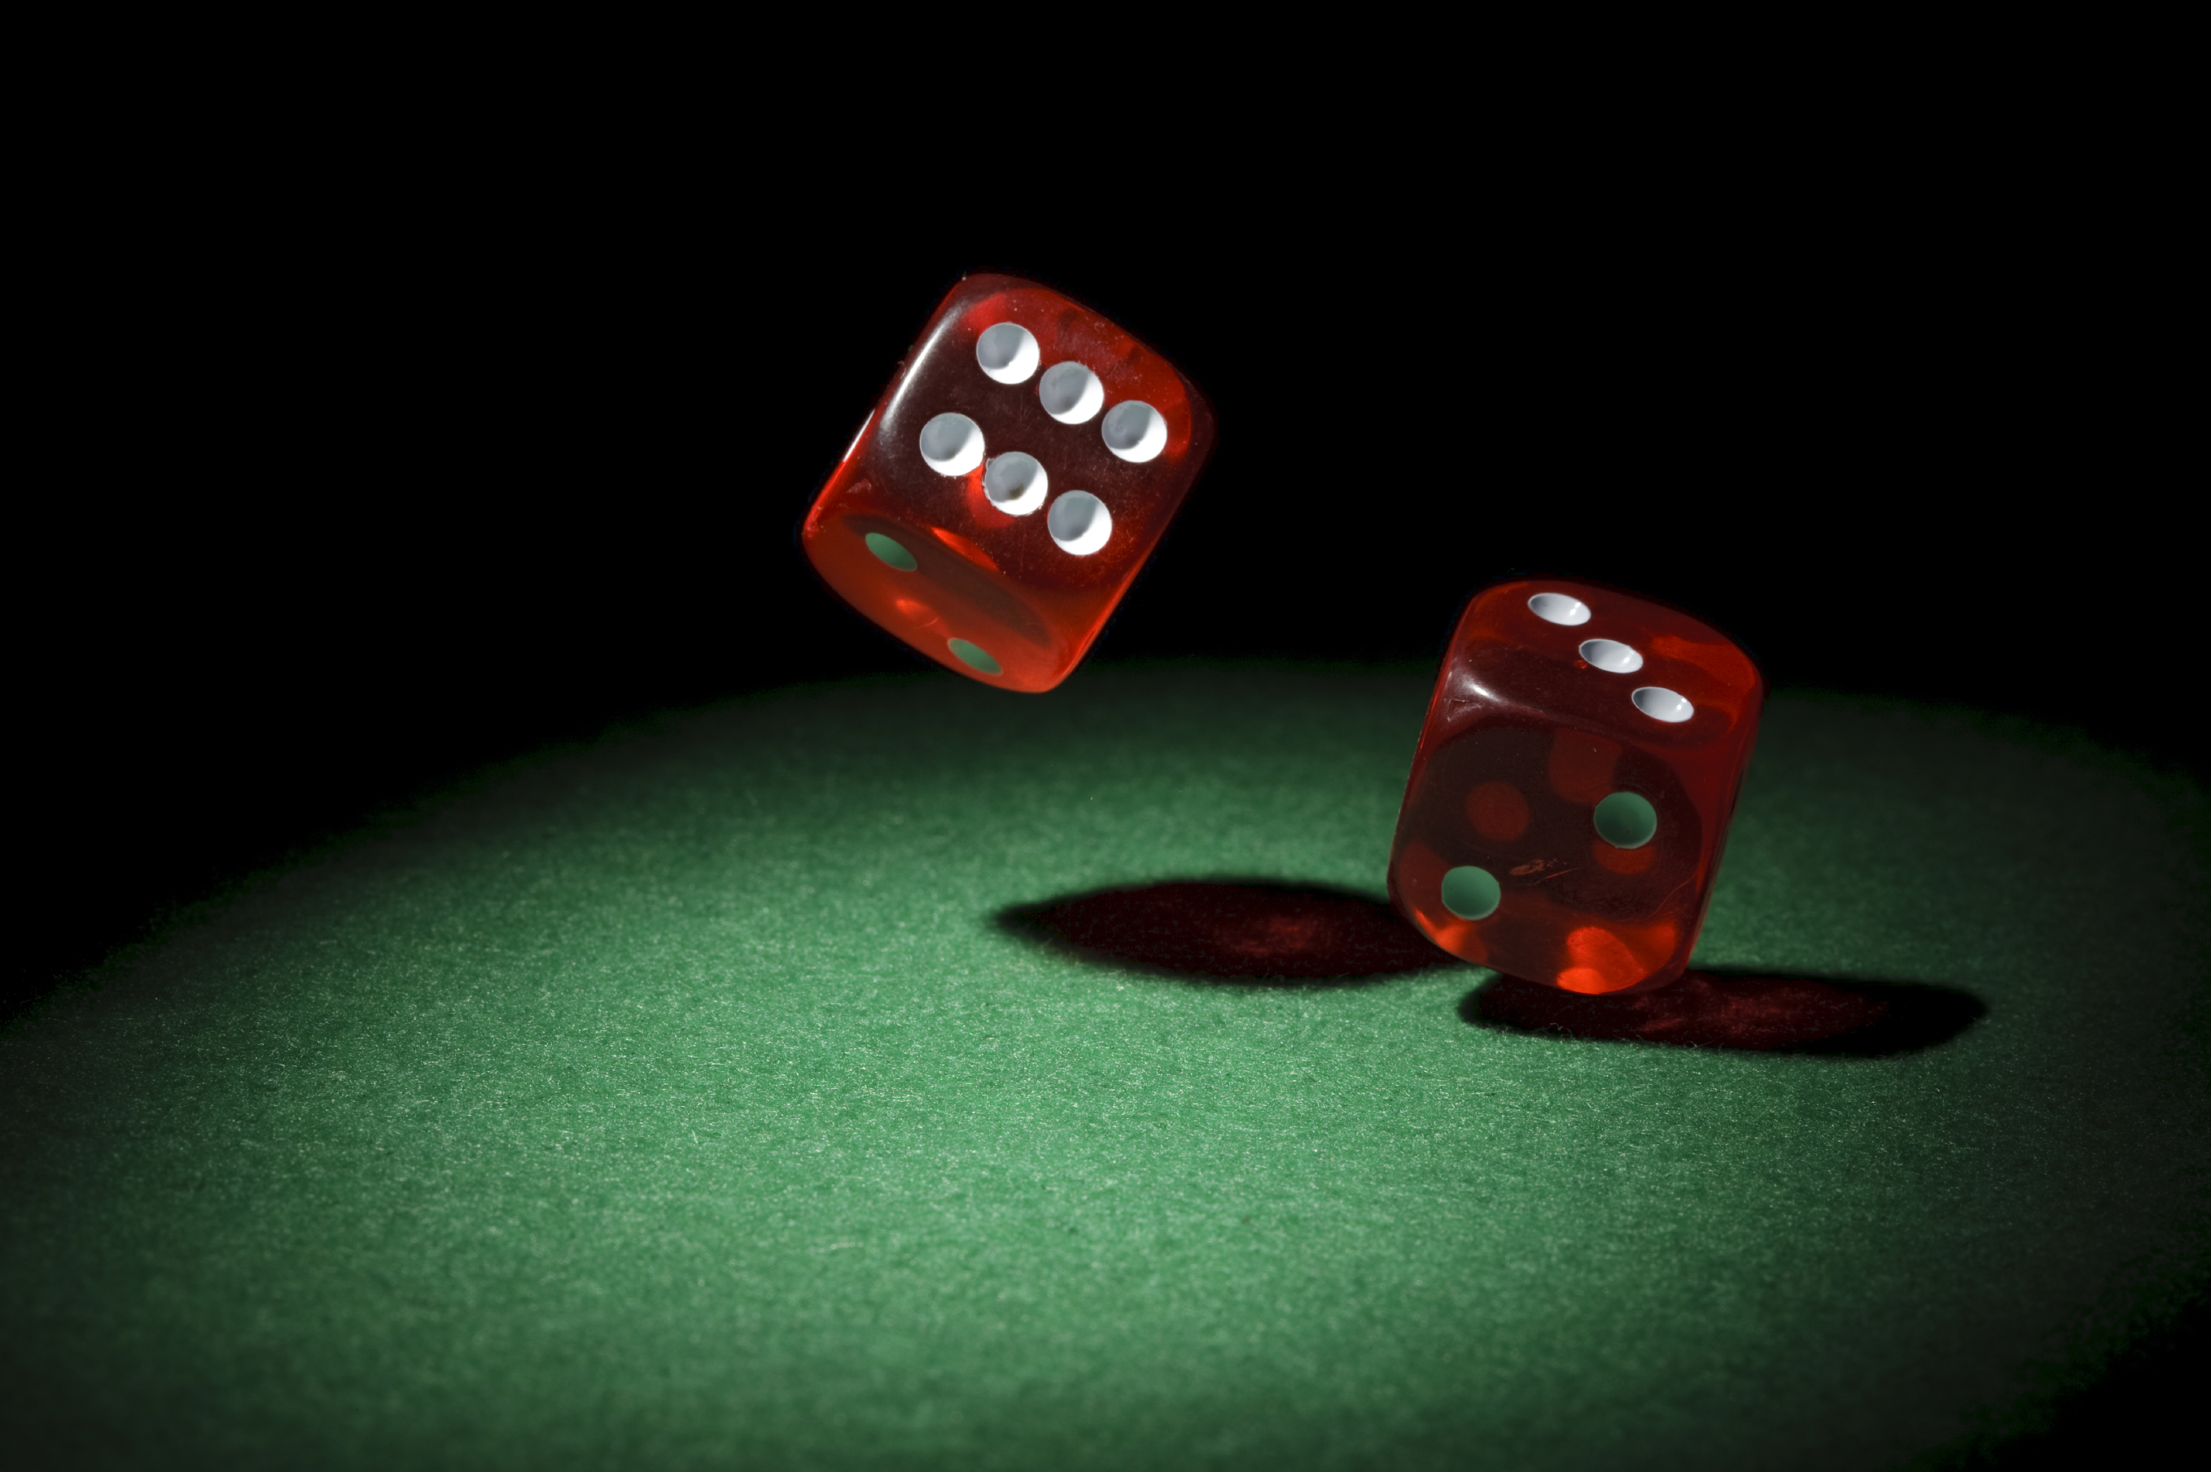
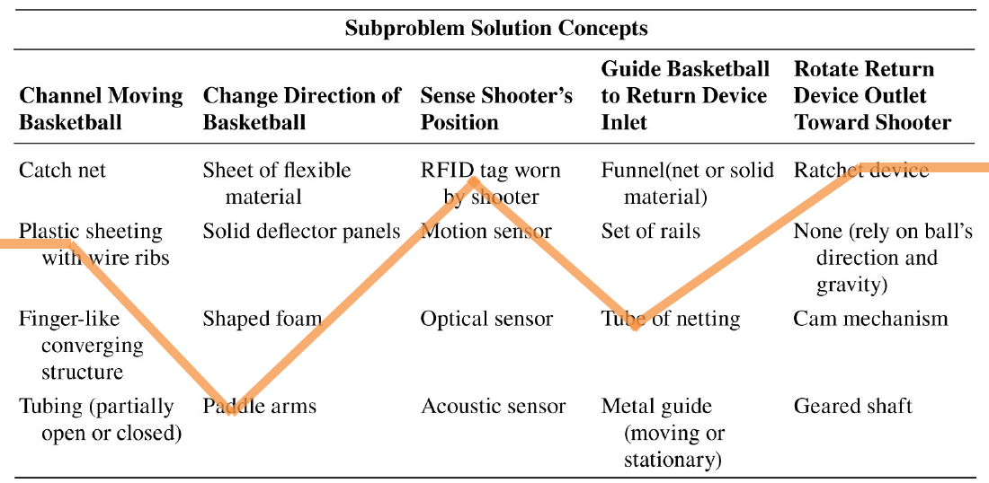
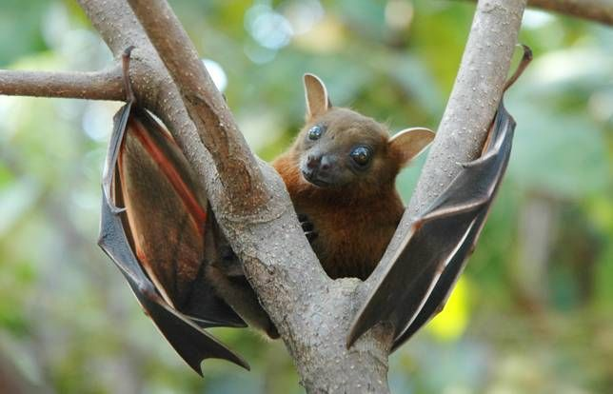
Concept Generation Tools
Crap Shoot
Morphological Chart
Biomimicry
McConomy, S. (2020, November 11). Engineering Characteristics, Functions, Targets, and Metric. FAMU-FSU College of Engineering.
David Alicea

Slide 44
Morphological Chart
Alert of Elevation | Determine Location | Alert of Physical Object | Inform of Possible Threats | Interpret Sensory Information
Sensor | GPS Through Wi-Fi/Internet Signal | Distance Sensor | Heat | Camera
Cane/Stick | GPS w/ Maps Downloaded | Velocity Sensor | Vibrate | Text Conversion
 | Camera to Read Street Signs and Other Landmarks | Lidar | Noise | Live Imaging Scanned to a PDF Document
 | Memory Storage of Previous Paths |  | Poke | Text to Braille
David Alicea

Slide 45
Medium Fidelity Concepts
GPS Watch:
- GPS indicate where the user is
- haptic feedback provided through vibration on wrist
Haptic Feedback cane:
- haptic feedback voice-activated
- phone compatible
Smart Glasses:
- sensor and GPS for user location
- Audio feedback through glass-mounted earpiece
Audio Feedback cane:
- audio feedback
- Tactile or voice activation
- Phone compatible
- camera to interpret the environment
GPS app:
- Lidar
- user information through haptics
- computer and GPS track and locate user
David Alicea

Slide 46
Concept Selection
David Alicea

Slide 47






Importance Weight Factor
Interpreted Customer Needs
Recognizes Surrounding Objects
Intuitive with O&M Training
Notify Emergency Contact
Importance Weight Factor
Priced for Low-Income Households
Helps Avoid Ground Irregularities
Identifies and Reads Text
Allows for Location Detection
Nicolas Garcia

Slide 48
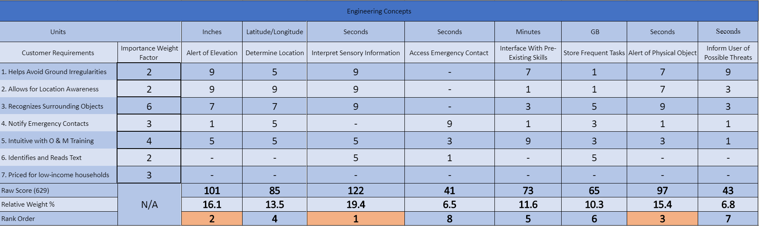
House of Quality
Nicolas Garcia

Slide 49
House of Quality
Interpret Sensory Information
Alert of Elevation
Alert of Physical Objects
Determine Location
Interface with Pre-Existing Skills
Store Frequent Tasks
Inform User of Potential Threats
Access Emergency Contacts
Nicolas Garcia

Slide 50
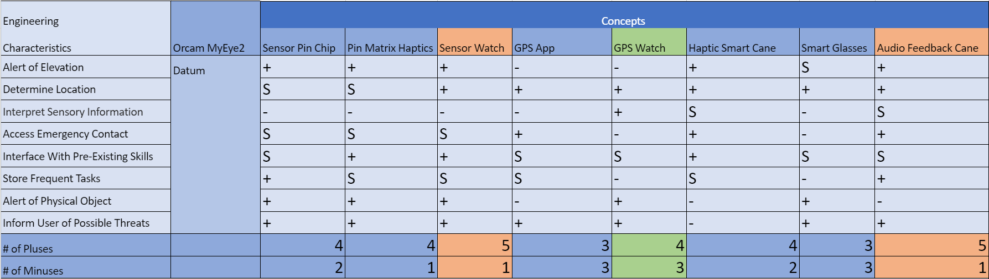
Pugh Chart
Nicolas Garcia

Slide 51
Pugh Chart
Nicolas Garcia

Slide 52
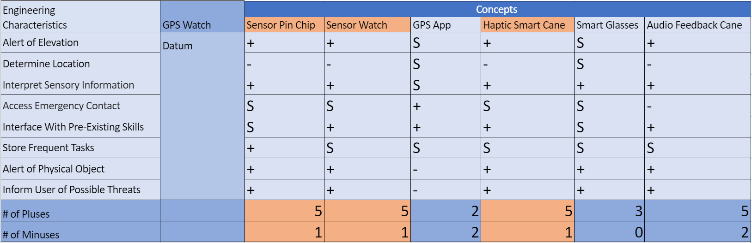
Second Pugh Chart
Nicolas Garcia

Slide 53
Second Pugh Chart
Nicolas Garcia

Slide 54
Analytical Hierarchy Process
Criteria Comparison Matrix [C]
Functions | Criteria Weights{W}
Alert of Elevation | 0.11
Determine Location | 0.13
Interpret Sensory Information | 0.24
Access Emergency Contact | 0.03
Interface With Pre-Existing Skills | 0.11
Store Frequent Tasks | 0.04
Alert of Physical Object | 0.19
Inform User of Possible Threats | 0.15
Sum | 1.00
Nicolas Garcia

Slide 55
Analytical Hierarchy Process
 | Sensor Pin Chip | Sensor Watch | Haptic Smart Cane
Alert of Elevation | 0.11 | 0.11 | 0.78
Determine Location | 0.16 | 0.19 | 0.66
Interpret Sensory Information | 0.45 | 0.45 | 0.09
Access Emergency Contact | 0.20 | 0.20 | 0.60
Interface with Pre-existing Skills | 0.14 | 0.14 | 0.71
Store Frequent Tasks | 0.33 | 0.33 | 0.33
Alert of a Physical Object | 0.43 | 0.14 | 0.43
Inform User of Possible Threats | 0.33 | 0.33 | 0.33
Nicolas Garcia

Slide 56
Analytical Hierarchy Process
 | Sensor Pin Chip | Sensor Watch | Haptic Smart Cane
Alert of Elevation | 0.11 | 0.11 | 0.78
Determine Location | 0.16 | 0.19 | 0.66
Interpret Sensory Information | 0.45 | 0.45 | 0.09
Access Emergency Contact | 0.20 | 0.20 | 0.60
Interface with Pre-existing Skills | 0.14 | 0.14 | 0.71
Store Frequent Tasks | 0.33 | 0.33 | 0.33
Alert of a Physical Object | 0.43 | 0.14 | 0.43
Inform User of Possible Threats | 0.33 | 0.33 | 0.33
Nicolas Garcia

Slide 57
Analytical Hierarchy Process
 | Sensor Pin Chip | Sensor Watch | Haptic Smart Cane
Alert of Elevation | 0.11 | 0.11 | 0.78
Determine Location | 0.16 | 0.19 | 0.66
Interpret Sensory Information | 0.45 | 0.45 | 0.09
Access Emergency Contact | 0.20 | 0.20 | 0.60
Interface with Pre-existing Skills | 0.14 | 0.14 | 0.71
Store Frequent Tasks | 0.33 | 0.33 | 0.33
Alert of a Physical Object | 0.43 | 0.14 | 0.43
Inform User of Possible Threats | 0.33 | 0.33 | 0.33
Nicolas Garcia

Slide 58
Binary Comparison Chart
Interprted Customer Needs | 1 | 2 | 3 | 4 | 5 | 6 | 7 | Total 1
1. Helps Avoid Ground Irregularities | - | 1 | 0 | 0 | 0 | 0 | 1 | 2
2. Allows for Location Awareness | 0 | - | 0 | 1 | 0 | 1 | 0 | 2
3. Recognizes Surrounding Objects | 1 | 1 | - | 1 | 1 | 1 | 1 | 6
4. Notify Emergency Contacts | 1 | 0 | 0 | - | 1 | 0 | 1 | 3
5. Intuitive with O & M Training | 1 | 1 | 0 | 0 | - | 1 | 1 | 4
6. Identifies and Reads Text | 1 | 0 | 0 | 1 | 0 | - | 0 | 2
7. Priced for low-income households | 0 | 1 | 0 | 1 | 0 | 1 | - | 3
Total: | 4 | 4 | 0 | 4 | 2 | 4 | 4 | 6

Slide 59
Functional Decomposition
 | Orientation | Mobility | Utility
Alert of Elevation | X | X
Determine Location | X | X
Alert of Physical Object | X | X
Inform User of Possible Threats |  | X | X
Access to Emergency Contact |  |  | X
Interpret Sensory information |  |  | X
Store Frequent Tasks | X |  | X
Interface With Pre-Existing Skills |  |  | X
David Alicea

Slide 60
Engineering |  | Concepts
Characteristics | Oram MyEye2 | Sensor Pin Chip | Pin Matrix Haptics | Sensor Watch | GPS App | GPS Watch | Haptic Smart Cane | Smart Glasses | Audio Feedback Cane
Alert of Elevation | Datum | + | + | + | - | - | + | S | +
Determine Location |  | S | S | + | + | + | + | + | +
Interpret Sensory Information |  | - | - | - | - | + | S | - | S
Access Emergency Contact |  | S | S | S | + | - | + | - | +
Interface With Pre-Existing Skills |  | S | + | + | S | S | + | S | S
Store Frequent Tasks |  | + | S | S | S | - | S | - | +
Alert of Physical Object |  | + | + | + | - | + | - | + | -
Inform User of Possible Threats |  | + | + | + | + | + | - | + | +
# of Pluses |  | 4 | 4 | 5 | 3 | 4 | 4 | 3 | 5
# of Minuses |  | 2 | 1 | 1 | 3 | 3 | 2 | 3 | 1

Slide 61
Engineering |  | Concepts
Characteristics | GPS Watch | Sensor Pin Chip | Sensor Watch | GPS App | Haptic Smart Cane | Smart Glasses | Audio Feedback Cane
Alert of Elevation | Datum | + | + | S | + | S | +
Determine Location |  | - | - | S | - | S | -
Interpret Sensory Information |  | + | + | S | + | + | +
Access Emergency Contact |  | S | S | + | S | S | -
Interface With Pre-Existing Skills |  | S | + | + | + | S | +
Store Frequent Tasks |  | + | S | S | S | S | S
Alert of Physical Object |  | + | + | - | + | + | +
Inform User of Possible Threats |  | + | + | - | + | + | +
# of Pluses |  | 5 | 5 | 2 | 5 | 3 | 5
# of Minuses |  | 1 | 1 | 2 | 1 | 0 | 2

Slide 62
Engineering Concepts
Units |  | Inches | Latitude/Longitude | Seconds | Seconds | Minutes | GB | Seconds | Seconds
Customer Requirements | Importance Weight Factor | Alert of Elevation | Determine Location | Interpret Sensory Information | Access Emergency Contact | Interface With Pre-Existing Skills | Store Frequent Tasks | Alert of Physical Object | Inform User of Possible Threats
1. Helps Avoid Ground Irregularities | 2 | 9 | 5 | 9 | - | 7 | 1 | 7 | 9
2. Allows for Location Awareness | 2 | 9 | 9 | 9 | - | 1 | 1 | 7 | 3
3. Recognizes Surrounding Objects | 6 | 7 | 7 | 9 | - | 3 | 5 | 9 | 3
4. Notify Emergency Contacts | 3 | 1 | 5 | - | 9 | 1 | 3 | 1 | 1
5. Intuitive with O & M Training | 4 | 5 | 5 | 5 | 3 | 9 | 3 | 3 | 1
6. Identifies and Reads Text | 2 | - | - | 5 | 1 | - | 5 | - | -
7. Priced for low-income households | 3 | - | - | - | - | - | - | - | -
Raw Score (629) | N/A | 101 | 85 | 122 | 41 | 73 | 65 | 97 | 43
Relative Weight % |  | 16.1 | 13.5 | 19.4 | 6.5 | 11.6 | 10.3 | 15.4 | 6.8
Rank Order |  | 2 | 4 | 1 | 8 | 5 | 6 | 3 | 7

Slide 63
Development of Candidate Set of Criteria Weights {W}
Criteria Comparison Matrix [C]
 | Alert of Elevation | Determine Location | Interpret Sensory Information | Access Emergency Contact | Interface With Pre-Existing Skills | Store Frequent tasks | Alert of Physical Objects | Inform User of Possible Threats
Alert of Elevation | 1.00 | 1.00 | 0.33 | 5.00 | 1.00 | 3.00 | 0.33 | 1.00
Determine Location | 1.00 | 1.00 | 0.33 | 5.00 | 1.00 | 3.00 | 1.00 | 1.00
Interpret Sensory Information | 3.00 | 3.00 | 1.00 | 5.00 | 3.00 | 5.00 | 1.00 | 1.00
Access Emergency Contact | 0.20 | 0.20 | 0.20 | 1.00 | 0.20 | 1.00 | 0.33 | 0.20
Interface With Pre-Existing Skills | 1.00 | 1.00 | 0.33 | 5.00 | 1.00 | 3.00 | 0.33 | 1.00
Store Frequent Tasks | 0.33 | 0.33 | 0.20 | 1.00 | 0.33 | 1.00 | 0.33 | 0.33
Alert of Physical Object | 3.00 | 1.00 | 1.00 | 3.00 | 3.00 | 3.00 | 1.00 | 1.00
Inform User of Possible Threats | 1.00 | 1.00 | 1.00 | 5.00 | 1.00 | 3.00 | 1.00 | 1.00
Sum | 10.53 | 8.53 | 4.40 | 30.00 | 10.53 | 22.00 | 5.33 | 6.53

Slide 64
Development of Candidate Set of Criteria Weights {W}
Criteria Comparison Matrix [C]
 | Alert of Elevation | Determine Location | Interpret Sensory Information | Acccess Emergency Contact | Interface With Pre-Existing Skills | Store Fequent tasks | Alert of Physical Objects | Inform User of Possible Threats | Criteria Weights{W}
Alert of Elevation | 0.09 | 0.12 | 0.08 | 0.17 | 0.09 | 0.14 | 0.06 | 0.15 | 0.11
Determine Location | 0.09 | 0.12 | 0.08 | 0.17 | 0.09 | 0.14 | 0.19 | 0.15 | 0.13
Interpret Sensory Information | 0.28 | 0.35 | 0.23 | 0.17 | 0.28 | 0.23 | 0.19 | 0.15 | 0.24
Access Emergency Contact | 0.02 | 0.02 | 0.05 | 0.03 | 0.02 | 0.05 | 0.06 | 0.03 | 0.03
Interface With Pre-Existing Skills | 0.09 | 0.12 | 0.08 | 0.17 | 0.09 | 0.14 | 0.06 | 0.15 | 0.11
Store Frequent Tasks | 0.03 | 0.04 | 0.05 | 0.03 | 0.03 | 0.05 | 0.06 | 0.05 | 0.04
Alert of Physical Object | 0.28 | 0.12 | 0.23 | 0.10 | 0.28 | 0.14 | 0.19 | 0.15 | 0.19
Inform User of Possible Threats | 0.09 | 0.12 | 0.23 | 0.17 | 0.09 | 0.14 | 0.19 | 0.15 | 0.15
Sum | 1.00 | 1.00 | 1.00 | 1.00 | 1.00 | 1.00 | 1.00 | 1.00 | 1.00

Slide 65
Weighted Sum Vector | Criteria Weights{W} | Consistency vector
0.94 | 0.11 | 8.37
1.07 | 0.13 | 8.32
2.02 | 0.24 | 8.57
0.29 | 0.03 | 8.23
0.94 | 0.11 | 8.37
0.35 | 0.04 | 8.32
1.61 | 0.19 | 8.61
1.22 | 0.15 | 8.32
# of criteria | RI value | Average Consistency | Consistency Index | Consistency Ratio
8.00 | 1.40 | 8.39 | 0.06 | 0.04

Slide 66
Development of Candidate Set of Criteria Weights {W} ALERT OF ELEVATION | Alert of Elevation
Criteria Comparison Matrix [C]
 | Sensor Pin Chip | Sensor Watch | Haptic Smart Cane
Sensor Pin Chip | 1.00 | 1.00 | 0.14
Sensor Watch | 1.00 | 1.00 | 0.14
Haptic Smart Cane | 7.00 | 7.00 | 1.00
Sum | 9.00 | 9.00 | 1.29

Slide 67
Analytical Hierarchy Process
Criteria Comparison Matrix [C]
 | Alert of Elevation | Determine Location | Interpret Sensory Information | Access Emergency Information | Interface with pre-existing skills | Store Frequent Tasks | Alert of Physical Objects | Inform User of Possible Threats
Alert of Elevation | 1.00 | 1.00 | 0.33 | 5.00 | 1.00 | 3.00 | 0.33 | 1.00
Determine Location | 1.00 | 1.00 | 0.33 | 5.00 | 1.00 | 3.00 | 1.00 | 1.00
Interpret Sensory Information | 3.00 | 3.00 | 1.00 | 5.00 | 3.00 | 5.00 | 1.00 | 1.00
Access Emergency Information | 0.20 | 0.20 | 0.20 | 1.00 | 0.20 | 1.00 | 0.33 | 0.20
Interface with Pre-existing Skills | 1.00 | 1.00 | 0.33 | 5.00 | 1.00 | 3.00 | 0.33 | 1.00
Store Frequent Tasks | 0.33 | 0.33 | 0.20 | 1.00 | 0.33 | 1.00 | 0.33 | 0.33
Alert of Physical Objects | 3.00 | 1.00 | 1.00 | 3.00 | 3.00 | 3.00 | 1.00 | 1.00
Inform User of Possible Threats | 1.00 | 1.00 | 1.00 | 5.00 | 1.00 | 3.00 | 1.00 | 1.00
Sum | 10.53 | 8.53 | 4.40 | 30.00 | 10.53 | 22.00 | 5.33 | 6.53
Nicolas Garcia

Slide 68
Development of Candidate Set of Criteria Weights {W}
Criteria Comparison Matrix [C]
 | Sensor Pin Chip | Sensor Watch | Haptic Smart Cane | Design Alternative Priorities {Pi}
Sensor Pin Chip | 0.11 | 0.11 | 0.11 | 0.11
Sensor Watch | 0.11 | 0.11 | 0.11 | 0.11
Haptic Smart Cane | 0.78 | 0.78 | 0.78 | 0.78
Sum | 1.00 | 1.00 | 1.00 | 1.00

Slide 69
Weighted Sum Vector | Design Alternative Priorities | Consistency vector
0.33 | 0.11 | 3.00
0.33 | 0.11 | 3.00
2.33 | 0.78 | 3.00
# of criteria | RI value | Average Consistency | Consistency Index | Consistency Ratio
3.00 | 0.52 | 3.00 | 0.00 | 0.00

Slide 70
Development of Candidate Set of Criteria Weights {W} | Determine Location
Criteria Comparison Matrix [C]
 | Sensor Pin Chip | Sensor Watch | Haptic Smart Cane
Sensor Pin Chip | 1.00 | 1.00 | 0.20
Sensor Watch | 1.00 | 1.00 | 0.33
Haptic Smart Cane | 5.00 | 3.00 | 1.00
Sum | 7.00 | 5.00 | 1.53

Slide 71
Development of Candidate Set of Criteria Weights {W}
Criteria Comparison Matrix [C]
 | Sensor Pin Chip | Sensor Watch | Haptic Smart Cane | Design Alternative Priorities {Pi}
Sensor Pin Chip | 0.14 | 0.20 | 0.13 | 0.16
Sensor Watch | 0.14 | 0.20 | 0.22 | 0.19
Haptic Smart Cane | 0.71 | 0.60 | 0.65 | 0.66
Sum | 1.00 | 1.00 | 1.00 | 1.00

Slide 72
Weighted Sum Vector | Design Alternative Priorities | Consistency vector
0.48 | 0.16 | 3.01
0.56 | 0.19 | 3.01
2.00 | 0.66 | 3.06
# of criteria | RI value | Average Consistency | Consistency Index | Consistency Ratio
3.00 | 0.52 | 3.00 | 0.00 | 0.00

Slide 73
Development of Candidate Set of Criteria Weights {W} | Interpret Sensory Information
Criteria Comparison Matrix [C]
 | Sensor Pin Chip | Sensor Watch | Haptic Smart Cane
Sensor Pin Chip | 1.00 | 1.00 | 5.00
Sensor Watch | 1.00 | 1.00 | 5.00
Haptic Smart Cane | 0.20 | 0.20 | 1.00
Sum | 2.20 | 2.20 | 11.00

Slide 74
Development of Candidate Set of Criteria Weights {W}
Criteria Comparison Matrix [C]
 | Sensor Pin Chip | Sensor Watch | Haptic Smart Cane | Design Alternative Priorities {Pi}
Sensor Pin Chip | 0.45 | 0.45 | 0.45 | 0.45
Sensor Watch | 0.45 | 0.45 | 0.45 | 0.45
Haptic Smart Cane | 0.09 | 0.09 | 0.09 | 0.09
Sum | 1.00 | 1.00 | 1.00 | 1.00

Slide 75
Weighted Sum Vector | Design Alternative Priorities | Consistency vector
1.36 | 0.45 | 3.00
1.36 | 0.45 | 3.00
0.27 | 0.09 | 3.00
# of criteria | RI value | Average Consistency | Consistency Index | Consistency Ratio
3.00 | 0.52 | 3.00 | 0.00 | 0.00

Slide 76
Development of Candidate Set of Criteria Weights {W} | Access Emergency Contact
Criteria Comparison Matrix [C]
 | Sensor Pin Chip | Sensor Watch | Haptic Smart Cane
Sensor Pin Chip | 1.00 | 1.00 | 0.33
Sensor Watch | 1.00 | 1.00 | 0.33
Haptic Smart Cane | 3.00 | 3.00 | 1.00
Sum | 5.00 | 5.00 | 1.67

Slide 77
Development of Candidate Set of Criteria Weights {W}
Criteria Comparison Matrix [C]
 | Sensor Pin Chip | Sensor Watch | Haptic Smart Cane | Design Alternative Priorities {Pi}
Sensor Pin Chip | 0.20 | 0.20 | 0.20 | 0.20
Sensor Watch | 0.20 | 0.20 | 0.20 | 0.20
Haptic Smart Cane | 0.60 | 0.60 | 0.60 | 0.60
Sum | 1.00 | 1.00 | 1.00 | 1.00

Slide 78
Weighted Sum Vector | Design Alternative Priorities | Consistency vector
0.60 | 0.20 | 3.00
0.60 | 0.20 | 3.00
1.80 | 0.60 | 3.00
# of criteria | RI value | Average Consistency | Consistency Index | Consistency Ratio
3.00 | 0.52 | 3.00 | 0.00 | 0.00

Slide 79
Development of Candidate Set of Criteria Weights {W} | Interface With Pre-Existing Skills
Criteria Comparison Matrix [C]
 | Sensor Pin Chip | Sensor Watch | Haptic Smart Cane
Sensor Pin Chip | 1.00 | 1.00 | 0.20
Sensor Watch | 1.00 | 1.00 | 0.20
Haptic Smart Cane | 5.00 | 5.00 | 1.00
Sum | 7.00 | 7.00 | 1.40

Slide 80
Development of Candidate Set of Criteria Weights {W}
Criteria Comparison Matrix [C]
 | Sensor Pin Chip | Sensor Watch | Haptic Smart Cane | Design Alternative Priorities {Pi}
Sensor Pin Chip | 0.14 | 0.14 | 0.14 | 0.14
Sensor Watch | 0.14 | 0.14 | 0.14 | 0.14
Haptic Smart Cane | 0.71 | 0.71 | 0.71 | 0.71
Sum | 1.00 | 1.00 | 1.00 | 1.00

Slide 81
Weighted Sum Vector | Design Alternative Priorities | Consistency vector
0.43 | 0.14 | 3.00
0.43 | 0.14 | 3.00
2.14 | 0.71 | 3.00
# of criteria | RI value | Average Consistency | Consistency Index | Consistency Ratio
3.00 | 0.52 | 3.00 | 0.00 | 0.00

Slide 82
Development of Candidate Set of Criteria Weights {W} | Store Frequent Tasks
Criteria Comparison Matrix [C]
 | Sensor Pin Chip | Sensor Watch | Haptic Smart Cane
Sensor Pin Chip | 1.00 | 1.00 | 1.00
Sensor Watch | 1.00 | 1.00 | 1.00
Haptic Smart Cane | 1.00 | 1.00 | 1.00
Sum | 3.00 | 3.00 | 3.00

Slide 83
Development of Candidate Set of Criteria Weights {W}
Criteria Comparison Matrix [C]
 | Sensor Pin Chip | Sensor Watch | Haptic Smart Cane | Design Alternative Priorities {Pi}
Sensor Pin Chip | 0.33 | 0.33 | 0.33 | 0.33
Sensor Watch | 0.33 | 0.33 | 0.33 | 0.33
Haptic Smart Cane | 0.33 | 0.33 | 0.33 | 0.33
Sum | 1.00 | 1.00 | 1.00 | 1.00

Slide 84
# of criteria | RI value | Average Consistency | Consistency Index | Consistency Ratio
3.00 | 0.52 | 3.00 | 0.00 | 0.00
Weighted Sum Vector | Design Alternative Priorities | Consistency vector
1.00 | 0.33 | 3.00
1.00 | 0.33 | 3.00
1.00 | 0.33 | 3.00

Slide 85
Development of Candidate Set of Criteria Weights {W} | Alert of Physical Object
Criteria Comparison Matrix [C]
 | Sensor Pin Chip | Sensor Watch | Haptic Smart Cane
Sensor Pin Chip | 1.00 | 3.00 | 1.00
Sensor Watch | 0.33 | 1.00 | 0.33
Haptic Smart Cane | 1.00 | 3.00 | 1.00
Sum | 2.33 | 7.00 | 2.33

Slide 86
Development of Candidate Set of Criteria Weights {W}
Criteria Comparison Matrix [C]
 | Sensor Pin Chip | Sensor Watch | Haptic Smart Cane | Design Alternative Priorities {Pi}
Sensor Pin Chip | 0.43 | 0.43 | 0.43 | 0.43
Sensor Watch | 0.14 | 0.14 | 0.14 | 0.14
Haptic Smart Cane | 0.43 | 0.43 | 0.43 | 0.43
Sum | 1.00 | 1.00 | 1.00 | 1.00

Slide 87
Weighted Sum Vector | Design Alternative Priorities | Consistency vector
1.29 | 0.43 | 3.00
0.43 | 0.14 | 3.00
1.29 | 0.43 | 3.00
# of criteria | RI value | Average Consistency | Consistency Index | Consistency Ratio
3.00 | 0.52 | 3.00 | 0.00 | 0.00

Slide 88
Development of Candidate Set of Criteria Weights {W} | Inform User of Possible Threats
Criteria Comparison Matrix [C]
 | Sensor Pin Chip | Sensor Watch | Haptic Smart Cane
Sensor Pin Chip | 1.00 | 1.00 | 1.00
Sensor Watch | 1.00 | 1.00 | 1.00
Haptic Smart Cane | 1.00 | 1.00 | 1.00
Sum | 3.00 | 3.00 | 3.00

Slide 89
Development of Candidate Set of Criteria Weights {W}
Criteria Comparison Matrix [C]
 | Sensor Pin Chip | Sensor Watch | Haptic Smart Cane | Design Alternative Priorities {Pi}
Sensor Pin Chip | 0.33 | 0.33 | 0.33 | 0.33
Sensor Watch | 0.33 | 0.33 | 0.33 | 0.33
Haptic Smart Cane | 0.33 | 0.33 | 0.33 | 0.33
Sum | 1.00 | 1.00 | 1.00 | 1.00

Slide 90
# of criteria | RI value | Average Consistency | Consistency Index | Consistency Ratio
3.00 | 0.52 | 3.00 | 0.00 | 0.00
Weighted Sum Vector | Design Alternative Priorities | Consistency vector
1.00 | 0.33 | 3.00
1.00 | 0.33 | 3.00
1.00 | 0.33 | 3.00

Slide 91
 | Sensor Pin Chip | Sensor Watch | Haptic Smart Cane
Alert of Elevation | 0.11 | 0.11 | 0.78
Determine Location | 0.16 | 0.19 | 0.66
Interpret Sensory Information | 0.45 | 0.45 | 0.09
Access Emergency Contact | 0.20 | 0.20 | 0.60
Interface With Pre-Existing Skills | 0.14 | 0.14 | 0.71
Store Frequent Tasks | 0.33 | 0.33 | 0.33
Alert of Physical Object | 0.43 | 0.14 | 0.43
Inform User of Possible Threats | 0.33 | 0.33 | 0.33
Concept | Alternative Value
Sensor Pin Chip | 0.27
Sensor Watch | 0.24
Haptic Smart Cane | 0.49

Slide 92
Standard Shapes
Summary Box
Text box 1
Outlined Text Box

Slide 93




Approved Logos

Slide 94
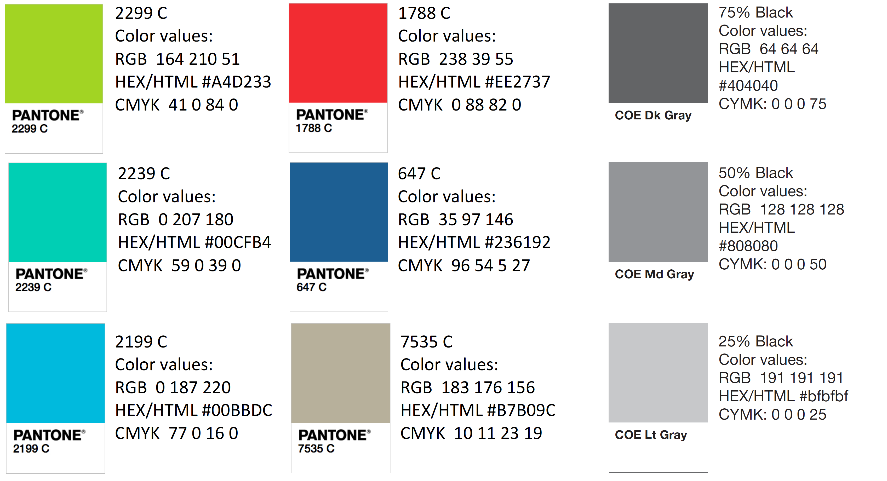
Color Palette

Slide 95
Slides to keep:
Intro, Synopsis of VDR1 (Rename), Customer Needs, minimize Concept Gen. & Selection, Final Selection?, What's Next, Last team member slide, Ref.
Slides to add:
Specs of design
BOM/Ordering parts
Our progress in the InNOLEvation challenge?

Slide 96
APA Tables
Category 1 | Category 2 | Category 3 | Category 4 | Category 5
Item 1
Item 2
Item 3
Item 4
 | Category 2 |  |  | Category 3
Category 1 | subcategory 1 | subcategory 2 |  | subcategory 1 | subcategory 2
Item 1
Item 2
Item 3
Item 4

