Slide 1
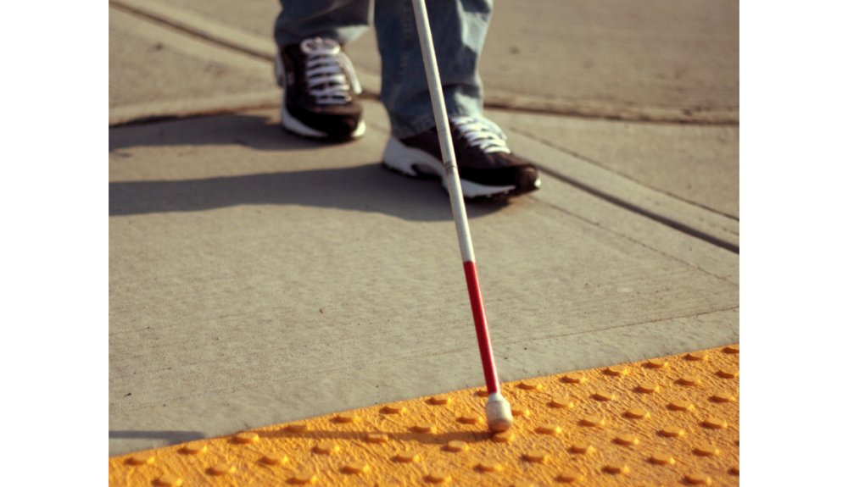
ESD- Vision Impaired Technology
Team 522

Slide 2
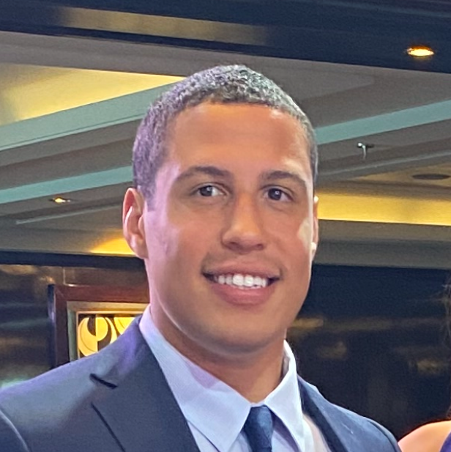
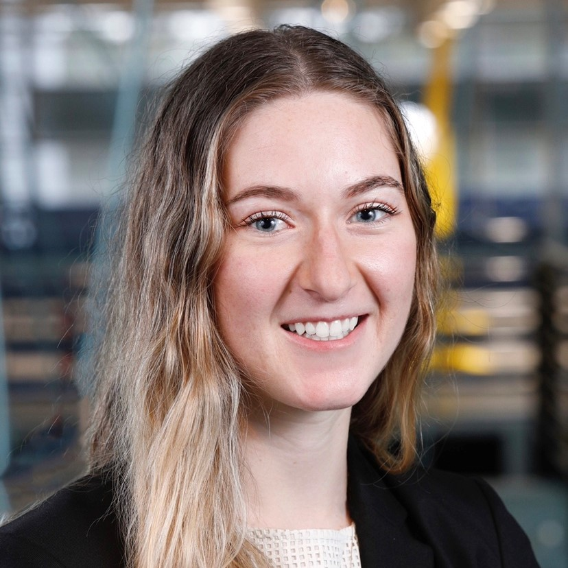
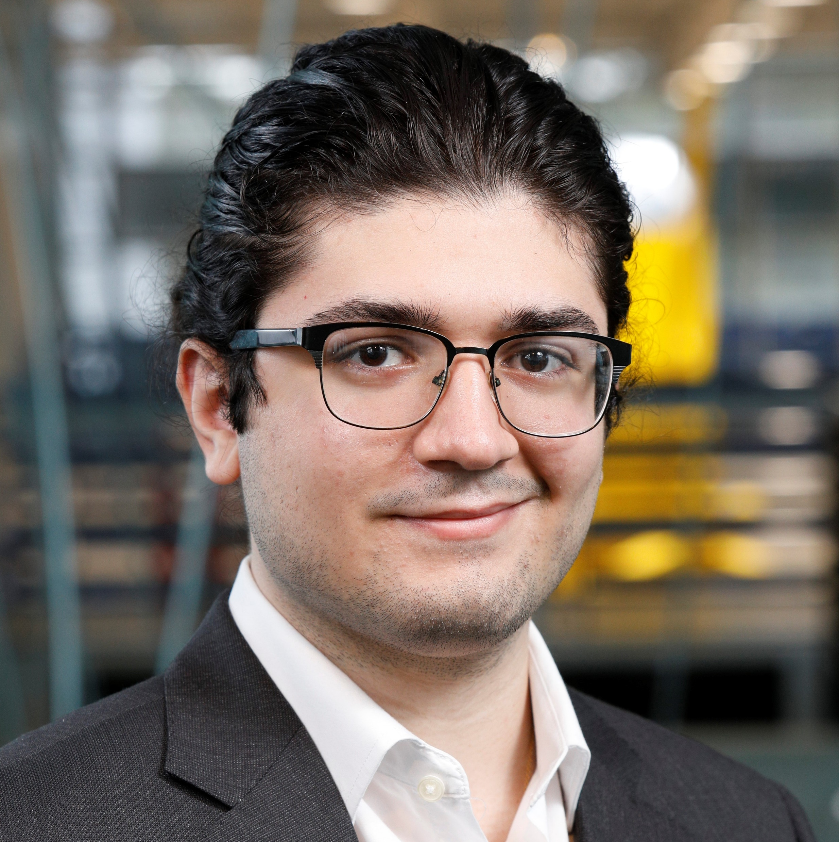
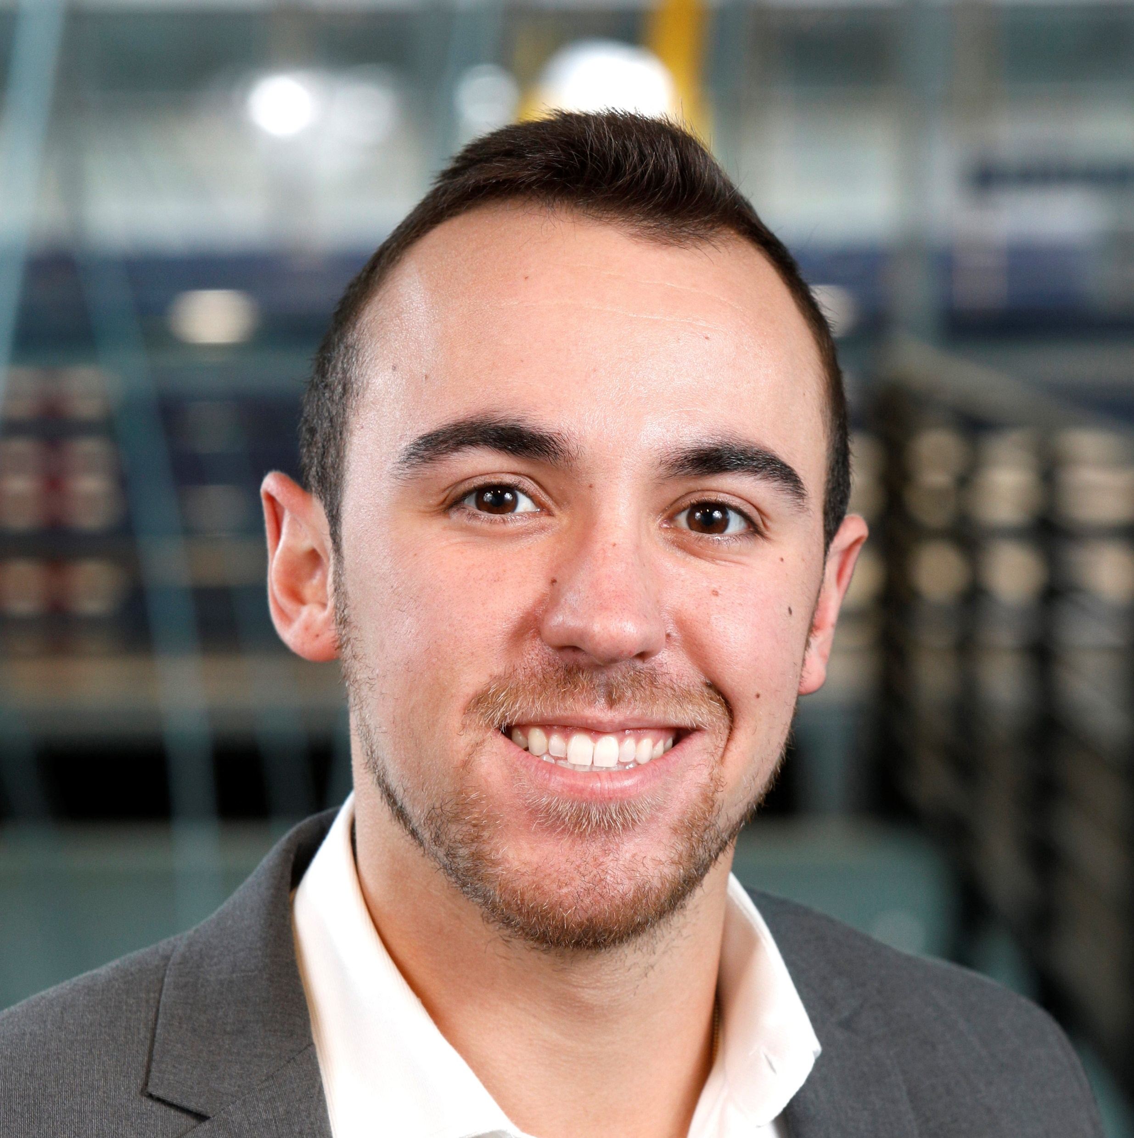
Team 522: Vision Impaired Technology
David Alicea
Field/Test Engineer and Quality Control
Daa16@my.fsu.edu
Madison Jaffe​
Project Manager and Manufacturing/Controls Engineer
Msj16d@my.fsu.edu
Nicolas Garcia
Webmaster, Design Engineer and Resource Manager
Ng16m@my.fsu.edu
Ethan Saffer
Systems and Design
Engineer
Ers16c@my.fsu.edu
Ethan Saffer

Slide 3
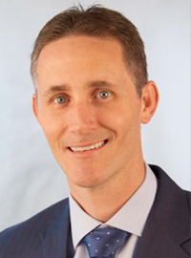
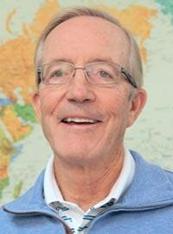

Advisors
Shayne McConomy​
FAMU-FSU College of Engineering​
Department of Mechanical Engineering​
Michael Devine
Florida State University
Jim Moran College of Entrepreneurship
Jerris Hooker
FAMU-FSU College of Engineering
Department of Electrical Engineering
Ethan Saffer

Slide 4
Summary
PROBLEM:
Ethan Saffer

Slide 5
Summary
PROBLEM:
The visually impaired have limited aid in current society. This leaves many of them dependent on others and unemployed.
Ethan Saffer

Slide 6
Summary
PROBLEM:
The visually impaired have limited aid in current society. This leaves many of them dependent on others and unemployed.
Current resources on the market are not affordable or effective for the average income of visually impaired individuals.
Ethan Saffer

Slide 7
Summary
PROBLEM:
The visually impaired have limited aid in current society. This leaves many of them dependent on others and unemployed.
Current resources on the market are not affordable or effective for the average income of visually impaired individuals.
Ethan Saffer

Slide 8
Summary
PROBLEM:
The visually impaired have limited aid in current society. This leaves many of them dependent on others and unemployed.
Current resources on the market are not affordable or effective for the average income of visually impaired individuals.
SOLUTION:
Our product attaches to the standard white cane.
Ethan Saffer

Slide 9
Summary
PROBLEM:
The visually impaired have limited aid in current society. This leaves many of them dependent on others and unemployed.
Current resources on the market are not affordable or effective for the average income of visually impaired individuals.
SOLUTION:
Our product attaches to the standard white cane.
HapTac allows for the visually impaired to sense and scan objects in front of them.
Ethan Saffer

Slide 10
Summary
PROBLEM:
The visually impaired have limited aid in current society. This leaves many of them dependent on others and unemployed.
Current resources on the market are not affordable or effective for the average income of visually impaired individuals.
SOLUTION:
Our product attaches to the standard white cane.
HapTac allows for the visually impaired to sense and scan objects in front of them.
Device is designed to feel organic and comfortable for prolonged uses.
Ethan Saffer

Slide 11
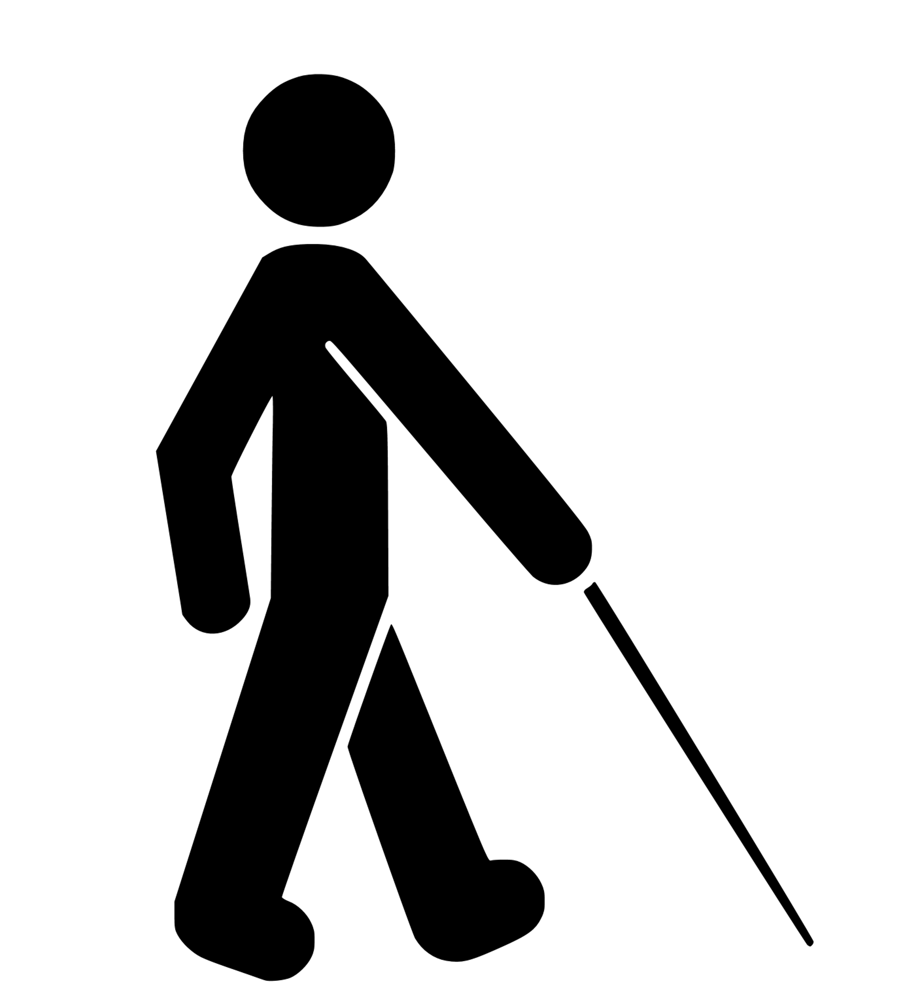
Functions
Ethan Saffer

Slide 12


Functions
Sense
The ultrasonic sensors will sense an object up to 3 meters away.
Ethan Saffer

Slide 13


Functions
Sense
Determine
The ultrasonic sensors will sense an object up to 3 meters away.
The Raspberry Pi will interpret the sensed information to calculate the proximity to an object.
Ethan Saffer

Slide 14


Functions
Sense
Determine
Alert
The ultrasonic sensors will sense an object up to 3 meters away.
The Raspberry Pi will interpret the sensed information to calculate the proximity to an object.
Haptic feedback will alert the user with multiple motors with intensity based on distance.
Ethan Saffer

Slide 15


Functions
Sense
Determine
Alert
The ultrasonic sensors will sense an object up to 3 meters away.
The Raspberry Pi will interpret the sensed information to calculate the proximity to an object.
Haptic feedback will alert the user with multiple motors with intensity based on distance.
Scan
The camera can be activated to scan the desired products.
Ethan Saffer

Slide 16


Functions
Sense
Determine
Alert
The ultrasonic sensors will sense an object up to 3 meters away.
The Raspberry Pi will interpret the sensed information to calculate the proximity to an object.
Haptic feedback will alert the user with multiple motors with intensity based on distance.
Scan
Identify
The camera can be activated to scan the desired products.
Up to 100 stored products will be in the memory of the Raspberry Pi to identify the product.
Ethan Saffer

Slide 17


Functions
Sense
Determine
Alert
The ultrasonic sensors will sense an object up to 3 meters away.
The Raspberry Pi will interpret the sensed information to calculate the proximity to an object.
Haptic feedback will alert the user with multiple motors with intensity based on distance.
Scan
Identify
Notify
The camera can be activated to scan the desired products.
Up to 100 stored products will be in the memory of the Raspberry Pi to identify the product.
Haptic feedback will
notify the user when the product has been identified and a speaker will relay the product name.
Ethan Saffer

Slide 18

Current Situation
Top View:
Side View:
45°
45°* 45°*
*Based on Standard Technique
3 feet
Nicolas Garcia

Slide 19
Situation Using HapTac
Top View:
Side View:
12 feet
5°
15° 15°
45°
45°* 45°*
*Based on Standard Technique
3 feet
Nicolas Garcia

Slide 20
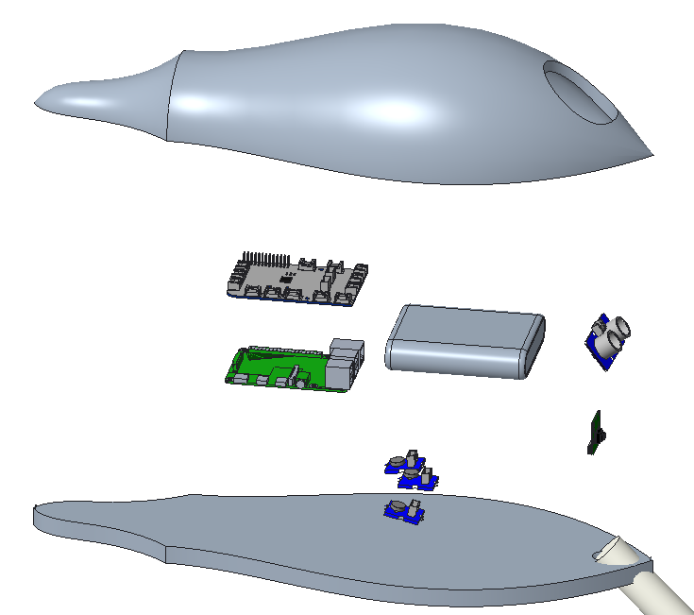
Housing: First Edition
GrovePi+
Battery Pack
Ultrasonic Sensor
Housing
Camera
Raspberry Pi 4
Vibration Motors (3)
Nicolas Garcia

Slide 21
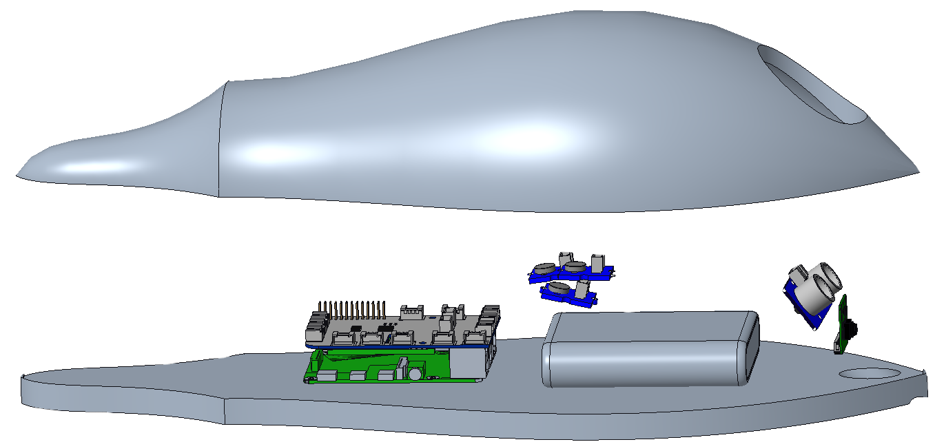

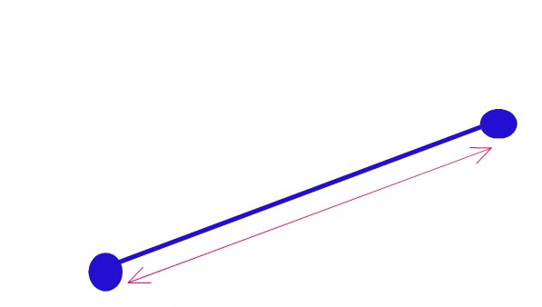
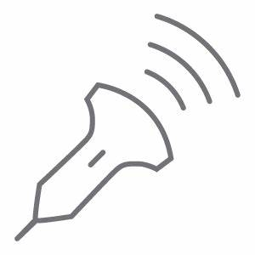

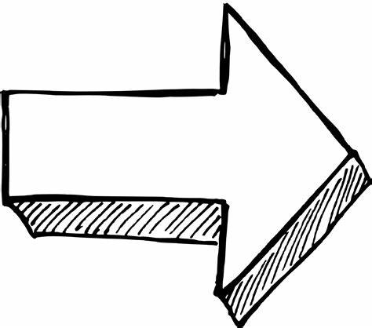

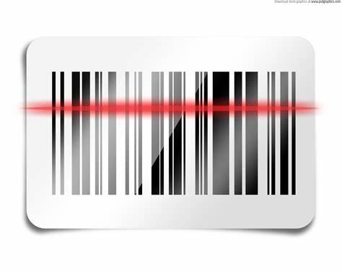


Housing: First Edition
Nicolas Garcia
Sense
Determine
Alert
Sense
Determine
Alert
Sense
Sense
The ultrasonic sensor will sense an object up to 3 meters away.
The Raspberry Pi will interpret the sensed information to calculate the proximity to an object.
Haptic feedback will alert the user with multiple motors with intensity based on distance.
The ultrasonic sensor will sense an object up to 3 meters away.
The Raspberry Pi will interpret the sensed information to calculate the proximity to an object.
Haptic feedback will alert the user with multiple motors with intensity based on distance.
Scan
Identify
Notify
Scan
Identify
Notify
The camera can be activated to scan the desired products.
The camera can be activated to scan the desired products.

Slide 22
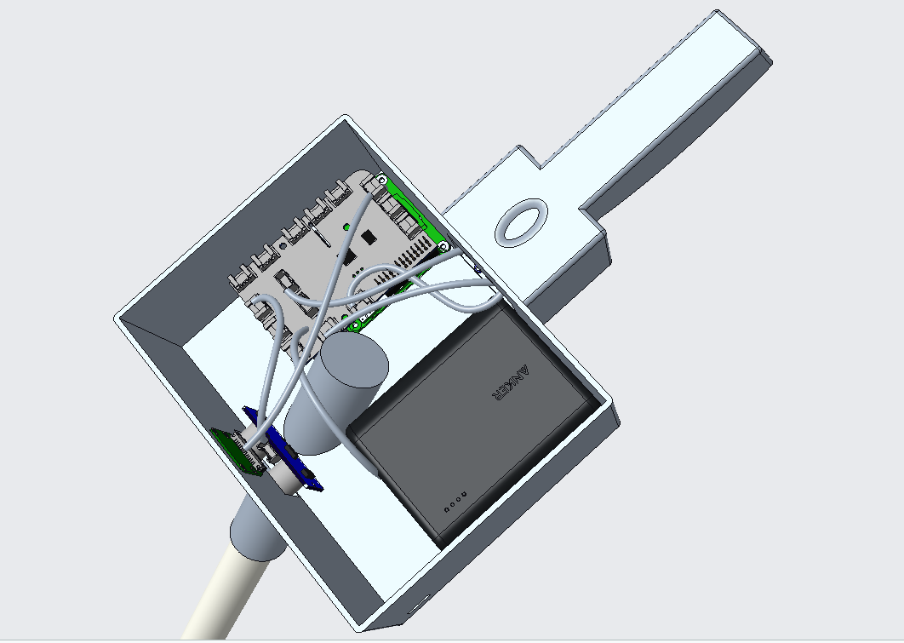
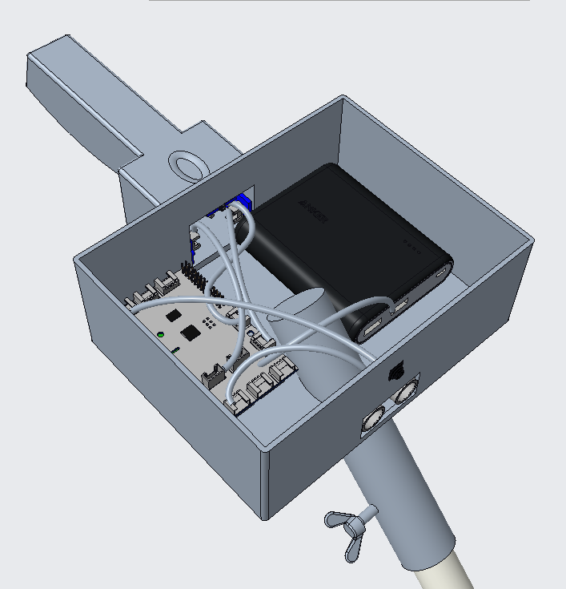
Housing: Second Edition
Nicolas Garcia

Slide 23
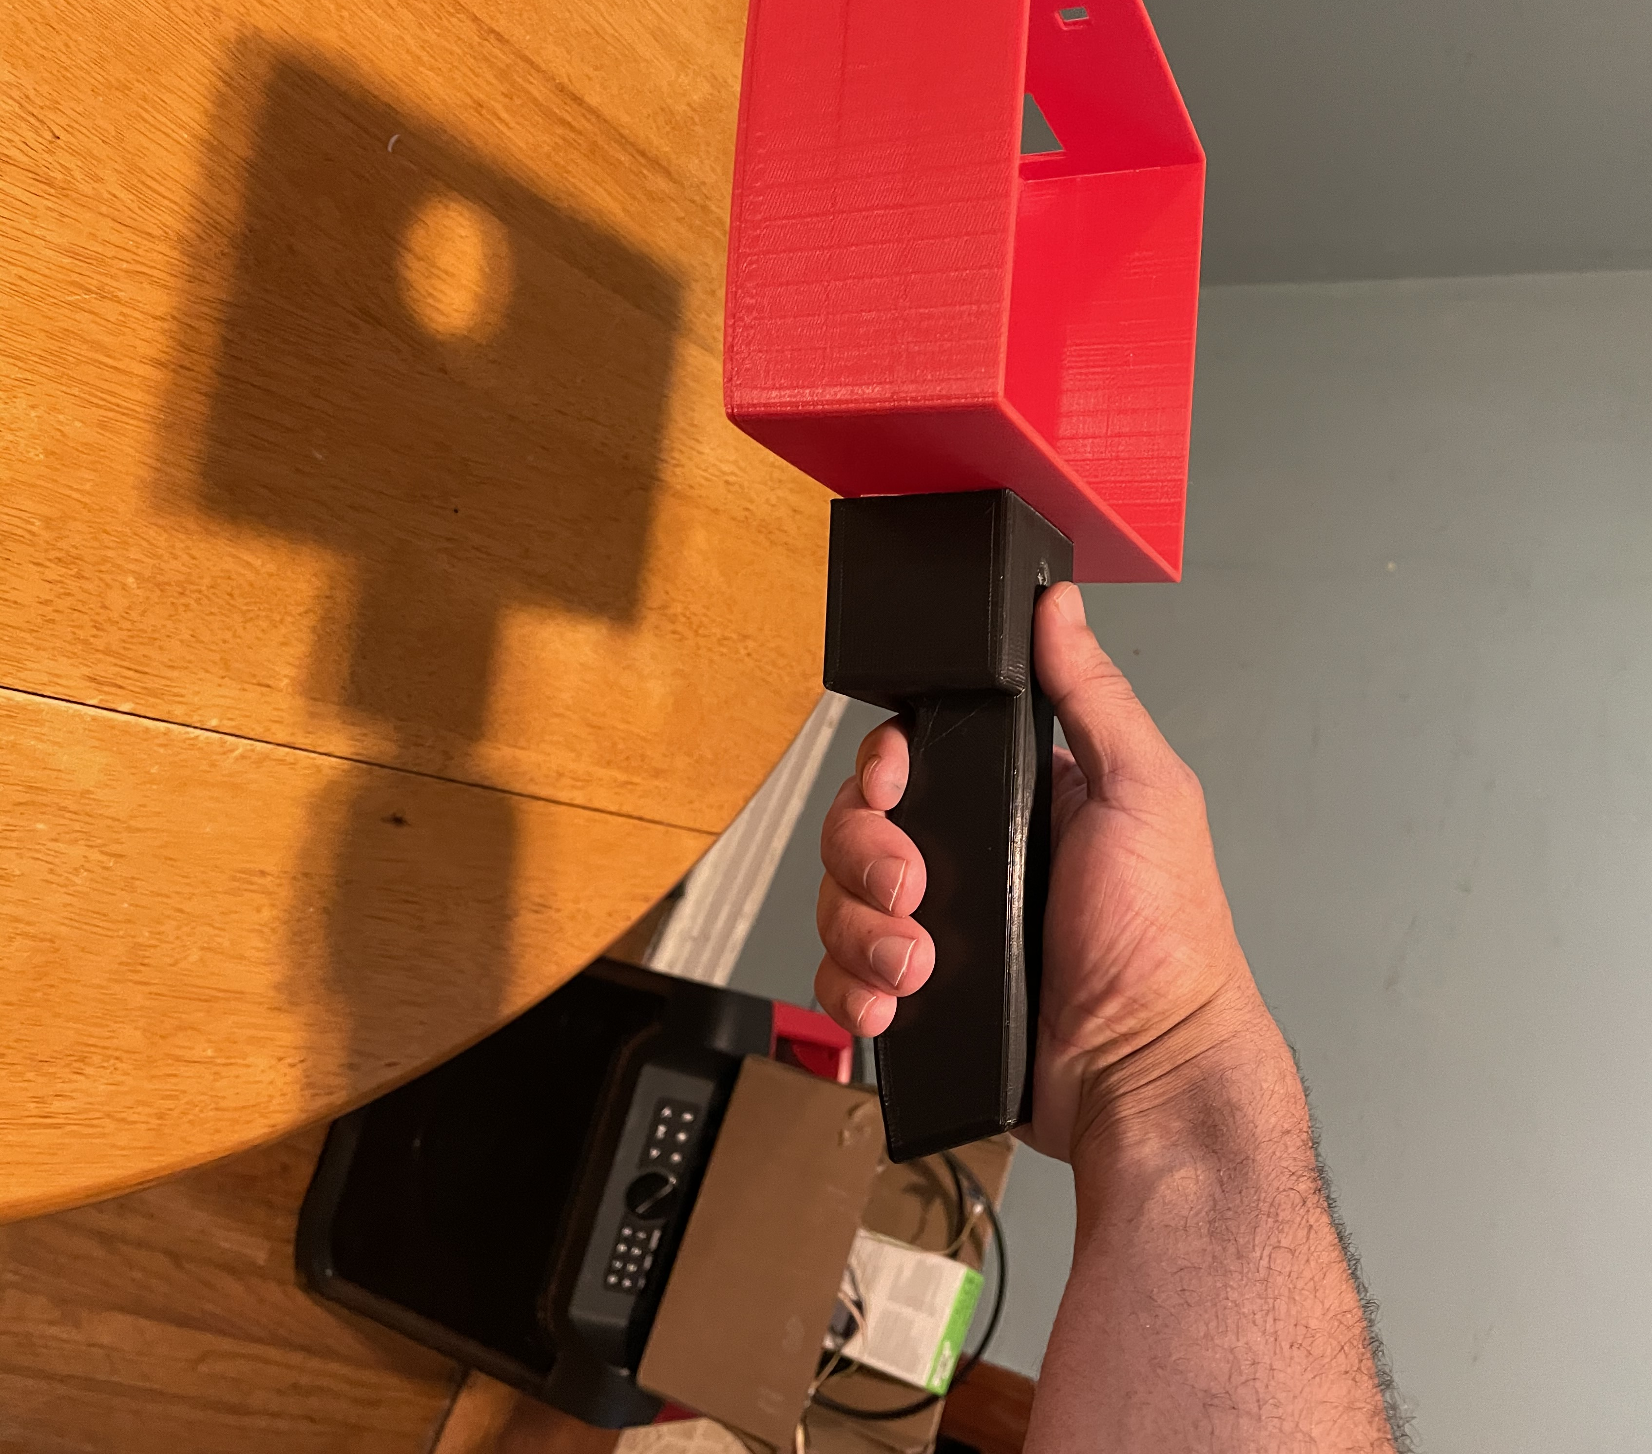
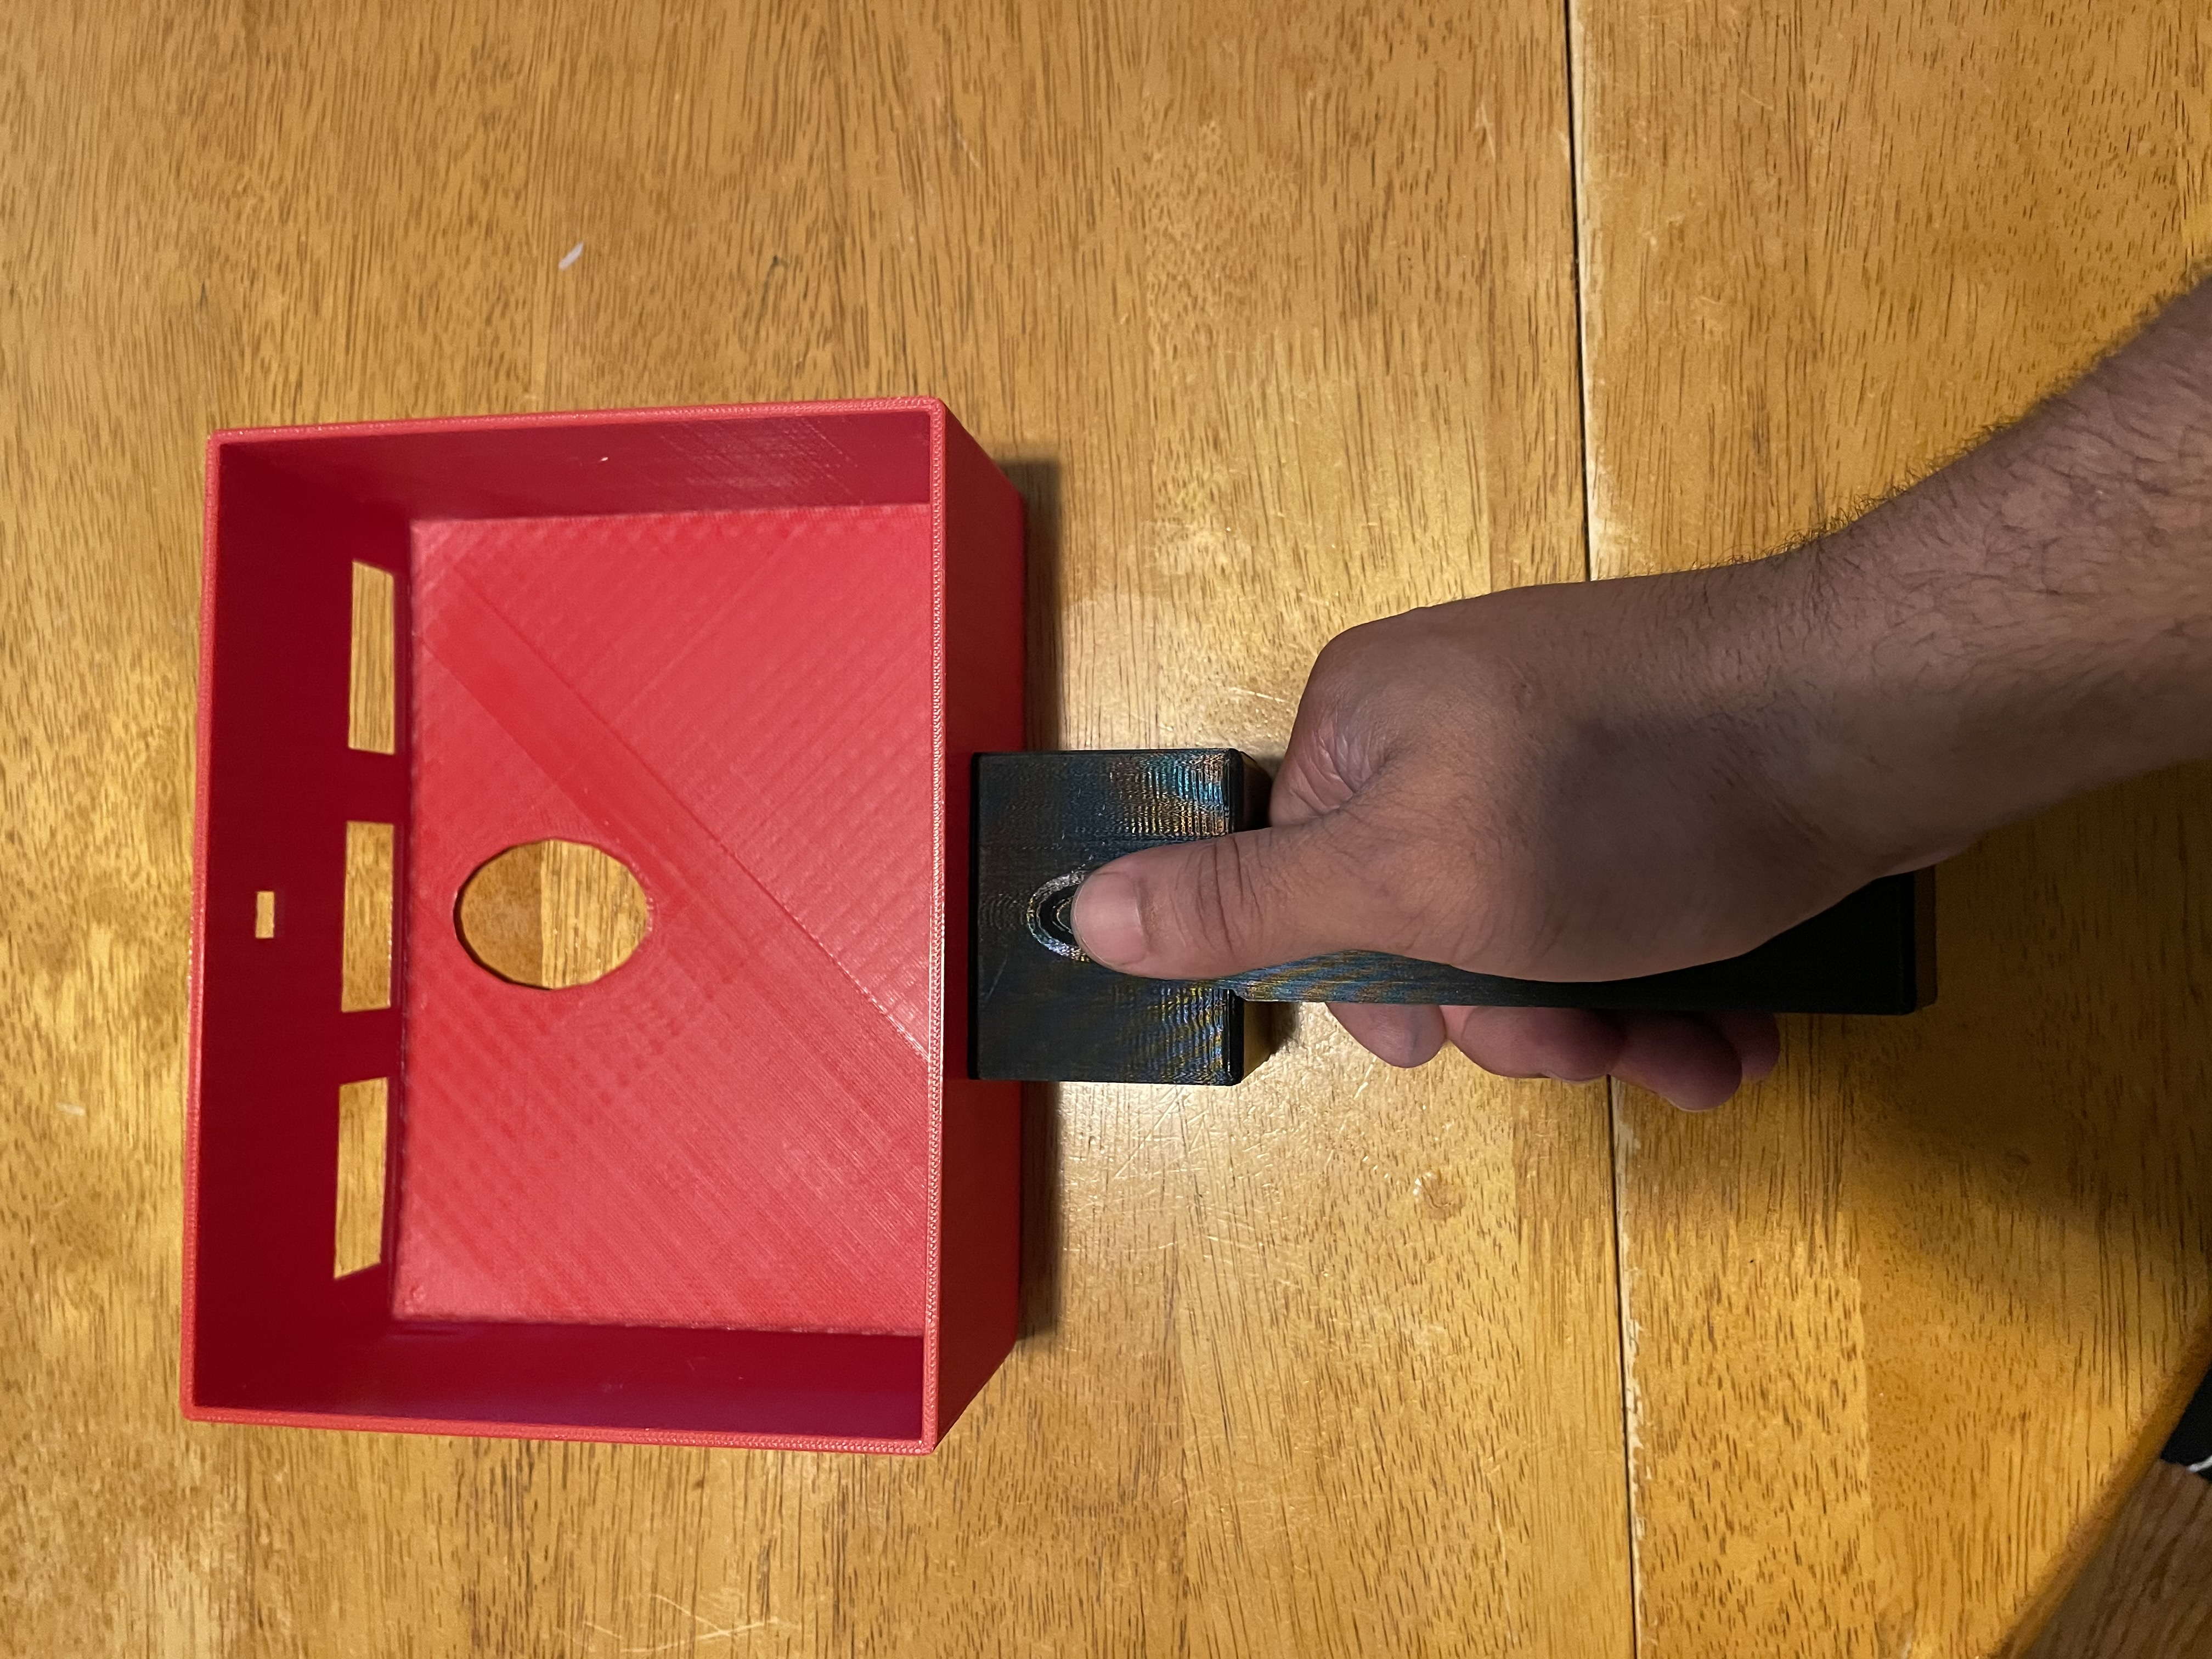
Housing Concerns: Handle
The handle is too wide, the user's fingers are not able to completely wrap around it.
The groove for the thumb is placed higher than what is comfortable
Nicolas Garcia

Slide 24
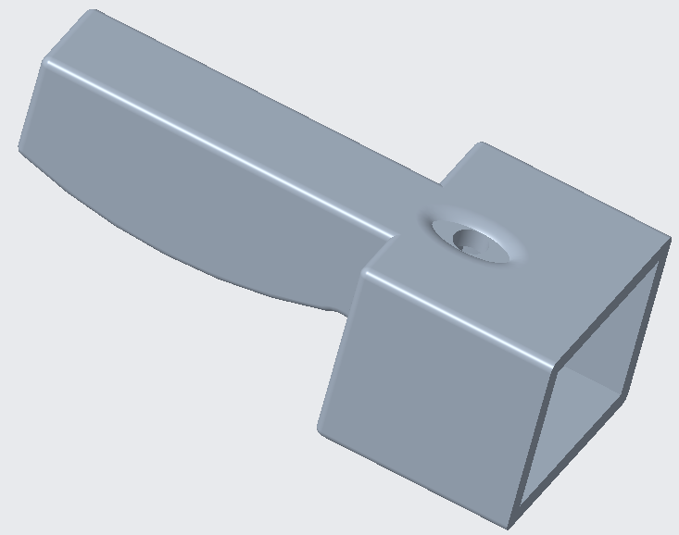
Housing Concerns: Addressed
Made shorter
Slimmer profile
Flat bottom for efficient printing
Opening for button at thumb groove
  Enables camera use
Nicolas Garcia

Slide 25
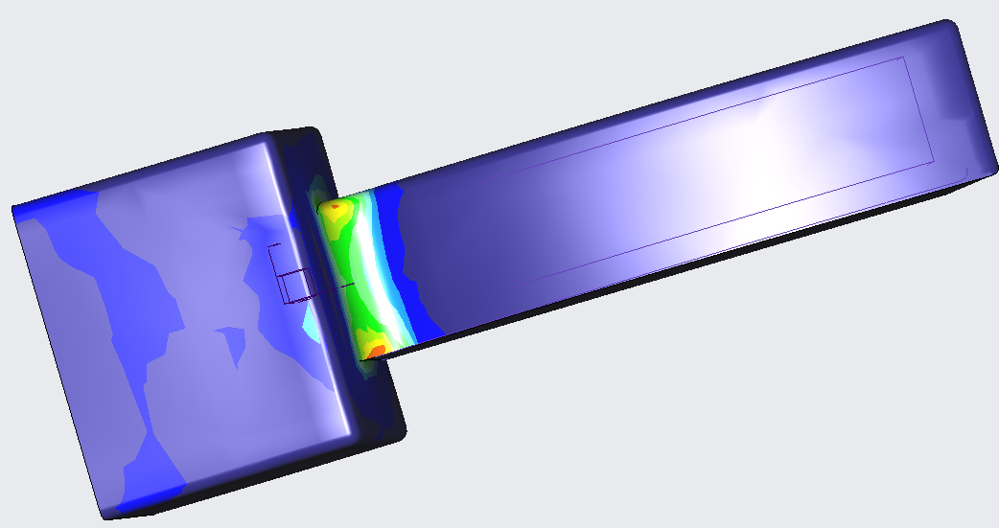

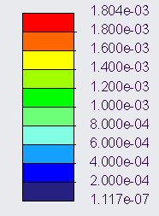
Housing Concerns: Addressed
Megapascals (MPa)
The orange shows where the stress is highest.
Nicolas Garcia

Slide 26
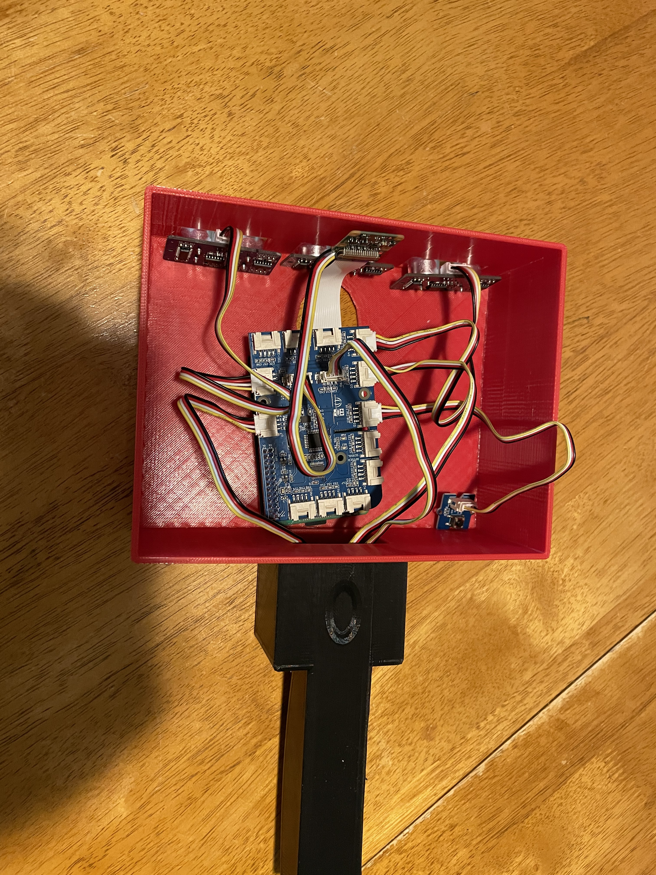
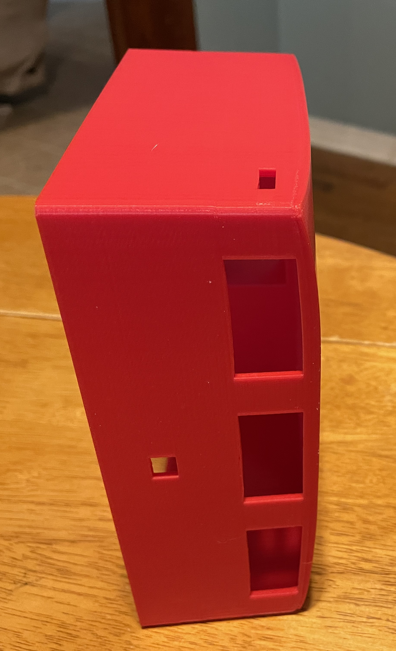
Housing Concerns – Main Housing
Too much excess room
The ultrasonic sensors cannot be properly mounted
Warping is taking place throughout the duration of the print
*Battery and speaker not pictured
Madison Jaffe

Slide 27
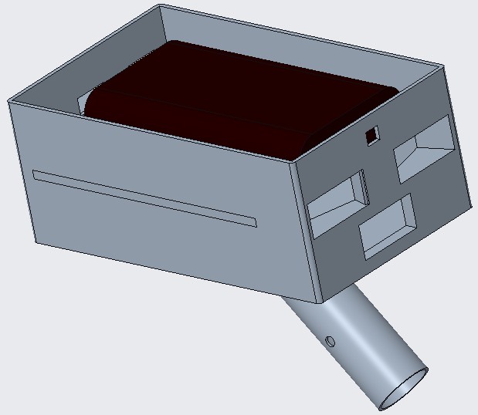
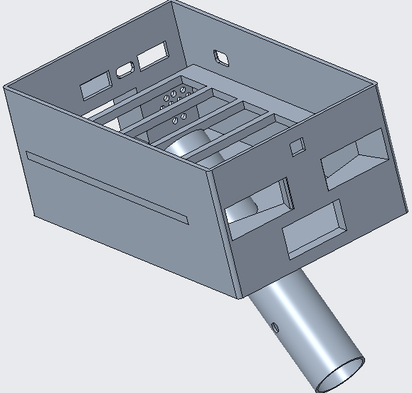
Housing
Madison Jaffe

Slide 28
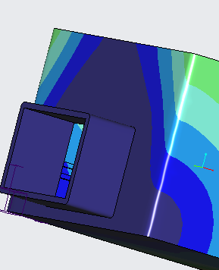
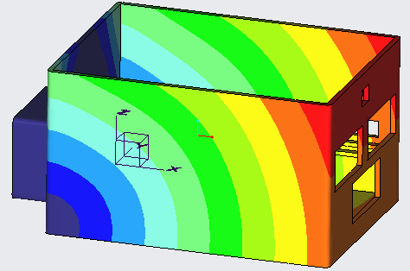

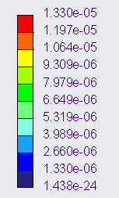

Housing Validation
Madison Jaffe

Slide 29
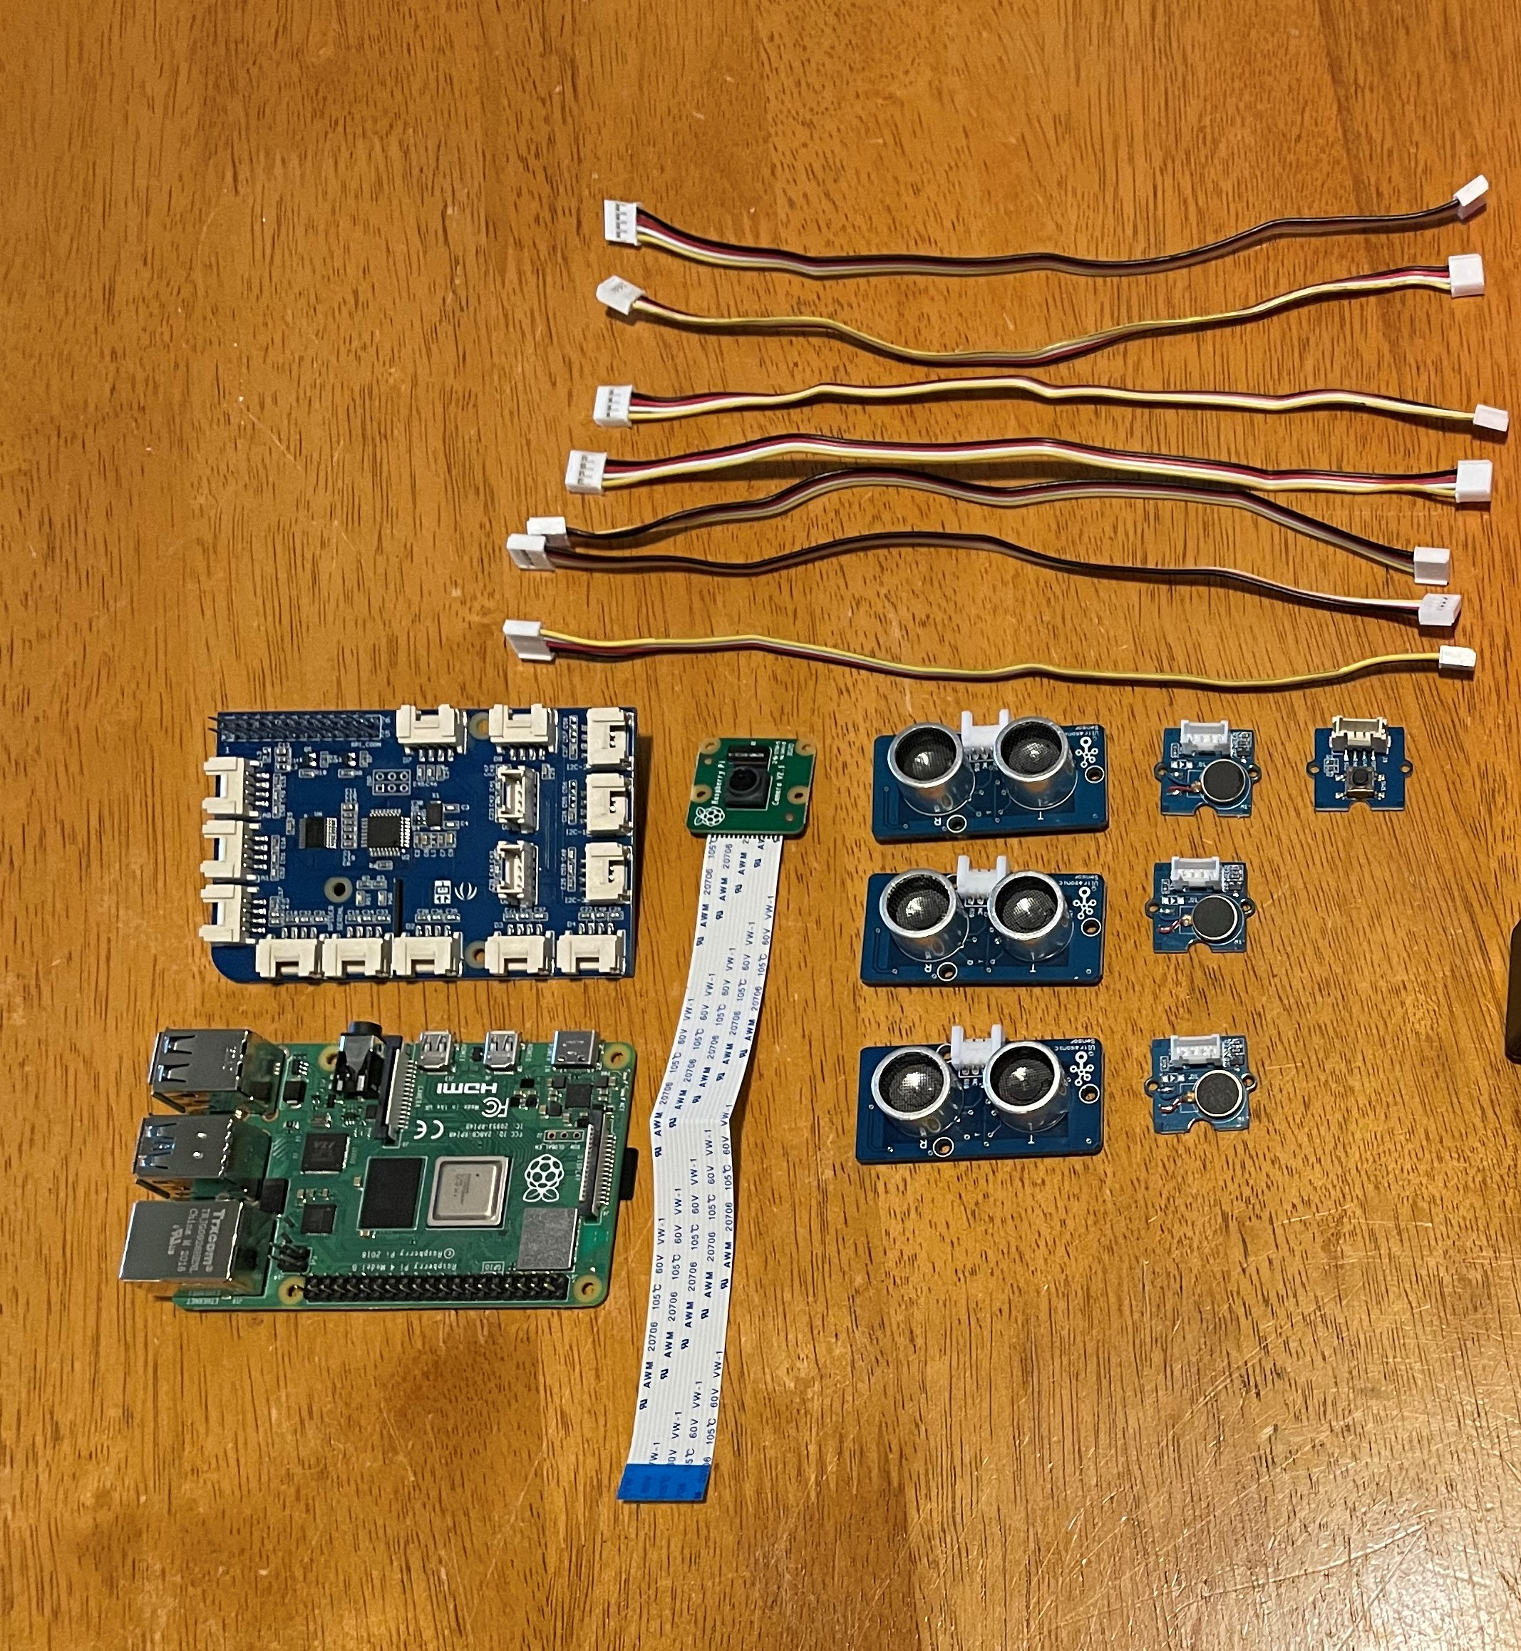
Raspberry Pi and Grove Parts
Raspberry Pi acts as our controller
Grove Pi is the attachment board that makes the Grove parts accessible
Raspberry Pi Camera is used to identify items
Ultrasonic sensors and vibration motors detect objects and notify the user of their presence
David Alicea

Slide 30
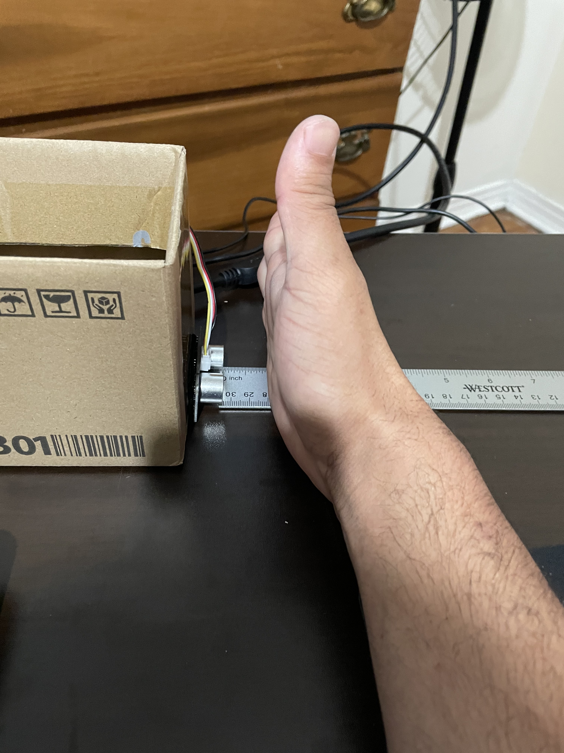
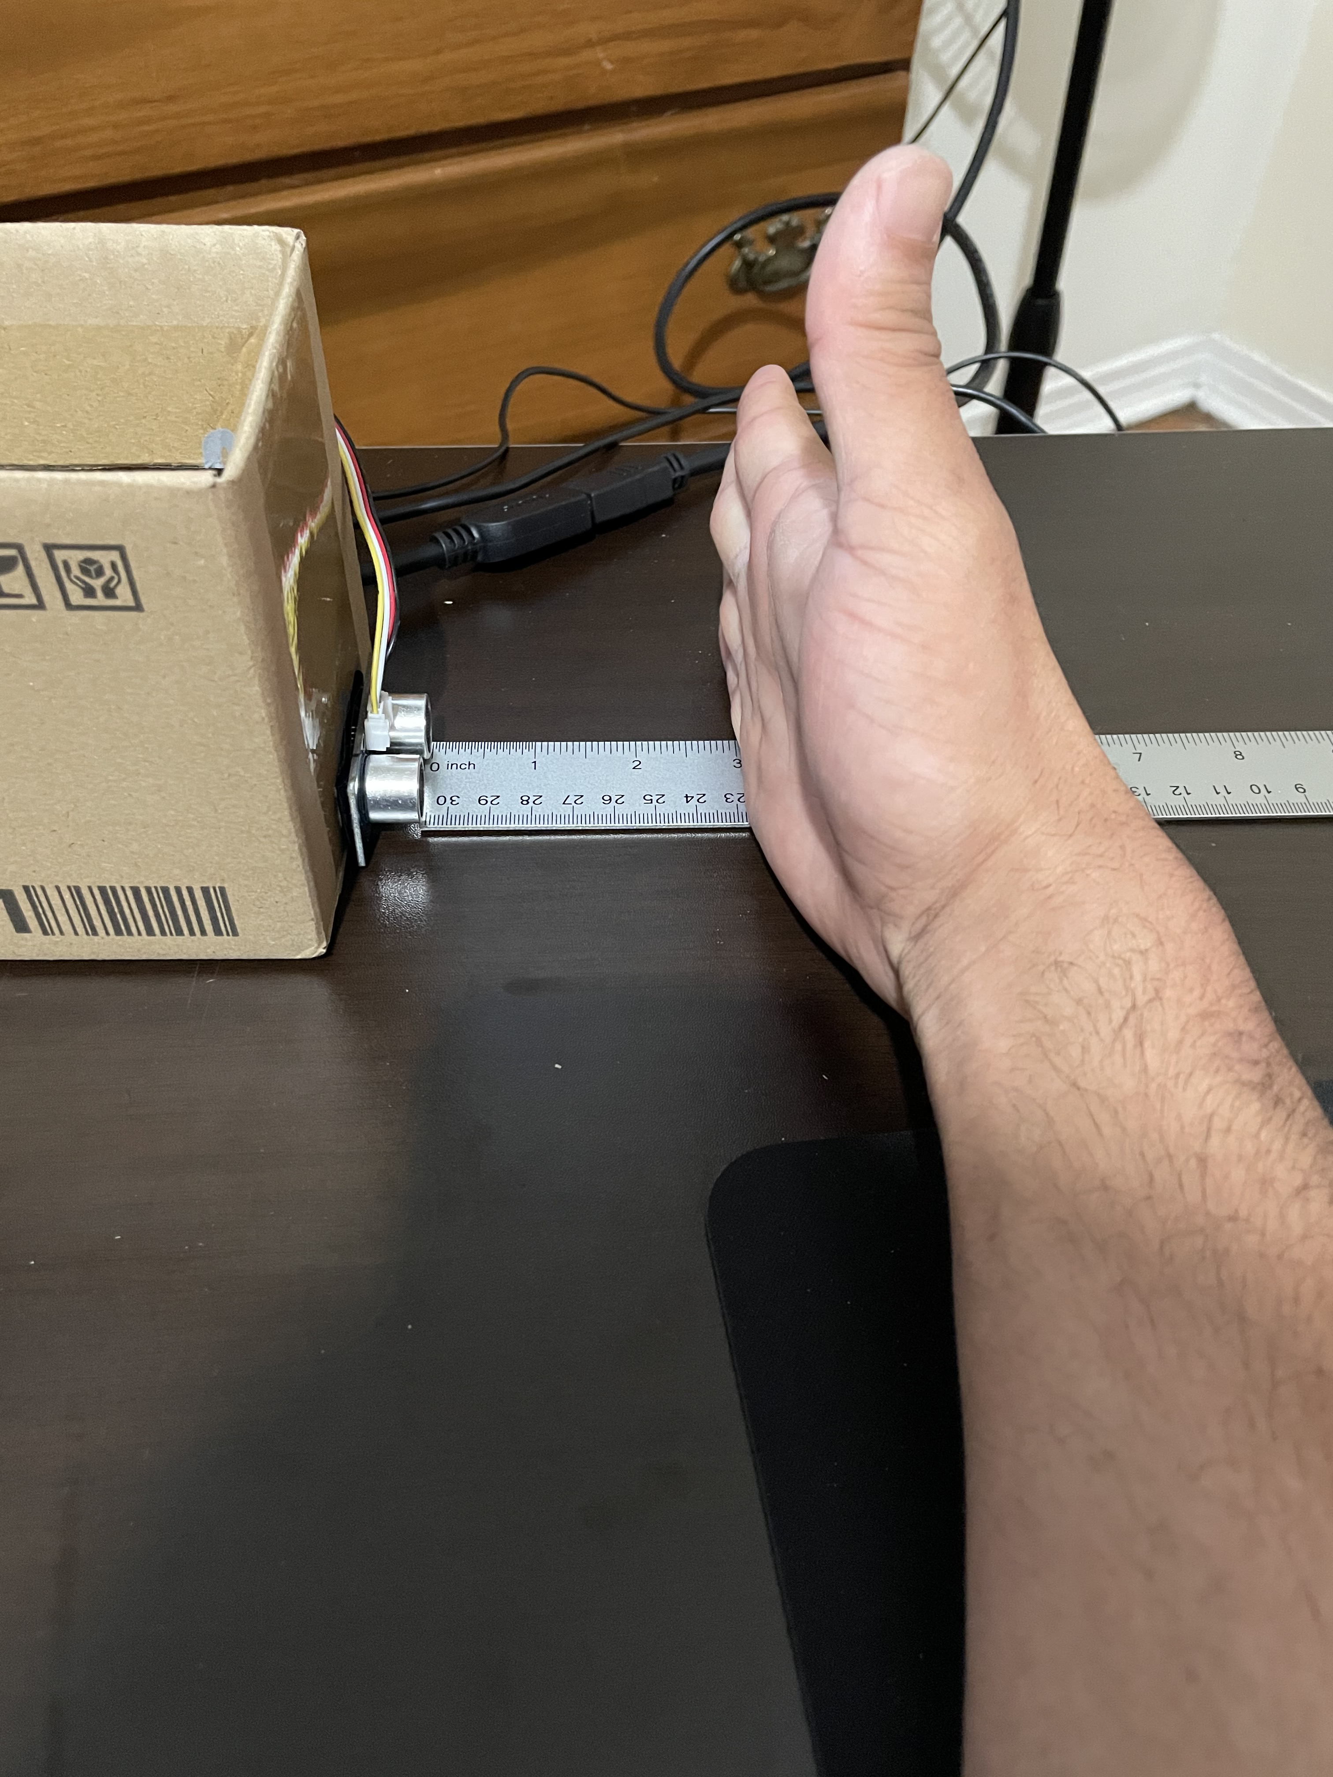
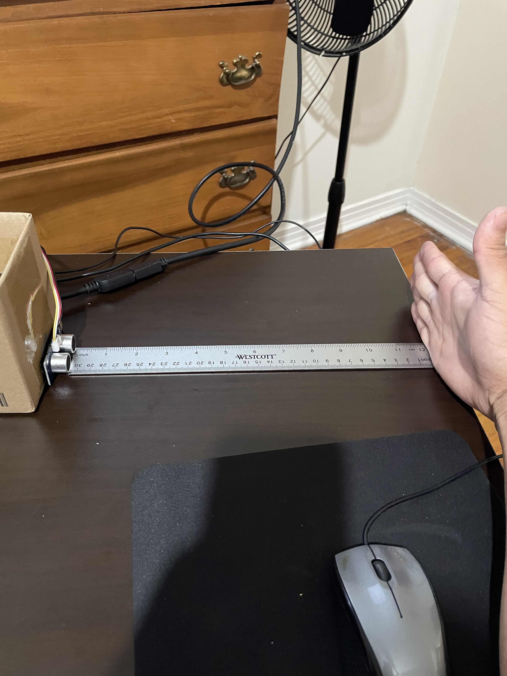
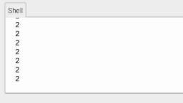
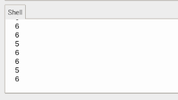
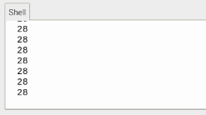
Sensor Validation
2.54 cm (1 inch)
7.62 cm (3 Inches)
30.48 cm (12 Inches)
David Alicea

Slide 31
Raspberry Pi: Sensors and Motors Code
Sensors are turned on
Object distance measured (cm)
Distance <= 100
100 < Distance <= 200
200 < Distance <= 300
Distance > 300
No
No
No
Yes
Yes
Yes
Yes
Motor is turned on
Motor is turned on
and off at 0.5 second intervals
Motor is turned on
and off at 1 second intervals
Motor is turned off
David Alicea

Slide 32
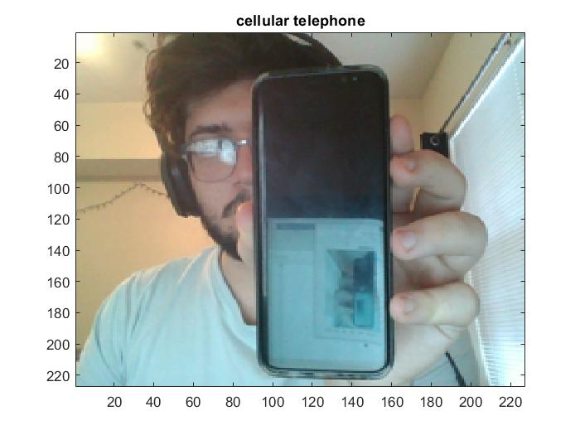
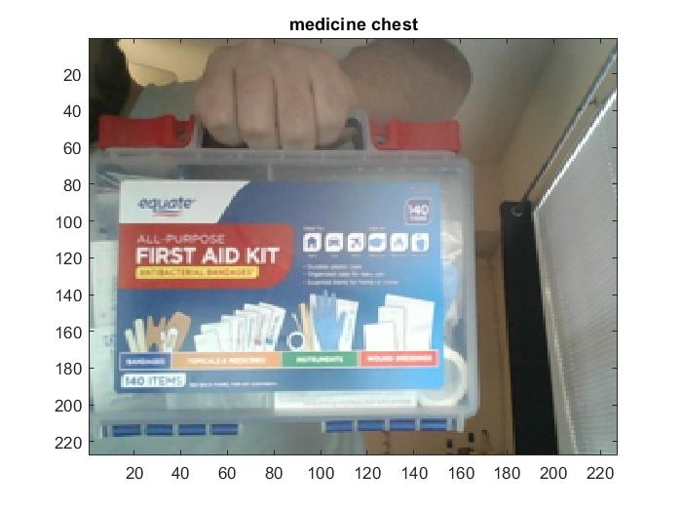
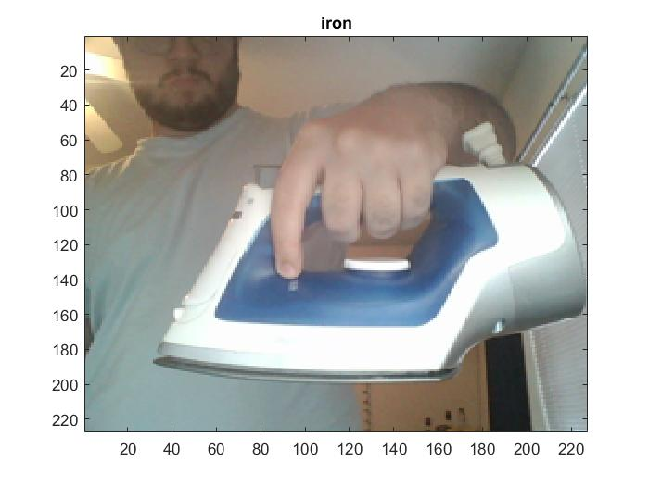
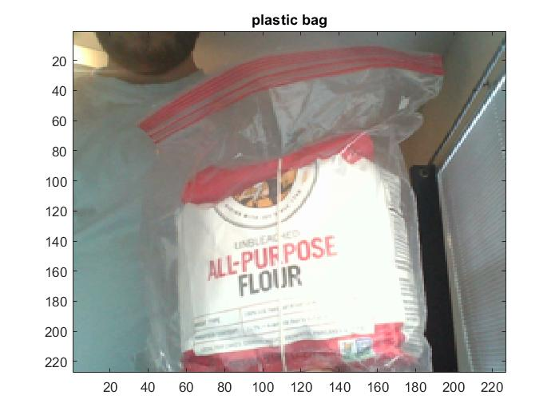
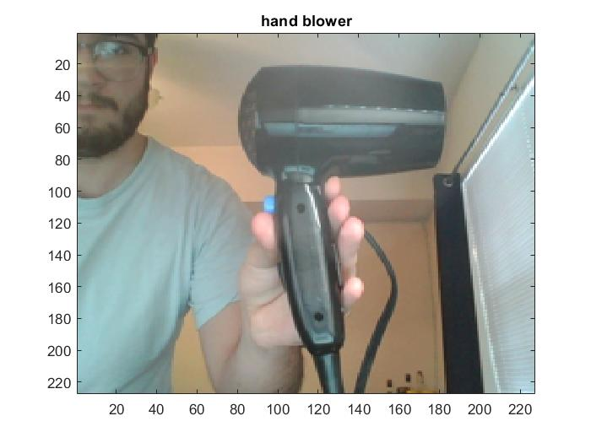
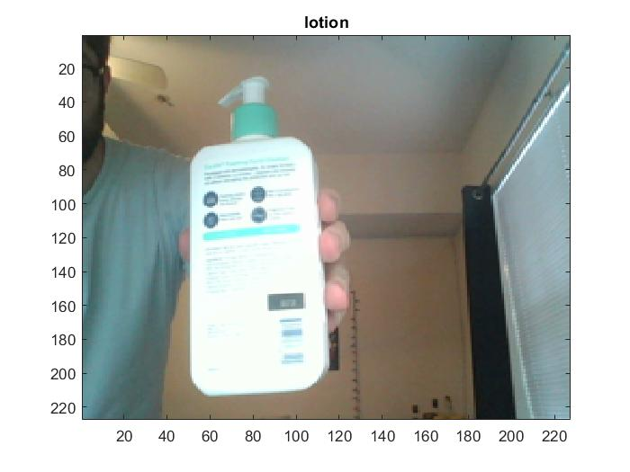
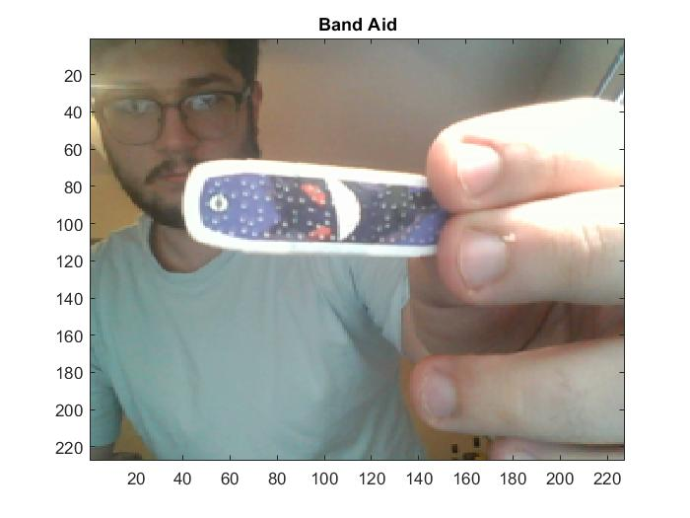
Camera Identification - AlexNet
Nicolas Garcia

Slide 33
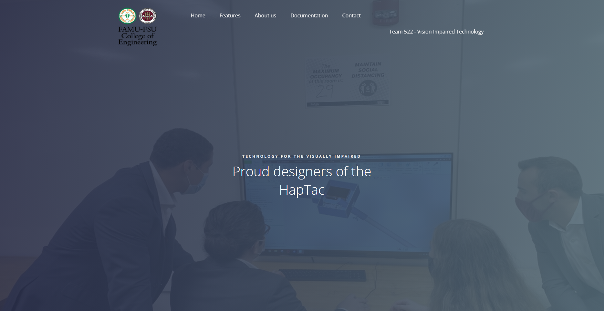
Team Website
Nicolas Garcia

Slide 34
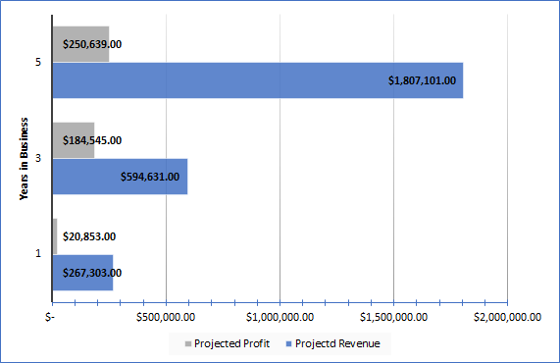
InNOLEvation
Challenge
Unit Price: $299
Yearly Projections
Competed in the InNOLEvation Competition
Selected as a finalist
  Received $500 for the company
Ethan Saffer

Slide 35
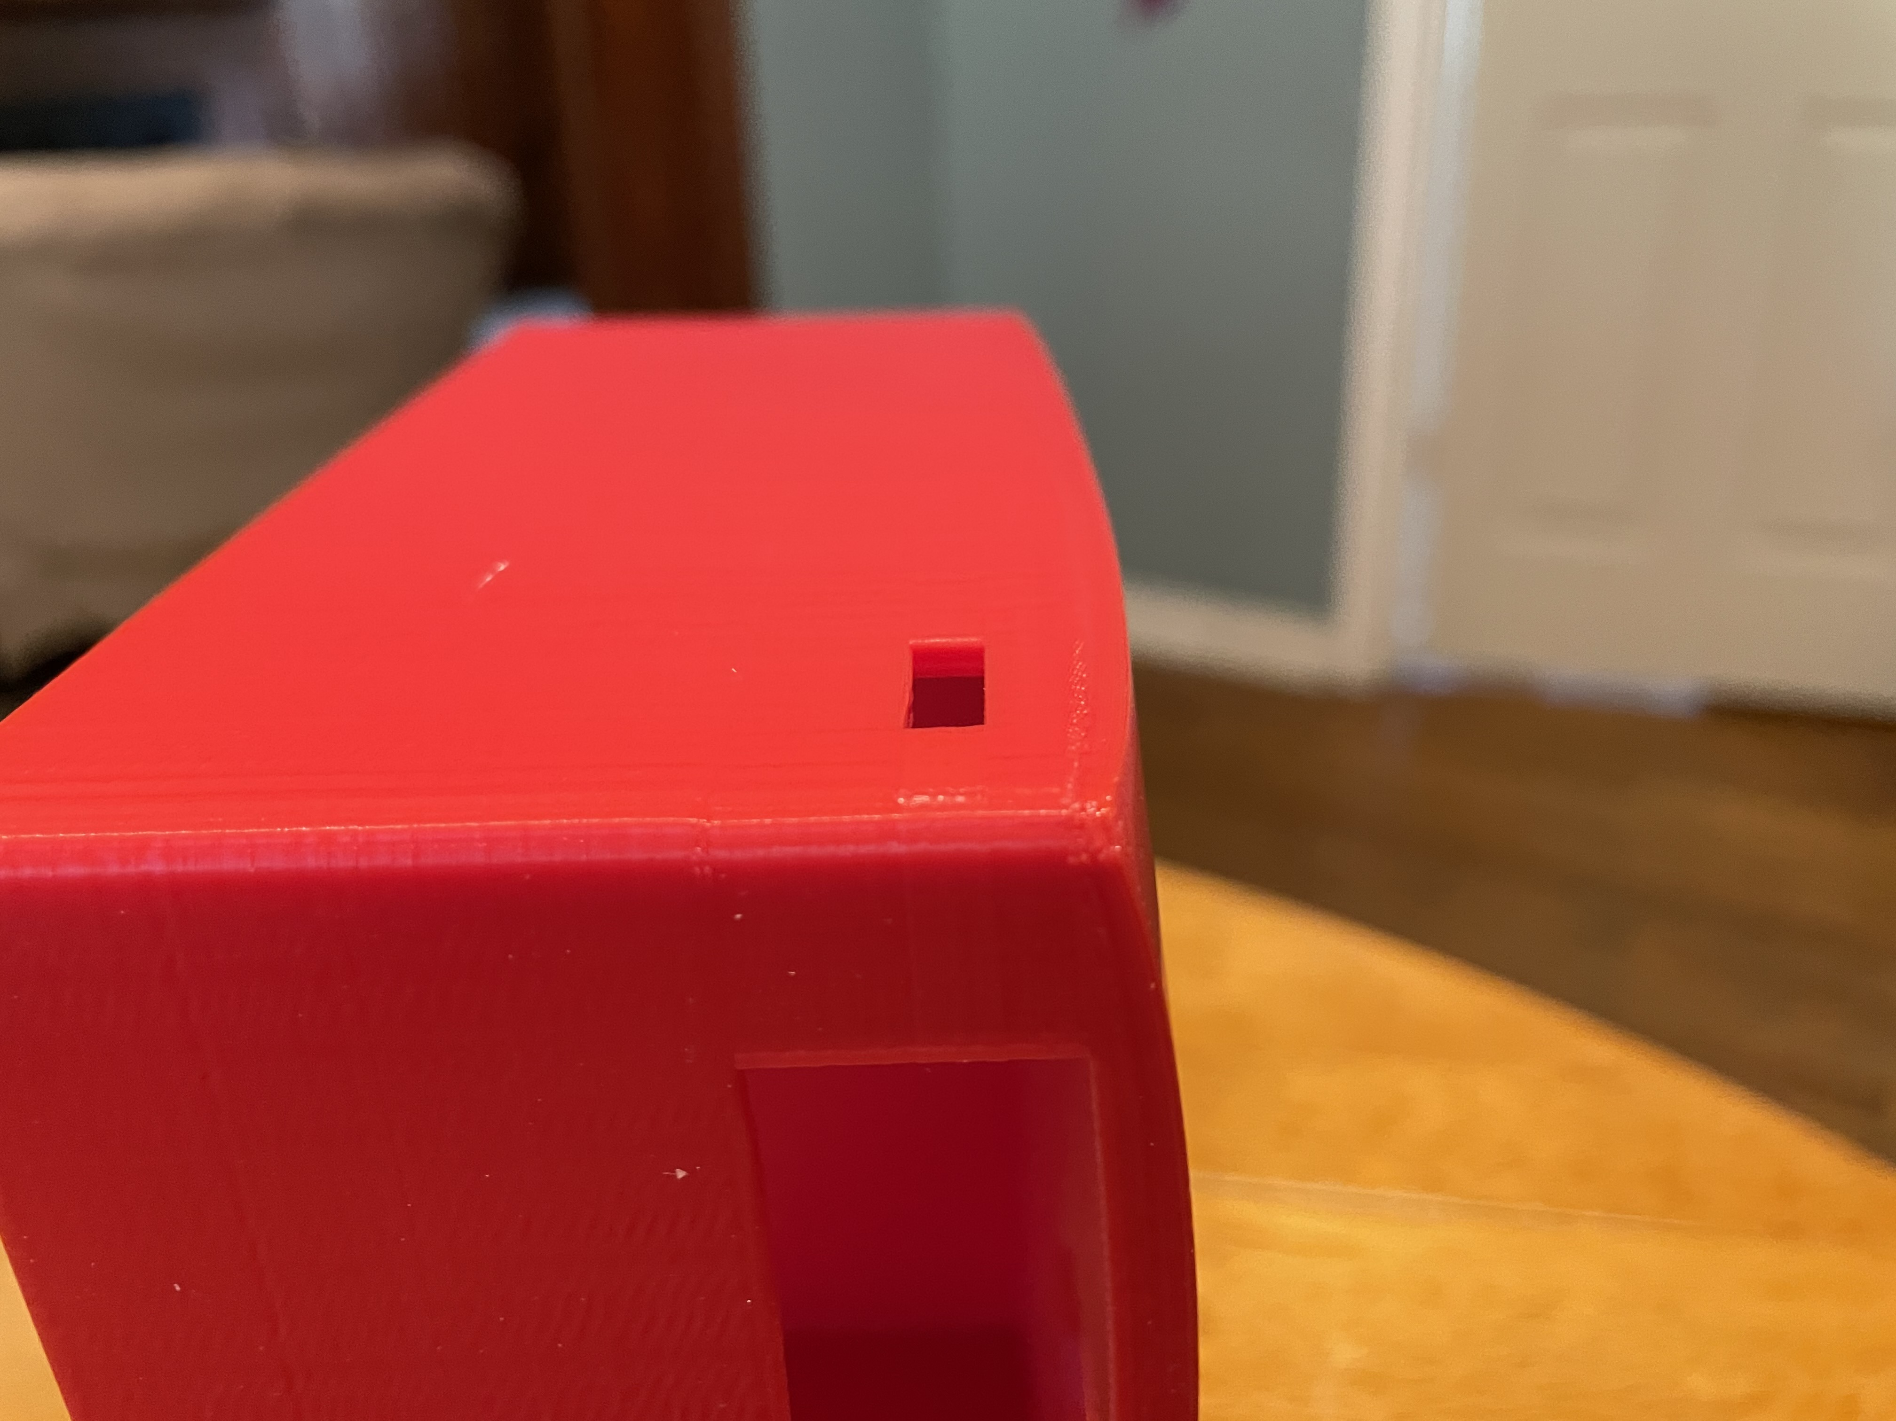
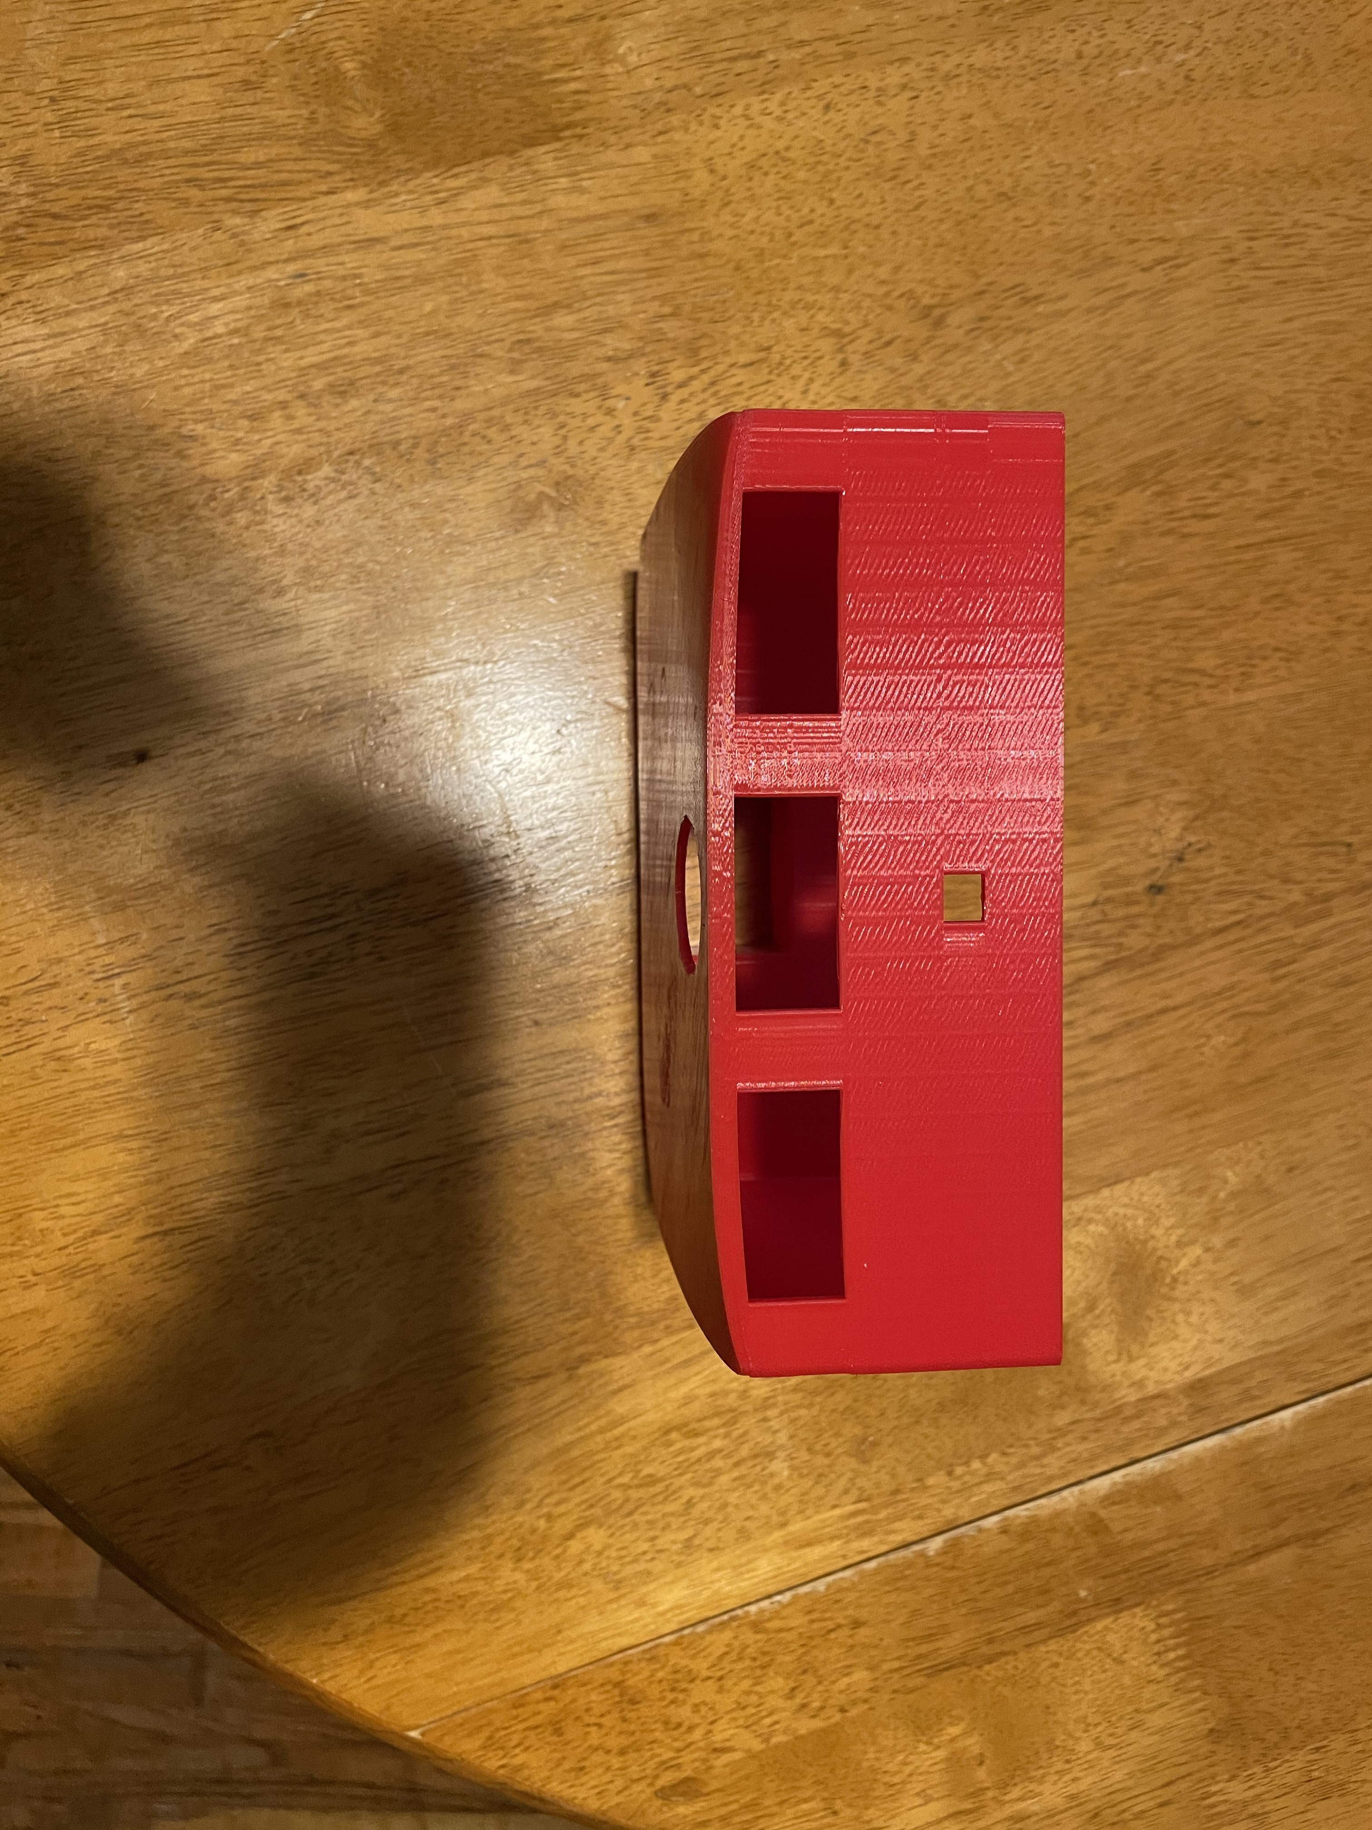
Lessons Learned
3D Printing is good for quick models
Tends to warp significantly without correct parameters
The front of the main housing has a downward bend.
Corners are warped, altering geometry
Madison Jaffe

Slide 36
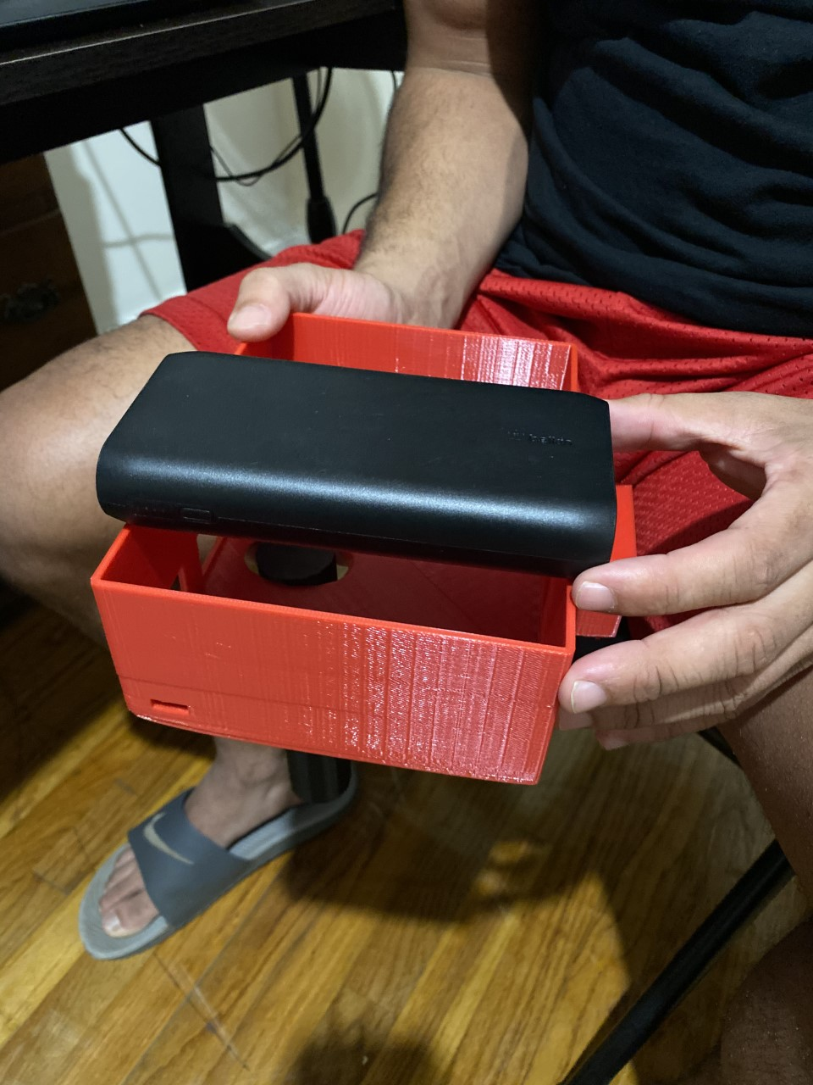
Lessons Learned
The battery served as the hardest object to design around.
  It is the largest and heaviest component of our assembly
New iterations of housing were made to make it as compact as possible.
Madison Jaffe

Slide 37
Lessons Learned
7.6 Centimeters
Proper calibration of sensors and motors are pivotal for their accurate usage.
Here the sensor should read 7.6cm, rounded between 7 and 8.
  The error propagates further as the distance increases
David Alicea

Slide 38
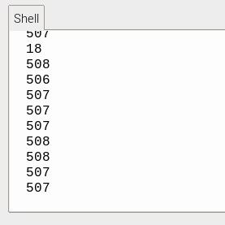

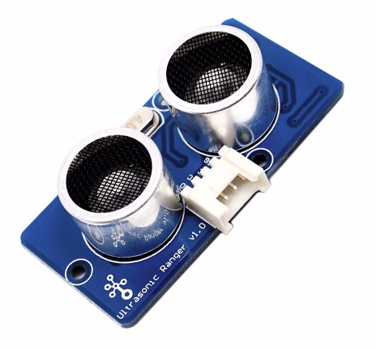




Lessons Learned
Ultrasonic sensor is directed forward and does not support large changes in angle or tilt.
O
B
J
E
C
T
O
B
J
E
C
T
David Alicea

Slide 39
Incomplete Work
Function | Target | Complete
Alert of Elevation* | 0.25 to 12 inches | Yes
Determine Location* | Margin of error of at most 16 feet | No
Alert of Physical Object* | 65 inches | Yes
Identify Possible Threats* | Up to 60 miles per hour | Yes
Access Emergency Contact | 15 seconds | No
Interpret Sensory Information* | 7 seconds | Yes
Store Frequent Tasks | 1 GB | Yes
Interface with Pre-Existing Skills | 70% | Yes*
Compete within Market | 20% | Yes
Remain Lightweight | <5.1 lb | Yes
Remain Discrete | 70% User Approval | N/A
Ethan Saffer

Slide 40
Incomplete Work
Image Recognition
Variable motors & sensors
We have most of the major functions of our project in separate stand-alone conditions
  We need to integrate them into the assembled final product.
Still waiting on parts to be shipped and added to final housing design.
Integrated Final Design
Final Housing
Haptic Feedback Location
Ethan Saffer

Slide 41
Summary
Overall, the project is successful in terms of a minimum viable prototype.
A few ideas needed to be dismissed due to scope creep.
Had to order cheaper parts to construct a prototype that would be cost efficient to market and sell.
  Ultimately affected the accuracy of the device.
Ethan Saffer

Slide 42
Reference
[1] Ebben, J. M., PhD. (n.d.). Wrists at risk: Awkward postures to avoid. Retrieved February 18, 2021, from https://www.iacindustries.com/get-started/ergonomics/wrists-at-risk.asp
[2] González, A., Salgado, D., García Moruno, L., & Sánchez Ríos, A. (2018). An Ergonomic Customized-Tool Handle Design for Precision Tools using Additive Manufacturing: A Case Study. Applied Sciences, 8(7), 1200. doi:10.3390/app8071200
[3] McConomy, S. (2020, November 11). Engineering Characteristics, Functions, Targets, and Metric. FAMU-FSU College of Engineering.
[4] National Federation of The Blind. https://www.nfb.org/resources/blindness-statistics
[5] Queen, K. (2016, June). 7 Ways to Make Communities More Livable for People With Vision or Hearing Impairments. AARP.
[6] Rosen, S. (n.d.). LONG CANE TECHNIQUES. Retrieved March 03, 2021, from https://tech.aph.org/sbs/04_sbs_lc_study.html
[7] Wang, C., & Cai, D. (2020). Hand tool handle size and shape determination based on hand measurements using a contour gauge. Human Factors and Ergonomics in Manufacturing &amp; Service Industries, 30(5), 349-364. doi:10.1002/hfm.20846
Ethan Saffer

Slide 43
Team 522: Vision Impaired Technology
David Alicea
Field/Test Engineer and Quality Control
Daa16@my.fsu.edu
Madison Jaffe​
Project Manager and Manufacturing/Controls Engineer
Msj16d@my.fsu.edu
Nicolas Garcia
Webmaster, Design Engineer and Resource Manager
Ng16m@my.fsu.edu
Ethan Saffer
Systems and Design
Engineer
Ers16c@my.fsu.edu
Ethan Saffer

Slide 44
APPENDIX

Slide 45
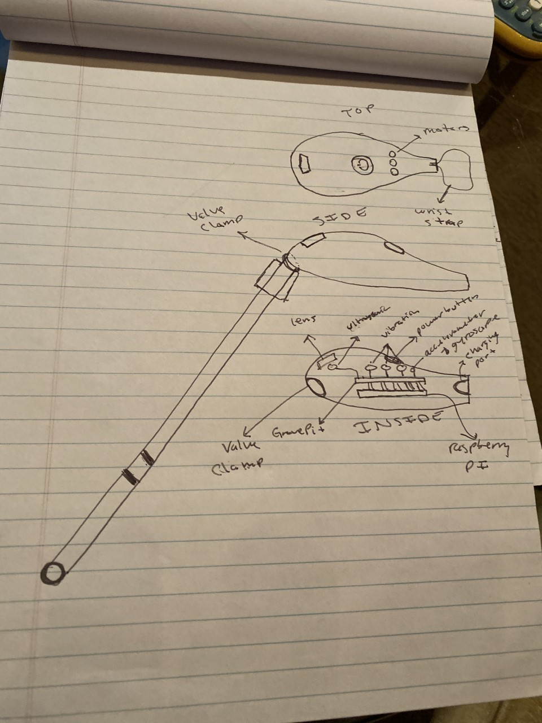
Housing
Original housing includes:
  1 Ultrasonic sensor
  3 Vibration Motors
  Raspberry Pi / Grove Pi+
  Accelerometer & Gyroscope
  Valve clamp
Ethan Saffer

Slide 46
Housing Validation
Megapascals (MPa)
The orange shows where the stress is highest.
Madison Jaffe

Slide 47



Housing
Ethan Saffer

Slide 48
Key Goals and Assumptions
Key Goals:
  Aids the visually impaired in daily activities.
  Assist people who are visually impaired to become more active.
  Keep the visually impaired safe while executing relatively complex tasks.
Assumptions:
  Users are unaware of objects in new surroundings.
  Users have undergone Orientation and Mobility training/rehabilitation.
  The visually impaired are not fully comfortable in our current society.
Ethan Saffer

Slide 49


Interpreted Customer Needs
1. Helps Avoid Ground Irregularities
2. Allows for Location Awareness
3. Recognizes Surrounding Objects
4. Notify Emergency Contacts
5. Intuitive with O & M Training
6. Identifies and Reads Text
7. Priced for Low-Income Households
Ethan Saffer

Slide 50





Critical Functions
Alert of Elevation
Determine Location
Alert of Physical Object
Identify Possible Threats
Interpret Sensory Information
Ethan Saffer

Slide 51



Raspberry Pi: Sensors and Motors Code
David Alicea

Slide 52




Slide 53
Yearly Projections
3 Year Sales Projection
Projected Revenue
  $594,631
Projected Profit
  $184,543
5 Year Sales Projection
Projected Revenue
  $1,807,101
Projected Profit
  $250,639
35% Growth from Year 3
Madison Jaffe

Slide 54

Housing
Our previous housing design was failing at the cane attachment.
The new design is more capable of handling the stresses that will act on the housing.
Nicolas Garcia

Slide 55
Housing Concerns: Warping
The front of the main housing has a downward bend.
Corners are warped, altering geometry

Slide 56



Medium-High Fidelity Concepts
GPS Watch:
Haptic Feedback cane:
Smart Glasses:
Audio Feedback cane:
GPS app:
Pin Matrix Haptics:
Sensor Watch:
Sensor Pin Chip:
Ethan Saffer

Slide 57


Markets
  Primary market: People with severe visual impairment, rehabilitation and treatment centers.
  Secondary market: Autonomous Systems and State-Local Departments of Transportation.
Ethan Saffer

Slide 58



Final Selection
Our final potential designs were ranked:
  Haptic Smart Cane
  Sensor Pin Chip
  Sensor Watch
#1
Haptic Smart Cane
#2
Sensor Pin Chip
#3
Sensor Watch
Ethan Saffer

Slide 59



Competitors
White Cane
Sunu Band
WeWalk
https://athome.medline.com/en/medline-white-cane-for-blind-vision-impaired-1ct-mdswhtcane
https://www.sunu.com/es/index
https://webrazzi.com/en/2020/05/01/wewalk-investment-750k/
Ethan Saffer

Slide 60

WeWalk
Similar product that incorporates ultrasonic sensors in the format of a smart-cane.
Uses infrared sensors to detect ground irregularities.
Overload of information.
Ethan Saffer

Slide 61
Competitor Comparison
White Cane | Sunu Band | WeWalk | Our Solution
Senses irregularities below the waist Standard aid for visually impaired | Senses objects nearby Set position on wrist, can discomfort user to "aim" | Infrared Sensor for floor irregularities Ultrasonic sensor for object detection | Senses ground irregularties Notifies user

Slide 62
Device Operational Time
Ultrasonic Sensor
8 mA
Camera
Up to 800 mA
Vibration Motor
58 mA average
100 mA max
Raspberry Pi
3,000 mA
Power Supply
20,000 mAh
Theoretical (Maximum Current Draw) Operation Time: 4.87 Hours
4 hours, 52 minutes and 12 seconds
Madison Jaffe

Slide 63
Targets and Metrics
Function | Target | Metric
Alert of Elevation* | 0.25 to 12 inches | Distance
Determine Location* | ~ 16 feet | Distance
Alert of Physical Object* | 65 inches | Distance
Identify Possible Threats* | Up to 60 miles per hour | Velocity
Access Emergency Contact | 15 seconds | Time
Interpret Sensory Information* | 7 seconds | Time
Store Frequent Tasks | 1 GB | Memory Allocation
Interface with Pre-Existing Skills | 70% | User Satisfaction
Compete within Market | 20% | Price Range USD ($)
Remain Lightweight | < 5.1 lb | Weight
Remain Discrete | 70% | User Approval
David Alicea

Slide 64



Concept Generation Tools
Crap Shoot
Morphological Chart
Biomimicry
McConomy, S. (2020, November 11). Engineering Characteristics, Functions, Targets, and Metric. FAMU-FSU College of Engineering.
David Alicea

Slide 65
Medium Fidelity Concepts
GPS Watch:
- GPS indicate where the user is
- haptic feedback provided through vibration on wrist
Haptic Feedback cane:
- haptic feedback voice-activated
- phone compatible
Smart Glasses:
- sensor and GPS for user location
- Audio feedback through glass-mounted earpiece
Audio Feedback cane:
- audio feedback
- Tactile or voice activation
- Phone compatible
- camera to interpret the environment
GPS app:
- Lidar
- user information through haptics
- computer and GPS track and locate user
David Alicea

Slide 66
Concept Selection
David Alicea

Slide 67






Importance Weight Factor
Interpreted Customer Needs
Recognizes Surrounding Objects
Intuitive with O&M Training
Notify Emergency Contact
Importance Weight Factor
Priced for Low-Income Households
Helps Avoid Ground Irregularities
Identifies and Reads Text
Allows for Location Detection
Nicolas Garcia

Slide 68

Pugh Chart
Nicolas Garcia

Slide 69
Pugh Chart
Nicolas Garcia

Slide 70

Second Pugh Chart
Nicolas Garcia

Slide 71
Second Pugh Chart
Nicolas Garcia

Slide 72
Analytical Hierarchy Process
Criteria Comparison Matrix [C]
Functions | Criteria Weights{W}
Alert of Elevation | 0.11
Determine Location | 0.13
Interpret Sensory Information | 0.24
Access Emergency Contact | 0.03
Interface With Pre-Existing Skills | 0.11
Store Frequent Tasks | 0.04
Alert of Physical Object | 0.19
Inform User of Possible Threats | 0.15
Sum | 1.00
Nicolas Garcia

Slide 73
Analytical Hierarchy Process
 | Sensor Pin Chip | Sensor Watch | Haptic Smart Cane
Alert of Elevation | 0.11 | 0.11 | 0.78
Determine Location | 0.16 | 0.19 | 0.66
Interpret Sensory Information | 0.45 | 0.45 | 0.09
Access Emergency Contact | 0.20 | 0.20 | 0.60
Interface with Pre-existing Skills | 0.14 | 0.14 | 0.71
Store Frequent Tasks | 0.33 | 0.33 | 0.33
Alert of a Physical Object | 0.43 | 0.14 | 0.43
Inform User of Possible Threats | 0.33 | 0.33 | 0.33
Nicolas Garcia

Slide 74
Analytical Hierarchy Process
 | Sensor Pin Chip | Sensor Watch | Haptic Smart Cane
Alert of Elevation | 0.11 | 0.11 | 0.78
Determine Location | 0.16 | 0.19 | 0.66
Interpret Sensory Information | 0.45 | 0.45 | 0.09
Access Emergency Contact | 0.20 | 0.20 | 0.60
Interface with Pre-existing Skills | 0.14 | 0.14 | 0.71
Store Frequent Tasks | 0.33 | 0.33 | 0.33
Alert of a Physical Object | 0.43 | 0.14 | 0.43
Inform User of Possible Threats | 0.33 | 0.33 | 0.33
Nicolas Garcia

Slide 75
Analytical Hierarchy Process
 | Sensor Pin Chip | Sensor Watch | Haptic Smart Cane
Alert of Elevation | 0.11 | 0.11 | 0.78
Determine Location | 0.16 | 0.19 | 0.66
Interpret Sensory Information | 0.45 | 0.45 | 0.09
Access Emergency Contact | 0.20 | 0.20 | 0.60
Interface with Pre-existing Skills | 0.14 | 0.14 | 0.71
Store Frequent Tasks | 0.33 | 0.33 | 0.33
Alert of a Physical Object | 0.43 | 0.14 | 0.43
Inform User of Possible Threats | 0.33 | 0.33 | 0.33
Nicolas Garcia

Slide 76
Standard Shapes
Summary Box
Text box 1
Outlined Text Box

Slide 77




Approved Logos

Slide 78

Color Palette

Slide 79
Slides to keep:
Intro, Synopsis of VDR1 (Rename), Customer Needs, minimize Concept Gen. & Selection, Final Selection?, What's Next, Last team member slide, Ref.
Slides to add:
Specs of design
BOM/Ordering parts
Our progress in the InNOLEvation challenge?

Slide 80
APA Tables
Category 1 | Category 2 | Category 3 | Category 4 | Category 5
Item 1
Item 2
Item 3
Item 4
 | Category 2 |  |  | Category 3
Category 1 | subcategory 1 | subcategory 2 |  | subcategory 1 | subcategory 2
Item 1
Item 2
Item 3
Item 4

