Slide 1
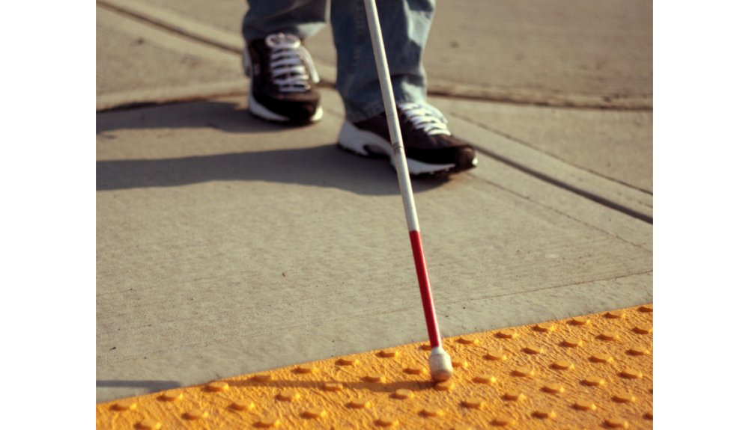
ESD- Vision Impaired Technology
Team 522

Slide 2
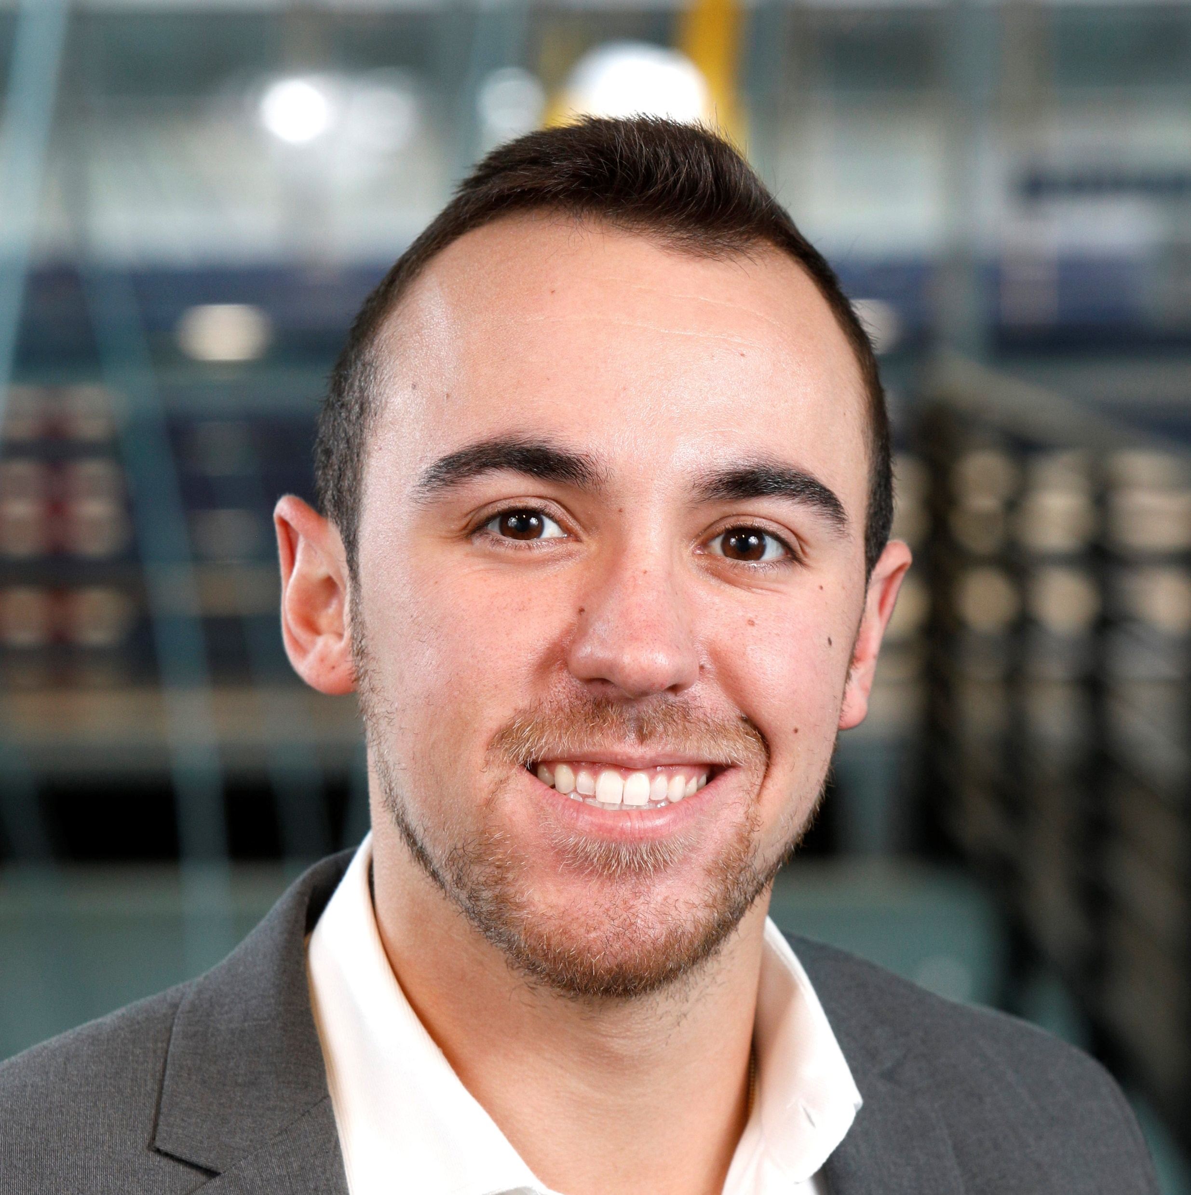
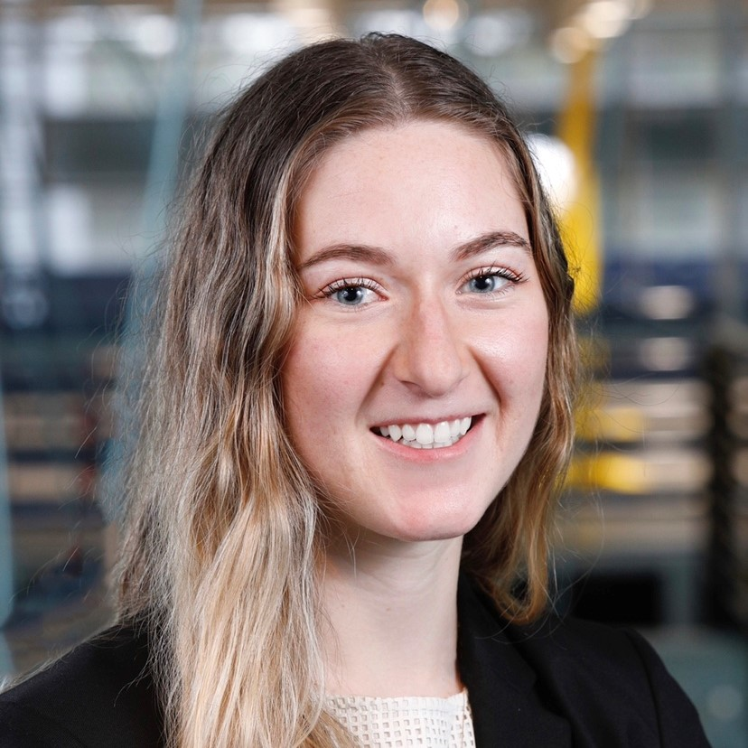
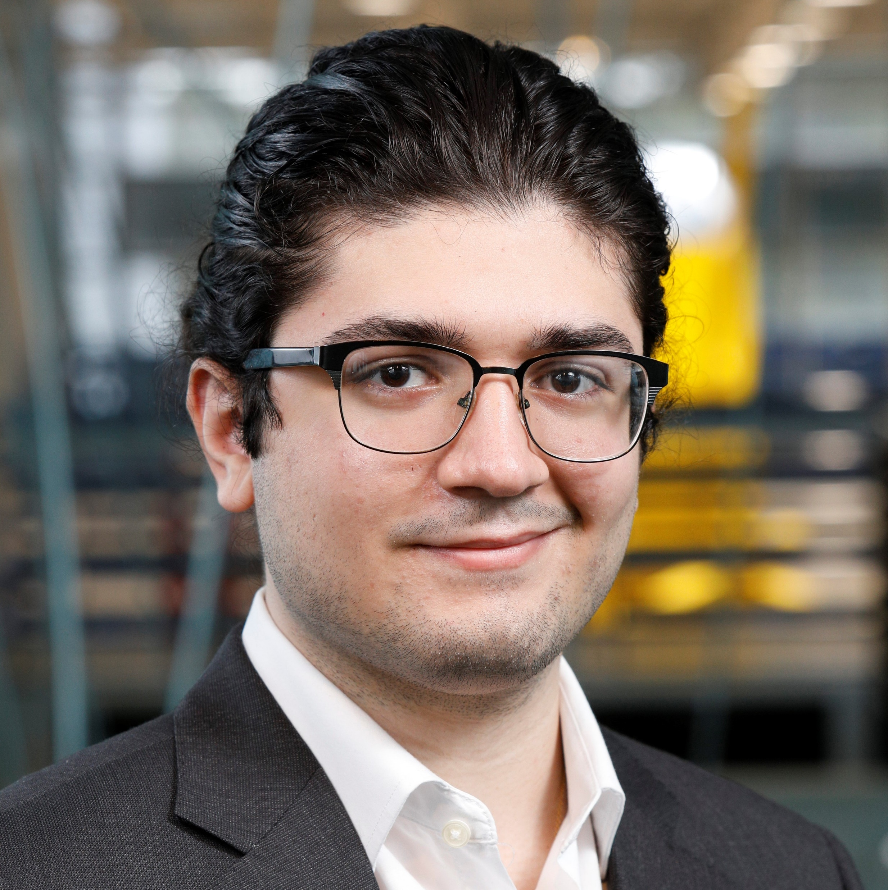
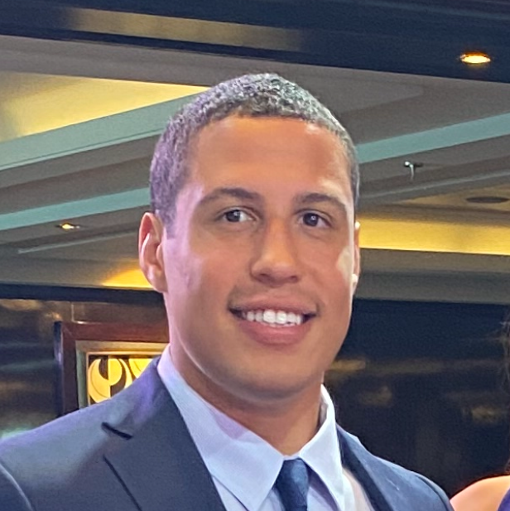
Team 522: Vision Impaired Technology
Ethan Saffer
Systems and Design
Engineer
Ers16c@my.fsu.edu
Madison Jaffe​
Project Manager and Manufacturing/Controls Engineer
Msj16d@my.fsu.edu
Nicolas Garcia
Design Engineer, Webmaster, and Resource Manager
Ng16m@my.fsu.edu
David Alicea
Field/Test Engineer and Quality Control
Daa16@my.fsu.edu
Ethan Saffer

Slide 3
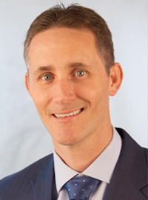
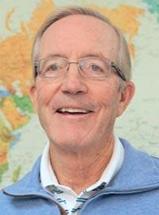

Advisors
Shayne McConomy​
FAMU-FSU College of Engineering​
Department of Mechanical Engineering​
Michael Devine
Florida State University
Jim Moran College of Entrepreneurship
Jerris Hooker
FAMU-FSU College of Engineering
Department of Electrical Engineering
Ethan Saffer

Slide 4
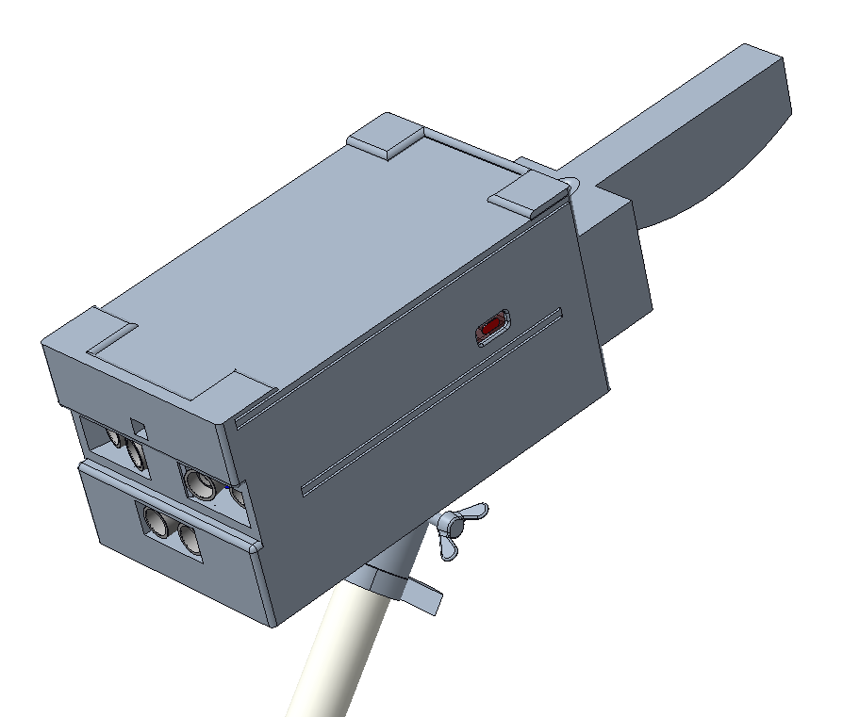
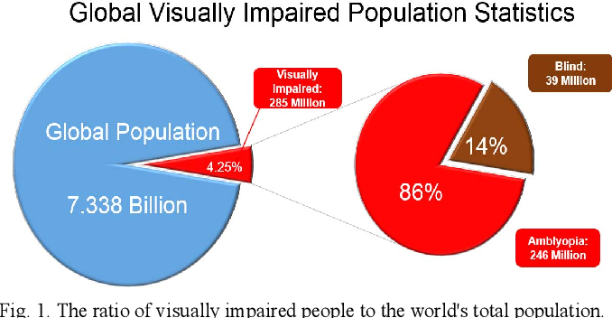
Introduction
PROBLEM:
The visually impaired have limited aid in current society.
This leaves many of them dependent on others and unemployed.
Median income is $38,500.
Technological aid is often not affordable or effective for their average income.
OUR SOLUTION: HAPTAC
Attaches to the standard white cane.
Senses and scans objects directly ahead.
Alerts users of possible hazards.
Ergonomic handle to remain comfortable for prolonged uses.
Low market price to maximize accessibility.
https://www.semanticscholar.org/paper/An-Implementation-of-an-Intelligent-Assistance-for-Chen-Su/172177515d0b1ee7bcef49cbefecf559c661324f
Ethan Saffer

Slide 5
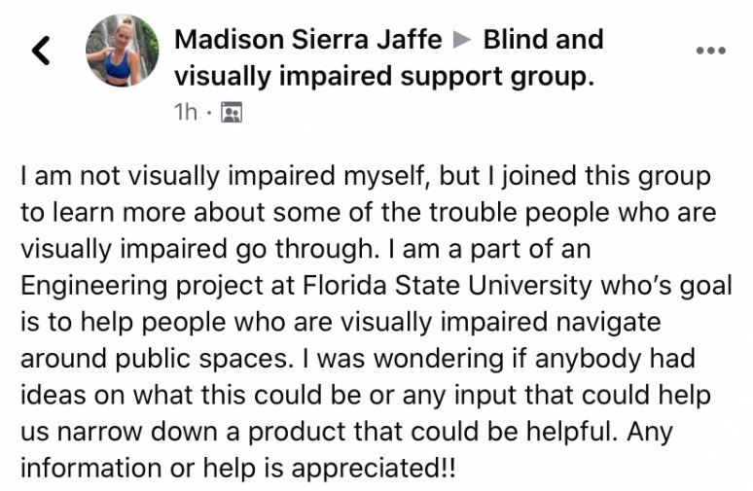
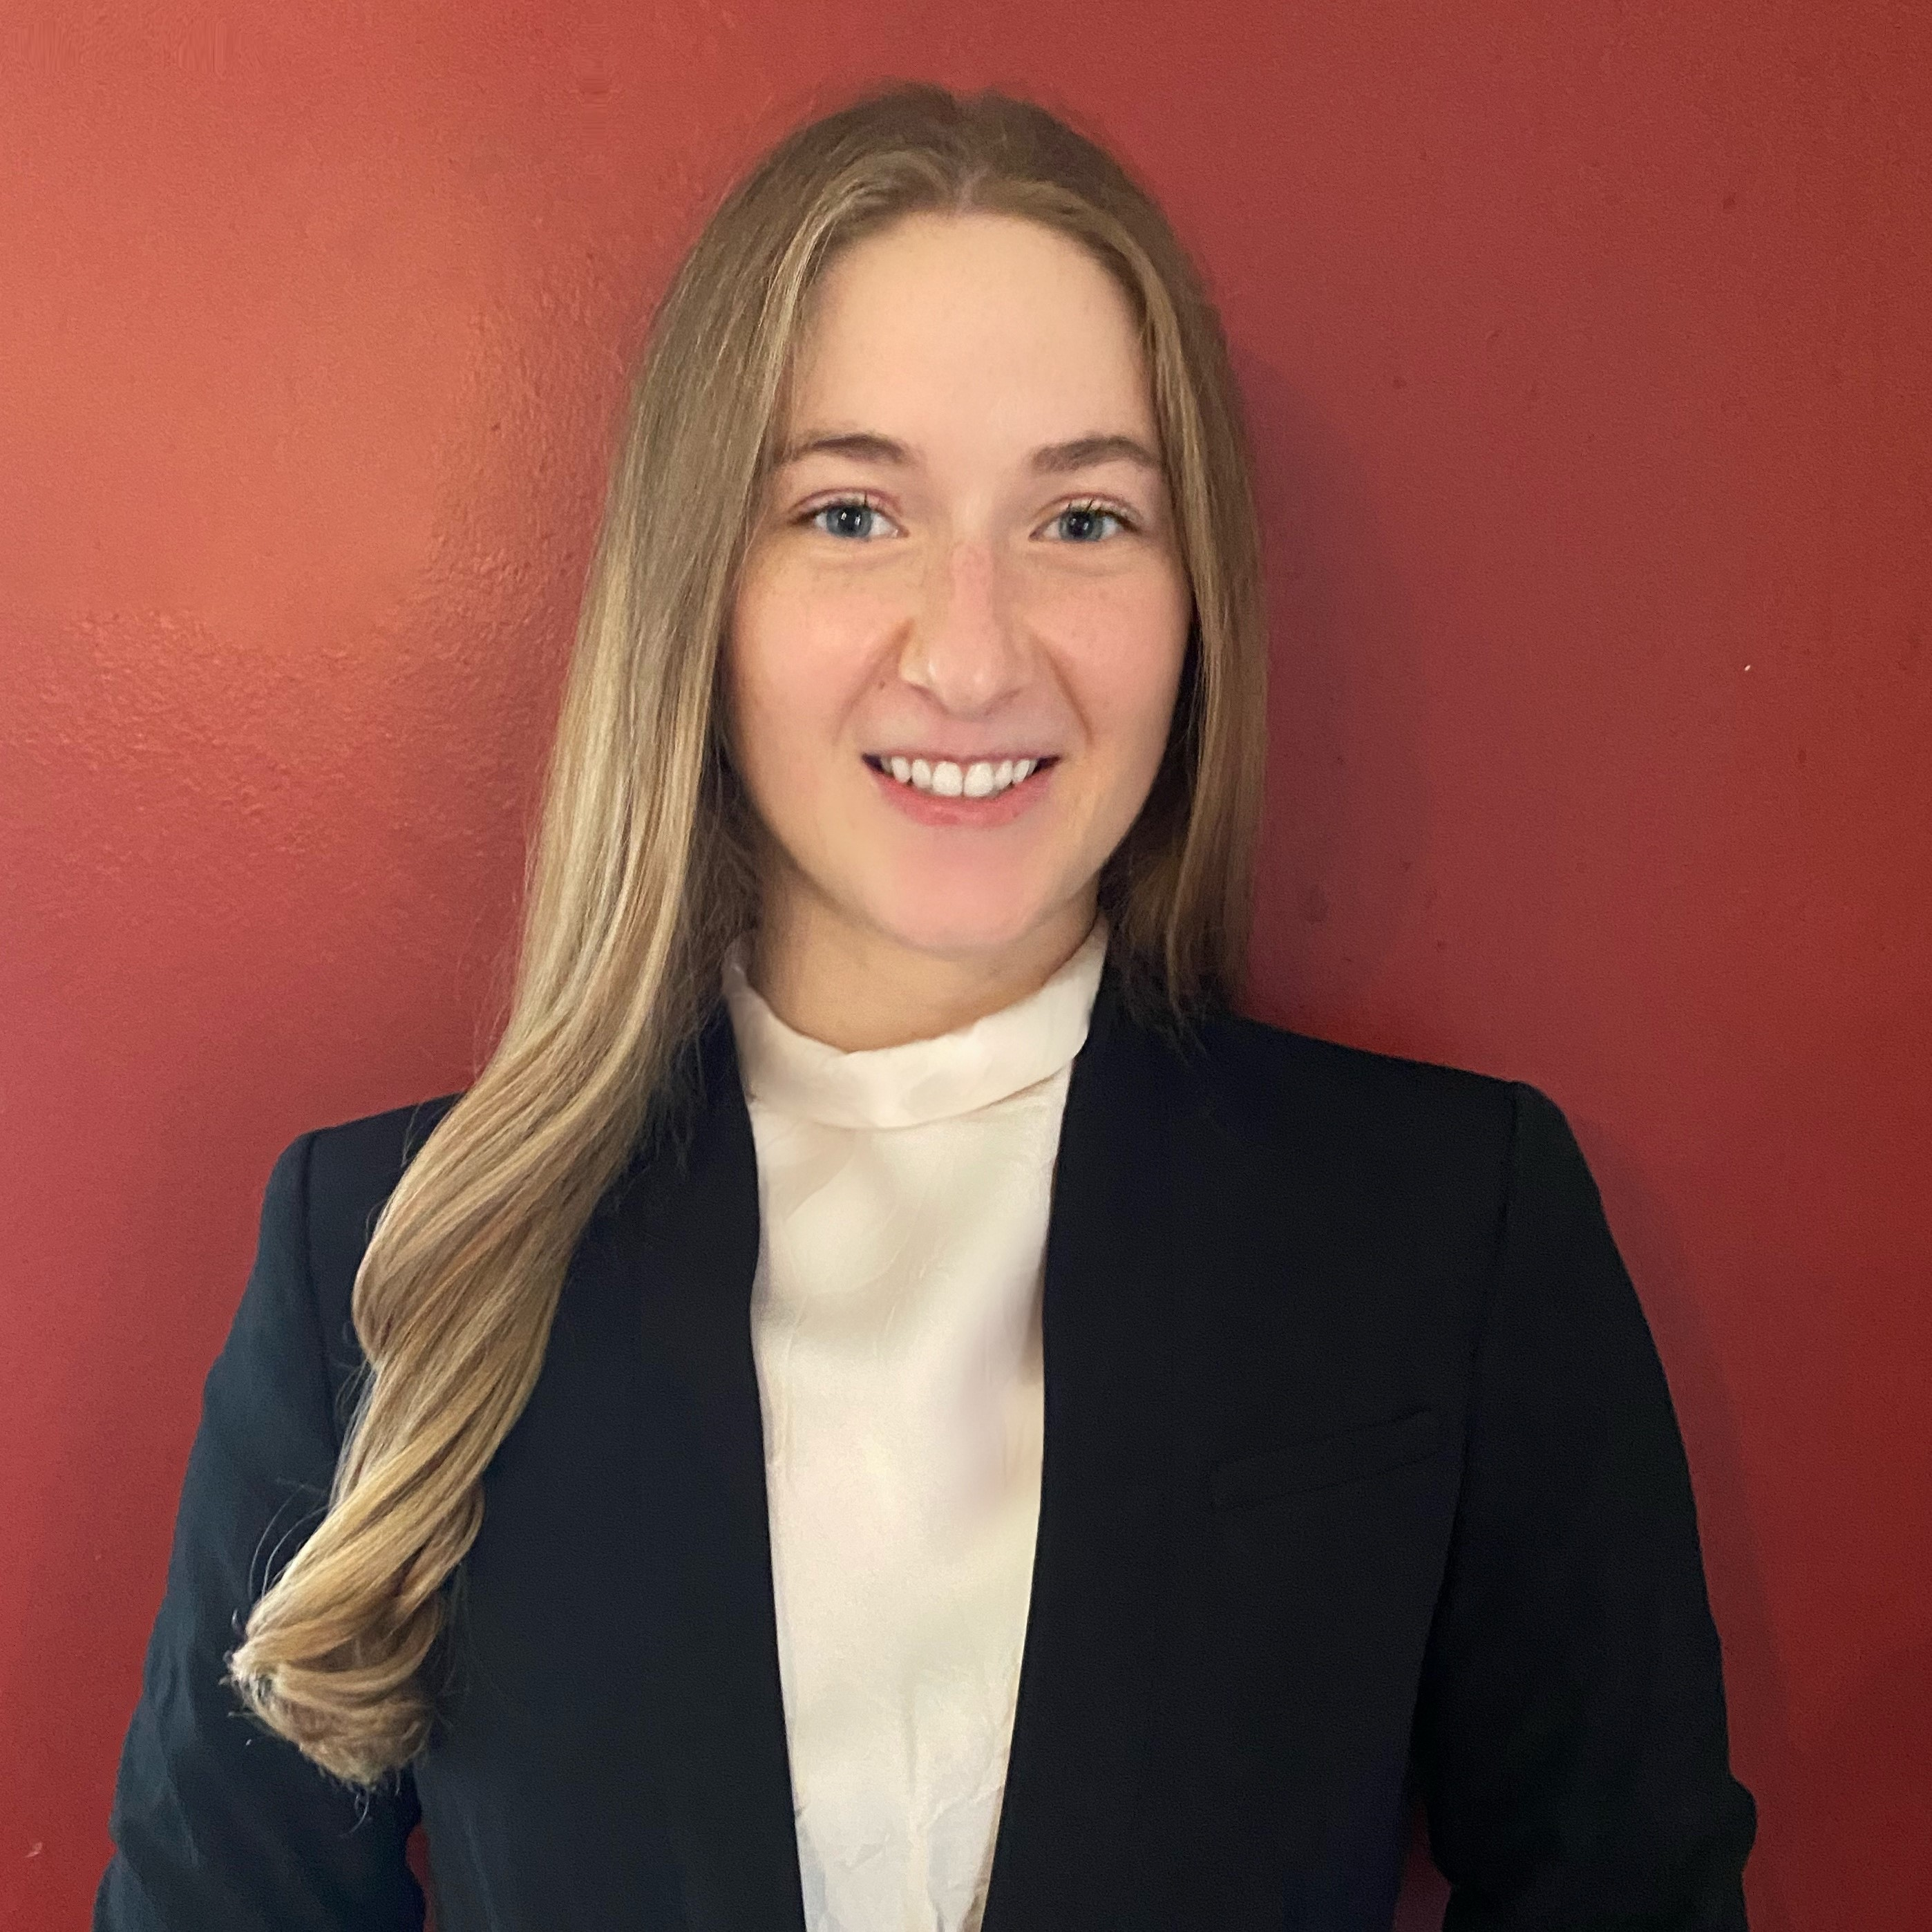
Interpreted Customer Needs
1. Helps Avoid Ground Irregularities
2. Allows for Location Awareness
3. Recognizes Surrounding Objects
4. Notify Emergency Contacts
5. Intuitive with O & M Training
6. Identifies and Reads Text
7. Priced for Low-Income Households
whose
Ethan Saffer

Slide 6
Targets and Metrics
Importance
Interpret Sensory Information
Scan and Interpret in ~ 7 Seconds
Alert of Physical Object
Detect Object From 165 cm Away
Inform User of Possible Threats
Detect Changes As Fast As 25 m/s
Determine Location
±5 m Accuracy in Position
Alert of Elevation
Detect Changes Between 0.6 to 30 cm
Interface with Pre-Existing Skills
70% Approval Based on User Feedback
Store Frequent Tasks
1 GB Worth Of "Tasks"
Access Emergency Contact
Contact in 15 Seconds
Ethan Saffer

Slide 7
Concept Generation
Detecting Changes Of Elevation
Determine User Location
Detection of Ranged Object
Response to Object Detection
Interpret Sensory Information
White Cane
GPS Using Internet
Ultrasonic Sensor
Heat
Camera
Infrared Sensor
GPS With Offline Mapping
Lidar
Vibrate
Text To Speech
Ultrasonic Sensor
Camera Analysis Of Street Signs
Relative Velocities
Sound
Imaging To PDF
Recording Of Previous Trips
Poke
Text To Braille
Ethan Saffer

Slide 8
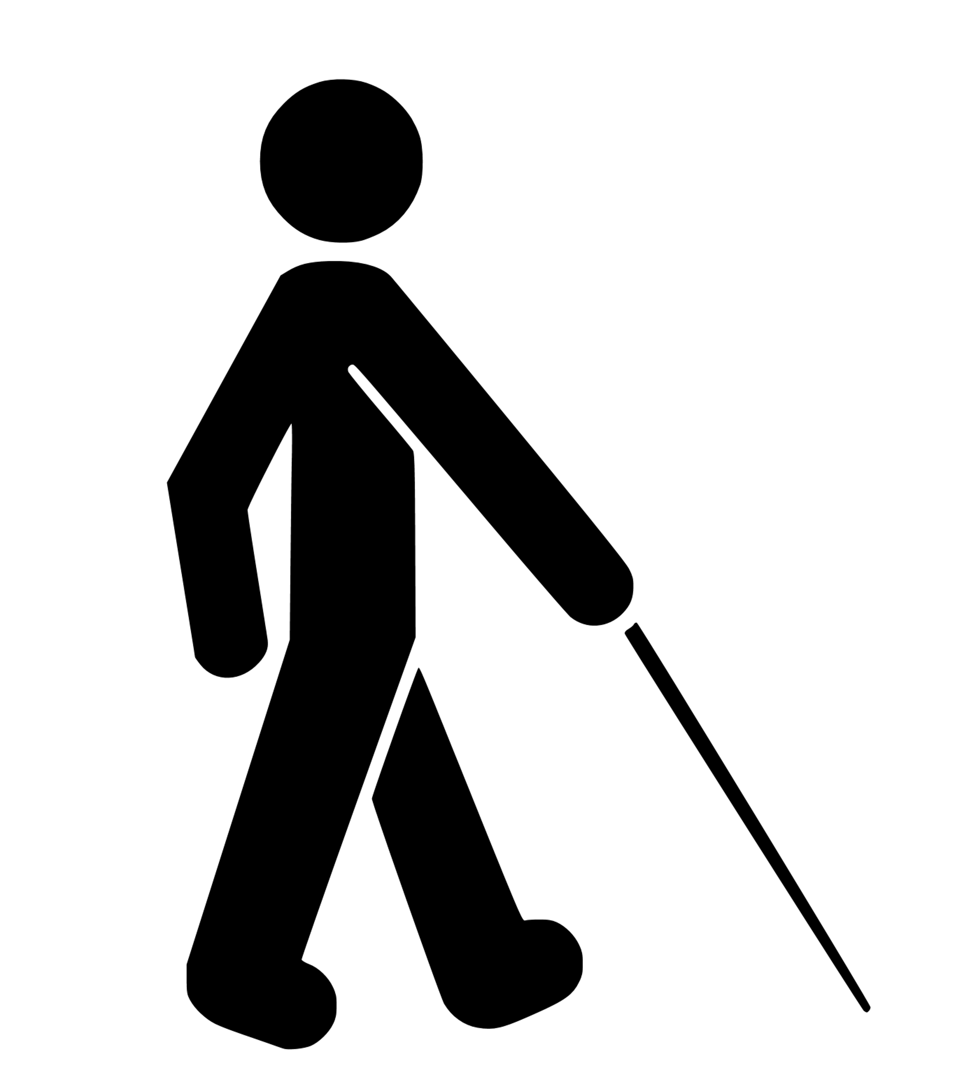
Functions
Ethan Saffer

Slide 9


Functions
Sense
The ultrasonic sensors will sense an object up to 3 meters away.
Ethan Saffer

Slide 10


Functions
Sense
Determine
The ultrasonic sensors will sense an object up to 3 meters away.
The Raspberry Pi will interpret the sensed information to calculate the proximity to an object.
Ethan Saffer

Slide 11


Functions
Sense
Determine
Alert
The ultrasonic sensors will sense an object up to 3 meters away.
The Raspberry Pi will interpret the sensed information to calculate the proximity to an object.
Haptic feedback will alert the user with multiple motors with intensity based on distance.
Ethan Saffer

Slide 12


Functions
Sense
Determine
Alert
The ultrasonic sensors will sense an object up to 3 meters away.
The Raspberry Pi will interpret the sensed information to calculate the proximity to an object.
Haptic feedback will alert the user with multiple motors with intensity based on distance.
Scan
The camera can be activated to scan the desired products.
Ethan Saffer

Slide 13


Functions
Sense
Determine
Alert
The ultrasonic sensors will sense an object up to 3 meters away.
The Raspberry Pi will interpret the sensed information to calculate the proximity to an object.
Haptic feedback will alert the user with multiple motors with intensity based on distance.
Scan
Identify
The camera can be activated to scan the desired products.
Up to 100 stored products will be in the memory of the Raspberry Pi to identify the product.
Ethan Saffer

Slide 14


Functions
Sense
Determine
Alert
The ultrasonic sensors will sense an object up to 3 meters away.
The Raspberry Pi will interpret the sensed information to calculate the proximity to an object.
Haptic feedback will alert the user with multiple motors with intensity based on distance.
Scan
Identify
Notify
The camera can be activated to scan the desired products.
Up to 100 stored products will be in the memory of the Raspberry Pi to identify the product.
Haptic feedback will
notify the user when the product has been identified and a speaker will relay the product name.
Ethan Saffer

Slide 15

Current Situation
Top View:
Side View:
45°
45°* 45°*
*Based on Standard Technique
1 meter
Nicolas Garcia

Slide 16
Situation Using HapTac
Top View:
Side View:
3.5 meter
5°
15° 15°
45°
45°* 45°*
*Based on Standard Technique
1 meter
Nicolas Garcia

Slide 17
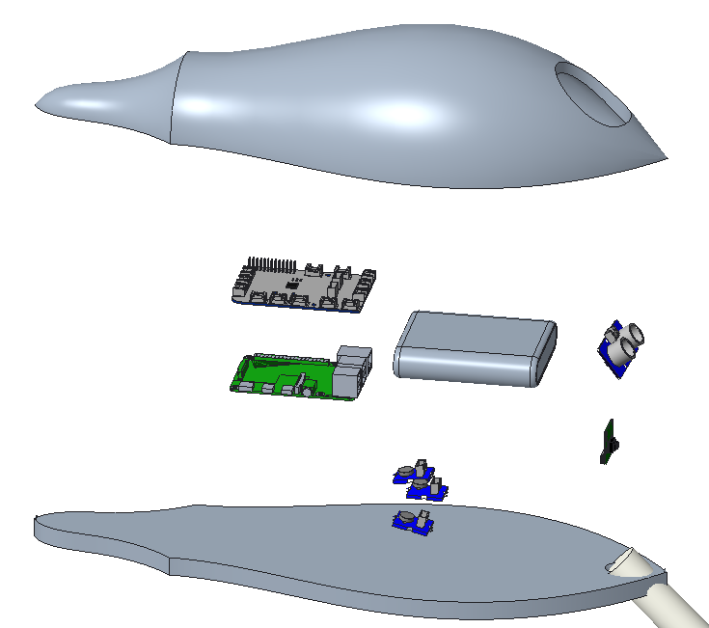
Assembly: First Edition
GrovePi+
Battery Pack
Ultrasonic Sensor
Housing
Camera
Raspberry Pi 4
Vibration Motors (3)
Nicolas Garcia

Slide 18
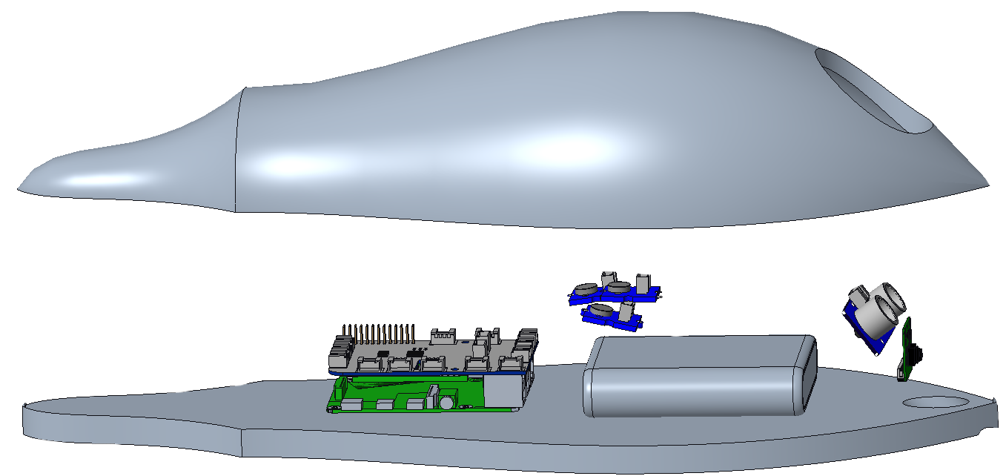
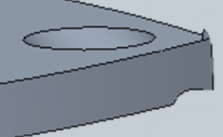
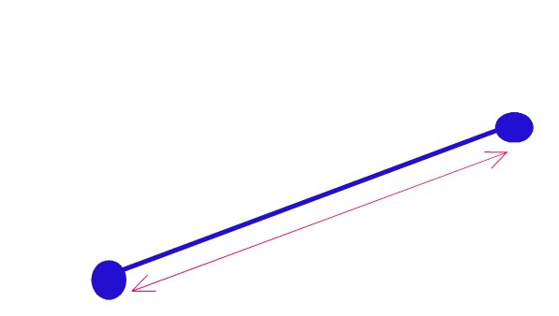
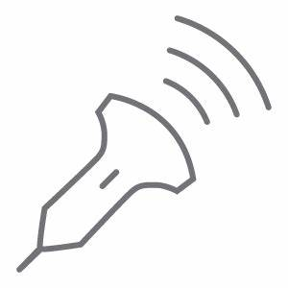

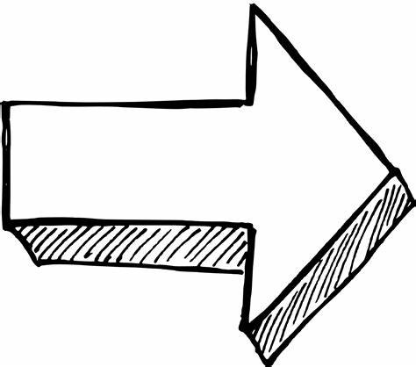

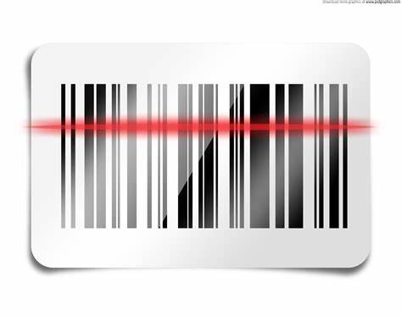


Assembly: First Edition
Thin walls and sharp tip led to stress concentration
Nicolas Garcia
Sense
Determine
Alert
Sense
Determine
Alert
Sense
Sense
The ultrasonic sensor will sense an object up to 3 meters away.
The Raspberry Pi will interpret the sensed information to calculate the proximity to an object.
Haptic feedback will alert the user with multiple motors with intensity based on distance.
The ultrasonic sensor will sense an object up to 3 meters away.
The Raspberry Pi will interpret the sensed information to calculate the proximity to an object.
Haptic feedback will alert the user with multiple motors with intensity based on distance.
Scan
Identify
Notify
Scan
Identify
Notify
The camera can be activated to scan the desired products.
The camera can be activated to scan the desired products.

Slide 19
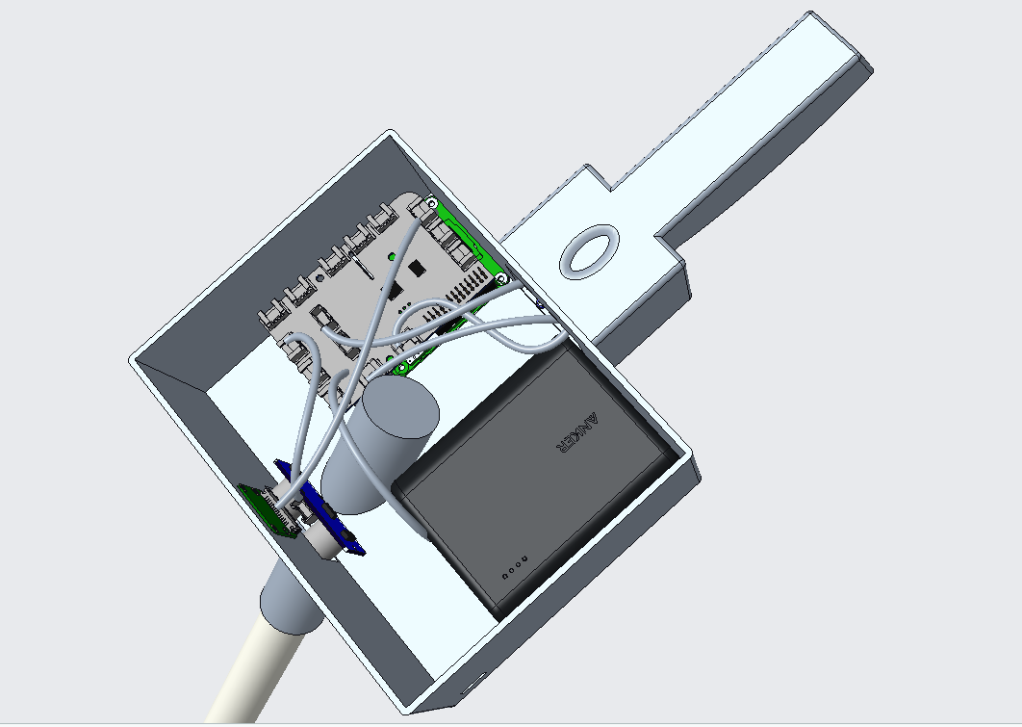
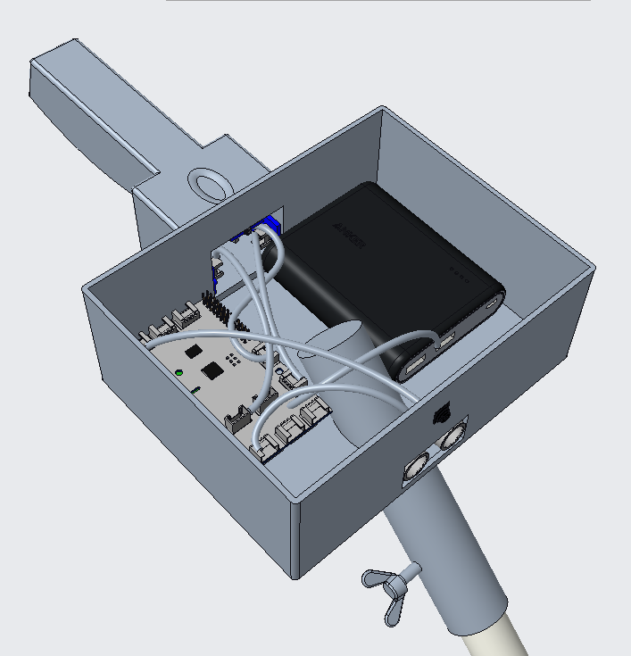
Assembly: Second Edition
Nicolas Garcia

Slide 20
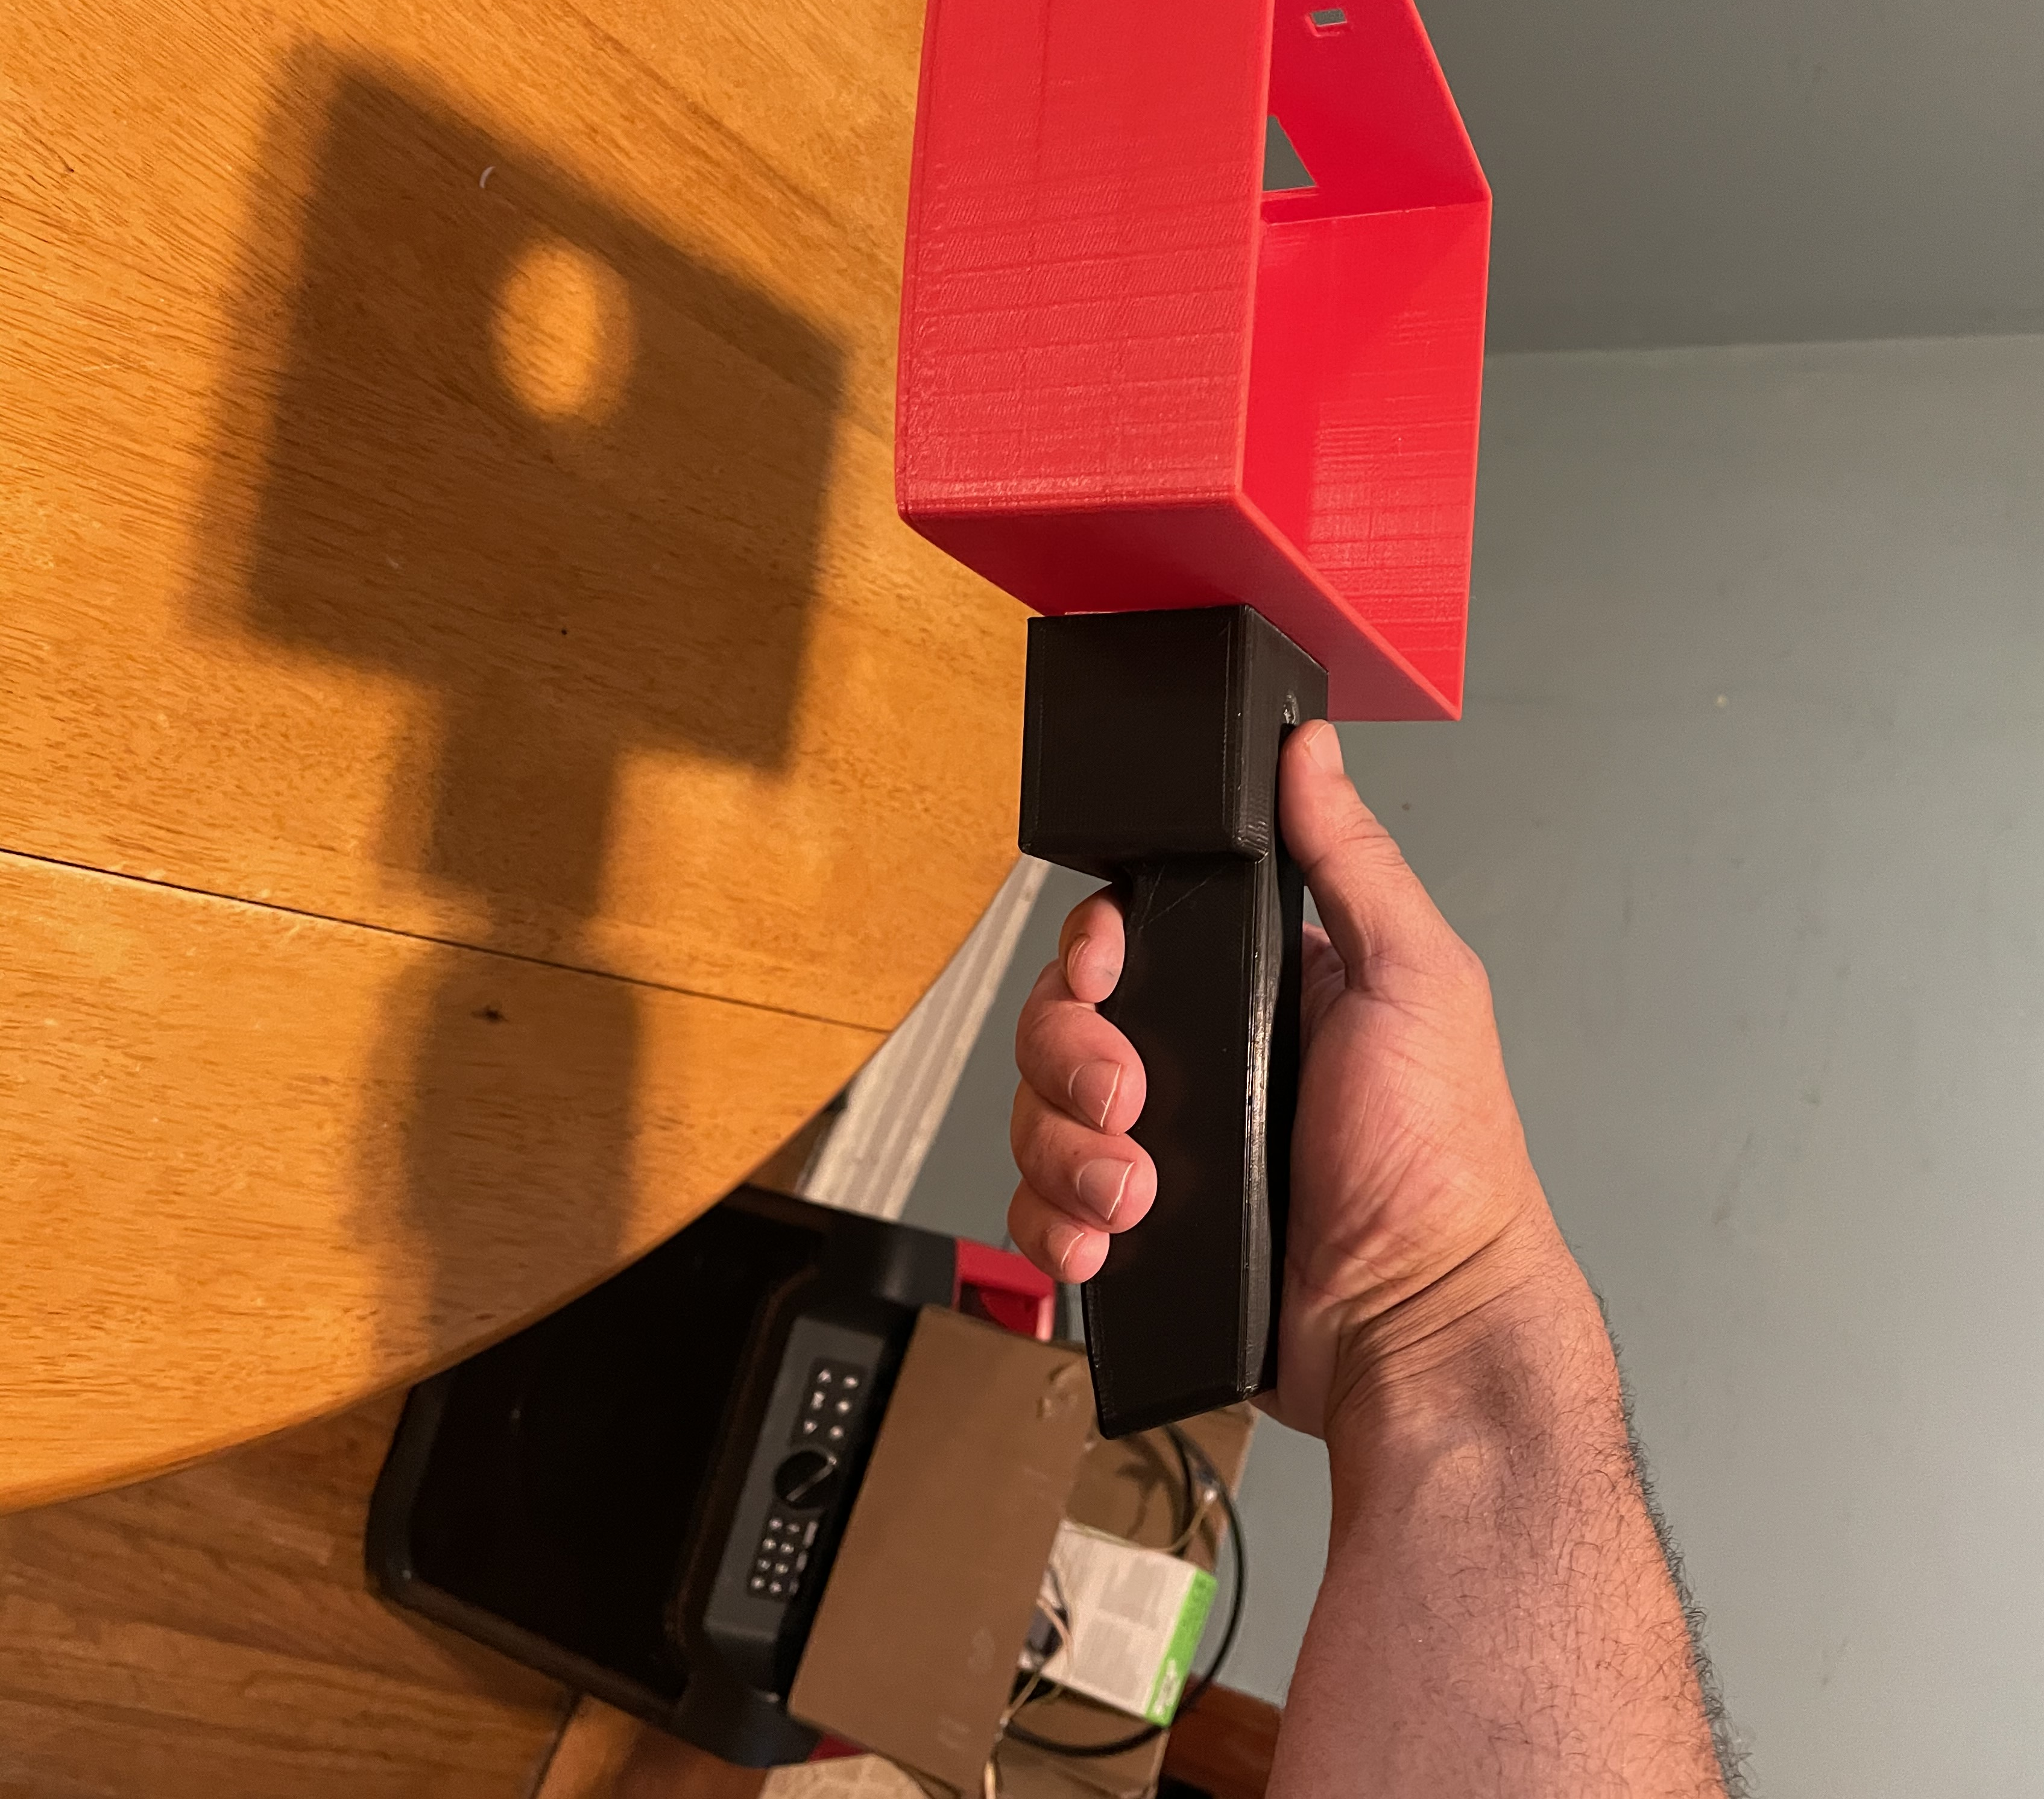
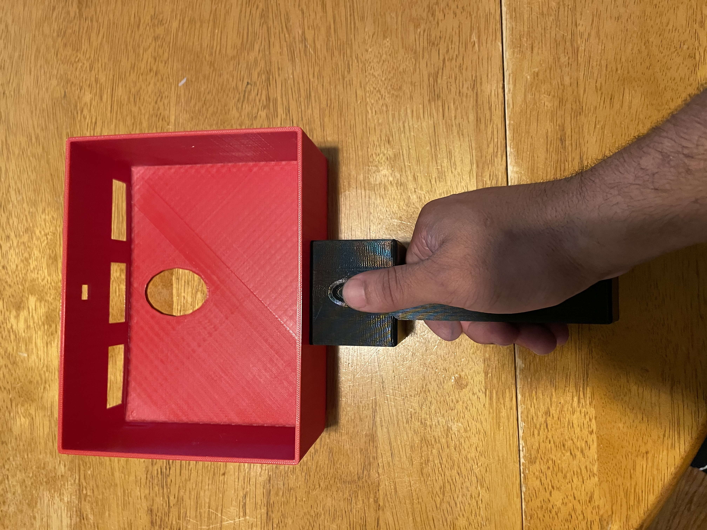
Assembly Concerns: Handle
The handle is too wide, the user's fingers are not able to completely wrap around it.
The groove for the thumb is placed higher than what is comfortable
Nicolas Garcia

Slide 21
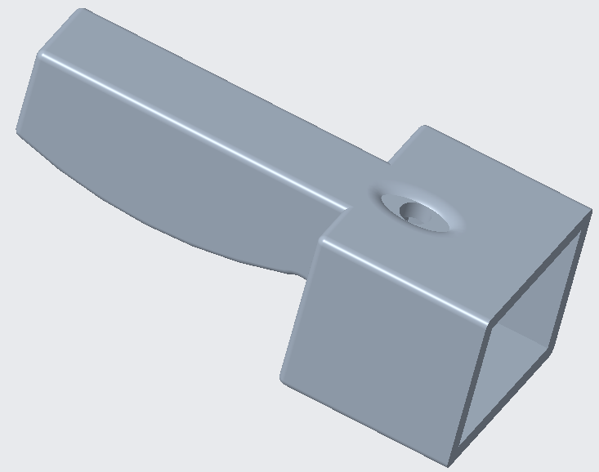
Assembly Concerns: Addressed
Made shorter.
Slimmer profile.
Flat bottom for efficient printing.
Opening for button at thumb groove
  Enables camera use.
Nicolas Garcia

Slide 22
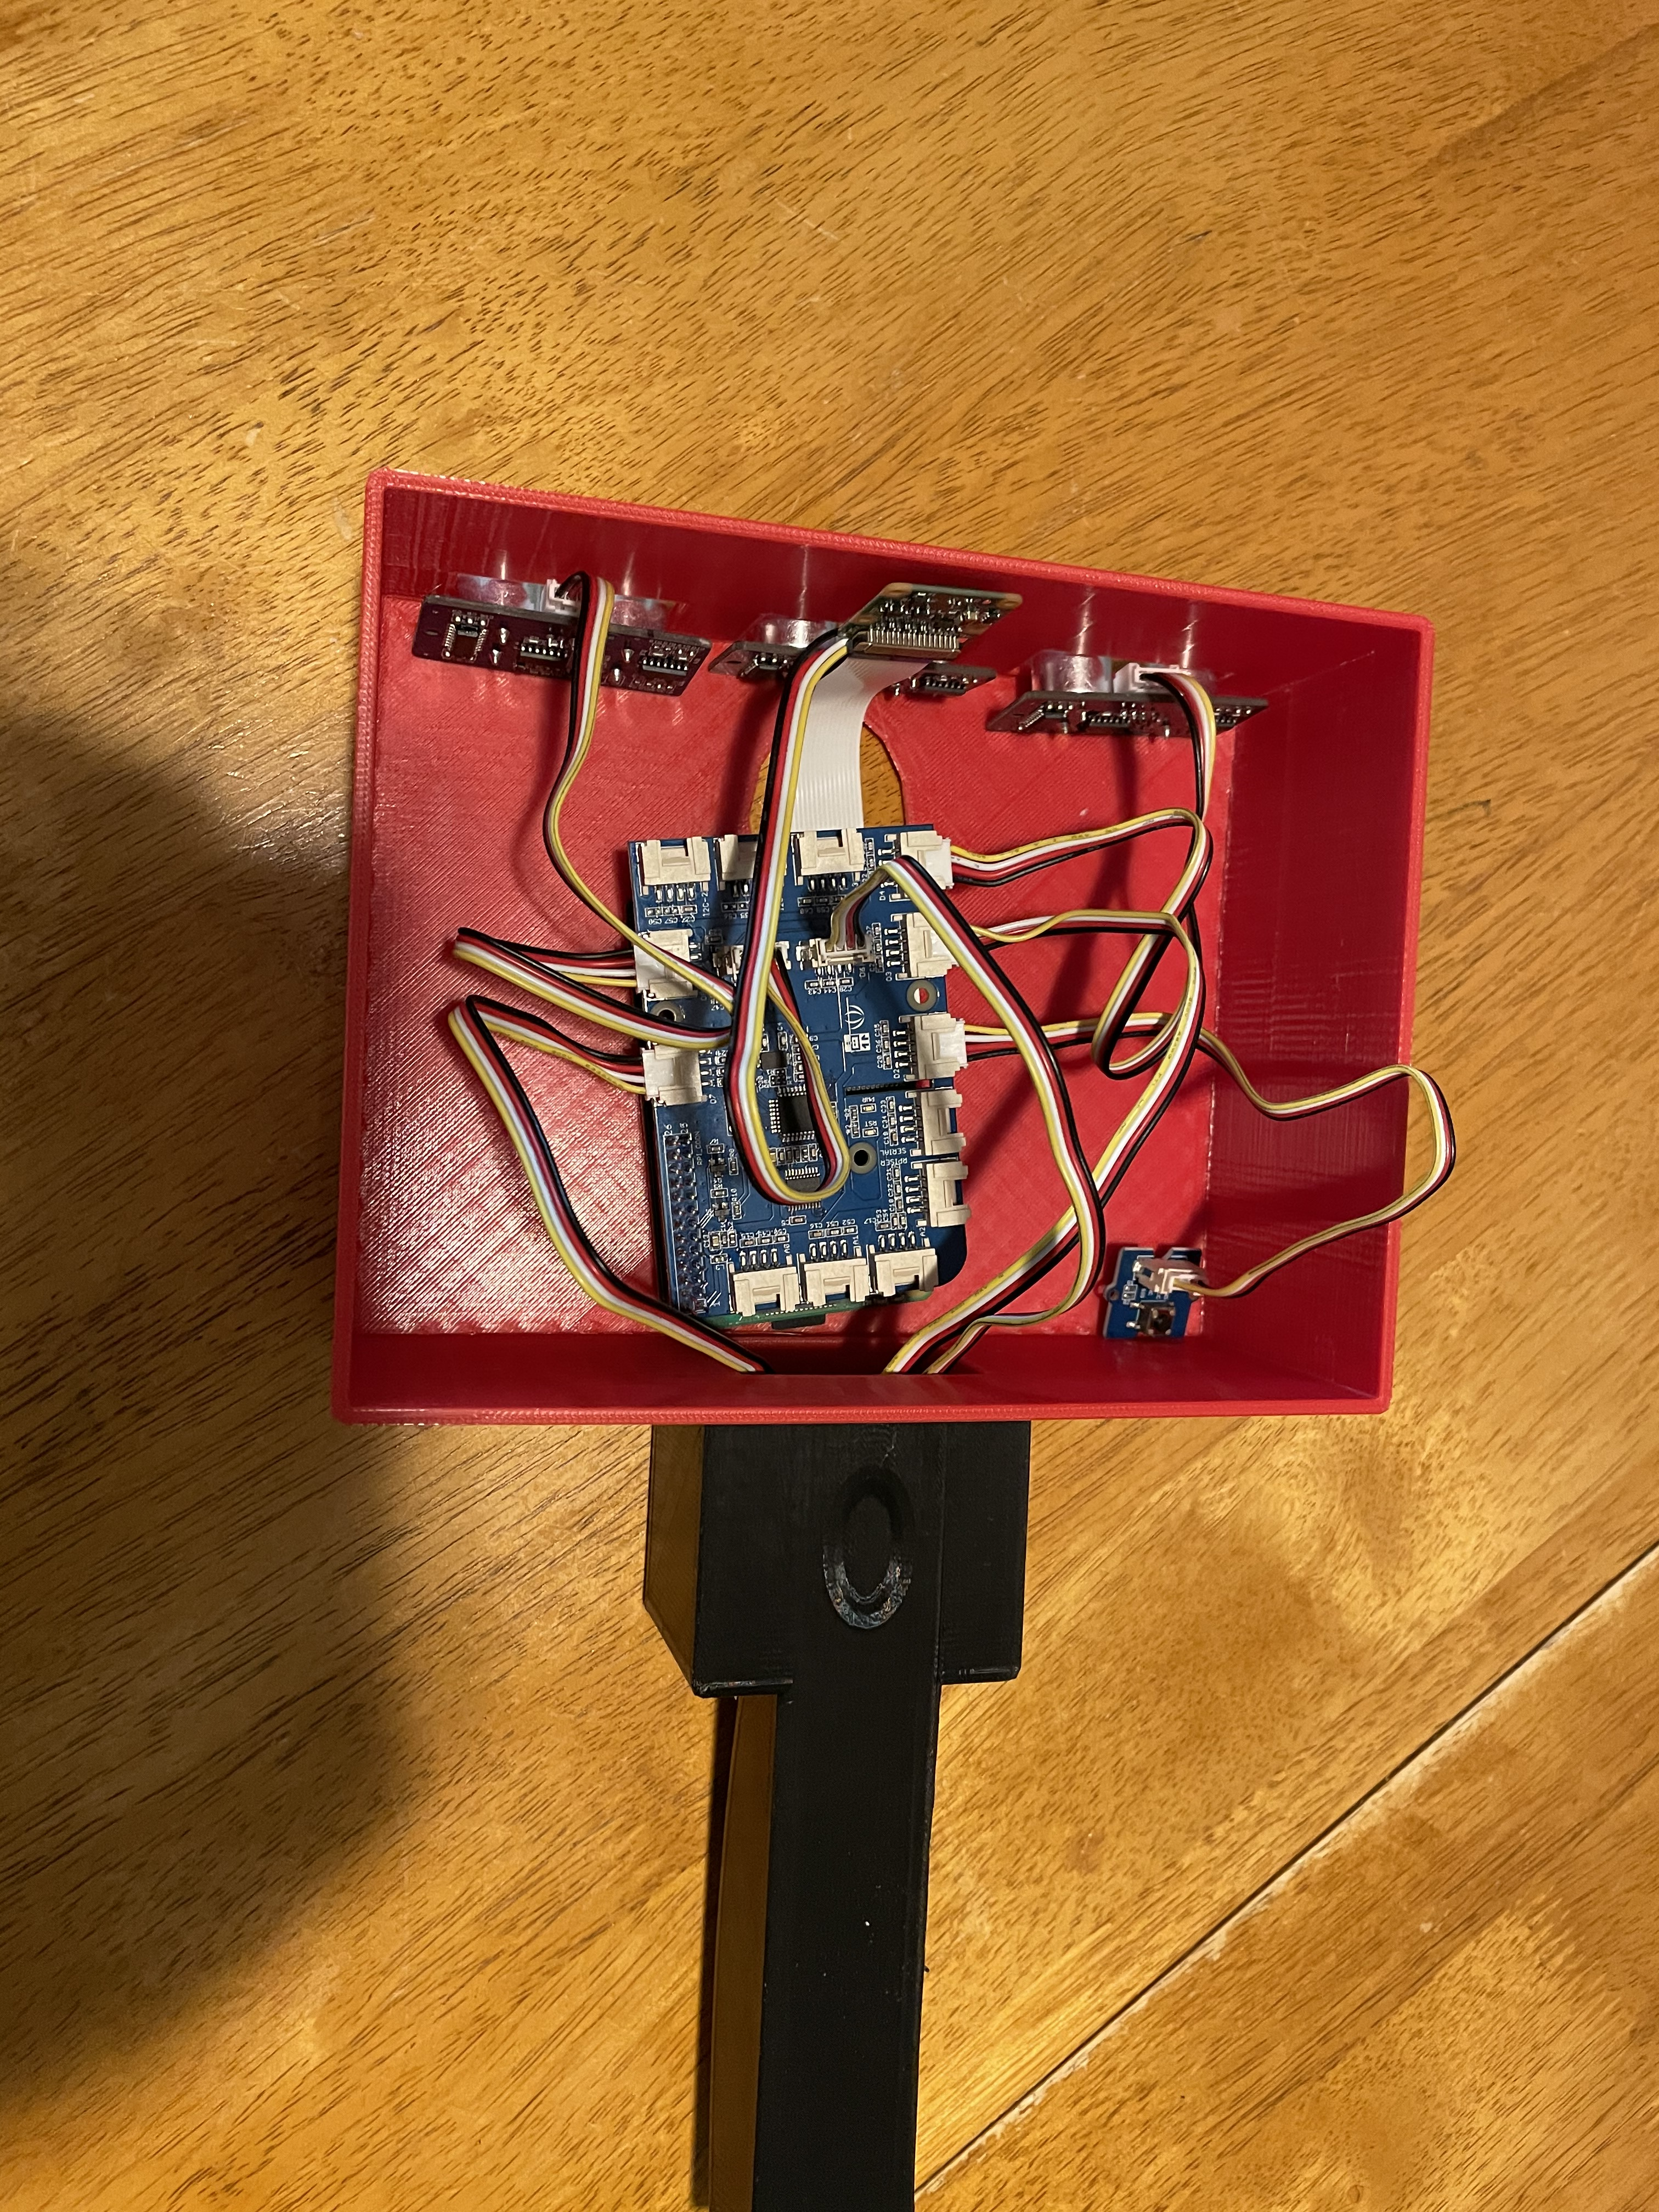
Assembly Concerns – Main Housing
Too much excess room.
The ultrasonic sensors cannot be properly mounted.
Did not include spots to mount all components.
*Battery and speaker not pictured
Madison Jaffe

Slide 23
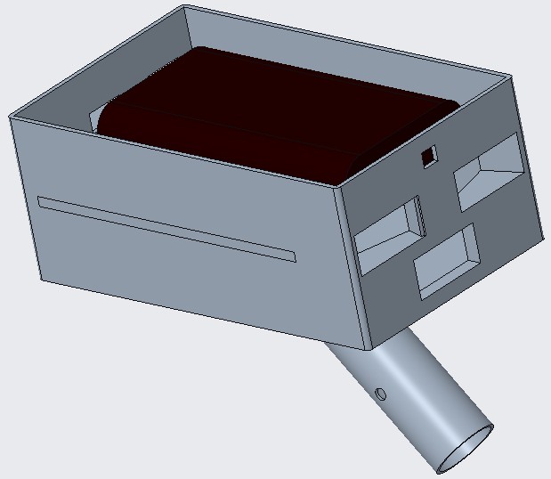
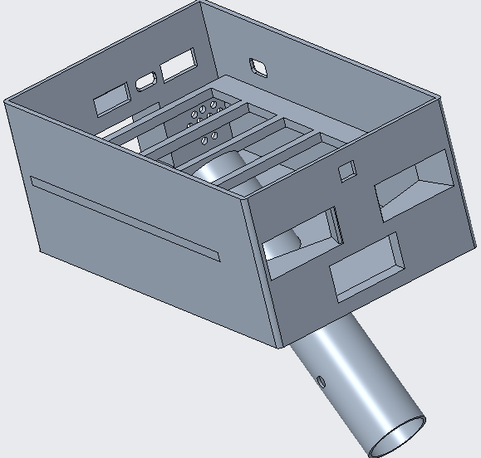
Assembly: Third Edition
Madison Jaffe

Slide 24
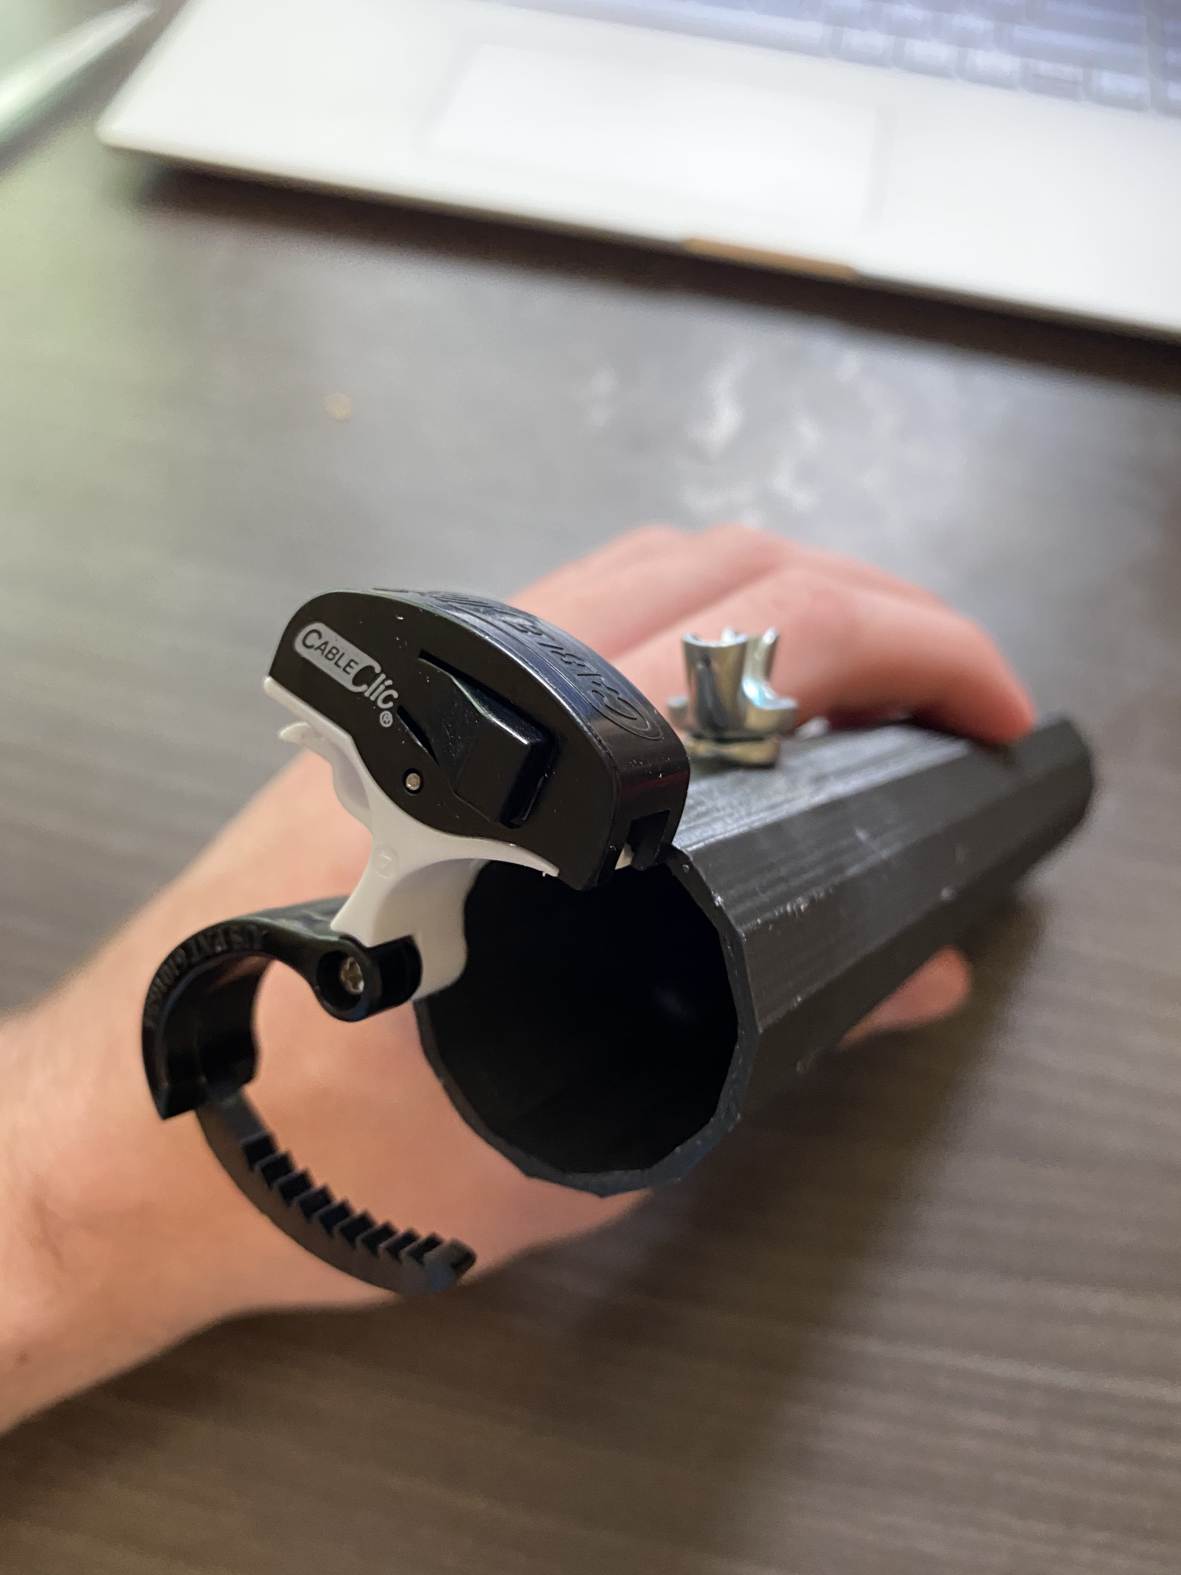
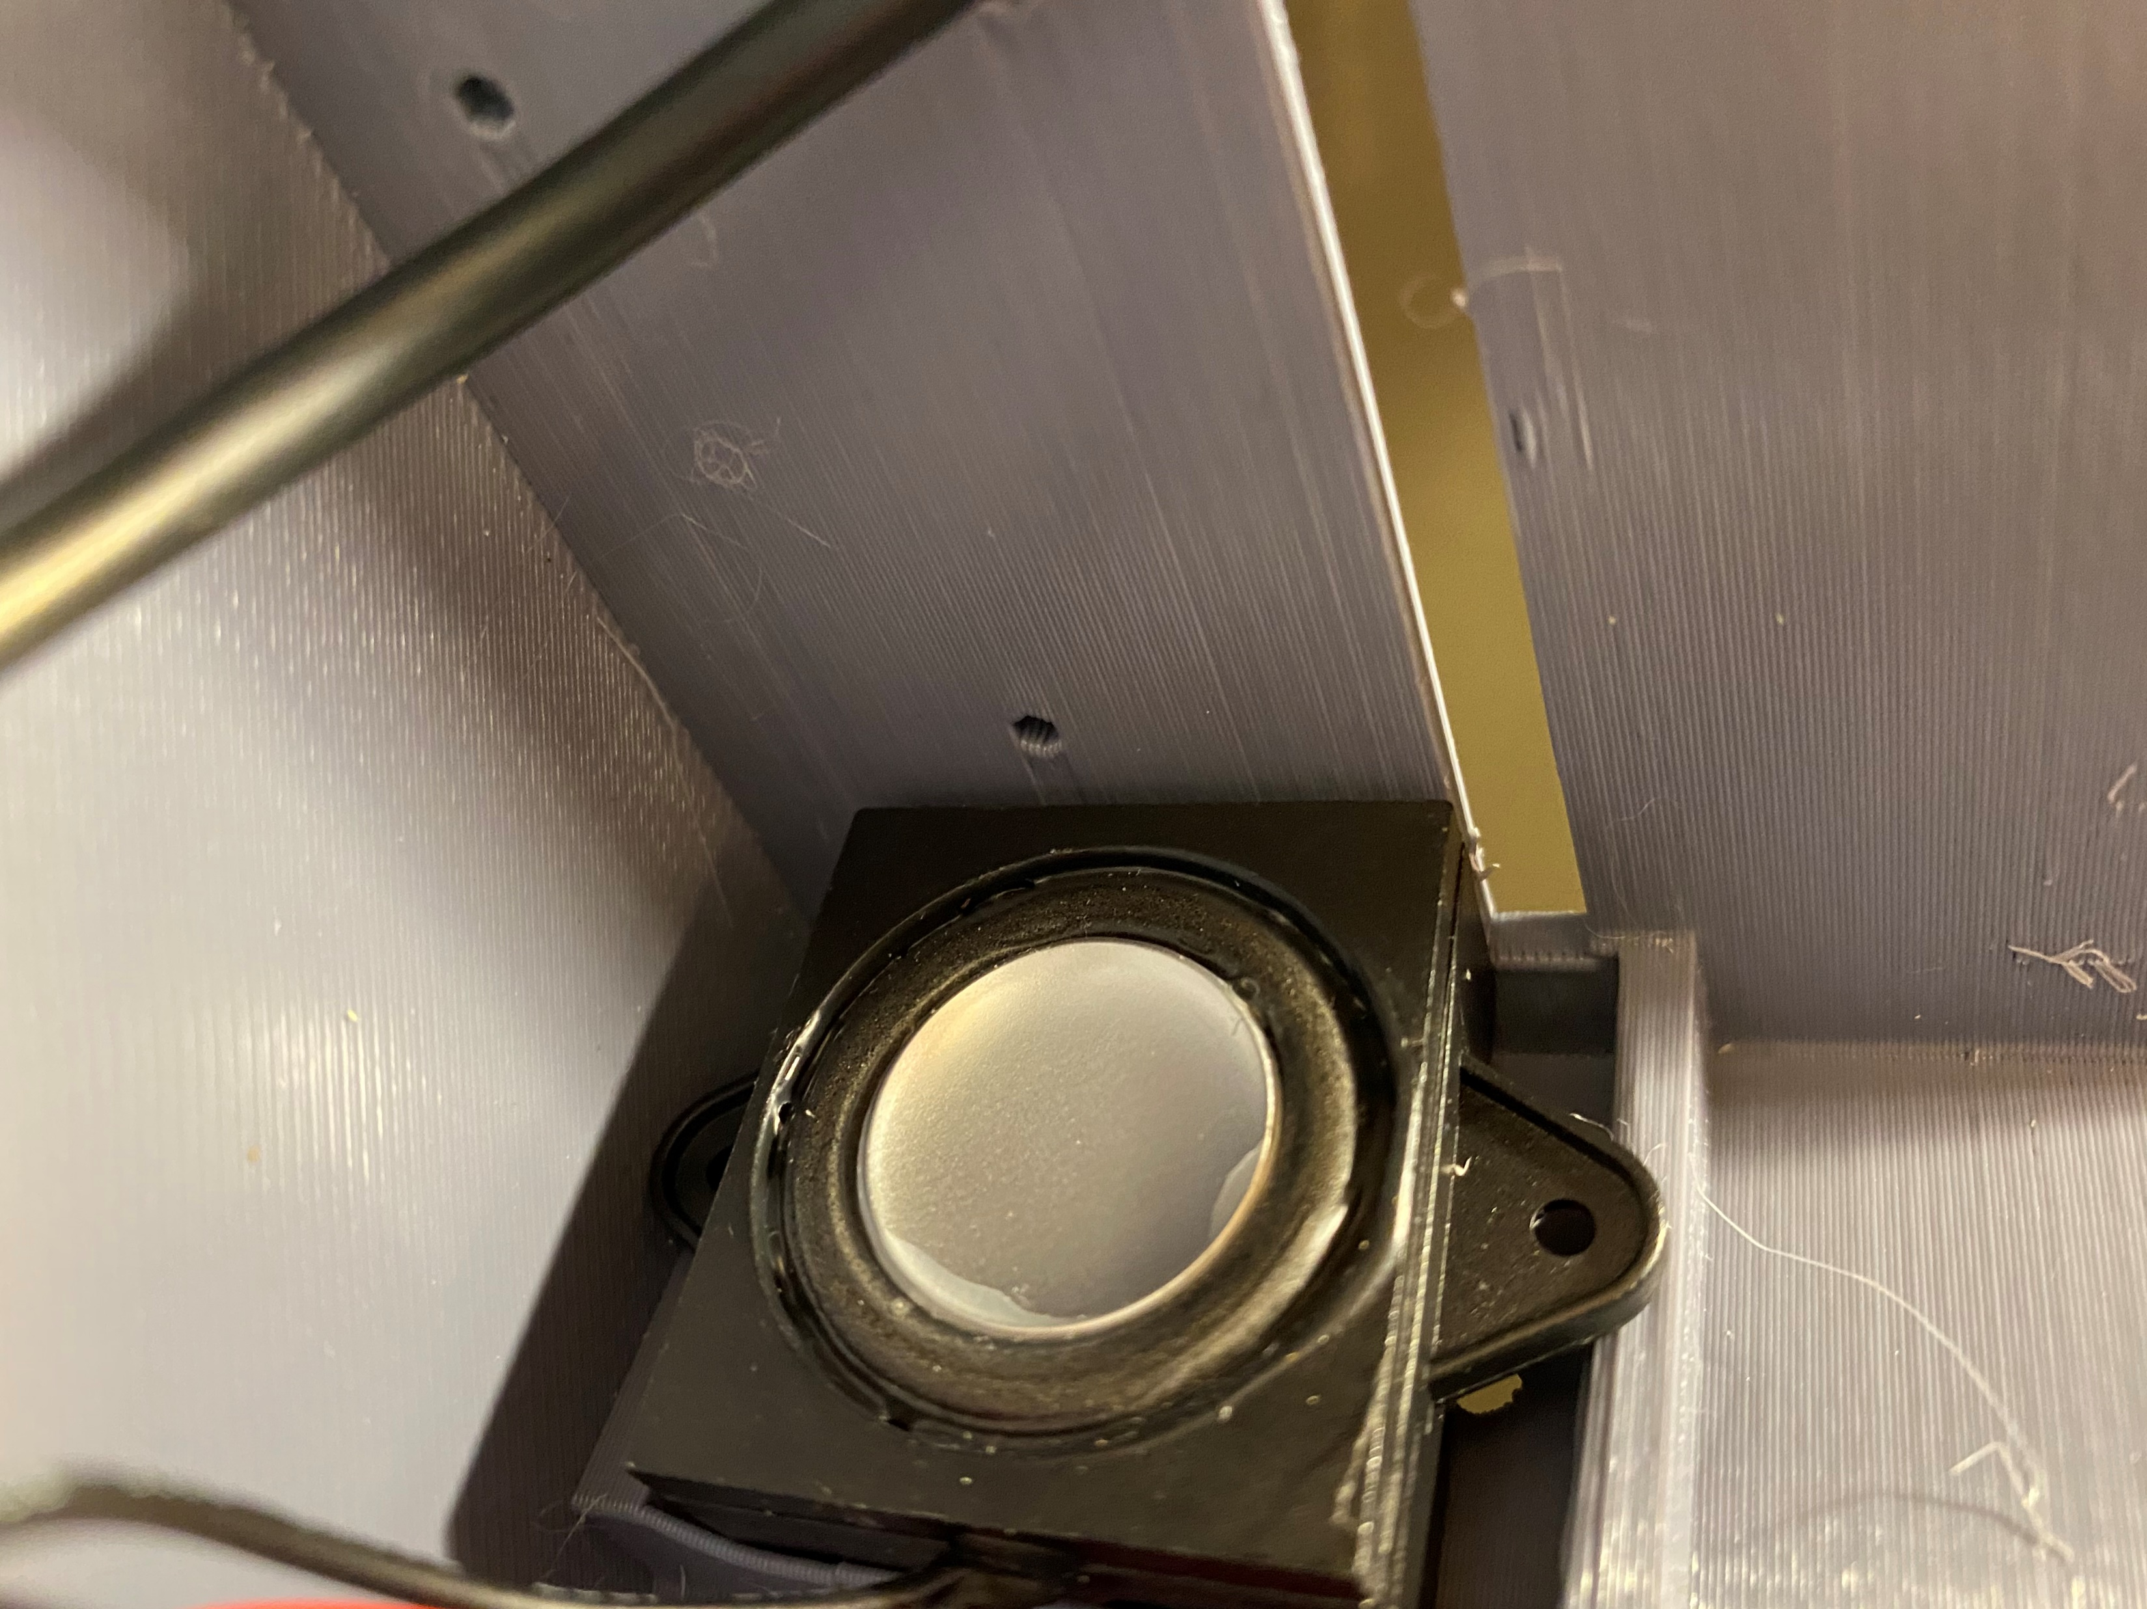
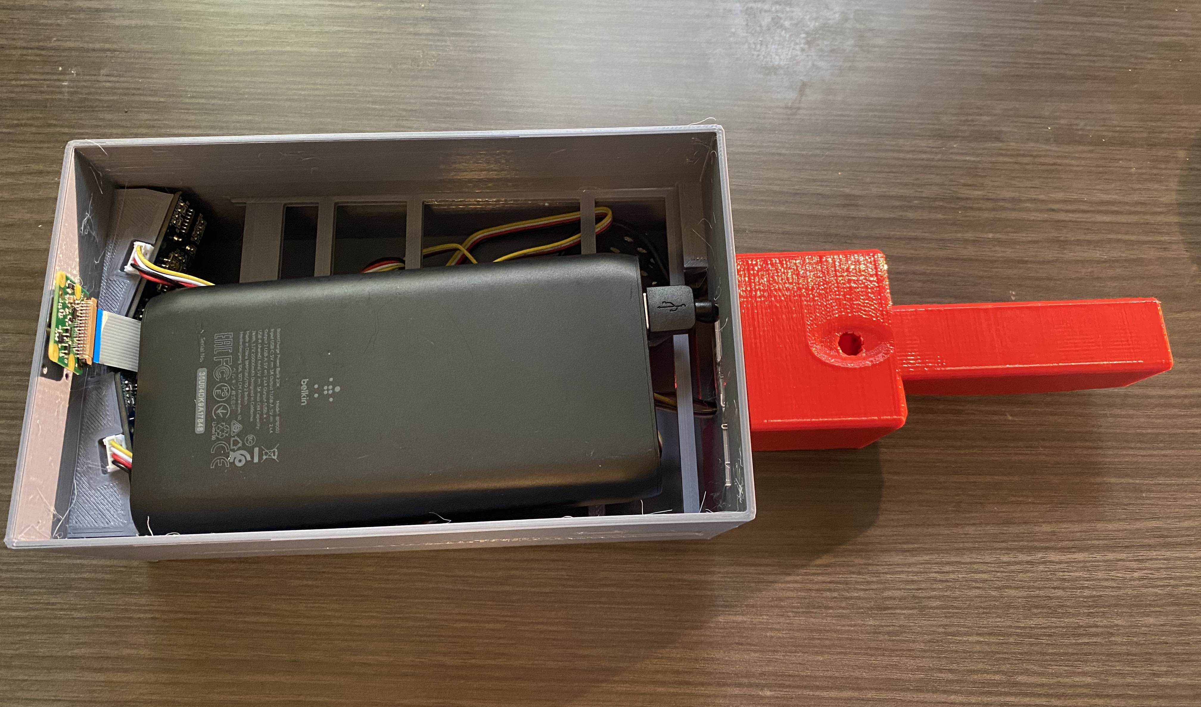
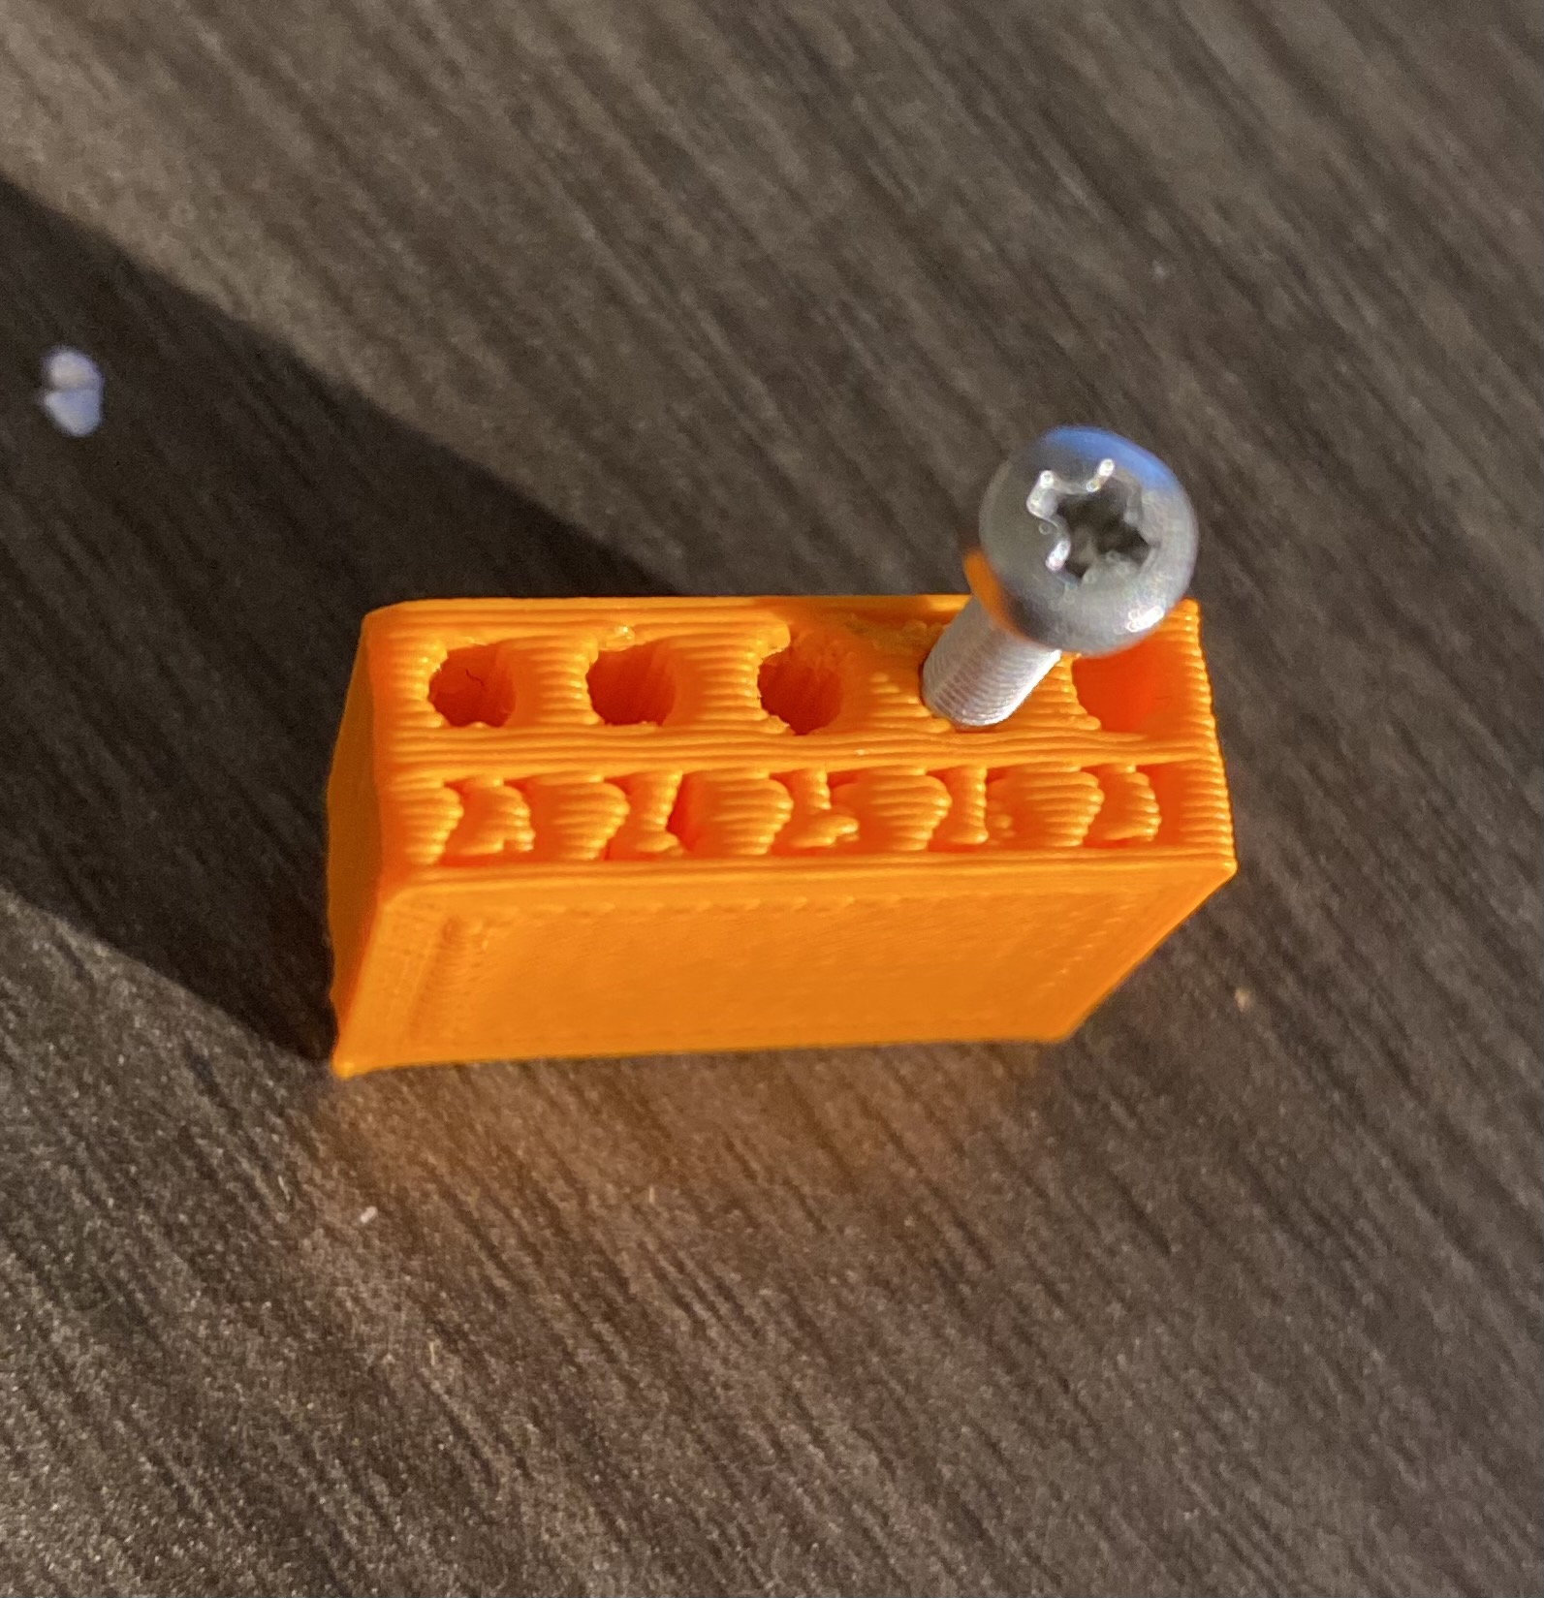
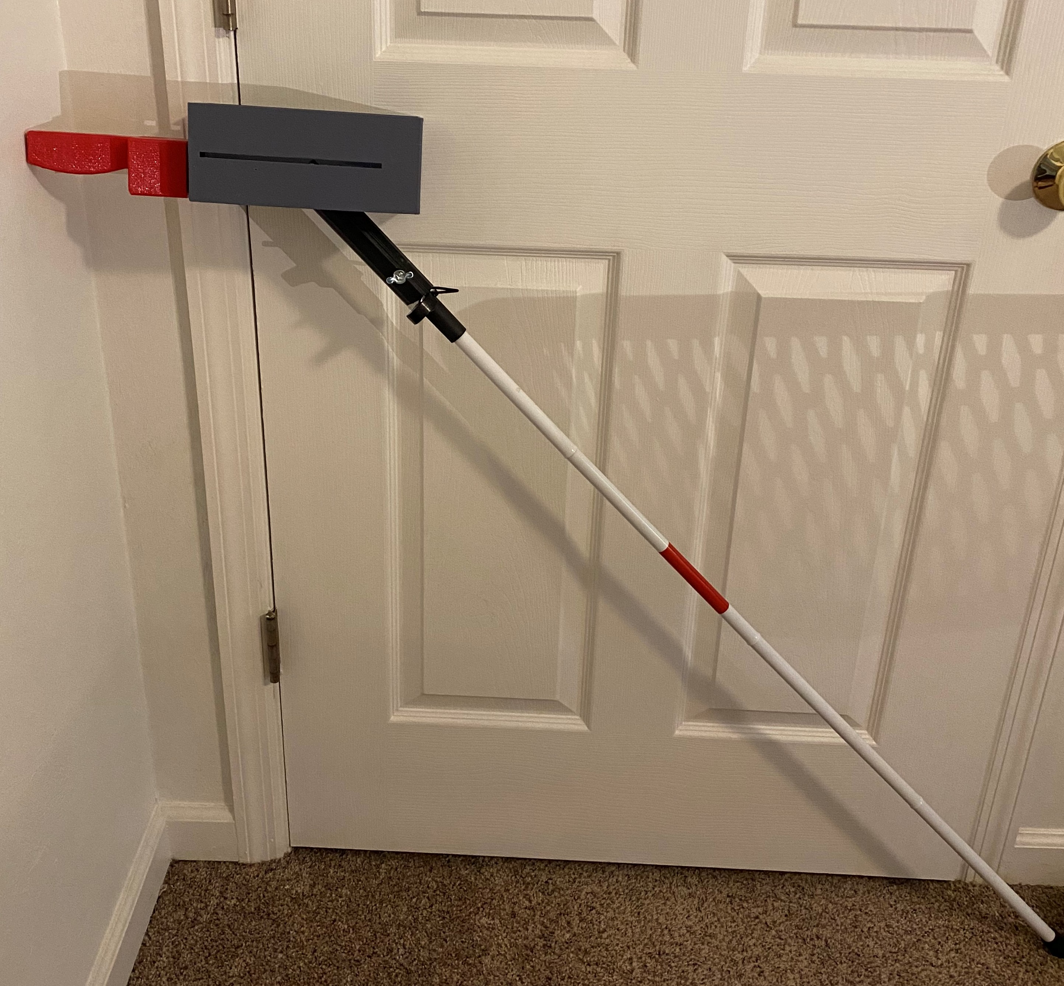
Assembly Concerns: Distribution
Shelf Location
Puts Pressure on Components.
Blocked Speaker.
Cane Attachment
Blocked Camera Wiring.
Mounting
Exterior Walls Are Too Thin.
Holes Are Not Deep/Wide Enough.
Battery
Bend in Cable Is Not Accounted For.
Power Button Is Not Properly Located.
Needs More Rigidity.
Madison Jaffe

Slide 25
Assembled View: Final Product
36.6 cm
12 cm
9.95 cm
Madison Jaffe

Slide 26
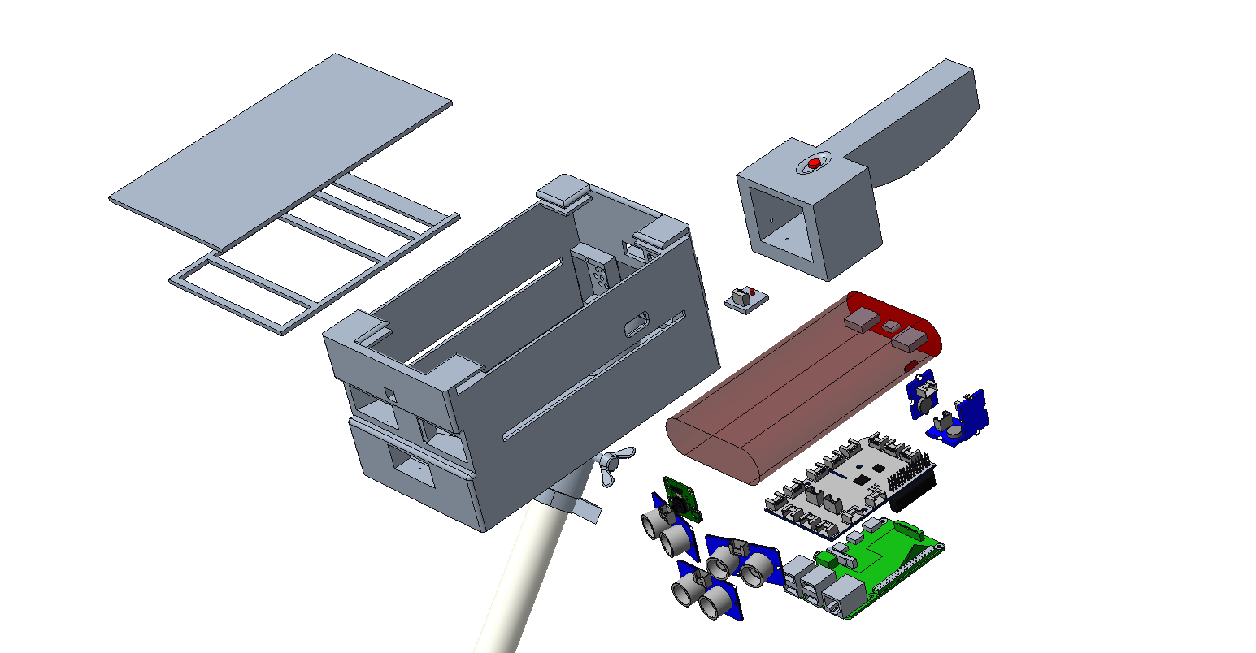



Exploded View
Push Button
Lid
Speaker
Handle
Button
Battery
Shelf
Vibration Motors (3)
Main Housing
GrovePi+
Wing Screw
Camera
Raspberry Pi 4
Clamp
Ultrasonic Sensors (3)
Madison Jaffe

Slide 27
Raspberry Pi: Sensors and Motors Code
Sensors are turned on
Object distance measured (cm)
Distance <= 100
100 < Distance <= 200
200 < Distance <= 300
Distance > 300
No
No
No
Yes
Yes
Yes
Yes
Motor is turned on
Motor is turned on
and off at 0.5 second intervals
Motor is turned on
and off at 1 second intervals
Motor is turned off
David Alicea

Slide 28
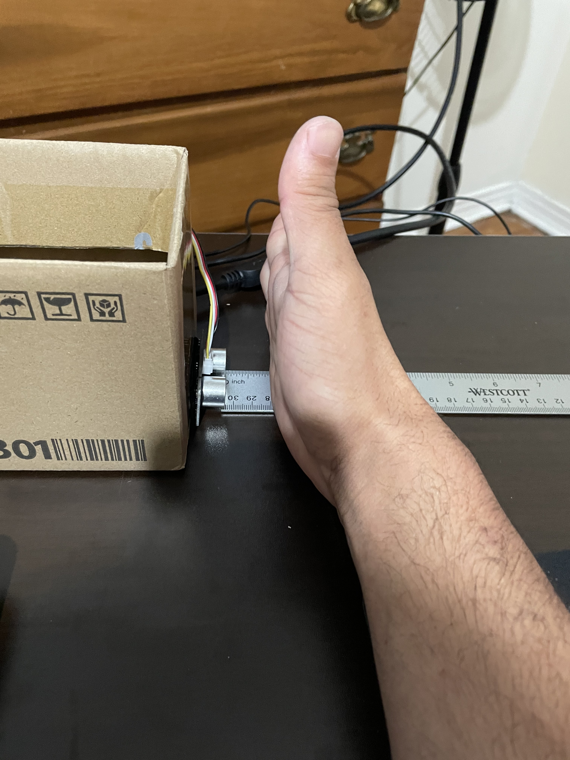
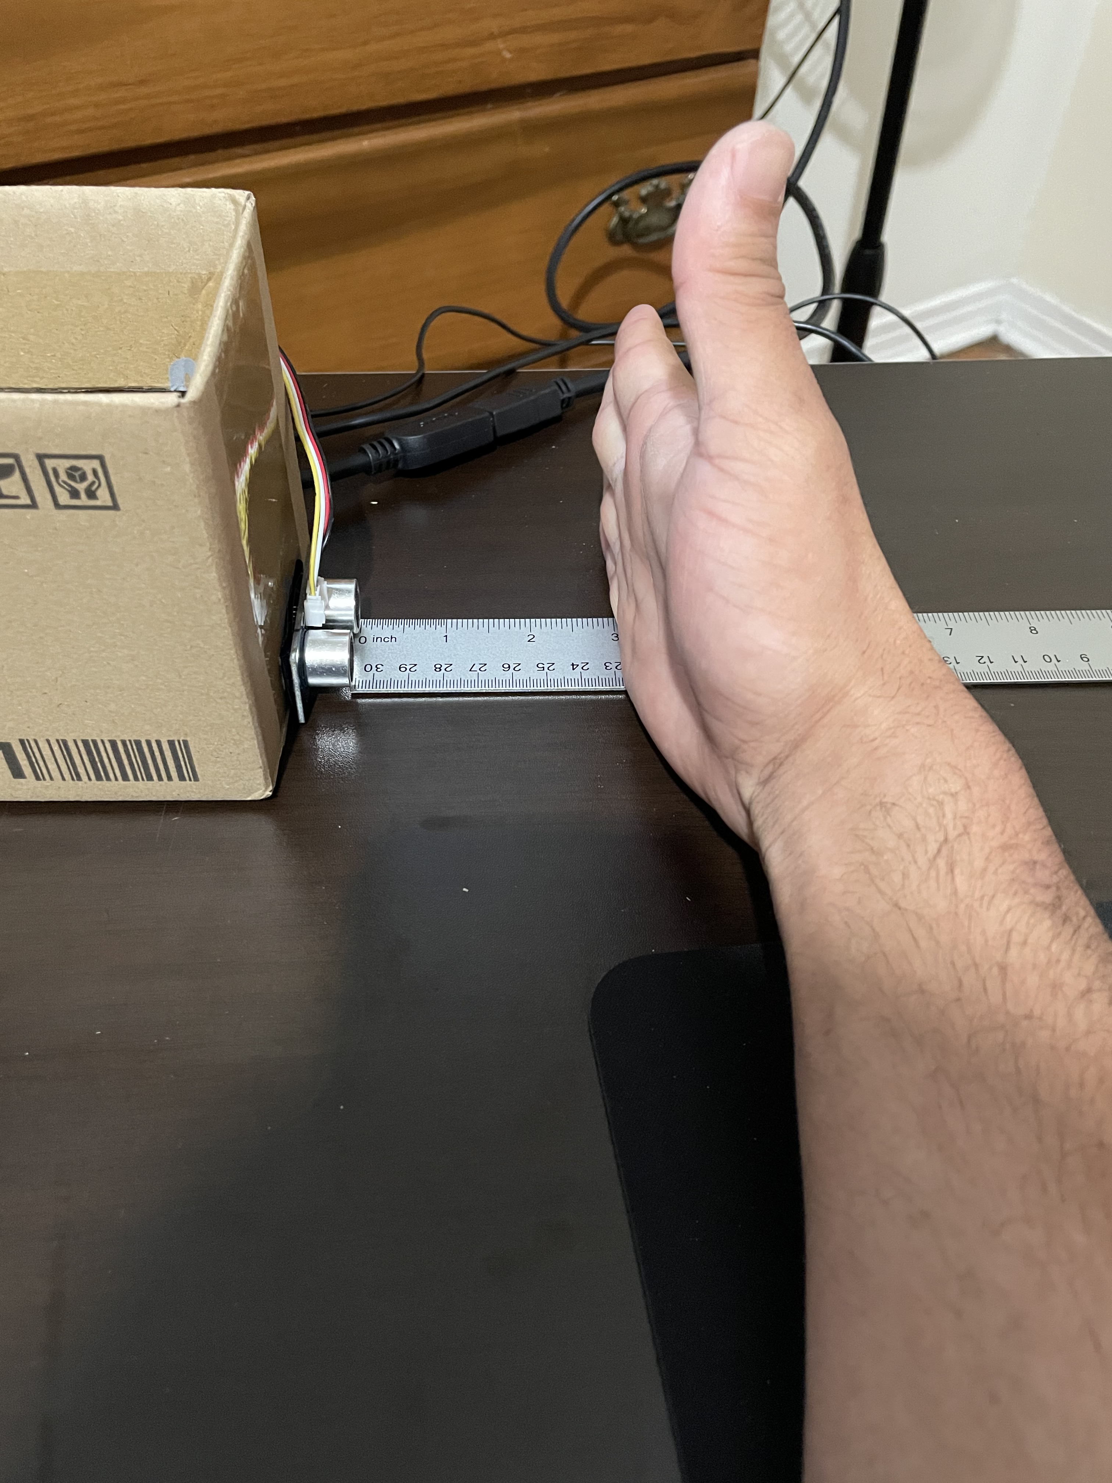
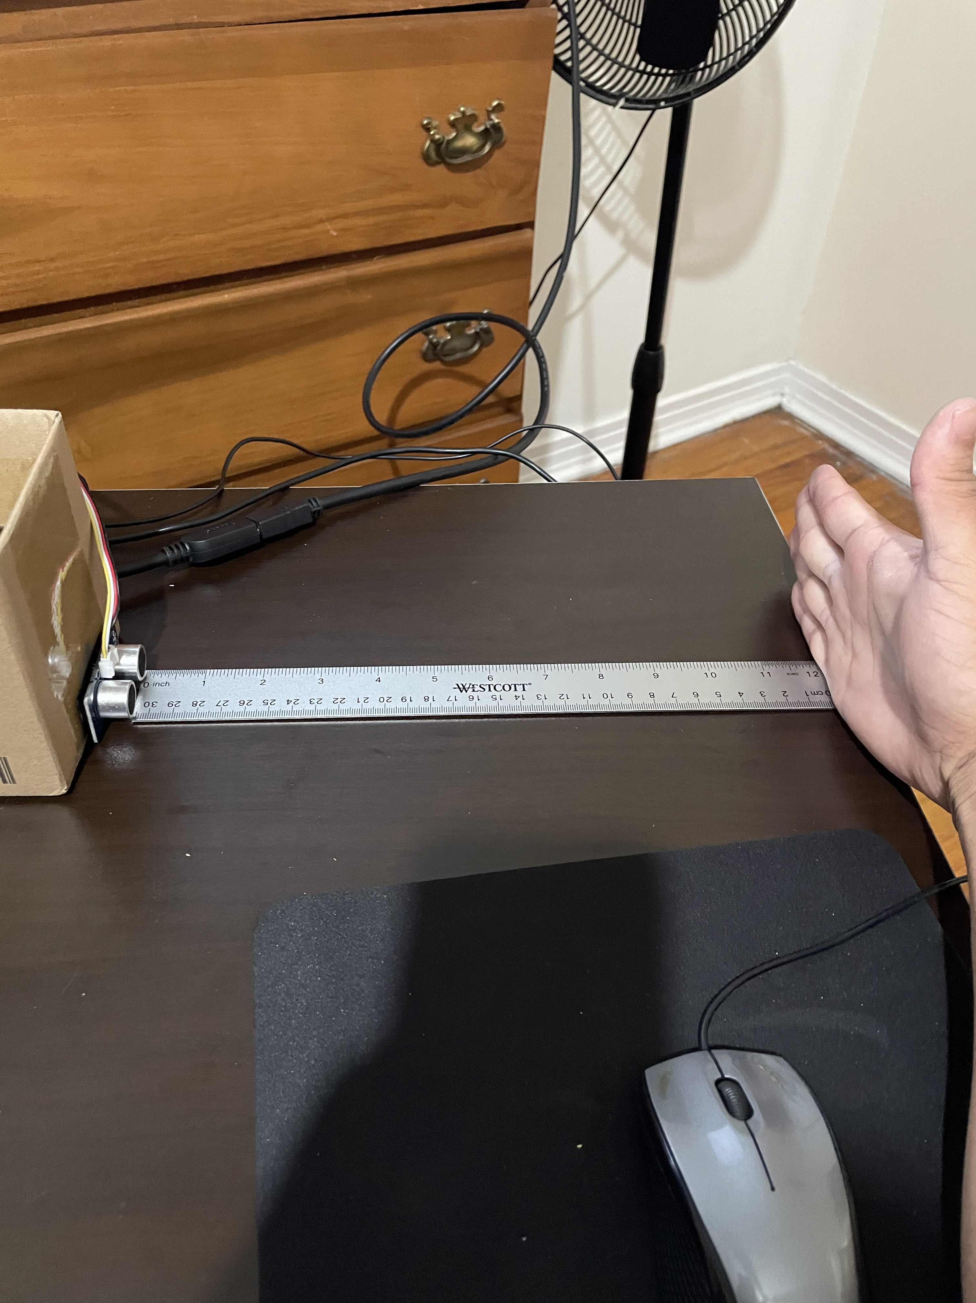
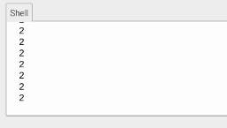
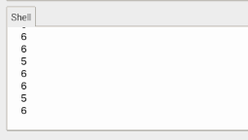
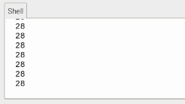
Sensor Validation
2.54 cm (1 inch)
7.62 cm (3 Inches)
30.48 cm (12 Inches)
David Alicea

Slide 29
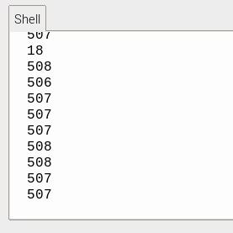

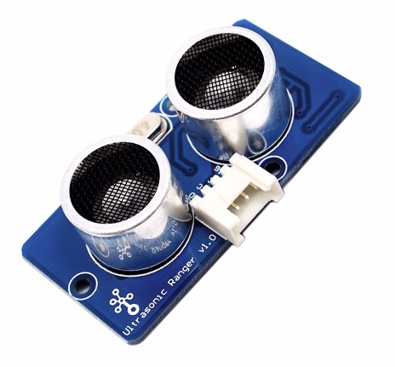




Sensor Limitations
Ultrasonic sensor is directed forward and does not support large changes in angle or tilt.
O
B
J
E
C
T
O
B
J
E
C
T
David Alicea

Slide 30
Item Identification on HapTac
Device is turned on
Button is pressed
Camera is activated
Camera takes
a picture of the object
¹Image is saved as a file
Alexnet takes image file and begins identifying
Alexnet gives prediction of what the object is
Speaker tells user what the object is
¹The same file is used for each use, therefore only the last image taken is saved on the device. Each image is deleted once a new one is taken.
David Alicea

Slide 31
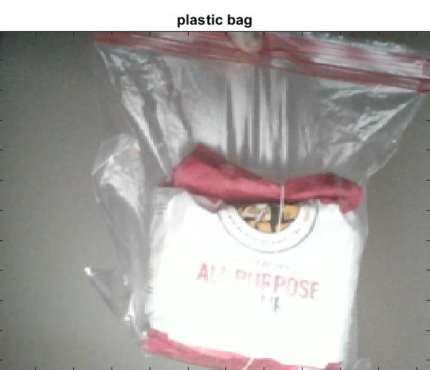
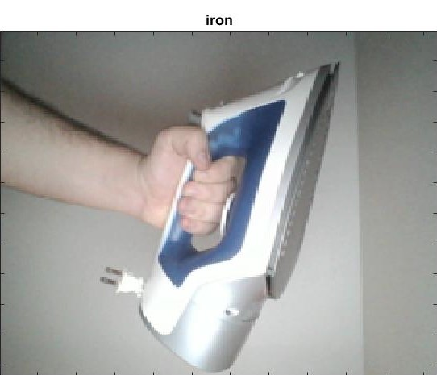
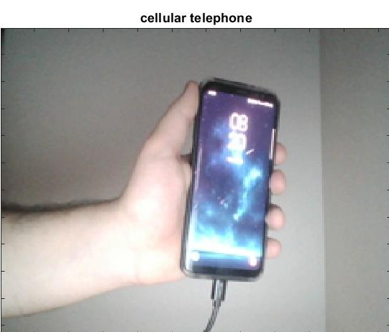
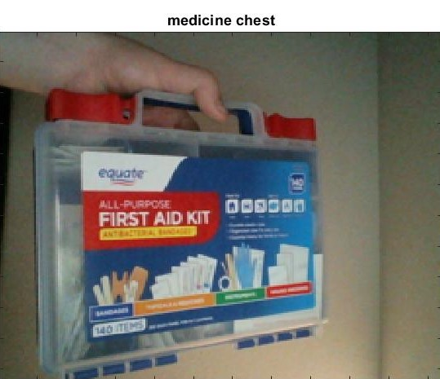
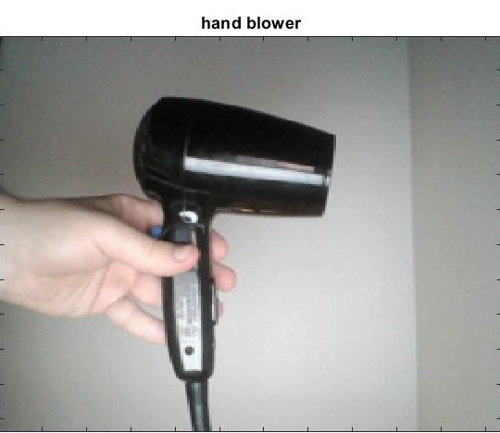
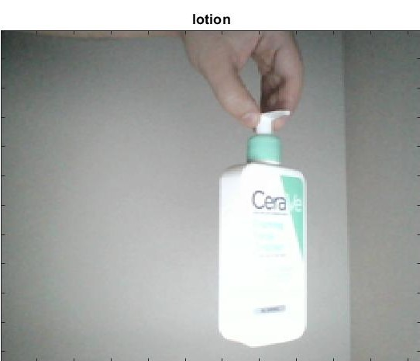
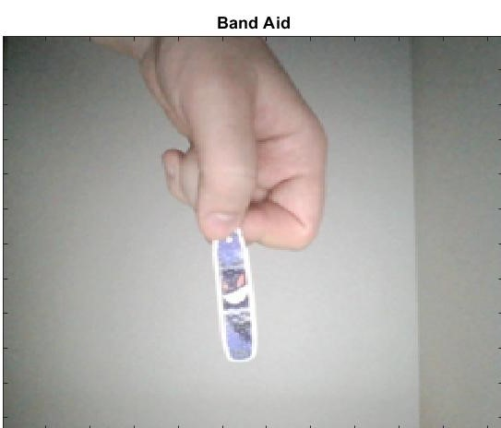
AlexNet – Normal Conditions
Why does it only detect the plastic bag?
Database has bias towards the plastic bag.
Nearly no instance of flour bags in database.
When scanned, overall shape is evaluated.
Nicolas Garcia

Slide 32
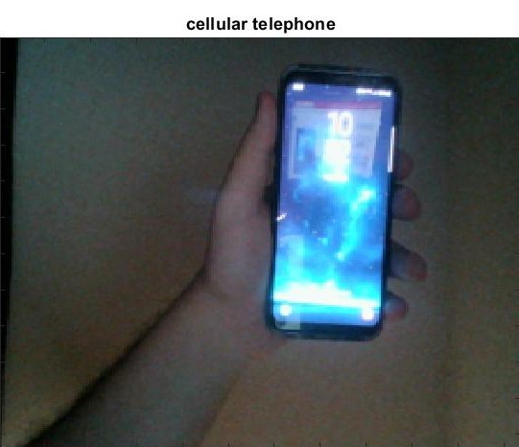
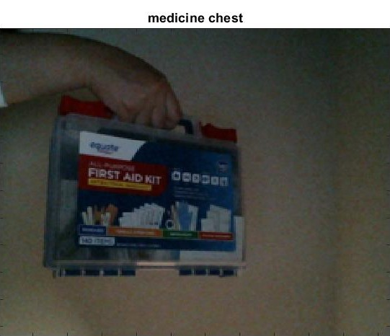





AlexNet – Lower Light Conditions
Nicolas Garcia

Slide 33


AlexNet – Various Objects in Frame
Software will analyze centerline first, even in low light conditions.
Nicolas Garcia

Slide 34
Validation
Function | Target
Alert of Elevation* | 0.6 to 30 cm
Determine Location* | Margin of error of at most 5 meters
Alert of Physical Object* | 165 cm
Identify Possible Threats* | Up to 25 m/s
Access Emergency Contact | 15 seconds
Interpret Sensory Information* | 7 seconds
Store Frequent Tasks | 1 GB
Interface with Pre-Existing Skills | 70%
Compete within Market | 20%
Remain Lightweight | <2.3 kg
Remain Discrete | 70% User Approval
*: Critical Function
Ethan Saffer

Slide 35
Validation
Function | Target | Complete
Alert of Elevation* | 0.6 to 30 cm | Yes
Determine Location* | Margin of error of at most 5 meters | No
Alert of Physical Object* | 165 cm | Yes
Identify Possible Threats* | Up to 25 m/s | No
Access Emergency Contact | 15 seconds | No
Interpret Sensory Information* | 7 seconds | Yes
Store Frequent Tasks | 1 GB | Yes
Interface with Pre-Existing Skills | 70% | Yes*
Compete within Market | 20% | Yes
Remain Lightweight | <2.3 kg | Yes
Remain Discrete | 70% User Approval | N/A
*: Critical Function
Ethan Saffer

Slide 36
Validation
Function | Target | Completion Metric
Alert of Elevation* | 0.6 to 30 cm | 0.6 to +30 cm
Determine Location* | Margin of error of at most 5 meters | Needs GPS, we should eliminate it
Alert of Physical Object* | 165 cm | 203 cm detection (high precision)
Identify Possible Threats* | Up to 25 m/s | Interpolation between sensors scans for threats
Access Emergency Contact | 15 seconds | No
Interpret Sensory Information* | 7 seconds | Scans and relays scanned object within 4-6 seconds
Store Frequent Tasks | 1 GB | Yes
Interface with Pre-Existing Skills | 70% | Yes*
Compete within Market | 20% | 67% cheaper than top competitor
Remain Lightweight | <2.3 kg | 1.2 kg (Including cane)
Remain Discrete | 70% User Approval | N/A
*: Critical Function
Ethan Saffer

Slide 37
Summary
Ideas had to be dismissed due to scope creep.
  May still be integrated in the future.
Cheaper parts for prototype made it cost efficient to market.
  Ultimately affected the accuracy of the device.
Overall, the project is successful in fulfilling its functions despite limitations.
Ethan Saffer

Slide 38
Reference
[1] Ebben, J. M., PhD. (n.d.). Wrists at risk: Awkward postures to avoid. Retrieved February 18, 2021, from https://www.iacindustries.com/get-started/ergonomics/wrists-at-risk.asp
[2] González, A., Salgado, D., García Moruno, L., & Sánchez Ríos, A. (2018). An Ergonomic Customized-Tool Handle Design for Precision Tools using Additive Manufacturing: A Case Study. Applied Sciences, 8(7), 1200. doi:10.3390/app8071200
[3] McConomy, S. (2020, November 11). Engineering Characteristics, Functions, Targets, and Metric. FAMU-FSU College of Engineering.
[4] National Federation of The Blind. https://www.nfb.org/resources/blindness-statistics
[5] Queen, K. (2016, June). 7 Ways to Make Communities More Livable for People With Vision or Hearing Impairments. AARP.
[6] Rosen, S. (n.d.). LONG CANE TECHNIQUES. Retrieved March 03, 2021, from https://tech.aph.org/sbs/04_sbs_lc_study.html
[7] Wang, C., & Cai, D. (2020). Hand tool handle size and shape determination based on hand measurements using a contour gauge. Human Factors and Ergonomics in Manufacturing &amp; Service Industries, 30(5), 349-364. doi:10.1002/hfm.20846
Ethan Saffer

Slide 39
Team 522: Vision Impaired Technology
David Alicea
Field/Test Engineer and Quality Control
Daa16@my.fsu.edu
Madison Jaffe​
Project Manager and Manufacturing/Controls Engineer
Msj16d@my.fsu.edu
Nicolas Garcia
Design Engineer, Webmaster, and Resource Manager
Ng16m@my.fsu.edu
Ethan Saffer
Systems and Design
Engineer
Ers16c@my.fsu.edu
Ethan Saffer

Slide 42
APPENDIX

Slide 43

Raspberry Pi and Grove Parts
Raspberry Pi acts as our main processing unit.
Grove Pi is the attachment board that makes the Grove parts accessible.
Raspberry Pi Camera is used to identify items.
Ultrasonic sensors and vibration motors detect objects and notify the user of their presence.
David Alicea

Slide 44


Lessons Learned
3D Printing is good for quick models
Warping and geometric constraints limit their use
The front of the main housing has a downward bend.
Corners are warped, altering geometry
Madison Jaffe

Slide 45

Lessons Learned
May not receive the parts originally desired.
Need to be constantly adapting to changes.
The battery served as the hardest object to design around.
  It is the largest and heaviest component of our assembly
New iterations of housing were made to make it as compact as possible.
Madison Jaffe

Slide 46
Lessons Learned
7.6 Centimeters
Calibration is essential to precise measurements.
Propagation of error can be reduced.
Proper calibration of sensors and motors are pivotal for their accurate usage.
Here the sensor should read 7.6cm, rounded between 7 and 8.
  The error propagates further as the distance increases
David Alicea

Slide 47

InNOLEvation
Challenge
Unit Price: $299
Yearly Projections
Competed in the InNOLEvation Competition
Selected as a finalist
  Received $500 for the company
Ethan Saffer

Slide 48



Third Housing

Slide 49

Third Housing

Slide 50



Assembly Concerns: Addressed
Megapascals (MPa)
The orange shows where the stress is highest.
Nicolas Garcia

Slide 51





Housing Validation
Madison Jaffe

Slide 52

Housing
Original housing includes:
  1 Ultrasonic sensor
  3 Vibration Motors
  Raspberry Pi / Grove Pi+
  Accelerometer & Gyroscope
  Valve clamp
Ethan Saffer

Slide 53







Camera Identification - AlexNet
Nicolas Garcia

Slide 54
Housing Validation
Megapascals (MPa)
The orange shows where the stress is highest.
Madison Jaffe

Slide 55



Housing
Ethan Saffer

Slide 56
Key Goals and Assumptions
Key Goals:
  Aids the visually impaired in daily activities.
  Assist people who are visually impaired to become more active.
  Keep the visually impaired safe while executing relatively complex tasks.
Assumptions:
  Users are unaware of objects in new surroundings.
  Users have undergone Orientation and Mobility training/rehabilitation.
  The visually impaired are not fully comfortable in our current society.
Ethan Saffer

Slide 57





Critical Functions
Alert of Elevation
Determine Location
Alert of Physical Object
Identify Possible Threats
Interpret Sensory Information
Ethan Saffer

Slide 58



Raspberry Pi: Sensors and Motors Code
David Alicea

Slide 59




Slide 60
Yearly Projections
3 Year Sales Projection
Projected Revenue
  $594,631
Projected Profit
  $184,543
5 Year Sales Projection
Projected Revenue
  $1,807,101
Projected Profit
  $250,639
35% Growth from Year 3
Madison Jaffe

Slide 61

Housing
Our previous housing design was failing at the cane attachment.
The new design is more capable of handling the stresses that will act on the housing.
Nicolas Garcia

Slide 62
Housing Concerns: Warping
The front of the main housing has a downward bend.
Corners are warped, altering geometry

Slide 63



Medium-High Fidelity Concepts
GPS Watch:
Haptic Feedback cane:
Smart Glasses:
Audio Feedback cane:
GPS app:
Pin Matrix Haptics:
Sensor Watch:
Sensor Pin Chip:
Ethan Saffer

Slide 64


Markets
  Primary market: People with severe visual impairment, rehabilitation and treatment centers.
  Secondary market: Autonomous Systems and State-Local Departments of Transportation.
Ethan Saffer

Slide 65



Final Selection
Our final potential designs were ranked:
  Haptic Smart Cane
  Sensor Pin Chip
  Sensor Watch
#1
Haptic Smart Cane
#2
Sensor Pin Chip
#3
Sensor Watch
Ethan Saffer

Slide 66



Competitors
White Cane
Sunu Band
WeWalk
https://athome.medline.com/en/medline-white-cane-for-blind-vision-impaired-1ct-mdswhtcane
https://www.sunu.com/es/index
https://webrazzi.com/en/2020/05/01/wewalk-investment-750k/
Ethan Saffer

Slide 67

WeWalk
Similar product that incorporates ultrasonic sensors in the format of a smart-cane.
Uses infrared sensors to detect ground irregularities.
Overload of information.
Ethan Saffer

Slide 68
Competitor Comparison
White Cane | Sunu Band | WeWalk | Our Solution
Senses irregularities below the waist Standard aid for visually impaired | Senses objects nearby Set position on wrist, can discomfort user to "aim" | Infrared Sensor for floor irregularities Ultrasonic sensor for object detection | Senses ground irregularties Notifies user

Slide 69
Device Operational Time
Ultrasonic Sensor
8 mA
Camera
Up to 800 mA
Vibration Motor
58 mA average
100 mA max
Raspberry Pi
3,000 mA
Power Supply
20,000 mAh
Theoretical (Maximum Current Draw) Operation Time: 4.87 Hours
4 hours, 52 minutes and 12 seconds
Madison Jaffe

Slide 70
Targets and Metrics
Function | Target | Metric
Alert of Elevation* | 0.25 to 12 inches | Distance
Determine Location* | ~ 16 feet | Distance
Alert of Physical Object* | 65 inches | Distance
Identify Possible Threats* | Up to 60 miles per hour | Velocity
Access Emergency Contact | 15 seconds | Time
Interpret Sensory Information* | 7 seconds | Time
Store Frequent Tasks | 1 GB | Memory Allocation
Interface with Pre-Existing Skills | 70% | User Satisfaction
Compete within Market | 20% | Price Range USD ($)
Remain Lightweight | < 5.1 lb | Weight
Remain Discrete | 70% | User Approval
David Alicea

Slide 71



Concept Generation Tools
Crap Shoot
Morphological Chart
Biomimicry
McConomy, S. (2020, November 11). Engineering Characteristics, Functions, Targets, and Metric. FAMU-FSU College of Engineering.
David Alicea

Slide 72
Medium Fidelity Concepts
GPS Watch:
- GPS indicate where the user is
- haptic feedback provided through vibration on wrist
Haptic Feedback cane:
- haptic feedback voice-activated
- phone compatible
Smart Glasses:
- sensor and GPS for user location
- Audio feedback through glass-mounted earpiece
Audio Feedback cane:
- audio feedback
- Tactile or voice activation
- Phone compatible
- camera to interpret the environment
GPS app:
- Lidar
- user information through haptics
- computer and GPS track and locate user
David Alicea

Slide 73
Concept Selection
David Alicea

Slide 74

Pugh Chart
Nicolas Garcia

Slide 75
Pugh Chart
Nicolas Garcia

Slide 76

Second Pugh Chart
Nicolas Garcia

Slide 77
Second Pugh Chart
Nicolas Garcia

Slide 78
Analytical Hierarchy Process
Criteria Comparison Matrix [C]
Functions | Criteria Weights{W}
Alert of Elevation | 0.11
Determine Location | 0.13
Interpret Sensory Information | 0.24
Access Emergency Contact | 0.03
Interface With Pre-Existing Skills | 0.11
Store Frequent Tasks | 0.04
Alert of Physical Object | 0.19
Inform User of Possible Threats | 0.15
Sum | 1.00
Nicolas Garcia

Slide 79
Analytical Hierarchy Process
 | Sensor Pin Chip | Sensor Watch | Haptic Smart Cane
Alert of Elevation | 0.11 | 0.11 | 0.78
Determine Location | 0.16 | 0.19 | 0.66
Interpret Sensory Information | 0.45 | 0.45 | 0.09
Access Emergency Contact | 0.20 | 0.20 | 0.60
Interface with Pre-existing Skills | 0.14 | 0.14 | 0.71
Store Frequent Tasks | 0.33 | 0.33 | 0.33
Alert of a Physical Object | 0.43 | 0.14 | 0.43
Inform User of Possible Threats | 0.33 | 0.33 | 0.33
Nicolas Garcia

Slide 80
Analytical Hierarchy Process
 | Sensor Pin Chip | Sensor Watch | Haptic Smart Cane
Alert of Elevation | 0.11 | 0.11 | 0.78
Determine Location | 0.16 | 0.19 | 0.66
Interpret Sensory Information | 0.45 | 0.45 | 0.09
Access Emergency Contact | 0.20 | 0.20 | 0.60
Interface with Pre-existing Skills | 0.14 | 0.14 | 0.71
Store Frequent Tasks | 0.33 | 0.33 | 0.33
Alert of a Physical Object | 0.43 | 0.14 | 0.43
Inform User of Possible Threats | 0.33 | 0.33 | 0.33
Nicolas Garcia

Slide 81
Analytical Hierarchy Process
 | Sensor Pin Chip | Sensor Watch | Haptic Smart Cane
Alert of Elevation | 0.11 | 0.11 | 0.78
Determine Location | 0.16 | 0.19 | 0.66
Interpret Sensory Information | 0.45 | 0.45 | 0.09
Access Emergency Contact | 0.20 | 0.20 | 0.60
Interface with Pre-existing Skills | 0.14 | 0.14 | 0.71
Store Frequent Tasks | 0.33 | 0.33 | 0.33
Alert of a Physical Object | 0.43 | 0.14 | 0.43
Inform User of Possible Threats | 0.33 | 0.33 | 0.33
Nicolas Garcia

Slide 82
Standard Shapes
Summary Box
Text box 1
Outlined Text Box

Slide 83




Approved Logos

Slide 84

Color Palette

Slide 85
Slides to keep:
Intro, Synopsis of VDR1 (Rename), Customer Needs, minimize Concept Gen. & Selection, Final Selection?, What's Next, Last team member slide, Ref.
Slides to add:
Specs of design
BOM/Ordering parts
Our progress in the InNOLEvation challenge?

Slide 86
APA Tables
Category 1 | Category 2 | Category 3 | Category 4 | Category 5
Item 1
Item 2
Item 3
Item 4
 | Category 2 |  |  | Category 3
Category 1 | subcategory 1 | subcategory 2 |  | subcategory 1 | subcategory 2
Item 1
Item 2
Item 3
Item 4

