Slide 1

ENVIRONMENTALLY CONTROLLED TEST CHAMBER
Nicholas Blenker | Tucker Hall | David Wilson
TEAM 503

Slide 2

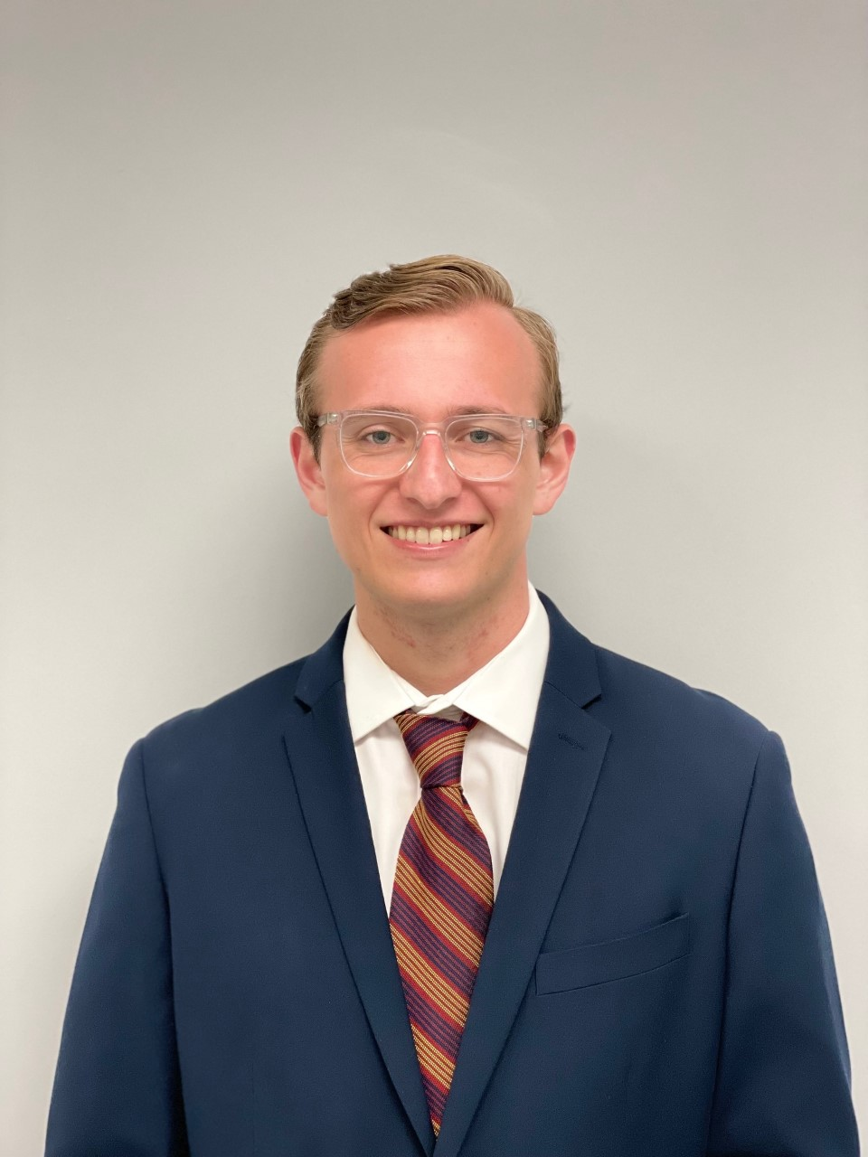
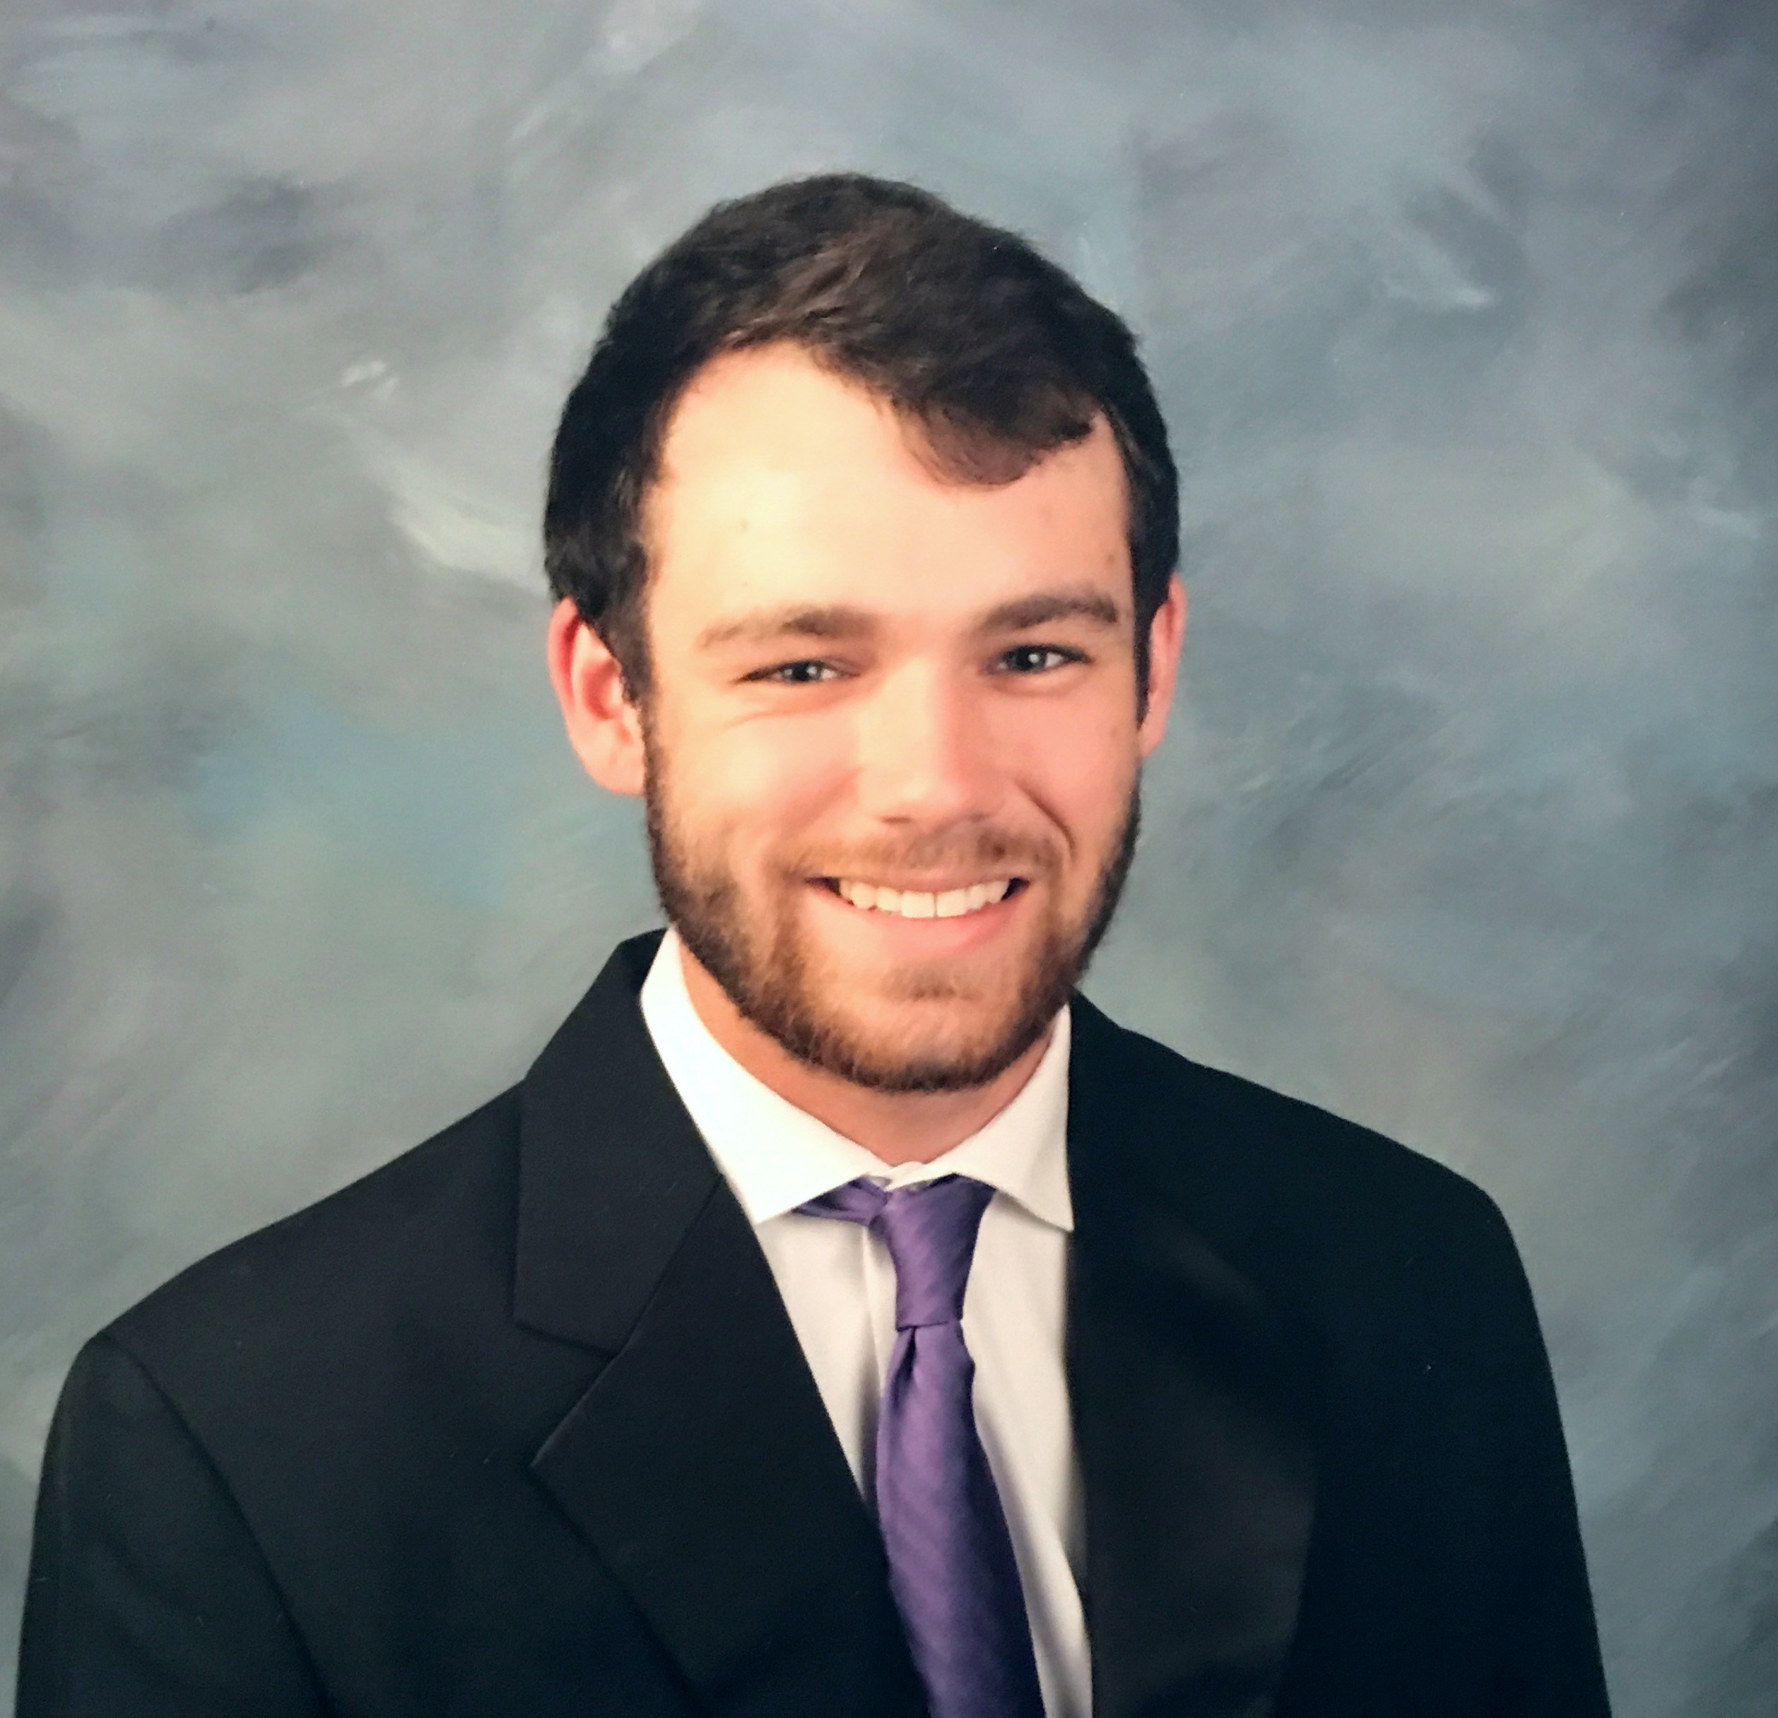
Meet Team 503
Nicholas Blenker
Tucker Hall
David Wilson
Tucker Hall
Design Engineer
Systems Engineer
Controls Engineer
Nicholas Blenker

Slide 3
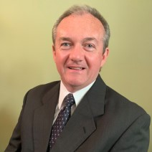
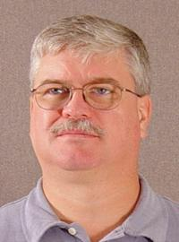
Sponsor & Advisor
William Bilbow
Keith Larson
Danfoss
FAMU-FSU College of Engineering
Nicholas Blenker

Slide 4
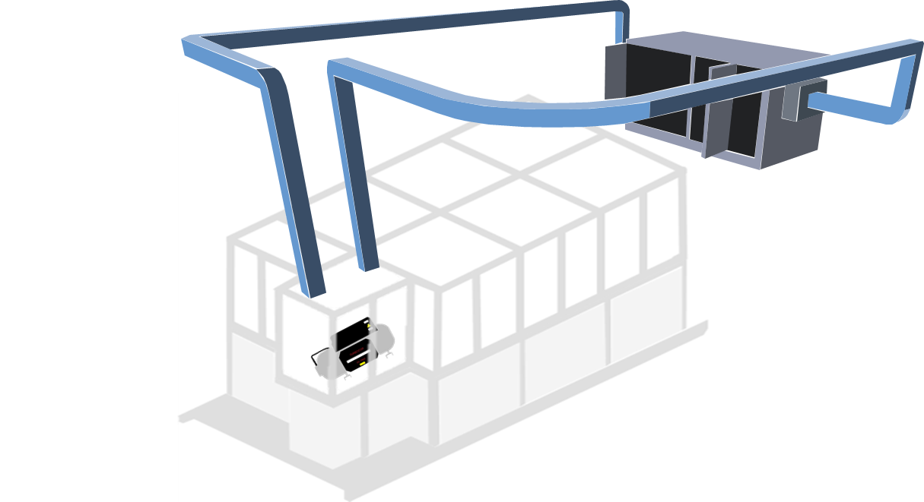
Project Objective
Validate the existing design of an environmental testing chamber and deliver an assembly that regulates its internal temperature and humidity for use in a laboratory environment.
Nicholas Blenker

Slide 5




Project Background
Created a Bill of Materials
  Project Start
  Fall 2019
v
v
CAD and
Calculations
Danfoss Project Approval
Nicholas Blenker
Notes:
Need to Add more specific dates for each item!

Slide 6
Motivation
DUCTWORK
TREATED AIR
AIR HANDLING
UNIT
RETURN AIR
CONTROL
VOLUME
CHAMBER
COMPRESSOR
Nicholas Blenker

Slide 7
Customer Needs
What are the expectations by the end of the project?
What components are already in place?
Question 1
Question 3
Question 5
What is the volume of air that needs to be controlled?
What are some other design considerations?
What problem(s) need to be solved?
Question 2
Question 4
Nicholas Blenker
Notes:
Clarify/change question 1
Basically outlines project scope

Slide 8
Interpreted Needs
Question 1
What problem(s) need to be solved?
What problem(s) need to be solved?
Adapt and tune current chamber components.
Build it to provide environmental control.
Nicholas Blenker
Notes:
Figure out exact volume, airflow, and exchange rate
Or change question to:
What part of the test chamber are we controlling air quality?

Slide 9
Interpreted Needs
Question 2
What are the expectations by the end of the project?
Ensure all hardware meets specified conditions.
Validate the previous heat balance analysis.
Tune the controls to achieve stable and specified conditions within target time.
Use 6-sigma problem-solving.
The chamber must go from 10 to 55 degrees Celsius and from 10% to 95% relative humidity.
Nicholas Blenker

Slide 10
Interpreted Needs
Question 3
What is the volume of air that needs to be controlled?
Focus on regulating the temperature and humidity of the air surrounding the compressor.
Nicholas Blenker

Slide 11
Interpreted Needs
Question 4
What components are already in place?
The design fits in and around the test rig and its surroundings.
The design is supported by previously installed parts.
Nicholas Blenker

Slide 12
Interpreted Needs
Question 5
What are some other design
considerations?
What are some other design
considerations?
Accommodate space for the crane to install the compressor from above.
The compressor and components are in view and the panels provide internal visibility.
Nicholas Blenker

Slide 13




Assumptions
The test rig will rest on a flat and level surface
Conductive heat from the compressor is negligible
The size of the compressor is unchanging
The existing support has adequate load capacity
Tucker Hall

Slide 14

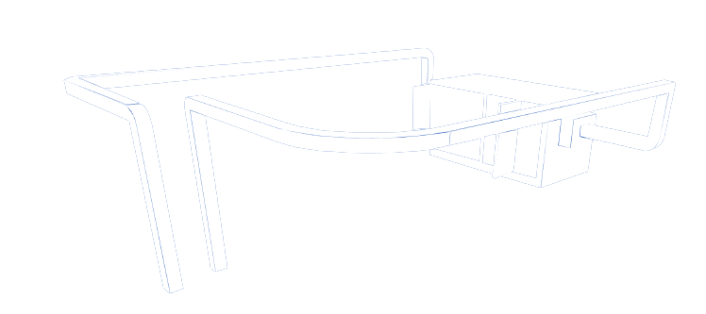




Key Goals
Validate
Finalize
Implement
Tucker Hall

Slide 15
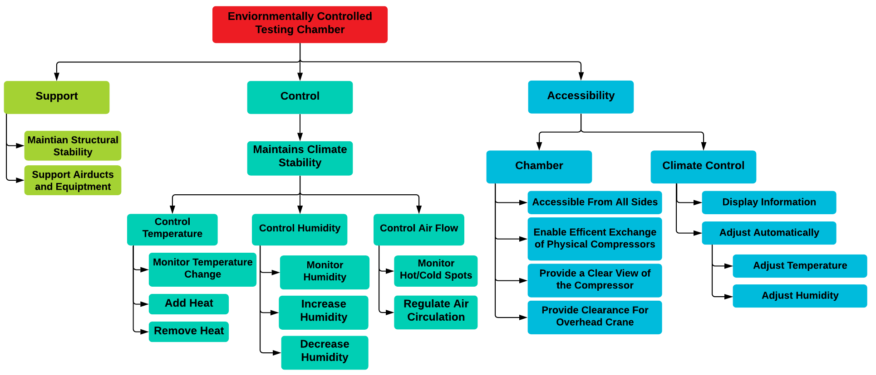
Functional Decomposition
Tucker Hall

Slide 16



Functional Decomposition
Accessibility
Support
Control
Tucker Hall

Slide 17


Functional Decomposition
Support
Maintain structural stability
Support airducts and equipment
Support
Tucker Hall

Slide 18

Functional Decomposition
Control
Maintains climate stability
Control temperature
Control humidity
Control airflow
Control
Tucker Hall

Slide 19

Functional Decomposition
Accessibility
Chamber
Enable exchange of compressors
Accessable from all sides
Provide clear view of compressor
Provide clearance for crane
Climate
Accessibility
Tucker Hall

Slide 20
Functional Decomposition
Accessibility
Chamber
Climate
Display information
Adjust automatically
Adjust temperature
Adjust humidity
Accessibility
Tucker Hall

Slide 21


Future Work
Equations
Controls
Materials

Slide 22




Future Work
Targets &
Metrics
Concept Evaluation
Concept
Generation
Concept
Selection
Tucker Hall

Slide 23
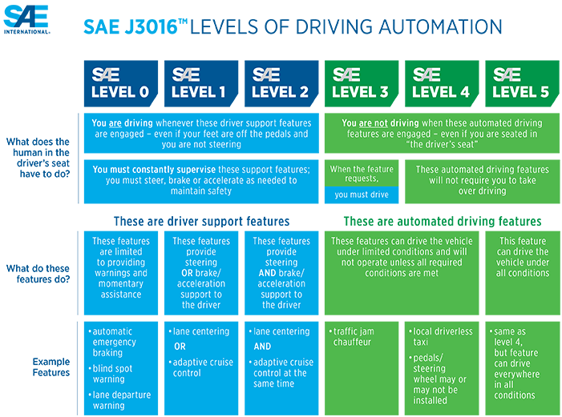

Key Goals – SAE Standards

Slide 24
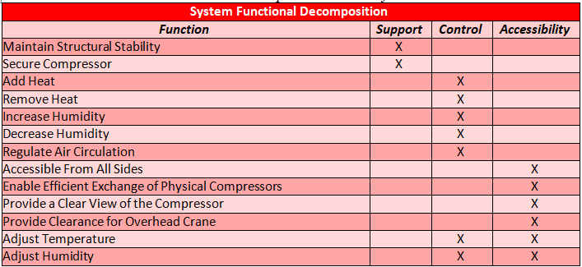
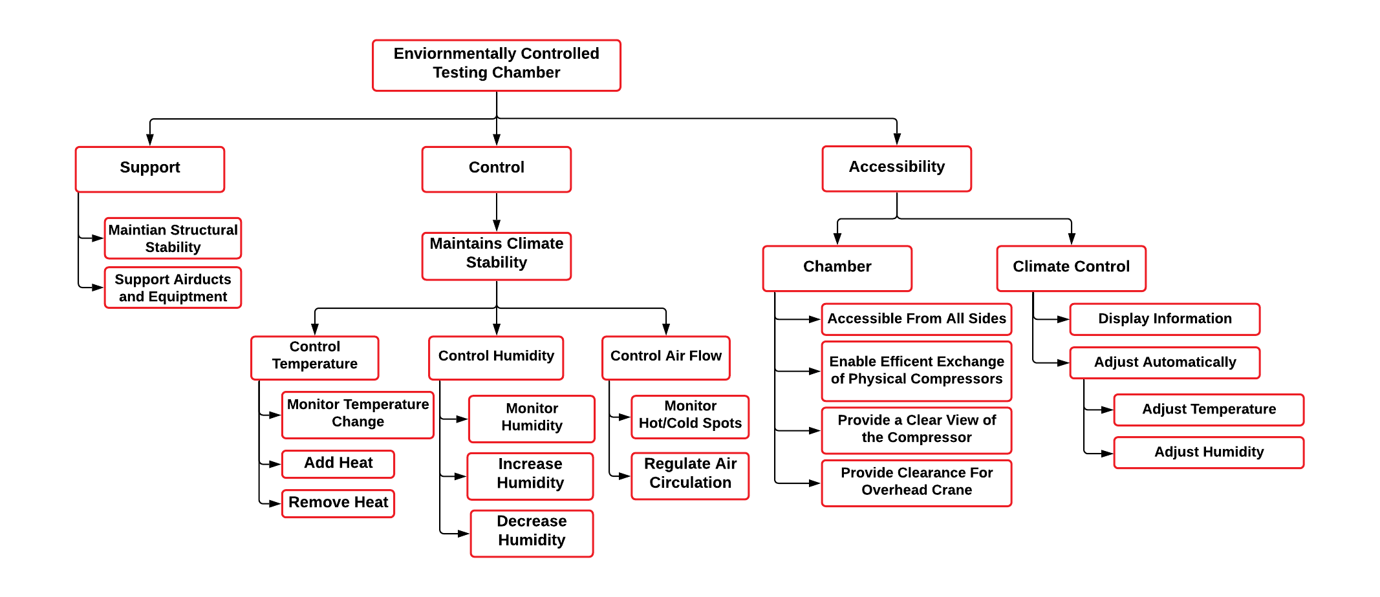
Functional Decomposition (new)
Cross Reference Chart
Hierarchy Flow Chart

Slide 25
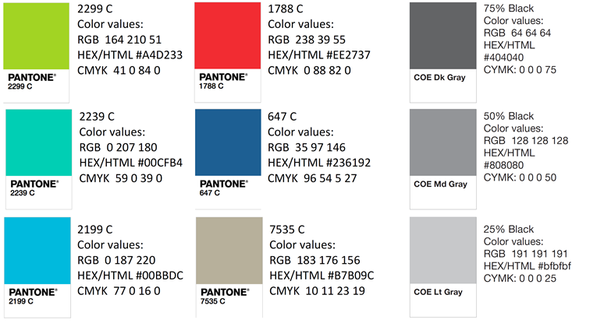
Color Palette

Slide 26



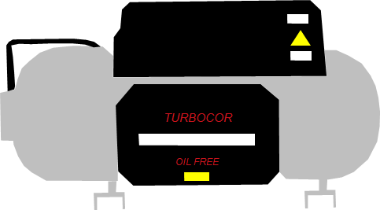





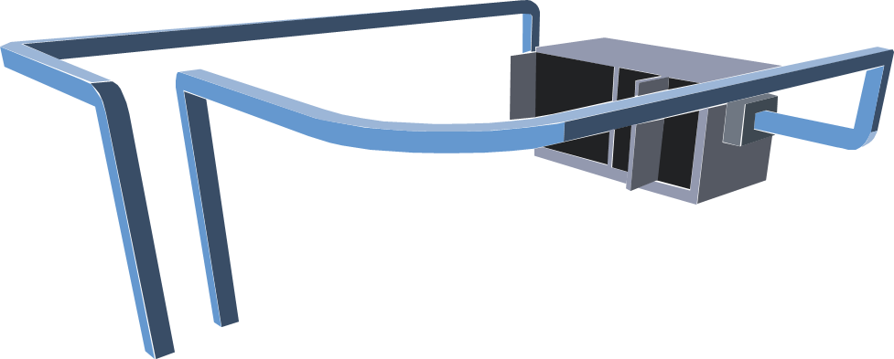


Team 503 Icons

Slide 27
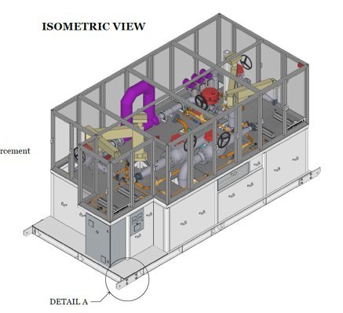
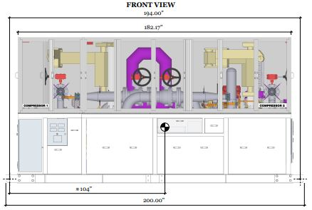
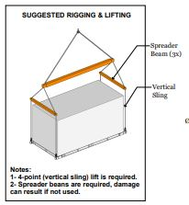
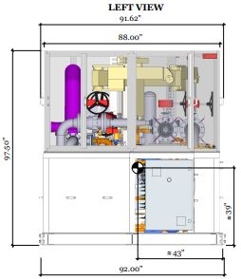
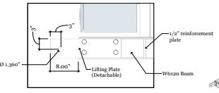
Views of Chamber

Slide 28





Logos

Slide 29
Tool kit
Summary Box
Text box 1
Outlined Text box

Slide 30
APA Tables
Category 1 | Category 2 | Category 3 | Category 4 | Category 5
Item 1
Item 2
Item 3
Item 4
 | Category 2 |  | Category 3
Category 1 | subcategory 1 | subcategory 2 | subcategory 3 | subcategory 4
Item 1
Item 2
Item 3
Item 4

