Slide 1
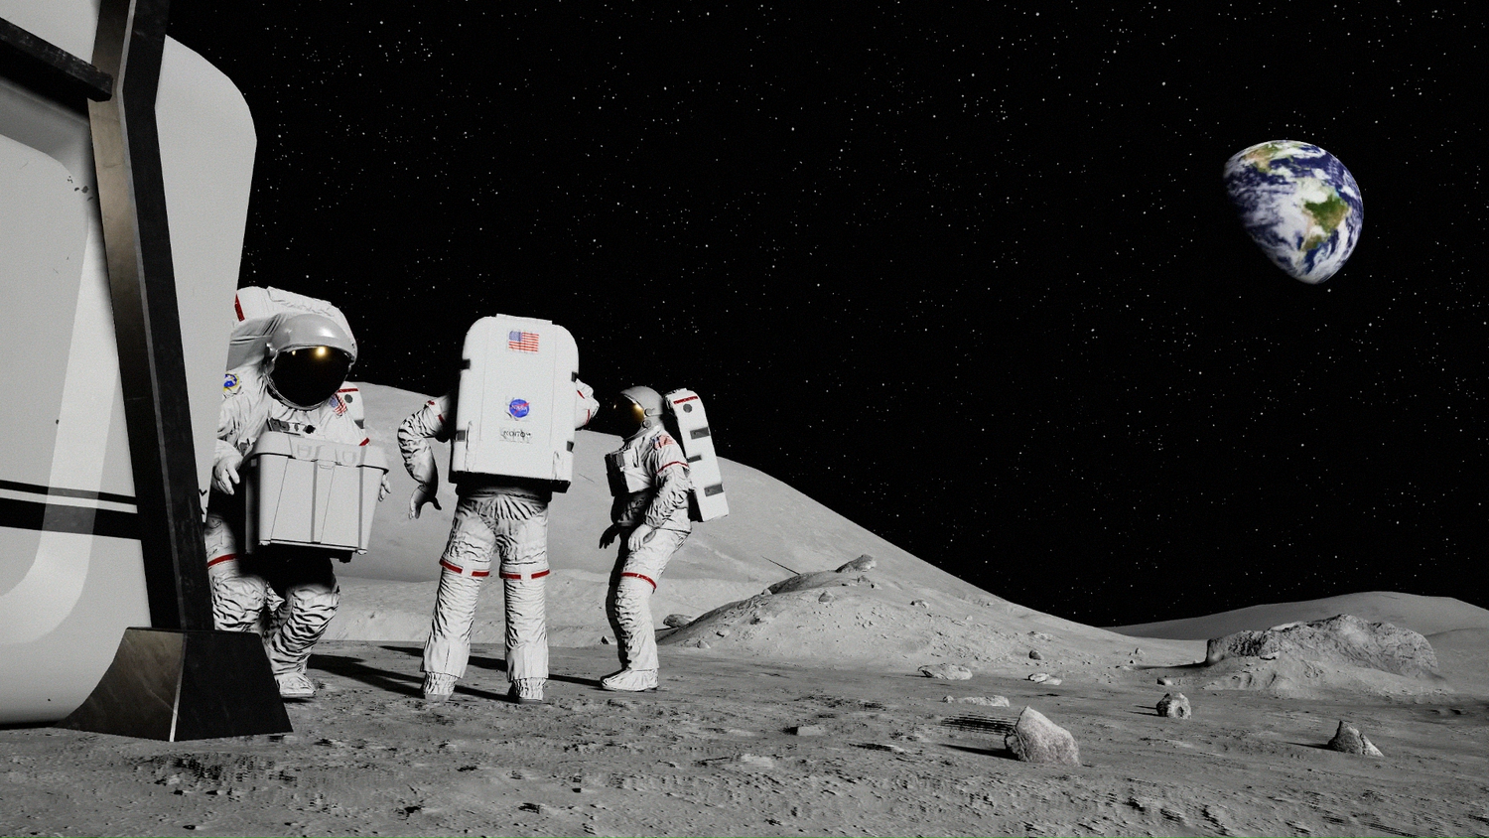

In-Space Cryogenic
Propellant Storage
Team 512
Anna Gilliard | Liam McConnell | Samantha Myers | Brandon Young
Notes:
Hi everyone. We are Team 512, and today we will be presenting the beginning stages of our project on In-Space Cryogenic Propellant Storage, which is sponsored by NASA.

Slide 2




Team Introductions
Anna Gilliard
Fluids Engineer
Liam McConnell
Cryogenics Engineer
Samantha Myers
Controls Engineer
Brandon Young
Materials Engineer
Notes:
My name is Anna Gilliard, and today I will be presenting with Samantha Myers. The other members of our team are Liam McConnell and Brandon Young.

Slide 3

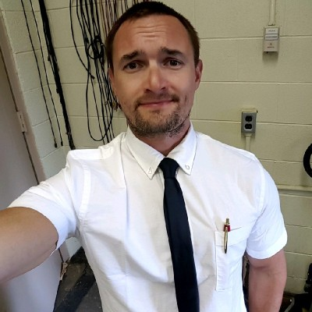
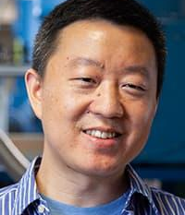
Sponsor and Advisor
Rachel McCauley
NASA Marshall Space Flight Center
Travis Belcher
NASA Marshall Space Flight Center
Wei Guo, Ph.D
FAMU-FSU College of Engineering
Notes:
Our sponsor contact from NASA is Rachel McCauley and our technical advisor from NASA is Travis Belcher. They are both working at the Marshall Space Flight Center in Huntsville, AL. Our faculty advisor is Dr. Wei Guo who specializes in cryogenics here at the college and the MagLab.

Slide 4

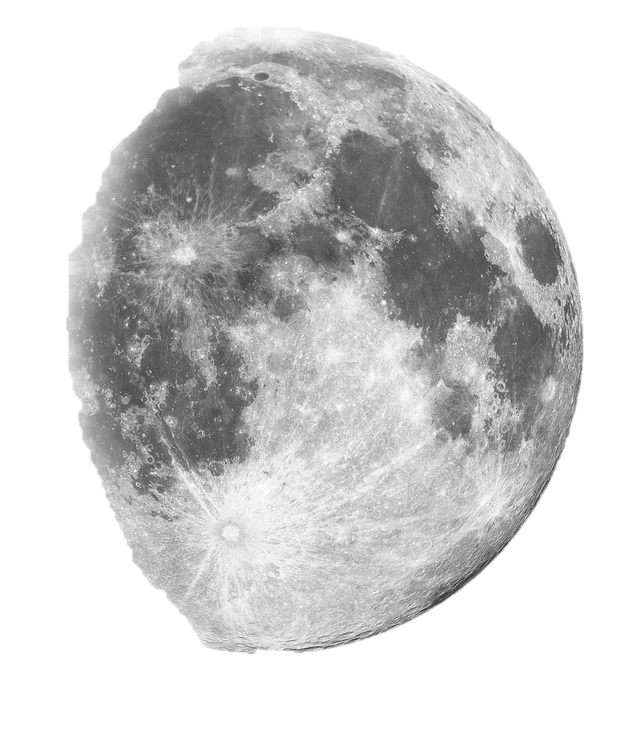
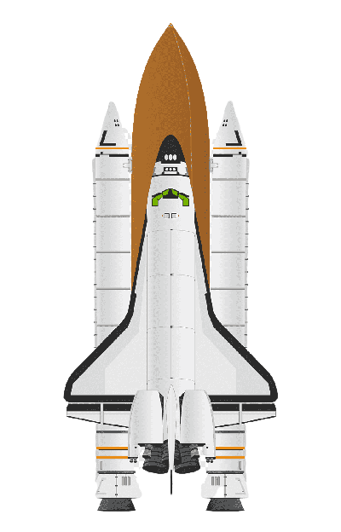
Project Objective
Hold cryogenic propellant in space.
Maximize storage time.
Minimize fuel loss.
Anna Gilliard
Notes:
The objective of our project is to hold cryogenic propellant in space by maximizing storage time and minimizing fuel loss. To do this, we must reduce the thermal transfer into the system. So, we have already made it to the moon and back during the Apollo 11 mission, and we regularly send people to and from the International Space Station, but we are aiming to surpass the amount of time that previous containers could be in space. With this time being extended, there are more possibilities for the future of space travel.

Slide 5
Project Background
Design cryogenic storage
Mars missions
Apollo 11
2009
1962
2024
1969
2020-21
Future
Centaur program
Titan Centaur-5
Artemis III
Anna Gilliard
Notes:
Centaur was the first operational, liquid hydrogen-fueled launch vehicle
Artemis III – next moon landing mission
Apollo 11 – first moon landing

Slide 6
Key Goals
Maintain fuel temperature
Minimize fuel loss
Maximize heat loss
Develop a prototype
Anna Gilliard
Notes:
For this project to be considered successful, these are the goals we need to achieve. The container must maintain the fuel temperature so that it doesn't boil off. This boil off causes fuel loss, which we need to minimize. We need to retain as much fuel as possible so that we are able to make it back to Earth from wherever we are in space.
We also need to maximize the heat loss out of the system and minimize the heat transfer into the system. The heat transfer will be mostly from radiation from the environment and conduction from the struts supporting it.
Finally, we must develop a prototype to test our design and validate our design choices.

Slide 7
Customer Needs
How long will the container be in space?
What type of fuel will be stored?
What conditions are we designing for?
What scale should be used?
Either liquid hydrogen or oxygen will be used.
The container must operate under all possible conditions.
It should be scalable to contain the required amount of fluid.
Select a hypothetical mission.
Anna Gilliard
Notes:
Next, we obtained our customer needs by asking our sponsor questions and interpreting their answers.
When asked how long we should design for the container be in space, NASA left our project relatively open ended, so we decided to design for a hypothetical mission to determine the duration.
The type of fuel that will be used in practice is either liquid hydrogen or liquid oxygen. These are the most common fuel types used in an RL10 engine. The RL10 engine is one of the commonly used for spacecraft at NASA.
We are designing for all possible conditions that the container could be under. In our case, this includes conditions on Earth, during the launch of the rocket, and in space. We must also account for the tank being filled and emptied. With the fluids being at such low temperatures, the material will expand and contract to some degree, so we need to ensure that the material we choose will not be subject to failure.
Finally, we need our prototype to scale to hold the required amount of propellant.

Slide 8

Assumptions
Filled with liquid Nitrogen or liquid Oxygen.
Prototype can be scaled to any size.
Filled on Earth, travels to moon and back.
Anna Gilliard
8
Notes:
Based on the customer needs, we developed the following assumptions.
We are assuming that the propellant being held in the container is either liquid nitrogen or liquid oxygen. In practice, liquid hydrogen would be used, but it is dangerous to work with due to its flammability. Liquid nitrogen would be ideal for testing due to its low cost and wider temperature range. Plus, it's one of the cryogenic fluids that Dr. Guo already has in the lab.
We are also assuming that our prototype can be scaled to any size. In practice, these containers typically hold hundreds of thousands of gallons of fluid, and our model will be much smaller so that we are able to do testing on it in the cryogenic lab. This will be a bit of a challenge to scale, since we are trying to maximize volume while minimizing surface area.
Finally, we are assuming that the container will be filled on Earth and then launched into space. This means that the container must be able to perform under the conditions mentioned previously. We chose a hypothetical Lunar Mission to determine the minimum duration of the mission. This idea was approved by our technical advisor.

Slide 9
Background Research
Apollo 17:
75 hours on lunar surface.
Samantha Myers
Notes:
The first thing we researched was the duration of previous manned lunar landing missions.
Apollo 17 was the most recent and the longest manned lunar mission to date.
It launched on December 7th , 1972 and was on the surface of the moon for 75 hours, or just over 3 days, with a total duration of 12 days and about 14 hours, landing back on Earth December 19th, 1972.
This mission is important to our project because it is the most recent information we have about a manned lunar landing.

Slide 10
Background Research
Apollo 17:
75 hours on lunar surface.
Cylinder with spherical endcaps.
Samantha Myers
Notes:
Another topic of background research was the shape of the storage.
The ideal shape would be spherical because it has minimum surface area with maximum volume.
That is, it holds the most amount of fuel with the least amount of surface contact.
Reducing surface contact is important in reducing conduction.
While the sphere is the most ideal for keeping the liquid at cryogenic temperatures, it is difficult to store.
Therefore, the common practice is to keep spherical endcaps, but to elongate the body and create a pill-shape container.

Slide 11
Background Research
Apollo 17:
75 hours on lunar surface.
Cylinder with spherical endcaps.
Aluminum alloy or stainless steel.
Samantha Myers
Notes:
The third main topic that we have researched is the material to fabricate the tank out of.
Common materials in Cryogen storage are aluminum and stainless steel.
They both have a face centered cubic structure, which has a better plastic deformation ability and no obvious ductile to brittle transition temperature at low temperatures.
In stainless steel, adding a higher content of nickel and chromium to the alloy will give the alloy higher stability at low temperatures.
Therefore, with the decrease in temperature, the strength of the stainless steel can be improved while maintaining superior plasticity and low temperature impact resistance.
Aluminum alloy has the characteristics of high specific strength, low sensitivity to hydrogen embrittlement, and high impact toughness.
Because of these material properties, stainless steels and aluminum alloys are the common materials used in cryogenic storage.

Slide 12
Background Research
Multi-layered insulation,
reflective layers,
double-walled vacuum.
Apollo 17:
75 hours on lunar surface.
Cylinder with spherical endcaps.
Aluminum alloy or stainless steel.
Samantha Myers
Notes:
The last main topic of research was the information on insulation methods.
Multi-layer insulation consists of many thin layers of material like aluminum and its primary purpose is to reduce heat transfer by radiation.
The layers are usually reflective and redirect radiation away from the surface of the tank.
The multiple layers serve as barriers for the heat to go through and as each layer takes a bit of heat, the overall heat transfer to the body decreases.
The multi-layer insulation is typically used in a vacuum, like a double-walled shell with a vacuum layer between the inner and outer shell.
This vacuum layer is intended to reduce any conduction or convection heat transfer coming from the outside of the outer wall.
The heat will come in contact with the outer shell and then have no medium to travel through to get to the inner shell.
So, the vacuum layer takes care of conduction and convection, while the multi-layer insulation with reflective layers targets radiation.

Slide 13
Functional Decomposition
In-Space Cryogenic Propellant Storage Container
Samantha Myers
Notes:
From our background research, assumptions, and customer needs, we broke down the project into major and minor functions.

Slide 14
Functional Decomposition
In-Space Cryogenic Propellant Storage Container
Communicates to User
Stores
Insulates
Connects
Samantha Myers
Notes:
The main functions of our in-space cryogenic propellant storage container are to store the cryogen, insulate it from heat transfer, communicate to the user, and to be able to physically connect.

Slide 15
Functional Decomposition
Stores
Hold Cryogenic Fluid
Prevent Fuel Loss
Maintains Pressure
Samantha Myers
Notes:
The first main function is to store the fuel. To successfully store the cryogen, the container must prevent fuel loss, maintain a desired pressure, and contain the fluid.

Slide 16
Functional Decomposition
In-Space Cryogenic Propellant Storage Container
Communicates to User
Stores
Insulates
Connects
Samantha Myers
Notes:
The second major function to break down is insulation.

Slide 17
Functional Decomposition
Insulates
Decrease Heat Absorption
Increase Heat Loss
Samantha Myers
Notes:
In order to successfully insulate the propellant, the storage must increase heat loss from the system and decrease heat absorption into the system.

Slide 18
Functional Decomposition
In-Space Cryogenic Propellant Storage Container
Communicates to User
Stores
Insulates
Connects
Samantha Myers
Notes:
The third major function to break down is communicating to the user.

Slide 19
Functional Decomposition
Communicates to User
Displays on Container
Sends Information
Samantha Myers
Notes:
To successfully communicate to the user, the container must send information and display the information on the container.

Slide 20
Functional Decomposition
In-Space Cryogenic Propellant Storage Container
Insulates
Communicates to User
Connects
Stores
Samantha Myers
Notes:
The last major function of the storage container is to physically connect.

Slide 21
Functional Decomposition
Connects
Attaches to Interior of Spacecraft
Attaches Inner and Outer Shell
Samantha Myers
Notes:
To successfully connect, the storage must be attachable to the spacecraft, meaning some type of hole or way to attach struts or other connectors. It must also connect the inner and outer shells of the double-shell tank, ideally with minimal conduction.

Slide 22




Upcoming Work
Targets & Metrics
Concept Generation
Concept Selection
Further Research
Samantha Myers
Notes:
Our team is currently working on translating our functions into some numerical targets and metrics, generating 100 or so reasonable concepts to analyze and reduce to come to our concept selection. Our research is ongoing, we are currently reading some published papers on cryogenic storage provided by our advisors, including the topic of zero-boil off systems.
That concludes our prepared presentation, and we would be happy to answer some questions at this time. (:

